Slide 1

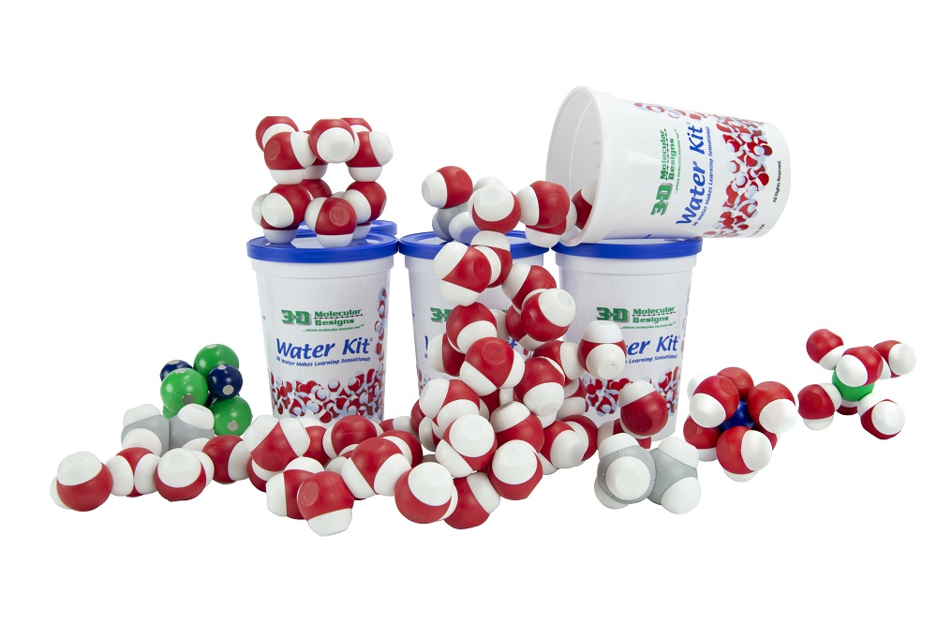
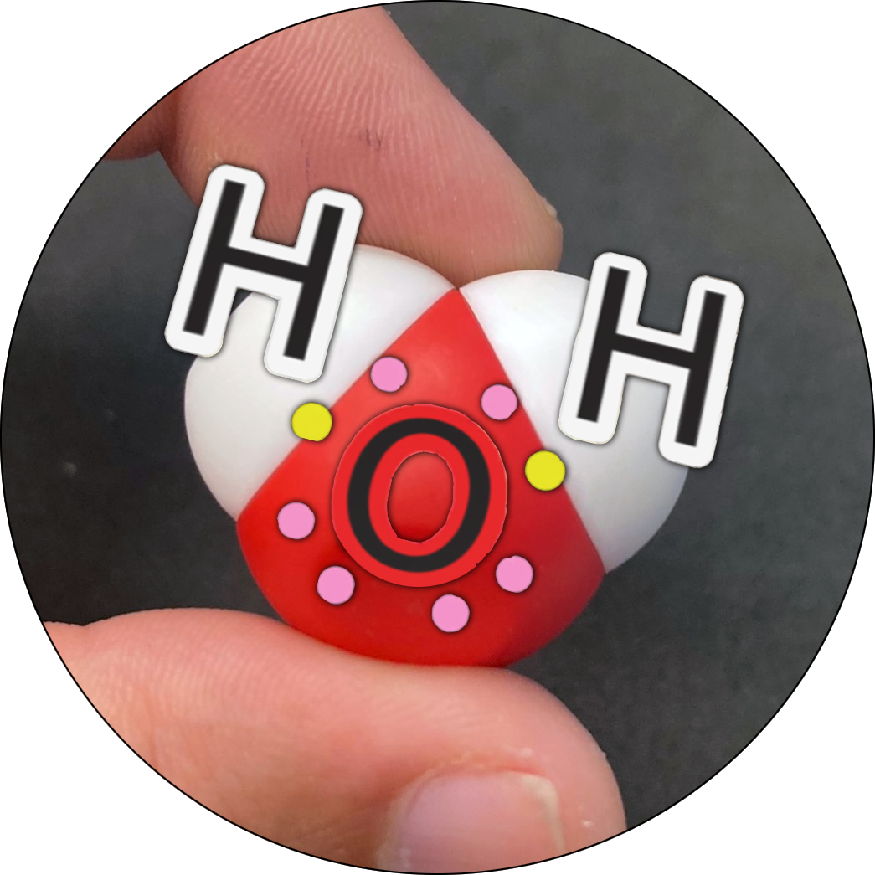

Discovering
Water Polarity
“If there is magic on this planet, it is contained in water.”
– Loren Eiseley
Activity ID: WK-AR1
Required Models: 1 Water Kit©/ 2 Groups
Required Media: 3DMD AR App

Slide 2

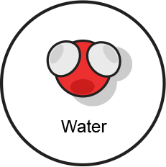
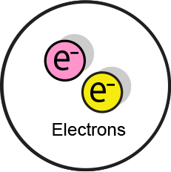
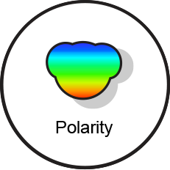
Teacher Guide - Summary
Activity Summary
In this activity, students will explore electron distribution in a water molecule to conclude that electrons are not equally shared, resulting in partial positive and partial negative regions, polarity, and hydrogen bonding.
This activity requires the 3DMD AR application, available for download from the Google Play and Apple App stores. The activity is split into three AR scenes designed to be explored in order. Each AR scene is represented by a consistent icon in this slide deck and the 3DMD AR app (see the icon images below.)
Scene 1: A single water molecule is explored, revealing three atoms connected by two covalent bonds with shared electrons.
Scene 2: Electron distribution and probability is explored, revealing an unequal distribution of shared electrons.
Scene 3: The resulting unequal charge is explored, revealing water molecule polarity and hydrogen bonding.

Slide 3
Teacher Guide - Overview
Activity Objectives
  Collect data and use it to determine what a covalent bond is.
  Explore how electron cloud density determines polarity.
  Evaluate different bonding models with molecules.
  Estimated Class Time:
35 minutes
Required Models:
5x water molecules from the Water Kit©
Required Media:
3DMD AR edu App + subscription
Other Materials Needed:
None
Grade, Class
9-12 Biology or Chemistry
Topics
Polarity of water
Covalent bonds
Hydrogen bonding
Chemical bonds and interactions
Atomic structure
Prerequisite Knowledge
Matter is made of molecules.
Protons have a positive charge and are found in the nucleus of an atom.
Electrons are negatively charged and move around the nucleus.
Neutrons are not addressed in this activity.

Slide 4






Teacher Guide - Using This Slide Deck
Student and Teacher Slide Deck Pages
  Slides that are meant for student viewing will feature a green top
  banner. Slides that are meant only for teacher viewing will feature a
  purple top banner and will appear hidden when in "slide show" mode.
Prompting Icons
  Each student slide will include a prompting icon in the top right corner of the slide. These icons are meant to queue students as to what they should be doing during each slide.
Teacher Moves and Student Moves
Class slides provide notes (teacher notes below the slide) with specific information to assist you in facilitating the activity using effective modeling and education practices.
Turn and talk discussion
Write in your notebook
Quiet thinking time
Digital modeling
Physical modeling

Slide 5
Teacher Guide - Standards
Next Generation Science Standards
Science and Engineering Practices | Cross Cutting Concepts | Disciplinary Core Ideas
Scientific Investigations Use a Variety of Methods | Patterns | PS1.A
Developing and Using Models
Constructing Explanations and Designing

Slide 6
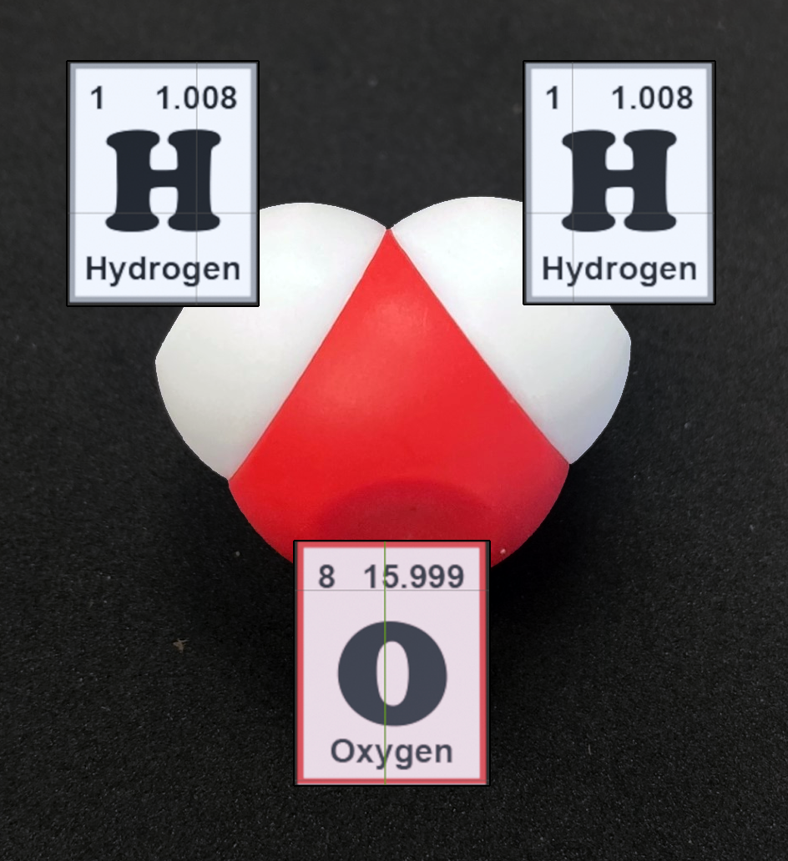
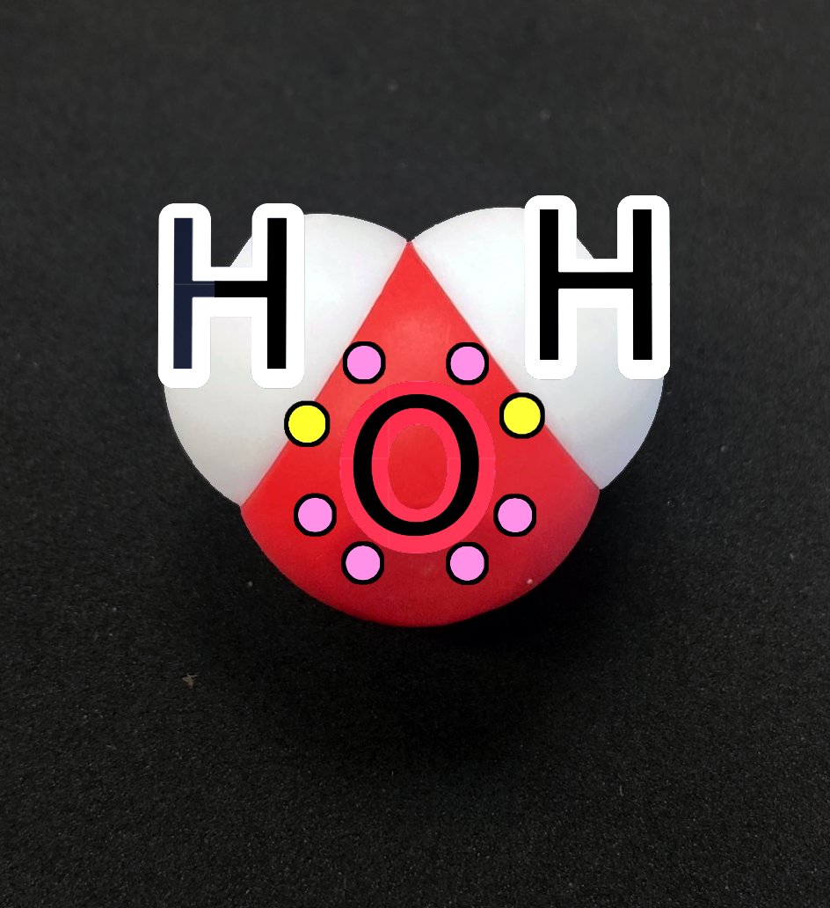
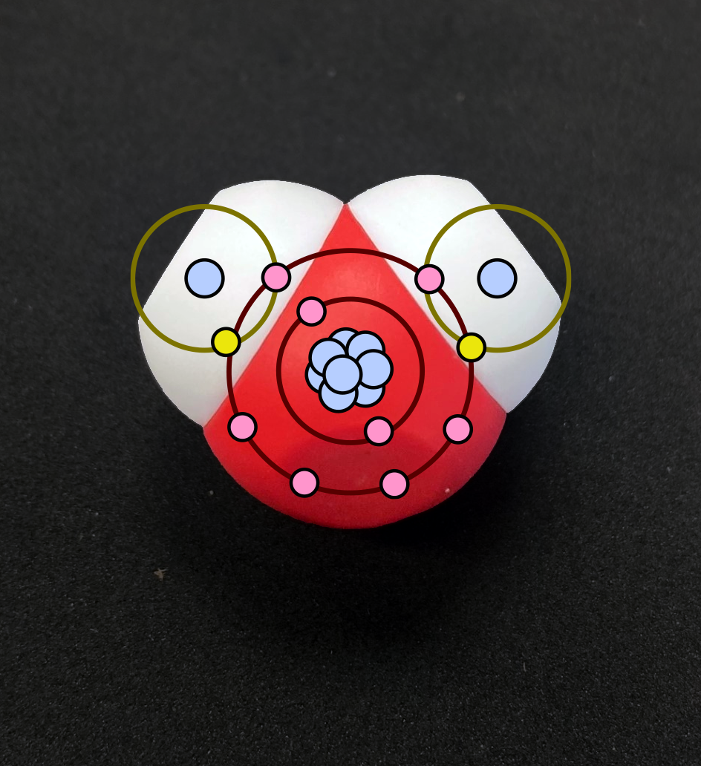
Teacher Guide - Scene 1
Scene 1: Water
Students will use a single water molecule from the Water Kit© to explore three AR overlays. Each overlay communicates a different aspect of the atoms and bonds in a water molecule. Students should pay extra attention to the number of electrons in each atom and the role of shared valence electrons in covalent chemical bonds.
Overlay 1: Periodic table representation shows the three atoms that make up a water molecule
Overlay 2: The Lewis Dot structure shows the valence electrons in each of the three atoms.
Overlay 3: The Bohr model shows all electrons in each of the three atoms, and that some electrons are shared.

Slide 7



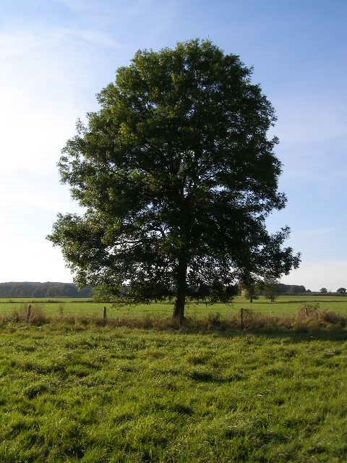

Water is an Amazing Substance
Water is an amazing substance with some remarkable properties. It can dissolve many materials, be pulled up a tree, float as a solid (ice) and erode mountains!
What else can water do?
Notes:
Teacher: Discuss the POWER OF WATER! It has dramatically changed our landscape.
Student: Brainstorm what water does for life on Earth.

Slide 8
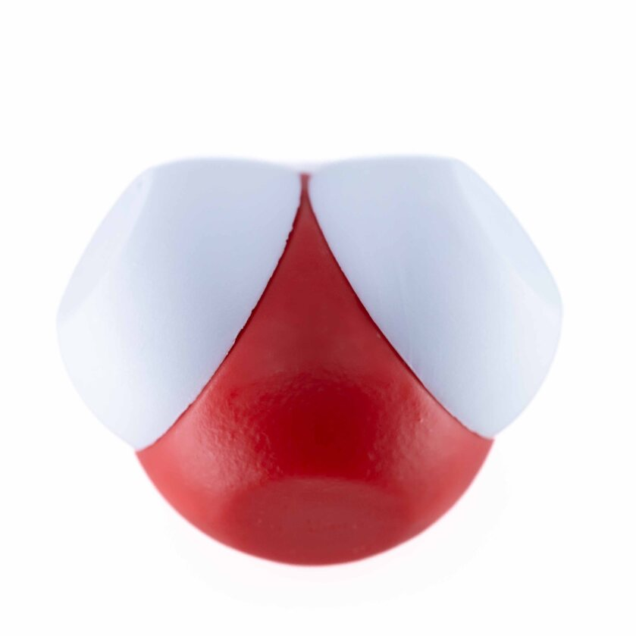
What is a Water Molecule?
Explore a single water molecule. Model and record your observations in your notebook.
What do you notice?
What do you wonder?
Notes:
Teacher: Give each student a water molecule. Encourage your students to look at a physical model of one water molecule. Facilitate learning through questions and observations.
Student: PLAY! Write observations in your notebook.

Slide 9

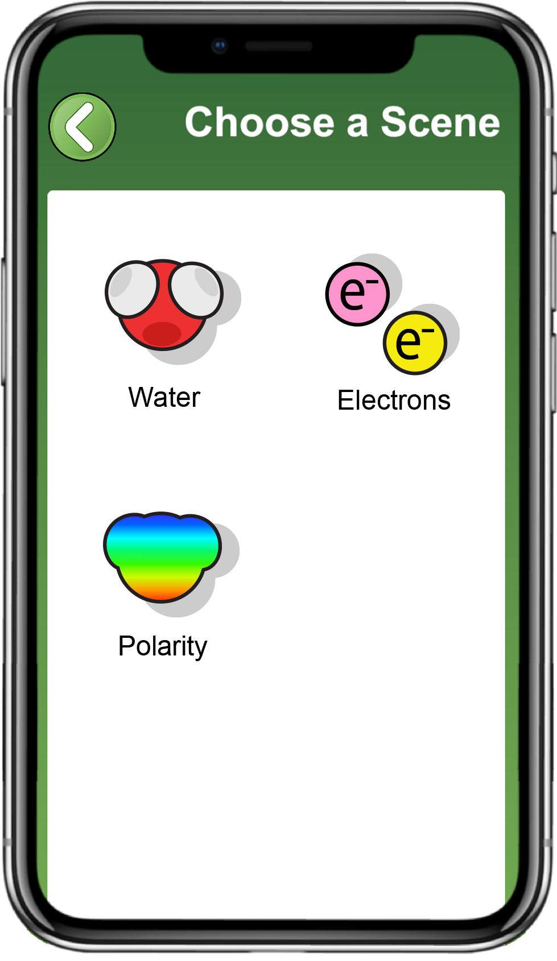
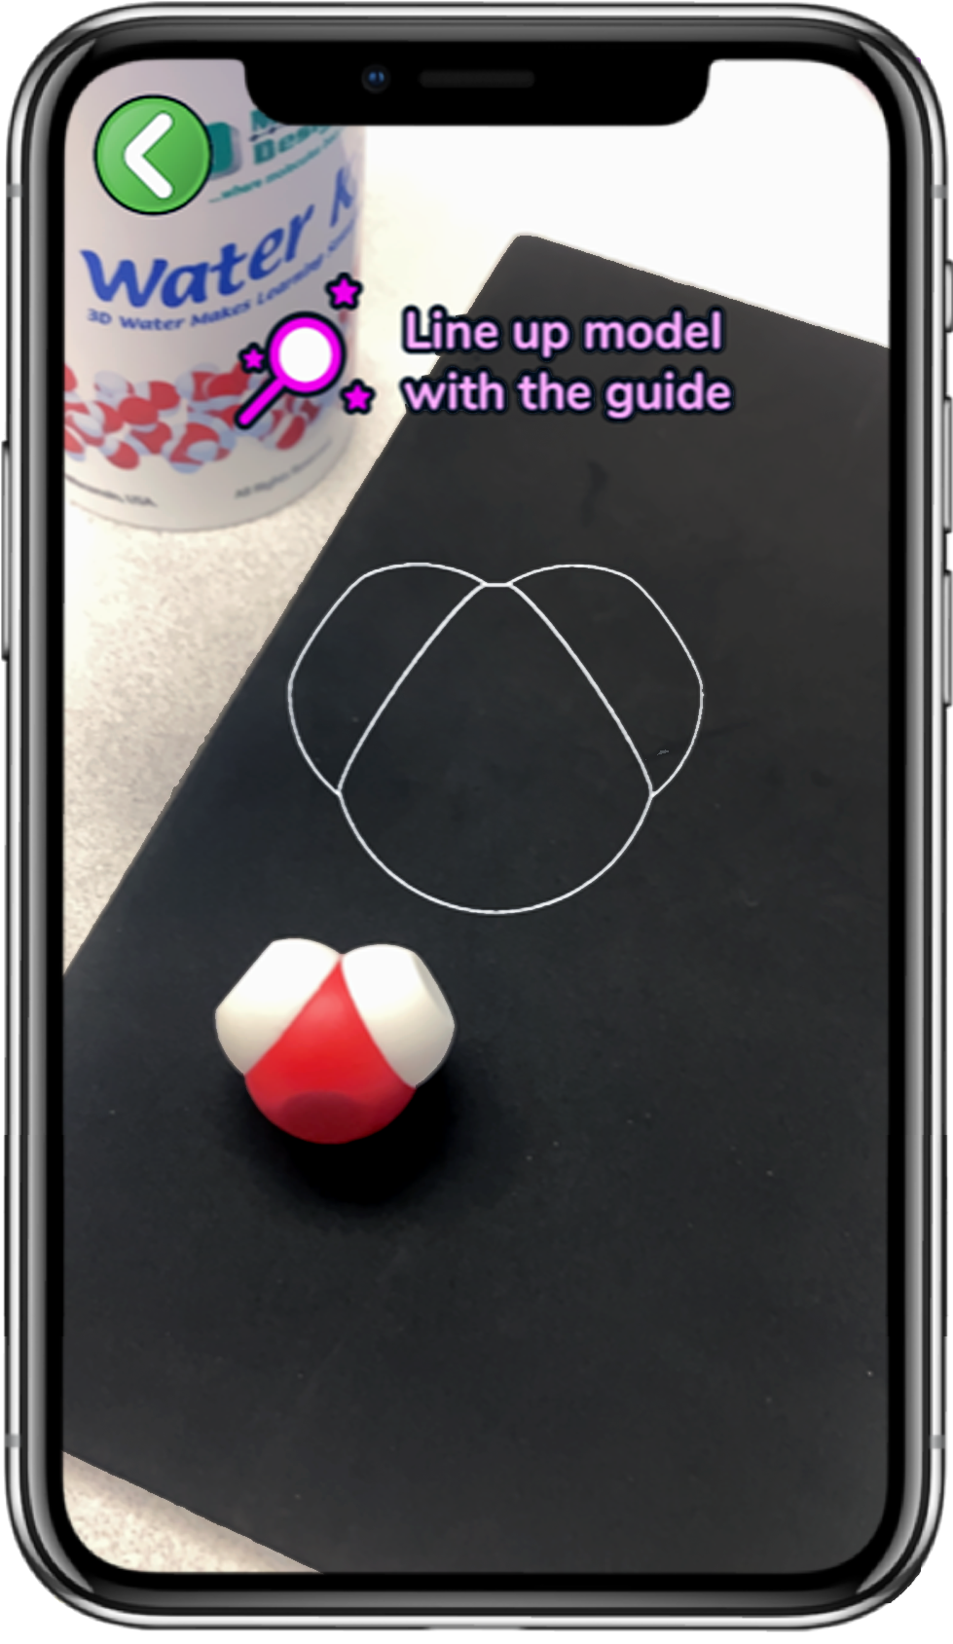
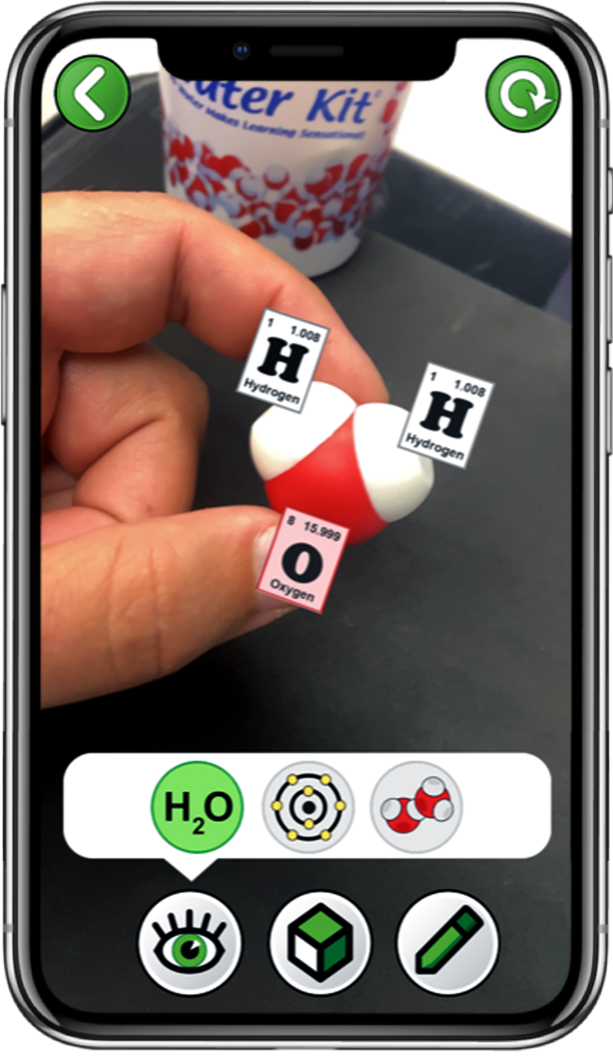
Explore Water with the 3DMD AR EDU App
Choose
Water
Scan a single water molecule
Explore the
three buttons
Notes:
Teacher: Move around the room and assist students with their technology.
Student: Follow the instructions on this slide.

Slide 10

What is a Water Molecule?
Draw a water molecule in your notebook or take a screenshot in the app using the pencil in the bottom right corner.
Record, draw, and label your observations.
What atoms are in a water molecule?
How are electrons shown?
How many electrons does each atom have?
Notes:
Teacher: Ask students to make three water molecule sketches and annotate the sketches using the individual overlays.
Student: PLAY! Write observations in your notebook. Sketch a water molecule and label the atoms in your notebook.

Slide 11
Three Atoms Covalently Bonded
A water molecule has two hydrogen atoms and one oxygen atom.
Three atoms are covalently bonded together and share electrons.
Each hydrogen atom has one electron orbiting its nucleus.
The oxygen atom has eight electrons orbiting its nucleus.
Notes:
Teacher: Encourage students to toggle through all three overlays and describe what they see in their notebook. Remind students that protons have a positive charge and electrons have a negative charge. Remind students there is no difference between electrons. Show this slide so students can confirm or edit their annotated sketches and discuss their observations.
Key Concepts: Protons are positive.
Electrons are negative.
Difference between Lewis Dot & Bohr
Student: Observe the number of electrons and protons within both the hydrogen atom and the oxygen atom. Notice the number of electrons shown for each atom and the electron shells for each atom.

Slide 12
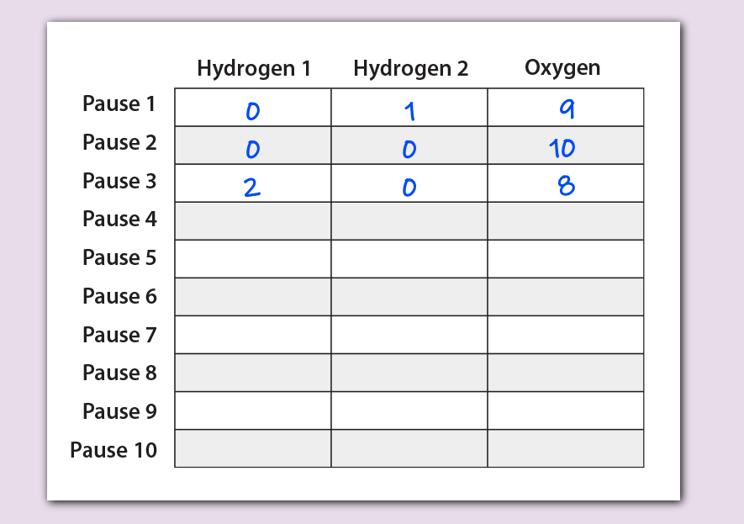
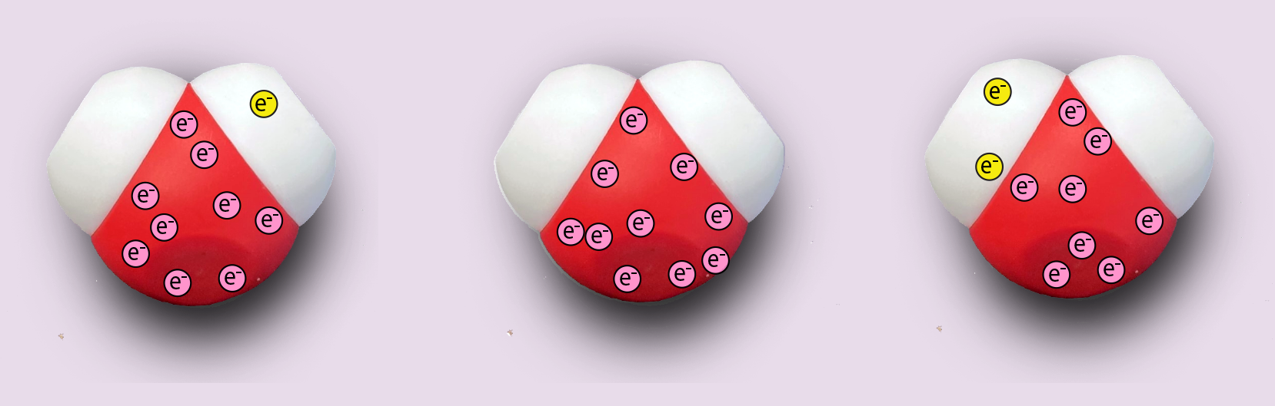

Teacher Guide - Scene 2
Scene 2: Electrons
In the second AR scene of this activity, students will use a single water molecule from the Water Kit© to explore a simulation of electron distribution. Electrons are shown flashing in random locations on the water molecule, and students can "sample" their movement to collect data on their paused location.
Electrons located near the oxygen atom will be shown in pink.
Electrons located near each of the hydrogen atoms will be shown in yellow.
We recommend students "sample" and collect data at least ten times during this scene. Each time they "sample", they should record how many electrons are located near hydrogen atom 1, hydrogen atom 2, and the oxygen atom.
Example sample 1
Example sample 2
Example sample 3

Slide 13
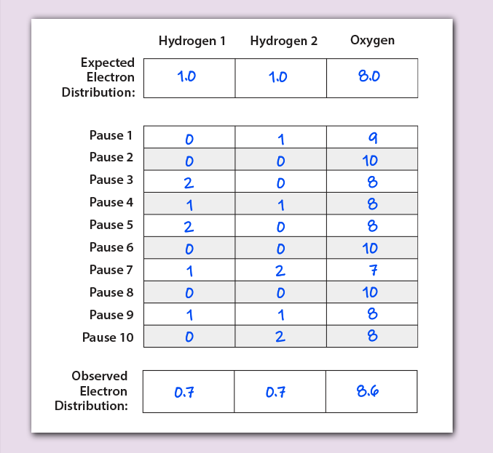
Teacher Guide - Scene 2 cont.
Scene 2
As individual atoms, each hydrogen atom has one electron and an oxygen atom has eight electrons. When two hydrogen atoms and one oxygen atom are covalently bonded together in a water molecule, some of these electrons are shared.
If the electrons in a water molecule were equally shared, we would expect to see an average of one electron near each hydrogen atom and eight electrons near the oxygen atom.
However, this is not the case!
Because the positively charged nucleus of an oxygen atom is larger than the positively charged nucleus of the hydrogen atoms, among other factors, the negatively charged electrons are a bit more strongly attracted to the oxygen atom.
An unequal distribution of electrons results, where electrons spend a bit more time near the oxygen atom than would be statistically expected if they were equally distributed.
A printable version of this student data table available on the last slide

Slide 14
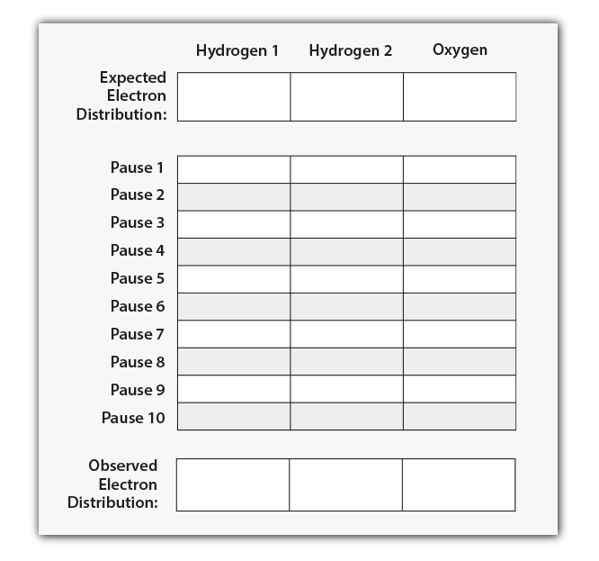

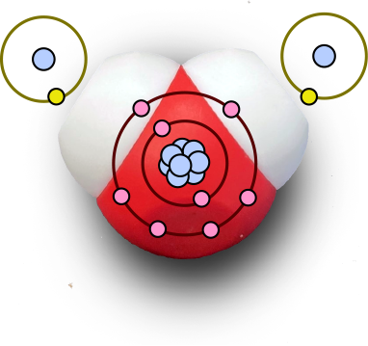
Where are the Shared Electrons?
Create a data table matching the one shown to the right. Based on your earlier observations,
How many electrons are in each hydrogen atom? How many electrons are in the oxygen atom?
Enter these numbers in the top row of your table.
Hydrogen 1
Hydrogen 2
Oxygen
Notes:
Teacher: Explain to students that they will be conducting a thought experiment where they will view the electron cloud surrounding the water molecule. Ask students to view the animation for 3 seconds, then pause the animation, and count the number of electrons associated with each atom. Remind them that an electron has a negative charge! Bring the color of electrons to the students' attention. In this model, the color does not show where the electrons are originating. The color is supposed to help students know what location the electron is associated for the data-collecting activity. Move around the room and assist students with their technology.
Student: Make a prediction about the expected electron distribution among the hydrogen and oxygen atoms. View the animation in camera or 3D mode. Pause the animation and count the number of electrons associated with each atom and record your data in the data table provided or create one in your notebook.

Slide 15
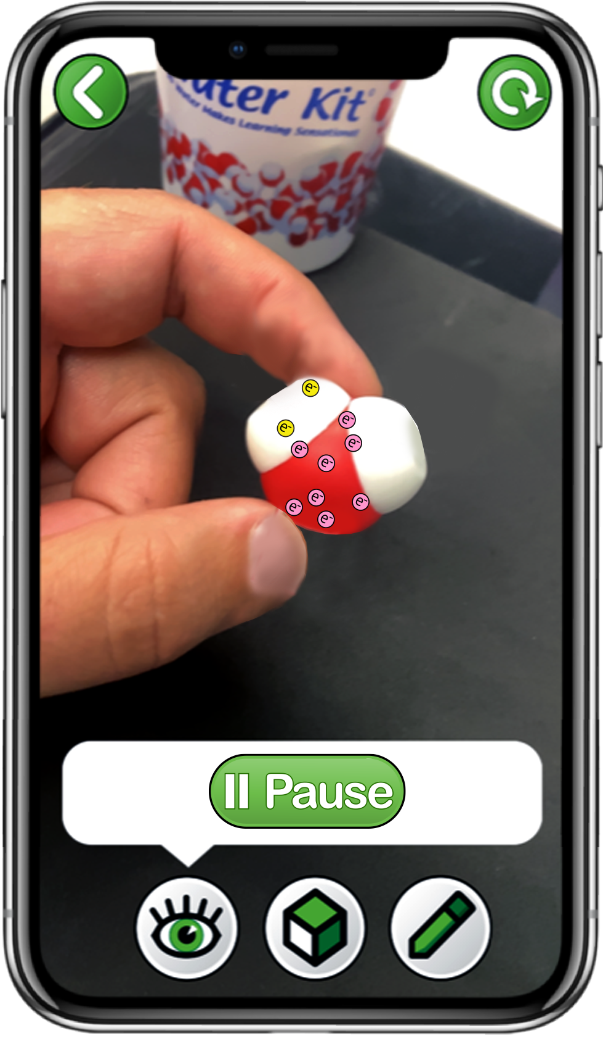

Explore Electrons with the 3DMD AR EDU App
Choose
Electrons
Scan a single water molecule
Explore the
Play and Sample buttons
Notes:
Teacher: Read the instructions on screen. Circulate through the room to assist students with technology needs.
Student: Select the correct activity and scene in the App. Record data in their data table as they begin sampling.

Slide 16
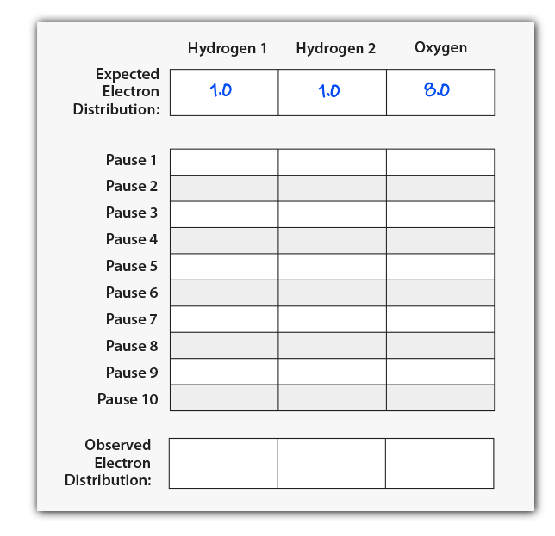
Explore Electron Distribution
Electrons move very, very fast!!
Use the Sample button to stop the movement of electrons.
Count and record the number of electrons for each sample on your data table.
Start and Sample electron locations ten times to complete your data table.
Notes:
Teacher: Give your students time to collect data. Point out that the electrons associated with the hydrogen atoms are yellow and the electrons associated with the oxygen atom are pink.
Clicking on the 3D view mode (bottom, center box) will assist students in collecting their data.
Student: Count the electrons associated with each atom and record the number in your data table .

Slide 17
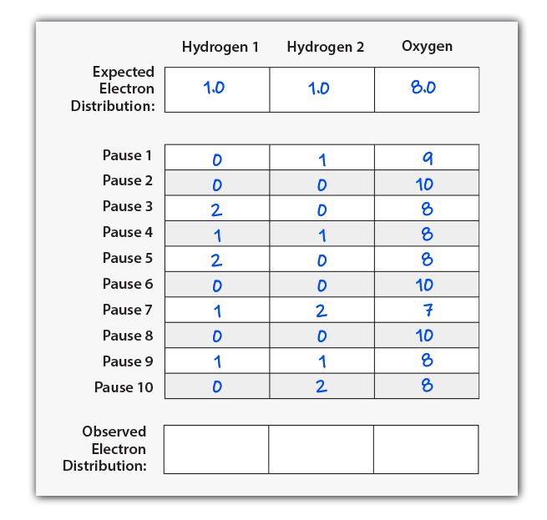
Average Observed Electron Distribution
Once your data table is filled with at least ten samples, calculate the average electrons observed near each atom.
Average of x = (x₁ + x₂ + x₃ +. . . x_{n}) / n
Record these averages in the bottom row of your table.
Notes:
Teacher: Work through calculating the mean of hydrogen 1 together and then give them time to calculate the mean for the hydrogen 2 and oxygen. Give students time to calculate the mean (average) of their ten trials for all three atoms. You may need to provide students with additional support for calculating a mean.
Extension: teach your students to use functions of Excel or Google Sheets to calculate means.
Student: Calculate the mean of each atom and record it in your data table.

Slide 18
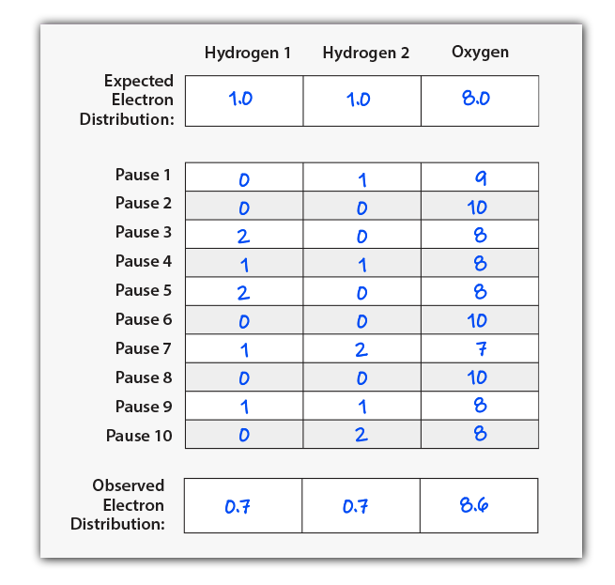
Does every group have the same data?
How does your Expected Electron Distribution compare to your average of Observed Electron Distributions?
Do electrons spend more time near the hydrogen atoms or the oxygen atom?
Why might that be?
What impact might this have on a water molecule?
Notes:
Teacher: Have students share their data with the class and create a class data table. Facilitate discussion, discourse, and consensus. By the end of the discussion, students should understand that the sharing of electrons constitutes a covalent bond between a hydrogen atom and an oxygen atom. Water has two covalent bonds. Note: These are example data. Results may vary.
Student: Students should compile data or have a discussion to form a classroom consensus model. They should notice that all groups’ data are similar, but not identical. Students should determine that reason for this is the random movement of electrons within the electron cloud.

Slide 19
Electrons Are Not Shared Equally
The electrons in a water molecule are not shared equally!
On average, electrons spend slightly more time near the oxygen atom than would be expected.
The oxygen atom’s large positive nucleus attracts the negatively charged electrons more strongly than the hydrogen atom’s small nucleus.
However, electronegativity is complicated and involves more than the size of the nucleus.
Notes:
Teacher: Allow students to edit their annotated sketches based upon new data. Ask your students: "How has your thinking changed? Why?" Have your student share their responses with a partner. You have an opportunity to discuss electronegativity with your students by pointing out that in addition to the size of the nucleus, the relative electronegativity of elements is also affected by electron shielding.
Student: Update their annotated sketch or confirm their thinking in their notebook.

Slide 20
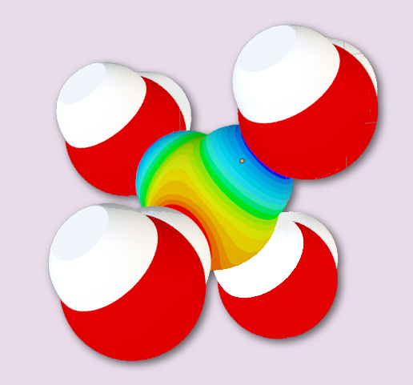
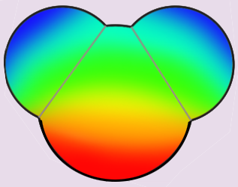

Teacher Guide - Scene 3
Scene 3: Polarity
In the third and final AR scene of this activity, students explore how the unequally shared electrons in a water molecule result in polarity. Students then predict how multiple water molecules might interact with each other and compare their predictions to the representations in the app.
Overlay 1: A standardized color scheme is explored, representing the partial positive and partial negative regions of a molecule.
Overlay 2: This color scheme is applied to a single water molecule, representing polarity.
Overlay 3: Polarity results in water molecules sticking together through hydrogen bonding.

Slide 21
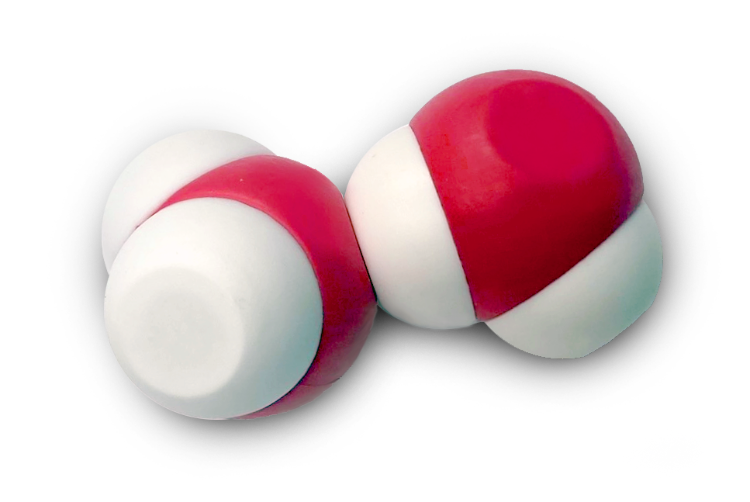
Water Molecule Interactions
Take out a second water molecule and explore how the two water molecules interact with each other. Make new observations in your notebook.
Do the two water molecules repel or attract?
Do the oxygen and hydrogen atoms in a water molecule repel and attract in the same ways?
How might these observations relate to the unequal distribution of electrons that we discovered earlier?
Notes:
Teacher: Move around the room and assist students as needed. Monitor their progress. Ask students to share how the two molecules interact with each other.
Student: Play and realize that there are multiple ways that these two water molecules can potentially interact.

Slide 22
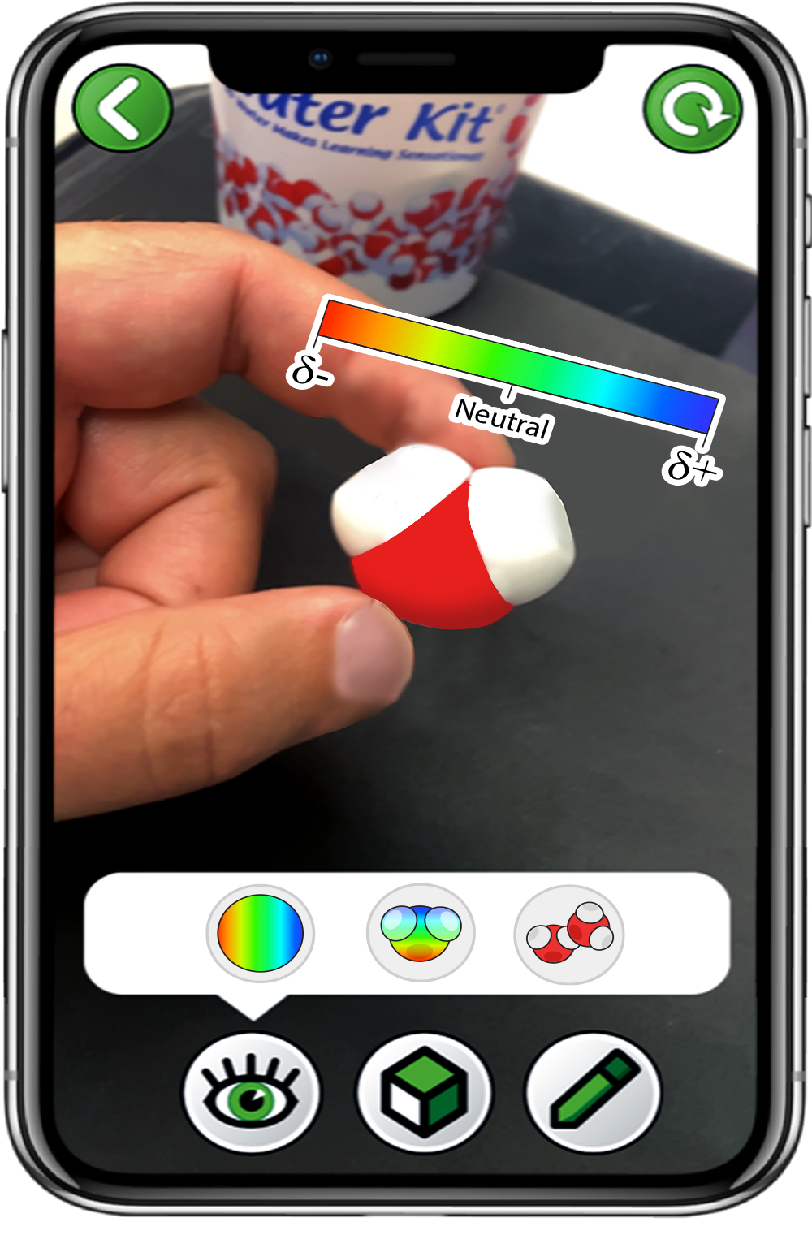
Explore Polarity with the 3DMD AR EDU App
Choose
Polarity
Scan a single water molecule
Only click the left button
Notes:
Teacher: Read the instructions on screen. Circulate through the room to assist students with technology needs.
Student: Select the correct activity and scene in the App.

Slide 23
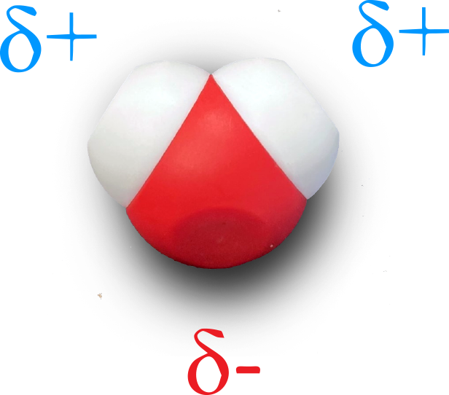
Partial Charges on a Water Molecule
Since negatively charged electrons spend slightly more time near the oxygen atom, it has a partial negative charge.
Since negatively charged electrons spend slightly less time near the two hydrogen atoms, they have partial positive charges.
This is called polarity, and results in water molecules sticking together!
Notes:
Teacher: This is a content slide – the symbol is pronounced sigma. Ask students to think of ways scientists could represent differences in charge.
Student: Write the information that they think is important in their notebook.

Slide 24
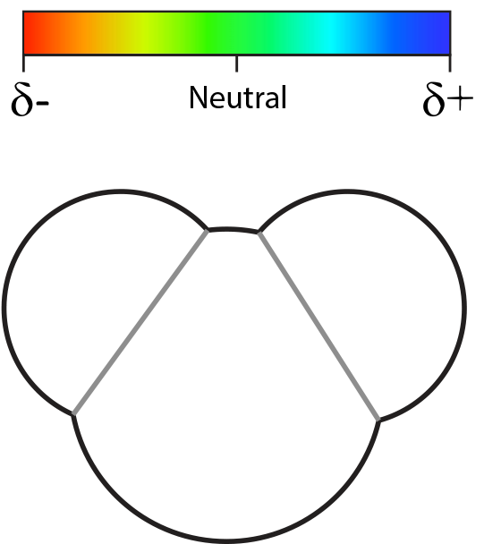
Visualizing Partial Charges
Draw a water molecule in your notebook or take a screenshot in the app using the pencil in the bottom right corner.
Annotate which end of the water molecule is more positive. Color it blue.
Annotate which end of the water molecule is more negative. Color it red.
What color should be used to indicate where the charge is neutral?
Notes:
Teacher: Move around the room to assist students in making their thinking visible. Do not correct them. Ask them to explain why they are coloring parts of the molecule the way they are.
Student: In your notebook, draw a water molecule and annotate which end of the molecule is more positive. Color it blue. Then, annotate which end of the water molecule is more negative. Color it red. Determine how you could indicate where the charge is neutral. Use the color code (yellows, greens, orange, light blue) to annotate your water molecule.

Slide 25
Check Your Drawing with the 3DMD AR EDU App
Choose
Polarity
Scan a single water molecule
Only click the middle button
Notes:
Teacher: Read the instructions on screen. Circulate through the room to assist students with technology needs.
Student: Select the correct activity and scene in the App.

Slide 26
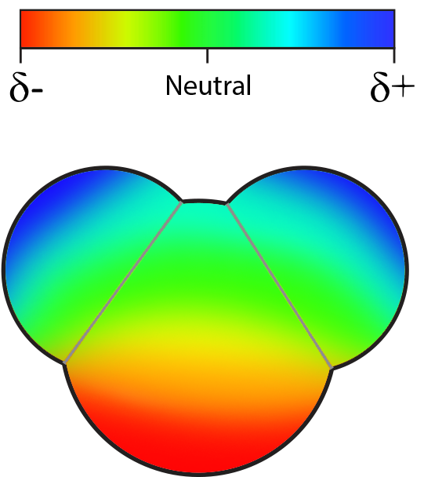
Review Or Revise Your Water Molecule Drawing
Did your drawing match the colors in the app?
Revise your drawing if necessary to show where the positive, negative and neutral charges are.
This is one of many different ways to think about water polarity. This color scheme is called an electrostatic potential map.
Notes:
Teacher: Here is one of many different ways to think about water polarity. Show them the image and let them revise their model if needed.
Student: Confirm your new mental model of water. Predict how water will interact with additional water molecules.

Slide 27
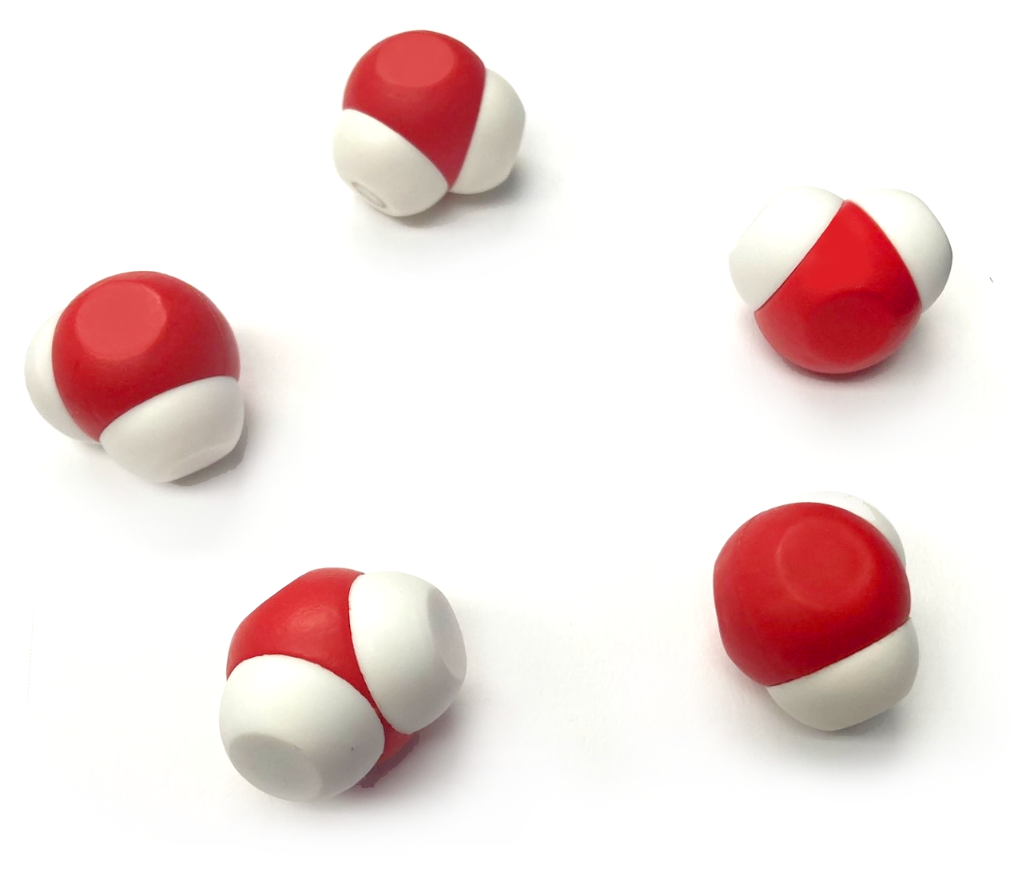
Polarity and Multiple Water Molecules
Using five water molecules, explore how multiple water molecules interact.
Try to build a structure that shows every interaction a single water molecule could have.
What do you notice about how four water molecules interact with a single water molecule?
Notes:
Teacher:. Give students a total of 5 physical water molecules and ask them to build a structure that shows the interactions between water molecules. Move around the room and help students with their models.
Student: PLAY! What atoms interact? H->O or O->H What type of interaction is this? (H-bond). Draw this in your journal / notebook. Add the RGB color scheme to show the electron cloud density overlay.

Slide 28
Check Your Drawing with the 3DMD AR EDU App
Choose
Polarity
Scan a single water molecule
Only click the right button
Notes:
Teacher: Read the instructions on screen. Circulate through the room to assist students with technology needs.
Student: Select the correct activity and scene in the App.

Slide 29
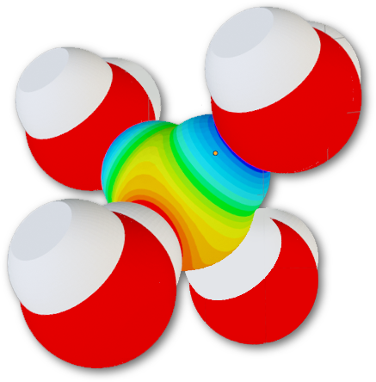
Check Your Water Molecule Drawing
Did your model match the animation in the app?
Revise your model if necessary to show how four water molecules interact with a single water molecule.
The bonds formed between multiple water molecules are called hydrogen bonds.
Notes:
Teacher: Move around the room and help students with their models. Answer questions student might have about what electron cloud density is.
Student: Check your work and possibly revise your model / color scheme

Slide 30
Water is an Amazing Substance
Polarity and hydrogen bonding make water molecules stick together.
How can this important characteristic explain water's ability to dissolve many materials, be pulled up a tree, float as a solid (ice) and erode mountains?
Notes:
Teacher: Explain that water is described as a POLAR COVALENT molecule. Explain what a covalent bond is. Help students develop criteria that allow them to determine the difference between polar and nonpolar molecules.
Student: Make a list of characteristics that you could use to determine if a covalent molecule was polar or nonpolar. Using the information that you gathered from both of the modules, determine what makes a molecule polar covalent.

Slide 31

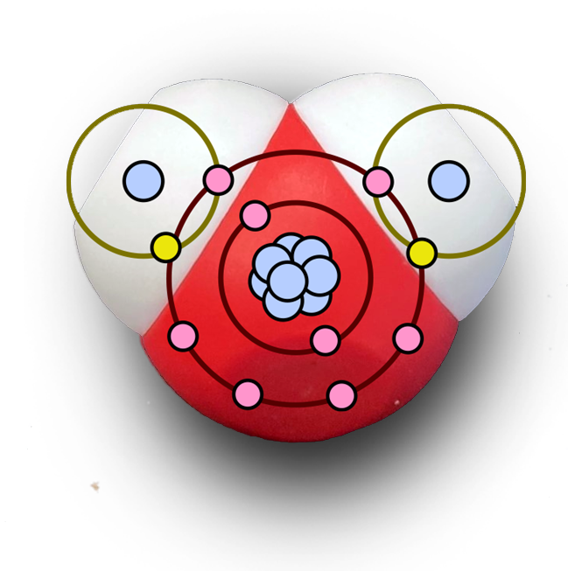
Conclusions
A water molecule is comprised of three atoms that share some electrons.
The shared electrons spend more time near the oxygen atom than the hydrogen atoms.
This results in slightly positive and slightly negative regions, making water polar.
Polar molecules stick together through weak interactions called hydrogen bonds.
Notes:
Teacher: Wrap up all of the lesson objectives.
Student: Jot down thoughts and ideas in your notebook.

Slide 33
