Slide 2
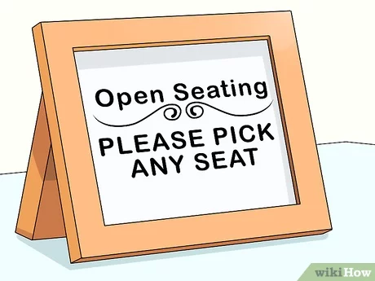
Morning Task
As you enter the room, please answer this question on the white board in front of the room:
What are the benefits of learning through modeling?

Slide 3
Tuesday’s Joy
Loved the enzyme activity!
The protein folding model
The enzyme model.
Viruses and Tim Talks
Virus, detailed imaging of what is really happening in bacteriophage
Plenty of models to see, touch, use.
The enzyme and bacteriophage models.
Acetylcholinesterase story
The enzyme models and the Wisconsin meat and cheese.
The enzyme models! Made concepts way easier to understand!
The aquaporin lesson!

Slide 4
Want to know more!
Viruses
The detailed picture we looked at with the bacteriophage and virus. How do I find those?
Enzymes, changing active site, 3D look
How I can create the flexible enzymes on my own
Phage therapy
Modeling more cellular processes
How to effectively create student prompts and reflection questions from a completed model
Elementary level “hooks” or “anchoring phenomena” for students

Slide 5
Wednesday Wants
Lessons to use in a lower level biology class
How to access the online resources.
Nothing- so far so good- keep the topics flowing!
Every thing
The same ;)
Stories!
Hands on, inquiry learning

Slide 6
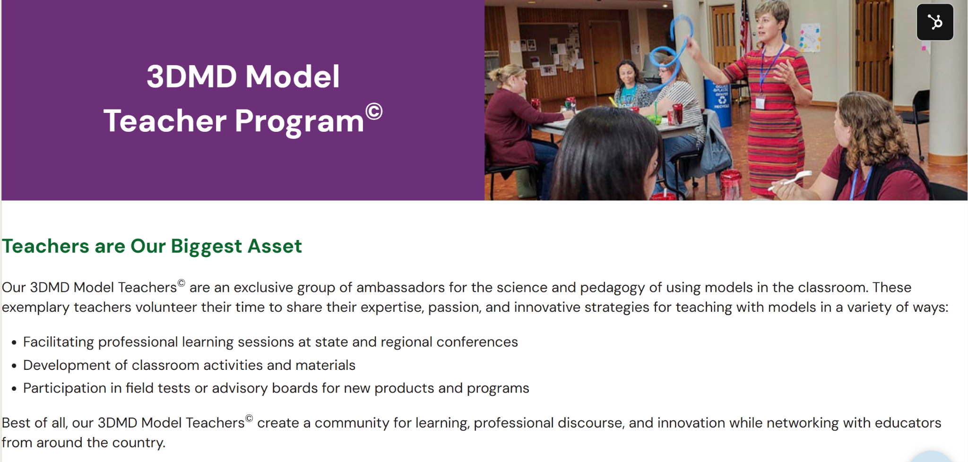

Slide 7
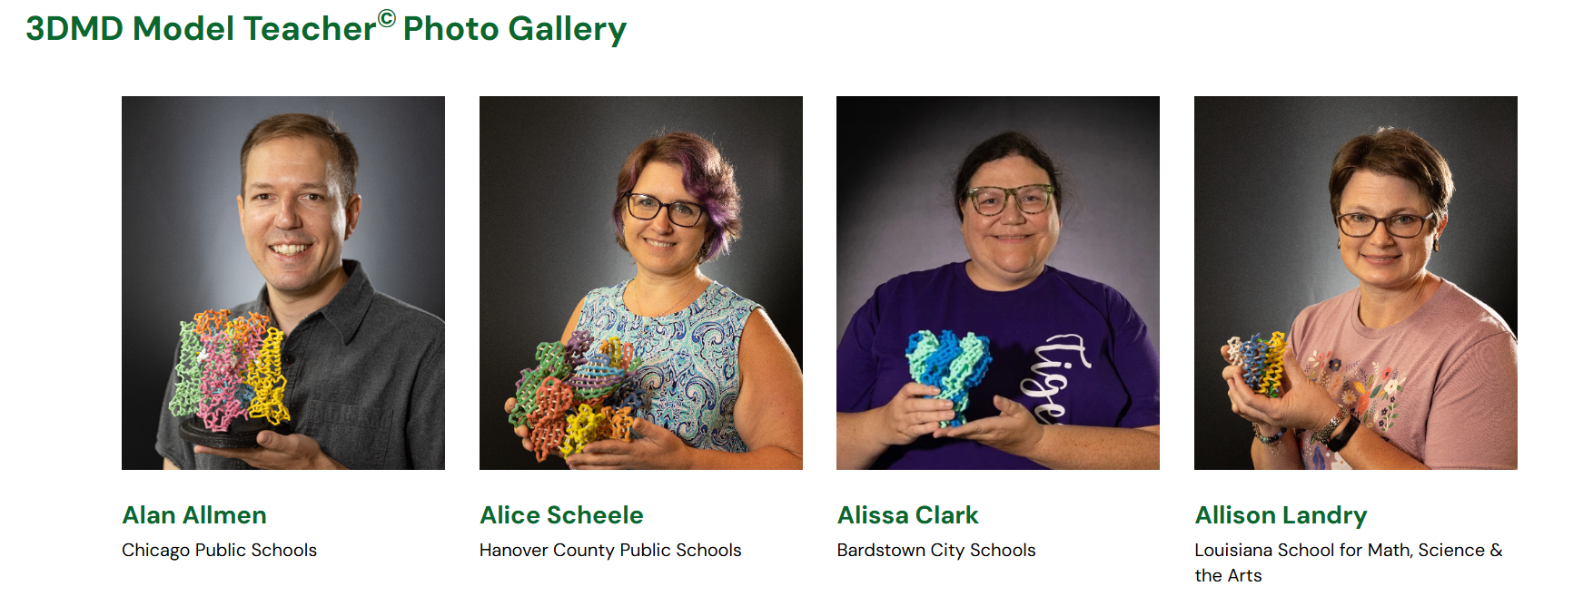

Slide 8
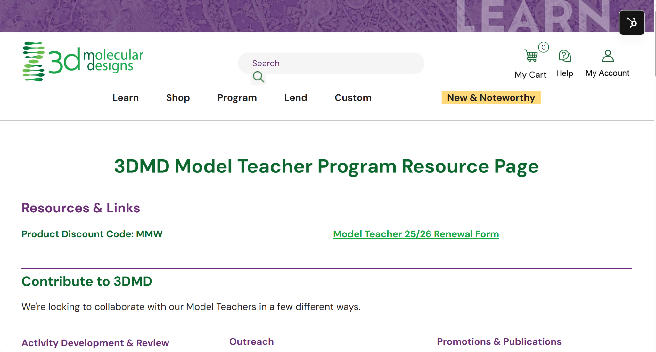
Model Teacher Program

Slide 9
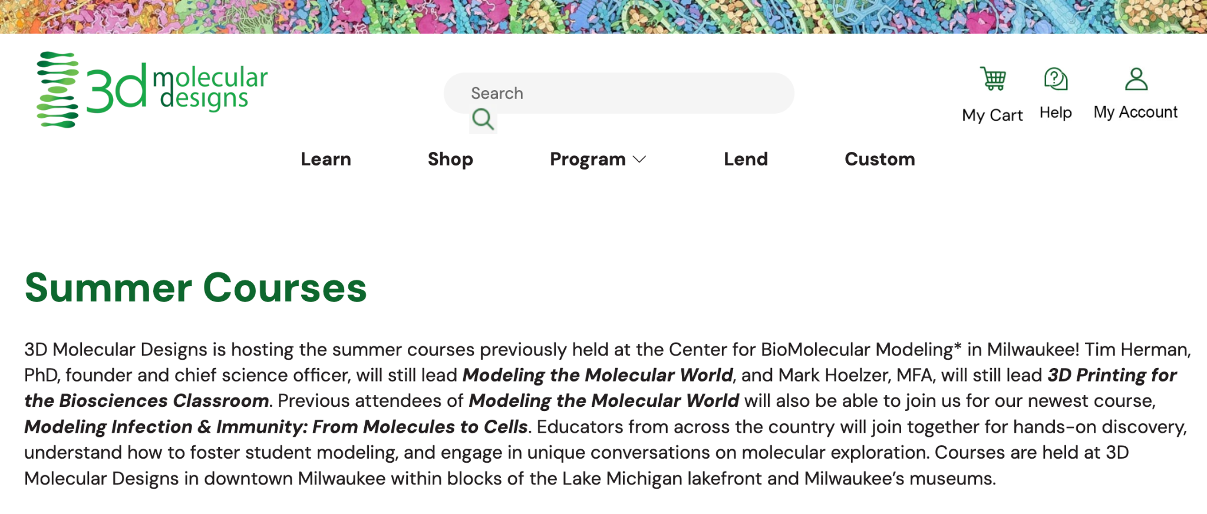
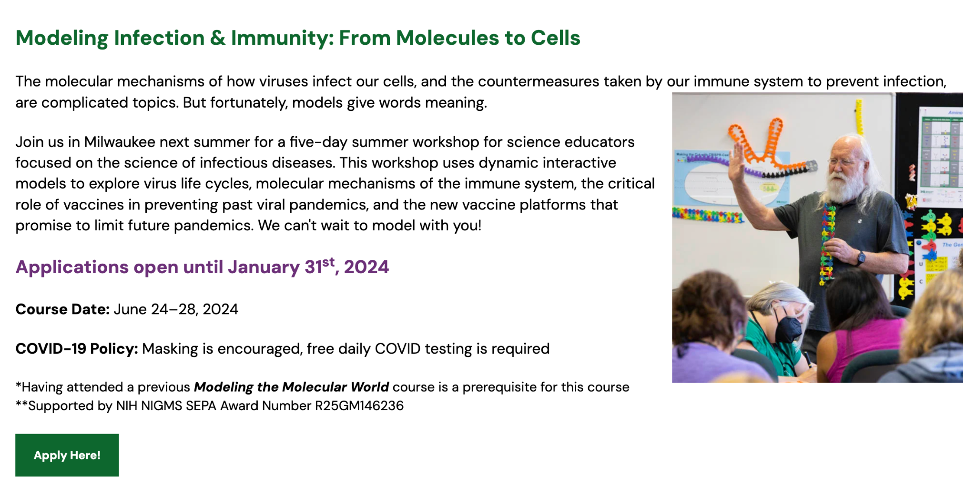
January 30, 2025
Stay tuned for the announcement This Fall!

Slide 10

Group Photo Time!

Slide 11

Your experience with WE²
  Wonder – Allows authentic learner play, Ignites learner questions, engages learners to want to know more.
  Explore – Allows learners to make sense of their thinking by systematically and intentionally applying content understanding and vocabulary within the context modeling as they and extend their thinking and expand on their questions.
  Explain – Allows students to articulate or illustrate their thinking, grounded in the learning from the models. Fosters confidence by using models to anchor their understanding but expands to connecting conceptual ideas
Notes:
The challenge for the week is to see and appreciate the whole “enzyme” while identifying those active sites
After we talk about protein structures and then enzymes we mention that active sites are often just a couple of side chains. This is a metaphor for our professional learning. We have a mass of learning that builds and supports our teaching but maybe only two or three pieces that will directly apply to our context.
But it was about how there is so much involved in the structure of an enzyme but the active site is just two or three key pieces (Aa’s). So pick the two or three key things for your own learning or practice instead of being overwhelmed with everything.

Slide 12
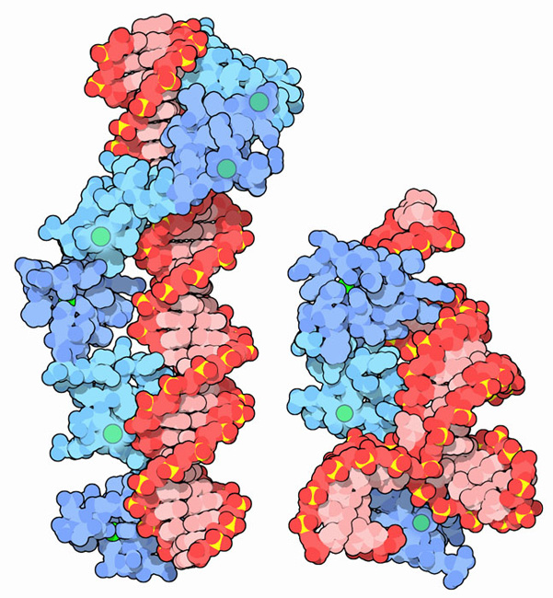
The Protein Data Bank, PDB101
…and Molecule of the Month

Slide 13
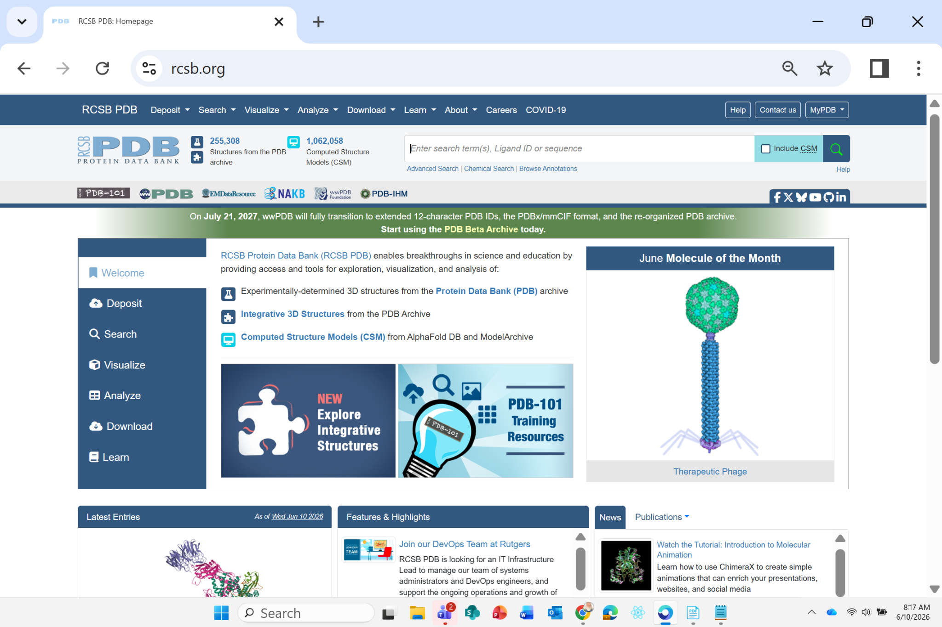
Notes:
Go to www.rcsb.org

Slide 14
A pdb file… is a text file.
X Y Z
ATOM 478 N ALA C 6 -9.539 4.454 64.244 1.00 26.78 N
ATOM 479 CA ALA C 6 -8.660 5.319 64.996 1.00 25.78 C
ATOM 480 C ALA C 6 -7.296 4.710 65.235 1.00 26.41 C
ATOM 481 O ALA C 6 -7.160 3.505 65.401 1.00 25.88 O
ATOM 482 CB ALA C 6 -9.252 5.649 66.356 1.00 28.88 C
ATOM 483 N CYS C 7 -6.276 5.548 65.269 1.00 24.39 N
ATOM 484 CA CYS C 7 -4.975 5.016 65.521 1.00 24.99 C
ATOM 485 C CYS C 7 -4.873 4.714 67.048 1.00 34.09 C
ATOM 486 O CYS C 7 -5.044 5.622 67.877 1.00 34.79 O
ATOM 487 CB CYS C 7 -3.909 5.974 65.010 1.00 19.74 C
ATOM 488 SG CYS C 7 -2.281 5.326 65.383 1.00 25.98 S
Notes:
Go to www.rcsb.org

Slide 15
Notes:
Go to www.rcsb.org

Slide 16
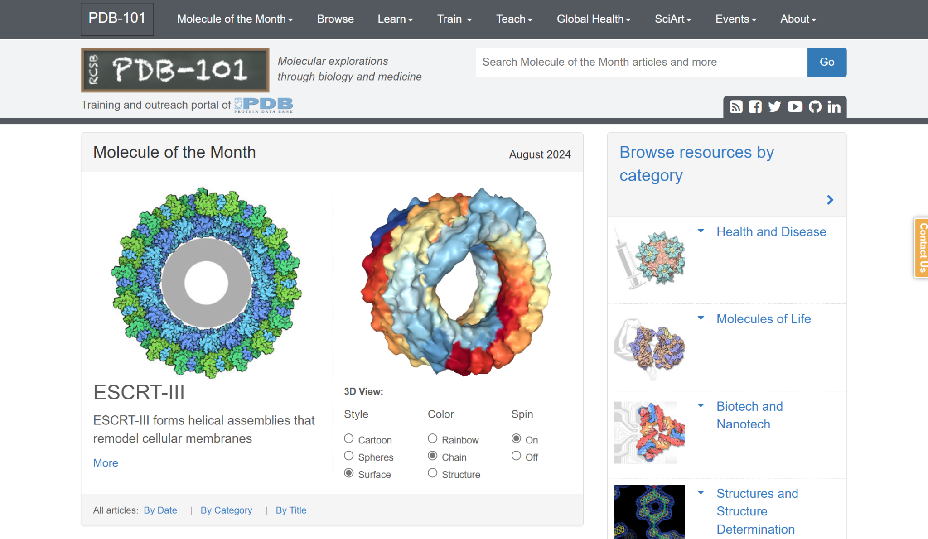
PBB-101

Slide 17
PBB-101

Slide 18
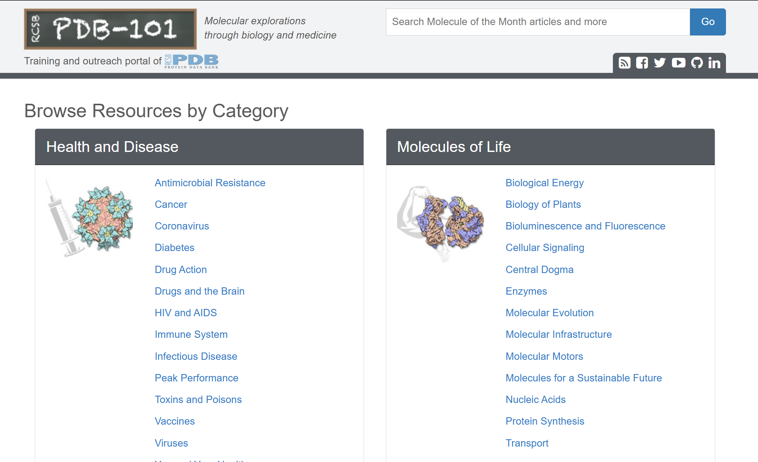

Slide 19
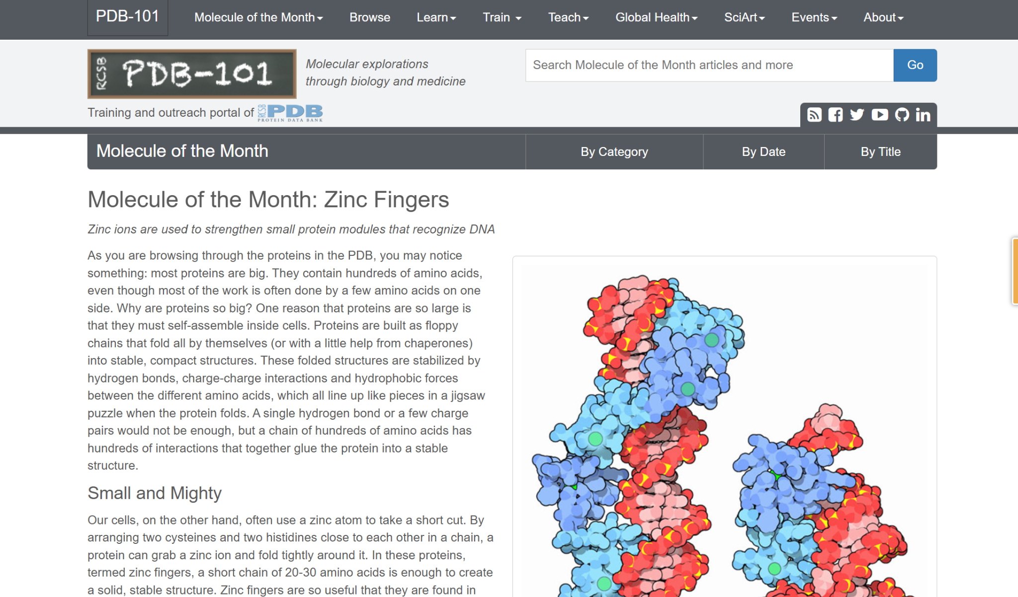
Find the Zinc Fingers resources
Notes:
Go to www.rcsb.org

Slide 20
PLAY!
What’s a protein story you’re interested in?
What’s a protein you think your STUDENTS may be interested in?
Notes:
Go to www.rcsb.org

Slide 21
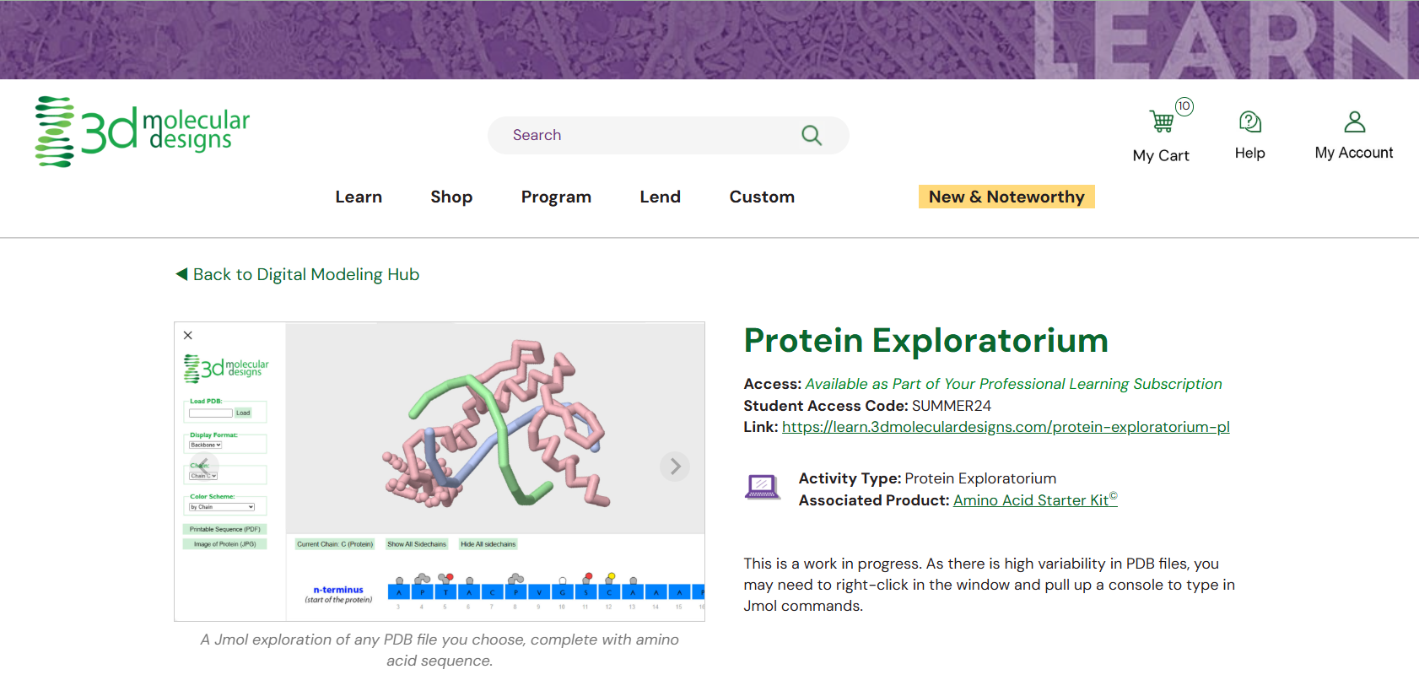
Protein Exploratorium

Slide 22


Slide 23

Model Melange
Rotate through 4 stations (12 minutes per station)
Bring your notebooks - jot down a list of the various protein stories featured
Ask lots of questions!

Slide 24
SMART Teams
SMART = Students Modeling A Research Topic
Dan Williams

Slide 25
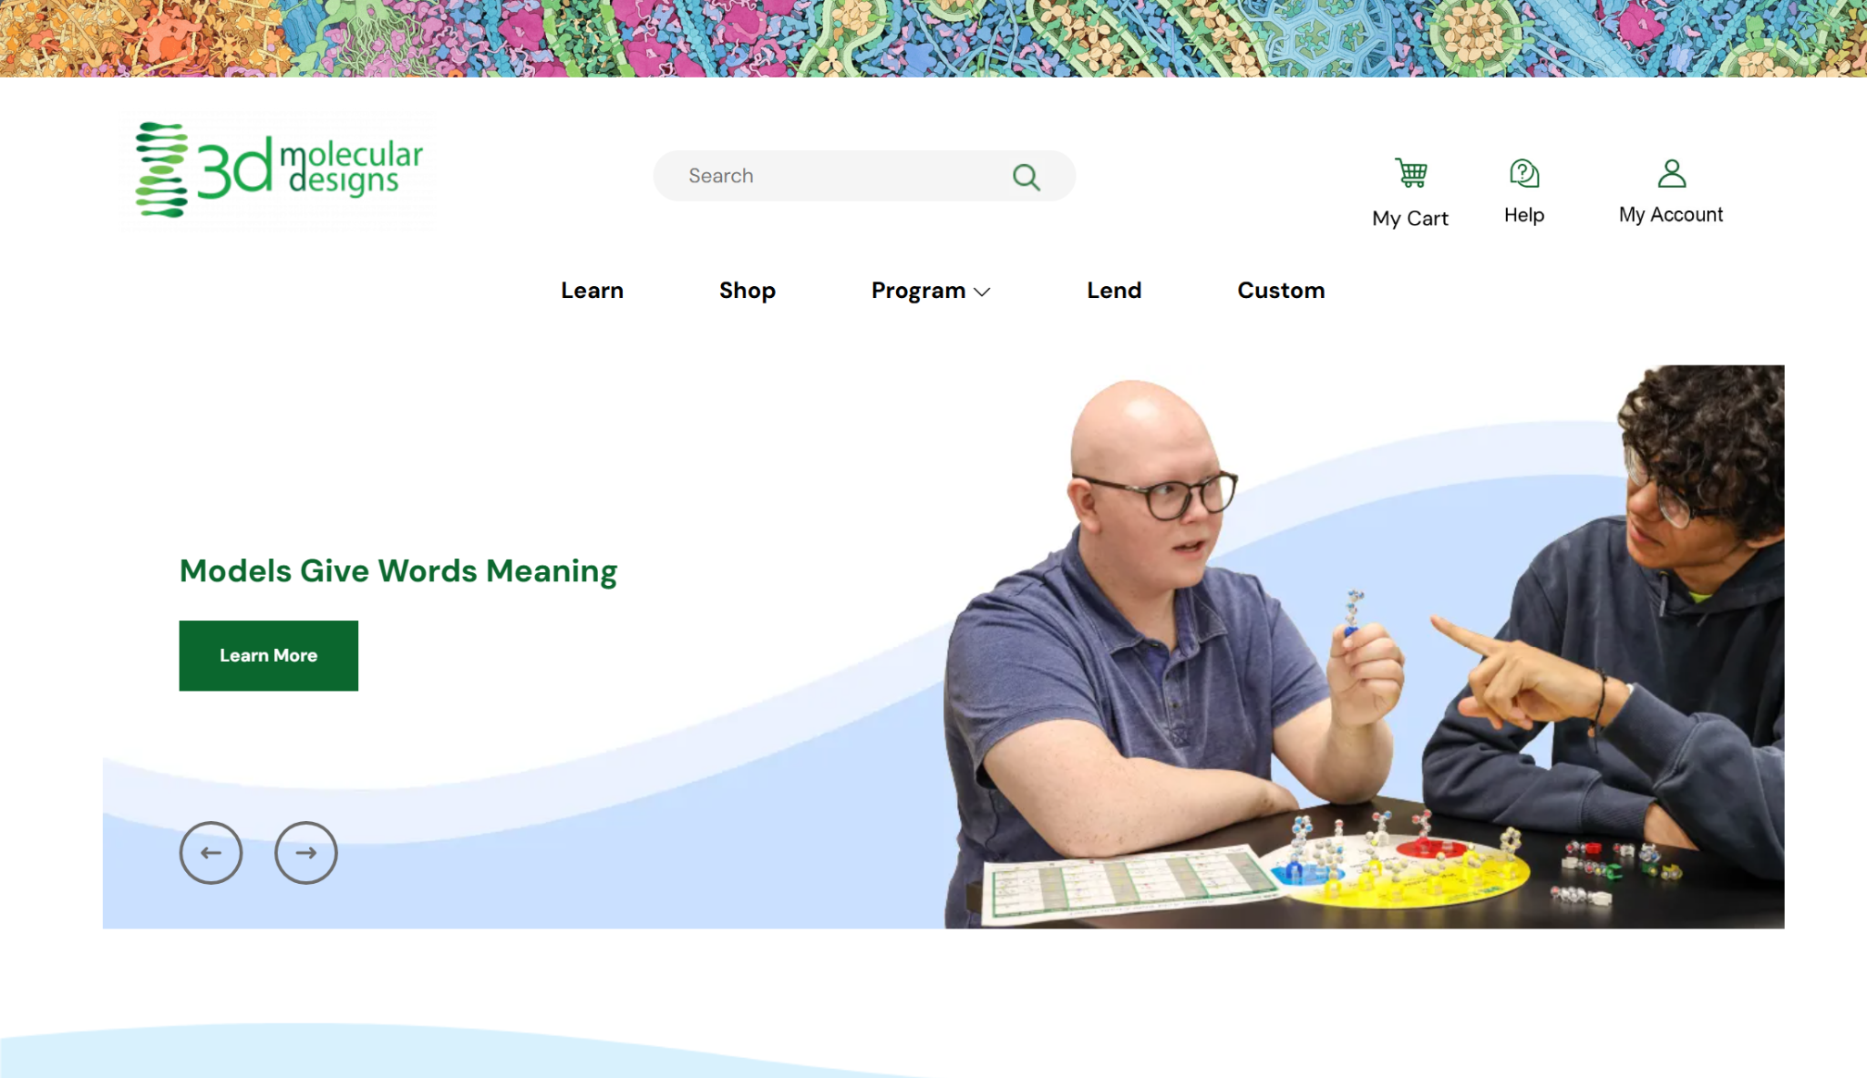

Slide 26
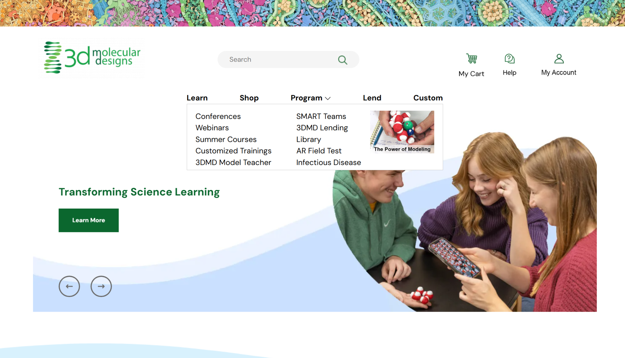

Slide 27
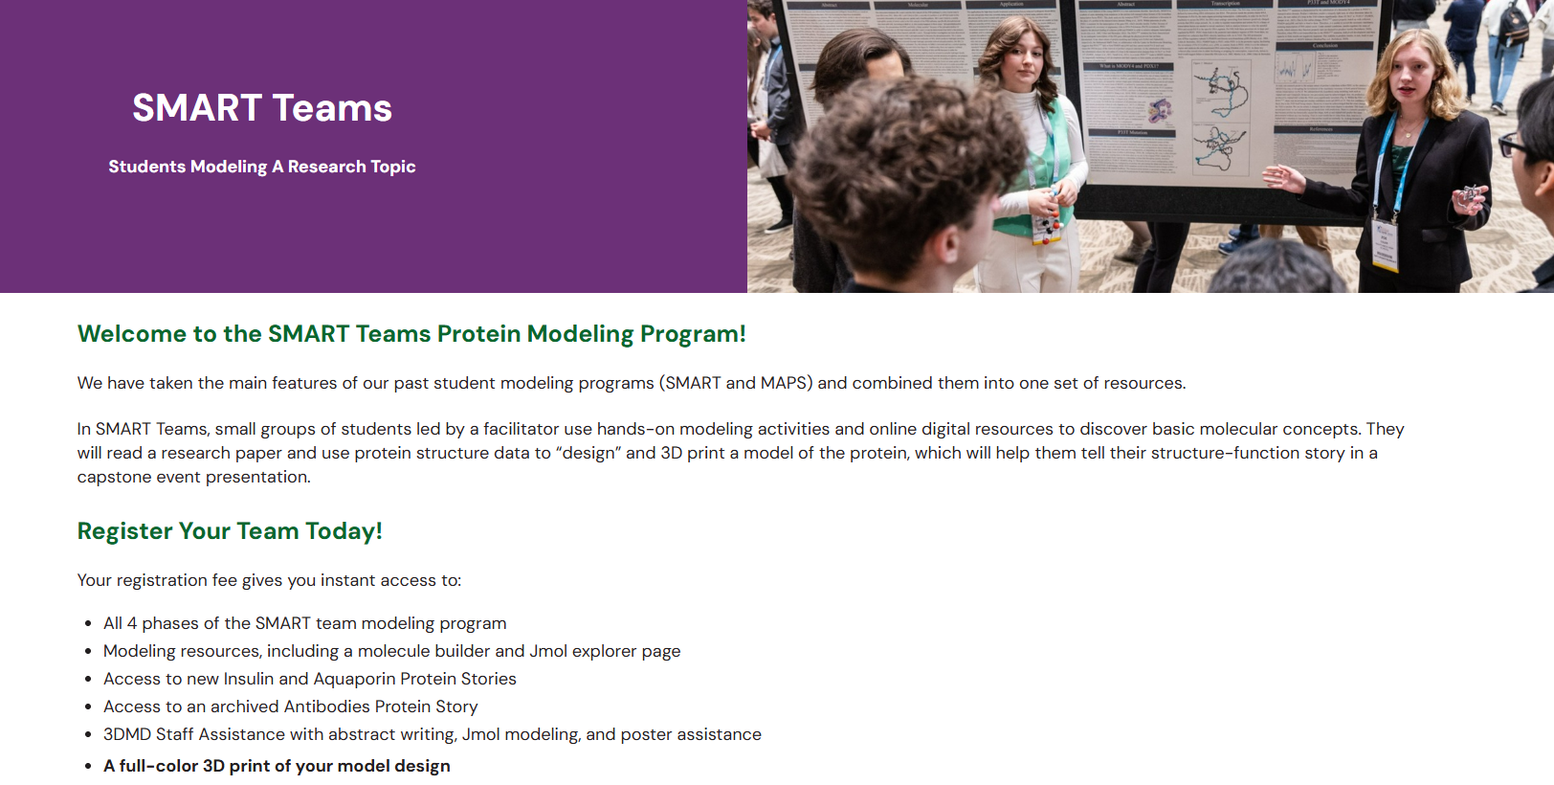

Slide 28
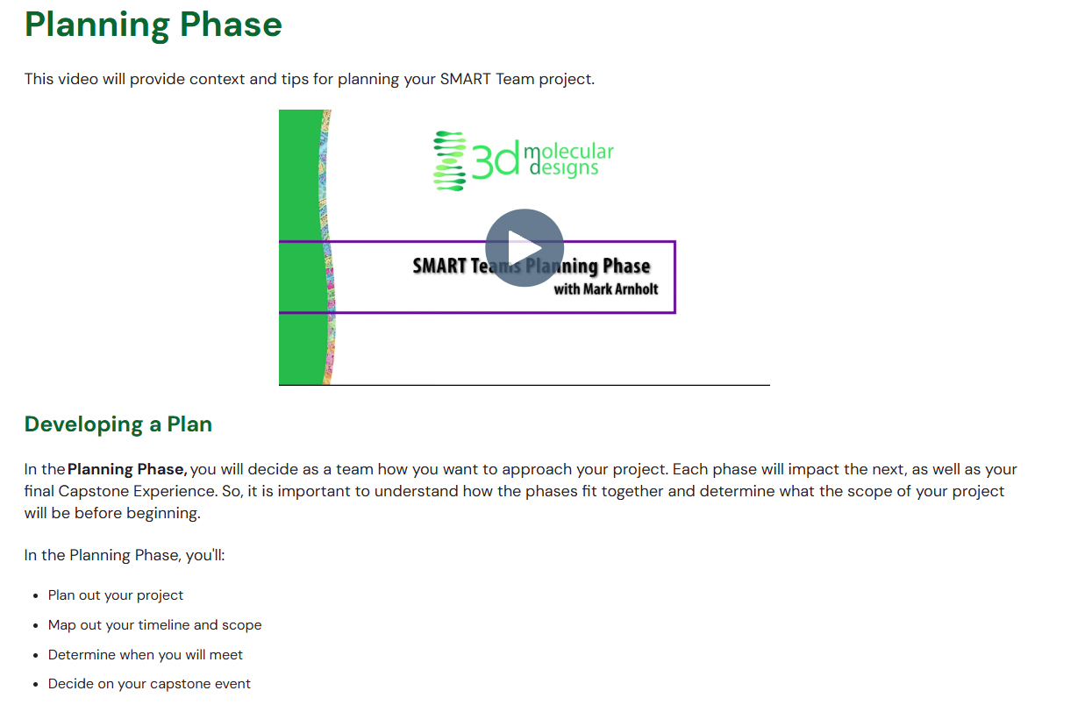

Slide 29
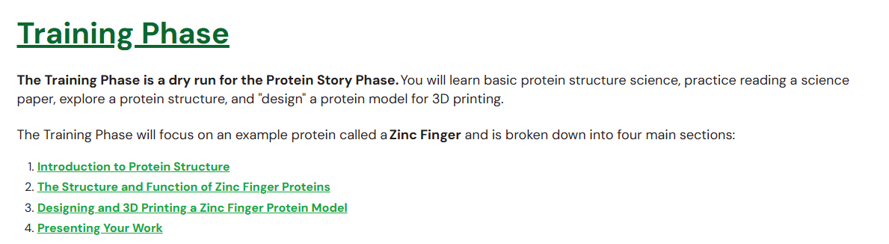
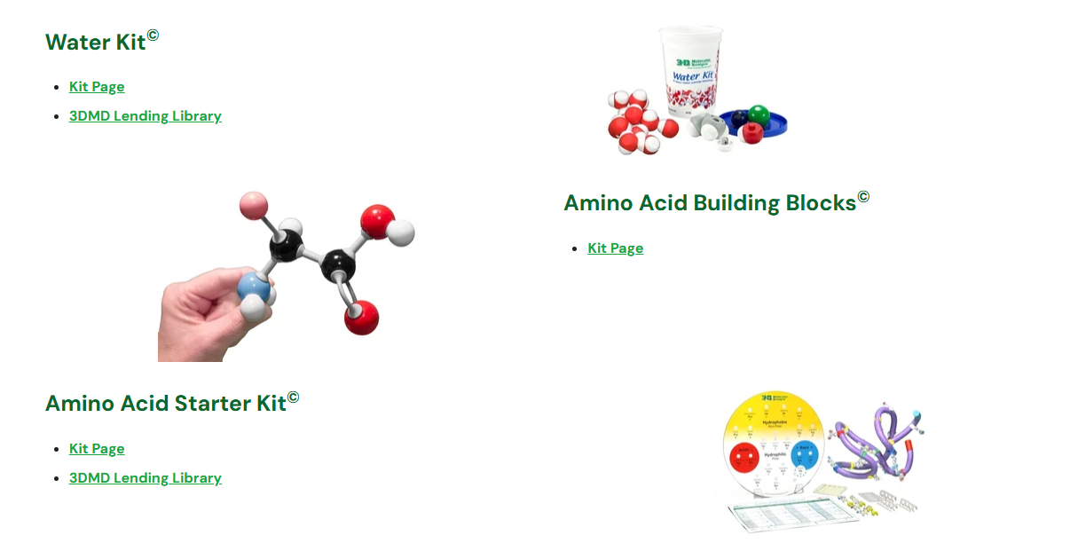
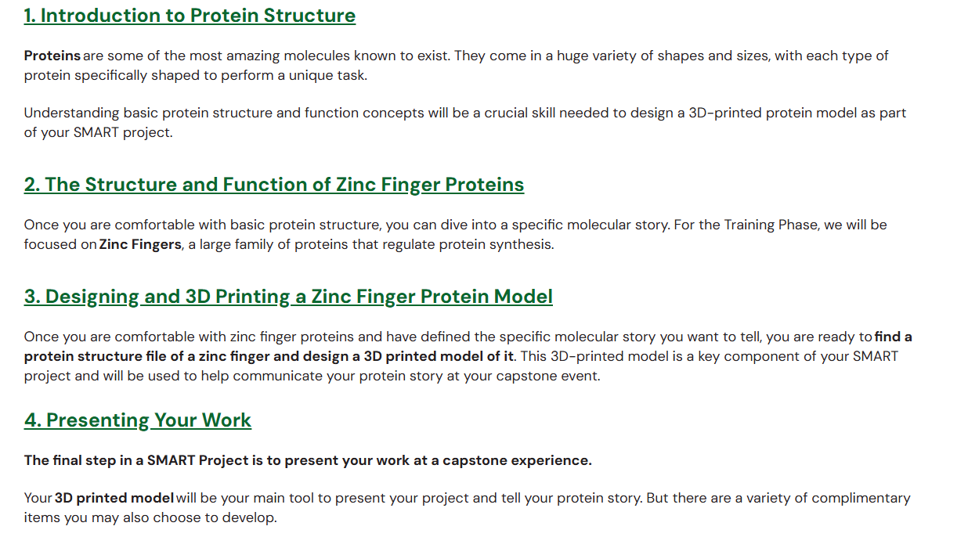

Slide 30
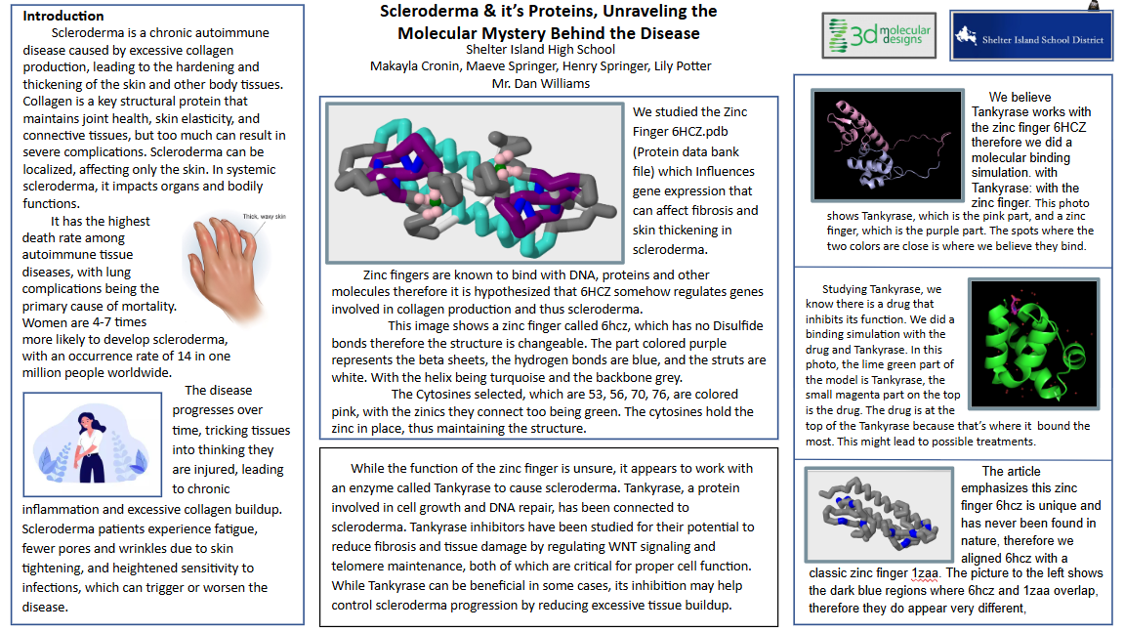

Slide 31
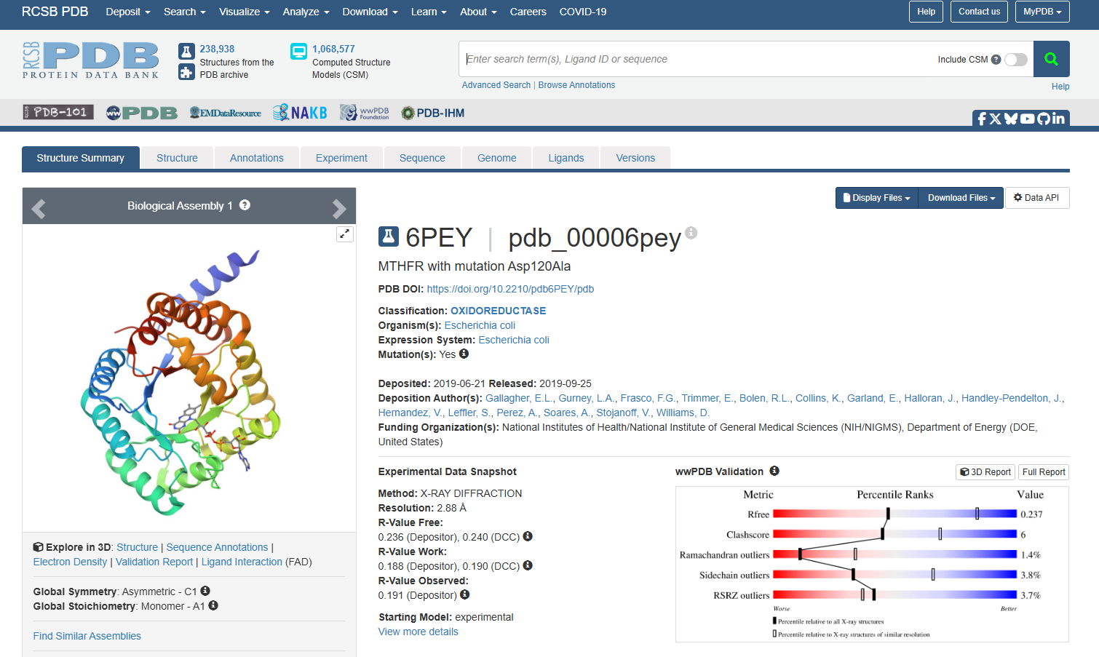

Slide 32
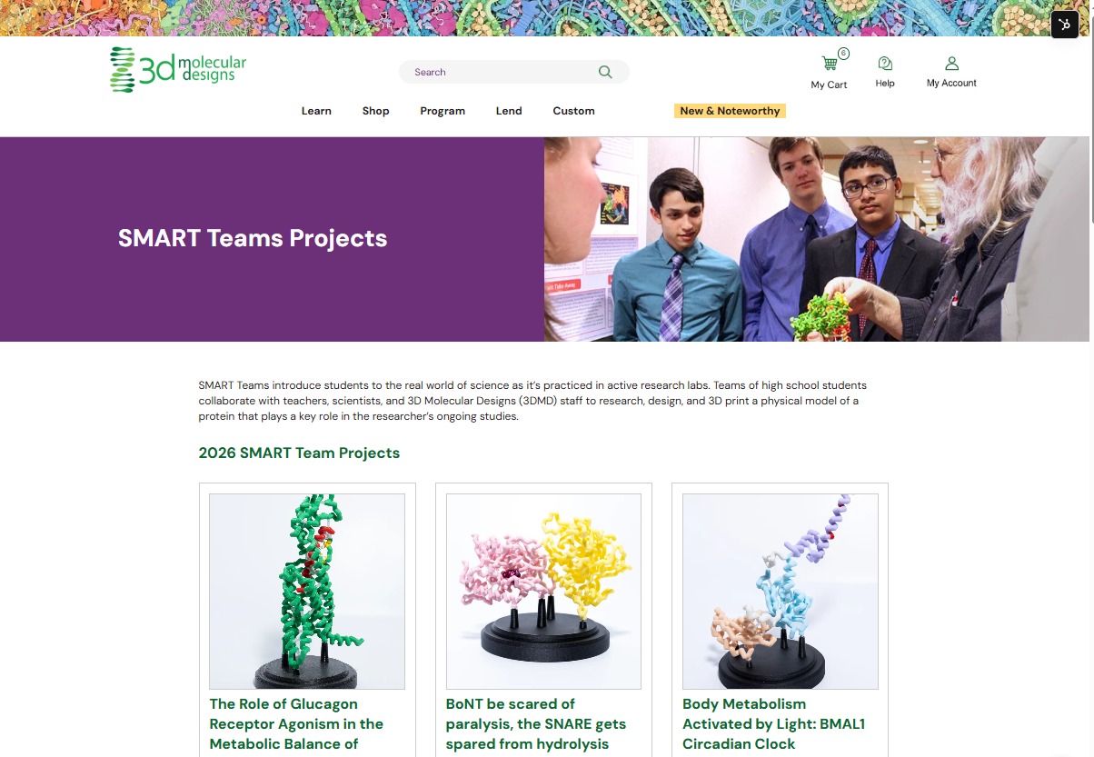

Slide 33
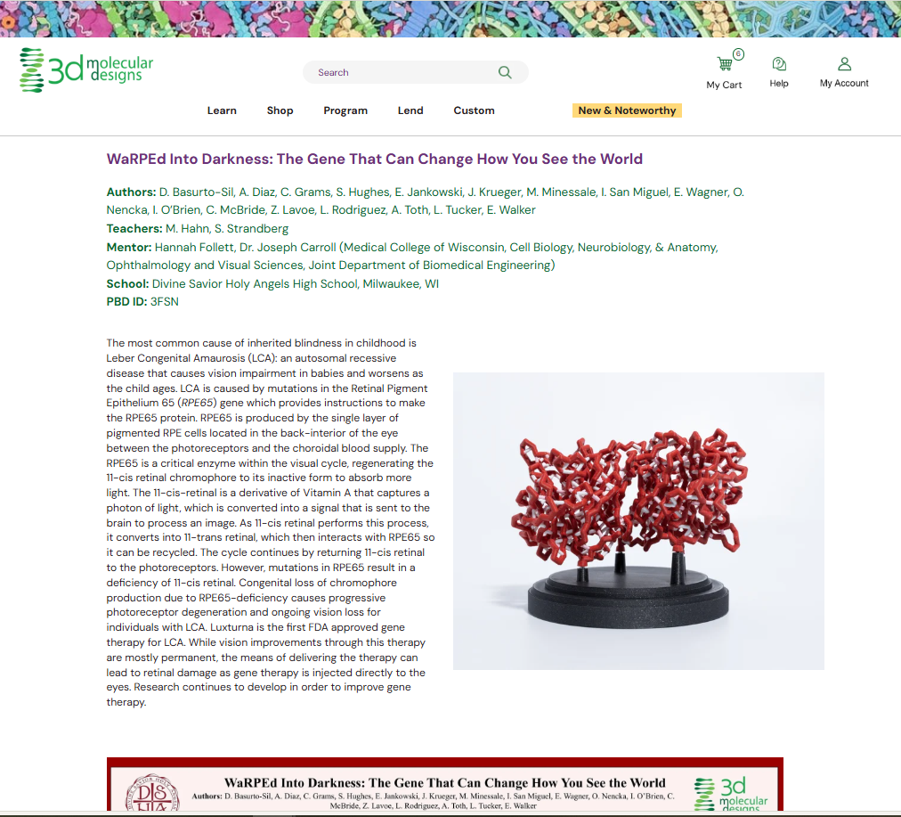

Slide 34
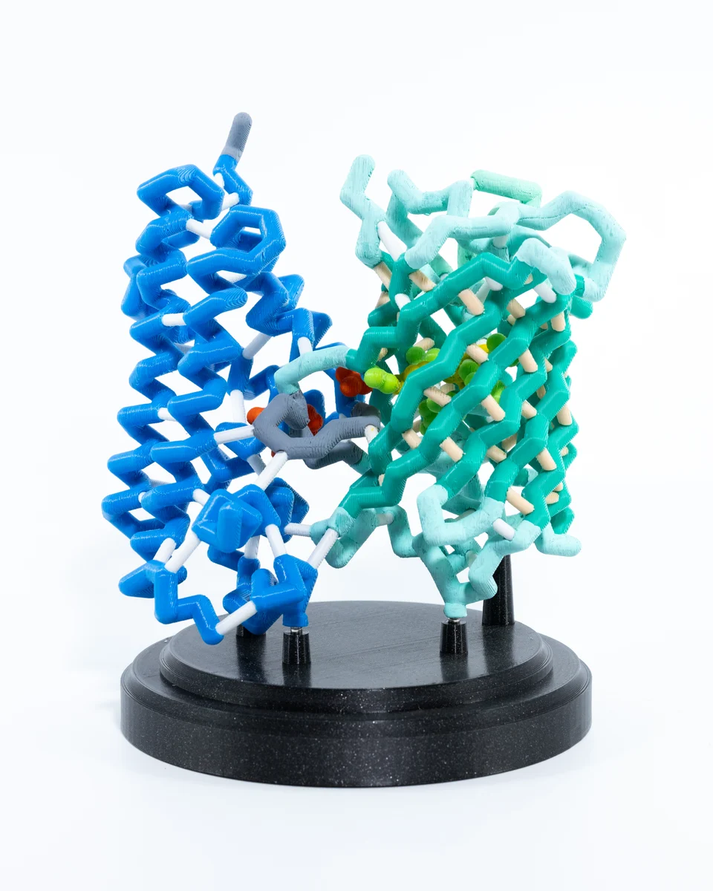
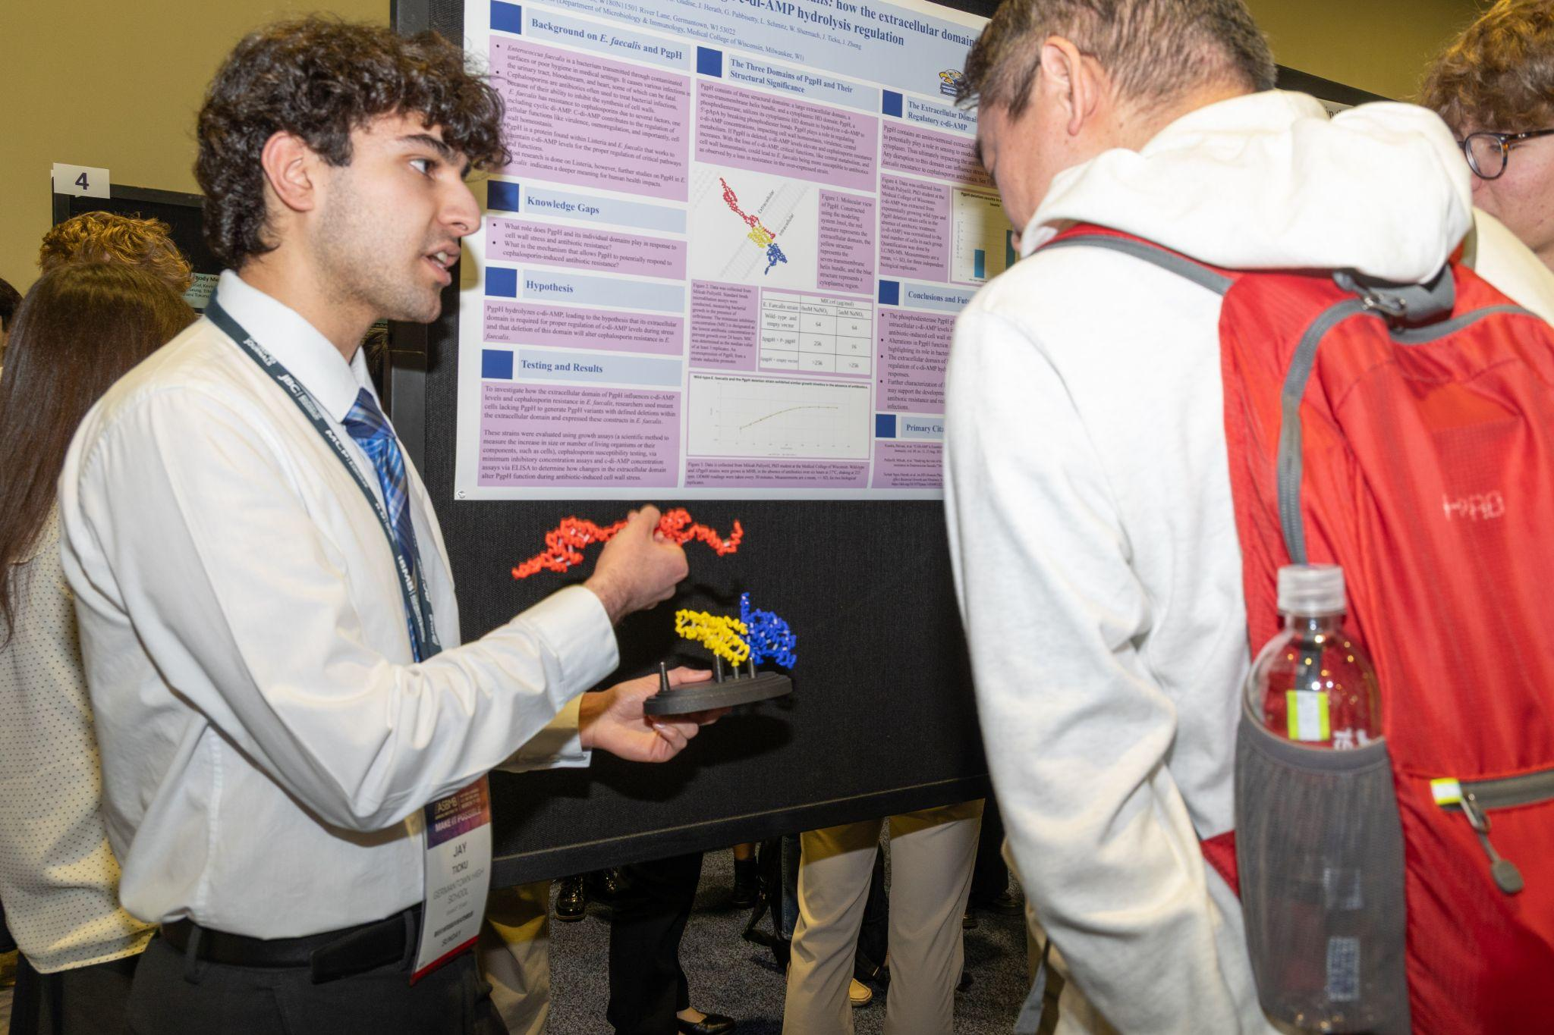
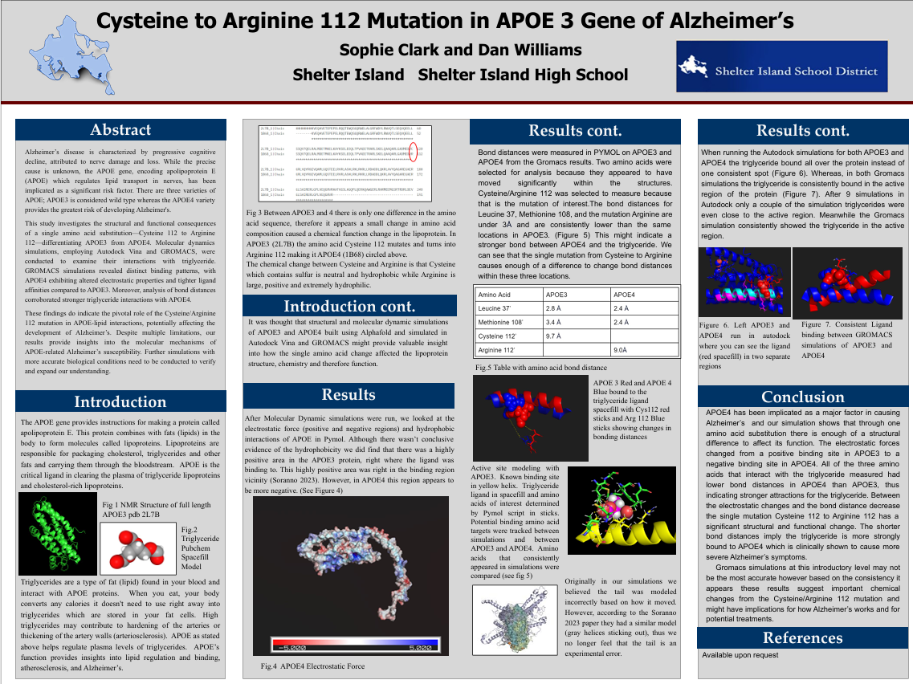
SMART Team Support
Access to the program for all teams in your school
Abstract, model & poster review for 1 team
3D Printed model for 1 team
ASBMB poster session for 1 team
  (for the first 10 schools to register*)

Slide 35
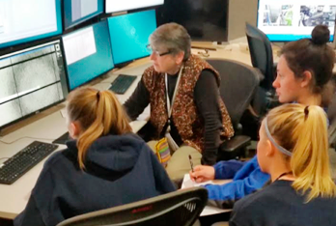
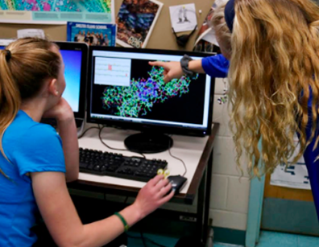
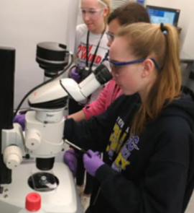
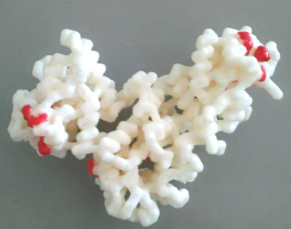
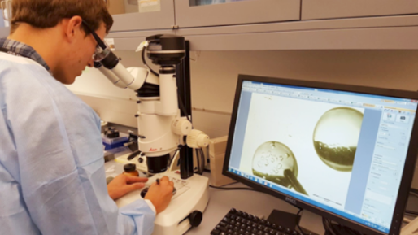
The Shelter Island Experience

Slide 36
The Shelter Island Experience

Slide 37
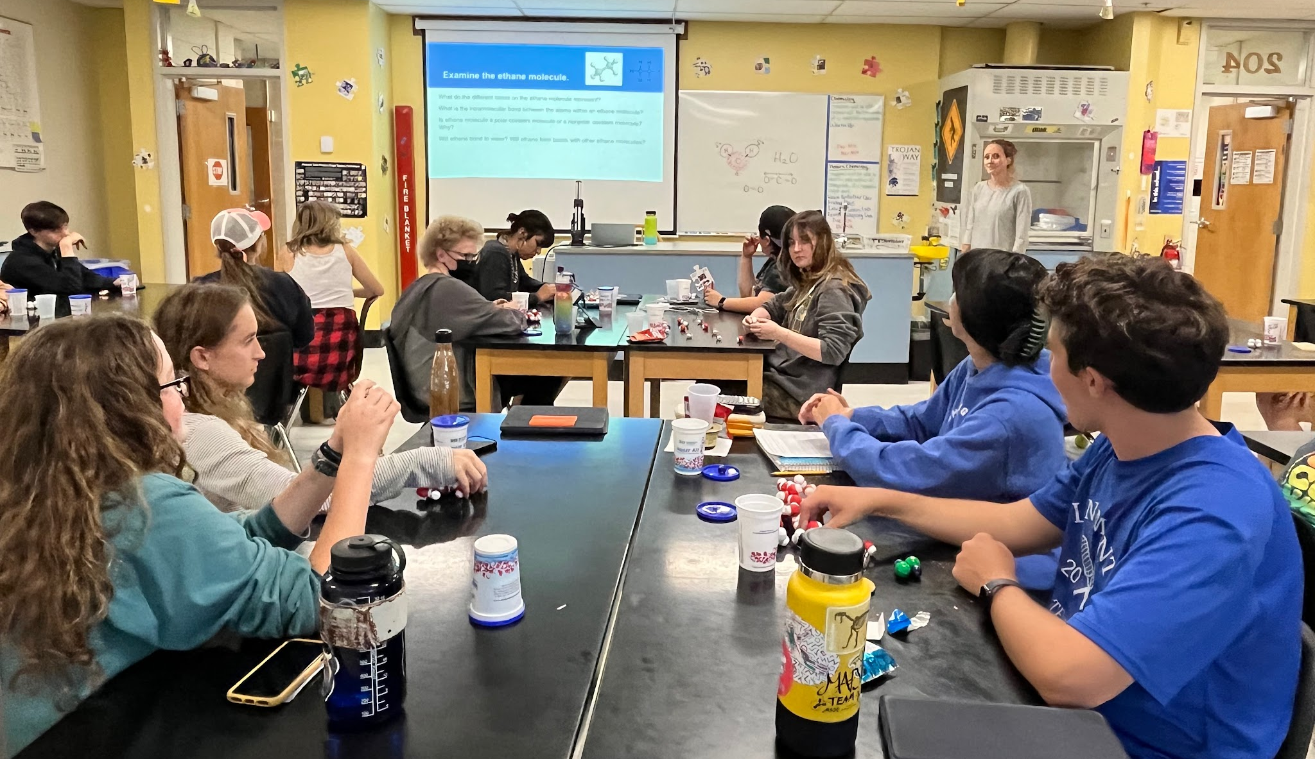

Slide 38
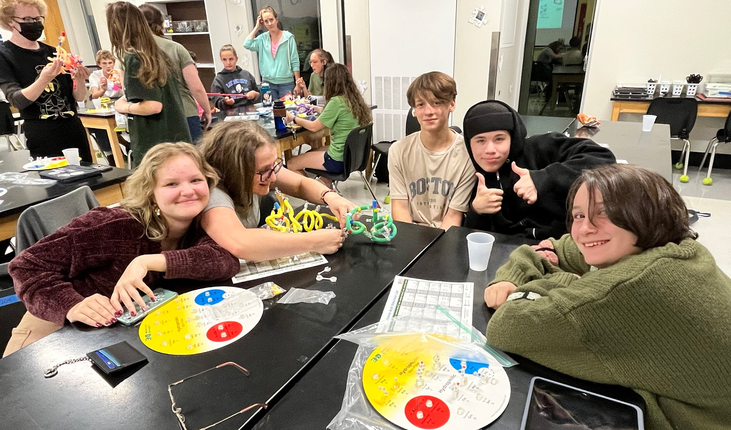
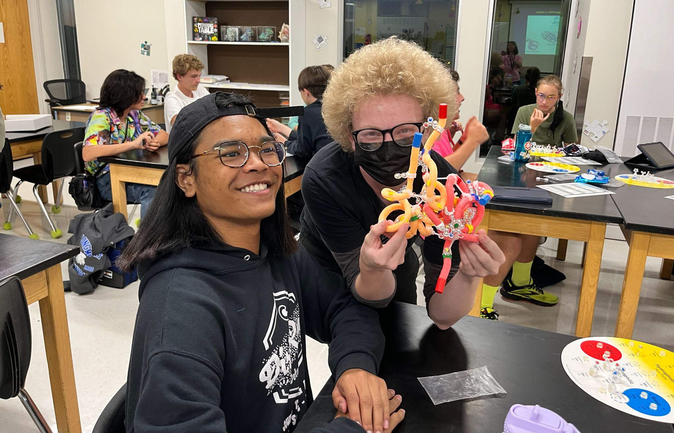

Slide 39
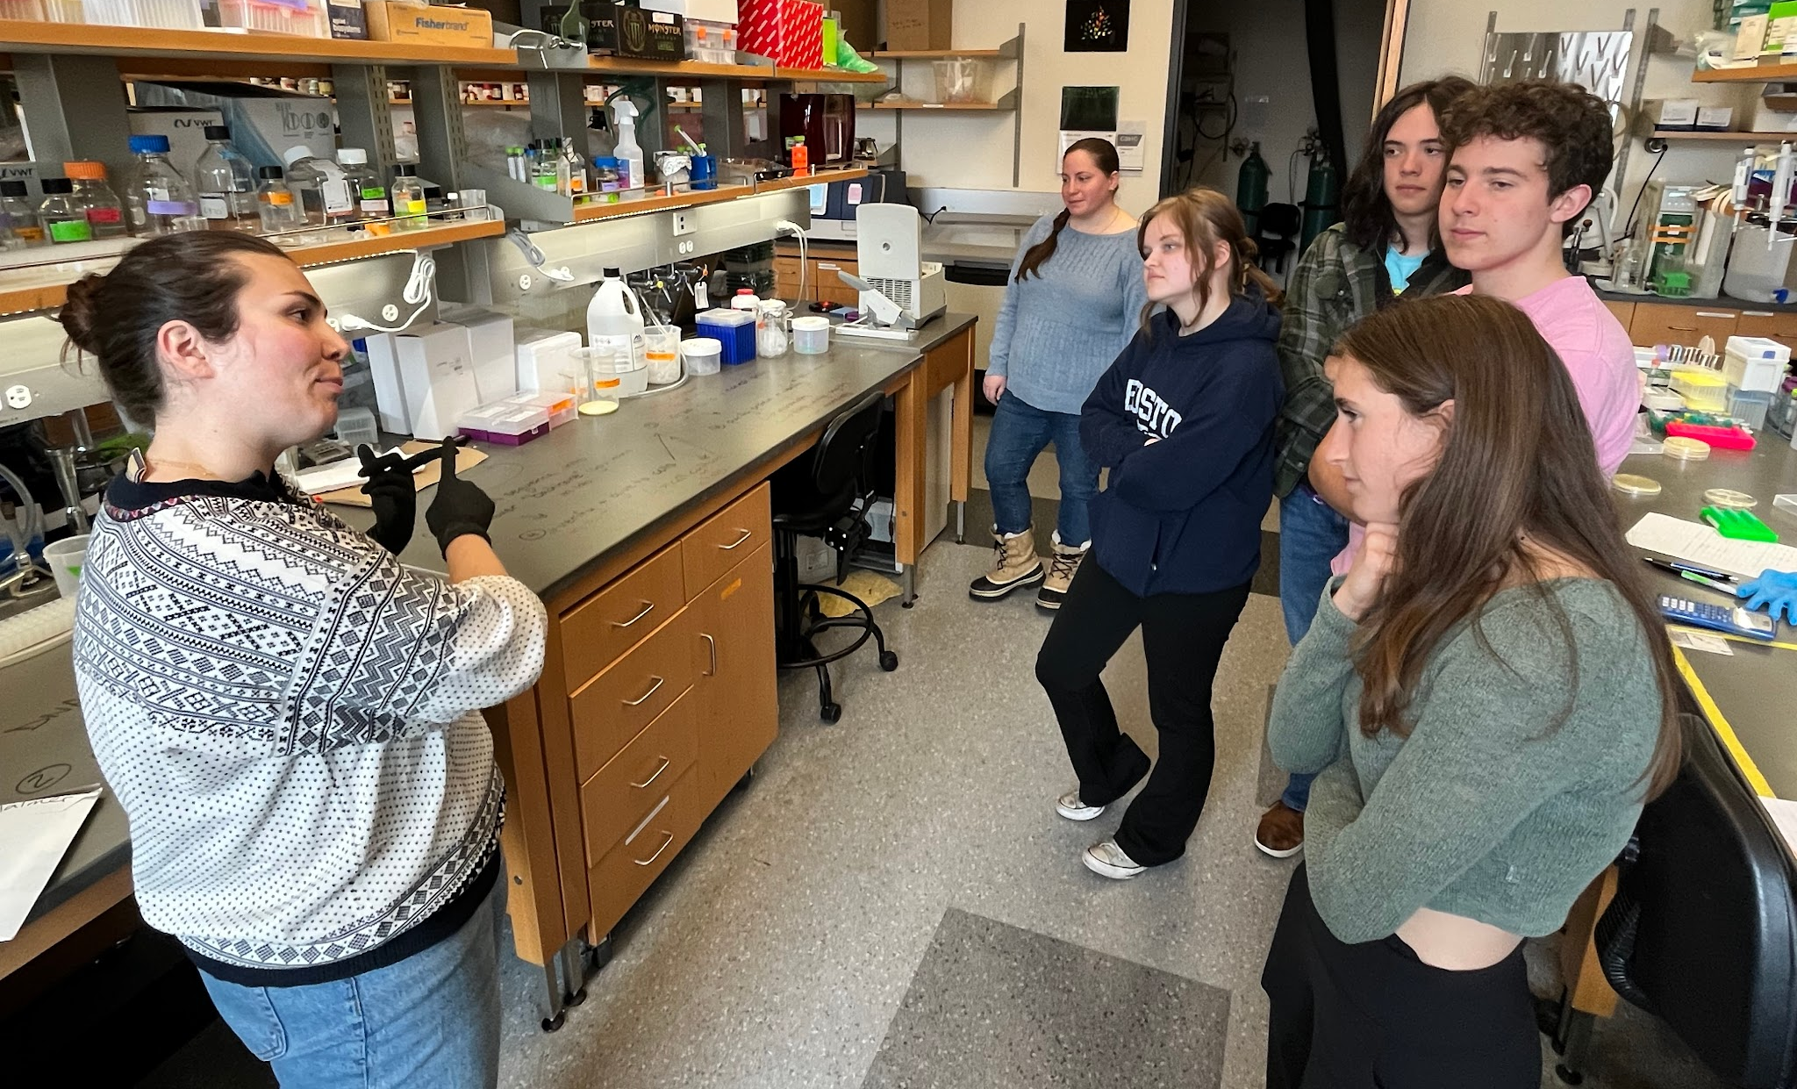
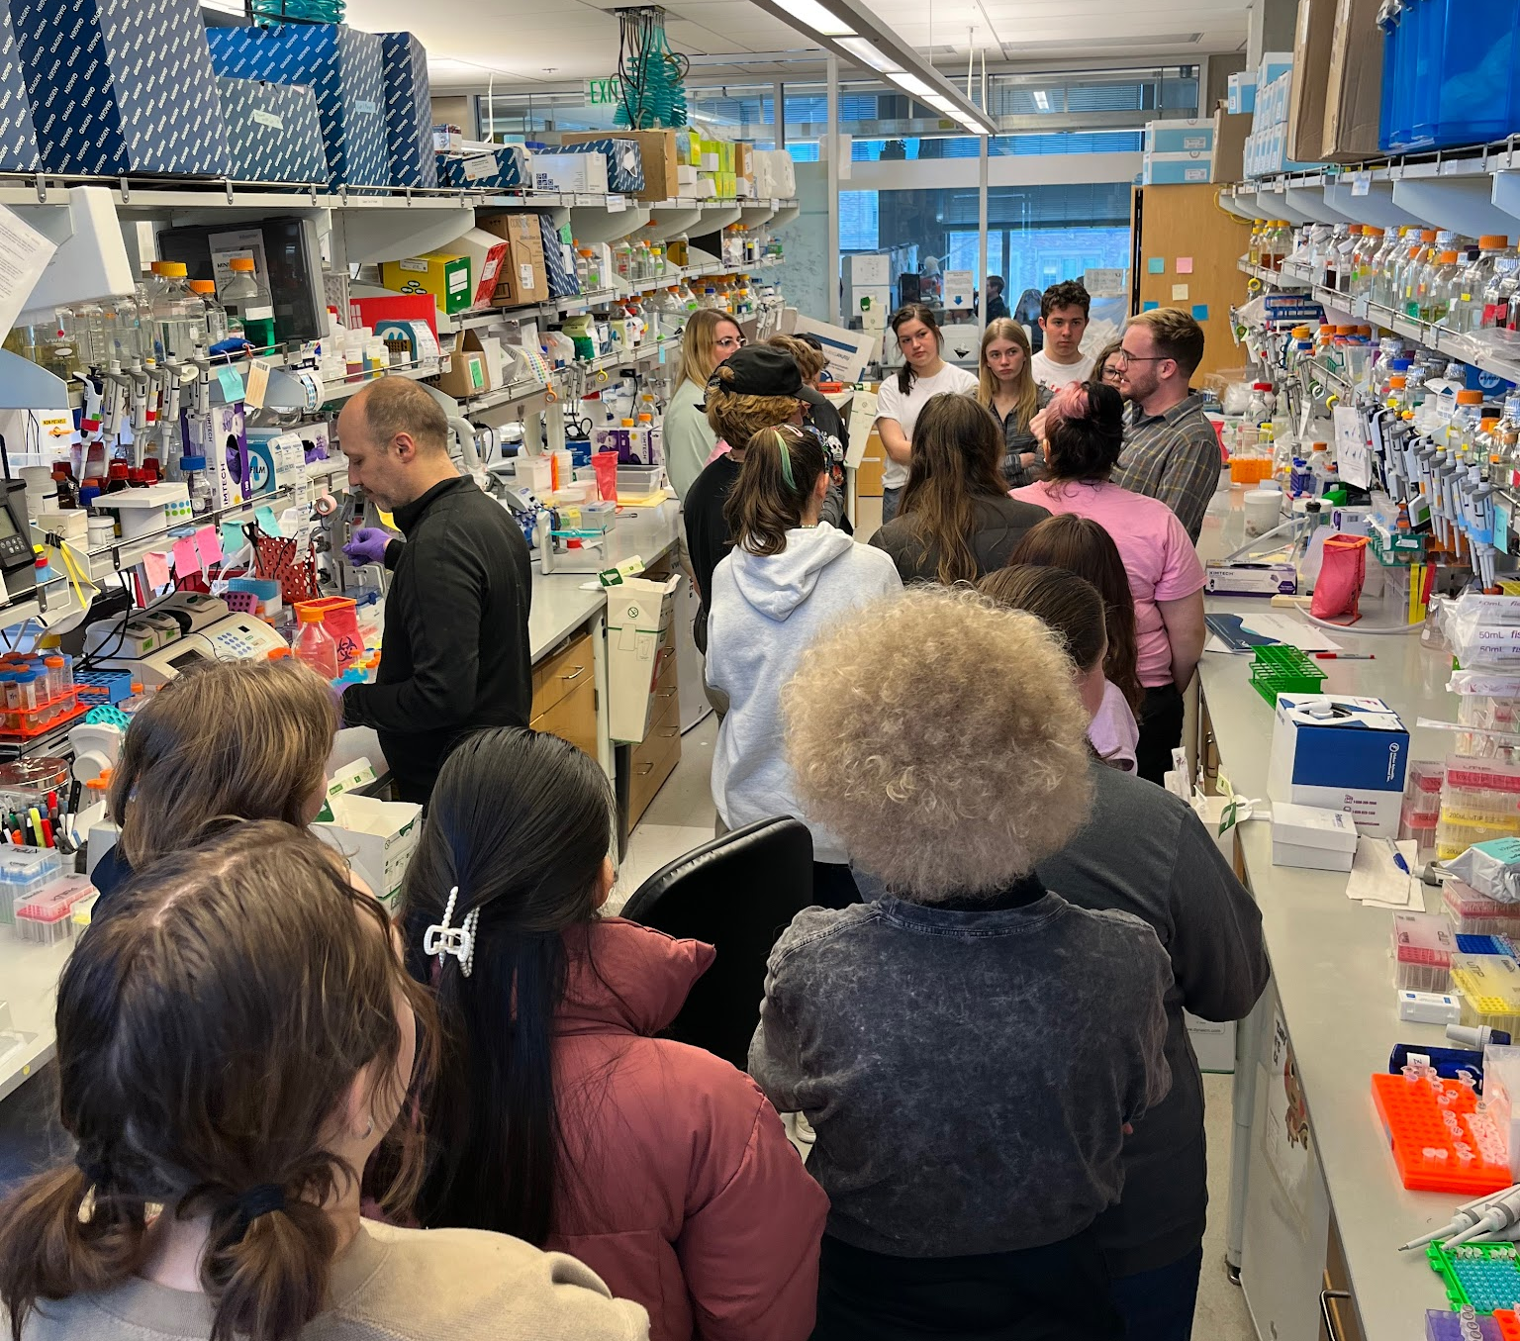

Slide 40
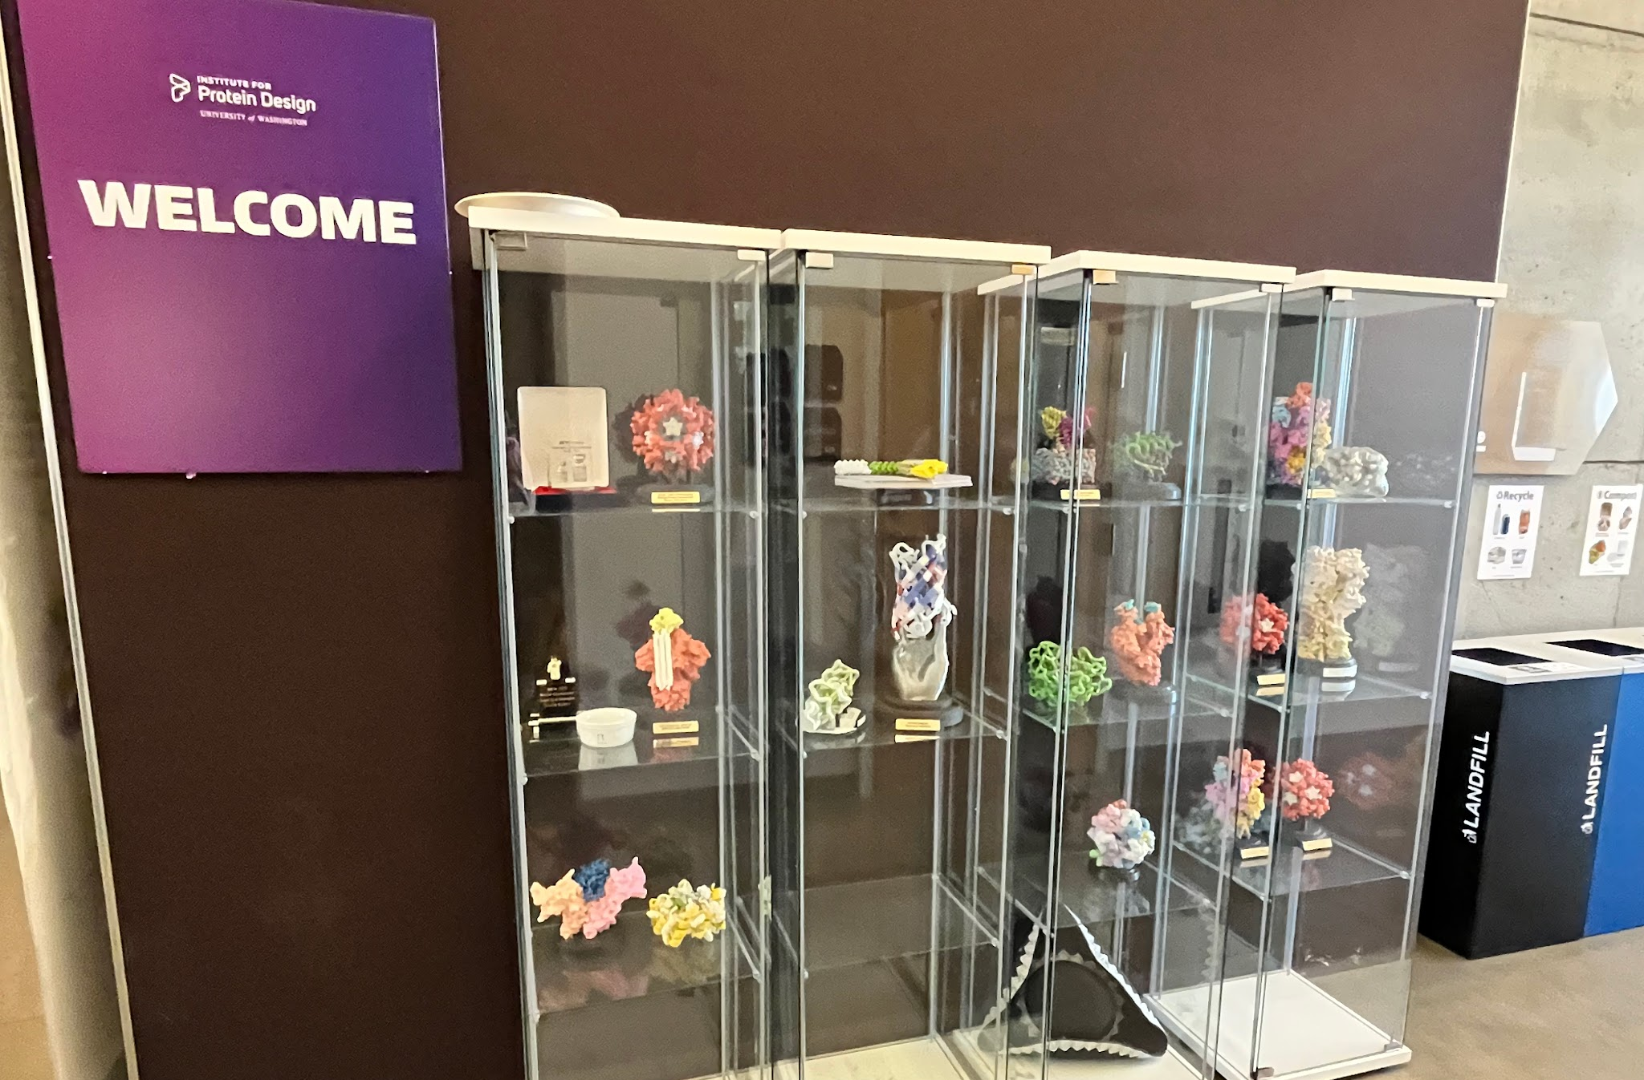

Slide 41
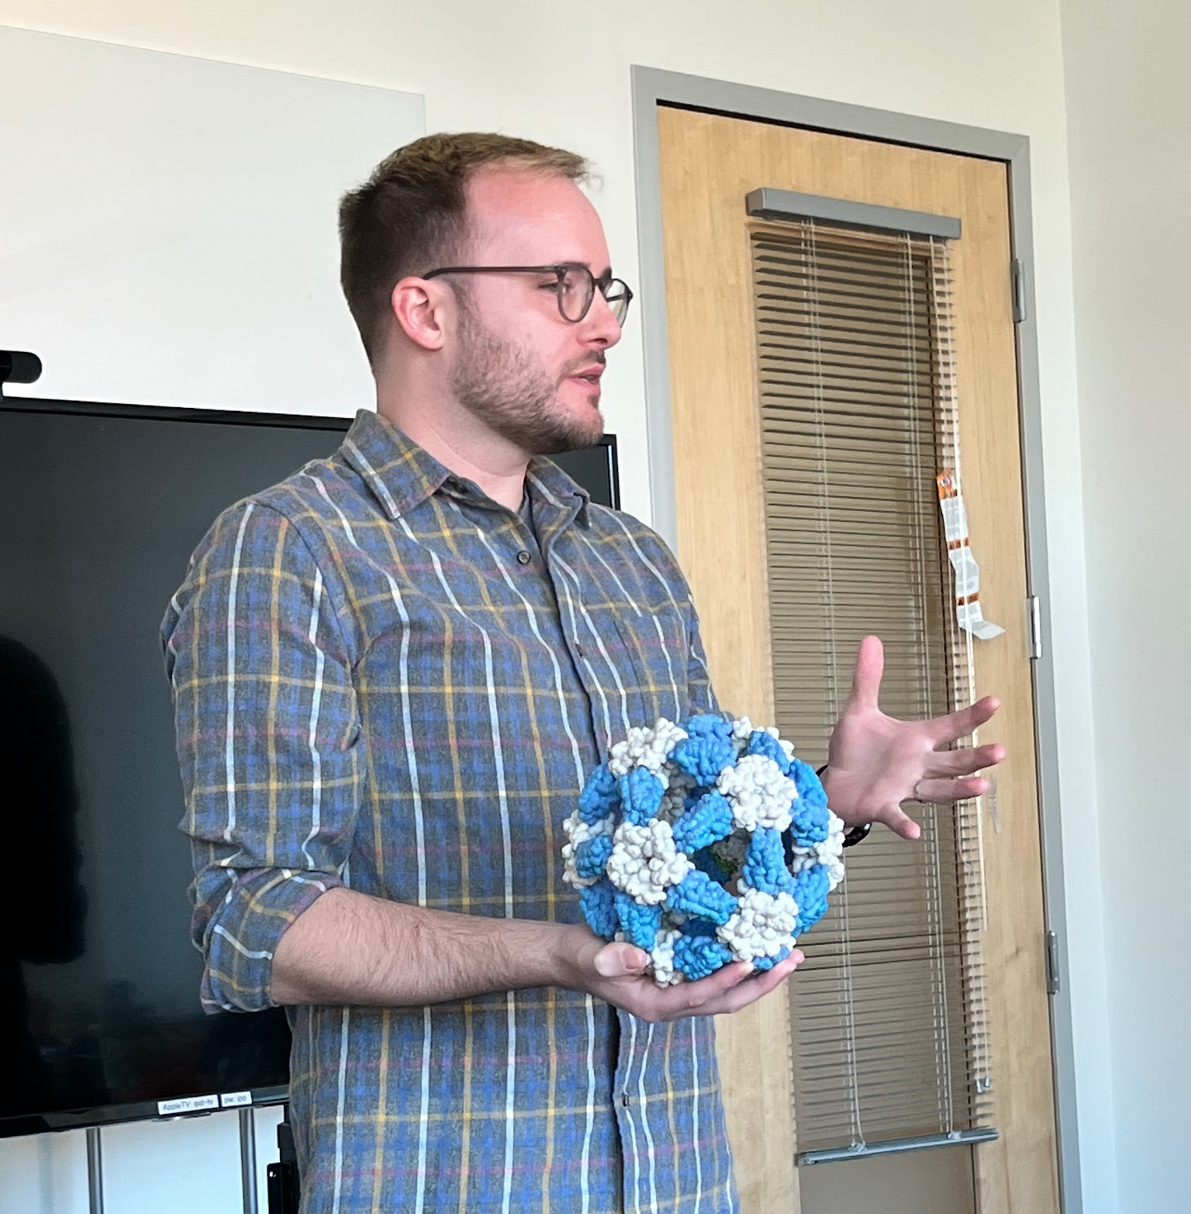
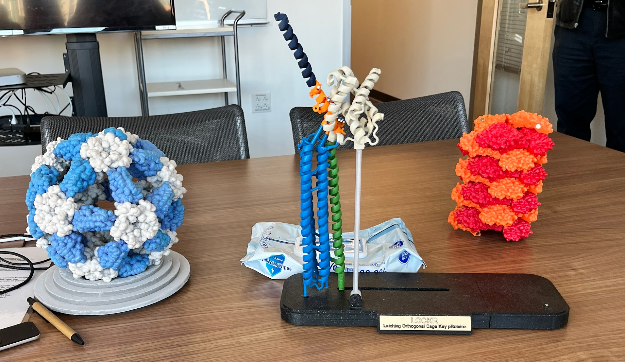

Slide 42
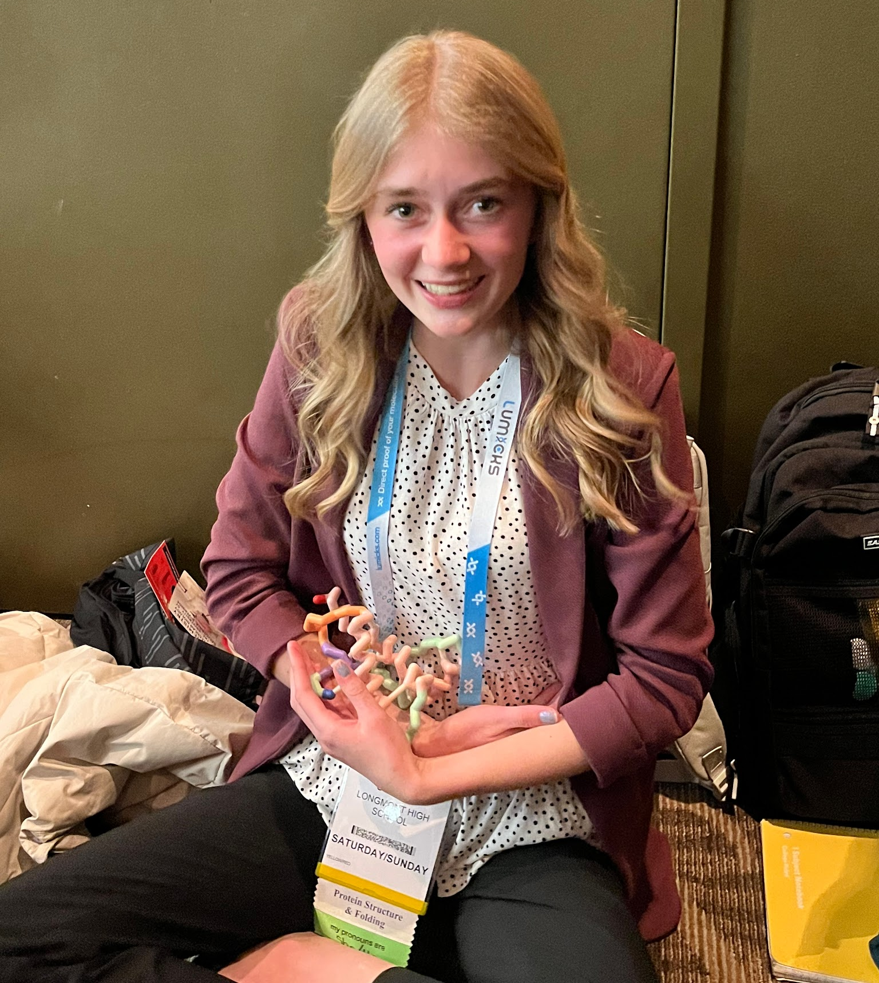
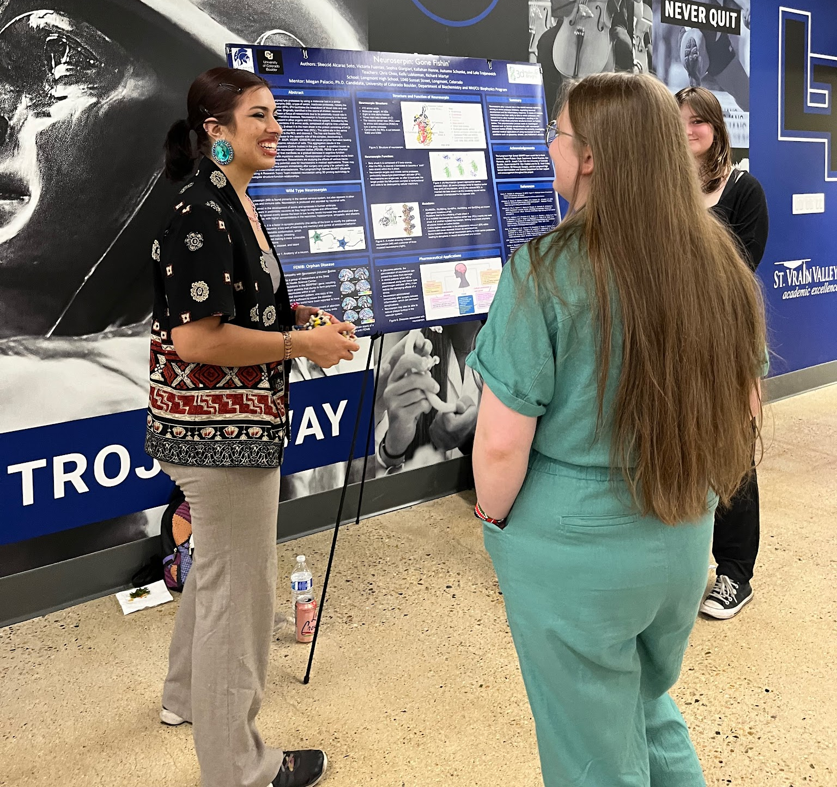

Slide 43
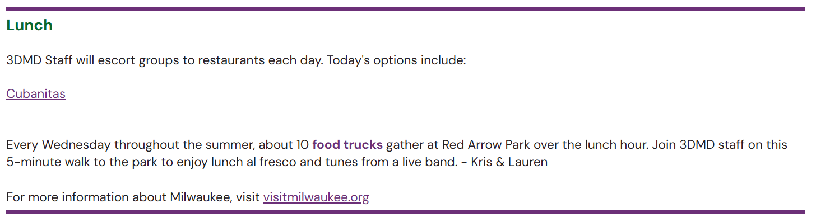
Food Truck Wednesday

Slide 44
Lunch Options
15 Minute Drive North
Chain Fast Food Options
15 Minute Walk West / 3 Minute Drive
Sonic & 7-Eleven
6 Minute Drive East
Local & Chain Fast /Counter Service
15 Minute Walk South / 3 Minute Drive
Local Counter Service

Slide 45
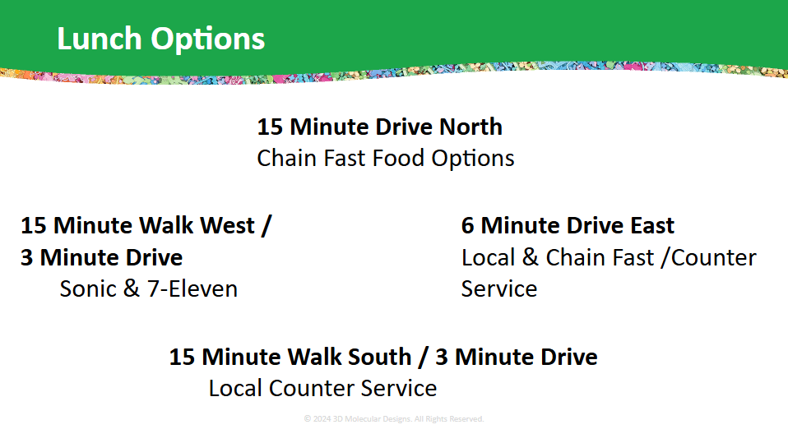


Slide 46


Slide 47
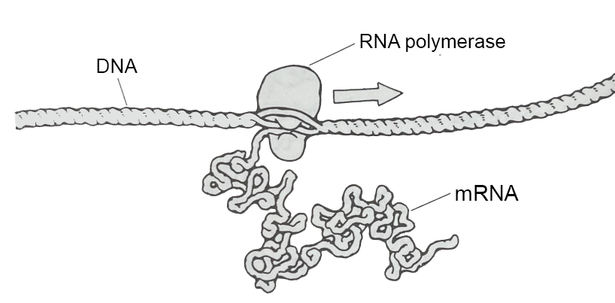
The Cellular Landscapes of David Goodsell
Tim Herman
3D Molecular Designs

Slide 48
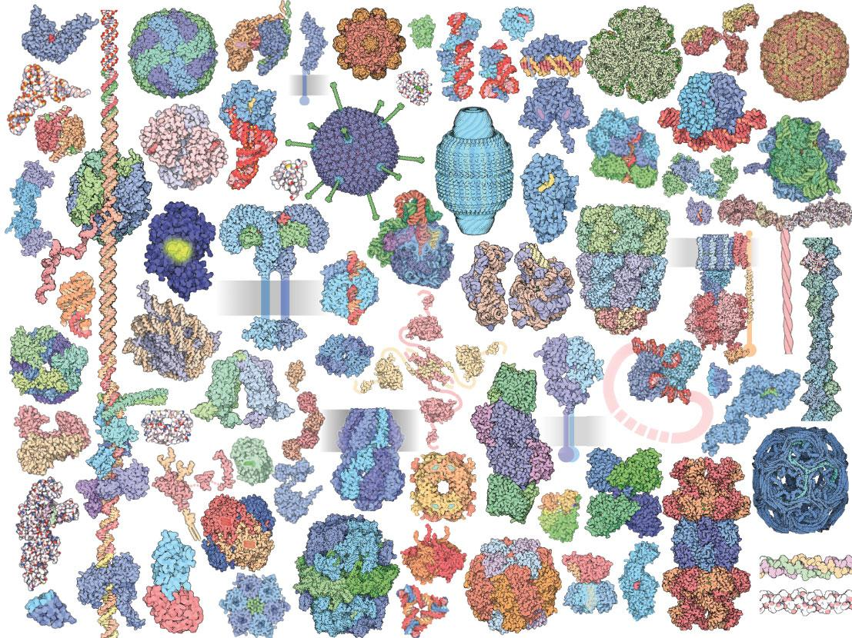

Slide 49
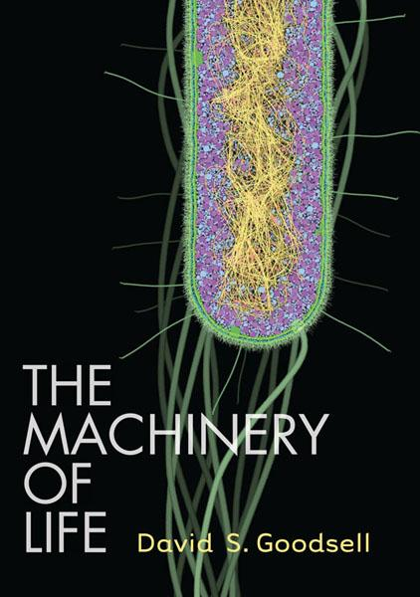
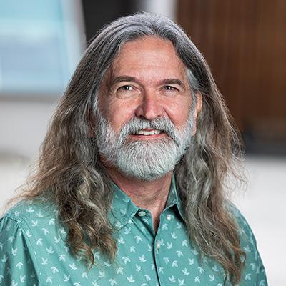
David Goodsell
Scripps Research institute
Scientist… Author… and Artist of all things small.

Slide 50
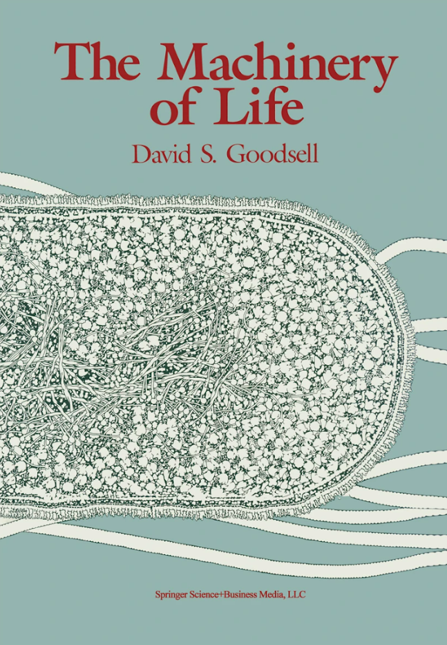
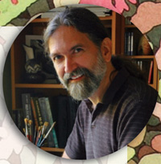
Imagine that we had some way to look directly at the molecules in our bodies…
1993

Slide 51
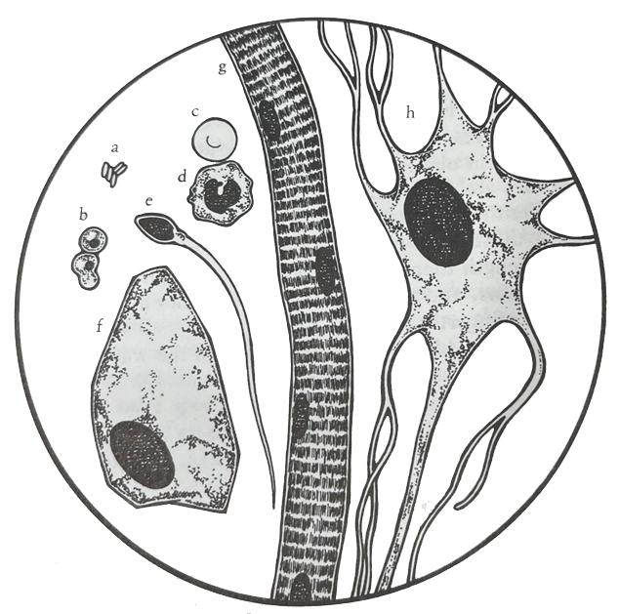
Red Blood Cell
Cells…
Neuron
Lymphocyte
1,000 X magnification
Bacteria
Sperm Cell
Yeast Cell
Human Skin Cell
Striated Muscle Cell

Slide 52

Bacteria,…
and Viruses
100,000 X magnification

Slide 53

Molecules…
1,000,000 X magnification

Slide 55


Slide 56




Slide 57


Tour of a Human Cell
An electron micrograph of an antibody-producing B-cell
Your flu/COVID-19 shot… in action.

Slide 58
Tour of a Human Cell
Create sticky note “arrows” to label these items on your poster.
Basic Features:
Bonus Features: **Advanced Level
Cell membrane
Nucleus
Ribosomes
Nuclear membrane
Nuclear pore
Endoplasmic reticulum
Golgi apparatus
Cytoskeleton
Vesicles
DNA
mRNA
Proteins
Identify different processes occurring within the cell
Different types of cytoskeleton
RNA polymerase
Transcription factors
Promoter
5’ cap of RNA, 3’ polyadenylation signal
Proteasome
Nucleosomes
Kinesins (motor proteins)
Clathrin

Slide 59


Slide 60



Slide 61


Learning the Landscape
Find the membranes.
What do you notice about the membranes?
What features or shapes do you think you recognize?

Slide 62

Alien Landing….!

Slide 63


Slide 64
BAMBED … Biochemistry and Molecular Biology Education
Article
Miniseries: Illustrating the Machinery of Life
Eukaryotic Cell Panorama
Received for publication, October 7, 2010, and in revised form, December 13, 2010
David S. Goodsell‡
From the Department of Molecular Biology, The Scripps Research Institute, La Jolla, CA 92102
Diverse biological data may be used to create illustrations of molecules in their cellular context. This report describes the scientific results that support an illustration of a eukaryotic cell, enlarged by one million times to show the distribution and arrangement of macromolecules. The panoramic cross section includes eight panels that extend from the nucleus to the cell surface, showing the process of protein synthesis and export. Results from biochemistry, electron microscopy, NMR spectroscopy and x-ray crystallography were used to create the image.

Slide 65


Slide 66


Slide 67


Slide 68


Slide 69


Slide 70


Slide 71


Slide 72


Slide 73


Slide 74


Slide 75


Slide 76


Slide 77


Slide 78

E. coli
Mitochondrion

Slide 79


Slide 80


Slide 81

Reflection
What is something new that you learned through studying the Goodsell images this morning?
What questions do you have after exploring molecular landscapes?

Slide 82

Computer Visualizations
Mark Hoelzer

Slide 83


3D Modeling with Master Mark

Slide 85



Modeling Sandbox Time

Slide 86
Anthrax Toxin
Tim Herman

Slide 87

Anthrax Pathogenesis
A story about…
A bacterial toxin
Bioterrorism and…
The CBM’s first SMART Team

Slide 88


Anthrax Pathogenesis…2001
A story of bioterrorism and the CBM’s first SMART Team

Slide 89



The first SMART Team… modeling Anthrax Pathogenesis (2001)
Bacillus anthracis produces an AB toxin composed of three proteins
Protective Antigen
Protective Antigen
Edema Factor
Lethal Factor

Slide 90
Storming the Castle,… an exercise in critical thinking
How does the anthrax toxin get into our cells and kill you?
Bacillus anthracis – hereafter known as Anthrax – produces 3 toxin proteins… Protective Antigen (PA), Lethal Factor(LF) and Edema Factor(EF).
PA is known to be necessary for either LF or EF to enter a cell:
If you inject Protective Antigen (PA) into a mouse – it has no effect.
If you inject Lethal Factor (LF) into a mouse – it has no effect.
If you inject a mixture of PA and LF into a mouse – the mouse dies.
A similar result is seen with PA and EF. The injection of either PA or EF alone has no effect. Injection of a mixture of PA and EF results in a dead mouse.
THE CHALLENGE: Consult with your group and suggest a molecular mechanism whereby these 3 proteins (PA, LF and EF) interact with each other to enter your cells…
… and lead to your demise.

Slide 91


2005

Slide 92

2002

Slide 93

2002

Slide 94


2 8 MAY 2 0 1 5 | VO L 5 2 1 | N AT U R E | 5 4 5

Slide 95


2020

Slide 96

The Anthrax Protective Antigen heptamer….following receptor-mediated endocytosis… and acidification of the endosome.
The 14-stranded beta-barrel forms a tube through which the unfolded Lethal Factor is transported across the cell membrane.

Slide 97


Slide 98



Slide 99


Slide 100


Slide 101

Models give meaning to words…
Until you have models,… molecular visualization software (Jmol) is the next-best thing.
The Protein Exploratorium
Hemolysin

Slide 102
Connecting the dots….
Other Protein Translocation/ Injection Systems
Bacteriophages delivering phage DNA into cells (Friday)
Injectisomes June 2024 MOTM
Salmonella bacteria invade our cells and reproduce inside, causing life-threatening diseases like typhoid fever. As part of their pathogenic strategy, these bacteria inject several dozen types of effector proteins using a molecular needle called the injectisome.
Contractile Injection Systems introducing proteins into cells
See Feng Zhang at MIT

Slide 103

Unfolded effector protein
June, 2024

Slide 104

Nature | Vol 616 | 13 April 2023 | 357

Slide 105
The first paragraph of Kreitz et.al.….
For endosymbiotic bacteria, it is often advantageous to secrete factors that modulate host biology in favour of symbiont fitness4. However, many such factors cannot readily pass through cellular membranes; this has led to the development of intricate systems that actively deliver payload proteins into cells. One example is the contractile injection systems (CISs), a class of syringe-like nanomachines resembling bacteriophage tails.

Slide 106

Model for protein delivery via reprogrammed CISs
Contractile
Injection
System

Slide 107

Digging deeper…
while avoiding rabbit holes…
….and knowing when to stop.

Slide 108
There are things we know…
As we think deeply about what we know, we will begin to ask questions about things we don’t know
There are things we don’t know…
There are two kinds of things we don’t know:
There are things we know we don’t know.
There are things we don’t know we don’t know
A teacher’s role is to encourage students to think deeply about what they know … and identify what they don’t know.

Slide 109
Teachers should model for students….
  The joy of discovering something you didn’t know
  The joy of discovering something you didn’t even know you didn’t know.
This discovery happens when you…
slow down, focus, think deeply…
and begin to ask questions.

Slide 111


Let’s Play!
Notes:
The activity I am using in Dallas is here: https://drive.google.com/file/d/15TekwUTHFU3q-Ef3HwEyVmPAPQqfA9Fv/view?usp=drive_link

Slide 112
Reflection
What is one misconception you had about proteins or that was addressed through your interactions with molecular stories this week?
What are some ways in which you would like to incorporate more protein stories in your classroom?

Slide 113
Digital Modeling Hub Resources
Search the DMH and explore the resources for a Kit or Model
New Resources
Hemoglobin Mighty Model
Molecules of Life Kit
Cell Modeling Kit
Alpha Helix & Beta Sheets
T4 Bacteriophage Model
Mosaic Membrane Model
Acetylcholinesterase Model
Classic Resources
Water Kit
Amino Acid Starter Kit
Phospholipid & Membrane
Transport Kit
Enzymes in Action Kit

Slide 114

End of Day Survey

Slide 115

Optional Activities
3:45 Tour of 3DMD’s Production Labs
Safety First!
Foam Roller Press & Kitting
Injection Molding
3D Print Lab
4:30 Snack Break
4:45 Cell Modeling Kit Exploration
& Other Modeling Infection & Immunity materials

