Slide 2
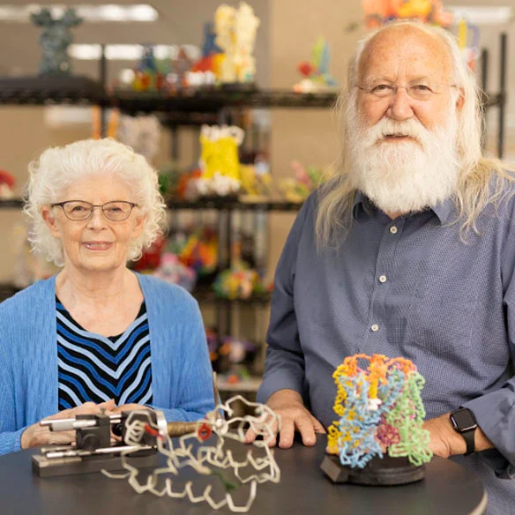
Welcome to the Family!
20% Lifetime Discount
Welcome to attend
Modeling the Molecular World free of charge

Slide 3
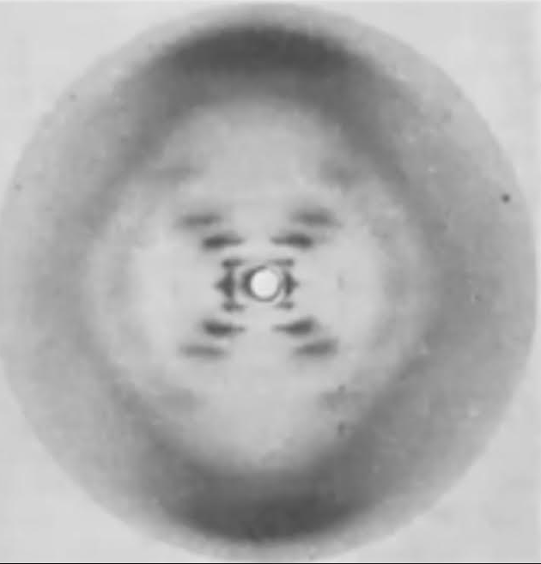
Photo 51
Using DATA to justify models of DNA.

Slide 4
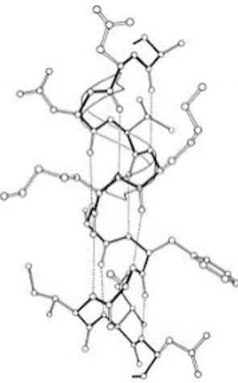
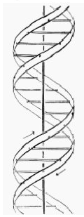
Pauling/Corey Alpha Helix
Watson/Crick
Double Helix

Slide 5
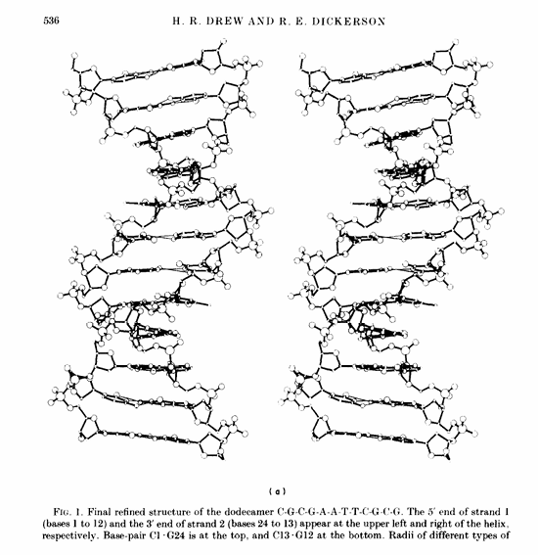
1981
Confirmation

Slide 6
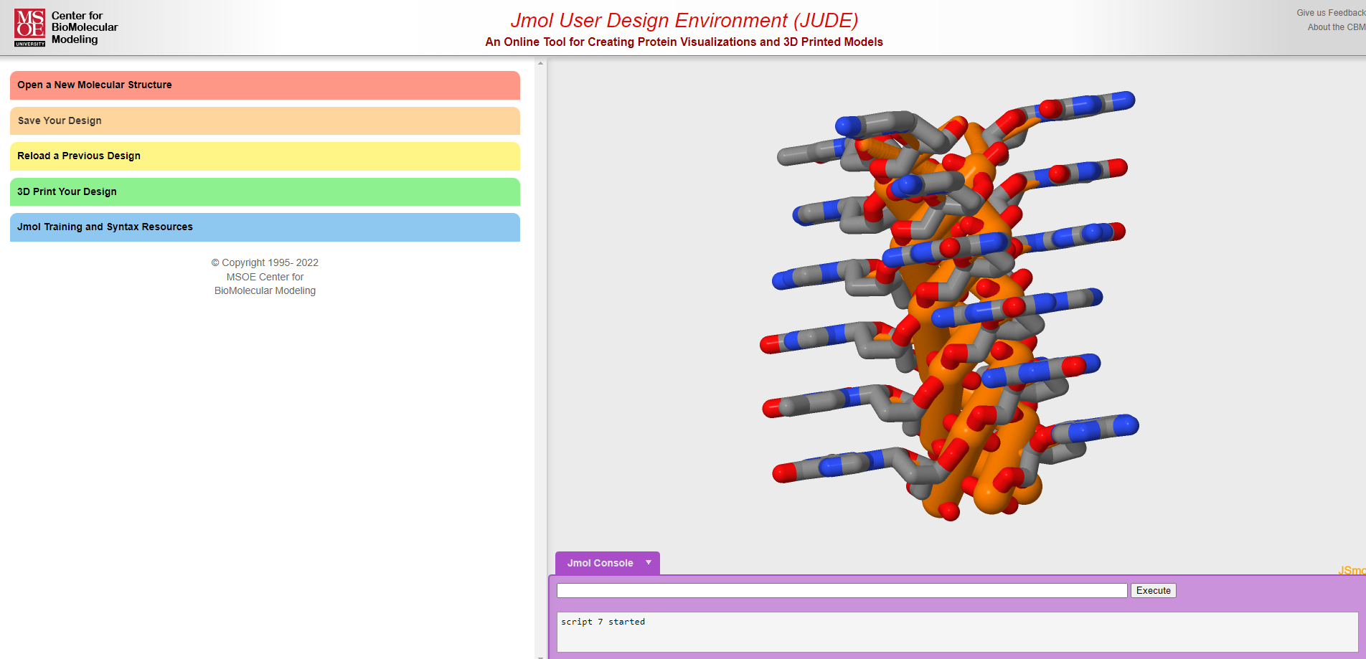
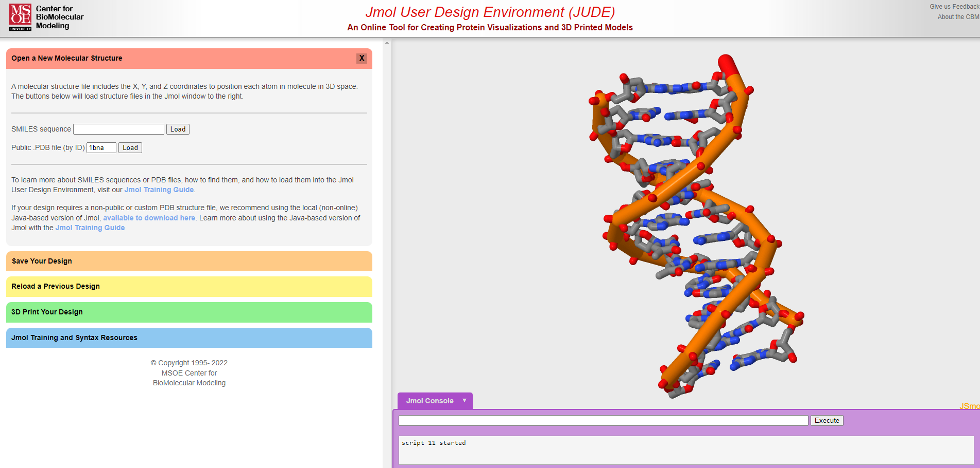

Slide 7
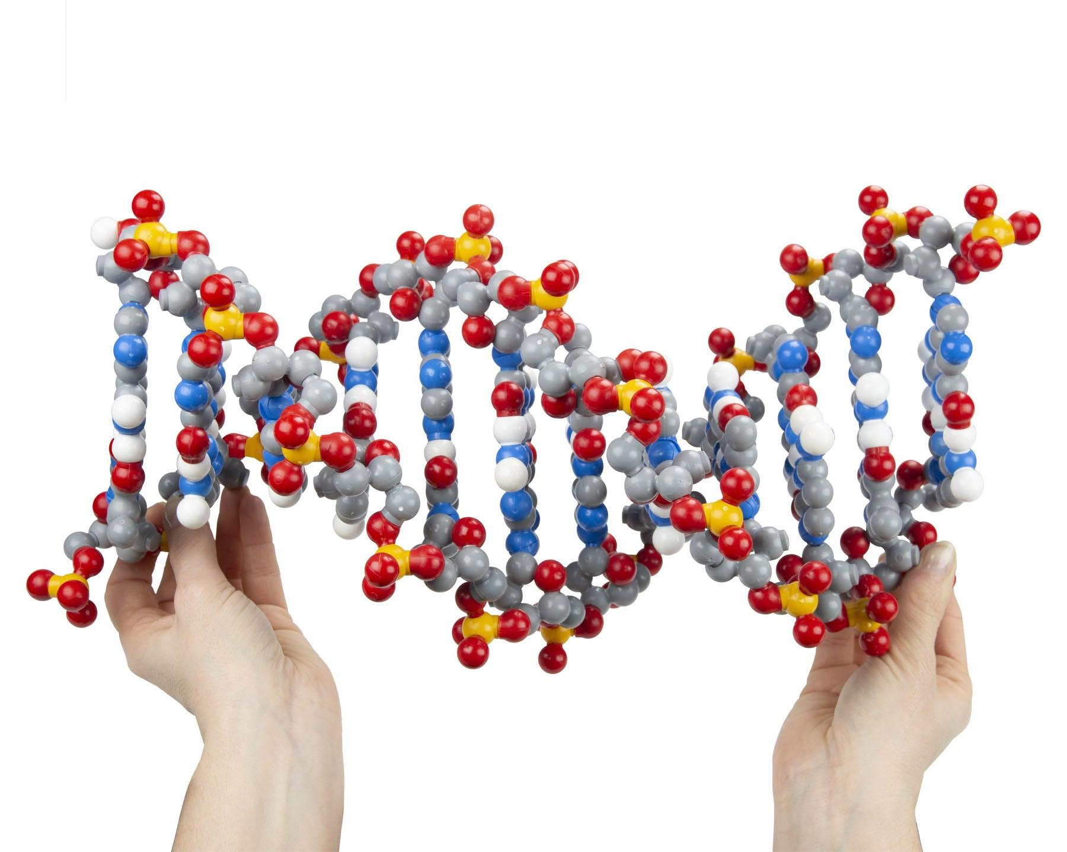
Ladders of Life
Dynamic DNA and Tactile DNA
“The greatest history book ever written is the one hidden in our DNA."
Spencer Wells

Slide 8
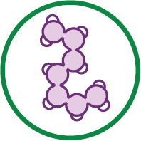
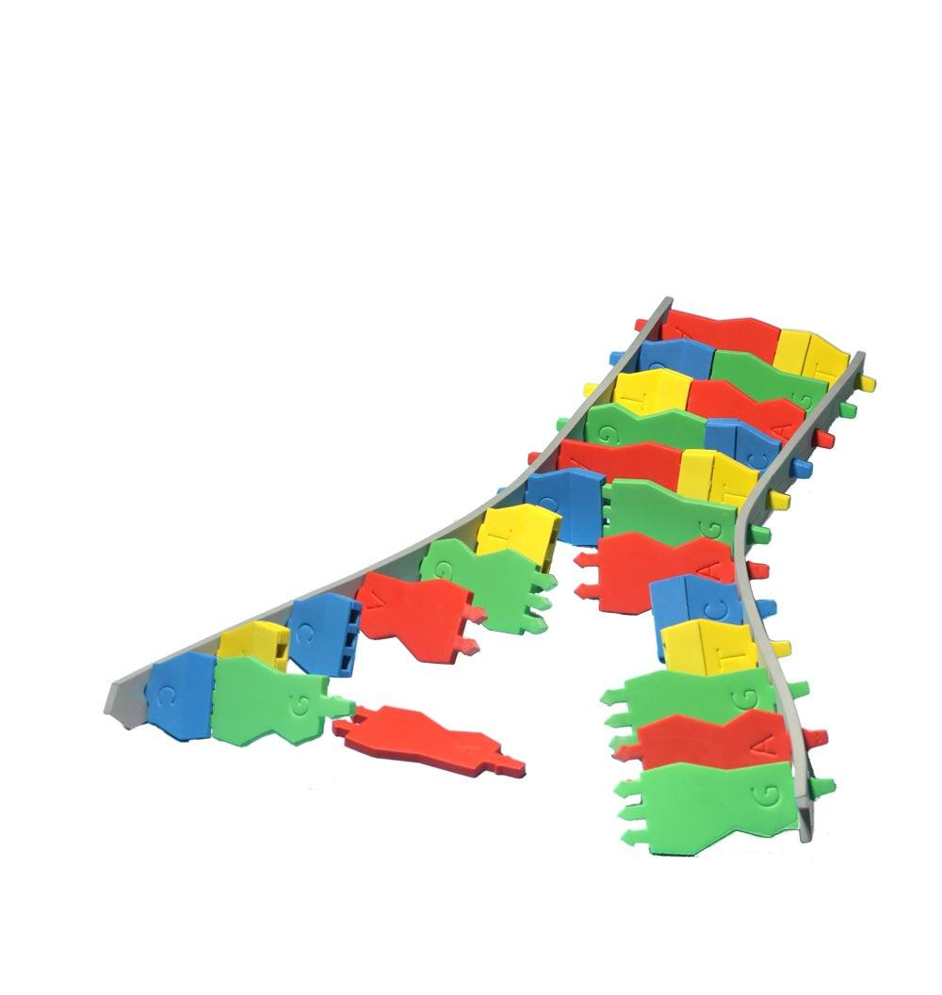
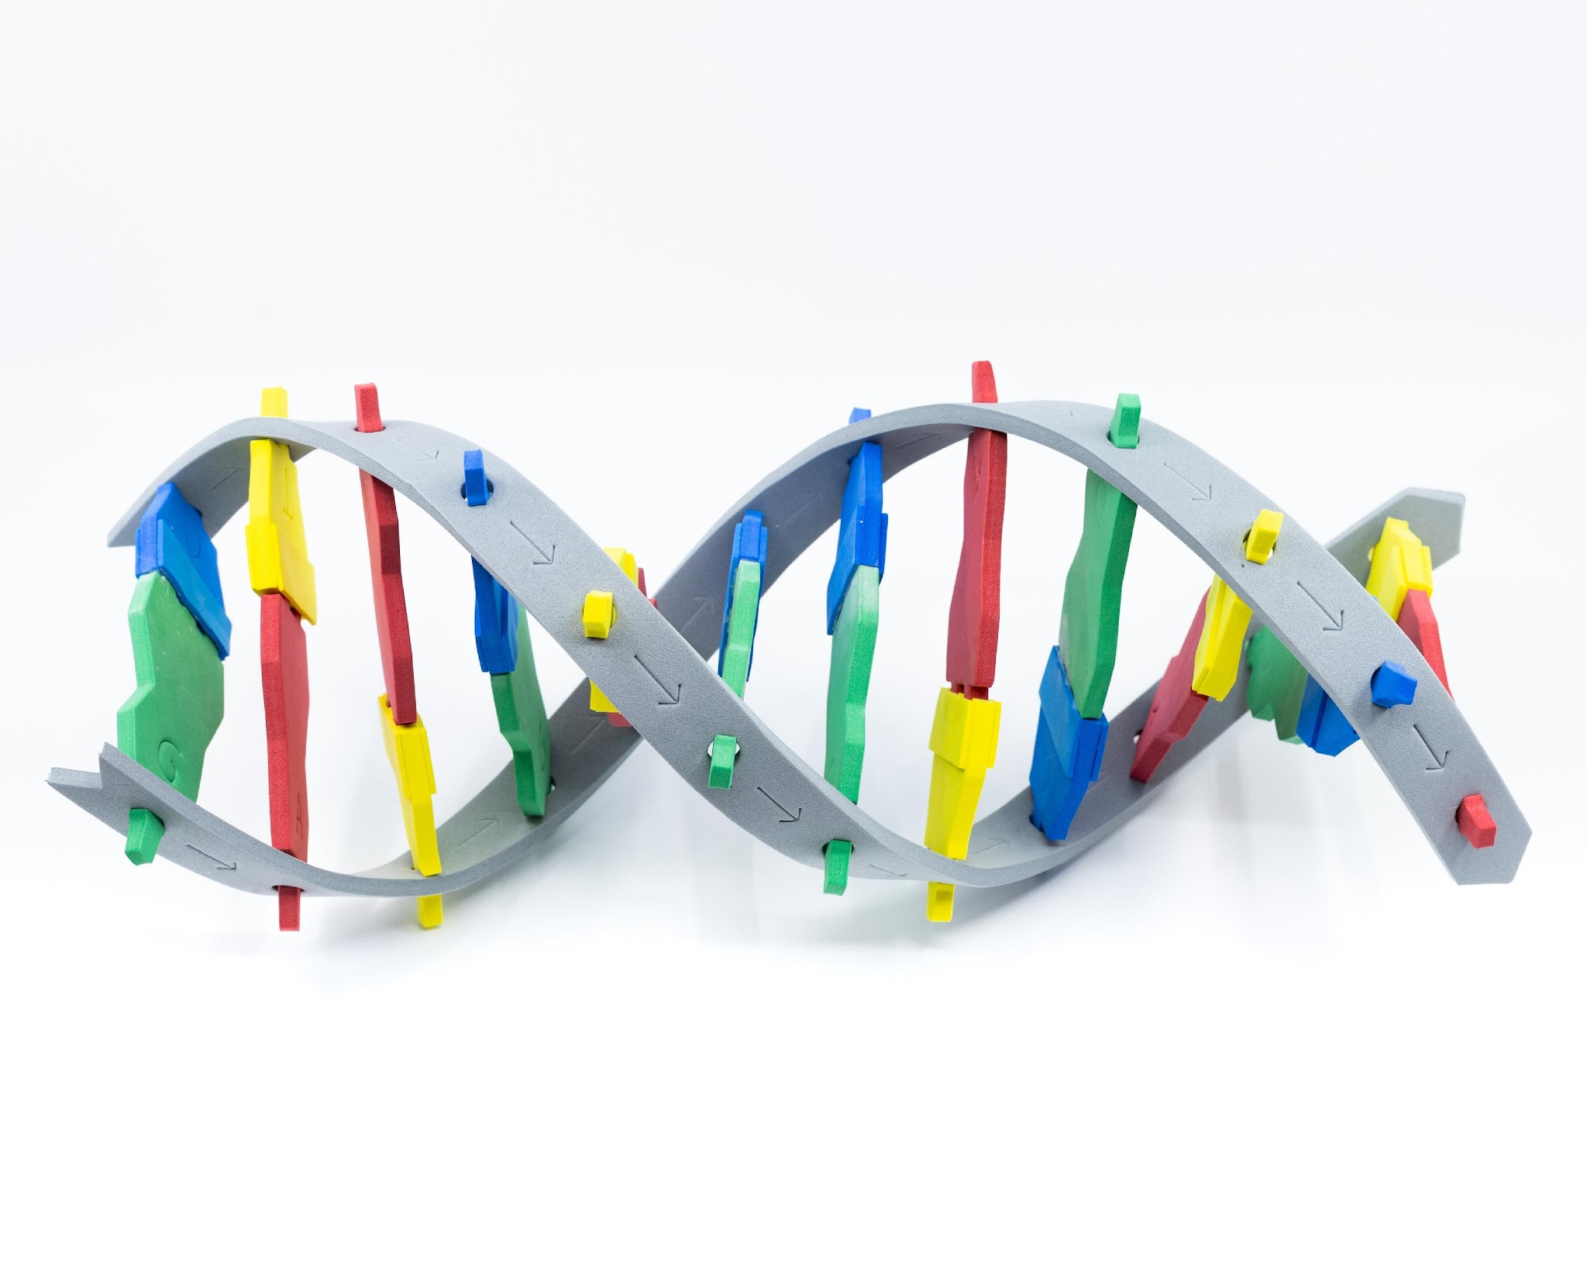
DNA Starter kit
Notes:
Lots to discuss: Grey backbone represents alternating phosphate and sugar, notice the arrows! DNA is directional - 5’ to 3’!
A bonds to T, C bonds to G. Purines and pyrimidines. Number of hydrogen bonds between base pairs.

Slide 9
DNA Starter kit
Notes:
Lots to discuss: Grey backbone represents alternating phosphate and sugar, notice the arrows! DNA is directional - 5’ to 3’!
A bonds to T, C bonds to G. Purines and pyrimidines. Number of hydrogen bonds between base pairs.

Slide 10
DNA Starter kit
Notice | Wonder

Slide 11

Discussion and clarifications
What does this model do well?
What are some limitations?
Notes:
TP

Slide 12
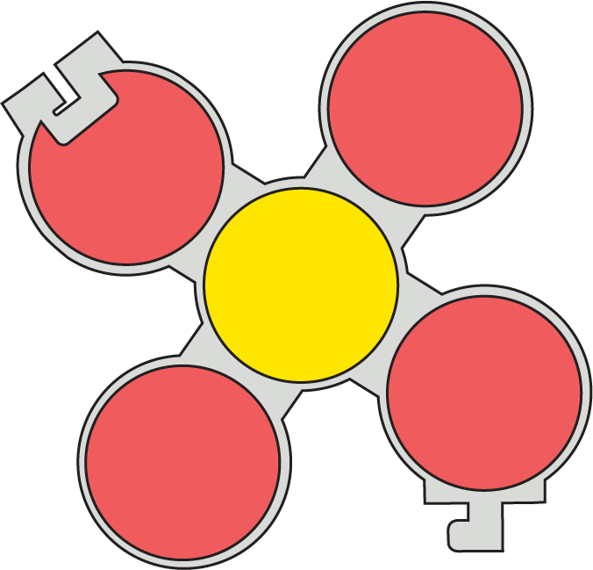
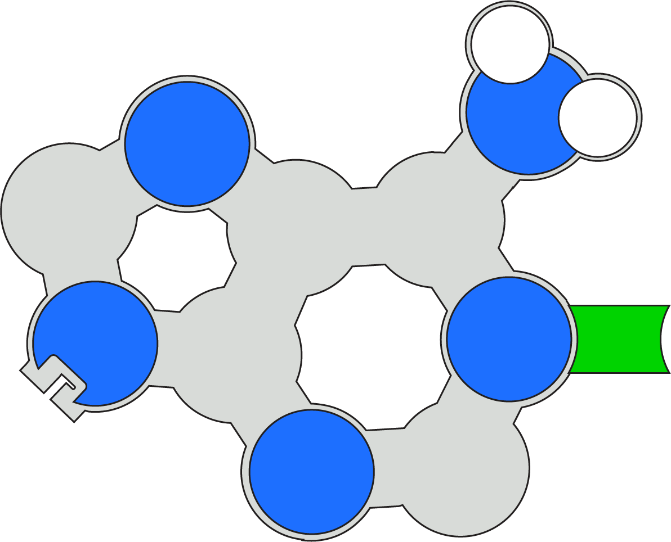
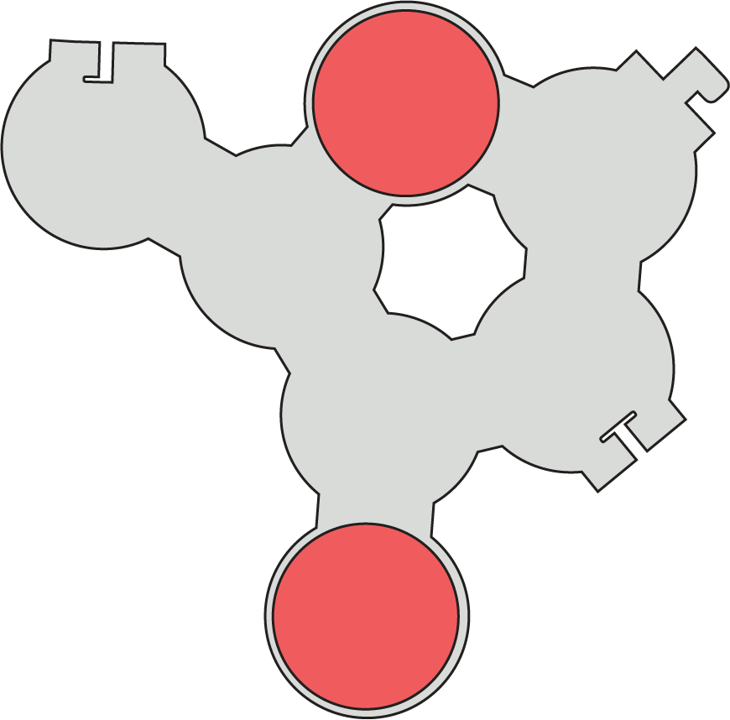
Model a Nucleotide

Slide 13
Base Pairing
DO: Use your nucleotides create two base pairs with the nucleotides at your group
EVALUATE: What are some strengths and limitations of this model?

Slide 14
Discussion and clarifications
What does this model do well?
What are some limitations?
Notes:
TP

Slide 15
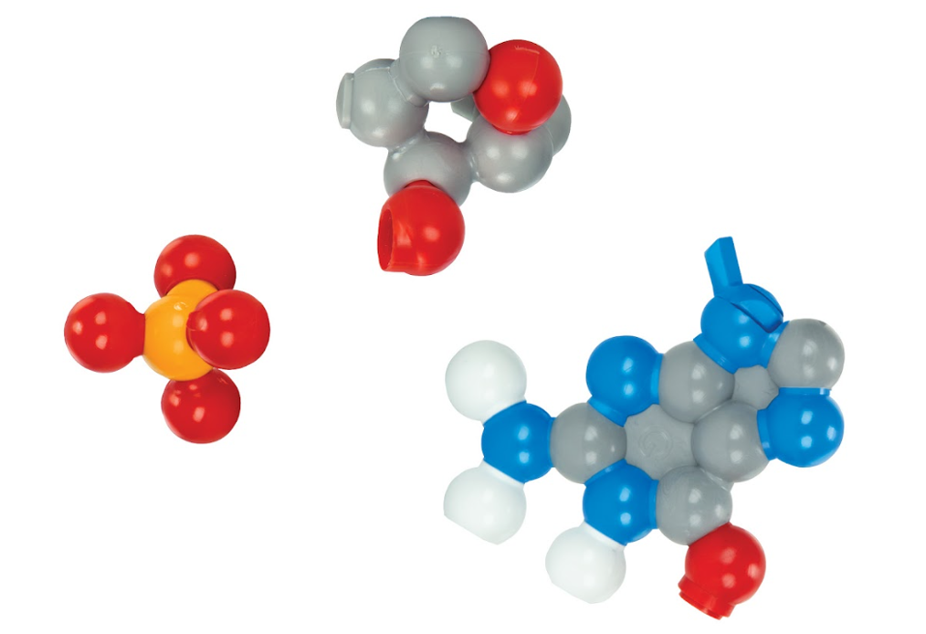
Model a Nucleotide
Using the information from the Tactile DNA model assemble a nucleotide of Dynamic DNA

Slide 16
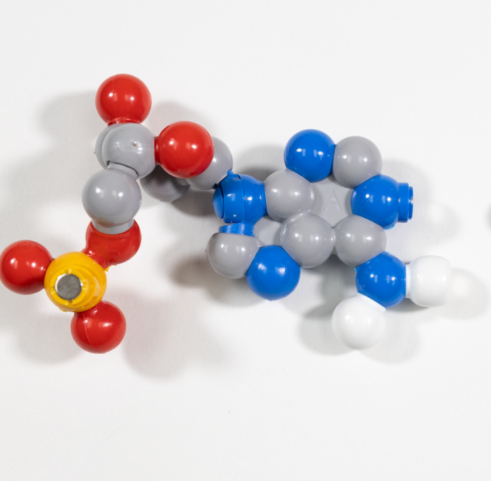
Base Pairing
DO: Use your nucleotides create two base pairs with the nucleotides at your group
EVALUATE: What are some strengths and limitations of this model?

Slide 17
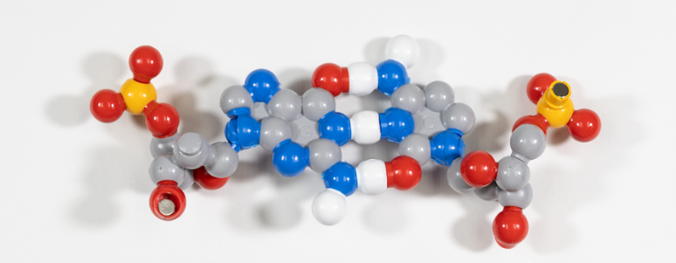
Base Pairs…Assemble!
Assemble your base pairs!
Notes:
Assemble base pairs and then into the full molecular structure (ladder or helix)
Major and minor groove, thinking about chemical properties of backbone and extending to chemical properties of transcription factors
Antiparallel strands
Location of basepairs
Bond strength

Slide 18
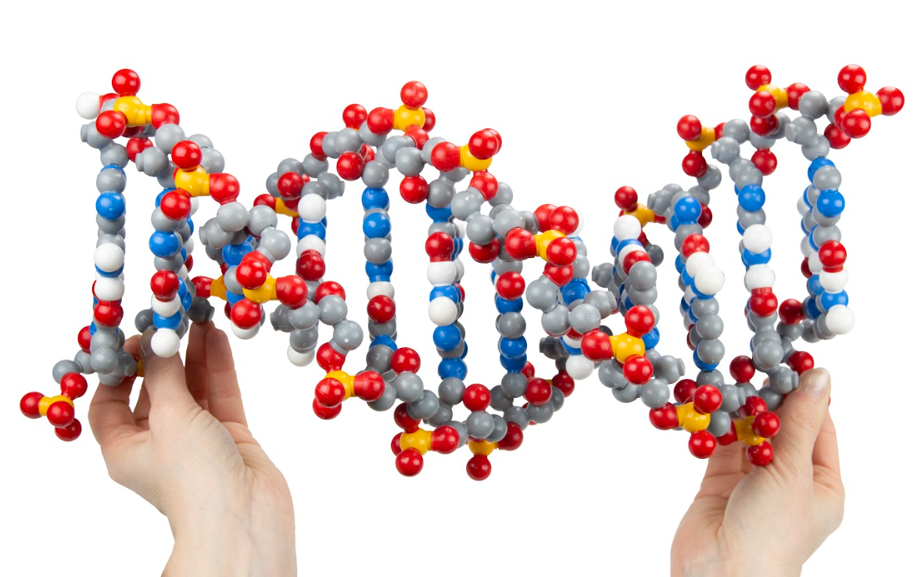
Extensions
Using the additional pieces how might we modify or extend this model?

Slide 19
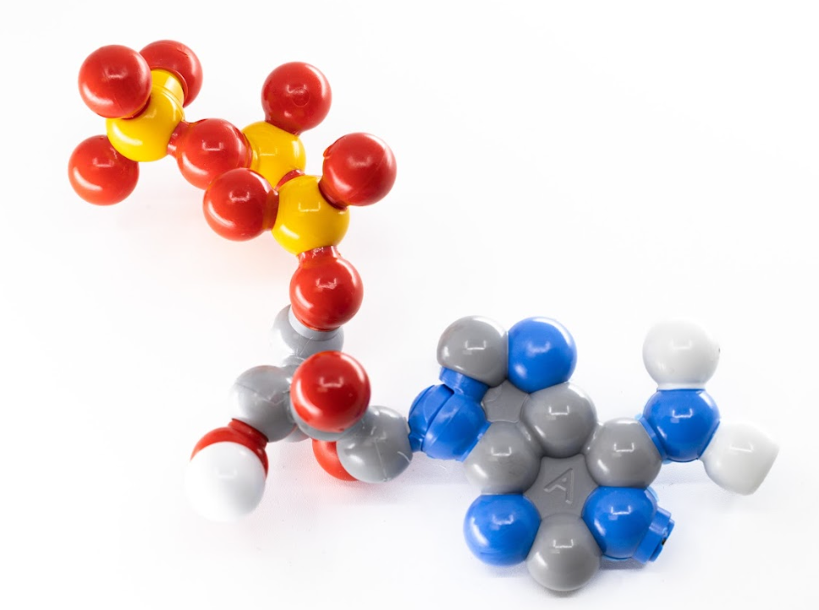
Extensions
Oh the places you will go!
ATP
RNA
Replication
Methylation

Slide 20
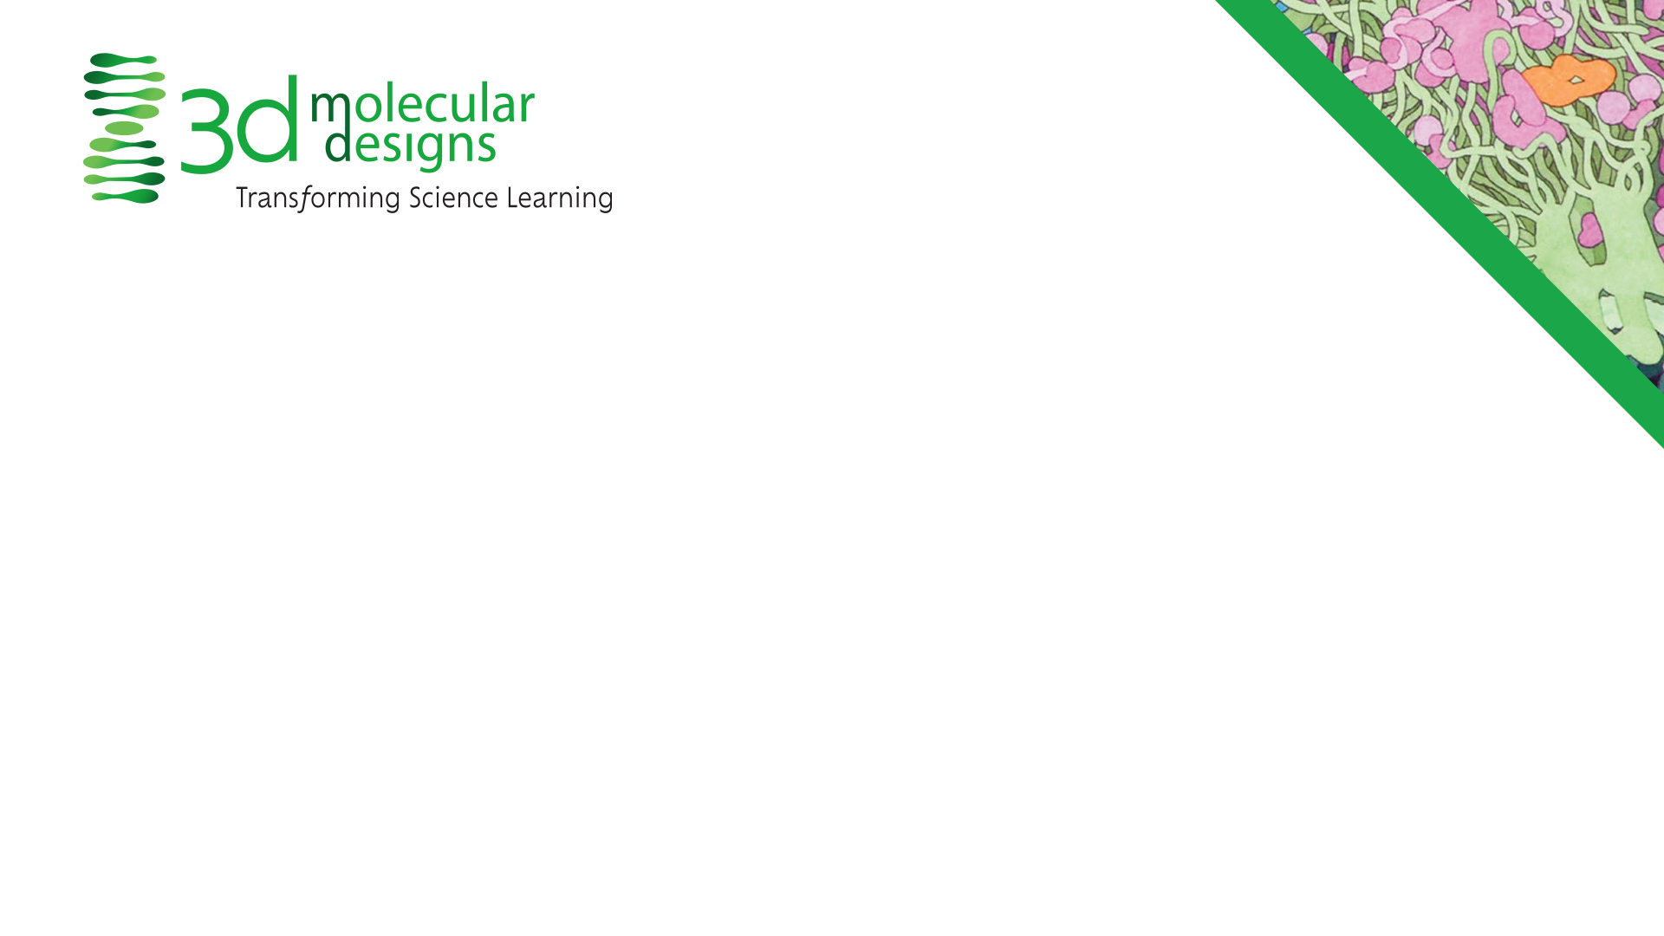
Conclusion Slide
Tactile DNA & Dynamic DNA
  DNA is made out of nucleotides
  Nucleotides form base pairs
  The chemical structure of base pairs create the double helical structure

Slide 22
Reflection
How might you use this in your practice?
What topics or content could you connect using these models?
What teaching strategies might you use with these models?
What other models might you connect to?

Slide 23
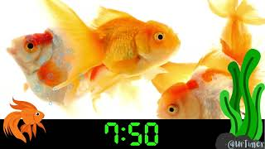

Slide 24
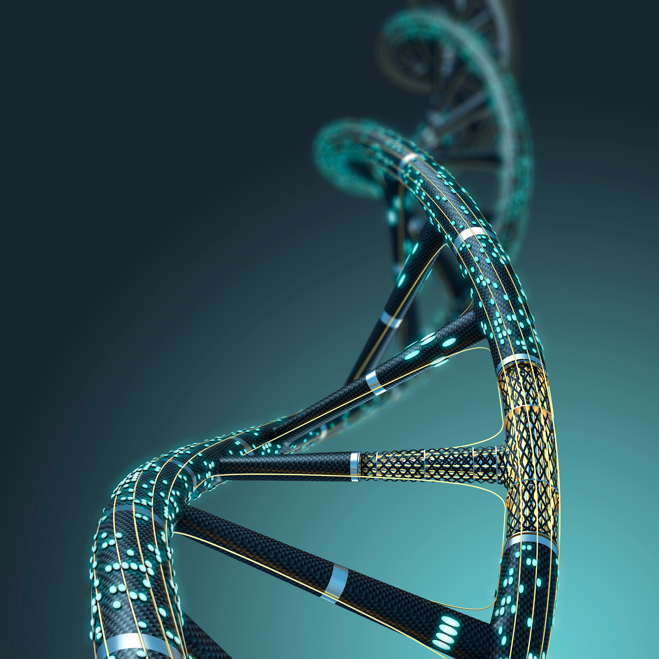
Why T?
"Genes are like the story, and DNA is the language that story is written in."
Sam Kean

Slide 25
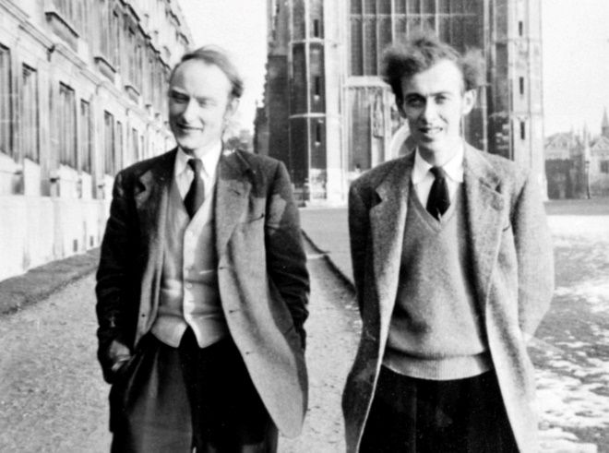
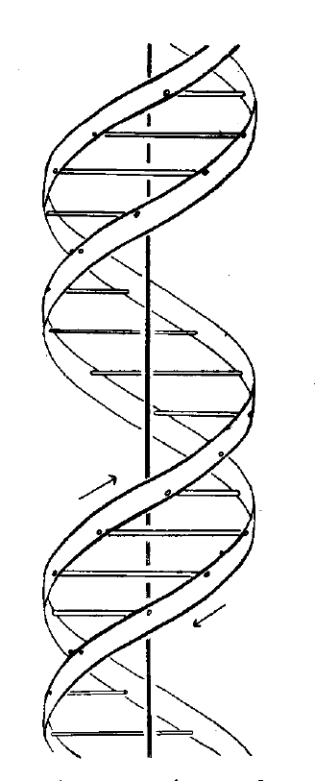
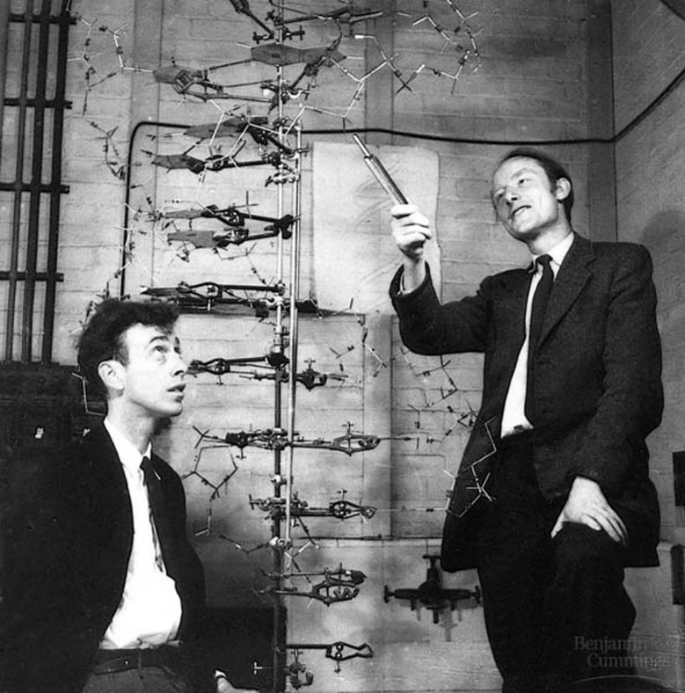
For the first generation of “molecular biologists”, life began in 1953…with these guys…
Francis Crick and James Watson
“It has not escaped our notice that the specific pairing we have postulated immediately suggests a possible copying mechanism for the genetic material”

Slide 26
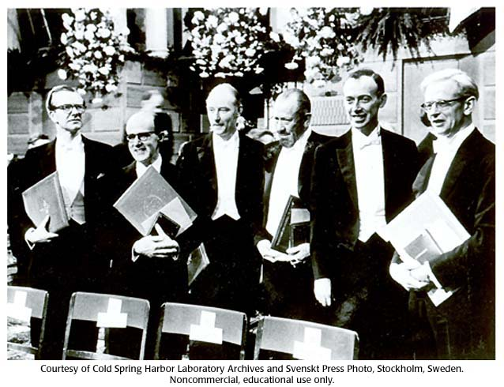
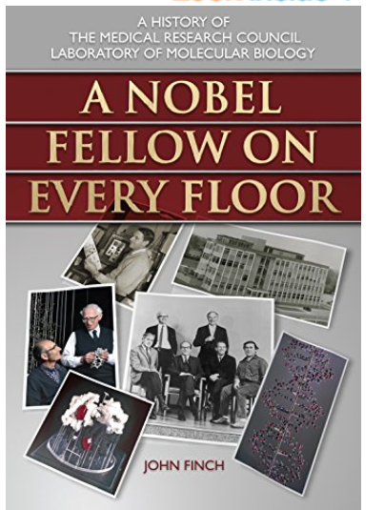
1962 was a very good year…. for the MRC Laboratory of Molecular Biology

Slide 27
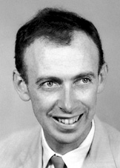
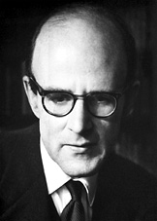
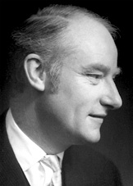
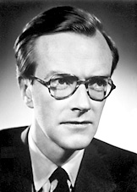
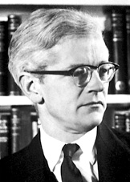
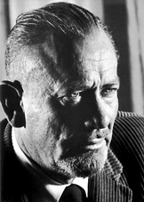
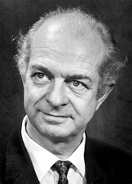
The 1962 Nobel Prizes…
…in Chemistry – Max Perutz and John Kendrew
"for their studies of the structures of globular proteins“
…in Physiology or Medicine – Francis Crick, James Watson and
Maurice Wilkins
"for their discoveries concerning the molecular structure of nucleic acids and its significance for information transfer in living material“
in Literature – John Steinbeck
"for his realistic and imaginative writings, combining as they do sympathetic humour and keen social perception“
The Nobel Peace Prize – Linus Pauling

Slide 28
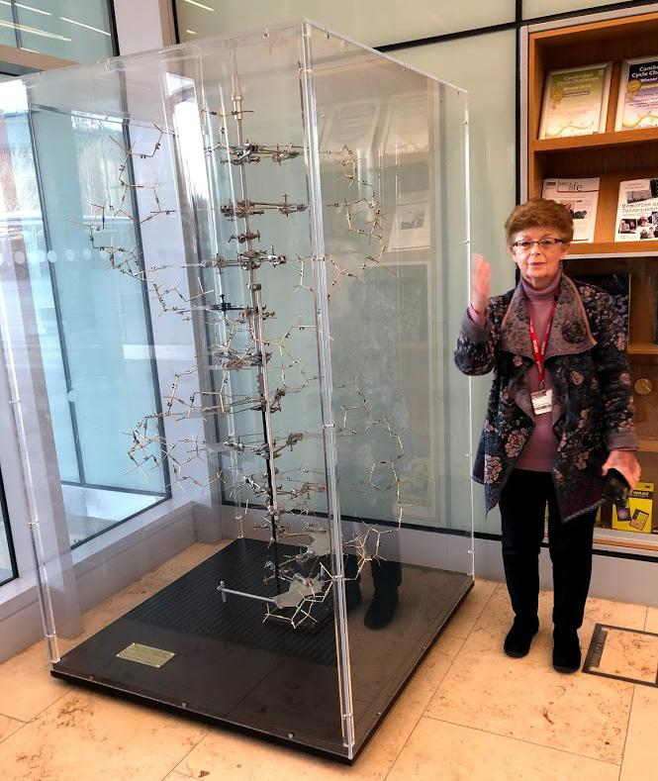
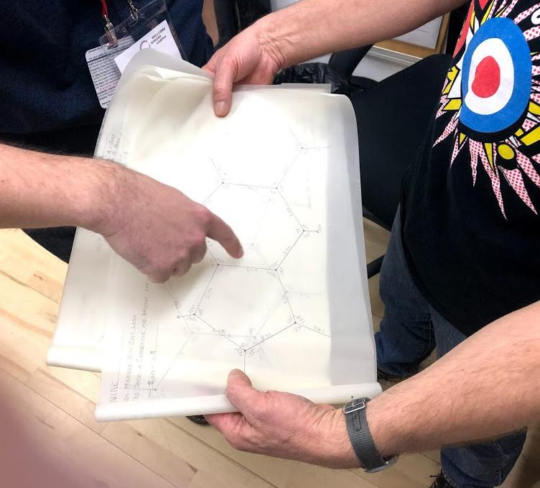
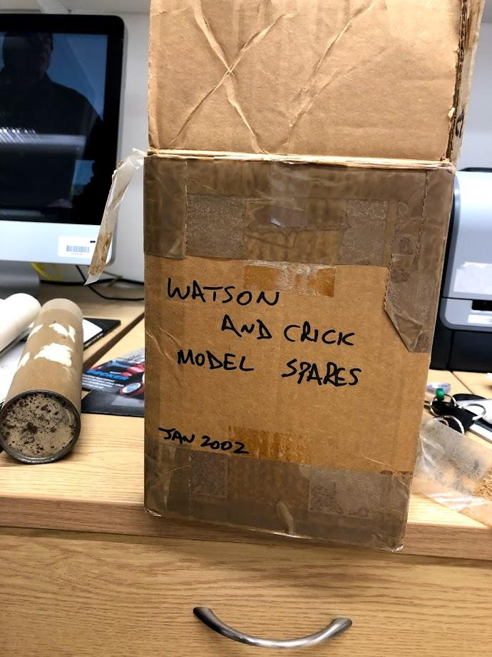
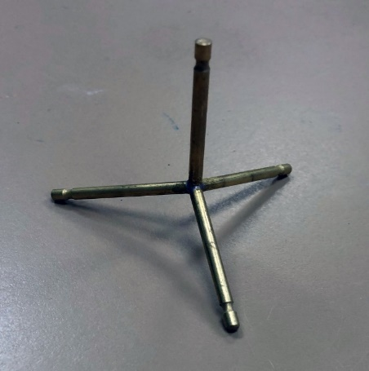
…at the LMB

Slide 29
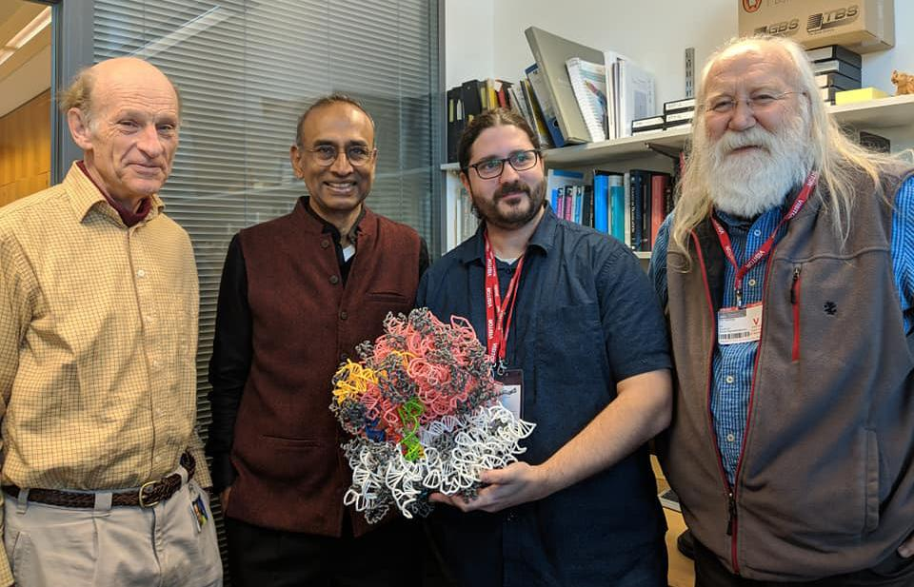
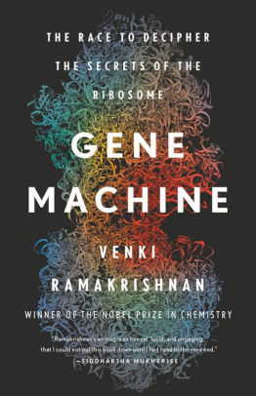
Mark with another reMARKable model. And oh yes, that’s Venki Ramakrishnan standing next to him.

Slide 30
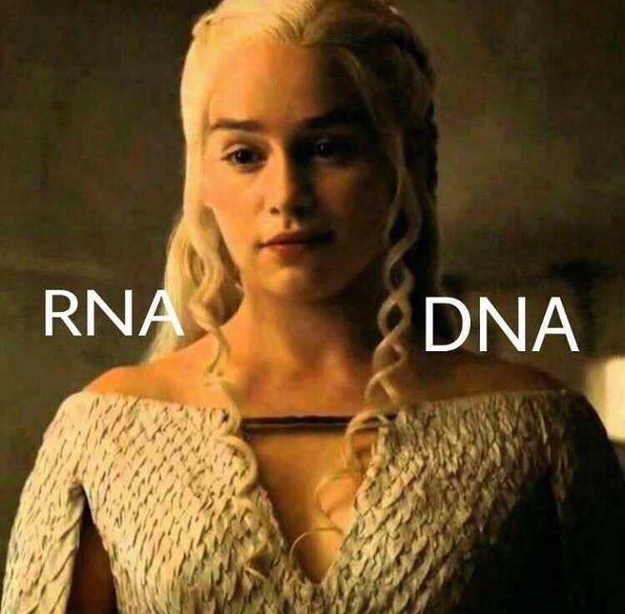
Teaching your kids to think…
As you reflect on your teaching, you may notice that you ask your students a lot of ”what” questions like:
What is the difference between DNA and RNA?
RNA has U’s and DNA has T’s
DNA has deoxyribose; RNA has ribose
RNA is single-stranded; DNA is double-stranded

Slide 31
Let’s think about teaching the “why” of these subjects, such as:
Why does T replace U in DNA?

Slide 32
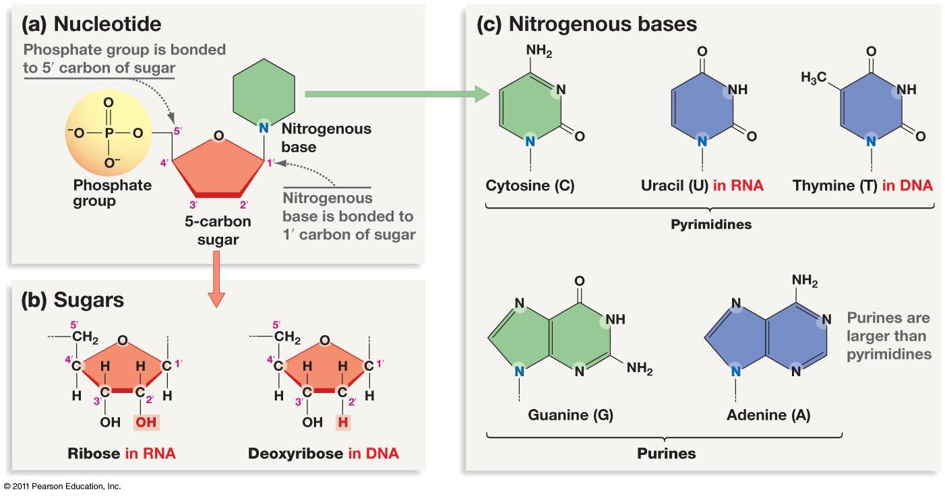

Slide 33
WHY…did T replace U in DNA?
spontaneous oxidative deamination of C
…if we had not switched…
AGUCGAAGUCAACCGAGGCUGCGCUAC
UCAGCUUCAGUUGGCUCCGACGCGAUG
U
AGUCGAAGU AACCGAGGCUGCGCUAC
x
UCAGCUUCA UUGGCUCCGACGCGAUG
G
A DNA repair system can remove “U” from DNA.
But,…how can we distinguish between a
“deaminated C” and a normal U?
ANSWER: We can’t.

Slide 34
WHY…did T replace U in DNA?
…but after we switched…
spontaneous oxidative deamination of C
AGTCGAAGTCAACCGAGGCTGCGCTAC
TCAGCTTCAGTTGGCTCCGACGCGATG
U
AGTCGAAGT AACCGAGGCTGCGCTAC
x
TCAGCTTCA TTGGCTCCGACGCGATG
G
Uracil glycosidase constantly scans the DNA…looking for U’s.
Any U is a bad U… and should be repaired.

Slide 35
Let’s think about teaching the “why” of these subjects, such as:
Why does T replace U in DNA?
Why is RNA single-stranded?
….but wait, RNA is not single-stranded…

Slide 36
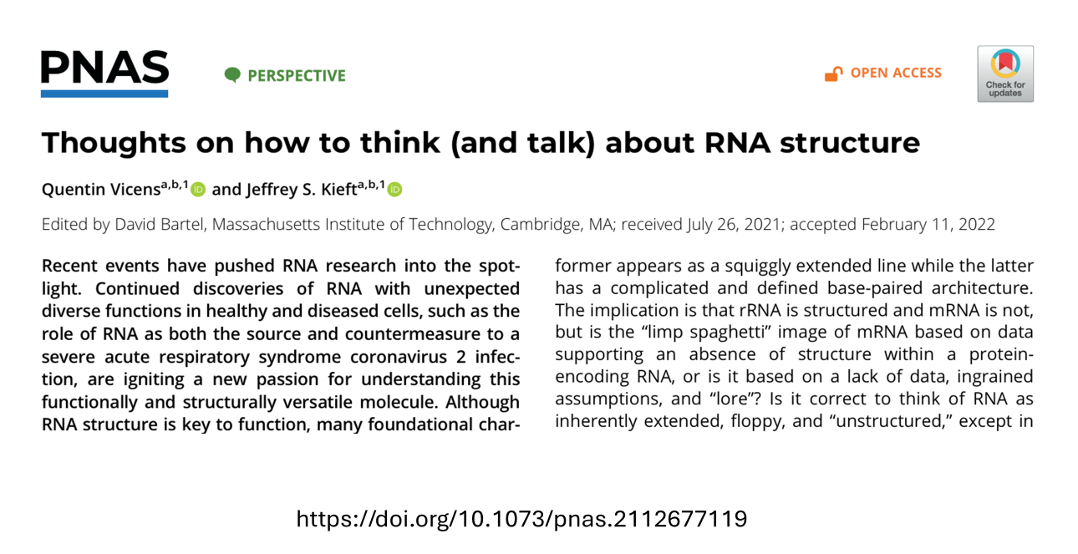

Slide 37
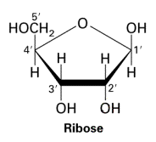
O
O
3 –OH groups on deoxyribose
O
O
H
Deoxyribose

Slide 38
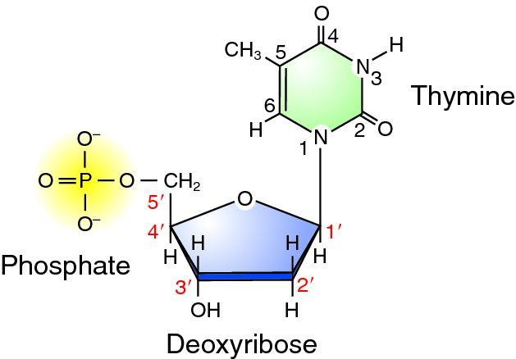
0 –OH groups on deoxyribose in DNA
The 2’ –OH group in RNA affords additional H-bonding opportunities

Slide 39
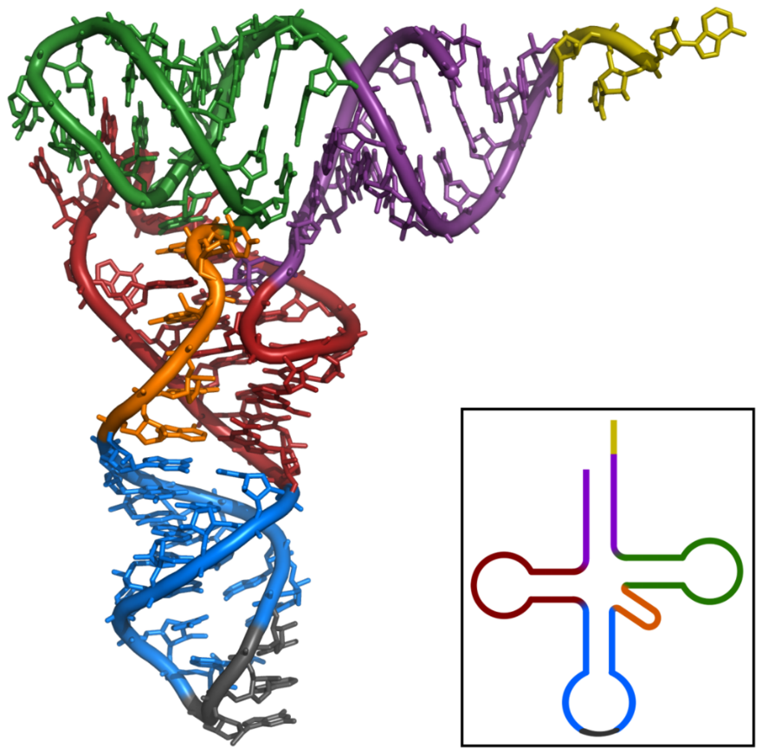
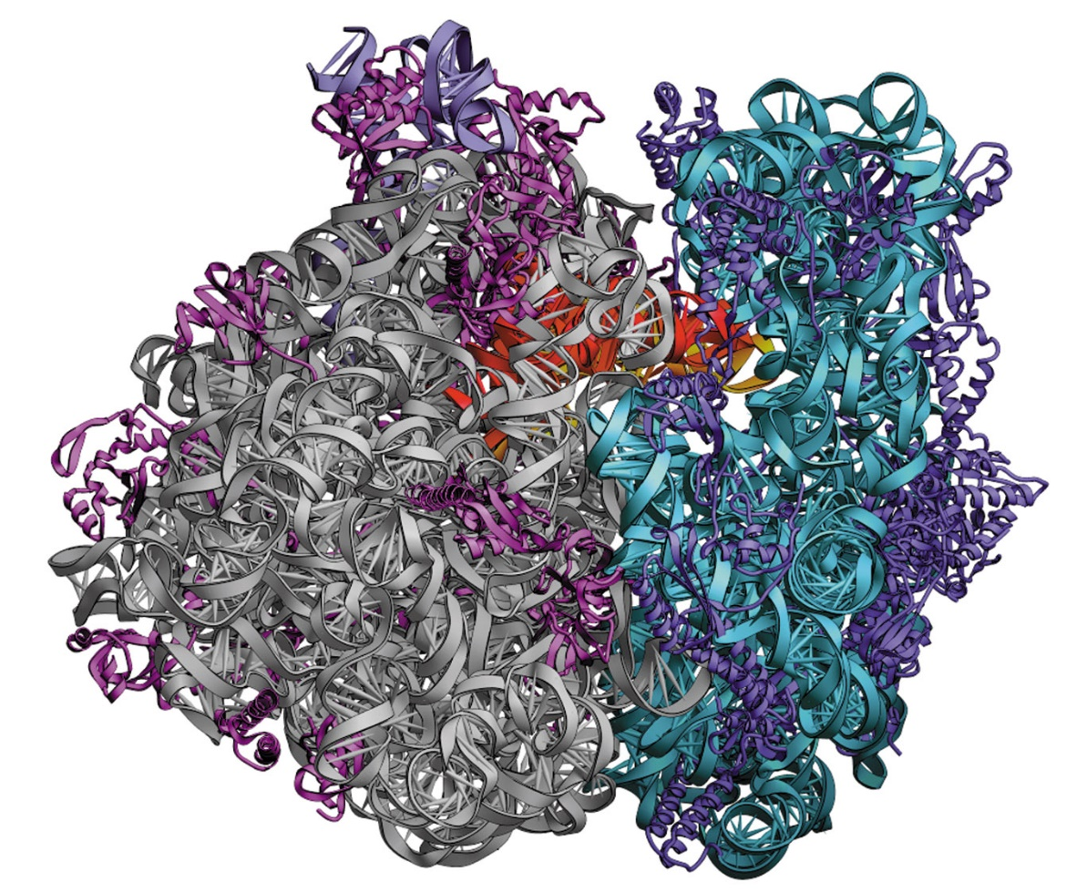
RNA folds up into a compact 3D shape,… following the same
principles of chemistry that drive protein folding.
tRNA
ribosome

Slide 41
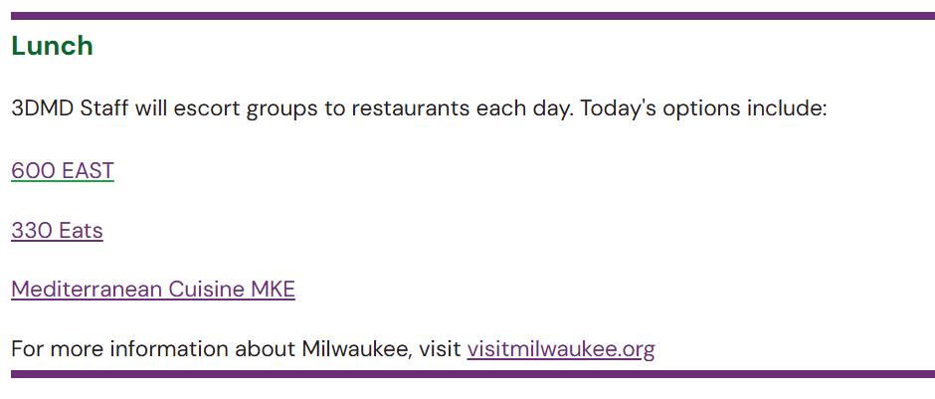
Thursday Lunch

Slide 42
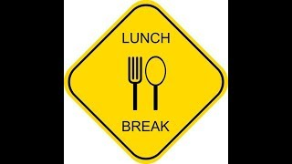

Slide 43
Lunch Options
15 Minute Drive North
Chain Fast Food Options
15 Minute Walk West / 3 Minute Drive
Sonic & 7-Eleven
6 Minute Drive East
Local & Chain Fast /Counter Service
15 Minute Walk South / 3 Minute Drive
Local Counter Service

Slide 44
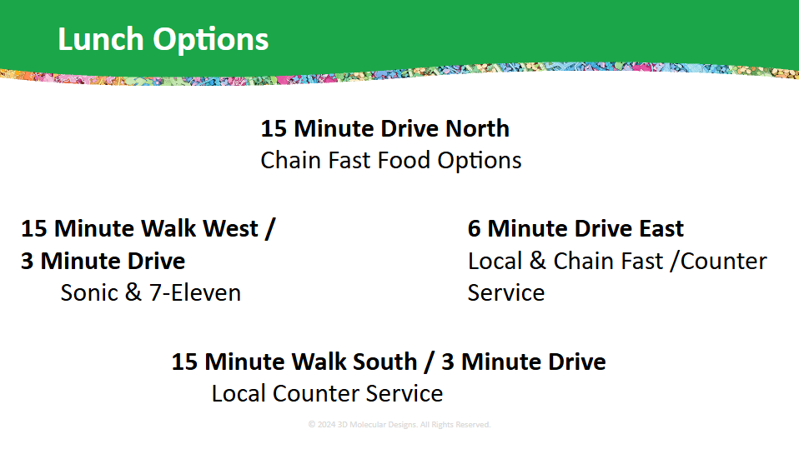


Slide 45


Transcription Action: Decoding Life's Blueprint
Flow of Genetic Information Kit
"If the secret of life could be likened to a machine, transcription would be a central cog in the machinery that drives all others."
-Roger Kornberg

Slide 46

How are proteins made in the cell?
Tim’s thoughts about the Central Dogma

Slide 47


Locate the sugar, phosphate, and the nitrogenous base
‹#›
Notes:
Teacher: Explain the model transfer from foam nucleotide to Dynamic DNA.
Learner: Identify the major components of the nitrogenous base. Add this information to their lab notebook

Slide 48


Sugar
‹#›
Notes:
Teacher: Explain the model transfer from foam nucleotide to Dynamic DNA.
Learner: Identify the major components of the nitrogenous base. Add this information to their lab notebook

Slide 49


Phosphate
‹#›
Notes:
Teacher: Explain the model transfer from foam nucleotide to Dynamic DNA.
Learner: Identify the major components of the nitrogenous base. Add this information to their lab notebook

Slide 50


Nitrogenous Base
‹#›
Notes:
Teacher: Explain the model transfer from foam nucleotide to Dynamic DNA.
Learner: Identify the major components of the nitrogenous base. Add this information to their lab notebook

Slide 51


Nucleotide
‹#›
Notes:
Teacher: Explain the model transfer from foam nucleotide to Dynamic DNA.
Learner: Identify the major components of the nitrogenous base. Add this information to their lab notebook

Slide 52




Build a segment of DNA!
‹#›
Notes:
Teacher: Provide learners with a handful of DNA nucleotides. Give them time to build a small segment of double-stranded DNA. Ideally, your learners are already familiar with the structure of DNA before they begin this lesson. However, if “just in time” learning and storyline coherence requires you to focus on gene expression without a deep dive into DNA structure before this lesson, you can trust this model to allow them to figure it out. They should be able to play and in doing so, turn these puzzle pieces into a double stranded molecule that follows the base pairing rules and indicates the antiparallel nature of DNA.
Staging the model: Before class, provide each team with about 40 nucleotides (equal numbers of G=C and A=T though the G:A ratio is not important). Placing them in a bag or on a tray will make it easier to provide the models to learners when needed.
Tactile play
Monitor learner understanding
Probing questions (if required)
Learner: Follow the prompt on the screen.

Slide 53
Discuss and investigate
What is the code of DNA?
Do all groups in the class have the same code?
‹#›
Notes:
Teacher:
Monitor learning understanding
Probing questions (if required)
Allow learners to move around and see the DNA constructed by other groups.
Learner:
With your small group.
Get up and investigate.

Slide 54

These are RNA nucleotides…
How are they different from the DNA nucleotides?
WHY is this model different from the DNA nucleotides?
‹#›
Notes:
Teacher: Summarize RNA after feedback from group. Remind them that RNA is also single stranded (until modified). Monitor learner understanding.
Learner:
Play with models
Connecting to previous learning.
Building consensus in collaborative groups.

Slide 55
Transcription Challenge
Use your RNA nucleotides and the DNA molecule you made.
Make a complementary piece of RNA from DNA.
‹#›
Notes:
Teacher:
Monitor learner understanding
Probing questions (if required)
Tactile play
Encourage questions. As learners begin this challenge, they may VISUALLY try to make an RNA (Talking through “G bonds with C”, looking at the base pairing.) Remind them that the cell cannot do this… how does base pairing really work? What might be needed to make this happen?
Learners may quickly get confused (which leads to questions). If DNA is double stranded, and RNA is single stranded, which side of the DNA holds the code? How does the cell know which side of the DNA to use?
LET THEM STRUGGLE! When it is clear that all (or most) groups have reached this important question and are struggling with what to do next, bring the class back together.
Learner: Follow the prompt on the slide.

Slide 56

What questions do you have?
What challenges did you have?
‹#›
Notes:
Teacher: Listen for their concerns and questions… prepare to give them the information they are asking for.
Specifically listen for questions about what strand to use?
Learner: Share as a class.

Slide 57

‹#›
Notes:
Teacher: Direct Instruction about only one strand of DNA containing the necessary code. Textbooks and standardized tests will refer to the Coding and Template strands.
Template strand: The biologically relevant strand. THIS is the one used as a “mold” for making the RNA.
Coding strand: (You may not choose to use this term). Learners will notice with practice that the RNA “looks like” this strand, the strand that was NOT used to form the RNA. This strand is often referred to as the coding strand.
The point is: Only one strand at a time is used for making RNA. But depending on the gene, it is one strand or the other. There is not a single side to the DNA that is always used or one that is never used.
Learner: Add new information to their notebook.

Slide 58

What 2 things must happen for the RNA to be produced?
‹#›
Notes:
Teacher: Listen for learner ideas. In particular, the DNA must be “unzipped” and the RNA must be base paired. Listen for these ideas. Coach teams that have not figured this out towards these ideas with probing questions.
Learner: Brainstorming with a team to figure out what must happen for the RNA to be made?

Slide 59
Engineering Challenge
Design a model of an enzyme that would assist in transcription.
‹#›
Notes:
Teacher: Give learners some time to complete the challenge.
Learner: Sketch their design in notebook.

Slide 60

And here it is!
‹#›
Notes:
Teacher: Give each group a transcription placemat.
Learner: Compare their design to the placement. Where are their designs the same? Where are they different?

Slide 61


A brief tour through the cell
This image is an excerpt from Tour of a Human Cell by David Goodsell, as shown in 3D Molecular
Designs’ Tour of a Human Cell© poster and David Goodsell’s book, The Machinery of Life.
Notes:
The circle shows RNA polymerase in a complex getting ready to transcribe DNA into mRNA.
Can you find the mediator, transcription factors, and enhanceosome in the circle?

Slide 62

Transcription looks something like this…
( Drew Berry from E. O. Wilson Life on Earth ibook.mov)
‹#›
Notes:
Teacher: Show learners the video.
Learner: Add new information to their notebook.

Slide 63
Now play!
Template
Strand
‹#›
Notes:
Teacher: Give each group a premade DNA sequence and allow time to model.
Note: The transcription process begins with RNA polymerase scanning along the DNA until it encounters a specific sequence called the promotor. In this model, we assume that the promotor sequence already has been recognized. In eukaryotes, it is a TATA box that is located 25 to 35 base pairs upstream of the transcription start site. Promotors can also have CpG islands and other regulatory elements. If you want to teach this additional information, check out Addgene: Promoters.
The promotor acts like a signpost, indicating where transcription should start. It tells RNA polymerase where to begin transcribing the DNA. Once polymerase binds to the promoter, it separates the DNA strands. One of these strands serves as the template strand (in this case on the top of the model) and provides the sequence needed for RNA synthesis. The other strand (in this case on the bottom of the model) is not directly involved in transcription. The RNA polymerase then builds an RNA strand complementary to the template strand, adding each new nucleotide to the 3’ end of the growing RNA molecule.
Learner: Model how RNA is transcribed from a double-stranded DNA.

Slide 64

Now play!
‹#›
Notes:
Teacher: Use this slide only in the case you need to point out the right direction.
Learner: They should only see this slide unless they are struggling.

Slide 65

Now play!
‹#›
Notes:
Teacher: Use this slide only in the case you need to point out the right direction.
Learner: They should only see this slide unless they are struggling.

Slide 66
Let’s talk about model limitations.
‹#›

Slide 67
A brief tour through the cell
This image is an excerpt from Tour of a Human Cell by David Goodsell, as shown in 3D Molecular
Designs’ Tour of a Human Cell© poster and David Goodsell’s book, The Machinery of Life.
Notes:
Scan the poster again and see what structures you notice in the nucleus? Can you find the nuclear pore?

Slide 68
Nucleus
Nuclear Membrane
Cytoplasm
This image is an excerpt from Tour of a Human Cell by David Goodsell, as shown in 3D Molecular
Designs’ Tour of a Human Cell© poster and David Goodsell’s book, The Machinery of Life.
Notes:
Let’s note where we have been and where we are going.

Slide 69
DNA
mRNA
mRNA
Nuclear Pore
RNA Polymerase
This image is an excerpt from Tour of a Human Cell by David Goodsell, as shown in 3D Molecular
Designs’ Tour of a Human Cell© poster and David Goodsell’s book, The Machinery of Life.
Notes:
Let’s also identify some structures. You can print these landscapes as a pdf in black and white or greyscale and have them color them in. I would have my students insert them in their lab notebooks so they could reference them later.
Look down in the lower left to see the capping enzyme which is adding methylguanosine to the 5”end of the mRNA. It is by the RNA polymerase.

Slide 70
A brief tour through the cell
This image is an excerpt from Tour of a Human Cell by David Goodsell, as shown in 3D Molecular
Designs’ Tour of a Human Cell© poster and David Goodsell’s book, The Machinery of Life.
Notes:
This is one of the many molecular landscapes by Dr. David Goodsell who is affiliated with the Protein Data Bank. You can more of these at PDB-101: Goodsell Gallery (rcsb.org). I love using them in conjunction with the kit because they demonstrate to students that we are only touching on a fraction of the cell’s complexity.

Slide 71
Let’s re-visit transcription…
(Drew Berry from E. O. Wilson Life on Earth ibook.mov)
‹#›
Notes:
Teacher: Show learners the video.
Learner: Add additional information to their notebook. What else do you notice now that you have taken time with the physical model?

Slide 72
Conclusion
There are three types of RNA: messenger RNA, transfer RNA, and ribosomal RNA.
RNA is made of four nucleotides: adenine, uracil, guanine, and cytosine.
Once transcribed from DNA, RNA leaves the nucleus and moves to a ribosome.

Slide 74


Reflection…
“Models give meaning to words.” - Tim Herman
In your notebook reflect:
How can using a model like this give meaning to words?
How might this improve student learning?
‹#›

Slide 75
Reflection–Share Out
What challenges did you have in making an enzyme model to make mRNA? How was it the same as RNA polymerase?
How could you adapt this activity for your students?

Slide 76

Take a break!

Slide 77
RNA is not…
…a limp noodle

Slide 78
RNA is not single-stranded.
But it is not exactly double-stranded.
RNA is structured.
RNA folds up into a compact 3D shape,… following the same
principles of chemistry that drive protein folding.

Slide 79
RNA folds up into a compact 3D shape,… following the same
principles of chemistry that drive protein folding.
tRNA
ribosome

Slide 80

Alexander Rich
Rich’s lab determined the structure of tRNA in 1973
Kim, S.H. et al. (1973) Three-dimensional structure of yeast phenylalanine transfer RNA: folding of the polynucleotide chain. Science 179, 285–288

Slide 81

The structure of tRNA is stabilized by Watson-Crick base pairs, Hoogsteen base pairs, and lots of modified nitrogenous bases.

Slide 82


Slide 83
Ribosomes …..
The 3D Translation Team….. Tom Steitz….
and the exit channel.

Slide 84


2 subunits composed of
60 proteins and
3 rRNAs (4,500 nucleotides)

Slide 85
Ribosomes and Tom Steitz

Slide 86

2 subunits composed of
60 proteins and
3 rRNAs (4,500 nucleotides)

Slide 87

Before the 3D structure of the ribosome was determined in late 1990s, we knew the secondary structure of the ribosomal RNAs.

Slide 88
Mark with another reMARKable model. And oh yes, that’s Venki Ramakrishnan standing next to him.

Slide 89
…at the LMB

Slide 90


Slide 91
RNA is not…
…a limp noodle
Tim Herman

Slide 92

What is RNA?
RNA

Slide 94

Protein Palooza: Ribosomes Rock
Flow of Genetic Information Kit
"I knew then how I wanted to understand the chemistry of biology."
THOMAS A. STEITZ, 2009

Slide 95

How do you think proteins are made?

Slide 96



Components of Translation (Textbook)
mRNA + tRNAs + ribosomes
(Subirana, 2008)
(tRNA 2022)

Slide 97



Components of Translation (Experimental)
mRNA + tRNAs + ribosome
(Liang et al., 2021)
(Zhao, 2021)
(Miller, Ribosomes)

Slide 98


Slide 99


Slide 100


Structure of a Ribosome
(Steitz, 2009)

Slide 101

Components of Translation (3DMD)
mRNA + tRNA + ribosome

Slide 102



How are tRNAs “charged”?
Aminoacyl-tRNA Synthetases
ATP
Energy is Required!
Notes:
Possible Tim “mini-talk”?

Slide 103


Now, “charge” the tRNAs!
YOU play the role of the Aminoacyl-tRNA Synthetases
Notes:
Possible Tim “mini-talk”?

Slide 104






Ribosome Comparisons
What aspects of the ribosome structure would you predict are most similar? Why?
Which might have more variation?
(Goodsell, 2024)
Notes:
More information is available at : PDB-101: Molecule of the Month: Ribosome Diversity (rcsb.org)

Slide 105

Putting it all together
Examine this model. What do you notice?

Slide 106


The Genetic Codon Circle / Chart
Both versions are located on the back cover of your notebook
Notes:
Genetic Codon Chart©.pdf (hubspotusercontent-na1.net)

Slide 107

AR: Protein Translation
Using the 3DMD AR EDU app, explore the process of Protein Translation.

Slide 108






Let’s Model Translation!
Notes:
All images showing - without “animation”

Slide 109


What Happens if Protein Translation Stops?
What happens if protein translation stops?
This is the goal of many different antibiotics.
Make a prediction with your partner about how antibiotics may cause this.
Notes:
Teacher: Facilitate a class discussion.
Student: Discuss with their partner and write a prediction in their notebook.
‹#›

Slide 110

AR: Protein Translation
Using the 3DMD AR EDU app, explore the structure and activity of the following compounds:
Chloramphenicol
Erythromycin
Tetracycline
Linezolid
What is the mechanism of action of these compounds?

Slide 111


Exploring Chloramphenicol
Choose
Chloramphenicol
Scan a purple
translation mat
Explore only the first button
Notes:
Teacher: Have students open the app and select the appropriate activity and scene. Move around the room and assist students with their technology. Students should point their cameras toward the A site of the ribosome.
Student: Open the app and select the appropriate activity and scene.
‹#›

Slide 112
$2.00 Feedback: 10￠per word
Learner Lens:
What content or new ideas did you learn?
Teacher Lens:
What are some teacher moves or pedagogy have been used that you might incorporate into your instruction?

Slide 113
CCCR Strategy
Consider - Contribute - Consult - Revise

Slide 114

CCCR Strategy (Consider - Contribute - Consult - Revise)

Slide 115
In your notebook….
Sketch a model of your understanding of the process of translation
Label and annotate your model to apply important terms and ideas
Notes:
Connecting to previous learning.

Slide 116

CCCR Strategy (Consider - Contribute - Consult - Revise)

Slide 117

CCCR Strategy (Consider - Contribute - Consult - Revise)

Slide 118

CCCR Strategy (Consider - Contribute - Consult - Revise)

Slide 119
CCCR Strategy Debriefing
How might this strategy help students to make sense of what they are learning?
Notes:
Connecting to previous learning.

Slide 120




Slide 121

Sandbox Time
Play with Models!
Plan Lessons
Ask Questions
Tinker with proteins in JUDE
Explore Digital Resources

Slide 122
Reflection
Summarize the student experience of modeling you have experienced in this course so far.
Be prepared to share 2 things that you hope to “take home” to use in your classroom practice.

Slide 123


Slide 125

End of Day Survey

Slide 126

What is a Gene?
gene

