Slide 1
Notes:
8:30 Heather Welcome
Best weeks of the year
Learn about 3DMD over the week
Family Owned - Diane
College Students
Thank you to Kim Hendricks, Cortney Toht & Northwest Independent School District
8:35 Tim Welcome
Keri Comments
8:40 Introductions
Instructor Bios via email - Tim, Keri, Heather & Mark
Model Teachers - Kim & Alice
Participants - where you’re from, what you teach & how you found us
8:55 Site Logistics - Kim
9:00 Course Logistics
Schedule
Website
3DMD Staff
9:10 Group Norms - Keri

Slide 2


Welcome Educators!
Modeling the Molecular World
Tim Herman, PhD
Heather Ryan, MPA
Keri Shingleton, PhD
Kim Hendrix: 806 445-6705
Wifi: NISDGuest
Password: NorthwestISD

Slide 3


Overview of the Week
Monday
Tuesday
Learner Lens
Educator Lens

Slide 4
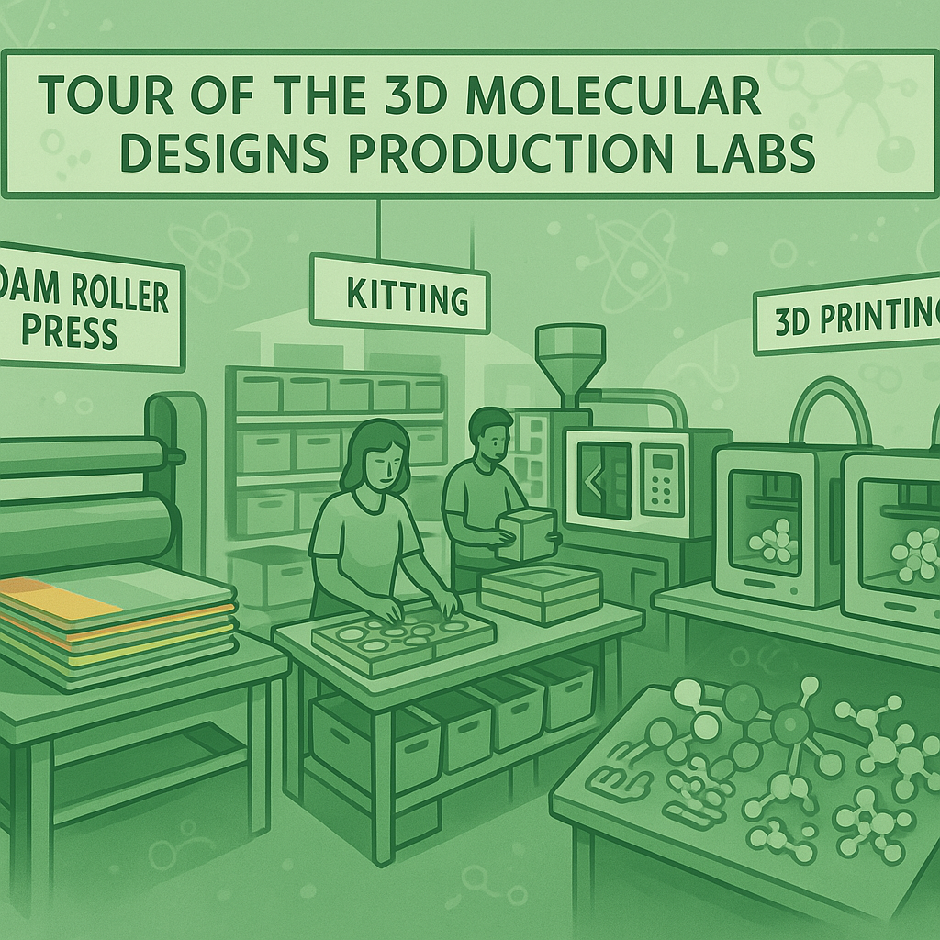

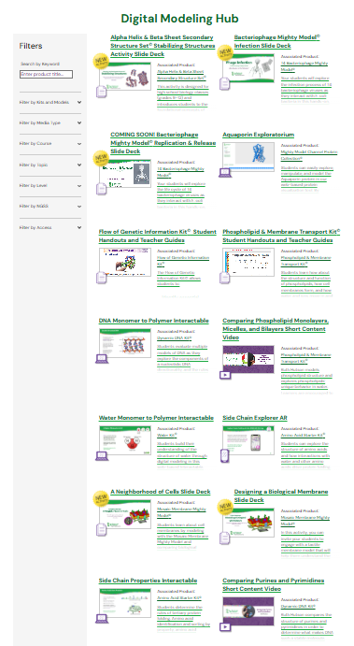
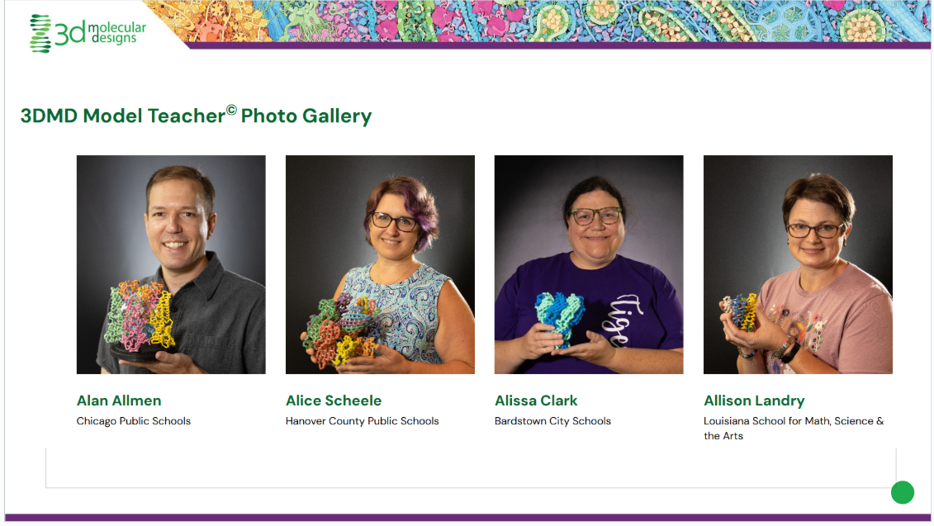
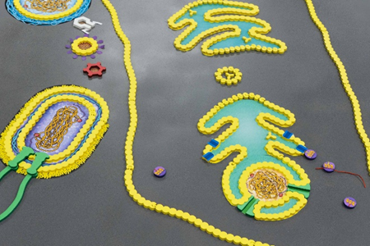
Overview of the Week
Wednesday

Slide 5
Overview of the Week
Wednesday

Slide 6
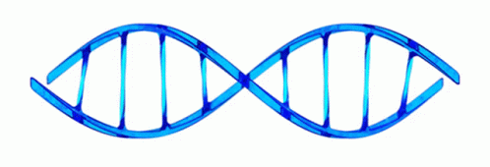
Overview of the Week
Thursday - DNA

Slide 7
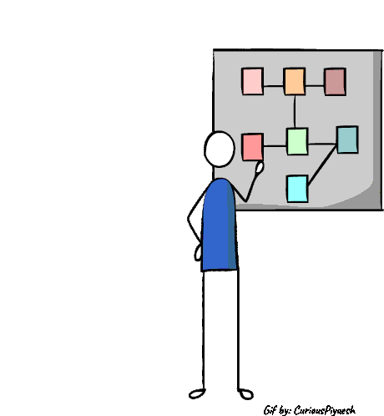
Overview of the Week
Friday - Implementation Planning

Slide 8
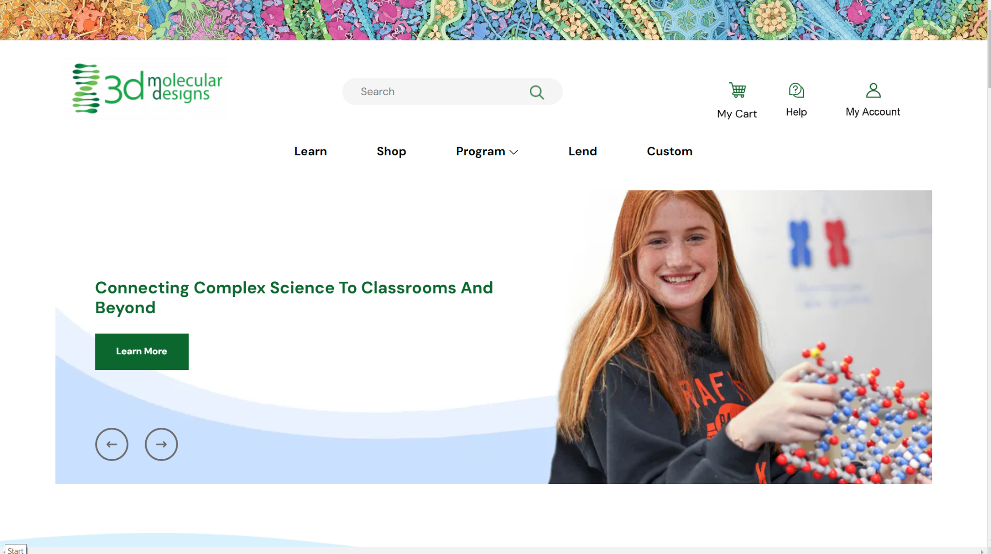

Slide 9
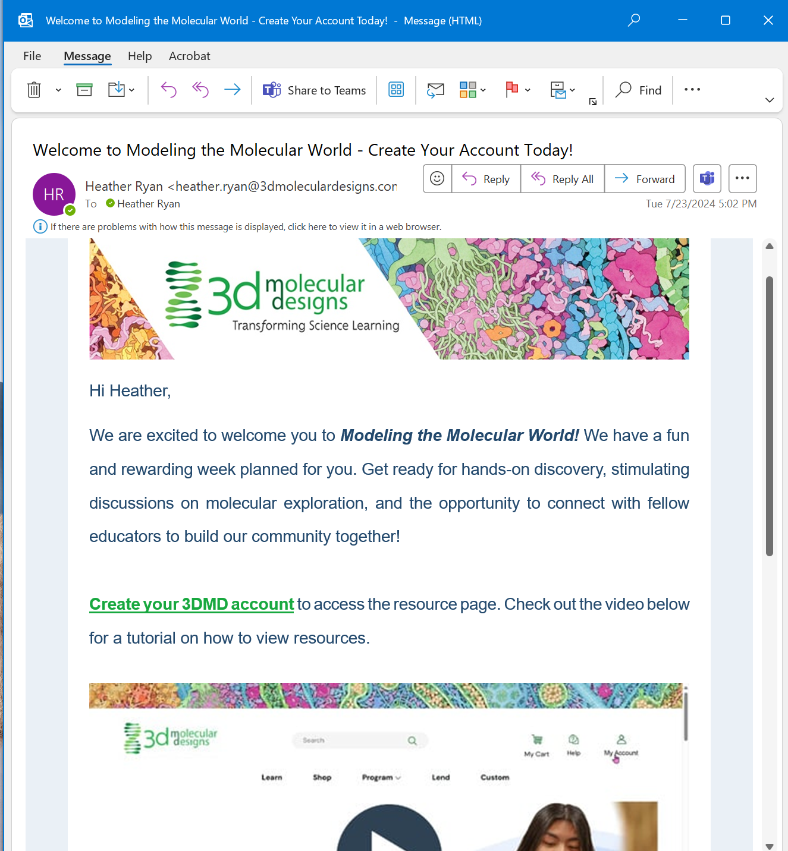
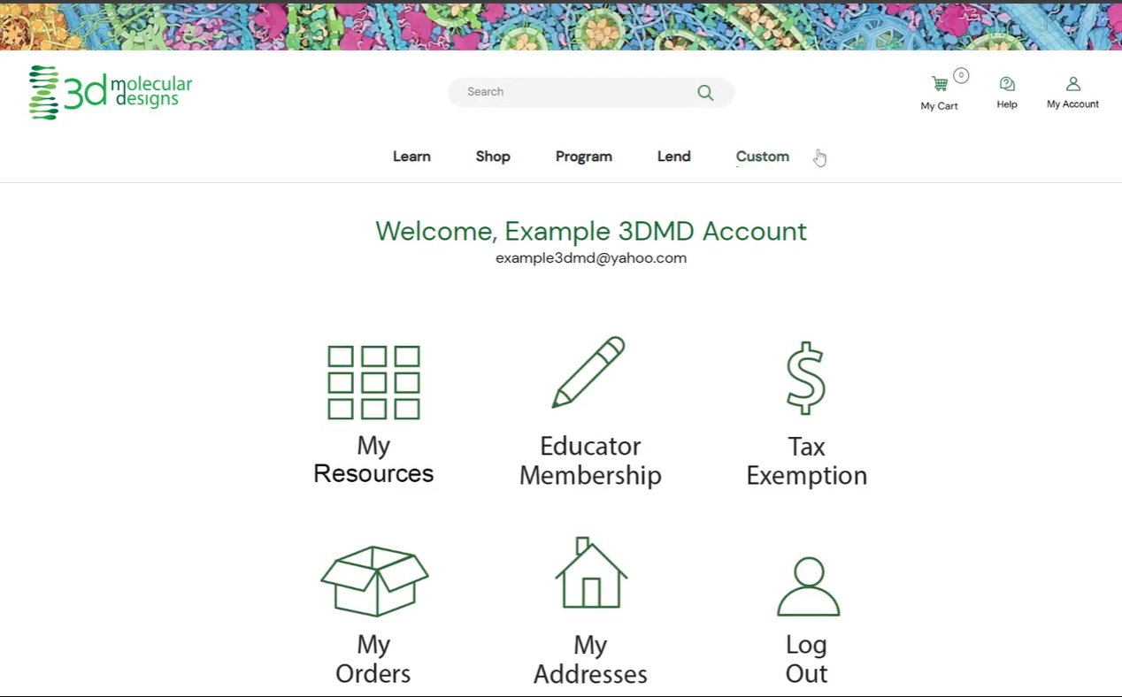

Email on 6/1

Slide 10
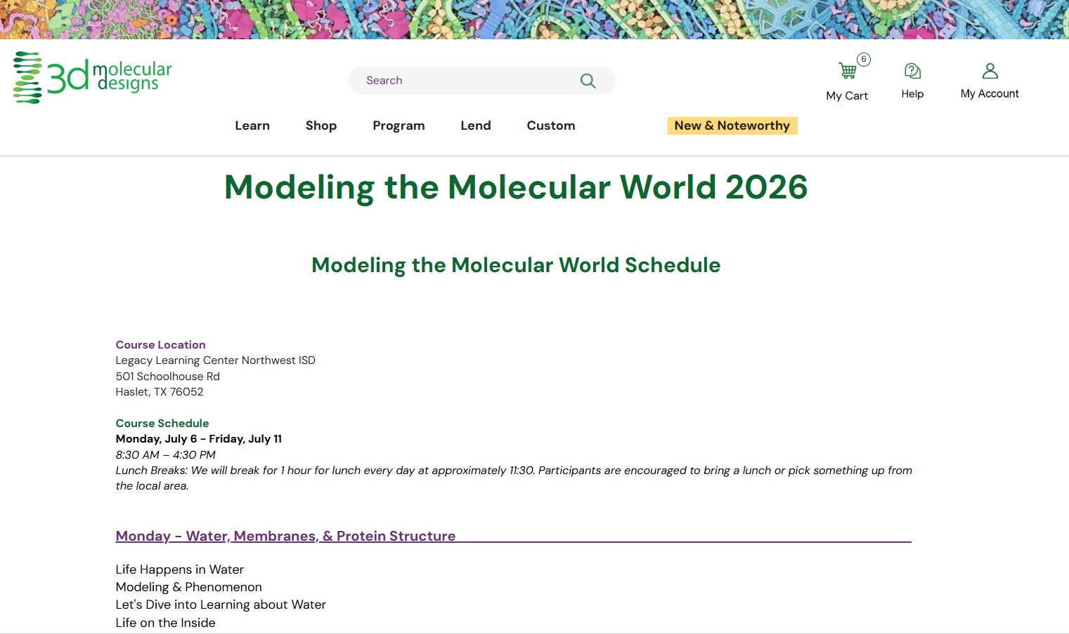
https://3dmoleculardesigns.com/2026-modeling-the-molecular-world-texas

Slide 11
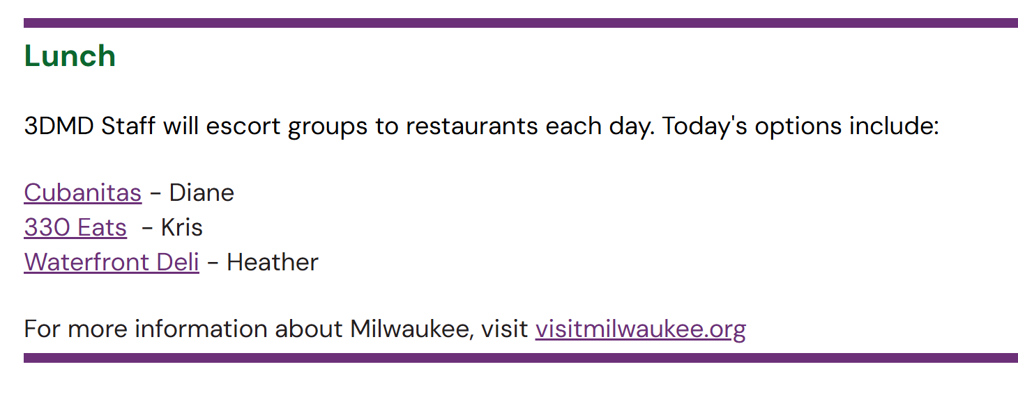

Slide 12

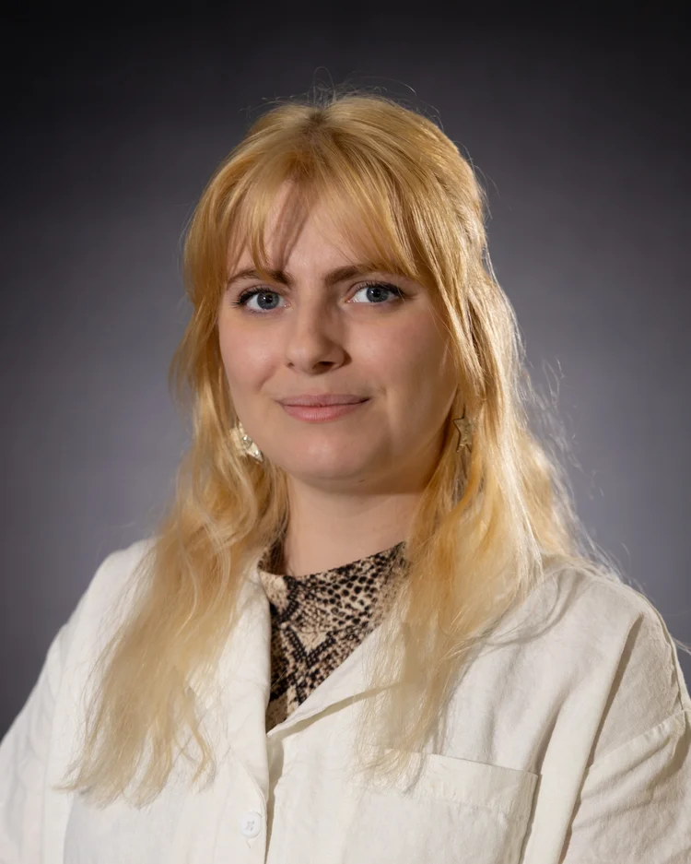

3D Molecular Designs Staff
Kris Herman
Education Relations Manager
Lauren Koepsel
Marketing Communications Manager
Mark Holzer
Director of Material Development

Slide 13
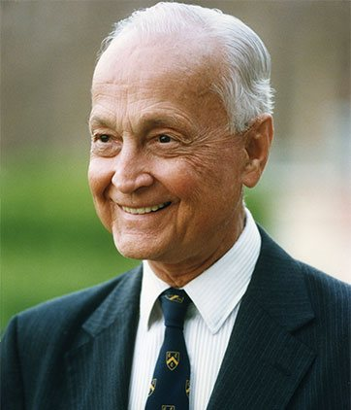
Be curious!
“If we become increasingly humble about how little we know, we may be more eager to search.”
~Sir John Templeton
Notes:
"The capacity to learn is a gift; the ability to learn is a skill; the willingness to learn is a choice." - Brian Herbert
"The mind is not a vessel to be filled, but a fire to be kindled." - Plutarch
"I am among those who think that science has great beauty." - Marie Curie
"Science means constantly walking a tightrope between blind faith and curiosity; between expertise and creativity; between bias and openness; between experience and epiphany; between ambition and passion; and between arrogance and conviction – in short, between and old today and a new tomorrow." — Henrich Rohrer

Slide 14
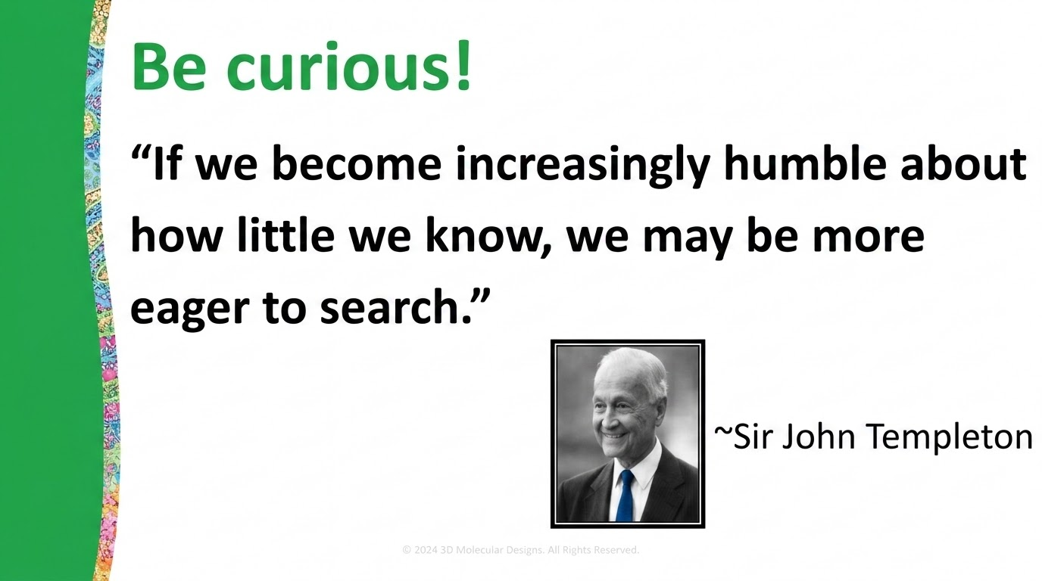

Slide 15

Norms for our time together this week:
Learner mindset
(Rhys, Writing from the Beginner’s Mind)
Notes:
For the first two days we want you to be learners. Engage as a learner, honor your expertise but don’t let it restrict your engagement with the learning process. Think about how your students would engage with the larger arc of using modeling to explore a phenomenon rather than the individual models. There will be time to connect and reflect on your own practice.

Slide 16
Norms for our time together this week:
Learner mindset
Be vulnerable
(Rhys, Writing from the Beginner’s Mind)

Slide 17
Norms for our time together this week:
Learner mindset
Be vulnerable
Speak with the intention of being heard–listen with the possibility changing your thinking
(Rhys, Writing from the Beginner’s Mind)

Slide 18
strange and invisible
Welcome to the Molecular World

Slide 19
The Science we teach, BIOLOGY
or more broadly, the LIFE SCIENCES
or the MOLECULAR BIOSCIENCES
It is in biology that chemistry and physics come to life.

Slide 20
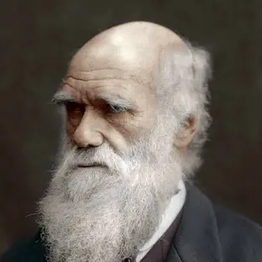
Charles Darwin’s On the Origin of Species
From the conclusion -
It is interesting to contemplate a tangled bank, clothed with many plants of many kinds, with birds singing on the bushes, with various insects flitting about, and with worms crawling through the damp earth, and to reflect that these elaborately constructed forms, so different from each other, and dependent upon each other in so complex a manner, have all been produced by laws acting around us.

Slide 21
…struggle for survival…natural selection…
Thus, from the war of nature, from famine and death, the most exalted object which we are capable of conceiving, namely, the production of the higher animals, directly follows.
There is grandeur in this view of life, with its several powers, having been originally breathed by the Creator into a few forms or into one; and that, whilst this planet has gone cycling on according to the fixed law of gravity, from so simple a beginning endless forms most beautiful and most wonderful have been, and are being, evolved.
Darwin would have loved DNA… and proteins!

Slide 22
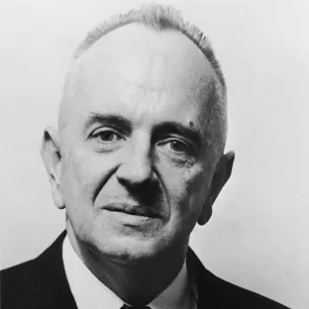
“Nothing in biology makes sense
except in the light of evolution.”
Theodosius Dobzhansky
American geneticist and evolutionary biologist
The American Biology Teacher, Vol. 35, No. 3 (Mar., 1973), pp. 125-129

Slide 23
The Unity of Life
Theodosius Dobzhansky
The American Biology Teacher, Vol. 35, No. 3 (Mar., 1973), pp. 125-129
­­­­The unity of life is­­­­ no less remarkable than its diversity.
Most forms of life are similar in many respects. The universal biologic similarities are particularly striking in the biochemical dimension. From viruses to man, heredity is coded in just two, chemically related substances: DNA and RNA. The genetic code is as simple as it is universal. There are only four genetic "letters" in DNA: adenine, guanine, thymine, and cytosine. Uracil replaces thymine in RNA. The entire evolutionary development of the living world has taken place not by invention of new "letters" in the genetic "alphabet" but by elaboration of ever-new combinations of these letters.

Slide 24
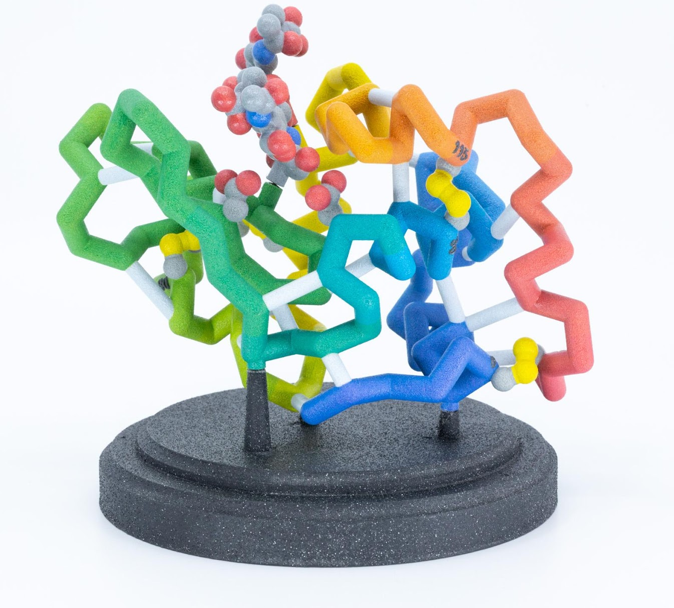
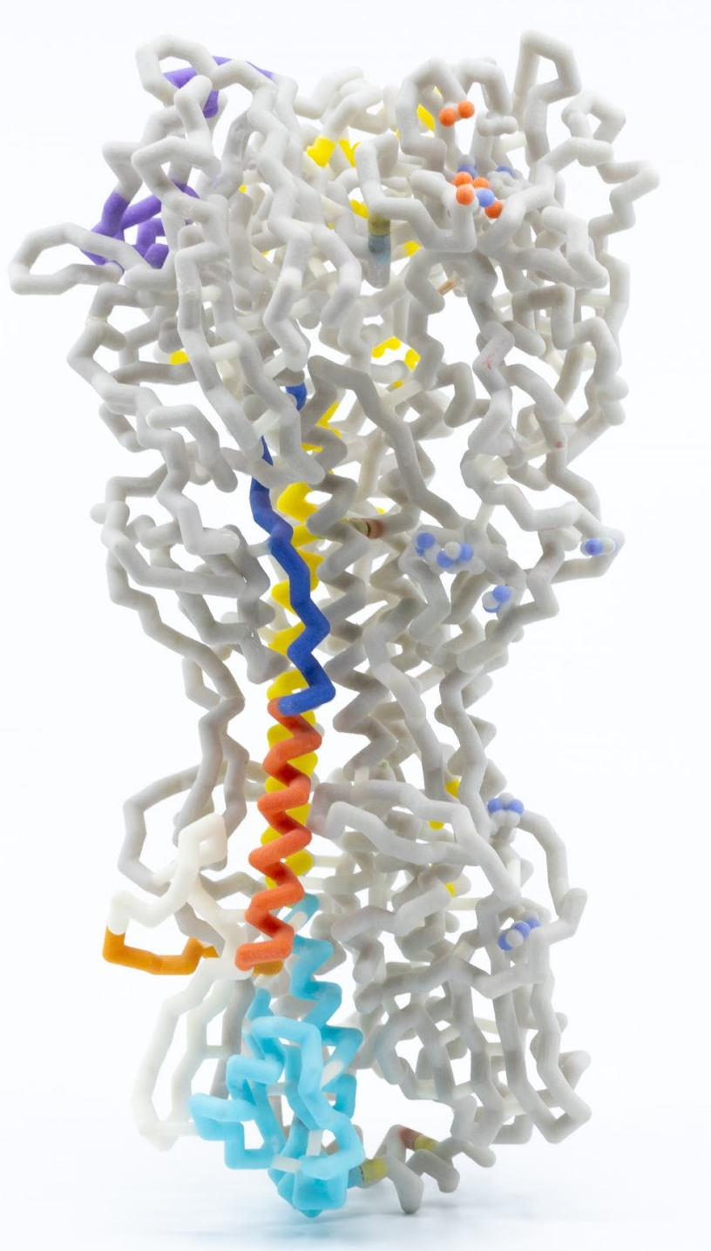
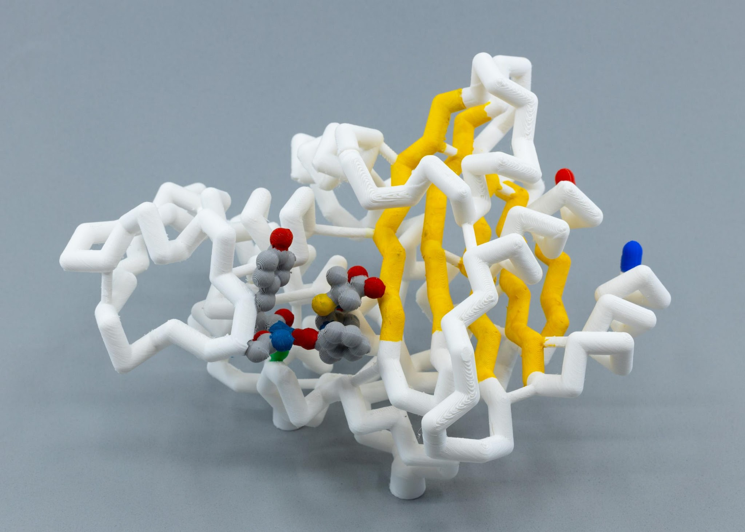
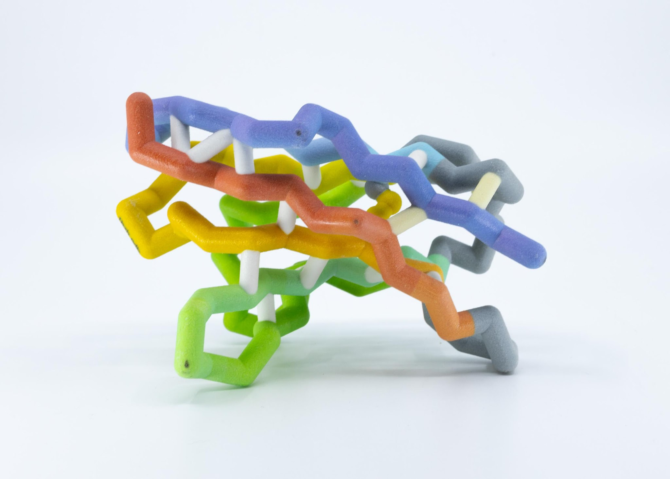
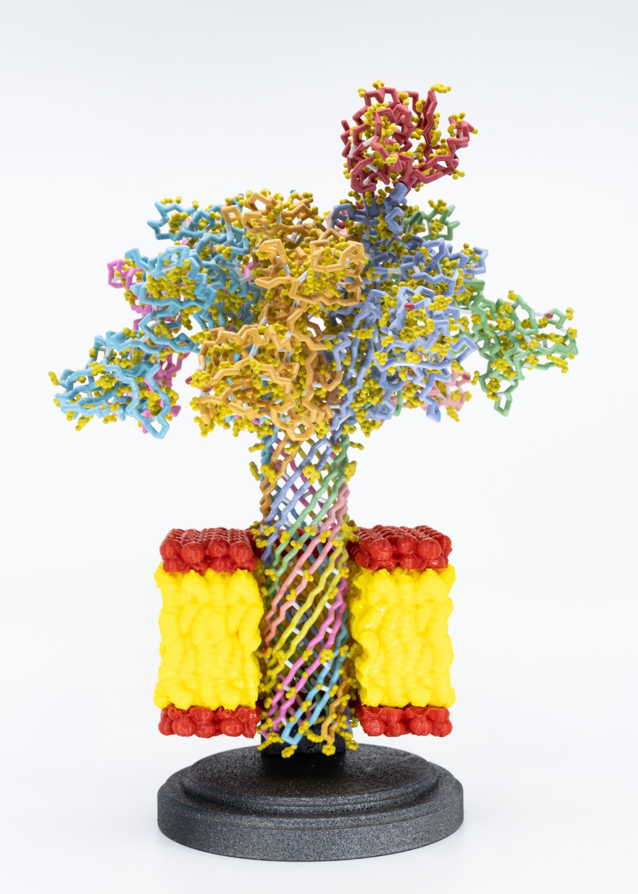
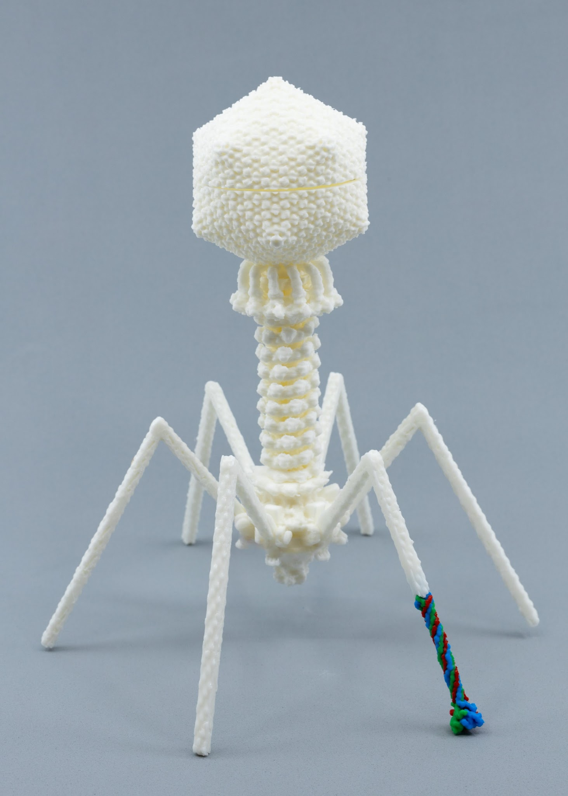
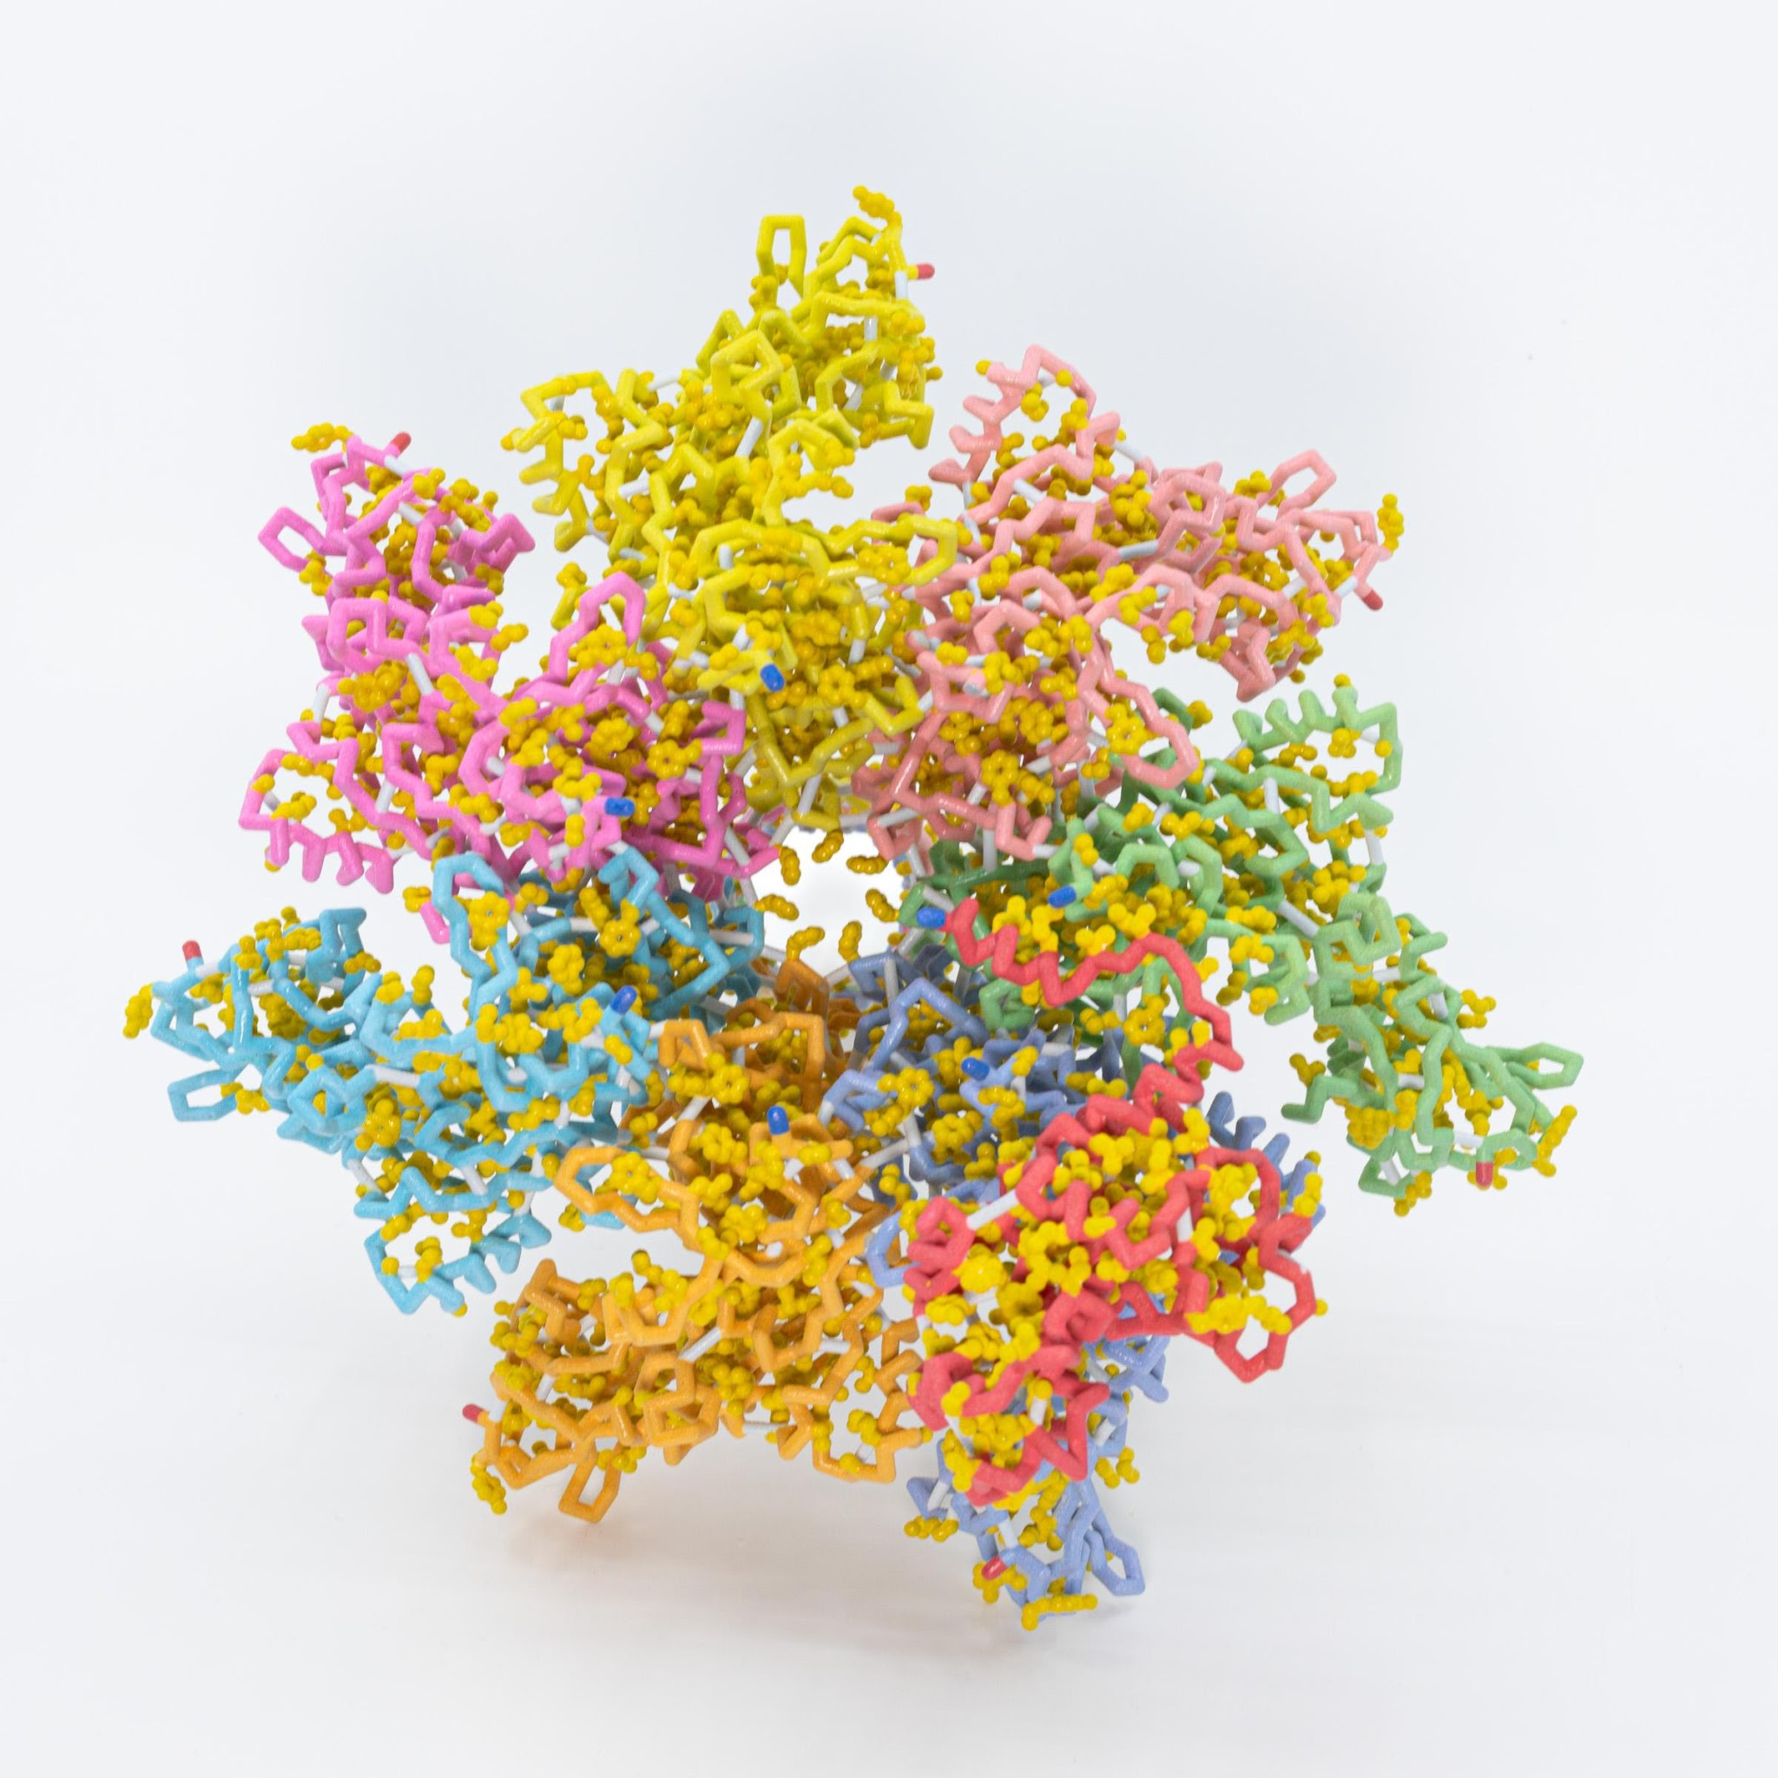
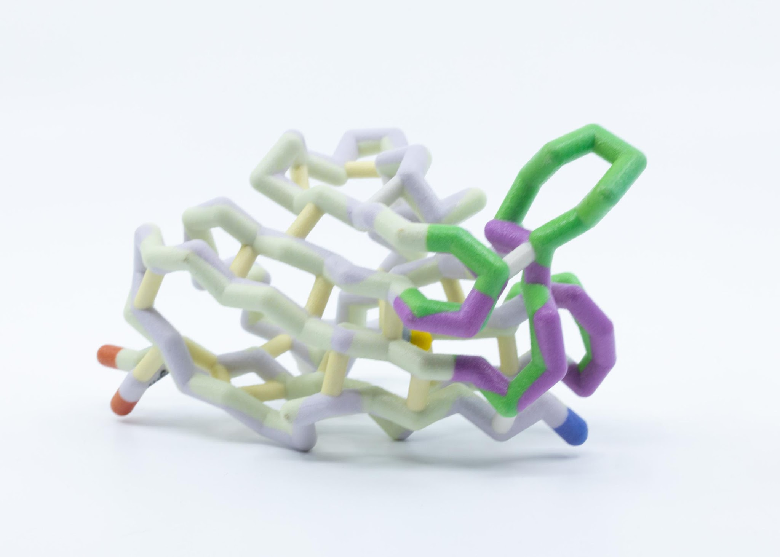
… and now…PROTEINS… in endless forms
most beautiful and most wondrous.

Slide 25
One final thought,…
Everyone will take something different from this course.
For some,… it will be deeper content knowledge.
For some,… it will improved pedagogy…. and an appreciation for the power of modeling in the classroom
Our hope is that everyone will take another step on their journey as a professional educator

Slide 26
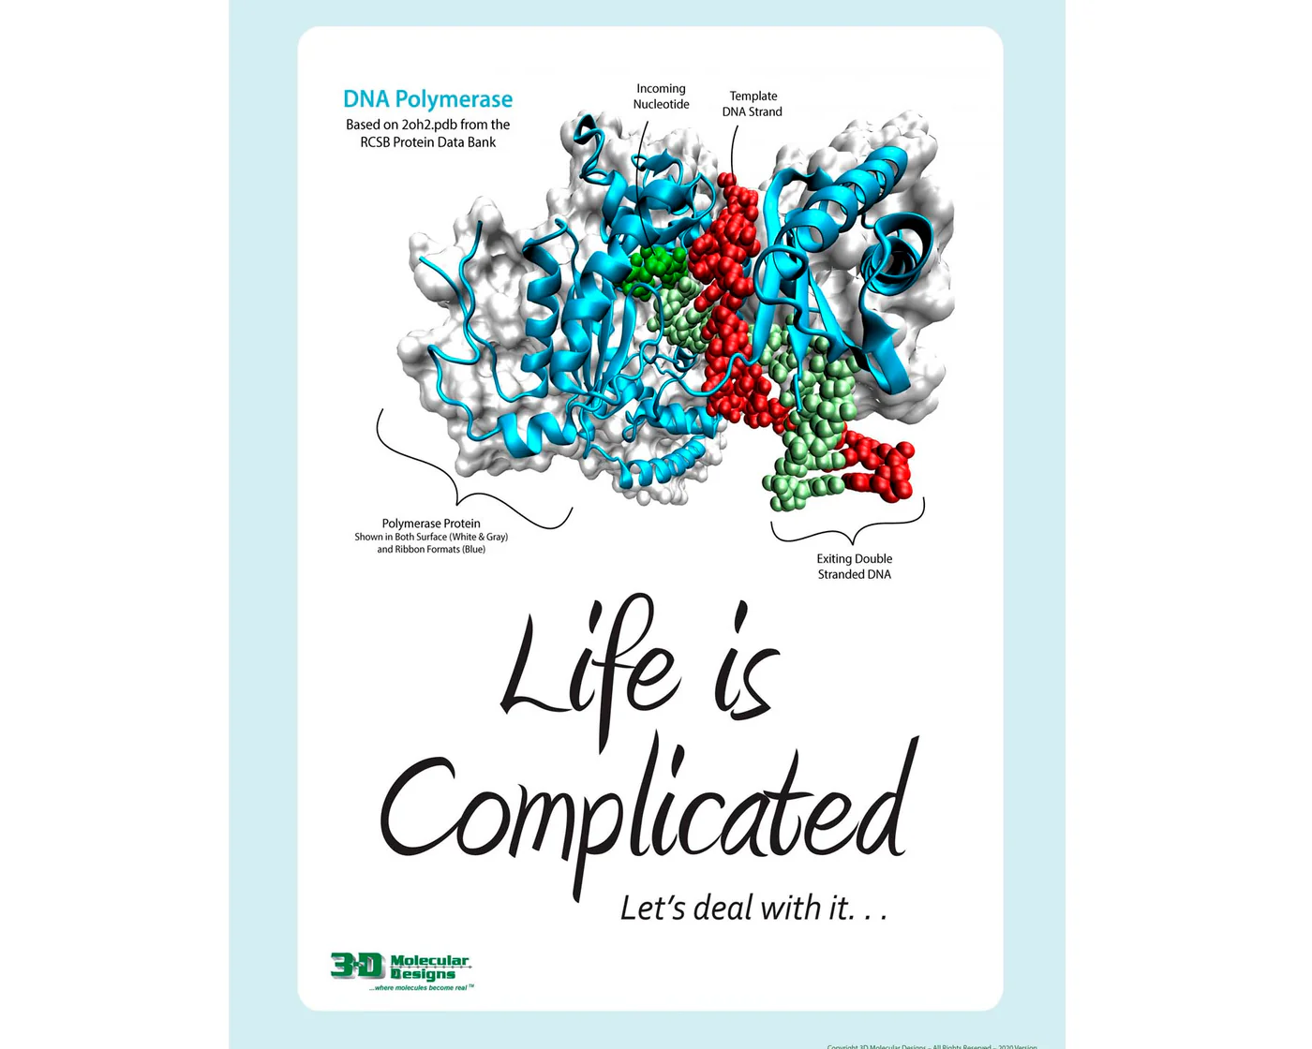

Slide 27
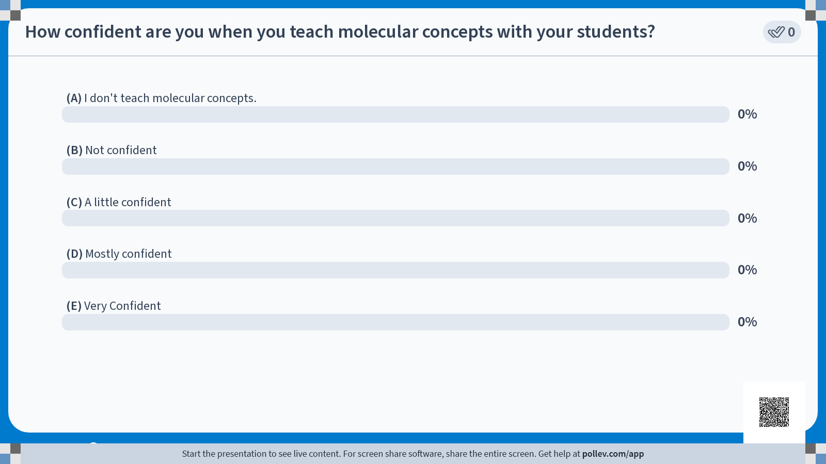

Slide 29


What is a model?
What is modeling?
How do you use models in your classroom?
A model (noun) is…
Modeling (verb) is…
In my classroom…
Notes:
Quiet reflection

Slide 30


What is a model?
What is modeling?
How do you use models in your classroom?
A model (noun) is…
Modeling (verb) is…
In my classroom…
Notes:
Table Share

Slide 31

What is a model?
What is modeling?
How do you use models in your classroom?
A model (noun) is…
Modeling (verb) is…
In my classroom…
Save a page in your notebook for later…
Notes:
Group share

Slide 32


Slide 34
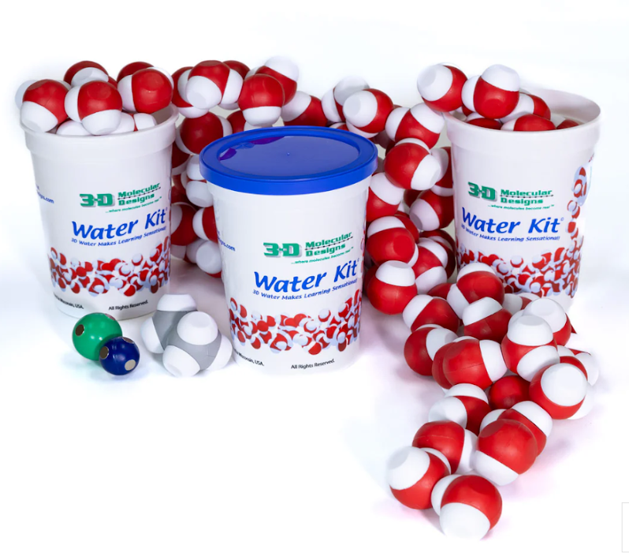
Life Happens in… …….…Water!
You can’t understand how proteins fold,
or how proteins function,……..
…. without first understanding the chemical
and physical properties of water.

Slide 35

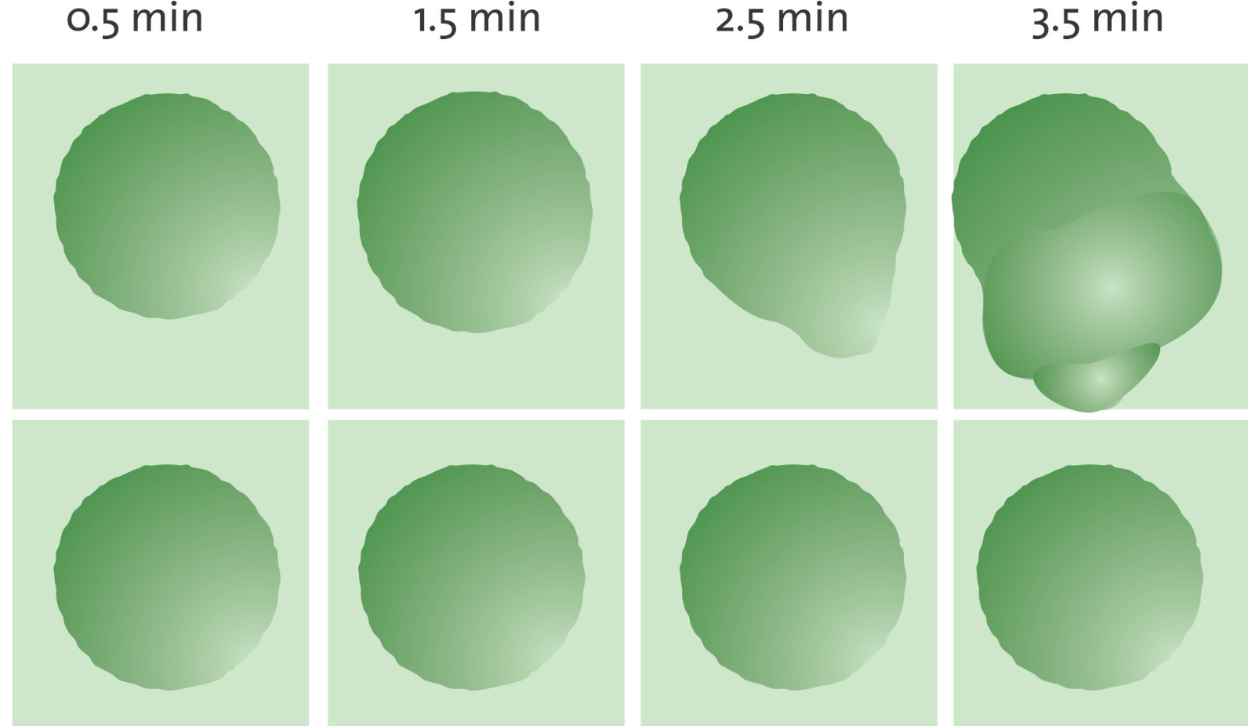
Frog Egg 1
Frog Egg 2
(Agre, 2003)
Notes:
Teacher: Pass out the image of frog eggs to the participants. Put this in your notebook, make some general observations about what you are seeing. By the end of day two, you will have a wonderful story to tell.
Students: Take notes about the phenomenon. What do you notice? What do you think is being represented? What do you wonder?

Slide 36
Let’s get started…
Save a page in your notebook for later…
Frog Egg 1
Frog Egg 2
(Agre, 2003)
Notes:
Teacher: Pass out the image of frog eggs to the participants. Put this in your notebook, make some general observations about what you are seeing. By the end of day two, you will have a wonderful story to tell.
Students: Take notes about the phenomenon. What do you notice? What do you wonder?

Slide 37

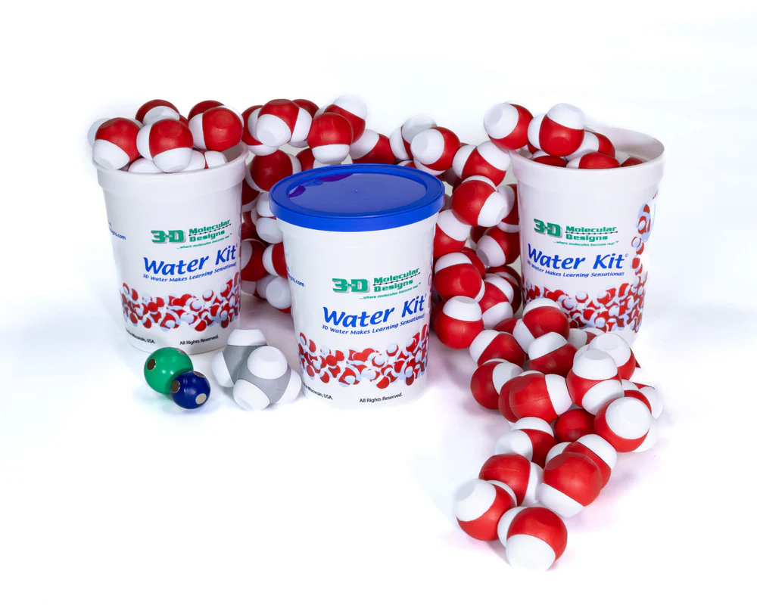
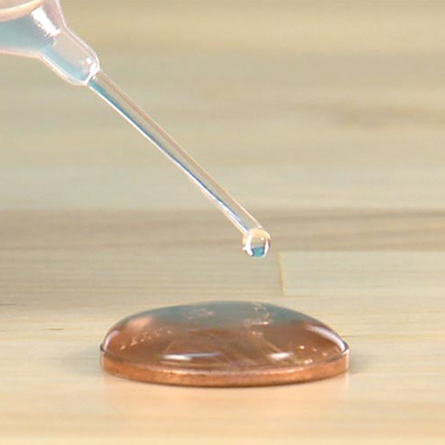
Let’s Make “Cents” of Water
Water Kit
“If there is magic on this planet, it is contained in water."
~ Loren Eiseley,
(Smith, 2021)
Notes:
45 minutes: 9:30-10:30
No computers… Notebooks and mobile devices

Slide 38
SEP’s:
Using models for sensemaking
Constructing models (detergent step)
Data collection
Constructing an explanation with models and data.
DCI’s
Some in PS and ES, not LS
C3:
Patterns
Scale and proportion

Slide 39

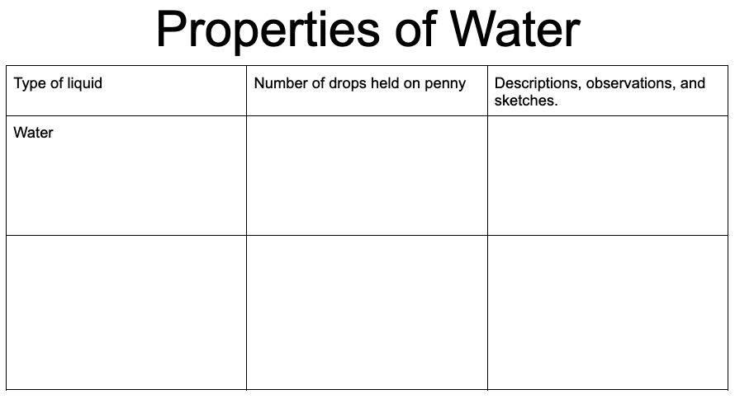
Place a data table in your notebook…
Notes:
To save time: Have a table ready for them to tape or glue into their notebook.

Slide 40
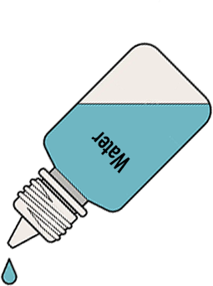
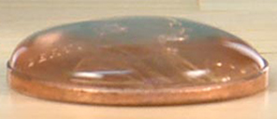
Collect your data
One drop at a time.
Count as you drop.
Remember how many drops were held BEFORE the water spills over the edge.
(Smith, 2021)

Slide 41
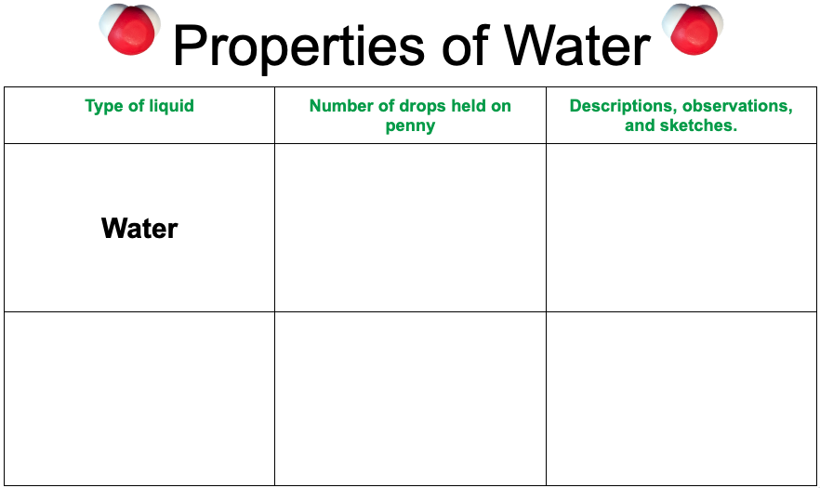
Record your data
50 drops
(Failed on the 51st)

Slide 42

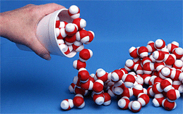
It’s time to play and observe!
What I observe What I wonder

Slide 43
Share at your table!
What I observe What I wonder

Slide 44
Share with the group!
What I observe What I wonder

Slide 45

In your notebook..
Given your experience with the water drops and the water models, develop a model to makes sense of what you observed in the water drop experiment…

Slide 46
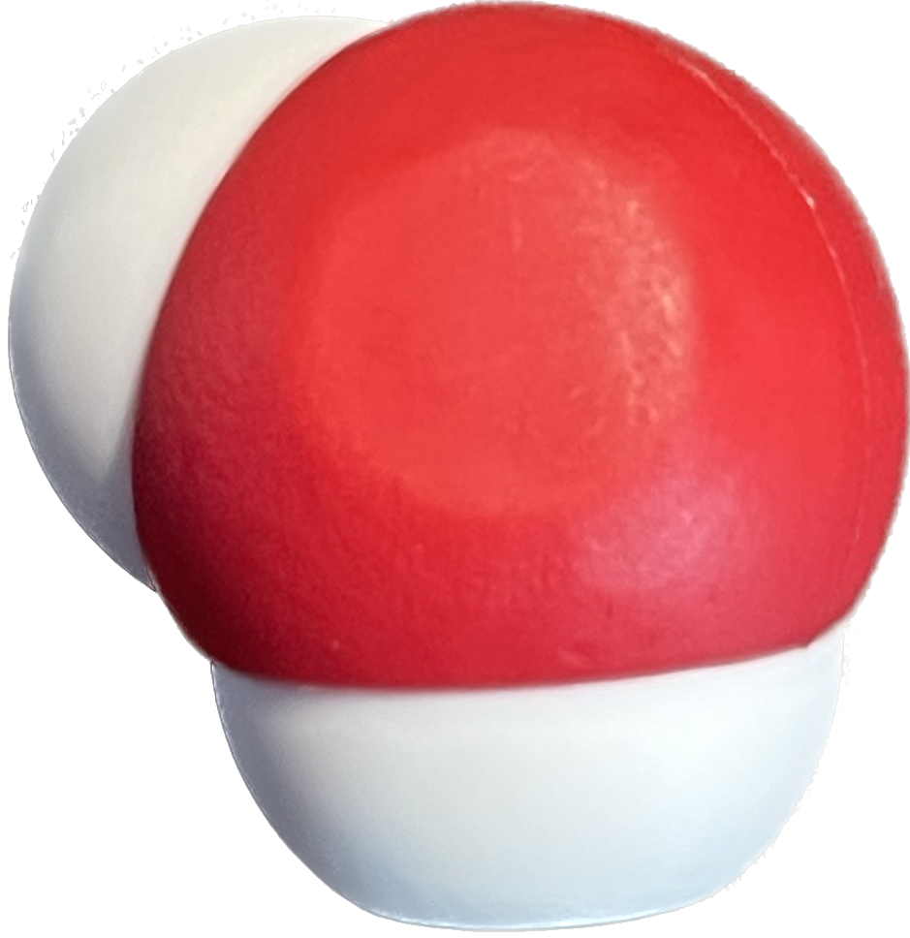
Why do the water molecules interact this way?
1
8
H
O
1.008
15.99
But first… what even IS water?
Notes:
A little information about the molecule of water…

Slide 47

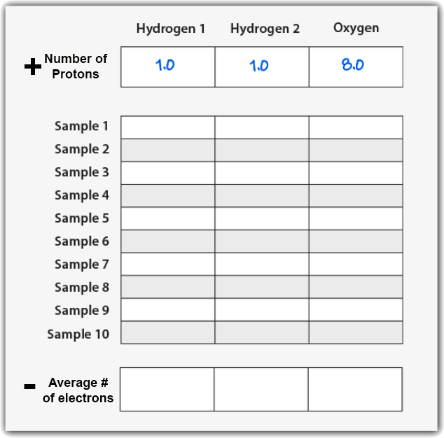
Where ARE the electrons in water?
Notes:
Provide this table to make transition to this activity go quickly!
Teacher: Give your students time to collect data. Point out that the electrons associated with the hydrogen atoms are yellow and the electrons associated with the oxygen atom are pink.
Clicking on the 3D view mode (bottom, center box) will assist students in collecting their data.
Student: Count the electrons associated with each atom and record the number in your data table .
‹#›

Slide 48


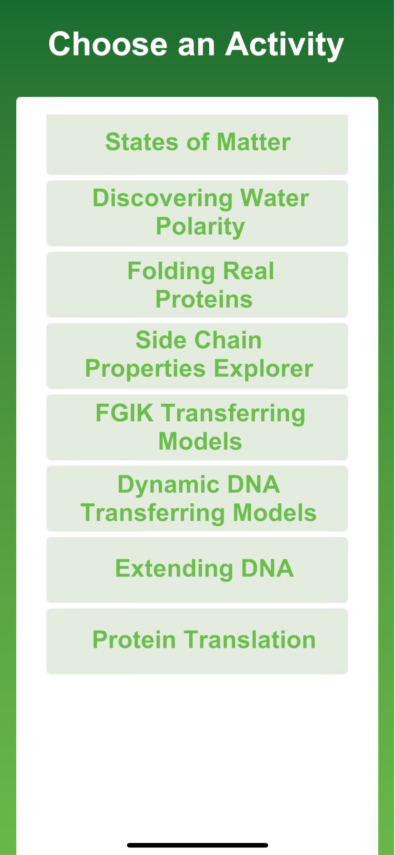
But why do the molecules interact this way?
Notes:
3DMD AR EDU app in the Google Play and Apple Store

Slide 49
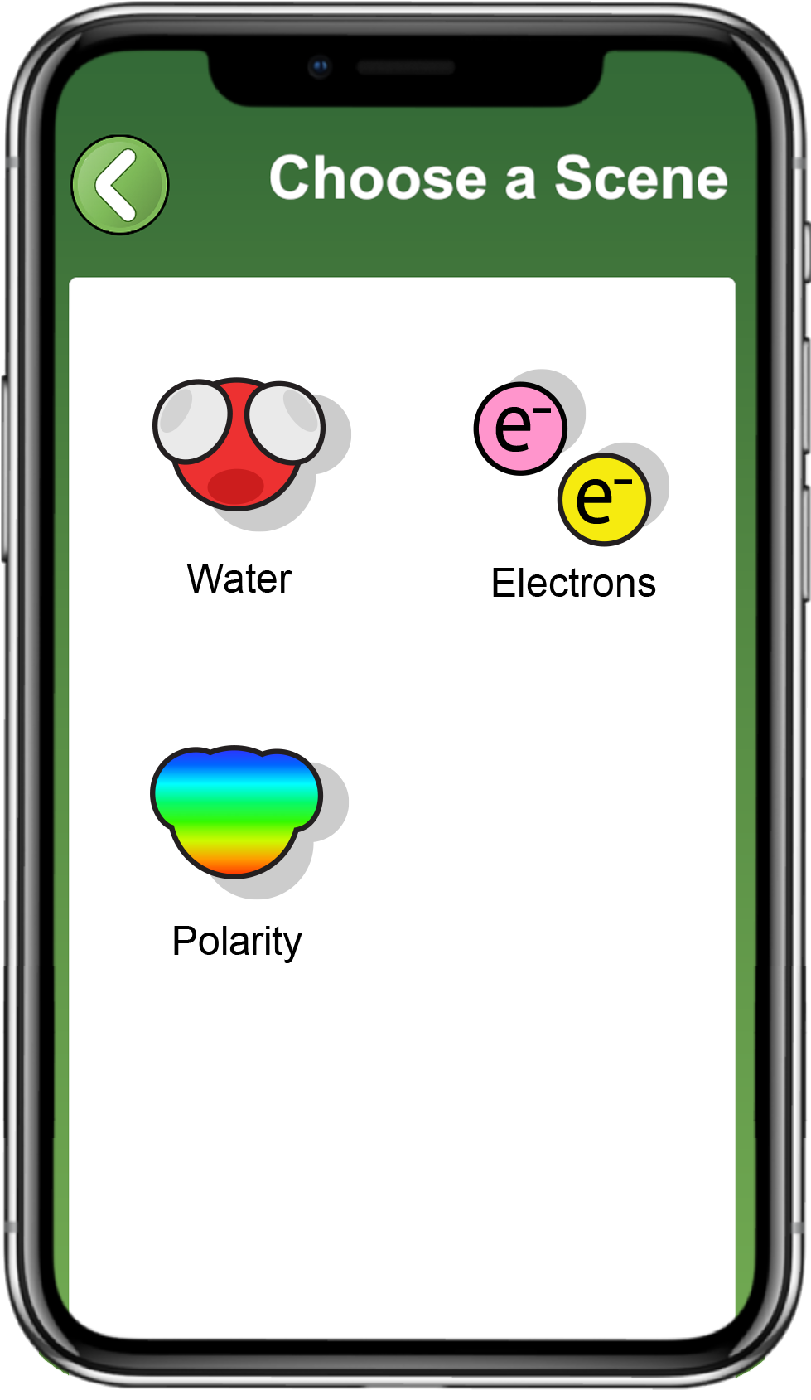
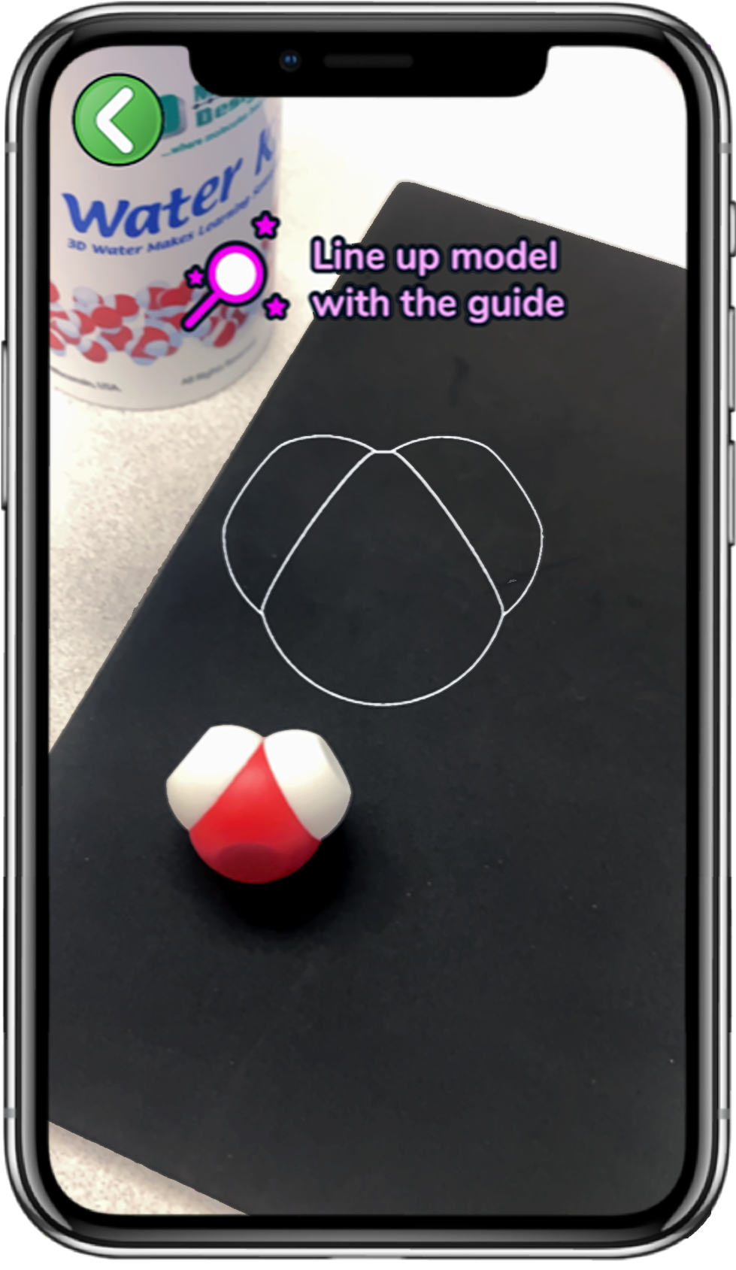
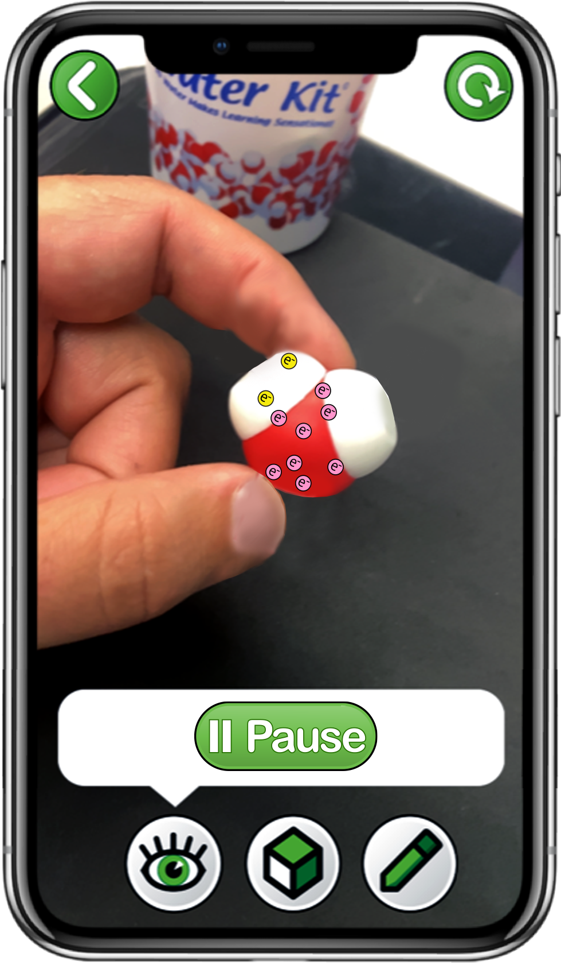

Explore Electrons with the 3DMD AR EDU App
Scan a single water molecule
Explore the
Play and Sample buttons
Choose
Electrons
Notes:
Teacher: Read the instructions on screen. Circulate through the room to assist students with technology needs.
Student: Select the correct activity and scene in the App. Record data in their data table as they begin sampling.
‹#›

Slide 50
Where ARE the electrons in water anyway?
Electrons move very, very fast!!
The Sample button stops the electrons so you can see where they are
Notes:
Provide this table to make transition to this activity go quickly!
Teacher: Give your students time to collect data. Point out that the electrons associated with the hydrogen atoms are yellow and the electrons associated with the oxygen atom are pink.
Clicking on the 3D view mode (bottom, center box) will assist students in collecting their data.
Student: Count the electrons associated with each atom and record the number in your data table .
‹#›

Slide 51

Explore Electron Distribution
Sample electron locations ten times to complete your data table.
Notes:
Provide this table to make transition to this activity go quickly!
Teacher: Give your students time to collect data. Point out that the electrons associated with the hydrogen atoms are yellow and the electrons associated with the oxygen atom are pink.
Clicking on the 3D view mode (bottom, center box) will assist students in collecting their data.
Student: Count the electrons associated with each atom and record the number in your data table .
‹#›

Slide 52
Average Observed Electron Distribution
Once your data table is filled with at least ten samples, calculate the average electrons observed near each atom.
Average of x = (x₁ + x₂ + x₃ +. . . x_{n}) / n
Record these averages in the bottom row of your table.
Notes:
Teacher: Work through calculating the mean of hydrogen 1 together and then give them time to calculate the mean for the hydrogen 2 and oxygen. Give students time to calculate the mean (average) of their ten trials for all three atoms. You may need to provide students with additional support for calculating a mean.
Extension: teach your students to use functions of Excel or Google Sheets to calculate means.
Student: Calculate the mean of each atom and record it in your data table.
‹#›

Slide 53
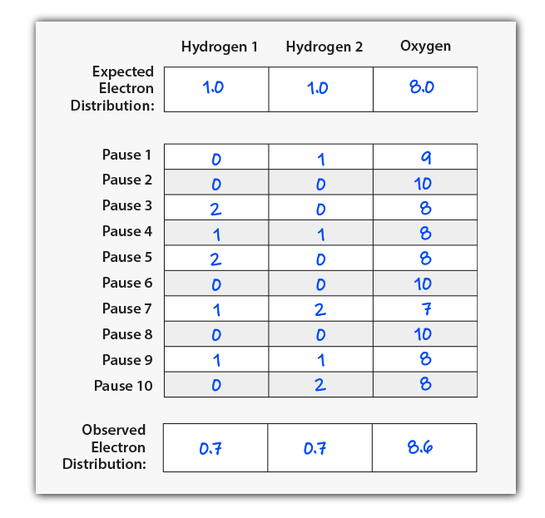



Discuss at your table!
Do electrons spend more time near the hydrogen atoms or the oxygen atom?
Notes:
Teacher: Have students share their data with the class and create a class data table. Facilitate discussion, discourse, and consensus. By the end of the discussion, students should understand that the sharing of electrons constitutes a covalent bond between a hydrogen atom and an oxygen atom. Water has two covalent bonds. Note: These are example data. Results may vary.
Student: Students should compile data or have a discussion to form a classroom consensus model. They should notice that all groups’ data are similar, but not identical. Students should determine that reason for this is the random movement of electrons within the electron cloud.
‹#›

Slide 54
Discuss at your table!
Do electrons spend more time near the hydrogen atoms or the oxygen atom?
How do the number of protons compare to the average number of electrons over time for each atom?
Notes:
Teacher: Have students share their data with the class and create a class data table. Facilitate discussion, discourse, and consensus. By the end of the discussion, students should understand that the sharing of electrons constitutes a covalent bond between a hydrogen atom and an oxygen atom. Water has two covalent bonds. Note: These are example data. Results may vary.
Student: Students should compile data or have a discussion to form a classroom consensus model. They should notice that all groups’ data are similar, but not identical. Students should determine that reason for this is the random movement of electrons within the electron cloud.
‹#›

Slide 55
Discuss at your table!
Do electrons spend more time near the hydrogen atoms or the oxygen atom?
How do the number of protons compare to the average number of electrons over time for each atom?
Why might that be?
Notes:
Teacher: Have students share their data with the class and create a class data table. Facilitate discussion, discourse, and consensus. By the end of the discussion, students should understand that the sharing of electrons constitutes a covalent bond between a hydrogen atom and an oxygen atom. Water has two covalent bonds. Note: These are example data. Results may vary.
Student: Students should compile data or have a discussion to form a classroom consensus model. They should notice that all groups’ data are similar, but not identical. Students should determine that reason for this is the random movement of electrons within the electron cloud.
‹#›

Slide 56
Discuss at your table!
Do electrons spend more time near the hydrogen atoms or the oxygen atom?
How do the number of protons compare to the average number of electrons over time for each atom?
Why might that be?
What impact might this have on the behavior of a water molecule?
Notes:
Teacher: Have students share their data with the class and create a class data table. Facilitate discussion, discourse, and consensus. By the end of the discussion, students should understand that the sharing of electrons constitutes a covalent bond between a hydrogen atom and an oxygen atom. Water has two covalent bonds. Note: These are example data. Results may vary.
Student: Students should compile data or have a discussion to form a classroom consensus model. They should notice that all groups’ data are similar, but not identical. Students should determine that reason for this is the random movement of electrons within the electron cloud.
‹#›

Slide 57
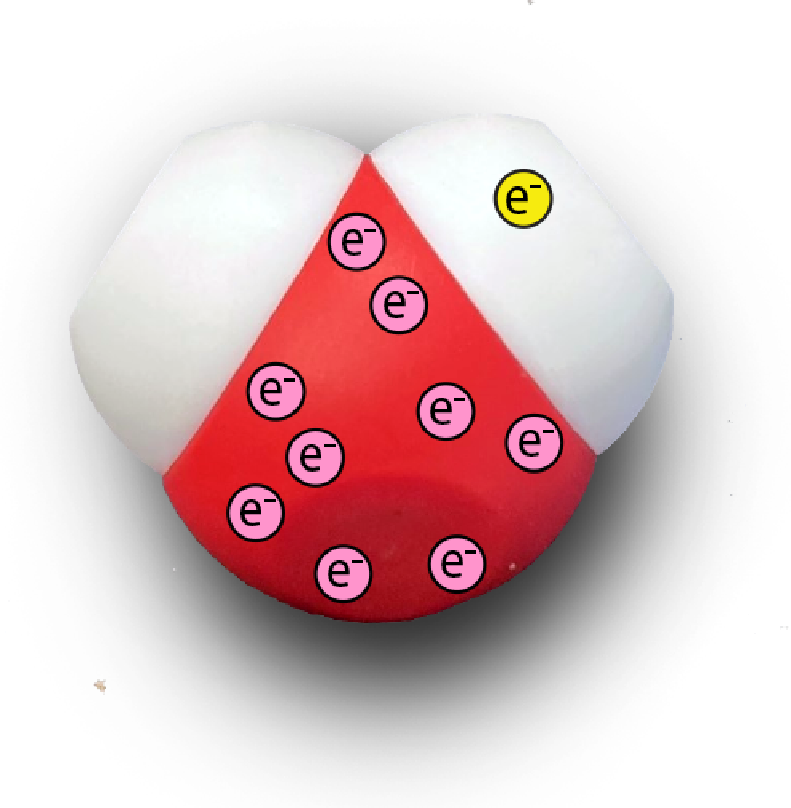
Electrons Are Not Shared Equally
The electrons in a water molecule are not shared equally!
On average, electrons spend slightly more time near the oxygen atom than the hydrogen atoms
We call this property of water POLARITY!
Notes:
Teacher: Allow students to edit their annotated sketches based upon new data. Ask your students: "How has your thinking changed? Why?" Have your student share their responses with a partner. You have an opportunity to discuss electronegativity with your students by pointing out that in addition to the size of the nucleus, the relative electronegativity of elements is also affected by electron shielding.
Student: Update their annotated sketch or confirm their thinking in their notebook.
‹#›

Slide 58
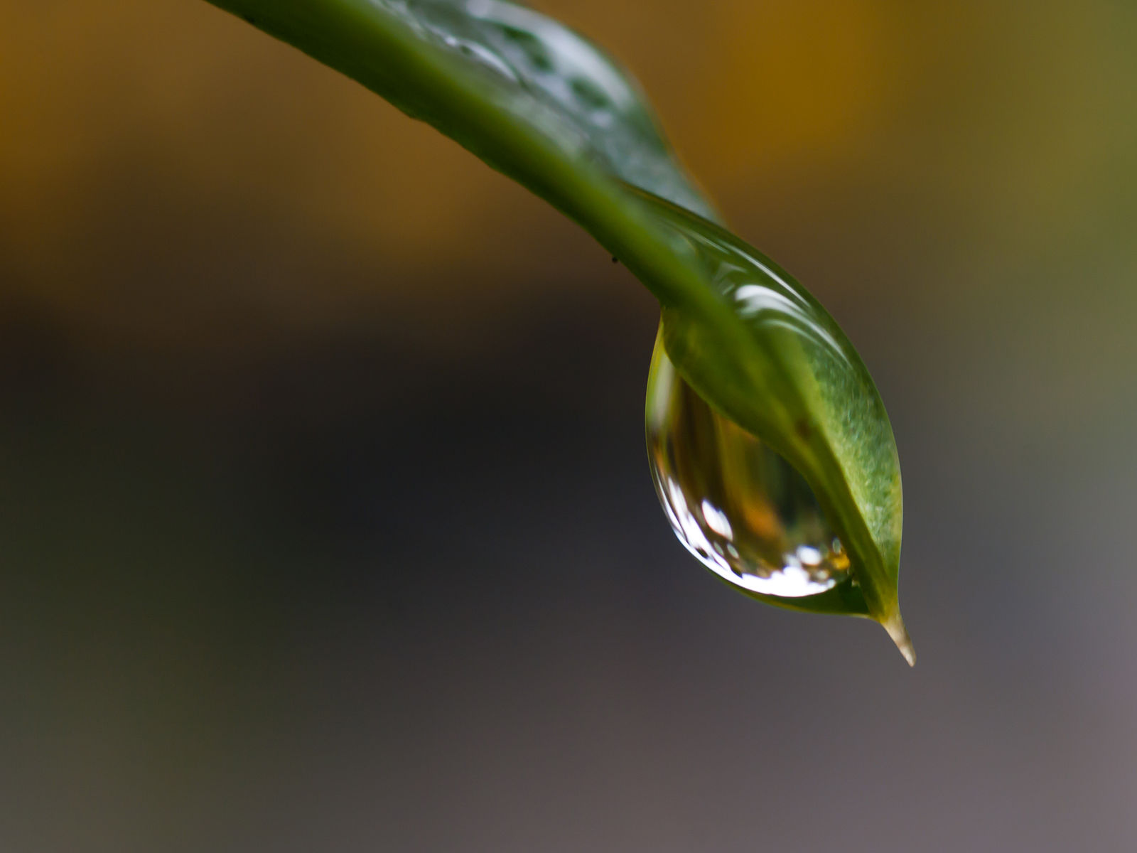
Cohesion
Explain with data:
Why is a water molecule polar?
Why are water molecules cohesive?
https://commons.wikimedia.org/wiki/File:Water_Droplet_On_Leaf.jpg
Notes:
Teacher: Allow students to edit their annotated sketches based upon new data. Ask your students: "How has your thinking changed? Why?" Have your student share their responses with a partner. You have an opportunity to discuss electronegativity with your students by pointing out that in addition to the size of the nucleus, the relative electronegativity of elements is also affected by electron shielding.
Student: Update their annotated sketch or confirm their thinking in their notebook.
‹#›

Slide 59
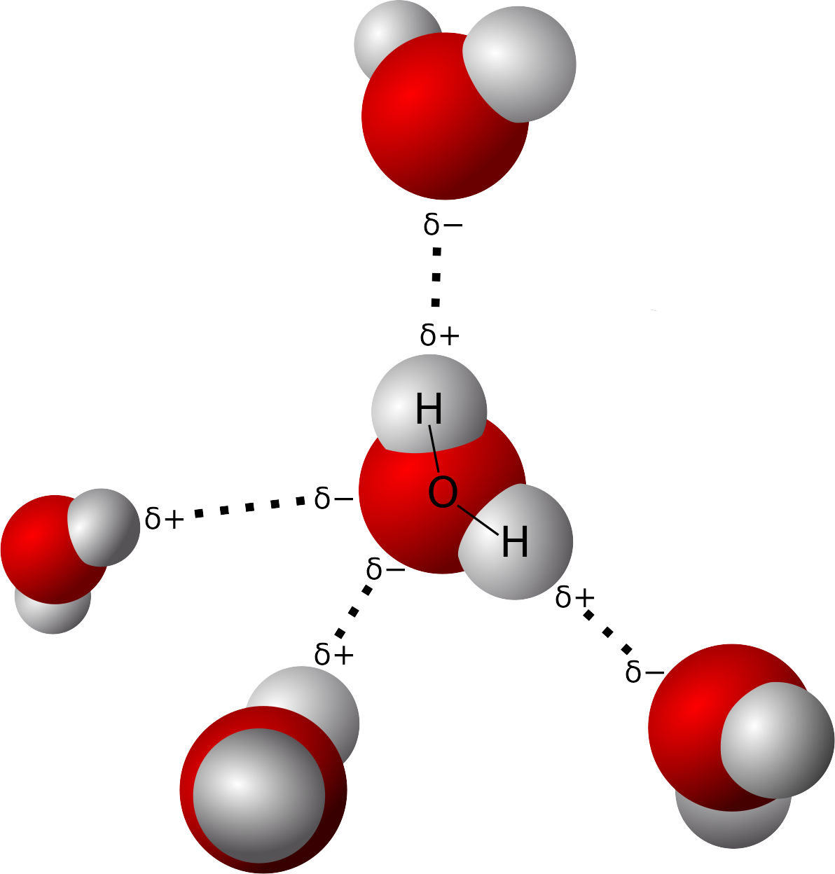
Hydrogen bonds
Notes:
By User Qwerter at Czech wikipedia: Qwerter. Transferred from cs.wikipedia to Commons by sevela.p. Translated to english by by Michal Maňas (User:snek01). Vectorized by Magasjukur2 - File:3D model hydrogen bonds in water.jpg, Public Domain, https://commons.wikimedia.org/w/index.php?curid=14929959

Slide 60
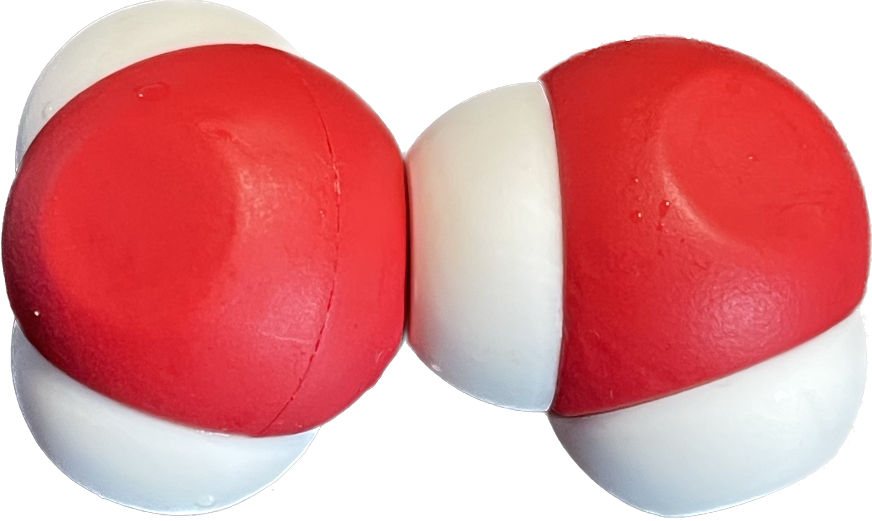
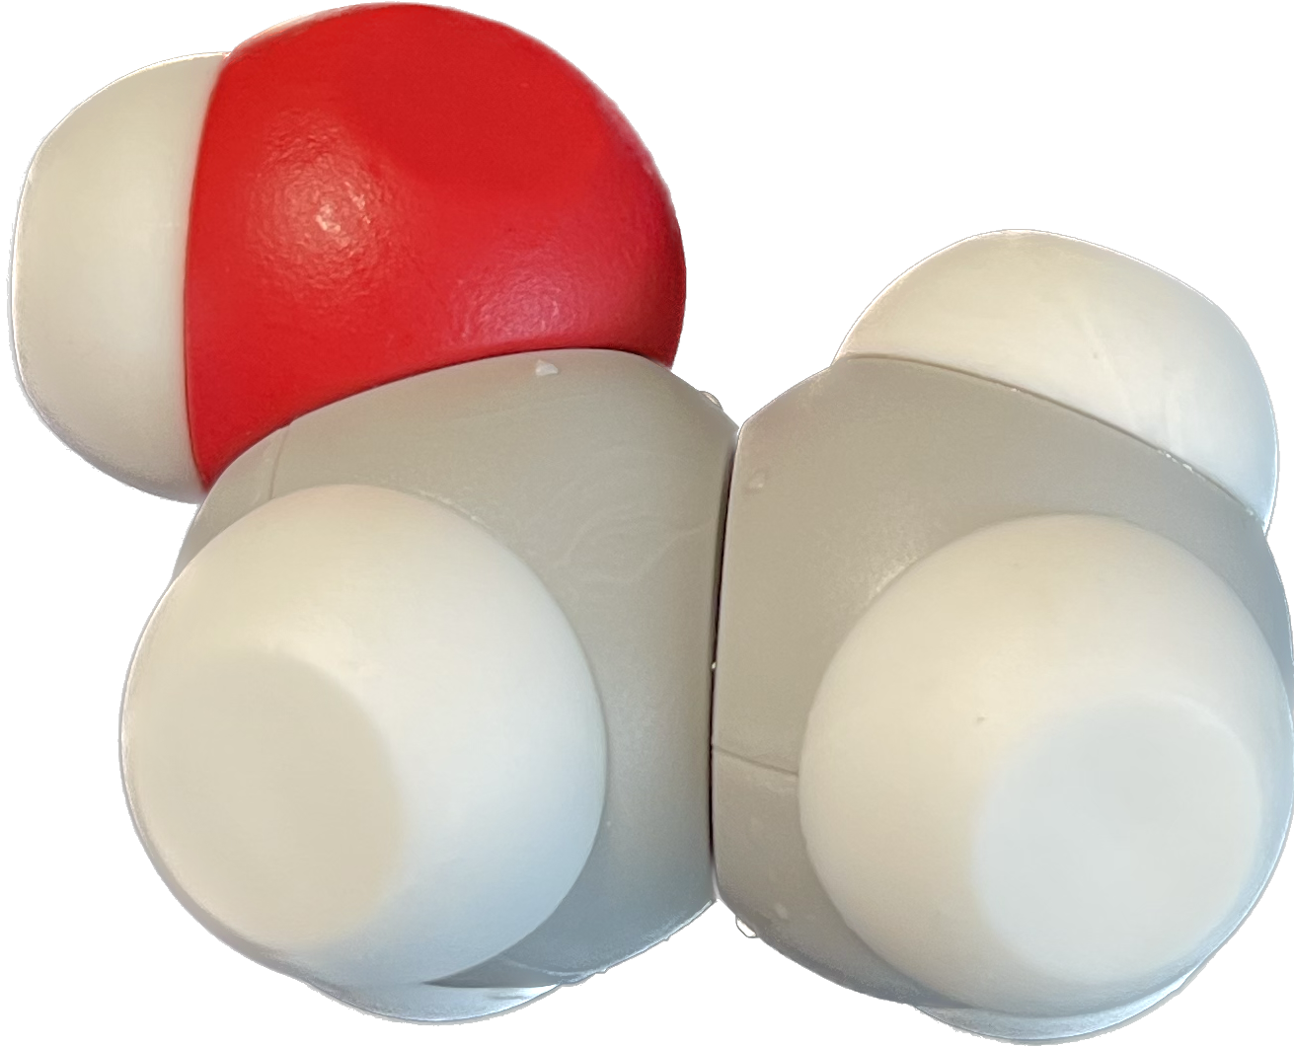
Ethanol: Play and observe!
What I observe What I wonder

Slide 61
Polar
Non-Polar

Slide 62
Discuss at your table
Based on how this model behaves, escribe your predictions of electron behavior in this molecule.

Slide 63
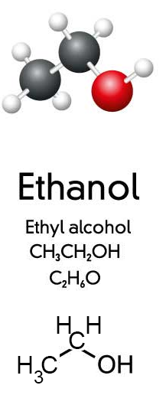
Is it Hydrophilic? Hydrophobic?

Slide 64
Is it Hydrophilic? Hydrophobic?
Hydrophilic

Slide 65
Is it Hydrophilic? Hydrophobic?
Hydrophilic
Hydrophobic

Slide 66
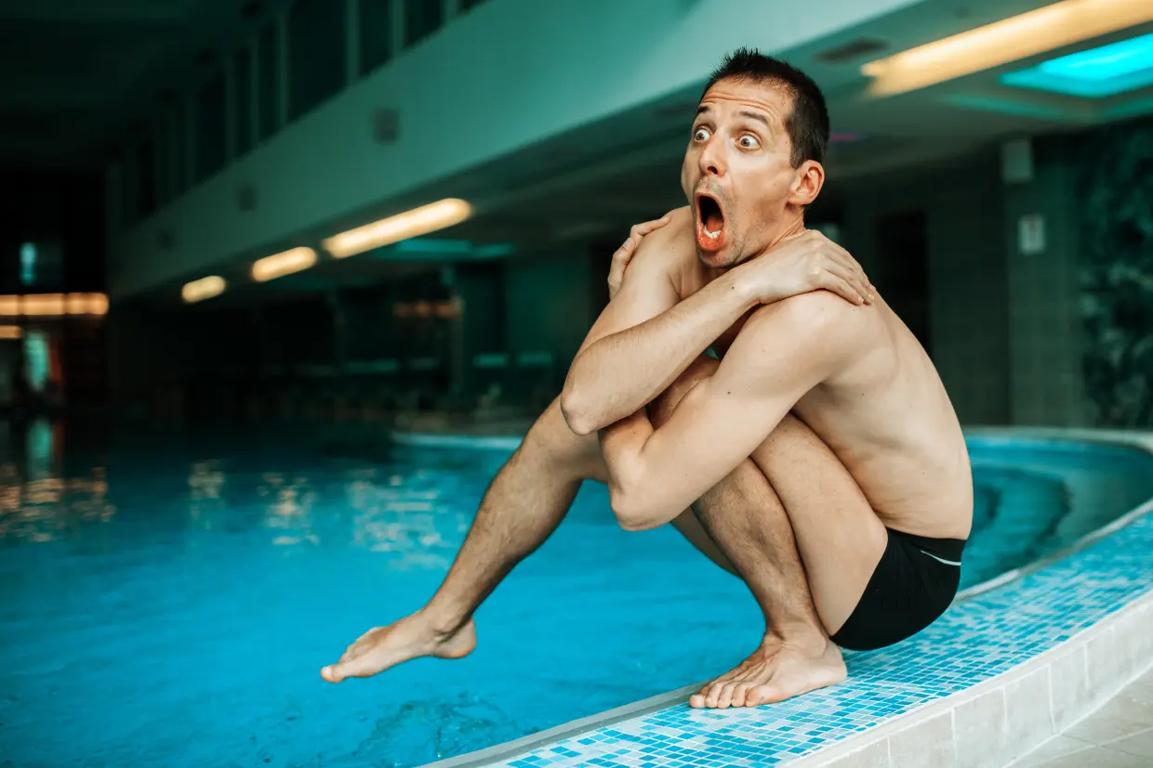
What does it mean to be hydrophobic?
(H2 OH NO What is aquaphobia and what causes fear of water? Symptoms, celebrity sufferers and cures 2018)

Slide 67
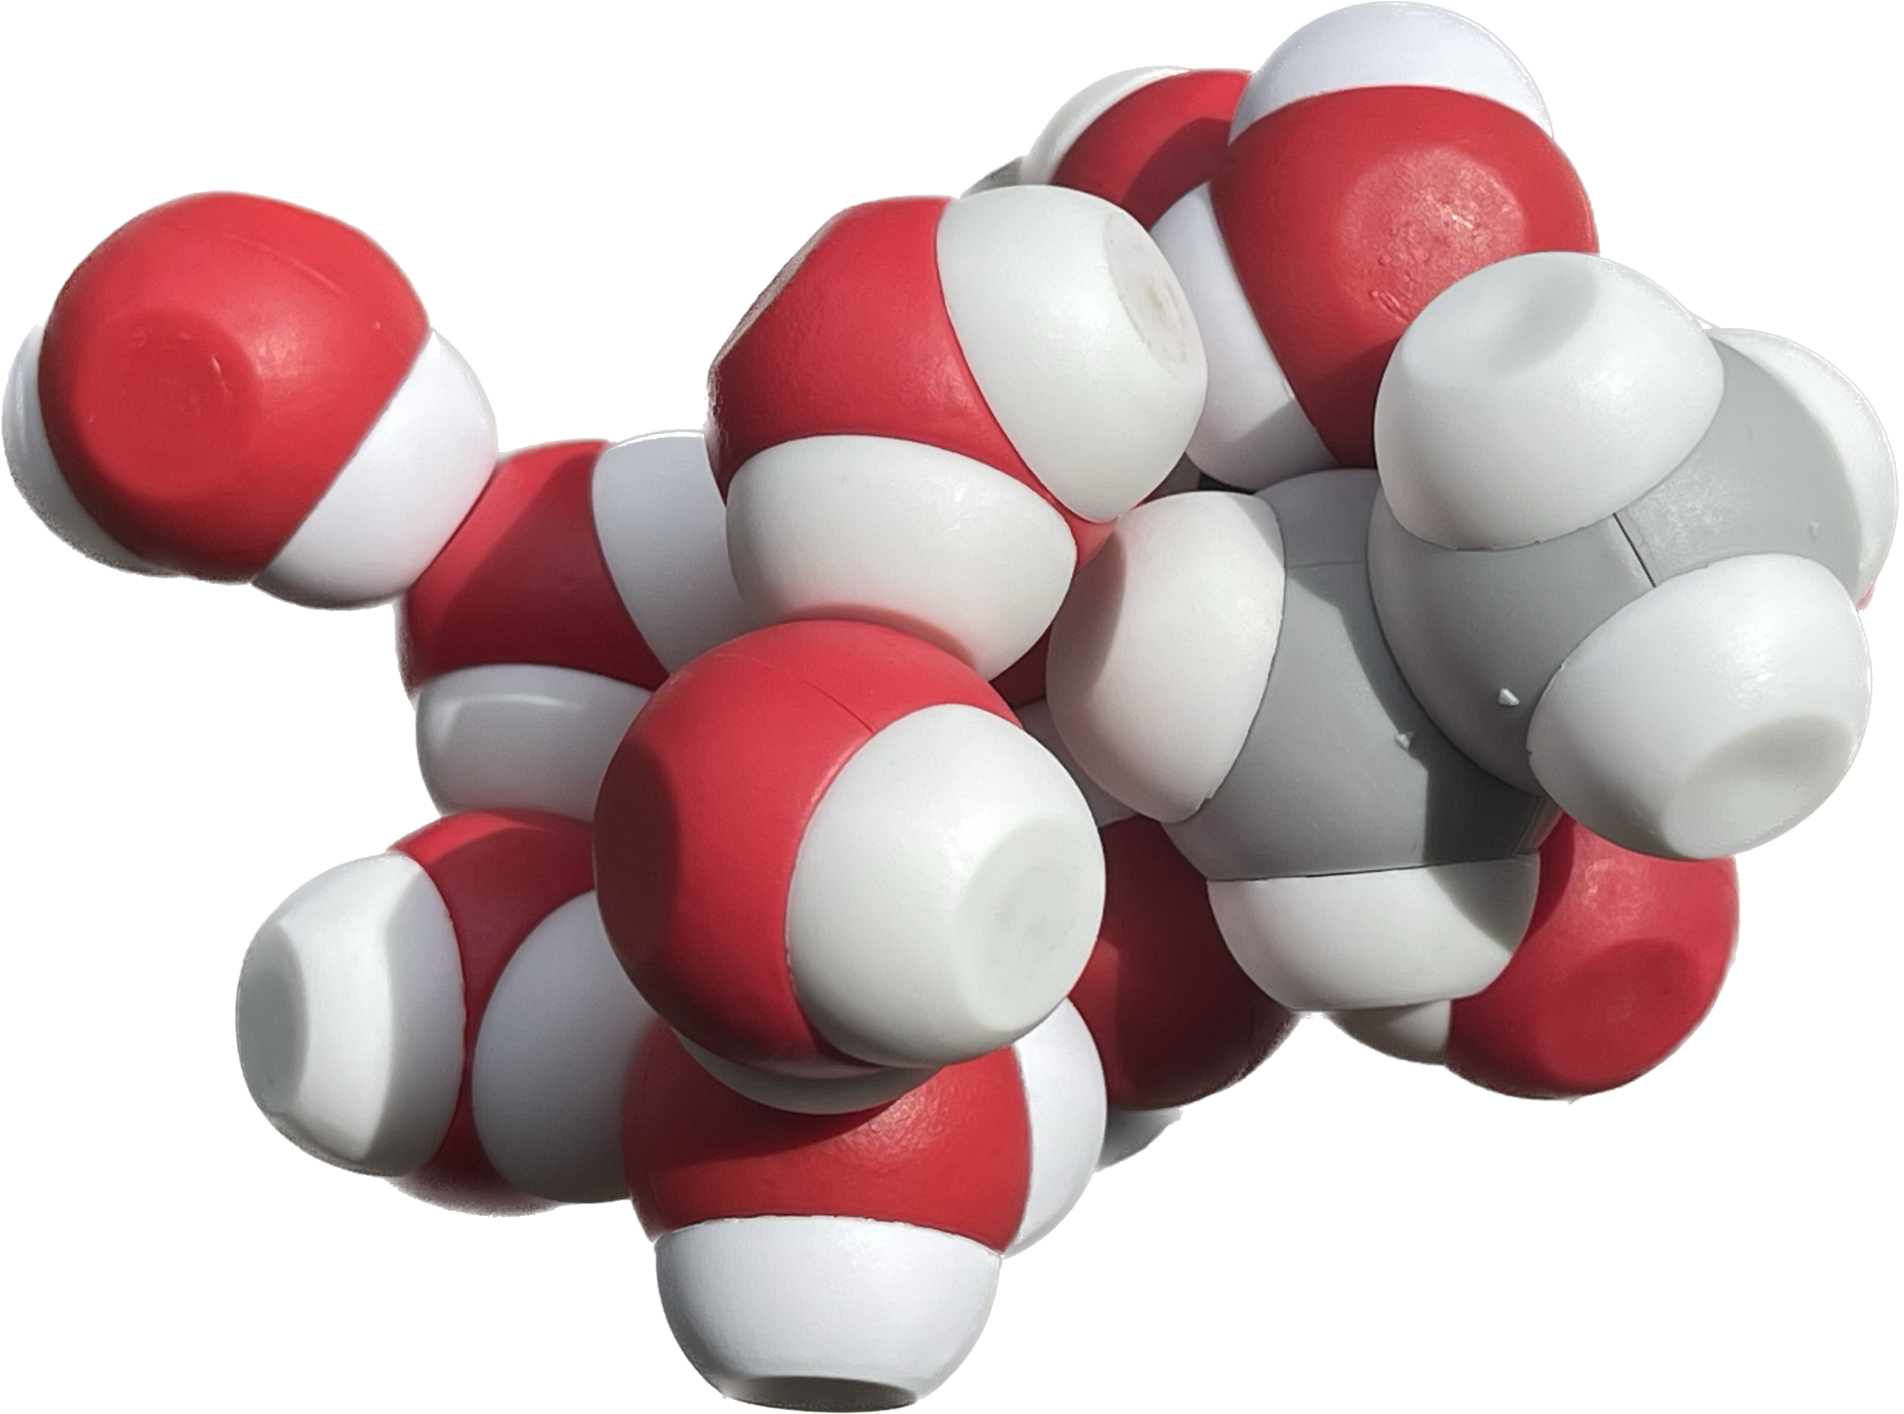
Play! What do you notice?

Slide 68

What does it mean to be… hydrophobic?
(H2 OH NO What is aquaphobia and what causes fear of water? Symptoms, celebrity sufferers and cures 2018)

Slide 69

Make a prediction!
PREDICT:
How many drops of ethanol (relative to water) do you think will stay on the penny?
(Smith, 2021)
Notes:
Omit if time is short!

Slide 70
Now do the experiment!
One drop at a time.
Count as you drop.
Remember how many drops were held BEFORE the water spills over the edge.
(Smith, 2021)

Slide 71
Record your data and discuss:
Did your Data Fit your Prediction?
How does your interaction with the physical models help you explain your data?
50 drops
Ethanol

Slide 72

P³: Play, Ponder and Predict
How might this (hexanol) behave in water differently than the ethanol you have already considered?
Notes:
Reflection 10:30-10:45

Slide 73


Solutions!
Notes:
Which is which? How do you know?

Slide 74

What about pH? Can you model it?
https://commons.wikimedia.org/wiki/File:PH_Scale.png

Slide 75
What about pH? Can you model it?
Increasing H⁺ ions
Increasing OH⁻ ions
https://commons.wikimedia.org/wiki/File:PH_Scale.png

Slide 76
On the whiteboard in the back…
Write down moments in the lesson that you think exemplified…
Wonder
Explore
Explain

Slide 77

Break

Slide 79


What have you learned?
What questions can you answer?
What new questions do you have?
What more do you need to know?
(Agre, 2003)
Notes:
Looking and listening for the idea of a membrane or barrier from inside and out or movement of water from inside and out. Or questions about the barriers? Share these observations after break to begin exploration of membranes

Slide 80
Regrounding in the Phenomenon
What can we explain? What might we explore next?
(Agre, 2003)
Notes:
Teacher: Give groups time to revise their explanation.
Learner: Apply learning from the previous lesson to revise your explanation for the phenomenon.

Slide 81


Life on the Inside
Phospholipid and Membrane Transport Kit
Water is the driving force of all of nature.
~Leonardo da Vinci

Slide 82

Let’s Play!
What elements do you see?
What chemical properties might this molecule have?
What new questions do you have?
Notes:
Teacher: Ask learners to look closely at the structure of the molecule in front of them. Share and compare the different structures
Learner: Compare phospholipids structure among other tables. Engage your phospholipid with another table. Why do we call them phospholipids?

Slide 83

Parts of a phospholipid
1
2
3

Slide 84




Could you build it?
Fatty Acids x2

Slide 85
Formalize Your Observations
On your own: Sketch a simplified model of a phospholipid in your notebook that represents the basic structures found in all phospholipids.
Reference text
Notes:
Teacher: Give learners time to ponder the three main structures on the phospholipid.
Learner: Sketch a generalized phospholipid in their notebook. Label it.

Slide 86
Formalize Your Observations
Did your model include?
Phosphate Head Group
Glycerol
Lipid Tails
Reference text
Notes:
Teacher: Give learners time to ponder the three main structures on the phospholipid.
Learner: Sketch a generalized phospholipid in their notebook. Label it.

Slide 87

How did this molecule interact with water?

Slide 88


One molecule, many properties…
Molecules that contain polar and nonpolar regions are amphipathic.
Where do you find polar and nonpolar properties on these models?
Notes:
Teacher: Introduce the concept of amphipathic. Facilitate discussion about the similarities and difference between these models.
Learner: Identify the polar and nonpolar areas on these models.

Slide 89


How do phospholipids form membranes?
Membrane Modeling Challenge 1
Using what you now know about phospholipid molecules, model what happens when 10 molecules of phospholipids are dropped on the surface of water.

Slide 90

How do phospholipids form membranes?
Membrane Modeling Challenge 1
Using what you now know about phospholipid molecules, model what happens when 10 molecules of phospholipids are dropped on the surface of water.

Slide 91
Membrane Modeling Challenge 2
Using the same 10 phospholipids, arrange them in the beaker so that they are submerged in the water while still maintaining the correct hydrophobic/hydrophilic interactions.

Slide 92

Membrane Modeling Challenge 2
Using the same 10 phospholipids, arrange them in the beaker so that they are submerged in the water while still maintaining the correct hydrophobic/hydrophilic interactions.

Slide 93



Slide 94


How are membranes formed?
Membrane Modeling Challenge 3
Using as many phospholipids as you need… create a membrane that can CONTAIN water as well as be surrounded by water.

Slide 95

How are membranes formed?
Membrane Modeling Challenge 3
Using as many phospholipids as you need… create a membrane that can CONTAIN water as well as be surrounded by water.

Slide 96


Slide 97

Draw your model of a membrane in your science notebook….
For 2 minutes… write what you know about the structure of a membrane from this activity.

Slide 98



?

Slide 100
On the whiteboard in the back…
Write down moments in the lesson that you think exemplified…
Wonder
Explore
Explaine
Notes:
Provide template for this in the notebook in this document: https://docs.google.com/document/d/1fHFFCYEjuT7f3A_Hzq_Rda3wu1335GnN5UXNggrgyzA/edit?usp=sharing

Slide 102
Regrounding in the Phenomenon
What can we explain? What might we explore next?
(Agre, 2003)
Notes:
Teacher: Give groups time to revise their explanation.
Learner: Apply learning from the previous lesson to revise your explanation for the phenomenon.

Slide 103


Slide 104
Lunch Options
15 Minute Drive North
Chain Fast Food Options
15 Minute Walk West / 3 Minute Drive
Sonic & 7-Eleven
6 Minute Drive East
Local & Chain Fast /Counter Service
15 Minute Walk South / 3 Minute Drive
Local Counter Service

Slide 105



Slide 106
Going Deeper…
Membranes

Slide 107

Not a single covalent bond…joins one phospholipid to another.

Slide 108


Slide 109


Slide 110
The appearance of phosphatidylserine in the outer leaflet of the plasma membrane appears to be a universal phenomenon in cells undergoing apoptosis, or programmed cell death
PtdSer acts as an ‘eat me’ signal on dead cells

Slide 111


Slide 112

Not a single covalent bond…joins one phospholipid to another.

Slide 113
Not a single covalent bond…joins one phospholipid to another.

Slide 114
QUESTIONS…
(Showing your students how to think….and ask questions)
What cellular processes require a ready supply of new phospholipids?
Where do these new phospholipids come from?
If different phospholipids are found in different membranes,… how do they get sorted out at their site of synthesis and sent to the right membrane?
If some phospholipids are found in the inner leaflet of a membrane,
and others are found in the outer leaflet….Why?... and then How?

Slide 116
Regrounding in the Phenomenon
What can we explain? What might we explore next?
(Agre, 2003)
Notes:
Teacher: Give groups time to revise their explanation.
Learner: Apply learning from the previous lesson to revise your explanation for the phenomenon.

Slide 117



Let’s Recap!
What questions have we answered and made good progress on?
What questions do we still have?

Slide 118

Building Blocks of Life
Amino Acid Building Blocks + Amino Acid Starter Kit
"Amino acids are as important to life as the letters of the alphabet are to language."
~Anonymous

Slide 119
What is a Protein?

Slide 120
A protein is a polymer, made of monomers.
⚫️
🟣
🟠
🟣🟠🟤🟢🔴⚫️🟡
🟢
🟤
🔴
🟡
And the monomer is...

Slide 121

A protein is a polymer of amino acid monomers.
Notes:
Give each participant a molymod (or two)
Carbon - Black
Oxygen - Red
Hydrogen - White
Nitrogen - Blue
Single Bond - Short Connector
Double Bond - Long Flexible Connector
Hydrogens are adjacent

Slide 122





Now play! What do you notice?
Notes:
Give each participant a molymod (or two)
Carbon - Black
Oxygen - Red
Hydrogen - White
Nitrogen - Blue
Single Bond - Short Connector
Double Bond - Long Flexible Connector
Hydrogens are adjacent

Slide 123




What did you notice?

Slide 124

Do this!

Slide 125
Dehydration synthesis

Slide 126

A protein is a polymer of amino acid monomers.
Notes:
Give each participant a molymod (or two)
Carbon - Black
Oxygen - Red
Hydrogen - White
Nitrogen - Blue
Single Bond - Short Connector
Double Bond - Long Flexible Connector
Hydrogens are adjacent

Slide 127
Central or ⍺
Carbon
Carboxyl group
Amino Group

Slide 128
A protein is a polymer of amino acids found in water.
Carboxyl group
Amino Group

Slide 129


Donates a hydrogen…
↓ pH
An acid!

Slide 130

Donates a hydrogen…
↓ pH
An acid!
Accepts a hydrogen
↑ pH
A base!

Slide 131

Overall, a zwitterion in water.
Donates a hydrogen…
An acid!
Accepts a hydrogen
A base!

Slide 132
Let’s make a protein…
Dehydration Synthesis
➕

Slide 133
Let’s make a protein…
Dehydration Synthesis
➕

Slide 134





Slide 135

A dipeptide!

Slide 136

What pattern do you see?

Slide 137
Peptide bond
C
C
N
C
C
N

Slide 138
Join with another person to put your dipeptide together and make a polypeptide!
➕

Slide 139

A protein is a polymer of amino acids found in water.

Slide 140
What is this???

Slide 141



Slide 142



Different Representations of Amino Acids

Slide 143

Sidechain or R-Groups…

Slide 144




Slide 145

Rotation is Not Folding
Polypeptides can rotate at backbone bonds.
Rotation changes shape moment to moment.
A tetrapeptide does not hold a stable folded structure.
https://d2u1z1lopyfwlx.cloudfront.net/thumbnails/95510ddd-aee9-52ad-b373-e4133616f429/42671cf9-78fd-58a6-b8da-dd6fce1eb3cc.jpg

Slide 146



Another Way to Model a Polypeptide
Notes:
Jim starts here. 1:20

Slide 147

Representations of Amino Acids
Using the amino acid sidechain chart, identify the different types of amino acids and place them on the bumpers of circle placemat.

Slide 148
What do you notice? What do you wonder?

Slide 149

Choose Your Own (Protein) Adventure
6 Hydrophobic sidechains
2 Acidic sidechains
2 Basic sidechains
2 Cysteine sidechains
3 Polar sidechains (white)

Slide 150

Primary Structure of a Polypeptide

Slide 151

Identifying Various Components of the Model
R-groups
Peptide bonds
N-terminus
C-terminus

Slide 152

Identifying Various Components of the Model
How might different amino acid R groups interact with each other in water (an aqueous environment)?
Model these interactions.

Slide 153
Tertiary Structure of a Polypeptide
How can these modeling activities help students deepen their understanding of protein structure?
Which scientific skills are students able to develop through this lesson?
How might you be able to utilize modeling in the lessons/units you currently teach?

Slide 154

Where will we find hydrophobic side chains?

Slide 155

Acidic - Basic associations

Slide 156

Cysteines!

Slide 157

Hydrophilic?

Slide 158



Predicting Protein Structure
How might a change in a single amino acid affect the tertiary structure of a polypeptide?

Slide 159
Amino Acid. (n.d.). Bluebonnet Nutrition. Retrieved July 3, 2024, from https://bluebonnetnutrition.com/products/amino-acid-750-mg-vegetable-capsules.
PerfectAmino Essential Amino Acid. (n.d.). Bodyhealth. Retrieved July 3, 2024, from https://bodyhealth.com/products/perfectamino.

Slide 160

Reflection: Give Me Five
Proteins are…
(list four features)
Proteins are not…
(list one thing)

Slide 161

Break like a ‘Sconnie!

Slide 162

Molecular Origami - Fold it!
AASK / DMH
"Protein folding is the Holy Grail of structural biology."
- Cyrus Chothia

Slide 163


What does “Folding a Protein” mean?

Slide 164


Shake it!

Slide 165
What happened?
What did the shaking represent?
What are some conditions or factors that may affect protein structure?
Notes:
Denaturation
pH, Temperature, Solvents, mechanical stress, radiation

Slide 166

Protein Denaturation
(‎ McGraw-Hill Science/Engineering/Math, 2011)
Notes:
Denaturation

Slide 167

Polypeptide: Secondary Structure
(Limeri, Chapter 21: Protein structure and function)
Notes:
Denaturation

Slide 168
Understanding Secondary Structures
Let's build a helix and a sheet!
What new questions do you have?
Notes:
Denaturation

Slide 169
Exploring Protein Structure
Use the Digital Modeling Hub to explore Secondary Structure of protein
https://learn.3dmoleculardesigns.com/zinc-finger-exploratorium-pl
Access code: SUMMER24
Link
What patterns do you notice?
How might this help us understand the phenomenon?

Slide 170
Let's add some secondary structures
Add 1 helix somewhere in your folded toober
Add 2 sheets to your toober

Slide 171

Teacher Guide
Next Generation Science Standards
Science and Engineering Practices | Cross Cutting Concepts | Disciplinary Core Ideas
Scientific Investigations Use a Variety of Methods | Stability and Change | HS-LS1-3
Developing and Using Models | Systems and System Models | HS-LS1-2
Constructing Explanations and Designing

Slide 172



Teacher Guide
Estimated Class Time Needed: Content Kit/Models Needed: Content Related Materials/Kits Content Technology Content | Grade, Class Content Topics Content

Slide 173
What happens when you try to denature it now?
Shake it again!
How is this protein different from your initial protein fold?
What are the limitations of this model?

Slide 174

Protein Structures
Alpha Helices and Beta Sheets are formed by interactions in the backbone
Hydrogen bonds are formed between amino and carbonyl groups
Secondary structures provide stability for a protein structure

Slide 175

Exploring Quaternary Protein Structure
Exploring Insulin
What secondary structures are found on your insulin model?
How many peptides are found in this model?
How are these peptides held together?
Notes:
Extension: extracellular proteins are rich in disulfide bonds to withstand the less stable environment outside of cells

Slide 176
Meta Moment
3
List three facts about the relationship between primary and tertiary structure.
What are two things you know now that you didn’t know or you didn’t know you didn’t know?
One way in which secondary structure is essential for protein stability.
2
1

Slide 177

Time to reflect:
All Models are wrong, some are useful.

Slide 178
Revisiting the Phenomenon
How might our new learning about amino acids and protein structure help make sense of our phenomenon?
What new questions do you have?
(Agre, 2003)
Notes:
Teacher: Give learners time to revise their models.
Learner: Update your model to include new learning.

Slide 179

Bio Break!

Slide 180
Going Deeper…
Exploding Frog Eggs Experiment

Slide 181


The value of collaboration….
In science, one should use all available resources to solve difficult problems. One of our most powerful resources is the insight of our colleagues.

Slide 182
Image that you were a graduate student
in Peter Agre’s lab back in 1991…..
Could you have discovered the function of CHIP28?

Slide 183
What was known in 1992?
Abundant protein in red blood cell membranes
28kDa protein… in a polyacrylamide gel
Cloned cDNA 🡪 mRNA transcript
269 amino acid protein

Slide 184

How would you determine the function of this protein?

Slide 185


The famous exploding frog egg experiment…
POP
Cell with CHIP28
Cell without CHIP28
Micro-injection of CHIP28
mRNA into frog oocytes…..

Slide 186

Protein Design Challenge
Individually, design a protein to span a membrane to transport water.
What properties would you include in your membrane?
  Which amino acids might you use?
What structures would you include in your design? Why?
How might it help explain our phenomenon?
Notes:
Design a channel protein challenge in their notebook so share tomorrow with their new group and then the room. The groups will change. Turn it back over Heather.

Slide 187
"Bang, bang, bang, bang—like popcorn, they all exploded by osmosis, so we knew we had it in the first experiment.... It was a lot of fun." -Peter Agre

Slide 189


What were your “Aha!” moments from today?
Notes:
Write first in your notebook. Then as they are comfortable, write out on the whiteboard.

Slide 190

What were your “Aha!” moments from today?
Notes:
Write first in your notebook. Then as they are comfortable, write out on the whiteboard.

Slide 191


Slide 192


Graduate Credit from the Teachers College of San Joaquin
3 Graduate Credits Available
$95/credit payable to the TCSJ
Additional Assignments: Lesson plan on
incorporating one of the kits into your class(s)
To apply:
Submit your lesson to contactus@3dmoleculardesigns.com to get an updated Certificate of Completion (reflection 45 hours)
Complete form at https://www.forms.teacherscollegesj.edu//3dmd
Pay $285 to TCSJ

Slide 193

MMW Texas Welcome Party
All are welcome and encouraged to attend!
June 8 at 5:30pm-ish
2009 Clover Spring Drive
Haslet, TX 76052
Chicken Fajita quesadillas and nachos
Soft drinks and water available
Pool available if you wish to lounge in the water.

Slide 194

End of Day Survey

