Slide 2

3DMD Photography Permissions

Slide 3
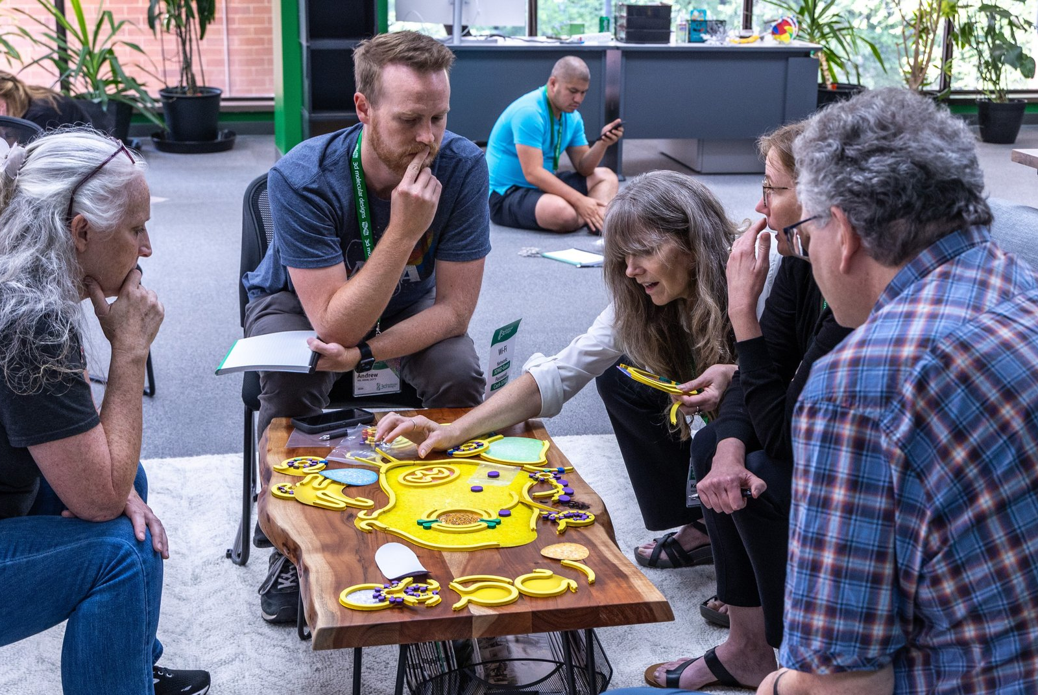
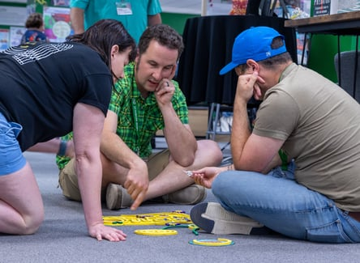
Join us,
at a 5-day Summer Workshop
Modeling Infection & Immunity
…or…
Watch our website…
… for more videos on this subject

Slide 4
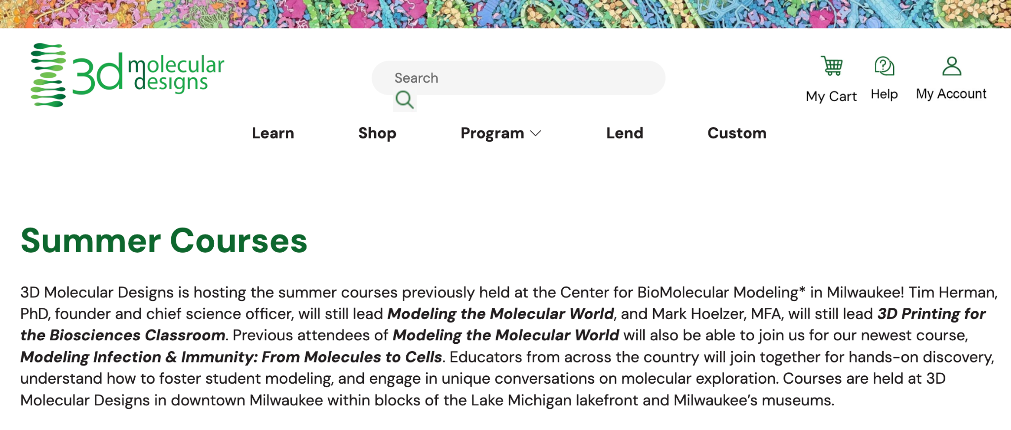
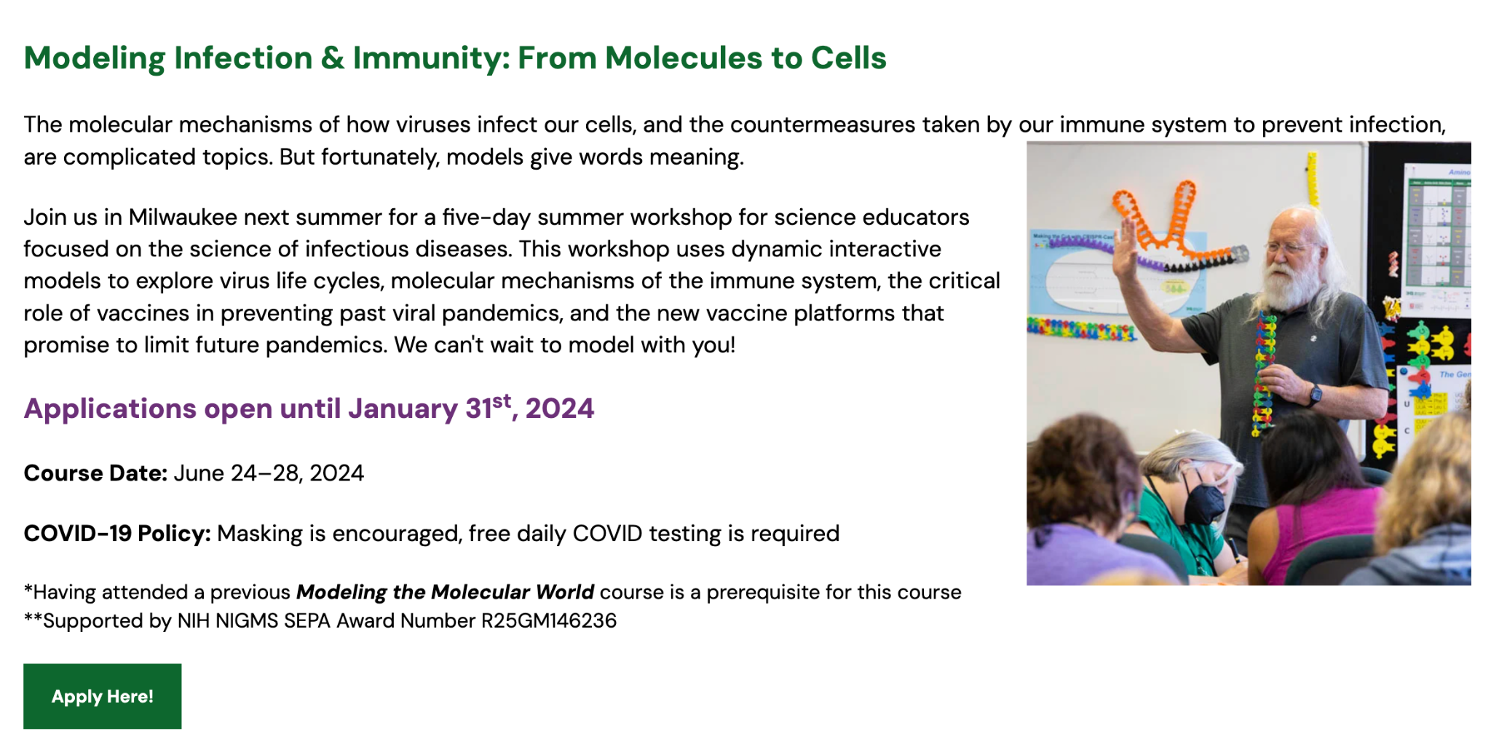
January 30, 2025
Stay tuned for the announcement This Fall!

Slide 5
Tuesday’s Joy
The collaborative learning
Working with the hands-on models
Playing with the kits and building up from yesterday’s work
working together on the cell model
The aquaporins and how water flips and hydrogen is kicked out
All of the stories and the deep dive into protein models.
The bacteriophage model, the cube model, working with cell modeling kit
Meeting new team members and getting to manipulate models
Intermembrane models
Learning about the aquaporin channel…
Building a challenging concept using models and craft supplies…
Aquaporin
The phages
Building models at the back tables and seeing the different perspectives… models.
Exploring the aquaporin model and then the K Chanel and Na Chanel models!
Manipulating the 3D printed proteins…
Enzymes in action kit
Hands on … with the cell modeling kit.
The lengthy, focused, quiet space provided for reflective journaling about my practice.

Slide 6
Wednesday’s Wants
Collaboration
Anything - I am open to learning.
Hand’s on !
Collaboration with my peers
Learning and exploring!
Of the same.
The same. Good flow/structure today
Opportunity to meet new people…
What we have been doing and…SMART teams
Protein modeling using computer software
working with a DQB board as a teacher.
I'm not sure.
Quaternary protein structures and active transport proteins
Conversations with colleagues about their experiences…
Conformational changes upon ligand binding
Other models available
Proteins with quaternary structures
Left versus right alpha helices
the other cell organelles
How to implement… don’t have a full class set
How to utilize and integrate models into teaching…
3DMD model teacher program
Stuff coming in the next few days
Na-K pump
Proteins. I love the stories…investigating and exploring
Cell signaling with receptors
Active sites
Bringing things to a big picture.
Stories I can apply… to help students remember topics.
Protein/nucleic acid interactions
How to give students more tools to study and review…
Protein interactions
Secondary, tertiary and quaternary structures…
The science…

Slide 7
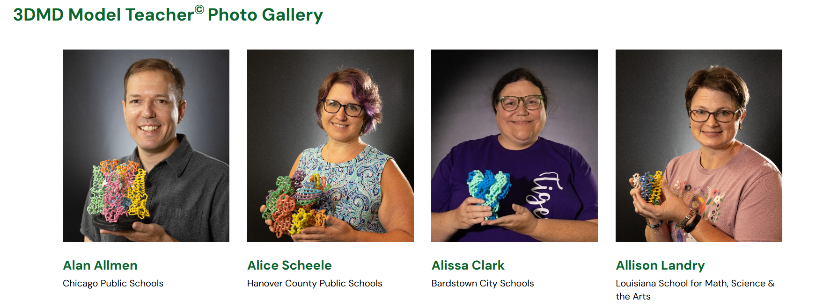

Slide 8

Group Photo Time!

Slide 10
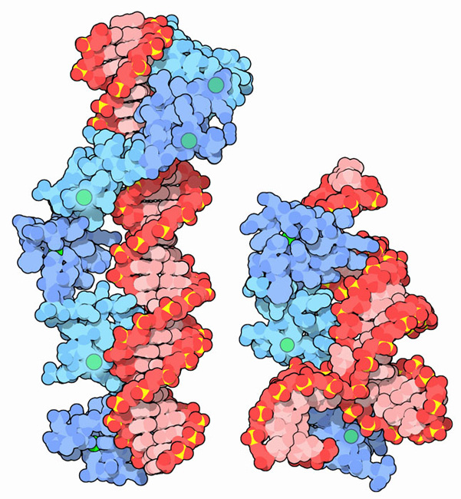
The Protein Data Bank…
PDB101…
…and Molecule of the Month
Tim Herman

Slide 11
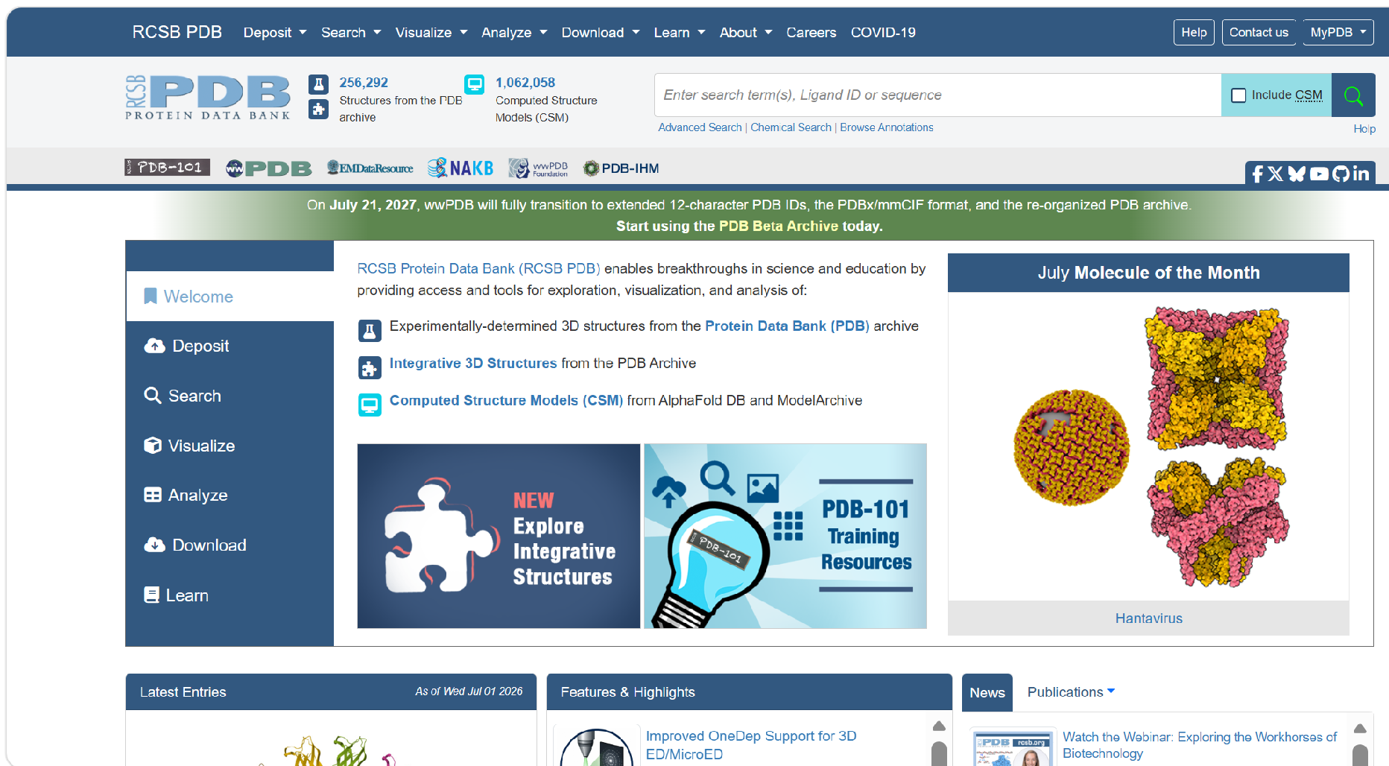
The Protein Data Bank
Notes:
Go to www.rcsb.org

Slide 12
The Protein Data Bank….
… is a repository of the atomic coordinates
that report the position in 3D space….
of all the atoms in a protein.
As of today, the PDB contains the coordinates for ~226,000 experimentally determined protein structures.

Slide 13
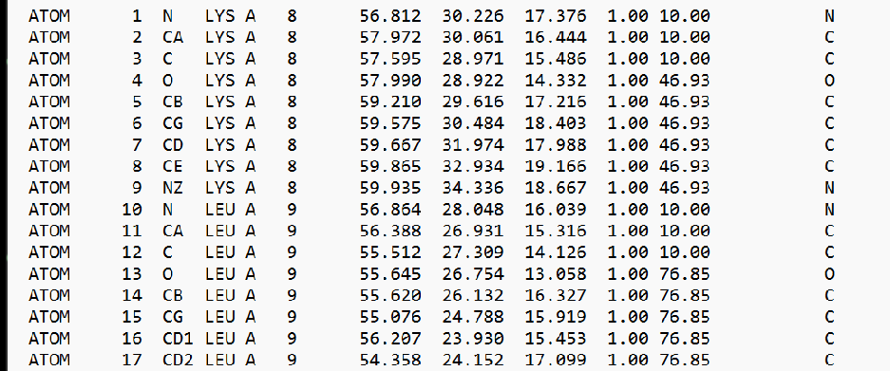
The pdb file (1FQY) describing aquaporin
(233 amino acids / 1,661 atoms)
X
Y
Z
Atom Records

Slide 14
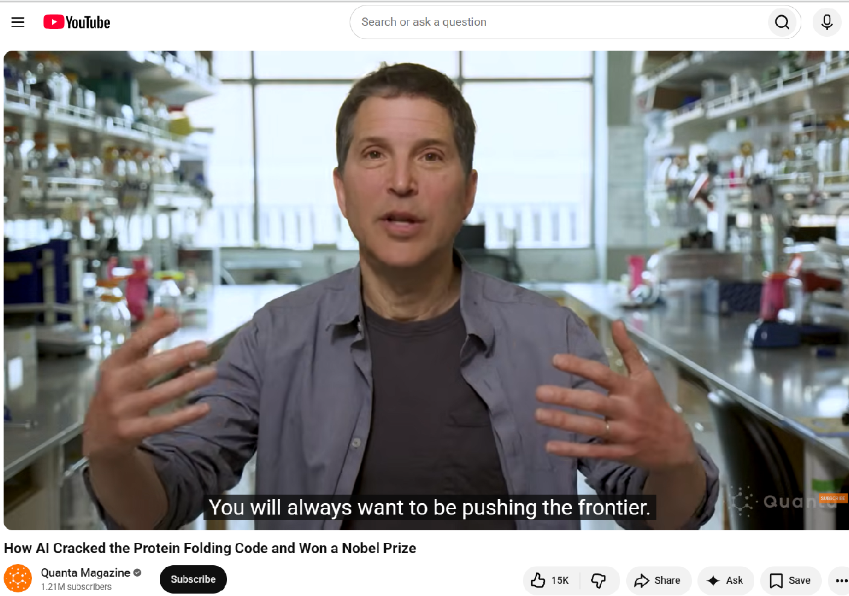
The Protein Folding Problem
Can we predict the 3D structure of a protein from its amino acid sequence?
https://www.youtube.com/watch?v=cx7l9ZGFZkw

Slide 15
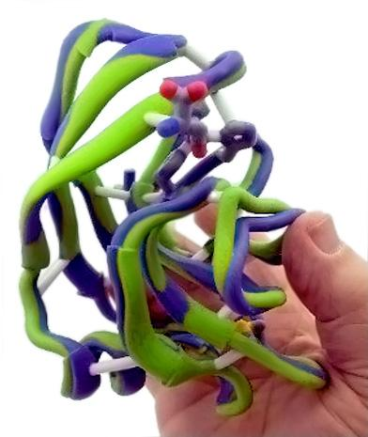
On December 30, 2020, the results of the CASP competition were announced.
With this announcement came the declaration that a grand challenge in science…a solution to the protein folding problem…had been solved.
“This is a big deal,” says John Moult, a computational biologist at the University of Maryland in College Park, who co-founded CASP in 1994 to improve computational methods for accurately predicting protein structures. “In some sense the problem is solved.”
https://www.youtube.com/watch?v=P_fHJIYENdI

Slide 16
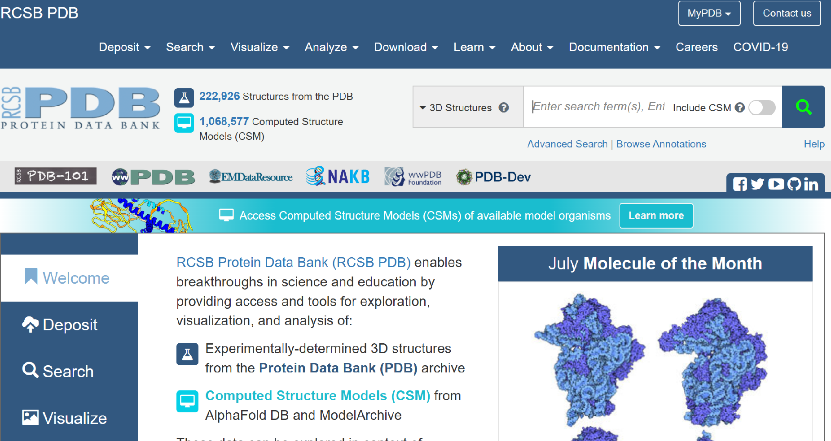
2024

Slide 17
Now that the Protein Folding Problem has been solved, should we change how we “teach proteins”?
No,….but:
we should acknowledge this milestone achievement in the molecular biosciences.
we should talk about Artificial Intelligence, Machine Learning and the value of Large Datasets of nucleotide sequences.
(we don’t have to know/teach how AlphaFold works)

Slide 18
How was the Protein Folding Problem solved??
The recent solution to the protein folding problem was made possible by decades of work by researchers around the world who…
sequenced genes,…and deposited these sequences in freely
accessible databases….(revealing coevolving amino acids)
determined protein structures… by x-ray diffraction methods, nuclear
magnetic resonance and most recently, by cryo-electron microscopy.
and developed Artificial Intelligence systems (AlphaFold).

Slide 19
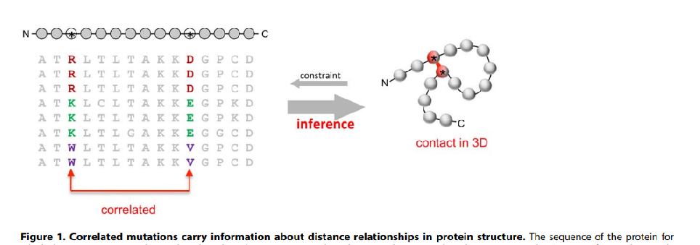
Protein 3D Structure Computed from Evolutionary Sequence Variation Debora S. Marks1 * ., Lucy J. Colwell2., Robert Sheridan3 , Thomas A. Hopf1 , Andrea Pagnani4 , Riccardo Zecchina4,5, Chris Sander3
co-evolving pairs of amino acids
PLoS ONE December 2011 | Volume 6 | Issue 12 | e28766

Slide 20
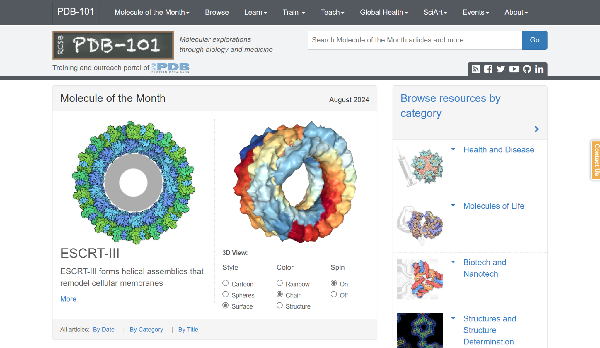
PBB-101

Slide 21
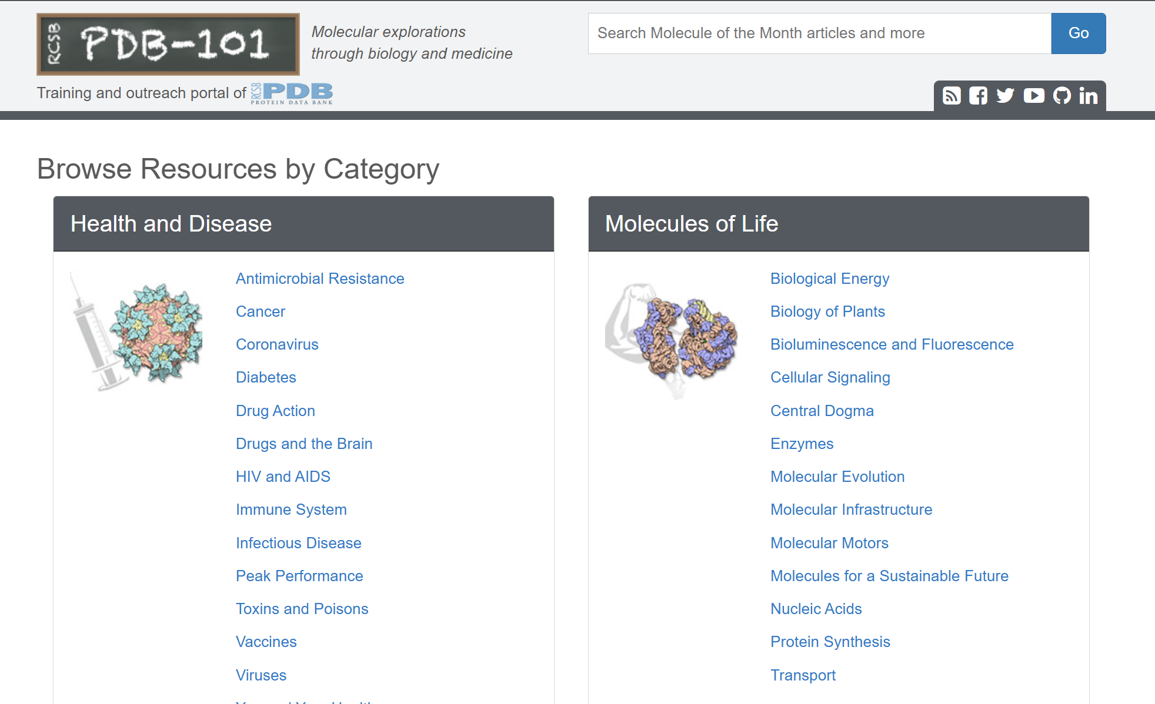

Slide 22
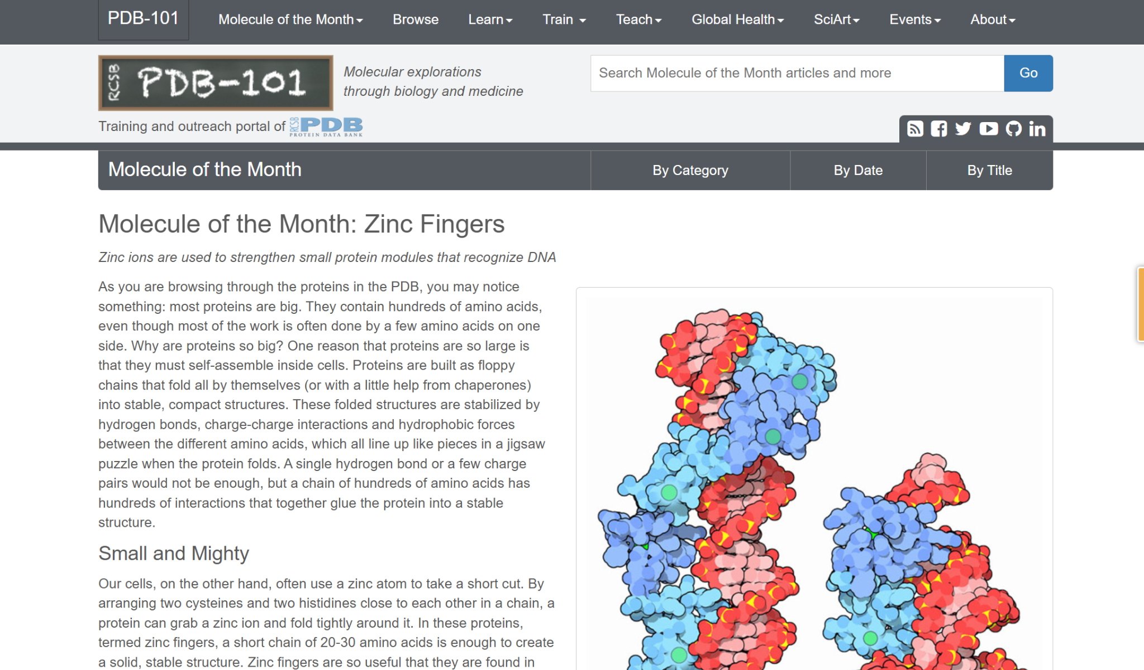
Find the Zinc Fingers resources
Notes:
Go to www.rcsb.org

Slide 23
PLAY!
What’s a protein story you’re interested in?
What’s a protein you think your STUDENTS may be interested in?
Notes:
Go to www.rcsb.org

Slide 26
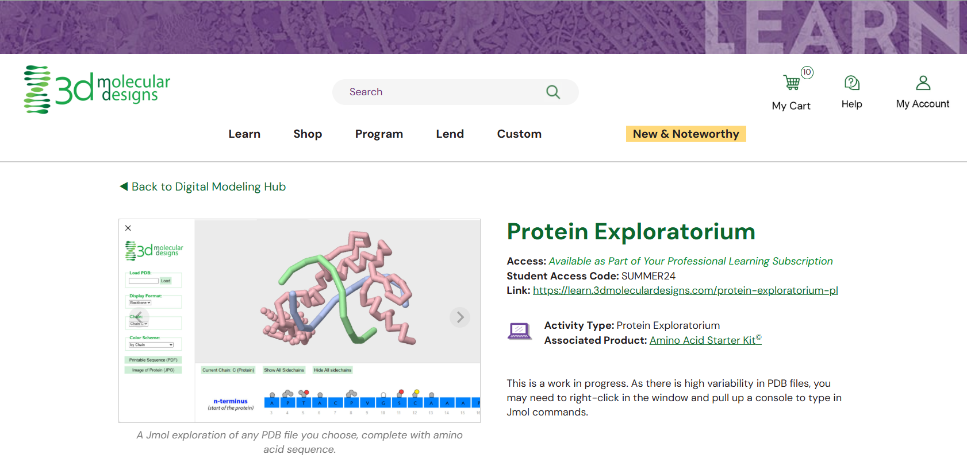
Protein Exploratorium

Slide 27


Slide 28

Model Melange
Rotate through 4 stations (12 minutes per station)
Bring your notebooks - jot down a list of the various protein stories featured
Ask lots of questions!

Slide 30
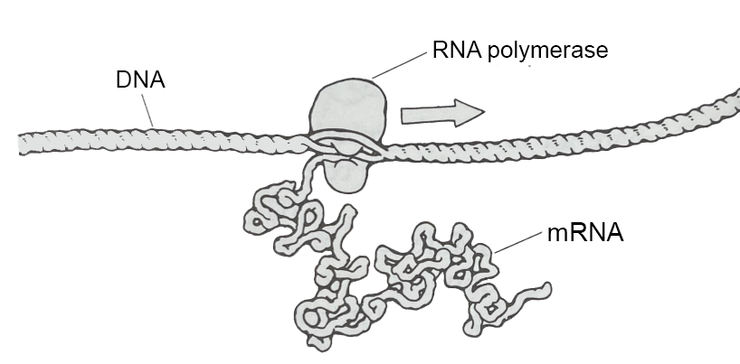
The Cellular Landscapes of David Goodsell
Tim Herman
3D Molecular Designs

Slide 31
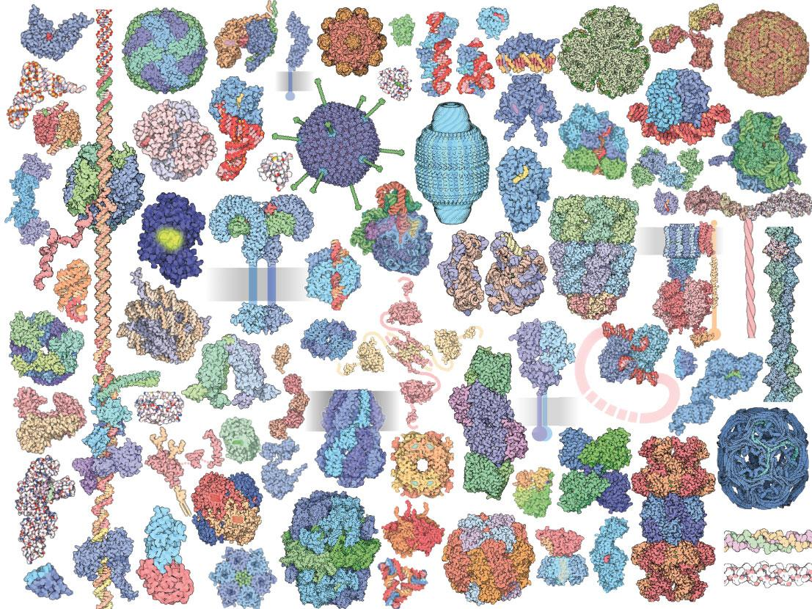

Slide 32
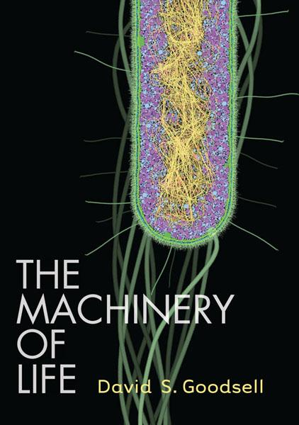

David Goodsell
Scripps Research institute
Scientist, Author, and Artist of all things small.

Slide 33
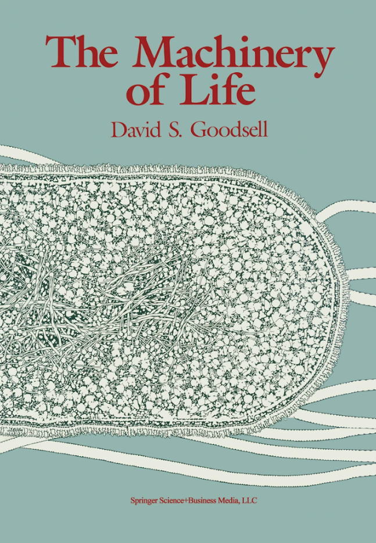

Imagine that we had some way to look directly at the molecules in our bodies…
1993

Slide 34
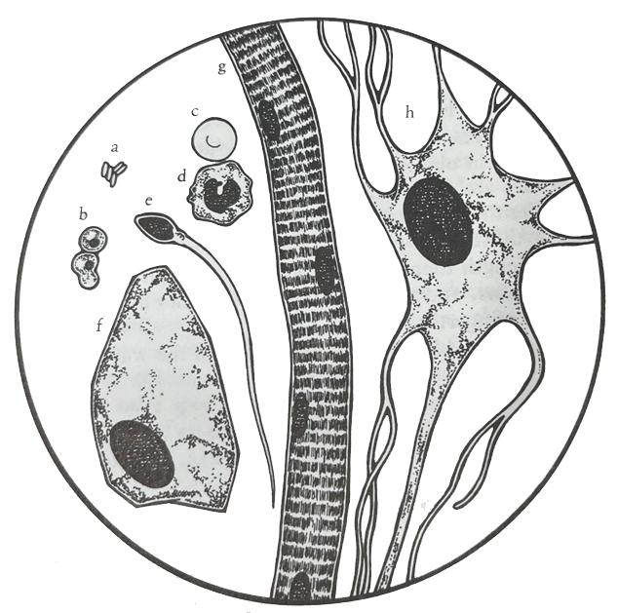
Red Blood Cell
Cells…
Neuron
Lymphocyte
1,000 X magnification
Bacteria
Sperm Cell
Yeast Cell
Human Skin Cell
Striated Muscle Cell

Slide 35
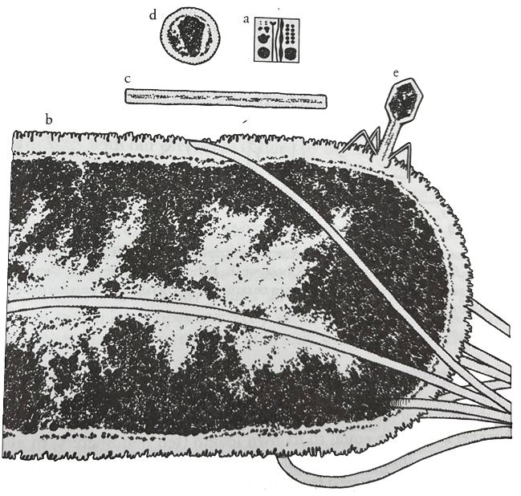
Bacteria,…
and Viruses
100,000 X magnification

Slide 36
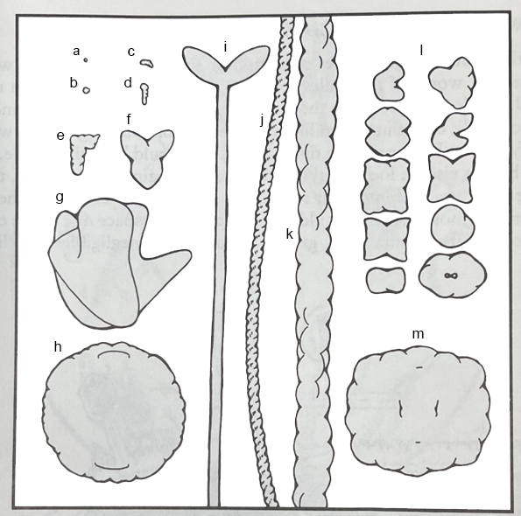
Molecules…
1,000,000 X magnification

Slide 38
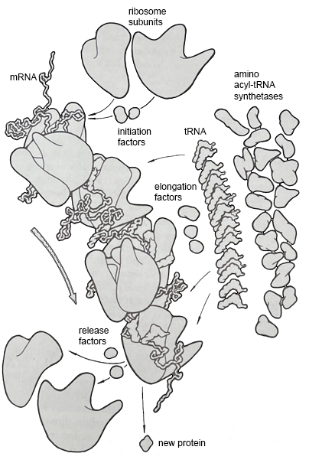

Slide 39
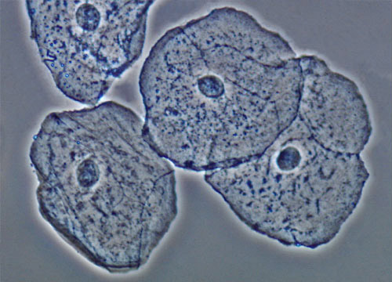
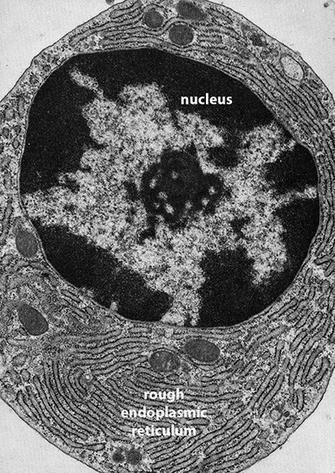
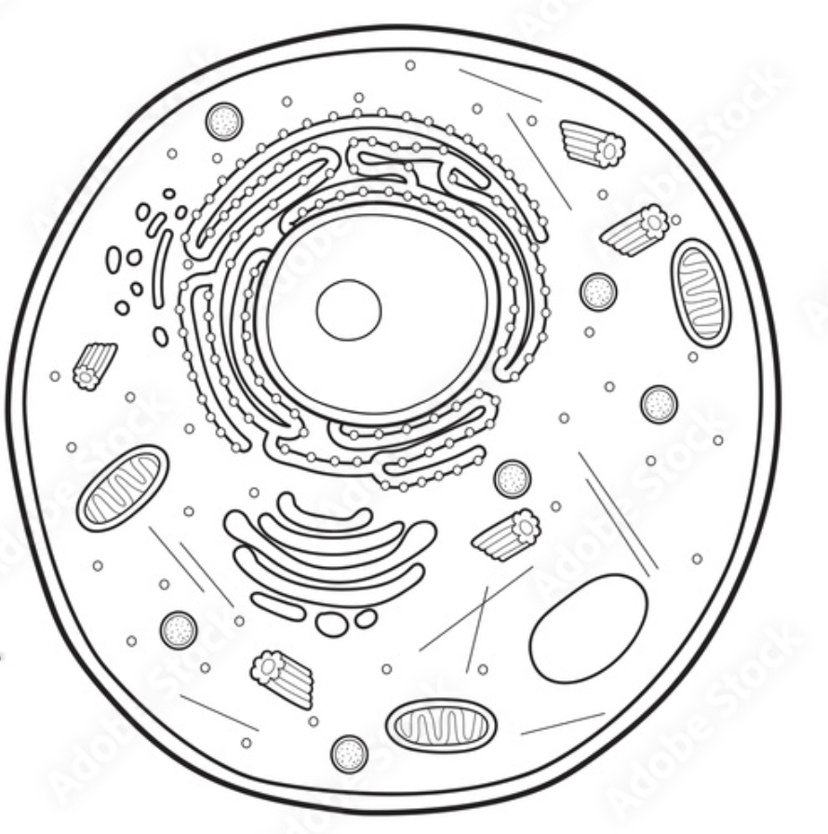

Slide 40
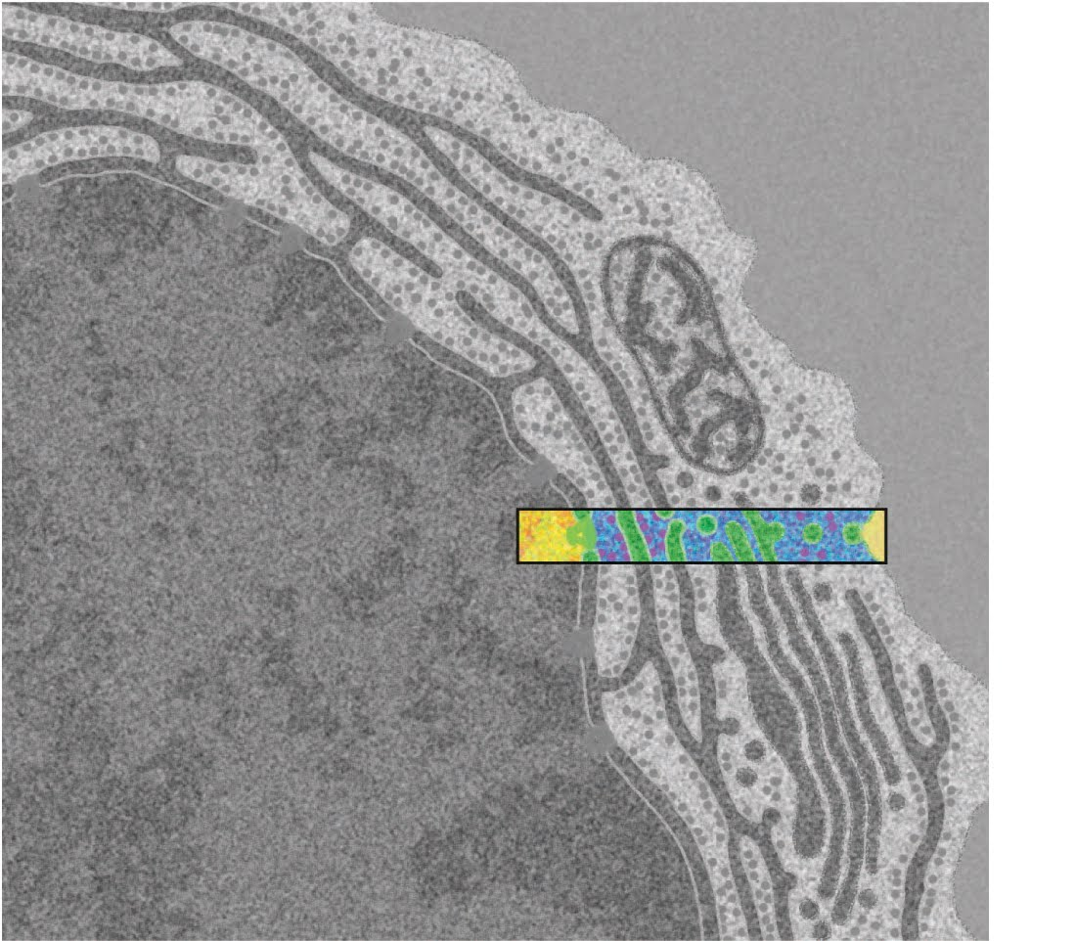
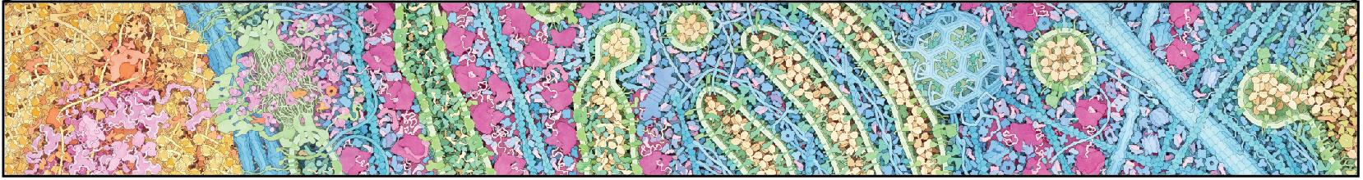
Tour of a Human Cell
An electron micrograph of an antibody-producing B-cell
Your flu/COVID-19 shot… in action.

Slide 41
Tour of a Human Cell
Create sticky note “arrows” to label these items on your poster.
Basic Features:
Bonus Features: **Advanced Level
Cell membrane
Nucleus
Ribosomes
Nuclear membrane
Nuclear pore
Endoplasmic reticulum
Golgi apparatus
Cytoskeleton
Vesicles
DNA
mRNA
Proteins
Identify different processes occurring within the cell
Different types of cytoskeleton
RNA polymerase
Transcription factors
Promoter
5’ cap of RNA, 3’ polyadenylation signal
Proteasome
Nucleosomes
Kinesins (motor proteins)
Clathrin

Slide 42
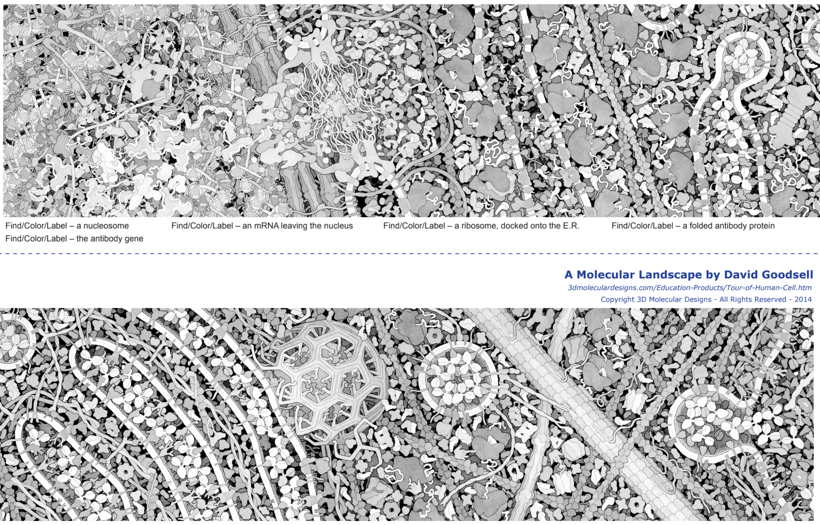

Slide 43
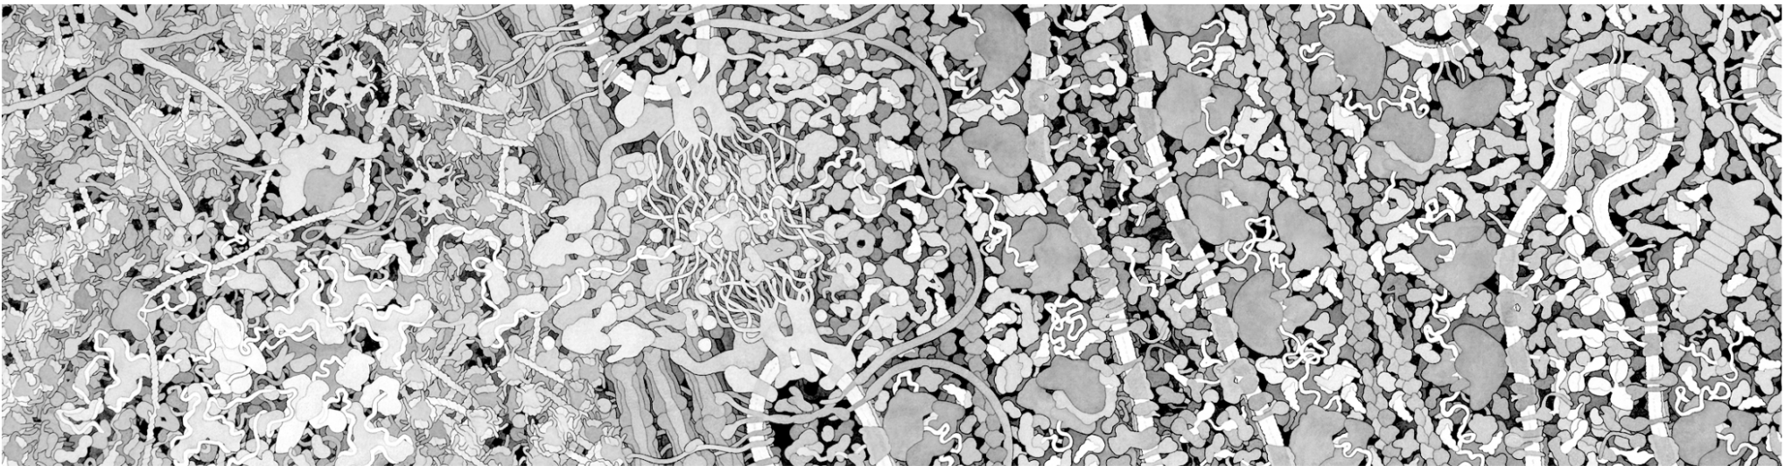
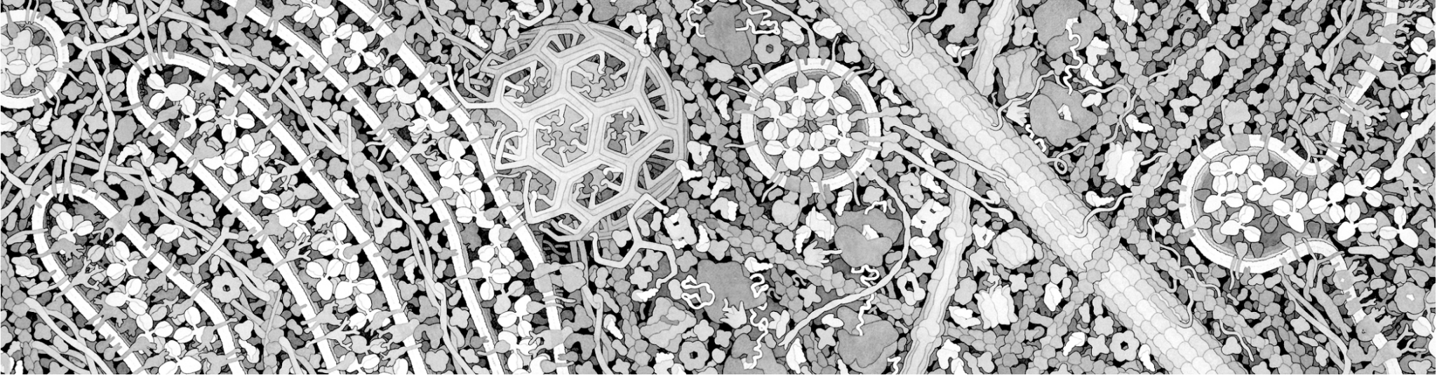
Learning the Landscape
Find the membranes.
What do you notice about the membranes?
What features or shapes do you think you recognize?

Slide 44
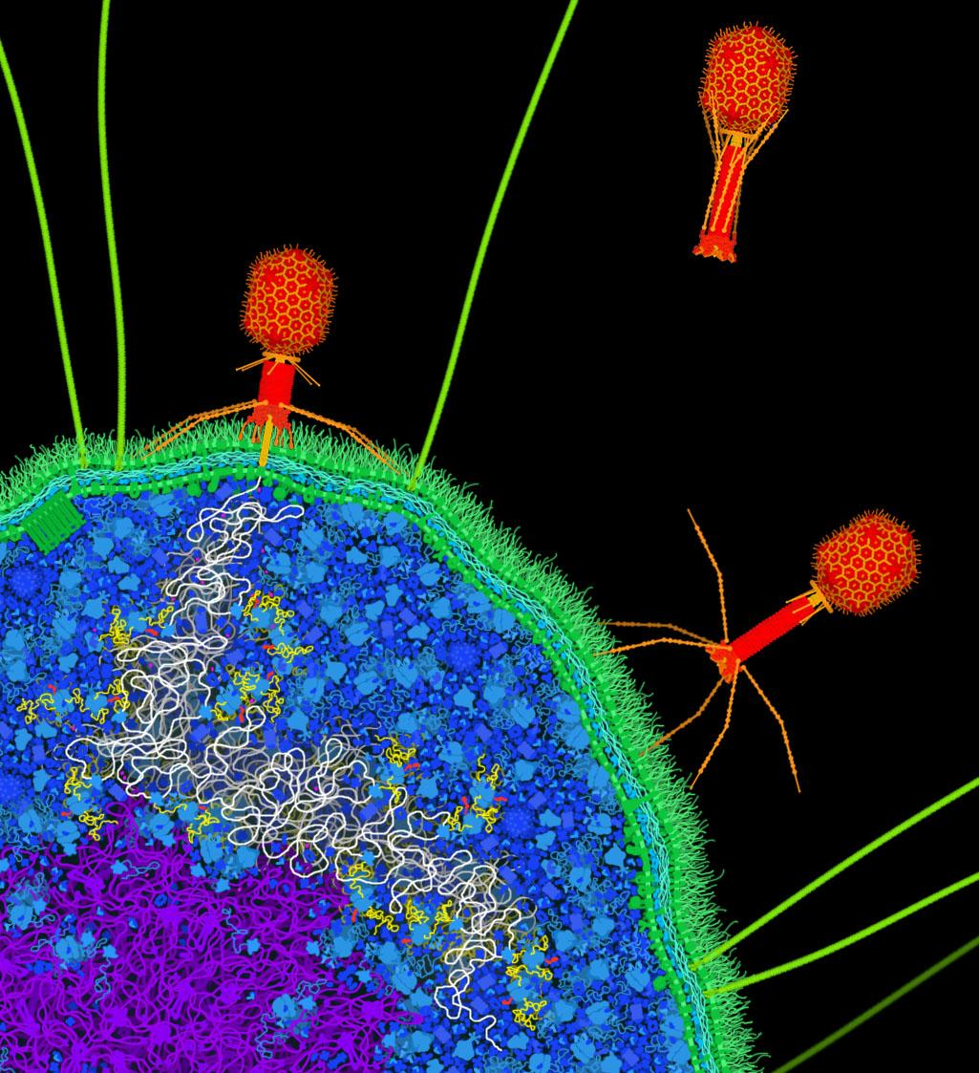
Alien Landing….!

Slide 45
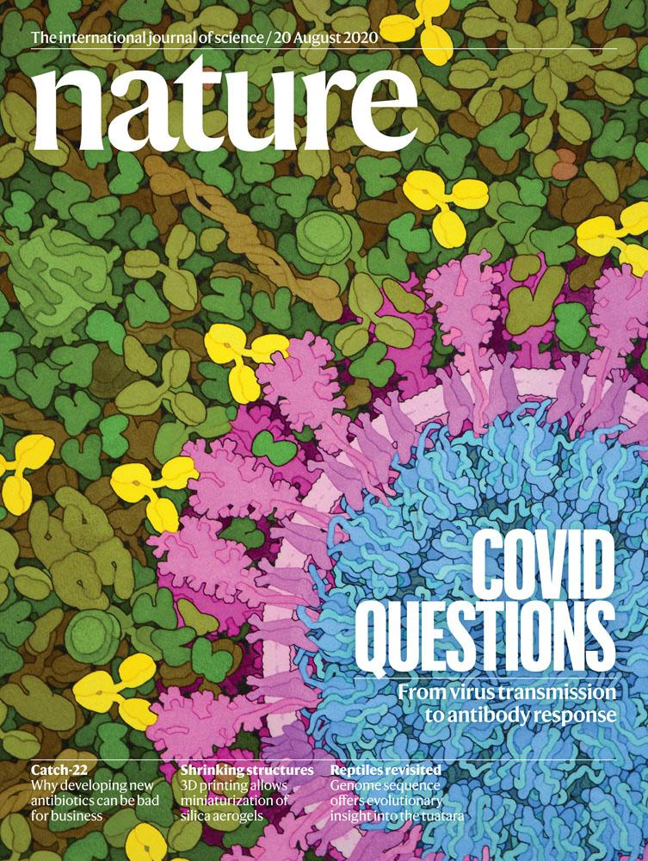

Slide 46
BAMBED … Biochemistry and Molecular Biology Education
Article
Miniseries: Illustrating the Machinery of Life
Eukaryotic Cell Panorama
Received for publication, October 7, 2010, and in revised form, December 13, 2010
David S. Goodsell‡
From the Department of Molecular Biology, The Scripps Research Institute, La Jolla, CA 92102
Diverse biological data may be used to create illustrations of molecules in their cellular context. This report describes the scientific results that support an illustration of a eukaryotic cell, enlarged by one million times to show the distribution and arrangement of macromolecules. The panoramic cross section includes eight panels that extend from the nucleus to the cell surface, showing the process of protein synthesis and export. Results from biochemistry, electron microscopy, NMR spectroscopy and x-ray crystallography were used to create the image.

Slide 47
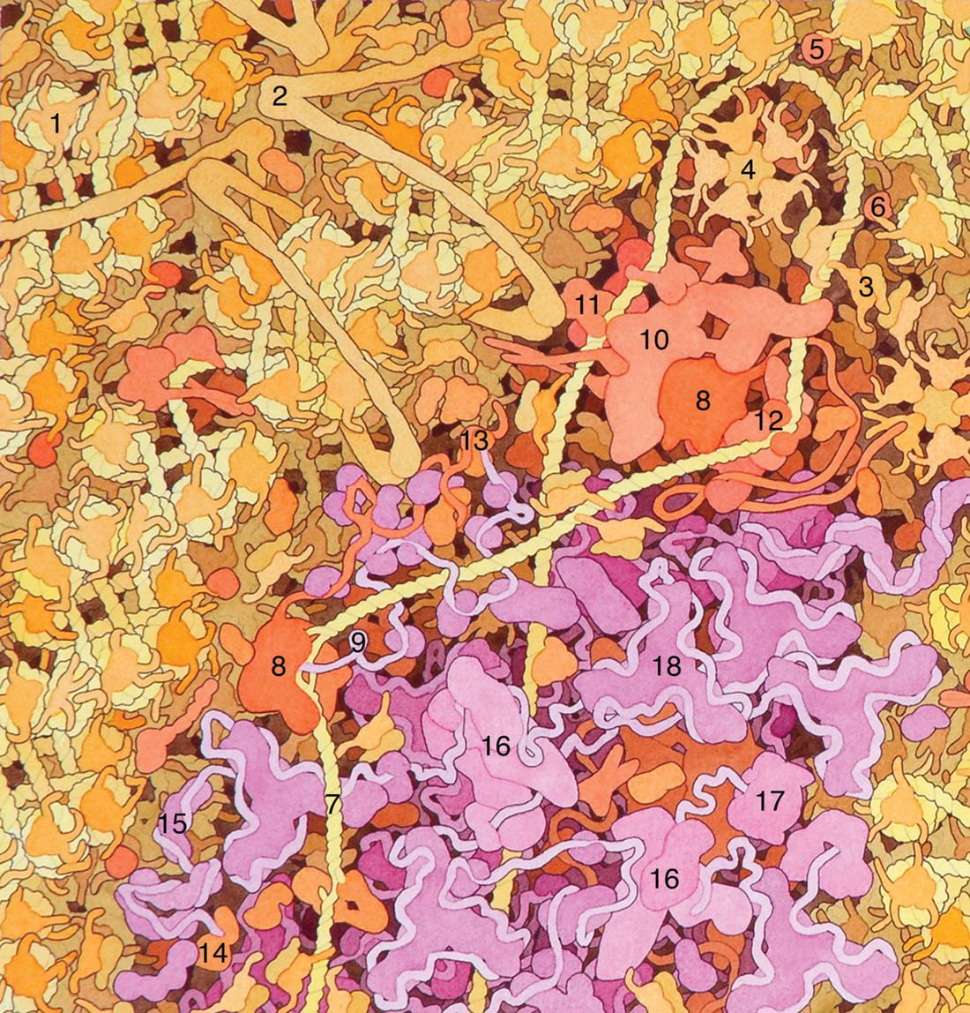

Slide 48
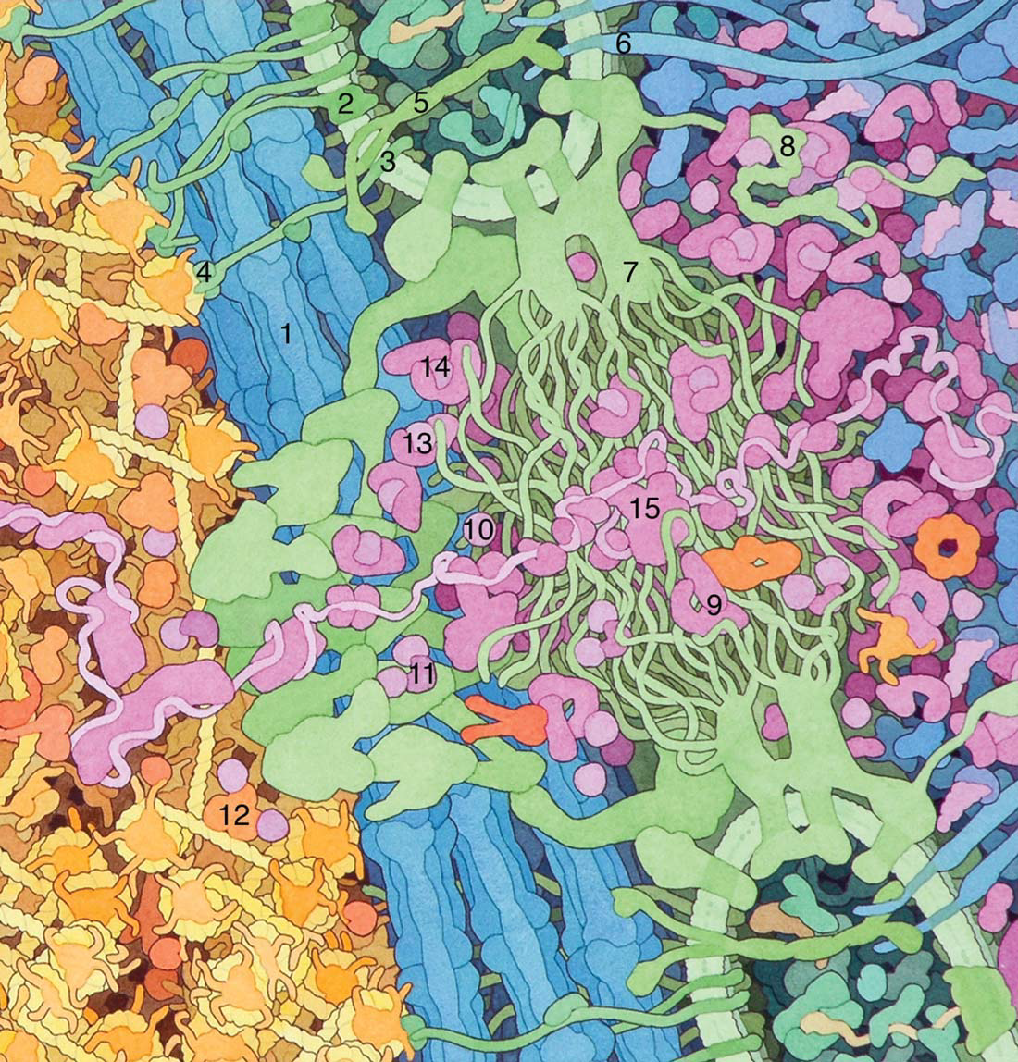

Slide 49
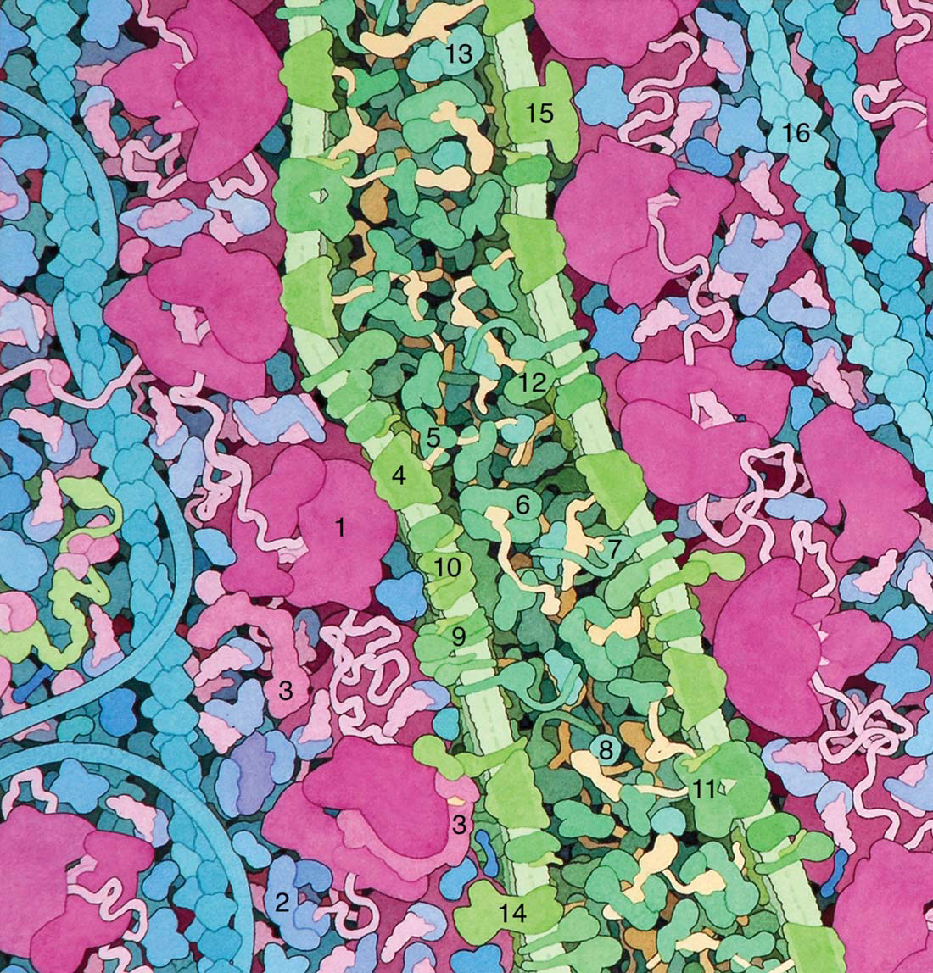

Slide 50
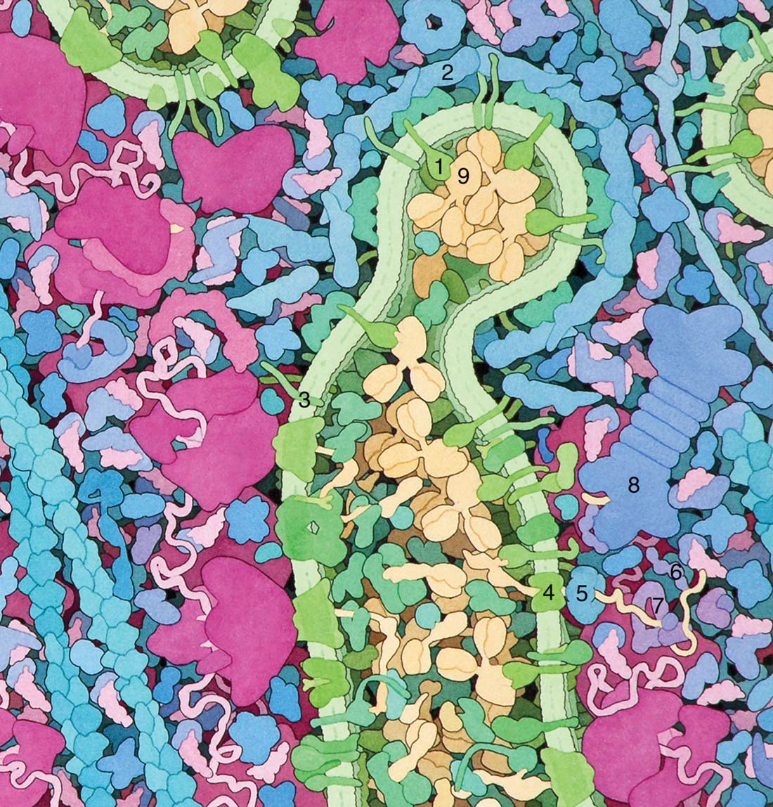

Slide 51
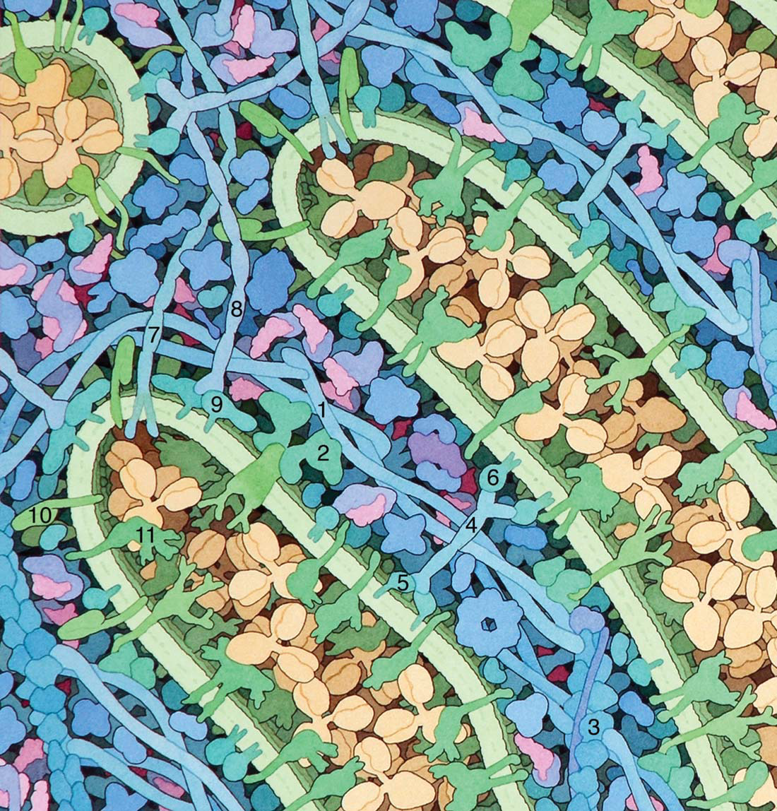

Slide 52
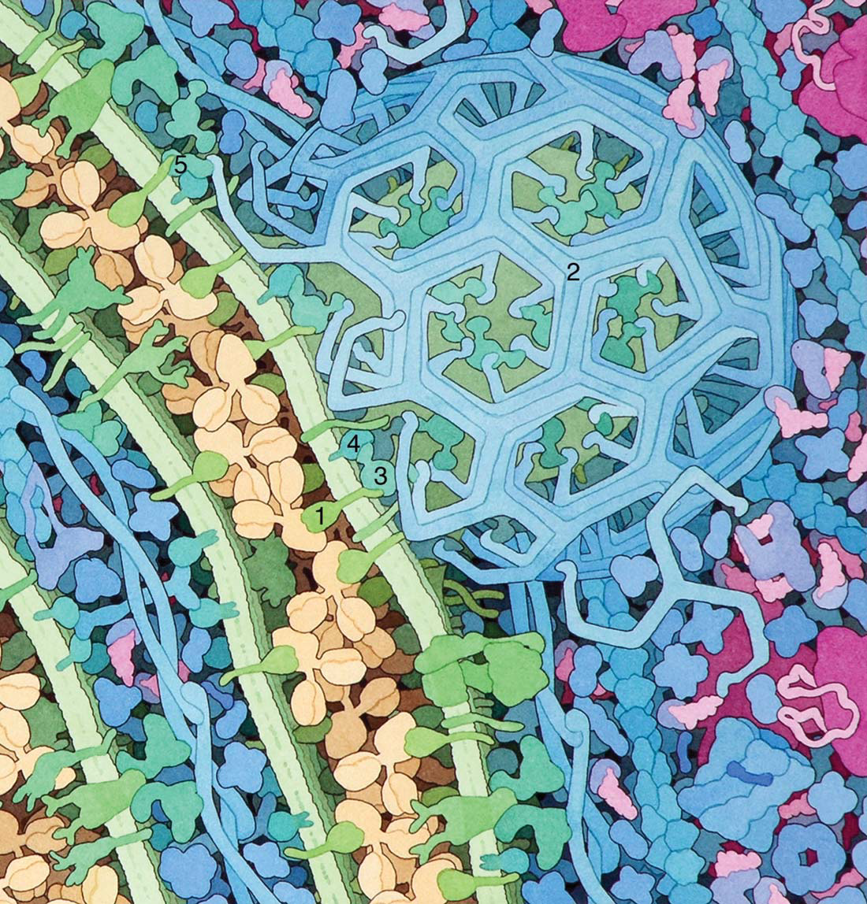

Slide 53
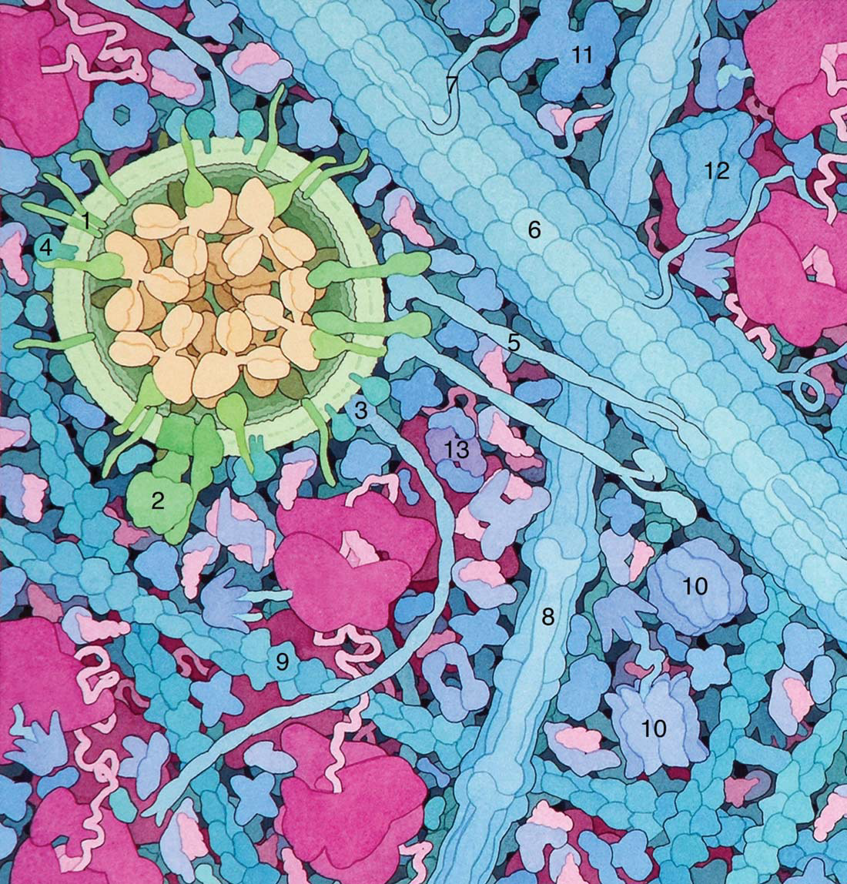

Slide 54
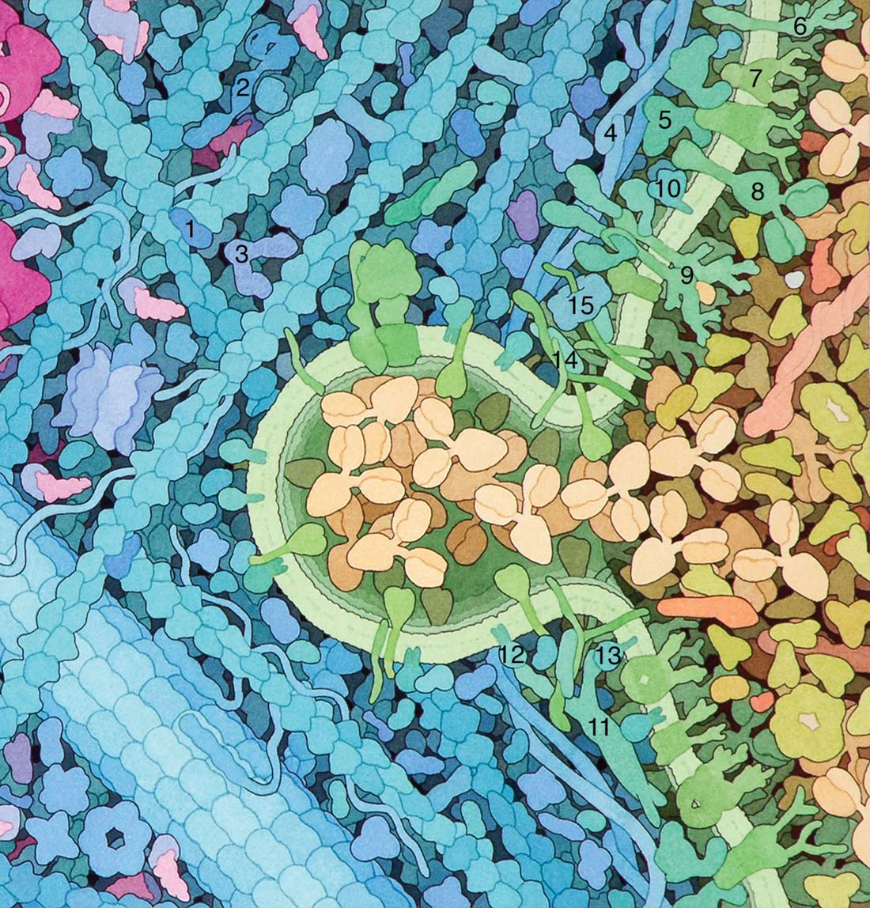

Slide 55
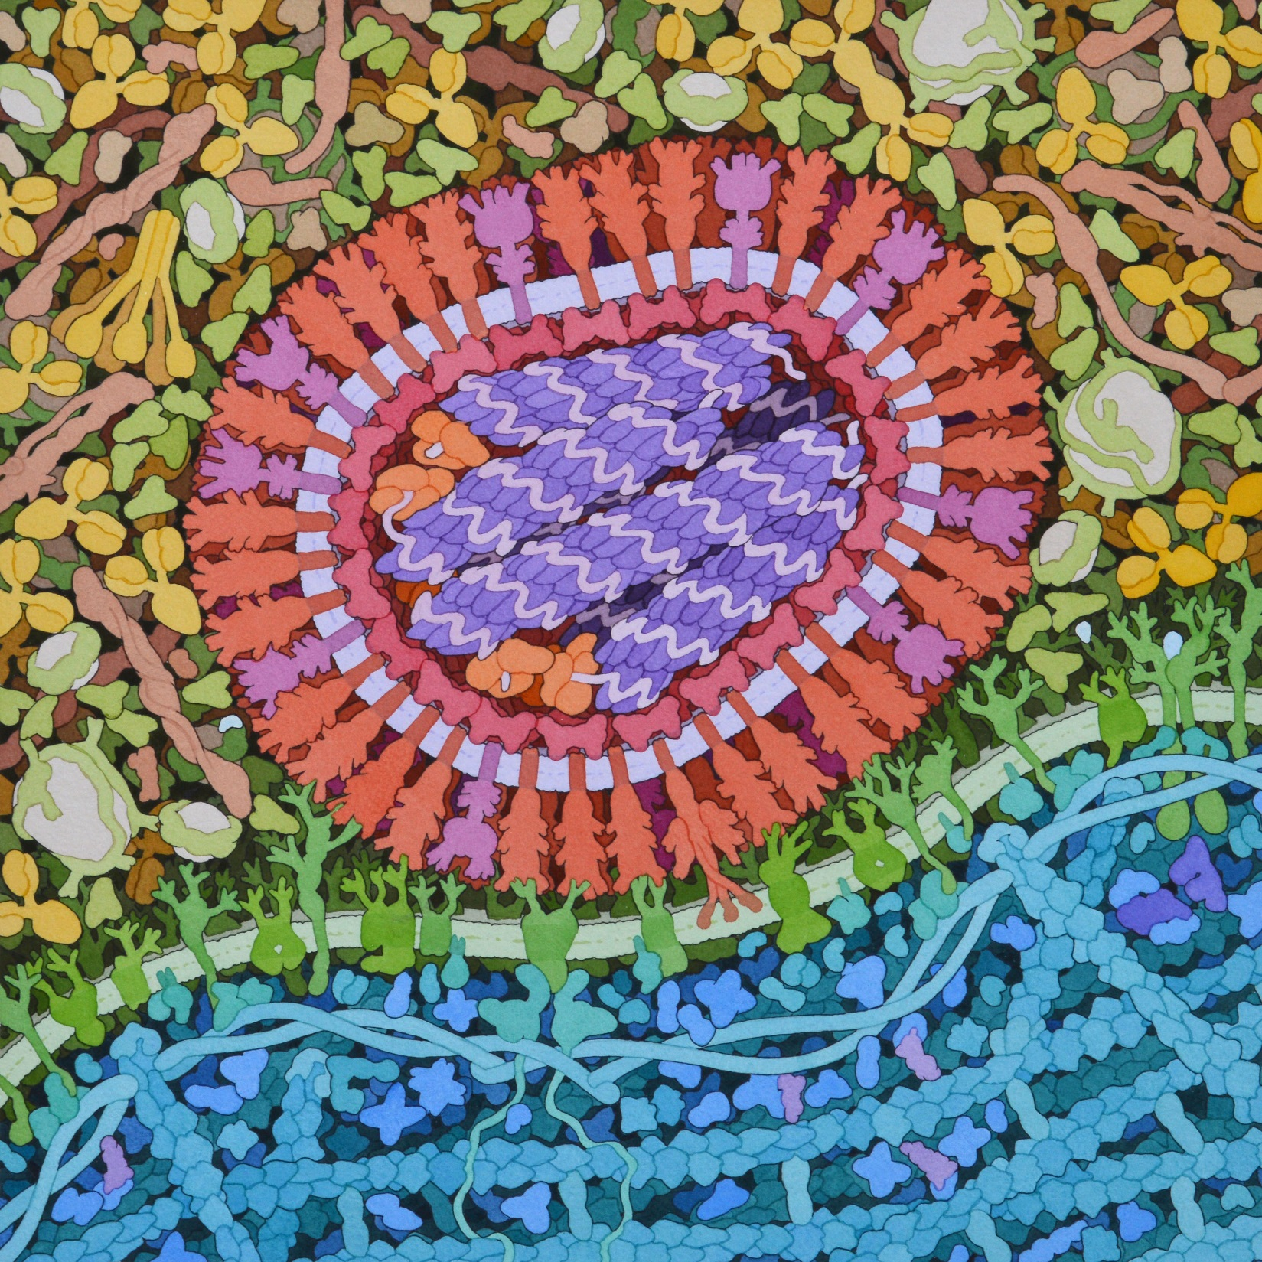

Slide 56
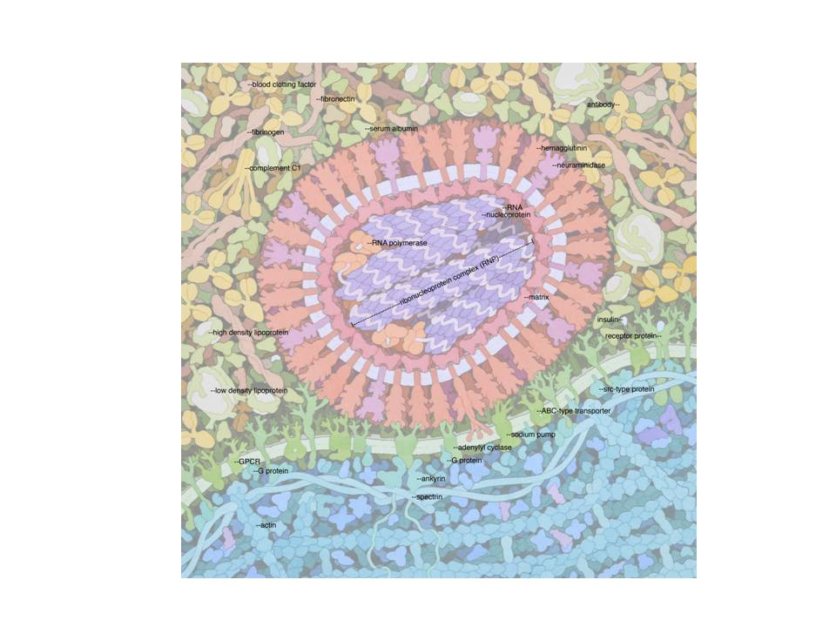

Slide 57
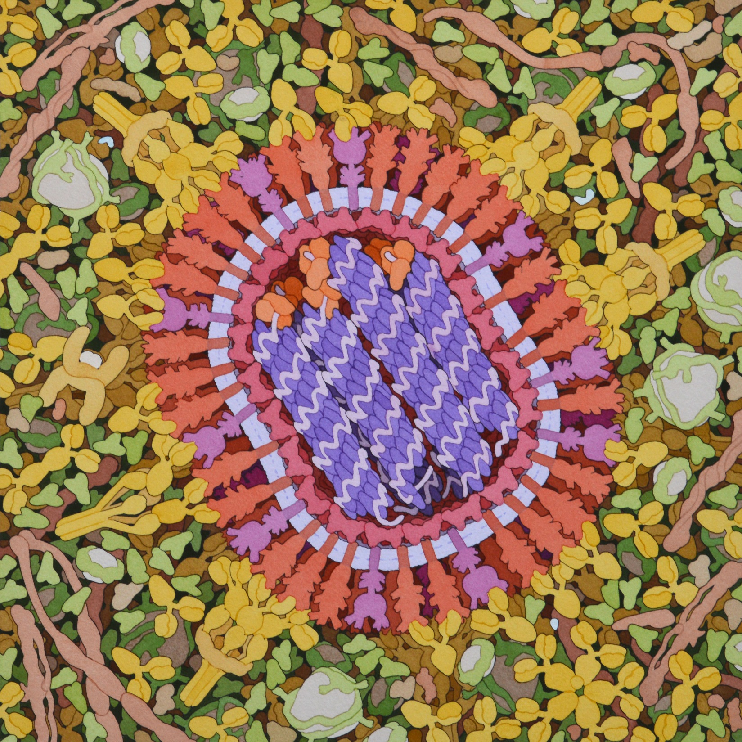

Slide 58
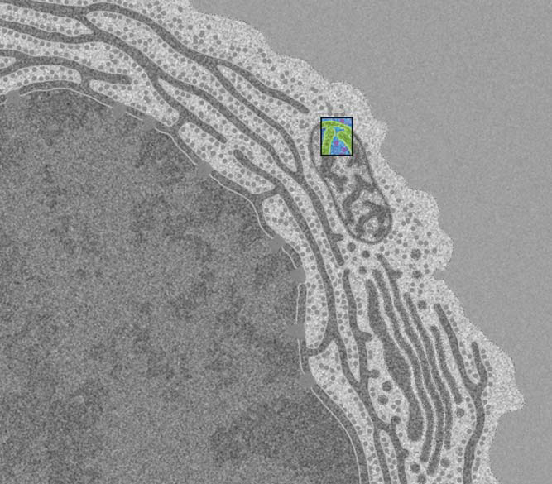

Slide 59
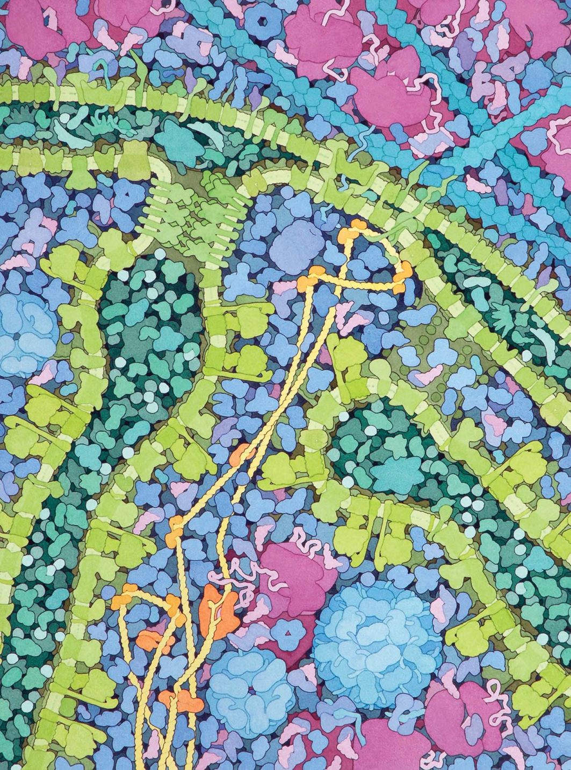

Slide 60
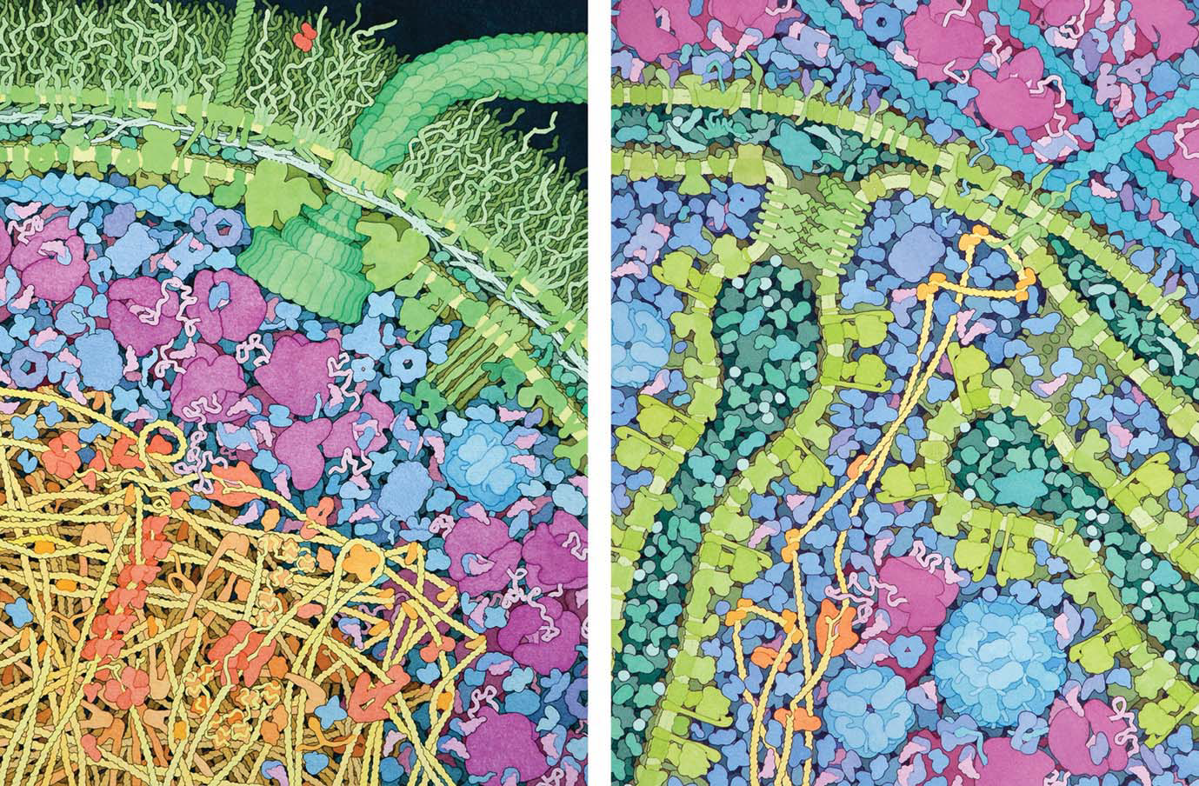
E. coli
Mitochondrion

Slide 61
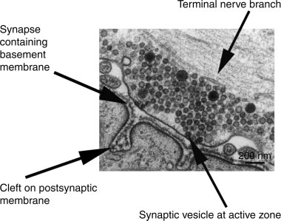

Slide 62
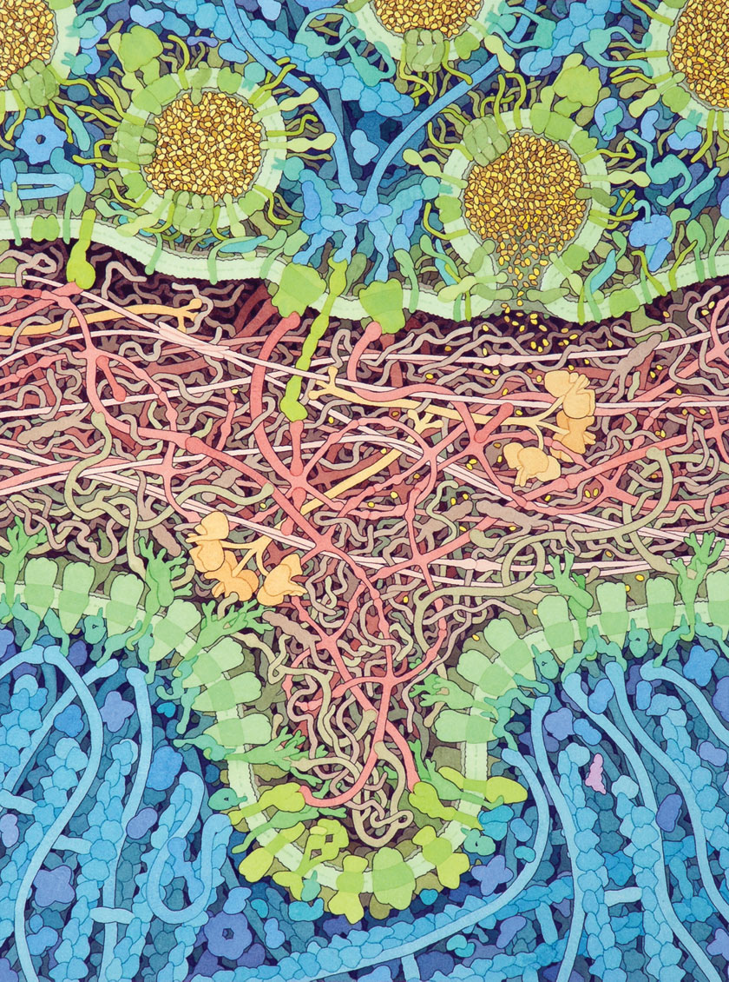

Slide 63

Reflection
What is something new that you learned through studying the Goodsell images this morning?
What questions do you have after exploring molecular landscapes?

Slide 65
Food Truck Wednesday
 | Monday | Tuesday | Wednesday | Thursday | Friday
330 Eats | Heather | Diane |  |  | Kris
Cubanitas | Diane | Heather | Diane | Kris | Lauren
Fiddleheads | Kris | Lauren |  | Diane | Heather
Med Cuisine |  | Kris
Waterfront Deli | Lauren |  |  | Heather
Red Arrow Food Trucks |  |  | Lauren

Slide 66


Slide 68
SMART Teams
SMART = Students Modeling A Research Topic
Dan Williams

Slide 69


Slide 70


Slide 71


Slide 72


Slide 73




Slide 74


Slide 75


The Shelter Island Experience

Slide 76


The Shelter Island Experience

Slide 77

The Shelter Island Experience

Slide 78





The Shelter Island Experience

Slide 79


Slide 80



Slide 81


Slide 82



Slide 83



Slide 84



Slide 85




Slide 86


Slide 87



Slide 88


Slide 89



Slide 90




Slide 91



Slide 92



Slide 94


3D Modeling with Master Mark

Slide 95


Slide 96
Anthrax Toxin
Tim Herman

Slide 97

Anthrax Pathogenesis
A story about…
A bacterial toxin
Bioterrorism and…
The CBM’s first SMART Team

Slide 98


Anthrax Pathogenesis…2001
A story of bioterrorism and the CBM’s first SMART Team

Slide 99



The first SMART Team… modeling Anthrax Pathogenesis (2001)
Bacillus anthracis produces an AB toxin composed of three proteins
Protective Antigen
Protective Antigen
Edema Factor
Lethal Factor

Slide 100
Storming the Castle,… an exercise in critical thinking
How does the anthrax toxin get into our cells and kill you?
Bacillus anthracis – hereafter known as Anthrax – produces 3 toxin proteins… Protective Antigen (PA), Lethal Factor(LF) and Edema Factor(EF).
PA is known to be necessary for either LF or EF to enter a cell:
If you inject Protective Antigen (PA) into a mouse – it has no effect.
If you inject Lethal Factor (LF) into a mouse – it has no effect.
If you inject a mixture of PA and LF into a mouse – the mouse dies.
A similar result is seen with PA and EF. The injection of either PA or EF alone has no effect. Injection of a mixture of PA and EF results in a dead mouse.
THE CHALLENGE: Consult with your group and suggest a molecular mechanism whereby these 3 proteins (PA, LF and EF) interact with each other to enter your cells…
… and lead to your demise.

Slide 101


2005

Slide 102

2002

Slide 103

2002

Slide 104


2 8 MAY 2 0 1 5 | VO L 5 2 1 | N AT U R E | 5 4 5

Slide 105


2020

Slide 106

The Anthrax Protective Antigen heptamer….following receptor-mediated endocytosis… and acidification of the endosome.
The 14-stranded beta-barrel forms a tube through which the unfolded Lethal Factor is transported across the cell membrane.

Slide 107


Slide 108



Slide 109


Slide 110


Slide 111

Models give meaning to words…
Until you have models,… molecular visualization software (Jmol) is the next-best thing.
The Protein Exploratorium
Hemolysin

Slide 112
Connecting the dots….
Other Protein Translocation/ Injection Systems
Bacteriophages delivering phage DNA into cells (Friday)
Injectisomes June 2024 MOTM
Salmonella bacteria invade our cells and reproduce inside, causing life-threatening diseases like typhoid fever. As part of their pathogenic strategy, these bacteria inject several dozen types of effector proteins using a molecular needle called the injectisome.
Contractile Injection Systems introducing proteins into cells
See Feng Zhang at MIT

Slide 113

Unfolded effector protein
June, 2024

Slide 114

Nature | Vol 616 | 13 April 2023 | 357

Slide 115
The first paragraph of Kreitz et.al.….
For endosymbiotic bacteria, it is often advantageous to secrete factors that modulate host biology in favour of symbiont fitness4. However, many such factors cannot readily pass through cellular membranes; this has led to the development of intricate systems that actively deliver payload proteins into cells. One example is the contractile injection systems (CISs), a class of syringe-like nanomachines resembling bacteriophage tails.

Slide 116

Model for protein delivery via reprogrammed CISs
Contractile
Injection
System

Slide 117

Digging deeper…
while avoiding rabbit holes…
….and knowing when to stop.

Slide 118
There are things we know…
As we think deeply about what we know, we will begin to ask questions about things we don’t know
There are things we don’t know…
There are two kinds of things we don’t know:
There are things we know we don’t know.
There are things we don’t know we don’t know
A teacher’s role is to encourage students to think deeply about what they know … and identify what they don’t know.

Slide 119
Teachers should model for students….
  The joy of discovering something you didn’t know
  The even greater joy of discovering something
  you didn’t even know you didn’t know.
This discovery happens when you…
slow down, focus, think deeply…
and begin to ask questions.

Slide 121
Digital Modeling Hub Resources
Search the DMH and explore the resources for a Kit or Model
New Resources
Hemoglobin Mighty Model
Molecules of Life Kit
Cell Modeling Kit
Alpha Helix & Beta Sheets
T4 Bacteriophage Model
Mosaic Membrane Model
Acetylcholinesterase Model
Classic Resources
Water Kit
Amino Acid Starter Kit
Phospholipid & Membrane
Transport Kit
Enzymes in Action Kit

Slide 122
Reflection
Which complex protein story from today most captured your attention?
How did models or modeling help you make sense of the research, the mechanism, or the bigger biological story?

Slide 123
Bringing Research to Students
Choose one protein story from today that you could imagine using with students.
What model or modeling experience would help students make sense of it?
What prior knowledge would students need before engaging with the story?
What required content, concepts, or skills could this research story help you teach?

Slide 124

End of Day Announcements
Thursday Focus
DNA
Bring Your
Notebooks
Evening Plans
Optional Production Lab Tour @4 PM
Dinner and/or Happy Hour @5:45 PM
Don’t forget to park some questions!

Slide 125

End of Day Survey

Slide 126

Optional Activities
Tour of 3DMD’s Production Labs
Safety First!
Foam Roller Press & Kitting
Injection Molding
3D Print Lab

Slide 127
Things to Do in Milwaukee Today
Live @ the Lakefront Concert Series
(Music on the pier of Discovery World, 20 minute walk from Drury)
Dinner at spy-themed restaurant SafeHouse
(3 minute walk from Drury)
Trivia Night at Lakefront Brewery
(5 minute drive/30 minute walk from Drury)

