Slide 2

Find your name tent and meet new people!

Slide 3
Monday’s Joy
Learning more about incorporation
Meeting new colleagues
Working with my peers at my table collaboratively.
Seeing the kits
The connectedness of the models
Shaking the water!
All of the varied models
Amino acid starter set and water cup
The sequence of modeling kits leading from properties of water to protein folding was a great way to develop student understanding of complex concepts and structures.
the modeling if how to guide students through the process of discovery using the molecular models.
how the different activities tied to the exploding frog egg experiment as a phenomena.
The balance of modeling WE2 with great questions and some further deep dives into some info with even deeper thoughts to ponder. Great mix!
The variety and cycling of presenters, presentation styles, and learning activities.

Slide 4
Tuesday’s Wants
Lesson papers or conjunction materials
The different types of phospholipids
Using these models in the chemistry classroom
Setting up the classroom for modeling … the work to explore and logging their explorations.
Professional folding!
How to use models … and different ways to scaffold them into my curriculum.
The frog eggs and aquaporins
… predict protein structures … intersection between that and emerging AI fields.
… models to identify and correct student misconceptions. Love the phenomena…
How to model more stories about molecules being discovered.
Scaffolds, tools, questioning protocols, and common misconceptions with each kit…
Proteins!
Hands-on and problem solving in groups (e.g. determining the structure of CHIP28)
Collaboration
Play !
The models and chemistry connections
How to ask appropriate questions that don't lead students but challenge them to think deeper
More ideas how to apply and introduce content.
Learning how to structure the pedagogy and DQB
Of what we got today.
All the ways we interacted today.
Deep dive questions with some answers
How to frame storytelling—where to start, banks of stories, ideas for in-roads to this practice in the science classroom.

Slide 5


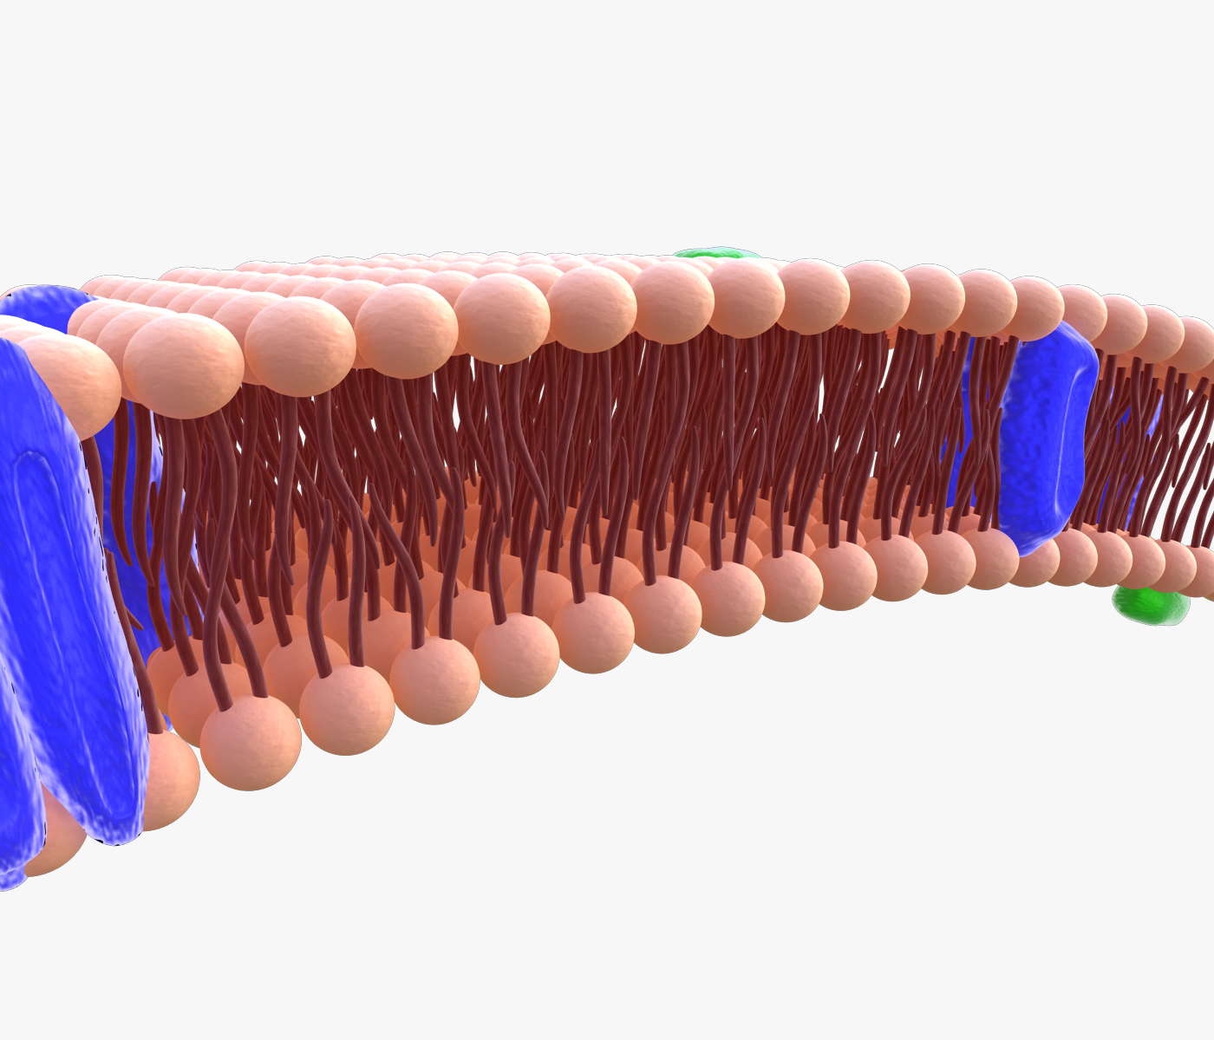
Recap: Protein Design Challenge
Discuss your designed protein at your table
Which amino acids might you use?
What secondary and tertiary structures would you include in your design? And why?
Update and annotate your Cell Model to illustrate your protein. Where in the cell did you put it?
(The gatekeeper of life: The Cell Membrane's master role 2024)
Notes:
Design a channel protein challenge

Slide 6
Peter Agre - Part II
The famous exploding
frog egg experiment
or…
The discovery of the water channel (aquaporin)

Slide 7
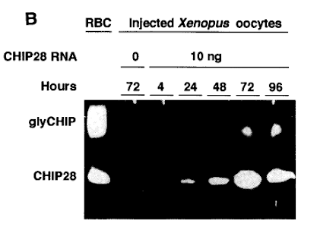
Reviewing…
How would you determine the function of this protein?

Slide 8
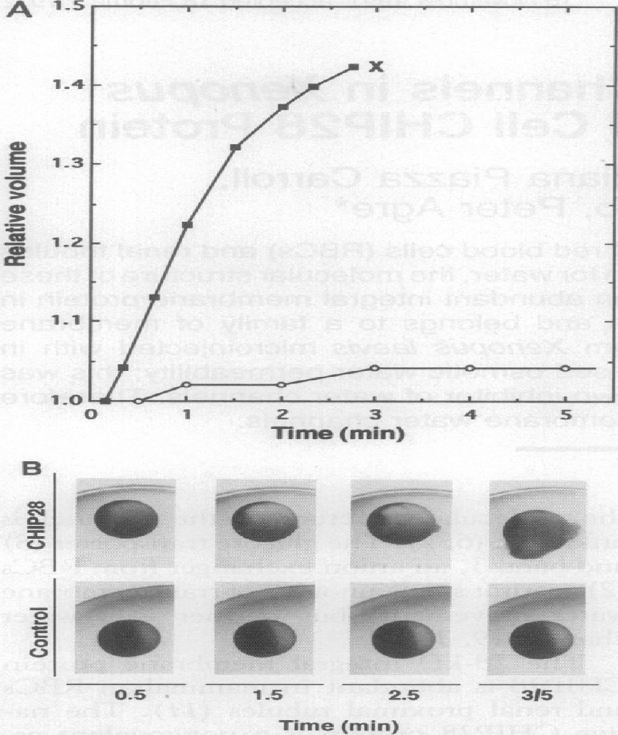
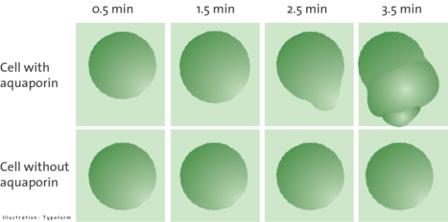
The famous exploding frog egg experiment…
POP
Micro-injection of aquaporin
mRNA into frog oocytes…

Slide 9
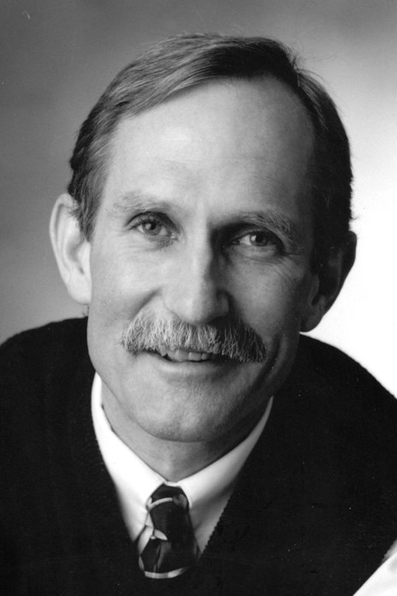
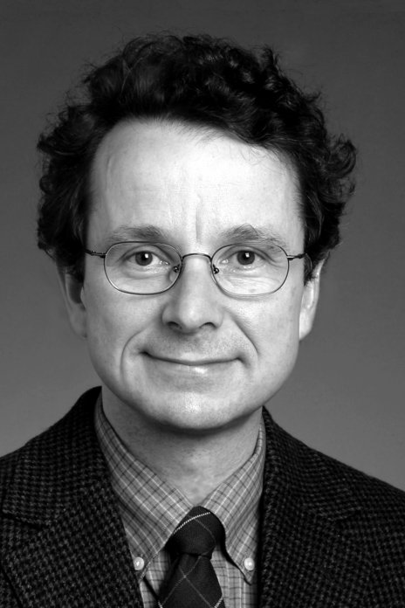
The Nobel Prize in Chemistry 2003 was awarded "for discoveries concerning channels in cell membranes" jointly with one half to Peter Agre "for the discovery of water channels" and with one half to Roderick MacKinnon "for structural and mechanistic studies of ion channels."

Slide 10
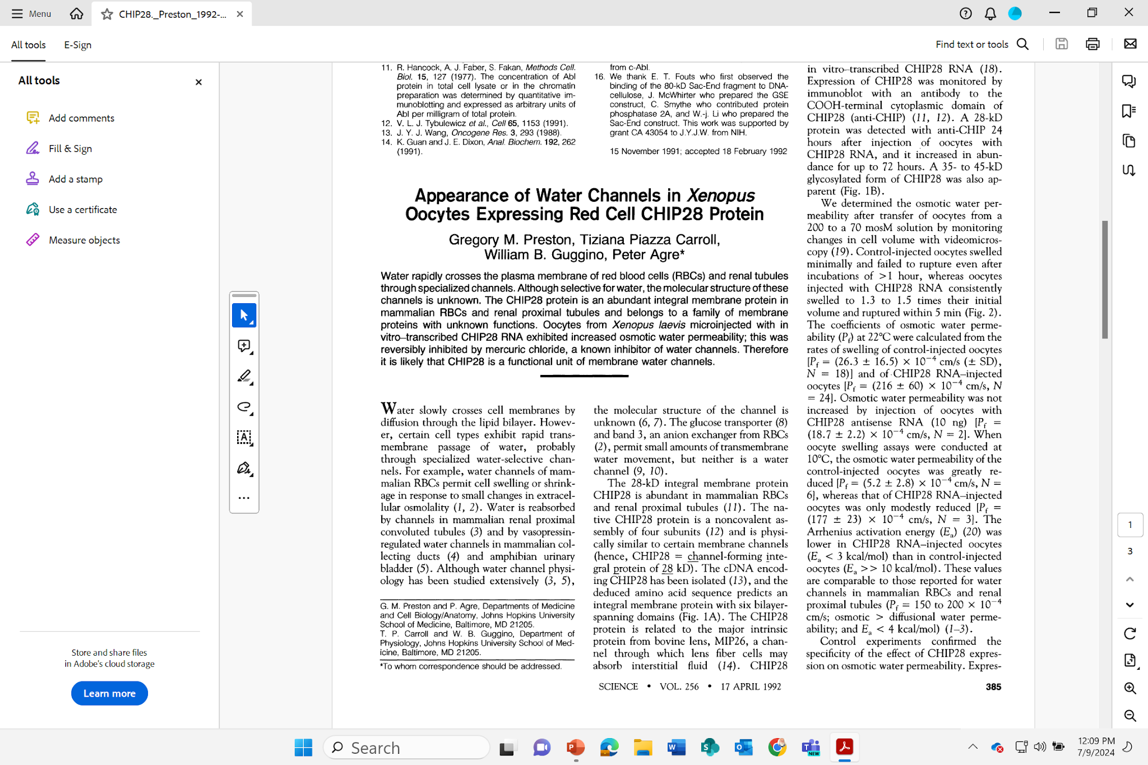

Slide 11
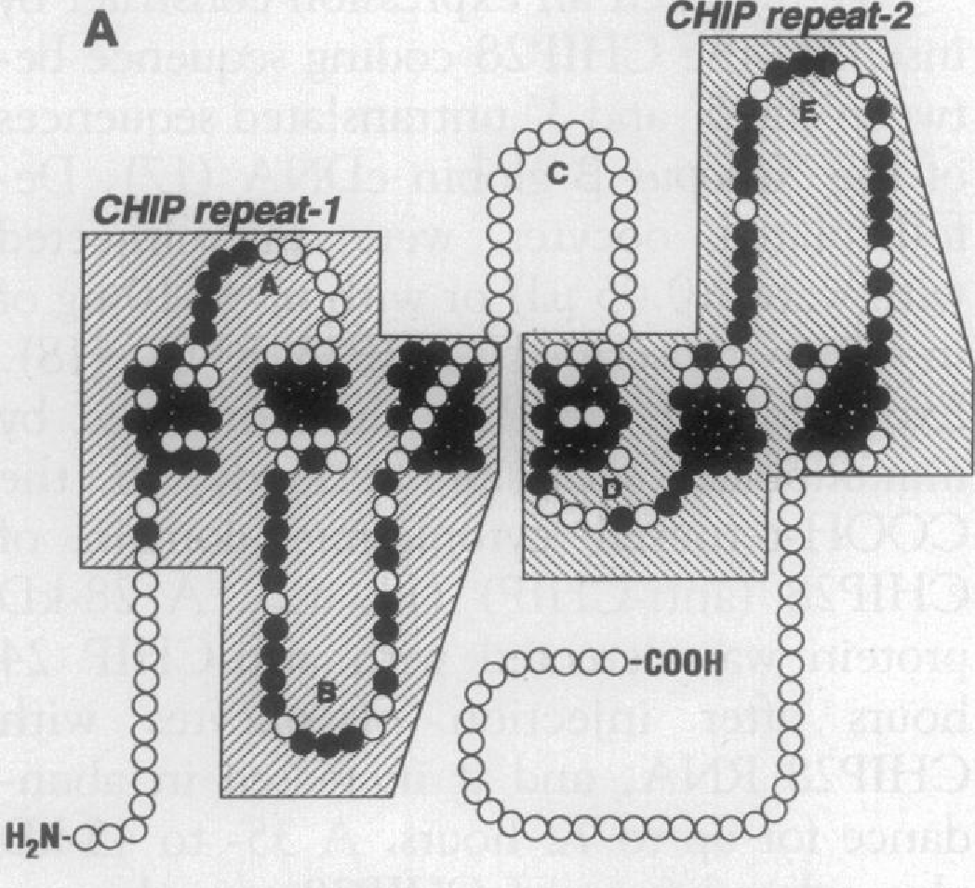
Model of Aquaporin…
in 1992
based on its
amino acid sequence!

Slide 12
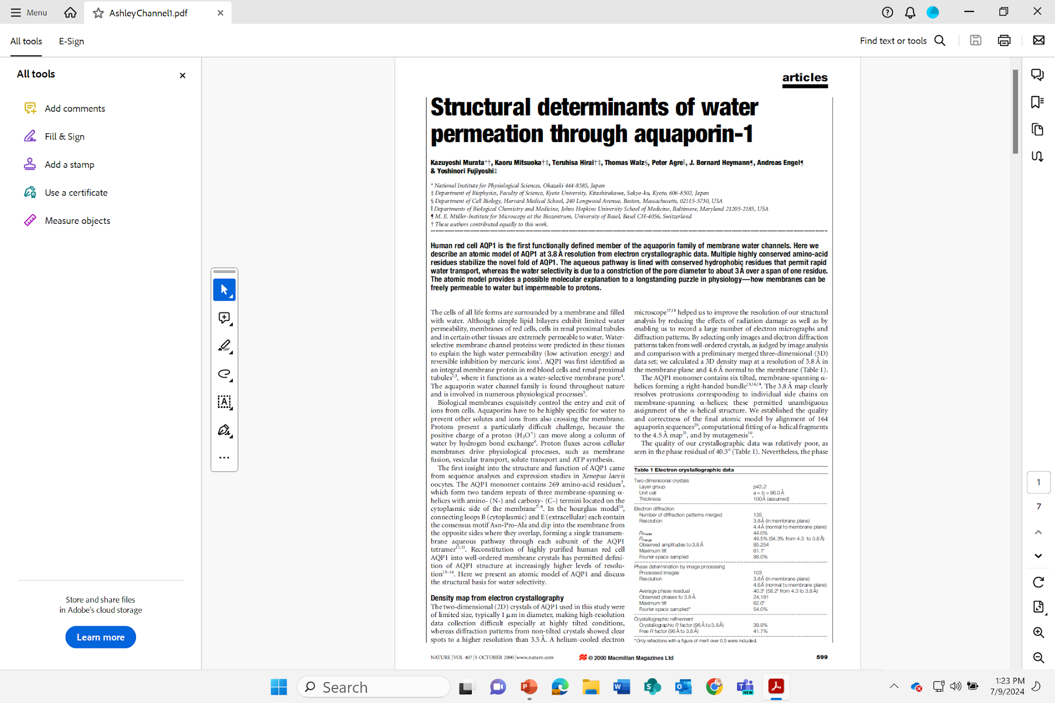

Slide 13
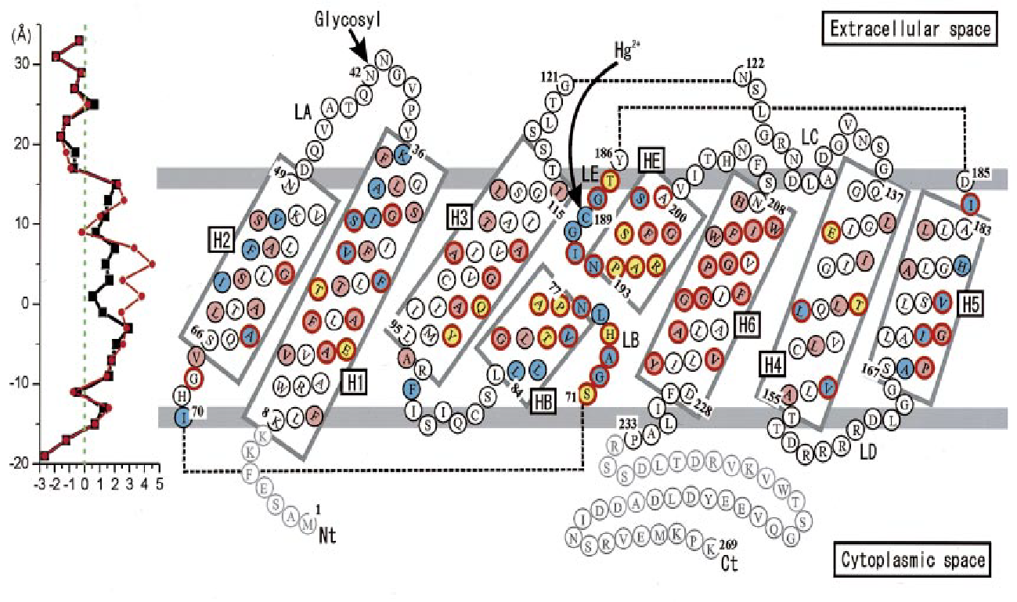
Model of Aquaporin… in 2000…
based on its amino acid sequence!

Slide 14
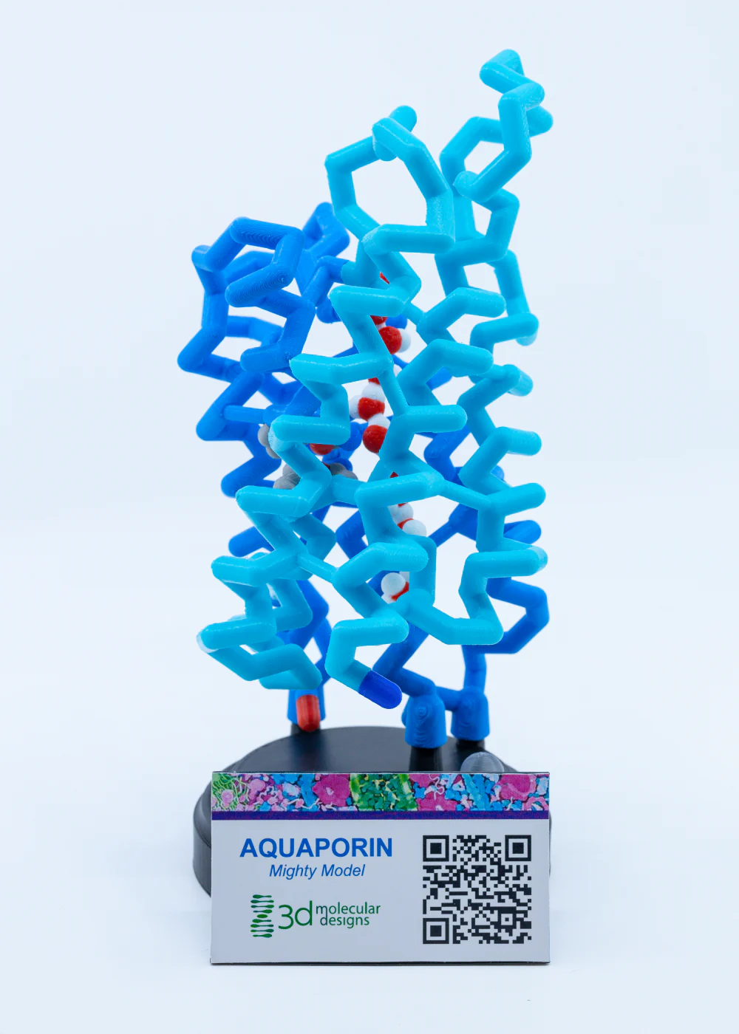
Your Aquaporin Mighty Model…
Explore your model…
What features do you notice?
What parts of the aquaporin story could you tell with this model?

Slide 15
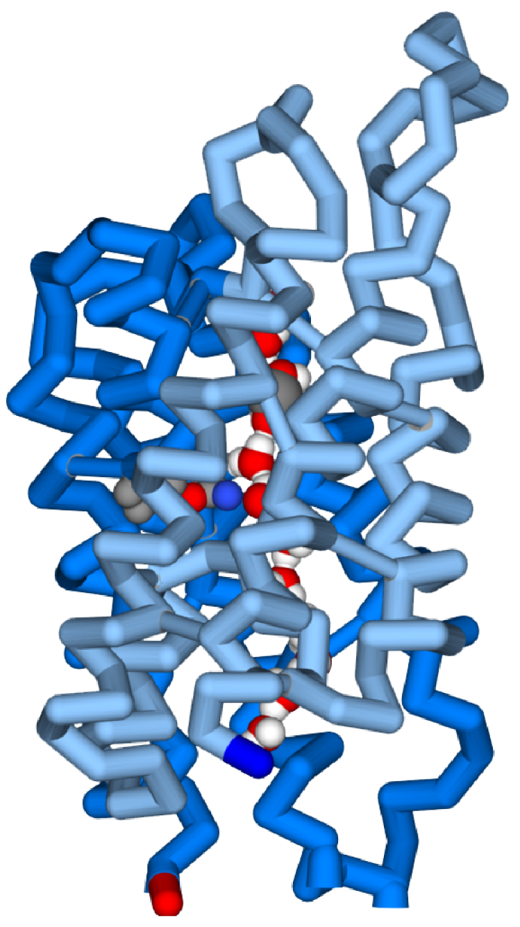
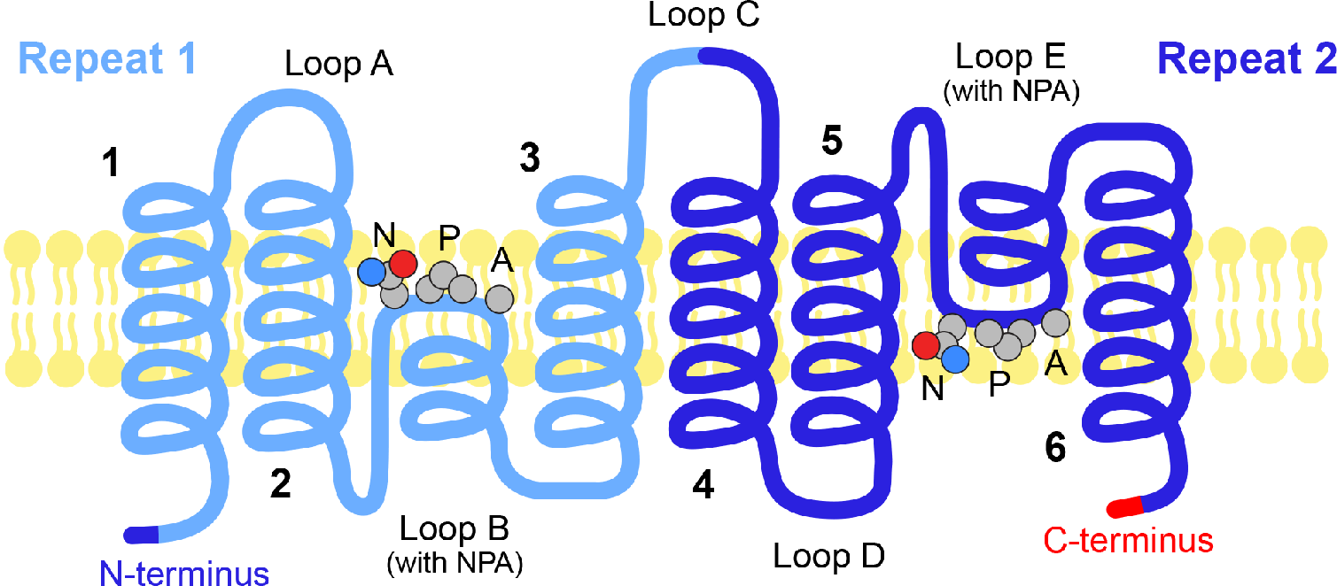
What is Aquaporin?
Water Channels in Cell Membranes
Notes:
Teacher Notes: Aid students in interpreting graphic to the right and comparing it with the model. You may wish students to open the jmol activity so they can view the protein monomer. Help students identify the specific locations labeled on the graphic to the right on the computer simulation.
Student Notes: Follow the prompts from your teacher. Use the physical model or the computer simulation to identify the six alpha helices that form a right-handed bundle: 1, 2, 3, 4, 5, and 6. In your lab notebook describe the location and orientation of these helices. Next locate loops A, B, C, D, and E. Compare length of these loops with each other. Finally, look at the tandem repeats (Repeat-1 and Repeat-2) that make the two halves of the monomer look similar.

Slide 16
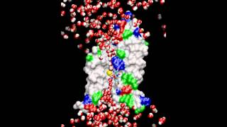
Water Channels in Cell Membranes

Slide 17
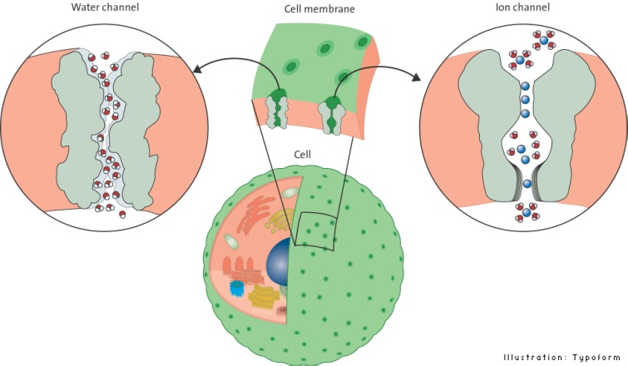
And now, the rest of the story

Slide 18
The ion channels… for K⁺ and Na⁺
These two ion channels are responsible for the action potentials that drive our neurons…
They are very fast…
They are very specific…
They are regulated by voltage sensor domains…
‹#›
Notes:
Teacher Notes: Facilitate a discussion in which student develop testable questions to determine if aquaporin plays a role in the woman losing her peripheral vision.
Elemental mercury may be absorbed through eye contact. However, the face cream primarily contain mercuric salts as mercuric oxide and mercuric chloride. Inorganic mercury can get into the body through the dermal route from the use of soaps, creams, topical antiseptics, and disinfectants that contain those salts.
Some aquaporins are mercury-sensitive, while others can be insensitive to mercury. There is even one type of aquaporin that is stimulated by the presence of mercury.
Mercury appears to collect within the eye balls themselves leading to the appearance of 'floaters' (dark cloudy areas), but also adversely affects the muscles controlling focusing of the eyes and lens and the sensory nerves of the retina itself leading to: intermittent visual blurring, deteriorating peripheral vision or 'tunnel' vision, bulging eyes, sensitivity to light, difficulty focusing, poor color vision, poor night vision, and difficulty moving the eyes.
Student Notes: Develop some testable questions with your peers.

Slide 19
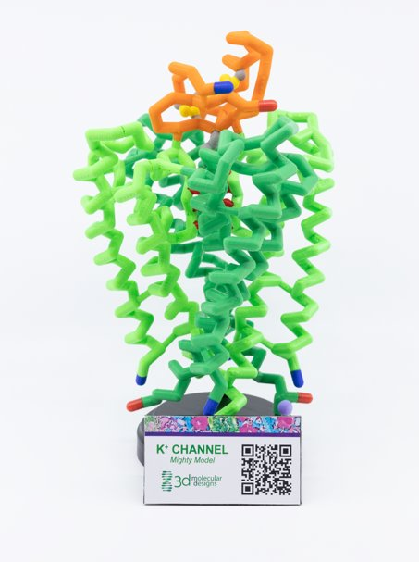
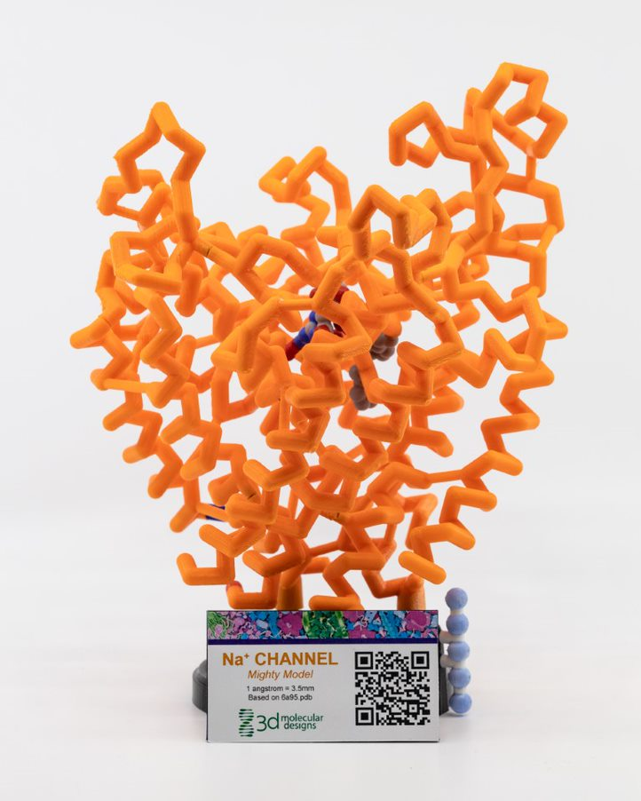
Potassium Channel Mighty Model
Sodium Channel Mighty Model

Slide 20
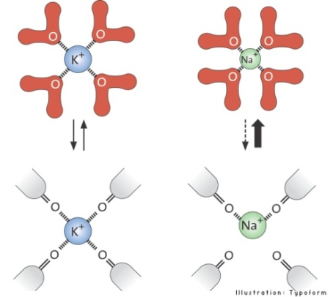
Why K⁺, but not Na⁺

Slide 21
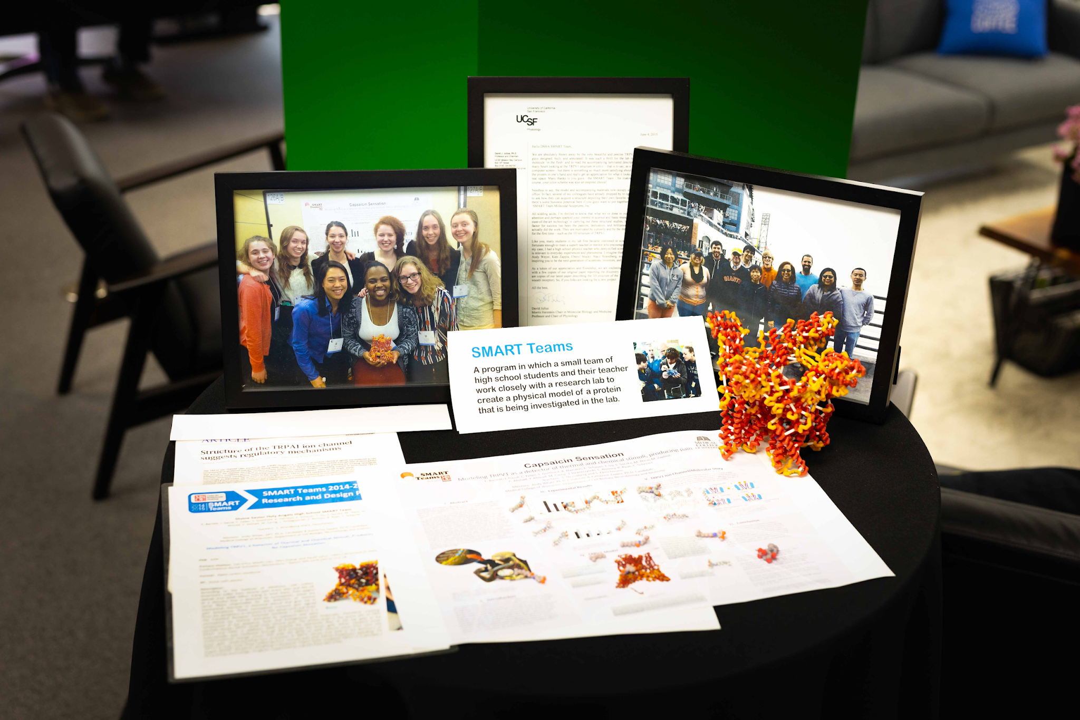
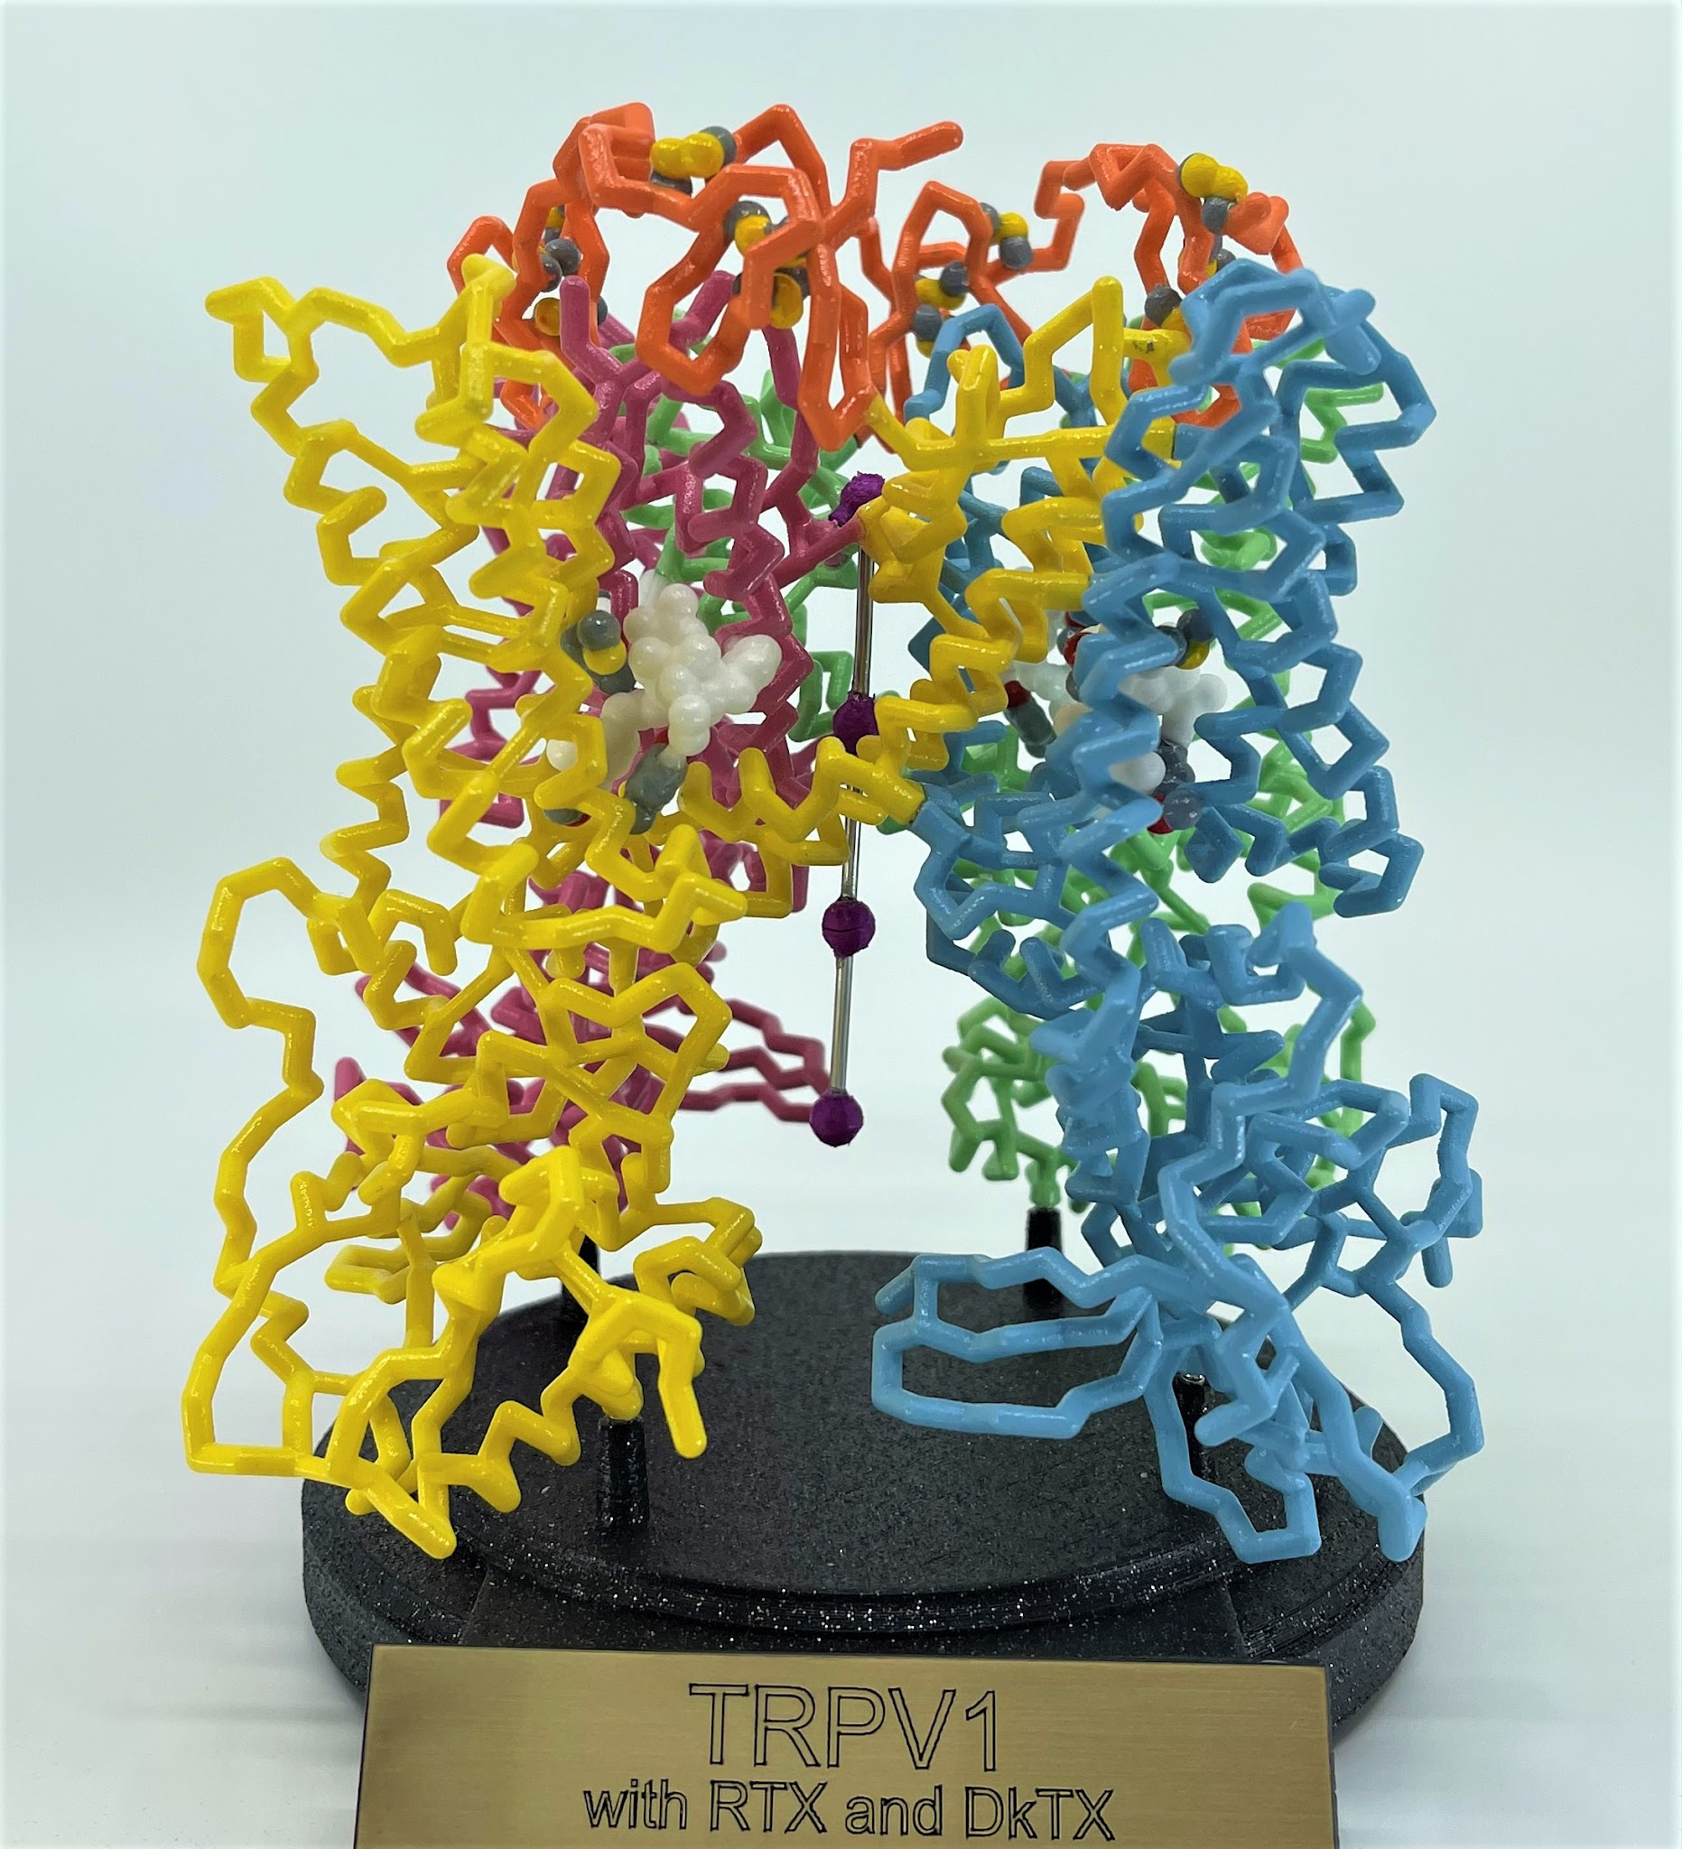
Another Nobel Prize-winning Channel Protein…
2021 Nobel Prize in Physiology or Medicine to David Julius
The Pain Receptor
TRPV1
A 2015 SMART Team Project

Slide 23
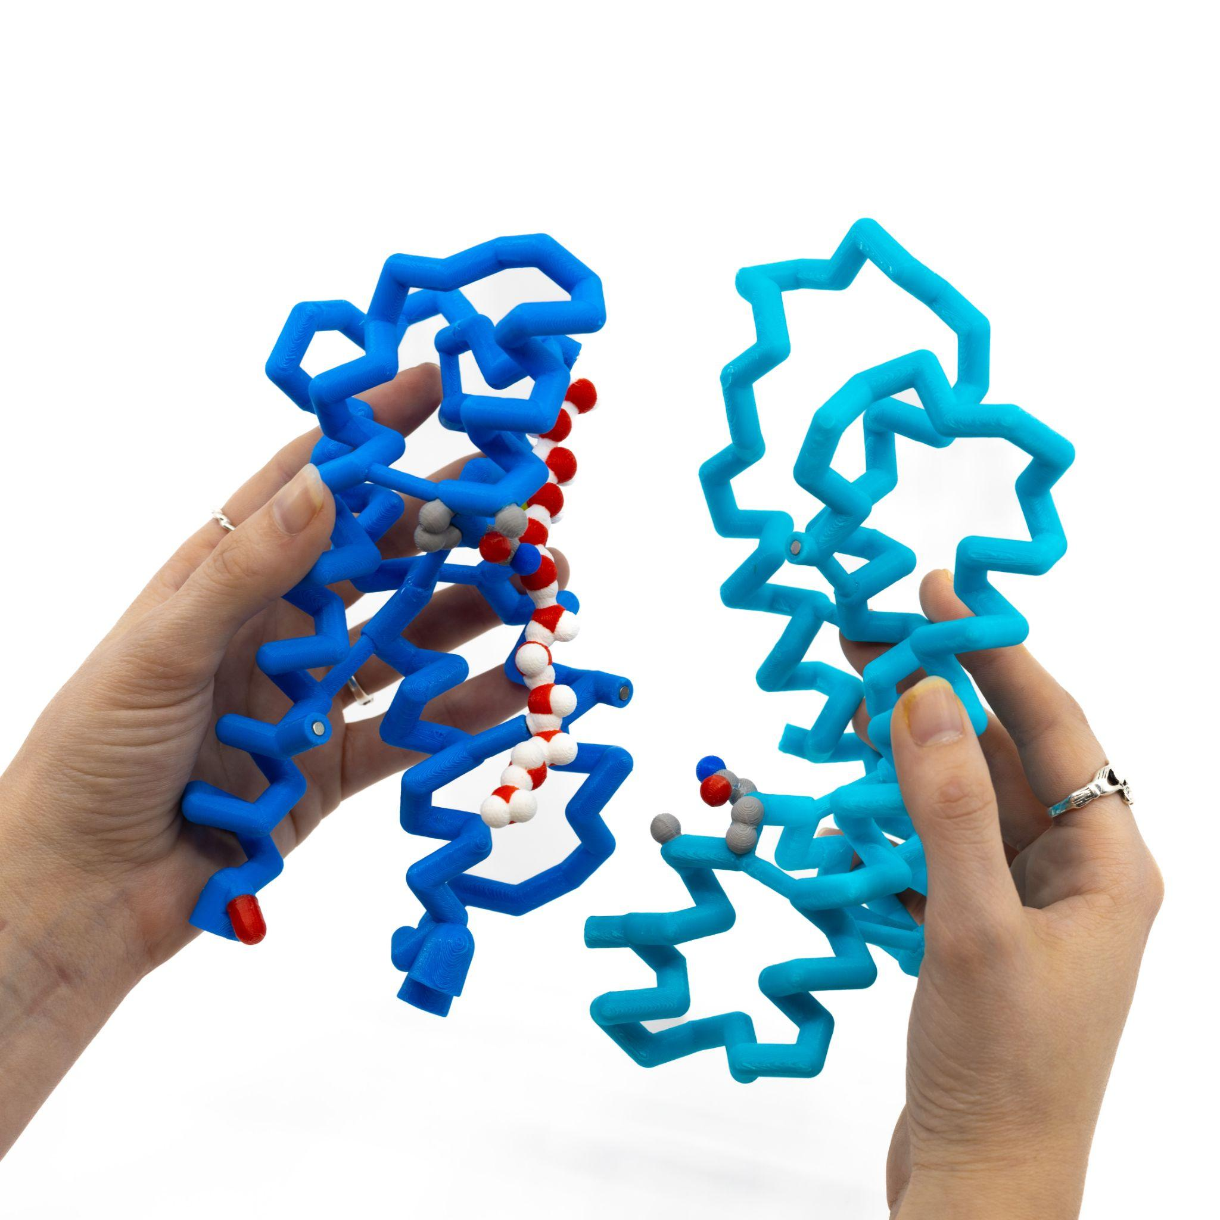
Reflect and Apply
Look back at your proposed model of a water channel.
How does your model compare to the structure of aquaporin?
What characteristics were similar and which were different?
Notes:
10:15-10:25

Slide 24


Slide 25

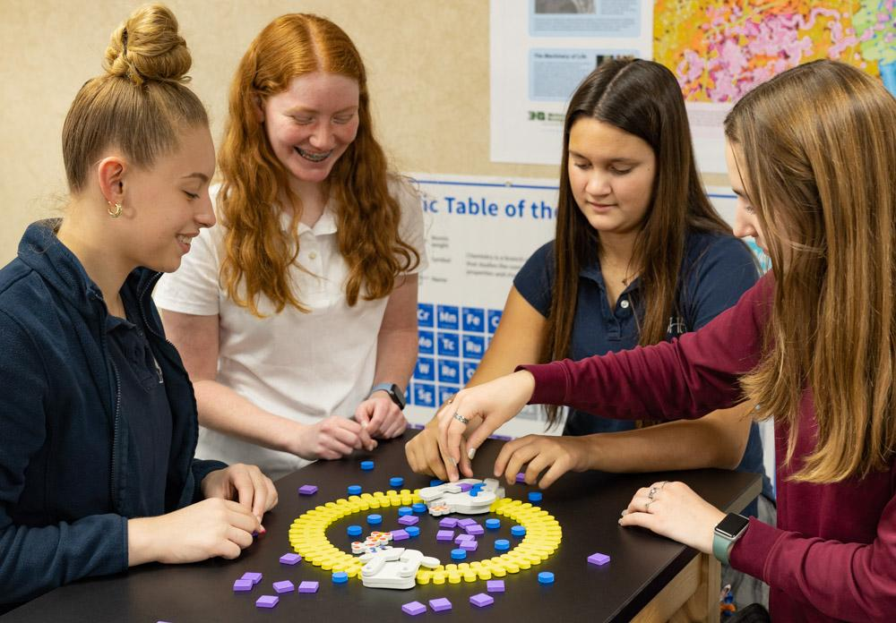

Life on the Inside: Break on Through to the Other Side
I swim in a sea of words. They flow around me and through me and, by a process that is not fully clear to me, some delicate hidden membrane draws forth the stuff that is the necessary condition of my life.
~Geraldine Brooks
Notes:
10:35-11:25
Ensure to tie Amino Acids to the Peter Agre story -the transition is….there is something MORE out there
What questions have we answered and made good progress on -what questions do we still have?

Slide 26

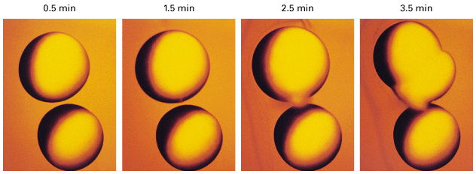
Back to the Exploding Frog Eggs…
Water
  How do the properties of water help us understand cells?
Membranes
  How do membranes form and serve as barriers?
Proteins
  How can protein structures allow for transport across membranes?
(Agre, 2003)

Slide 27
DQB: Revisit and Reflect
Driving Question: How do cellular structures function together?
What questions have we answered or made good progress on?
What new questions do we have?

Slide 28
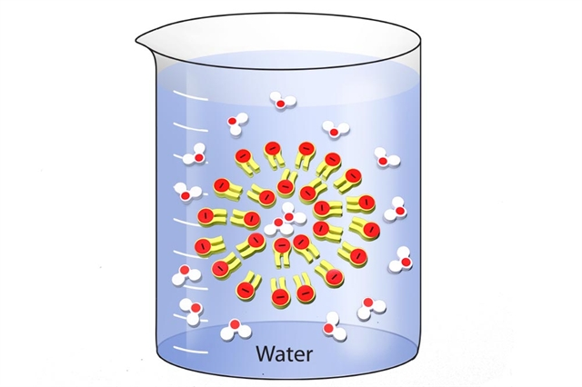
Phospholipid & Membrane Transport Kit©
But Wait!
There’s more!

Slide 29

Model Transition from…

Slide 30

Model Transition from…
to…

Slide 31
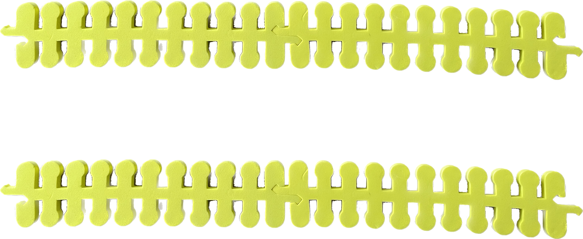
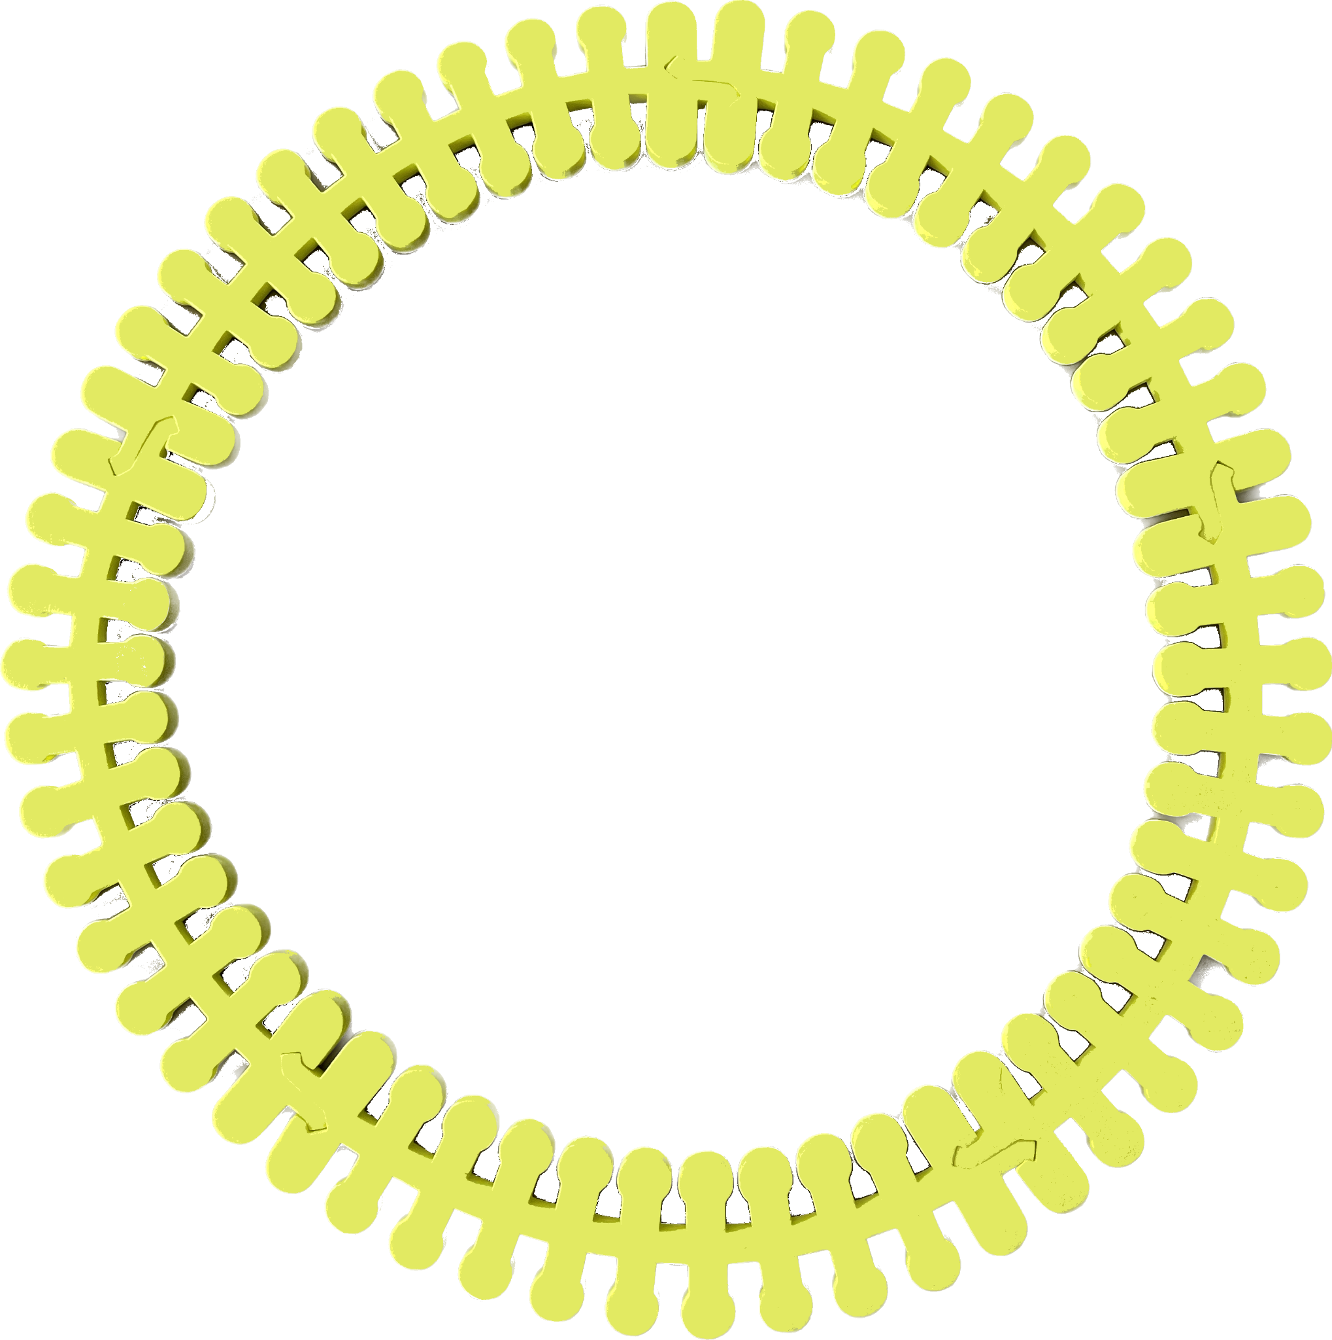
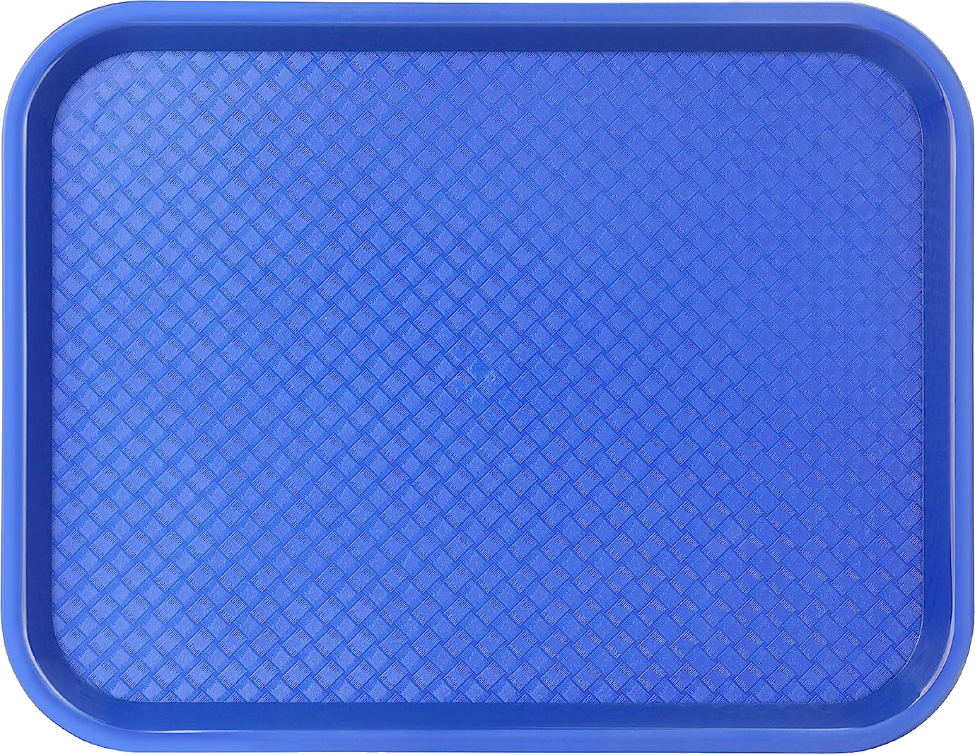
Let’s Play!
Notes:
Ask participants to differentiate between inter and extracellular

Slide 32

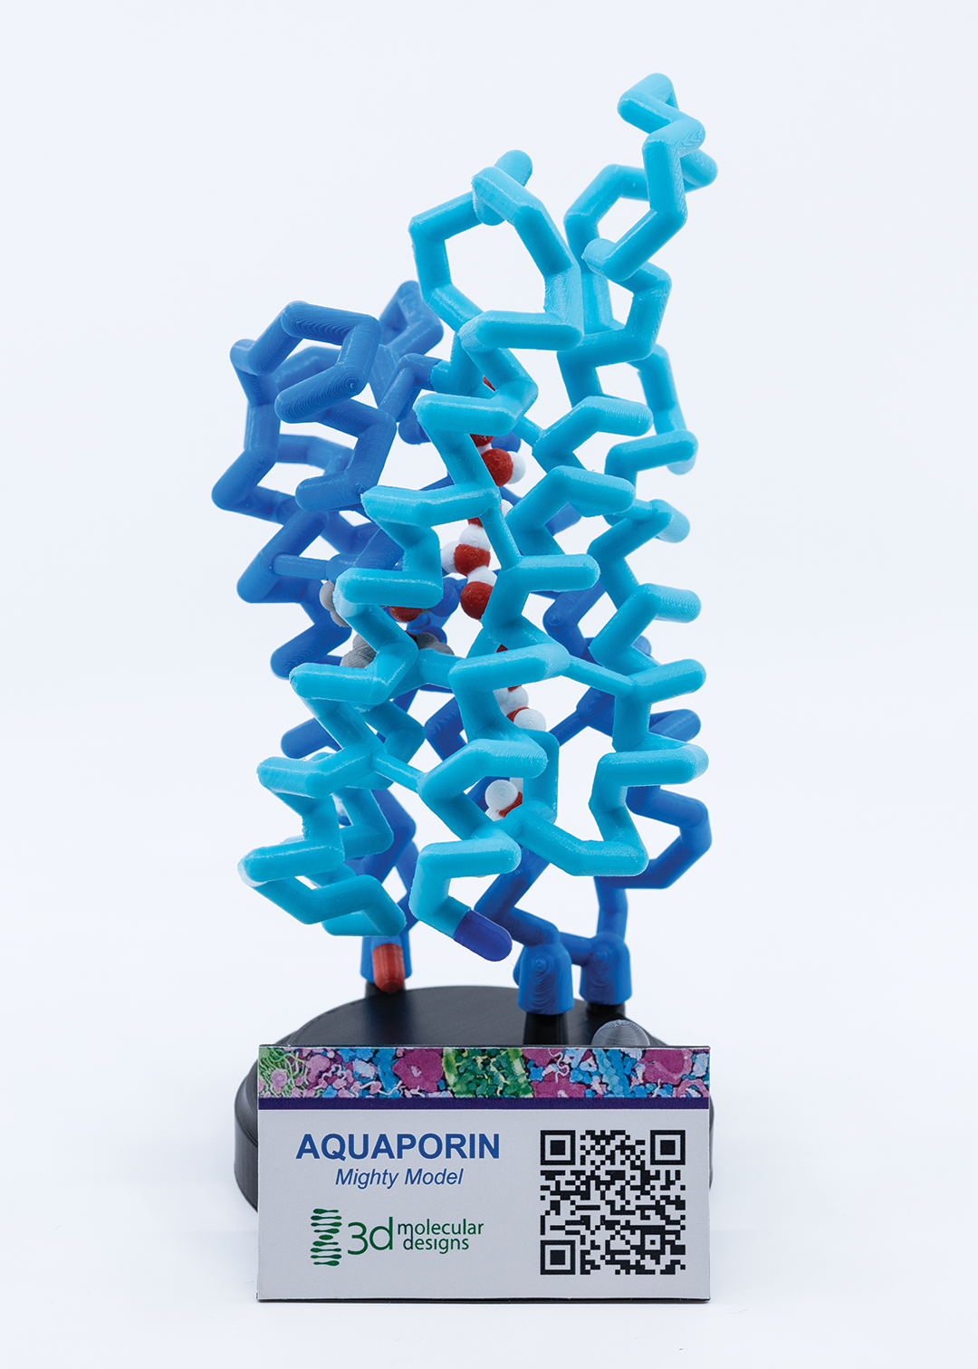
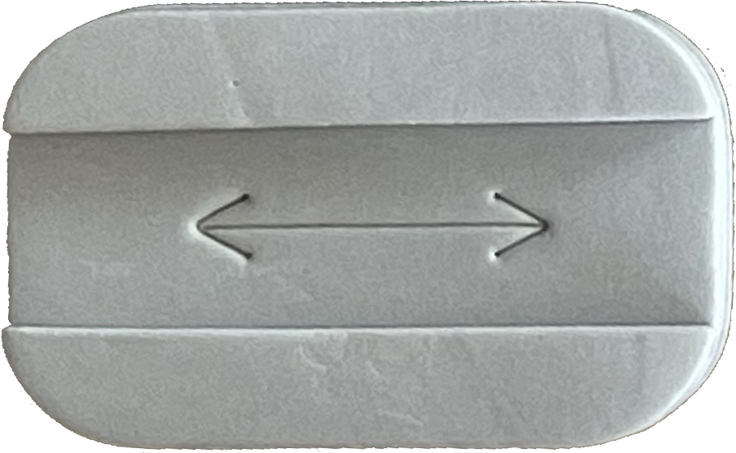
Aquaporin = Channel Protein

Slide 33

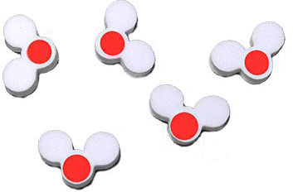
Osmosis: Transport of Water Through Aquaporins

Slide 34

Model a cell in each of these environmental conditions.
← Solute (Example: Na⁺)
Hypertonic Solution
Isotonic Solution
Hypotonic Solution

Slide 35
What is happening to those eggs???
Construct a model to explain what is happening to the frog eggs.
(Agre, 2003)

Slide 36
Model a cell in each of these environmental conditions.
← Solute (Example: Na⁺)
Hypertonic Solution
Isotonic Solution
Hypotonic Solution

Slide 37
Remember: Water will diffuse from an area of high water potential (low solute concentration) to an area of low water potential (high solution concentration).
Which direction will water flow?
Hypertonic Solution
Isotonic Solution
Hypotonic Solution

Slide 38
What is happening to those eggs???
Develop a model to explain what is happening to the frog eggs.
(Agre, 2003)

Slide 39

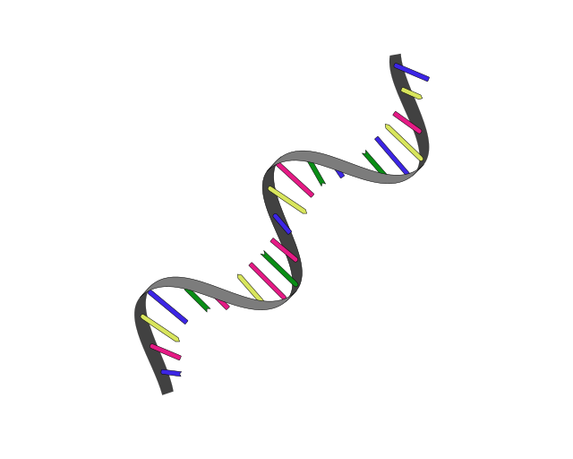
(Agre’s) Frog Eggs
mRNA
distilled water
mRNA
Extracellular
Intracellular
Extracellular

Slide 40

(Agre’s) Exploding! Frog Eggs
distilled water
Extracellular
Intracellular
Extracellular

Slide 41
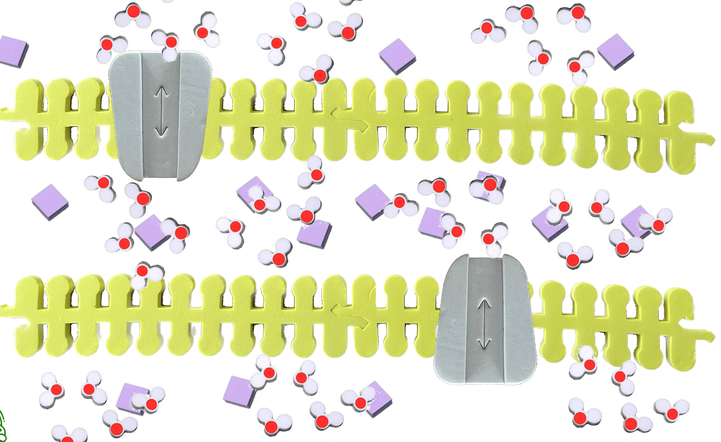
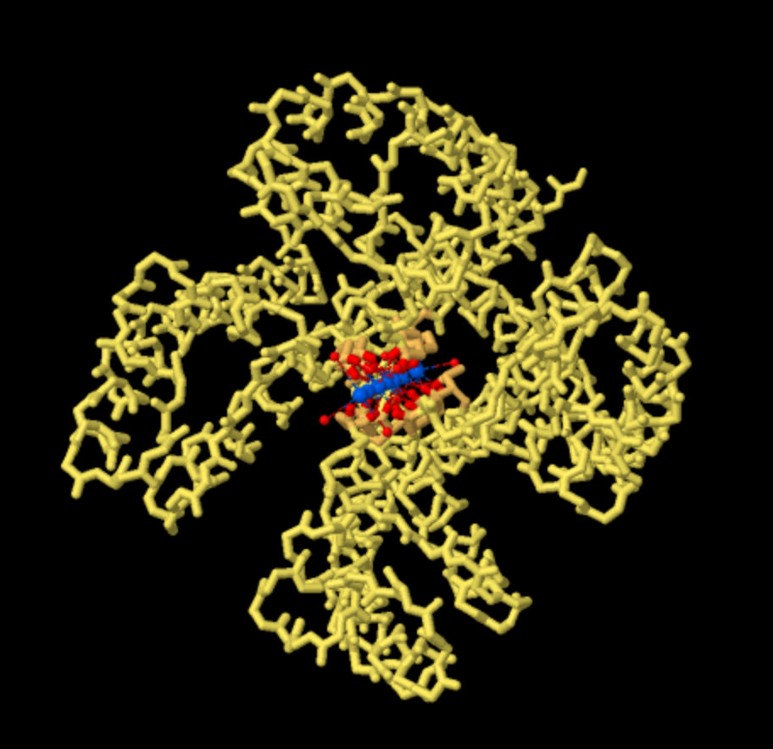
Potassium Channel
(or any channel you like for your story!)
PDB ID: 1K4C
Notes:
https://pdb101.rcsb.org/motm/38

Slide 42
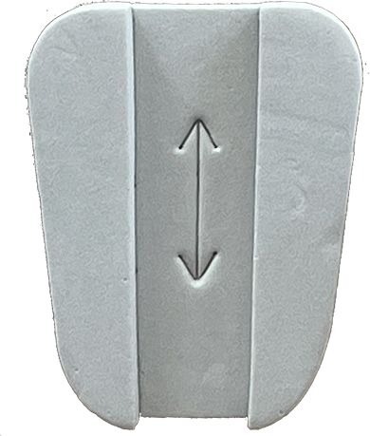
Diffusion!

Slide 43
Osmosis and Diffusion!

Slide 44
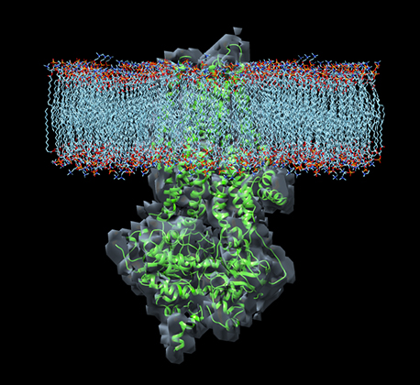
CFTR Protein: Chloride Channel
(TCBG highlight: Placing new proteins 2011)
Notes:
https://pdb101.rcsb.org/motm/38

Slide 45
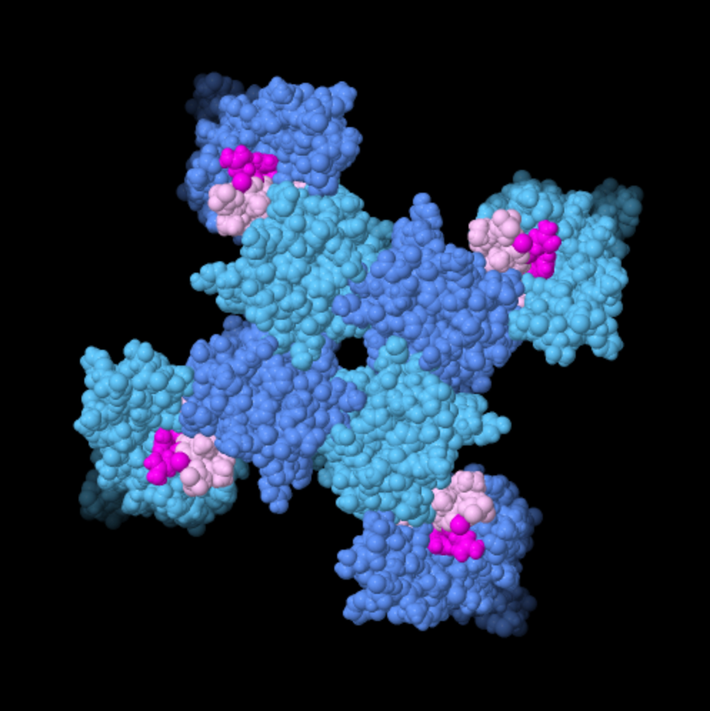
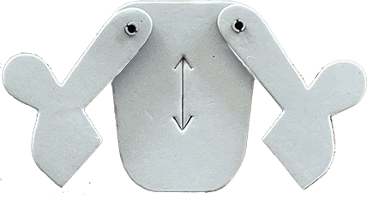
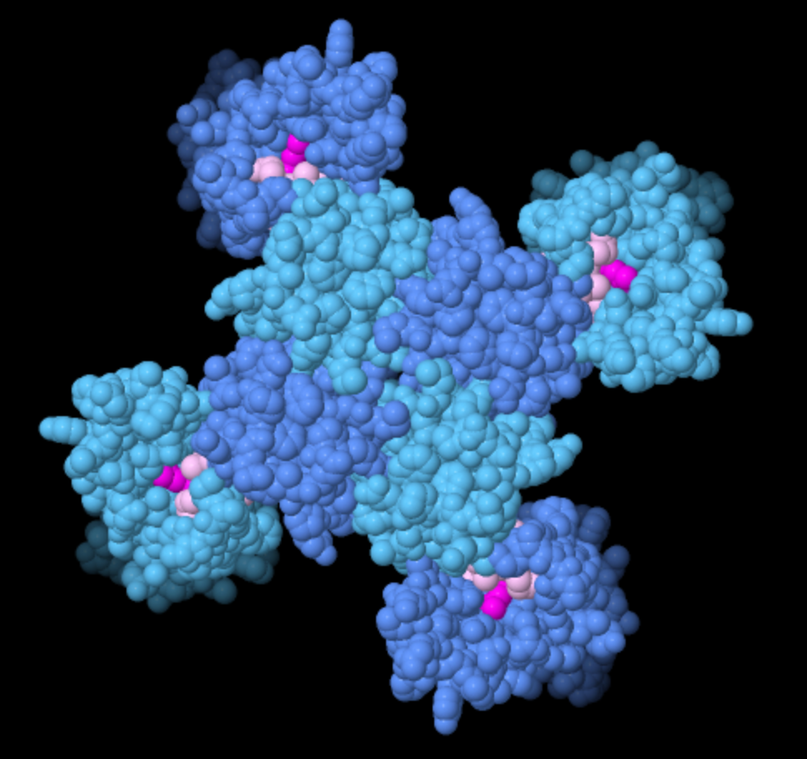
Voltage-Gated Sodium Channel
PDB ID: 5vb8, 6p6w
Notes:
https://pdb101.rcsb.org/motm/243

Slide 46
But! How to reset
Against the gradient?

Slide 47
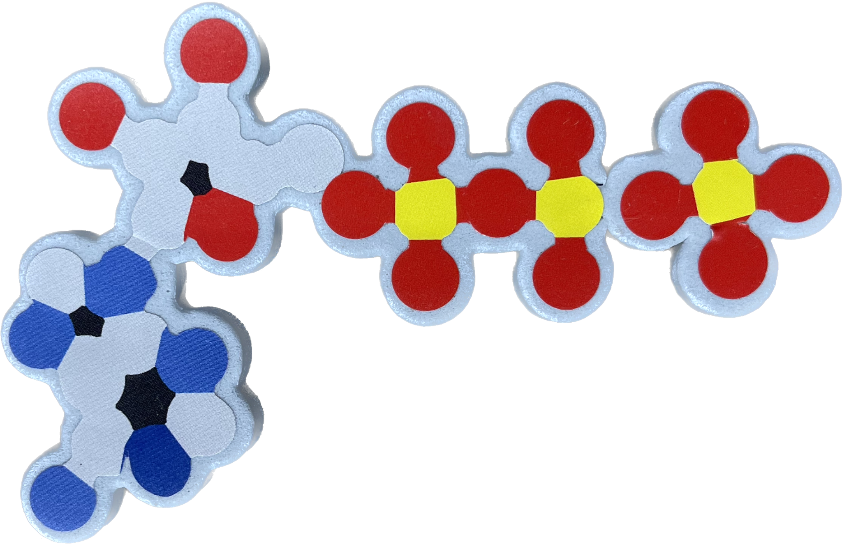

ENERGY REQUIRED!!

Slide 48
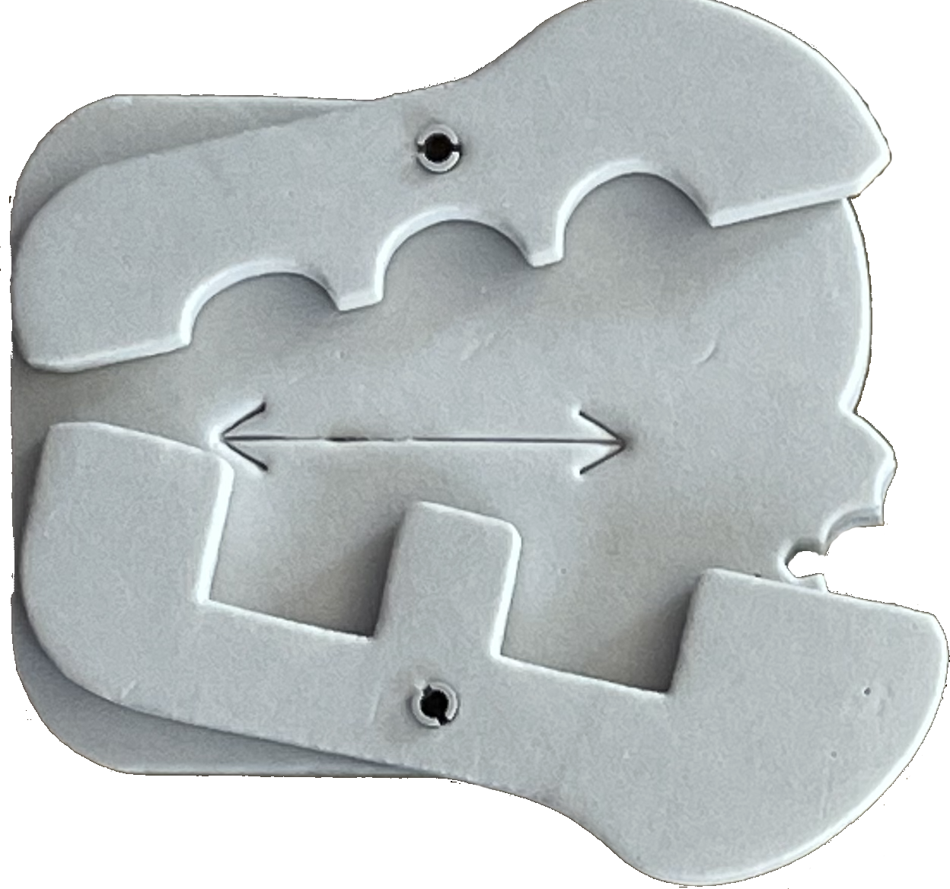
Sodium / Potassium
Pump

Slide 49
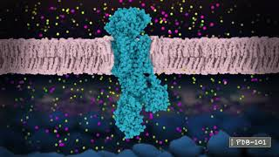

Slide 50
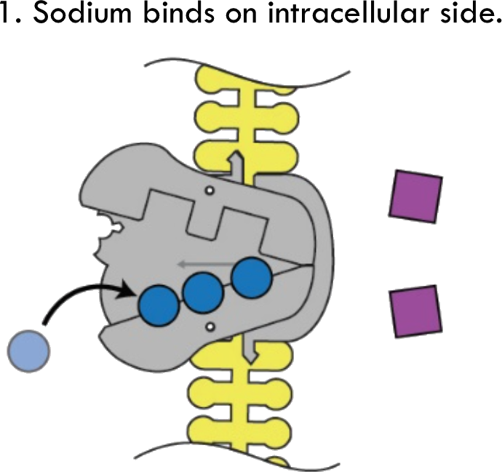
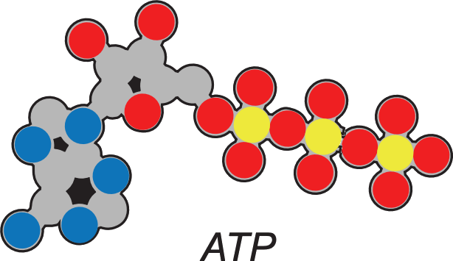
Intracellular
Extracellular

Slide 52
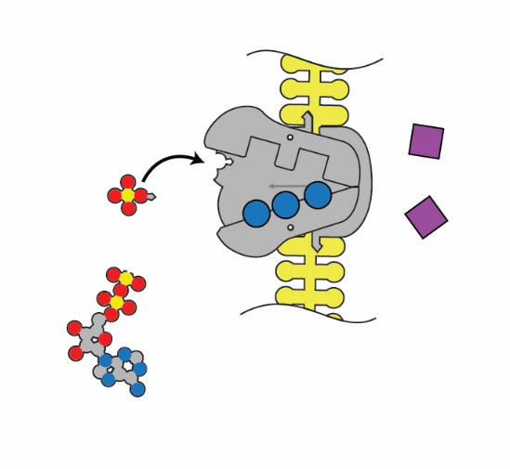
2. The pump is phosphorylated by ATP.
Intracellular
Extracellular

Slide 53
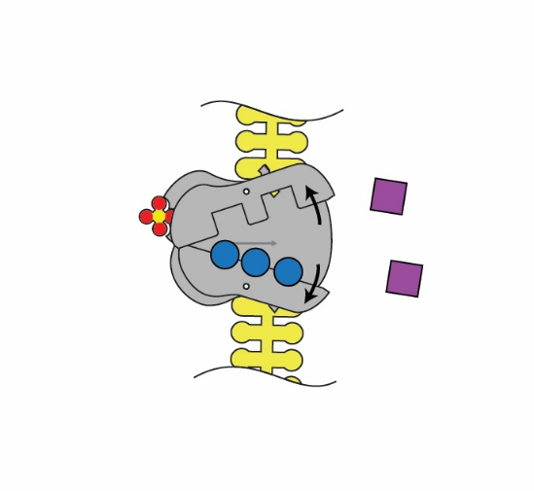
3. The pump shape changes, exposing the sodium to the extracellular space.
Intracellular
Extracellular

Slide 54
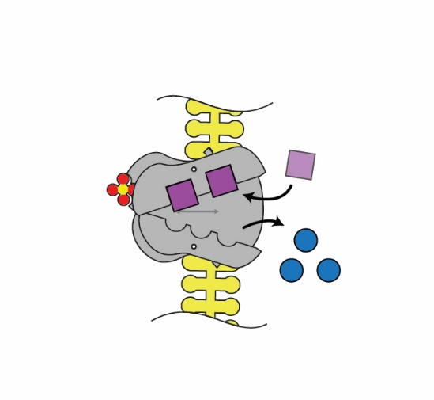
4. Binding affinity changes to release Na+, and take in K+.
Intracellular
Extracellular

Slide 56
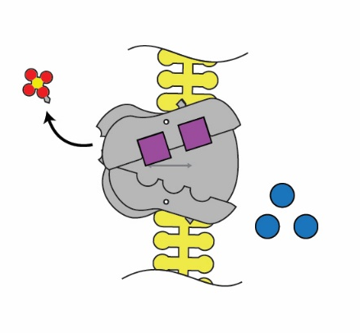
5. Phosphate detaches.
Intracellular
Extracellular

Slide 57
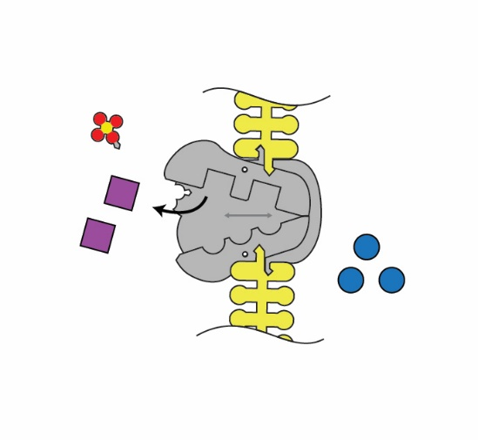
6. Original shape is restored, releasing K+ into the cell.
Intracellular
Extracellular

Slide 59
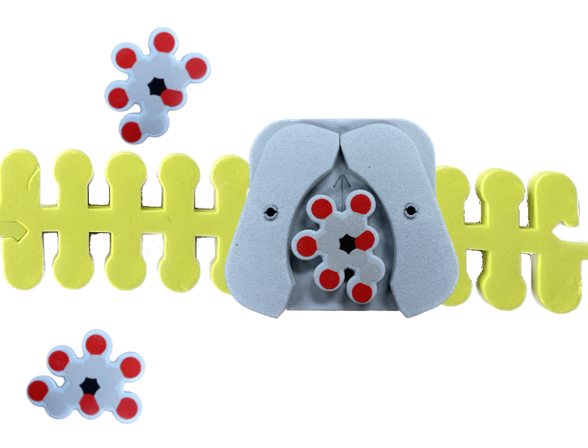
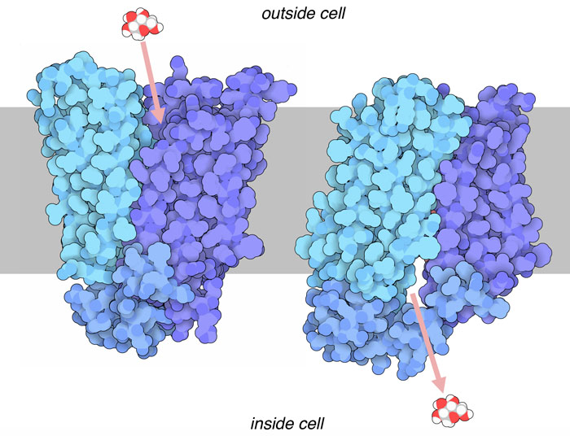
Glucose Transporter (Carrier Protein)
(PDB101: Molecule of the month: Glucose Transporters)
Notes:
https://pdb101.rcsb.org/motm/38

Slide 60


Slide 61








The story of the model maker…
What is the purpose of each model?
What feature(s) of each model allow it to serve the purpose?
What misconceptions might each model promote?
How can you help students avoid those misconceptions?
Notes:
Move to Tuesday PM or Wednesday

Slide 62
Close out the DQB
Driving Question: How do cellular structures function together?
What questions have we answered or made good progress on?
What questions do we still have?
Can we answer the driving question?
  If so, how could you use models to explain?
  If not, what information do you still need to know?

Slide 63
Synthesis Model
Use the models we have explored to construct a summary model to synthesize and explain your observations of the frog eggs

Slide 64
Modeling Options
Construct a model to explain your observations of the frog eggs
Model a frog egg in saltwater
Model how an organism can survive in saltwater
Model how marine organisms’ cells might be affected if the pH of the ocean changes
Model how an aquatic cell might be affected by temperature
Choose a channel protein, now model a cell with a defect in that protein

Slide 65


3-2-1 Reflection
3 | Ways the Phospholipid and Membrane Kit could connect to your curriculum
2 | Things I’ve learned today
1 | Question I still have
Notes:
11:25

Slide 67

The Proteins of the Cell Membrane
derivative work: Dhatfield (talk)Cell_membrane_detailed_diagram_3.svg: *derivative work: Dhatfield (talk)Cell_membrane_detailed_diagram.svg: LadyofHats Mariana Ruiz, CC BY-SA 3.0 <https://creativecommons.org/licenses/by-sa/3.0>, via Wikimedia Commons

Slide 68
The Proteins of the Cell Membrane
How membrane proteins integrate into the lipid bilayer and achieve their different topologies remains mysterious. What is clear, however, is that most of them integrate into the ER membrane cotranslationally – in other words, during their synthesis on membrane-bound ribosomes.
Rapoport et.al. TRENDS in Cell Biology Vol 14 No.10 October 2004
derivative work: Dhatfield (talk)Cell_membrane_detailed_diagram_3.svg: *derivative work: Dhatfield (talk)Cell_membrane_detailed_diagram.svg: LadyofHats Mariana Ruiz, CC BY-SA 3.0 <https://creativecommons.org/licenses/by-sa/3.0>, via Wikimedia Commons

Slide 70

Lunch Options
 | Monday | Tuesday | Wednesday | Thursday | Friday
330 Eats | Heather | Diane
Cubanitas | Diane | Heather | Diane
Fiddleheads | Kris | Lauren
Med Cuisine |  | Kris
Waterfront Deli | Lauren |  | Heather
Red Arrow Food Trucks |  |  | Lauren
330 Eats - Cafe with salads & sandwiches
Cubanitas - Cuban sandwiches & bowls
Fiddleheads - Coffee shop with sandwiches
Mediterranean Cuisine - Cafe with gyros & kebabs
Red Arrow Food Trucks - Rotating food trucks
600 East Cafe - Cafe and bakery
Loaded Spuds - Baked potatoes with toppings
Your Office - (Elevated) Dive bar for lunch

Slide 71


Slide 72
Science Olympiad
Protein Modeling Event

Slide 73



Pics of Protein Modeling Event

Slide 74




Slide 75

Protein Modeling 2027 & 2028

Slide 76


Slide 78




Implementation Planning
4 minutes to choose a task.
25 minutes to individually complete your task.
15 minutes to share ideas at your table.
Notes:
Teacher: Give learners time to respond to the prompts.
Learner: Respond in their notebooks and then share their ideas with their peers.
If you want to examine this high school student resolved structure in the pdb https://www.rcsb.org/structure/6pey

Slide 79








Slide 80



Slide 81


Share ideas and ask for feedback.

Slide 83

Catalyzing Curiosity
Enzyme in Action Kit & Substrate Specificity Kit
"Our cells engage in protein production, many of those proteins are enzymes, responsible for the chemistry of life"
~Randy Schekman

Slide 84

What do you remember about enzymes?
What do enzymes do?
What structures in an enzyme are important?
6PEY.pdb
Notes:
Teacher: Give learners time to respond to the prompts.
Learner: Respond in their notebooks and then share their ideas with their peers.
If you want to examine this high school student resolved structure in the pdb https://www.rcsb.org/structure/6pey

Slide 85
“Enzymes build and break molecules.”

Slide 86

Acetylcholine

Slide 87

Enzyme Model
What do you notice?
What do you you wonder?
Notes:
Teacher: Give learners time to respond to the prompts.
Learner: Respond in their notebooks and then share their ideas with their peers.
If you want to examine this high school student resolved structure in the pdb https://www.rcsb.org/structure/6pey

Slide 88

Catabolic process - breaks the substrate into products

Slide 89
A
ACh
Ch
ACh
Acetylcholinesterase
Acetylcholinesterase
Acetylcholinesterase
Catabolic process - breaks the substrate into products

Slide 90
What did you notice about the behavior of the active site?
MHET
TPA
EG
MHET
MHETase
MHETase
MHETase
Catabolic process - breaks the substrate into products

Slide 91

What is an Active Site?
Using the foam models in front of you, select what you think models an active site.
WHY did you select this model?
What properties do all active sites have?
Notes:
Teacher: Ask learners to dump out the entire contents of the kit. Give them time to consider which model is the best representation of an active site. Ask them to report their ideas.
Learner: Talk within their group, select the best model of an active site, and justify your answer.

Slide 92
Enzyme Model
Where is the active site on this model?
What properties do you think that active sites will have?
Notes:
Teacher: Give learners time to respond to the prompts.
Learner: Respond in their notebooks and then share their ideas with their peers.
If you want to examine this high school student resolved structure in the pdb https://www.rcsb.org/structure/6pey

Slide 93

Active Site Highlights
Active sites have a specific shape.
Active sites have chemical properties that will attract their substrate.
Notes:
Teacher: Discuss with learners when you would use the model with the active site labeled by chemical properties and when you would use the solid gray one.
Learner: Consider what would work best in their classroom.

Slide 94
Catabolic Reaction
Model a catabolic reaction.
AB —> A + B
Predict the behavior of chemical interactions.
Evaluate the merits and limitations of the models.
Notes:
Teacher: Give learners a chance to model a catabolic reaction, then show them the reaction in the active site using the magnetic pieces. Note: the green pieces show a catabolic reaction. Help learners notice the differences between the orange and green pieces.
Learner: Use the kit pieces to model the displayed reaction. Explain their reasoning.

Slide 95

Catabolic Reaction Interactable
Let’s explore this reaction further.
Navigate through the first six slides.
Focus on the animations.
How is the reaction different when an enzyme is added?
Notes:
Teacher: Have learners navigate to https://learn.3dmoleculardesigns.com/catabolic-reactions-interactable-pl?hsLang=en.
Passcode is SUMMER24

Slide 96
Anabolic Reaction
Model a anabolic reaction.
A + B —> AB
Predict the behavior of chemical interactions.
Evaluate the merits and limitations of the models.
Notes:
Teacher: Give learners a chance to model an anabolic reaction, then show them the reaction in the active site using the magnetic pieces. Note: the orange pieces show an anabolic reaction. Help learners notice the differences between the orange and green pieces.
Learner: Use the kit pieces to model the displayed reaction. Explain their reasoning.

Slide 97

Anabolic Reaction Interactable
Let’s explore this reaction further.
Navigate through the first six slides.
Focus on the animations.
How is the reaction different when an enzyme is added?
Notes:
Teacher: Have learners navigate to https://learn.3dmoleculardesigns.com/anabolic-reactions-interactable-pl
Passcode: SUMMER24

Slide 98


Specificity of the Active Site
What patterns did you notice while modeling the enzyme substrate interactions?
Alpha helices and beta sheets rarely are found within an active site.
Why do you think that is?
Notes:
Teacher: Give learners a chance to model specificity, then show them the reaction in the active site using the magnetic pieces. Note: What pisces fit/do not fit. Help learners notice the differences.
Learner: Use the kit pieces to model the displayed reaction. Explain their reasoning.

Slide 99
Induced fit
Slowly slide the substrate into the active site.
Describe what happens to the model.
What do you notice?
Notes:
Teacher:Note How the gray active site slightly changes
Learner: Use the kit pieces to model the displayed reaction. Explain their reasoning.

Slide 100
Modeling Competitive Inhibition
Determine what piece(s) could be used to model competitive inhibition.
Notes:
Teacher:
Learner:

Slide 101

What is Competitive Inhibition?
A type of inhibition where a substrate molecule is prevented from binding to the active site of an enzyme by a molecule that is very similar in structure to the substrate.
What do you notice about the shape of the active site?
Notes:
Teacher:
Learner:

Slide 102
Modeling Non-Competitive Inhibition
Determine what pieces show model non-competitive inhibition.
In your Notebook: Create a simple sketch to illustrate the difference between competitive and non-competitive inhibition of an enzyme.
Notes:
Teacher:
Learner:

Slide 103

What is Non-Competitive Inhibition?
A type of enzyme inhibition where an inhibitor binds to an allosteric site resulting in decreased efficacy of the enzyme.
What do you notice about the shape of the active site?
Notes:
Teacher:
Learner:

Slide 104
Substrate Specificity Kit
Amino Acid sequence of Acetylcholinesterase
What do you notice?
What do you wonder?
Notes:
Teacher: Ask learners to Please note the amino acid sequence above starts at amino acid 122.
Learner:

Slide 105

Substrate Specificity Kit
Colored circles are binding locations for the active site.
What do you notice?
What do you wonder?
Notes:
Teacher: To model the active site in JUDE use the following file PDB 6UQW
and select
phe150, asp154,ala200, val201,arg206,trp287
phe-yellow asp-red ala-yellow val-yellow arg-blue trp-yellow
Learner:

Slide 106

Substrate Modeling Kit
Create a substrate with the ball and stick models
What do you notice?
What do you wonder?
Notes:
Teacher: Give learners the supplies to make a ball and stick substrate model.
Learner: Follow the prompts on the slide.

Slide 107

Substrate Modeling Kit
Space out the magnets along the toober.
Fold the magnets to bind to the substrate forming an active site.
What do you notice?
What do you wonder?
Notes:
Teacher: Give learners the supplies to make a ball and stick substrate model.
Learner: Follow the prompts on the slide.

Slide 108


Substrate Specificity Kit
Notes:
Teacher: Explain briefly that enzymes are three-dimensional protein. We are going to make a model of the active site determine how the substrate and active site interact.
Learner: Consider the similarities and differences between the two models. The green substrate from the Enzymes in Action kit will now be represented by the colored spheres.

Slide 109


Substrate Specificity Kit
Notes:
Teacher: Explain briefly that enzymes are three-dimensional protein. We are going to make a model of the active site determine how the substrate and active site interact.
Learner: Consider the similarities and differences between the two models. The green substrate from the Enzymes in Action kit will now be represented by the colored spheres.

Slide 110


Why Secondary Structures?
Thomas Shaffee, 2015 (PDB 9LYZ)
Notes:
Secondary structures like alpha helices and beta sheet allow the 2 to 3 amino acids in the active site to be situated in the precise location in 3-D space to catalyze the reaction.

Slide 111
3
2
1
things my students need to know about proteins
Ways this kit can fit to my curriculum
Question I / my students might have

Slide 112

Conclusion:
Interaction between the substrate and enzyme is highly specific.
A slight change in the shape of substrate or enzyme will alter the ability to catalyze the reaction which attracts both the selective ability and the efficiency of the enzyme.

Slide 114


Slide 115

Evolution in Action
Acetylcholinesterase (ACHE) Cube
“Nothing in biology makes sense except in the light of evolution.”
~Theodosius Dobzhansky

Slide 116

Acetylcholinesterase
Notes:
Teacher: Introduce what acetylcholinesterase is and does.
Neuromuscular synapse - Goodsell - 2009 - Biochemistry and Molecular Biology Education - Wiley Online Library
Learner: Respond in their notebooks and then share their ideas with their peers.

Slide 117
Conclusion:
Interaction between the substrate and enzyme is highly specific.
A slight change in the shape of substrate or enzyme will alter the ability to catalyze the reaction which attracts both the selective ability and the efficiency of the enzyme.

Slide 119
Cell Modeling Kit Sandbox Time
Molecules to Cells!
Use the Cell Modeling Kit to make sense and create context of your learning thus far. How can you use the Cell Modeling Kit to make connections between all of the other models?
Some ideas to model:
Explain how and why Agre’s frog eggs exploded
Build a neuron signalling to a muscle cell. Where would you place acetylcholinesterase in your model’s neuromuscular junction?
Think of a concept that your students struggle with and create a model to help address the common misconceptions or misunderstandings

Slide 121


Slide 122

Explain Phase
Reflect on your day, when were you in the Explain Phase?
What did your Explain Phase look and feel like?
Notes:
Time: 4–6 min.
Launch: Prompt participants to explain what the model helps them understand, predict, or communicate.
Facilitate: Press for evidence with prompts like “What in the model supports that idea?” or “How did your exploration change your explanation?”
Avoid: Do not reduce this phase to answer-checking or instructor summary only.
Quick check: Look for causal or mechanistic reasoning made visible through the model.

Slide 123
Discuss the Explain Phase
How did the model support confidence in explaining?
What counted as evidence in this phase?
How could this explanation lead to a new cycle of Wonder?
Notes:
Time: 3–4 minutes.
Help instructors notice that Explain is not the end of thinking; strong explanations often surface new questions.
Discuss how grounding explanations in the model supports accessibility and clearer communication.
Name assessment possibilities here, including observing reasoning, listening for conceptual connections, and identifying misconceptions.

Slide 124
Key Aspects of Explain
Learners articulate or illustrate thinking grounded in the model.
Explanations are supported by evidence from exploration.
Models anchor understanding and build confidence.
Explaining often generates deeper questions and another WE² Model cycle.
This phase supports both formative and summative assessment by making reasoning visible.
Notes:
Time: 2–3 minutes.
Reinforce that Explain includes communication, evidence, conceptual connection, and possible revision.
Close by making the iterative nature of WE2 explicit: Wonder, Explore, and Explain are revisited, not treated as one-and-done steps.

Slide 126
Protein Quaternary Structure
Teaching the Why…

Slide 127
Make a short list of proteins you may discuss with your students… that have quaternary structure.

Slide 128
Hemoglobin……..
Antibody………….
Ribosome…………
K⁺ Channel……….
2 α chains
2 β chains
How does quaternary structure contribute to the function of these proteins?
2 light chains
2 heavy chains
80 proteins
5 RNAs
Homo tetramer

Slide 129
QUESTIONS… about quaternary structure
WHY?
How do two different subunits of a multi-subunit
protein find each other in the cell?
How does the cell ensure that two different subunits
are present at the same concentration?
Where…and How… are ribosomes assembled?
In a biosynthetic pathway, how does one enzyme pass its product along to the next enzyme in the pathway?

Slide 130
QUESTIONS… about quaternary structure
Where…and How… are ribosomes assembled?
In a biosynthetic pathway, how does one enzyme pass its product along to the next enzyme in the pathway?
Your own burning questions…
Notes:
What questions do teachers have?

Slide 131

Bacteriophage T4
…a molecular killing machine!
Tim Herman

Slide 132
Bacteriophage T4
Head
A molecular killing machine
Some numbers:
169,000 bp genome
…encoding >200 proteins
The virus particle is composed of
~50 different structural proteins.
The virus particle is composed of
>2000 individual proteins.
Collar
Sheath
Base Plate
Long Tail Fiber

Slide 134
$2.00 Reflection: 10￠per word
Learner Lens:
What content or new ideas did you learn?
Teacher Lens:
What are some teacher moves or pedagogy have been used that you might incorporate into your instruction?

Slide 135


Slide 136

Model Teacher Program

Slide 137

End of Day Announcements
Wednesday Focus
Proteins & Computer Visualizations
Optional Production Lab Tour
Bring Your
Notebooks
Laptop or Tablet
Evening Plans
Dinner and/or Happy Hour @5:30
Don’t forget to park some questions!

Slide 138
Things to Do in Milwaukee Tonight
Dinner at spy-themed restaurant SafeHouse
(3 minute walk from Drury)
Lakefront Brewery Tour
(5 minute drive/30 minute walk from Drury)
Milwaukee Sightseeing and Architecture Boat Cruise
(15 minute walk from Drury, $28.99/person)
Join Heather & Sean for dinner - meet in the kickback area between 5:45 - 6:00

Slide 139

End of Day Survey

Slide 142
The story of the model maker…
What is the purpose of each model?
What feature(s) of each model allow it to serve the purpose?
What misconceptions might each model promote?
How can you help students avoid those misconceptions?
Notes:
Move to Tuesday PM or Wednesday

