Slide 2
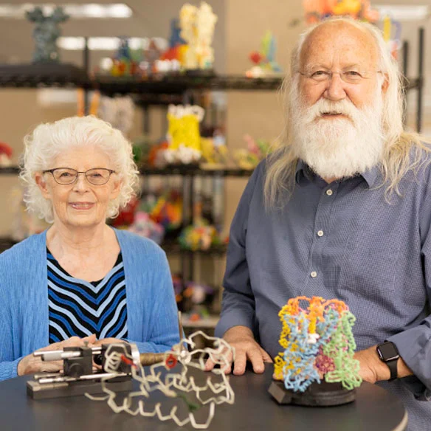
Welcome to the Family!
20% Lifetime Discount
Welcome to attend
Modeling the Molecular World free of charge

Slide 3
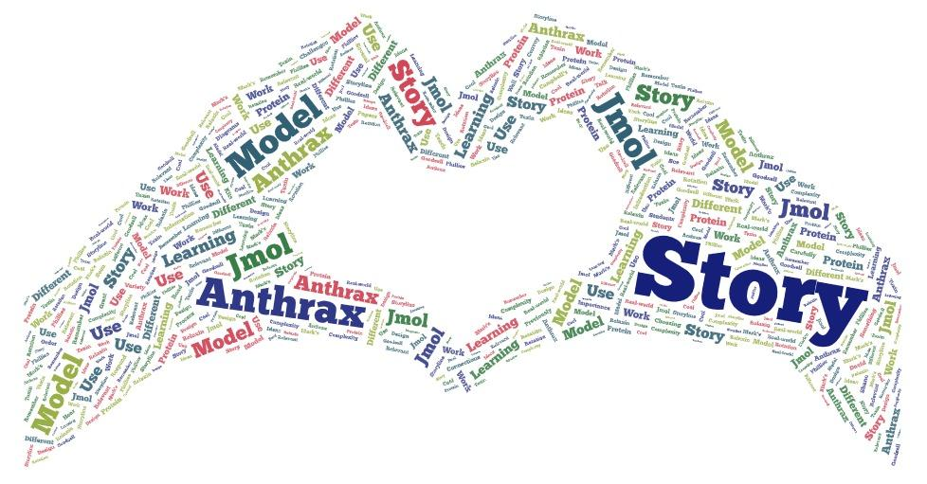
Wednesday’s Joy

Slide 4
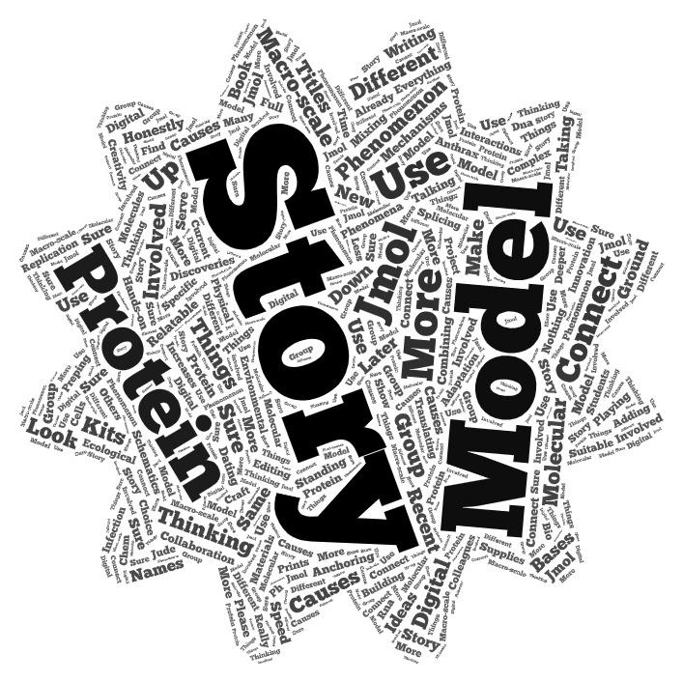
Thursday’s Wants

Slide 6
What is a protein?
Answer…. A protein is simply a linear polymer of amino acids…
that spontaneously folds up into a complex 3D shape…
following basic principles of chemistry… and physics.

Slide 7
4
We encode in a sequence of nucleotides…. … the sequence of amino acids in a protein.
20

Slide 8
How many different proteins are found in the human body?
Answer…. ~25,000 or 2.5 X 10⁴
How many different proteins could nature make?
Answer…. 20 x 20 = …………………………………….……… 400 di-peptides
20 x 20 x 20 = …………..………………….……8,000 tri-peptides
20 x 20 x 20 x 20 = ...........................160,000 tetra-peptides
20 x 20 x 20 x 20 x 20 = ………………3,200,000 pepta-peptides
20¹⁰ = ………………..……………10,240,000,000,000 deca-peptides
20¹⁰⁰ = ………………………….1.267,000,000,000,000…… x 10¹³⁰

Slide 9
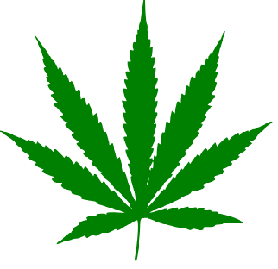
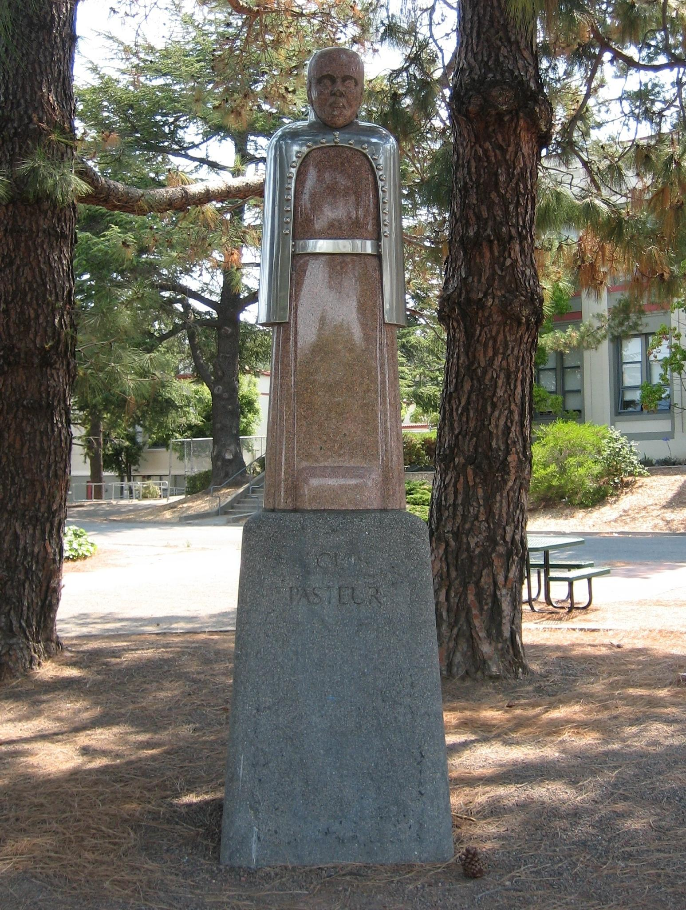
What does 4:20 mean to you?
4 Nucleotides
A T G C
20 Amino Acids
^{Triplet}
^{Genetic Code}
A,R,N,D,C,Q,E,G,H,I,
L,K,M,F,P,S,T,W,Y,V
3.2 billion of these …. make up a human genome.
Statue of Louis Pasteur at
San Rafael High School
That a string of letters could make a person…. that just blows my mind.

Slide 10
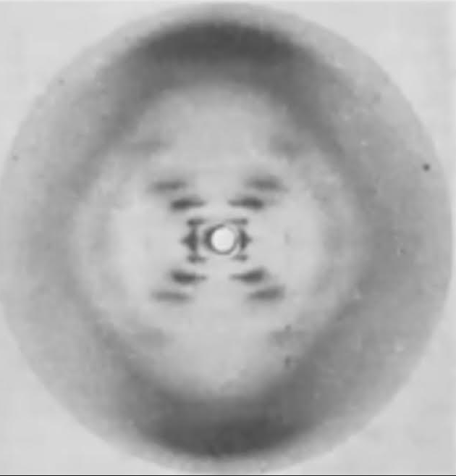
Photo 51
Using DATA to justify models of DNA.

Slide 11
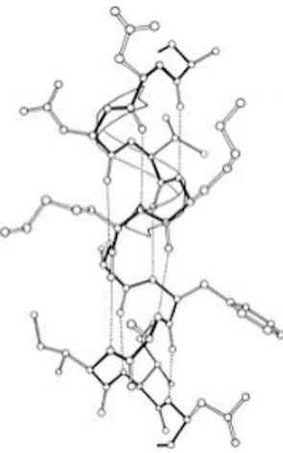
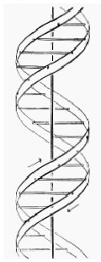
Pauling/Corey Alpha Helix
Watson/Crick
Double Helix

Slide 12
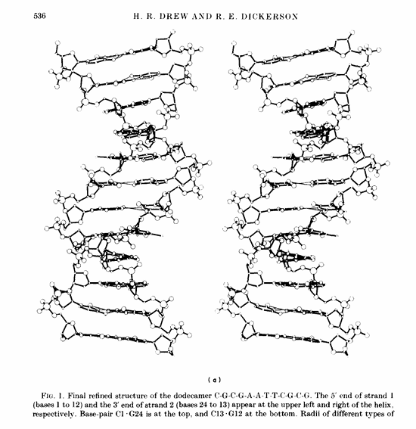
1981
Confirmation

Slide 13
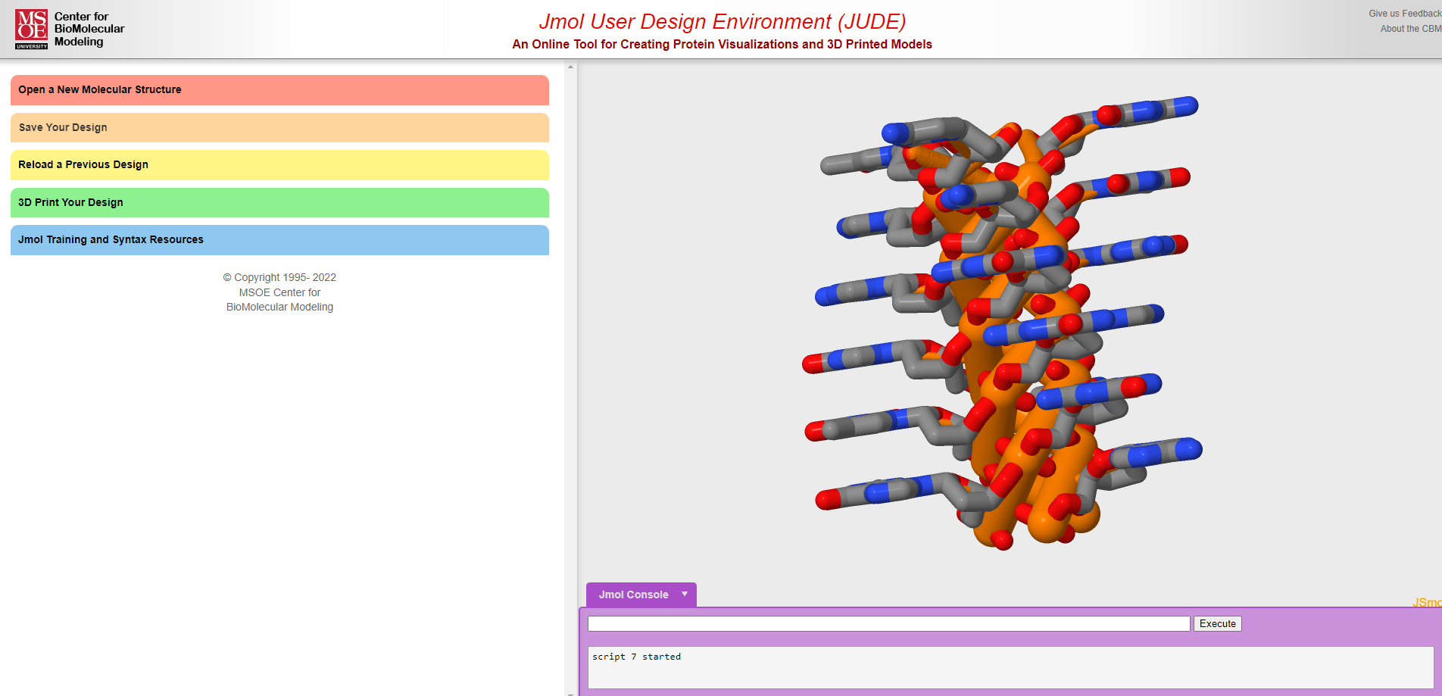
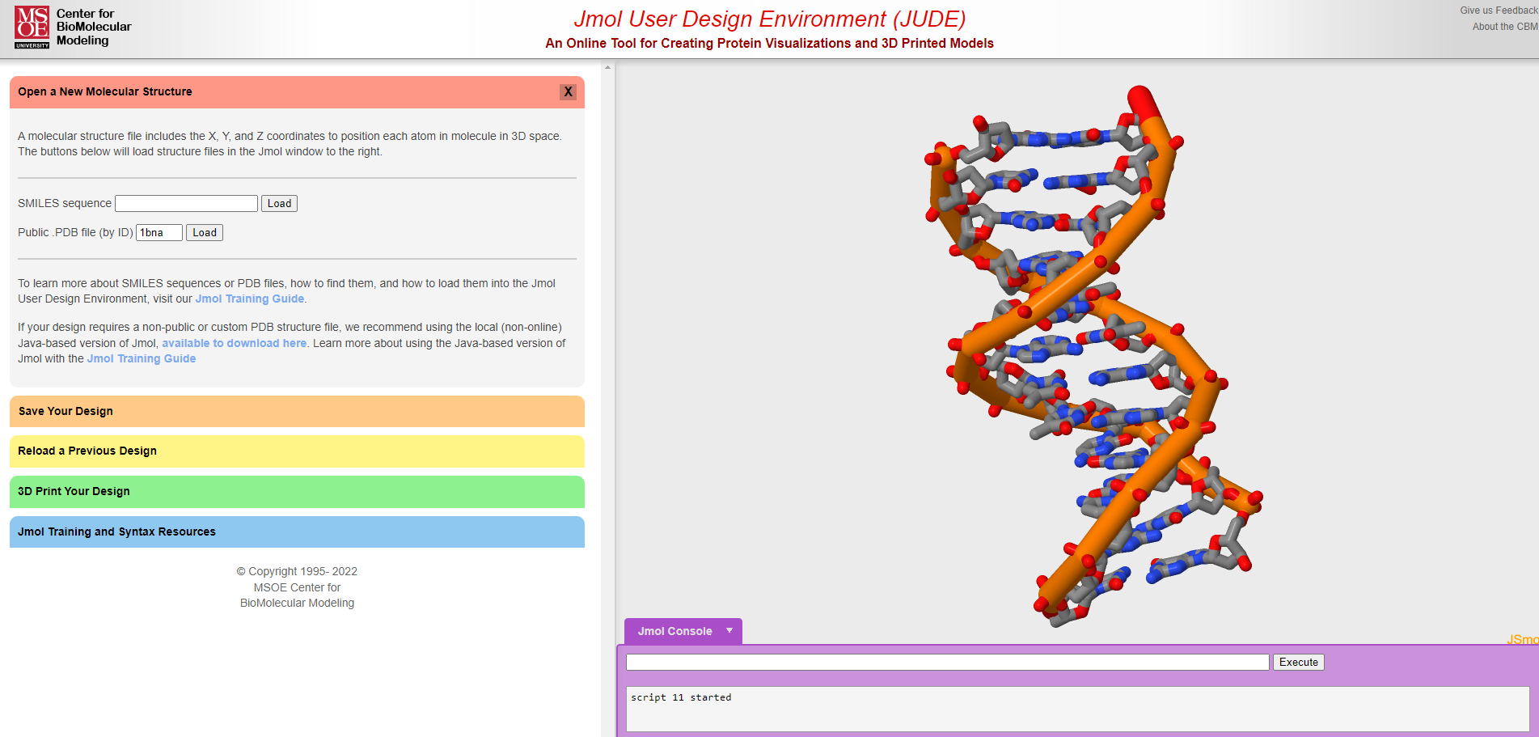

Slide 14

Ladders of Life
Dynamic DNA and Tactile DNA
“The greatest history book ever written is the one hidden in our DNA."
Spencer Wells

Slide 15

Discussion and clarifications
Through play:
What can learners authentically discover about DNA structure?
What might they wonder about?
Notes:
TP

Slide 16
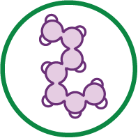
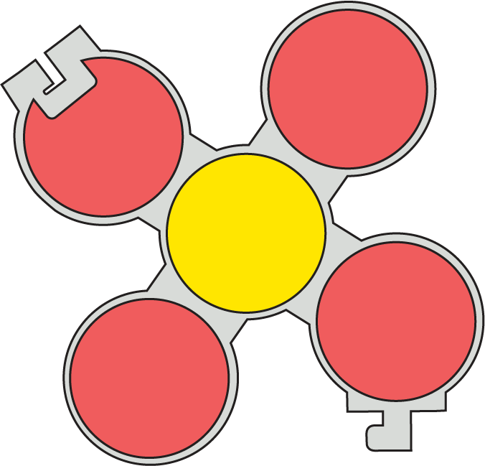
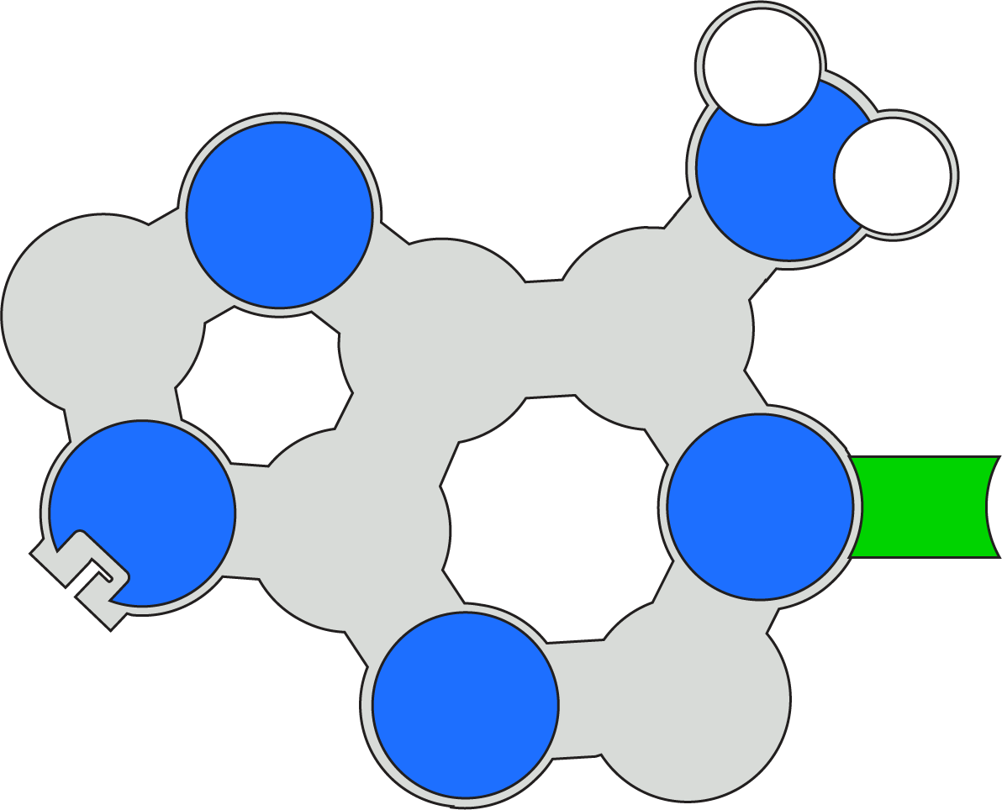
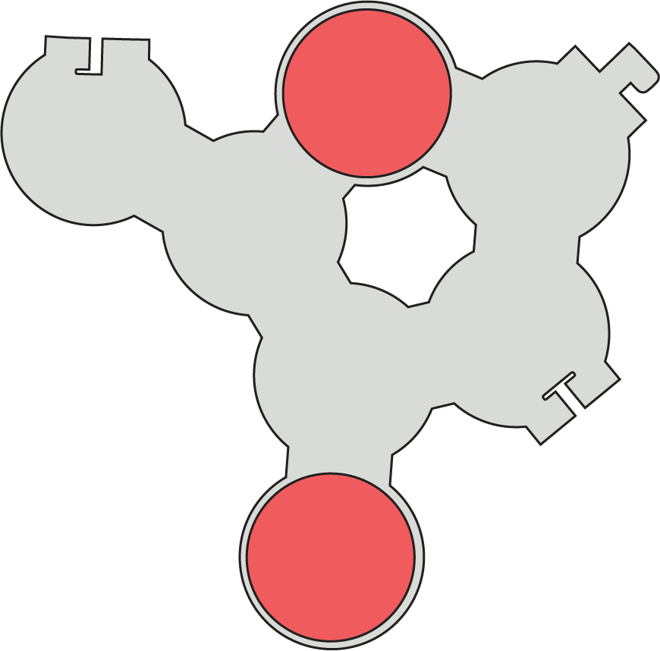
Model a Nucleotide

Slide 17
Base Pairing
DO: Use your nucleotides create two base pairs with the nucleotides at your group
EVALUATE: What are some strengths and limitations of this model?

Slide 18
Discussion and clarifications
What does this model do well?
What are some limitations?
Notes:
TP

Slide 19
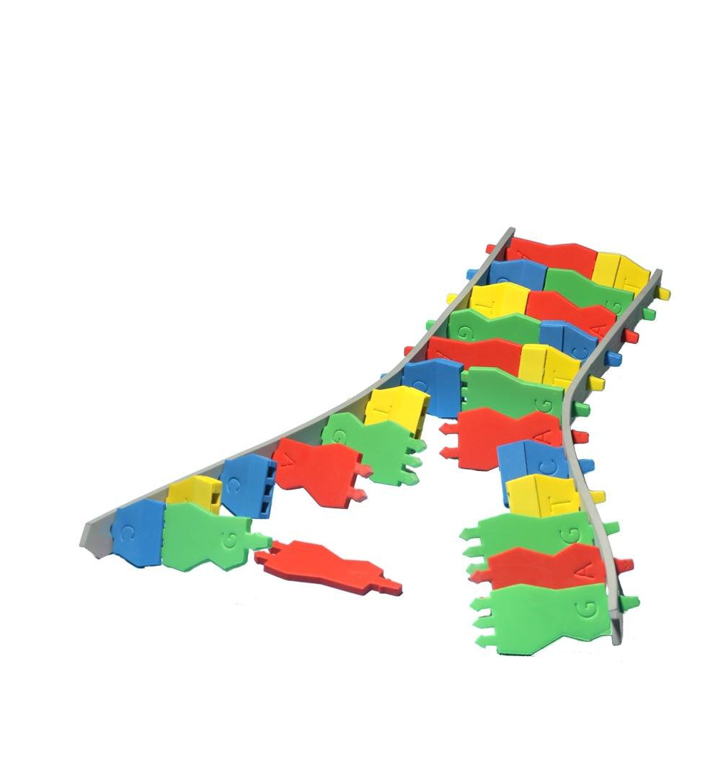
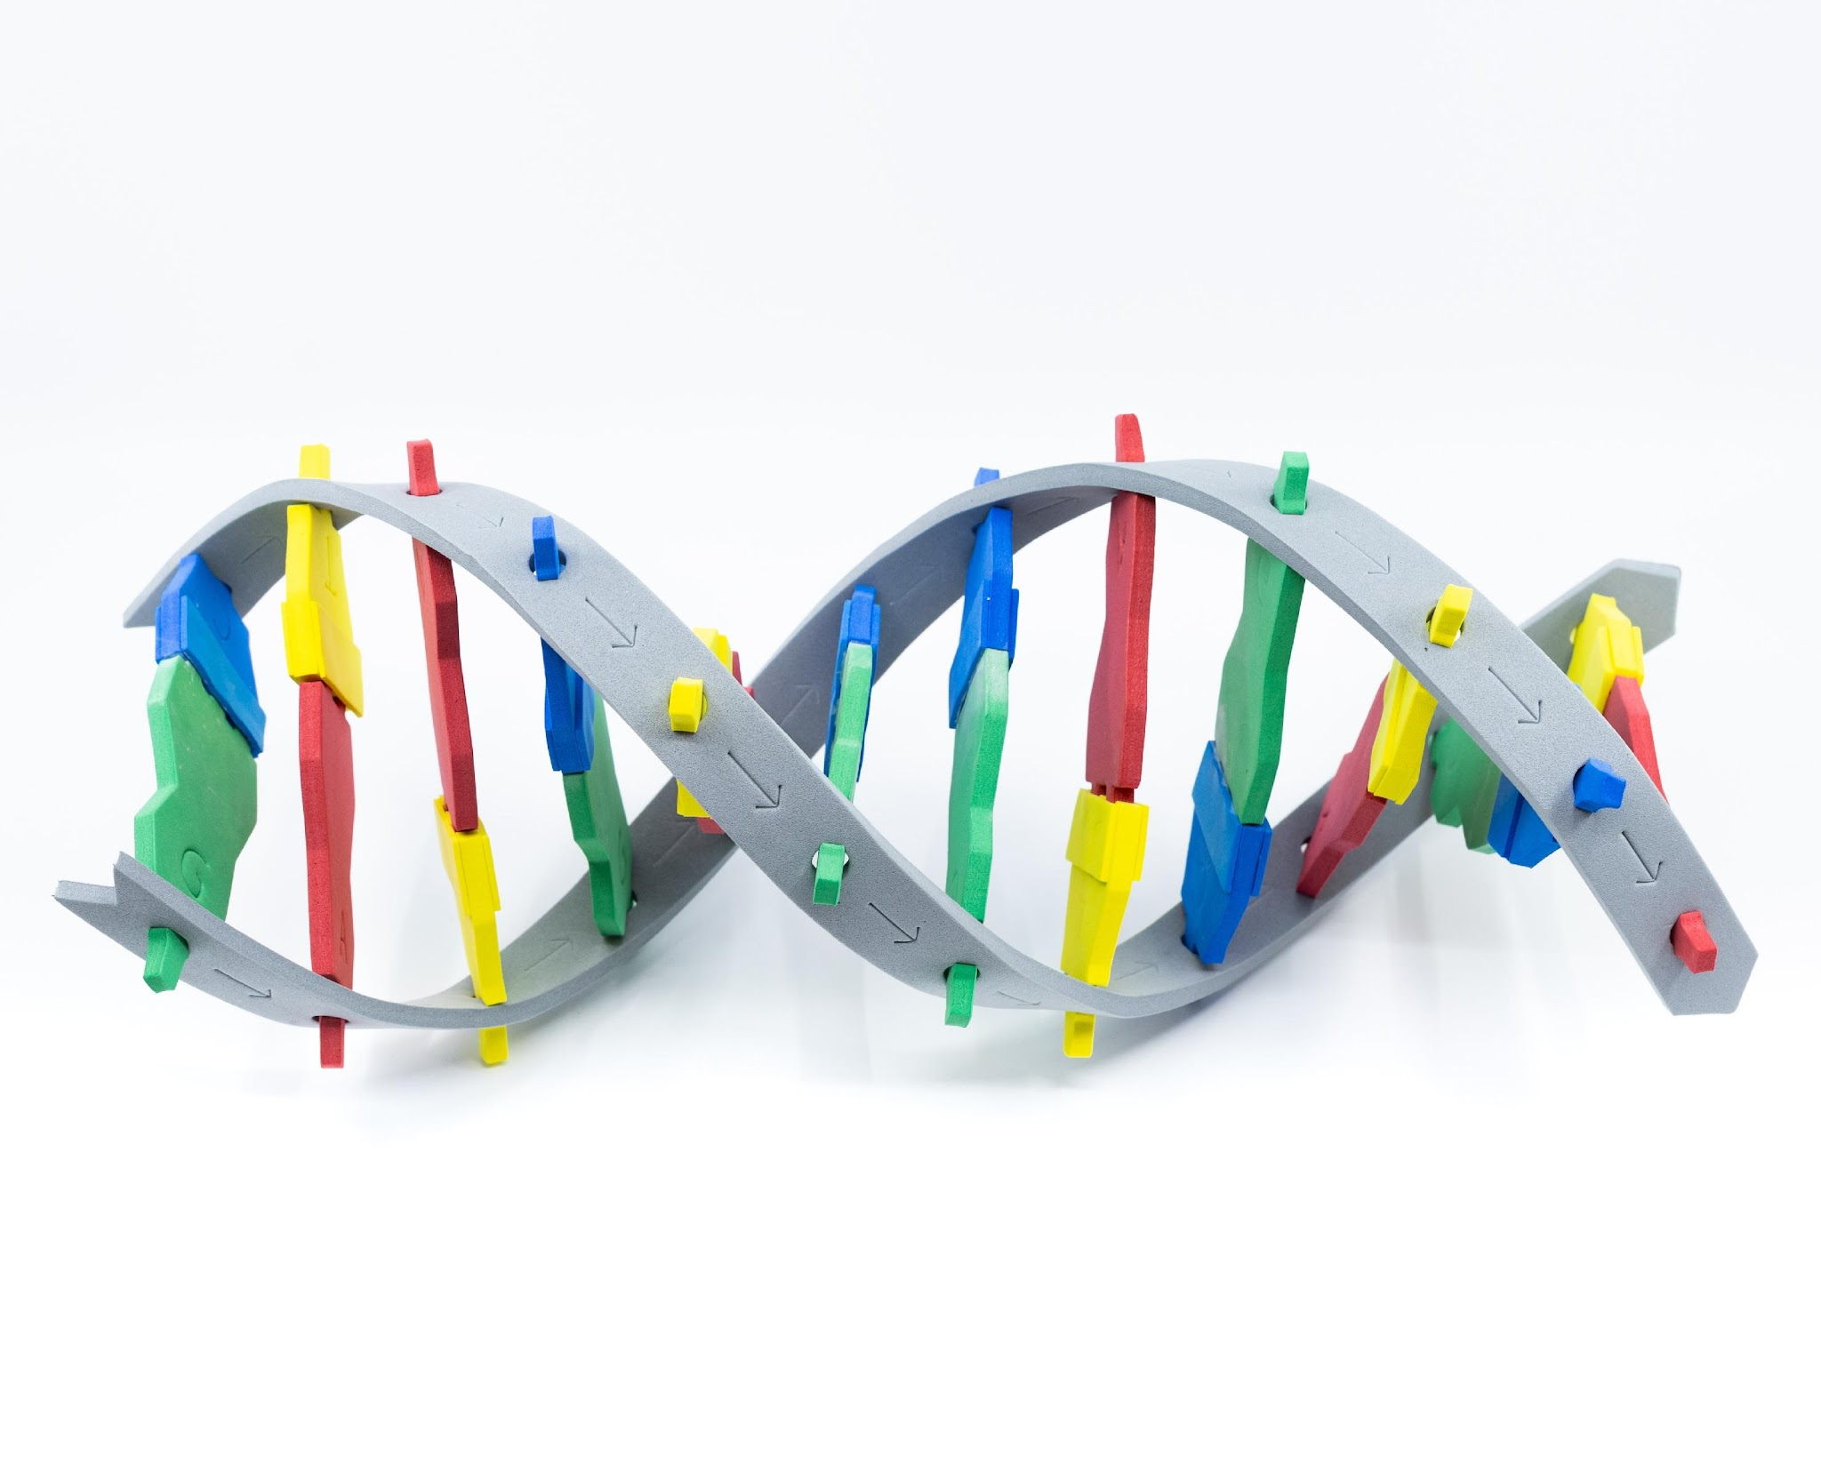
DNA Starter kit
Notes:
Lots to discuss: Grey backbone represents alternating phosphate and sugar, notice the arrows! DNA is directional - 5’ to 3’!
A bonds to T, C bonds to G. Purines and pyrimidines. Number of hydrogen bonds between base pairs.

Slide 20
DNA Starter kit
Notes:
Lots to discuss: Grey backbone represents alternating phosphate and sugar, notice the arrows! DNA is directional - 5’ to 3’!
A bonds to T, C bonds to G. Purines and pyrimidines. Number of hydrogen bonds between base pairs.

Slide 21
Discussion and clarifications
What does this model do well?
What are some limitations?
Notes:
TP

Slide 22
DNA Starter kit
Notice | Wonder

Slide 23
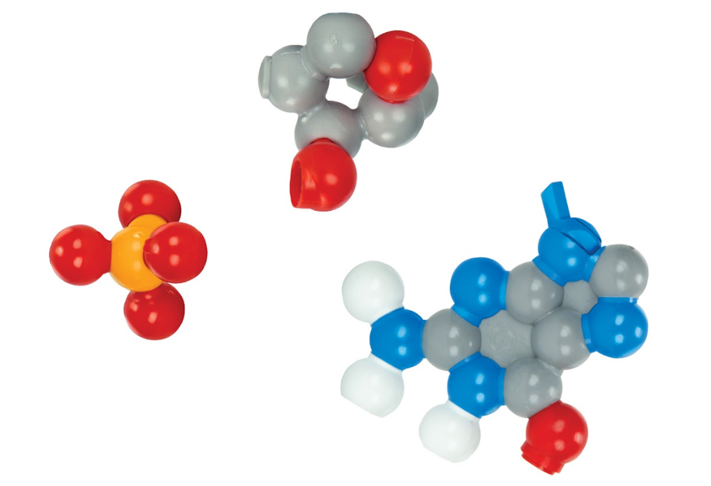
Model a Nucleotide
Using the information from the Tactile DNA model assemble a nucleotide of Dynamic DNA

Slide 24
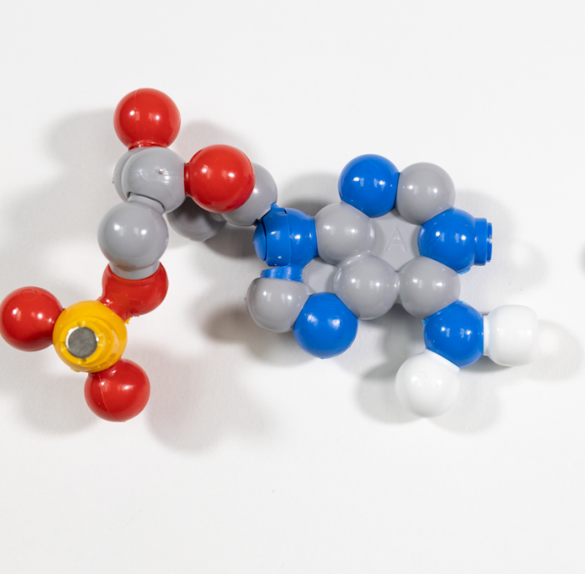
Base Pairing
DO: Use your nucleotides create two base pairs with the nucleotides at your group
EVALUATE: What are some strengths and limitations of this model?

Slide 25
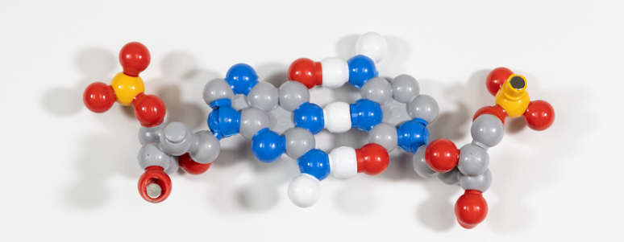
Base Pairs…Assemble!
Assemble your base pairs!
Notes:
Assemble base pairs and then into the full molecular structure (ladder or helix)
Major and minor groove, thinking about chemical properties of backbone and extending to chemical properties of transcription factors
Antiparallel strands
Location of basepairs
Bond strength

Slide 26
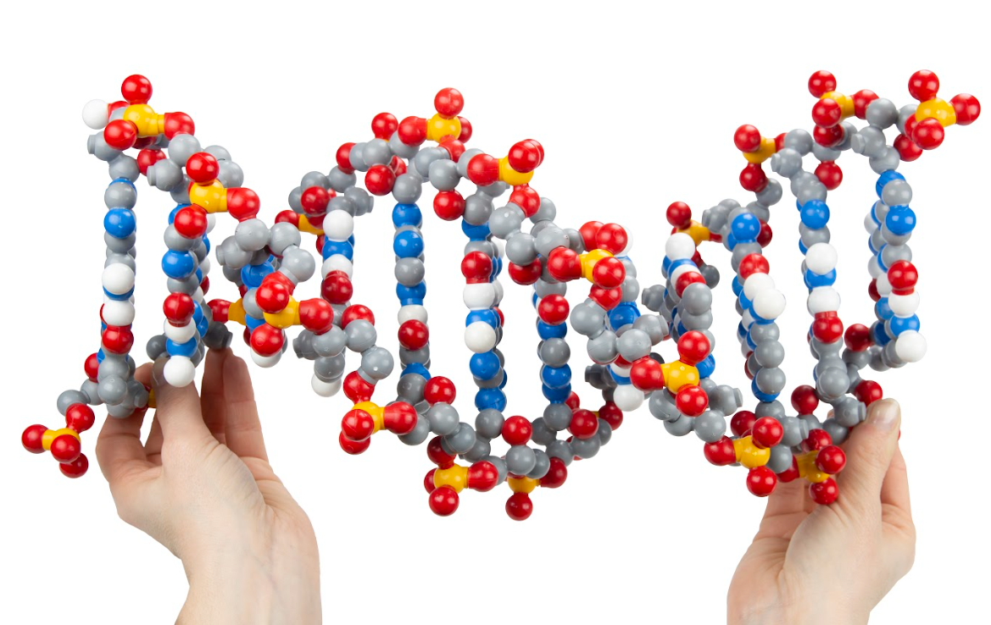
Extensions
Using the additional pieces how might we modify or extend this model?

Slide 27
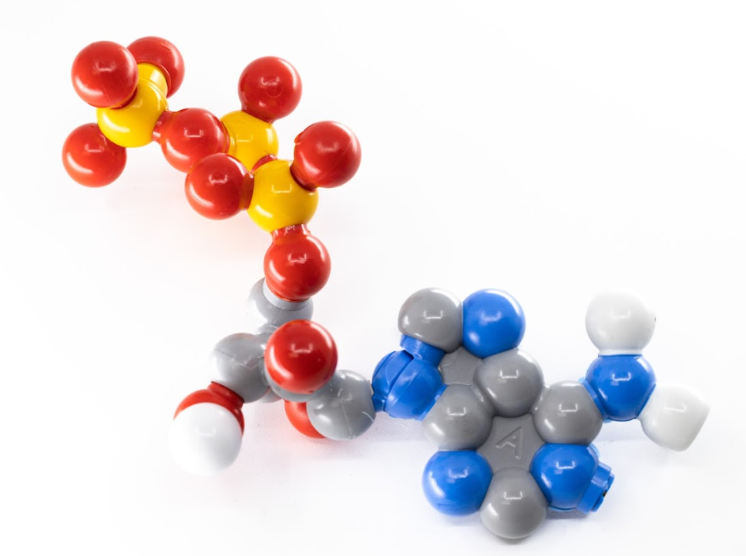
Extensions
Oh the places you will go!
ATP
RNA
Replication
Methylation

Slide 28
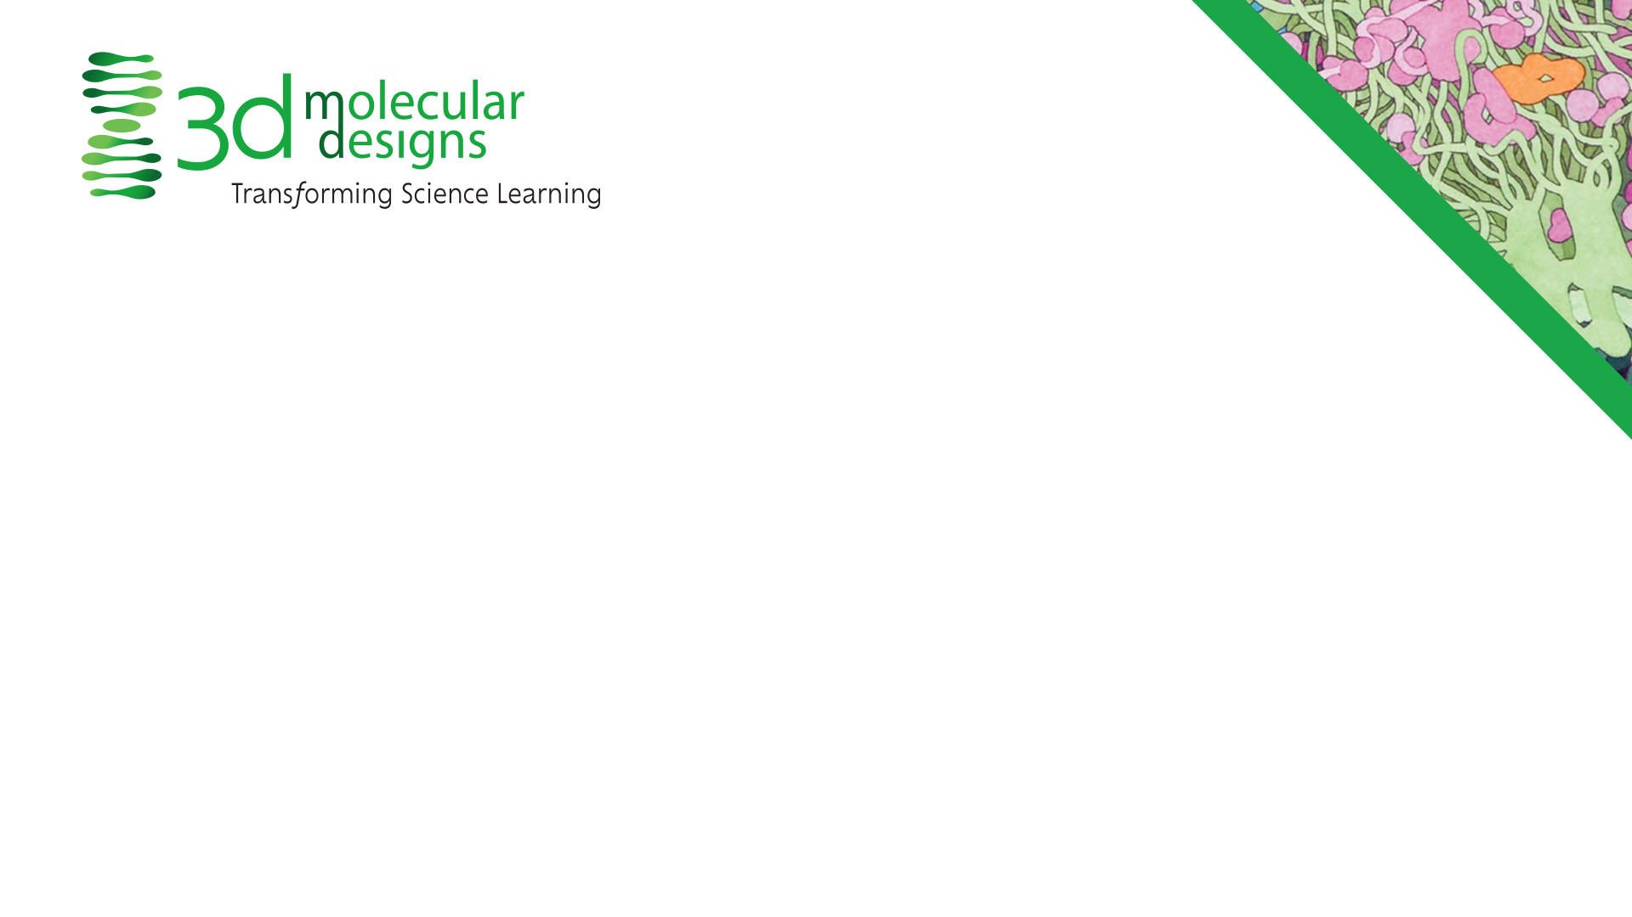
Conclusion Slide
Tactile DNA & Dynamic DNA
  DNA is made out of nucleotides
  Nucleotides form base pairs
  The chemical structure of base pairs create the double helical structure

Slide 30
Reflection
How might you use this in your practice?
What topics or content could you connect using these models?
What teaching strategies might you use with these models?
What other models might you connect to?

Slide 31
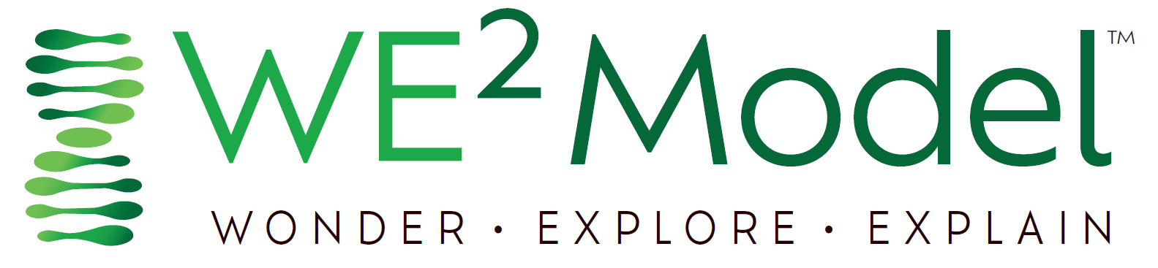

Slide 32
How do our best models vary from traditional?
Traditional Models
Are representational models designed to communicate specific information with limited opportunities for learner engagement or discovery
Are used to inform or as an end-product of the learning cycle
Are simplified representations created to provide information about a singular narrative or learning pathway
Are designed to inform learners of specific features and ideas; generally have limited opportunities for discovery
Are designed for prescribed learning, fitting in a specific context or learning arc
Are often vocabulary-dependent and require significant conceptual background to engage with the model, creating a high cognitive load on the learner.
Limits student accessibility with required conceptual background (high threshold for entry to learning)
Limits mindsets for authentic model development with simple visual schematics and information already applied to the given model
Are grounded in convergent thinking, expecting students to learn a particular set of features

Slide 33
Traditional vs. Foundational Models
Traditional Models | Foundational Models
Are representational models designed to communicate specific information with limited opportunities for learner engagement or discovery | Are interactive models that learners at various levels can actively engage with and discover features of throughout the learning cycle
Are used to inform or as an end-product of the learning cycle | Are integral to every phase of the learning cycle and sensemaking process
Are simplified representations created to provide information about a singular narrative or learning pathway | Are appropriate to use for a variety of learning objectives and at various levels.
Are designed to inform learners of specific features and ideas; generally have limited opportunities for discovery | Are designed for learners to make observations, uncover understanding, and generate questions through play
Are designed for prescribed learning, fitting in a specific context or learning arc | Are designed for just-in-time learning, allowing educators and learners to interact at just the appropriate level for any given storyline, phenomenon, or health concern
Are often vocabulary-dependent and require significant conceptual background to engage with the model, creating a high cognitive load on the learner. | Encourage the exploration and engagement of new concepts and vocabulary within the model's context, thereby lowering the learner's cognitive load
Limits student accessibility with required conceptual background (high threshold for entry to learning) | Allow all learners to accessibly enter the learning cycle confidently (low threshold for entering learning)
Limits mindsets for authentic model development with simple visual schematics and information already applied to the given model | Promote mindsets that allow learners to develop dynamic conceptual models that are open to learner revision and modification
Are grounded in convergent thinking, expecting students to learn a particular set of features | Promote divergent thinking led by learner wondering and questioning

Slide 34
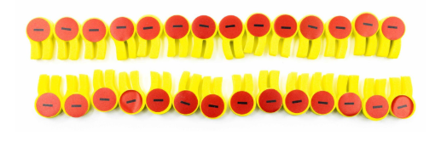
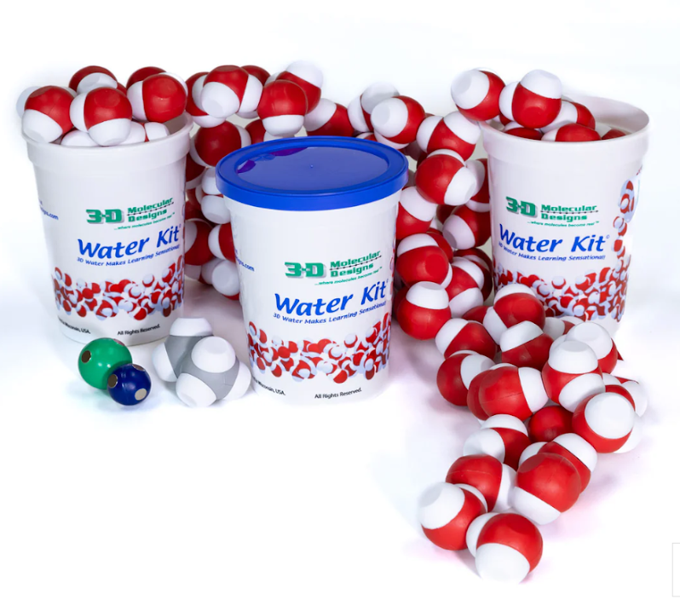
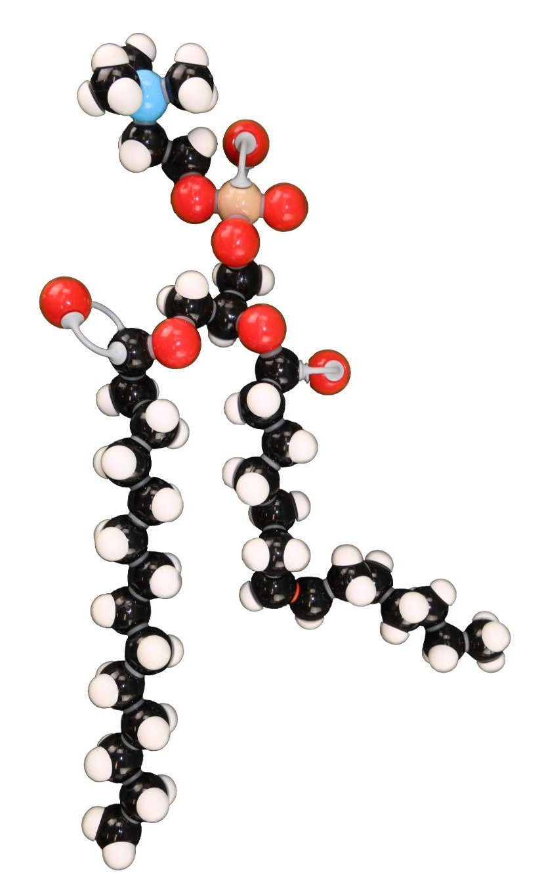
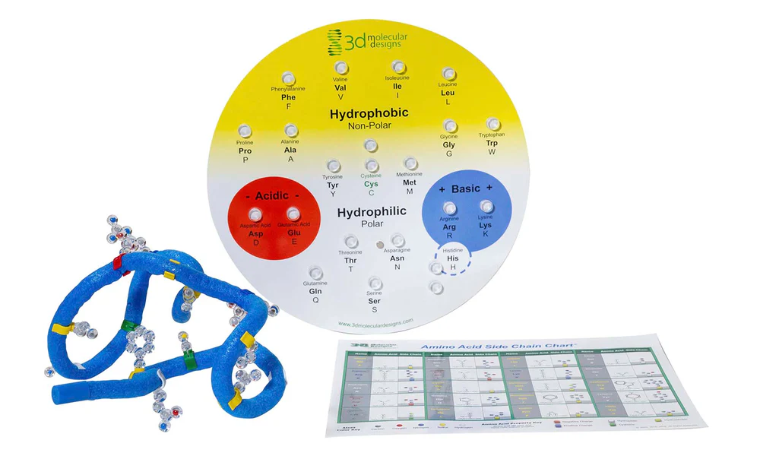
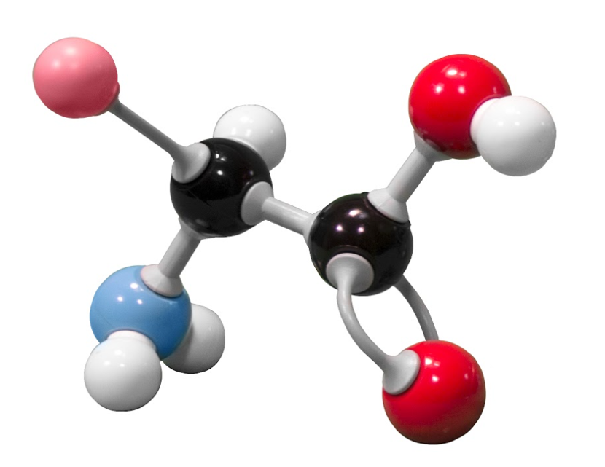
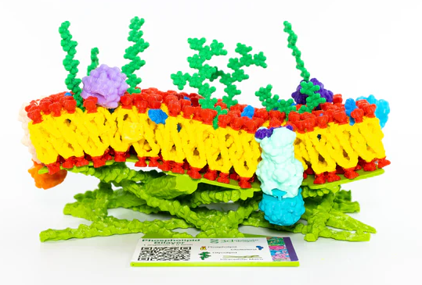
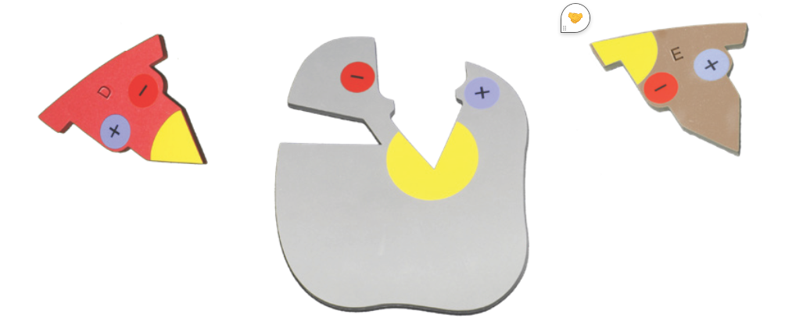
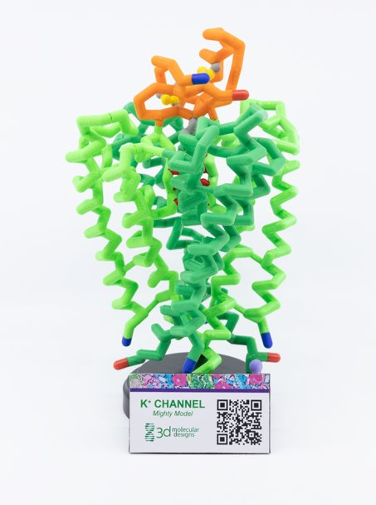
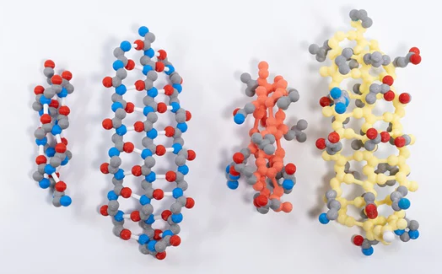
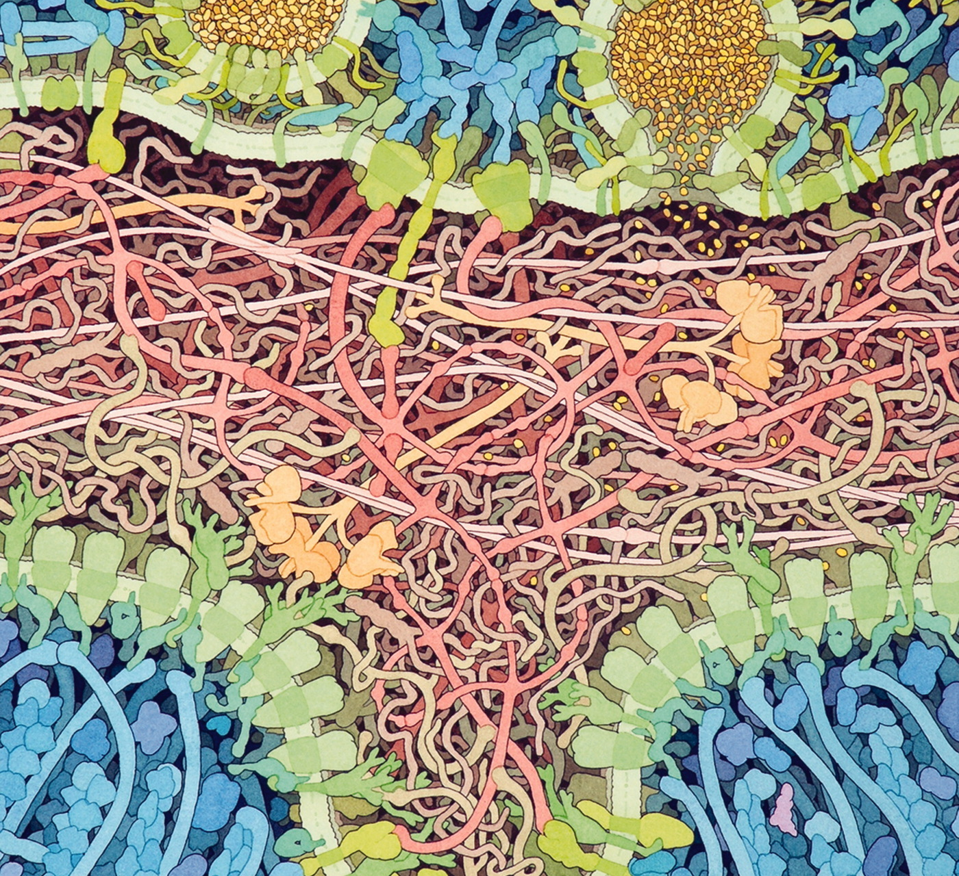
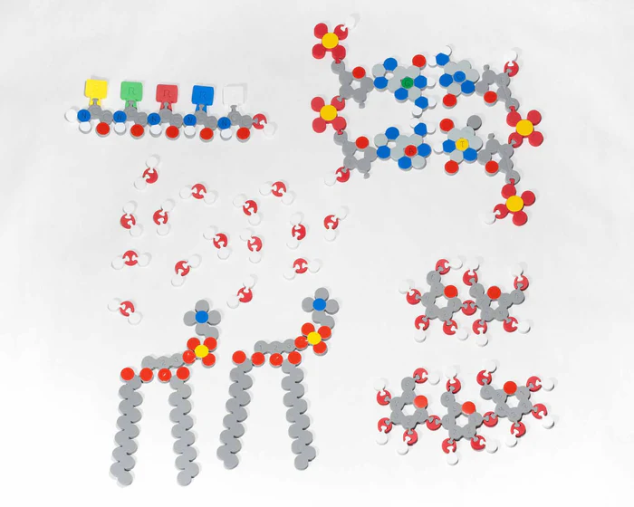
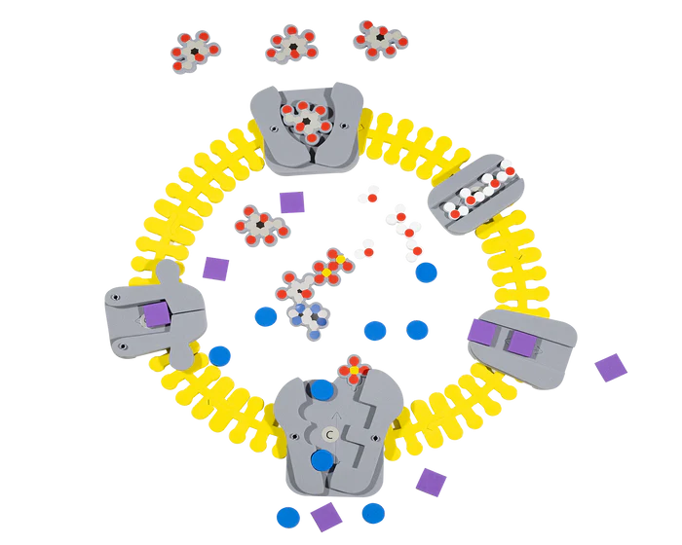
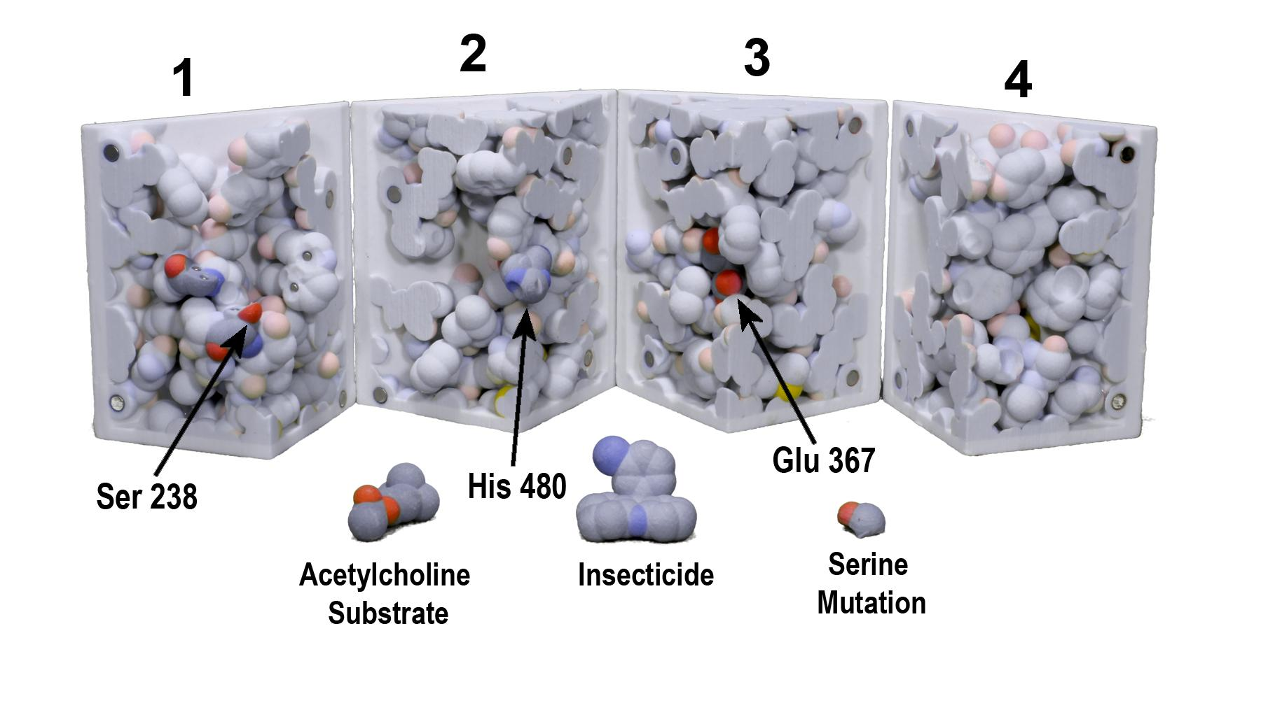
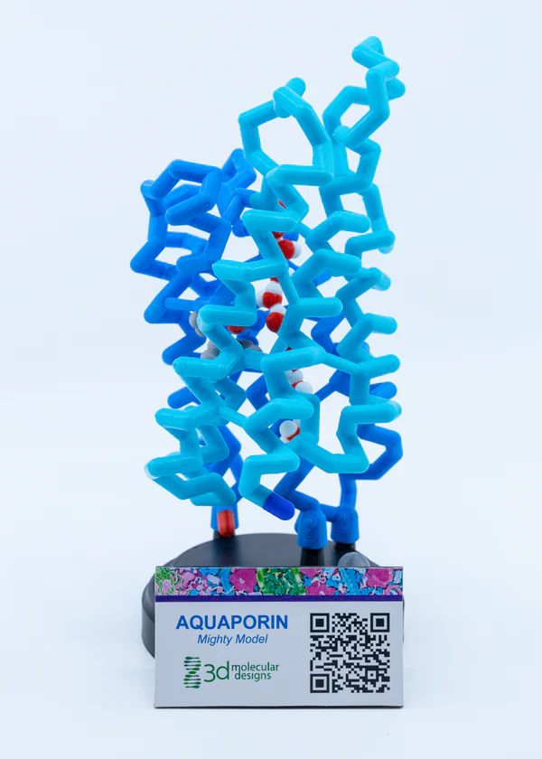
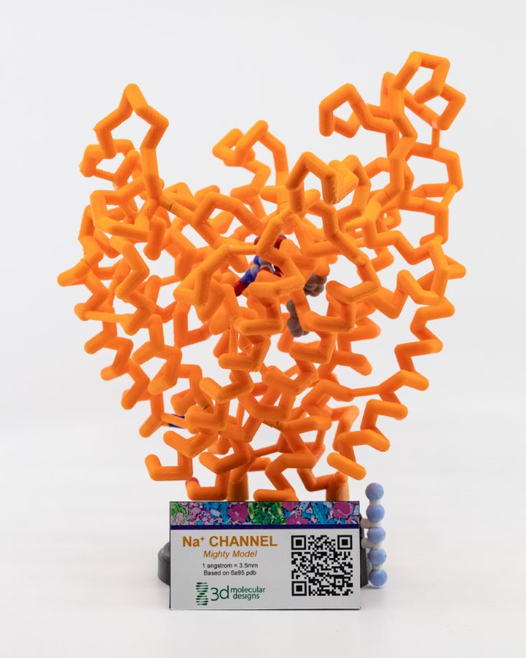
Foundational Models
A foundational model is an interactive model with a low threshold and high ceiling that students can use throughout the learning cycle for multiple learning objectives.

Slide 35
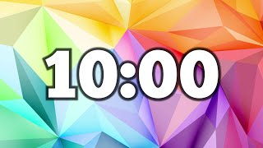

Slide 36
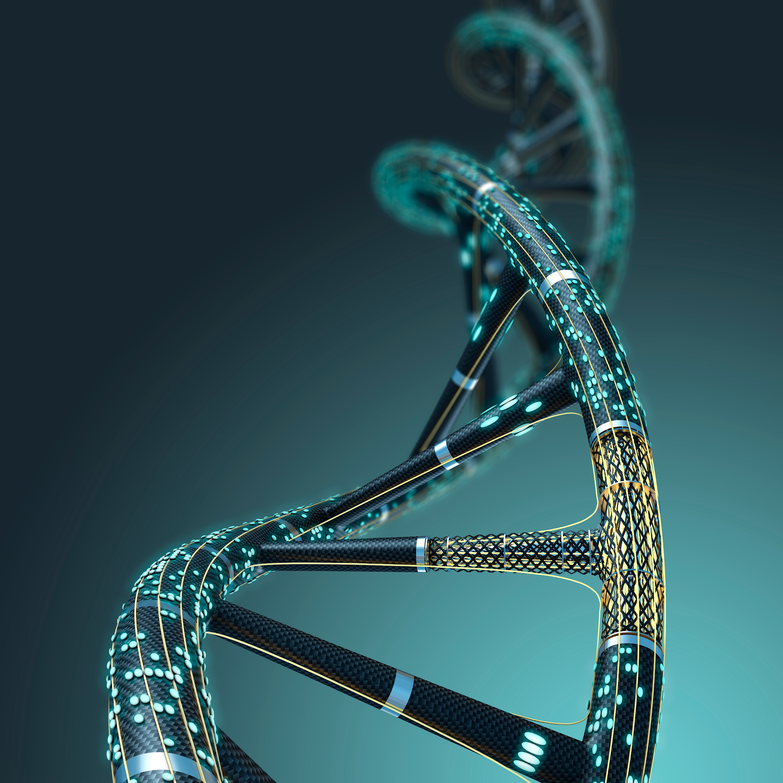
Why T?
"Genes are like the story, and DNA is the language that story is written in."
Sam Kean

Slide 37
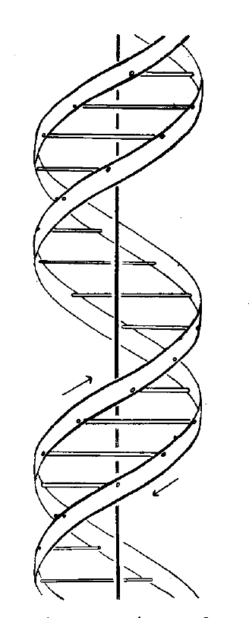
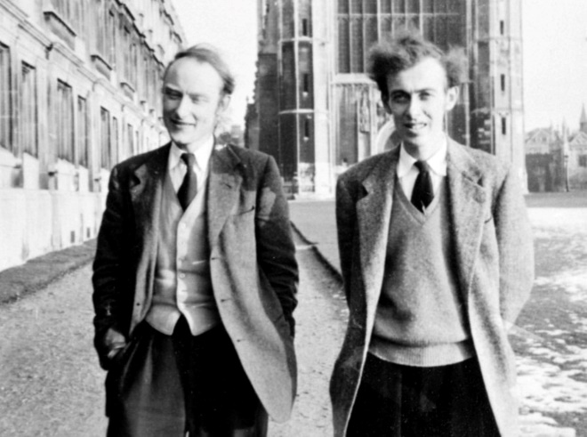
For the first generation of “molecular biologists,”
life began in 1953,
With these guys…
Francis Crick and James Watson
“It has not escaped our notice that the specific pairing we have postulated immediately suggests a possible copying mechanism for the genetic material”

Slide 38
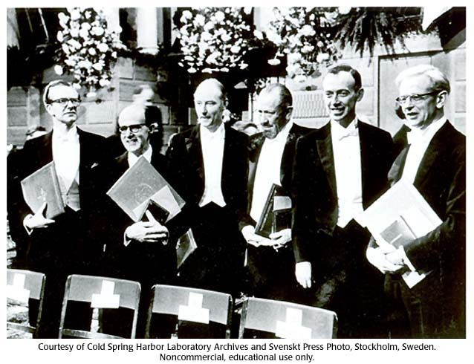
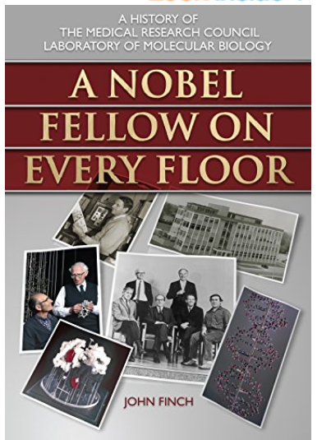
1962 was a very good year…
for the MRC Laboratory of Molecular Biology

Slide 39
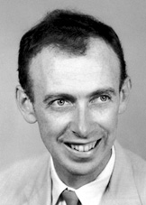
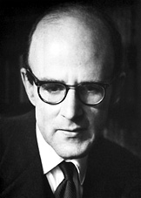
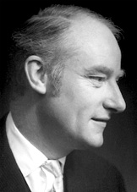
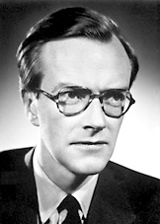
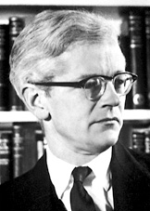


The 1962 Nobel Prizes…
in Chemistry – Max Perutz and John Kendrew
"for their studies of the structures of globular proteins“
in Physiology or Medicine – Francis Crick, James Watson and Maurice Wilkins
"for their discoveries concerning the molecular structure of nucleic acids and its significance for information transfer in living material“
in Literature – John Steinbeck
"for his realistic and imaginative writings, combining as they do sympathetic humour and keen social perception“
The Nobel Peace Prize – Linus Pauling

Slide 40




…at the LMB

Slide 41


Mark with another reMARKable model. And oh yes, that’s Venki Ramakrishnan standing next to him.

Slide 42

Teaching your kids to think…
As you reflect on your teaching, you may notice that you ask your students a lot of ”what” questions like:
What is the difference between DNA and RNA?
RNA has U’s and DNA has T’s
DNA has deoxyribose; RNA has ribose
RNA is single-stranded; DNA is double-stranded

Slide 43
Let’s think about teaching the “why” of these subjects, such as:
Why does T replace U in DNA?

Slide 44


Slide 45
WHY…did T replace U in DNA?
spontaneous oxidative deamination of C
…if we had not switched…
AGUCGAAGUCAACCGAGGCUGCGCUAC
UCAGCUUCAGUUGGCUCCGACGCGAUG
U
AGUCGAAGU AACCGAGGCUGCGCUAC
x
UCAGCUUCA UUGGCUCCGACGCGAUG
G
A DNA repair system can remove “U” from DNA.
But,…how can we distinguish between a
“deaminated C” and a normal U?
ANSWER: We can’t.

Slide 46
WHY…did T replace U in DNA?
spontaneous oxidative deamination of C
…but after we switched…
AGTCGAAGTCAACCGAGGCTGCGCTAC
TCAGCTTCAGTTGGCTCCGACGCGATG
U
AGTCGAAGT AACCGAGGCTGCGCTAC
x
TCAGCTTCA TTGGCTCCGACGCGATG
G
Uracil glycosidase constantly scans the DNA…looking for U’s.
Any U is a bad U and should be repaired.

Slide 47
Let’s think about teaching the “why” of these subjects, such as:
Why does T replace U in DNA?
Why is RNA single-stranded?
...but wait, RNA is not single-stranded…

Slide 48

O
O
3 –OH groups on deoxyribose
O
O
H
Deoxyribose

Slide 49

0 –OH groups on deoxyribose in DNA
The 2’ –OH group in RNA affords additional H-bonding opportunities

Slide 50


RNA folds up into a compact 3D shape… following the same
principles of chemistry that drive protein folding.
tRNA
ribosome

Slide 52

Lunch Options
 | Monday | Tuesday | Wednesday | Thursday | Friday
330 Eats | Heather | Diane |  |  | Kris
Cubanitas | Diane | Heather | Diane | Kris | Lauren
Fiddleheads | Kris | Lauren |  | Diane | Heather
Med Cuisine |  | Kris
Waterfront Deli | Lauren |  |  | Heather
Red Arrow Food Trucks |  |  | Lauren
330 Eats - Cafe with salads & sandwiches
Cubanitas - Cuban sandwiches & bowls
Fiddleheads - Coffee shop with sandwiches
Mediterranean Cuisine - Cafe with gyros & kebabs
Red Arrow Food Trucks - Rotating food trucks
600 East Cafe - Cafe and bakery
Loaded Spuds - Baked potatoes with toppings
Your Office - (Elevated) Dive bar for lunch

Slide 53

Lunch at Bastille Days in Cathedral Square Park

Slide 54


Transcription Action: Decoding Life's Blueprint
Flow of Genetic Information Kit
"If the secret of life could be likened to a machine, transcription would be a central cog in the machinery that drives all others."
-Roger Kornberg

Slide 55

How are proteins made in the cell?
Tim’s thoughts about the Central Dogma

Slide 56


Locate the sugar, phosphate, and the nitrogenous base
‹#›
Notes:
Teacher: Explain the model transfer from foam nucleotide to Dynamic DNA.
Learner: Identify the major components of the nitrogenous base. Add this information to their lab notebook

Slide 57


Sugar
‹#›
Notes:
Teacher: Explain the model transfer from foam nucleotide to Dynamic DNA.
Learner: Identify the major components of the nitrogenous base. Add this information to their lab notebook

Slide 58


Phosphate
‹#›
Notes:
Teacher: Explain the model transfer from foam nucleotide to Dynamic DNA.
Learner: Identify the major components of the nitrogenous base. Add this information to their lab notebook

Slide 59


Nitrogenous Base
‹#›
Notes:
Teacher: Explain the model transfer from foam nucleotide to Dynamic DNA.
Learner: Identify the major components of the nitrogenous base. Add this information to their lab notebook

Slide 60


Nucleotide
‹#›
Notes:
Teacher: Explain the model transfer from foam nucleotide to Dynamic DNA.
Learner: Identify the major components of the nitrogenous base. Add this information to their lab notebook

Slide 61




Build a segment of DNA!
‹#›
Notes:
Teacher: Provide learners with a handful of DNA nucleotides. Give them time to build a small segment of double-stranded DNA. Ideally, your learners are already familiar with the structure of DNA before they begin this lesson. However, if “just in time” learning and storyline coherence requires you to focus on gene expression without a deep dive into DNA structure before this lesson, you can trust this model to allow them to figure it out. They should be able to play and in doing so, turn these puzzle pieces into a double stranded molecule that follows the base pairing rules and indicates the antiparallel nature of DNA.
Staging the model: Before class, provide each team with about 40 nucleotides (equal numbers of G=C and A=T though the G:A ratio is not important). Placing them in a bag or on a tray will make it easier to provide the models to learners when needed.
Tactile play
Monitor learner understanding
Probing questions (if required)
Learner: Follow the prompt on the screen.

Slide 62
Discuss and investigate
What is the code of DNA?
Do all groups in the class have the same code?
‹#›
Notes:
Teacher:
Monitor learning understanding
Probing questions (if required)
Allow learners to move around and see the DNA constructed by other groups.
Learner:
With your small group.
Get up and investigate.

Slide 63

These are RNA nucleotides…
How are they different from the DNA nucleotides?
WHY is this model different from the DNA nucleotides?
‹#›
Notes:
Teacher: Summarize RNA after feedback from group. Remind them that RNA is also single stranded (until modified). Monitor learner understanding.
Learner:
Play with models
Connecting to previous learning.
Building consensus in collaborative groups.

Slide 64
Transcription Challenge
Use your RNA nucleotides and the DNA molecule you made.
Make a complementary piece of RNA from DNA.
‹#›
Notes:
Teacher:
Monitor learner understanding
Probing questions (if required)
Tactile play
Encourage questions. As learners begin this challenge, they may VISUALLY try to make an RNA (Talking through “G bonds with C”, looking at the base pairing.) Remind them that the cell cannot do this… how does base pairing really work? What might be needed to make this happen?
Learners may quickly get confused (which leads to questions). If DNA is double stranded, and RNA is single stranded, which side of the DNA holds the code? How does the cell know which side of the DNA to use?
LET THEM STRUGGLE! When it is clear that all (or most) groups have reached this important question and are struggling with what to do next, bring the class back together.
Learner: Follow the prompt on the slide.

Slide 65

What questions do you have?
What challenges did you have?
‹#›
Notes:
Teacher: Listen for their concerns and questions… prepare to give them the information they are asking for.
Specifically listen for questions about what strand to use?
Learner: Share as a class.

Slide 66

‹#›
Notes:
Teacher: Direct Instruction about only one strand of DNA containing the necessary code. Textbooks and standardized tests will refer to the Coding and Template strands.
Template strand: The biologically relevant strand. THIS is the one used as a “mold” for making the RNA.
Coding strand: (You may not choose to use this term). Learners will notice with practice that the RNA “looks like” this strand, the strand that was NOT used to form the RNA. This strand is often referred to as the coding strand.
The point is: Only one strand at a time is used for making RNA. But depending on the gene, it is one strand or the other. There is not a single side to the DNA that is always used or one that is never used.
Learner: Add new information to their notebook.

Slide 67

What 2 things must happen for the RNA to be produced?
‹#›
Notes:
Teacher: Listen for learner ideas. In particular, the DNA must be “unzipped” and the RNA must be base paired. Listen for these ideas. Coach teams that have not figured this out towards these ideas with probing questions.
Learner: Brainstorming with a team to figure out what must happen for the RNA to be made?

Slide 68
Engineering Challenge
Design a model of an enzyme that would assist in transcription.
‹#›
Notes:
Teacher: Give learners some time to complete the challenge.
Learner: Sketch their design in notebook.

Slide 69

And here it is!
‹#›
Notes:
Teacher: Give each group a transcription placemat.
Learner: Compare their design to the placement. Where are their designs the same? Where are they different?

Slide 70


A brief tour through the cell
This image is an excerpt from Tour of a Human Cell by David Goodsell, as shown in 3D Molecular
Designs’ Tour of a Human Cell© poster and David Goodsell’s book, The Machinery of Life.
Notes:
The circle shows RNA polymerase in a complex getting ready to transcribe DNA into mRNA.
Can you find the mediator, transcription factors, and enhanceosome in the circle?

Slide 71

Transcription looks something like this…
( Drew Berry from E. O. Wilson Life on Earth ibook.mov)
‹#›
Notes:
Teacher: Show learners the video.
Learner: Add new information to their notebook.

Slide 72
Now play!
Template
Strand
‹#›
Notes:
Teacher: Give each group a premade DNA sequence and allow time to model.
Note: The transcription process begins with RNA polymerase scanning along the DNA until it encounters a specific sequence called the promotor. In this model, we assume that the promotor sequence already has been recognized. In eukaryotes, it is a TATA box that is located 25 to 35 base pairs upstream of the transcription start site. Promotors can also have CpG islands and other regulatory elements. If you want to teach this additional information, check out Addgene: Promoters.
The promotor acts like a signpost, indicating where transcription should start. It tells RNA polymerase where to begin transcribing the DNA. Once polymerase binds to the promoter, it separates the DNA strands. One of these strands serves as the template strand (in this case on the top of the model) and provides the sequence needed for RNA synthesis. The other strand (in this case on the bottom of the model) is not directly involved in transcription. The RNA polymerase then builds an RNA strand complementary to the template strand, adding each new nucleotide to the 3’ end of the growing RNA molecule.
Learner: Model how RNA is transcribed from a double-stranded DNA.

Slide 73

Now play!
‹#›
Notes:
Teacher: Use this slide only in the case you need to point out the right direction.
Learner: They should only see this slide unless they are struggling.

Slide 74

Now play!
‹#›
Notes:
Teacher: Use this slide only in the case you need to point out the right direction.
Learner: They should only see this slide unless they are struggling.

Slide 75
Let’s talk about model limitations.
‹#›
Notes:
Misconception check! RNA Polymerase does not start at the end of the DNA, it binds mid strand and opens up the DNA. The Polymerase moves down the DNA rather than the DNA through the enzyme. Connect back to Goodsell Landscape illustration of transcription

Slide 76
A brief tour through the cell
This image is an excerpt from Tour of a Human Cell by David Goodsell, as shown in 3D Molecular
Designs’ Tour of a Human Cell© poster and David Goodsell’s book, The Machinery of Life.
Notes:
Scan the poster again and see what structures you notice in the nucleus? Can you find the nuclear pore?

Slide 77
Nucleus
Nuclear Membrane
Cytoplasm
This image is an excerpt from Tour of a Human Cell by David Goodsell, as shown in 3D Molecular
Designs’ Tour of a Human Cell© poster and David Goodsell’s book, The Machinery of Life.
Notes:
Let’s note where we have been and where we are going.

Slide 78
DNA
mRNA
mRNA
Nuclear Pore
RNA Polymerase
This image is an excerpt from Tour of a Human Cell by David Goodsell, as shown in 3D Molecular
Designs’ Tour of a Human Cell© poster and David Goodsell’s book, The Machinery of Life.
Notes:
Let’s also identify some structures. You can print these landscapes as a pdf in black and white or greyscale and have them color them in. I would have my students insert them in their lab notebooks so they could reference them later.
Look down in the lower left to see the capping enzyme which is adding methylguanosine to the 5”end of the mRNA. It is by the RNA polymerase.

Slide 79
A brief tour through the cell
This image is an excerpt from Tour of a Human Cell by David Goodsell, as shown in 3D Molecular
Designs’ Tour of a Human Cell© poster and David Goodsell’s book, The Machinery of Life.
Notes:
This is one of the many molecular landscapes by Dr. David Goodsell who is affiliated with the Protein Data Bank. You can more of these at PDB-101: Goodsell Gallery (rcsb.org). I love using them in conjunction with the kit because they demonstrate to students that we are only touching on a fraction of the cell’s complexity.

Slide 80
Let’s re-visit transcription…
(Drew Berry from E. O. Wilson Life on Earth ibook.mov)
‹#›
Notes:
Teacher: Show learners the video.
Learner: Add additional information to their notebook. What else do you notice now that you have taken time with the physical model?

Slide 81
Reflection–Share Out
What challenges did you have in making an enzyme model to make mRNA? How was it the same as RNA polymerase?
How could you adapt this activity for your students?

Slide 82
Conclusion
There are three types of RNA: messenger RNA, transfer RNA, and ribosomal RNA.
RNA is made of four nucleotides: adenine, uracil, guanine, and cytosine.
Once transcribed from DNA, RNA leaves the nucleus and moves to a ribosome.

Slide 84


Reflection…
“Models give meaning to words.” - Tim Herman
In your notebook reflect:
How can using a model like this give meaning to words?
How might this improve student learning?
‹#›

Slide 85
Reflection–Share Out
What challenges did you have in making an enzyme model to make mRNA? How was it the same as RNA polymerase?
How could you adapt this activity for your students?

Slide 86

Take a break!

Slide 87
RNA is not…
a limp noodle

Slide 88
RNA is not single-stranded.
But it is not exactly double-stranded.
RNA is structured.
RNA folds up into a compact 3D shape… following the same
principles of chemistry that drive protein folding.

Slide 89
RNA folds up into a compact 3D shape… following the same
principles of chemistry that drive protein folding.
tRNA
ribosome

Slide 90

Alexander Rich
Rich’s lab determined the structure of tRNA in 1973
Kim, S.H. et al. (1973) Three-dimensional structure of yeast phenylalanine transfer RNA: folding of the polynucleotide chain. Science 179, 285–288

Slide 91

The structure of tRNA is stabilized by Watson-Crick base pairs, Hoogsteen base pairs, and lots of modified nitrogenous bases.

Slide 92


Slide 93
Ribosomes ….
The 3D Translation Team… Tom Steitz…
and the exit channel.

Slide 94


2 subunits composed of
60 proteins and
3 rRNAs (4,500 nucleotides)

Slide 95

Before the 3D structure of the ribosome was determined in late 1990s, we knew the secondary structure of the ribosomal RNAs.

Slide 96
Ribosomes and Tom Steitz

Slide 97

2 subunits composed of
60 proteins and
3 rRNAs (4,500 nucleotides)

Slide 98
Mark with another reMARKable model. And oh yes, that’s Venki Ramakrishnan standing next to him.

Slide 99
…at the LMB

Slide 100


Slide 101

Components of Translation (3DMD)
mRNA + tRNA + ribosome

Slide 102



How are tRNAs “charged”?
Aminoacyl-tRNA Synthetases
ATP
Energy is Required!
Notes:
Possible Tim “mini-talk”?

Slide 103
We‘ve got a model for that….

Slide 104


Now, “charge” the tRNAs!
YOU play the role of the Aminoacyl-tRNA Synthetases
Notes:
Possible Tim “mini-talk”?

Slide 105






Ribosome Comparisons
What aspects of the ribosome structure would you predict are most similar? Why?
Which might have more variation?
(Goodsell, 2024)
Notes:
More information is available at : PDB-101: Molecule of the Month: Ribosome Diversity (rcsb.org)

Slide 106

Putting it all together
Examine this model. What do you notice?

Slide 107


The Genetic Codon Circle / Chart
Both versions are located on the back cover of your notebook
Notes:
Genetic Codon Chart©.pdf (hubspotusercontent-na1.net)

Slide 108

AR: Protein Translation
Using the 3DMD AR EDU app, explore the process of Protein Translation.

Slide 109






Let’s Model Translation!
Notes:
All images showing - without “animation”

Slide 110


What Happens if Protein Translation Stops?
What happens if protein translation stops?
This is the goal of many different antibiotics.
Make a prediction with your partner about how antibiotics may cause this.
Notes:
Teacher: Facilitate a class discussion.
Student: Discuss with their partner and write a prediction in their notebook.
‹#›

Slide 111

Superbugs poster…
Notes:
Teacher: Facilitate a class discussion.
Student: Discuss with their partner and write a prediction in their notebook.
‹#›

Slide 112

AR: Protein Translation
Using the 3DMD AR EDU app, explore the structure and activity of the following compounds:
Chloramphenicol
Erythromycin
Tetracycline
Linezolid
What is the mechanism of action of these compounds?

Slide 113


Exploring Chloramphenicol
Choose
Chloramphenicol
Scan a purple
translation mat
Explore only the first button
Notes:
Teacher: Have students open the app and select the appropriate activity and scene. Move around the room and assist students with their technology. Students should point their cameras toward the A site of the ribosome.
Student: Open the app and select the appropriate activity and scene.
‹#›

Slide 114
CCCR Strategy
Consider - Contribute - Consult - Revise

Slide 115

CCCR Strategy (Consider - Contribute - Consult - Revise)

Slide 116
In your notebook….
Sketch a model of your understanding of the process of translation
Label and annotate your model to apply important terms and ideas
Notes:
Connecting to previous learning.

Slide 117

CCCR Strategy (Consider - Contribute - Consult - Revise)

Slide 118

CCCR Strategy (Consider - Contribute - Consult - Revise)

Slide 119

CCCR Strategy (Consider - Contribute - Consult - Revise)

Slide 120
CCCR Strategy Debriefing
How might this strategy help students to make sense of what they are learning?
Notes:
Connecting to previous learning.

Slide 121




Slide 122

Sandbox Time
Play with Models!
Plan Lessons
Ask Questions
Tinker with proteins in JUDE
Explore Digital Resources
Notes:
Cell Modeling Kit. Bring it all together. How does aquaporin get to the membrane? Tell the whole story!

Slide 123



Aquaporin: From DNA to the Membrane
Not much is known about how membrane proteins are trafficked to the membrane…
Propose a pathway for this process.
Support your proposed pathway with evidence in your model.

Slide 125

Neanderthal Poetry
Rules: You may only use single syllable words
Task: Use Neanderthal Poetry to describe your most impactful learning from the week thus far. This could be a model, concept, teacher move, or something that has just blown your mind.
Is hard to make hard thing make sense with small word.
Make good use of your words for make learn good and have fun!

Slide 126
Reflection
Summarize the student experience of modeling you have experienced in this course so far.
Be prepared to share 2 things that you hope to “take home” to use in your classroom practice.
Notes:
Jim’s Reflection Time

Slide 127

End of Day Announcements
Friday Focus
Replication & Chromosomes
Implementation Planning
Bring Your
Notebooks
Computers
Evening Plans
Dinner and/or Happy Hour @5:45 PM
Don’t forget to park some questions!

Slide 128

End of Day Survey

Slide 129
Things to Do in Milwaukee Today
Bastille Days Opening Night - Storm the Bastille 5k starts at 9PM
(10 minute walk from Drury, hosted in park by 3DMD)
It’s Alive! Concert Series until 6PM - Marcus Performing Arts Center (7 minute walk from Drury)
Thursday Nights at MAM - Live music & open-late exhibits, pay-as-you-wish admission
(20 minute walk from Drury)

