Slide 1
Notes:
8:15 Heather Welcome
WE2 Model
8:20 Tim & Jim Welcome
8:25 Introductions
Tim, Jim, Heather & Mark
Diane
Participants - where you’re from, what you teach & how you found us
Favorite Amino Acid, Protein or Dinosaur
8:40 Logistics
Schedule
Website
Restrooms, Coffee Cart

Slide 2

Welcome Educators!
Modeling the Molecular World
Wifi: 3DMDGuest
Password: Cas9-3DMD
Notes:
8:00 Heather Welcome
Best weeks of the year
WE2 Model
8:05 Tim Welcome
8:10 Tina Welcome
8:15 Introductions - Heather
Instructor Bios via email - Tim, Tina, Heather & Mark
Evaluators
Facilitators
Participants - Josh
8:45 Course Logistics - Heather
Schedule - breaks
Website
3DMD Staff
Building
Lunches
Mug Exchange
8:55 Group Norms - Josh

Slide 3


Slide 4
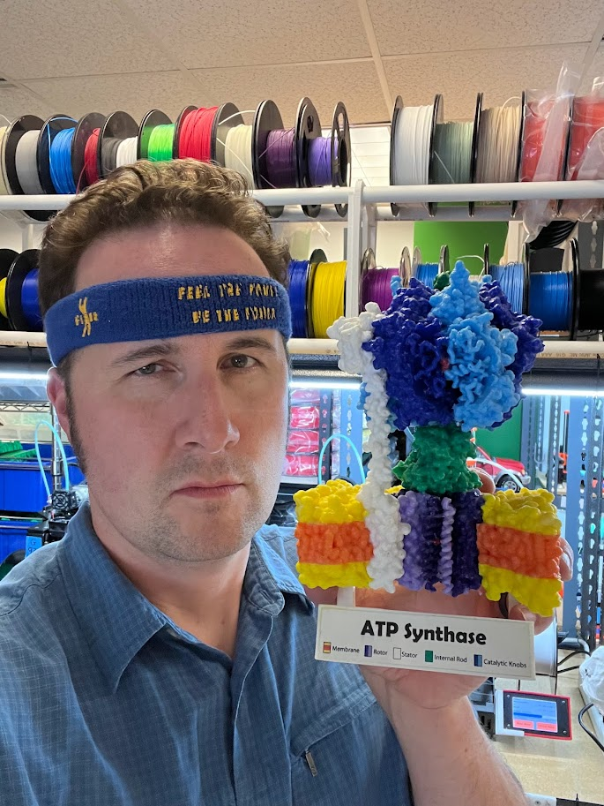
Who is this guy?
Jim Lane
Mahtomedi High School, Mahtomedi, MN
17 years of teaching experience
3DMD Model Teacher
3DMD SMART Team Advisor since 2017
Attended Modeling the Molecular World in 2013
Favorite Protein: ATP Synthase
Favorite Dinosaur: Pachycephalosaurus

Slide 5

Who’s in the room?
Introduce yourself:
You Name
Where you are from
What level/courses you teach
Favorite amino acid, protein, or dinosaur

Slide 6


Overview of the Week
Monday
Tuesday
Learner Lens
Educator Lens

Slide 7

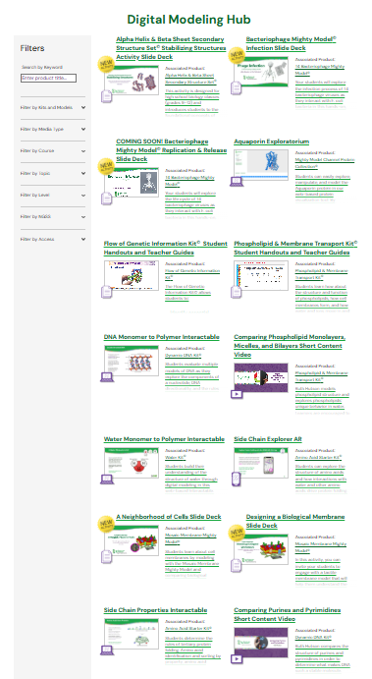
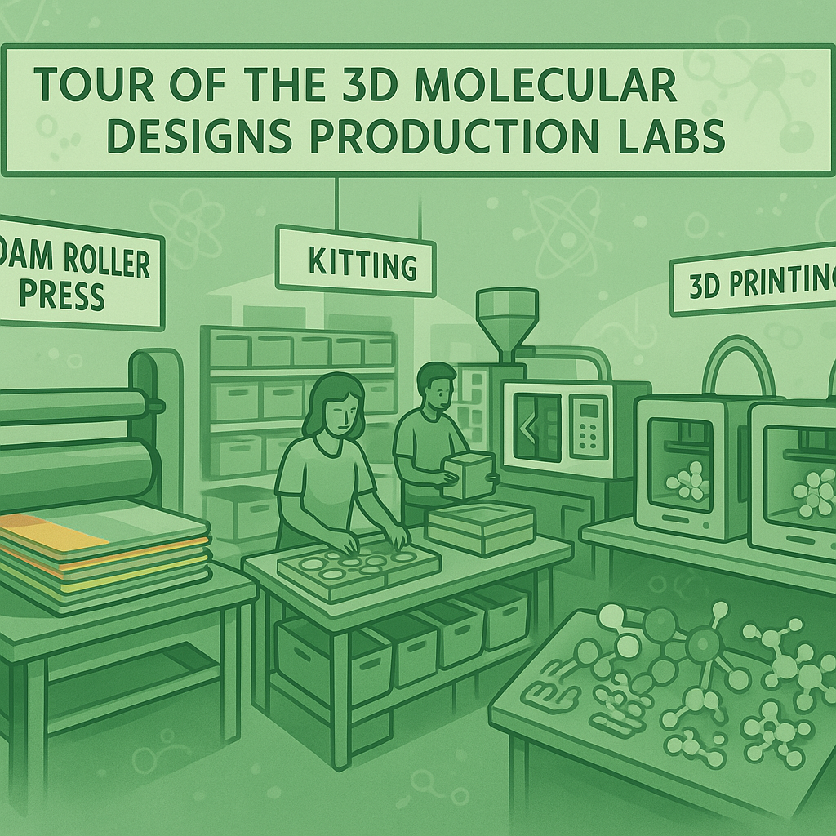
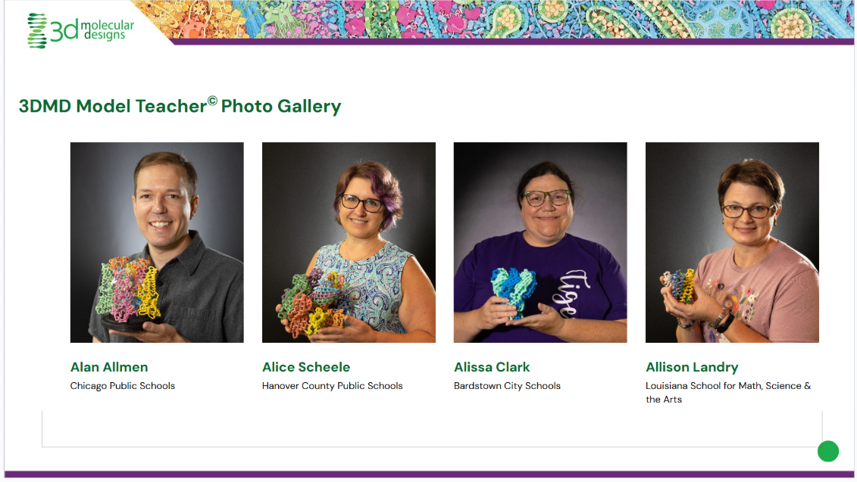
Overview of the Week
Wednesday

Slide 8
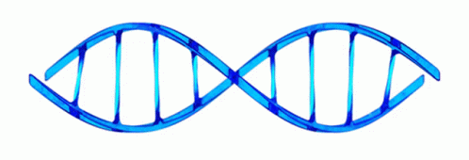
Overview of the Week
Thursday - DNA

Slide 9
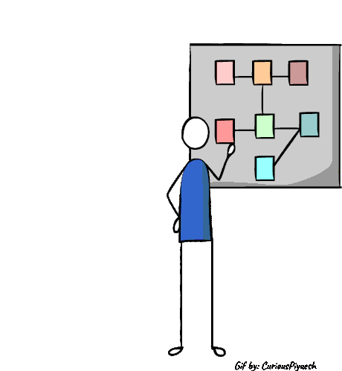
Overview of the Week
Friday - Implementation Planning

Slide 10
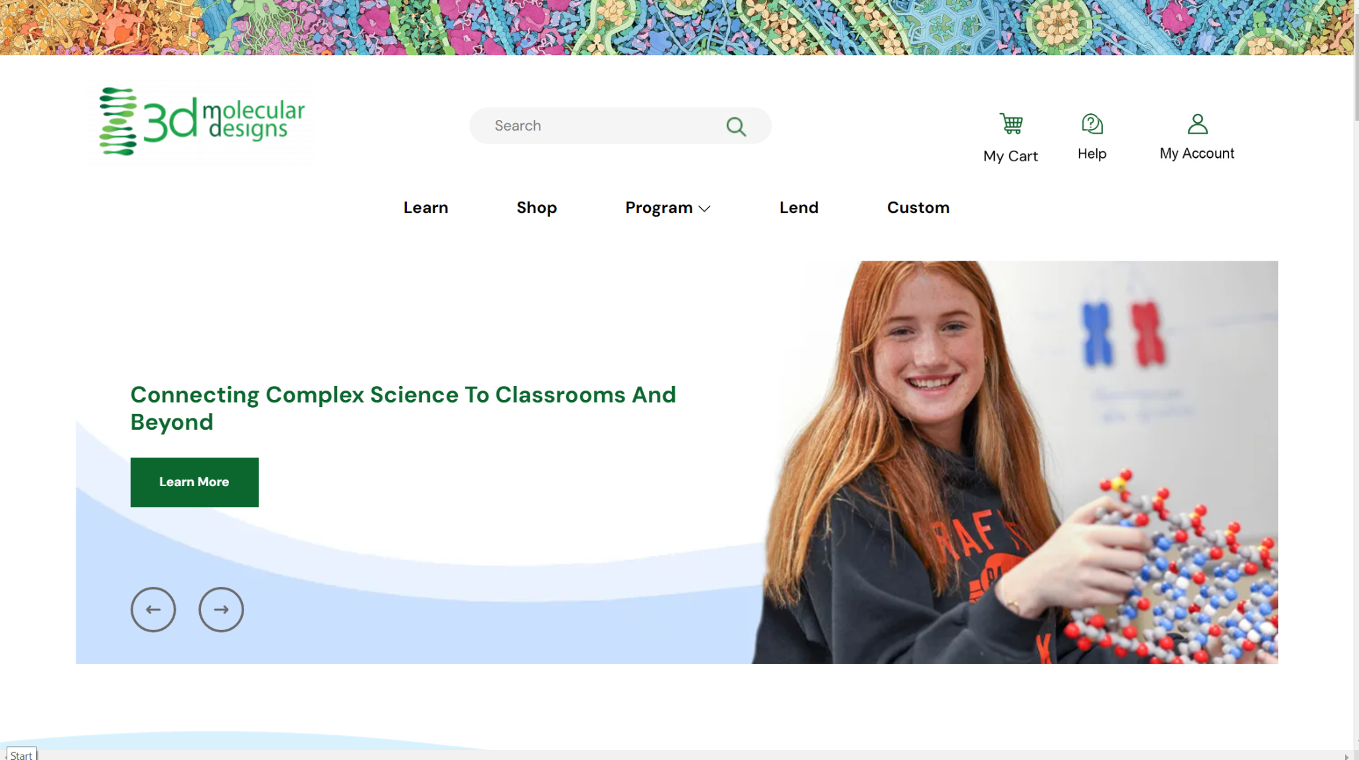
Notes:
Heather will give the MKE welcome.
Something about 3DMD.
Logistics
Introductions

Slide 11
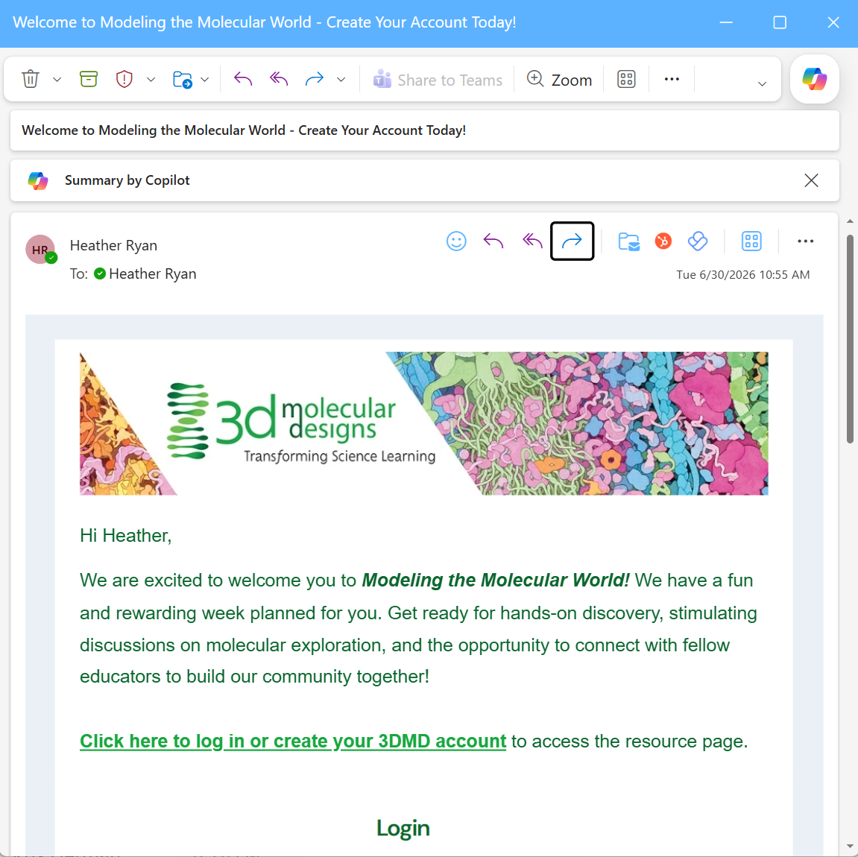
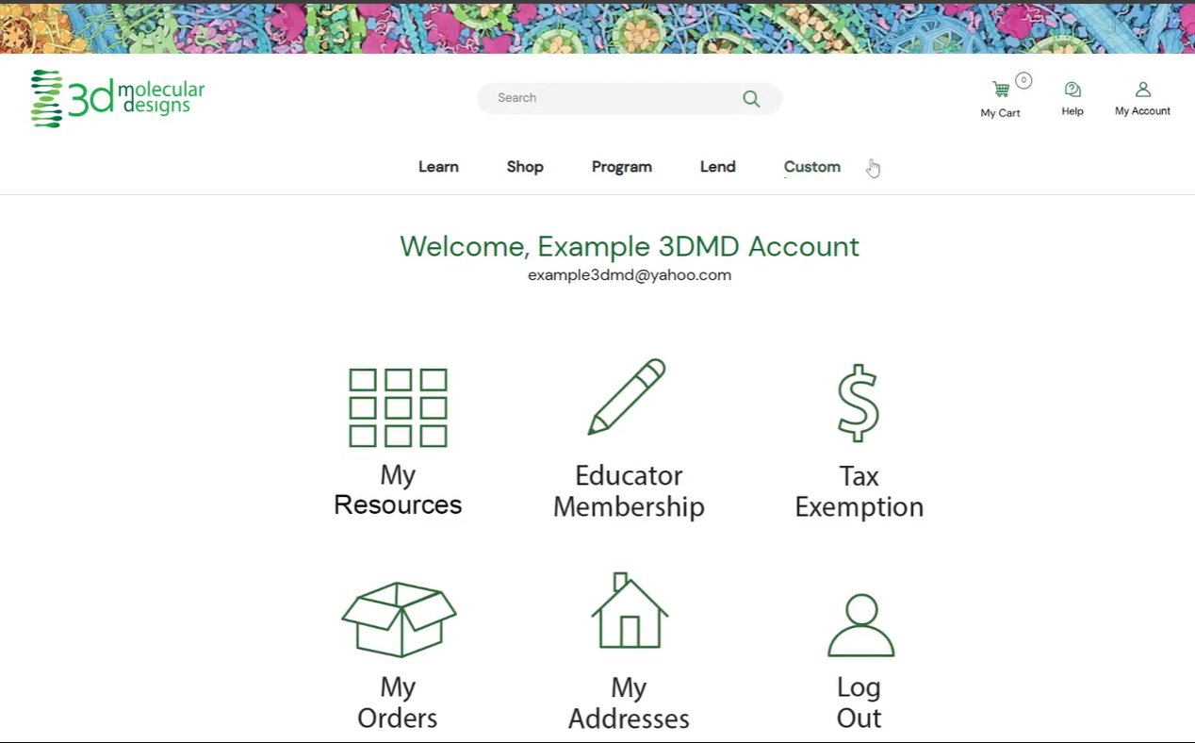

Email on 6/30

Slide 12
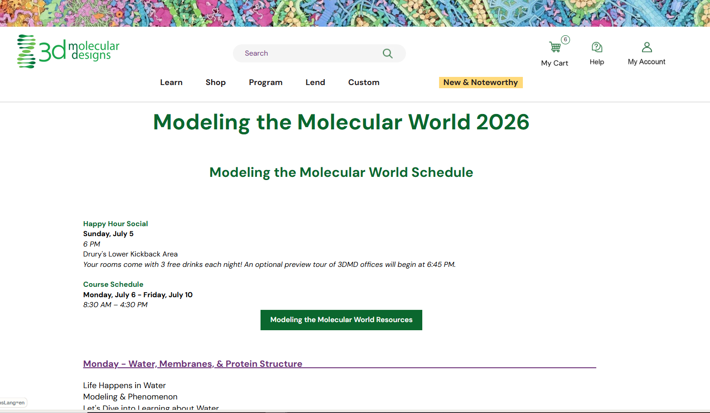

Slide 13
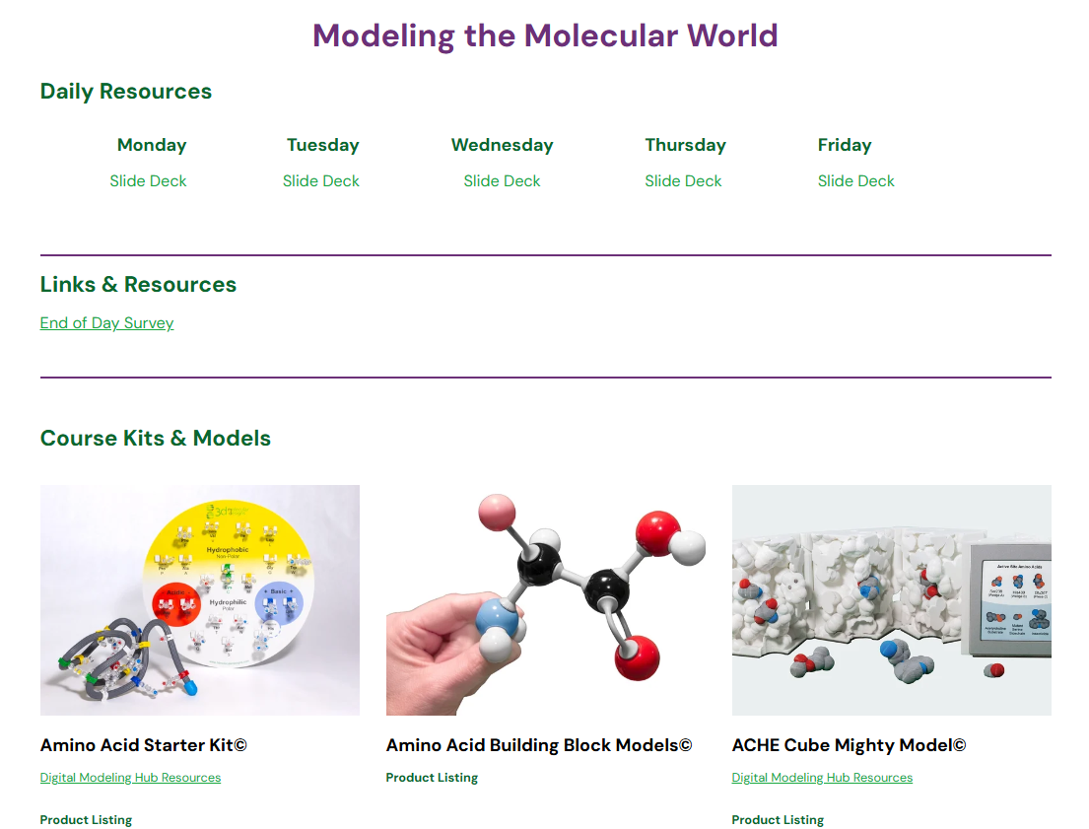

Slide 14
Lunch Options
 | Monday | Tuesday | Wednesday | Thursday | Friday
330 Eats | Heather | Diane |  |  | Kris
Cubanitas | Diane | Heather | Diane | Kris | Lauren
Fiddleheads | Kris | Lauren |  | Diane | Heather
Med Cuisine |  | Kris
Waterfront Deli | Lauren |  |  | Heather
Red Arrow Park Food Trucks |  |  | Lauren
330 Eats - Cafe with salads & sandwiches
Cubanitas - Cuban sandwiches & bowls
Fiddleheads - Coffee shop with sandwiches
Mediterranean Cuisine - Cafe with gyros & kebabs
Red Arrow Food Trucks - Rotating food trucks
600 East Cafe - Cafe and bakery
Loaded Spuds - Baked potatoes with toppings
Your Office - (Elevated) Dive bar for lunch

Slide 15

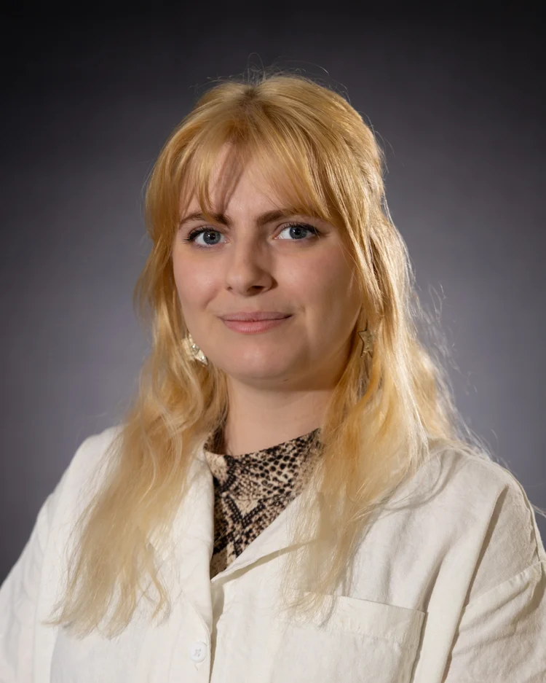
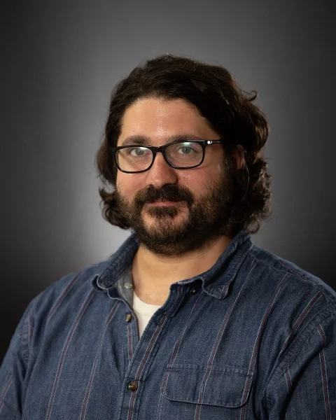
3D Molecular Designs Staff
Kris Herman
Education Relations Manager
Lauren Koepsel
Marketing Communications Manager
Mark Holzer
Director of Material Development

Slide 16

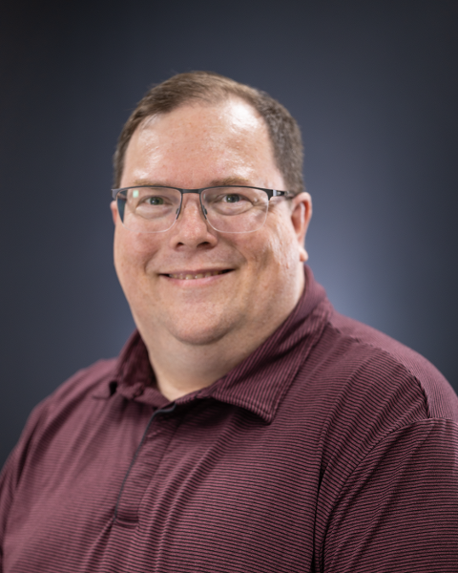
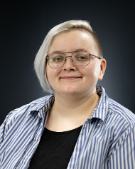
3D Molecular Designs Staff
Bobbi Kuhn
Business Manager
Sean Ryan
Media Manager
Hannah Smith
Production Manager

Slide 17
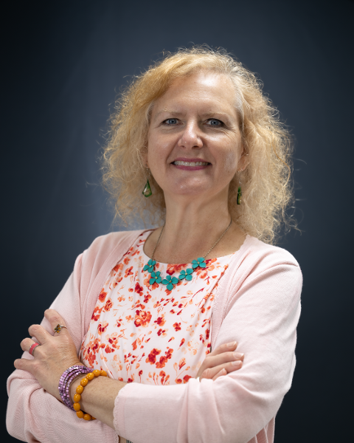
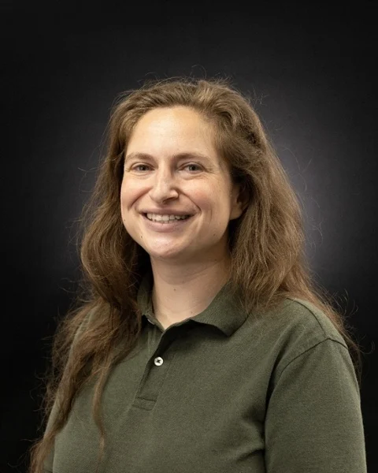
3D Molecular Designs Staff
Laura Gronek
Graphic Designer
Leah Krevitt
3D Printing Specialist & SMART Teams Educator

Slide 18

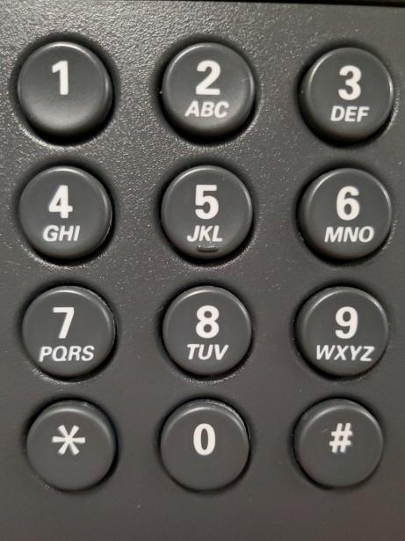


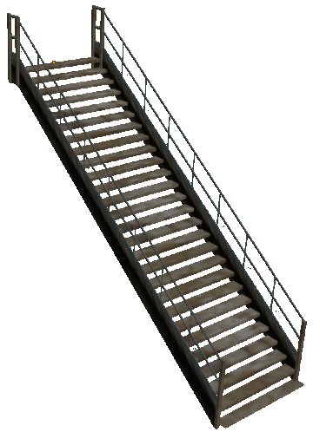
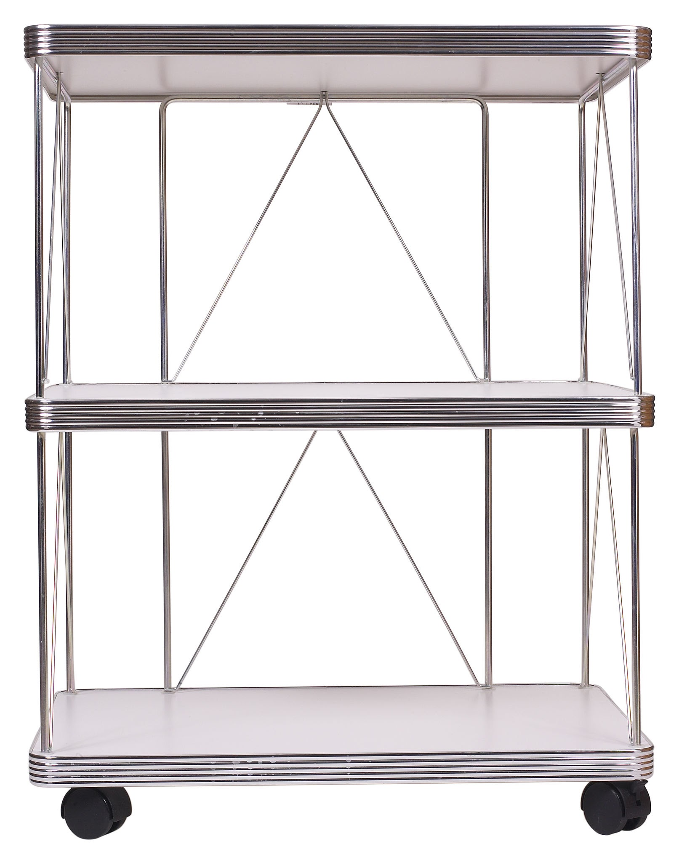
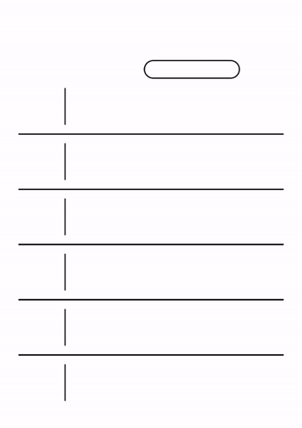

Logistics

Slide 19

Mug Exchange
Leave a mug, take a mug!

Slide 20
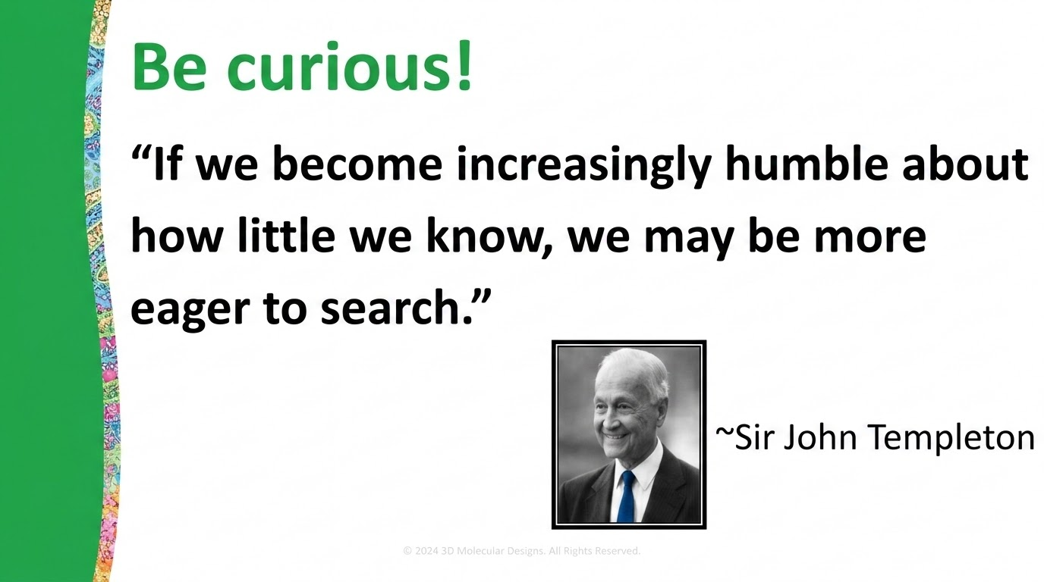

Slide 21

Norms for our time together this week:
Learner mindset
(Rhys, Writing from the Beginner’s Mind)
Notes:
For the first two days we want you to be learners. Engage as a learner, honor your expertise but don’t let it restrict your engagement with the learning process. Think about how your students would engage with the larger arc of using modeling to explore a phenomenon rather than the individual models. There will be time to connect and reflect on your own practice.

Slide 22
Norms for our time together this week:
Learner mindset
Be vulnerable
(Rhys, Writing from the Beginner’s Mind)

Slide 23
invisible
Welcome to the Molecular World

Slide 24
The Science we teach, BIOLOGY
or more broadly, the LIFE SCIENCES
or more precisely, the MOLECULAR BIOSCIENCES
It is in biology that chemistry and physics come to life.

Slide 25
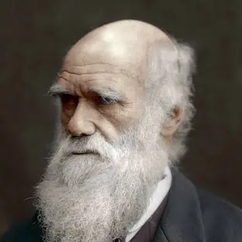
Charles Darwin’s On the Origin of Species
From the conclusion – (in 1859)
It is interesting to contemplate a tangled bank, clothed with many plants of many kinds, with birds singing on the bushes, with various insects flitting about, and with worms crawling through the damp earth, and to reflect that these elaborately constructed forms, so different from each other, and dependent upon each other in so complex a manner, have all been produced by laws acting around us.

Slide 26
…struggle for survival…natural selection…
Thus, from the war of nature, from famine and death, the most exalted object which we are capable of conceiving, namely, the production of the higher animals, directly follows.
There is grandeur in this view of life, with its several powers, having been originally breathed by the Creator into a few forms or into one; and that, whilst this planet has gone cycling on according to the fixed law of gravity, from so simple a beginning endless forms most beautiful and most wonderful have been, and are being, evolved.
Darwin would have loved DNA… and proteins!

Slide 27
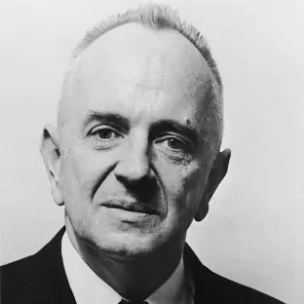
“Nothing in biology makes sense
except in the light of evolution.”
Theodosius Dobzhansky
American geneticist and evolutionary biologist
The American Biology Teacher, Vol. 35, No. 3 (Mar., 1973), pp. 125-129

Slide 28
The Unity of Life
Theodosius Dobzhansky
The American Biology Teacher, Vol. 35, No. 3 (Mar., 1973), pp. 125-129
­­­­The unity of life is­­­­ no less remarkable than its diversity.
Most forms of life are similar in many respects. The universal biologic similarities are particularly striking in the biochemical dimension. From viruses to man, heredity is coded in just two, chemically related substances: DNA and RNA. The genetic code is as simple as it is universal. There are only four genetic "letters" in DNA: adenine, guanine, thymine, and cytosine. Uracil replaces thymine in RNA. The entire evolutionary development of the living world has taken place not by invention of new "letters" in the genetic "alphabet" but by elaboration of ever-new combinations of these letters.

Slide 29
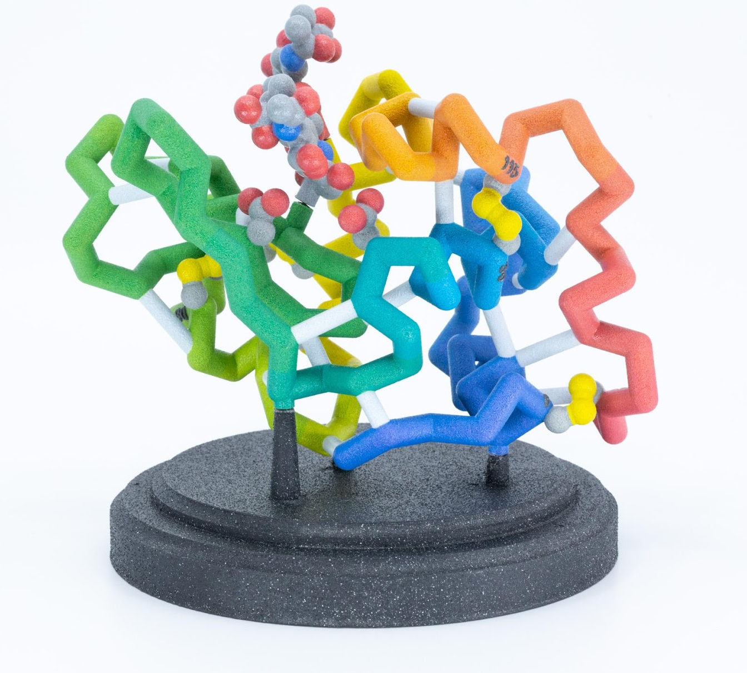
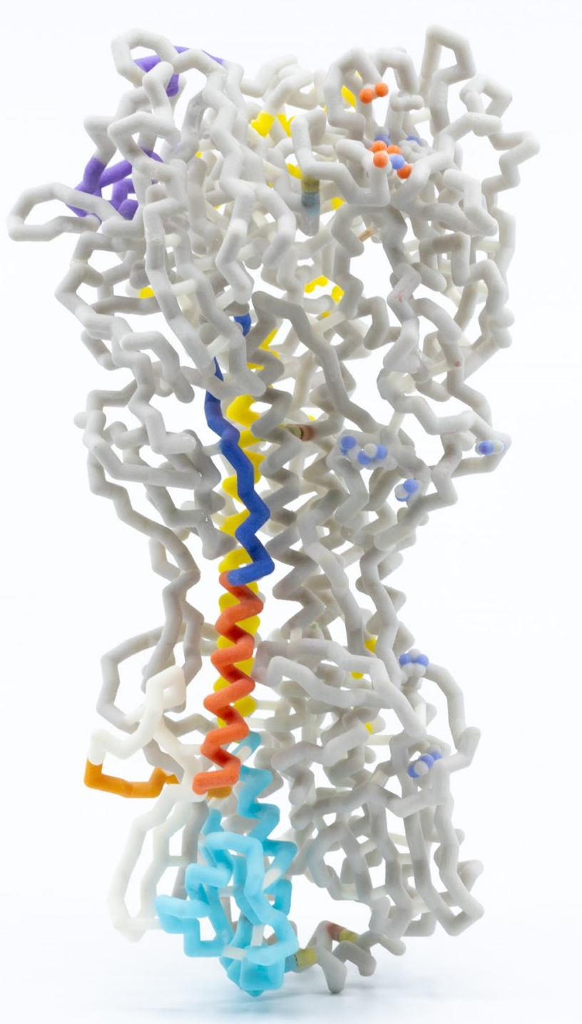
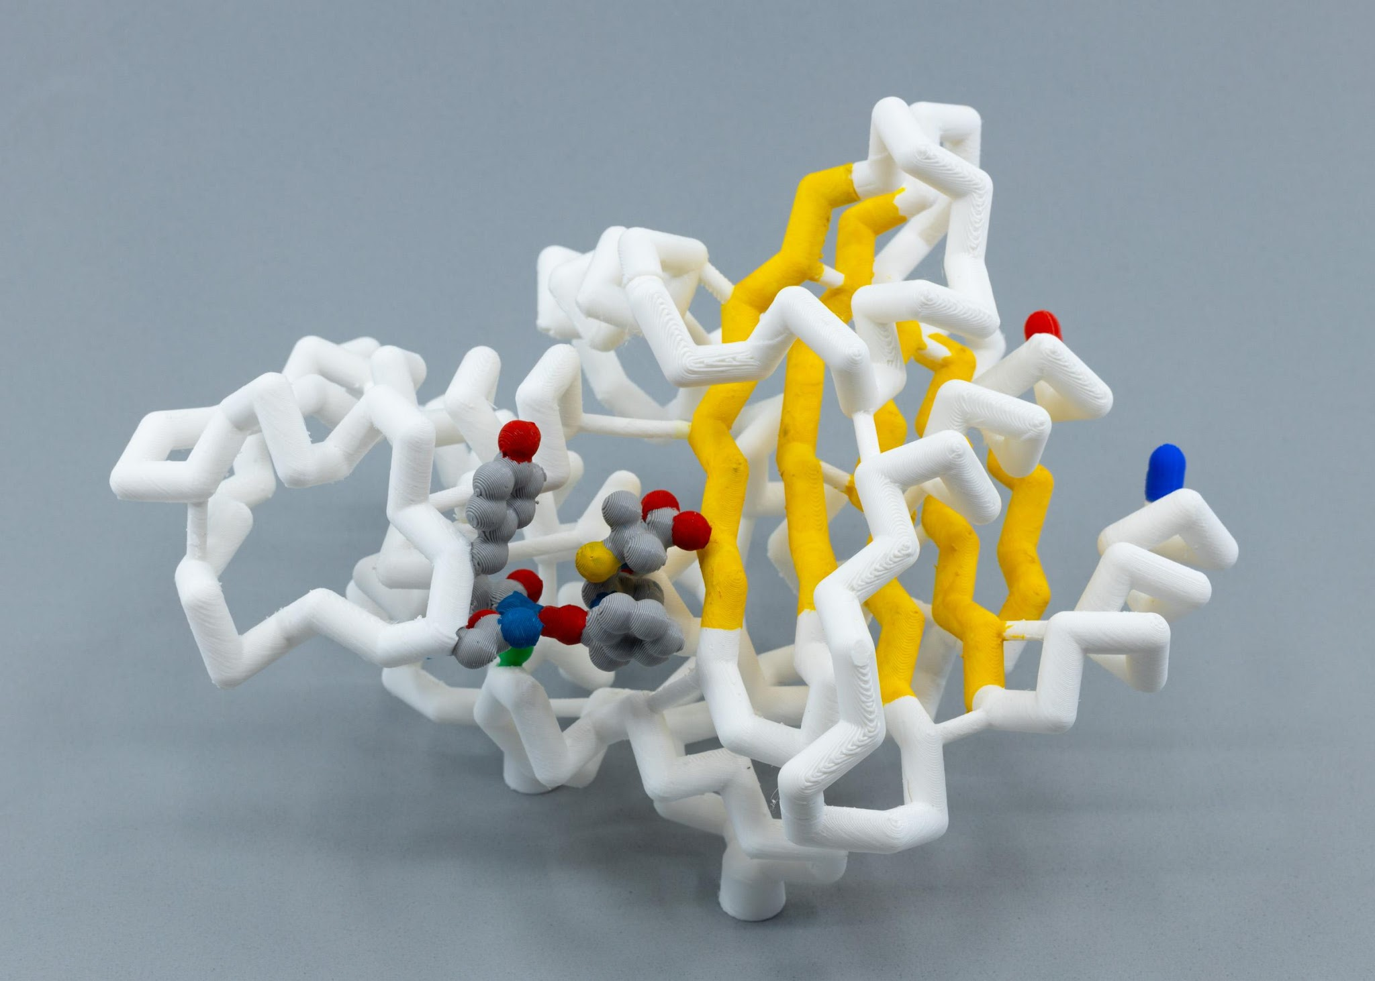
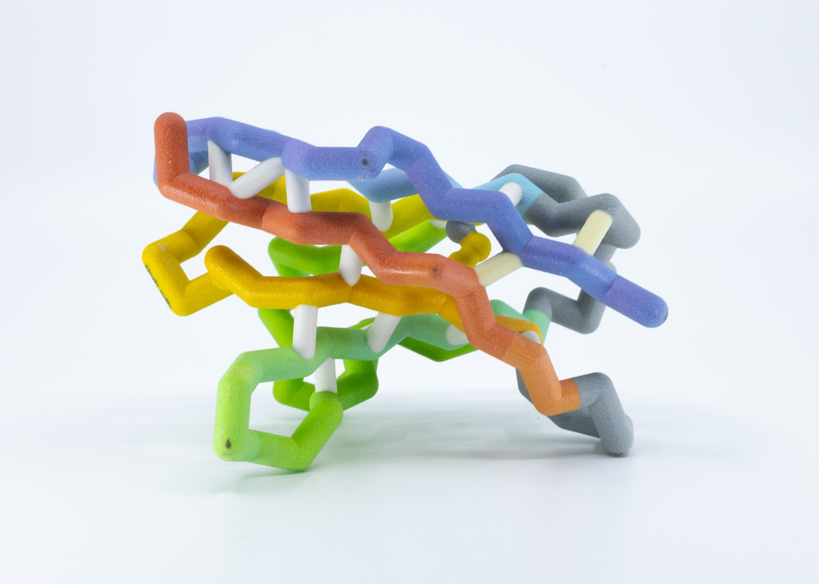
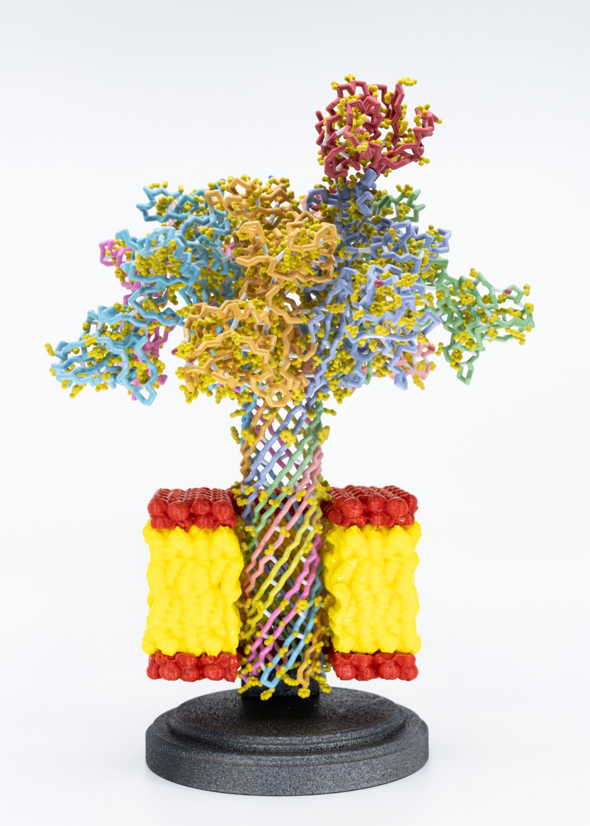
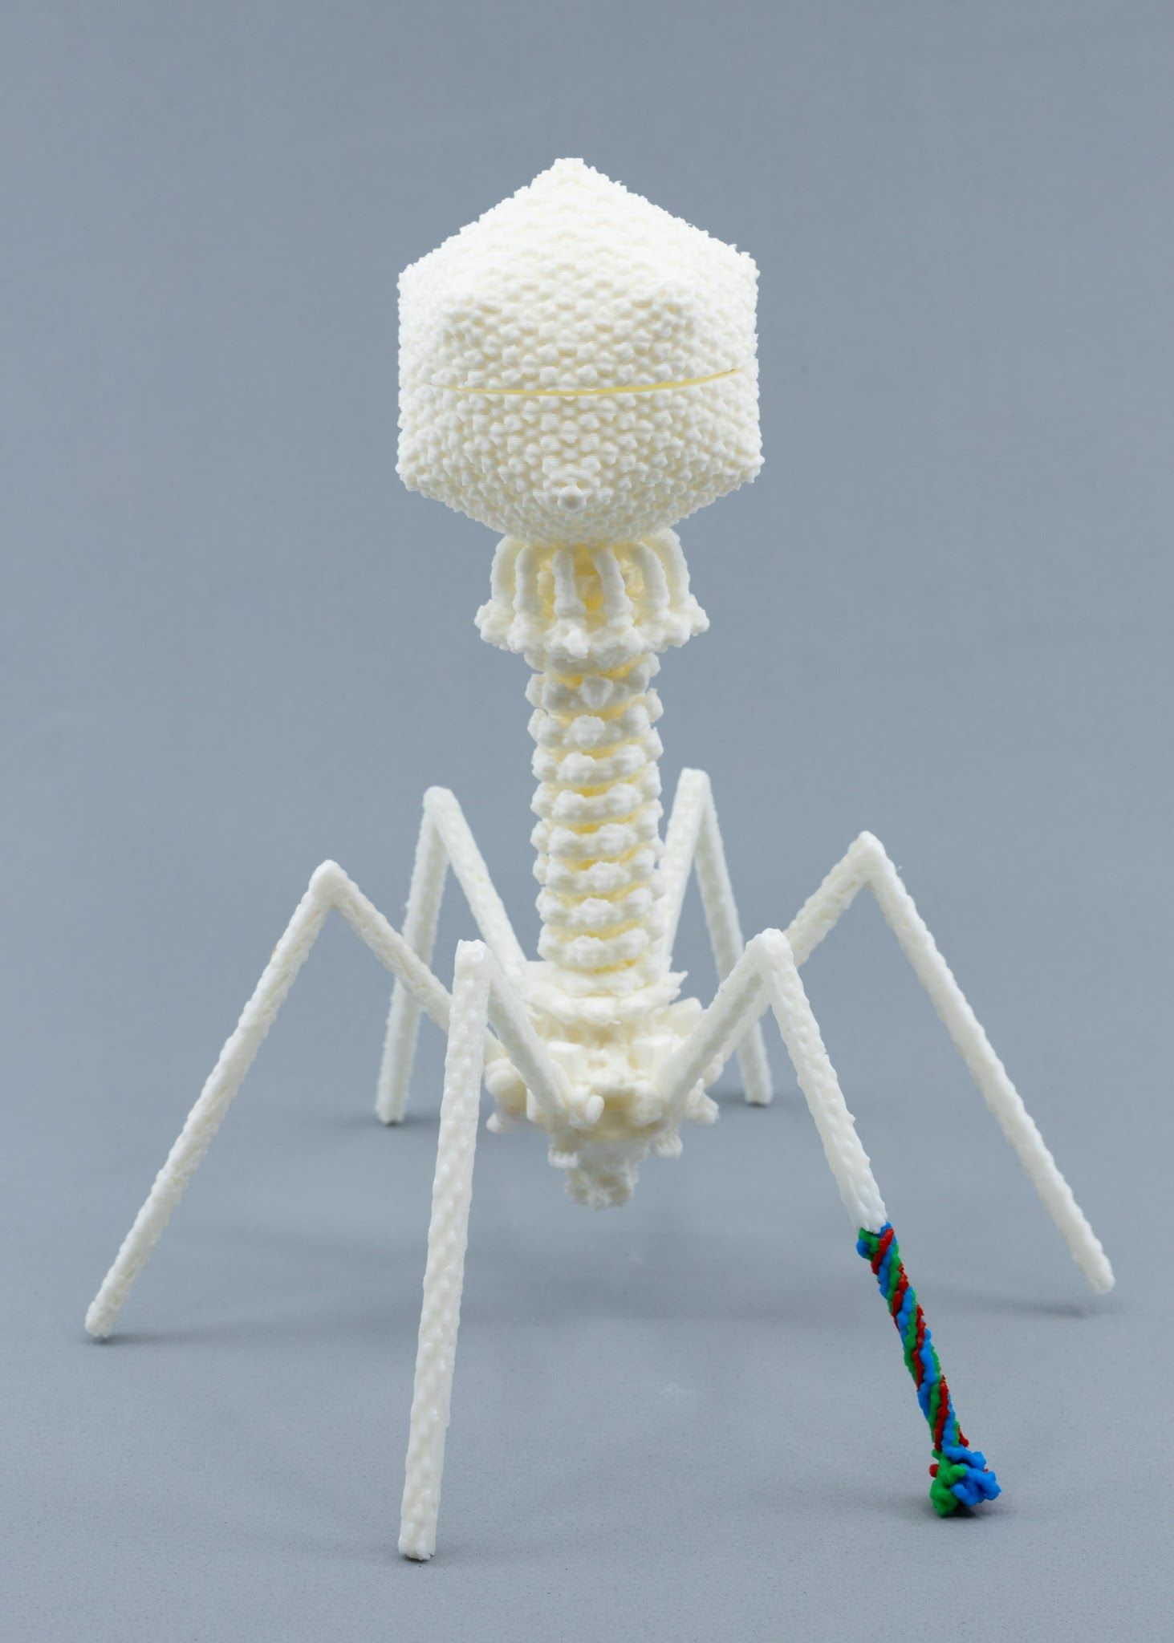
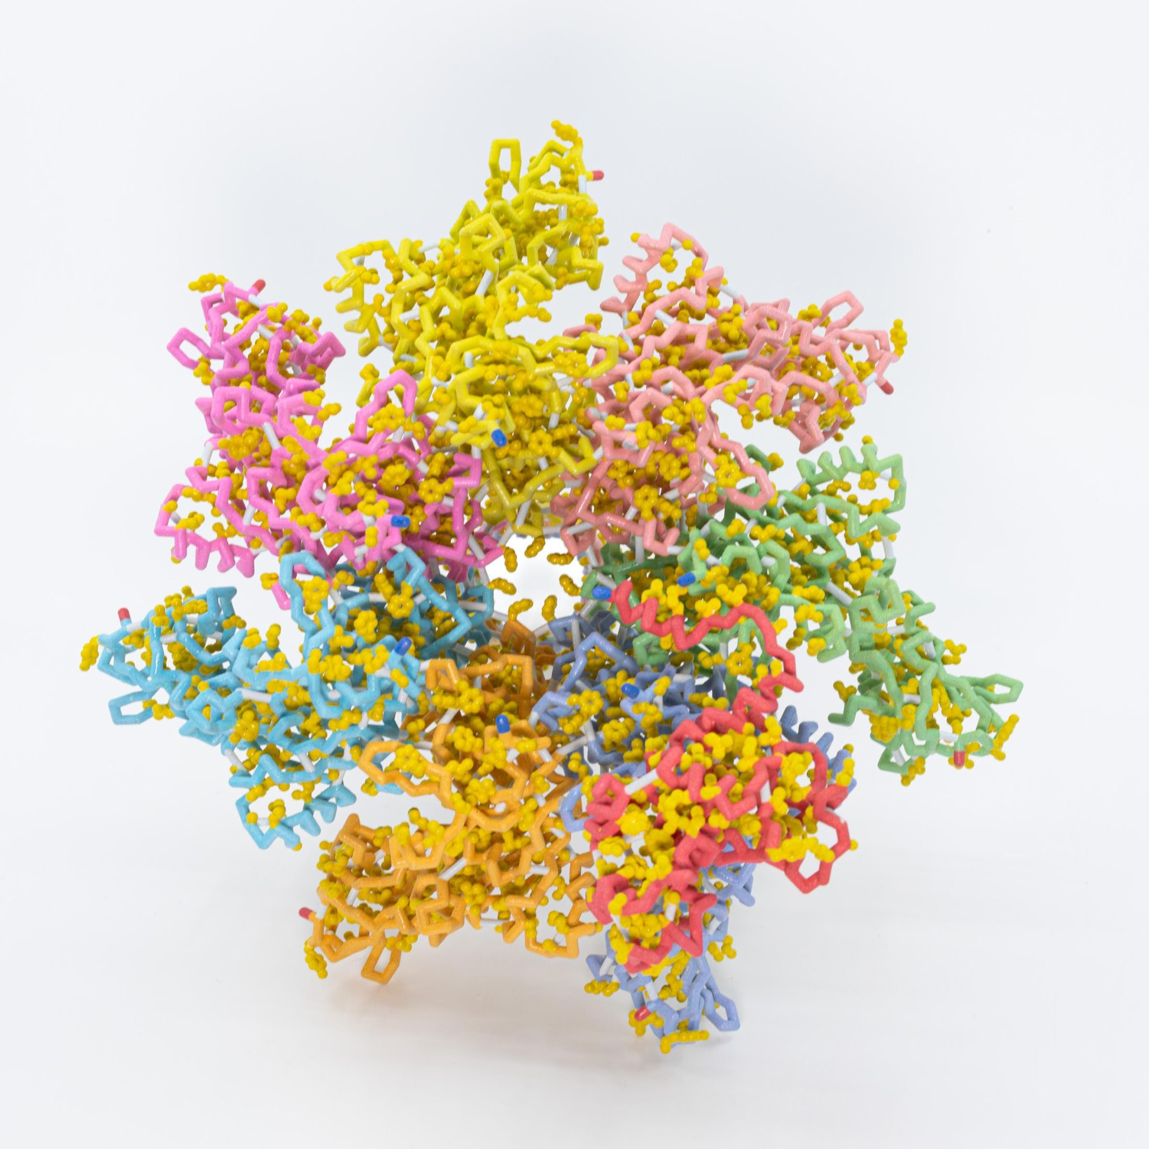
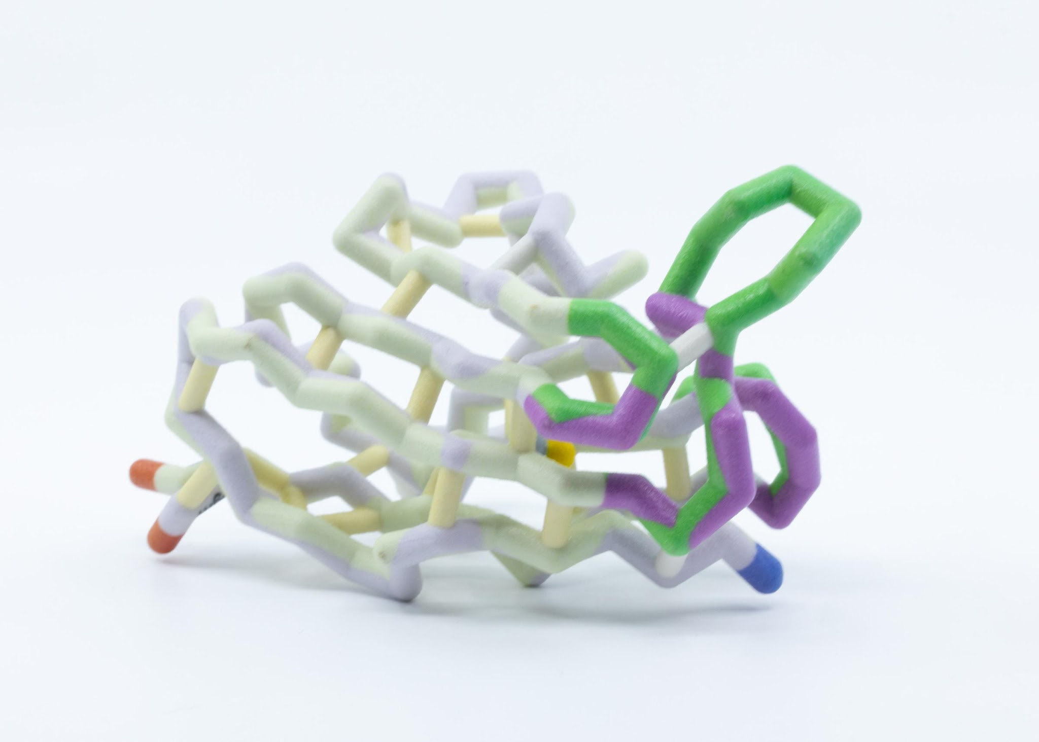
PROTEINS… in endless forms
most beautiful and most wonderous.

Slide 30
One final thought,…
Everyone will take something different from this course.
For some,… it will be deeper content knowledge.
For some,… it will improved pedagogy…. and an appreciation for the power of modeling in the classroom
Our hope is that everyone will take another step on their journey as a professional educator

Slide 32


What is a model?
What is modeling?
How do you use models in your classroom?
A model (noun) is…
Modeling (verb) is…
In my classroom…
Notes:
Heather
Table Share

Slide 33


What is a model?
What is modeling?
How do you use models in your classroom?
A model (noun) is…
Modeling (verb) is…
In my classroom…
Notes:
Table Share

Slide 34

What is a model?
What is modeling?
How do you use models in your classroom?
A model (noun) is…
Modeling (verb) is…
In my classroom…
Save a page in your notebook for later…
Notes:
Group share

Slide 37
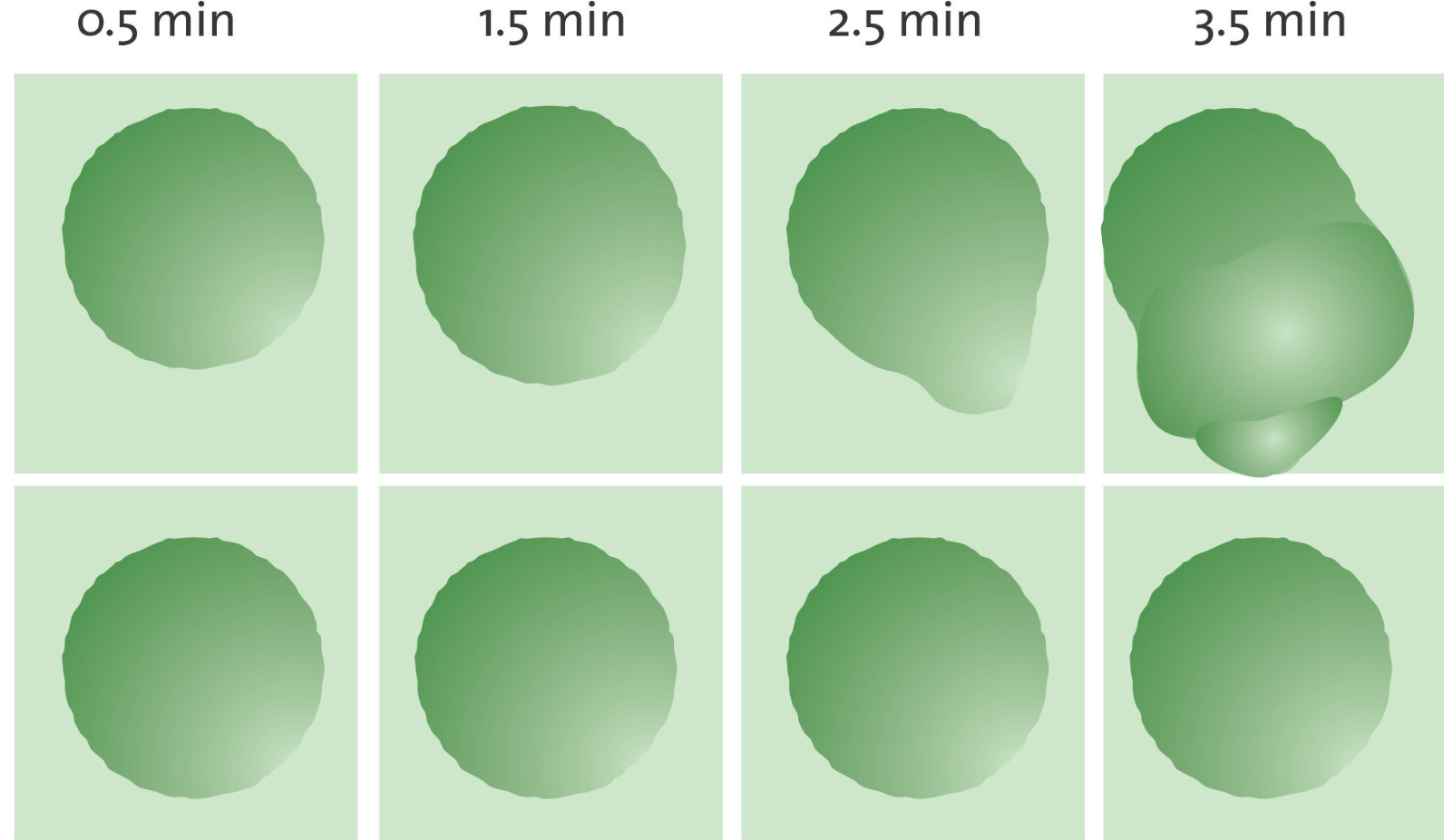
Let’s get started…
Frog Egg 1
Frog Egg 2
(Agre, 2003)
Notes:
Teacher: Pass out the image of frog eggs to the participants. Put this in your notebook, make some general observations about what you are seeing. By the end of day two, you will have a wonderful story to tell.
Students: Take notes about the phenomenon. What do you notice? What do you wonder?

Slide 38
Let’s get started…
Save a page in your notebook for later…
Frog Egg 1
Frog Egg 2
(Agre, 2003)
Notes:
Teacher: Pass out the image of frog eggs to the participants. Put this in your notebook, make some general observations about what you are seeing. By the end of day two, you will have a wonderful story to tell.
Students: Take notes about the phenomenon. What do you notice? What do you wonder?

Slide 39
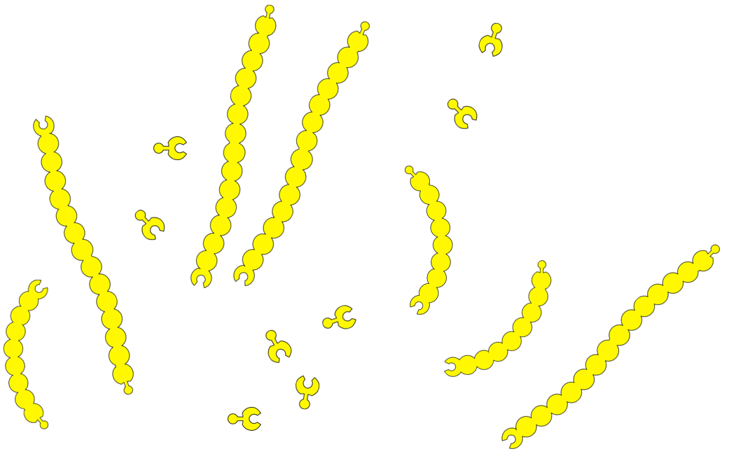
Make a Model!
Create a model of your observations

Slide 40
Driving Question Board
Driving Question: How do cellular structures function together?
Take 6 sticky notes
Write one question per sticky note
  Put your name on the back side of each sticky note
Bring them to the DQB!

Slide 41
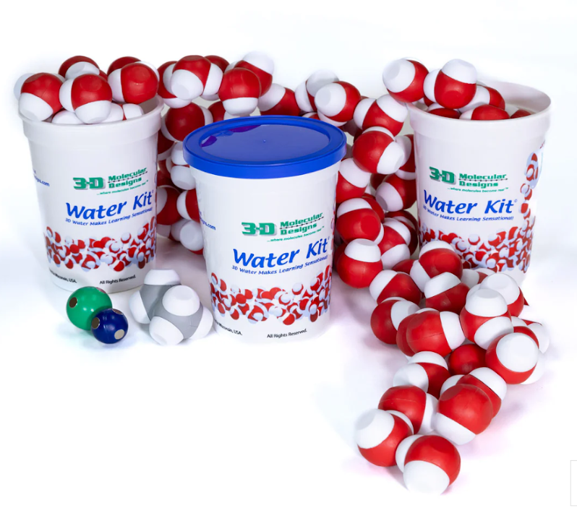
Life Happens in… …Water!
You can’t understand how life functions at the cellular or molecular leverl…
without first understanding the chemical and physical properties of water.

Slide 42

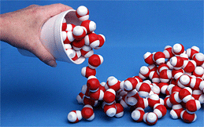
It’s time to play and observe!
What I observe What I wonder

Slide 43
Share at your table!
What I observe What I wonder

Slide 44
Share with the group!
What I observe What I wonder

Slide 45
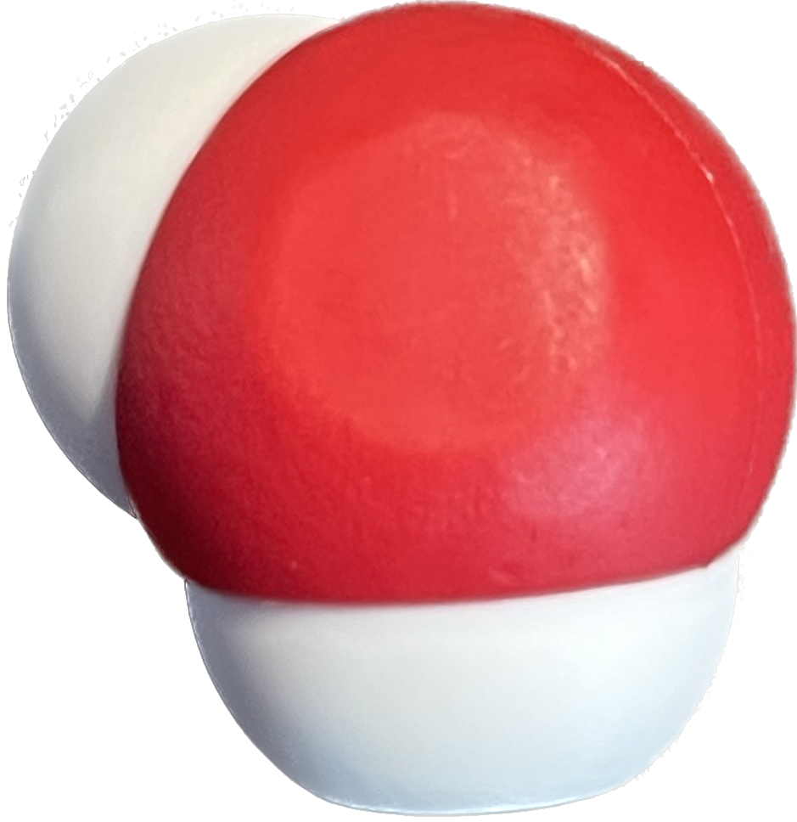
Why do the water molecules interact this way?
1
8
H
O
1.008
15.99
But first… what even IS water?
Notes:
A little information about the molecule of water… Create a sketch of the molecule in notebook, labeling and annotating as necessary

Slide 46

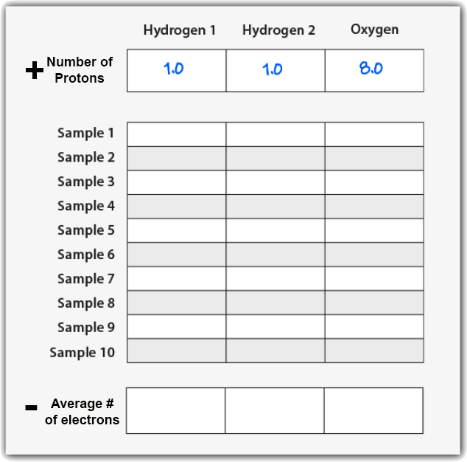
Where ARE the electrons in water?
Notes:
Provide this table to make transition to this activity go quickly!
Teacher: Give your students time to collect data. Point out that the electrons associated with the hydrogen atoms are yellow and the electrons associated with the oxygen atom are pink.
Clicking on the 3D view mode (bottom, center box) will assist students in collecting their data.
Student: Count the electrons associated with each atom and record the number in your data table .
‹#›

Slide 47


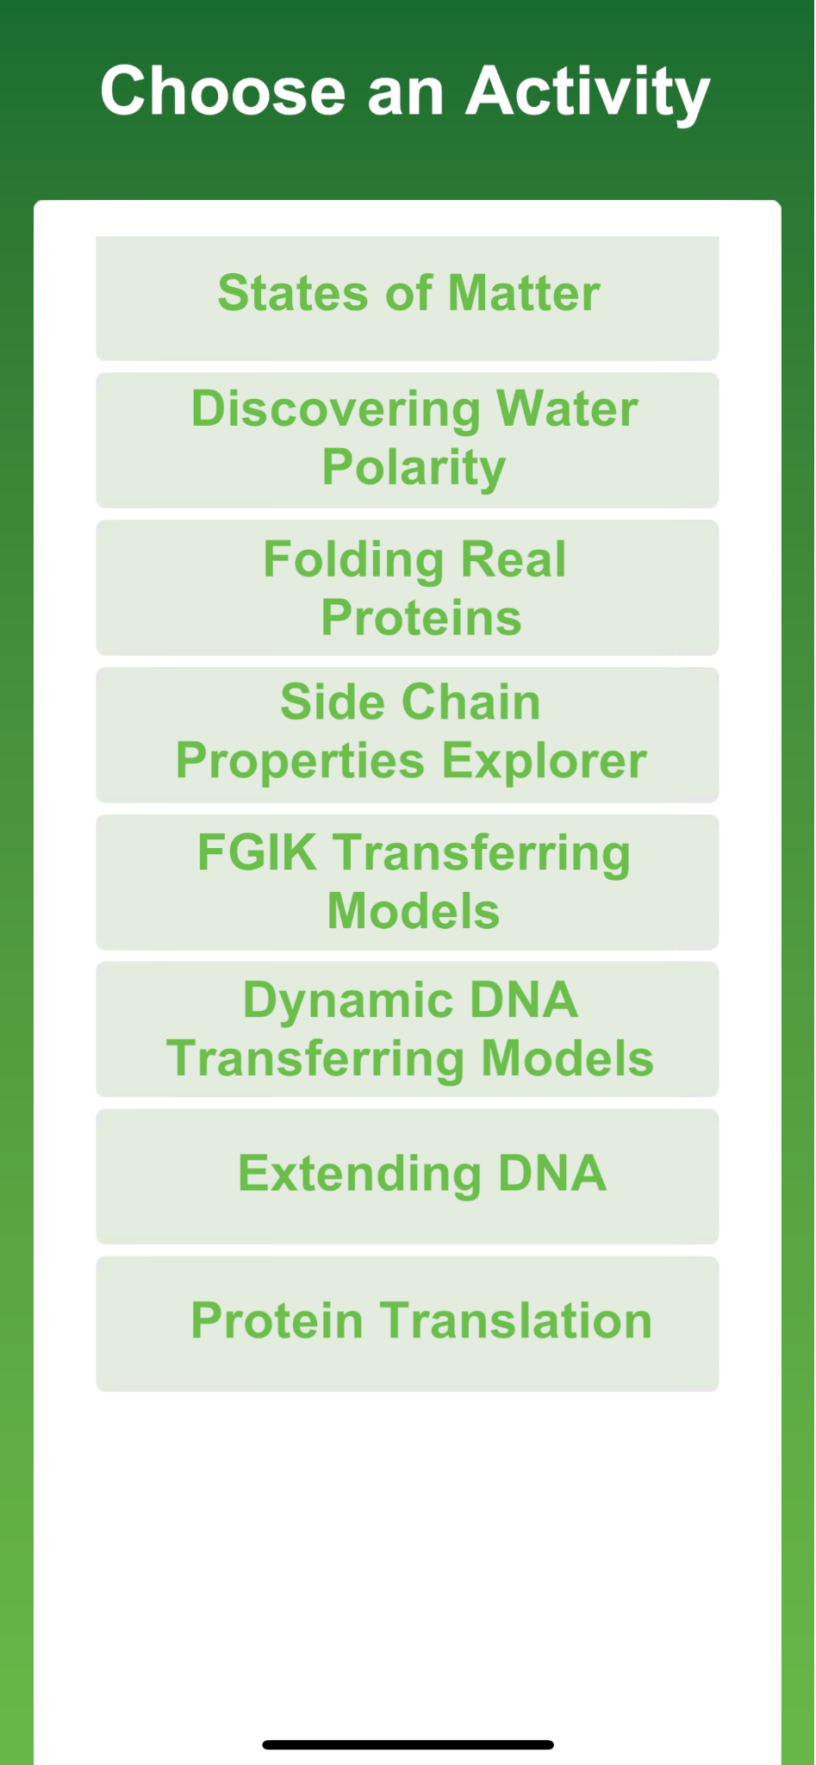
But why do the molecules interact this way?
Notes:
3DMD AR EDU app in the Google Play and Apple Store

Slide 48

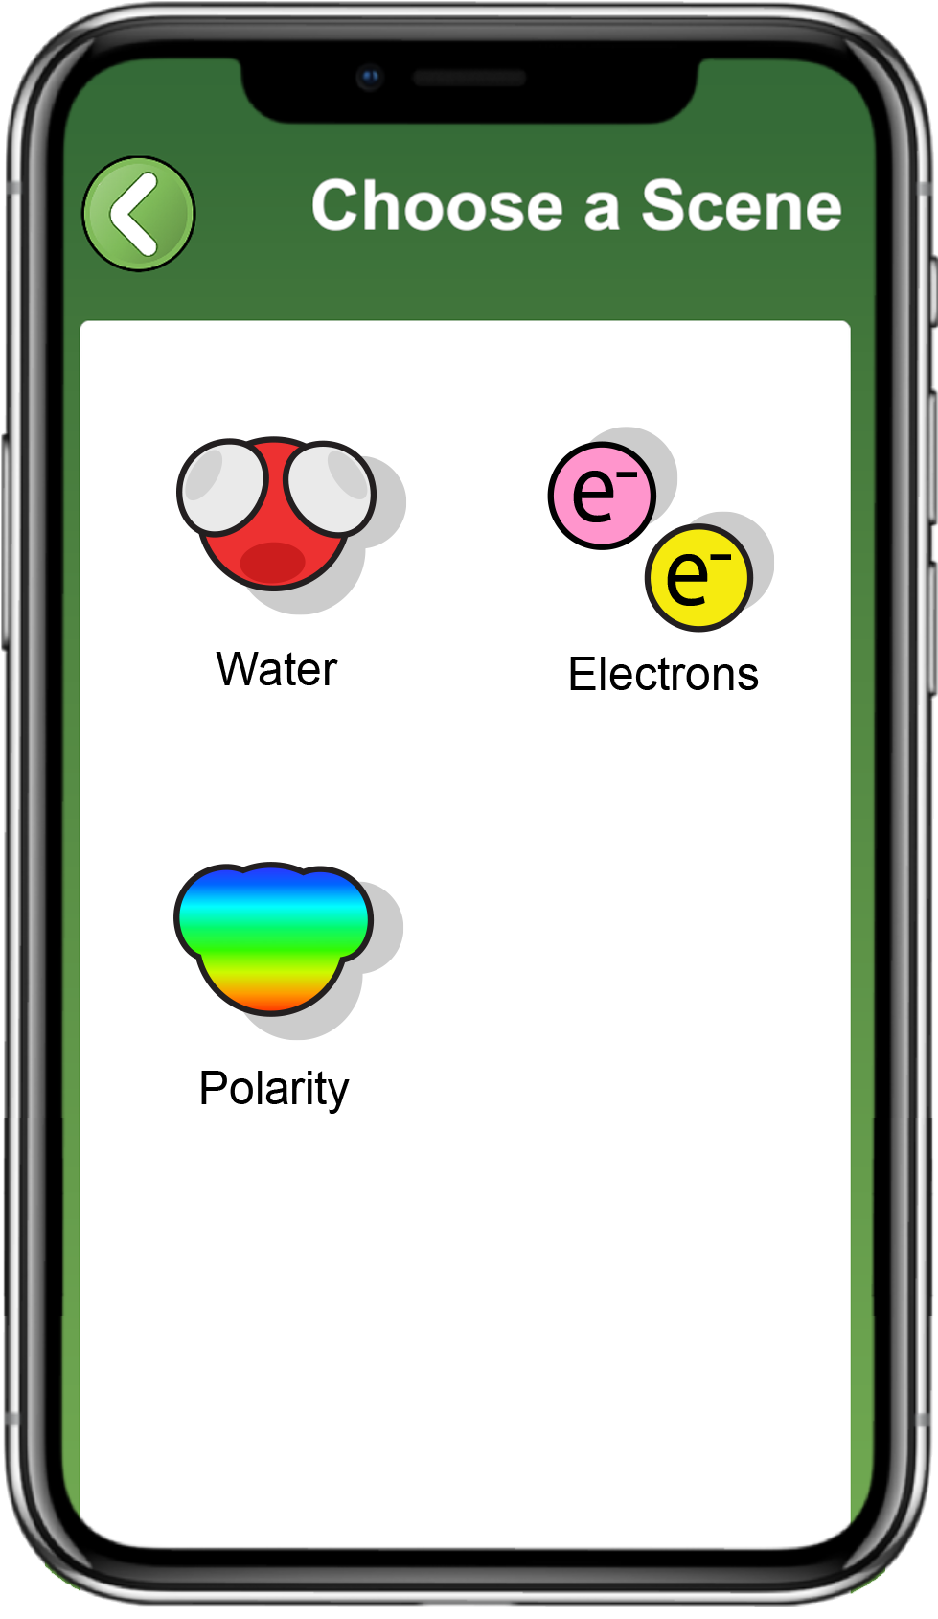
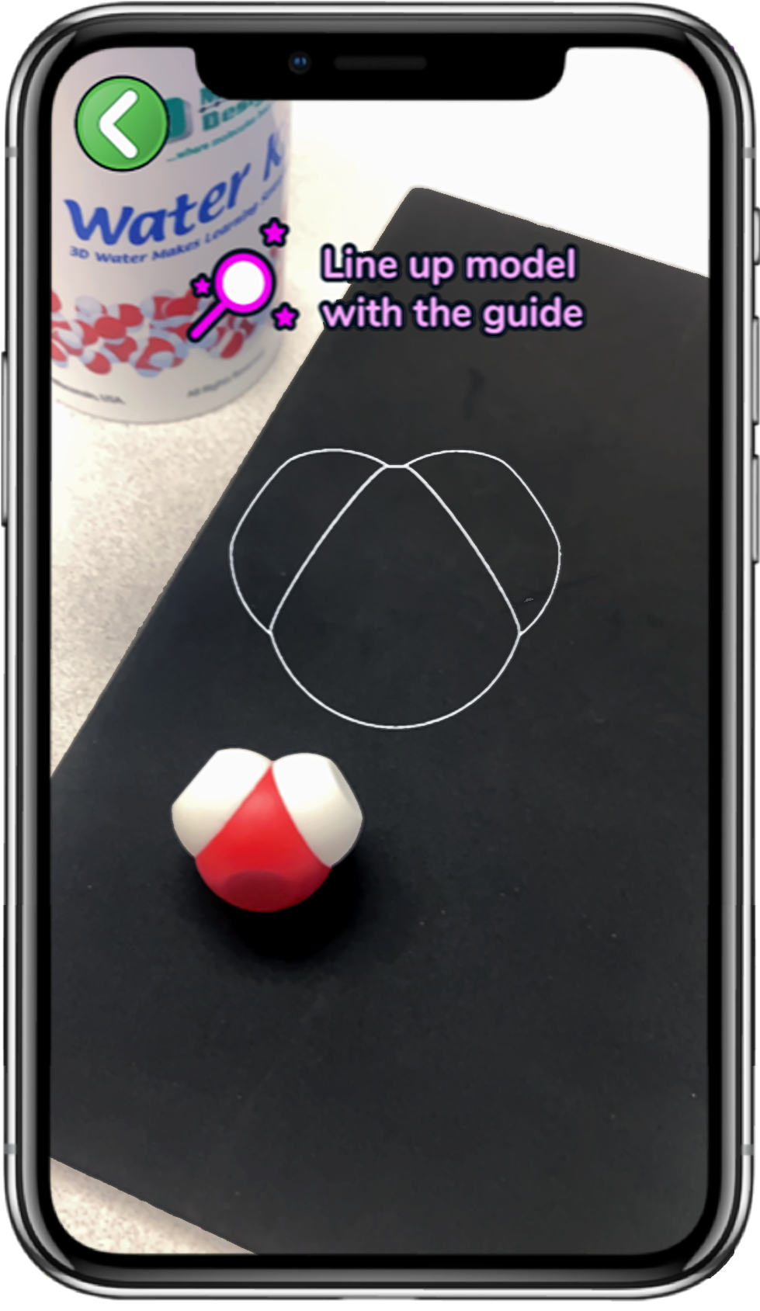
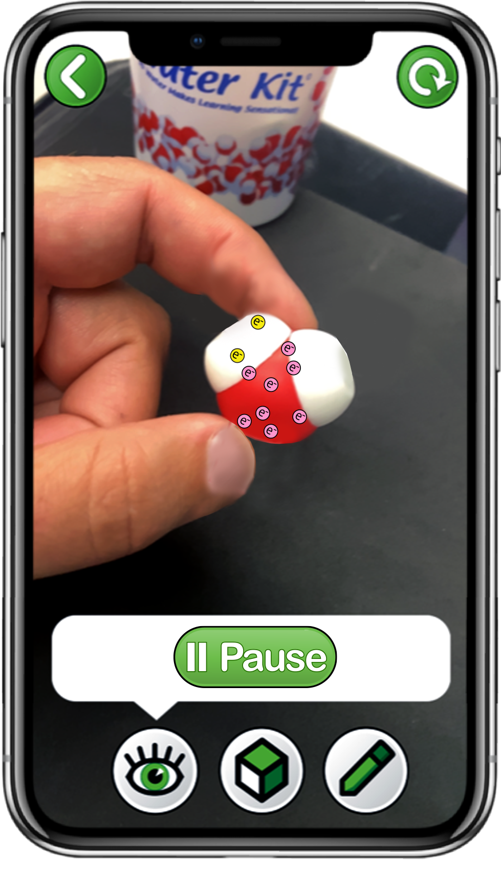

Explore Electrons with the 3DMD AR EDU App
Choose
Electrons
Scan a single water molecule
Explore the
Play and Sample buttons
Notes:
Teacher: Read the instructions on screen. Circulate through the room to assist students with technology needs.
Student: Select the correct activity and scene in the App. Record data in their data table as they begin sampling.
‹#›

Slide 49
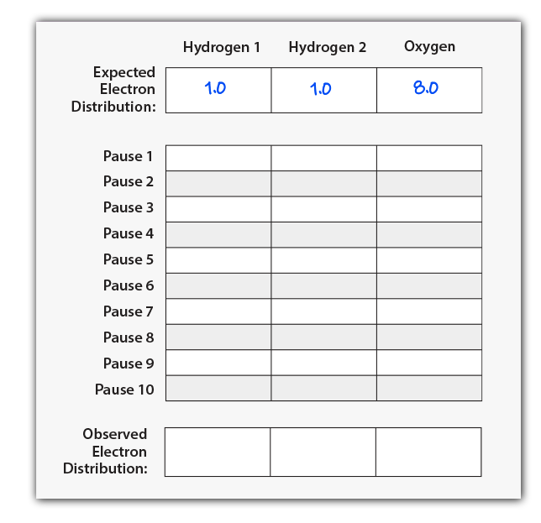

Explore Electron Distribution
Electrons move very, very fast!!
Use the Sample button to stop the movement of electrons.
Count and record the number of electrons for each sample on your data table.
Start and Sample electron locations ten times to complete your data table.
Notes:
Provide this table to make transition to this activity go quickly!
Teacher: Give your students time to collect data. Point out that the electrons associated with the hydrogen atoms are yellow and the electrons associated with the oxygen atom are pink.
Clicking on the 3D view mode (bottom, center box) will assist students in collecting their data.
Student: Count the electrons associated with each atom and record the number in your data table .
‹#›

Slide 50
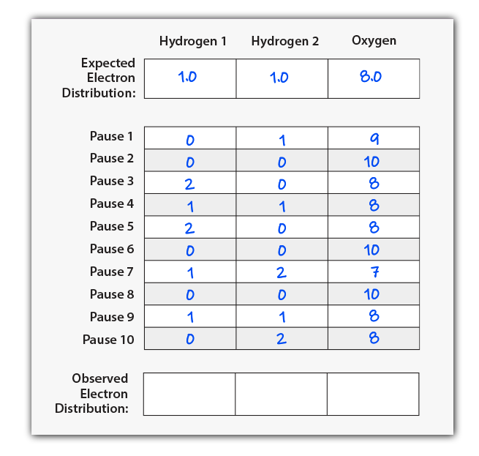
Average Observed Electron Distribution
Once your data table is filled with at least ten samples, calculate the average electrons observed near each atom.
Average of x = (x₁ + x₂ + x₃ +. . . x_{n}) / n
Record these averages in the bottom row of your table.
Notes:
Teacher: Work through calculating the mean of hydrogen 1 together and then give them time to calculate the mean for the hydrogen 2 and oxygen. Give students time to calculate the mean (average) of their ten trials for all three atoms. You may need to provide students with additional support for calculating a mean.
Extension: teach your students to use functions of Excel or Google Sheets to calculate means.
Student: Calculate the mean of each atom and record it in your data table.
‹#›

Slide 51
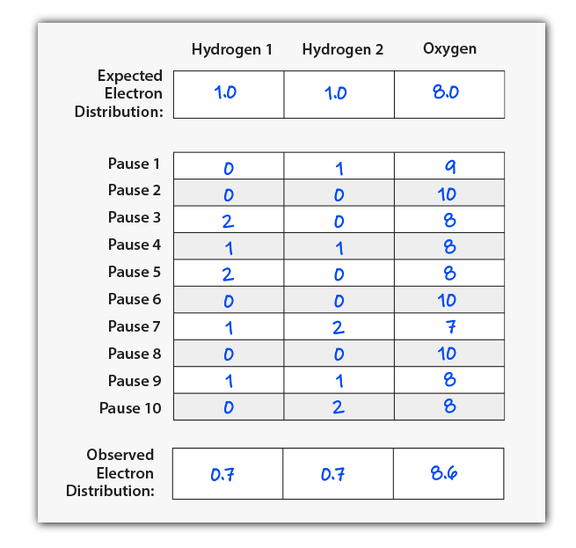
Does every group have the same data?
How does your Expected Electron Distribution compare to your average of Observed Electron Distributions?
Do electrons spend more time near the hydrogen atoms or the oxygen atom?
Why might that be?
What impact might this have on a water molecule?
Notes:
Teacher: Have students share their data with the class and create a class data table. Facilitate discussion, discourse, and consensus. By the end of the discussion, students should understand that the sharing of electrons constitutes a covalent bond between a hydrogen atom and an oxygen atom. Water has two covalent bonds. Note: These are example data. Results may vary.
Student: Students should compile data or have a discussion to form a classroom consensus model. They should notice that all groups’ data are similar, but not identical. Students should determine that reason for this is the random movement of electrons within the electron cloud.
‹#›

Slide 52
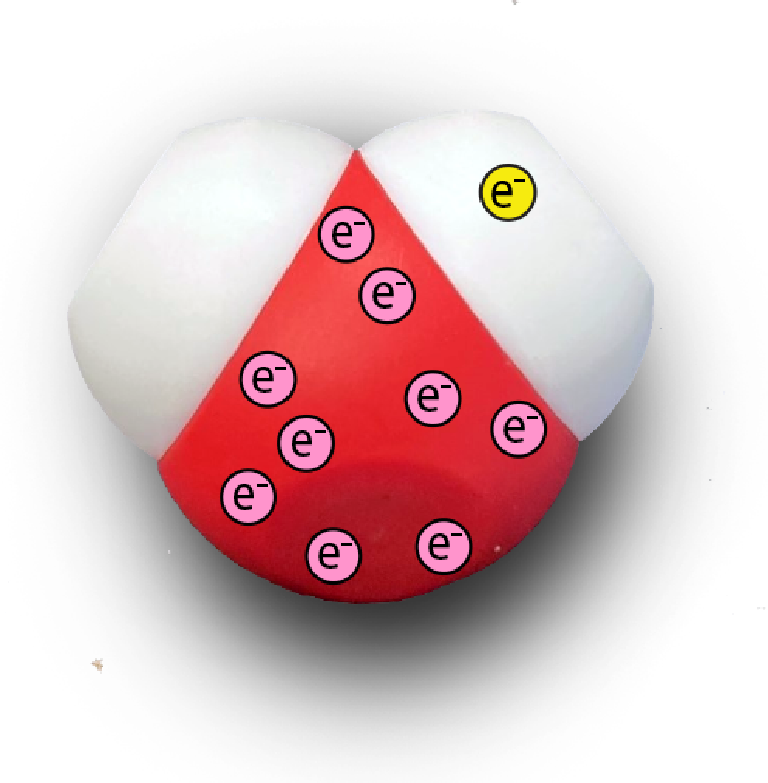
Electrons Are Not Shared Equally
The electrons in a water molecule are not shared equally!
On average, electrons spend slightly more time near the oxygen atom than would be expected.
We call this property of water POLARITY!
Notes:
Teacher: Allow students to edit their annotated sketches based upon new data. Ask your students: "How has your thinking changed? Why?" Have your student share their responses with a partner. You have an opportunity to discuss electronegativity with your students by pointing out that in addition to the size of the nucleus, the relative electronegativity of elements is also affected by electron shielding.
Student: Update their annotated sketch or confirm their thinking in their notebook.
‹#›

Slide 53

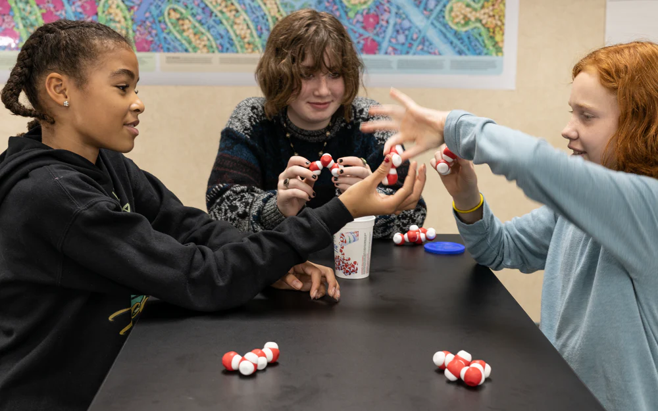
Polarity and Multiple Water Molecules
How do multiple water molecules interact?
Try to build a structure that shows every interaction a single water molecule could have.
Notes:
Teacher:. Give students a total of 5 physical water molecules and ask them to build a structure that shows the interactions between water molecules. Move around the room and help students with their models.
Student: PLAY! What atoms interact? H->O or O->H What type of interaction is this? (H-bond). Draw this in your journal / notebook. Add the RGB color scheme to show the electron cloud density overlay.
‹#›

Slide 54
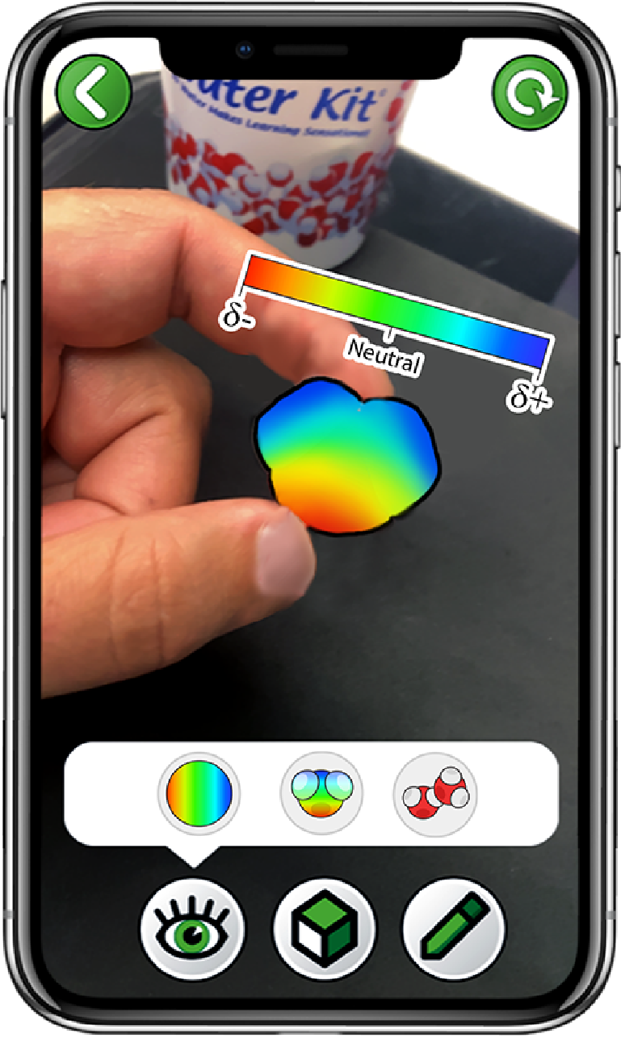
Check Your Drawing with the 3DMD AR EDU App
Choose
Polarity
Scan a single water molecule
Only click the right button
Notes:
Teacher: Read the instructions on screen. Circulate through the room to assist students with technology needs.
Student: Select the correct activity and scene in the App.
‹#›

Slide 55
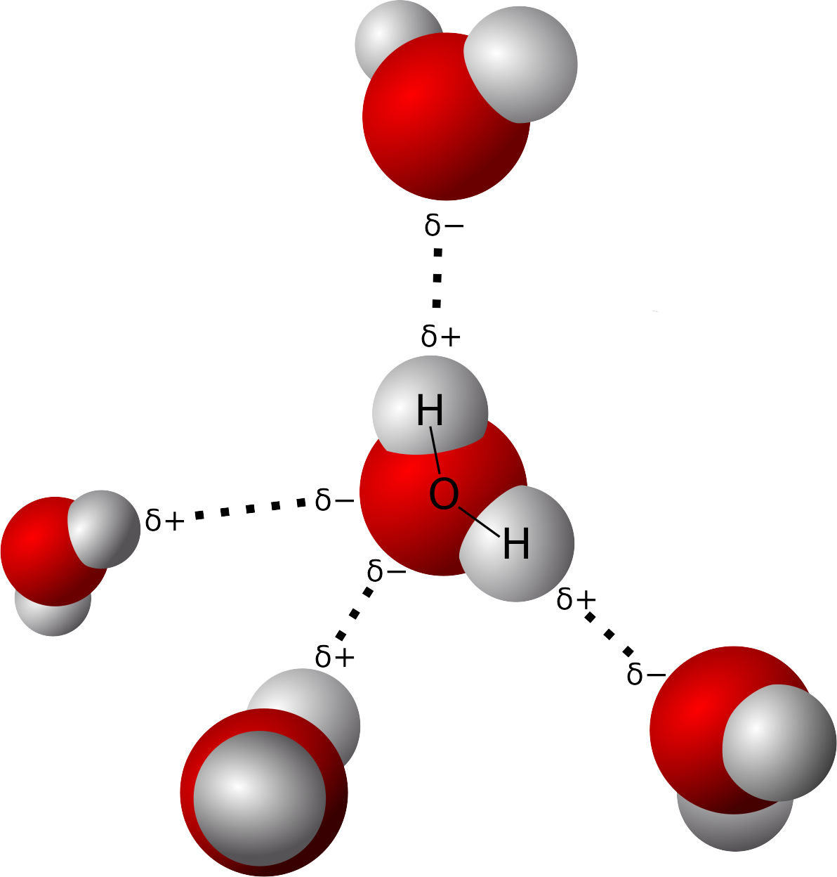
Hydrogen Bonds
Notes:
By User Qwerter at Czech wikipedia: Qwerter. Transferred from cs.wikipedia to Commons by sevela.p. Translated to english by by Michal Maňas (User:snek01). Vectorized by Magasjukur2 - File:3D model hydrogen bonds in water.jpg, Public Domain, https://commons.wikimedia.org/w/index.php?curid=14929959

Slide 56
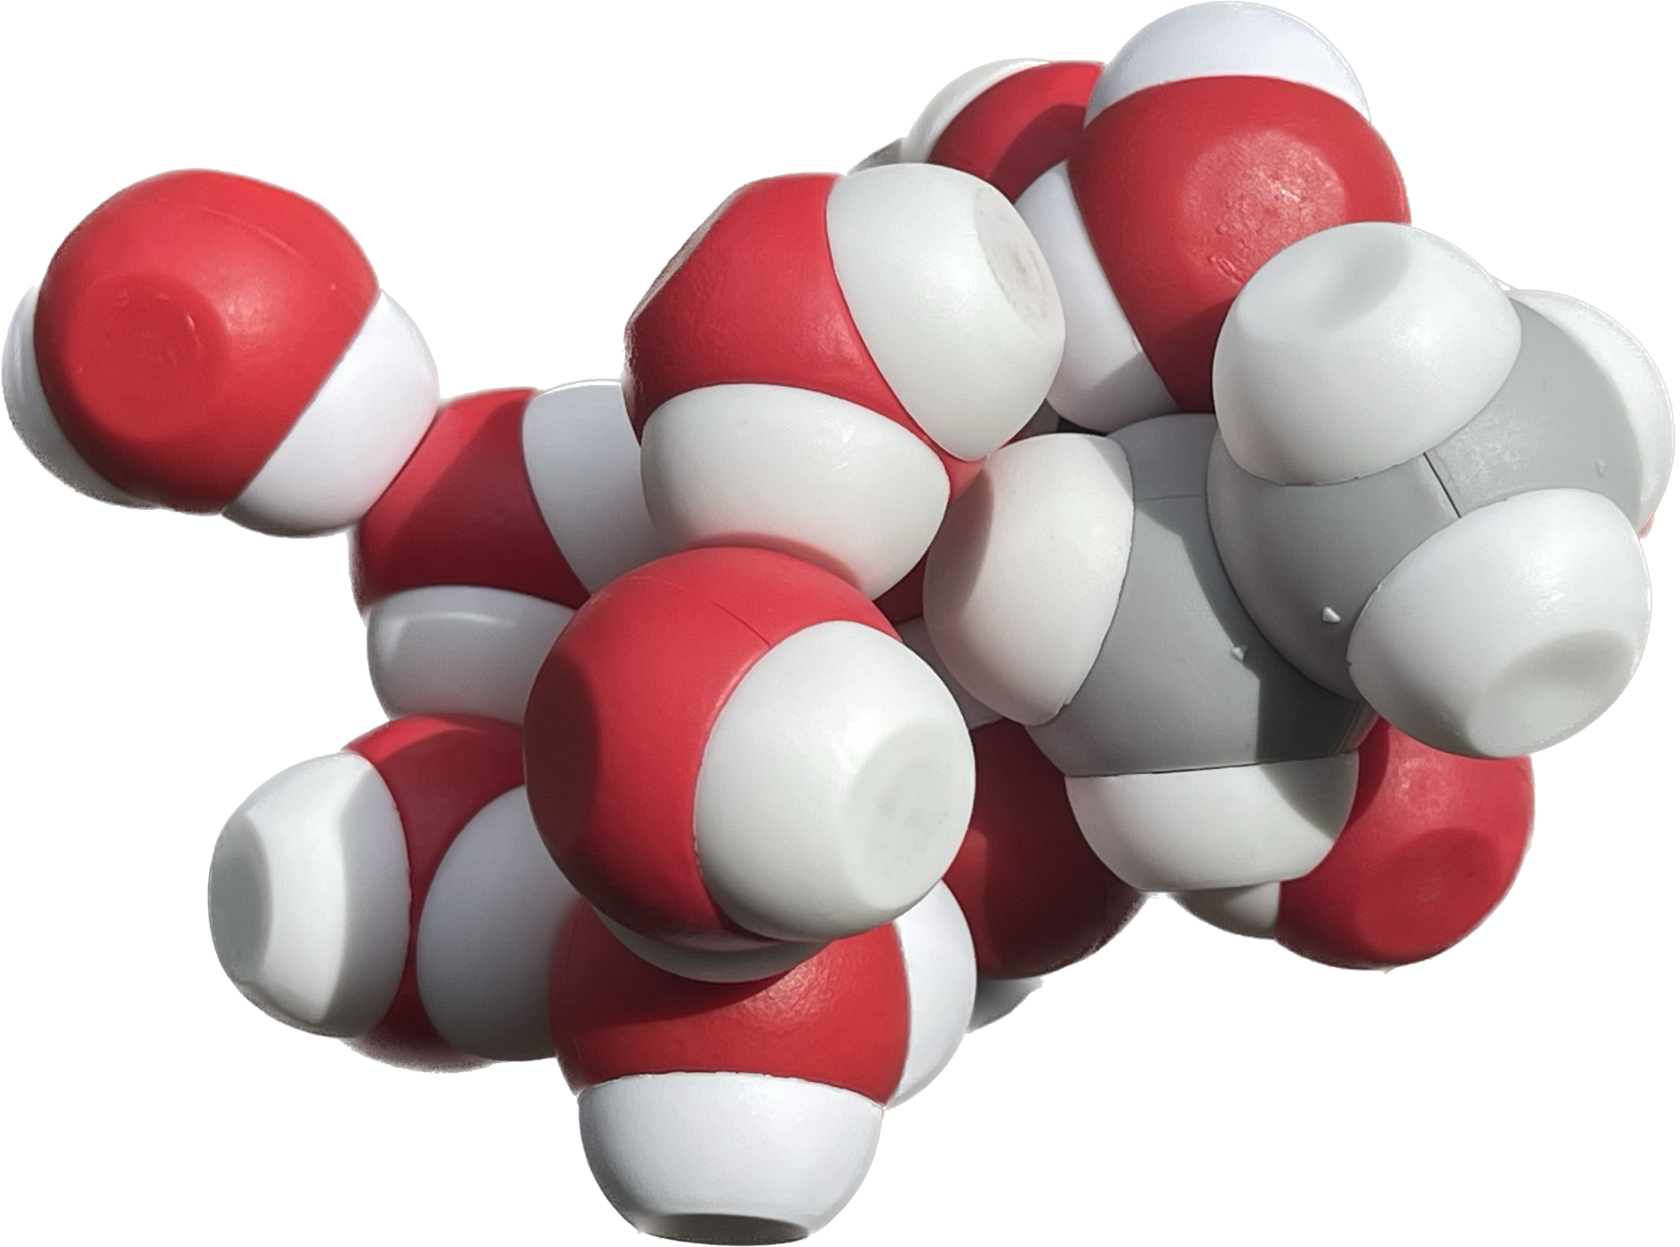
Play! What do you notice?

Slide 57


But wait, there’s more….
How does this molecule interact with water?
How can we make sense of these observations?
Record your thinking in your notebook!

Slide 58


Ethanol: Play and observe!
What I observe What I wonder

Slide 59
Polar
Non-Polar

Slide 60
Discuss at your table
Use your observations to predict the electron behavior in this molecule.

Slide 61

Is it Hydrophilic? Hydrophobic?

Slide 62
Is it Hydrophilic? Hydrophobic?
Hydrophilic

Slide 63
Is it Hydrophilic? Hydrophobic?
Hydrophilic
Hydrophobic

Slide 64

What does it mean to be hydrophobic?
(H2 OH NO What is aquaphobia and what causes fear of water? Symptoms, celebrity sufferers and cures 2018)

Slide 65

What does it mean to be… hydrophobic?
(H2 OH NO What is aquaphobia and what causes fear of water? Symptoms, celebrity sufferers and cures 2018)

Slide 66

Extend and Apply
How might this (hexanol) behave in water differently than the ethanol you have already considered?
Notes:
Pause, Rewind, Ponder, Play

Slide 67


What about pH? Can you model it?
https://commons.wikimedia.org/wiki/File:PH_Scale.png

Slide 68
What about pH? Can you model it?
Increasing H⁺ ions
Increasing OH⁻ ions
https://commons.wikimedia.org/wiki/File:PH_Scale.png

Slide 69


DQB Check: What have you learned?
What questions can you answer?
What new questions do you have?
What more do you need to know?
(Agre, 2003)
Notes:
Looking and listening for the idea of a membrane or barrier from inside and out or movement of water from inside and out. Or questions about the barriers? Share these observations after break to begin exploration of membranes

Slide 70
On the whiteboard in the back…
Write down moments in the lesson that you think exemplified…
Wonder
Explore
Explain
Notes:
Provide template for this in the notebook in this document: https://docs.google.com/document/d/1fHFFCYEjuT7f3A_Hzq_Rda3wu1335GnN5UXNggrgyzA/edit?usp=sharing

Slide 71

Break

Slide 73
Regrounding in the Phenomenon
What can we explain? What might we explore next?
(Agre, 2003)
Notes:
Teacher: Give groups time to revise their explanation and update their cell models
Learner: Apply learning from the previous lesson to revise your explanation for the phenomenon.

Slide 74




Making Sense of Molecules: Apply and Predict
Apply your understanding from the Water Kit to make sense of these new models.
How might you organize these models?
What elements do you notice?
What chemical properties can you predict?
What new questions do you have?

Slide 75



Life on the Inside
Phospholipid and Membrane Transport Kit
Water is the driving force of all of nature.
~Leonardo da Vinci

Slide 76

Let’s Play!
What elements do you see?
What chemical properties might this molecule have?
What new questions do you have?
Notes:
Teacher: Ask learners to look closely at the structure of the molecule in front of them. Share and compare the different structures
Learner: Compare phospholipids structure among other tables. Engage your phospholipid with another table. Why do we call them phospholipids?

Slide 77

Let’s build a phospholipid
Parts of a phospholipid
1
2
3
Notes:
Have participants build a phosphoslipid

Slide 78




Could you build it?
Fatty Acids x2

Slide 79
Formalize Your Observations
On your own: Sketch a simplified model of a phospholipid in your notebook that represents the basic structures found in all phospholipids.
Reference text
Notes:
Teacher: Give learners time to ponder the three main structures on the phospholipid.
Learner: Sketch a generalized phospholipid in their notebook. Label it.

Slide 80
Formalize Your Observations
Did your model include?
Phosphate Head Group
Glycerol
Lipid Tails
Reference text
Notes:
Teacher: Give learners time to ponder the three main structures on the phospholipid.
Learner: Sketch a generalized phospholipid in their notebook. Label it.

Slide 81

How did this molecule interact with water?

Slide 82


One molecule, many properties…
Molecules that contain polar and nonpolar regions are amphipathic.
Where do you find polar and nonpolar properties on these models?
Notes:
Teacher: Introduce the concept of amphipathic. Facilitate discussion about the similarities and difference between these models.
Learner: Identify the polar and nonpolar areas on these models.

Slide 83


How do phospholipids form membranes?
Membrane Modeling Challenge 1
Using what you now know about phospholipid molecules, model what happens when 10 molecules of phospholipids are dropped on the surface of water.

Slide 84

How do phospholipids form membranes?
Membrane Modeling Challenge 1
Using what you now know about phospholipid molecules, model what happens when 10 molecules of phospholipids are dropped on the surface of water.

Slide 85
Membrane Modeling Challenge 2
Using the same 10 phospholipids, arrange them in the beaker so that they are submerged in the water while still maintaining the correct hydrophobic/hydrophilic interactions.

Slide 86

Membrane Modeling Challenge 2
Using the same 10 phospholipids, arrange them in the beaker so that they are submerged in the water while still maintaining the correct hydrophobic/hydrophilic interactions.

Slide 87



Slide 88


How are membranes formed?
Membrane Modeling Challenge 3
Using as many phospholipids as you need… create a membrane that can CONTAIN water as well as be surrounded by water.

Slide 89

How are membranes formed?
Membrane Modeling Challenge 3
Using as many phospholipids as you need… create a membrane that can CONTAIN water as well as be surrounded by water.

Slide 90

Draw your model of a membrane in your science notebook
For 2 minutes, write what you know about the structure of a membrane from this activity.

Slide 91

On your own: Use your understanding to explain how this membrane formed and stays together

Slide 92




Slide 93
On the whiteboard in the back…
Write down moments in the lesson that you think exemplified…
Wonder
Explore
Explain
Notes:
Provide template for this in the notebook in this document: https://docs.google.com/document/d/1fHFFCYEjuT7f3A_Hzq_Rda3wu1335GnN5UXNggrgyzA/edit?usp=sharing

Slide 95
Regrounding in the Phenomenon
What can we explain? What might we explore next?
(Agre, 2003)
Notes:
Teacher: Give groups time to revise their explanation.
Learner: Apply learning from the previous lesson to revise your explanation for the phenomenon.

Slide 98

Wonder Phase
Reflect on your morning, when were you in the Wonder Phase?
What did the Wonder Phase look and feel like?

Slide 99
Discuss the Wonder Phase
How did the model create access for everyone?
What instructor moves protected authentic wondering?
What would have shut Wonder down too early?
Notes:
Time: 3–4 minutes.
Ask participants to reflect as instructors, not just learners.
Surface that Wonder is grounded in a common model experience, which supports equitable discourse and lowers risk in sharing ideas.
Encourage examples such as withholding vocabulary, allowing silence, inviting multiple observations, and treating divergent noticing as valuable.

Slide 100
Key Aspects of Wonder
Begins with shared interaction with a foundational model.
Allows authentic learner play and observation.
Ignites learner questions before formal instruction.
Is non-evaluative and supports equitable participation.
Wonder raises the status of diverse voices because learners can point to and manipulate the model as they share ideas.
Notes:
Time: 3–4 minutes.
Make explicit that Wonder is not just an icebreaker; it is a pedagogical phase that launches sensemaking.
Connect to WE2’s low-threshold, high-ceiling model design and the importance of learner-generated questions.

Slide 102

Lunch Options
 | Monday | Tuesday | Wednesday | Thursday | Friday
330 Eats | Heather | Diane |  |  | Kris
Cubanitas | Diane | Heather | Diane | Kris | Lauren
Fiddleheads | Kris | Lauren |  | Diane | Heather
Med Cuisine |  | Kris
Waterfront Deli | Lauren |  |  | Heather
Red Arrow Food Trucks |  |  | Lauren
330 Eats - Cafe with salads & sandwiches
Cubanitas - Cuban sandwiches & bowls
Fiddleheads - Coffee shop with sandwiches
Mediterranean Cuisine - Cafe with gyros & kebabs
Red Arrow Food Trucks - Rotating food trucks
600 East Cafe - Cafe and bakery
Loaded Spuds - Baked potatoes with toppings
Your Office - (Elevated) Dive bar for lunch

Slide 104
Going Deeper…
Membranes
Tim Herman

Slide 105

Not a single covalent bond…joins one phospholipid to another.

Slide 106
Life is as complicated as you want to make it…

Slide 107


Slide 108
QUESTIONS…
(Showing your students how to think….and ask questions)
What cellular processes require a ready supply of new phospholipids?
Where do these new phospholipids come from?
If they are made in the cell,… where in the cell are they made?
If different phospholipids are found in different membranes,… how do they get sorted out at their site of synthesis and sent to the right membrane?
The answers to these questions are not as important
as the questions themselves.

Slide 109



Slide 110


Slide 111


Slide 112
The appearance of phosphatidylserine in the outer leaflet of the plasma membrane appears to be a universal phenomenon in cells undergoing apoptosis, or programmed cell death
PtdSer acts as an ‘eat me’ signal on dead cells

Slide 115
Regrounding in the Phenomenon
What can we explain? What might we explore next?
(Agre, 2003)
Notes:
Teacher: Give groups time to revise their explanation.
Learner: Apply learning from the previous lesson to revise your explanation for the phenomenon.

Slide 116



Let’s Recap!
What questions have we answered and made good progress on?
What questions do we still have?

Slide 117

Building Blocks of Life
Amino Acid Building Blocks + Amino Acid Starter Kit
"Amino acids are as important to life as the letters of the alphabet are to language."
~Anonymous

Slide 118
What is a Protein?

Slide 119
A protein is a polymer, made of monomers.
⚫️
🟣
🟠
🟣🟠🟤🟢🔴⚫️🟡
🟢
🟤
🔴
🟡
And the monomer is...

Slide 120

A protein is a polymer of amino acid monomers.
Notes:
Give each participant a molymod (or two)
Carbon - Black
Oxygen - Red
Hydrogen - White
Nitrogen - Blue
Single Bond - Short Connector
Double Bond - Long Flexible Connector
Hydrogens are adjacent

Slide 121





Now play! What do you notice?
Notes:
Give each participant a molymod (or two)
Carbon - Black
Oxygen - Red
Hydrogen - White
Nitrogen - Blue
Single Bond - Short Connector
Double Bond - Long Flexible Connector
Hydrogens are adjacent

Slide 122




What did you notice?

Slide 123

Do this!

Slide 124
Dehydration synthesis

Slide 125

A protein is a polymer of amino acid monomers.
Notes:
Give each participant a molymod (or two)
Carbon - Black
Oxygen - Red
Hydrogen - White
Nitrogen - Blue
Single Bond - Short Connector
Double Bond - Long Flexible Connector
Hydrogens are adjacent

Slide 126
Central or ⍺
Carbon
Carboxyl group
Amino Group

Slide 127
A protein is a polymer of amino acids found in water.
Carboxyl group
Amino Group

Slide 128


Donates a hydrogen…
↓ pH
An acid!

Slide 129

Donates a hydrogen…
↓ pH
An acid!
Accepts a hydrogen
↑ pH
A base!

Slide 130

Overall, a zwitterion in water.
Donates a hydrogen…
An acid!
Accepts a hydrogen
A base!

Slide 131
Let’s make a protein using
Dehydration Synthesis
➕

Slide 132
Let’s make a protein using
Dehydration Synthesis
➕

Slide 133





Slide 134

A dipeptide!

Slide 135

What pattern do you see?

Slide 136
Peptide bond
C
C
N
C
C
N

Slide 137
Join with another person to put your dipeptide together and make a polypeptide!
➕

Slide 138

A protein is a polymer of amino acids found in water.

Slide 139
What is this???

Slide 140



Slide 141




Another Way to Model a Polypeptide
Notes:
Jim starts here. 1:20

Slide 142


Different Representations of Amino Acids
Using the amino acid sidechain chart, identify the different types of amino acids and place them on the bumpers of circle placemat.
Located in the back of your notebook!
Notes:
Augmented Reality from the QR code on the back cover of your notebook works with the Amino Acid Side Chain Chart.

Slide 143
What do you notice? What do you wonder?

Slide 144

Choose Your Own (Protein) Adventure
6 Hydrophobic sidechains
2 Acidic sidechains
2 Basic sidechains
2 Cysteine sidechains
3 Polar sidechains (white)

Slide 145

Primary Structure of a Polypeptide

Slide 146

Identifying Various Components of the Model
Identify:
R-groups
Peptide bonds
N-terminus (amino group)
C-terminus (carboxylic acid group)

Slide 147
R Group Interactions
How might different amino acid R groups interact with each other in water (an aqueous environment)?
hydrophobic
hydrophilic
acidic
basic
cysteine

Slide 148
R Group Interactions
How might different amino acid R groups interact with each other in water (an aqueous environment)?
hydrophobic
hydrophilic
acidic
basic
cysteine
hydrophobic interactions
hydrogen bonds
acid + base = ionic bonds
disulfide bond (covalent bond)

Slide 149

R Group Interactions
Use your model to demonstrate how the different R groups in a polypeptide might interact with water molecules in an aqueous environment.

Slide 150
Tertiary Structure of a Polypeptide
How can these modeling activities help students deepen their understanding of protein structure?
Which scientific skills are students able to develop through this lesson?
How might you be able to utilize modeling in the lessons/units you currently teach?

Slide 151

Where will we find hydrophobic side chains?

Slide 152

Acidic - Basic associations

Slide 153

Cysteines!

Slide 154

Hydrophilic?

Slide 155



Predicting Protein Structure
How might a change in a single amino acid affect the tertiary structure of a polypeptide?

Slide 156

Reflection: Give Me Five
Proteins are…
(list four features)
Proteins are not…
(list one thing)

Slide 157
Share your Reflection: Give Me Five
Proteins are…
(list four features)
Proteins are not…
(list one thing)

Slide 158

Break like a ‘Sconnie!

Slide 159

Molecular Origami - Fold it!
AASK / DMH
"Protein folding is the Holy Grail of structural biology."
- Cyrus Chothia

Slide 160


What does “Folding a Protein” mean?

Slide 161


Shake it!

Slide 162
What happened?
What did the shaking represent?
What are some conditions or factors that may affect protein structure?
Notes:
Denaturation
pH, Temperature, Solvents, mechanical stress, radiation

Slide 163

Protein Denaturation
(‎ McGraw-Hill Science/Engineering/Math, 2011)
Notes:
Denaturation

Slide 164

Polypeptide: Secondary Structure
(Limeri, Chapter 21: Protein structure and function)
Notes:
Denaturation

Slide 165
Understanding Secondary Structures
Let's build a helix and a sheet!
What new questions do you have?
Notes:
Denaturation

Slide 166
Exploring Protein Structure
Use the Digital Modeling Hub to explore Secondary Structure of protein
https://learn.3dmoleculardesigns.com/zinc-finger-exploratorium-pl
Access code: SUMMER24
Link
What patterns do you notice?
How might this help us understand the phenomenon?

Slide 167
Let's add some secondary structures
Add 1 helix somewhere in your folded toober
Add 2 sheets to your toober

Slide 168

Teacher Guide
Next Generation Science Standards
Science and Engineering Practices | Cross Cutting Concepts | Disciplinary Core Ideas
Scientific Investigations Use a Variety of Methods | Stability and Change | HS-LS1-3
Developing and Using Models | Systems and System Models | HS-LS1-2
Constructing Explanations and Designing

Slide 169



Teacher Guide
Estimated Class Time Needed: Content Kit/Models Needed: Content Related Materials/Kits Content Technology Content | Grade, Class Content Topics Content

Slide 170
What happens when you try to denature it now?
Shake it again!
How is this protein different from your initial protein fold?
What are the limitations of this model?

Slide 171

Exploring Quaternary Protein Structure
Exploring Insulin
What secondary structures are found on your insulin model?
How many peptides are found in this model?
How are these peptides held together?
Notes:
Extension: extracellular proteins are rich in disulfide bonds to withstand the less stable environment outside of cells

Slide 172

Protein Structures
Alpha Helices and Beta Sheets are formed by interactions in the backbone
Hydrogen bonds are formed between amino and carbonyl groups
Secondary structures provide stability for a protein structure

Slide 173
Revisiting the Phenomenon
How might our new learning about amino acids and protein structure help make sense of our phenomenon?
What new questions do you have?
(Agre, 2003)
Notes:
Teacher: Give learners time to revise their models.
Learner: Update your model to include new learning.

Slide 174

Bio Break!

Slide 176
On the whiteboard in the back…
Write down moments in the lesson that you think exemplified…
Wonder
Explore
Explain
Notes:
Provide template for this in the notebook in this document: https://docs.google.com/document/d/1fHFFCYEjuT7f3A_Hzq_Rda3wu1335GnN5UXNggrgyzA/edit?usp=sharing

Slide 177


Explore Phase
Reflect on your afternoon, when were you in the Explore Phase?
What did the Explore Phase look and feel like?
Notes:
Time: 5–7 min.
Launch: Ask participants to pursue one observation or wondering by testing, comparing, building, revising, or tracing with the model.
Facilitate: Introduce vocabulary or content only when it helps participants express or refine their thinking more precisely.
Avoid: Do not solve the sensemaking for them through explanation first.
Quick check: Look for participants using the model to investigate, not just describing it.

Slide 178
Discuss the Explore Phase
How did the model help you investigate, not just observe?
When did vocabulary become useful?
What teacher moves kept Explore learner-centered?
Notes:
Time: 3–4 minutes.
Help instructors notice that Explore is where content understanding becomes more intentional, but still stays grounded in modeling.
Draw attention to the shift from broad wondering to testing or extending ideas.
Invite examples of scaffolds that supported sensemaking without taking over the thinking.

Slide 179
Key Aspects of Explore
Learners investigate using the same foundational model.
Content understanding and vocabulary are applied just in time.
Thinking is extended through testing, revision, and comparison.
The model helps make developing ideas and misconceptions visible.
Explore supports learners in expanding their questions while deepening conceptual understanding.
Notes:
Time: 2–3 minutes.
Emphasize that Explore is not “teacher explains while students watch.” It is learners making sense of ideas through guided interaction with the model.
Note that Explore may include constructing added model parts or modifying the model to test thinking.

Slide 181
The Famous
Exploding Frog Egg Experiment

Slide 182


Who is the
old guy?
The value of collaboration….
In science, one should use all available resources to solve difficult problems. One of our most powerful resources is the insight of our colleagues.

Slide 183
Image that …you were a graduate student
in Peter Agre’s lab back in 1991…
Could you have discovered the function of CHIP28?

Slide 184
What was known about CHIP28 in 1992?
Abundant protein in red blood cell membranes
28kDa protein… in a polyacrylamide gel
Cloned cDNA 🡪 mRNA transcript
269 amino acid protein

Slide 185

How would you determine the function of this protein?

Slide 186


The famous exploding frog egg experiment…
POP
Cell with CHIP28
Cell without CHIP28
Micro-injection of CHIP28
mRNA into frog oocytes…

Slide 187

Protein Design Challenge
Individually, design a protein to span a membrane to transport water.
What properties would you include in your membrane?
  Which amino acids might you use?
What structures would you include in your design? Why?
How might it help explain our phenomenon?
Notes:
Design a channel protein challenge in their notebook so share tomorrow with their new group and then the room. The groups will change. Turn it back over Heather.

Slide 188
"Bang, bang, bang, bang—like popcorn, they all exploded by osmosis, so we knew we had it in the first experiment.... It was a lot of fun." -Peter Agre

Slide 190


What were your “Aha!” moments from today?
Notes:
Write first in your notebook. Then as they are comfortable, write out on the whiteboard.

Slide 191

What were your “Aha!” moments from today?
Notes:
Write first in your notebook. Then as they are comfortable, write out on the whiteboard.

Slide 192


Slide 193


Graduate Credit from the Teachers College of San Joaquin
3 Graduate Credits Available
$95/credit payable to the TCSJ
Additional Assignments: Lesson plan on
incorporating one of the kits into your class(s)
To apply:
Submit your lesson to contactus@3dmoleculardesigns.com to get an updated Certificate of Completion (reflection 45 hours)
Complete form at https://www.forms.teacherscollegesj.edu//3dmd
Pay $285 to TCSJ

Slide 194

Shipping of Materials
All course materials fit in one 20x14x14 sized box.
Shipping one box is $37.
Additional boxes ship for $12 each.
Please let Kris know by 4:00 on Thursday if you want your kits shipped.
Plan on paying via credit card using a secure payment link Kris will email to you.
Plan on packing your own box on Friday after the course
Leave your box open, with the check out packing list on top.
Email at Kris.Herman@3dmoleculardesigns.com or find Kris’ desk in the shipping area.

Slide 195

End of Day Announcements
Tuesday Focus
Proteins
Bring Your
Notebooks
Evening Plans
Dinner and/or Happy Hour @5:30
Don’t forget to park some questions!

Slide 196

End of Day Survey

Slide 197
Things to Do in Milwaukee Tonight
Watch the World Cup at Tom’s Watch Bar in the Deer District (15 minute walk from Drury)
Dinner at spy-themed restaurant SafeHouse
(3 minute walk from Drury)
Lakefront Brewery Tour
(5 minute drive/30 minute walk from Drury)
Roundhouse Beer Garden at McKinley Marina
(5 minute drive/30 minute walk from Drury)

