Slide 2

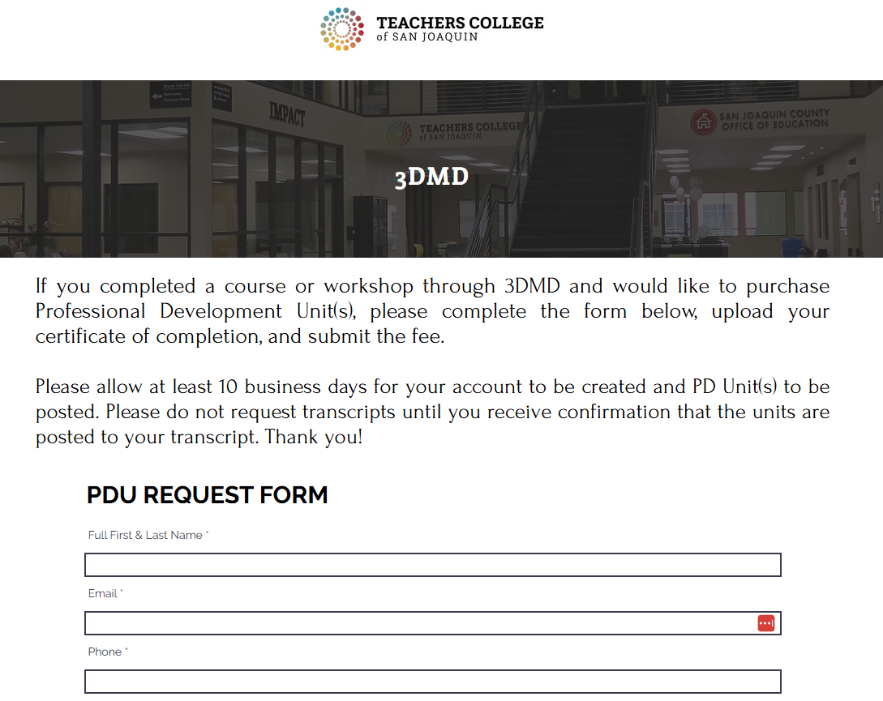
Graduate Credit from the Teachers College of San Joaquin
3 Graduate Credits Available
$95/credit payable to the TCSJ
Additional Assignments: Lesson plan on
incorporating one of the kits into your class(s)
To apply:
Submit your lesson to contactus@3dmoleculardesigns.com to get an updated Certificate of Completion (reflection 45 hours)
Complete form at https://www.forms.teacherscollegesj.edu//3dmd
Pay $285 to TCSJ

Slide 3
Digital Modeling Hub Resources
Search the DMH and explore the resources for a Kit or Model
New Resources
Hemoglobin Mighty Model
Molecules of Life Kit
Cell Modeling Kit
Alpha Helix & Beta Sheets
T4 Bacteriophage Model
Mosaic Membrane Model
Acetylcholinesterase Model
Classic Resources
Water Kit
Amino Acid Starter Kit
Phospholipid & Membrane
Transport Kit
Enzymes in Action Kit

Slide 5
Molecules of Life:
Carbohydrates

Slide 6
From the simple……….. to the sublime!
Start Simple….
………………Deep
….. and then go
…………Deeper
…………Deeper

Slide 7
The Molecules of Life Kit teaches …….
Small Molecules
1.
--- can be joined together to make ---
Macromolecules
Amino Acids Proteins
Carbohydrates Glycogen / Cellulose
Nucleotides DNA / RNA
Phospholipids Membranes
2. Dehydration Synthesis

Slide 8
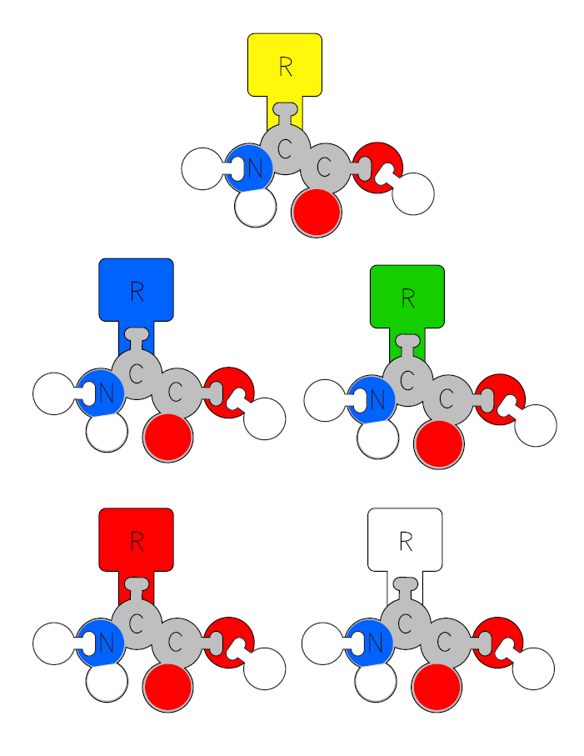
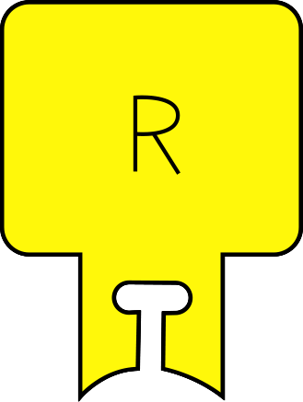
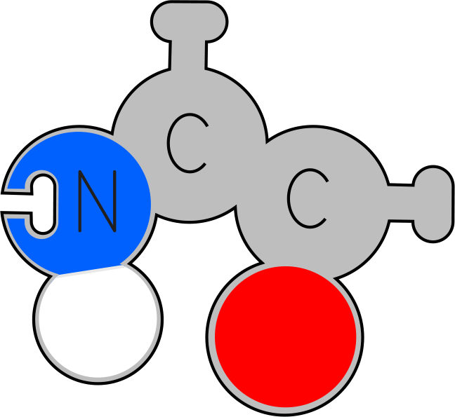
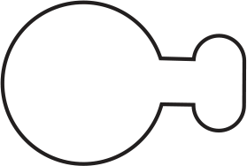

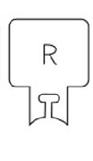
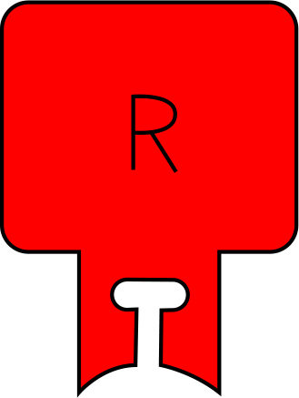
Amino Acids
+
Dehydration Synthesis

Slide 9
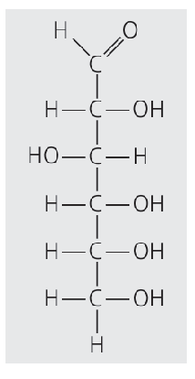
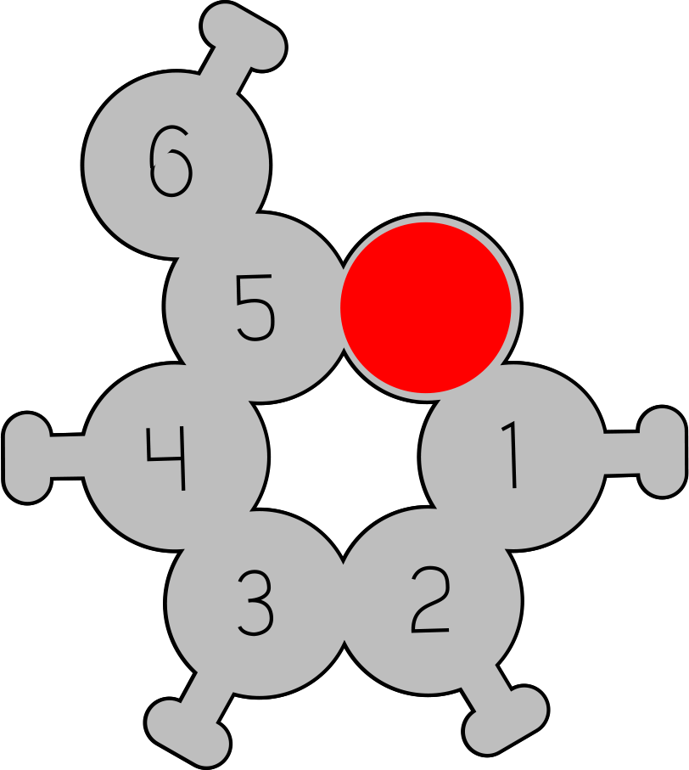
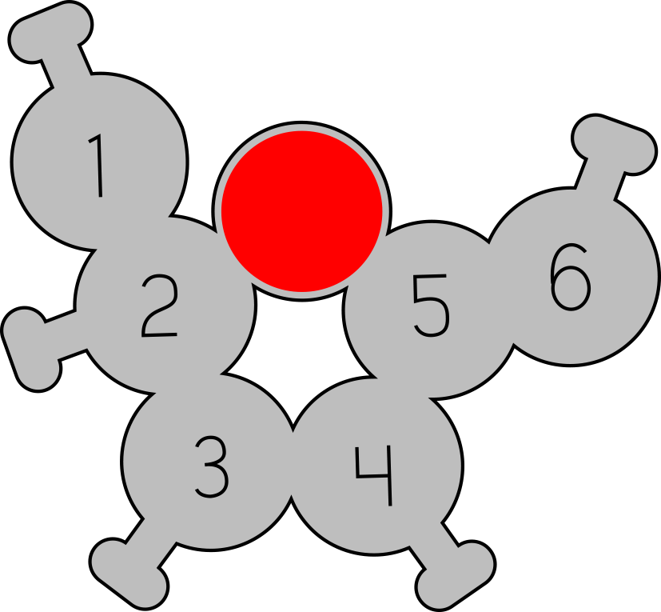
Carbohydrates
Glucose
Fructose

Slide 10
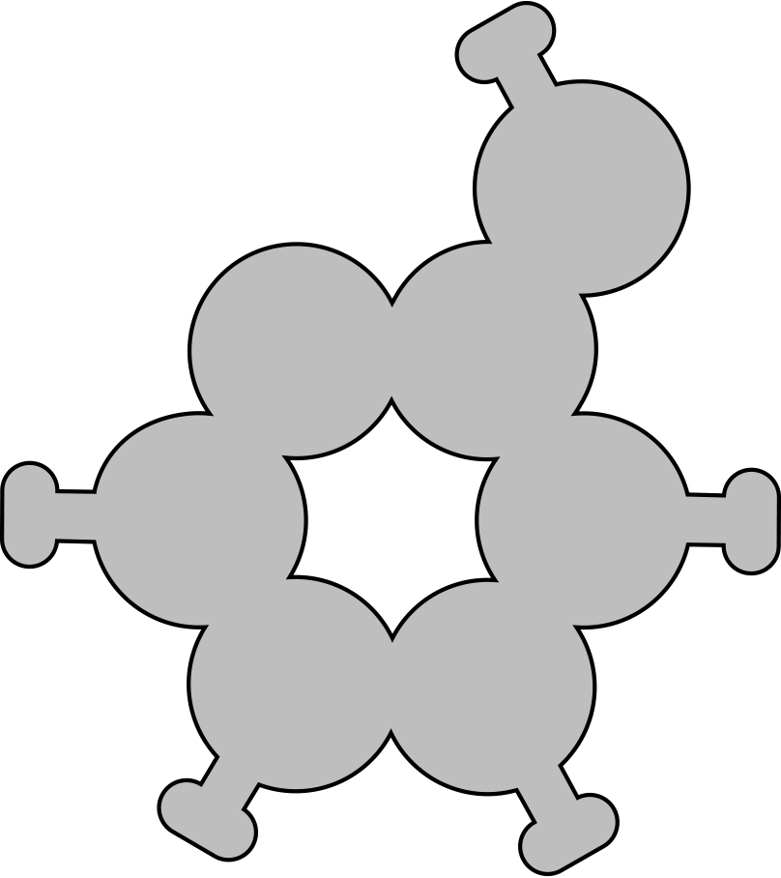
Starch / Glycogen
Cellulose

Slide 11
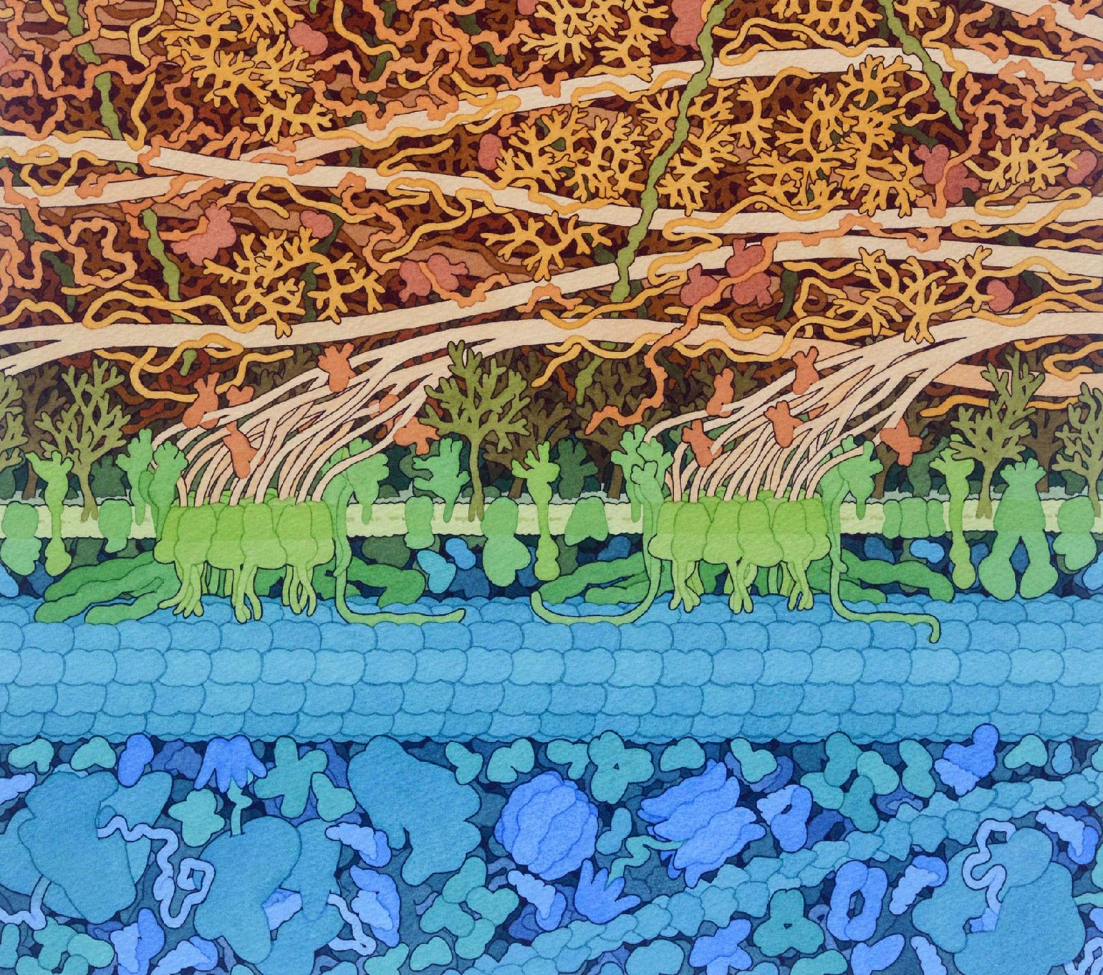
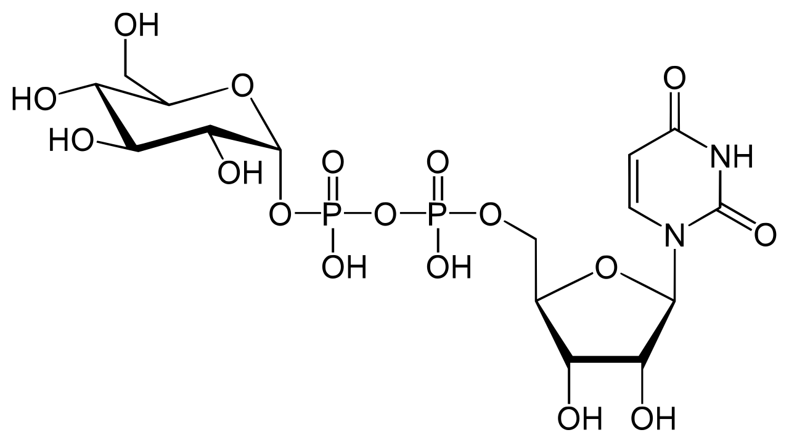
Making cellulose….. with cellulose synthase
glucose
UDP-glucose
https://pdb101.rcsb.org/sci-art/goodsell-gallery/cellulose-synthase

Slide 14
Reflection
All models are wrong, but some models are useful.
How is the model you used similar to the real thing?
How is the model you used different from the real thing?

Slide 15

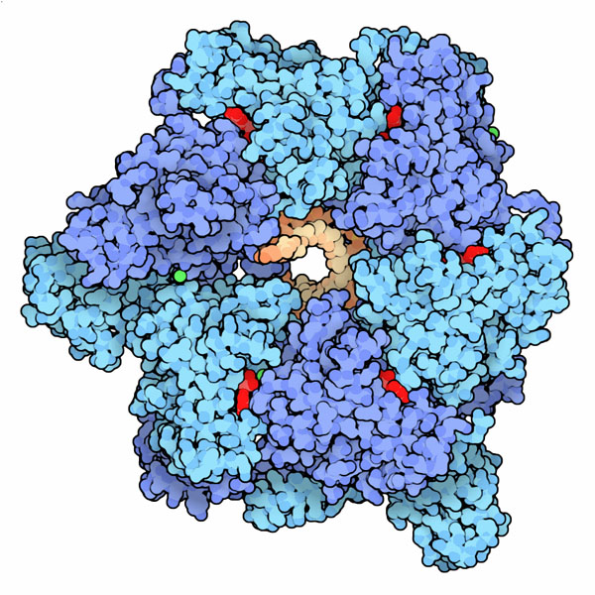
Copy That!
Flow of Genetic Information: Replication
"It has not escaped our notice that the specific pairing we have postulated immediately suggests a possible copying mechanism for the genetic material."
Francis Crick and James Watson
(Molecule of the Month: DNA Helicase)

Slide 16
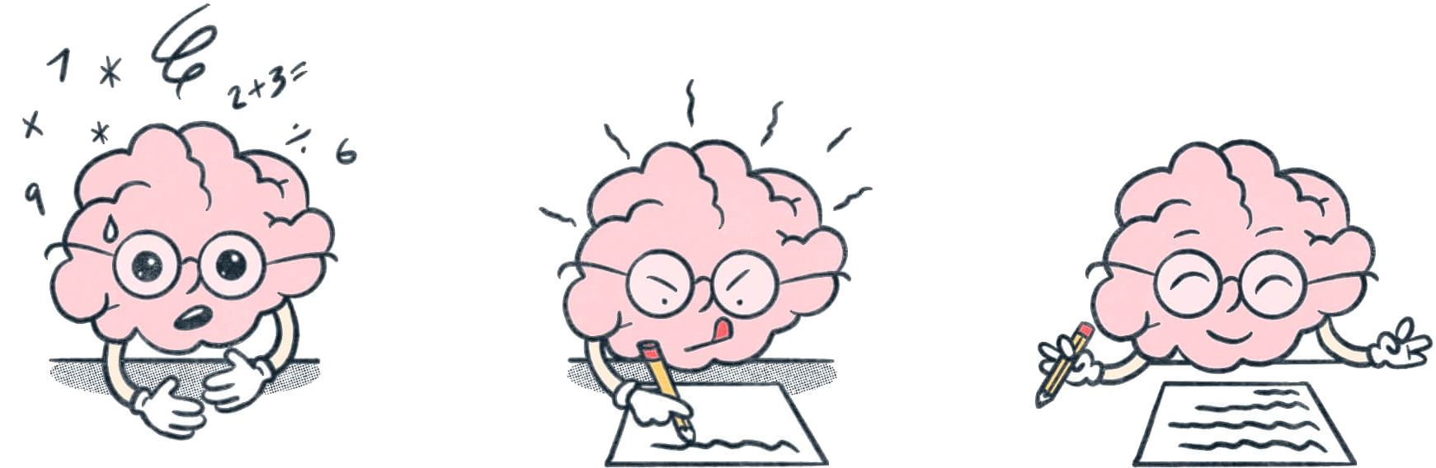
Brain dump…
Things I know this about DNA replication include…
Things I am not sure about or wonder about are...

Slide 17
Why do cells need to copy DNA?

Slide 18
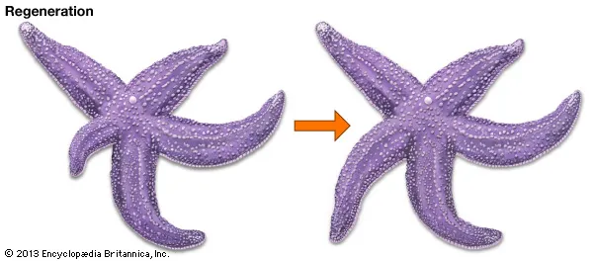
Why do cells need to copy DNA?
Notes:
[~4-5 MINUTES]
TEACHER MOVES:
Begin with the essential question that anchors the entire activity. Project the slide and read the main question aloud: "Before a cell divides, what happens to its genetic information?" Give students 30-60 seconds of quiet thinking time before they write.
Direct students: "Write your prediction in your lab notebook. Complete this sentence starter: 'Each daughter cell needs...'" Circulate as students write, looking for evidence they're thinking about genetic information distribution. After 2 minutes of individual writing, ask students to "Think about" the two follow-up questions. You can have them discuss with a partner (Think-Pair-Share) or use these as whole-class discussion prompts.
Facilitate whole-class discussion:
"What would happen if a cell divided without copying its DNA first?" (Expected: cells would have incomplete information, wouldn't function properly, might die)
"How many complete sets of instructions does each new cell need?" (Expected: one complete set each, so the original cell needs TWO copies before dividing)
[BLOOM'S LEVEL: UNDERSTAND / ANALYZE / PREDICT]
STUDENT MOVES:
Students engage in quiet individual thinking, then write a prediction in their notebooks. They should predict that genetic information must be copied so each daughter cell receives a complete set. Students participate in discussion, connecting cell division to the need for DNA replication. They begin to articulate the purpose of replication: ensuring daughter cells have identical, complete genetic information.
❌ COMMON MISCONCEPTION:
Students might think:
"The DNA splits in half, and each daughter cell gets half" (confusing DNA strands with complete genetic information)
"Cells only need to copy DNA when they're damaged or sick"
"Only some of the DNA needs to be copied, not all of it"
CLARIFICATION:
Emphasize that BOTH daughter cells need a COMPLETE, IDENTICAL copy of ALL the genetic information. If a cell divided without copying DNA first, each daughter would only get half the instructions—like trying to bake a cake with only half a recipe. Neither cell could survive or function properly.
Use the analogy: "If you're building two identical houses, you need two complete sets of blueprints—not one blueprint torn in half."
📦 MODEL/VISUAL REFERENCE:
Point to the visual showing cell division (if available). Emphasize the progression: one parent cell → must copy DNA → two daughter cells, each with complete DNA.
Ask students: "Look at the image. How many complete genomes does the parent cell need to have before it divides?" (Answer: TWO—one for each daughter)
✓ FORMATIVE ASSESSMENT (Quick Check):
Ask: "Why must DNA be copied BEFORE cell division, not during or after?"
Listen for:
Understanding that timing matters (both daughters need DNA immediately)
Recognition that each daughter cell needs a complete, functional set
Connection to growth, repair, and reproduction at the organism level
→ If students understand → Move forward to Slide 7
→ If students struggle → Reteach: Use a concrete analogy: "Imagine you're a cell that helps heal a cut on your skin. Your job is to divide to make new skin cells. If you divided without copying your DNA first, your daughter cells would be incomplete and couldn't do their jobs. The cut wouldn't heal. This is why EVERY cell division requires DNA replication first."
🔗 CONNECTIONS:
Prior knowledge: Cell division, growth and repair, inheritance
Looking ahead: This sets up WHY replication matters before exploring HOW it works
NGSS: HS-LS1-4 (feedback mechanisms maintain homeostasis—cell division requires completed replication first)
DIFFERENTIATION NOTES:
For struggling students: Provide sentence frames: "Each daughter cell needs ___ because ___. If DNA wasn't copied first, then ___."
For advanced students: Ask: "How does this connect to cancer? What happens when cells divide without properly copying or checking their DNA?"
For ELL students: Pre-teach vocabulary: daughter cell, genetic information, complete set, instructions
ADDITIONAL NOTES:
This slide establishes the PURPOSE before diving into the mechanism. Students need to understand WHY replication is essential before they'll be motivated to learn HOW it works. If time allows, you can also connect to real-world contexts: growth (baby → adult requires trillions of cell divisions), wound healing (skin cells dividing to close a cut), or reproduction (passing DNA to offspring).

Slide 19
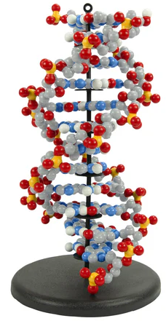
DNA Structure
What do you already know about DNA structure?
Share with your partner:
  One structural feature of DNA you remember
  One way you think DNA's structure might make replication possible
  One question you have about how replication works
Be ready to share with the class
Notes:
[~3-4 MINUTES]
TEACHER MOVES:
This is a prior knowledge activation slide that helps you assess what students remember and builds a collaborative classroom culture.
Direct students: "Turn to your partner. You have 2 minutes to share two things with each other: (1) One thing you already know about DNA, and (2) One question you have about how DNA works."
Circulate and listen to partner conversations. Take note of:
Accurate prior knowledge you can build on (e.g., "DNA is a double helix," "DNA is in the nucleus," "DNA has instructions")
Misconceptions you need to address (e.g., "DNA is only in blood," "All DNA is the same")
Common questions that this activity will answer
After 2 minutes, bring the class together: "Let's hear a few examples. Who wants to share something their partner said they already know about DNA?" Call on 3-4 students.
Then: "Now let's hear some questions. What are you curious about?" Call on 3-4 students. Affirm their curiosity: "Great question! We'll explore that today as we model DNA replication."
[BLOOM'S LEVEL: REMEMBER / UNDERSTAND]
STUDENT MOVES:
Students activate prior knowledge about DNA structure and function. They verbalize what they remember to a peer, which helps consolidate memory. They ask authentic questions, demonstrating curiosity and identifying gaps in their understanding. Students practice speaking and listening skills in a low-stakes environment before sharing with the whole class.
❌ COMMON MISCONCEPTION:
Students might think:
"DNA is only in certain parts of the body (like blood or saliva)"
"DNA and genes are completely different things"
"DNA is the same in all organisms"
"DNA never changes"
CLARIFICATION:
Affirm accurate knowledge students share. For misconceptions, gently correct:
"DNA is in the nucleus of EVERY cell in your body (except red blood cells, which lose their nucleus)"
"Genes are segments of DNA—DNA is like a cookbook, and genes are the individual recipes"
"All living things have DNA, but the SEQUENCE is different—that's what makes you different from a tree or a bacterium"
"DNA can change through mutations, and we'll explore that concept later"
📦 MODEL/VISUAL REFERENCE:
If you have a Tour of a Human Cell poster, E. coli Poster or DNA model available, point to it:
"Here's where DNA is located—in the nucleus"
"This double helix structure is what we'll be building with our models today"
✓ FORMATIVE ASSESSMENT (Quick Check):
Ask: "What's one thing almost everyone in the room said they know about DNA?"
Listen for:
Common accurate knowledge (double helix, carries instructions, made of nucleotides, A-T-G-C bases)
Gaps in understanding you need to address
Ask: "What's a question several people have?"
Listen for:
Questions this activity will answer (How does DNA copy itself? How does DNA make proteins? What happens if DNA makes a mistake?)
Questions to address later or redirect
→ If students demonstrate solid prior knowledge → Move forward confidently
→ If students have major gaps → Consider briefly reviewing DNA structure basics (5 minutes) before proceeding, OR address gaps as they come up during modeling
🔗 CONNECTIONS:
Prior learning: This assesses what students remember from earlier DNA structure lessons
Looking ahead: Their questions give you insight into what they're curious about—you can reference these questions later ("Remember when we asked how DNA copies itself? Now we're seeing it!")
NGSS: Science and Engineering Practice 1 (Asking questions)
DIFFERENTIATION NOTES:
For shy/anxious students: Let them know they can share what their PARTNER said rather than their own ideas (reduces pressure)
For advanced students: Encourage deeper questions: "How does DNA relate to inheritance? Evolution? Disease?"
For struggling students: Provide sentence frames: "I know that DNA ___. I wonder ___."
For ELL students: Allow use of drawings or diagrams if verbal explanation is difficult
ADDITIONAL NOTES:
Why this slide matters: Starting with prior knowledge:
Validates students' existing understanding (they're not starting from zero)
Reveals misconceptions you can address proactively
Builds community through partner sharing
Increases engagement by honoring student questions
Time management tip: If you're pressed for time, you can skip whole-class sharing and just do partner conversations. You'll still get the benefits of activation without the 2-3 minutes of whole-class discussion.
Equity consideration: Be mindful that students come with varied prior experiences. Some may have had rich DNA instruction in earlier grades; others may have significant gaps. Affirm ALL contributions and frame questions as "curious wondering" rather than "not knowing."

Slide 20
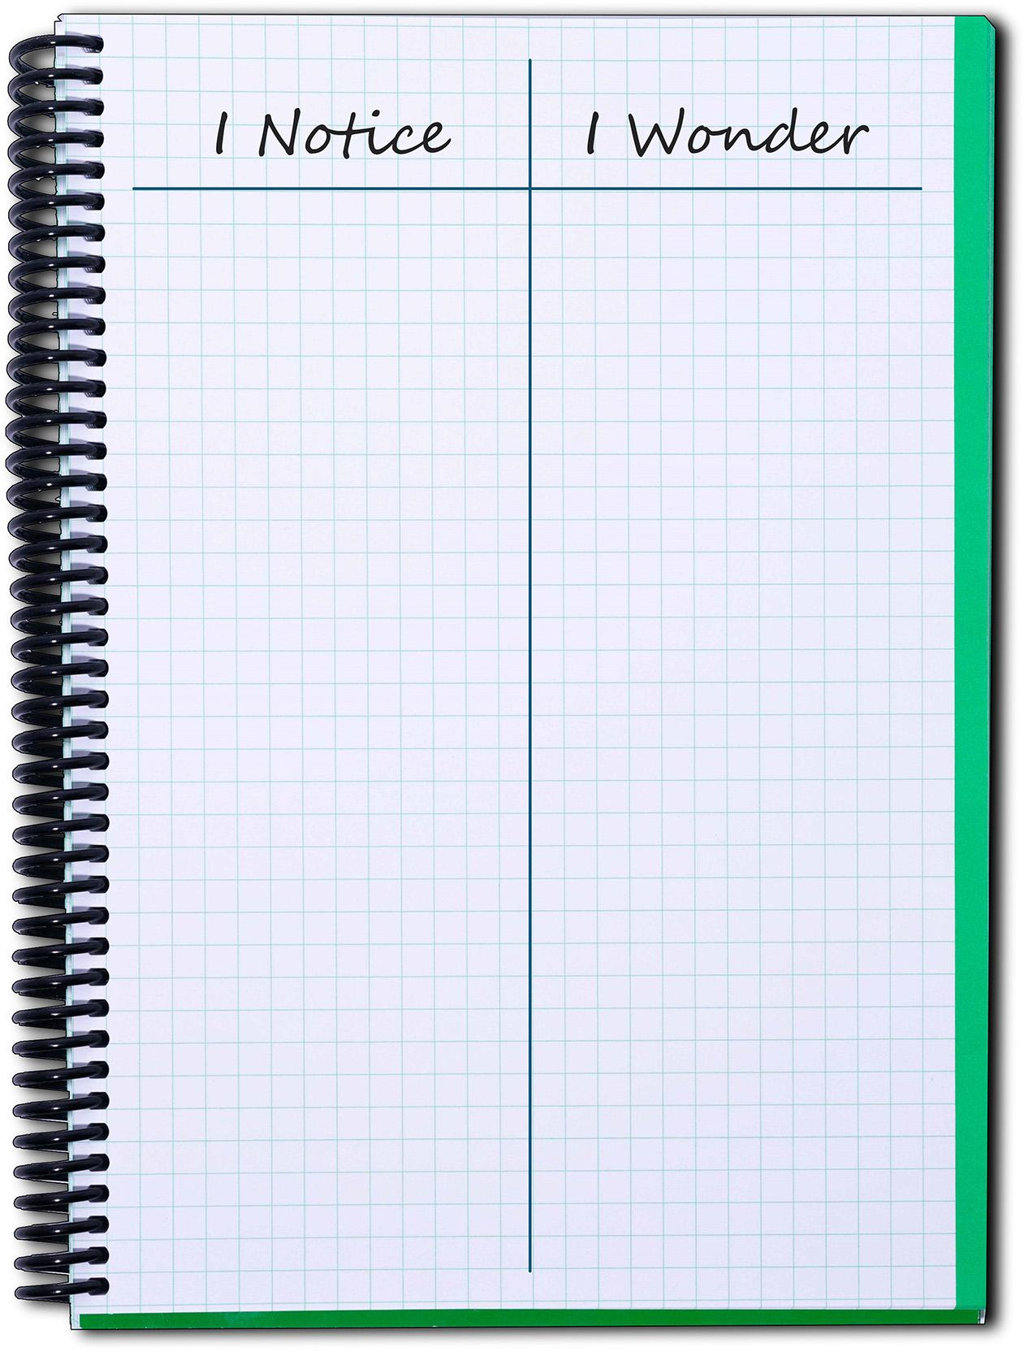
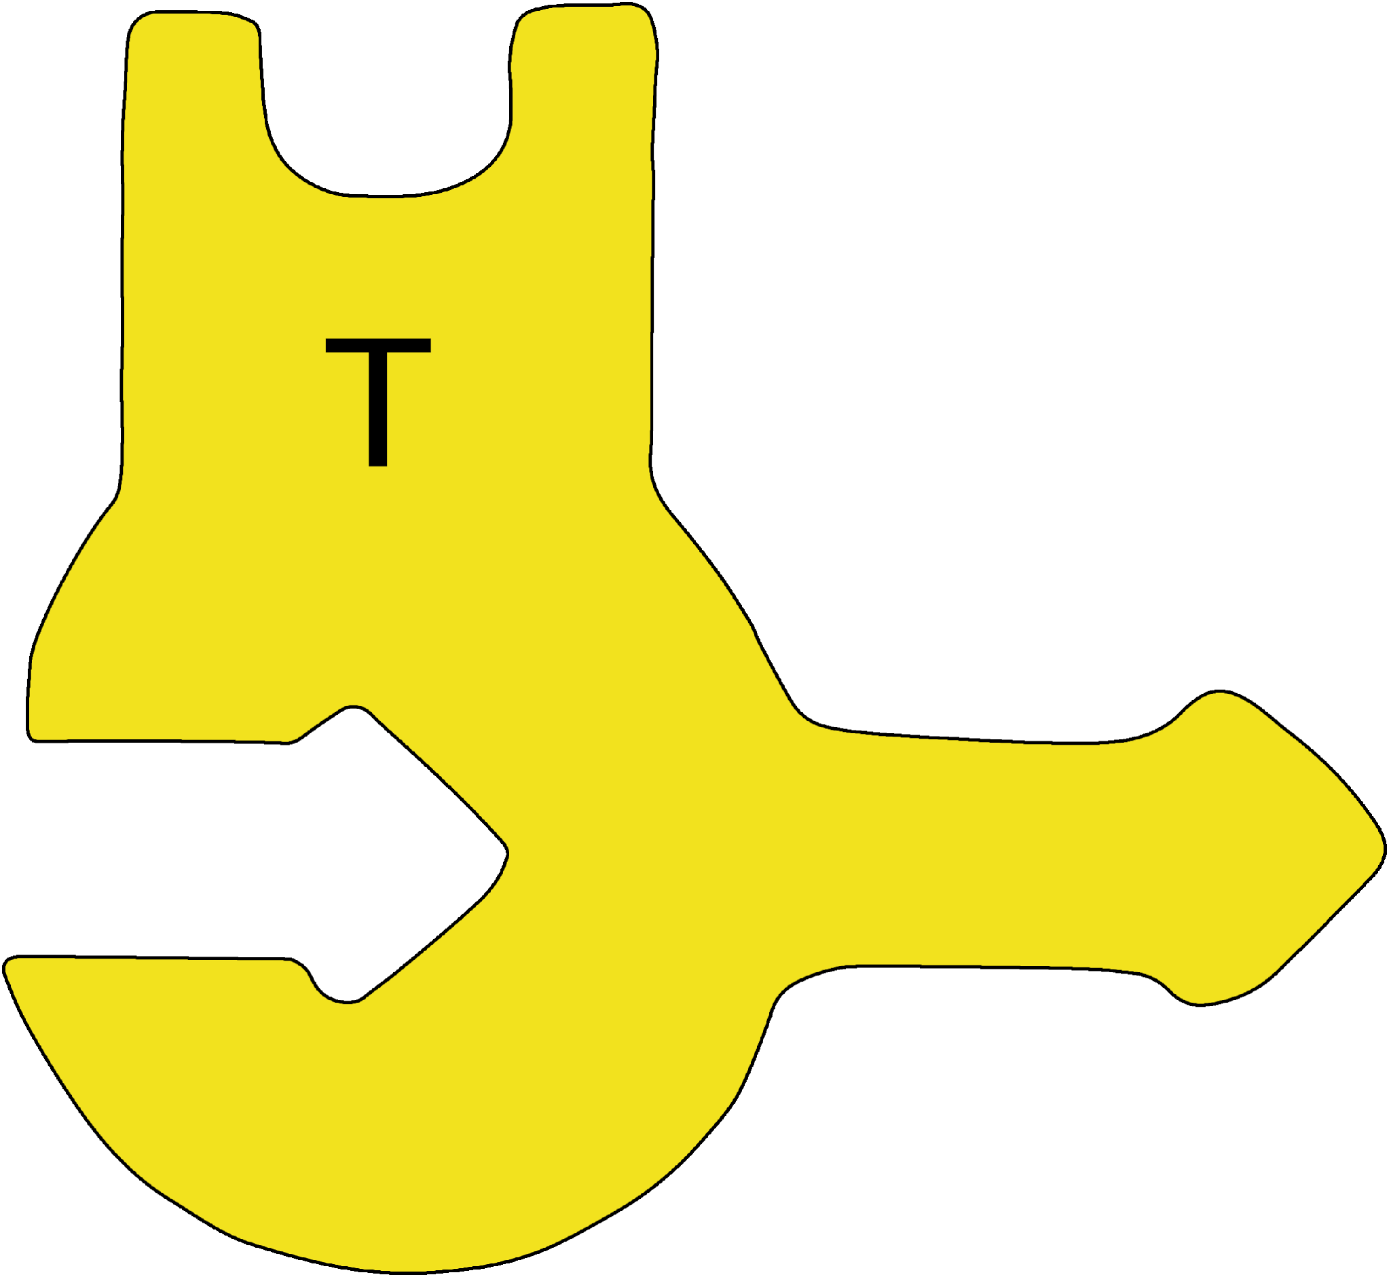
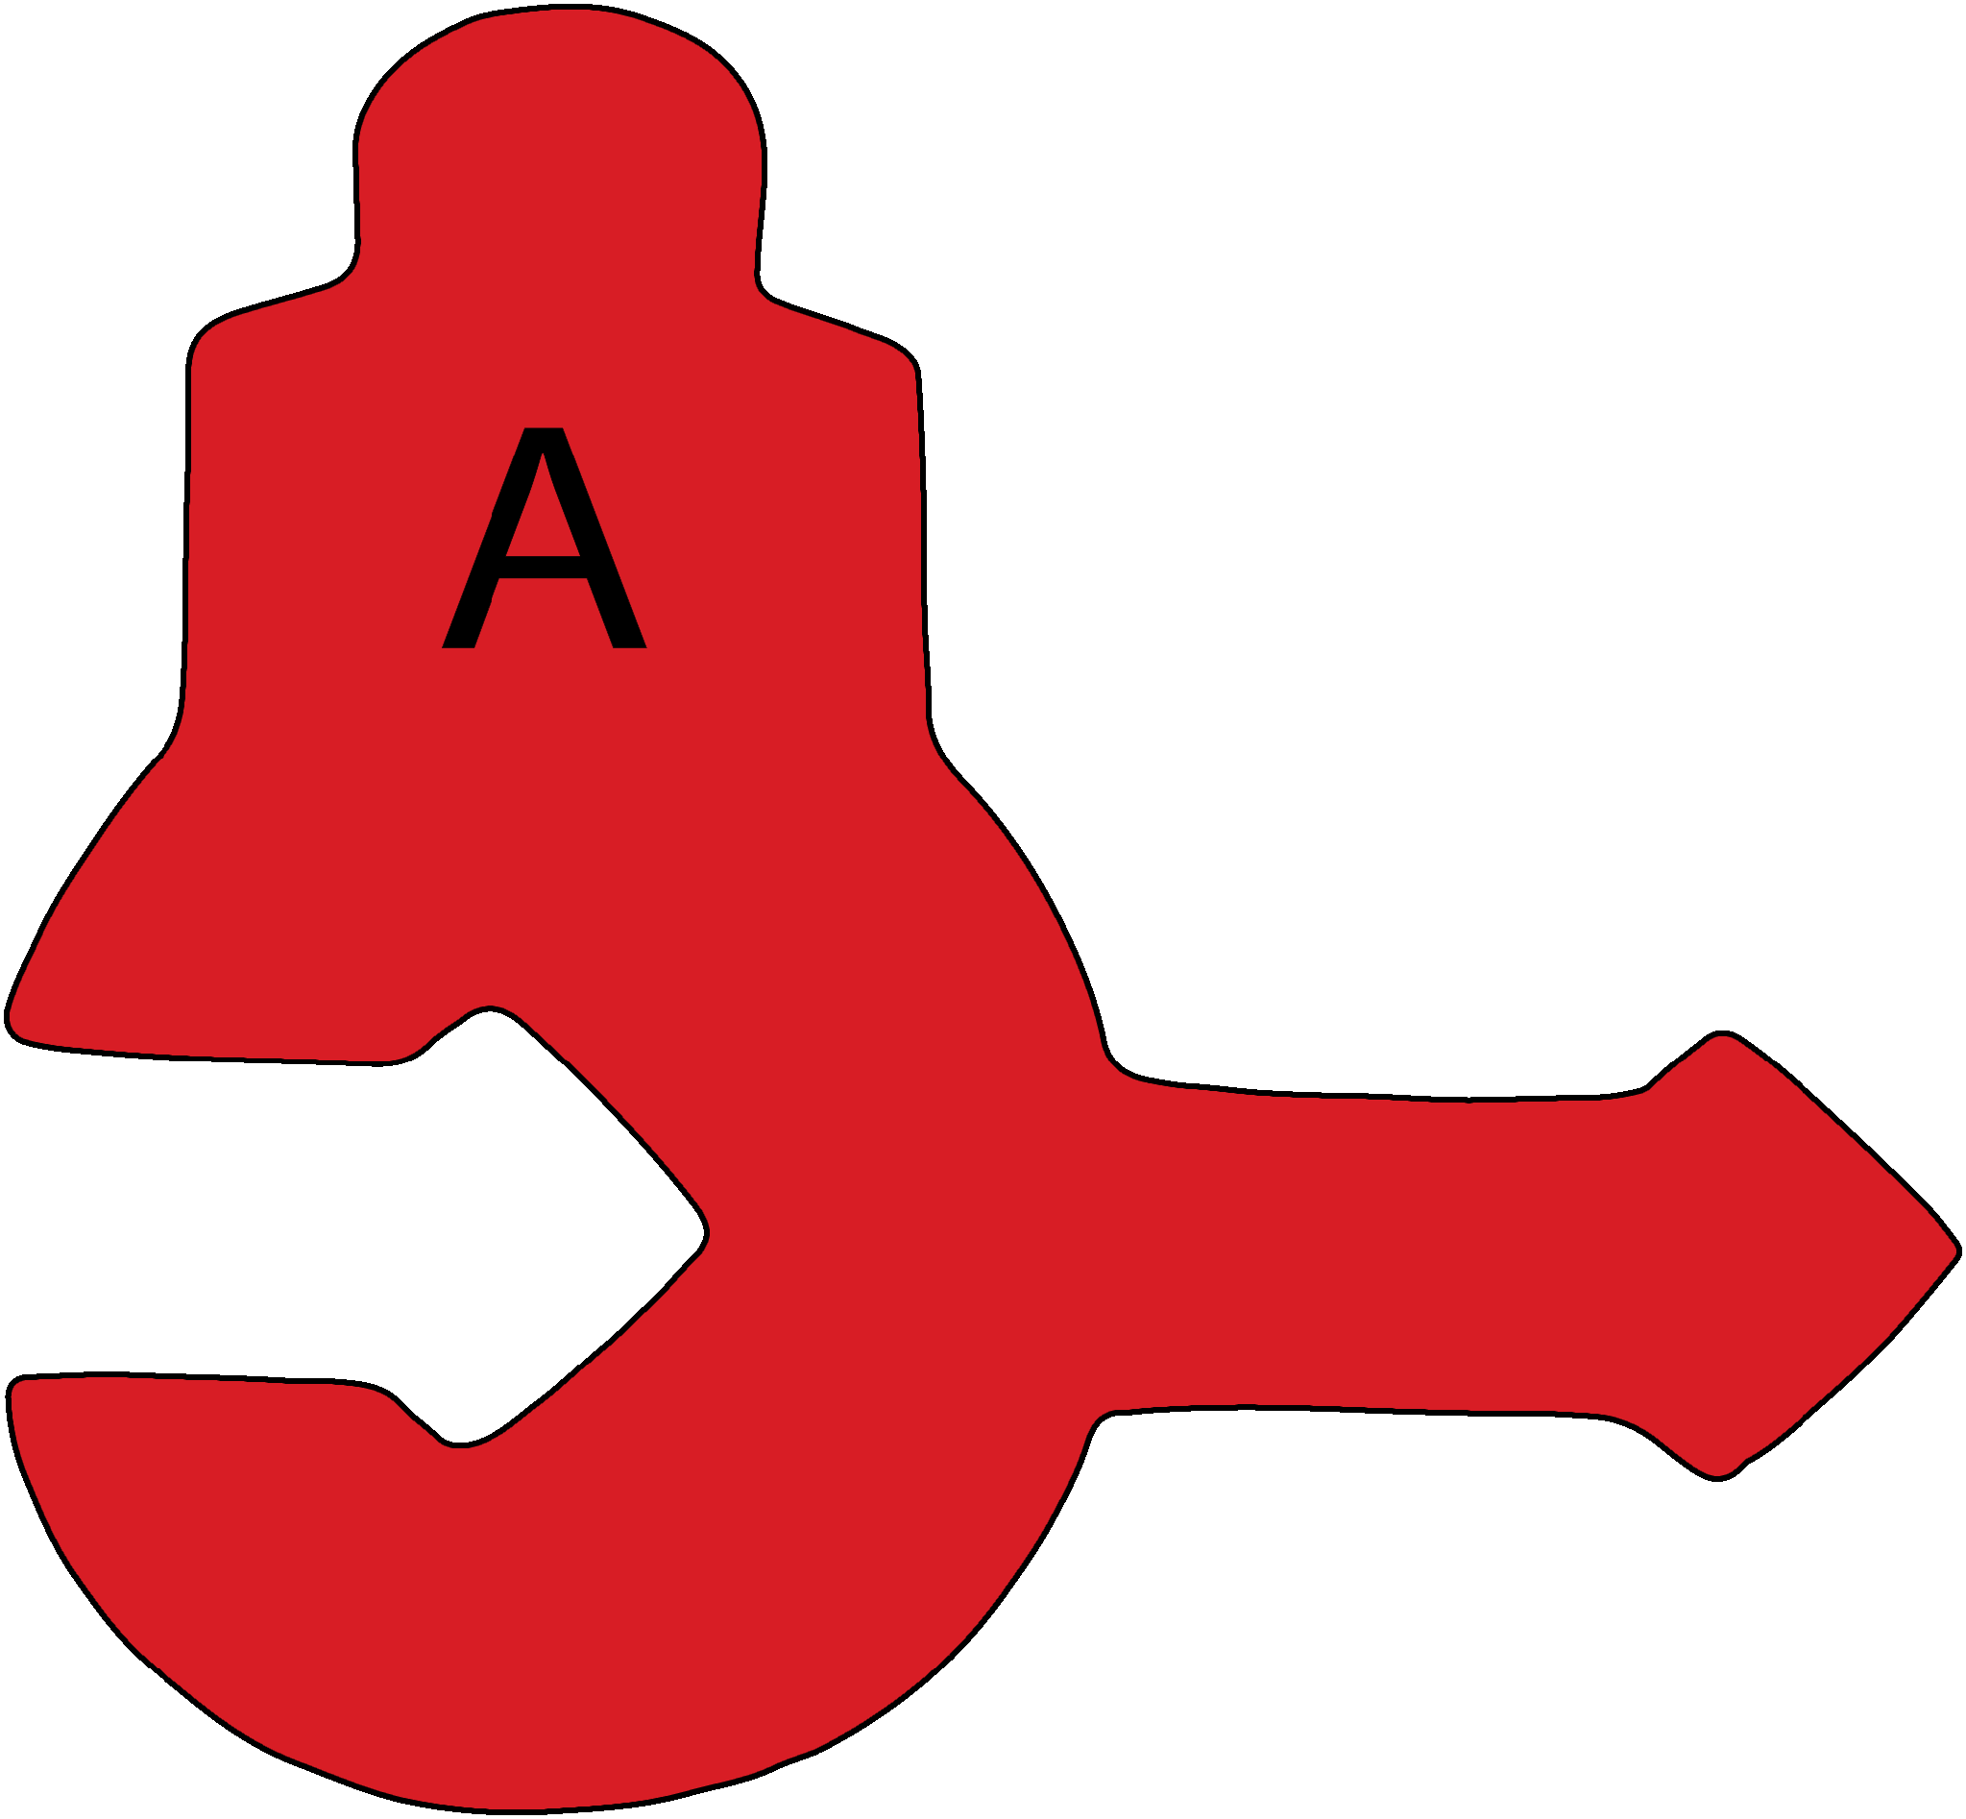
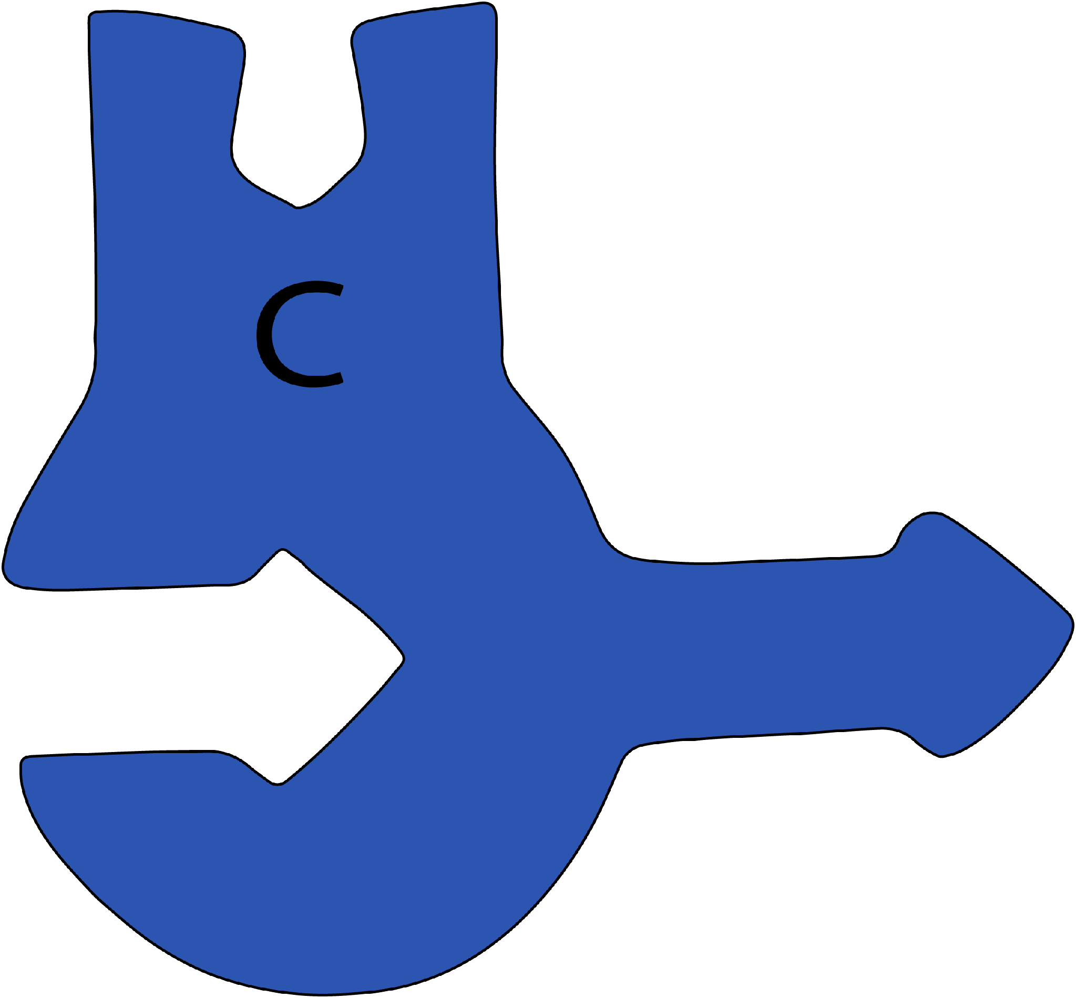
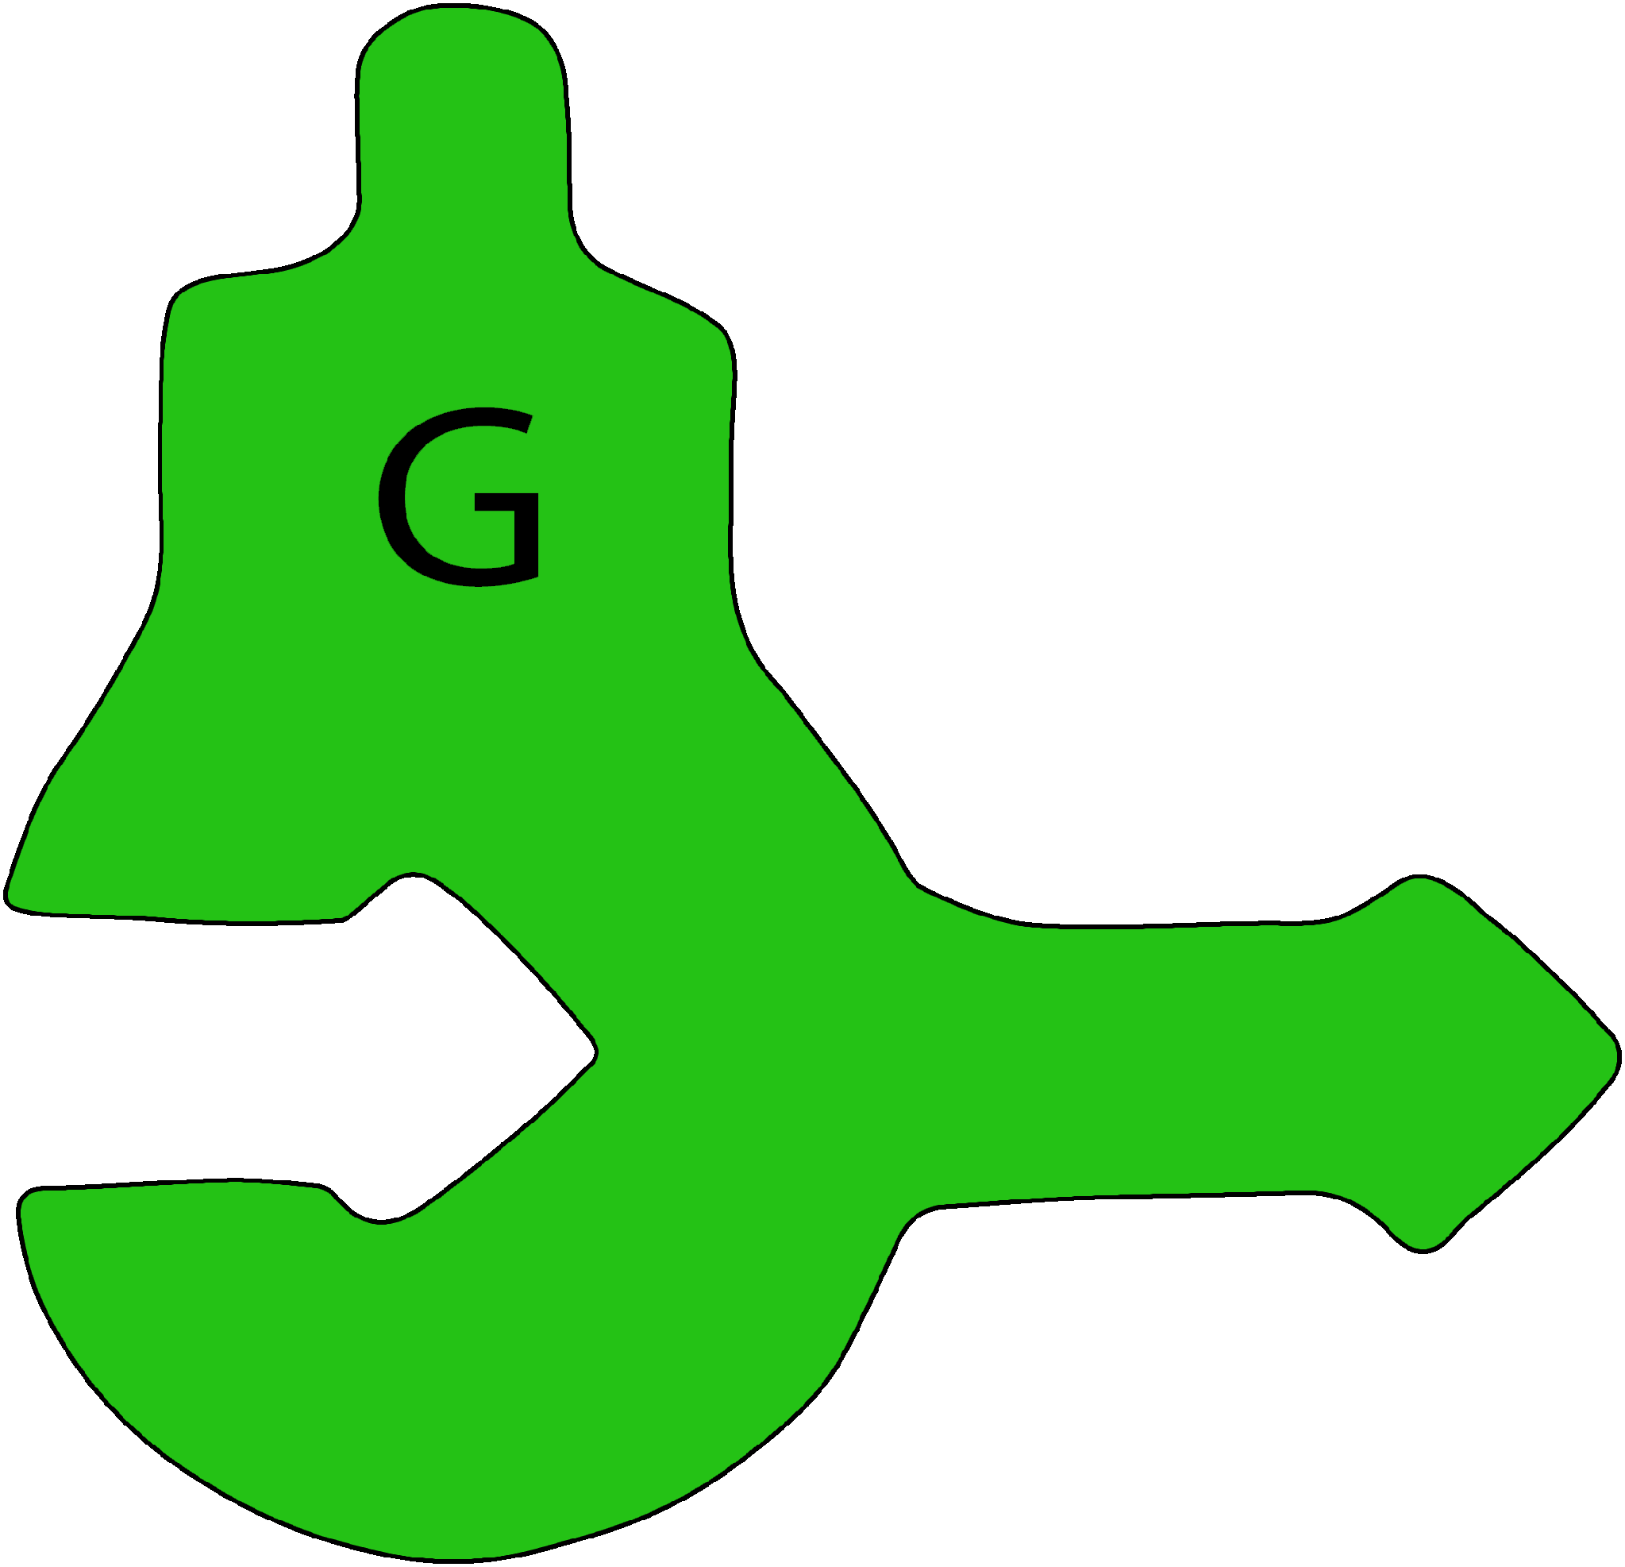
DNA Nucleotides
Examine your nucleotide models.
Create a Notice-Wonder T-chart in your notebook and record:
3 things you notice
2 things you are curious about
Notes:
[~5-7 MINUTES]
TEACHER MOVES:
This is the FIRST hands-on modeling moment—students transition from abstract discussion to concrete, tactile exploration.
"Setup (1 minute): Before showing the slide, distribute four foam pieces to each group (one red, one yellow, one green, one blue). As you distribute, say: 'Don't build anything yet—just observe!' Avoid labeling the pieces as A, T, G, C at this stage—let students notice the letters imprinted on each piece during their observation.“
Project the slide and give instructions:
"Examine your models. You have four different colored pieces in front of you. Your job right now is NOT to build—just to observe carefully."
"Create a Notice/Wonder chart in your notebook. Draw a T-chart with 'NOTICE' on the left and 'WONDER' on the right."
"Record at least 3 things you NOTICE about these pieces—what do you observe about colors, shapes, how they might fit together?"
"Then record at least 2 things you WONDER—what are you curious about?"
Circulate (4-5 minutes) while students work:
Listen for observations about physical features:
'There are letters on the tops' (students discovering the imprinted letters)
'The middle part looks like an arrow pointing one way' (discovering directionality)
'The bottom has a hole that looks like it could connect to the arrow' (discovering backbone connection)
'The sides have different shapes' (discovering complementary shapes for base pairing)
Do not confirm or name these parts yet—just validate: 'Good observation! Write that down. What else do you notice about those shapes?'"
Listen for emerging questions:
✅ "Why are there four different pieces?"
✅ "Do certain colors go together?"
✅ "What do the arrows mean?"
✅ "Why don't all the pieces fit together?"
Avoid answering questions yet—validate them instead: "Great question! Hold onto that—we'll explore it."
Whole-class share (2 minutes):
"What's something you noticed?" (Call on 3-4 students)
"What's something you're wondering?" (Call on 3-4 students)
Chart 2-3 common observations and questions on the board if time allows.
[BLOOM'S LEVEL: OBSERVE / ANALYZE]
STUDENT MOVES:
Students physically handle foam nucleotide models, examining them visually and tactilely. They practice scientific observation skills, distinguishing between objective observations (NOTICE) and questions/hypotheses (WONDER). They record observations in their notebooks using a structured T-chart format. Students begin to recognize patterns (certain pieces fit together, arrows show direction, colors/shapes vary) without explicit instruction, engaging in discovery-based learning.
❌ COMMON MISCONCEPTION:
Students might think:
"All four pieces should fit together in a chain" (not yet recognizing complementary base pairing)
"The arrows don't matter" (not yet understanding 5'→3' directionality)
"Colors are just for decoration" (not recognizing they represent different nucleotides)
CLARIFICATION:
At this stage, DO NOT correct misconceptions yet. This is a discovery phase. Students need time to observe before you explain. Their misconceptions will be addressed naturally in the next few slides as they explore how pieces fit together.
However, if a student makes a dangerously incorrect statement (e.g., "These models are wrong because they don't match real DNA"), gently redirect: "These are simplified models to help us understand the key features of DNA. Real DNA molecules are much smaller and more complex, but these models show us the important patterns."
📦 MODEL/VISUAL REFERENCE:
Point to the foam models on desks: "These are physical representations of the four DNA nucleotides. What patterns do you notice about their structure?”
Key observation to highlight without explaining: 'Notice that each piece has multiple parts—a colored section, a middle section, and a bottom section. You'll discover what each part does as we explore.’
✓ FORMATIVE ASSESSMENT (Quick Check):
Look for:
Are students actively handling and examining the models?
Are they recording multiple observations (not just 1-2)?
Are their observations specific and detailed (not vague like "they're colorful")?
Ask a few students individually:
"Show me one thing you noticed about your models."
"Point to a part of the model you're curious about."
If whole class is stuck or making surface-level observations, prompt:
"Look closely at the SIDES of the pieces. What shapes do you see?"
"Try holding two pieces next to each other. Do they look like they'd fit together?"
"Look at the arrows. Do they all point the same way?"
→ If students are engaged and recording thoughtful observations → Move forward
→ If students are rushed or superficial → Slow down: "Take another minute. I want to see at least 3 SPECIFIC observations—not just 'they're different colors' but HOW they're different."
🔗 CONNECTIONS:
Science practice: This is authentic scientific observation—the foundation of inquiry
Looking ahead: These observations will become explanations (arrows = directionality, shape = base pairing rules, colors = different nucleotides)
NGSS: Science and Engineering Practice 2 (Developing and using models), Practice 8 (Obtaining, evaluating, and communicating information)
DIFFERENTIATION NOTES:
For visual learners: This slide is already ideal—hands-on, colorful, tactile
For struggling students: Provide observation prompts: "I notice the colors are... I notice the shapes are... I notice the arrows..."
For advanced students: Push for deeper observations: "What patterns do you see? What might the different shapes tell us about function?"
For students with fine motor challenges: Ensure they can handle the foam pieces comfortably; provide larger pieces if available
For ELL students: Pre-teach "observe," "notice," "wonder," "pattern," "shape"
ADDITIONAL NOTES:
Why Notice & Wonder?
This instructional routine (from the Modeling Instruction pedagogy) has multiple benefits:
Low-risk entry point - All observations are valid; no "wrong answers"
Student-centered - Students generate their own questions rather than answering yours
Builds curiosity - Questions drive engagement through the rest of the activity
Formative assessment - Reveals what students already understand and what confuses them
Common teacher mistakes to avoid:
❌ Jumping in too quickly to explain ("That's the phosphate group!")
❌ Dismissing "wrong" observations ("No, that's not important")
❌ Answering their "wonder" questions immediately (let the questions drive exploration)
If you have the 3DMD AR EDU app available:
You can mention it here: "Later, you'll have the option to use augmented reality to see these nucleotides at the molecular level. But for now, let's work with these physical models to understand the big patterns."
Photo opportunity:
If you want to document student learning, take photos of students' Notice/Wonder charts or students examining models. These are great for showcasing inquiry-based learning.

Slide 21
How do Nucleotides fit together?
Explore how nucleotide pieces connect.
Can you connect two pieces together? How?
Which pieces fit with which other pieces?
Do they connect at the top? The side? Both?
Can you build a chain?
Notes:
[~6-8 MINUTES]
TEACHER MOVES:
This slide transitions from observation to exploration—students now actively test their hypotheses about how the pieces connect.
Give exploration instructions:
"Now it's time to explore HOW these pieces fit together. You're going to test different combinations and discover the rules."
Read the four guiding questions aloud (or have students read them):
"Can you connect two pieces together? How?"
"Which pieces fit with which other pieces?"
"Do they connect at the top? The bottom? Both?"
"Can you build a chain?"
"Work with your group. Try different combinations. Test your ideas. You have about 5 minutes."
"Circulate and facilitate (5-6 minutes): As you move around the room, use guiding questions that prompt investigation rather than direct instruction:
If students are randomly trying combinations: 'Try connecting those two pieces. Does it feel secure? What happens if you try a different partner for that same piece?'
If students try to force incompatible pieces: 'Does that connection feel natural, or are you having to force it? What does that tell you?'
If students discover certain pairs fit easily: 'Interesting! Which other piece does that one partner with? Can you find a pattern?'
If students only try side-by-side connections: 'You found one way to connect. Are there other parts of the pieces that might connect differently? Explore all the surfaces.'
If students discover arrow-to-hole connection: 'What happens when you connect several pieces that way? What are you building?'
DO NOT tell them:
Which colors pair together
That A pairs with T and G pairs with C
That the arrow is the sugar and the hole is the phosphate
That one connection type is 'base pairing' and the other is 'backbone'
Let them discover through trial and error. Your role is to prompt continued exploration, not to provide answers."
Whole-class discussion (2 minutes):
Bring the class together: 'What did you discover?' Use collective sensemaking—chart student discoveries without labeling them yet:
Ask: 'Which pieces fit together?' Chart student responses (e.g., 'red with yellow, green with blue').
Ask: 'Did you find any combinations that DON'T work?' Chart these too.
Ask: 'Did you find different WAYS to connect pieces?' Listen for two types of connections emerging.
Ask: 'Can anyone show us how you built a chain?' Have a student demonstrate at the front.
At this stage, name the pattern but don't over-explain: 'You've discovered something really important—certain pieces pair together consistently, and there's a way to build chains. Scientists call these patterns complementary base pairing and the backbone structure. We'll explore why these patterns matter as we keep building.'"
[BLOOM'S LEVEL: APPLY / ANALYZE / DISCOVER]
STUDENT MOVES:
Students actively manipulate foam models, testing different combinations through trial and error. They discover through hands-on exploration (not teacher explanation) that certain pieces fit together while others don't. They identify two types of connections: (1) base pairing (sides connect A-T and G-C), and (2) backbone formation (arrows connect end-to-end). Students build evidence-based conclusions: "A always pairs with T because they fit together perfectly." They practice collaborative problem-solving, discussing findings with group members.
❌ COMMON MISCONCEPTION:
Students might think:
"All pieces should connect to all other pieces" (not recognizing specific pairing rules)
"The colors are random" (not connecting color to specific nucleotide identity)
"You can force pieces together even if they don't fit well" (not recognizing that complementary base pairing is structurally determined)
"The chain can be built in any direction" (not yet understanding 5'→3' directionality)
CLARIFICATION:
As students discover that certain combinations DON'T work, affirm: "You're right—A and G don't fit together. That's not a problem with your model; that's showing you the real rule in DNA. The shapes are specifically designed so that A ONLY pairs with T, and G ONLY pairs with C."
If students try to force incompatible pieces together: "Does that feel secure? In real DNA, the base pairs need to fit perfectly to hold the double helix together. Try a different combination that clicks more easily."
If students connect the wrong parts (trying to pair bases to backbone): "You're trying to connect the colored part to the arrow. Instead, try connecting the SIDES—where the puzzle-piece shapes are."
📦 MODEL/VISUAL REFERENCE:
Point to the slide images showing individual nucleotides: "These are your four pieces. Notice each has a unique shape on the side."
Walk around and point to student models:
"Show me two pieces that fit together... Now try a different combination. Do they fit?"
Key demonstration (if needed): Hold up two pieces (e.g., A and T) and show how they connect at the sides. Then try A and C to show they DON'T fit. "See the difference? One clicks together nicely, the other doesn't fit at all."
For backbone: Hold up two nucleotides and connect arrow-to-arrow: "This is how you build a chain—the arrows connect end-to-end. This forms the sugar-phosphate backbone of DNA."
✓ FORMATIVE ASSESSMENT (Quick Check):
Circulate and ask individual groups:
"Show me two pieces that fit together. Why do you think they fit?"
"Can you make A pair with G?" (They should say no and demonstrate why)
"How do you connect pieces to make a chain?" (They should show backbone connection)
Red flags to watch for:
❌ Students randomly snapping pieces together without testing fit
❌ Students frustrated because they can't get "wrong" pairs to work
❌ Students only connecting backbone, not discovering base pairing
❌ Groups not collaborating or taking turns
If you see red flags:
Pause and redirect: "I notice some groups are getting frustrated. Remember, if two pieces don't fit easily, that's giving you information! Try a different combination."
Model think-aloud: "I'm going to try connecting A and C... hmm, they don't fit. Now I'll try A and T... ah! These fit perfectly. What does that tell me?"
→ If most students discover A-T and G-C pairing → Move forward
→ If students are struggling → Give a hint: "Try connecting the yellow piece to different partners. Which one fits best?" Then let them generalize the pattern.
🔗 CONNECTIONS:
Chemistry: Shape complementarity (structure determines function)
Prior knowledge: Puzzle pieces fitting together (students understand this from early childhood)
Looking ahead: Base pairing rules ensure accurate replication (next slides)
NGSS: Crosscutting Concept 6 (Structure and Function)
DIFFERENTIATION NOTES:
For struggling students: Provide a hint card: "Try these combinations: A+T, G+C, A+G, T+C. Which ones work?"
For advanced students: Ask: "Why do you think only certain pairs work? What might be special about the shapes?"
For kinesthetic learners: This slide is perfect—hands-on, movement, tactile feedback
For students who discover the pattern quickly: Challenge: "Can you build a chain that's 6 nucleotides long? Can you build TWO chains that fit together?"
ADDITIONAL NOTES:
Why exploration before explanation?
Research in science education shows that students retain concepts better when they DISCOVER patterns before being told the "rule." This is the core of modeling instruction pedagogy:
Students experience the phenomenon
Students generate the pattern
Teacher names and formalizes the concept
Timing note: This slide often takes longer than expected because discovery is messy! Some groups will figure it out quickly; others will need more time. Plan for 6-8 minutes, but be flexible.
What if students can't figure it out?
If after 5-6 minutes groups are still struggling, it's okay to provide scaffolding:
"I'm noticing that every group who connected the yellow piece (T) used it with the red piece (A). What does that pattern tell us?"
Show one example (A-T), then ask them to find the other pair (G-C)
Management tip: Foam pieces can be distracting. Set a clear expectation: "When I say 'eyes up,' that means put the pieces down gently on the table and look at me." Practice this once before starting exploration.
Extension for fast finishers: "Can you build a double strand? Try making two chains and connecting them with base pairs along the whole length."

Slide 22
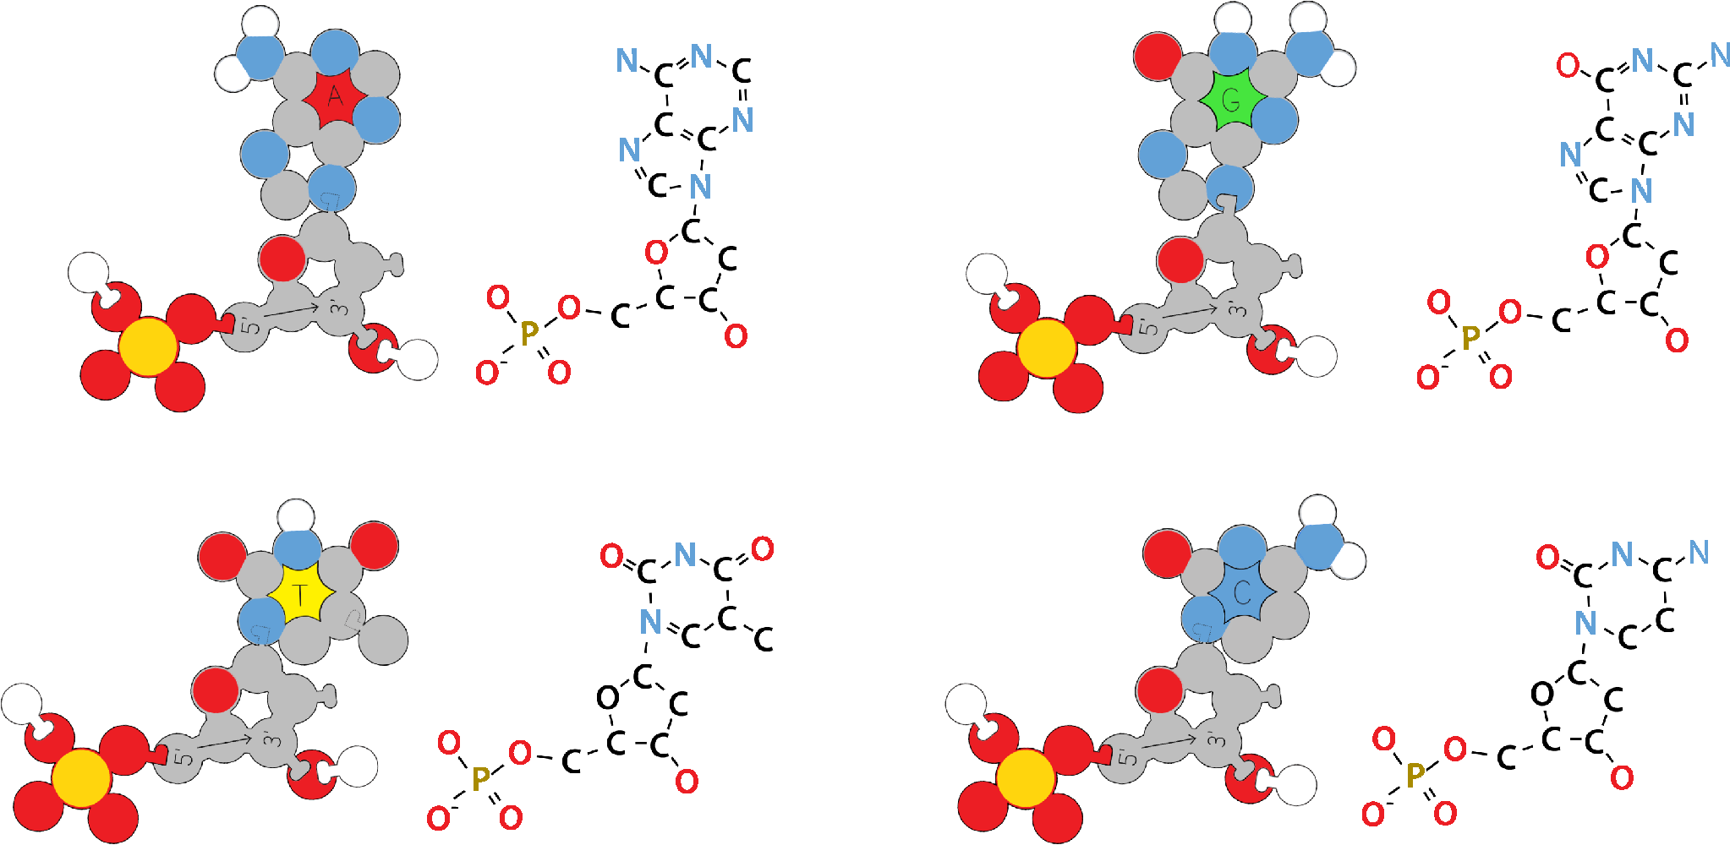
Parts of a Nucleotide
Nitrogenous
Base
Nitrogenous
Base
Nitrogenous
Base
Nitrogenous
Base
Compare your foam nucleotide to these representations of nucleotides.
What portion of your model represents each of the parts of a nucleotide?
Nitrogenous base
Phosphate group
Sugar group
Sugar
Group
Sugar
Group
Sugar
Group
Sugar
Group
Phosphate
Group
Phosphate
Group
Phosphate
Group
Phosphate
Group
Nitrogenous
Base
Nitrogenous
Base
Nitrogenous
Base
Nitrogenous
Base
Sugar
Group
Sugar
Group
Sugar
Group
Sugar
Group
Phosphate
Group
Phosphate
Group
Phosphate
Group
Phosphate
Group
Notes:
[~5-6 MINUTES]
TEACHER MOVES:
This slide transitions from discovery to formal labeling—students now learn the scientific names for the parts they've been manipulating.
Set up the comparison:
"You've been exploring these foam models and figuring out how they fit together. Now let's connect what you've discovered to the scientific names and structures of real nucleotides."
"Look at the slide. You'll see two representations of nucleotides—a simplified diagram and a more detailed chemical structure. Now look at your foam model."
Guide the comparison (3-4 minutes):
Now that students have explored the pieces, help them connect their physical discoveries to scientific vocabulary:
Project the slide: 'You've been working with these foam pieces. Now let's connect what you've discovered to what scientists call these parts.'
Nitrogenous base:
Ask: 'You noticed each piece has a colored section with a letter and a unique shape on the top. Point to that part on your model.' (Pause—let students point.) 'In science, we call this the nitrogenous base. This is the part that's different in each nucleotide—A, T, G, and C. The different shapes you discovered explain why only certain pairs fit together.'
Sugar and Phosphate (backbone connectors):
Ask: 'Some of you discovered you could connect pieces end-to-end to build a chain. Show me the parts that connect when you build a chain.' (Pause—students should indicate arrow and hole.) 'The arrow-shaped part is called the sugar, and the rounded part with the hole is the phosphate. When you connect arrow-to-hole, you're building what scientists call the sugar-phosphate backbone.'
Key teaching move: You're not introducing NEW information—you're naming what students already discovered physically. They found the patterns; now they're learning the scientific vocabulary for those patterns.“
Whole-class check:
"Everyone point to the nitrogenous base on your model." (Scan room—everyone should point to the lettered portion.)
"Now point to the sugar." (Everyone should point to the arrow)
"Now point to the phosphate group." (Everyone should point to the middle section)
[BLOOM'S LEVEL: UNDERSTAND / APPLY]
STUDENT MOVES:
Students make connections between their concrete foam models and abstract scientific diagrams. They compare three representations: (1) foam model in hand, (2) simplified diagram on slide, (3) chemical structure on slide. They learn and apply scientific vocabulary (nitrogenous base, phosphate group, sugar) to physical parts they've already manipulated. Students develop representational competence—the ability to translate between different ways of showing the same concept.
❌ COMMON MISCONCEPTION:
Students might think:
"The foam model is 100% accurate to real DNA structure" (it's a simplified representation)
"All the parts are the same size" (in reality, atoms/molecules vary in size)
"The colors of the bases matter in real DNA" (color is for easily distinguishing the nucleotides from each other. Real DNA isn't colored.)
"DNA only has three parts total" (each nucleotide has three parts, but DNA has millions of nucleotides)
CLARIFICATION:
Address the model's limitations upfront:
"These foam models are simplified representations. Real nucleotides are made of individual atoms (carbon, hydrogen, nitrogen, oxygen, phosphorus) bonded together. Our models show the key features we need to understand—the three parts of a nucleotide and how they connect—but they don't show every single atom."
"The colors are for easily distinguishing the four nucleotides from each other—real DNA molecules aren’t red, yellow, green, and blue! But the SHAPES are important. The bases really do have complementary shapes that determine how they pair."
If students ask about chemical structures on the slide: "You'll explore the detailed chemistry in later courses. For now, focus on the three parts: nitrogen base (what makes each nucleotide unique), sugar (structural support), phosphate (connects nucleotides in a chain)."
📦 MODEL/VISUAL REFERENCE:
Three representations on this slide:
Foam model (in students' hands): Physical, tactile, simplified
Diagram on slide (left side): Simplified schematic with labels
Chemical structure on slide (right side): Atoms and bonds shown
Point to all three while explaining: "Scientists use different representations for different purposes. For now, the foam model helps us see how pieces fit together. The diagram helps us see the parts labeled. The chemical structure shows the actual atoms—but that level of detail isn't necessary for understanding DNA replication."
Use your own foam nucleotide as a visual aid: Hold it up and point to each part as you name it. Students should be doing the same with their models.
✓ FORMATIVE ASSESSMENT (Quick Check):
Ask the whole class:
"Hold up your foam model. Point to the part that's DIFFERENT in A, T, G, and C." (They should point to the nitrogenous base)
"Point to the part that connects nucleotides into a chain." (They should point to the phosphate/arrow)
"Point to the middle structural part." (They should point to the sugar)
Listen for understanding:
If you ask, "What's the nitrogenous base?" students should be able to:
Point to it on their model
Say "It's the part with the letter.” or "It's what makes A, T, G, C different."
Identify it as the part that does base pairing
→ If 80%+ of students can identify all three parts → Move forward
→ If students are confused → Slow down and use color-coding: "The nitrogenous base SHOWS THE LETTER. The phosphate is the ARROW. The sugar is the MIDDLE CONNECTOR. Let's try again—point to the phosphate."
🔗 CONNECTIONS:
Prior knowledge: Students tactily explored these parts; now they're labeling what they already understand
Looking ahead: Understanding these three parts is essential for understanding how DNA polymerase builds new strands (adds nucleotides one at a time)
NGSS: Disciplinary Core Idea LS1.A (Structure and Function—the three parts have specific roles.)
DIFFERENTIATION NOTES:
For visual learners: Provide a printed handout with labeled diagram they can keep in their notebook
For struggling students: Use the foam model ONLY at first—skip the chemical structure slide. Focus on “lettered portion = base, arrow = phosphate, connector = sugar."
For advanced students: Point out the chemical structures: "Notice the bases have different ring structures—some have two rings (purines: A, G), some have one ring (pyrimidines: T, C). This affects their size and pairing."
For ELL students: Write the three terms on the board with simple drawings. Practice pronunciation: "NI-TRO-JEN-US BASE, PHOS-PHATE, SHU-GAR."
ADDITIONAL NOTES:
Why this slide matters:
Students have been working with nucleotides for 10+ minutes without knowing the formal vocabulary. Now that they understand the FUNCTION (how pieces fit together), they're ready to learn the names. This sequence (function before vocabulary) is more effective than the reverse (memorizing terms without understanding purpose).
Avoid:
❌ Spending too much time on chemical structures or biochemistry details. General biology students don't need to know that deoxyribose is a pentose sugar or that phosphate has a negative charge (save that for AP/honors). Keep it simple: three parts, three names, three functions.
Optional depth (for honors/AP):
"The 'deoxy' in deoxyribose means 'without oxygen'—DNA's sugar is missing one oxygen compared to RNA's sugar. That small difference makes DNA more stable for long-term storage."
Connection to next slide:
"Now that you know the three parts of a single nucleotide, the next slide will show you how these parts connect in the structure of DNA."

Slide 23
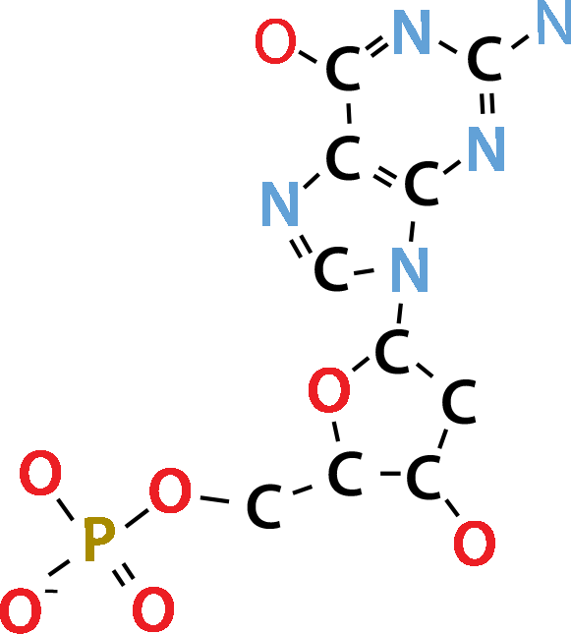
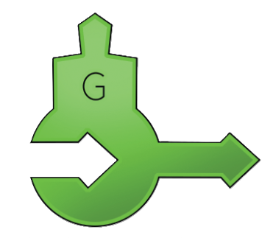
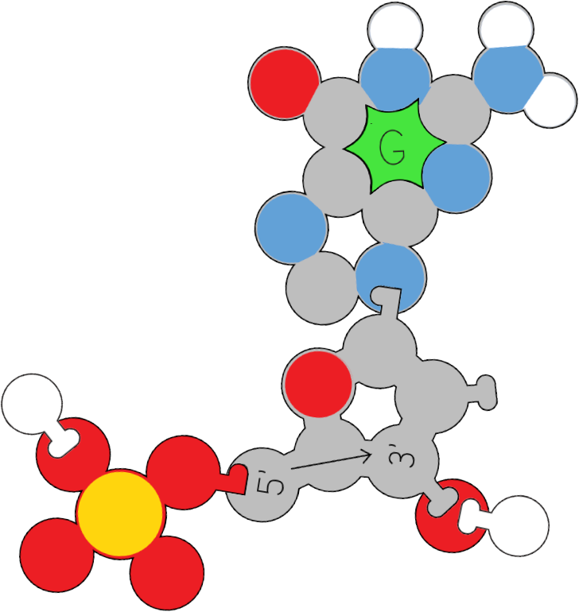
Components of DNA Nucleotides
Nitrogenous
Base
Nitrogenous
Base
Nitrogenous
Base
Phosphate
Group
Phosphate
Group
Sugar
Group
Sugar
Group
Phosphate
Group
Sugar
Group
Notes:
[~2-3 MINUTES]
TEACHER MOVES:
This is a visual reinforcement slide—primarily image-based with minimal text. Its purpose is to provide a clear, labeled reference diagram that students can refer back to throughout the activity.
Present the slide:
"This slide shows you a clear diagram of a DNA nucleotide with all three parts labeled. Take 30 seconds to look at this image and compare it to your foam model."
Give think time (30-60 seconds): Students should silently examine the diagram and their models.
Narrate the diagram:
Point to each part on the slide as you explain:
"Nitrogenous base (with letter)" - "This is the part that pairs with another base. Notice it has a unique shape—this is what determines which bases pair together."
"Sugar (middle connector)" - "This deoxyribose sugar is the structural scaffold. It connects the base to the phosphate. Remember you aren’t seeing all the atoms."
"Phosphate group (arrow)" - "This phosphate links one nucleotide to the next, forming the backbone of DNA."
Emphasize the relationship:
"These three parts work together. The base determines identity (A, T, G, or C). The sugar connects the structure together. The phosphate links nucleotides in a chain."
Optional quick activity (if time allows):
"In your notebook, quickly sketch a nucleotide from memory. Label the three parts. You have 1 minute."
Circulate to check sketches—this is a quick formative assessment.
[BLOOM'S LEVEL: REMEMBER / UNDERSTAND]
STUDENT MOVES:
Students visually compare the labeled diagram to their foam models, reinforcing the connection between representation and terminology. They process the spatial relationships: base to sugar to phosphate. If sketching, they practice recall and spatial reasoning. They consolidate vocabulary introduced in the previous slide.
❌ COMMON MISCONCEPTION:
Students might think:
"The parts are always arranged vertically (base on top, phosphate on bottom)" - orientation can vary depending on how DNA is drawn
"Each part is separate" - they're covalently bonded together into a single molecule
"You need to memorize the detailed chemical structure" - at this level, focus on identifying the three parts and their roles
CLARIFICATION:
"In diagrams, nucleotides might be drawn vertically (like this slide), horizontally, or at an angle. The orientation doesn't matter—what matters is recognizing the three parts and how they connect."
"These three parts are chemically bonded together. You can't pull them apart—together they form one nucleotide unit."
📦 MODEL/VISUAL REFERENCE:
Point to the slide diagram: "This is a standard way scientists represent a nucleotide. You'll see this diagram in textbooks, articles, and other activities."
Hold up a foam nucleotide: "Our simplified foam model represents the same three parts."
Show the connection: Place your foam model next to the projected slide. "See how they correspond? Lettered nitrogenous base, middle connecting sugar. Arrowed phosphate."
✓ FORMATIVE ASSESSMENT (Quick Check):
If you had students sketch:
Circulate quickly and look for:
✅ Three distinct parts drawn
✅ Labels present (even if spelling is approximate)
✅ Reasonable spatial relationship (parts connected, not floating)
If you didn't have students sketch, ask:
"Without looking at your notes, who can name the three parts of a nucleotide?" (Call on 3 students to name one each)
→ If students can identify and label all three parts → Move forward
→ If students are hesitant → Review once more: "Base makes each nucleotide unique. Sugar provides structure. Phosphate connects nucleotides together. Let's say it together..."
🔗 CONNECTIONS:
Looking ahead: This diagram prepares students for the next slide (Slide 12) where they'll sketch and label a nucleotide
Cross-disciplinary: Reading and interpreting scientific diagrams is a critical literacy skill
NGSS: Science and Engineering Practice 2 (Developing and using models)
DIFFERENTIATION NOTES:
For visual learners: This slide is ideal—clear, simple, labeled diagram
For struggling students: Provide a printed handout of this diagram to keep in their notebook as a reference
For advanced students: Challenge them to sketch a nucleotide from memory without looking at the slide
For students with processing challenges: Don't rush this slide—give extra time to visually process the diagram
ADDITIONAL NOTES:
Time management:
This slide should be brief (2-3 minutes max). Its purpose is visual reinforcement, not deep exploration. If you're running short on time, you can even combine this slide with Slide 10 or skip it entirely and move directly to Slide 12 (the sketching activity).
Why a diagram-only slide?
Sometimes less is more. After two slides of active exploration and labeling, students need a moment to visually consolidate. This clean, uncluttered diagram serves as a reference point they can return to throughout the activity.
Tech tip:
If you're using a digital version of this slide deck, consider keeping this slide visible on a secondary screen or printing it as a poster. Students will refer back to nucleotide structure multiple times during the activity.

Slide 24
Recall: Without using your Notes!
Create an annotated sketch of a nucleotide from the Flow of Genetic Information Kit from yesterday.
Create a simple model to describe how the process of transcription accommodates the structure of DNA

Slide 25
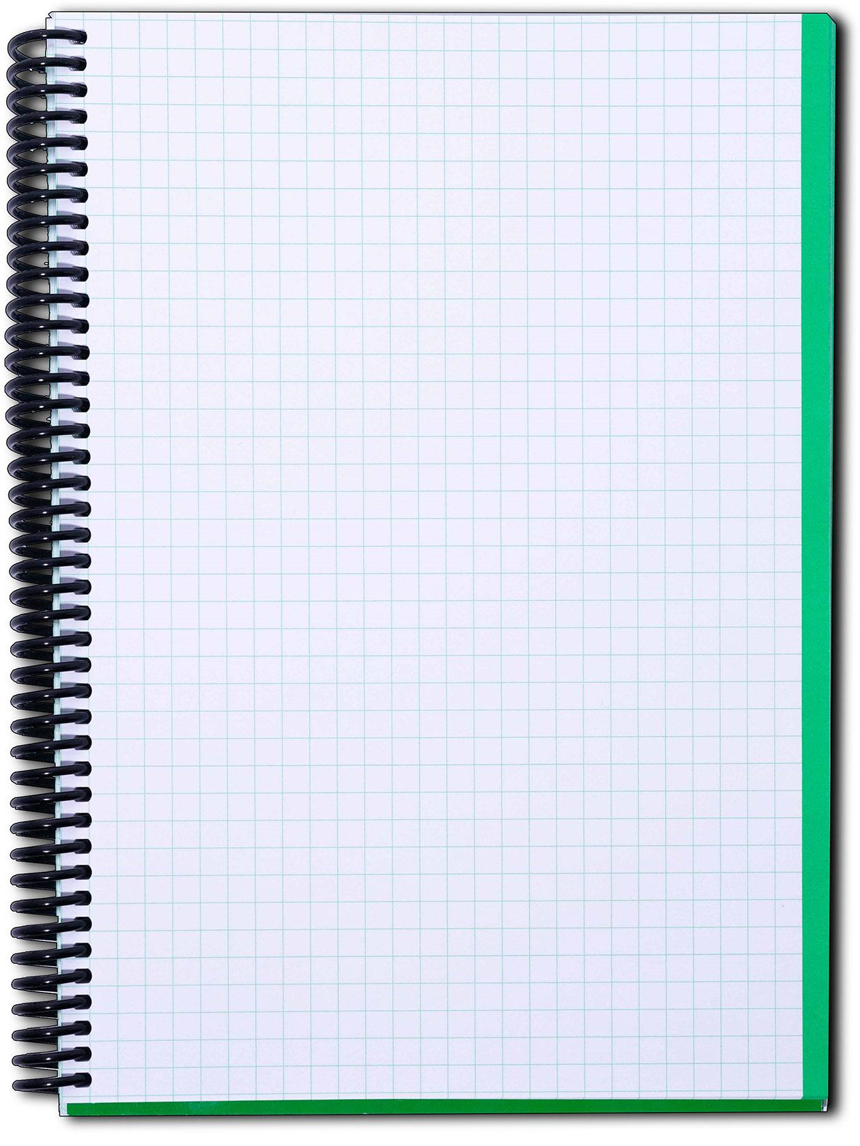
Parts of a Nucleotide
Sketch a nucleotide in your lab notebook and annotate the following:
  Nitrogenous base
  Phosphate group
  Sugar group
Nitrogenous
Base
Phosphate
Group
Sugar
Group
Notes:
[~4-5 MINUTES]
TEACHER MOVES:
This slide asks students to demonstrate their understanding through drawing—a key science practice that reveals conceptual grasp better than verbal explanation alone.
Give clear instructions:
"Now you're going to show what you've learned by drawing. In your lab notebook, sketch a nucleotide and label the following three parts: nitrogenous base, sugar and phosphate group."
Set expectations:
"This doesn't need to be a perfect drawing—scientists' sketches are often rough! What matters is:
All three parts are present
All three parts are labeled clearly
The parts are connected in a reasonable way"
"You can look at your foam model and the previous slides for reference. You have 3-4 minutes."
Circulate while students sketch (3-4 minutes):
As you move around the room, provide individualized feedback:
✅ For accurate sketches: "Great! I can clearly see all three parts and they're connected properly."
❌ For missing labels: "I see your drawing, but I don't see labels. Add the three scientific names."
❌ For disconnected parts: "In your drawing, the parts are floating separately. Remember, they're bonded together into one molecule. Redraw them connected."
❌ For incorrect spatial relationships: "Check your foam model—is the phosphate connected to the sugar? Does your drawing show that?"
Look for common errors:
Missing one or more parts
Parts drawn separately (not connected)
Unclear/missing labels
Confusing which part is which
Quick whole-class check (30 seconds):
"Hold up your notebooks so I can see your sketches." (Scan the room quickly—you should see drawings with three labeled parts)
Optional: Gallery walk (if time allows):
"Walk around and look at 2-3 other people's sketches. Notice different ways people drew the same structure."
[BLOOM'S LEVEL: APPLY / CREATE]
STUDENT MOVES:
Students translate their understanding from three-dimensional foam models and two-dimensional diagrams into their own hand-drawn representation. They practice scientific drawing conventions: clear shapes, labels with lines, spatial relationships shown. They recall vocabulary from Slides 10-11 and apply it correctly. They demonstrate synthesis—combining visual information from models, diagrams, and prior explanation into an original creation.
❌ COMMON MISCONCEPTION:
Students might draw:
Three separate circles/shapes floating in space (misconception: parts aren't connected)
Only the nitrogenous base (misconception: that's the whole nucleotide)
A full DNA double helix instead of a single nucleotide (misconception: conflating nucleotide with DNA structure)
Chemical structures with atoms and bonds (overcomplicating beyond what's expected)
CLARIFICATION:
If you see disconnected parts: "Remember, a nucleotide is one molecule made of three parts bonded together. Draw them connected—like your foam model where all three parts are attached."
If students draw a double helix: "That's DNA—which is made of many nucleotides. For this task, just draw one nucleotide with its three parts."
If students try to draw detailed chemistry: "You're working too hard! A simple shape for each part is fine. Scientists often use simplified sketches to communicate ideas quickly."
📦 MODEL/VISUAL REFERENCE:
Remind students of available references:
"You can look at your foam model—it's right in front of you."
"You can look at the previous slide (Slide 11) on the screen."
"You can look at your Notice/Wonder notes from earlier."
Show an example (if needed): Quickly sketch on the board:
Oval or rectangle for base (labeled "nitrogenous base")
Pentagon for sugar (labeled "sugar")
Circle for phosphate (labeled "phosphate group")
Lines connecting them
"Something like this is perfect! Simple, clear, labeled."
✓ FORMATIVE ASSESSMENT (Quick Check):
This IS the formative assessment. Student sketches reveal:
✅ Full understanding: Three parts present, correctly labeled, appropriately connected
⚠️ Partial understanding: Two parts correct, one missing or mislabeled
❌ Gaps: Parts floating separately, no labels, incorrect identification
Use this data to decide:
→ If 80%+ of students have accurate sketches → Move forward confidently
→ If 50-79% have accurate sketches → Brief review: "I'm seeing some confusion about [specific issue]. Let's clarify..."
→ If <50% have accurate sketches → STOP and reteach: Pull out the foam model again, review each part, then have students revise their sketches
Individual check-ins:
As you circulate, ask 2-3 students: "Explain your drawing to me. Point to the nitrogenous base... now the phosphate... now the sugar." Verbal explanation confirms visual understanding.
🔗 CONNECTIONS:
Science practice: Scientific drawing is a core skill in biology (cell diagrams, anatomical drawings, field sketches)
Looking ahead: Students will sketch more complex structures later (double helix, replication fork)
NGSS: Science and Engineering Practice 2 (Developing and using models through drawing)
DIFFERENTIATION NOTES:
For struggling students: Provide a partially completed sketch outline—they just add labels
For advanced students: Challenge: "Add arrows showing how nucleotides connect to form a DNA strand"
For students with fine motor difficulties: Allow them to label a provided diagram instead of drawing from scratch
For visual-spatial learners: This task plays to their strengths—celebrate their detailed, accurate drawings
For ELL students: Allow them to draw + label in both English and home language if that aids understanding
ADDITIONAL NOTES:
Why sketching matters in science education:
Drawing forces students to think carefully about spatial relationships, components, and connections. It's harder to fake understanding in a drawing than in verbal explanation. Research shows that students who draw concepts retain them better than students who only read/hear about them.
Sketches belong in lab notebooks:
Emphasize that scientists keep sketches in lab notebooks to document observations and understanding. This isn't "art class"—it's scientific practice.
What to do with the sketches:
Collect and review (formative assessment for you)
Have students share (pair-share: "Show your neighbor your sketch and explain each part")
Revisit later (after building DNA strands: "Look back at your nucleotide sketch. Now you're connecting many of these together!")
Time-saving option:
If you're pressed for time, you can have students label a pre-drawn diagram instead of sketching from scratch. This saves 2-3 minutes but sacrifices some of the cognitive benefit of creating their own drawing.
Extension for fast finishers:
"Draw a SECOND nucleotide next to your first one. Show how they would connect to start forming a DNA strand."

Slide 26
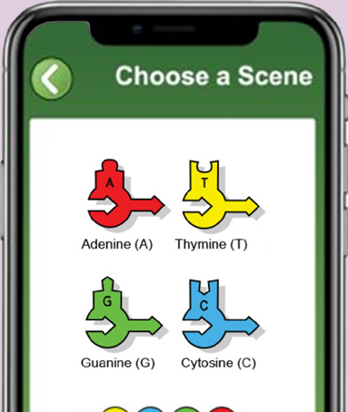
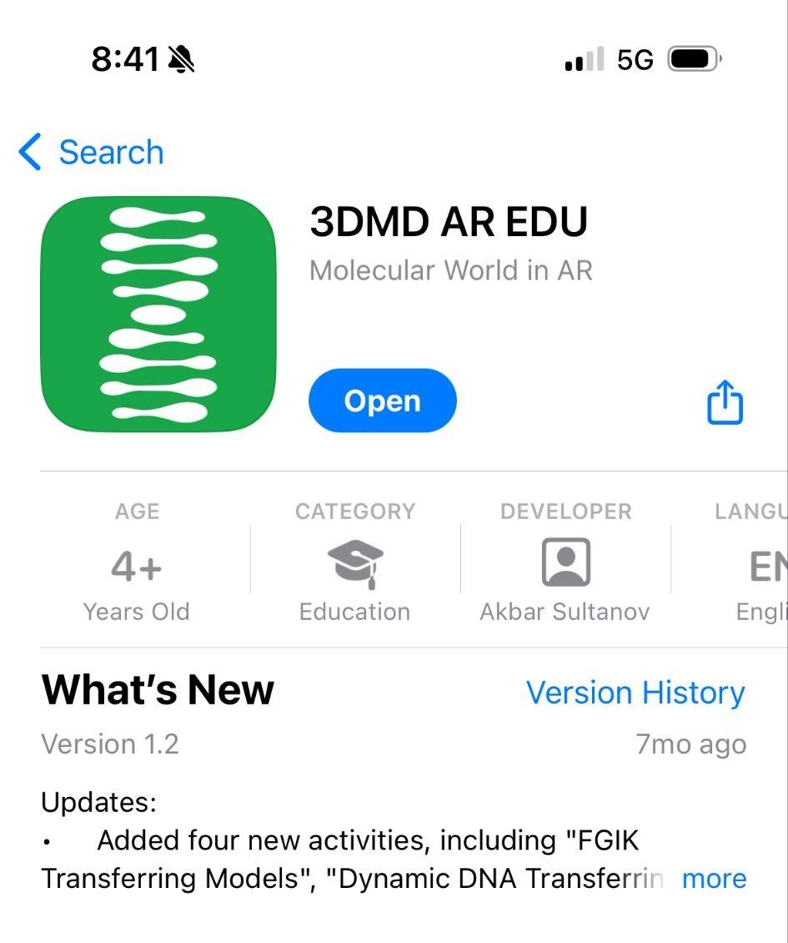
Optional Extension:
Augmented Reality Nucleotide Exploration
When to Use:
After students have completed hands-on exploration, sketching, and comparison activities (Slides 10-13)
Purpose:
Provides detailed molecular visualization for students who want/need to see 3D chemical structures
How to Implement:
Ensure students have completed physical modeling first
Have students download 3DMD AR EDU app
Navigate to FGIK → Transferring Models section
Scan individual foam nucleotides to see:
  Cartoon representation
  Ball & stick model
  Chemical structure diagram
Recommended for:
Gen Bio honors students (optional extension)
Visual learners who benefit from multiple representations
Students struggling to connect foam model to molecular reality
Time Allocation:
10-15 minutes if using AR extension

Slide 27
Build a DNA Strand
Connect nucleotides into a chain.
Connect the arrow ends together (this is the backbone)
Make a strand that is 6-8 nucleotides long
Use a variety of colors in any order you choose
Why might the order be important?
What do you think happens next?
Notes:
[~6-8 MINUTES]
TEACHER MOVES:
This slide transitions from understanding individual nucleotides to building a DNA strand—students now create the sugar-phosphate backbone.
Give clear construction instructions:
“Everyone should create their own DNA strand.”
"Now that you understand the parts of a nucleotide, you're going to connect them into a chain—a DNA strand."
Read the three bullet points aloud:
"Connect the arrow ends together (this is the backbone)"
"Make a strand that is 6-8 nucleotides long"
"Use a variety of colors in any order you choose"
Demonstrate the connection:
Hold up two foam nucleotides. "Watch how I connect these. The pointy end of the arrow on this nucleotide connects to the flat end of the arrow on the next nucleotide." (Demonstrate the connection clearly.) "This arrow-to-arrow connection forms what we call the sugar-phosphate backbone—it's the structural 'spine' of DNA."
Clarify key points:
"You can use any order of colors you want. Your sequence might be A-T-G-C-A-G, and your neighbor's might be G-G-A-T-C-C. That's fine! DNA sequences vary."
"Make your strand 6-8 nucleotides long—no shorter than 6, no longer than 8."
"All the arrows should point the SAME direction when you're done. If they don't, you connected something backwards."
Give work time (4-5 minutes):
"Work with your group. Build your strand now. You have about 5 minutes."
Circulate and troubleshoot:
Watch for common errors:
❌ Connecting bases instead of backbone: "You're trying to connect the colored parts. Remember, we're building a CHAIN first—connect the arrows end-to-end."
❌ Arrows pointing different directions: "Look at your arrows. They should ALL point the same way—either all up or all down. If one is backwards, disconnect and flip it around."
❌ Too short/too long: "Count your nucleotides. You need 6-8 total."
❌ Trying to make pairs already: "Right now we're just building ONE strand—a single chain. We'll add the matching strand in the next step."
Ask guiding questions (green questions on slide):
Once most groups have finished building (after 4-5 minutes), project the questions:
"Why might the order be important?"
Call on 2-3 students. Listen for: "The order is like instructions/code," "Different sequences make different proteins," "The sequence determines what the DNA does."
Affirm: "Exactly! The SEQUENCE of bases (the order of A, T, G, C) carries genetic information—like letters in a sentence."
"What do you think happens next?"
Listen for: "We add another strand," "We connect matching bases," "We make the double helix."
Respond: "Let's find out! Hold onto that prediction."
[BLOOM'S LEVEL: APPLY / CREATE / PREDICT]
STUDENT MOVES:
Students physically construct a DNA strand by connecting nucleotides via the sugar-phosphate backbone. They make choices about sequence order (reinforcing that different sequences exist). They ensure arrows point uniformly in one direction (introducing directionality without explicitly naming 5'→3' yet). They observe that the backbone forms a continuous chain while bases stick out to the side. Students predict the next step (adding complementary strand), demonstrating anticipatory thinking.
❌ COMMON MISCONCEPTION:
Students might think:
"The order doesn't matter" (confusing structure with information content)
"Everyone should build the same sequence" (not understanding DNA variation)
"We're building the whole DNA molecule now" (not realizing this is only ONE strand of the double helix)
"The arrows can point any direction" (not yet understanding 5'→3' directionality matters)
CLARIFICATION:
Order matters: "Think of DNA like a sentence. 'CAT' and 'ACT' use the same letters but mean different things. Same with DNA—the sequence of A, T, G, C determines what instructions the DNA carries."
Variation is normal: "Every person's DNA has a different sequence—that's what makes you unique! Your DNA sequence is different from your neighbor's, just like your strand is different from theirs."
This is half the structure: "Right now you're building ONE strand—half of DNA. DNA is actually TWO strands connected together. We'll add the second strand next."
Directionality preview: "I see all your arrows pointing the same way. Good! DNA strands have a direction—scientists call it 5' to 3' (we'll learn what that means soon). The arrows on your model show that direction."
📦 MODEL/VISUAL REFERENCE:
Point to students' completed strands: "Look at what you've built. This is ONE strand of DNA. The backbone is the repeating sugar-phosphate-sugar-phosphate chain (run your finger along the arrows). The bases (colored parts) stick out to the side—these will pair with another strand."
Visual comparison: If you have images of DNA on the slide or posters, point to them: "See this diagram? The backbone is like the side of a ladder. The bases are like half of each rung, sticking out and ready to connect to the other side."
Demonstrate with your own model: Hold up your pre-built strand and trace the backbone with your finger while holding it vertically: "Arrow connects to arrow connects to arrow—one continuous chain. Bases stick out here, here, here—ready to pair."
✓ FORMATIVE ASSESSMENT (Quick Check):
Scan the room for visual evidence:
✅ Do all groups have a 6-8 nucleotide chain completed?
✅ Are arrows all pointing the same direction within each strand?
✅ Are bases sticking out to the side (not tangled or connected)?
Ask individual groups:
"Point to the backbone of your strand." (They should trace the arrow connections)
"Point to the bases." (They should point to the colored heads sticking out)
"How many nucleotides did you use?" (Answer should be 6-8)
Quick conceptual check—ask the whole class:
"If I have the sequence A-T-G-C on my strand, and my partner has the sequence G-C-A-T on theirs, is one of us wrong?"
Listen for: "No, both are right—DNA can have different sequences."
→ If students successfully built strands with correct structure → Move forward
→ If many students have backwards arrows or disconnected pieces → Pause and demonstrate again: "Everyone disconnect your strand. Watch me build one correctly, then rebuild yours."
🔗 CONNECTIONS:
Prior knowledge: Students already know how to connect pieces (Slide 9)—now they're applying that to build a longer chain
Information science: DNA as code/language (sequence = information)
Looking ahead: This single strand will become a template for replication
NGSS: HS-LS1-1 (Structure of DNA), Crosscutting Concept 4 (Systems—backbone + bases work together)
DIFFERENTIATION NOTES:
For struggling students: Provide a "recipe card" showing a specific sequence to build (e.g., "Build: A-T-G-C-A-T"). This reduces cognitive load from decision-making.
For advanced students: Ask: "How many different sequences could you build with 6 nucleotides?" (Answer: 4^6 = 4,096 combinations)
For students with fine motor challenges: Allow them to work with a partner who does the physical connection while they direct ("Connect yellow to green, then add orange...")
For visual learners: Show a completed strand example on the document camera
ADDITIONAL NOTES:
Why "any order"?
This is intentional! By allowing students to choose their own sequence, you're reinforcing that:
DNA sequences vary (genetic diversity)
The structure (backbone) is the same, but the information (sequence) differs
There's no single "correct" sequence for this activity
Management tip:
Students may want to build longer strands ("Can I make 20 nucleotides?"). Set firm limits: "For this activity, 6-8 is the right length. Longer strands will be too difficult to work with in the next steps."
Vocabulary note:
You're using "backbone" here informally. On later slides, you'll formalize it as "sugar-phosphate backbone." For now, "backbone" is sufficient.
Connection to previous slide:
"Remember on Slide 9 when you discovered the arrows connect end-to-end? That's exactly what you're doing now—creating a long chain."
Photo opportunity:
Take photos of student-built strands showing variety in sequences. These can be used later for class discussion: "Look at all the different sequences our class created!"
Time management:
If students finish early, you can ask them to:
Build a SECOND strand (different sequence) for comparison
Count how many of each nucleotide they used (quantitative analysis)
Write their sequence in their notebook using letters (A-T-G-C-A-T...)

Slide 28
Add the Matching Strand
Now build a matching strand that pairs with your first strand
How do they fit together?
Can you assemble any sequence?
Test your predictions by trying to connect the pieces.
Notes:
[~8-10 MINUTES]
TEACHER MOVES:
This is a critical discovery moment—students discover complementary base pairing rules by building the second strand.
Set up the challenge:
"You've built one strand of DNA. But DNA is a DOUBLE helix—it has TWO strands connected together. Now you're going to build a matching strand that pairs with your first strand."
Give instructions:
"Using the remaining nucleotides, build a SECOND strand that pairs with your first strand. Try to connect the bases—the colored parts—to see which ones fit together."
Pose the guiding questions (green text on slide):
"How do they fit together?"
"Test different combinations. Do all bases pair with all other bases, or are there rules?"
"Can you assemble any sequence?"
"Try pairing different colors. Can you make A pair with C? A with G? What do you discover?"
Give work time (6-8 minutes):
"Work with your group. Build the matching strand and connect it to your first strand. You have about 6-8 minutes."
Circulate and facilitate discovery:
This is NOT the time to tell students the base pairing rules. Let them discover through trial and error.
Use guiding questions:
✅ If students are struggling: "Try pairing the yellow piece (A) with different partners. Which color fits best?"
✅ If students discover A-T pairing: "Interesting! Now try the green piece (G). Which color fits with it?"
✅ If students try incorrect pairs: "Does that fit snugly? Try a different combination."
✅ If students finish quickly: "Now try building a different first strand and see if the same pairing rules apply."
Watch for emerging understanding:
Listen for students saying:
"Yellow (A) only fits with orange (T)!"
"Green (G) matches with pink (C)!"
"You can't just use any color—there are rules!"
Whole-class discussion (2-3 minutes):
Once most groups have completed their double helix, bring the class together.
"What did you discover? Which colors pair together?"
Chart responses on the board:
A (yellow) pairs with T (orange)
G (green) pairs with C (pink)
"Did anyone successfully pair A with G? A with C?" (No one should have)
"Why not?" (They don't fit—the shapes aren't complementary)
Introduce the term: "What you've discovered is called complementary base pairing. The bases have specific shapes that allow only certain pairs: A with T, and G with C. This is one of the most important rules in biology!"
[BLOOM'S LEVEL: APPLY / ANALYZE / DISCOVER]
STUDENT MOVES:
Students engage in guided inquiry, testing hypotheses about which bases pair. They use tactile feedback (pieces that fit snugly vs. pieces that don't fit) to discover base pairing rules empirically. They construct a double helix structure, seeing how two strands connect via hydrogen bonds between bases. They articulate the pattern they discovered: A-T and G-C pairing. They reason about WHY the pattern exists (shape complementarity).
❌ COMMON MISCONCEPTION:
Students might think:
"Any base can pair with any other base" (not recognizing specific pairing rules)
"The bases pair because of color" (confusing teaching aid with actual mechanism)
"A-T and G-C are arbitrary rules someone made up" (not understanding it's based on molecular structure)
"Only A pairs with T, but T doesn't pair back with A" (not understanding reciprocity)
CLARIFICATION:
Specific pairing is structural: "The bases pair in specific combinations because of their SHAPES—not because of their colors. In our model, A (red) has a shape that fits perfectly with T (yellow), like puzzle pieces. In real DNA, the shapes of the molecules determine pairing."
It's reciprocal: "A pairs with T, AND T pairs with A. G pairs with C, AND C pairs with G. The pairing goes both ways."
This is crucial for replication: "These strict pairing rules are what make DNA copying accurate. If you know one strand's sequence, you automatically know the other strand's sequence!"
Color is just for learning: "In real DNA, nucleotides aren't colored! But they DO have different shapes that determine pairing. Our colored models help us see the pattern more easily."
📦 MODEL/VISUAL REFERENCE:
Point to completed student models: "Look at your double helix. You have two strands connected by base pairs. Run your finger along one backbone, then the other—they're parallel to each other."
Show the connection: Hold up a completed double helix model. "See how the bases in the middle connect the two strands? These connections are called hydrogen bonds in real DNA. They're strong enough to hold the strands together, but weak enough to be separated when needed (like during replication)."
Demonstrate incorrect pairing: Try to force A and C together (they shouldn't fit well). "See? These don't fit. The shapes aren't complementary. Only A-T and G-C fit properly."
Visual representation on slide: Point to the images showing connected base pairs: "In this diagram, you can see how A (yellow) connects to T (orange) across the middle, and G (green) connects to C (pink)."
✓ FORMATIVE ASSESSMENT (Quick Check):
Visual scan:
✅ Do all groups have two strands connected by base pairs?
✅ Are bases paired correctly (A-T, G-C)?
✅ Are the two backbones running parallel?
Ask individual groups:
"Show me an A-T pair on your model." (They should point to yellow-orange connection)
"Show me a G-C pair." (They should point to green-pink connection)
"Why can't you pair A with G?" (They should explain: shapes don't fit / not complementary)
Quick whole-class quiz:
"If one strand has the sequence A-T-G, what sequence does the other strand have?"
Expected answer: "T-A-C" (complementary to the first strand)
Listen for understanding of:
Complementary pairing (A↔T, G↔C)
Sequence specificity (if you know one strand, you can determine the other)
→ If 80%+ of students successfully built correct double helix → Move forward
→ If many students have incorrect pairings → STOP and clarify: "Let's check everyone's model. Hold up your double helix. I'm going to check that all your base pairs are correct. If you have any A-C or G-T pairs, disconnect them and fix them."
🔗 CONNECTIONS:
Prior knowledge: Slide 9 (students already explored which pieces fit together)—now they're applying that discovery systematically
Chemistry: Shape complementarity, molecular recognition (structure determines function)
Looking ahead: Complementary base pairing is the KEY to replication accuracy
NGSS: HS-LS1-1 (Structure of DNA determines function), Crosscutting Concept 6 (Structure and Function)
DIFFERENTIATION NOTES:
For struggling students: Provide a hint card showing A↔T and G↔C pairings. Let them reference it while building.
For advanced students: Ask: "If one strand has 30% adenine, what percentage of thymine does the other strand have?" (Also 30%—this is Chargaff's rule)
For kinesthetic learners: This activity is ideal—hands-on, trial-and-error, tactile feedback
For students who finish early: Challenge: "Build a NEW double helix with a different sequence. Does the same pairing rule apply?"
ADDITIONAL NOTES:
Why discovery before direct instruction?
Students who DISCOVER base pairing rules through hands-on exploration remember them better and understand them more deeply than students who are simply TOLD the rules. The struggle and trial-and-error is productive!
What if students can't figure it out?
If after 6-7 minutes, most groups are still struggling, provide scaffolding:
"I notice that every group who used yellow (A) connected it to orange (T). What does that tell you?"
Show ONE correct pair (A-T), then challenge them to find the other pair (G-C)
Timing note:
This slide often takes longer than expected because discovery is messy and iterative. Plan for 8-10 minutes. If you're running short on time, you can provide more scaffolding to speed up discovery.
Common student question:
"Why do A and T pair, but not A and C?"
Answer: "Great question! It comes down to molecular structure. Adenine and thymine have shapes that fit together perfectly, with the right number of hydrogen bonds (2 bonds). Guanine and cytosine also fit perfectly (3 bonds). But A and C don't fit—their shapes aren't complementary. We'll see this more clearly if you use the AR app later."

Slide 29
Compare your DNA Molecules
Move around the room and observe other groups' DNA molecules.
What is the same about everyone’s DNA models?
What is different about everyone’s models?
In your notebook, complete these three statements:
The rule for base pairing is…
Different DNA molecules can have different…
This matters because…
Notes:
[~5-6 MINUTES]
TEACHER MOVES:
This is a gallery walk activity that reinforces understanding through peer observation and comparison.
Give instructions for gallery walk:
"Now we're going to do a gallery walk. Leave your DNA model on your desk. When I say 'go,' walk around the room and observe OTHER groups' DNA molecules. Don't touch them—just observe."
"As you walk, think about these two questions:" (Read green questions from slide)
"What is the same about everyone's DNA models?"
"What is different about everyone's models?"
Set expectations:
"You should visit at least 3-4 other groups' models. Walk quietly. Take notes mentally—you'll write in your notebook after the gallery walk."
Give walk time (2-3 minutes):
"Go ahead—start your gallery walk."
Circulate and listen to student observations. You might hear:
"Their sequence is different from ours!"
"But the pairing looks the same—A with T, G with C."
"Everyone has two strands connected."
Return to seats and written reflection (2-3 minutes):
"Return to your seats. In your notebook, complete these three statements:"
Project the three sentence starters:
"The rule for base pairing is…"
"Different DNA molecules can have different…"
"This matters because…"
"You have 2 minutes to write. Use complete sentences."
Whole-class discussion (2 minutes):
After students write, facilitate a discussion:
"What is the SAME about everyone's DNA?"
Listen for (and chart on board if time allows):
Two strands connected
A pairs with T, G pairs with C (base pairing rules)
Sugar-phosphate backbone structure
Arrows point the same direction on each strand
"What is DIFFERENT?"
Listen for:
Sequence (order of A, T, G, C)
Length (some 6 nucleotides, others 8)
Total number of each base (some have more A's, others more G's)
Synthesize the big idea:
"So DNA structure is UNIVERSAL—all DNA follows the same base pairing rules and has the same double helix structure. But DNA SEQUENCE is VARIABLE—the order of bases differs between organisms, between people, even between different genes in your body. This combination of universal structure and variable sequence is what makes DNA so powerful!"
[BLOOM'S LEVEL: ANALYZE / EVALUATE / SYNTHESIZE]
STUDENT MOVES:
Students engage in peer observation, walking around the classroom to examine multiple DNA models. They practice comparative analysis, identifying similarities (universal structure) and differences (variable sequence). They synthesize observations into written statements, articulating the relationship between structure and information. They recognize that DNA has both constant features (pairing rules, backbone structure) and variable features (sequence order). Students connect observations to broader biological significance (why variation matters).
❌ COMMON MISCONCEPTION:
Students might think:
"Everyone should have built the same DNA molecule" (not understanding sequence variation)
"If our sequences are different, someone made a mistake" (confusing structure with content)
"Different sequences mean different structures" (not distinguishing between universal structure and variable sequence)
"DNA is exactly the same in all living things" (not understanding genetic diversity)
CLARIFICATION:
Structure vs. sequence: "Think of DNA like books. ALL books have the same STRUCTURE—pages, binding, text—but they have different CONTENT—different words and stories. Same with DNA: same structure (double helix, base pairing rules), different content (sequence of A, T, G, C)."
Variation is essential: "Different sequences are SUPPOSED to happen! That's what makes you different from your classmate, what makes humans different from bacteria, what makes brown eyes different from blue eyes. If all DNA had the same sequence, all living things would be identical clones."
Base pairing rules are universal: "Even though sequences vary, the PAIRING RULES never change. Everywhere in nature, in every living thing, A pairs with T and G pairs with C. That's a universal law of biology."
📦 MODEL/VISUAL REFERENCE:
During gallery walk, point out specific examples:
Walk alongside students and narrate: "Look at this group's model—they have A-T-G-C. Now look at this one—they have G-G-C-A. Different sequences! But notice—both follow the same pairing rules."
Use document camera (if available):
After the gallery walk, place two different groups' models under the document camera side-by-side. Project them on the screen.
"Let's look at these two models closely. What's the same?" (Point to base pairs, backbone)
"What's different?" (Point to sequence differences)
If slide has image: Point to the visual (if present) showing different DNA sequences: "This image shows the same idea—DNA molecules with different sequences but the same structure."
✓ FORMATIVE ASSESSMENT (Quick Check):
Read student notebook responses while circulating:
For "The rule for base pairing is…"
✅ Correct responses: "A pairs with T, G pairs with C" / "Complementary bases pair" / "Purines pair with pyrimidines"
❌ Incorrect responses: "Bases pair randomly" / "Colors that match pair" / Blank
For "Different DNA molecules can have different…"
✅ Correct responses: "Sequences" / "Orders of bases" / "Arrangements of A, T, G, C"
❌ Incorrect responses: "Structures" / "Base pairing rules" / "Number of strands"
For "This matters because…"
✅ Correct responses: "Different sequences carry different information" / "This creates genetic diversity" / "This is why organisms are different"
❌ Incorrect responses: "It doesn't matter" / Superficial responses / Blank
Quick oral check:
Ask the whole class: "If I gave you a strand with sequence A-G-T-C, what would the complementary strand be?"
Expected answer: "T-C-A-G"
→ If 80%+ of students correctly identify structure vs. sequence → Move forward
→ If students confuse structure with sequence → Clarify with analogy: "All cars have the same basic structure (wheels, engine, body), but they come in different colors and models. Same with DNA—same structure, different sequences."
🔗 CONNECTIONS:
Genetics: Genetic variation, alleles, inheritance
Evolution: DNA sequence differences drive diversity and evolution
Forensics: DNA fingerprinting relies on sequence variation
Medicine: Mutations are changes in DNA sequence
NGSS: HS-LS3-1 (Role of DNA in coding instructions—sequence determines genes)
DIFFERENTIATION NOTES:
For struggling students: Provide sentence frames with word banks:
"The rule for base pairing is ___ [A pairs with T, G pairs with C]."
"Different DNA molecules can have different ___ [sequences / orders of bases]."
"This matters because ___ [different sequences = different traits / information]."
For advanced students: Ask: "How might sequence differences relate to evolution? How might mutations (sequence changes) lead to new traits?"
For introverted students: Gallery walk can be done silently—no need for verbal interaction, just observation
For ELL students: Provide visual comparison chart showing "SAME" and "DIFFERENT" columns with pictures
ADDITIONAL NOTES:
Why gallery walk?
Gallery walks:
Get students moving (addresses kinesthetic learning needs)
Expose students to multiple examples (strengthens pattern recognition)
Build community (students see each other's work)
Provide low-stakes formative assessment (you can observe understanding through conversations)
Management tips:
Set clear expectations: "Walk, don't run. Observe, don't touch. Talk quietly if at all."
Time limits: Use a timer. Give a 1-minute warning: "You should be wrapping up your observations."
Traffic flow: If the room is crowded, you can do a "museum rotation"—half the class stays at their desks while the other half walks, then switch.
Alternative if space is limited:
If you can't do a physical gallery walk:
Use document camera to project 4-5 different group models one at a time
Students observe from their seats and take notes
Discuss what's the same/different
Connection to real-world genetics:
"Just like you all built different sequences, every person on Earth has a unique DNA sequence (except identical twins). Your DNA sequence is like your genetic fingerprint—it determines your traits, your health risks, and what makes you YOU."
Preview of next slide:
"We've talked about the double helix structure, but we haven't talked about an important feature—DIRECTION. DNA strands have a beginning and an end, like a one-way street. Let's explore that next."

Slide 30
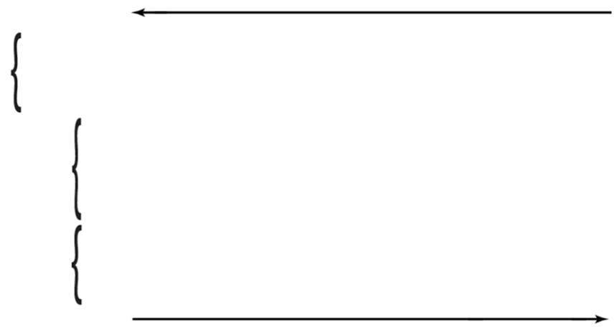
DNA Strands Have Direction
Look at your DNA model. All the arrows on each strand point the same way!
DNA strands have a “beginning” and an “end”
Scientists call these 5’ and 3’ (say “five prime” and “three prime”)
The arrows on your foam models show the direction
3'
Strand Directionality
5'
Backbone
Base Pairs
Backbone
5'
3'
Strand Directionality
Notes:
[~4-5 MINUTES]
TEACHER MOVES:
This slide introduces directionality (5'→3')—a critical but often confusing concept for students.
Direct students' attention to their models:
"Everyone, look at your DNA model—the double helix you just built. I want you to focus on ONE strand. Pick one of the two backbones and look closely at the arrows."
Give 10 seconds of observation time.
Ask: "What do you notice about the arrows on one strand?"
Expected response: "They all point the same way" / "They all go up" or "They all go down"
Affirm: "Exactly! All the arrows on each strand point the same direction. DNA strands have a DIRECTION—a beginning and an end, like a one-way street."
Introduce the terminology:
"Scientists call the two ends of a DNA strand 5' (five prime) and 3' (three prime)."
Write on the board: 5' → 3'
"You can see 5' and 3' (say 'five prime' and 'three prime') on the slide. These numbers come from the chemistry of the sugar molecule, which we don't need to worry about right now. What's important is that DNA has DIRECTION."
Point to the foam models:
"The arrows on your foam models show this direction. If the arrows point up, that strand runs 5' to 3' going up. If the arrows point down, it runs 5' to 3' going down."
Now show the TWO-STRAND relationship:
"Now look at BOTH strands of your double helix. Do the arrows on both strands point the same direction?"
Expected response: "No! One goes up, the other goes down!"
Introduce the term: "This is called antiparallel. The two strands run in OPPOSITE directions. One strand runs 5' to 3' going up ↑, the other runs 5' to 3' going down ↓. They're parallel (side-by-side) but pointing opposite directions—antiparallel."
Connect to future learning:
"This directional property will be really important when we model DNA replication. DNA polymerase (the enzyme that copies DNA) can only build in ONE direction: 5' to 3'. We'll explore what that means in a few slides."
Check the slide image:
Point to the diagram on the slide showing 5' and 3' labels: "Here's a diagram showing the 5' and 3' ends. Notice how the two strands run in opposite directions."
Optional (if time allows):
"In your notebook, draw a quick sketch of your DNA double helix. Label the 5' and 3' ends on both strands. Use arrows to show direction."
[BLOOM'S LEVEL: UNDERSTAND / APPLY]
STUDENT MOVES:
Students examine their models to identify directional features (arrows). They observe that all arrows on one strand point uniformly in one direction. They learn new vocabulary (5', 3', antiparallel) connected to concrete observations. They recognize the spatial relationship: two strands running in opposite directions. Students practice applying new terminology by identifying 5' and 3' ends on their models. They anticipate future relevance (directionality matters for replication).
❌ COMMON MISCONCEPTION:
Students might think:
"5' and 3' are arbitrary labels with no meaning" (not understanding they refer to carbon atoms in the sugar)
"Both strands run in the same direction" (not recognizing antiparallel orientation)
"Direction doesn't matter for DNA function" (not understanding its importance for replication/transcription)
"5' is always at the top and 3' is always at the bottom" (not understanding it depends on orientation of the molecule)
CLARIFICATION:
Direction matters: "DNA direction is like traffic on a one-way street. Cars can only go one direction. Same with DNA polymerase during replication—it can only build new DNA in the 5' to 3' direction. If DNA didn't have direction, replication couldn't work properly."
Antiparallel is essential: "The two strands MUST run in opposite directions for base pairing to work correctly and for replication to happen. This isn't random—it's a fundamental feature of DNA structure."
5' and 3' are relative: "Whether 5' is at the top or bottom depends on how you're holding the model. What matters is the RELATIONSHIP: the two strands run opposite to each other."
Not chemistry class: "The terms 5' and 3' come from numbering the carbon atoms in the sugar molecule. You don't need to memorize that chemistry right now—just know that DNA has direction, and it matters."
📦 MODEL/VISUAL REFERENCE:
Use student models:
Walk to a student's desk and hold up their double helix: "Look at this model. See how the arrows on this strand (point to one) all go up? That's the 5' to 3' direction going up. Now look at the other strand (point to it)—the arrows go down. That's 5' to 3' going down. Opposite directions—antiparallel."
Draw on the board:
Sketch a simple double helix showing:
text
5' ↓ 3' ↑
↓ ↑
↓ 3’ ↑ 5'
"This is a simplified view. One strand goes 5'→3' from top to bottom (↓). The other goes 5'→3' from bottom to top (↑). They're antiparallel."
Point to slide diagram:
"Look at this image on the slide. It shows the 5' and 3' ends labeled. Notice the two strands run opposite directions."
✓ FORMATIVE ASSESSMENT (Quick Check):
Ask individual students:
"Point to the 5' end of this strand." (They should point to the end where the arrow starts/where phosphate is)
"Point to the 3' end." (They should point to the end where the arrow points to/where sugar OH is)
"Are the two strands parallel or antiparallel?" (Answer: antiparallel)
Quick whole-class check:
"Hold up your model. Show me the strand where arrows point UP. That's 5'→3' going up. Now show me the strand where arrows point DOWN. That's 5'→3' going down."
Check for understanding:
"Why do we say DNA is 'antiparallel'?"
Listen for: "The two strands run in opposite directions" / "One goes 5'→3' up, the other goes 5'→3' down"
→ If students can identify direction and understand antiparallel → Move forward
→ If students are confused → Simplify: "Antiparallel just means 'opposite directions.' Think of two cars on a two-way street—one going north, one going south. That's antiparallel. Same with DNA strands."
🔗 CONNECTIONS:
Chemistry: Carbon numbering in sugar molecules (5' carbon has phosphate, 3' carbon has hydroxyl group)
Looking ahead: DNA polymerase builds 5'→3' (critical for understanding leading vs. lagging strands)
Molecular biology: Transcription also proceeds 5'→3'
NGSS: Crosscutting Concept 6 (Structure and Function—directionality affects function)
DIFFERENTIATION NOTES:
For struggling students: Don't emphasize the chemistry origin of 5' and 3'. Just focus on: "DNA has direction. The two strands run opposite directions. This matters for copying."
For advanced students (see speaker notes on slide): Provide additional context: "The 5' refers to the 5th carbon in the deoxyribose sugar, which is bonded to the phosphate group. The 3' refers to the 3rd carbon, which has a hydroxyl (OH) group. DNA polymerase adds new nucleotides to the 3' OH group, which is why synthesis only goes 5'→3'."
For visual learners: Use color coding on the board—draw one strand in blue (5'↓3') and one in red (3'↑5')
For ELL students: Break down vocabulary: "Prime = ' symbol. Five prime = 5'. Three prime = 3'. Anti = opposite. Parallel = side by side. Antiparallel = side by side but opposite directions."
ADDITIONAL NOTES:
5' and 3' Origin:
The numbers refer to the carbon atoms in the deoxyribose sugar molecule:
5' carbon: Bonded to the phosphate group (PO₄³⁻)
3' carbon: Has a hydroxyl group (OH)
Directionality: DNA synthesis occurs by adding new nucleotides to the 3' OH group, forming a phosphodiester bond between the 3' OH of the existing strand and the 5' phosphate of the incoming nucleotide
Result: DNA strands always grow 5'→3'
For general biology students, you DON'T need to teach this chemistry—just the concept that DNA has direction and it matters.
Why antiparallel?
The antiparallel arrangement is essential for:
Base pairing geometry (bases fit together properly)
Uniform helix width (purine-pyrimidine pairing)
Replication mechanism (allows simultaneous copying of both strands)
Common student question:
"Why does it matter which direction DNA goes?"
Answer: "Great question! It will matter A LOT when we model replication. The enzyme that copies DNA (DNA polymerase) can only work in one direction: 5' to 3'. Because the two strands run opposite directions, they have to be copied differently. We'll see that in action soon!"
Connection to next slide:
"Now that we understand DNA structure—nucleotides, base pairing, backbone, and direction—let's think about the BIG PICTURE: Why do cells need to copy this DNA in the first place?"

Slide 31
How do cells copy DNA?
You’ve built a DNA molecule with complementary base-pairing.
Before a cell divides, it must copy ALL of its DNA.
  Humans have 3 billion base pairs
  It must be accurate, mistakes = problems
  It must be fast – cells divide constantly
Discuss with your partner:
How do you think the cell accomplishes this?
What would need to happen to the DNA you built?
Take apart your DNA model before you move forward.
Notes:
[~5-6 MINUTES]
TEACHER MOVES:
This slide transitions from structure to process—students shift from understanding WHAT DNA is to exploring HOW it gets copied.
Recap what students have learned:
"You've built a DNA molecule with complementary base-pairing. You understand the structure: two antiparallel strands connected by base pairs (A-T, G-C)."
Introduce the problem:
Read the bullet points from the slide:
"Before a cell divides, it must copy ALL of its DNA."
"Humans have 3 billion base pairs"
"It must be accurate—mistakes = problems"
"It must be fast—cells divide regularly"
Emphasize the scale:
"Think about that. THREE BILLION base pairs. You just built 6-8 nucleotides, and it took you several minutes. Imagine copying 3 billion! And it has to be nearly perfect—99.9999999% accurate. And it has to happen in just a few hours."
Pose the Turn & Talk questions:
"Turn to your partner and discuss these two questions:" (Project the green questions)
"How do you think the cell accomplishes this?"
"What would need to happen to the DNA you built?"
"You have 2 minutes to discuss. Think about the model in front of you—what would need to happen to copy it?"
Circulate and listen (2 minutes):
Walk around and eavesdrop on conversations. Listen for:
✅ "The strands would need to separate"
✅ "Something would need to unzip the DNA"
✅ "Each strand could be a template to build a new partner strand"
✅ "You'd need to add new nucleotides following the base pairing rules"
Bring class together for discussion (2 minutes):
"What ideas did you come up with? How might cells copy DNA?"
Call on 3-4 pairs to share. Chart ideas on the board.
Anticipated student ideas:
"Separate the two strands"
"Use each strand as a pattern/template"
"Build new matching strands"
"Need some kind of enzyme or protein to do the work"
Affirm productive thinking:
"These are excellent predictions! You're thinking like molecular biologists. Now we're going to MODEL the process to see how cells actually accomplish this."
Give preparation instruction:
"Before we move on, take apart your DNA model. Separate into individual nucleotides. You will get a longer sequence in a few minutes."
Give students 30-60 seconds to disconnect their base pairs and separate the strands into two single chains.
Preview next activity:
"In the next part of this activity, you're going to explore the ENZYMES—the molecular machines—that make DNA replication possible. Get ready to meet helicase and DNA polymerase!"
[BLOOM'S LEVEL: UNDERSTAND / PREDICT / APPLY]
STUDENT MOVES:
Students synthesize their structural knowledge (base pairing, complementary strands, directionality) to predict the replication process. They engage in collaborative discussion with a partner, verbalizing predictions and reasoning. They connect the concrete model (6-8 nucleotide double helix) to the abstract reality (3 billion base pairs in human genome), grasping the scale and complexity of replication. Students disassemble their models, preparing to use them as templates for the replication modeling activity. They begin thinking about MECHANISM (how it works) rather than just STRUCTURE (what it looks like).
❌ COMMON MISCONCEPTION:
Students might think:
"The cell makes a copy of the whole double helix at once" (not understanding strand separation first)
"Replication happens randomly whenever the cell needs DNA" (not understanding it's timed with cell division)
"Mistakes don't matter much" (not understanding the consequences of mutations)
"DNA can copy itself automatically without enzymes" (not understanding the role of proteins)
CLARIFICATION:
Strand separation first: No need to clarify this at this time. The next slides will address this concept.
Replication is tightly controlled: "Cells don't copy DNA randomly. It happens during a specific phase of the cell cycle called S-phase (S for synthesis). If replication happened at the wrong time or didn't finish, cell division would fail."
Accuracy is critical: "Even ONE wrong base pair in an important gene could cause a protein to malfunction, potentially leading to disease or cancer. That's why cells have multiple accuracy mechanisms—which we'll explore in the optional extension."
Enzymes do the work: "DNA can't copy itself automatically. Cells use dozens of different proteins and enzymes working together as a molecular machine. We'll focus on the two most important ones: helicase (the unzipper) and DNA polymerase (the builder)."
📦 MODEL/VISUAL REFERENCE:
Point to student models:
"Look at your DNA double helix. Imagine you're a cell, and you need to make TWO identical copies—one for each daughter cell. What would you need to do?"
Walk to a student's desk and hold up their model: "Would you copy this as one big piece?"
✓ FORMATIVE ASSESSMENT (Quick Check):
Listen during Turn & Talk:
As you circulate, assess whether students are:
✅ Recognizing the need for new nucleotides to be added
✅ Connecting base pairing rules to copying mechanism
❌ Completely stuck or off-task
Ask individual pairs:
"What's one idea you discussed about how DNA gets copied?"
Quick whole-class quiz:
"If I separate my double helix into two single strands, and I use each strand as a template to build a new partner, how many complete double helices will I end up with?"
Expected answer: "Two!" (This is semi-conservative replication—each new double helix has one old strand and one new strand)
Check comprehension of scale:
"Why is copying 3 billion base pairs challenging?"
Listen for: "It takes a long time" / "There's a lot of room for mistakes" / "The cell needs to be very accurate"
→ If students have no predictions or incorrect ideas → Provide scaffolding: "Think about your model. If you wanted to make TWO identical copies, what's the first thing you'd need to do?" (Separate strands) "Good! Now what?"
🔗 CONNECTIONS:
Cell cycle: S-phase (DNA synthesis phase) occurs before mitosis
Prior knowledge: Students already know cells divide (from Slide 6)—now they're connecting division to the need for replication
Looking ahead: Next slides will model the actual mechanism with enzyme models
NGSS: HS-LS1-4 (Feedback mechanisms—replication must complete before cell division proceeds)
DIFFERENTIATION NOTES:
For struggling students: Provide a visual flowchart showing the logic: "Cell needs to divide → Each daughter cell needs complete DNA → Original DNA must be copied first"
For advanced students: Ask: "How do you think the cell ensures that ALL 3 billion base pairs get copied without missing any sections?" (Foreshadows multiple origins of replication in Extension 1)
For students who need writing support: Provide sentence frames: "I think the cell copies DNA by ___. First it would ___, then it would ___."
For kinesthetic learners: Have them physically demonstrate with their model: "Show me with your hands how the DNA might be copied."
ADDITIONAL NOTES:
Why emphasize the challenge?
By highlighting the scale (3 billion base pairs), speed requirement (hours), and accuracy requirement (99.9999999%), you're building student appreciation for the elegance and complexity of molecular machinery. This makes the next section (exploring enzymes) more compelling.
Why "Turn & Talk" instead of whole-class discussion?
Turn & Talk ensures EVERY student engages with the question. In whole-class discussion, only 3-4 students speak. In Turn & Talk, all 30 students think and talk, increasing engagement and accountability.
Why take apart the model now?
Students will use a specific, longer sequence for the rest of the activity. The nucleotides they have been using will be used to make the new strands.
Connection to real-world biology:
"Every time your body heals a cut, grows taller, or replaces old cells, DNA replication is happening. Right now, thousands of your cells are copying their DNA to prepare for division. It's happening constantly, quietly, with incredible precision."
Management tip:
Some students may be reluctant to take apart the model they worked hard to build. Reassure them: "Don't worry—you'll build it again in the next activity, and you'll understand it even better!"
Preview next section:
"Now we're going to explore the molecular machines that make replication possible. You'll get to handle models of the enzymes and discover through hands-on exploration how they work. This is where it gets really fun!"

Slide 32
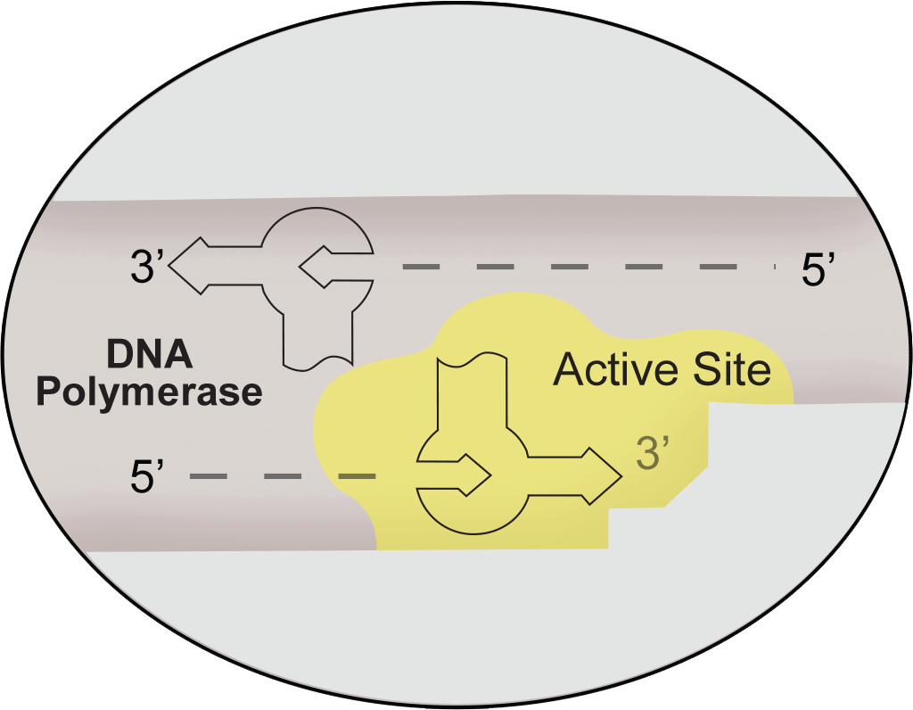
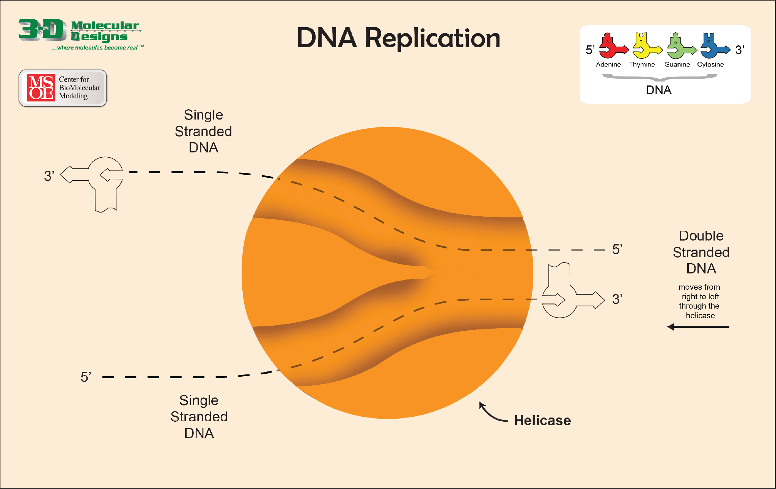
Replication Enzymes
Examine these models of enzymes used in DNA replication. In your lab notebook, record:
NOTICE – at least 2 observations per enzyme:
  What shapes do you observe?
  How might these enzymes interact with your DNA model?
  Do they look like they have specific jobs?
WONDER (at least 2 questions):
  What do you think each enzyme does?
  Where on the DNA might each enzyme work?
  How might these enzymes help cells copy DNA?
Notes:
[~6-8 MINUTES]
TEACHER MOVES:
This slide introduces enzyme models—students transition from understanding DNA structure to exploring the proteins that manipulate DNA during replication.
Distribute enzyme models:
Before showing the slide, distribute the enzyme models to each group:
Helicase placemat (large mat with replication fork design)
DNA polymerase model(s) (2 polymerase pieces per group)
As you distribute: "These are models of the enzymes—the molecular machines—that copy DNA. Don't use them yet. Just observe."
Project the slide and give instructions:
"Examine these models of enzymes used in DNA replication."
Read the instructions from the slide:
"In your lab notebook, record:
NOTICE – at least 2 observations per enzyme
What shapes do you observe?
How might these enzymes interact with your DNA model?
Do they look like they have specific jobs?
WONDER (at least 2 questions):
What do you think each enzyme does?
Where on the DNA might each enzyme work?
How might these enzymes help cells copy DNA?"
Give observation time (4-5 minutes):
"You have 4-5 minutes. Pick up the enzyme models, examine them closely, and record your observations and questions in your notebook."
Circulate and listen:
As students examine the models, listen for productive observations and questions:
About HELICASE (placemat):
✅ "It has a split/fork shape"
✅ "It looks like DNA could fit through the middle"
✅ "Maybe it separates the two strands?"
✅ "It has an opening where DNA enters and two openings where strands exit"
About DNA POLYMERASE:
✅ "It has a curved/C-shaped design"
✅ "It looks like it could hold onto DNA"
✅ "Maybe it adds nucleotides?"
✅ "It has a channel where DNA might fit"
Use guiding questions (without giving answers):
If students are stuck: "Look at the helicase placemat. How many strands of DNA go IN versus how many come OUT?"
"Look at the shape of DNA polymerase. Where might DNA fit into this enzyme?"
"Think about what needs to happen during replication. Which enzyme might separate strands? Which might build new strands?"
Validate observations and questions:
"Great observations! I'm hearing lots of thinking about HOW these shapes might FUNCTION. You're connecting structure to function—that's exactly what molecular biologists do!"
Whole-class share (2-3 minutes):
"Let's share some observations. What did you notice about the helicase?"
Call on 2-3 students.
"What about DNA polymerase?"
Call on 2-3 students.
"What questions do you have about how these enzymes work?"
Call on 2-3 students. Chart questions on the board if time allows.
Preview next activity:
"In the next slides, you're going to TEST these enzymes with your DNA models. You'll discover through hands-on exploration what each enzyme does. Think of yourselves as molecular biologists running experiments!"
[BLOOM'S LEVEL: OBSERVE / ANALYZE / HYPOTHESIZE]
STUDENT MOVES:
Students engage in tactile exploration of enzyme models, examining physical features (shape, openings, curvature). They practice observation skills, recording specific structural details in their notebooks. They generate hypotheses about enzyme function based on structure (inferring function from form). They ask authentic scientific questions about mechanism: "How does this work? Where does it act? Why this shape?" Students build anticipation for the upcoming hands-on exploration, priming their minds for discovery.
❌ COMMON MISCONCEPTION:
Students might think:
"Enzymes are rigid, static objects" (not understanding they're dynamic, flexible proteins)
"Each enzyme works alone" (not understanding coordinated action of multiple proteins)
"Enzymes are the same size as DNA strands in the model" (not understanding relative scale)
"Enzymes randomly do things to DNA" (not understanding specific substrate recognition and active sites)
CLARIFICATION:
Enzymes are dynamic: "These foam models show the basic SHAPE of the enzymes, but real enzymes are flexible proteins that change shape as they work. Think of them like molecular machines with moving parts."
Enzymes work together: "In real cells, helicase and DNA polymerase work as a coordinated team, along with many other proteins we won't model today. It's like an assembly line—each protein has a specific job, and they all work together."
Scale is simplified: "These models are sized for you to manipulate easily. In reality, enzymes are thousands of times smaller than you can see. But the SHAPES and FUNCTIONS shown in the models are accurate."
Specificity matters: "Helicase doesn't just separate any molecule—it specifically recognizes DNA and breaks hydrogen bonds between base pairs. DNA polymerase doesn't just add any molecules—it specifically adds DNA nucleotides in the correct sequence. Enzymes are highly specific."
📦 MODEL/VISUAL REFERENCE:
Point to the enzyme models on students' desks:
HELICASE PLACEMAT:
"Look at this helicase model. Notice the FORK shape—like a Y or a tuning fork. The double helix enters at the bottom (point to entry), and two separated single strands exit at the top (point to the two arms). This shape tells you what helicase DOES—it separates strands!"
DNA POLYMERASE:
"Look at the DNA polymerase model. It has a curved, clamp-like shape. See how it could grip around a DNA strand? (Demonstrate with a single strand if available.) This shape allows polymerase to hold onto the template strand while adding new nucleotides."
Show slide images:
Point to the images of enzymes on the slide: "Here are photos of the actual models you're holding. Compare what you see on the screen to what's in your hands."
Optional: Use Enzymes in Action kit visuals (if available):
If you have the Enzymes in Action kit, you can reference the protein structure representations: "These are simplified versions. The actual molecular structures are even more complex, but our foam models capture the key functional features."
✓ FORMATIVE ASSESSMENT (Quick Check):
Scan student notebooks while circulating:
Look for:
✅ At least 2 observations per enzyme (specific, detailed)
✅ At least 2 questions (genuine wondering, not superficial)
✅ Connections between structure and function ("The fork shape might separate strands")
Ask individual students:
"Show me the helicase. What's one thing you noticed about its shape?"
"Show me DNA polymerase. Where do you think DNA fits into this enzyme?"
"What's one question you have about how these enzymes work?"
Red flags to watch for:
❌ Vague observations ("It's big" / "It's made of foam")
❌ No questions recorded
❌ Off-task behavior (playing with models instead of observing)
Quick whole-class check:
"Without telling you what they do yet, based ONLY on shape, which enzyme do you think SEPARATES DNA strands?"
Expected response: "Helicase!" (based on fork shape)
"Which enzyme do you think BUILDS new DNA strands?"
Expected response: "DNA polymerase!" (based on clamp shape)
→ If students make reasonable structure-function predictions → Move forward
→ If students are completely uncertain → Provide more scaffolding: "Think about the shapes. A fork splits things. A clamp holds things. How might those shapes relate to DNA replication?"
🔗 CONNECTIONS:
Protein structure and function: Classic example of how 3D protein shape determines biological function
Engineering: Enzymes as molecular machines (connects biology to engineering/design thinking)
Prior knowledge: Students already predicted strand separation and nucleotide addition (Slide 18)—now they see the TOOLS that do those jobs
NGSS: Crosscutting Concept 6 (Structure and Function), Science and Engineering Practice 2 (Developing and using models)
DIFFERENTIATION NOTES:
For visual-spatial learners: This activity plays to their strengths—3D models, shape analysis
For struggling students: Provide observation prompts:
"I notice the helicase has ___ (describe shape)"
"I notice the DNA polymerase has ___ (describe shape)"
"I wonder if the helicase might ___"
"I wonder if the DNA polymerase might ___"
For advanced students: Challenge: "Research the actual protein structures of helicase and DNA polymerase. How do our simplified models compare to the real molecular structures?"
For kinesthetic learners: Encourage physical manipulation: "Pick up the models, rotate them, feel the shapes, imagine how DNA would interact with them."
ADDITIONAL NOTES:
Why Notice & Wonder again?
This is the SECOND Notice & Wonder in the activity (first was with nucleotides on Slide 8). This instructional routine is used whenever students encounter NEW materials/phenomena. It:
Activates prior knowledge
Builds curiosity and ownership
Provides formative assessment data
Prepares minds for focused exploration
Optional Extension: Enzymes in Action Kit
If you have the Enzymes in Action© kit mentioned in the materials list, this is a good time to reference it: "The Enzymes in Action kit has additional proteins involved in replication—primers, ligase, single-strand binding proteins. For today, we're focusing on the two main players: helicase and DNA polymerase."
Optional Extension: AR App
From the teacher guide, students can use the 3DMD AR EDU app to scan the enzyme models and see molecular-level representations. If time allows (and if you did AR exploration earlier with nucleotides), you could offer this as an extension: "If you finish early, you can use the AR app to scan these enzyme models and see their molecular structures."
Management note:
Enzyme models (especially the helicase placemat) can be large and take up significant desk space. Make sure students have enough room to spread out materials. You might need to have groups move to larger tables or floor space.
Time-saving option:
If you're running short on time, you can reduce the Notice & Wonder time to 3 minutes and move quickly to the hands-on exploration (next slides). The core value is in USING the enzymes, not just observing them.
Preview of next slides:
"In the next few slides, you'll test each enzyme individually. First, you'll explore what helicase does. Then you'll explore DNA polymerase. Finally, you'll use BOTH together to model the complete replication process. Let's start with helicase—the DNA unzipper!"

Slide 33

What does the Helicase do?
Explore how the DNA strand interacts with the helicase placemat.
Record your observations in your lab notebook.
  Are the two strands still connected after helicase passes?
  Why might this action be called "unzipping"?
  What is the helicase’s job during DNA replication?
Notes:
[~6-8 MINUTES]
TEACHER MOVES:
This is the first hands-on enzyme exploration—students discover helicase function through direct manipulation.
Set up the exploration:
Distribute pre-assembled double-strand DNA that is about 40 nucleotides long. Use either sequence 1 or 2 fin the kit. If you don’t have these pre-assembled, give students one of the sequence maps and have them assemble the DNA before distributing the placemat.
Give exploration instructions:
"Now you're going to explore how the DNA strand interacts with the helicase placemat."
Read the instructions from the slide:
"Explore how the DNA strand interacts with the helicase placemat"
"Record your observations in your lab notebook"
If needed demonstrate the setup (critical for success):
Hold up a double helix model and the helicase placemat:
"Take your double helix and thread it through the helicase placemat. Start at the right where the opening is (point to entry point). Push the double helix through slowly, as if the helicase is moving along the DNA."
Model the motion: Slowly push (a jiggling or small shaking motion will help separate the strands) the double helix through the helicase fork, showing how the two strands separate as they emerge from the two upper arms of the fork.
"As you push the DNA through, watch carefully what happens. That's what you're observing and recording."
Give exploration time (4-5 minutes):
"Work with your group. Thread your DNA through the helicase and observe what happens. Answer the questions in your notebook. You have about 5 minutes."
The three guiding questions (green text on slide):
Project and read these aloud:
"Are the two strands still connected after helicase passes?"
"Why might this action be called 'unzipping'?"
"What is the helicase's job during DNA replication?"
Circulate and facilitate (4-5 minutes):
As students explore, use guiding questions:
✅ "What happens to the base pairs as DNA goes through the helicase?"
✅ "Count the strands going IN to helicase. Now count the strands coming OUT. What do you notice?"
✅ "Try moving the helicase along the DNA in both directions. Does it work the same way?"
Watch for key observations:
Listen for students saying:
"The two strands separate!"
"The base pairs come apart!"
"It's like unzipping a zipper!"
"One double strand goes in, two single strands come out!"
Whole-class discussion (2 minutes):
Bring the class together: "What did you observe?"
Call on 3-4 students to share.
Key discussion questions:
"Are the two strands still connected after helicase passes?"
Expected: "No! They're separated."
Follow-up: "What held them together before?" (Base pairs / hydrogen bonds)
"Why might this action be called 'unzipping'?"
Expected: "It's like unzipping a zipper—the two sides separate"
Affirm: "Exactly! Helicase 'unzips' the DNA double helix by breaking the hydrogen bonds between base pairs."
"What is the helicase's job during DNA replication?"
Expected: "To separate the two strands" / "To unzip the DNA"
Formalize: "Helicase's job is to separate the two DNA strands by breaking the hydrogen bonds between base pairs. This creates the replication fork—the Y-shaped structure where replication happens."
Introduce vocabulary:
Write on the board: REPLICATION FORK
"The Y-shaped region where DNA is being unwound is called the replication fork. One double helix enters, two single strands exit. Those single strands become TEMPLATES for building new strands."
[BLOOM'S LEVEL: APPLY / ANALYZE / DISCOVER]
STUDENT MOVES:
Students physically manipulate DNA models through the helicase placemat, observing strand separation in real-time. They make tactile observations: double helix enters, single strands exit. They record detailed observations in notebooks, answering guided questions. They discover helicase function through hands-on exploration rather than being told. They connect the physical model behavior to biological function (unzipping, creating replication fork). Students practice scientific vocabulary: helicase, unzip, replication fork, template strands.
❌ COMMON MISCONCEPTION:
Students might think:
"Helicase cuts or destroys the DNA" (not understanding it only breaks hydrogen bonds, not covalent bonds)
"The strands can never reconnect after helicase separates them" (not understanding this is reversible)
"Helicase works on any part of DNA at any time" (not understanding it requires specific starting signals)
"Once separated, the DNA stays separated permanently" (not understanding strand re-annealing)
CLARIFICATION:
Helicase doesn't destroy DNA: "Helicase breaks the WEAK hydrogen bonds between base pairs—like opening velcro. It does NOT break the STRONG covalent bonds in the sugar-phosphate backbone. The backbone stays intact! So each strand remains a complete chain."
Separation is temporary and localized: "Helicase only separates a small region of DNA at a time—the replication fork. Behind the replication fork, after new strands are built, the DNA can form a double helix again. It's not permanent destruction—it's temporary separation for copying."
Helicase requires energy: "In real cells, helicase uses ATP (cellular energy) to break those hydrogen bonds. It's not passive—it's an active molecular motor that moves along DNA and uses energy to unwind it."
📦 MODEL/VISUAL REFERENCE:
Demonstrate with the model:
Hold up the helicase placemat and a double helix: "Watch what happens. The double helix enters here (point to bottom opening). As I push it through, the two strands separate here (point to the fork). Two single strands exit here and here (point to the two upper arms)."
Physically show the process: Slowly thread the DNA through while students watch – use a jiggling or small shaking motion as you push. "See? One becomes two. Double helix → two single strands."
Point to student models: Walk around and point to groups' setups: "Look at this group's model. Count the strands before helicase—one double helix. Count after helicase—two single strands. That's helicase's job!"
Draw on the board (quick sketch):
text
/ \ ← Two single strands (separated)
/ \
| ⬡ | ← Helicase (the fork)
\ /
\ /
|| ← Double helix (paired)
"This is the replication fork. Helicase creates and moves along this fork, continuously separating strands."
Point to slide images:
If the slide has images of helicase in action, point to them: "Here's a diagram showing helicase at work. Notice the Y-shape—that's the replication fork."
✓ FORMATIVE ASSESSMENT (Quick Check):
Observe during exploration:
✅ Are students successfully threading DNA through the helicase placemat?
✅ Are they observing that strands separate?
✅ Are they recording observations in notebooks?
Ask individual groups:
"Show me what happens when DNA goes through helicase." (They should demonstrate threading and separation)
"Point to the replication fork in your model." (They should point to the Y-shaped region)
"What does helicase do?" (Answer: separates/unzips DNA strands)
Quick whole-class check:
"Everyone hold up your helicase placemat. Point to where the double helix enters." (Check that students identify bottom opening)
"Now point to where the separated strands exit." (Check that students identify the two upper arms)
Conceptual check—ask the class:
"Does helicase break the sugar-phosphate backbone?"
Expected answer: "No! It only breaks the hydrogen bonds between base pairs. The backbone stays intact."
→ If students understand helicase separates strands → Move forward
→ If students are confused → Demonstrate again with your own model: "Watch carefully. I'm going to do this in slow motion. Double helix in... two single strands out. What's happening to the base pairs? They're separating."
🔗 CONNECTIONS:
Chemistry: Hydrogen bonds vs. covalent bonds (weak vs. strong bonds)
Energy: Helicase requires ATP (connects to cellular respiration)
Prior knowledge: Students predicted strand separation on Slide 18—now they see HOW it happens
Looking ahead: Separated strands become templates for DNA polymerase
NGSS: Crosscutting Concept 6 (Structure and Function—helicase structure enables its separating function)
DIFFERENTIATION NOTES:
For struggling students: Provide a step-by-step card:
Build a double helix (6 base pairs)
Place helicase placemat in front of you
Thread double helix through bottom opening
Push slowly upward
Watch what happens to the strands
For advanced students: Ask: "Helicase moves at about 1000 base pairs per second in bacteria. How might cells regulate the speed of helicase to coordinate with DNA polymerase?"
For visual learners: Use the document camera to project one group's model so everyone can see the process in real-time
For kinesthetic learners: This activity is perfect—hands-on, movement-based, tactile
ADDITIONAL NOTES:
Why this hands-on exploration matters:
Students could simply be TOLD "helicase unzips DNA," but by DOING it themselves, they:
Remember it better (kinesthetic memory)
Understand it more deeply (not just memorizing)
See the mechanism visually and tactilely
Build intuition about molecular processes
Common teacher mistake to avoid:
❌ Don't rush through this exploration. Students need time to thread DNA through, observe carefully, and discuss with their group. If you rush, they'll miss key observations.
Troubleshooting:
Problem: Students can't figure out how to thread DNA through helicase
Solution: Demonstrate clearly at the front of the room. Use document camera if available. Walk around and help groups get started.
Problem: The foam pieces are difficult to manipulate through the placemat
Solution: If a shaking motion doesn’t work for students, they can gently start to pull the strands apart before threading them through the model.
Vocabulary reinforcement:
Write these terms on the board:
Helicase = enzyme that unzips DNA
Unzip = separate the two strands
Replication fork = Y-shaped structure where DNA is separated
Template strand = single strand used as a pattern for building new DNA
Connection to real molecular biology:
"In bacteria, helicase moves at about 1,000 base pairs per second—incredibly fast! In humans, it's slower (about 100 base pairs per second), but there are thousands of replication forks working simultaneously across all your chromosomes."
Preview next slide:
"Now you've seen how helicase separates the strands. But separation is only HALF the job. Next, you'll explore DNA polymerase—the enzyme that BUILDS new DNA strands using those separated strands as templates."

Slide 34
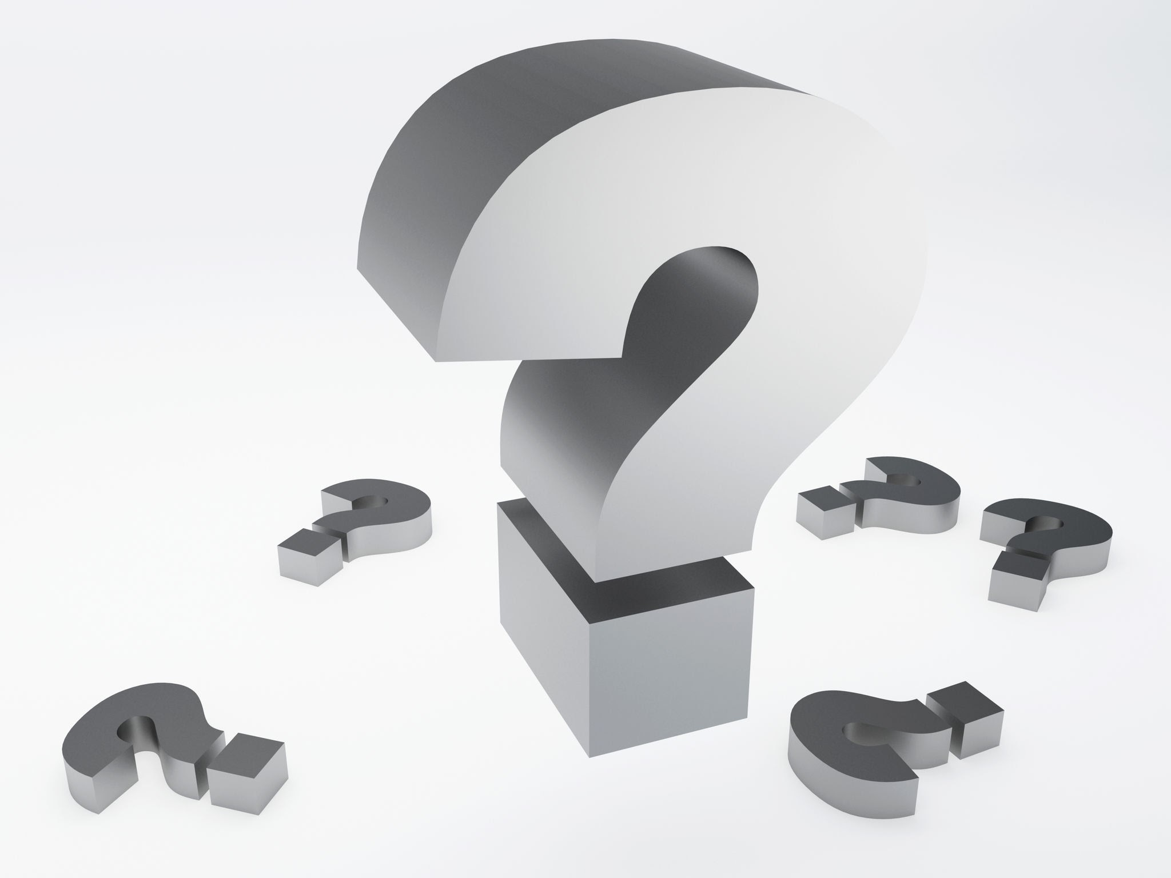
What does the DNA Polymerase do?
Test the DNA polymerase with top DNA strand. Use 5 – 10 nucleotides.
Record your observations in your lab notebook.
  Where does DNA polymerase sit on the DNA?
  Can you add nucleotides to rebuild the second strand?
  Does DNA polymerase help you match the correct bases?
What is DNA polymerase's job during replication?
Notes:
[~6-8 MINUTES]
TEACHER MOVES:
This slide explores DNA polymerase function—students discover how new strands are synthesized.
Set up the exploration:
"You've seen how helicase separates DNA strands. Now we're going to explore the enzyme that BUILDS new strands: DNA polymerase."
Prepare materials:
"For this activity, you need ONE of your separated strands—use the top strand. You also need the DNA polymerase model and some free nucleotides (loose, unconnected pieces)."
Give students 30-60 seconds to prepare materials.
Give exploration instructions:
Read from the slide:
"Test the DNA polymerase with the top DNA strand. Use 5-10 nucleotides."
"Record your observations in your lab notebook."
Demonstrate the setup:
Hold up a single DNA strand and the DNA polymerase model:
"Take your single strand—this is the TEMPLATE strand. Place the DNA template strand on top of the DNA polymerase following the printed shapes." (Demonstrate positioning polymerase on the strand)
"Now, DNA polymerase's job is to BUILD a new complementary strand. Take loose nucleotides and try adding them one at a time, following the base pairing rules. But you can only add nucleotides in the active site highlighted in yellow."
Give exploration time (4-5 minutes):
"Work with your group. Position template DNA strand on top of the DNA polymerase and start building the complementary strand only in the yellow active site region. Answer the questions in your notebook. You have about 5 minutes."
The three guiding questions (from slide):
"Where does DNA polymerase sit on the DNA?"
"Can you add nucleotides to rebuild the second strand?"
"Does DNA polymerase help you match the correct bases?"
Circulate and facilitate:
As students explore, use guiding questions:
✅ "What's the sequence of your template strand? What bases should you add to make the complementary strand?"
✅ "Try adding a WRONG base (like A to A). Does it fit through the polymerase?"
✅ "Which direction does the polymerase face? Does it matter?"
Watch for key discoveries:
Listen for students saying:
"The polymerase holds the template strand!"
"It guides the new nucleotides into place!"
"It only lets the correct base pair through!"
"We're building the complementary strand one nucleotide at a time!"
Address the green question on the slide:
After students have explored for 4-5 minutes, bring the class together for the key question:
"What is DNA polymerase's job during replication?"
Call on 3-4 students. Listen for:
"It builds the new DNA strand"
"It adds nucleotides one at a time"
"It matches the correct bases using the base pairing rules"
"It uses the old strand as a template"
Formalize the concept:
"DNA polymerase's job is to read the template strand and build a new complementary strand by adding nucleotides one at a time. It follows the base pairing rules: if the template has A, it adds T; if the template has G, it adds C."
"The polymerase acts like a molecular 'quality control' machine—its shape ensures only the correct base pairs can fit through. This is how DNA replication stays accurate!"
Introduce key vocabulary:
Write on the board:
DNA Polymerase = enzyme that builds new DNA strands
Template strand = the original strand used as a pattern
Complementary strand = the new strand being built
[BLOOM'S LEVEL: APPLY / ANALYZE / DISCOVER]
STUDENT MOVES:
Students position the template DNA on the DNA polymerase, exploring how the enzyme interacts with DNA. They select appropriate free nucleotides and add them to build a complementary strand, applying base pairing rules. They observe that polymerase constrains where nucleotides can be added (in the yellow active site). They record observations about polymerase positioning, nucleotide addition, and accuracy mechanisms. Students discover synthesis direction and sequential addition (one nucleotide at a time). They articulate polymerase function: reading template and building complement.
❌ COMMON MISCONCEPTION:
Students might think:
"DNA polymerase creates nucleotides from scratch" (not understanding it assembles pre-existing nucleotides)
"DNA polymerase can add nucleotides in any order" (not understanding it reads the template)
"DNA polymerase works without any direction/orientation" (not yet understanding 5'→3' synthesis)
"DNA polymerase can start building anywhere on DNA" (not understanding it needs a primer—simplified in this model)
CLARIFICATION:
Polymerase assembles, doesn't create: "DNA polymerase doesn't make nucleotides—it takes nucleotides that already exist in the cell (from food you eat!) and connects them in the right order. Think of it like a construction worker: it doesn't make bricks, but it assembles bricks into a wall."
Template dictates sequence: "Polymerase can't just add any random nucleotide. It READS the template strand and adds the complementary nucleotide. If template says A, polymerase MUST add T. If template says G, polymerase MUST add C. The sequence is determined by the template."
Direction matters (preview): "DNA polymerase can only build in ONE direction: 5' to 3'. We'll explore what that means in the next few slides, but for now, know that polymerase has a specific orientation—it can't work backwards."
Primer requirement (simplified here): "In real cells, DNA polymerase can't start from nothing—it needs a short RNA primer to start building. Our foam models simplify this—you can start adding nucleotides directly. But in reality, another enzyme (primase) creates the starting point."
📦 MODEL/VISUAL REFERENCE:
Demonstrate with the model:
Hold up DNA polymerase and a single strand: "Watch how I position the polymerase. The template strand fits into the top channel (indicated with a dashed line and a nucleotide outline ). Now I take a free nucleotide—let's say the template has A, so I need to add T (hold up T nucleotide). I slide T into position under A in the yellow active site, and they pair. The polymerase guides this pairing."
"Now I move the polymerase forward one position and add the next nucleotide. One at a time, reading the template, adding the complement."
Point to student models:
Walk around and highlight good examples: "Look at this group's model. See how the polymerase is positioned on the template strand? See the new complementary strand being built? That's DNA synthesis in action!"
Point to slide image:
If the slide has an image of DNA polymerase at work, point to it: "Here's a diagram showing DNA polymerase. Notice how it clamps around the DNA? That's what your foam model represents."
✓ FORMATIVE ASSESSMENT (Quick Check):
Observe during exploration:
✅ Are students successfully positioning DNA polymerase on their template strand?
✅ Are they adding nucleotides that follow base pairing rules?
✅ Are they building the strand sequentially (one nucleotide at a time)?
Ask individual groups:
"Show me your template strand. Now show me the new strand you're building." (Check for complementary pairing)
"What happens if you try to add a wrong base?" (They should explain it doesn't fit well)
"What does DNA polymerase do?" (Answer: builds new DNA strand using template)
Quick sequence check:
Write a template sequence on the board: A - T - G - C
"If this is your template strand, what sequence should DNA polymerase build?"
Expected answer: T - A - C - G
Listen for understanding of:
Template-directed synthesis
Base pairing rules application
Sequential addition (not all at once)
→ If students successfully build complementary strands → Move forward
→ If students add incorrect bases or don't understand → Clarify: "Let's practice together. My template is A-T-G. What's the first base I should add? (T) Good. What's the second? (A) Good. What's the third? (C) Yes! The template TELLS you what to add."
🔗 CONNECTIONS:
Protein function: DNA polymerase is one of the most important enzymes in biology
Information transfer: Template strand contains information; new strand copies it
Prior knowledge: Students already know base pairing rules (Slide 15)—now they're applying them in synthesis
Looking ahead: DNA polymerase's direction (5'→3') will explain leading vs. lagging strand differences
NGSS: HS-LS1-1 (Structure of DNA determines structure of proteins—accurate copying is essential)
DIFFERENTIATION NOTES:
For struggling students: Provide a template sequence card and a matching answer key so they can check their work:
Template: A-T-G-C-T-A
Complement: T-A-C-G-A-T
For advanced students: Ask: "DNA polymerase has a 'proofreading' function—it checks each nucleotide after adding it. How might that work? What happens if it detects an error?"
For visual learners: Use document camera to show one group's model in action—project it so whole class can see nucleotides being added
For kinesthetic learners: This is highly kinesthetic—students are physically building
ADDITIONAL NOTES:
Why this exploration matters:
DNA polymerase is the KEY enzyme of replication. By manipulating the model, students viscerally understand:
Template-directed synthesis (the template TELLS polymerase what to add)
Sequential addition (one nucleotide at a time, not all at once)
Accuracy mechanism (shape complementarity ensures correct pairing)
Polymerase accuracy in real cells:
"DNA polymerase is incredibly accurate. It makes only about 1 error per 10,000 nucleotides. And it has built-in proofreading—if it adds a wrong base, it can back up, remove it, and try again. We'll explore error correction in detail in the optional extension."
Connection to medicine:
"Many cancer treatments target DNA polymerase. Chemotherapy drugs can block DNA polymerase in rapidly dividing cancer cells, stopping them from copying their DNA and dividing."
Troubleshooting:
Problem: Students struggle to position the template DNA on the DNA polymerase
Solution: Show them the graphics where the template fits. The images on the polymerase should match the strand.
Problem: Students try to add all nucleotides at once instead of sequentially
Solution: Emphasize: "One at a time! Polymerase adds ONE nucleotide in the active site, then moves forward, then adds the NEXT nucleotide. It's sequential, not simultaneous. You may only add nucleotides in the yellow active site."
Problem: Students add incorrect bases
Solution: Check their base pairing understanding. Review: A↔T, G↔C. Have them check each nucleotide: "Read the template base, then ask yourself what the complement is."
Preview of next slide:
"Now you understand what helicase does (separates strands) and what DNA polymerase does (builds new strands). The next slide asks you to REFLECT on what you've learned and explain these enzyme functions in your own words."

Slide 35
Template
Strand
DNA Polymerase
New
Strand
5'
3'

Slide 36
Model DNA Replication
Use the three enzymes together and model DNA replication.
Notes:
[~8-10 MINUTES]
TEACHER MOVES:
This slide provides a comprehensive hands-on synthesis—students model the complete replication process using all three enzymes together.
Transition to full modeling:
"You've learned about each enzyme individually. Now it's time to put it ALL together. You're going to model the complete DNA replication process from start to finish using helicase, DNA polymerase, and conceptually, DNA ligase."
Set expectations:
"This is your chance to show you understand the entire process. You'll need to coordinate:
Helicase unzipping the DNA
Leading strand synthesis (continuous)
Lagging strand synthesis (Okazaki fragments)
Conceptually, how ligase would join the fragments"
Review materials needed:
"Each group should have:
One helicase placemat
Two DNA polymerase models
Your rebuilt double helix (6-8 base pairs)
Extra loose nucleotides for building new strands"
Give students 1 minute to gather materials if needed.
Give modeling instructions:
"Use all three enzymes together and model DNA replication."
"Here's the process you should demonstrate:
Step 1: Thread your double helix through the helicase (separation begins)
Step 2: Position one DNA polymerase on the TOP strand (leading strand)—it should follow helicase
Step 3: Position another DNA polymerase on the BOTTOM strand (lagging strand)—remember it builds in short pieces
Step 4: Build the NEW leading strand continuously, adding nucleotides one at a time following helicase
Step 5: Build the NEW lagging strand in short pieces (2-3 nucleotides per fragment), multiple fragments
Step 6: Imagine DNA ligase joining the lagging strand fragments (you can point to where gaps would be filled)"
Give modeling time (6-8 minutes):
"You have 6-8 minutes. Work as a team. Make sure EVERYONE in your group understands each step."
Circulate and facilitate:
As groups work, walk around and ask probing questions:
✅ "Show me which strand is the leading strand. How do you know?"
✅ "Show me an Okazaki fragment. Which direction is it built?"
✅ "What direction does helicase move?"
✅ "If I'm DNA ligase, where would I work?" (Pointing to gaps between Okazaki fragments)
✅ "What's the result of this process? How many double helices do you end up with?"
Watch for successful modeling:
Look for groups that:
✅ Thread DNA through helicase correctly (separation)
✅ Position leading strand polymerase following helicase
✅ Position lagging strand polymerase building away from helicase
✅ Build leading strand continuously
✅ Build lagging strand in short, separate pieces
✅ Can explain where ligase would act
Provide real-time coaching:
If groups struggle:
"Start with helicase—unzip the DNA first"
"Now add the leading strand polymerase—which direction should it face?"
"For the lagging strand, don't try to build one long piece—build SHORT pieces"
"Remember: each Okazaki fragment is built 5'→3', but positioned toward helicase"
Showcase strong examples:
After 5-6 minutes, identify a group with excellent modeling. Use document camera (if available) or invite class to gather around:
"Everyone, let's look at this group's model. They've done a great job showing the complete process. Notice how they have:
Helicase creating the replication fork (point)
Leading strand being built continuously (point)
Multiple Okazaki fragments on the lagging strand (point)
Gaps where ligase would work (point)"
Whole-class discussion (2 minutes):
Bring everyone back to seats.
"Now that you've modeled replication, let's reflect:
Question 1: "How many complete double helices do you create during replication?"
Expected answer: "Two! Each template strand gets a new complementary strand, creating two complete double helices from one original."
Question 2: "Are the two new double helices identical to the original?"
Expected answer: "Yes! Because of base pairing rules, the sequence is copied exactly."
Question 3: "Does each new double helix contain one old strand and one new strand?"
Expected answer: "Yes! This is called semi-conservative replication—each new double helix has one parental strand and one newly synthesized strand."
Introduce terminology (if time allows):
Write on the board: SEMI-CONSERVATIVE REPLICATION
"Each new DNA molecule contains one OLD strand (from the parent) and one NEW strand (newly synthesized). Half is conserved (old), half is new. That's why it's called semi-conservative replication."
[BLOOM'S LEVEL: APPLY / CREATE / SYNTHESIZE]
STUDENT MOVES:
Students orchestrate a complex multi-step process, coordinating multiple enzymes and synthesizing all prior learning. They physically manipulate models to demonstrate helicase movement, leading strand synthesis (continuous), and lagging strand synthesis (discontinuous). They apply understanding of directionality (5'→3'), antiparallel orientation, and enzyme functions. They demonstrate spatial reasoning, positioning enzymes correctly relative to DNA strands and fork movement. Students explain the process to group members, teaching and learning from peers. They consolidate understanding through hands-on application, creating a memorable kinesthetic experience.
❌ COMMON MISCONCEPTION:
Students might model:
Both strands synthesized continuously (forgetting lagging strand fragments)
Lagging strand fragments built in wrong direction (away from helicase instead of toward)
Helicase working after polymerase (wrong order—separation must happen first)
Only ONE new double helix created (not understanding both strands become templates)
Completely new DNA unrelated to original sequence (not understanding template-directed synthesis)
CLARIFICATION:
Both strands, different strategies: "Make sure you're showing BOTH strands being copied—one continuously (leading), one in pieces (lagging). If you're only showing one strand, you're missing half the process!"
Okazaki fragment direction: "Check your Okazaki fragments. Each one should be built 5'→3', and they should be oriented TOWARD the helicase, not away from it."
Order matters: "Helicase FIRST, then polymerase. You can't synthesize new DNA until the strands are separated!"
Two identical double helices: "The result of replication is TWO complete double helices. Each original template strand gets a new complementary strand built on it, creating two identical copies."
📦 MODEL/VISUAL REFERENCE:
Use your own model to demonstrate:
Walk through the entire process at the front of the room:
"Watch me model replication step-by-step:
Step 1: I thread my double helix through helicase. The strands separate. (Demonstrate)
Step 2: I position leading strand polymerase following helicase. (Show position)
Step 3: I build the new leading strand continuously. (Add nucleotides one at a time)
Step 4: I position lagging strand polymerase. (Show it faces away from helicase)
Step 5: I build one short Okazaki fragment. (Build 3 nucleotides toward helicase)
Step 6: I move to a new position and build another fragment. (Build another 3 nucleotides)
Step 7: Ligase would join these fragments. (Point to gaps)
Result: Two double helices!"
Draw comprehensive diagram on board:
text
BEFORE REPLICATION:
================== (one double helix)
DURING REPLICATION:
Helicase ⬡
/ \
Leading =====> \ (continuous)
Lagging <== <== \ (fragments)
AFTER REPLICATION:
================== (double helix #1: old strand + new strand)
================== (double helix #2: old strand + new strand)
✓ FORMATIVE ASSESSMENT (Quick Check):
This activity IS the formative assessment. As you circulate, evaluate:
✅ Excellent understanding:
Correctly positions all three enzymes
Builds leading strand continuously
Builds lagging strand in multiple short pieces
Can explain each step
Understands semi-conservative replication
⚠️ Partial understanding:
Positions enzymes correctly but builds both strands continuously
Builds fragments but in wrong direction
Can demonstrate but can't explain verbally
❌ Needs reteaching:
Can't position enzymes correctly
Builds randomly without following base pairing rules
Doesn't understand difference between leading/lagging
Thinks only one strand is copied
Ask each group:
"Walk me through your model. Explain what each enzyme is doing."
"How many double helices do you end up with?" (Two)
"Show me where DNA ligase would work." (Gaps between Okazaki fragments)
→ If 80%+ of groups successfully model the complete process → Excellent! Move forward.
→ If 50-79% have partial success → Pause and do a whole-class demonstration with your model, then have groups try again.
→ If <50% are successful → STOP and reteach systematically: review helicase function, leading strand, lagging strand separately before combining.
🔗 CONNECTIONS:
Cell cycle: This process happens during S-phase before cell division
Growth and repair: Every time your body grows or heals, cells replicate DNA this way
Heredity: DNA replication ensures genetic information passes to daughter cells
Looking ahead: Next slide will formalize the steps in a summary
NGSS: HS-LS1-4 (Use models to illustrate mechanisms of feedback), HS-LS3-1 (Ask questions about role of DNA)
DIFFERENTIATION NOTES:
For struggling students: Provide a step-by-step instruction card they can follow while building
For advanced students: Add complexity: "Show where primase would add RNA primers. Show where DNA polymerase I would remove primers and fill gaps with DNA."
For kinesthetic learners: This is ideal—full hands-on synthesis activity
For visual learners: Encourage them to sketch their model in their notebook alongside the physical modeling
For students who finish early: Challenge: "Model replication at TWO replication forks moving in opposite directions (bidirectional replication from one origin)"
ADDITIONAL NOTES:
Why this comprehensive modeling matters:
This is the CULMINATION of the entire activity. Students have learned about:
DNA structure (Slides 8-17)
Individual enzymes (Slides 19-21, 23-24)
The leading/lagging problem and solution (Slides 25-28)
Now they APPLY all that knowledge in a coordinated, multi-step process. This synthesis activity:
Reveals gaps in understanding (if students can't model it, they don't fully understand it)
Creates memorable kinesthetic experience
Demonstrates mastery through application
Prepares students for formal assessment
Time management:
This slide often takes longer than expected because the process is complex. Budget at least 8-10 minutes. If you're running short on time, you could shorten earlier slides, but try to preserve this synthesis activity—it's the heart of the lesson.
Group dynamics:
Make sure ALL group members participate. Rotate roles:
One student positions helicase
Another builds leading strand
Another builds lagging strand
All explain the process
Connection to semi-conservative replication:
"The term 'semi-conservative' was confirmed by the Meselson-Stahl experiment in 1958. They used heavy nitrogen isotopes to track old vs. new DNA strands and proved that each new double helix contains one old strand and one new strand."
Photo opportunity:
Take photos of student models in action. These make great documentation for:
Lab reports
Newsletters
Showcasing student learning
Preview next slide:
"You've successfully modeled the entire replication process hands-on. Now let's step back and look at a formalized, written summary of the complete replication process with all the steps clearly labeled."

Slide 37
Leading and Lagging Strands
Notes:
[~6-8 MINUTES]
TEACHER MOVES:
This slide guides students in discovering the lagging-strand solution through hands-on problem-solving.
State the problem clearly:
Read the problem statement from the slide:
"Problem: DNA polymerase MUST build 5'→3', but on the bottom strand, this direction points AWAY from the helicase."
"But the cell still needs to copy this strand!"
Pose the challenge question:
Project the green question: "How can the cell solve this? What are some potential solutions?"
Give thinking time (2 minutes):
"Turn to your partner. Brainstorm: How could the cell copy the difficult strand, given the constraint that polymerase must build 5'→3' but can't follow helicase?"
"Think creatively! Use your models to test ideas. You have 2 minutes."
Circulate and listen to ideas:
As students discuss, listen for creative solutions:
✅ "What if it builds little pieces at a time?"
✅ "What if polymerase starts farther ahead and builds backward toward helicase?"
✅ "What if it builds in short chunks instead of one long strand?"
✅ "What if there are multiple polymerases working on small sections?"
Facilitate whole-class brainstorm (2 minutes):
"Let's hear some ideas. What solutions did you come up with?"
Call on 3-4 pairs. Chart ideas on the board without judging.
Common student proposals:
Build in short pieces
Have multiple polymerases
Start ahead and build toward helicase
Wait until helicase is done, then build
Validate creative thinking:
"These are excellent ideas! Several of you proposed building in SHORT PIECES. That's exactly what cells do! Let's test it."
Give the hands-on challenge:
Read from the slide: "Test different techniques. Hint: try building short segments at a time."
"Use your models. Try to copy the bottom strand by building SHORT PIECES instead of one long continuous strand. See if this workaround solves the directional problem."
Give exploration time (4-5 minutes):
"You have 4-5 minutes to test this. Work with your group."
Circulate and guide discovery:
As students work, use guiding questions:
✅ "Start a short distance away from the helicase. Build a short piece (3-4 nucleotides) toward the helicase. Does that work?"
✅ "Now move farther away from helicase and start another short piece. Build toward helicase again."
✅ "Can you build multiple short pieces this way, all building 5'→3' but in the direction TOWARD helicase?"
Watch for the "aha" moment:
Listen for students realizing:
"Oh! If I build short pieces, I can build 5'→3' AND toward the helicase!"
"I start farther away and build backward toward where helicase was!"
"We need multiple pieces that get joined together later!"
Key insight to facilitate:
"You're building BACKWARD relative to the overall replication direction, but each SHORT PIECE is still built 5'→3'. It's like writing your name backward—you still write each letter from left to right (5'→3'), but you place the letters in reverse order!"
Bring class together (2 minutes):
"Let's talk about what you discovered. Did building short pieces solve the problem?"
Expected response: "Yes! We can build short pieces, each 5'→3', in the direction toward helicase!"
Explain the solution:
"You've discovered the cell's solution! On the difficult strand, DNA polymerase builds in SHORT PIECES called Okazaki fragments (named after the scientists who discovered them). Each piece is built 5'→3', but the pieces are oriented toward the helicase—opposite to the overall direction of replication fork movement."
"So instead of one long continuous strand, this strand is built in many short pieces that later get joined together."
Introduce key vocabulary:
Write on the board:
Okazaki fragments = short DNA pieces built on the lagging strand
Typically 100-200 nucleotides long in eukaryotes
DNA ligase = enzyme that joins the fragments together (mention briefly; will explore more on next slide)
Visual reinforcement:
Draw on the board:
Helicase →
Top (continuous): ==================> (one long piece)
Bottom (pieces): ===> ===> ===> ===> (short pieces toward helicase)
← ← ← ← (each built 5'→3')
"See? Each piece is built 5'→3' (left to right in the diagram), but they're positioned right-to-left, toward the helicase."
[BLOOM'S LEVEL: CREATE / SYNTHESIZE / PROBLEM-SOLVE]
STUDENT MOVES:
Students engage in authentic problem-solving: identifying constraints, brainstorming solutions, testing hypotheses. They discover that discontinuous synthesis resolves the directional conflict. They manipulate models to build multiple short pieces, each 5'→3', but positioned toward helicase. They experience the "aha" moment of realizing short pieces CAN satisfy both constraints (5'→3' synthesis + copying toward helicase). Students learn through discovery rather than being told, creating deeper understanding and better retention.
❌ COMMON MISCONCEPTION:
Students might think:
"Each Okazaki fragment is built 3'→5' since they go 'backward'" (confusing overall direction with synthesis direction)
"Okazaki fragments are mistakes that need to be fixed" (not understanding this is the NORMAL mechanism)
"The lagging strand ends up incomplete or inferior" (not understanding fragments are joined into a complete strand)
"Okazaki fragments stay separated forever" (not understanding DNA ligase joins them)
CLARIFICATION:
Each fragment is still 5'→3': "This is the key insight: EACH individual Okazaki fragment is built 5'→3'. But the PLACEMENT of fragments is toward the helicase. Think of it like writing words backward: each letter is still written normally (left to right), but you place the letters in reverse order. Same with Okazaki fragments—each piece is built 5'→3', but pieces are positioned 'backward' relative to replication fork movement."
This is normal, not a mistake: "Okazaki fragments aren't errors—this is the NORMAL way the lagging strand is replicated. Every time your cells divide, billions of Okazaki fragments are made and joined together. It's a routine part of DNA replication."
Fragments get joined: "The fragments don't stay separated. An enzyme called DNA ligase 'glues' them together by forming bonds between adjacent fragments. The final result is one continuous strand, just like the leading strand—you can't tell which strand was made continuously vs. in pieces."
📦 MODEL/VISUAL REFERENCE:
Demonstrate with foam models:
Use your own model to show the class:
Continuous strand (leading): "On the top strand, I start here (point near helicase) and build continuously, following helicase. One long piece."
Discontinuous strand (lagging): "On the bottom strand, I start HERE (point away from helicase), build a short piece toward helicase (demonstrate). Now I move to HERE (point farther away), build another short piece toward helicase. And HERE (even farther), another piece. Multiple short pieces, all built 5'→3', all directed toward helicase."
Visual on board:
Draw a detailed diagram:
Leading: =================> (continuous)
Helicase →
Lagging: <== <== <== <== (each arrow is one Okazaki fragment)
1 2 3 4 (built in this order: 1, 2, 3, 4)
"Polymerase builds fragment 1 first (farthest from helicase), then fragment 2, then fragment 3, then fragment 4 (closest to helicase). Each is built 5'→3', but they're synthesized in reverse order relative to fork movement."
✓ FORMATIVE ASSESSMENT (Quick Check):
Observe during exploration:
✅ Are students successfully building short pieces on the lagging strand?
✅ Are they building each piece 5'→3' (correct direction)?
✅ Are pieces oriented toward helicase?
Ask individual groups:
"Show me one Okazaki fragment. Which direction is it built?" (5'→3')
"Show me where you'd build the NEXT Okazaki fragment." (Farther from helicase)
"Why are these pieces built 'backward' relative to replication?" (Because helicase moves away, so new pieces start farther from helicase)
Quick concept check:
"True or false: Each Okazaki fragment is built 3'→5'."
Expected answer: "FALSE! Each fragment is built 5'→3'. It's the PLACEMENT of fragments that's 'backward,' not the synthesis direction of individual fragments."
→ If students understand discontinuous synthesis solves the problem → Move forward
→ If students think fragments are built 3'→5' → Clarify: "Let me be very clear: DNA polymerase ALWAYS builds 5'→3'. It cannot build 3'→5'. Each Okazaki fragment is built 5'→3'. But the fragments are POSITIONED toward the helicase, which makes them oriented opposite to the replication fork movement overall."
🔗 CONNECTIONS:
Creative problem-solving: Demonstrates how biological systems solve structural constraints creatively
Engineering: Workarounds and creative solutions within constraints
History of science: Okazaki fragments were discovered in 1968 by Reiji and Tsuneko Okazaki
Prior knowledge: Applies understanding from Slide 26 (why problem exists) to create solution
NGSS: Science and Engineering Practice 6 (Constructing explanations), Crosscutting Concept 6 (Structure and function)
DIFFERENTIATION NOTES:
For struggling students: Provide a template showing where to place fragments: "Start here (mark), build 3 nucleotides toward helicase. Now start here (mark farther away), build 3 more toward helicase."
For advanced students: Ask: "How might the cell COORDINATE leading and lagging strand synthesis so they happen at roughly the same rate?" (This introduces the concept of the replisome—the protein complex that coordinates replication)
For visual learners: Use different colored nucleotides for each Okazaki fragment to visually distinguish the pieces
For kinesthetic learners: Have them physically build 4-5 separate Okazaki fragments and then line them up to show how they'd be joined
ADDITIONAL NOTES:
Okazaki fragment discovery (historical context):
"In the 1960s, scientists Reiji and Tsuneko Okazaki discovered these short DNA pieces while studying replication in bacteria. They found radioactive 'pulses' of newly synthesized DNA that were short fragments, not long strands. This proved that one strand is synthesized discontinuously. It was a major breakthrough in understanding replication!"
Size of Okazaki fragments:
Bacteria: 1,000-2,000 nucleotides
Eukaryotes (humans): 100-200 nucleotides
"Okazaki fragments are longer in bacteria than in humans, possibly because bacterial DNA isn't wrapped around histones, making it easier to synthesize longer pieces."
DNA ligase (preview):
"After fragments are built, an enzyme called DNA ligase joins them together by forming bonds between the 3' end of one fragment and the 5' end of the next. We'll formalize this on the next slide."
Troubleshooting:
Problem: Students build pieces in the wrong direction on the lagging strand (toward the helicase)
Solution: "Check the arrow on each piece. It should point AWAY from the helicase, not toward it. Each piece builds 5'→3', but the 5' end should be closer to the helicase than the 3' end."
Problem: Students don't understand why this is "backward"
Solution: "Imagine you're walking forward (helicase moving right). On one side of you, a friend walks forward with you (leading strand—continuous). On the other side, another friend walks backward relative to you, but each STEP they take is still forward (each Okazaki fragment is 5'→3'), they're just taking steps in reverse order. That's lagging strand synthesis."
Preview next slide:
"You've discovered the solution: short pieces! Now let's formalize this with the proper terminology and understand the TWO different copying strategies the cell uses—continuous and discontinuous."

Slide 38
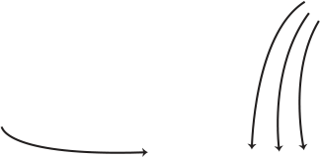
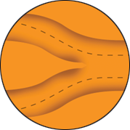
Helicase: The DNA Unzipper
Helicase Function:
  Breaks the hydrogen bonds between base pairs
  Separates the two DNA strands ("unzips" double helix)
  Creates the replication fork where copying happens
  Moves along the DNA as replication continues
Sketch & label the following in your notebook:
  DNA double helix before helicase
  Helicase enzyme (draw as a circle or hexagon)
  DNA strands are separating at the replication fork
  Label: "hydrogen bonds broken," "replication fork," "template strands exposed"
Hydrogen
Bonds
Replication
Fork
Helicase
Notes:
[~4-5 MINUTES]
TEACHER MOVES:
This slide formalizes helicase function with diagrams and scientific vocabulary, building on hands-on exploration from Slide 20.
Transition to formalization:
"You've explored helicase hands-on. Now let's formalize what you discovered with scientific diagrams and vocabulary. This slide will help you create a clear reference in your notebook."
Read through the helicase functions:
Project the slide and read the bullet points under "Helicase Function":
"Breaks the hydrogen bonds between base pairs"
"Separates the two DNA strands (unzips the double helix)"
"Creates the replication fork where copying happens"
"Moves along the DNA as replication continues"
Explain each point:
"Breaks hydrogen bonds between base pairs"
"Remember the A-T and G-C connections? Those are held together by HYDROGEN BONDS—weak bonds. Helicase breaks these bonds to separate the strands."
"Important: It does NOT break the sugar-phosphate backbone. The backbone stays intact!"
"Separates the two DNA strands"
"You saw this with your model—double helix in, two single strands out. This is called 'unzipping' because it's like opening a zipper."
"Creates the replication fork"
"The Y-shaped structure where DNA is being unwound is the replication fork. This is where replication actively happens."
"Moves along the DNA"
"Helicase doesn't just unzip one spot and stop. It's like a molecular motor—it moves continuously along the DNA, opening up the double helix as it goes."
Give sketching instructions:
Read the sketching task:
"Sketch and label the following in your notebook:"
"DNA double helix before helicase"
"Helicase enzyme (draw as a circle or hexagon)"
"DNA strands separating at the replication fork"
"Label: 'hydrogen bonds broken,' 'replication fork,' 'template strands exposed'"
Set expectations for the sketch:
"This is a quick scientific sketch—not artwork. It should take 2-3 minutes. Focus on LABELS and ACCURACY, not perfect drawing."
Model what you expect (draw on the board):
text
| | ← template strands exposed
\/
(O) ← helicase (circle)
|| ← hydrogen bonds broken
|| ← double helix before helicase
"Something like this! Simple shapes, clear labels. That's all you need."
Give sketch time (2-3 minutes):
"Begin your sketch now. You have 3 minutes."
Circulate and check sketches:
Walk around and look for:
✅ Double helix shown before helicase
✅ Helicase represented (circle, hexagon, or simple shape)
✅ Fork/Y-shape showing separation
✅ All required labels present
Provide real-time feedback:
"Add labels! I see your drawing, but I need to see the vocabulary words."
"Show the replication fork—the Y-shape where strands separate."
"Great! I can clearly see all the parts and they're labeled."
[BLOOM'S LEVEL: UNDERSTAND / CREATE / APPLY]
STUDENT MOVES:
Students transition from hands-on model to abstract diagram, practicing representational translation. They learn formal vocabulary (hydrogen bonds, replication fork, template strands) and connect it to previous observations. They create a labeled scientific diagram demonstrating spatial understanding of helicase function. Students practice scientific drawing conventions: simple shapes, clear labels, accurate representation. They build a notebook reference they can use for future study and assessment.
❌ COMMON MISCONCEPTION:
Students might draw:
Helicase cutting the DNA backbone in half (confusion about what breaks)
Strands completely separated along entire length (not understanding localized unwinding)
Helicase as a static object (not understanding it's a moving molecular motor)
Replication fork with parallel strands (forgetting antiparallel orientation)
CLARIFICATION:
Hydrogen bonds, not backbone: "Make sure your diagram shows that helicase breaks the CONNECTIONS between bases (hydrogen bonds), NOT the backbone. The backbone stays continuous!"
Localized unwinding: "Helicase creates a localized replication fork—it's not unzipping the entire chromosome at once. Just a small region (the fork) is unwound at any given time."
Dynamic process: "Your sketch is a 'snapshot,' but remember that helicase is moving. In real time, it's constantly moving along DNA, creating more and more fork as it goes."
📦 MODEL/VISUAL REFERENCE:
Reference student foam models:
"Look back at your model from Slide 20. That's what you're drawing! Your foam model showed helicase separating strands—now you're drawing that same process."
Point to slide images:
"Here's a professional diagram showing what you're sketching. Notice the labels—those are the same labels you're adding."
Use your own sketch on the board:
Walk students through your board sketch step by step: "First I draw the double helix at the bottom. Then I draw helicase as a circle. Then I show the fork—two strands diverging. Then I add labels."
✓ FORMATIVE ASSESSMENT (Quick Check):
Visual scan of notebooks:
As you circulate, quickly assess:
✅ Does the sketch show double helix → helicase → separated strands?
✅ Are all four required labels present?
✅ Is the spatial relationship accurate (fork shape)?
Ask individual students:
"Point to the replication fork in your drawing. Now point to where hydrogen bonds are broken."
Quick class check:
"Hold up your notebooks so I can see your sketches." (Scan the room—you should see Y-shapes with labels)
If common errors appear:
Address them immediately: "I'm seeing some sketches where the backbone looks cut. Remember—helicase doesn't cut the backbone! It only breaks the hydrogen bonds between bases. Revise if needed."
→ If most students have accurate labeled diagrams → Move forward
→ If many students have incomplete/incorrect diagrams → Pause and draw a model diagram on the board together as a class, having students copy it
🔗 CONNECTIONS:
Prior exploration: Formalizes what students discovered in Slide 20
Chemistry: Reinforces hydrogen bonds vs. covalent bonds
Scientific communication: Practices creating and labeling diagrams
Study skill: Creates a reference students can review before assessments
NGSS: Science and Engineering Practice 2 (Developing and using models through diagrams)
DIFFERENTIATION NOTES:
For struggling students: Provide a partially completed diagram template—they just add labels
For advanced students: Challenge: "Add arrows showing the direction helicase moves. Add a label showing where energy (ATP) is used."
For artistic students: Encourage more detailed drawings if time allows, but emphasize that SIMPLE sketches with good labels are perfectly acceptable
For students with fine motor difficulties: Allow them to label a pre-drawn diagram instead of creating their own
ADDITIONAL NOTES:
Why sketching matters:
Creating diagrams forces students to think spatially about molecular processes. They must decide:
What goes where?
How do parts relate spatially?
What labels communicate the process?
This cognitive work deepens understanding beyond passive reading/listening.
Time management:
If you're short on time, you can skip the sketching and just discuss the bullet points. But sketching provides valuable formative assessment and creates a study resource, so try to keep it if possible.
Connection to next slide:
"Now you have a diagram showing helicase. The next slide asks you to create a similar diagram for DNA polymerase. By the end, you'll have both enzymes documented in your notebook!"

Slide 39
DNA Polymerase: DNA Builder
Template
Strand
DNA Polymerase Function
  Reads the template strand
  Adds new nucleotides following base pairing
  rules (A-T, G-C)
  Builds the new DNA strand one nucleotide at a time
  Checks for mistakes (proofreading!)
Sketch and label the following in your lab notebook:
  Template strand (label with several bases: A, T, G, C)
  DNA polymerase enzyme (draw as an oval or rectangle)
  New strand being built with complementary bases
  Arrow showing 5' to 3' direction of building
  Label: "template strand," "new strand," "base pairing (A-T, G-C)," "5' to 3' synthesis"
DNA Polymerase
New
Strand
5'
3'
Notes:
[~4-5 MINUTES]
TEACHER MOVES:
This slide formalizes DNA polymerase function with diagrams and vocabulary, parallel to Slide 23 for helicase.
Transition:
"You've just created a diagram for helicase. Now let's do the same for DNA polymerase—the enzyme that BUILDS new DNA strands."
Read through the DNA polymerase functions:
Project the slide and read the bullet points under "DNA Polymerase Function":
"Reads the template strand"
"Adds new nucleotides following base pairing rules (A-T, G-C)"
"Builds the new DNA strand one nucleotide at a time"
"Checks for mistakes (proofreading!)"
Explain each point:
"Reads the template strand"
"Polymerase doesn't randomly add bases. It READS the template strand and uses that information to determine what to add next."
"If the template has A, polymerase knows to add T. If template has G, polymerase adds C."
"Adds new nucleotides following base pairing rules"
"You practiced this with your model! The base pairing rules (A-T, G-C) ensure accuracy."
"Polymerase only accepts the CORRECT nucleotide—its shape rejects incorrect ones."
"Builds the new DNA strand one nucleotide at a time"
"This is sequential synthesis. Polymerase adds one nucleotide, moves forward, adds the next one, moves forward, repeats."
"It's like building a brick wall—one brick at a time, in order."
"Checks for mistakes (proofreading!)"
"Polymerase has a 'proofreading' function. After adding a nucleotide, it checks: 'Is this correct?' If not, it backs up, removes the wrong one, and tries again."
"This proofreading makes DNA replication incredibly accurate—we'll explore this more in the optional extension."
Give sketching instructions:
Read the sketching task:
"Sketch and label the following in your notebook:"
"Template strand (label with several bases: A, T, G, C)"
"DNA polymerase enzyme (draw as an oval or rectangle)"
"New strand being built with complementary bases"
"Arrow showing 5' to 3' direction of building"
"Label: 'template strand,' 'new strand,' 'base pairing (A-T, G-C),' '5' to 3' synthesis'"
Set expectations:
"Again, simple sketch with clear labels. You have 3 minutes."
Model what you expect (draw on the board):
5' ← 3'
New: T-A-C-G ← new strand being built
[Polymerase]
Template: A-T-G-C ← template strand
3' → 5'
Labels:
- Template strand
- New strand
- 5' to 3' synthesis
- Base pairing (A-T, G-C)
"Show the template strand with specific bases. Show the new strand with complementary bases. Show polymerase. Add labels. Include the 5'→3' direction arrow."
Give sketch time (2-3 minutes):
"Begin your sketch now. You have 3 minutes."
Circulate and check sketches:
Look for:
✅ Template strand shown with labeled bases
✅ New strand shown with complementary bases
✅ DNA polymerase represented
✅ 5'→3' direction arrow present
✅ All required labels
Provide feedback:
"Show me the template strand—label a few bases (A, T, G, C) on it."
"Show me the complementary bases on the new strand. Do they match correctly?"
"Add an arrow showing 5'→3' direction!"
"Great! Your diagram clearly shows template-directed synthesis."
[BLOOM'S LEVEL: UNDERSTAND / CREATE / APPLY]
STUDENT MOVES:
Students create a second labeled diagram, now representing DNA polymerase function. They apply base pairing rules by showing complementary sequences. They represent directional synthesis (5'→3') with an arrow. They distinguish template strand (pre-existing) from new strand (being built). Students practice vocabulary: template, complementary, synthesis, proofreading, 5'→3'. They build a comprehensive notebook reference showing both major replication enzymes.
❌ COMMON MISCONCEPTION:
Students might draw:
Both strands already complete (not showing synthesis in progress)
Random bases on new strand (not following base pairing rules)
No directional arrow (forgetting 5'→3' synthesis direction)
Polymerase creating nucleotides (not understanding it assembles existing nucleotides)
CLARIFICATION:
Show synthesis in progress: "Your diagram should show the new strand PARTIALLY built—not complete. Show that polymerase is ADDING nucleotides, not that it's finished."
Check base pairing: "Make sure your new strand bases are COMPLEMENTARY to the template. If template is A-T-G, new strand should be T-A-C. Check each pair!"
Direction matters: "Add the 5'→3' arrow! This shows that polymerase builds in a specific direction. We'll explore why this matters in the next few slides."
📦 MODEL/VISUAL REFERENCE:
Reference foam models:
"Look back at Slide 21 where you used DNA polymerase. Your diagram should show what you did with the model—positioning polymerase on a template and adding nucleotides."
Point to slide images
"Here's what a professional diagram looks like. Notice the labels—those are the same labels you're adding."
Use board sketch as scaffold:
"I've drawn an example on the board. Yours can look similar to this."
✓ FORMATIVE ASSESSMENT (Quick Check):
Visual scan:
As you circulate, quickly check:
✅ Are bases complementary (A↔T, G↔C)?
✅ Is 5'→3' arrow present?
✅ Are all required labels included?
Ask individual students:
"Show me the template strand. Now show me the new strand. Are they complementary?"
"Point to the arrow showing synthesis direction. Which direction is it?" (5'→3')
Quick class check:
"Hold up your notebooks. I should see template strands with labels, new strands with complementary bases, and directional arrows."
→ If most students have accurate diagrams with correct base pairing → Move forward
→ If many students have errors → Pause and correct: "I'm seeing some base pairing errors. Let's review: A pairs with T, G pairs with C. Check your diagram and fix any mismatches."
🔗 CONNECTIONS:
Prior exploration: Formalizes Slide 21 hands-on activity
Information transfer: Template → new strand (information copying)
Directionality: Introduces 5'→3' formally (critical for next section)
Looking ahead: This diagram prepares students for understanding leading/lagging strand differences
NGSS: Science and Engineering Practice 2 (Models), HS-LS1-1 (Structure determines function)
DIFFERENTIATION NOTES:
For struggling students: Provide a template with bases already filled in—they just draw polymerase, new strand, and add labels
For advanced students: Challenge: "Add a label showing where the 3' OH group is (where the next nucleotide attaches). Show the proofreading function with a second diagram."
For students who need support with base pairing: Provide a reference card showing A↔T, G↔C
For students with spatial reasoning challenges: Show multiple examples on document camera before they start
ADDITIONAL NOTES:
Why this diagram matters:
This diagram sets up understanding of the PROBLEM that leads to leading vs. lagging strands:
Polymerase builds 5'→3' (shown in this diagram)
DNA strands are antiparallel (learned in Slide 17)
Therefore: The two strands can't BOTH be copied 5'→3' in the same direction relative to the replication fork
Students need this diagram as a reference when that complexity is introduced next.
5' to 3' direction emphasis:
Make sure EVERY student includes the 5'→3' arrow. This is non-negotiable because it's essential for understanding the next slides.
"Everyone check: Do you have an arrow showing 5' to 3'? If not, add it now!"
Proofreading mention:
This is the first time proofreading is explicitly mentioned (it will be explored in depth in Extension 2). For now, just introduce the concept: "Polymerase doesn't just build blindly—it checks its work! This makes replication very accurate."
Connection to next slide:
"Now you have diagrams for BOTH enzymes. You understand how they work individually. But here's the challenge: What happens when you try to use BOTH enzymes TOGETHER to copy BOTH strands at the same time? Let's find out!"

Slide 40
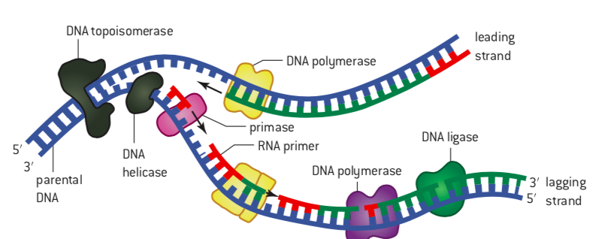

Slide 41
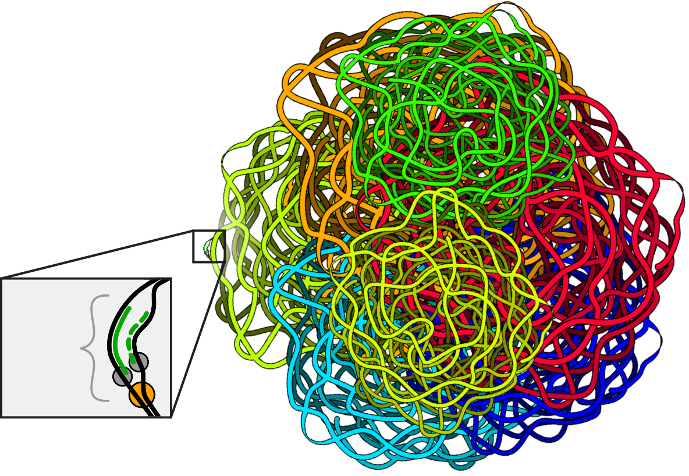
The Speed Problem
How Fast Can One Fork Copy DNA?
One replication fork copies about 3,000 base pairs per minute
Human cells have about 3 billion base pairs of DNA total
Time cells need to finish copying during S-phase (about 8 hours)
In your notebook, calculate:
If one fork copies 3,000 bp/minute,
how many base pairs can it copy in:
1 hour (60 minutes)?
8 hours?
Is that enough to copy 3 billion base pairs?
  3,000
  bp
Notes:
[~5-6 MINUTES]
TEACHER MOVES:
This slide introduces Extension 1 by posing a mathematical problem that reveals why single-origin replication would be impossibly slow.
Transition to Extension 1:
"You've mastered the core replication process. Now let's explore an interesting problem: SPEED. How fast does DNA replication actually happen, and is that fast enough?"
Set the context:
"Human cells contain approximately 3 billion base pairs of DNA across all chromosomes. Before a cell divides, ALL of that DNA must be copied. Let's figure out how long that would take."
Present the given information:
Read from the slide:
"Given Information:
Human genome: ~3 billion base pairs
DNA polymerase speed: ~50 nucleotides per second (in human cells)
S-phase (DNA replication phase): ~8 hours"
Explain each fact:
"Human genome: ~3 billion base pairs"
"That's 3,000,000,000 base pairs—a 3 with nine zeros! That's the total amount of DNA in a human cell that needs to be copied."
"For perspective: if you printed one letter per base pair, it would fill about 1,000 books of 1,000 pages each!"
"DNA polymerase speed: ~50 nucleotides per second"
"In human cells, DNA polymerase adds about 50 nucleotides per second. That might sound fast, but let's do the math to see if it's fast enough."
"Note: This is MUCH slower than in bacteria (which can do ~1,000 nucleotides per second). Human cells replicate more carefully and slowly."
"S-phase: ~8 hours"
"S-phase is the part of the cell cycle when DNA replication happens. In typical human cells, S-phase lasts about 8 hours."
"So the cell has an 8-hour window to copy all 3 billion base pairs."
Pose the calculation challenge:
Read the green question: "If there were only ONE starting point (origin) for replication, how long would it take to copy the entire genome?"
Guide students through the calculation setup:
"Let's think about this mathematically. We need to calculate:
Total base pairs to copy: 3 billion
Speed of copying: 50 base pairs per second
Time needed = Total base pairs ÷ Speed"
Write the calculation framework on the board:
Time = Total base pairs ÷ Speed
Time = 3,000,000,000 bp ÷ 50 bp/sec = ?
Give students calculation time (2-3 minutes):
"Work with your partner. Calculate how many SECONDS it would take. Then convert to hours and days. You may use calculators. You have 3 minutes."
Provide calculation scaffolding if needed:
As students work, circulate and help groups that are stuck:
✅ "Start by dividing 3 billion by 50. What do you get?"
✅ "Now you have seconds. How do you convert seconds to hours?" (Divide by 60 twice: seconds → minutes → hours)
✅ "How do you convert hours to days?" (Divide by 24)
Facilitate the calculation (whole class):
After 2-3 minutes, work through it together:
Step 1: Calculate seconds
"3,000,000,000 ÷ 50 = 60,000,000 seconds"
Write on board: 60,000,000 seconds
Step 2: Convert to minutes
"60,000,000 seconds ÷ 60 seconds/minute = 1,000,000 minutes"
Write on board: 1,000,000 minutes
Step 3: Convert to hours
"1,000,000 minutes ÷ 60 minutes/hour = 16,667 hours"
Write on board: ~16,667 hours
Step 4: Convert to days
"16,667 hours ÷ 24 hours/day = 694 days"
Write on board: ~694 DAYS (almost 2 YEARS!)
Let that sink in:
"If human cells had only ONE starting point for DNA replication, it would take almost TWO YEARS to copy the genome!"
Compare to reality:
"But remember: S-phase only lasts 8 hours in real cells. So there's a huge problem:
Time NEEDED (one origin): ~694 days (~16,700 hours)
Time AVAILABLE (S-phase): 8 hours
That's a difference of more than 2,000 times!"
Pose the problem:
"Clearly, cells can't wait 2 years to replicate DNA—they'd die waiting! So how do cells solve this speed problem?"
Give think time (30 seconds):
"Turn to your partner. How might cells speed up DNA replication to fit into 8 hours? You have 30 seconds to brainstorm."
Listen for student ideas:
Common hypotheses:
"Use more than one starting point"
"Have multiple polymerases working at once"
"Copy different parts of DNA simultaneously"
"Use faster enzymes"
Validate the thinking:
"Many of you suggested using MULTIPLE starting points—that's exactly what cells do! Instead of one starting point, human cells have THOUSANDS of starting points for replication. We'll explore this solution on the next slide."
[BLOOM'S LEVEL: APPLY / ANALYZE / CALCULATE / EVALUATE]
STUDENT MOVES:
Students engage in quantitative reasoning, applying mathematical calculations to biological context. They calculate time requirements using dimensional analysis (converting seconds → minutes → hours → days). They compare calculated values to biological constraints, identifying a problem (calculated time >> available time). They engage in problem-solving, hypothesizing solutions to the speed problem. Students connect abstract numbers (3 billion base pairs) to tangible understanding (2 years is impossibly long). They practice scientific reasoning: identify constraints, perform calculations, recognize problem, propose solutions.
❌ COMMON MISCONCEPTION:
Students might think:
"50 nucleotides per second is slow, but cells could just use faster enzymes" (not understanding biochemical constraints limit speed)
"The 694-day calculation must be wrong because cells obviously replicate faster" (not recognizing this reveals the PROBLEM that needs solving)
"Cells can speed up DNA polymerase to go 2,000× faster" (not understanding enzyme speed has limits)
"This is just a math exercise, not a real biological problem" (not recognizing this is a genuine constraint cells face)
CLARIFICATION:
Enzyme speed is constrained: "DNA polymerase speed isn't arbitrary—it's limited by the chemistry of bond formation and the enzyme's structural changes during catalysis. Cells can't just 'speed up' polymerase 2,000 times—that would sacrifice accuracy. In fact, 50 nucleotides/second in humans is already FAST for such a careful, accurate process."
The calculation is correct AND reveals the problem: "The 694-day calculation is mathematically correct, and it's SUPPOSED to seem impossibly long. That's the point! It shows that a single-origin replication strategy DOESN'T WORK for large genomes like ours. The calculation reveals why cells MUST use a different strategy."
Speed vs. accuracy trade-off: "Cells could potentially use faster polymerases, but there's a trade-off: speed vs. accuracy. Faster synthesis = more errors. Human DNA polymerase is slower than bacterial polymerase partly because it's more careful and accurate. Evolution has optimized for accuracy, not maximum speed."
📦 MODEL/VISUAL REFERENCE:
Use a timeline visual:
Draw on the board:
Single-origin replication timeline:
|————————————————————————————————————| 694 days (~2 years)
Start End
Actual S-phase:
|—| 8 hours
Can you see the problem?
Use a real-world analogy:
"Imagine you need to paint a 1,000-foot-long fence, and you have only one painter working at 1 foot per minute. How long would it take?"
1,000 feet ÷ 1 foot/min = 1,000 minutes = 16.7 hours
"But you only have 30 minutes before the paint truck leaves. What do you do?"
Expected answer: "Use multiple painters!"
"Exactly! That's what cells do—they use MULTIPLE starting points, like having multiple painters working on different sections of the fence simultaneously."
✓ FORMATIVE ASSESSMENT (Quick Check):
Check calculation accuracy:
As students work, walk around and check their work:
✅ Did they correctly divide 3 billion by 50? (60 million seconds)
✅ Did they convert to hours correctly? (~16,667 hours)
✅ Did they convert to days? (~694 days)
Common calculation errors to watch for:
❌ Dividing by 60 only once (forgetting to convert minutes → hours)
❌ Misplacing decimal points (3 billion has 9 zeros!)
❌ Calculator errors
Conceptual check:
After the calculation, ask: "Is 694 days longer or shorter than the 8-hour S-phase?"
Expected answer: "MUCH longer! About 2,000 times longer!"
"Right! So what does that tell us?"
Expected answer: "Single-origin replication is too slow. Cells need a different strategy."
→ If most students complete the calculation correctly and recognize the problem → Move forward
→ If many students struggle with calculation → Work through it as a whole class, step by step, showing all unit conversions
→ If students don't see why this is a problem → Emphasize: "The cell literally cannot wait 694 days to replicate. It would die long before finishing! This calculation proves single-origin replication DOESN'T WORK for large genomes."
🔗 CONNECTIONS:
Mathematics: Dimensional analysis, unit conversion, scientific notation, rate calculations
Cell biology: Cell cycle, S-phase timing, constraints on cell division
Evolution: Explains why prokaryotes (small genomes) can use single origins, but eukaryotes (large genomes) cannot
Problem-solving: Quantitative reasoning reveals biological constraints
NGSS: Science and Engineering Practice 5 (Using mathematics and computational thinking), Crosscutting Concept 3 (Scale, proportion, and quantity)
DIFFERENTIATION NOTES:
For students struggling with large numbers: Provide the calculation broken into steps with intermediate answers they can check:
Step 1: 3,000,000,000 ÷ 50 = 60,000,000 sec
Step 2: 60,000,000 ÷ 60 = 1,000,000 min
Step 3: 1,000,000 ÷ 60 = 16,667 hr
Step 4: 16,667 ÷ 24 = 694 days
For advanced students: Add challenge: "Bacteria have genomes of ~4 million base pairs and polymerase speed of ~1,000 bp/sec. Calculate how long single-origin replication takes in bacteria. Is it feasible?" (Answer: ~4,000 sec = ~67 min = feasible!)
For students who finish early: "Calculate how many origins would be needed to complete replication in 8 hours at 50 bp/sec." (This previews the solution on the next slide)
For students without calculators: Allow use of phone calculators or provide calculators
ADDITIONAL NOTES:
Why this calculation matters:
This isn't just math practice—it's revealing a fundamental biological problem through quantitative reasoning. Students often accept that "cells replicate DNA" without questioning whether it's physically possible. This calculation forces them to confront the speed constraint and recognize that single-origin replication is inadequate for large genomes.
Historical context:
In the 1960s, before the discovery of multiple replication origins in eukaryotes, scientists performed similar calculations and predicted that eukaryotic chromosomes MUST have multiple origins. Experiments later confirmed this prediction—a beautiful example of using mathematics to make and test biological predictions.
Bacterial vs. eukaryotic comparison:
FeatureE. coli (Bacteria)Human (Eukaryote)Genome size~4 million bp~3 billion bp (750× larger)Polymerase speed~1,000 bp/sec~50 bp/sec (20× slower)Number of origins1~30,000-50,000
"Bacteria can get away with one origin because their genomes are much smaller AND their polymerase is faster. Humans need multiple origins because our genomes are huge AND our polymerase is slower (but more accurate)."
Real-world calculation application:
"This type of calculation—figuring out whether a process is fast enough to meet biological needs—is used by researchers all the time. For example, calculating whether a metabolic pathway produces energy fast enough, or whether a protein can be synthesized quickly enough for cell growth."
Preview next slide:
"Now that you understand WHY single-origin replication doesn't work, let's figure out exactly HOW MANY origins cells actually use, and how that solves the speed problem."

Slide 42
How Can Cells Copy DNA Fast Enough?
Notes:
[~6-7 MINUTES]
TEACHER MOVES:
This slide reveals the solution to the speed problem through guided calculation and visual analysis.
Transition:
"You've calculated that single-origin replication would take 694 days—impossibly slow. Now let's discover how cells solve this problem using MULTIPLE origins of replication."
Introduce the concept:
"Instead of starting DNA replication at ONE location, human cells start at THOUSANDS of locations simultaneously. Each starting point is called an origin of replication."
Write on the board: ORIGIN OF REPLICATION = location where DNA replication begins
Explain the strategy:
"Imagine you're reading a 1,000-page book, but you can start reading from multiple pages at once—page 1, page 100, page 200, etc.—and read in both directions from each starting point. You'd finish MUCH faster than reading start-to-finish!"
"That's exactly what cells do with DNA. They start replication at many origins simultaneously, and each origin creates a replication fork moving in BOTH directions (bidirectional replication)."
Present the diagram analysis:
Project the slide image showing multiple replication bubbles.
Point to key features:
"Look at this diagram. Each 'bubble' represents one origin of replication. Notice:
Multiple bubbles along the DNA strand (multiple origins)
Each bubble has TWO replication forks—one moving left, one moving right (bidirectional)
Eventually, the bubbles merge when the forks meet
Result: the entire DNA molecule is copied much faster!"
Trace with your finger/pointer:
"Let's trace what happens at one origin:" (point to one bubble)
"Replication begins here—the origin" (point to center)
"Two replication forks form, moving in opposite directions" (trace both forks)
"Each fork has a leading and lagging strand" (point to both)
"The forks move outward until they meet forks from neighboring origins" (show convergence)
"The DNA segments are all joined together—complete copy!"
Pose the calculation challenge:
Read the green question: "Calculate: How many origins are needed to complete replication in 8 hours?"
Set up the calculation:
"We need to figure out: If we have multiple origins working simultaneously, how many do we need to finish in 8 hours?"
Guide the reasoning:
Write on the board:
FROM SLIDE 33:
- With 1 origin: 16,667 hours needed
- Time available: 8 hours
How many origins needed?
Number of origins = Time with 1 origin ÷ Time available
Give students calculation time (2 minutes):
"Work with your partner. Calculate how many origins are needed. You have 2 minutes."
Circulate and support:
As students work, help groups that are stuck:
✅ "We calculated 16,667 hours for one origin. We have 8 hours available. What operation should you use?" (Division)
✅ "If 1 origin takes 16,667 hours, and you want to finish in 1/2,083rd of that time, what do you need?" (2,083 origins working simultaneously)
Work through the calculation (whole class):
After 2 minutes, solve together:
Step 1: Set up the calculation
"Time with 1 origin = 16,667 hours
Time available = 8 hours
To finish in 8 hours instead of 16,667 hours, we need to speed up the process by a factor of:
16,667 ÷ 8 = 2,083"
Step 2: Interpret the result
"This means we need approximately 2,000 origins working simultaneously to complete replication in 8 hours!"
Write on the board: ~2,000 origins needed
Step 3: Compare to reality
"In reality, human cells use 30,000 to 50,000 origins across all chromosomes! That's actually MORE than the minimum needed."
Explain why more than minimum:
"Why do cells use more origins than mathematically necessary?
Safety margin - Not all origins activate every time; having extras ensures replication completes on time
Damage response - If DNA is damaged in one region, extra origins can compensate
Chromosome differences - Some chromosomes replicate faster/slower, so they need different numbers of origins"
Connect to chromosome structure:
"Each chromosome has MANY origins. For example:
Chromosome 1 (largest): ~7,000-10,000 origins
Chromosome 21 (smaller): ~1,500-2,000 origins
Origins are spaced about 50,000-300,000 base pairs apart, depending on the region."
Visualize the spacing:
Draw on the board:
Chromosome:
|—Origin—|—Origin—|—Origin—|—Origin—|—Origin—|
Each segment = 50,000-300,000 bp
Multiple forks moving simultaneously
All merge to complete replication
Discuss the reflection question:
Read the green question: "Why is having multiple origins more efficient than one?"
Give students 30 seconds to think, then call on 3-4 students.
Expected answers:
"Parallel processing—many sections copying at once instead of one at a time"
"Reduces total time dramatically"
"Like having multiple workers instead of one worker"
"Distributes the workload across the genome"
Formalize the concept:
"Multiple origins enable parallel processing. Instead of copying 3 billion base pairs sequentially (one after another), cells copy many segments simultaneously (all at once). This is the ONLY way to replicate large genomes in a reasonable timeframe."
"It's like the difference between:
Sequential: One person making 1,000 sandwiches (very slow)
Parallel: 1,000 people each making 1 sandwich at the same time (very fast)"
Introduce regulation (briefly):
"Cells carefully REGULATE which origins activate and when. This ensures:
Even distribution across chromosomes
Coordination with cell cycle
Each region copied exactly once (no more, no less)"
[BLOOM'S LEVEL: APPLY / ANALYZE / CALCULATE / SYNTHESIZE]
STUDENT MOVES:
Students perform quantitative analysis, calculating origin requirements from time constraints. They interpret biological diagrams, identifying origins, replication forks, and bubble merging. They engage in proportional reasoning: if 1 origin takes X time, N origins take X/N time. Students connect calculation results to real cell biology (30,000-50,000 origins). They explain efficiency in terms of parallel processing and workload distribution. Students synthesize mathematical and visual information into coherent understanding of genome-scale replication.
❌ COMMON MISCONCEPTION:
Students might think:
"Each origin copies 1/2,000th of the genome" (not understanding origins can be different distances apart and coverage overlaps)
"All origins activate simultaneously at the start of S-phase" (not understanding staggered activation)
"More origins = faster polymerase" (confusing parallel processing with enzyme speed)
"Each origin produces one complete chromosome" (not understanding many origins per chromosome)
CLARIFICATION:
Origins vary in spacing and activation: "Origins aren't evenly distributed, and they don't all fire at once. Some regions have origins every 50,000 bp, others every 300,000 bp. Some origins activate early in S-phase, others late. This staggered activation allows cells to regulate replication and prevent overwhelming the cell's resources (nucleotide supply, polymerase availability, etc.)."
Parallel processing vs. enzyme speed: "Having multiple origins doesn't make each polymerase faster—each still works at 50 bp/sec. But when you have 30,000 polymerases working simultaneously at different locations, the TOTAL genome gets copied much faster. It's parallel processing, not faster individual enzymes."
Many origins per chromosome: "Each chromosome has thousands of origins. For example, Chromosome 1 (the largest) might have 7,000-10,000 origins all working simultaneously during its replication. They're not one-origin-per-chromosome—they're thousands-of-origins-per-chromosome."
📦 MODEL/VISUAL REFERENCE:
Diagram analysis (on slide):
Point to the slide image showing multiple replication bubbles:
"See these eye-shaped structures? Each is a replication bubble from one origin. The two ends of each bubble are the two replication forks moving in opposite directions."
"Notice how bubbles are getting bigger—that's the forks moving apart. Eventually, neighboring bubbles will merge when their forks meet."
Draw a simplified version on the board:
DNA: ================================
With 1 origin:
←Fork ⬡ Fork→
With multiple origins:
←⬡→ ←⬡→ ←⬡→ ←⬡→
(4 origins, 8 forks, much faster!)
Use a visual analogy:
Show on board:
SEQUENTIAL (1 origin):
Person 1: ————————————————————————> (takes 694 days)
PARALLEL (2,000 origins):
Person 1: ——>
Person 2: ——>
Person 3: ——>
...
Person 2000: ——>
(all working simultaneously, finishes in 8 hours!)
✓ FORMATIVE ASSESSMENT (Quick Check):
Check calculation:
"How many origins are needed to finish in 8 hours?"
Expected answer: "About 2,000 origins" (accepting 2,000-2,100 as correct)
Concept check:
"Do human cells actually use 2,000 origins or more than that?"
Answer: "More! They use 30,000-50,000 origins"
"Why do cells use MORE origins than mathematically necessary?"
Listen for: Safety margin, not all activate, compensate for damage, variation
"Does having more origins make each DNA polymerase work faster?"
Answer: "No! Each polymerase still works at 50 bp/sec. But many working simultaneously = faster overall replication"
Visual interpretation check:
Point to the diagram: "Show me one origin. Now show me two replication forks from that origin. Now show me where two bubbles will merge."
→ If students correctly calculate ~2,000 origins and understand parallel processing → Move forward
→ If students struggle with calculation → Review: "We need to speed up 2,083 times (16,667 hrs ÷ 8 hrs). To speed up 2,083 times, we need 2,083 workers (origins) instead of 1."
→ If students don't understand bubble merging → Draw step-by-step: Bubbles start small → grow → neighboring bubbles contact → merge into continuous replicated DNA
🔗 CONNECTIONS:
Computer science: Parallel processing vs. sequential processing (algorithmic thinking)
Mathematics: Inverse relationships (more workers → less time), proportional reasoning
Evolution: Genome size correlates with number of origins (bacteria: 1, yeast: ~400, humans: 30,000+)
Cell cycle: Origin activation is carefully regulated during S-phase
Cancer biology: Dysregulated origin firing contributes to genomic instability in cancer
NGSS: Crosscutting Concept 3 (Scale, proportion, quantity), Crosscutting Concept 4 (Systems and system models)
DIFFERENTIATION NOTES:
For struggling students: Provide the division setup: "16,667 hours ÷ 8 hours = ?" and let them use calculator
For advanced students: Challenge: "If origins are spaced 100,000 bp apart on average, and the human genome is 3 billion bp, how many origins would that spacing create? (Answer: 3,000,000,000 ÷ 100,000 = 30,000 origins—matches reality!)
For visual learners: Provide a handout with the replication bubble diagram and have them label: origins, replication forks, direction of fork movement, where bubbles merge
For students who finish calculations early: "Research: Do all human chromosomes have the same density of origins? Why or why not?" (Answer: No—active gene regions often have more origins)
ADDITIONAL NOTES:
Why this matters in real biology:
Origin licensing and regulation:
Cells must ensure each origin fires EXACTLY ONCE per cell cycle—no more, no less. This is accomplished through "origin licensing":
During G1 phase: Origins are "licensed" (marked as ready to fire)
During S-phase: Licensed origins can fire (activate)
After firing: Origins cannot fire again until next cell cycle
This prevents "re-replication"—copying the same region multiple times, which would be catastrophic.
Connection to cancer:
In cancer cells, origin regulation is often disrupted:
Some origins fire multiple times (re-replication → extra DNA copies)
Some origins don't fire (incomplete replication → DNA breaks)
Abnormal origin firing causes "replication stress"—a hallmark of cancer cells
Experimental evidence:
Scientists use techniques like "DNA combing" to visualize replication origins:
DNA molecules stretched on slides
Newly replicated DNA labeled with fluorescent nucleotides
Microscopy reveals replication bubbles as fluorescent stretches
Can count origins and measure fork speeds directly
Evolutionary perspective:
Organism Genome Size # Origins Origins Per Million bp
E. coli (bacteria) 4.6 Mb 1 0.2
Yeast 12 Mb ~400 33
Fruit fly 140 Mb ~3,500 25
Human 3,000 Mb 30,000-50,000 10-17
"As genomes got larger during evolution, organisms evolved more origins to keep replication time reasonable. But origin density actually DECREASES in larger genomes—possibly because fewer origins = better control and fewer opportunities for errors."
Preview next slide:
"Now you understand that cells use tens of thousands of origins working in parallel. But there's another question: Are all these origins active all the time? Do all chromosomes replicate at the same time? Let's explore the TIMING and REGULATION of origin activation."

Slide 43

Discovering Replication

Slide 44
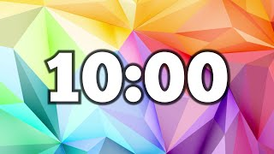

Slide 45
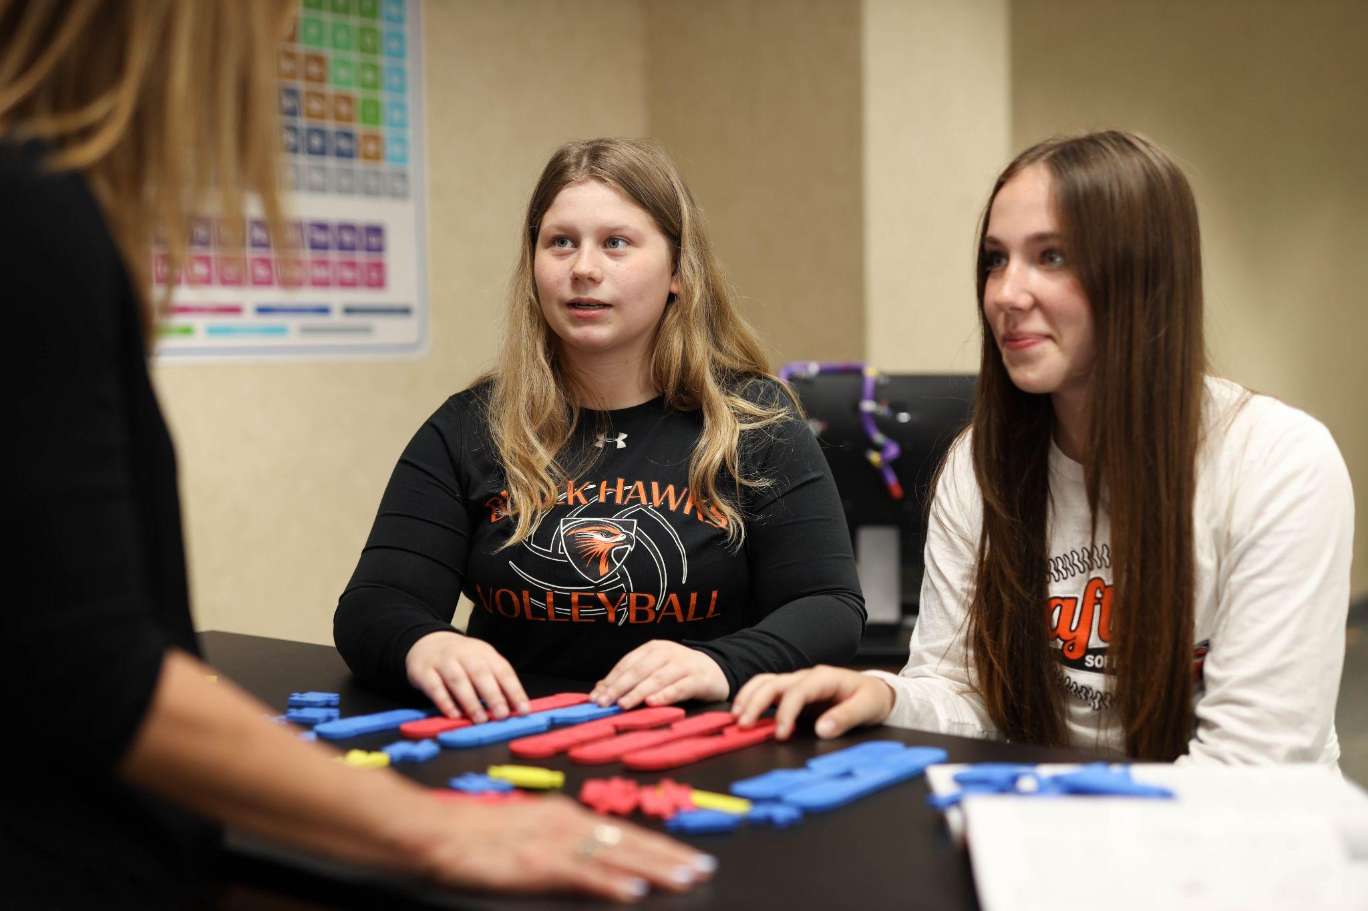
Chromosomes:
One word, several meanings, much confusion!

Slide 46
Chromosomes-Learning Targets
What do your students NEED to know about chromosomes, and why?
What are the essential vocabulary words?
Notes:
Learner: Brief engaging reflection in notebooks.
Facilitator: Give time to reflect, then time to share out. Listen for the ideas shared so that you can address them throughout the workshop.

Slide 47
“Models bring meaning to words.”
-Tim Herman
Let’s start with models instead of confusing words!

Slide 48
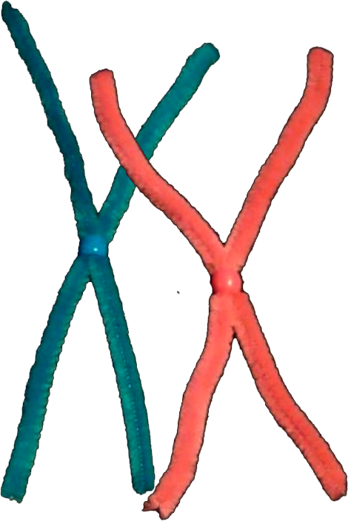
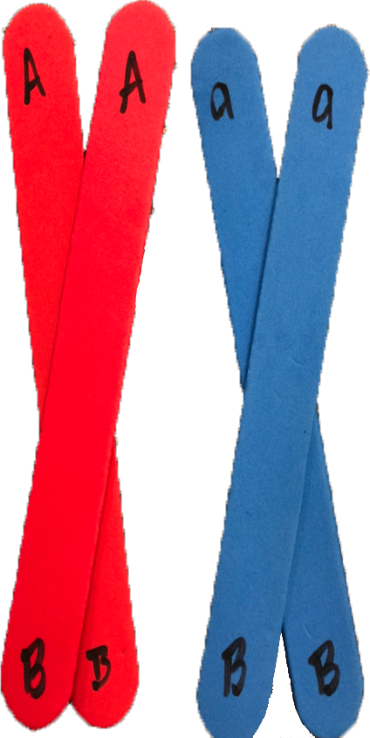
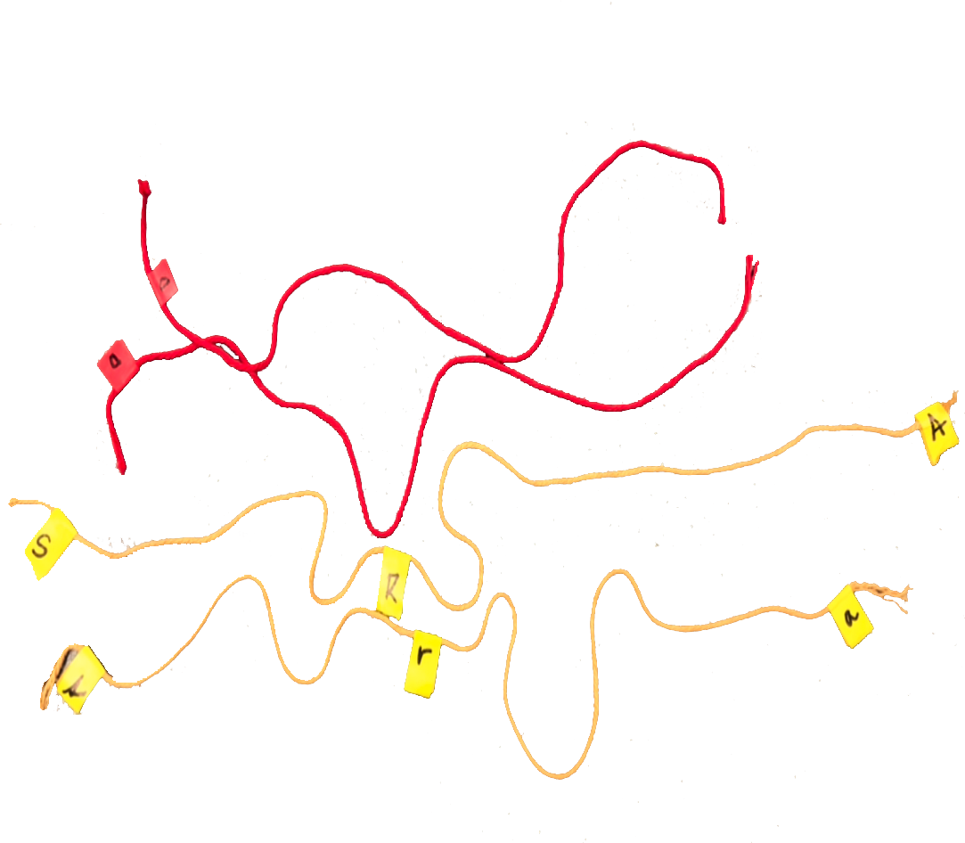
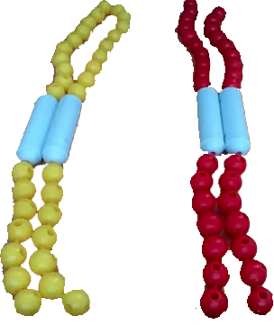
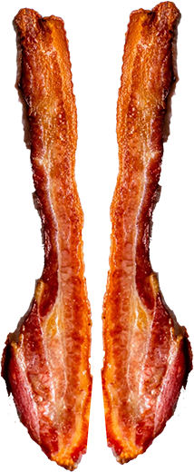
You may already use models of chromosomes..
Notes:
Educator: Talking points. You already use models to teach concepts around chromosomes… Today we will introduce you to another model with many more features!

Slide 49

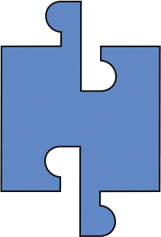



Chromosome connections…Build a chromosome!
Red or Blue? You choose… this is YOUR conceptual model!
Notes:
Educator: Build YOUR model of a chromosome.
Learner: Make a chromosome with these pieces so that it represents what you think it should.
Bag with chromosomes as above that this out first, then add sequence, then the histone pieces as we progress through the activity

Slide 50
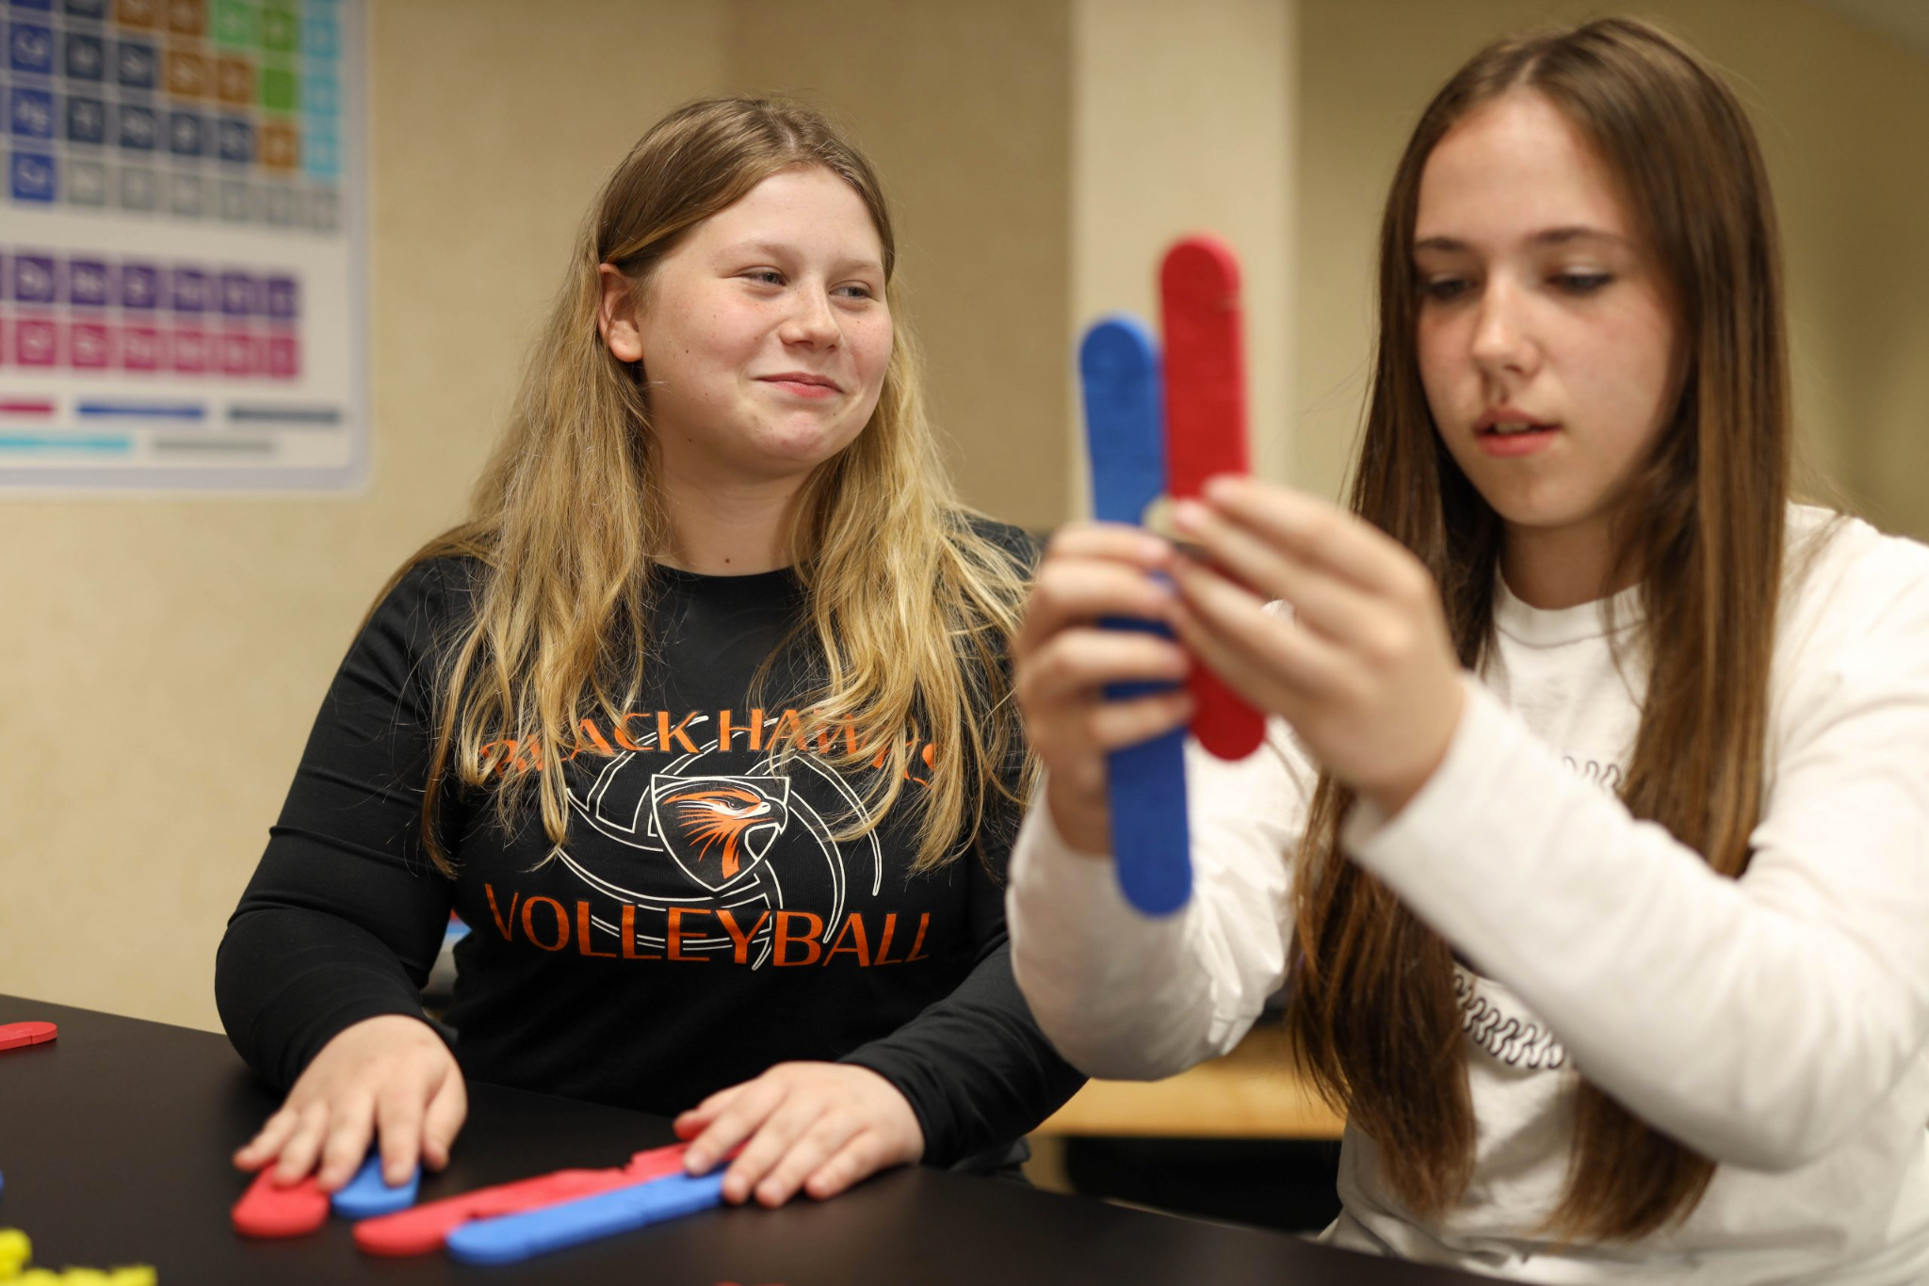
Discuss… What did you build and WHY?

Slide 51
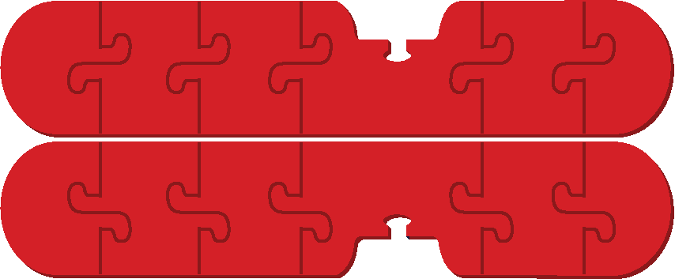

Is this a chromosome? Or this?

Slide 52
Is this a chromosome? Or this?
Or both?

Slide 53
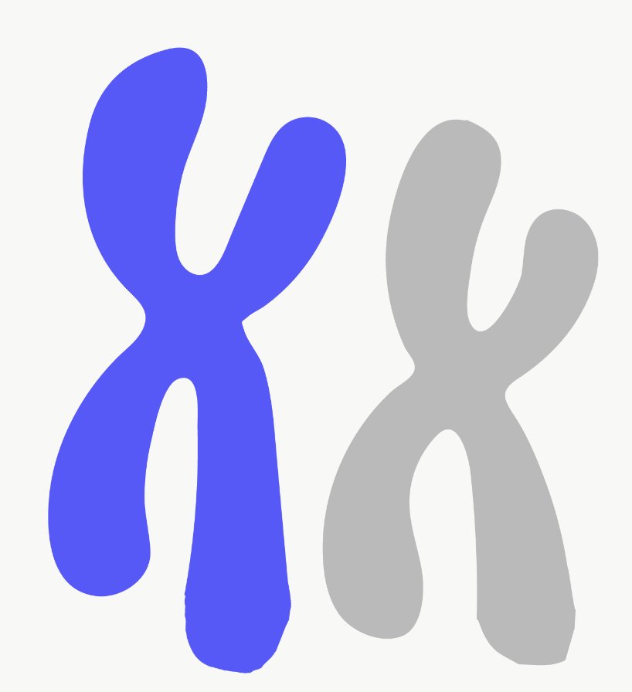
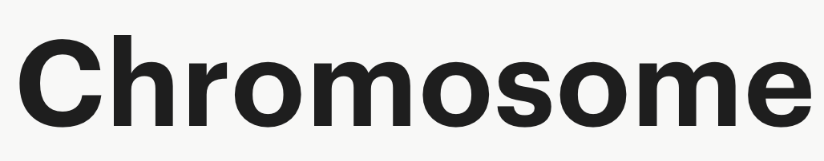
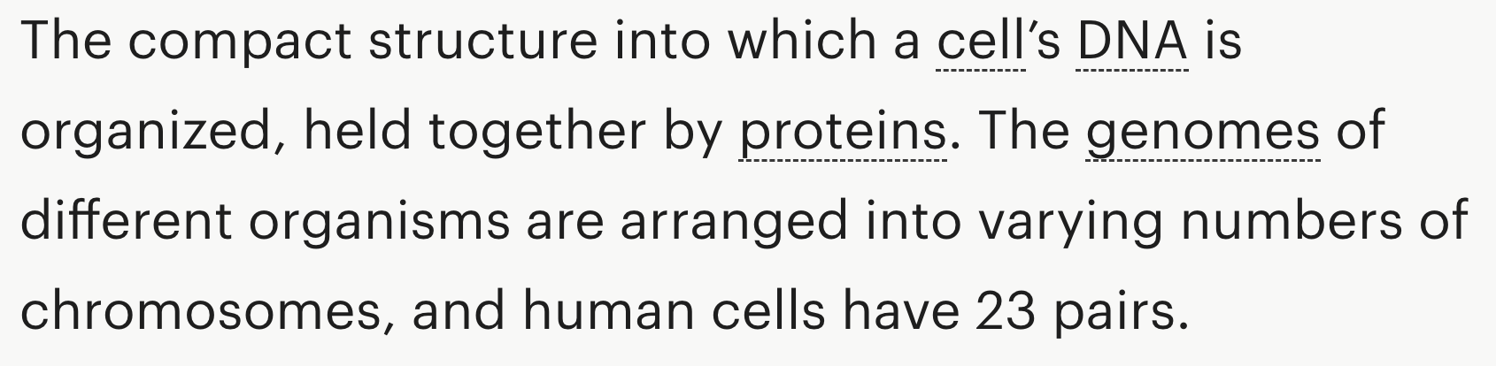
Notes:
Innovative Genomics

Slide 54


(Laurent, 2022)

Slide 55

(Laurent, 2022)

Slide 56

Chromosomes are threadlike structures made of protein and a single molecule of DNA that serve to carry the genomic information from cell to cell. In plants and animals (including humans), chromosomes reside in the nucleus of cells.
(Bates, Chromosome)

Slide 57
(Laurent, 2022)

Slide 58
?
(Laurent, 2022)

Slide 59

Chromosomes: one word, several meanings, much confusion!
(Westerlund , 2017)

Slide 60
The Etymology
Origin:
Greek
Khrõma
(color)
Greek
Sõma
Body
German
Chromosome
Late 19th century
Notes:
Educator: The confusion comes from the history of the word!

Slide 61
The Etymology:
“The scaffold owes its capability of refraction, the way how it behaves, and in particular its colorability to a substance which, with regard to its latter attribute, I have termed Chromatin. It is possible that this substance is really identical with the Nuclein-bodies. .... I’ll retain the name Chromatin as long as Chemistry has decided about it, and I empirically refer to it as that substance in the cell's nucleus which takes up the dye upon staining the nucleus ("Kerntinktionen").-1882- Walther Flemming.
(chromosome)

Slide 62

The Etymology:
Use over time for the word Chromosome
The discovery of the double helix structure of DNA
“Nuclein” discovered
by Meischer
(chromosome)
Notes:
Graph from google search for “chromosome etymology… I cannot find a way to cite this!
Educator: The confusion comes from the history of the word!

Slide 63
So it is no wonder that there is so much confusion!

Slide 64
Moving on–now build a homologous pair!

Slide 65



Are these homologous pairs?
What more do you need to know?
OR
OR
Notes:
Colors are not a cue!

Slide 66

Are these homologous pairs?
A
A
A
A
A
a
a
A

Slide 67

“To improve understanding of topics related to genetic information flow, we suggest that instructors use pedagogies and activities that prime students for making connections between chromosome structure and cellular processes.”

Slide 68

Could this model represent a portion of a chromosome?

Slide 69

Chromosomes or homologous pair?

Slide 70
Chromosomes or homologous pair?
What is your evidence?

Slide 71


Slide 72

What does A mean? a?
A
A
A
A
A
a
a
A

Slide 73
These are 99% the same…
Humans are 99.9% the same.

Slide 74

What is a chromosome?
I think a chromosome is…

Slide 75
“To improve understanding of topics related to genetic information flow, we suggest that instructors use pedagogies and activities that prime students for making connections between chromosome structure and cellular processes.”

Slide 76
What connections are your students possibly “failing to transfer”?
Notes:
Educator: Talking points. You already use models to teach concepts around chromosomes… Today we will introduce you to another model with many more features!

Slide 77


What if we could…

Slide 78

Wait! What???
EVEN BETTER!
Notes:
What if you had a model that could do all of that?
Give out expanded model right now

Slide 79








Let’s Do This!
Notes:
What if you had a model that could do all of that?
Give out expanded model right now

Slide 80


Let’s Do It Again!
Notes:
What if you had a model that could do all of that?
Give out expanded model right now

Slide 81

Sister Chromosomes or Homologous Pair?
Notes:
What if you had a model that could do all of that?
Give out expanded model right now

Slide 82
Replicate the chromosomes…
Notes:
What if you had a model that could do all of that?
Give out expanded model right now

Slide 83


Slide 84



Slide 85

Chromosome Connections!
Connects to… Classical Genetics!
Hb^{A}Hb^{S}
X Hb^{A}Hb^{S}
Hb^{A}
Hb^{S}
Hb^{A}
Hb^{A}Hb^{A}
Hb^{A}Hb^{S}
Hb^{S}
Hb^{A}Hb^{S}
Hb^{S}Hb^{S}
(Sickle Cell Disease Fact Sheet 2022)
Notes:
Connecting the chromosomes with allelesCe-ru-men

Slide 86

“we suggest that instructors use pedagogies and activities that prime students for making connections between chromosome structure and cellular processes.”
?
Notes:
Reference on Slide 21
But how does this approach limit student understanding between the conceptual ideas of chromosomes and the conceptual understanding of molecular processes?
Students can not understand gene editing at the molecular level unless they have those connections between chromosome structure and gene sequence.
Recent news and sickle cell makes it an engaging story for our students

Slide 87

But what is Hb^{A} or Hb^{S}?
T
A
Notes:
But how does this approach limit student understanding between the conceptual ideas of chromosomes and the conceptual understanding of molecular processes?
Students can not understand gene editing at the molecular level unless they have those connections between chromosome structure and gene sequence.
Recent news and sickle cell makes it an engaging story for our students

Slide 88


But what is Hb^{A} or Hb^{S}?
T
A
Notes:
But how does this approach limit student understanding between the conceptual ideas of chromosomes and the conceptual understanding of molecular processes?
Students can not understand gene editing at the molecular level unless they have those connections between chromosome structure and gene sequence.
Recent news and sickle cell makes it an engaging story for our students

Slide 89




Hb^{S}
Parent 1
Hb^{A}
X
Hb^{S}
HB^{A}
HB^{A}
Parent 2
Hb^{A}

Slide 90






Slide 95


Metaphase!
(Laurent, 2022)
Notes:
Why? Because cells are not two dimensional!

Slide 96


Meiosis metaphase–in 3 Dimensions!
(Reischig, Meiosis (261 36)- Dividing pollen mother cells M I, A I, T I (metaphase I, anaphase I, telophase I) - Lilium plant.jpg)
Notes:
Teacher note: Discuss the strengths/limitations of the image

Slide 97

Crossing over!

Slide 98

…or THIS?
Notes:
Educator notes: This is the time to talk about the actual reason for what we call “crossing over”
Extensions
NHEJ leads to understanding how CRISPR works

Slide 99


Modeling genetic organization during nuclear division…
Now you try!
Model what YOU need your students to try!

Slide 101

WE² Model
In one sentence each, how would you define Wonder, Explore, and Explain for a colleague?

Slide 102
WE² Model
  Wonder – Allows authentic learner play, Ignites learner questions, engages learners to want to know more.
  Explore – Allows learners to make sense of their thinking by systematically and intentionally applying content understanding and vocabulary within the context modeling as they and extend their thinking and expand on their questions.
  Explain – Allows students to articulate or illustrate their thinking, grounded in the learning from the models. Fosters confidence by using models to anchor their understanding but expands to connecting conceptual ideas

Slide 103

WE² Model
Reflect on one session from this week (e.g., Water, Proteins, Membranes, Replication, Transcription & Translation, Chromosomes, etc).
Sketch the flow of that lesson as a timeline.
Label each section as Wonder, Explore, and Explain—and where they overlapped.

Slide 104
WE² Model
Where did Wonder continue during Explore? What did that look like in student talk or modeling?
How did Explore and Explain overlap—were students explaining as they explored, and how can we design for that?
What teacher moves helped one phase ‘spill into’ the next instead of stopping and starting?

Slide 106

Lunch at Bastille Days in Cathedral Square Park

Slide 108

Reflection
Summarize the student experience of modeling you have experienced in this course so far.
Be prepared to share 2 things that you hope to “take home” to use in your classroom practice.
Notes:
Jim’s Reflection Time

Slide 109


Time to reflect
A model (noun) is…
Modeling (verb) is…
In my classroom…
What is a model?
What is modeling?
How will you use models in your classroom now?
Notes:
Individual reflection…brain dump

Slide 111

Round Robin Model Exploration Time
Collaborative Exploration Spaces
Individual Exploration - ask for a kit to explore at your table
Water Kit | Cell Modeling Kit
Molecules of Life Kit | Flow of Genetic Information Kit
Phospholipid & Membrane Transport Kit | Chromosomes Connection Kit
Aquaporin Mighty Model | Mosaic Membrane Mighty Model
Amino Acid Starter Kit | Dynamic DNA Kit
Enzymes in Action Kit

Slide 112


Individual Planning Implementation Time
Create one implementation artifact you can use this year. Prompts include:
Build a Unit Spine
Design a Multi-Lesson Modeling Sequence
Create a Classroom Modeling Playbook
Plan for Assessment and Evidence of Learning
Design One WE² Model Lesson
Be prepared to share:
Your central idea
Anticipated challenges
One aha moment you experienced while working

Slide 113
Things to Do in Milwaukee Today
Bastille Days
(10 minute walk from Drury, hosted in park by 3DMD)
Festa Italiana - Summerfest Grounds
(22 minute walk from Drury)
Deer Garden Summer Concert Series
(15 minute walk from Drury)

Slide 114

End of Course Survey

Slide 115


