Slide 1
Research is supported by the National Institute of General Medical Sciences of the National Institutes of Health under Award Number 5R25GM146236. The content is solely the responsibility of the authors and does not necessarily represent the official views of the National Institutes of Health.
Notes:
8:00 Heather Welcome
Best weeks of the year
WE2 Model
8:05 Tim Welcome
8:10 Tina Welcome
8:15 Introductions - Heather
Instructor Bios via email - Tim, Keri, Heather & Mark
Evaluators
Facilitators
Participants - Josh
8:45 Course Logistics - Heather
Schedule - breaks
Website
3DMD Staff
Building
Lunches
Mug Exchange
8:55 Group Norms - Josh

Slide 2
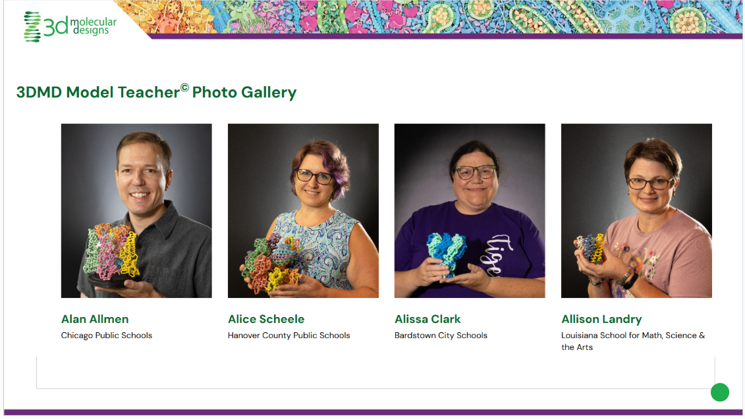
Model Teacher Pictures during Breaks
Choose a model (not huge) and go to the 3rd Floor!

Slide 3

Free to Attend!

Slide 4

Tuesday’s Joy

Slide 5

Wednesday’s Wants

Slide 6
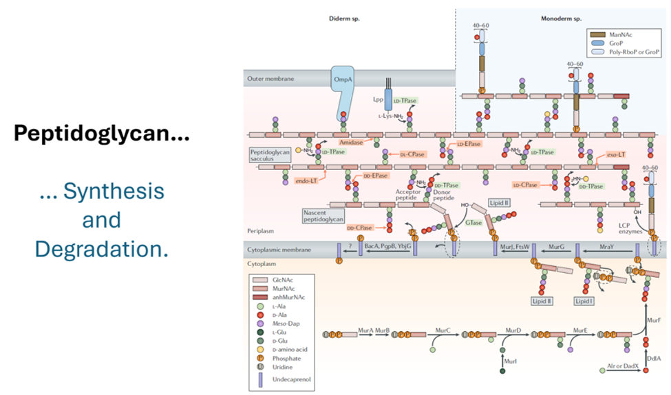

Slide 8
Innate Immunity: Threat Detection
Christina Bowers

Slide 9
Session Goals
Macrophage and Dendritic are first responder immune cells.
Macrophage engulf whole microbes.
Dendritic cells sample microbe fragments (PAMPs) and deliver the signals to cells in the lymph node
They are shaped differently in accordance with their functions.
Receptors are non-specific but broadly sense pathogen associated molecular patterns.

Slide 10
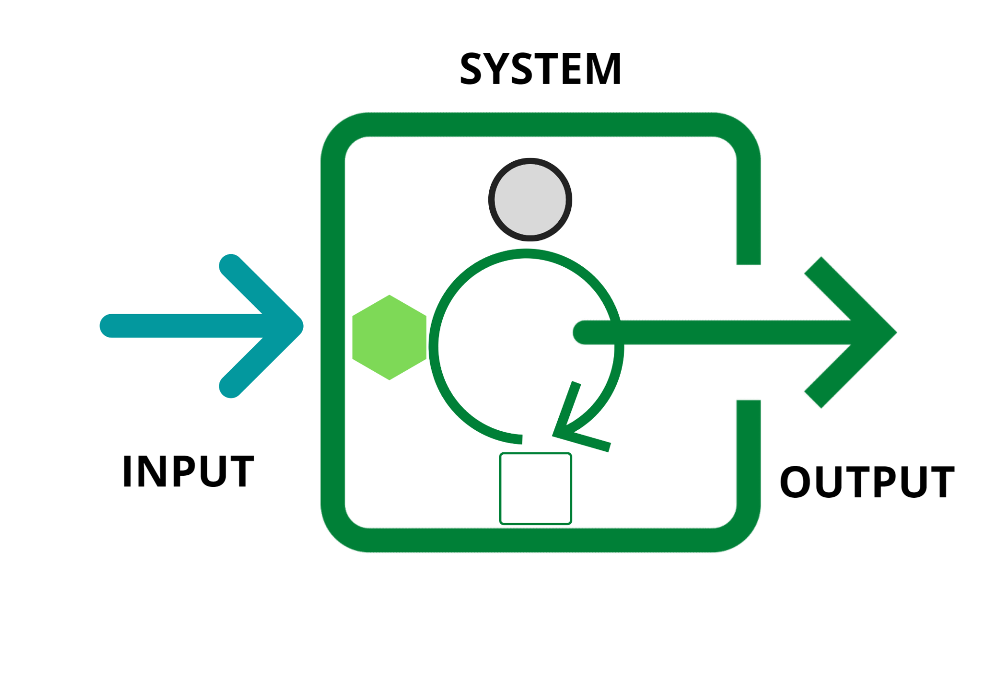
How do our bodies sense threats they have never seen (or prepare for threats that may not even exist yet?!)
Threat detection
Response Coordination

Slide 11
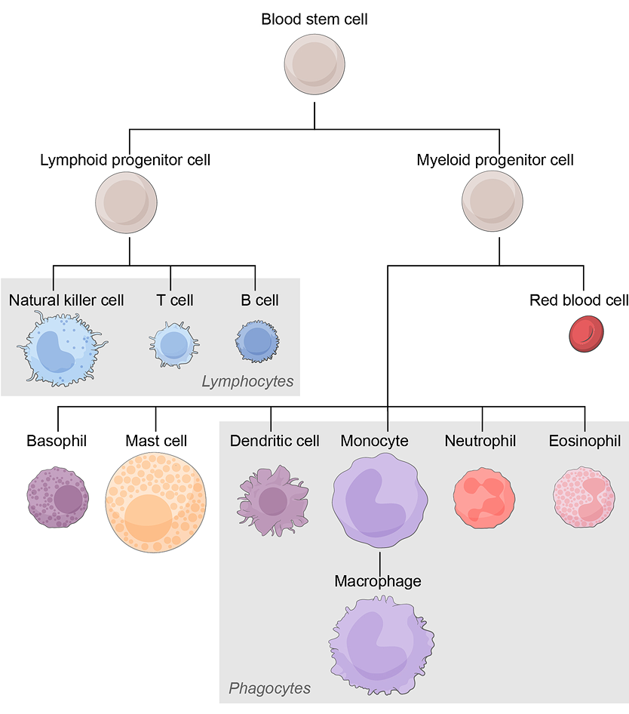
Focus modeling on Macrophage
Job: “Sniff out” the building blocks of life
Discuss some hypotheses for how a cell might do this.
What kinds of structures would the cell need in order to do this?
What kinds of structures would the “pathogen” be presenting?
https://www.biointeractive.org/classroom-resources/immune-system

Slide 12
Recognizing patterns vs recognizing specific molecular signals.
General vs highly specialized (destruction, signal)
Patterns vs 1 ligand, 1 precise fit
(orderly housekeeping)
Detect first, decide later.

Slide 13
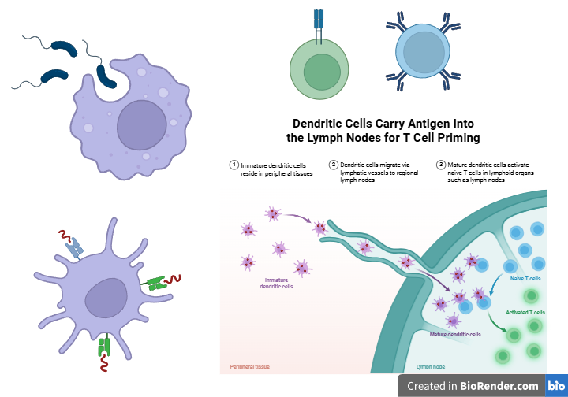

Macrophage (L) and Dendritic (R) cells have overlapping “skill sets”...but dendritic cells are more specialized and bridge the innate and adaptive immunity.
Generalist
Specialist
Dendritic cells swallow with AND without using receptors.
Macrophage cells swallow without using receptors.
Created in https://BioRender.com

Slide 14
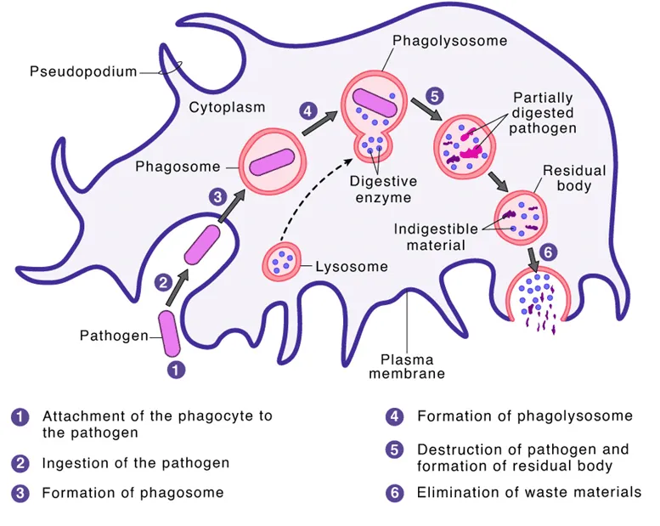
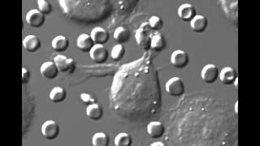

Slide 15
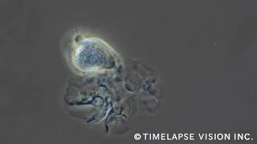
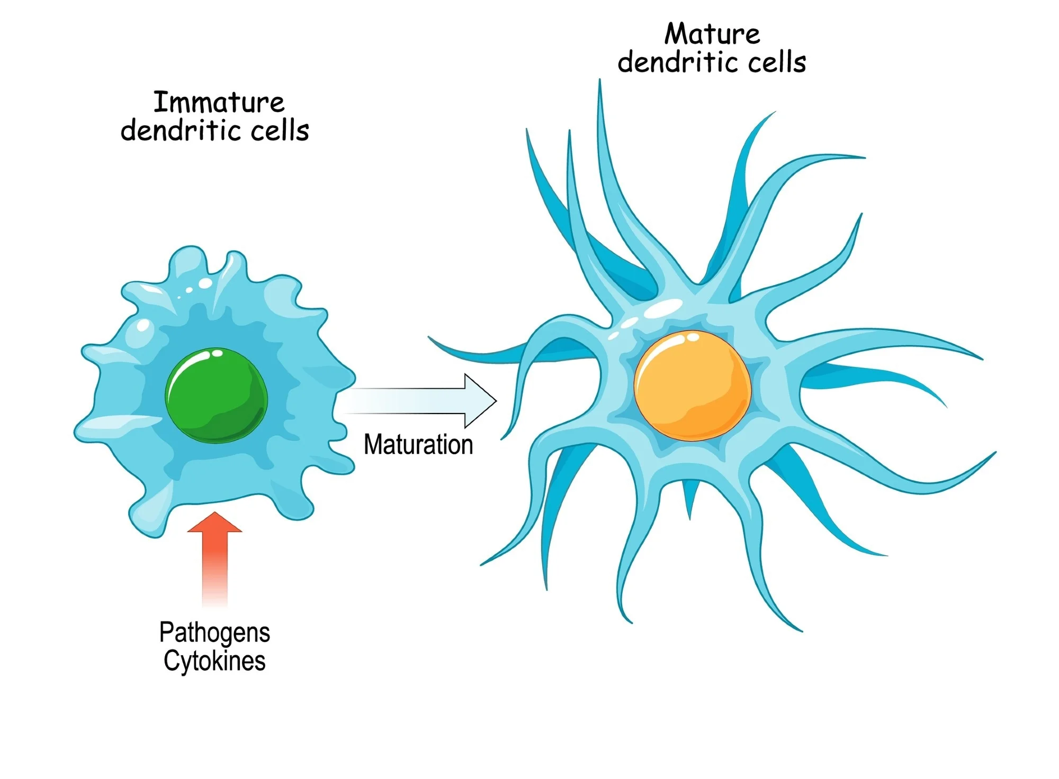

Slide 16
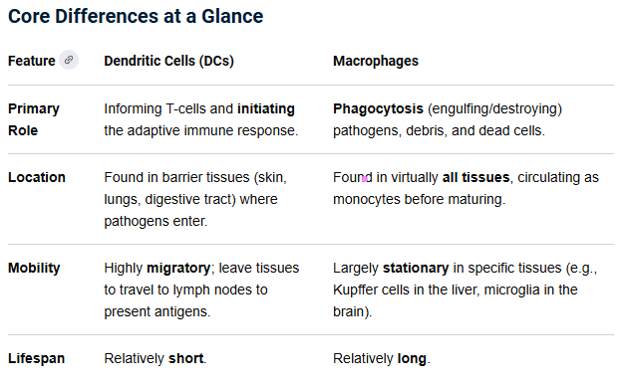

Slide 17
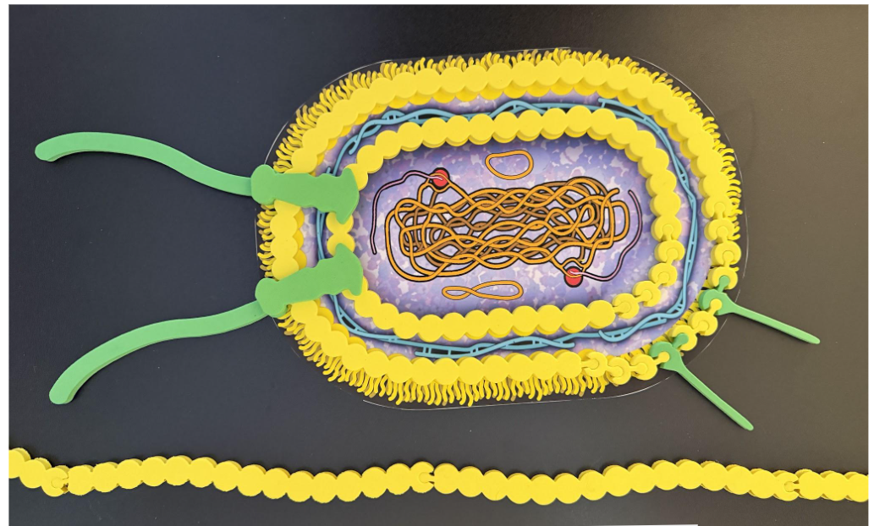
A true human macrophage is 3 to 15 times larger than a single bacterial microbe. How much larger a would you have to make the macrophage model for the scale to work?
3μm

Slide 18




Modeling a Macrophage
Using the cell membrane pieces at your table and any art supplies you want, can you create your own microbe, to scale, and only showed a curved edge or section of your macrophage membrane to preserve the actual size relationship.
How can this strategy of reminding students about scale help to build connections across both models and content?

Slide 19

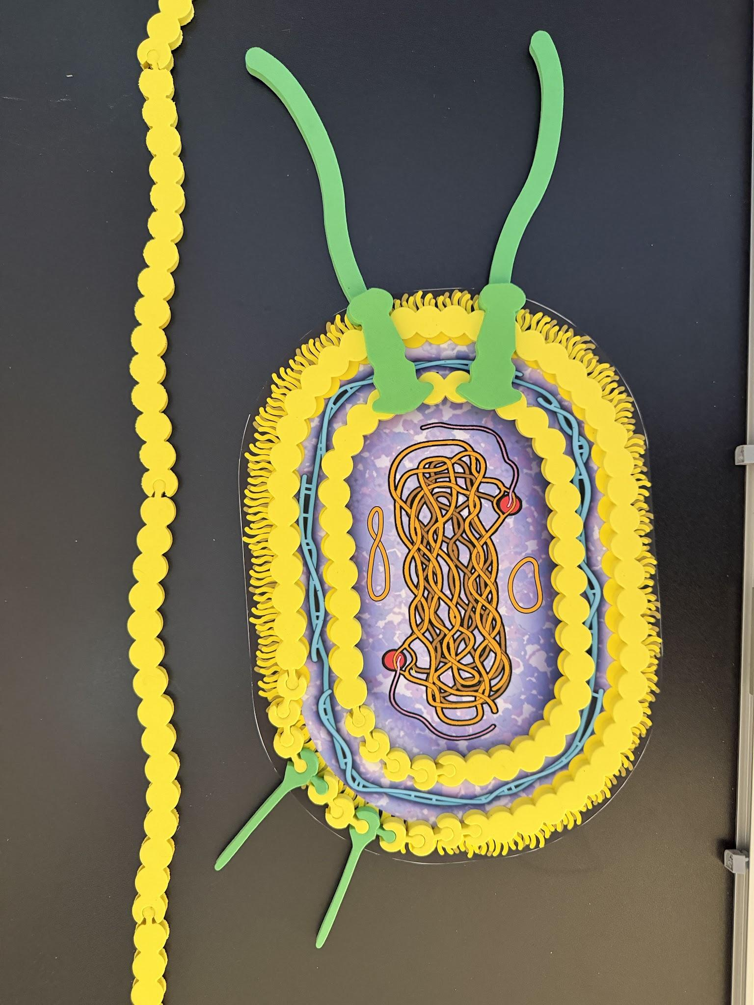
Do you have ideas about how you might modify this activity or an aspect of the activity to use with your students?
EX: Use analogies! If the bacterium is the size of a basketball then…what might they use from their world to make connections? Any ideas?
What additional scaffolds might they need to engage with the concepts?
EX: What would you do the day BEFORE this lesson?
EX: What would you do the day AFTER this lesson?

Slide 20
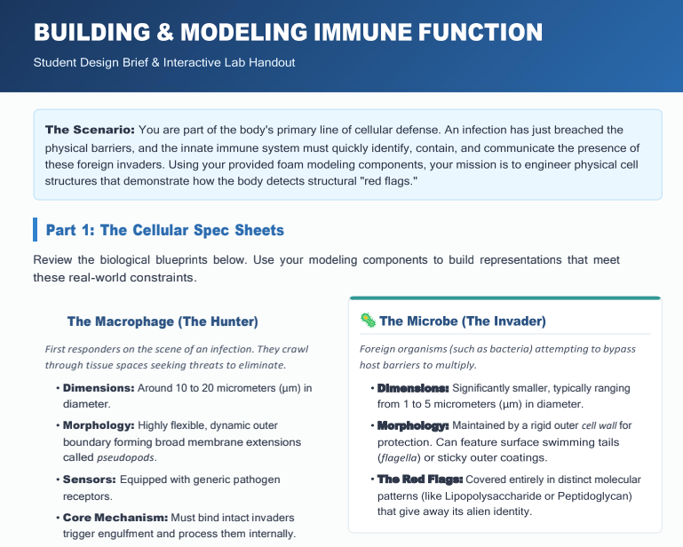
Model a Macrophage activity in the drive.

Slide 21

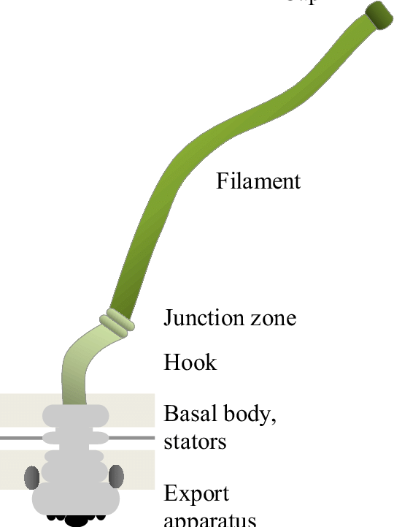
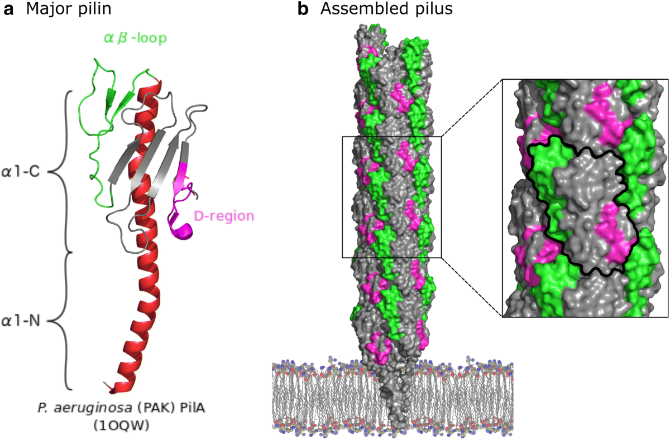
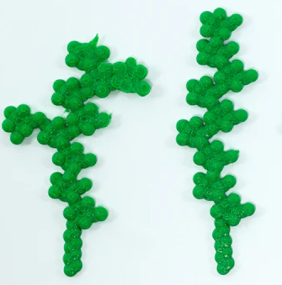
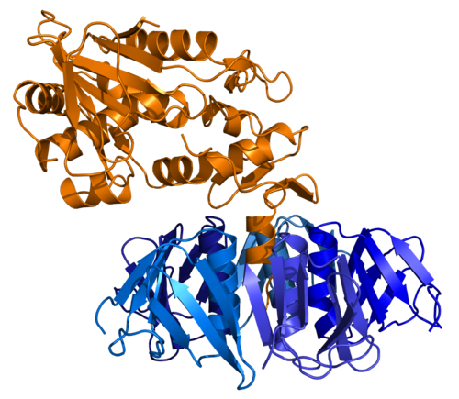
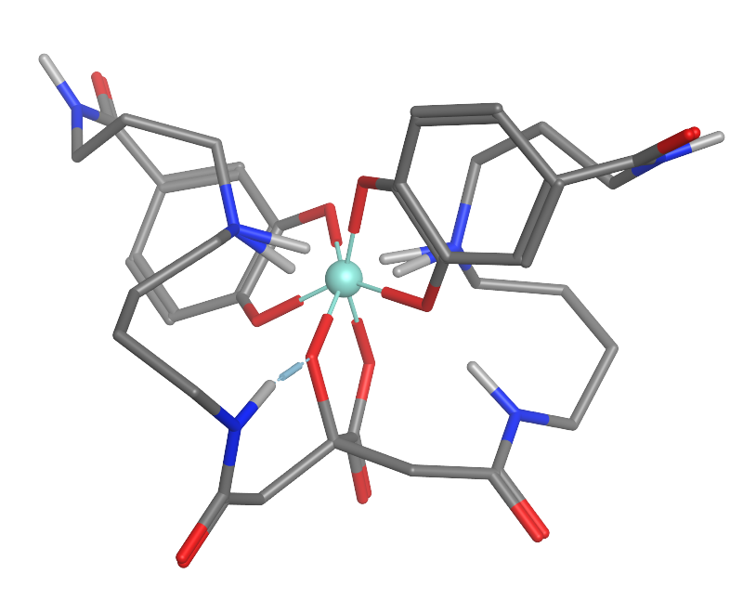
Discuss: Which of the following microbial structures do you think a macrophage could “sniff out” and why do you think so?
Shiga Toxin
Glycolipid
Pilus
Flagellum
Siderophore

Slide 22
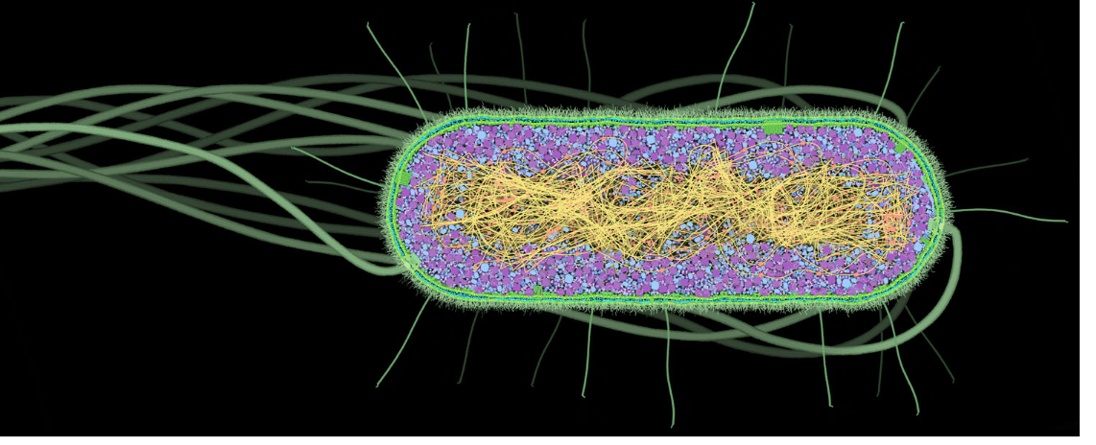
Pilus
Flagellum
Pathogen Associated Molecular Pattern (PAMP)

Slide 23
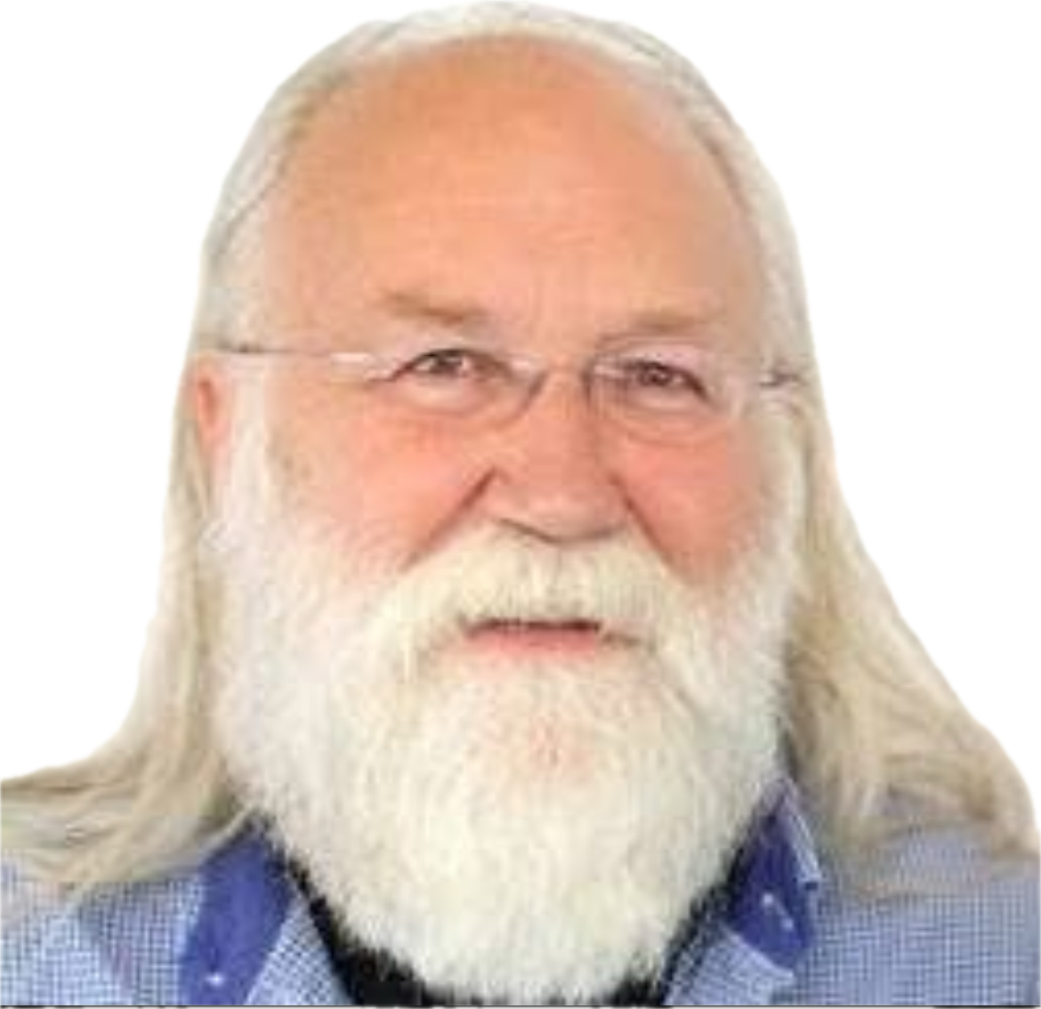
PAMPs are displayed to the immune System
Threat detection
Pathogen Associated Molecular Pattern (PAMP)
Notes:
This figure is fundamentally ironic. An anachronism, actually. Because bacteria have “PAMPs” and Tim never will….

Slide 24
This figure is ironic, a collision of realms, if you will... because bacteria have “PAMPs” and Tim never will… and yet there he is…
Threat detection
Pathogen Associated Molecular Pattern (PAMP)
Notes:
This figure is fundamentally ironic. An anachronism, actually. Because bacteria have “PAMPs” and Tim never will….

Slide 25
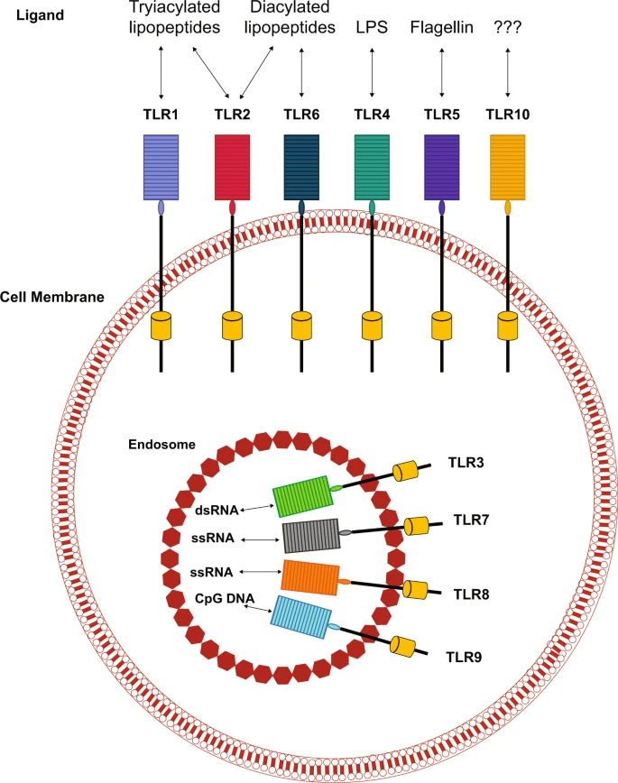
Receptors face out toward the external environment.
Endosomes also carry PAMP sensors which face inside toward the endosome.

Slide 26
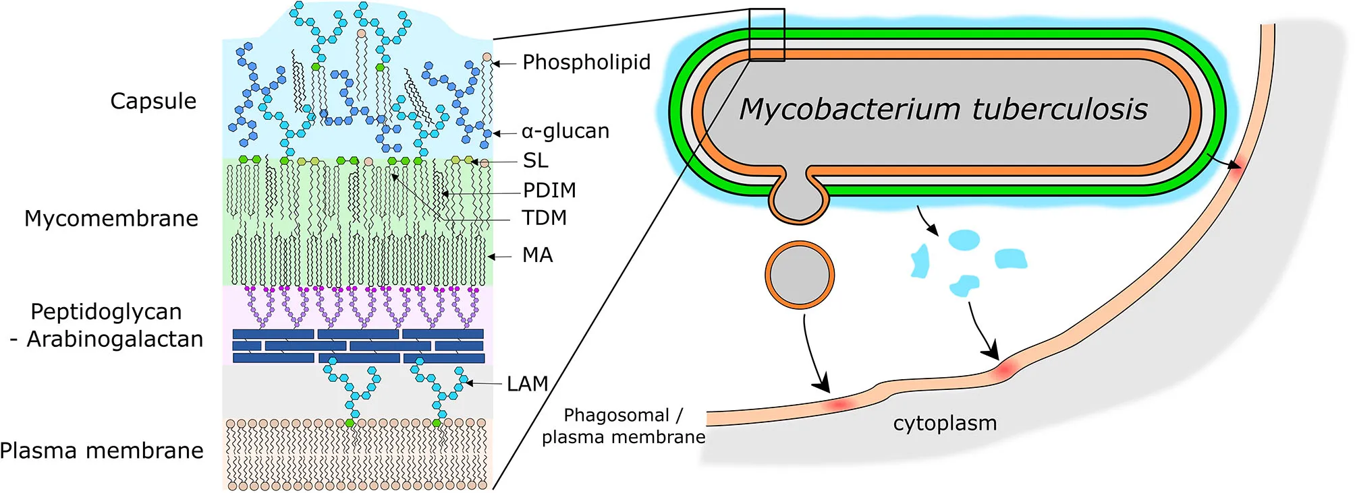
Mtb (Mycobacterium tuberculosis): Buried in soft slime
This pathogen hides from the receptors!

Slide 27
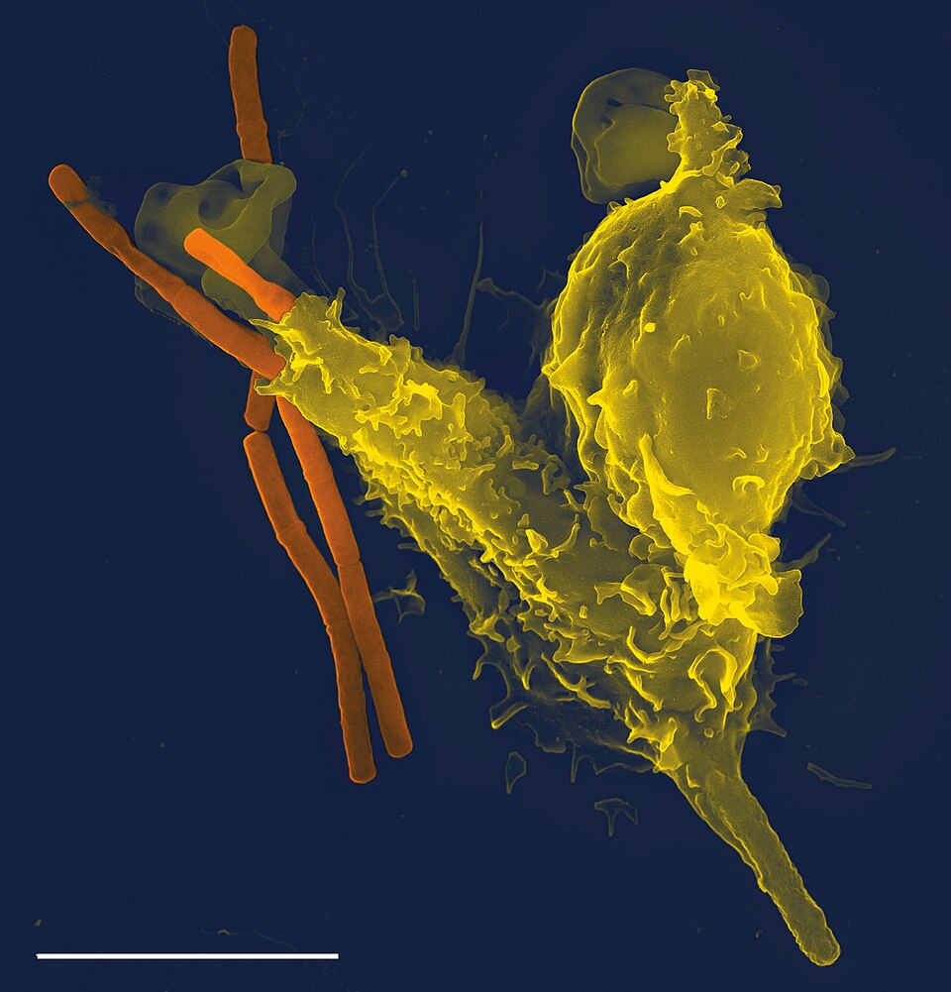
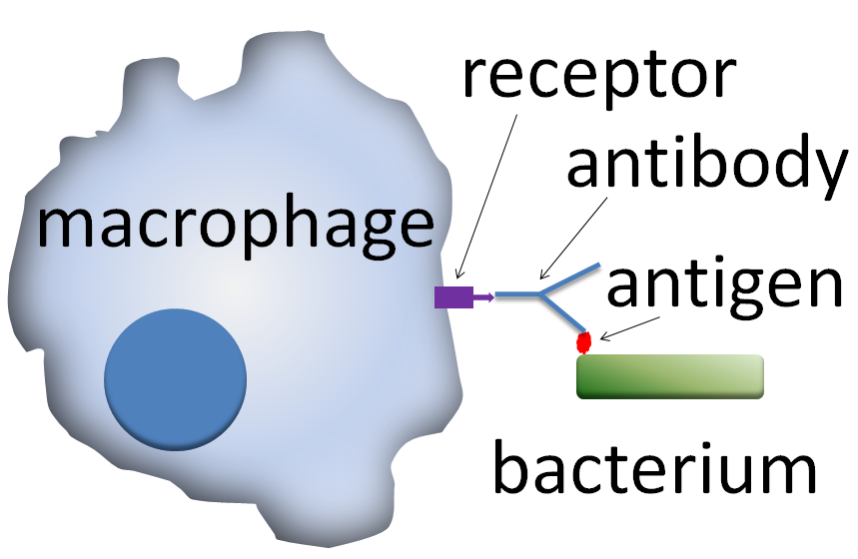
Macrophage engulfing B. anthracis
PLoS Pathogens 1 (3): Cover page. DOI:10.1371. Archived from the original on 2015-01-09. Retrieved on 2009-01-04.
Wikipedia CC.

Slide 28
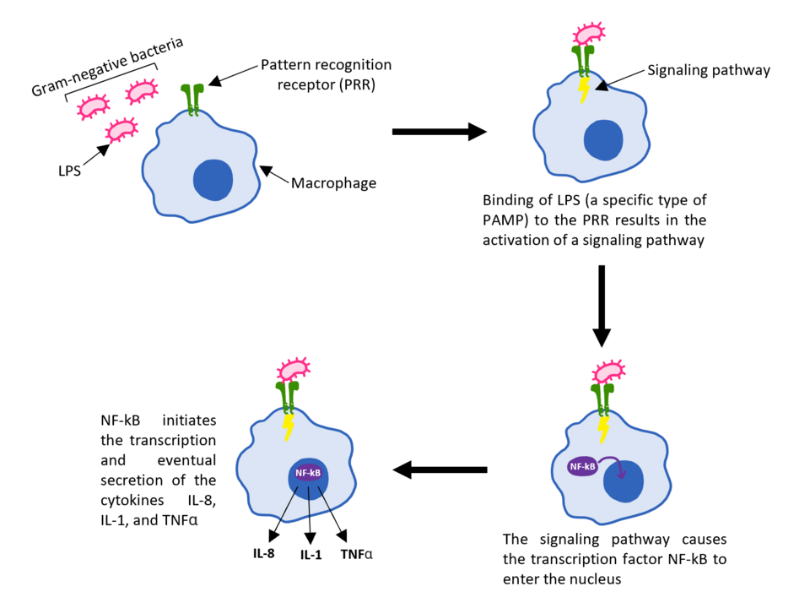
Possible Scenario

Slide 29

E.coli size varies depending on growth conditions.
Starvation: stay small
Plenty: grow larger
0.5 μM

Slide 30
How big would the E.coli cell be that is laying next to the Tour of the Human cell?

Slide 32
Our Innate Immune System…
(Toll-Like Receptors)
Tim Herman

Slide 33
Toll-Like Receptors (TLRs) are a class of proteins that are a key part of the innate immune system. They are immune sensors.
They are named after the toll gene, which was first discovered in the 1980s as a gene that controls the dorsal-ventral polarity of the Drosophila embryo. In 1996, it was also shown that the toll gene has an important anti-fungal function in Drosophila. In 1997, the mammalian homolog of the toll receptor, now called TLR4, was discovered to play a critical role in innate immunity by inducing the expression of genes related to inflammatory responses.

Slide 34
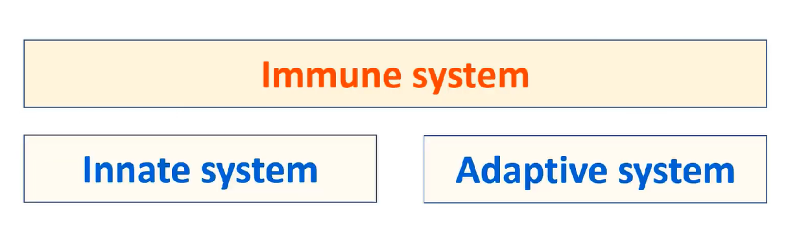
Physical barriers
Humoral immune system (antibodies)
Cellular Components
Cellular immune system
(T-cells)
Non Cellular Components
(Toll-Like Receptors)
https://www.youtube.com/watch?v=Sx1jKujXwjY

Slide 35
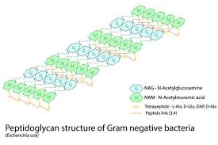
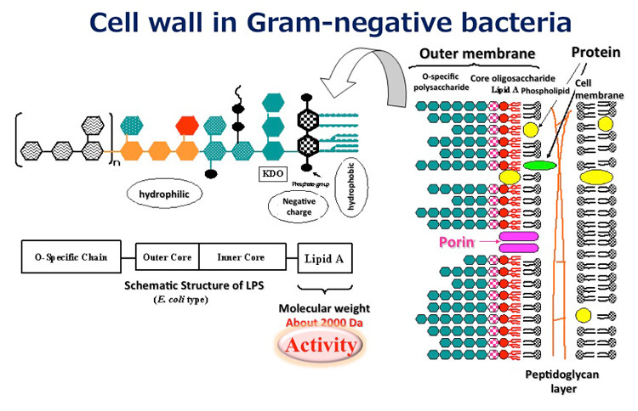
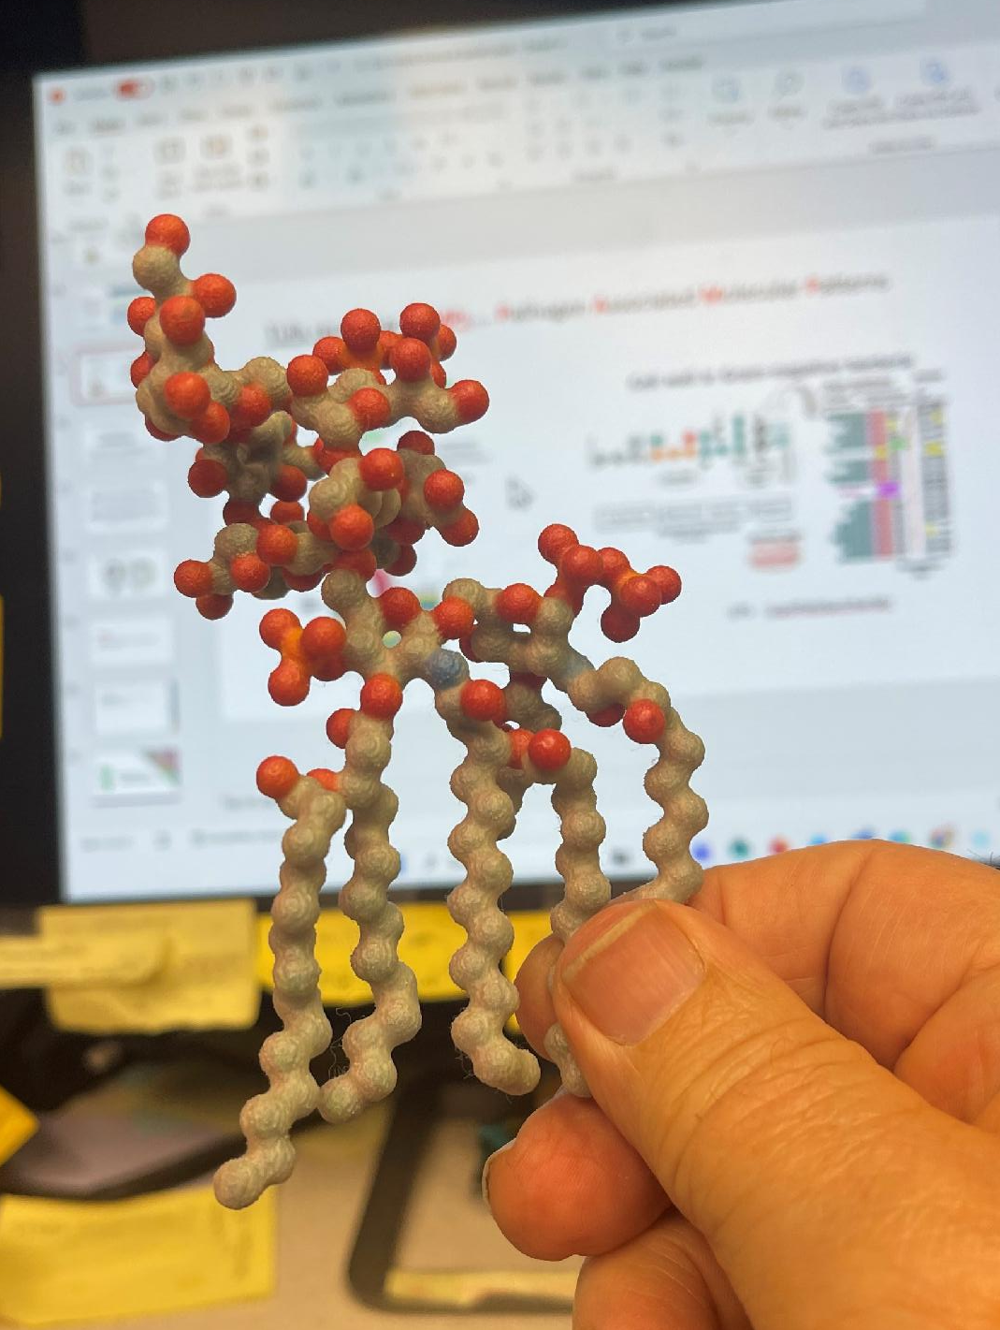
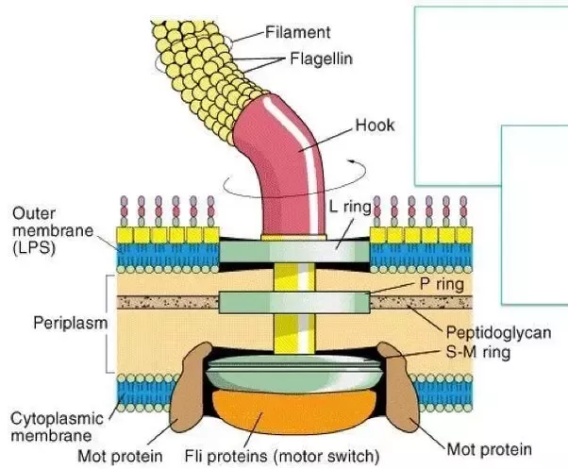
TLRs recognize PAMPs…. Pathogen Associated Molecular Patterns
LPS - LipoPolySaccharide

Slide 36
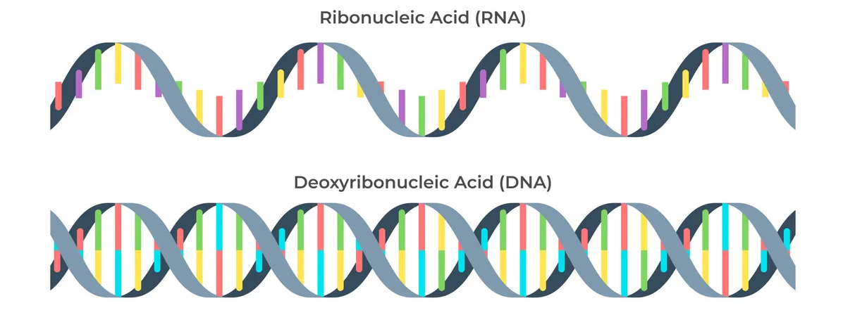
Another important PAMP… is RNA and DNA
TLR3, TLR7, TLR8 and TLR9 recognize nucleic acid derived from viruses as well as endogenous nucleic acids in context of pathogenic events.
Activation of these receptor leads to production of inflammatory cytokines as well as type I interferons to help fight viral infection.

Slide 37
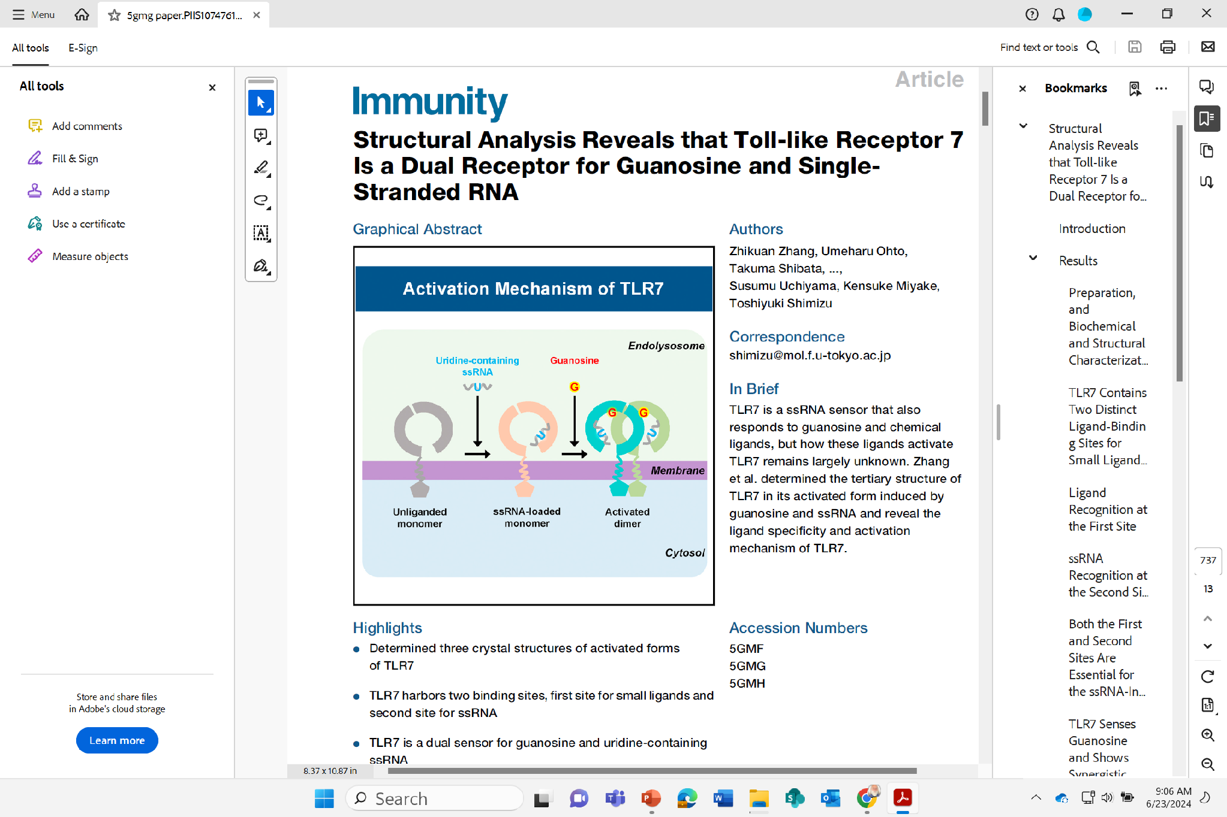
TLR7
Highlights
Determined three crystal structures of activated forms of TLR7
TLR7 is a dual sensor for guanosine and uridine-containing ssRNA
TLR7 is synergistically activated by guanosine and ssRNA
Zhang et al., 2016, Immunity 45, 737–748
October 18, 2016 ª 2016 Elsevier Inc.
http://dx.doi.org/10.1016/j.immuni.2016.09.011

Slide 38
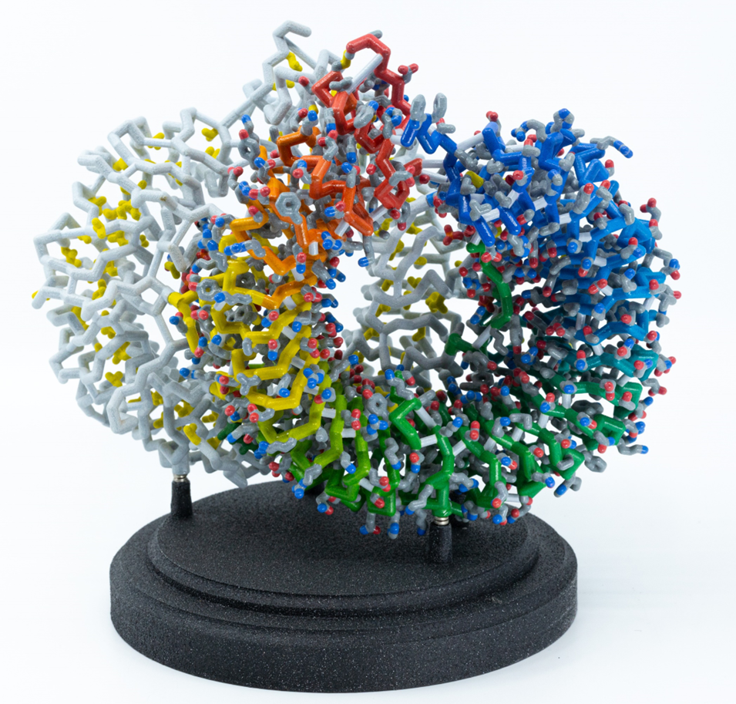
Zhikuan Zhang, Umeharu Ohto, Takuma Shibata, ..., Susumu Uchiyama, Kensuke Miyake, Toshiyuki Shimizu
TLR7 is a ssRNA sensor that also responds to guanosine and chemical ligands, but how these ligands activate TLR7 remains largely unknown. Zhang et al. determined the tertiary structure of TLR7 in its activated form induced by guanosine and ssRNA and reveal the ligand specificity and activation mechanism of TLR7.
Zhang et al., 2016, Immunity 45, 737–748
October 18, 2016 ª 2016 Elsevier Inc.
http://dx.doi.org/10.1016/j.immuni.2016.09.011

Slide 39
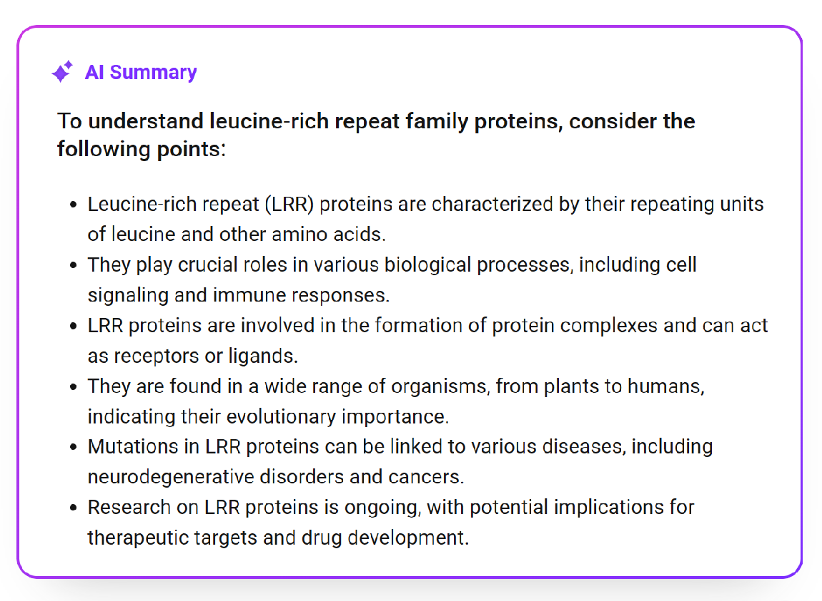

Slide 40
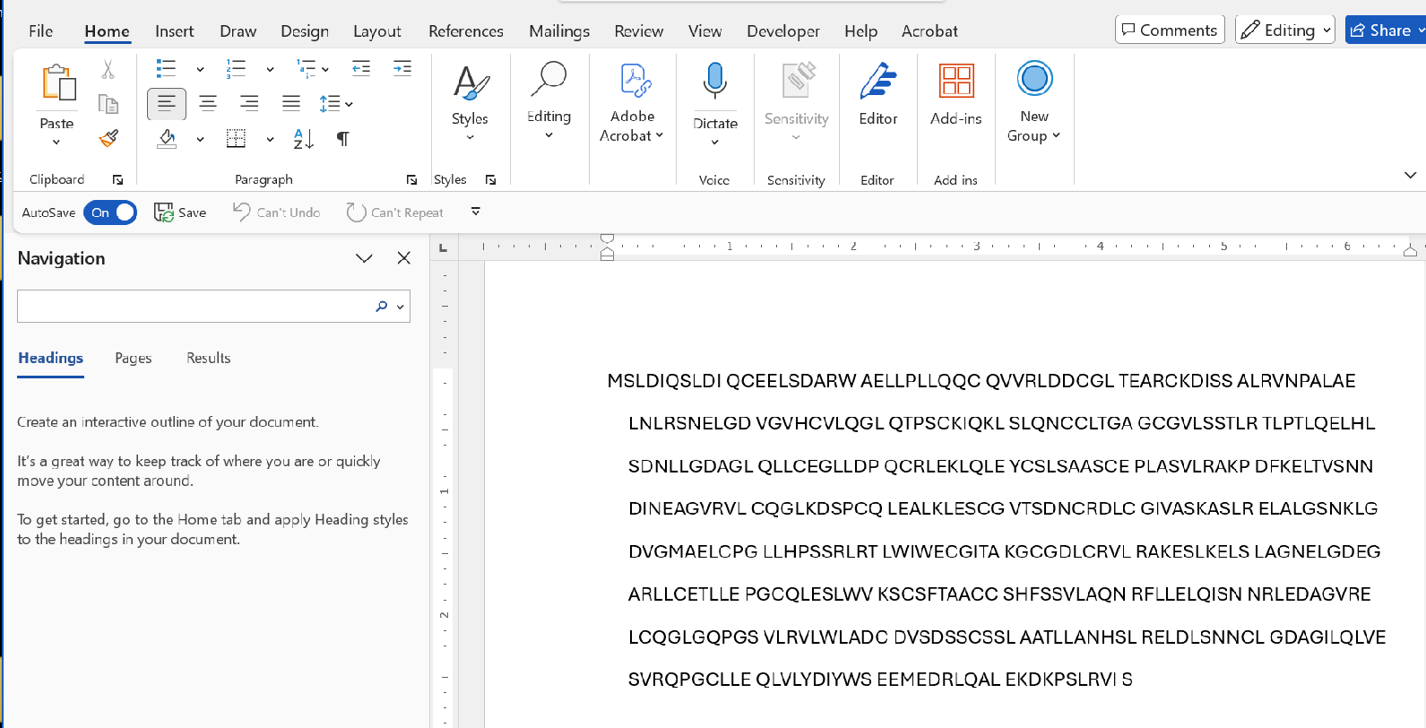

Slide 41
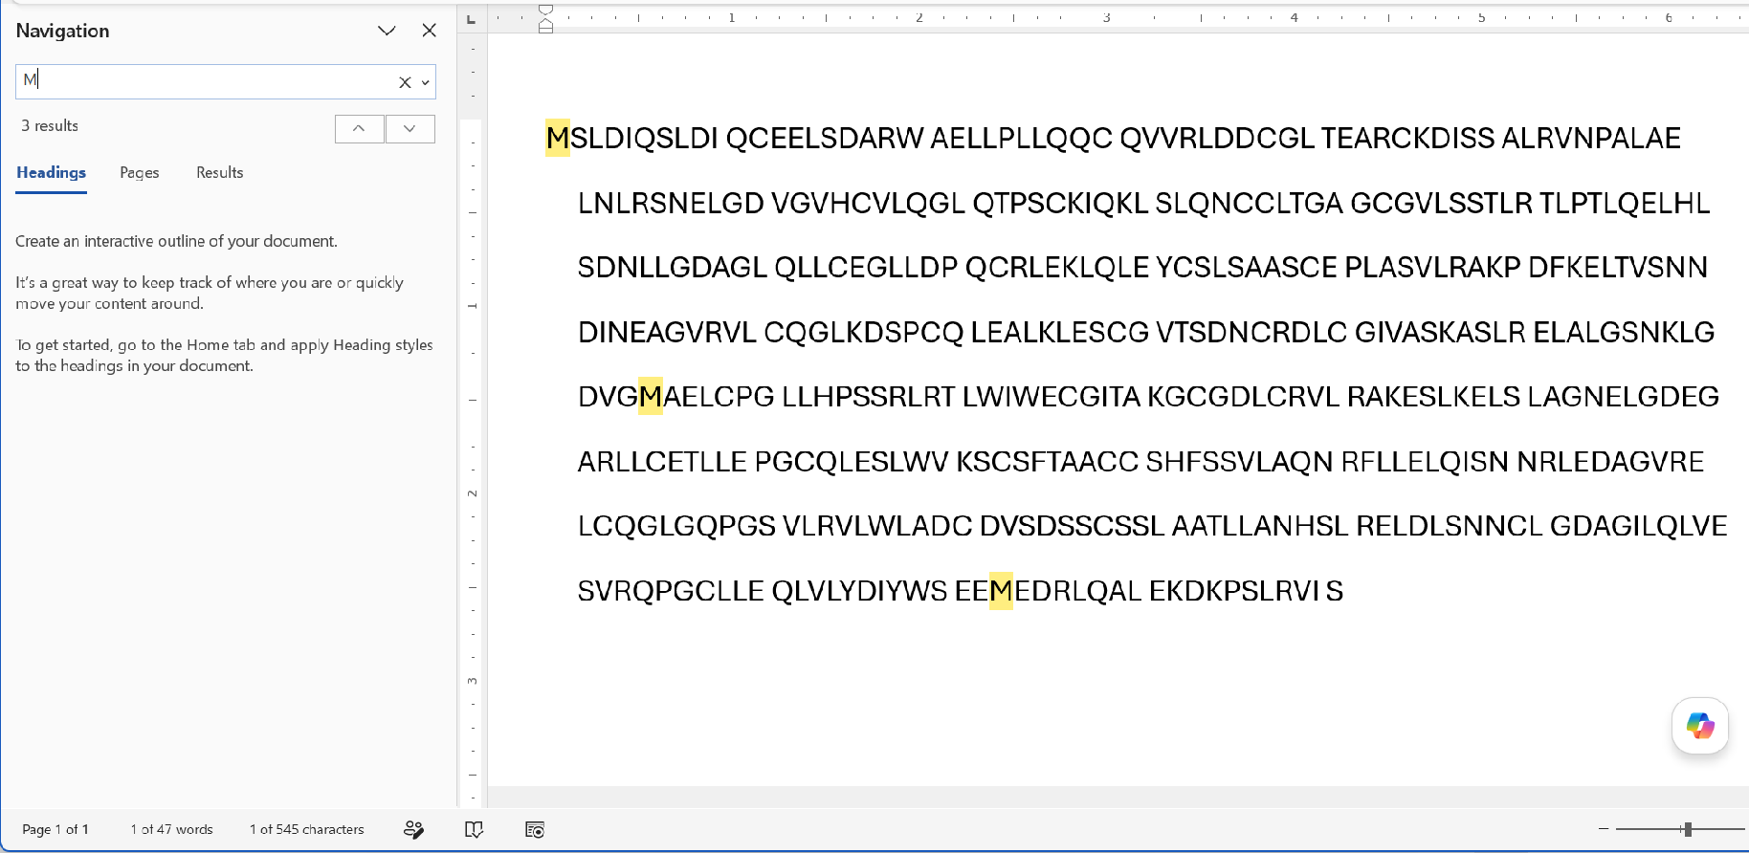
How many Methionines (M) are there in this sequence?
Predicted Frequency = 17 (5%)
Actual Frequency = 5 (1%)

Slide 42
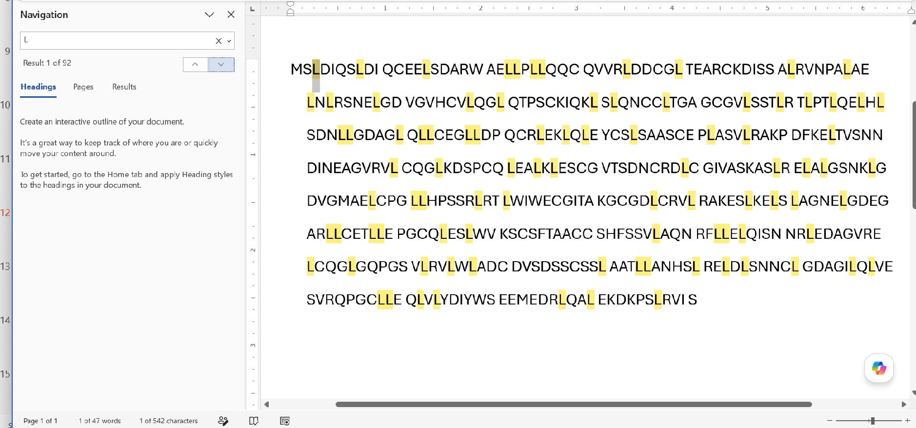
How many Leucines (L) are there in this sequence?
Predicted Frequency = 17 (5%)
Actual Frequency = 92 (17%)

Slide 43
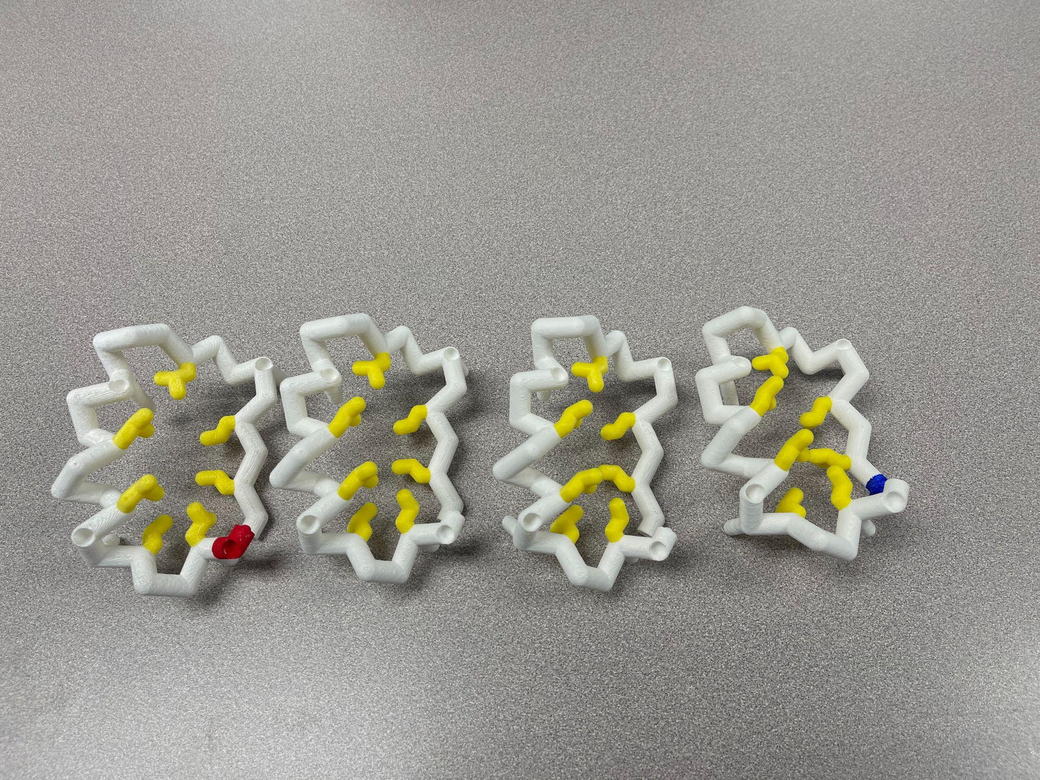
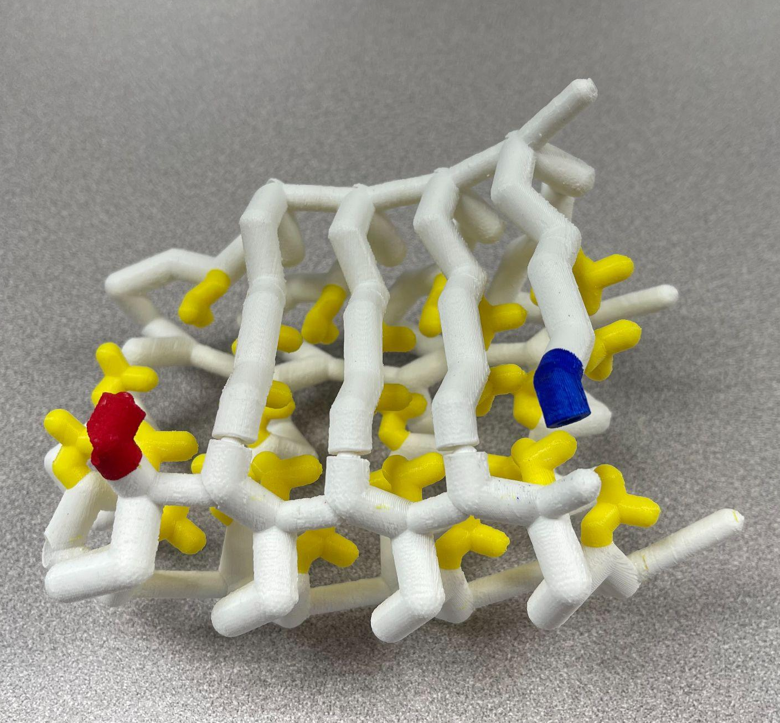
Leucine Rich Repeats…

Slide 44
Do It…
Explore Leucine Rich Repeats with physical models
Remember,.... Models give meaning to words!

Slide 45
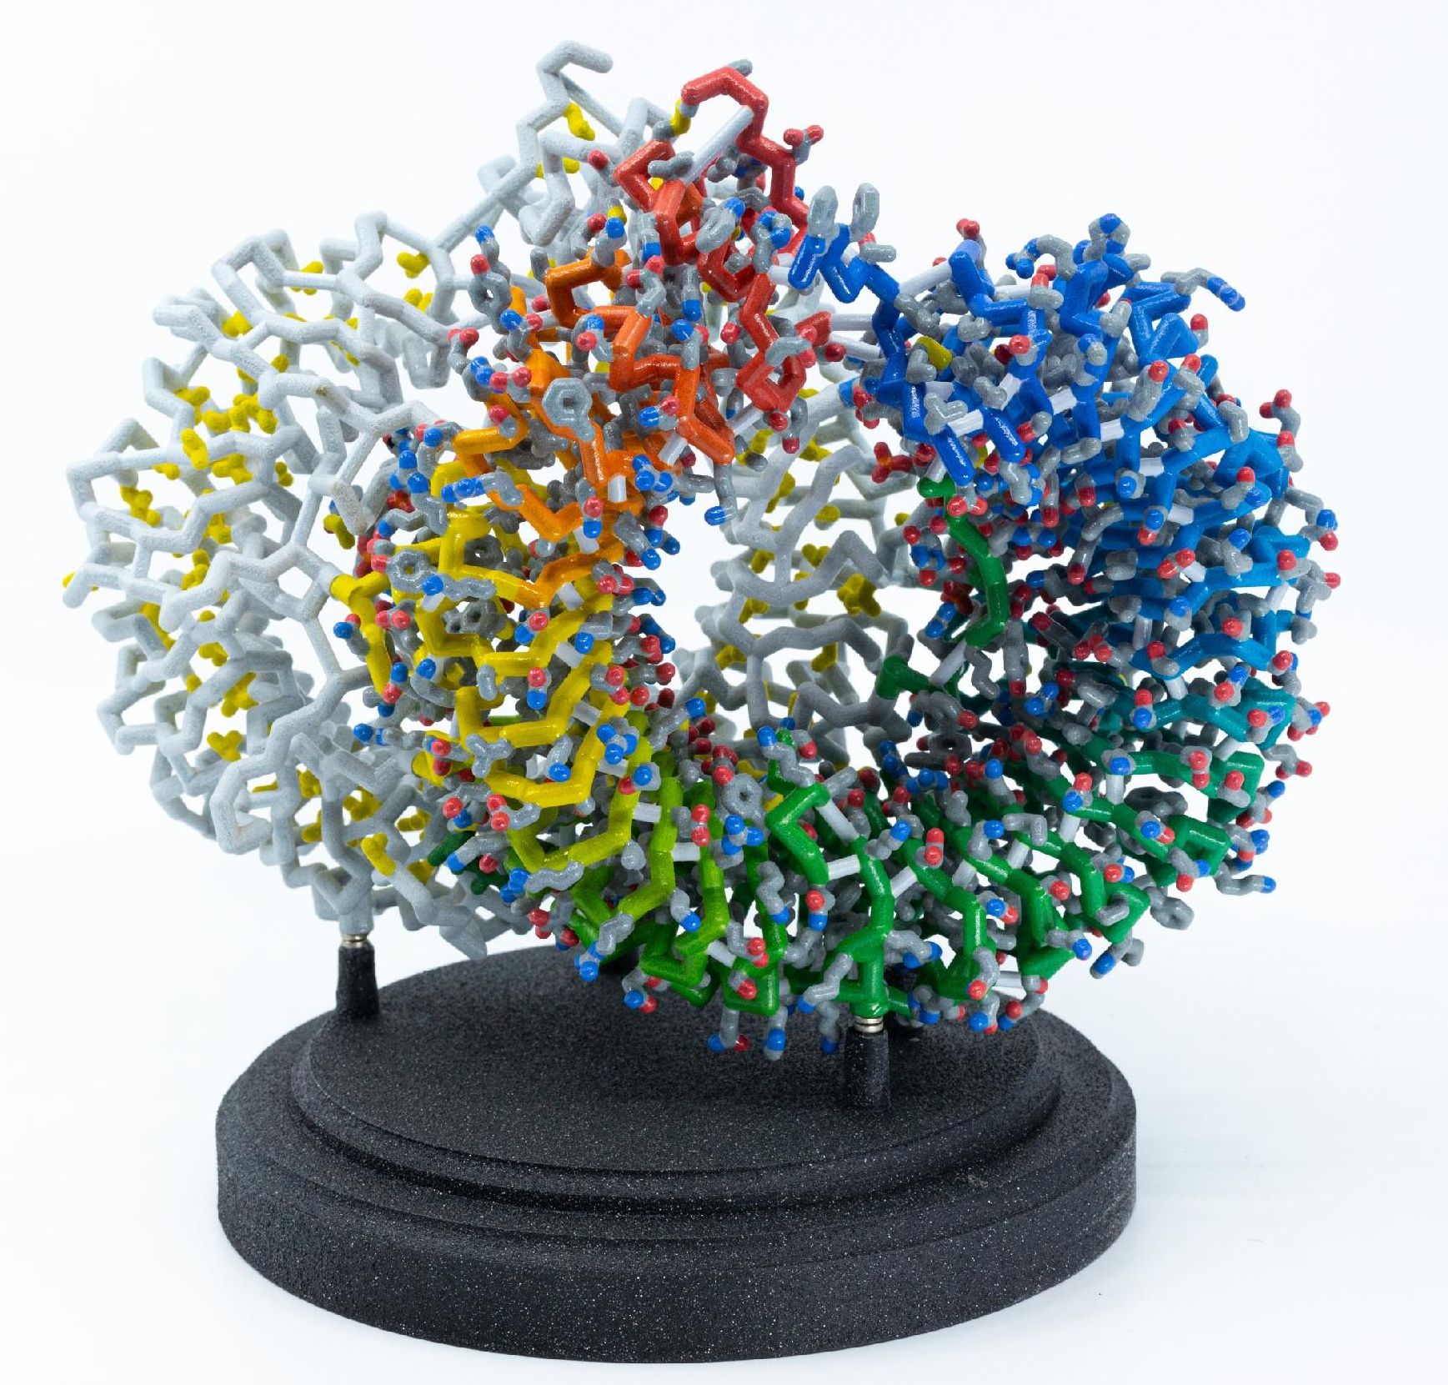
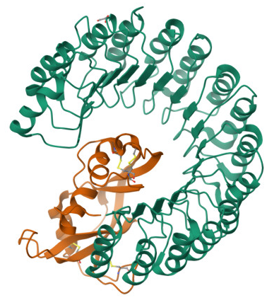
Modularity in biology,…
Leucine-Rich Repeats (LRRs)…and Toll-Like Receptors (TLRs)
TLR7
Ribonuclease Inhibitor

Slide 46
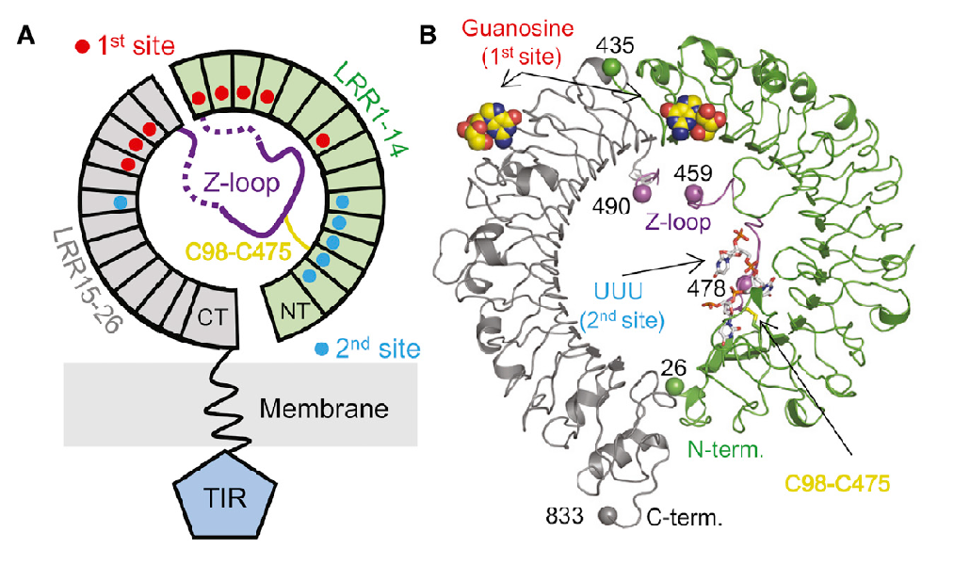
…and finally, a closer look at TLR7

Slide 47
TLR7 detects single-strand viral RNA.
…but wait?
QUESTIONS to ponder:
How do we distinguish between viral RNA and our endogenous mRNA??
How do we distinguish between an mRNA vaccine and endogenous mRNA??

Slide 48
Hint:
How does E. coli protect its own genome from the EcoRI restriction endonuclease??
Connecting the dots….
Islands of knowledge… amidst a sea of unknowing.

Slide 49
The Answer…
( How do we distinguish between viral RNA and endogenous mRNA?? )
We modify uridine in our mRNA… to pseudouridine !
Really?? Can we / Should we start teaching this to our students??

Slide 50
Another QUESTION to ponder…
What was the mechanism whereby a gene encoding TLR7 evolved?

Slide 51
Additional Resources and Links
Structural Analysis Reveals that Toll-like Receptor 7 Is a Dual Receptor for Guanosine and Single-Stranded RNA. http://dx.doi.org/10.1016/j.immuni.2016.09.011
Leucine-rich repeats (LRR) proteins… http://dx.doi.org/10.4161/auto.7.9.16464

Slide 53



Reflection
Whew! Let’s 3…2…1 this reflection.
What are the 3
most important concepts here?
What are 2
ways to introduce pattern recognition with your students?
What is 1
struggle you anticipate if you were to teach this?

Slide 54


Slide 55
Adaptive Immunity: Assembling Defense
Christina Bowers

Slide 56
Session Goals
Differentiate between inactive and active cell states
B-lymphocytes produce antibodies but they don’t produce them all the time
T-cells “wake up” when they “see” a signal from dendritic cells in the lymph node.
Model to explore ideas: Both cell types exist in active and inactive states.
Vibing State
“Low key chillin’”
Activated
“High alert”
“locked-in”
What is different about each condition?
What stays the same?

Slide 57
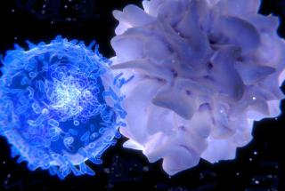
Dendritic
Dendritic
T-cell
Dendritic cells form a bridge to encoding memory.

Slide 58
Many Surface Receptors
Flexibility
Major Receptor: bound antibodies
Extreme specialist
Generalist
Coordinators; Promote cell to cell communication

Slide 59
What happens when a B-cell becomes activated?

Slide 60
How would we know an “activated” cell if we saw one?
Collaborate to make a list of cell “activities” that might indicate that a cell is in an “awakened” state.

Slide 61
Dendritic cells present antigen and activate T-cells in the lymph node.
Activated helper T-cells

Slide 62
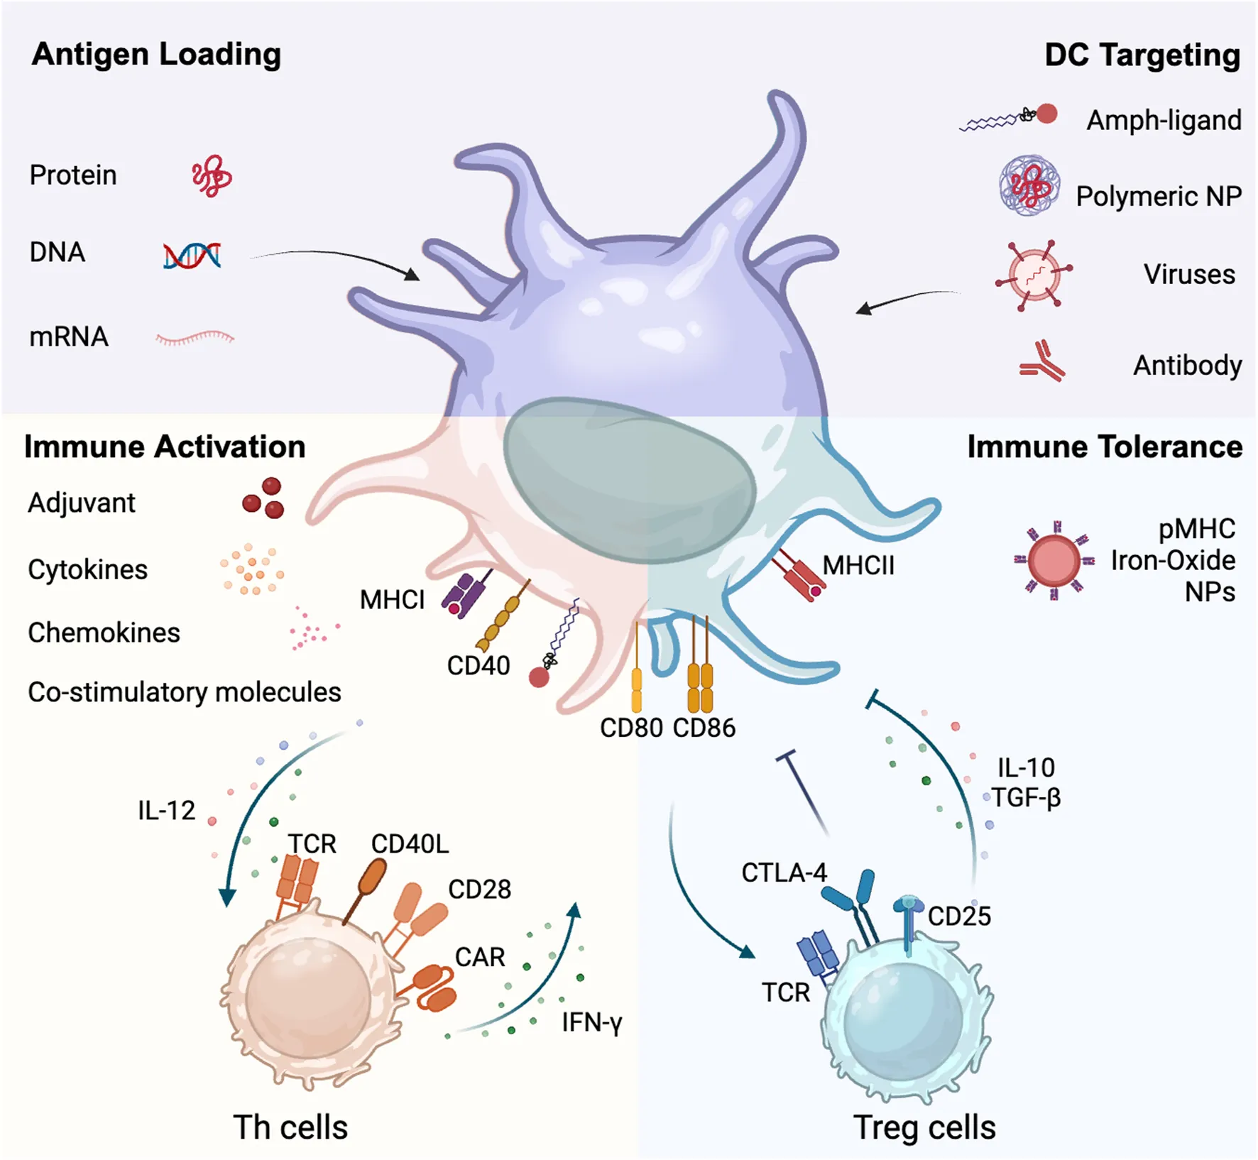

Slide 63
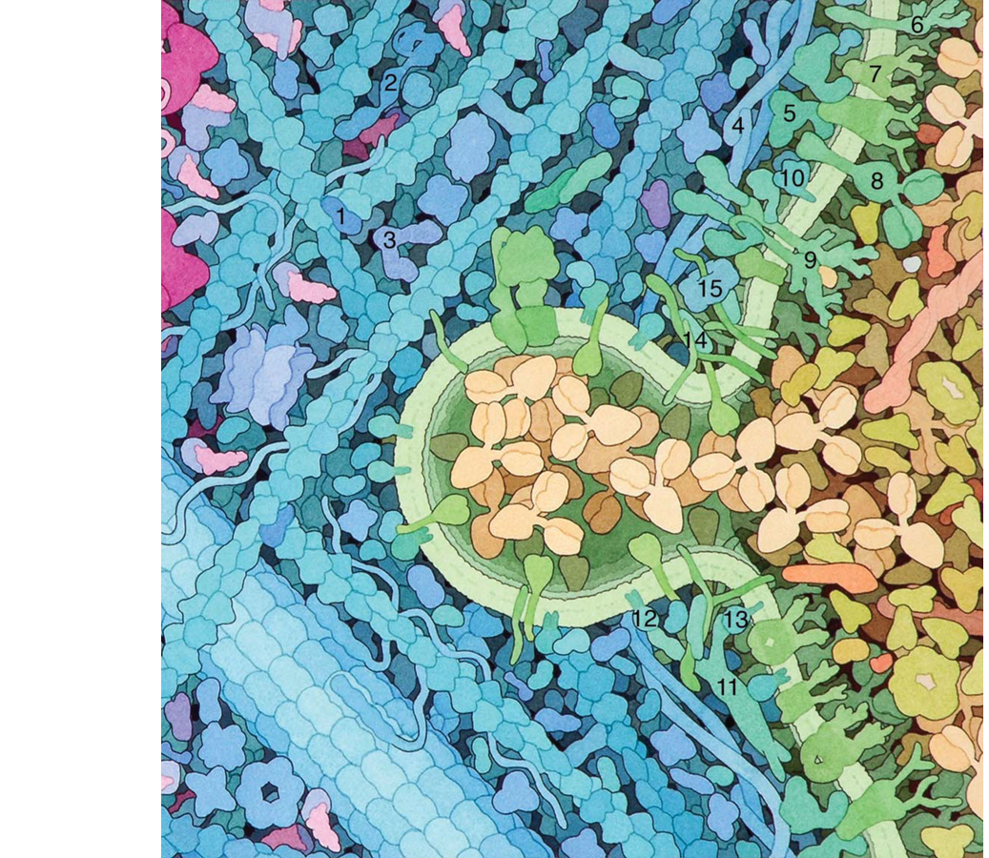
Where are the antibodies in this activated B cell?

Slide 64
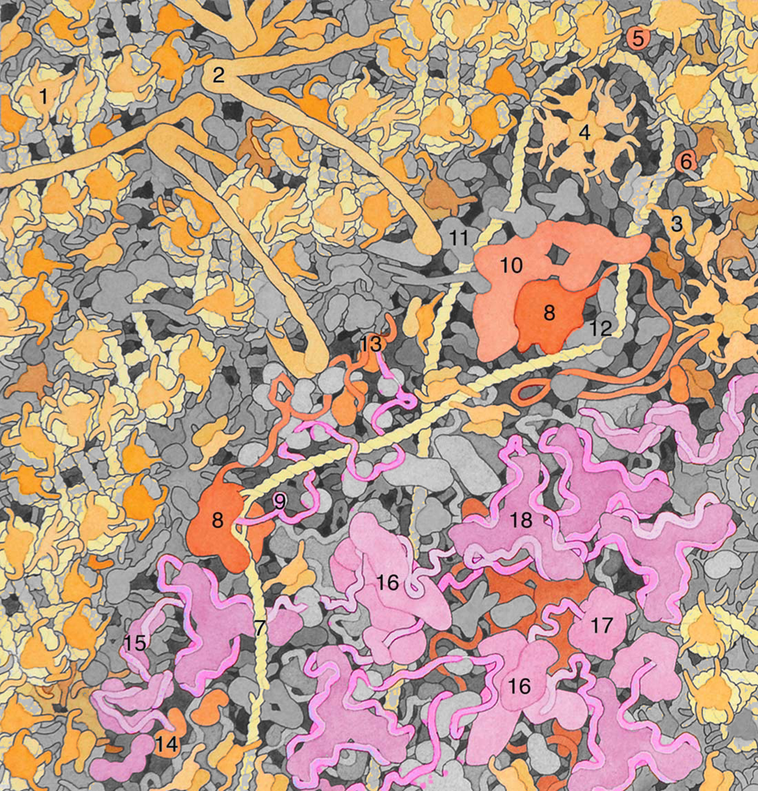
mRNA is spliced to remove the region of the antibody gene sequences that code for the protein stem that embeds in the cell membrane!

Slide 65
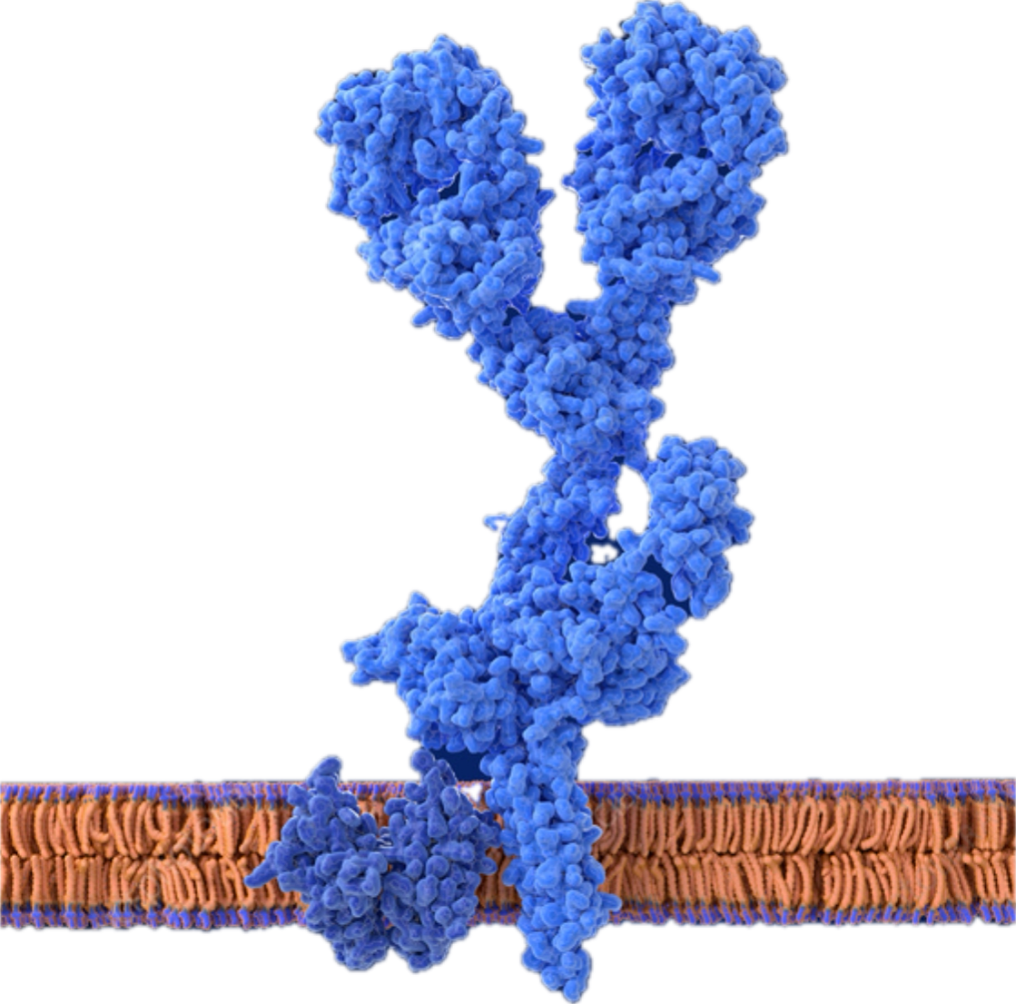

Membrane bound antibody (B-cell receptor)
B-Cell
An “inactive” B cell is bound in the B-cell membrane through a hydrophobic domain.

Slide 66

IgM
B-dell Activation leads to an mRNA splicing change that removes the hydrophobic tail.

Slide 67
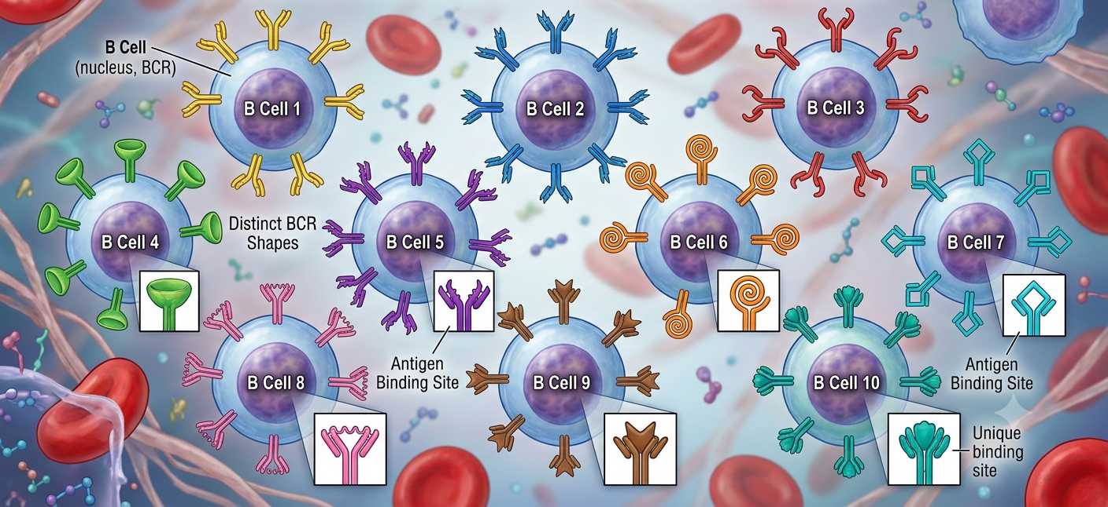
Weird AI B-cell diagram. Prompt: make 10 B-cells, each with a different shaped BCR(B-cell Receptor). B-cells sense shape.

Slide 68
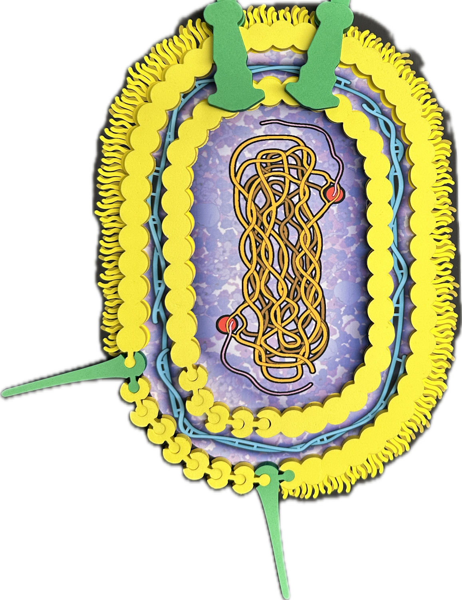
How big would the E.coli cell be that is laying next to the Tour of the Human cell?

Slide 69
Let’s play!
This microbe bumps into the B-cell membrane shown to the left.
What happens next?
What structure will you add?

Slide 70
Whip Around Share Out! Choose 1:
Something you learned that surprised you.
Something that is still confusing to you that you would like to understand better.
A detail that you understood…

Slide 72

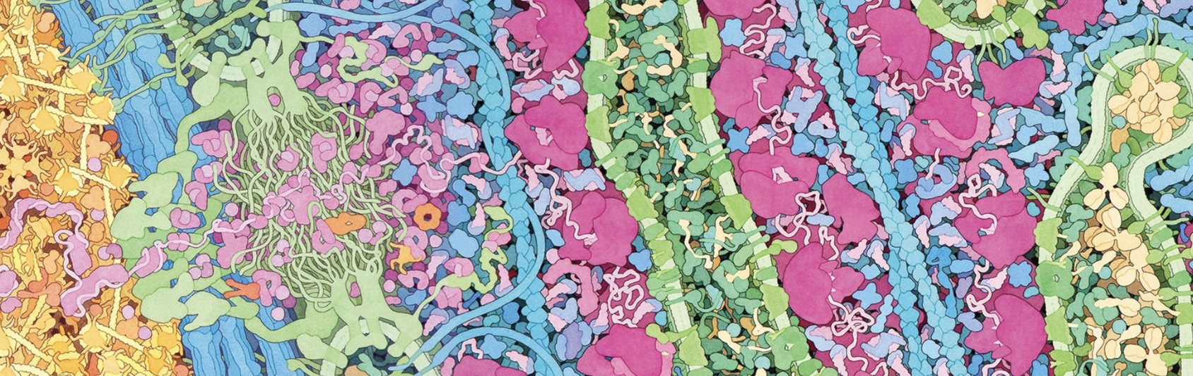
Reflection
GET UP! You’ll share ideas, but NOT at the same table. Conversation is our focus…
Discuss 2 of the following: Points of confusion, something I learned, something I wonder about, an idea I have for my classroom, a question I want answered!

Slide 73


Slide 74

Lunch Options
3DMD Staff will escort groups to restaurants each day. Other good local options for fast lunches include: 600 East Café Loaded Spuds Mediterranean Cuisine Your Office

Slide 75


Slide 76

IgG Fold

Slide 77

IgG Fold

Slide 79


Antibodies:
A universe within us
Christina Bowers
Antibody image: https://pdb101.rcsb.org/motm/21
Icon by Noun Project

Slide 80
Session Goals
“The human body has the capacity to deal with threats it has not yet set “seen” (or that might not even exist yet!)”.
How can we evaluate claims such as this using models as tools for understanding?
We will explore how genetic recombination events generate billions of variations in the binding surfaces (Complementary Determination Regions) of Antibodies.
We will apply antibody structure to understand why we might need a new flu shot each year.

Slide 81

Some True Facts about antibodies:
Every antibody is unique.
Creating variation relies on molecular mechanisms that act on genomic DNA, RNA and protein shape-interactions.
Each antibody is produced in a single line of B-cells.
Antibodies are created BEFORE ever seeing the antigen they recognize.

Slide 82


Antibody — Antigen
Lysozyme
Antigen:
structure bound by antibody

Slide 83

Antibody — Antigen
Shape that Fits
F-antibody (Fab) for antibody binding fragment (part of the protein that binds to the antigen.)

Slide 84



Compare models…
Complementary Determination Regions CDR

Slide 85



In what context do you teach recombination?
1
2
3
Notes:
1:https://www.pearson.com/channels/genetics/study-guides/genetic-linkage-and-mapping-in-eukaryotes-6
2. https://www.khanacademy.org/test-prep/mcat/biological-sciences-practice/x04f6bc56:mcat-bio-biochem-foundation-1-passages/e/genetic-recombination-and-conditional-knockouts
3. https://iotasciences.com/applications/crispr-cas9/

Slide 86


CDR: Complementary Determining Region (15 amino acids)
Regions that bind to a shape.
20 possible amino acids
Factor different CDR regions:
=10²⁶
Stars in milky way: 10¹¹

Slide 87



First: a Meal Analogy…Choose One from Each category
40 Veggies
6 Meats
25 Carbs
You need to prepare a million different meals and each meal will contain 1 product from each category. Does this give you a million variations?
40 X 6 X 25: 6000 variations…what can we do to increase this number?
From Immune Ch. 17: (Philipp Dettmer)

Slide 88



Slide 89

Segment Rearrangement: Sequential rounds of deletion, recombination and repair
VDJ locus on chromosome 14
wikipedia

Slide 90

Chromosome 14
Immunoglobulin IG: Heavy Chain Locus
V₁
V₂
V₃
D₁
D₂
D₃
J₁
J₂
J₃
Variable: 40
Diversity: 6
Joining: 25
3
3
3

Slide 91
Chromosome 2
Immunoglobulin IG: Light Chain Locus
V₁
V₂
V₃
J₁
J₂
J₃
Constant
V₂
Variable: 40
Diversity: 0
Joining: 5
3
0
3

Slide 92

Rag1: Decide which version of V and which version of J that you want to keep.
RAG
V₁
V₂
V₃
J₁
J₂
J₃
Constant
V₂
RAG: Recombination Activating Gene

Slide 93
With your hands playing the role of Rag1, splice out the versions you don’t want.
RAG
RAG
V₂
V₁
J₂
J₃
V₂
During the repair process, nucleotides get lost, adding more variation!
Constant
V₃
J₁

Slide 94
These genes need to be transcribed and translated now. Where in the B-cell does this happen?
Constant
V₃
J₁
B-Cell

Slide 95



Slide 96


Build Tips: Lay out your pieces next to your gene sequence. Organization helps as you model!
CDR 2
V3
CDR 1
V1
V2
J2
J1
J3
V1
V2
V3
J1
J2
J3
Notes:
CDR = complementary determining region (CDR)

Slide 97


2. Remove the protein pieces for the genes you will delete.
Build the other half with the same V and J pieces.
Build 1 half of the antibody.
Constant
V₃
J₁

Slide 98



2. Use the notches as a guide.
The pieces should only fit together one way.
Line up the cut sites.

Slide 99
Repeat the process now, working with your table to complete the build for two light and two heavy chains..
Chromosome 14
Immunoglobulin IG: Heavy Chain Locus
Rag1
Which gene segments will you delete?
V₁
V₂
V₃
D₁
D₂
D₃
J₁
J₂
J₃

Slide 100



Slide 101

Gentle reminder….you are folding an antibody! We have seen this before. What role are your hands playing here?

Slide 102


We are inside the ER of a B-cell…folding antibodies!
Chaperone

Slide 103

Folding takes two hands!
6. Chaperone
6. Chaperone

Slide 104


Don’t forget to include your Cysteine Disulfide Bond bridge.
Cys
Cys

Slide 105


Slide 106
Each B-cell records one set of rearrangements.
Each B-cell can only make one type of antibody.
Your final build will have 2 identical light chains and 2 identical heavy chains.
B-Cell

Slide 107

Use the side chain chart in your notebook to ID the CDR (complementary binding region) amino Acids
 | Heavy Chain amino acids | Light Chain amino acids
Complementary Binding Region (CDR) | V3, J1, D3 | V3, J1
1 | Phe, Leu | Phe, Glu
2 | Leu, Val | Ala, Asp
3 | Glu, Leu | Glu, Ala

Slide 108
Take a walk…
B-Cell
Each table group is functioning like a separate, independent “B-cell”. Take your Antibody for a walk and see whether anyone else made one like yours.

Slide 109

NHEJ: Adds variation during repair
Non-homologous End Joining leads to deletions adding variation.
This is similar to what can happen after CRISPR makes a cut…

Slide 110

Cytidine Deaminase introduces mutations that trigger error prone repair.

Slide 111

Compare the 2 antibodies shown below. What kinds of applications for a change like this can your team imagine?

Slide 112
Puzzle:
The Classroom Mystery: Two patients walk into your clinic. Both are completely healthy and asymptomatic, but both show positive IgG antibody tests for a specific virus.
Patient 1 has a wide variety of IgG antibodies that bind to the virus's outer spike and its internal core proteins.
Patient 2 only has IgG antibodies that bind to the outer spike protein. They have zero antibodies against the internal core.
Work with your table team to provide an evidence based explanation.

Slide 113
What are some questions that surfaced as you modeled?

Slide 114
Did your group discuss any barriers that you might need to address?
New ideas for implementation?

Slide 115
Session Goals
“The human body has the capacity to deal with threats it has not yet set “seen” (or that might not even exist yet!)”.
How can we evaluate claims such as this using models as tools for understanding?
You will explore how genetic recombination events generate billions of variations in the binding surfaces (Complementary Determination Regions) of Antibodies.
We will apply antibody structure to explore why we might need a new flu shot each year.

Slide 117

Antibody Mighty Model

Slide 118

Remember
This?

Slide 121


What are these pieces?
Can they assemble?

Slide 122


How about these assemblies?
Can they come together?

Slide 123

Yeah!
…We have an antibody…

Slide 124
Yeah!
…We have an antibody…

Slide 125


Remember…

Slide 126



Slide 128


Antigen
Fragment

Slide 129
Antigen
Antigen
Binding
Domain

Slide 130
Antigen
Antigen
Binding
Domain

Slide 131
Antigenic Drift!

Slide 132
Antigen
Antigen
Binding
Domain

Slide 134
Reflection

Slide 135


Slide 136

Lateral Flow Tests &
Diagnostics
Tim Herman

Slide 137
Lateral Flow Tests
All sufficiently developed technology… appears to be Magic
Dispelling the Magic…..

Slide 140
Session Reflection

Slide 142


Field Test Kit Feedback Discussion
Lateral Flow & Diagnostics
Antibody Diversity Kit
New Antibody Mighty Model

Slide 144
Ordering Field Test Materials
Budget of $750
Free Shipping
MMW 20% off Discount is Valid
Place your order by Friday, July 3rd
Google Sheet to calculate options
Place order online (links in Google Sheet)
Enter MII on the PO Line
If you spend over $750, you will be billed for the balance
Add your PO# with MII
Pay with a credit card - we will send an email with a payment link
Blood Typing Kits
Available for purchase
CANNOT use MII Funds
Google Sheet link is posted in your MII Course Resources Page

Slide 145


Slide 146
End of Day Announcements
Thursday Focus
Viruses & Vaccines
Bring Your
Notebooks
Computer for Planning Time
Evening Plans
Optional Blood Typing Kit Session @4:30
Dinner and/or Happy Hour @5:30

Slide 147


End of Day Survey
End of Day Survey
Material Feedback Form

