Slide 1
Research is supported by the National Institute of General Medical Sciences of the National Institutes of Health under Award Number 5R25GM146236. The content is solely the responsibility of the authors and does not necessarily represent the official views of the National Institutes of Health.
Notes:
8:00 Heather Welcome
Best weeks of the year
WE2 Model
8:05 Tim Welcome
8:10 Tina Welcome
8:15 Introductions - Heather
Instructor Bios via email - Tim, Keri, Heather & Mark
Evaluators
Facilitators
Participants - Josh
8:45 Course Logistics - Heather
Schedule - breaks
Website
3DMD Staff
Building
Lunches
Mug Exchange
8:55 Group Norms - Josh

Slide 2
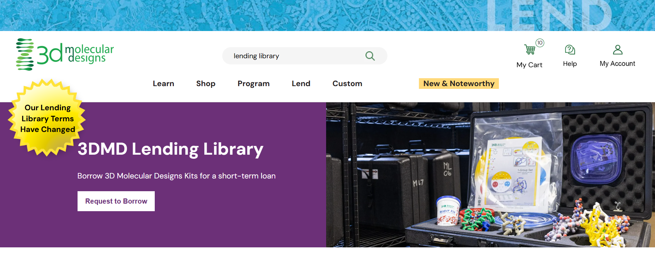

Slide 3
Field Test Pricing Updates
Virus Infection & Immunity Kits $36
Blood Typing Kits TBD
A new spreadsheet with updated information will be posted before lunch.

Slide 5
Evaluation
Tomorrow we will be collecting post-workshop survey information
  Teacher Participant Evaluation
  Teacher Participant Qualitative Post-Workshop Survey
Participants who submit their posters will receive an additional $250 Material Stipend!
You will also complete a poster documenting your implementation experience.
During the late fall/early winter, we will reach out with two further surveys.
We will also be requesting short online interviews with a random selection of participants to learn more about your implementation.

Slide 7


Slide 8
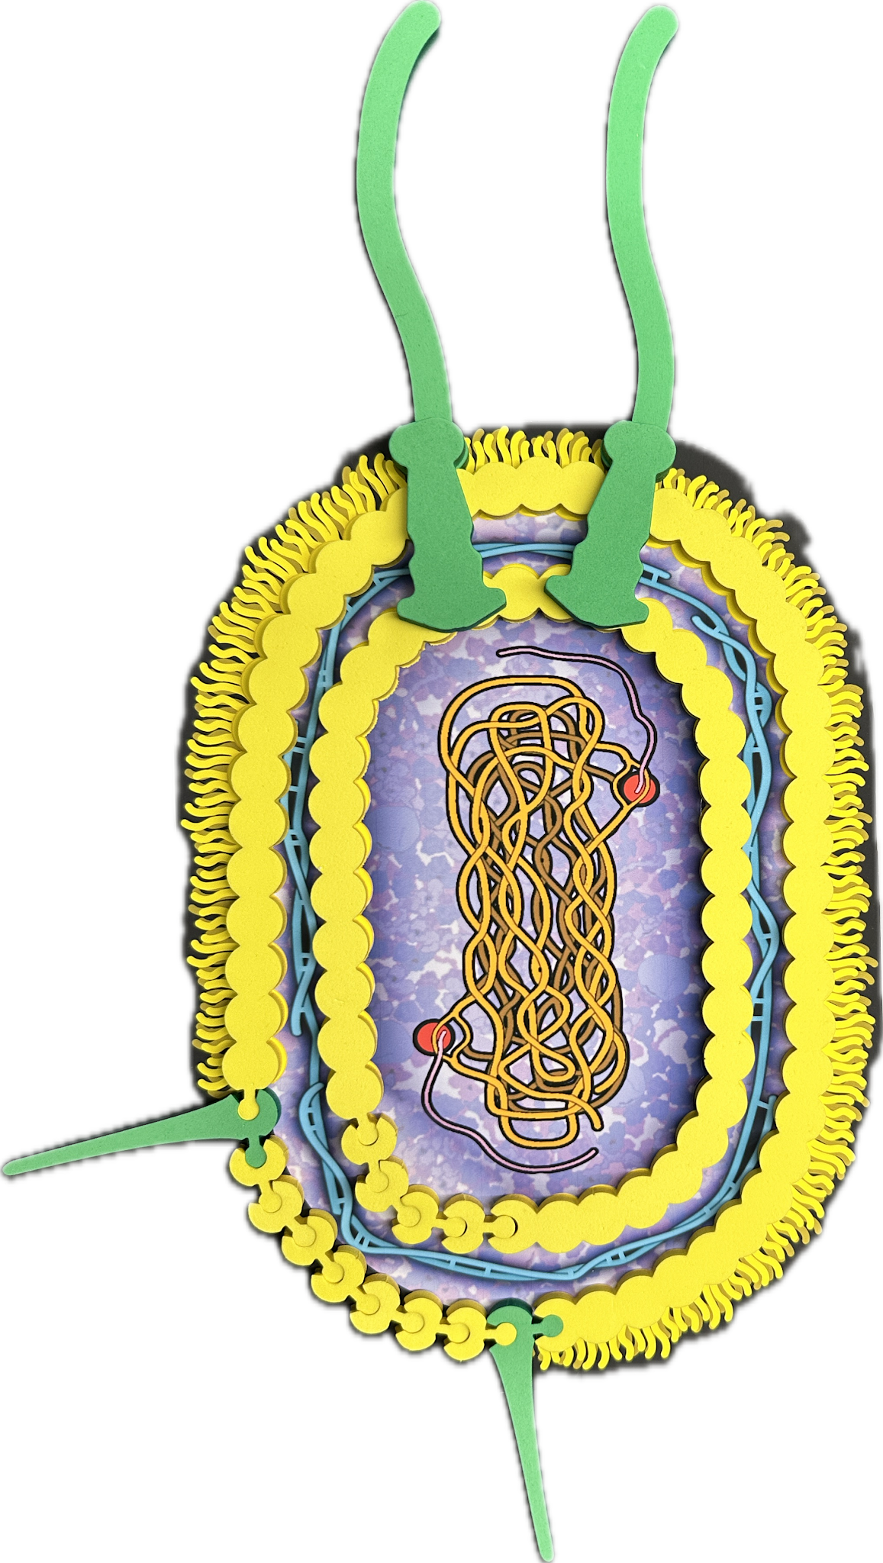
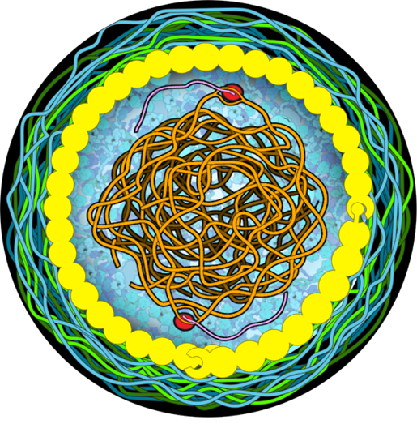
Explain
Use the microbes to explain how macrophage cells sense microbes.
What evidence from your exploration supports your explanation?
Notes:
Time: 4–6 min.
Launch: Prompt participants to explain what the model helps them understand, predict, or communicate.
Facilitate: Press for evidence with prompts like “What in the model supports that idea?” or “How did your exploration change your explanation?”
Avoid: Do not reduce this phase to answer-checking or instructor summary only.
Quick check: Look for causal or mechanistic reasoning made visible through the model.

Slide 9
Discuss the Explain Phase
How did the model support confidence in explaining?
What counted as evidence in this phase?
How could this explanation lead to a new cycle of Wonder?
Notes:
Time: 3–4 minutes.
Help instructors notice that Explain is not the end of thinking; strong explanations often surface new questions.
Discuss how grounding explanations in the model supports accessibility and clearer communication.
Name assessment possibilities here, including observing reasoning, listening for conceptual connections, and identifying misconceptions.

Slide 10
Key Aspects of Explain
Learners articulate or illustrate thinking grounded in the model.
Explanations are supported by evidence from exploration.
Models anchor understanding and build confidence.
Explaining often generates deeper questions and another WE² cycle.
This phase supports both formative and summative assessment by making reasoning visible.
Notes:
Time: 2–3 minutes.
Reinforce that Explain includes communication, evidence, conceptual connection, and possible revision.
Close by making the iterative nature of WE2 explicit: Wonder, Explore, and Explain are revisited, not treated as one-and-done steps.

Slide 12
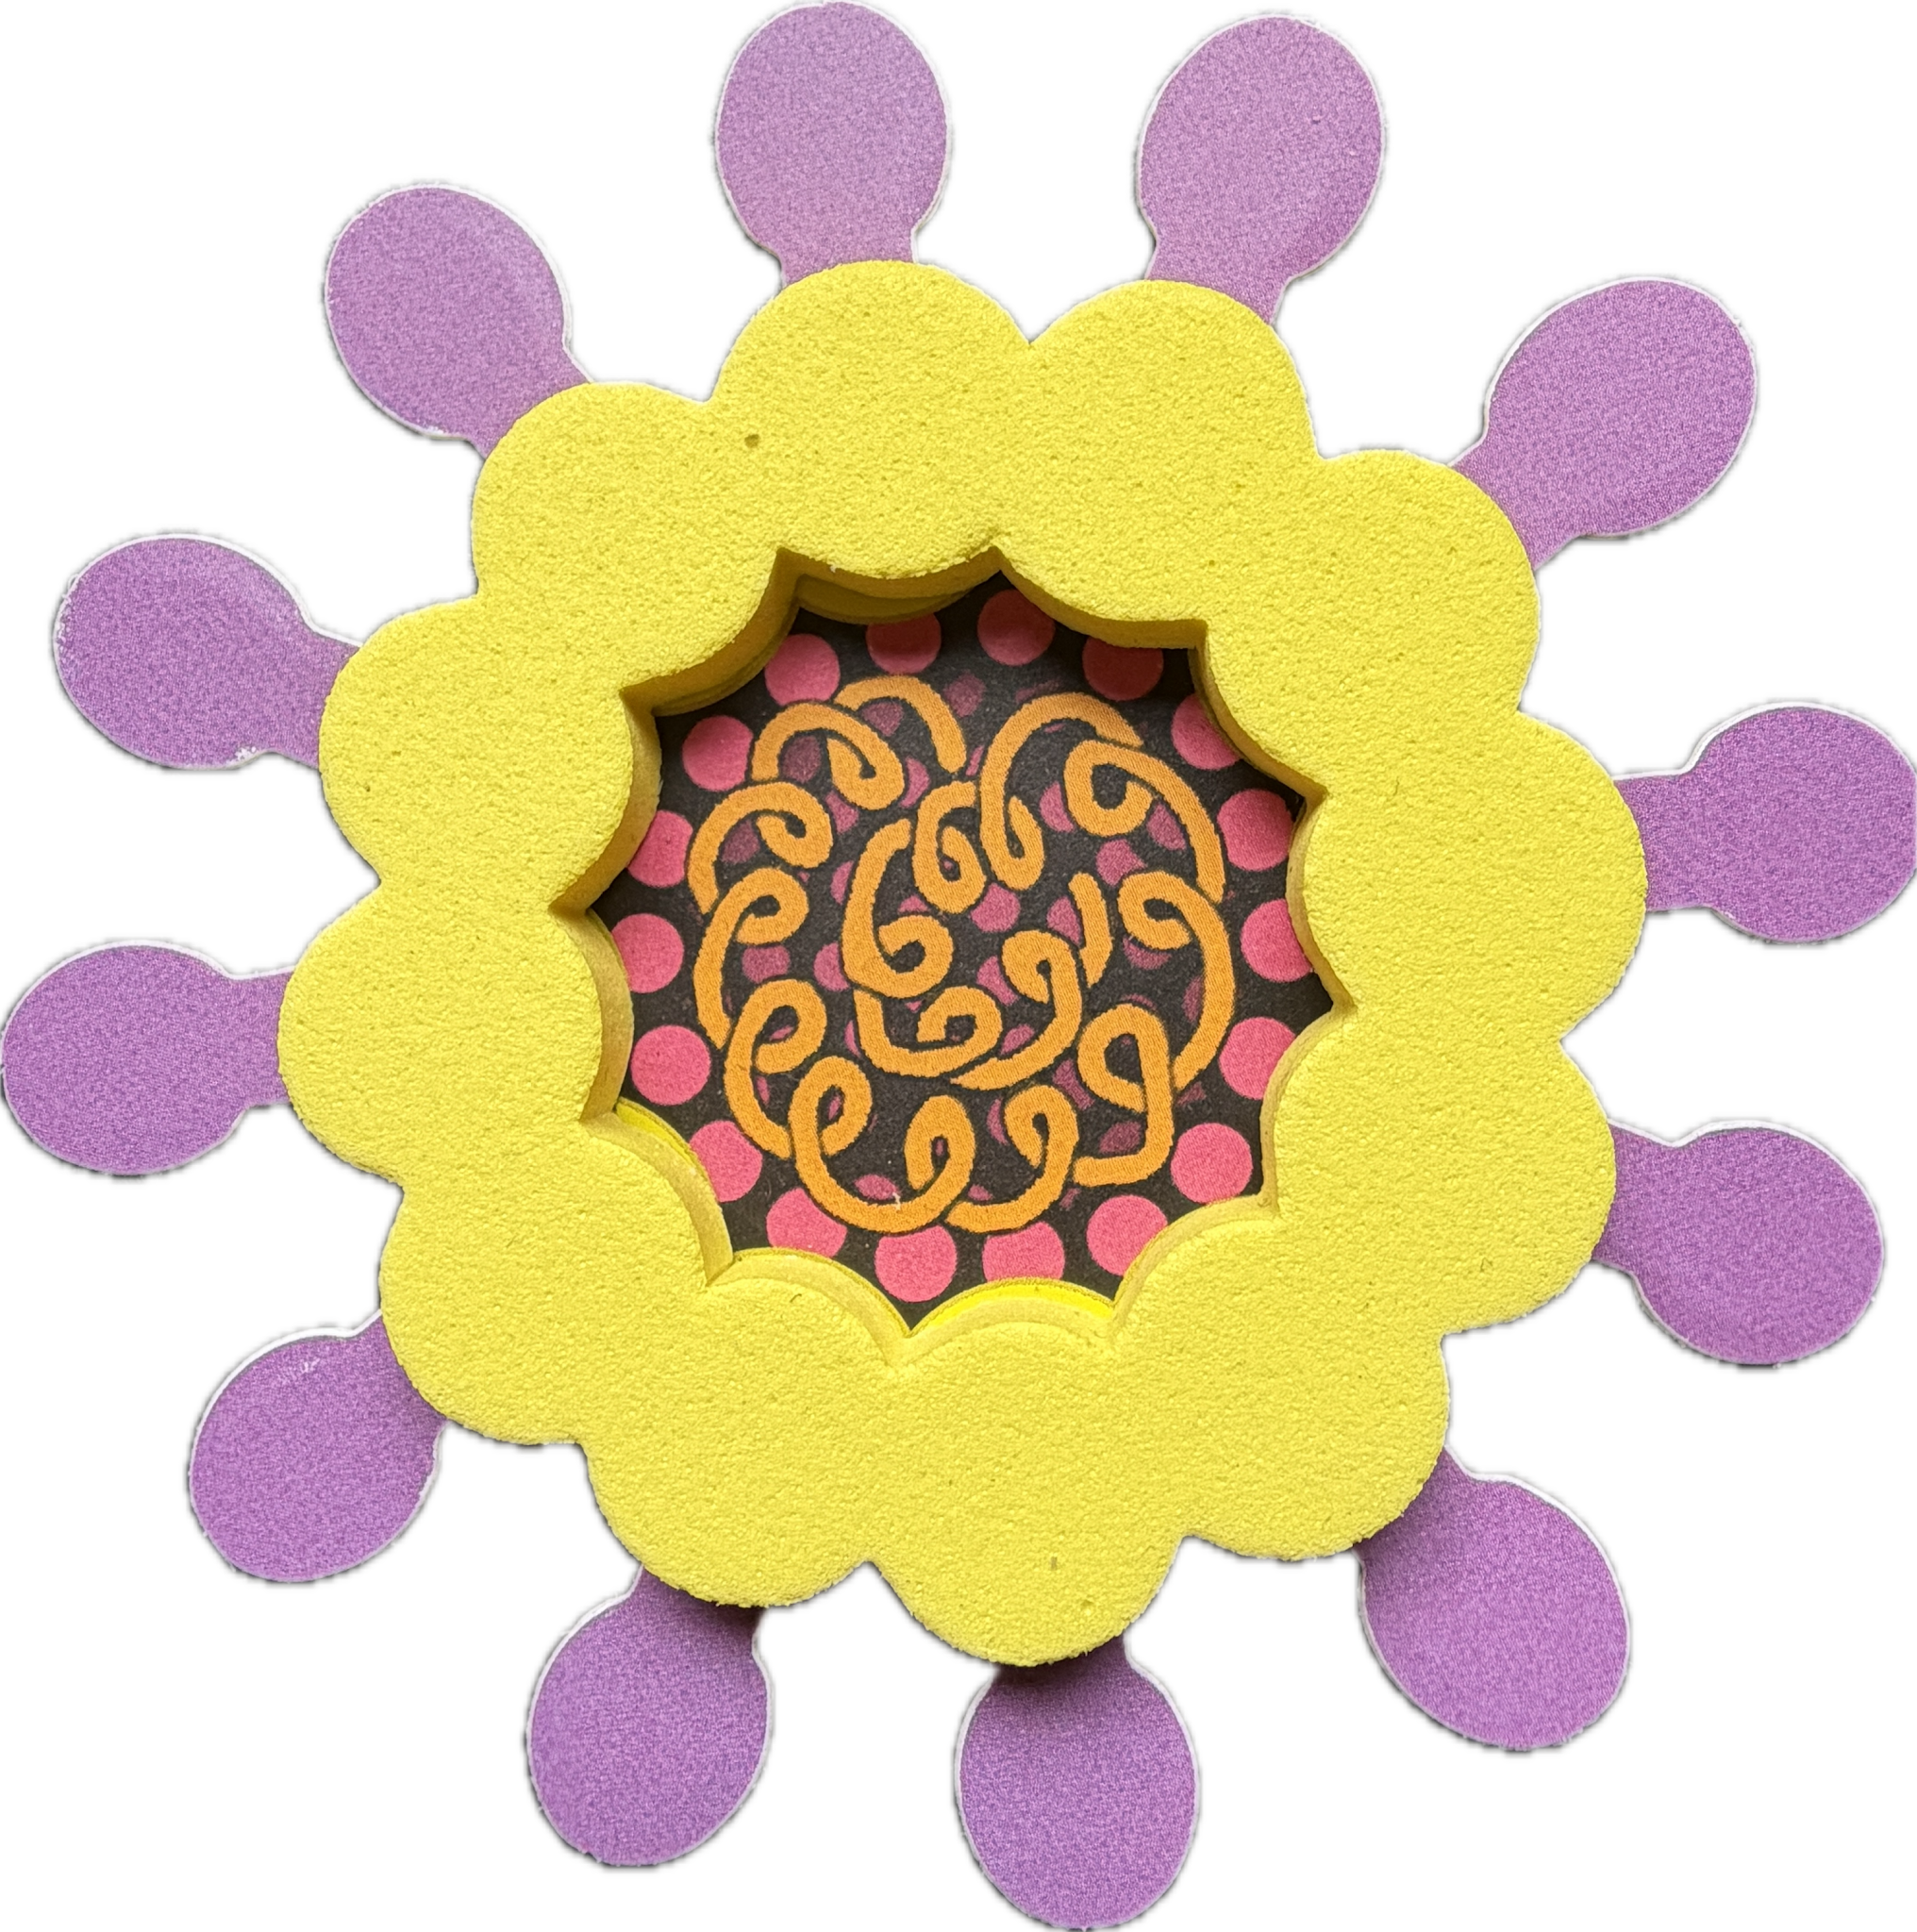
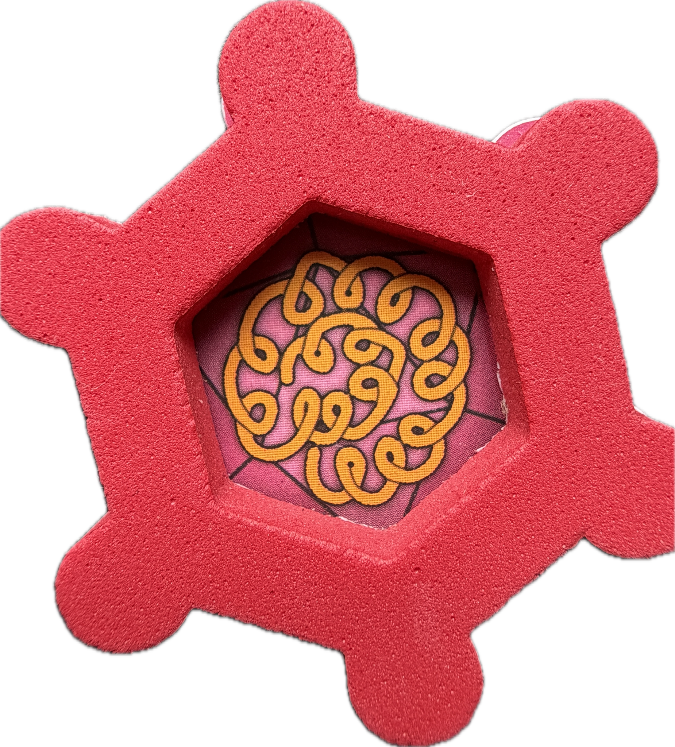
Modeling
Infection & Immunity:
Cell exploration goes viral!
Christina Bowers

Slide 13
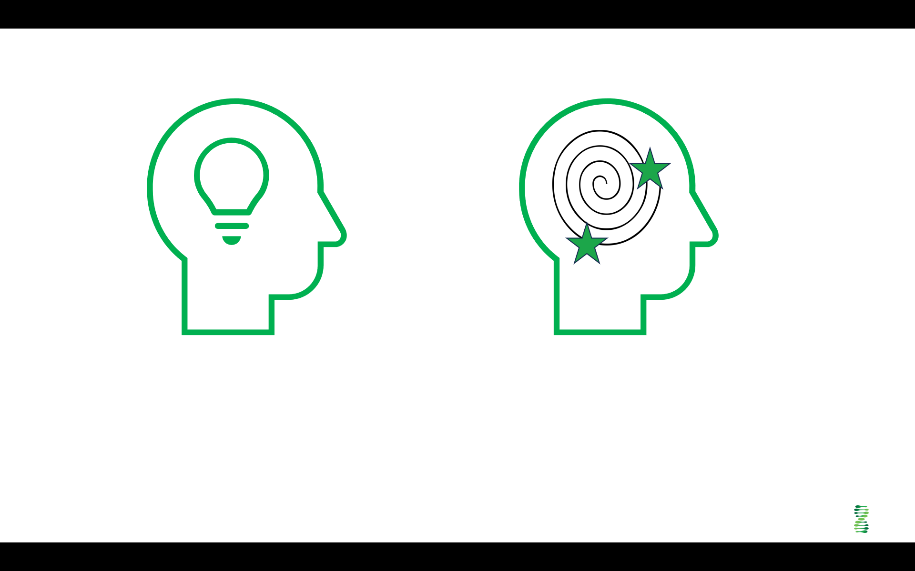
Table talk: Discuss (2-3 mins)
“Things Cells Do.”
Discuss with your group to identify 1 or 2 things that you know cells do.
Decide/report:
Each table has to share one unique thing.
Cells behave in certain predictable ways.

Slide 14
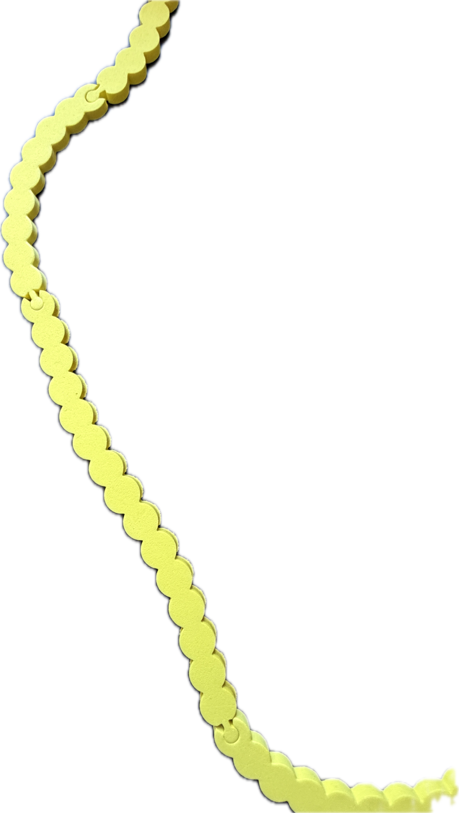
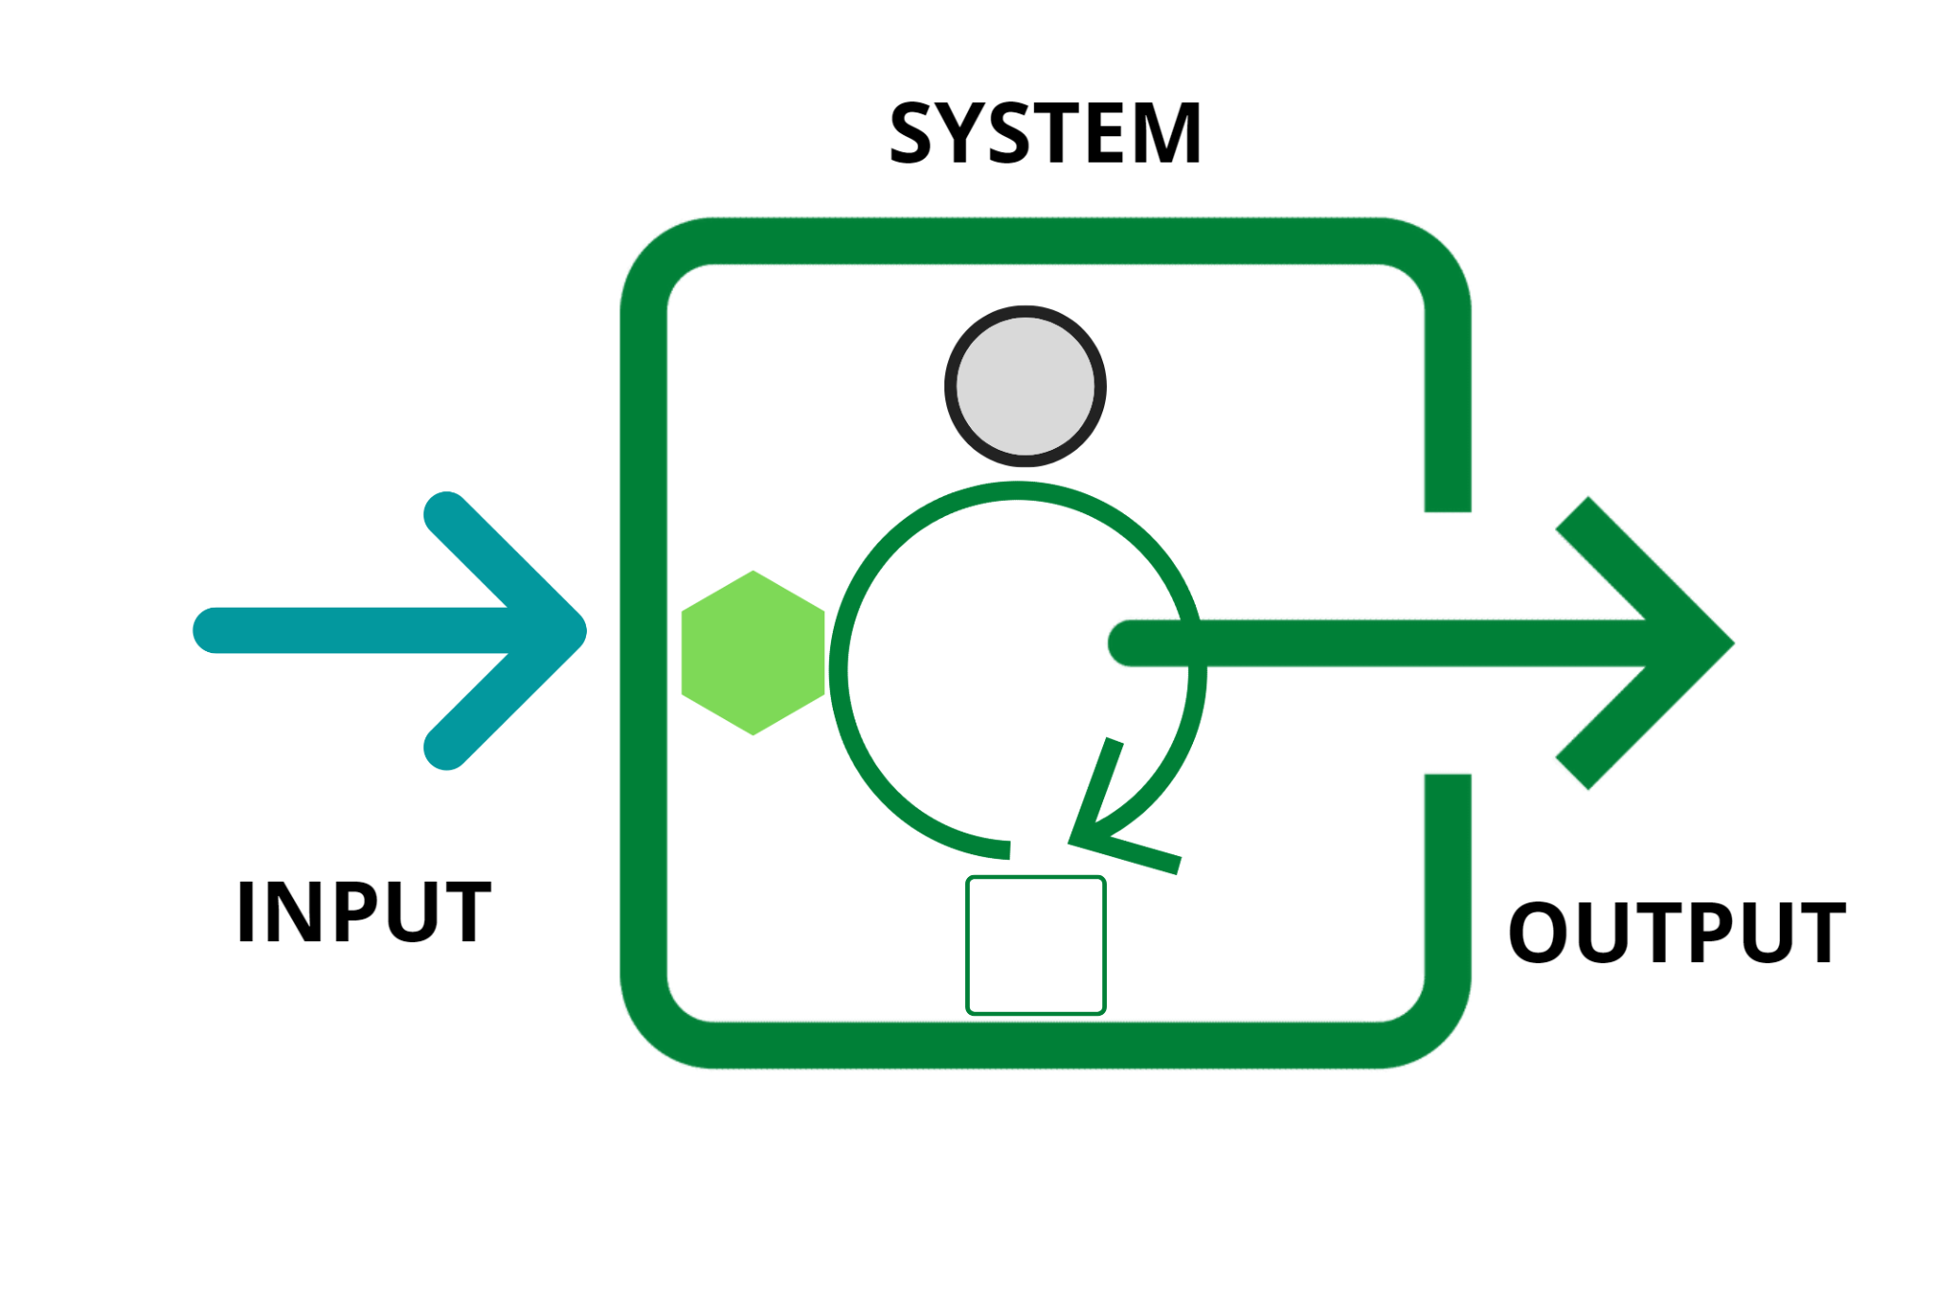

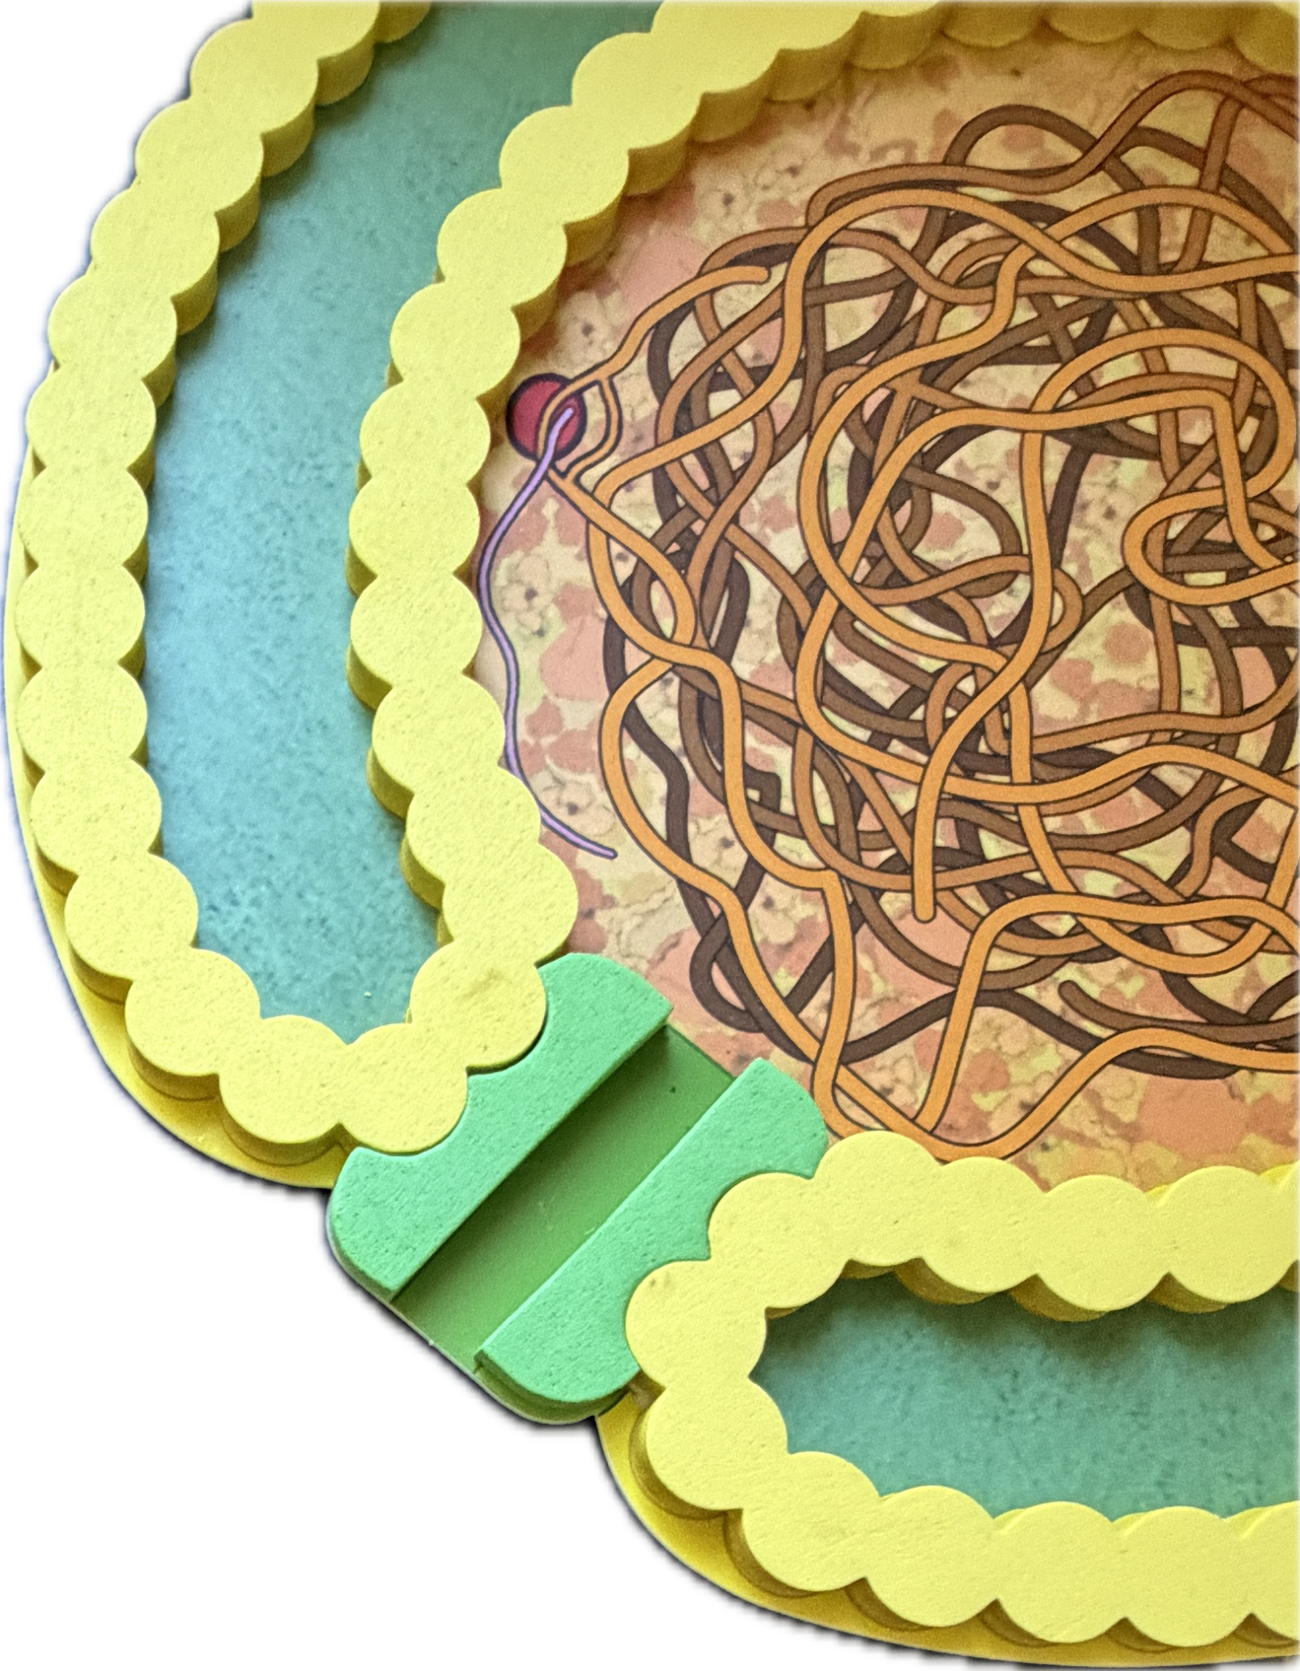
Modeling Dysfunction: Deactivate the Macrophage
Decide on a Context:
Pick one part of the system and model how the cell would look if that part broke down.
Work in pairs.

Slide 15
Goals
Explore ways to deepen student understanding of the systems of cells by predicting disruptions caused by virus infections.
Viruses fail several criteria that cells meet which provided insight into their discovery.
We will use models to predict consequences of cellular damage and to anticipate possible ways that viruses might use the structures and systems of the cell to reproduce and spread.
Modeling changes to surface antigens will alter antibody efficacy causing reduced protection against seasonal viruses like Influenza A.

Slide 16
Puzzle of “Contagious Fluid” (Beijerinck 1850-1930)
Identify by exclusion (based on what was known about cells)
Heat stable
Alcohol Stable
Survives being dried
Smaller than E.coli
Nucleotide ratios aren’t always predictable (A=T; G=C); Sometimes U instead of T (1950)

Slide 17
Compare and contrast:
I notice…. I wonder…

Slide 18
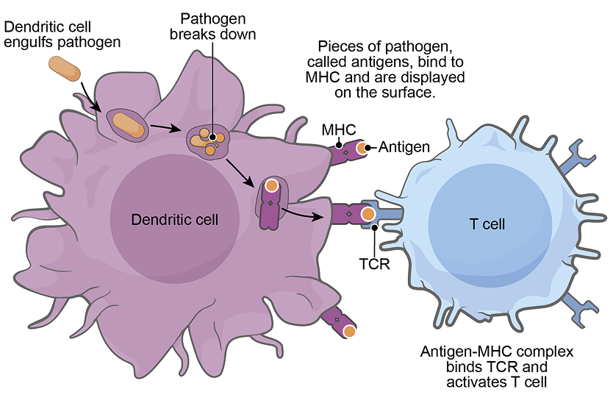
https://www.biointeractive.org/classroom-resources/immune-system

Slide 19
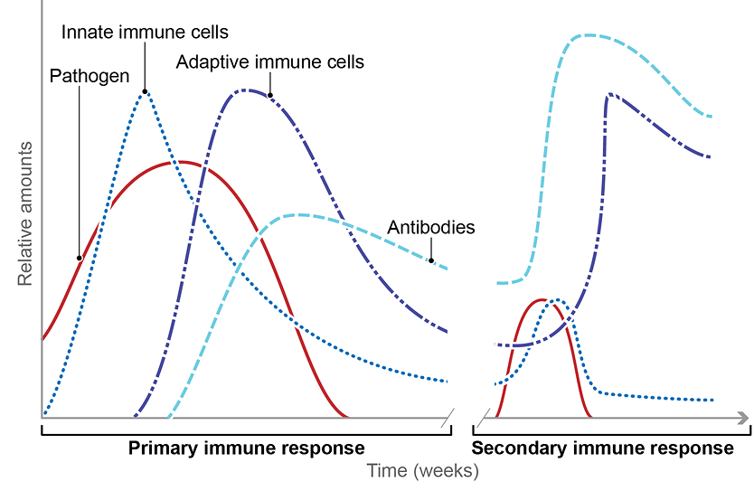
https://www.biointeractive.org/classroom-resources/immune-system

Slide 20
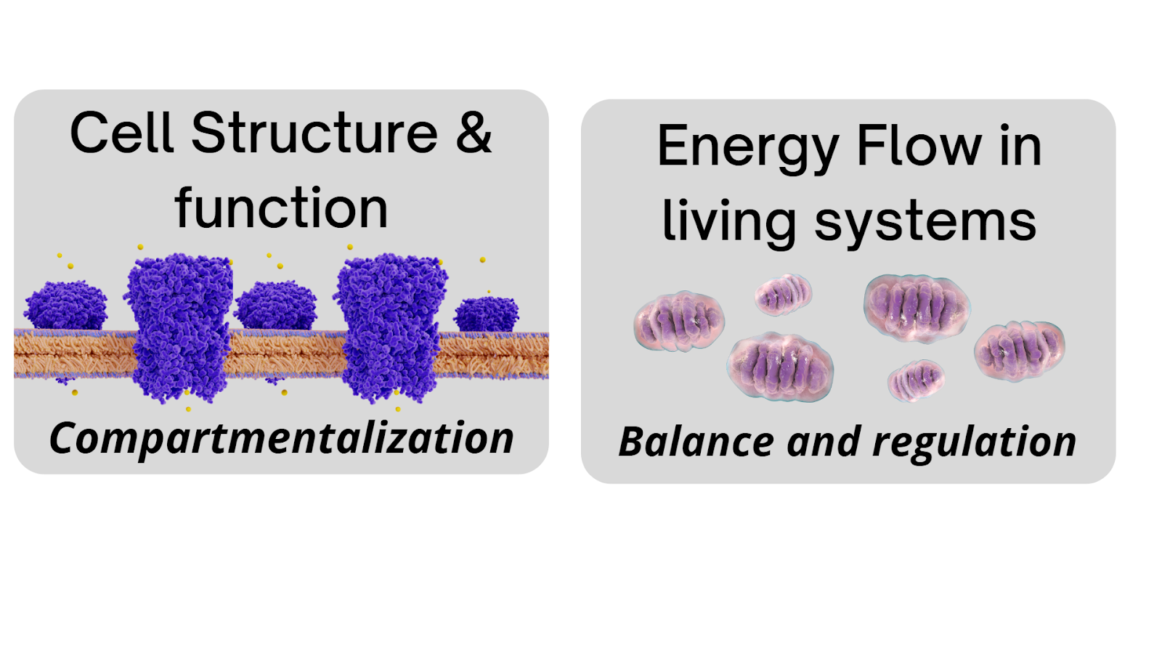
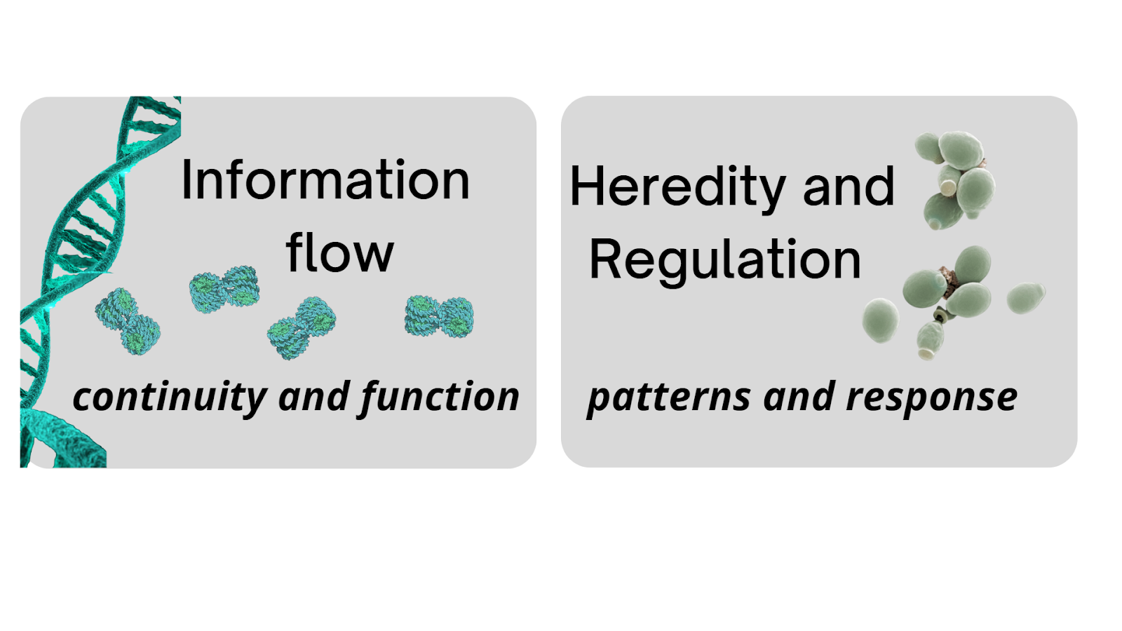
Cells and their structures form frameworks of interacting systems.
Goal: Apply knowledge about cell systems in a new context.
Project: Create teaching materials to explain viral pathways
Brod 2021: Toward an understanding of when prior knowledge helps or hinders learning.NPJ Sci Learn 2021 Aug 19;6(1):24.

Slide 21
Explain molecular mechanisms of viral infection pathways.

Slide 22
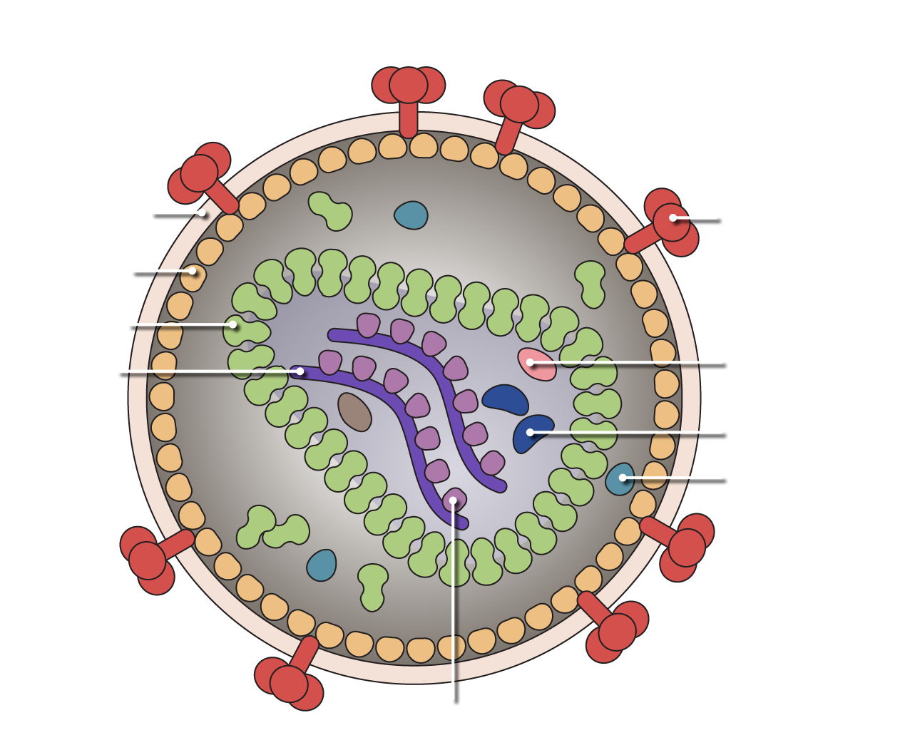
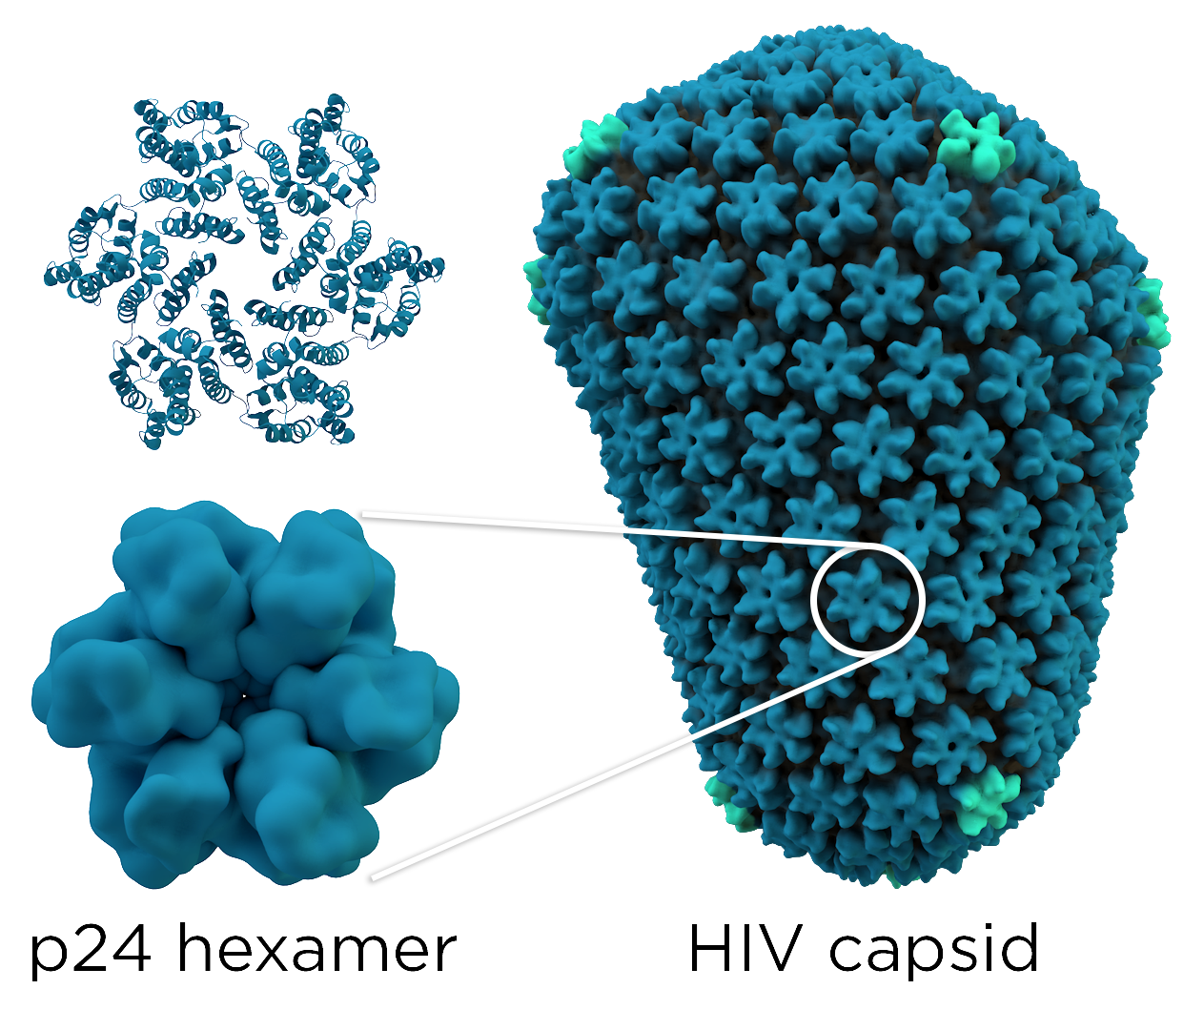
All viruses have a capsid but for some it is tucked inside the membrane. How could this form inside of a host cell?

Slide 23
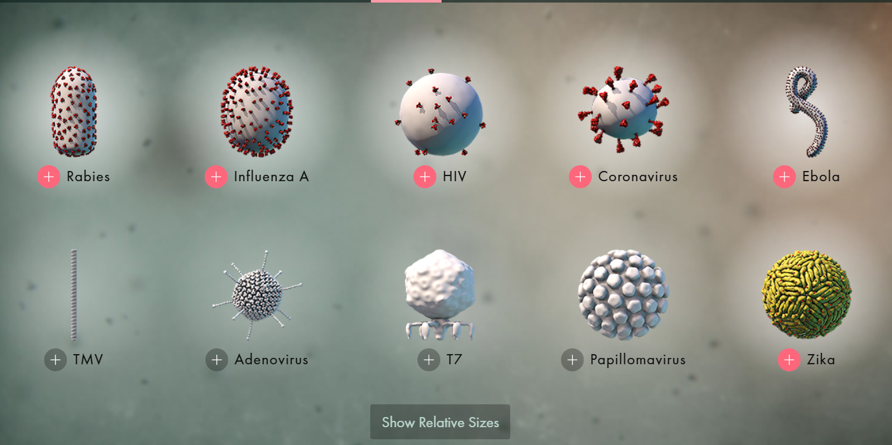
Enveloped viruses

Slide 24
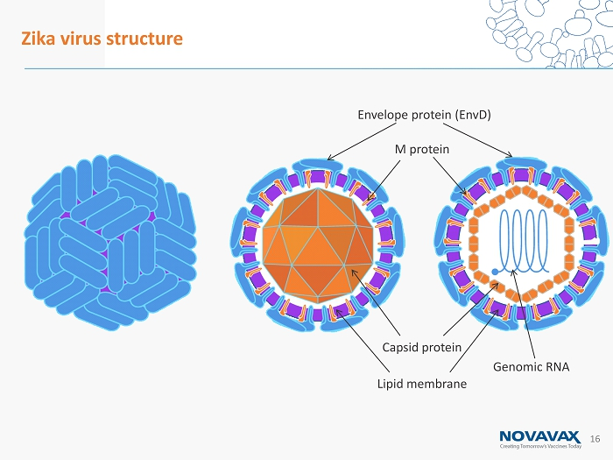
Where do you think the membrane comes from?
Zika has proteins tightly packed on the outside but the proteins are membrane embedded.

Slide 25
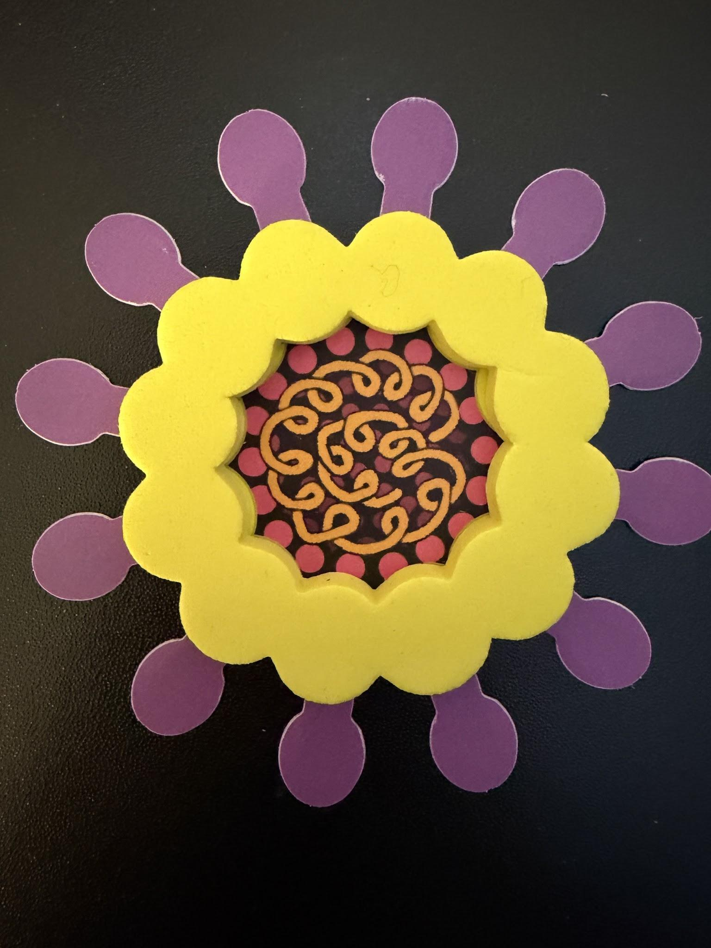
Influenza A
This virus has an envelope made of membrane
Inside there is a genome and assorted proteins.

Slide 26
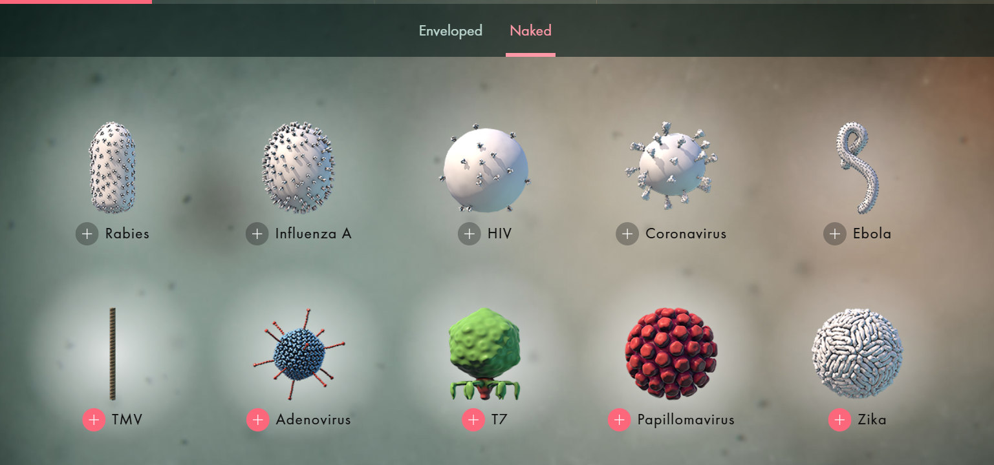
Naked viruses have a “non membranous” protein shell.

Slide 27
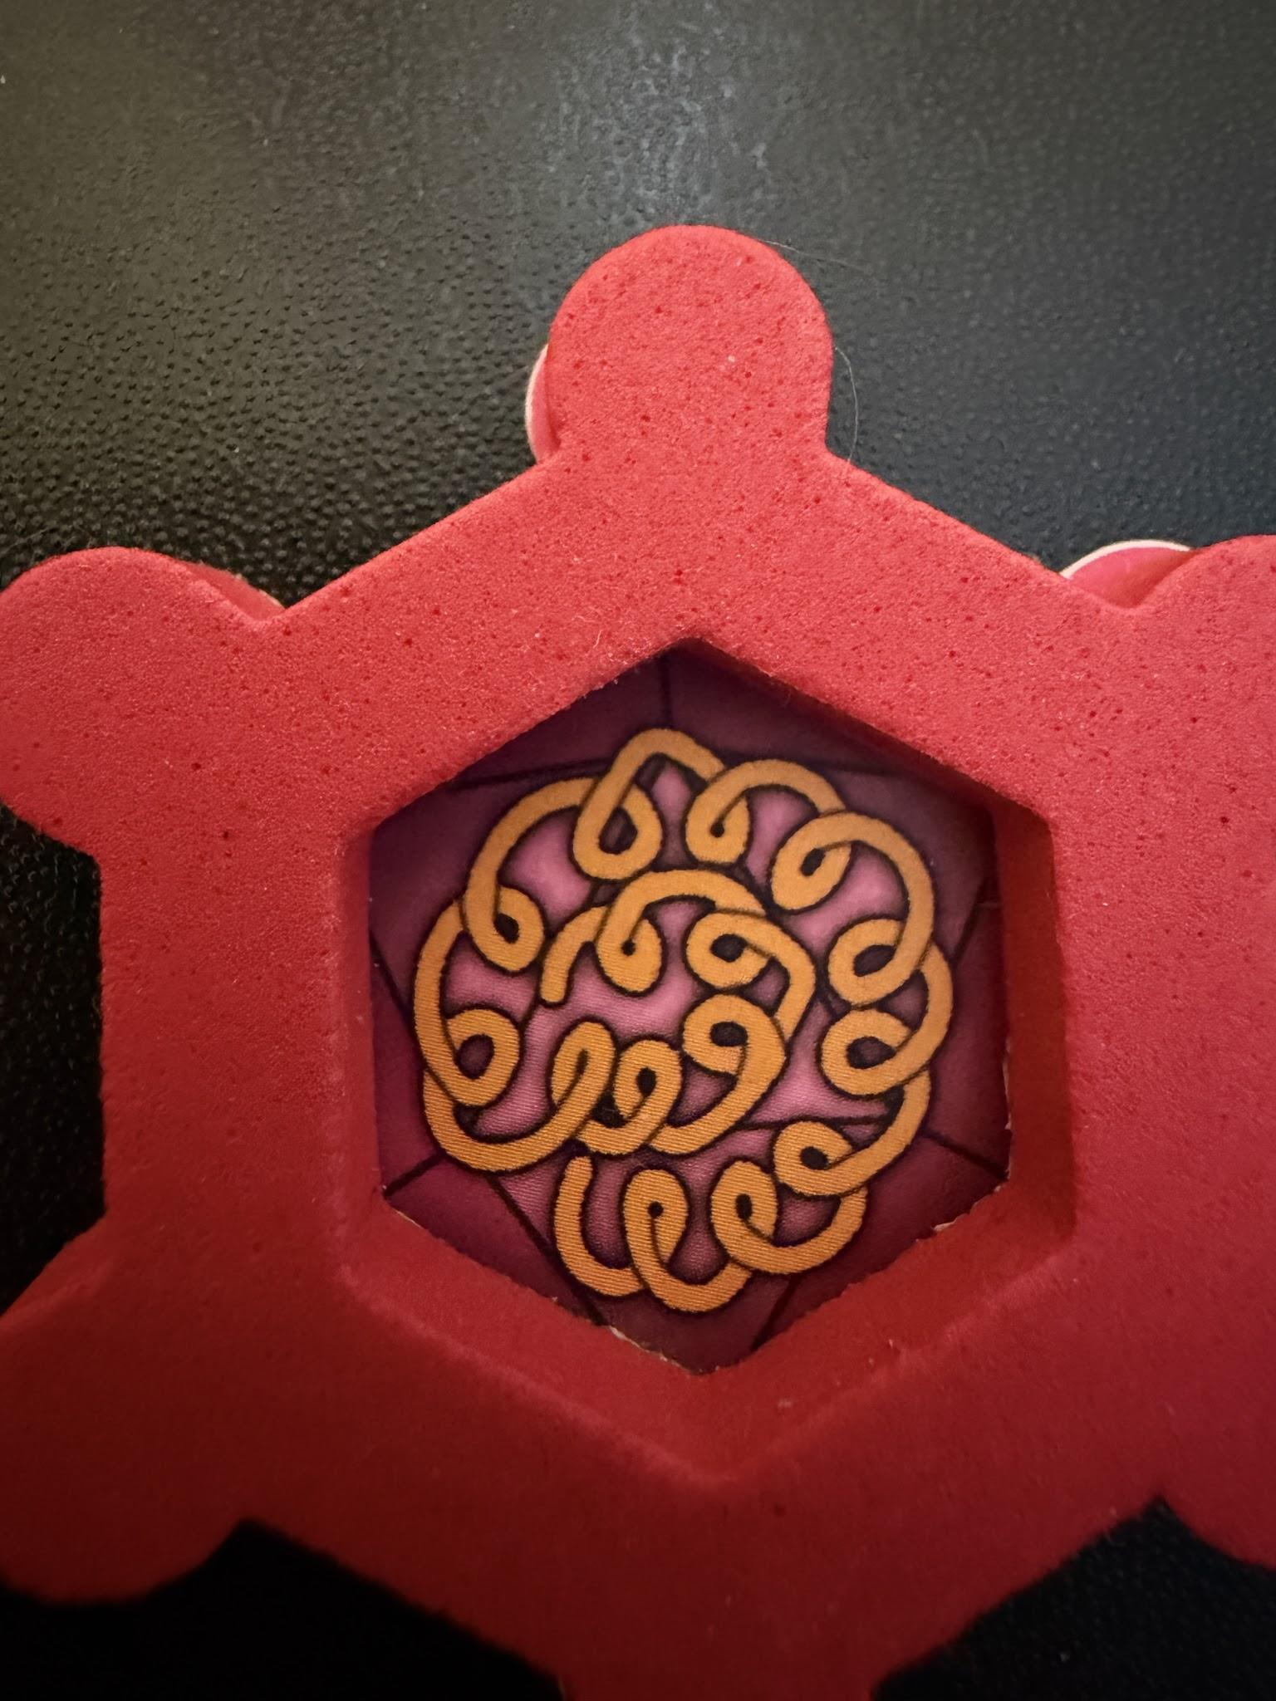
Adenovirus
How might the process differ for a virus enclosed in a protein-coat?

Slide 28
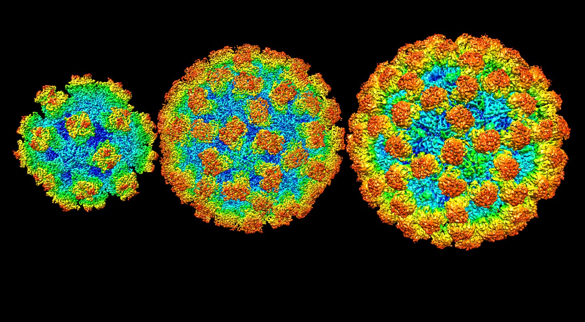
These noroviruses each have hard protein shells. What do you think this means about the physical tolerance of the virus?

Slide 29
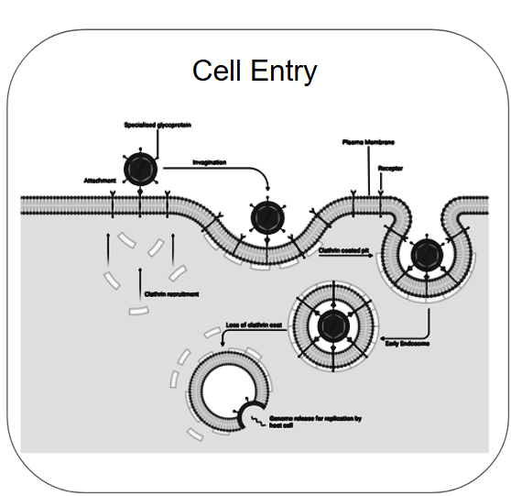
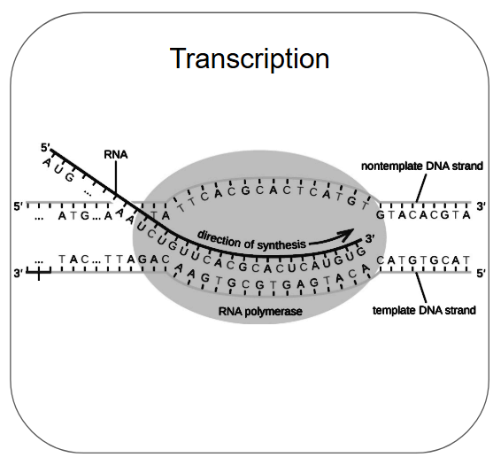
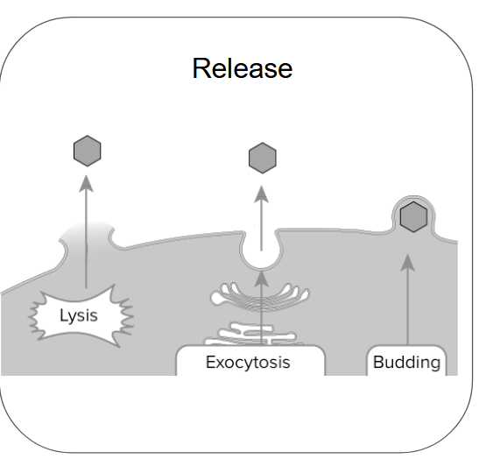
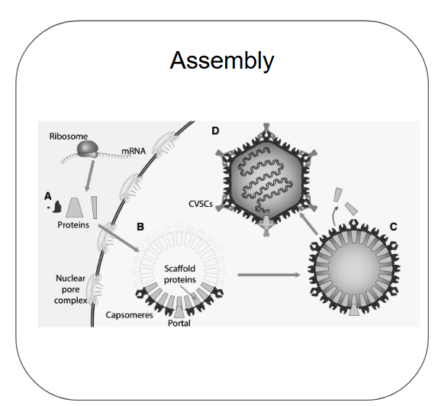
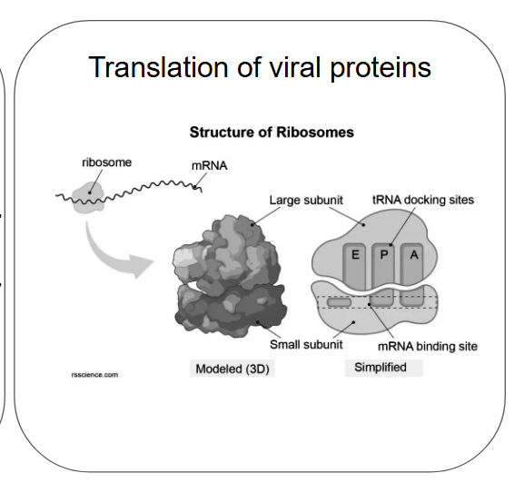
Work with your team to order the infection cycle cards.

Slide 30
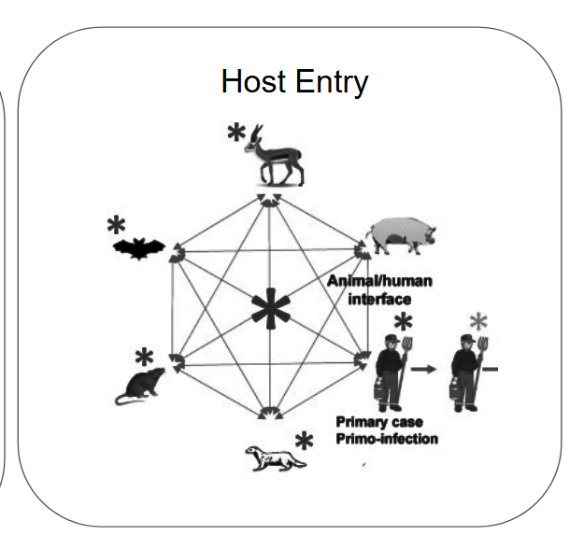
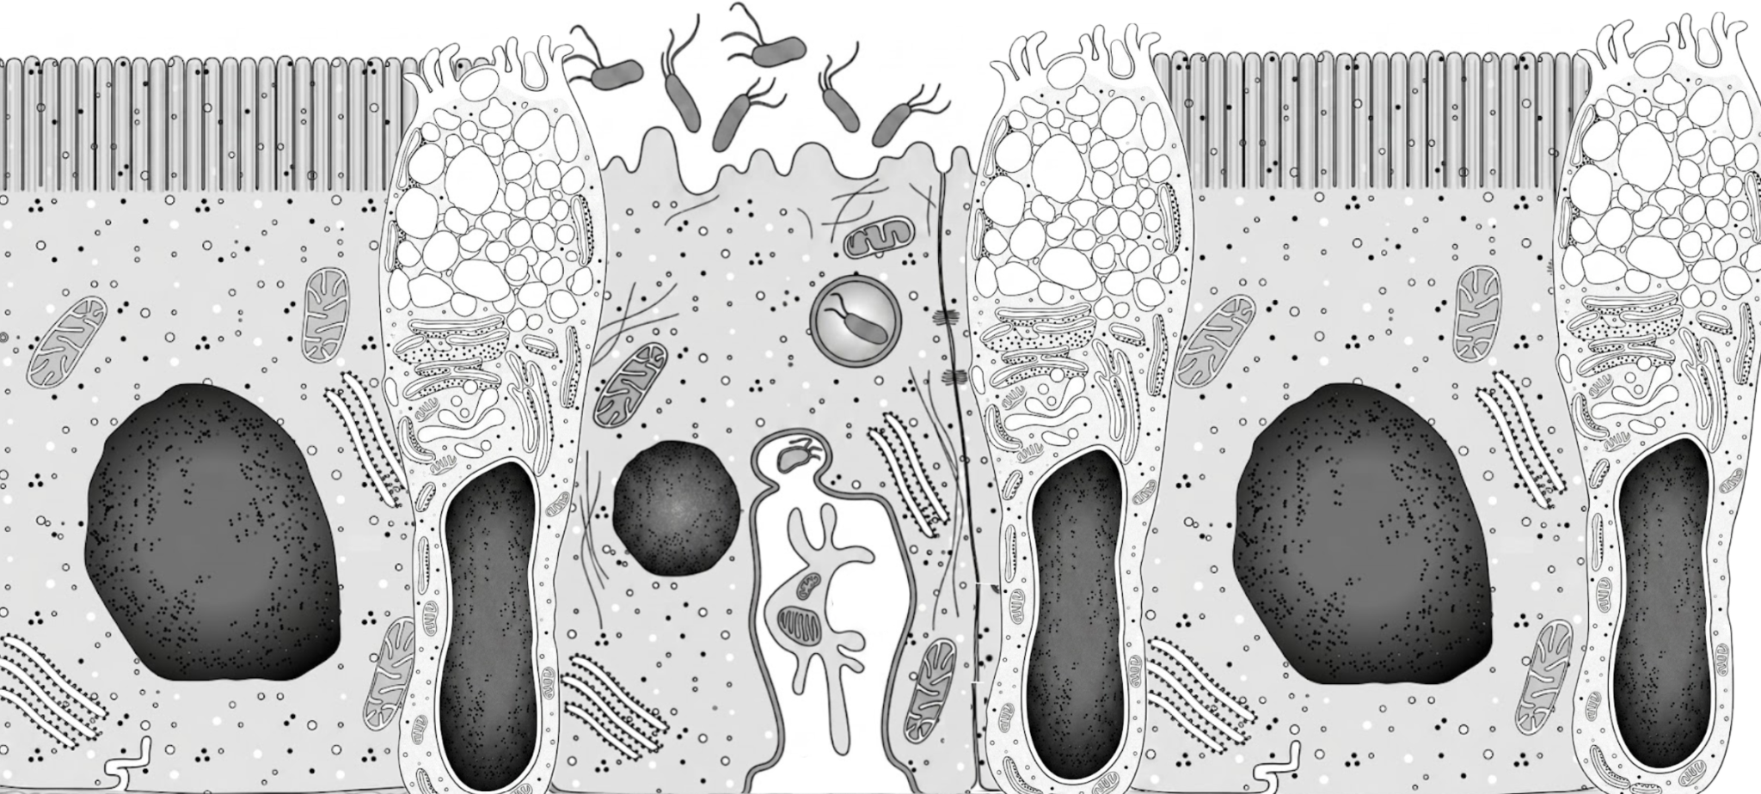
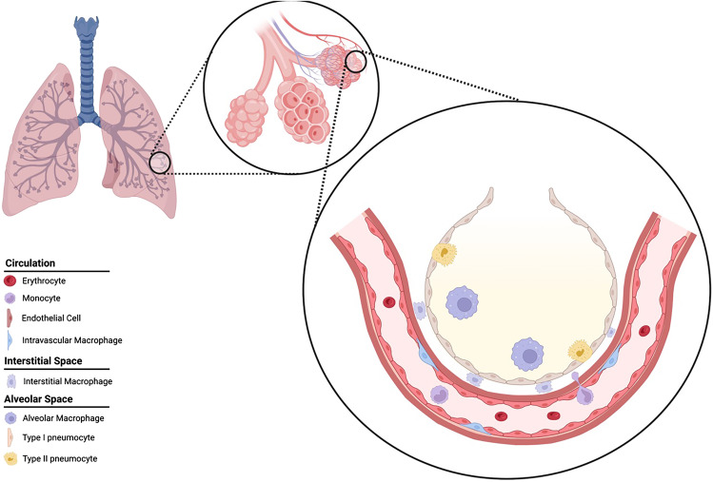
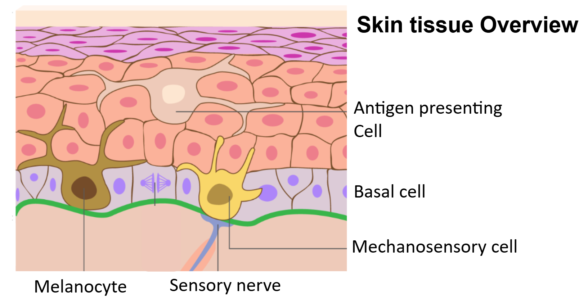
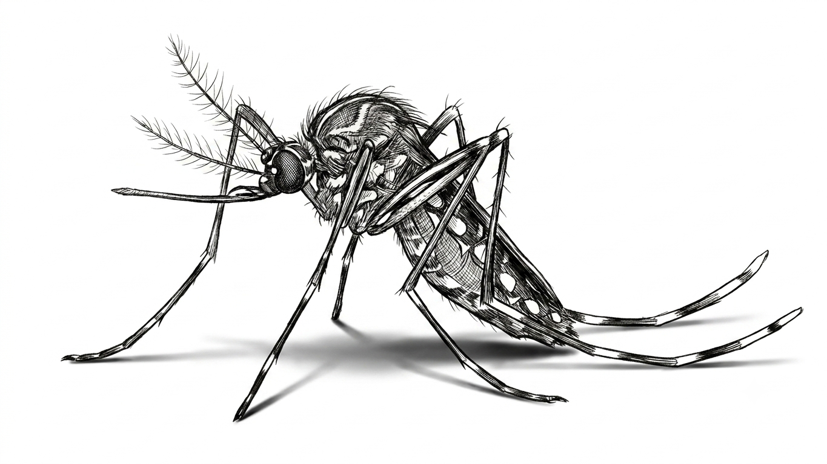

Slide 31
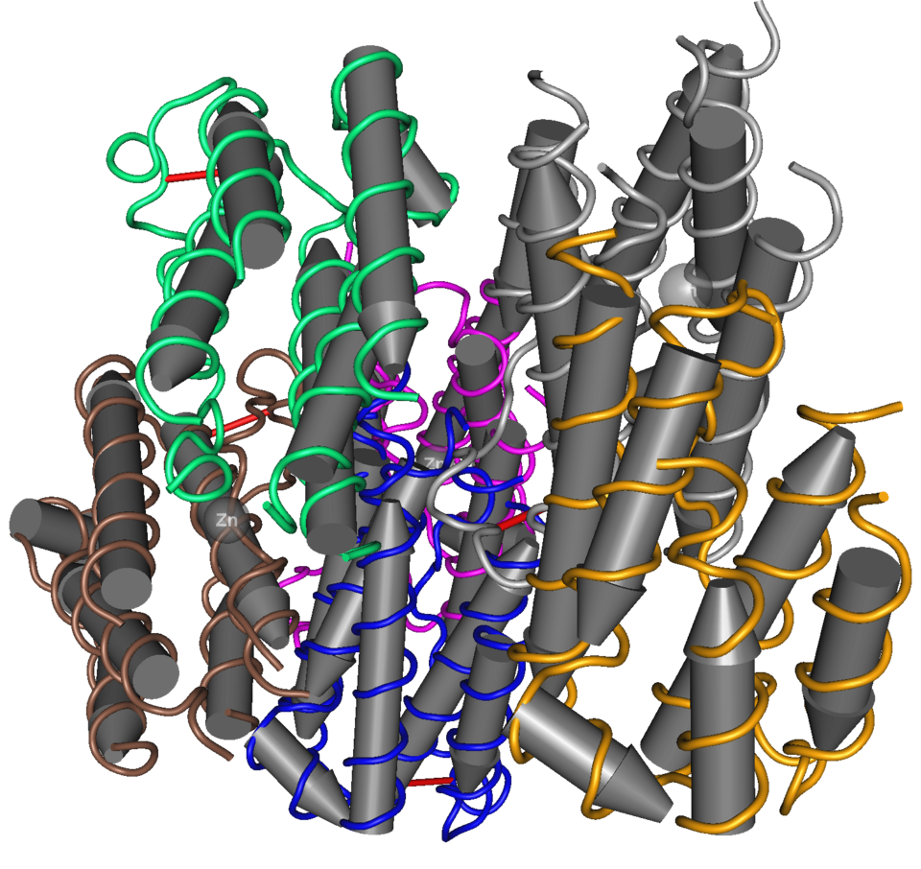
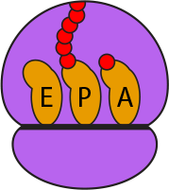

Infected cells sound the alarm molecule: “interferon”.

Slide 32
Why is interfering in this cell signalling “good” for the virus?
Virus scrambles the signals.

Slide 33
What does it need to do?

Slide 34
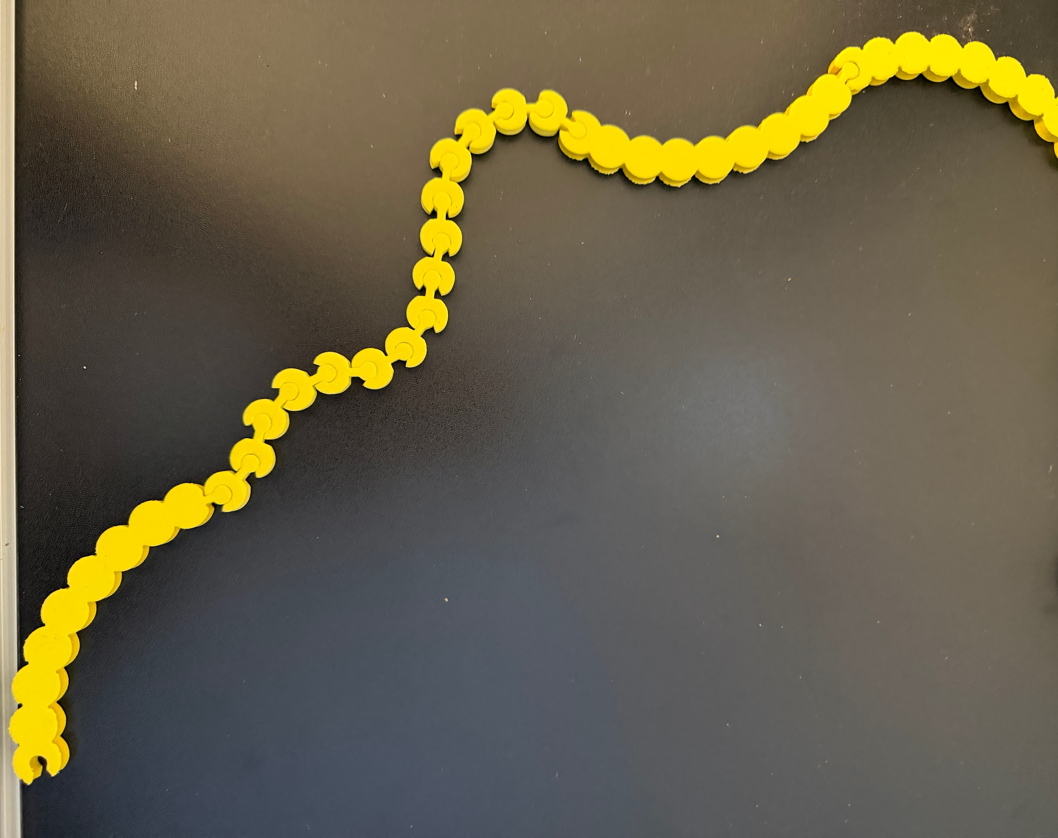
Make a cell’s edge along one side of your lab table.
What will a virus “see” when it first encounters a cell?

Slide 35
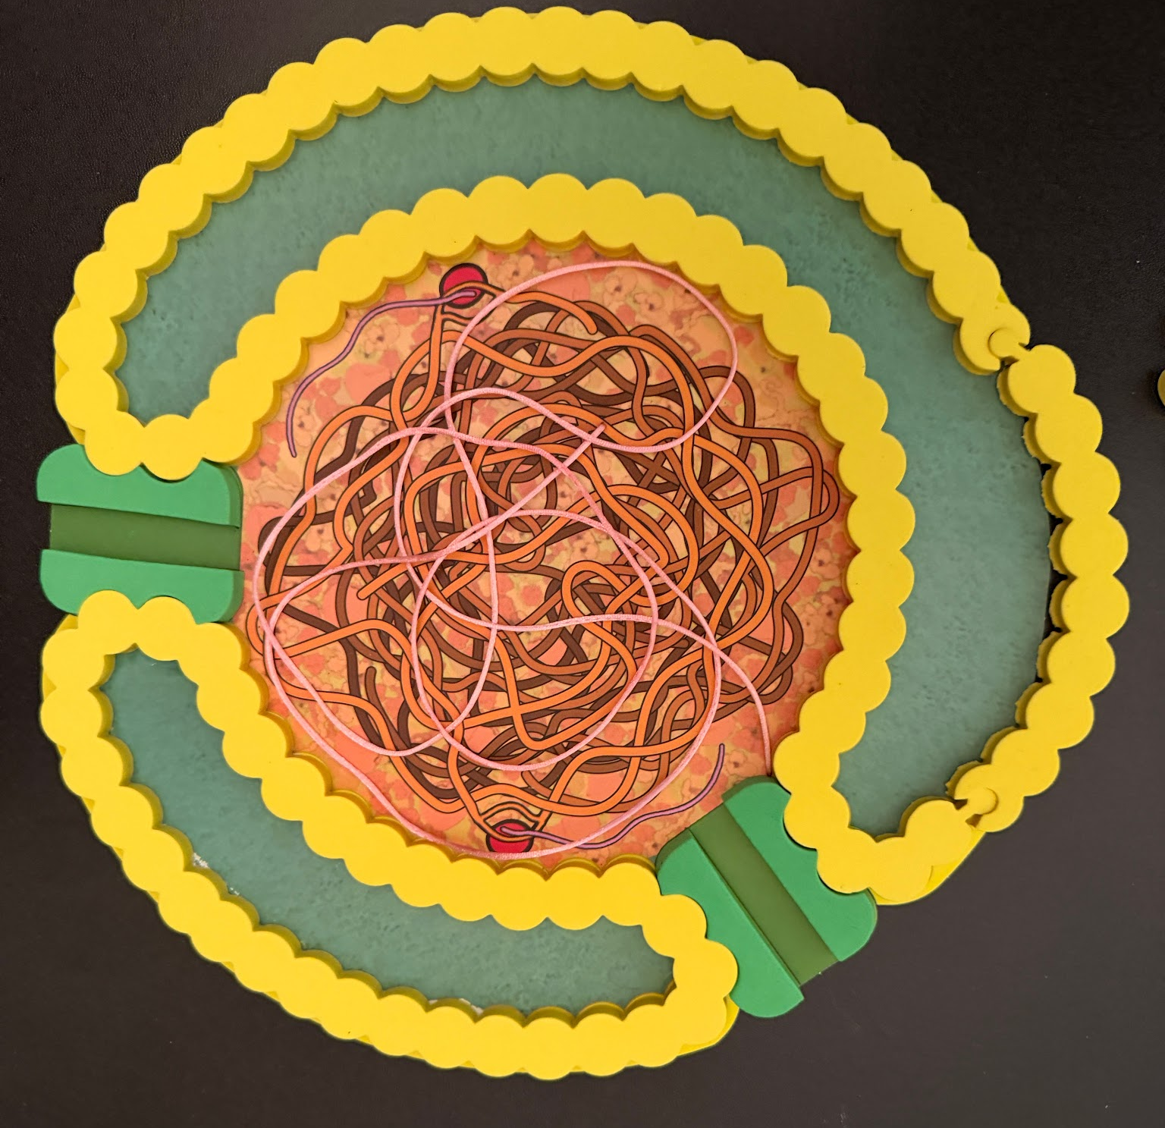
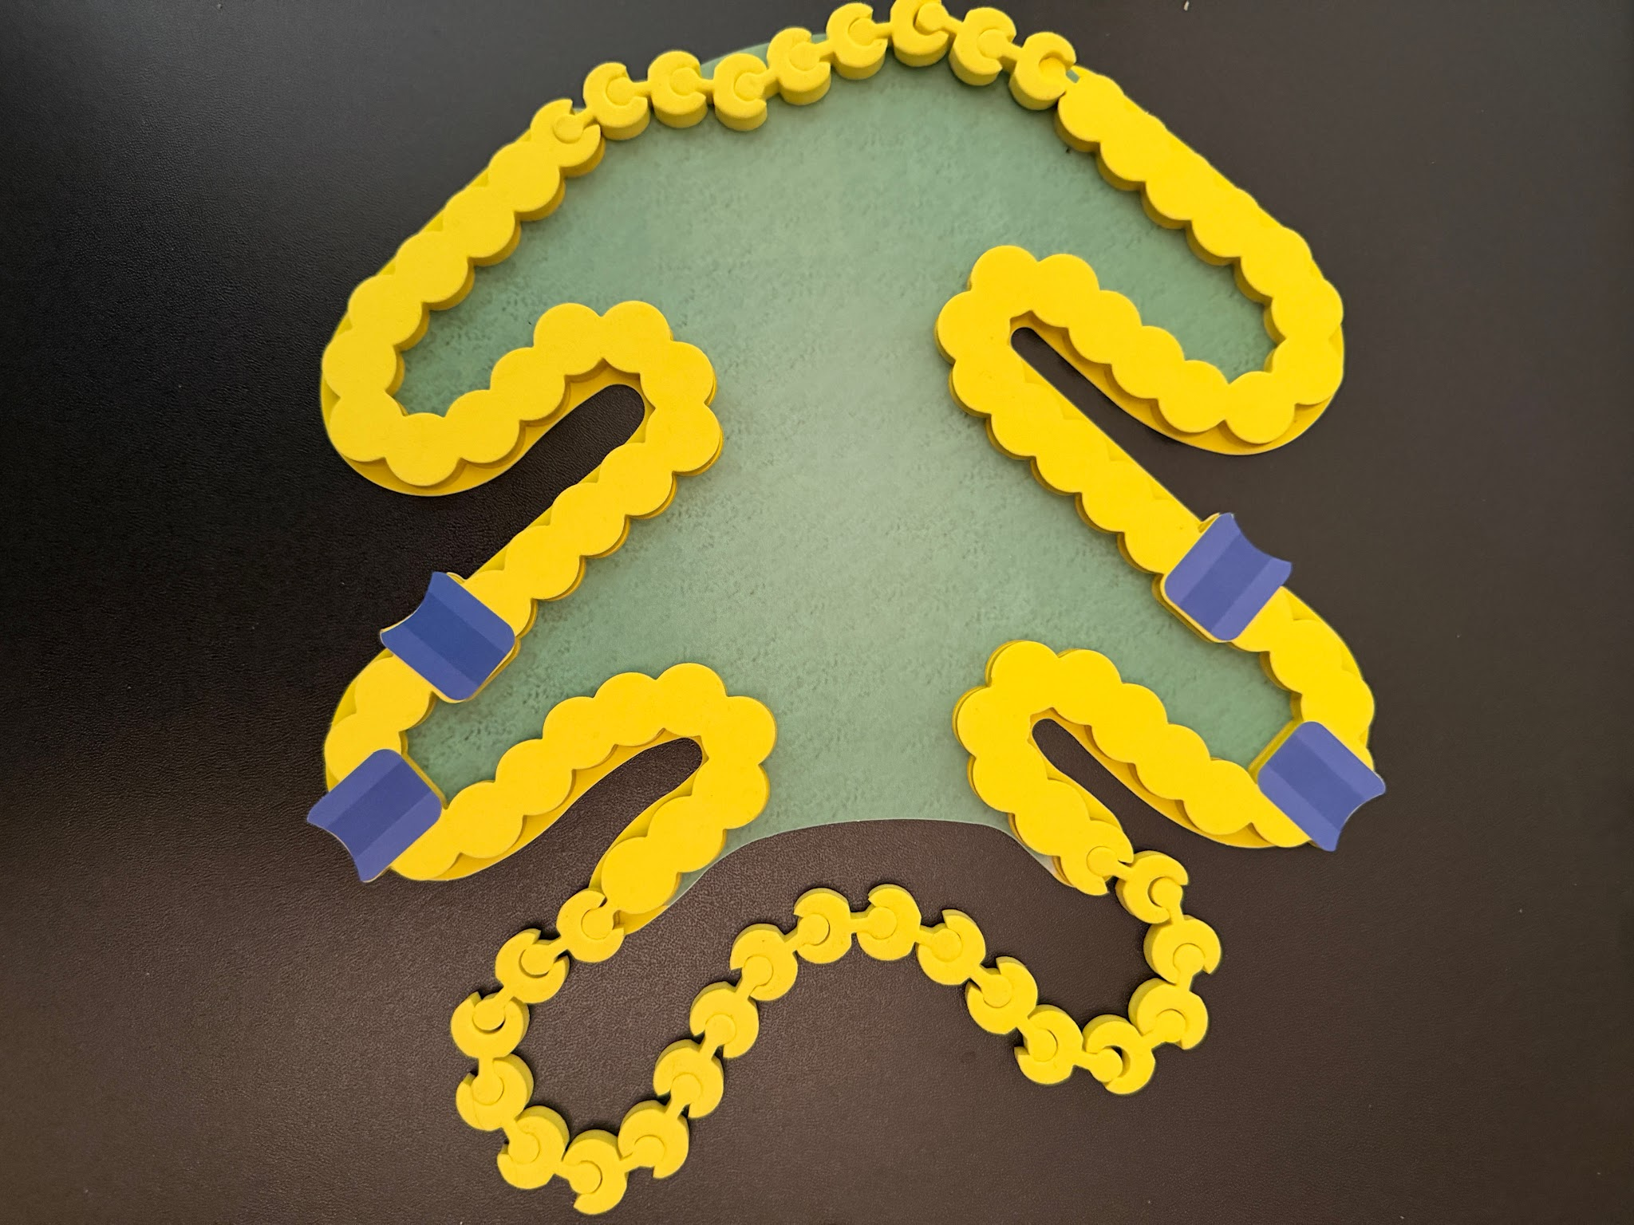
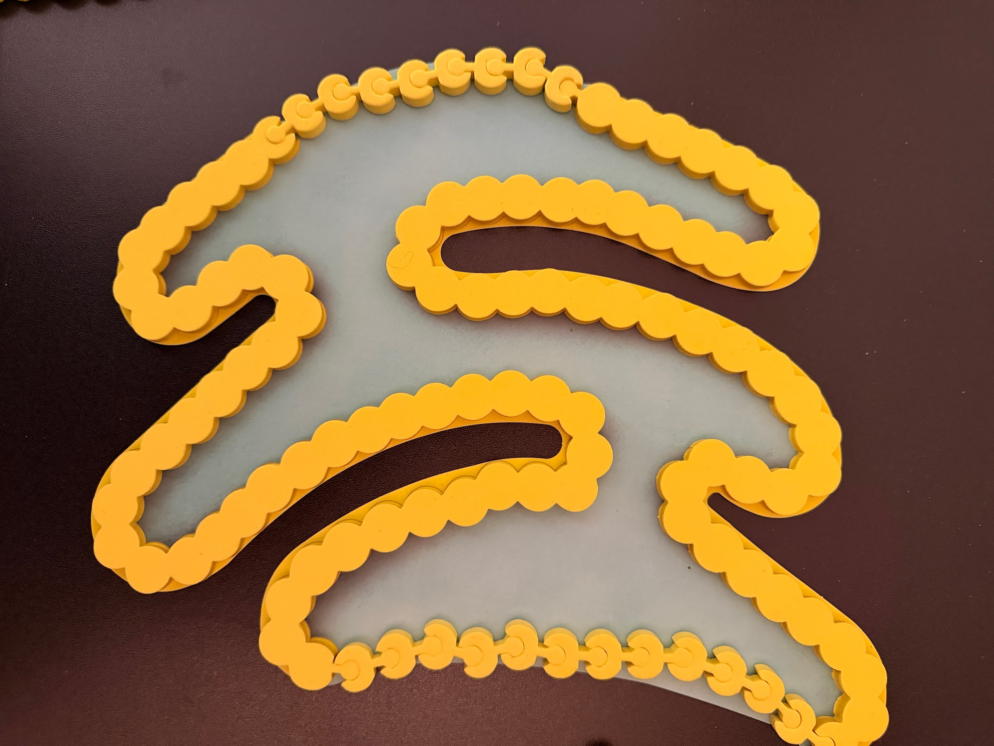
Endoplasmic Reticulum
Nucleus
Golgi
Distribute your endomembrane system.

Slide 36
What are the blue structures?

Slide 37
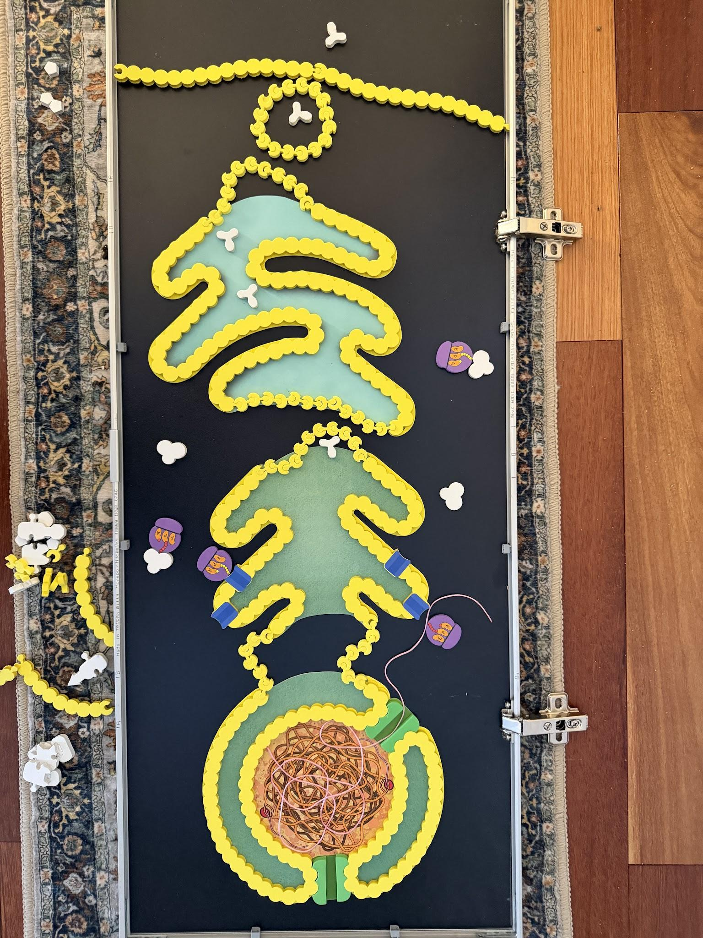
Recall: Activated B cell making antibodies.

Slide 38
Model for a general target cell.
(Measles and EBV infect B cells!)

Slide 39
Goal: Enter host & build more viruses.
Limited Cargo:
RNA genome
RNA polymerase
Challenge:
Lacks ribosomes
Flu Virus
RNA

Slide 40
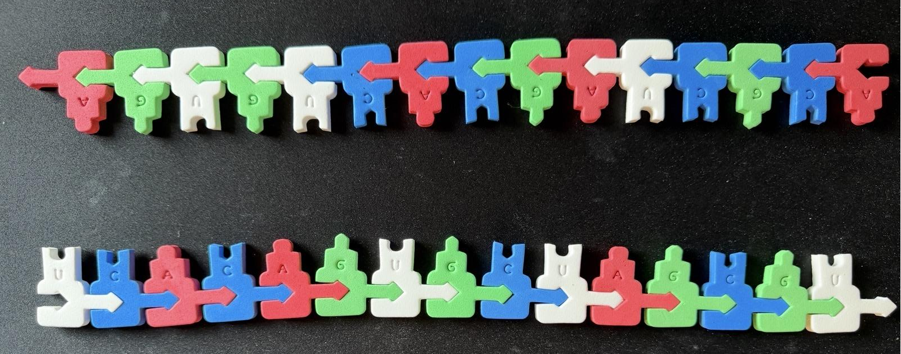
What are the implications of an RNA Genome?
- Strand
3’
5’
Template
3’
Coding
5’
Strand
Opportunity to apply knowledge!

Slide 41
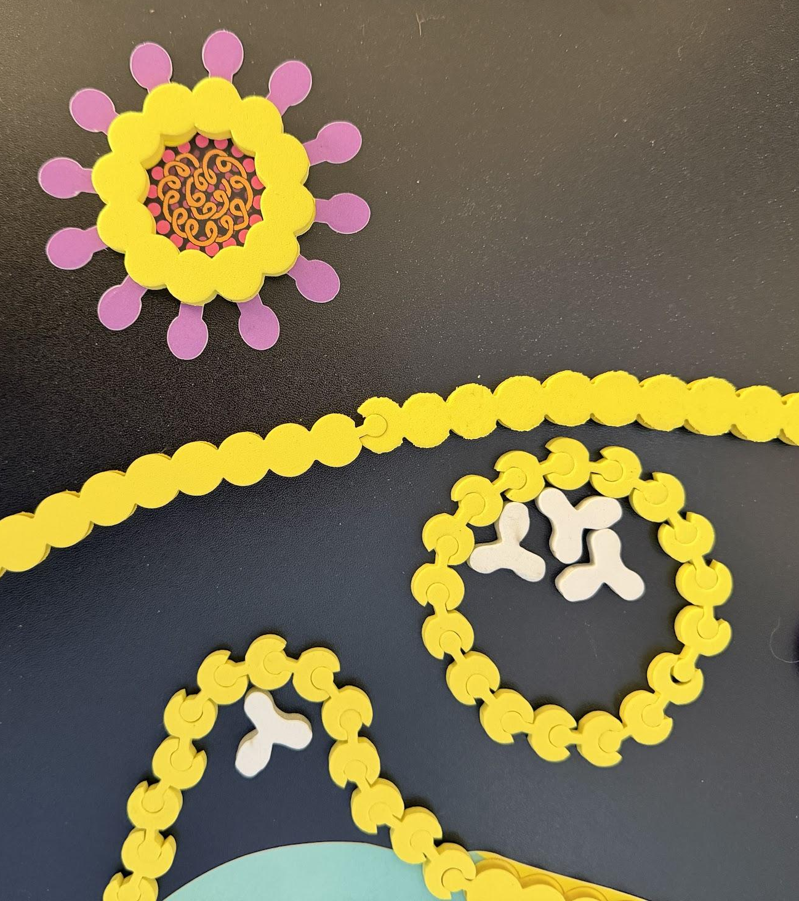
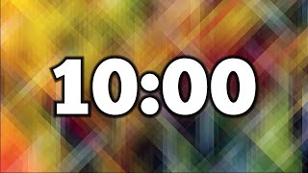
Use the cell model kit to EXPLORE ways this virus might engage with a cell.

Slide 42
Now EXPLORE ways this cell might “notice” that a virus is inside.

Slide 43
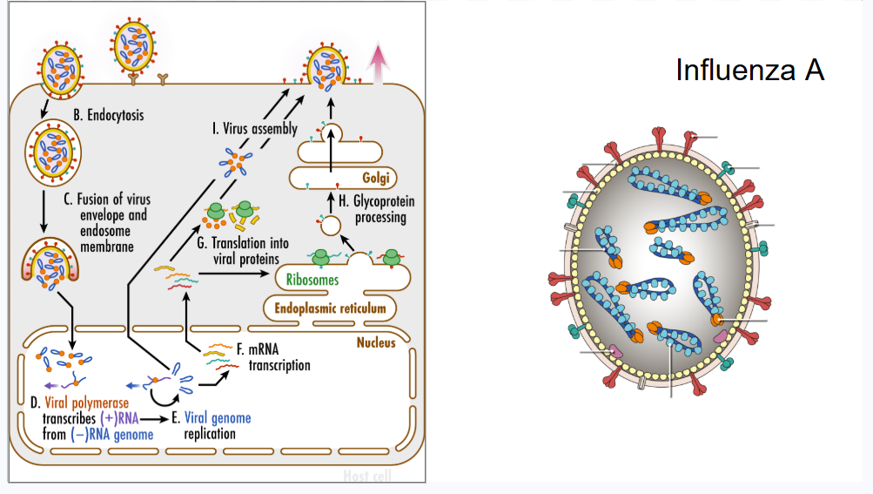
How is color being used in this model?
Where in the cell do transcription and translation happen?
What do the arrows mean?

Slide 44
Continue modeling the pathway.
Consider redesigning your virus model for more effective modeling.

Slide 45
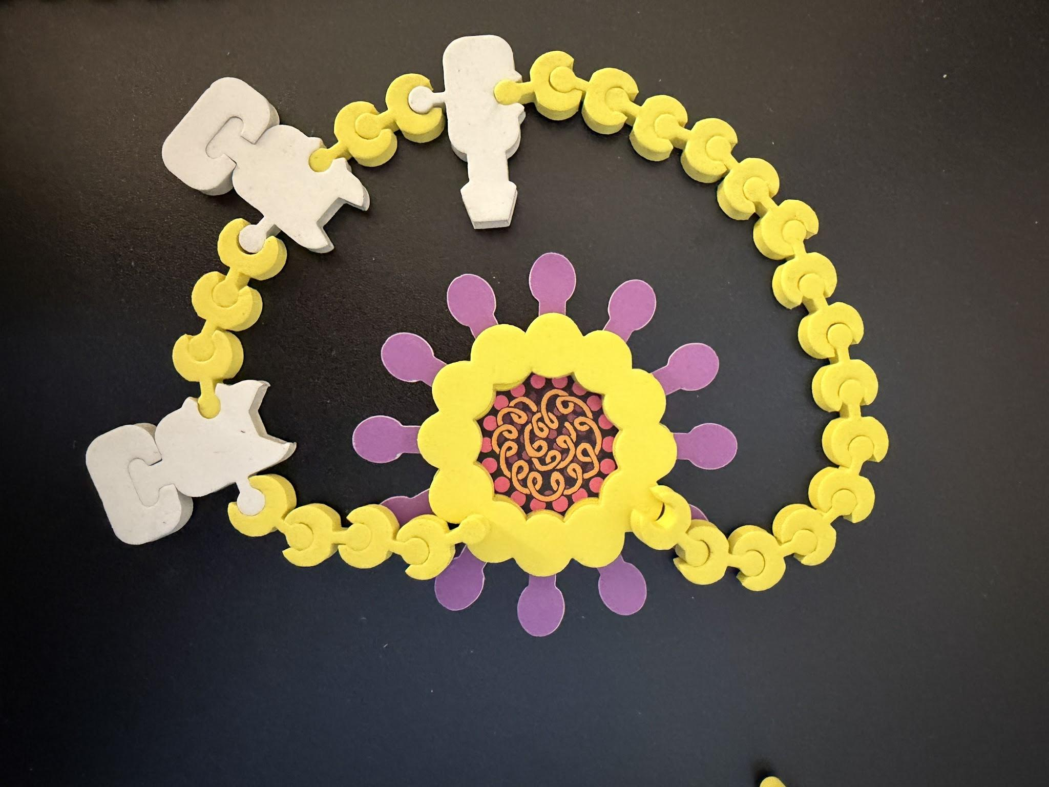
Can you build a better model?
Virus and endosome membranes fuse!
Contents of the virus particle are released into the cytoplasm.
Our model is limited!

Slide 46
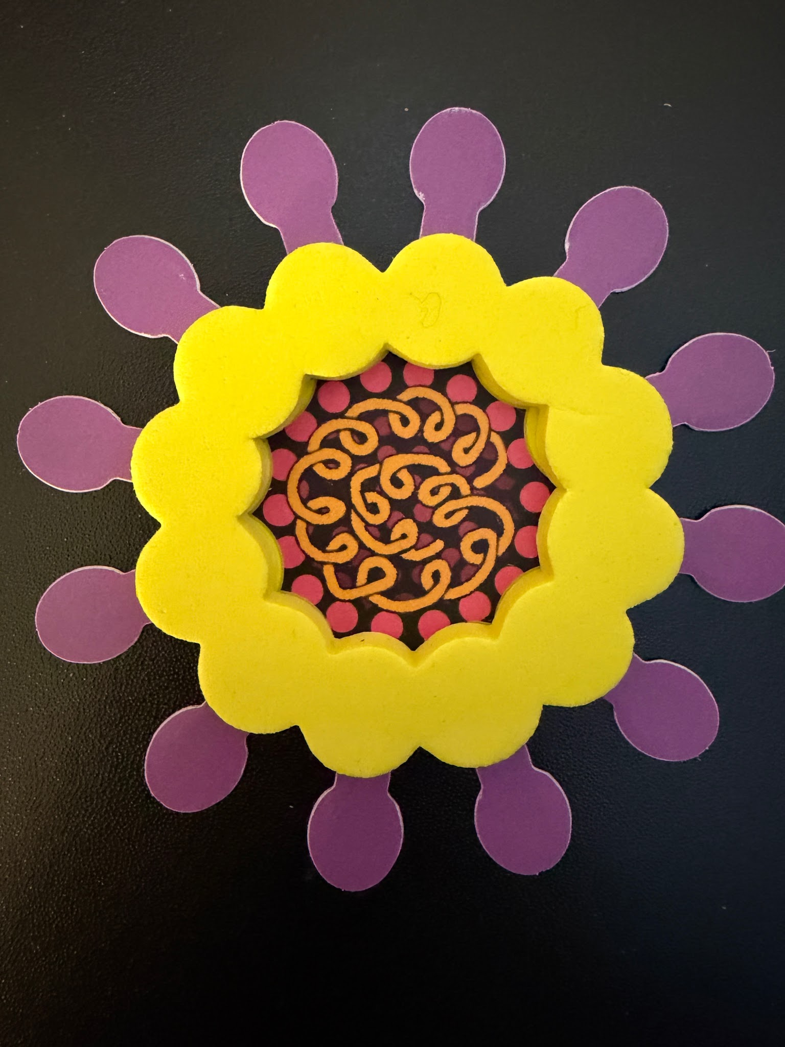
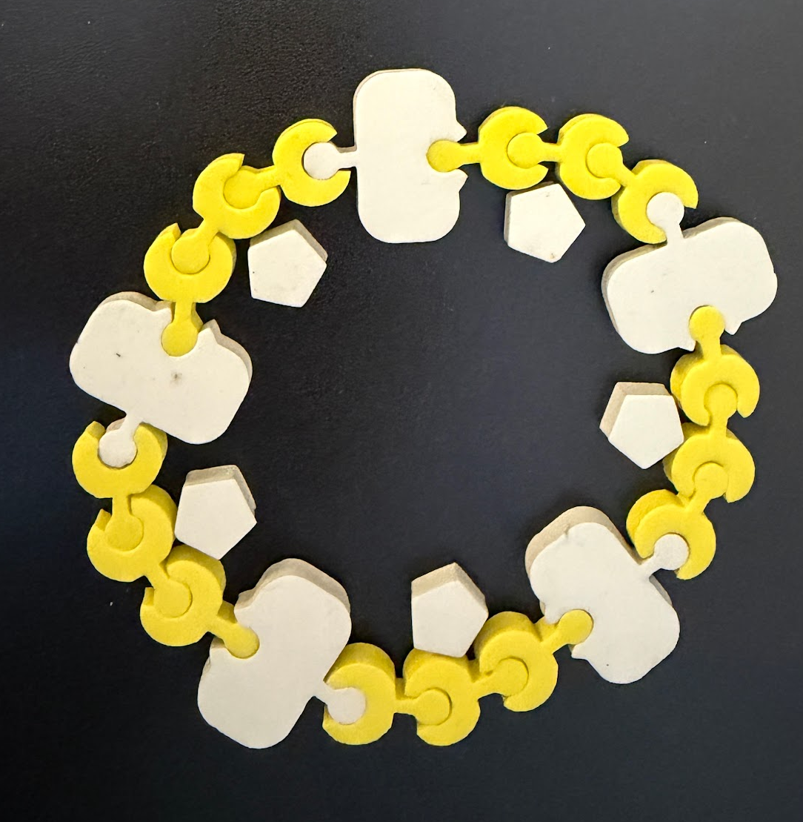
This was the model a student group built.

Slide 47
Why do you think that the virus receptors are synthesized on bound ribosomes?
Use the model to figure out how the receptor moves from the RER, to Golgi to the cell membrane.

Slide 48
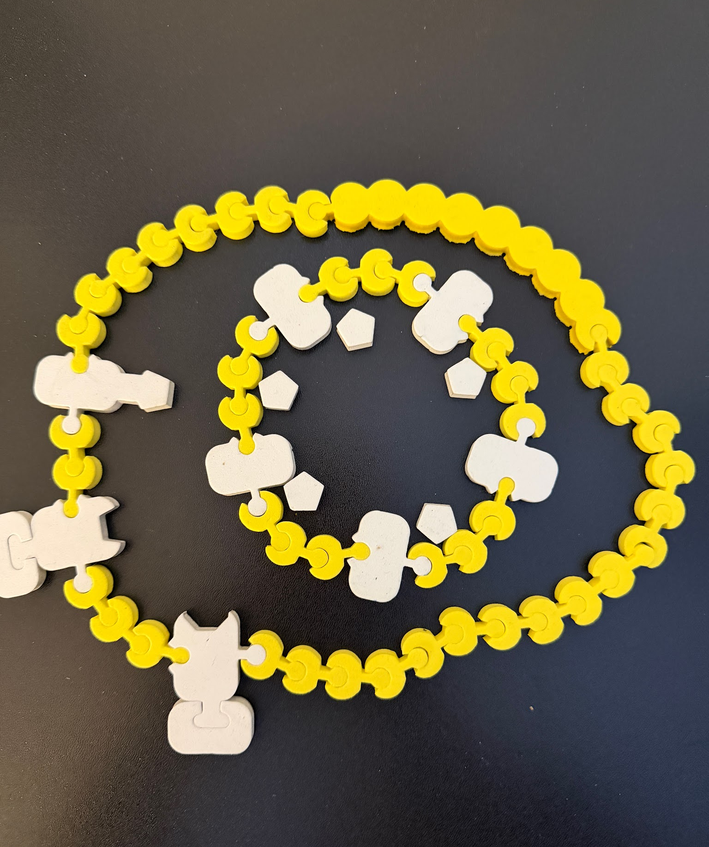
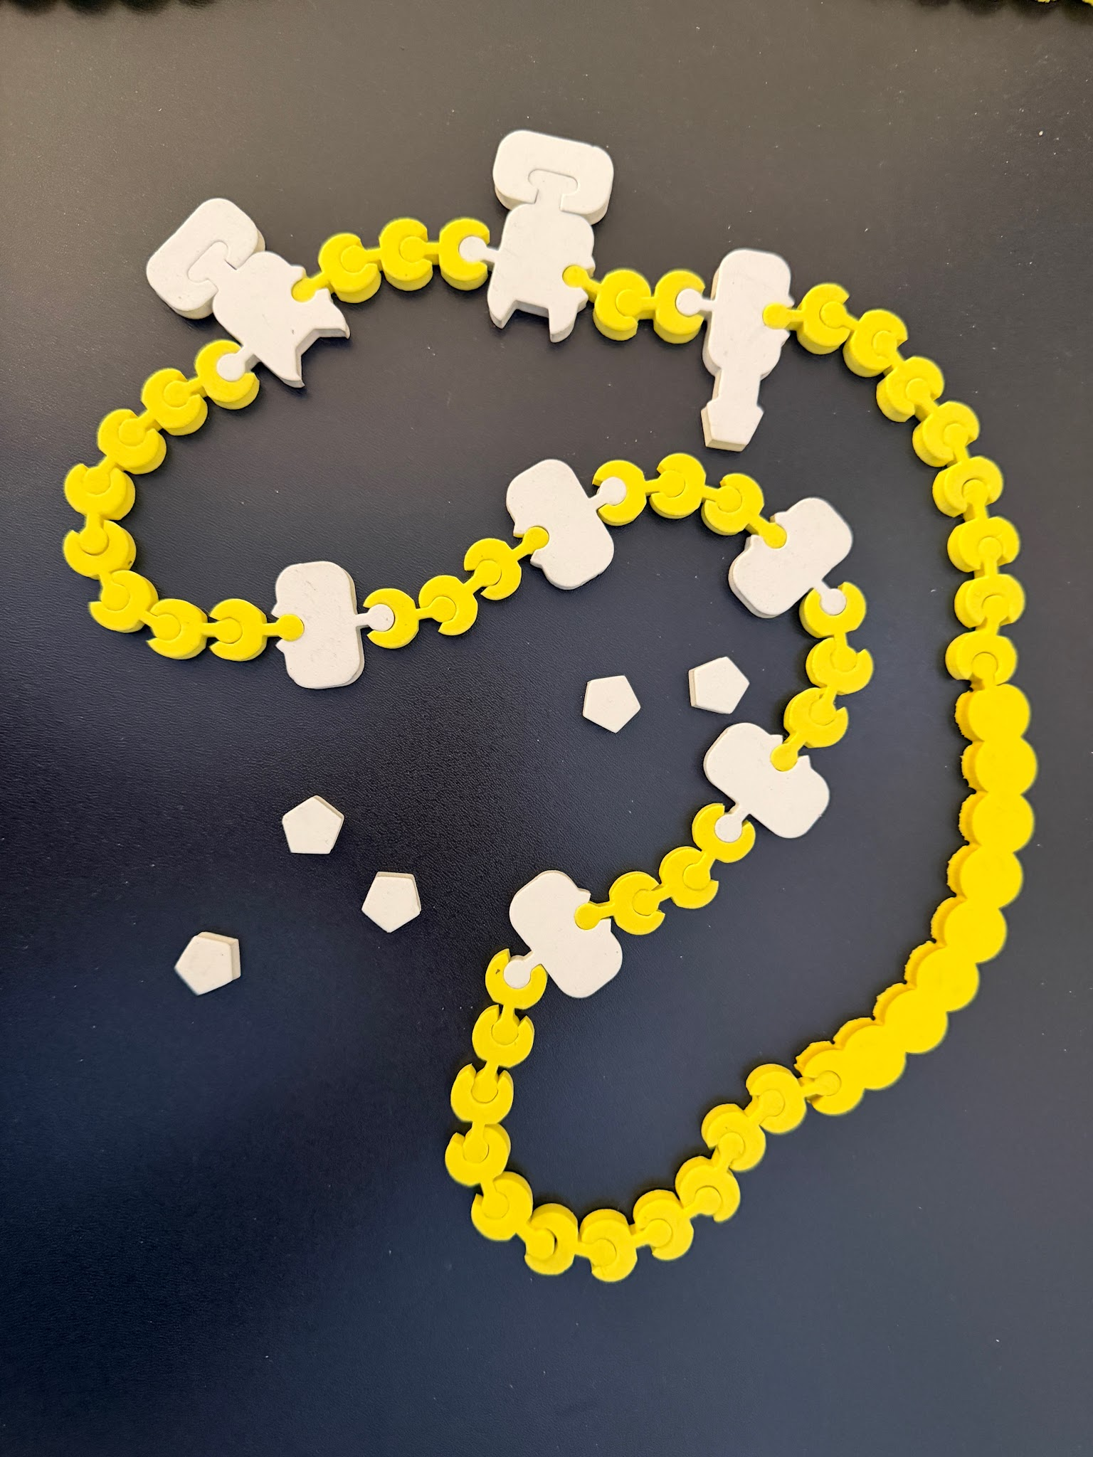
Modeling membrane fusion

Slide 49
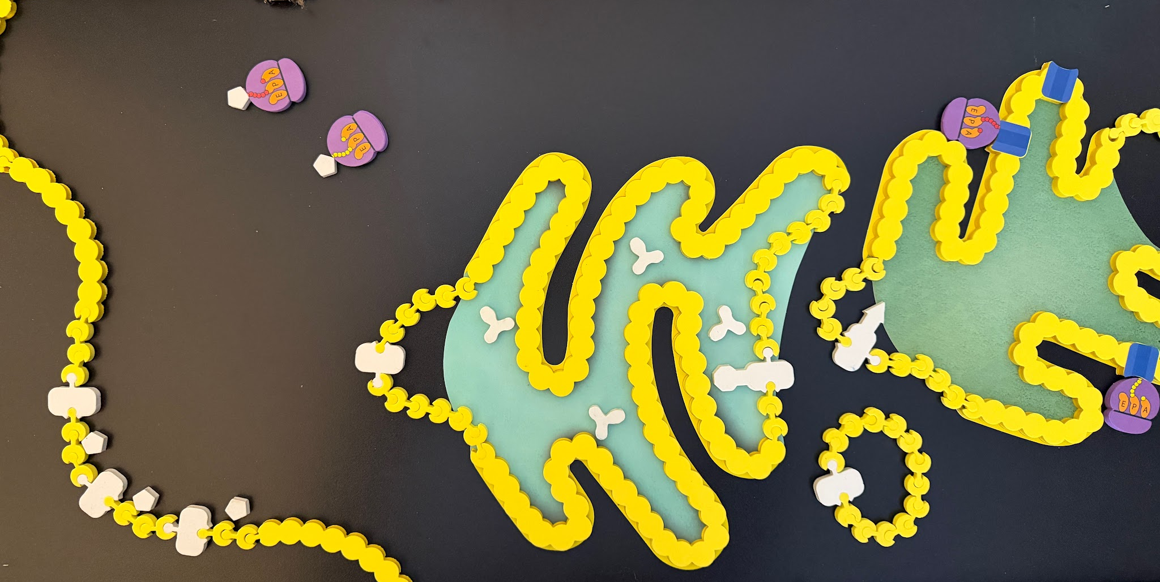
outside
inside
Virus particles assemble on the cell membrane.

Slide 50
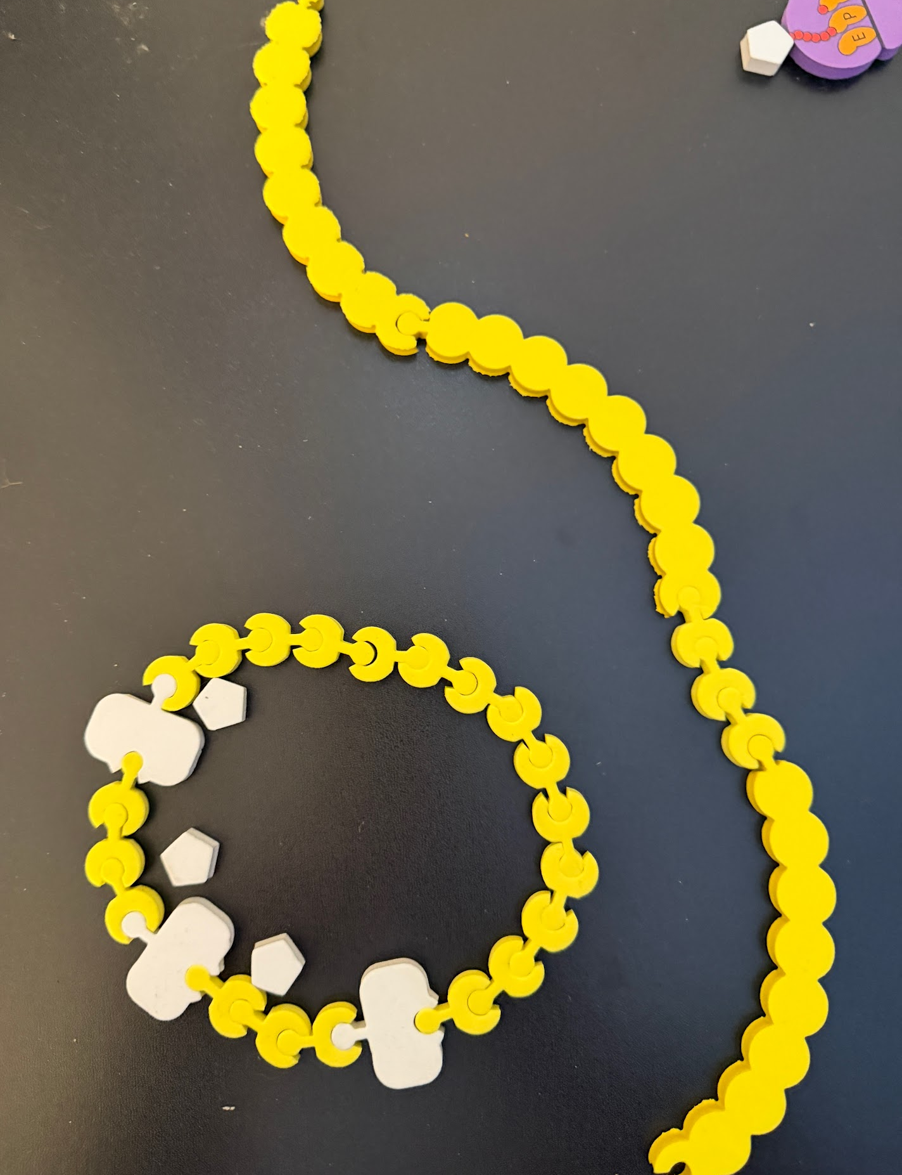
outside
inside
Exocytosis!

Slide 51
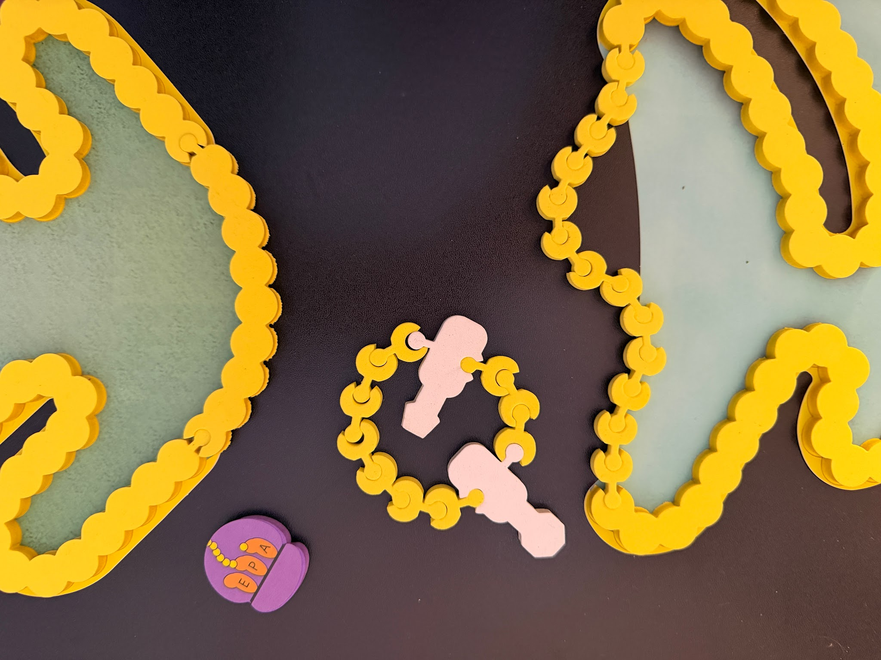

Vesicle travels to Golgi
Vesicle buds from RER

Slide 52




Vesicle travels to and fuses with the cell membrane.
Vesicle buds from Golgi

Slide 53
Using your handout, explore this pathway.
3 similarities, 3 differences across pathways.

Slide 54

https://media.hhmi.org/biointeractive/click/virus-explorer/index.html
How is color used?
What do the arrows mean?

Slide 55






Entry: 3 viruses, 3 mechanisms
Influenza
HIV
HPV
I notice…. I wonder….

Slide 56

Exit: 3 viruses, 3 mechanisms
I notice…. I wonder….

Slide 57


Models and micrographs…
https://worldofviruses.unl.edu/category/image-wall/microbe-sems/

Slide 58
HPV
How might the process differ for a virus enclosed in a protein-coat?

Slide 59



Slide 60

Adenovirus has to find its way into the nucleus. How might this happen?

Slide 61

Could the vesicle travel backwards through the endomembrane system?

Slide 62
What are some inferences we can make about infection pathway differences based on genome type?
DNA Genome
HPV
Adenovirus
RNA Genome
(template strand)
Rabies
Influenza
Ebola
RNA Genome
(Coding Strand)
SarsCov2
Zika
HIV
TMV
Notes:
DNA genomes might integrate with host DNA or enter the nucleus; - RNA genome needs to be copied into + RNA before ribosomes can translate; + RNA can be immediately translated but a -RNA must be made to copy the genome (they bring their own RNAP for this!).

Slide 63

How do variations in virus proteins come about?
RNA Polymerase lacks error-proofing!

Slide 64

Flu
HIV
HPV

Slide 65
Receptor binding is shown as a key process common to all virus pathways.
What are some themes/concepts that we teach that we can connect to cell receptors and binding to receptors?

Slide 66



Why do we need a new vaccine every year to protect against the flu?

Slide 67

Hemagglutination Assay: Test Flu Virus Antigens
HA proteins on the surface of flu viruses can bind to RBC and “glue” them together, forming a lattice structure (this is known as “hemagglutination”
https://www.cdc.gov/flu/php/viruses/antigenic.html

Slide 68

Predict: How would this result change if the antibodies lost their effectiveness?
The HI test works by measuring how well antibodies bind to the HA proteins and prevent them from “gluing” red blood cells together

Slide 69

CDR region of the antibody binds to the virus surface protein. What is the consequence?

Slide 70
https://www.cdc.gov/flu/php/viruses/antigenic.html

Slide 71


https://ivr.cidrap.umn.edu/universal-influenza-vaccine-technology-landscape

Slide 72

https://www.biointeractive.org/classroom-resources/immune-system

Slide 73

Scientific data demonstrate vaccine effectiveness
https://www.biointeractive.org/classroom-resources/immune-system

Slide 74

Antigenic variation: happens in the most flexible protein regions
https://worldofviruses.unl.edu

Slide 75




Slide 76

Janet Iwasa

Slide 77

SARS-CoV 2 can enter two different ways.

Slide 78

https://animationlab.utah.edu/cova

Slide 79



Slide 82
Reflection

Slide 83


Slide 84

Teaching mRNA Vaccines…
and the future of therapeutic RNAs
Tim Herman
3D Molecular Designs

Slide 85
COVID-19… and mRNA vaccines
A story about the process of science...
An mRNA Vaccine Design Activity
Why did it take so long?
…and…
Why did it happen so fast?
Student Challenge: Can you engineer an mRNA vaccine?

Slide 86

Coronavirus …and the Spike protein
The magic of models…

Slide 87

Here’s the story: SCIENCE to the rescue…
December 2019, new coronavirus (CoV-2) reported in China
January 10, 2020, nucleotide sequence of CoV-2 reported…
and shared with the world.
January 13, 2020, optimized version of the spike gene sent to Moderna.
March 20, 2020, Jason McLellan publishes 3D structure
of CoV-2 spike protein.
Clinical Trials...
December 18, 2021, Moderna mRNA vaccine EUA.

Slide 88


within 3 months of the CoV-2 genome being sequenced...
Key Innovations from UT Austin’s McLellan Lab Powers COVID-19 Vaccines
UT-Austin researcher explains lab’s key role in coronavirus vaccine development

Slide 89



mRNA Vaccines, yesterday’s science today!
CoV2 RNA genome published in December of 2020
mRNA vaccine for CoV2 approved for emergency use in less than 1 year.
Kati Kariko… persistence rewarded.

Slide 90


Slide 91


The 2023 Nobel Prize in Medicine
Katalin Kariko and Drew Weissman
Katalin donated the more than half a million dollars associated with her Nobel Prize to her former alma mater, which will benefit outstanding teachers and students.

Slide 92

…WHY?
tRNA Modifications

Slide 93



Molecular Therapy vol. 16 no. 11, 1833–1840 nov. 2008
pseudouridine
GUAACUGCAUGCUAGCUAGCUAGCUCAGUGCUGCUGCUGUAUUUGCUUGA
GΨAACΨGCAUGCΨAGCΨAGCΨAGCΨCAGΨGCΨGCΨGCΨGΨAΨΨΨGCΨΨGA

Slide 94









Tactile Base Pairs
Uridine
Pseudo-Uridine

Slide 95


Slide 96


Slide 97

...a vaccine design activity

Slide 98

A Table of Genetic Codons…
… with human codon preferences

Slide 99

The Components of mRNA
WHY?
Protect mRNA from degradation
Ribosome engagement site
Distinguish between viral RNA and endogenous mRNA
HOW? … with T7 RNA polymerase

Slide 100


Kaitlyn Kariko and Drew Weissman
2023 Nobel Prize in Physiology or Medicine
“for their discoveries concerning nucleoside base modifications that enabled the development of effective mRNA vaccines against COVID-19”

Slide 101
But wait…
How do our cells distinguish between viral RNA
and our endogenous mRNA?
Answer… Toll–Like Receptors (TLRs)

Slide 102


Modularity in biology…
Leucine-Rich Repeats (LRRs)…
and Toll Like Receptors (TLRs)
Ribonuclease Inhibitor
TLR7

Slide 103

…and finally, a closer look at TLR7

Slide 105
Reflection

Slide 106

Lunch Options
3DMD Staff will escort groups to restaurants each day. Other good local options for fast lunches include: 600 East Café Loaded Spuds Mediterranean Cuisine Your Office

Slide 107


Slide 108
How do our best models vary from traditional?
Traditional Models
Are representational models designed to communicate specific information with limited opportunities for learner engagement or discovery
Are used to inform or as an end-product of the learning cycle
Are simplified representations created to provide information about a singular narrative or learning pathway
Are designed to inform learners of specific features and ideas; generally have limited opportunities for discovery
Are designed for prescribed learning, fitting in a specific context or learning arc
Are often vocabulary-dependent and require significant conceptual background to engage with the model, creating a high cognitive load on the learner.
Limits student accessibility with required conceptual background (high threshold for entry to learning)
Limits mindsets for authentic model development with simple visual schematics and information already applied to the given model
Are grounded in convergent thinking, expecting students to learn a particular set of features

Slide 109
Traditional vs. Foundational Models
Traditional Models | Foundational Models
Are representational models designed to communicate specific information with limited opportunities for learner engagement or discovery | Are interactive models that learners at various levels can actively engage with and discover features of throughout the learning cycle
Are used to inform or as an end-product of the learning cycle | Are integral to every phase of the learning cycle and sensemaking process
Are simplified representations created to provide information about a singular narrative or learning pathway | Are appropriate to use for a variety of learning objectives and at various levels.
Are designed to inform learners of specific features and ideas; generally have limited opportunities for discovery | Are designed for learners to make observations, uncover understanding, and generate questions through play
Are designed for prescribed learning, fitting in a specific context or learning arc | Are designed for just-in-time learning, allowing educators and learners to interact at just the appropriate level for any given storyline, phenomenon, or health concern
Are often vocabulary-dependent and require significant conceptual background to engage with the model, creating a high cognitive load on the learner. | Encourage the exploration and engagement of new concepts and vocabulary within the model's context, thereby lowering the learner's cognitive load
Limits student accessibility with required conceptual background (high threshold for entry to learning) | Allow all learners to accessibly enter the learning cycle confidently (low threshold for entering learning)
Limits mindsets for authentic model development with simple visual schematics and information already applied to the given model | Promote mindsets that allow learners to develop dynamic conceptual models that are open to learner revision and modification
Are grounded in convergent thinking, expecting students to learn a particular set of features | Promote divergent thinking led by learner wondering and questioning

Slide 110















Foundational Models
A foundational model is an interactive model with a low threshold and high ceiling that students can use throughout the learning cycle for multiple learning objectives.

Slide 112

Round Robin Model Exploration Time
Collaborative Exploration Spaces
Individual Exploration - ask for a kit to explore at your table
Cell Modeling Kit | Receiving Table
Molecules of Life Kit | Graphic Design
Bacterial Membrane Modeling Kit | Conference Room
Antibody Diversity Kit | Product Shelves
Lateral Flow & Diagnostics | Behind Whiteboards
Virus Infection & Immunity Kit | Sitting Area
3D Printed Models | West of Sitting Area

Slide 113


Slide 114


Individual Planning Implementation Time
Create one implementation artifact you can use this year. Prompts include:
Build a Unity Spine
Design a Multi-Lesson Modeling Sequence
Create a Classroom Modeling Playbook
Plan for Assessment and Evidence of Learning
Design One WE² Model Lesson
Be prepared to share:
Your central idea
Anticipated challenges
One aha moment you experienced while working

Slide 115

Share-out with your Table

Slide 117



Field Test Kit Feedback Discussion
Virus Infection & Immunity Kit
mRNA Vaccine Expansion Kit

Slide 119


Slide 120
End of Day Announcements
Friday Focus
Phage!
Download T4 Bacteriophage (search “Goodsell T4 Bacteriophage)
Bring Your
Notebooks
Computer Phage Exploration
Evening Plans
Dinner and/or Happy Hour @5:30

Slide 121


End of Day Survey
End of Day Survey
Material Feedback Form

