Slide 1
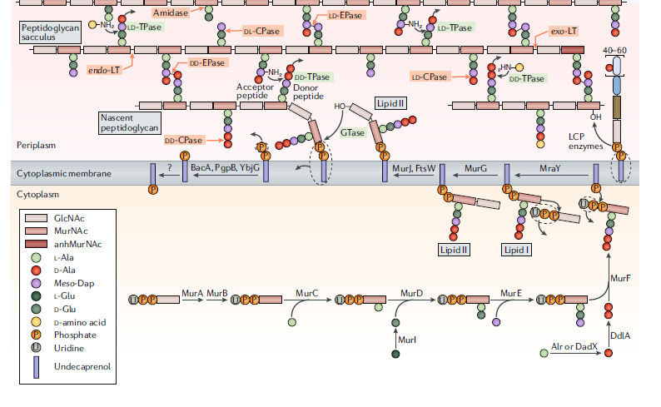
https://doi.org/10.1038/
s41579-020-0366-3
Notes:
Here is an illustration (model) showing the synthesis of NAM plus peptide – plus NAG (all in the cytoplasm) … and then the flipping of this into the periplasmic space … joining to the pre-existing peptidoglycan…. and eventual crosslinking of peptides. Life is complicated.

