Slide 1
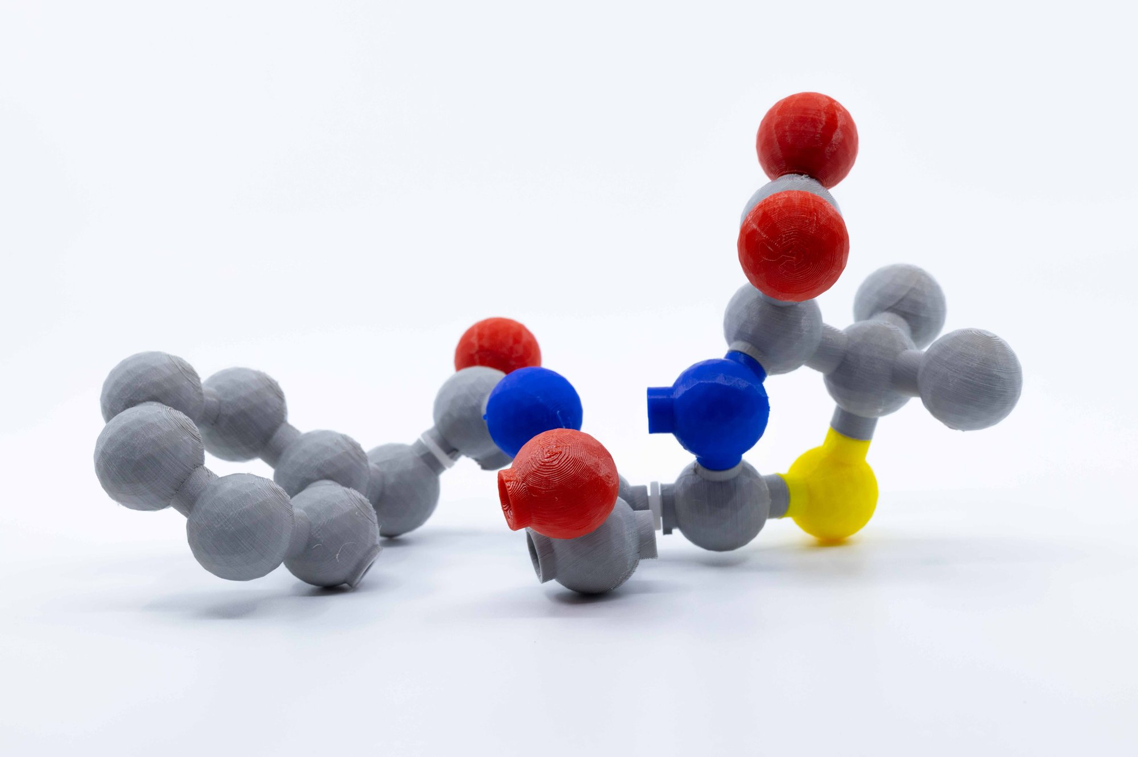
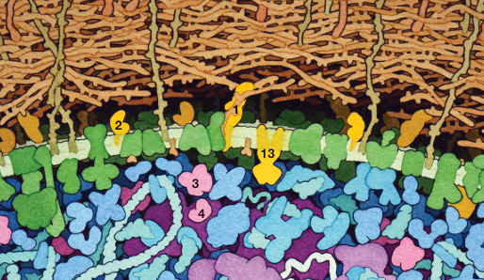
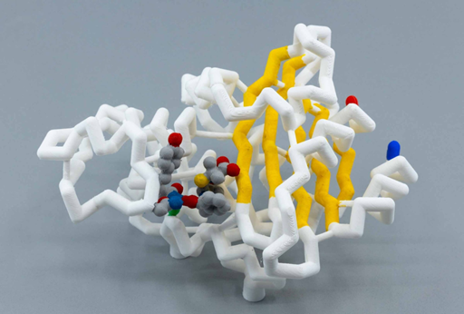
PBP
(Penicillin Binding Protein)
Peptidolycan
Penicillin
(a β-lactam)
β
-Lactamase
Notes:
Christina,… you mentioned talking about the evidence that ultimately results in “models” that illustrate how things work. Here is a slide that features 3 separate but related models

