Slide 1
Extra Slides
Tissue specific cell types: Lung and Skin

Slide 2
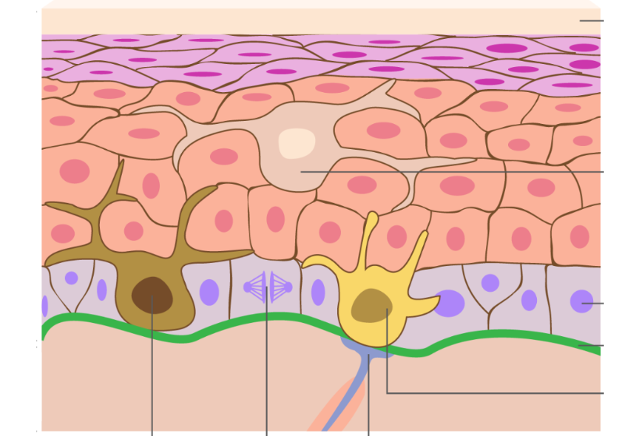
Skin tissue Overview
Antigen presenting Cell
Basal cell
Mechanosensory cell
Melanocyte
Sensory nerve
https://www.plasticsurgeoncapetown.com/skin-cancers.php

Slide 3
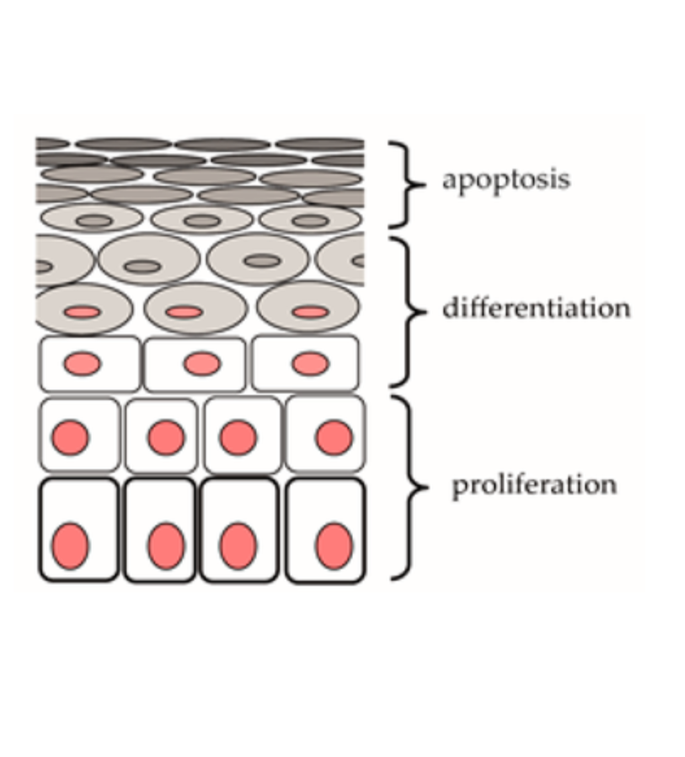
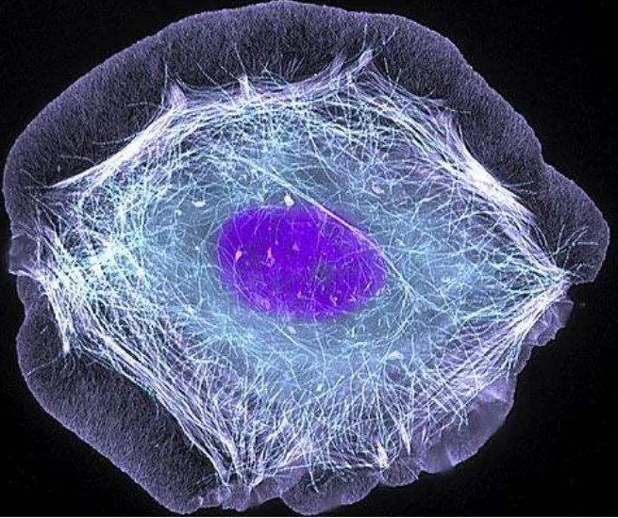
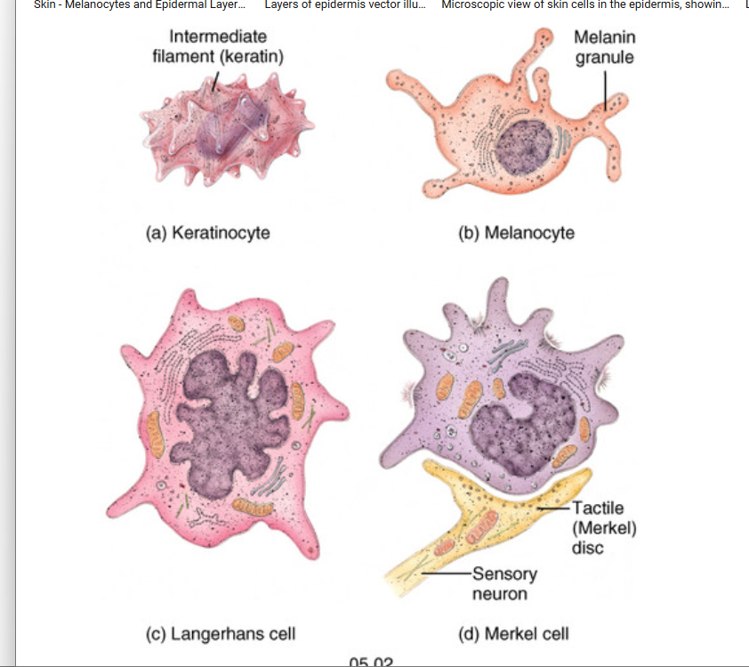
“Armor Builder”: Keratinocytes
Intermediate Filaments
Notes:
Skin dendritic cell: https://www.frontiersin.org/journals/immunology/articles/10.3389/fimmu.2015.00534/full
Skin dendritic cell colorized: https://sqonline.ucsd.edu/2022/11/dendritic-cells-stimulating-immune-response/

Slide 4
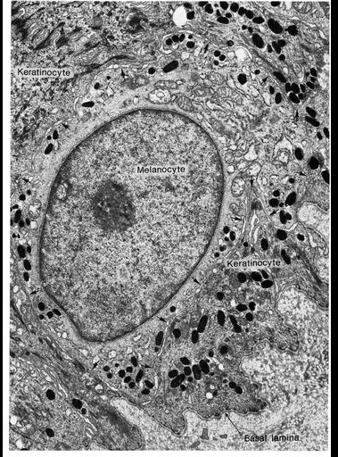
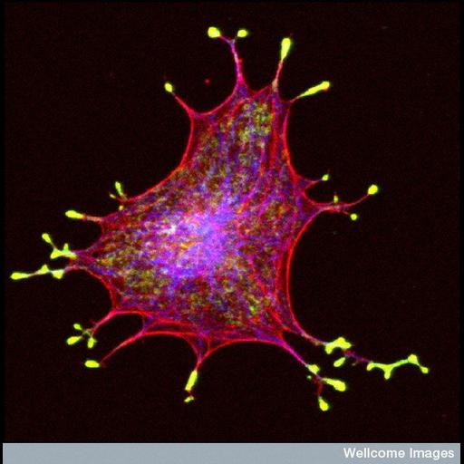
“Pigment Broadcaster”: Melanocytes
Notes:
Skin dendritic cell: https://www.frontiersin.org/journals/immunology/articles/10.3389/fimmu.2015.00534/full
Skin dendritic cell colorized: https://sqonline.ucsd.edu/2022/11/dendritic-cells-stimulating-immune-response/

Slide 5
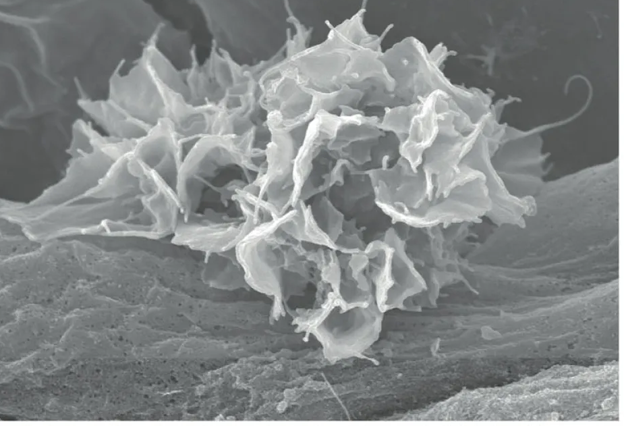
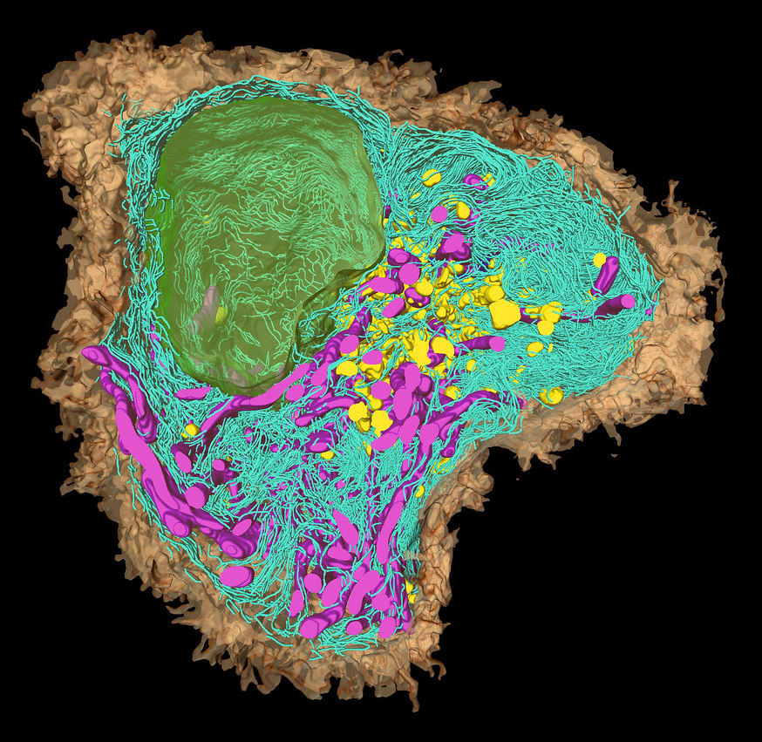
“Intradermal sentinel”: antigen presenting cell
Notes:
Skin dendritic cell: https://www.frontiersin.org/journals/immunology/articles/10.3389/fimmu.2015.00534/full
Skin dendritic cell colorized: https://sqonline.ucsd.edu/2022/11/dendritic-cells-stimulating-immune-response/

Slide 6
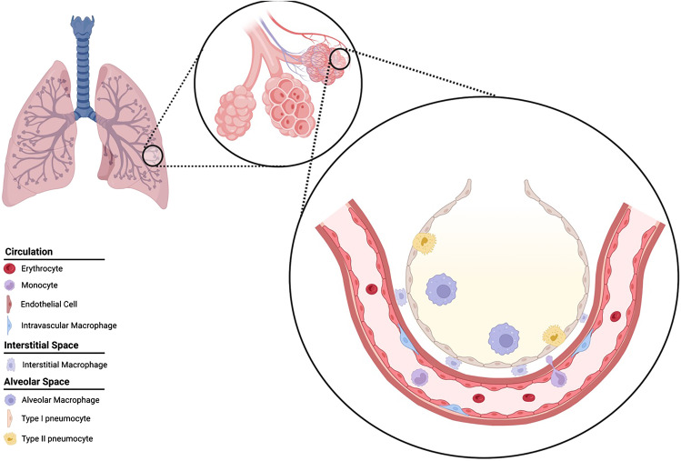
Lung Tissue Overview

Slide 7
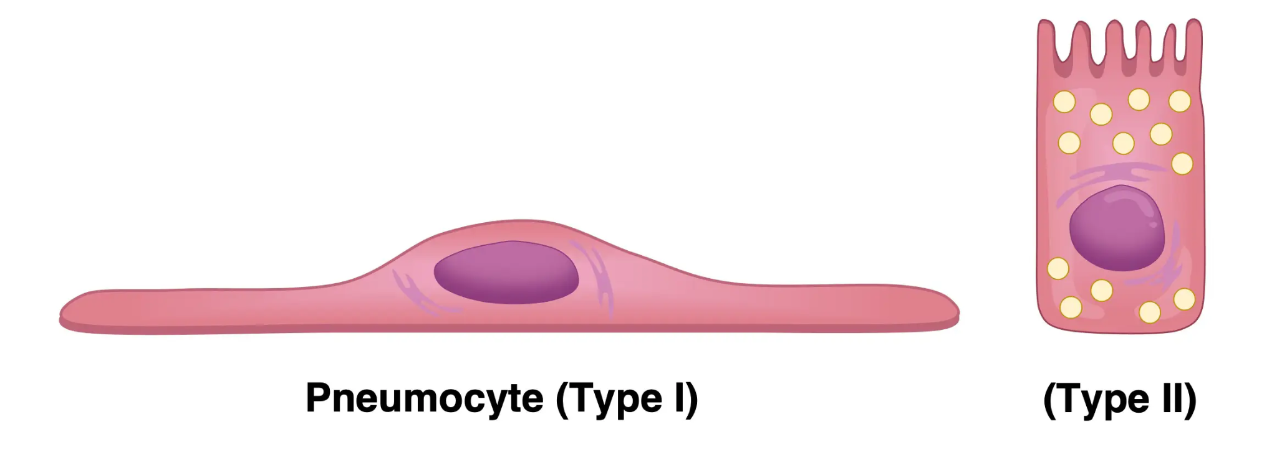
Type II Alveolar Cell
The Ultra-Thin Window (Type I Alveolar Cell)

Slide 8
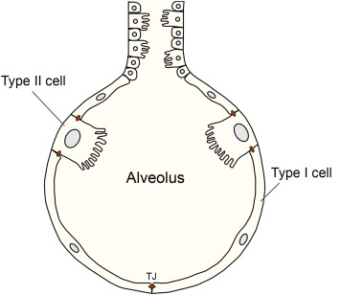
Surfactant Factory (Type II Alveolar Cell)
The Ultra-Thin Window (Type I Alveolar Cell)

Slide 9
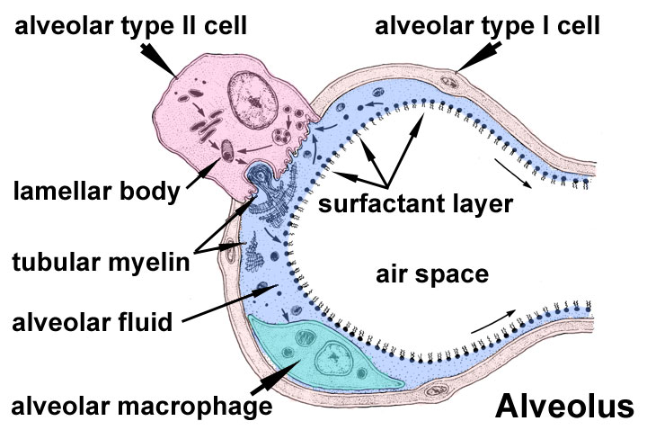

Slide 10
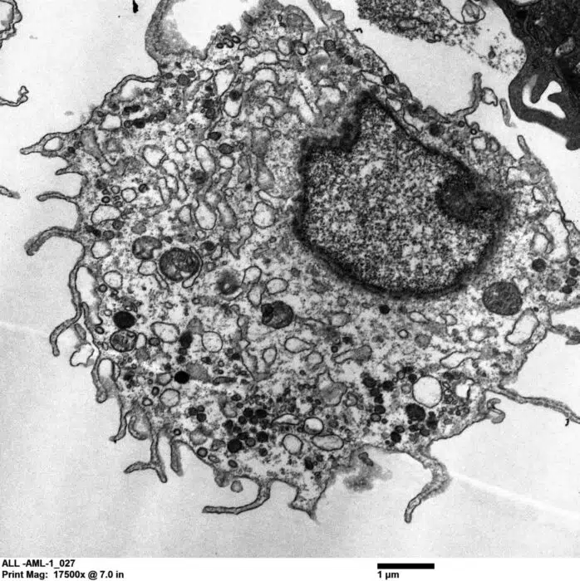
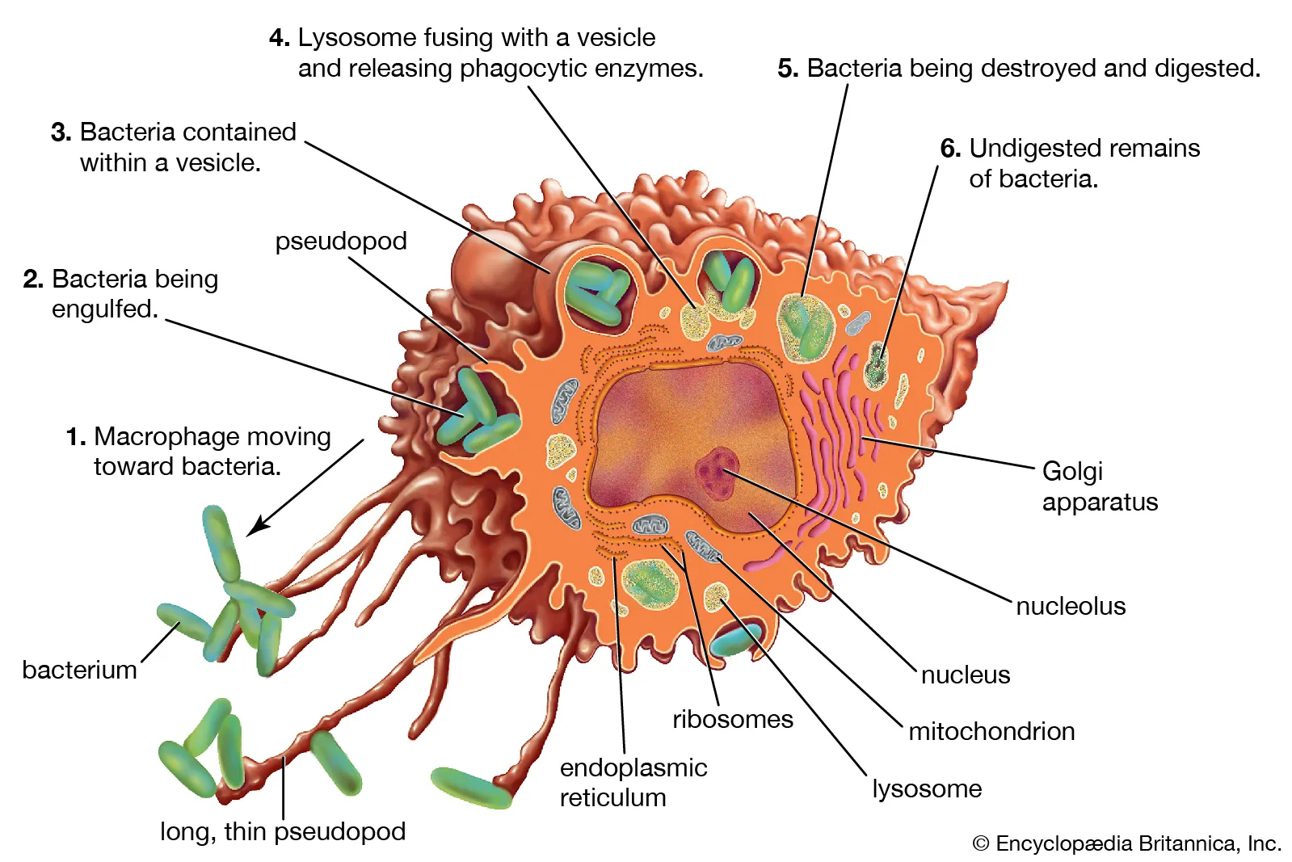
Devouring Sentinel (Macrophage)

Slide 11
Devouring Sentinel (Alveolar Macrophage)
https://www.txbiomed.org/news-press/news/alveolar-macrophage-model/

Slide 12
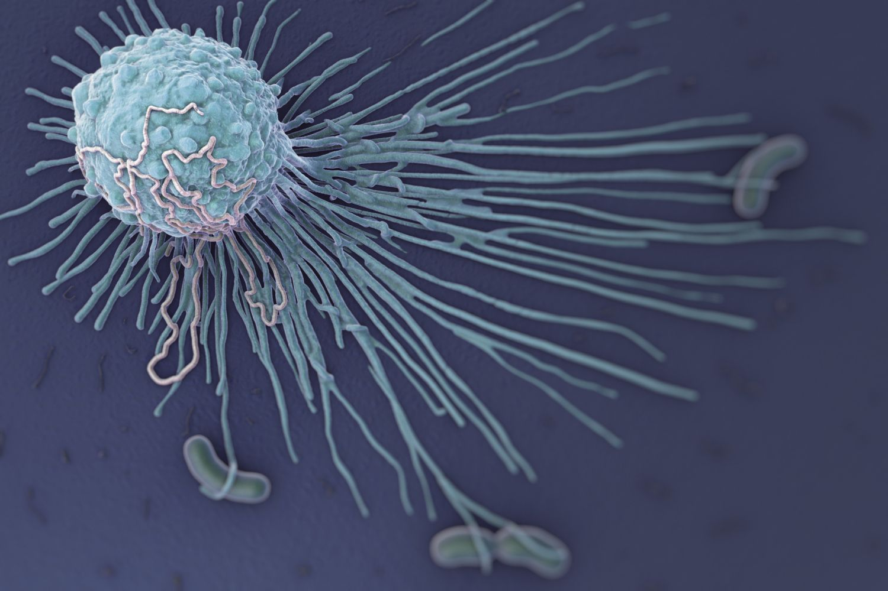
Macrophage

