Slide 1

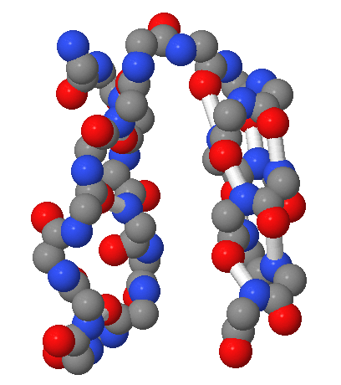
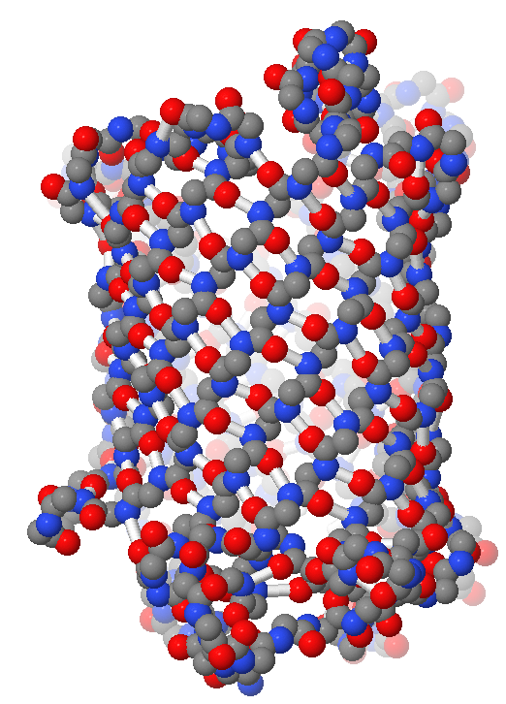
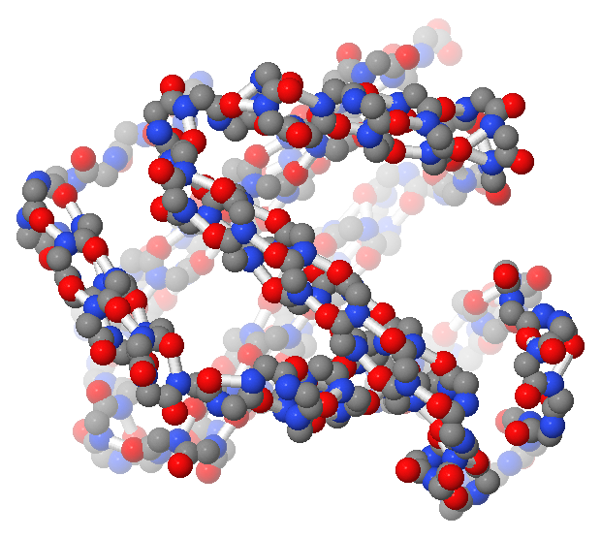

Alpha Helix - Beta Sheet Secondary Structure Set©
Stabilizing Structures
“When I saw the alpha-helix and saw what a beautiful, elegant structure it was, I was thunderstruck."
– Max Perutz

Slide 2

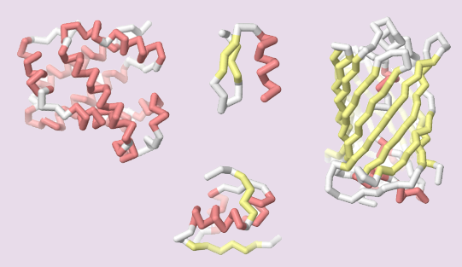
Teacher Guide – Summary
Activity Summary
Proteins are complex molecules that do most of the work in cells. Each type of protein folds into a unique and stable structure that allows it to perform a unique function. Maintaining this precise and stable structure is crucial for a protein to function properly.
There are two secondary structures that can be found in nearly all folded proteins:
• alpha helices - a spiral shape
• beta sheets - a zig-zag shape
These secondary structures act as an overall scaffold for a folded protein. Hydrogen bonds connect the backbone atoms of the secondary structures to further stabilize the folded protein.
In this activity, students will explore a physical model of an alpha helix and a beta sheet to examine amino acids in proteins’ secondary backbone structures.

Slide 3
Teacher Guide - Overview
Activity Objectives
  Discover the structure of amino acids and protein backbones
  Identify secondary structures: alpha helices and beta sheets
  Discover how hydrogen bonding stabilizes folded proteins
  Estimated Class Time
20 minutes
Required Models
Alpha Helix - Beta Sheet Secondary Structure Set©
Required Media
None
Recommended Resources
Amino Acid Starter Kit©
Grade, Class
9-12 Biology, AP Bio, Honors Bio
Topics
Amino acids
Protein structure
Secondary structures
Hydrogen and covalent bonding
Prerequisite Knowledge
None

Slide 4
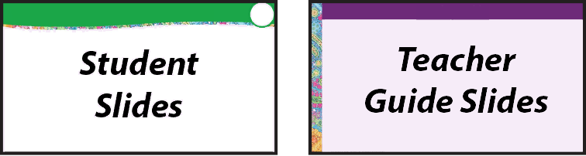




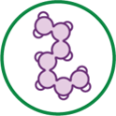
Teacher Guide - Using This Slide Deck
Student and Teacher Slide Deck Pages
  Slides that are meant for student viewing will feature a green top
  banner. Slides that are meant only for teacher viewing will feature a
  purple top banner and will appear hidden when in "slide show" mode.
Prompting Icons
  Each student slide will include a prompting icon in the top right corner of the slide. These icons on each slide cue your students to the type of activity they will be doing.
Turn and talk discussion
Write in your notebook
Quiet thinking time
Digital modeling
Physical modeling
Teacher Moves and Student Moves
Class slides provide notes (teacher notes below the slide) with specific information to assist you in facilitating the activity using effective modeling and education practices.

Slide 5
Teacher Guide - Standards
Next Generation Science Standards
Science and Engineering Practices | Cross Cutting Concepts | Disciplinary Core Ideas
Developing and Using Models | Patterns | HS-LS1-1
Constructing Explanations and Designing Solutions | Structure and Function | HS-LS1-6

Slide 6

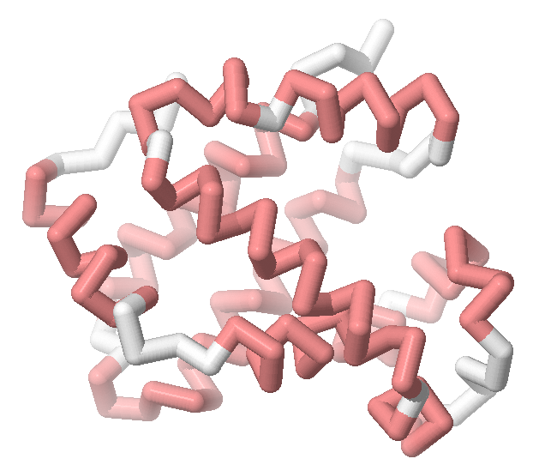
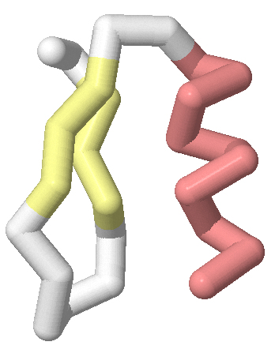
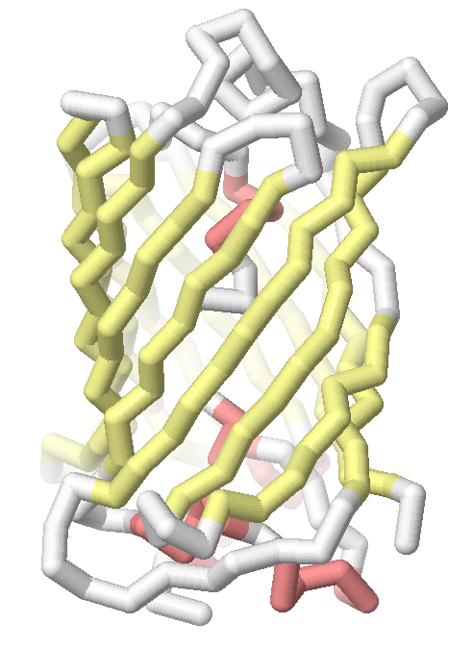
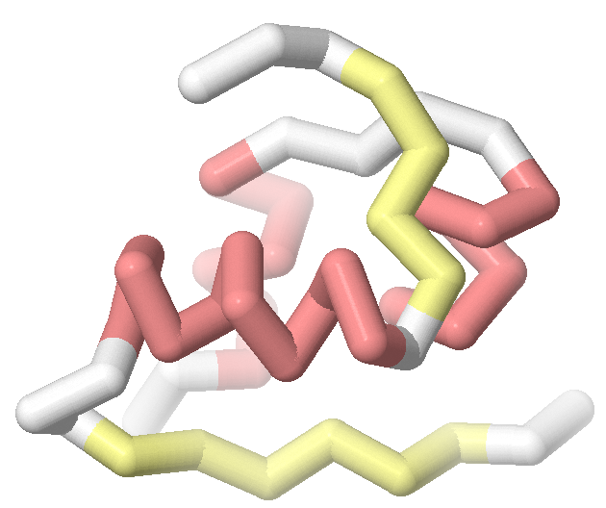
A Wide Variety of Protein Structures
Beta-globin
Carries oxygen in our blood
Zinc Finger
Binds to and regulates DNA
GFP Protein
Makes jellyfish glow green
Proteins are complex molecules that do most of the work in cells.
Each type of protein folds into a unique and stable structure so that it can perform its unique function.
Explore the example protein structures shown to the right.
How are they similar?
How are they different?
What patterns do you see?
Insulin
Regulates sugar
in the blood
Notes:
Teacher: Give students time to think about the question above
Student: Think about the similarities, differences, and patterns you can see

Slide 7

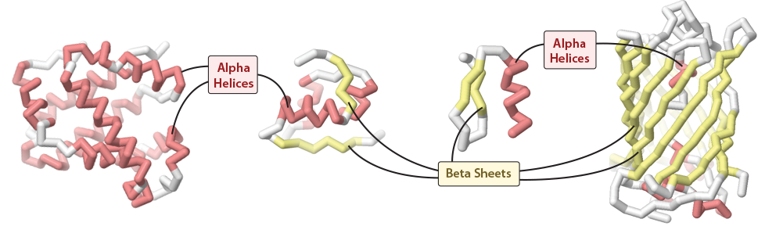
Alpha Helices and Beta Sheets
Different types of proteins have specific shapes that enable their functions – but nearly all protein structures contain two common structures: alpha helices (a spiral shape) and beta sheets (a zig-zag shape).
These two common shapes are referred to as secondary structures.
Notes:
Teacher: Give students time to think and discuss with a partner or small group​​
Student: Think about questions and share as directed

Slide 8
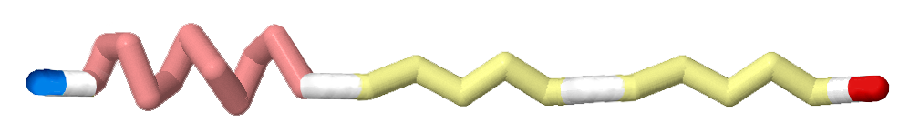
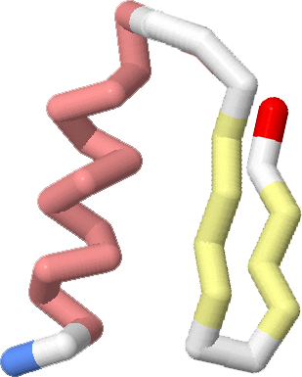
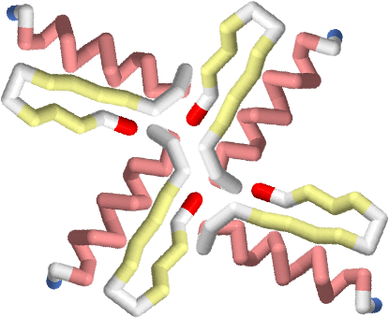
Four Levels of Protein Structure
Alpha helices and beta sheets are called "secondary structures" because they are the second level of a four-level approach to describing the shape of a folded protein.
Primary Structure is the sequence of amino acids, the building blocks that link together to make the protein chain.
Secondary Structure is the distribution of alpha helices and beta sheets in the protein chain.
Tertiary Structure is the overall shape the protein chain folds into.
Quaternary Structure is the assembly of multiple protein chains. Note that not all protein structures are made of multiple protein chains, so not all proteins have quaternary structure.
Notes:
Teacher: Explain the concepts on the slide as needed
Student: Engage with the concepts as directed

Slide 9
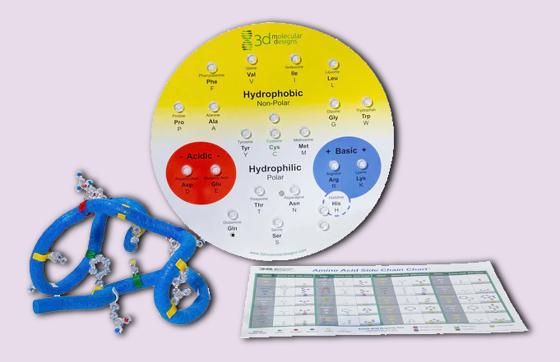
Extension - Amino Acid Starter Kit
For a more thorough introduction to amino acids and protein folding, we recommend the Amino Acid Starter Kit.
WorkFoing collaboratively, groups of students explore the chemical properties of amino acids to guide them as they fold their own protein. As they realize how amino acid sequences ultimately determine protein structure, students will:
Examine patterns within and between side chains of amino acids
Organize the side chains based on chemical properties they uncover in their investigation
Group the side chains into one of 5 categories: hydrophobic (nonpolar), hydrophilic (polar), negatively charged, positively charged, and cysteines, which sometimes form disulfide bonds
Explore the primary and tertiary structure of proteins by constructing a 15-amino acid protein
Examine the secondary structure of proteins by folding a mini toober model of the first of 3 zinc fingers of the Zif268 protein

Slide 10
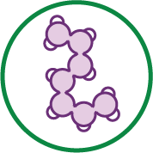
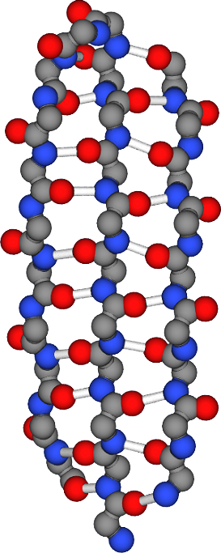
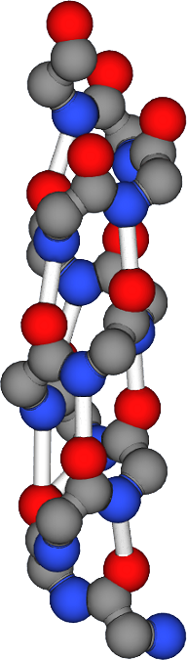

Exploring the Physical Models
But why would so many different protein structures contain the same two secondary structures?
To answer this question, we need study alpha helices and beta sheets in more detail. Explore the two physical models shown to the right.
Record your initial observations and questions in a Notice│Wonder Chart in your lab notebook.
alpha helix
beta sheet
I Notice I wonder
Notes:
Teacher: Allow students to explore the model ​
​
Student: Closely examine the model and write what you notice and wonder in your notebook.

Slide 11
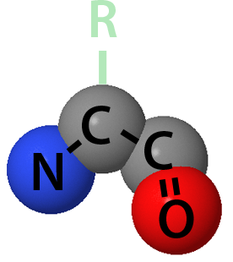
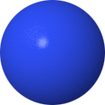
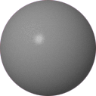
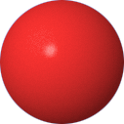
Proteins are Made of Amino Acids
Proteins are made of individual building blocks called amino acids.
Can you find an amino acid on your secondary structure models?
Can you find more than one amino acid?
How do amino acids link together?
* Note, for this activity we will be ignoring the R functional group (side chains) of amino acids.
Nitrogen
Carbon
Oxygen
Notes:
Teacher: Allow students to explore the model ​​
Student: Closely examine the model and ponder the questions on the slide

Slide 12

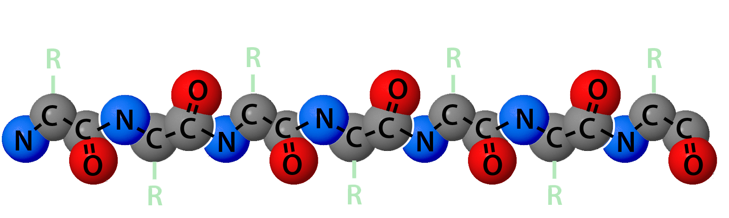
Linking Amino Acids Together
Amino acids link together in a consistent way, with the second carbon atom of one amino acid bonding to the nitrogen atom of the next amino acid.
In your notebook, write the pattern of atoms that result from amino acids forming a protein chain.
Notes:
Teacher: Give students time to explore the model and respond to the prompt​​
Student: Follow the onscreen prompts

Slide 13
Linking Amino Acids Together
Amino acids link together in a consistent way, with the second carbon atom of one amino acid bonding to the nitrogen atom of the next amino acid.
In your notebook, write the pattern of atoms that result from amino acids forming a protein chain.
N-C-C - N-C-C - N-C-C - N-C-C ...
(Note that the oxygen atom is not involved in this linkage.)
Notes:
Teacher: Explain the concept on the slide as needed
Student: Edit, or elaborate on your sketch as needed

Slide 14
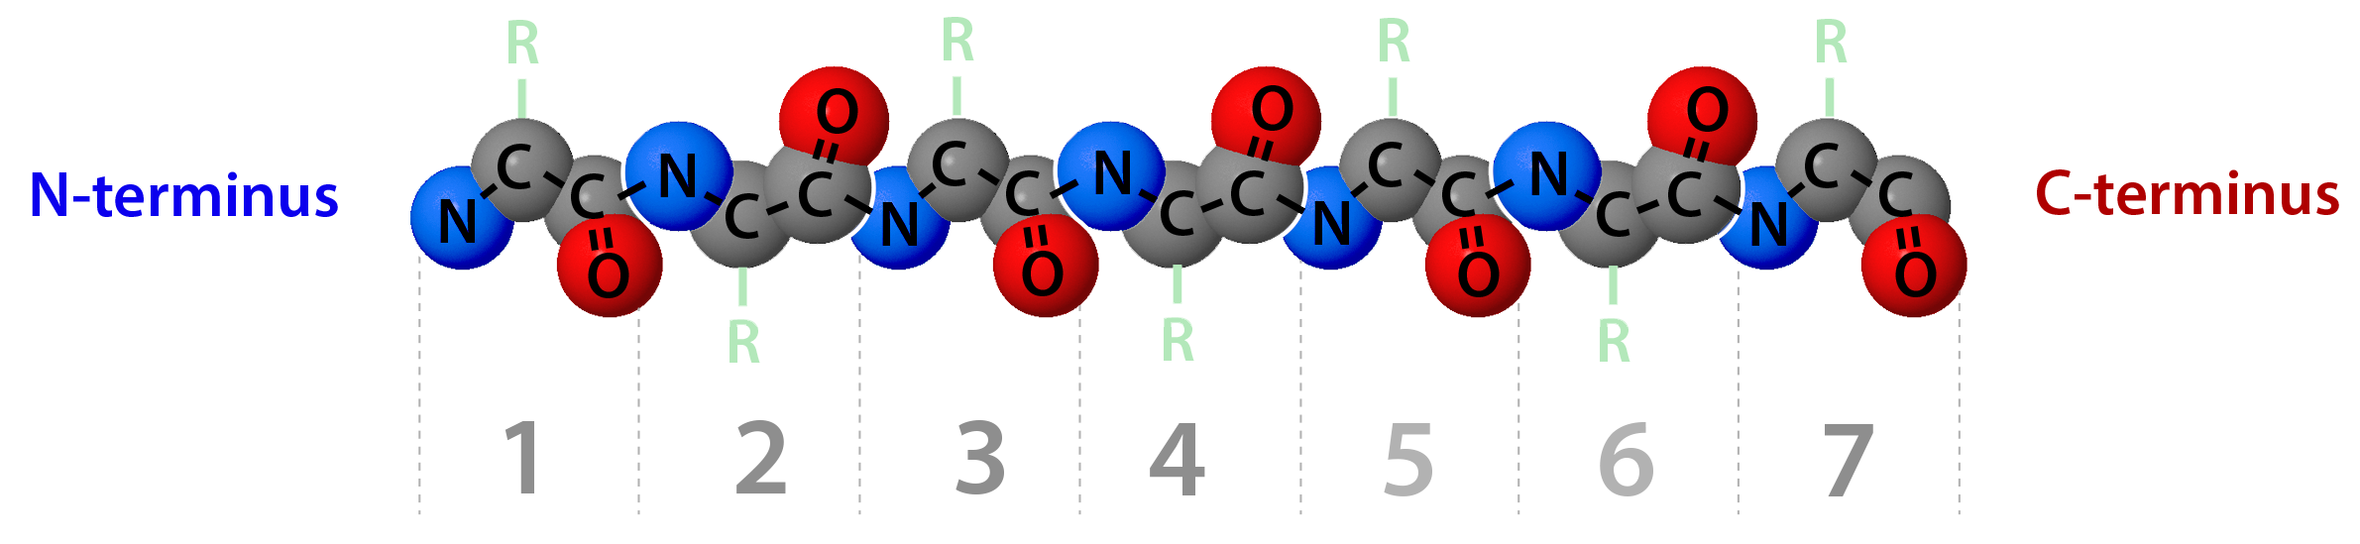
The Beginning and End of a Protein Chain
This pattern (N-C-C - N-C-C - N-C-C) gives a protein chain directionality.
Each protein chain has a beginning, referred to as the N-terminus, and an end, referred to as the C-terminus.
In your notebook, add labels for the N-terminus and C-terminus to your diagram.
Number the amino acids.
Notes:
Teacher: Give students time to think and respond to the writing prompt​​
Student: Write a response in your notebook

Slide 15
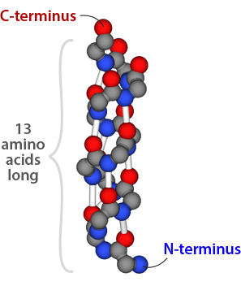
Analyzing the Alpha Helix Model
Can you find the N-terminus and C-terminus in your alpha helix model?
How many amino acids make up the alpha helix model?
Notes:
Teacher: Allow students to explore the model ​​
Student: Closely examine the model and try to answer the posted questions

Slide 16
Analyzing the Alpha Helix Model
Can you find the N-terminus and C-terminus in your alpha helix model?
How many amino acids make up the alpha helix model?
The alpha helix has a clear N-terminus and C-terminus, and is 13 amino acids long.
Notes:
Teacher: Explain the concept on the slide as needed
Student: Edit, or elaborate on your sketch as needed

Slide 17
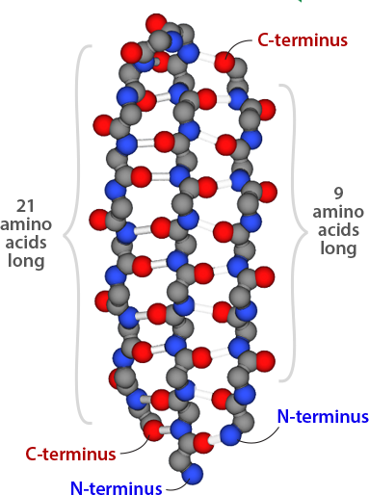
Analyzing the Beta Sheet Model
Can you find the N-terminus and C-terminus in your beta sheet model?
How many amino acids are in the beta sheet?
Notes:
Teacher: Allow students to explore the model ​​
Student: Closely examine the model and try to answer the posted questions

Slide 18
Analyzing the Beta Sheet Model
Can you find the N-terminus and C-terminus in your beta sheet model?
How many amino acids are in the beta sheet?
There is something odd here! The beta sheet model appears to have more than one N-terminus and C-terminus.
In your notebook, illustrate the path of the protein chain from each N-terminus to each C-terminus.
Notes:
Teacher: Explain the concept on the slide as needed
Student: Edit, or elaborate on your sketch as needed

Slide 19
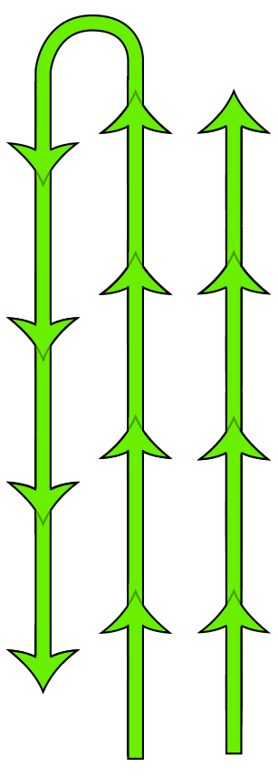
Parallel and Antiparallel Strands
The left and center strands of this beta sheet run antiparallel to each other, meaning that the N-C-C pattern goes in opposite directions.
The right and center strands of this beta sheet run parallel to each other, meaning that the N-C-C pattern goes in the same direction.
In your notebook, add parallel and anti-parallel labels to your sketch.
Notes:
Teacher: Explain the concept on the slide as needed
Student: Edit, or elaborate on your sketch as needed

Slide 20
Analyzing the Beta Sheet Model
The beta sheet model also appears to have two protein chains, one is 9 amino acids long and one that is 21 amino acids long and contains a turn.
Why might this be?
Notes:
Teacher: Give students time to explore the model and ponder the question
Student: Explore the model and think about how to answer the question

Slide 21
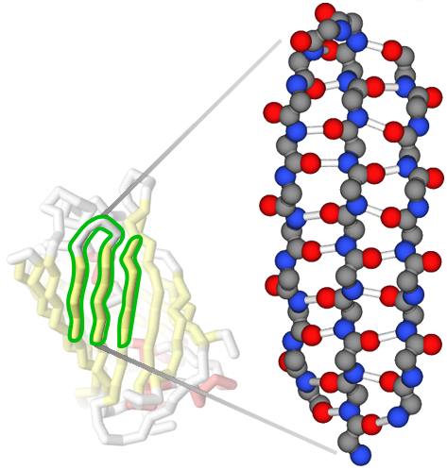
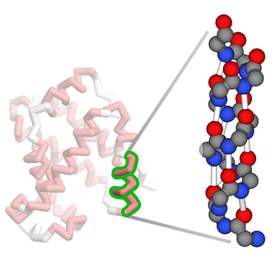
Secondary Structures in Proteins
These individual alpha helices or beta sheets are only a small part of entire protein structures.
The alpha helix model is from the beta-globin protein.
The beta sheet model is from the green fluorescent protein (GFP).
The region of the GFP structure that connects the two segments of the physical model is not included in the model.
Notes:
Teacher: Explain the concept on the slide as needed
Student: Revise or elaborate on your ideas as needed

Slide 22
What Holds Secondary Structures Together?
What holds the two pieces of the beta sheet model together?
What makes both the alpha helix model and the beta sheet model structurally stable?
Notes:
Teacher: Allow students to explore the model ​
​
Student: Closely examine the model and propose answers to the questions

Slide 23

Hydrogen Bonds Provide Stability
The white posts add stability to the alpha helix model and beta sheet model.
These white posts represent hydrogen bonds.
What atoms are involved in each hydrogen bond?
Notes:
Teacher: Explain the concepts on the slide as needed
Student: Engage with the concepts as directed

Slide 24
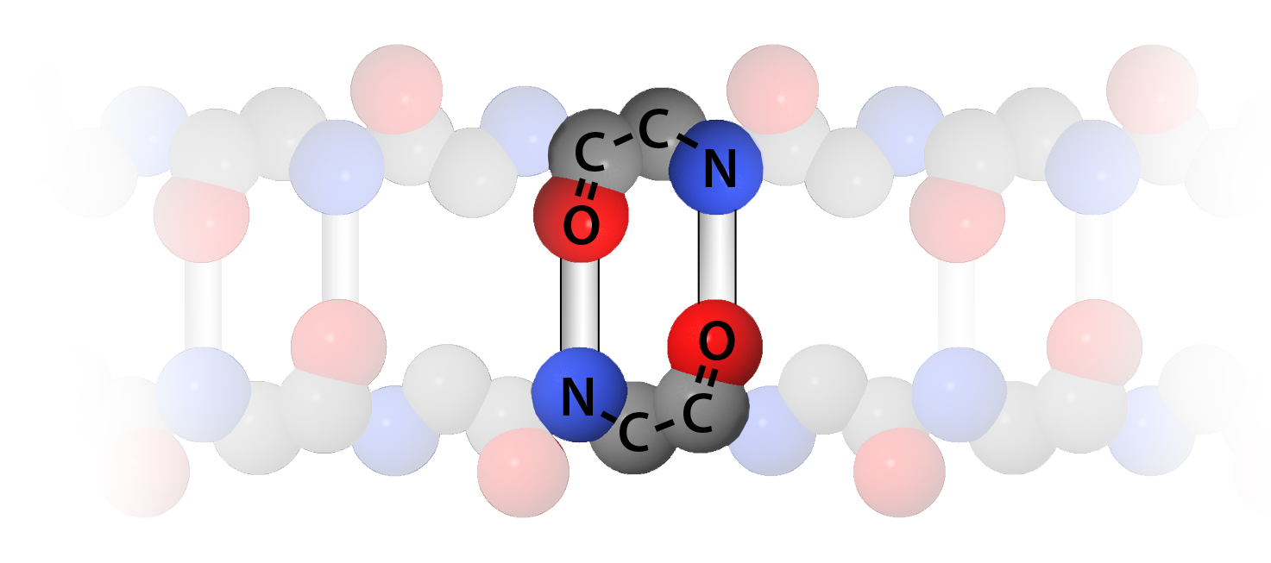
Hydrogen Bonds Provide Stability
Hydrogen Bonds form between the nitrogen atom of one amino acid and the oxygen atom of another amino acid.
In this way, hydrogen bonds stabilize alpha helices and beta sheets.
Notes:
Teacher: Explain the concepts on the slide as needed
Student: Engage with the concepts as directed

Slide 25
Secondary Structures Provide Stability
Because of their consistent shape supported by hydrogen bonding, alpha helices and beta sheets function as rigid scaffolds, stabilizing proteins structures.
Notes:
Teacher: Explain the concepts on the slide as needed
Student: Engage with the concepts as directed

Slide 26
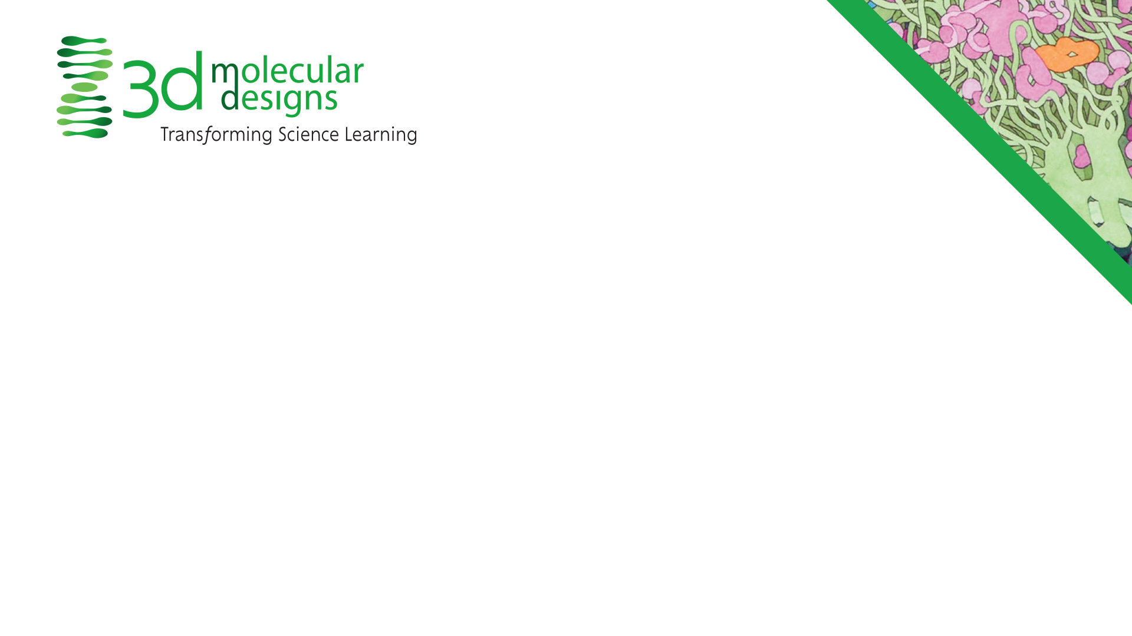
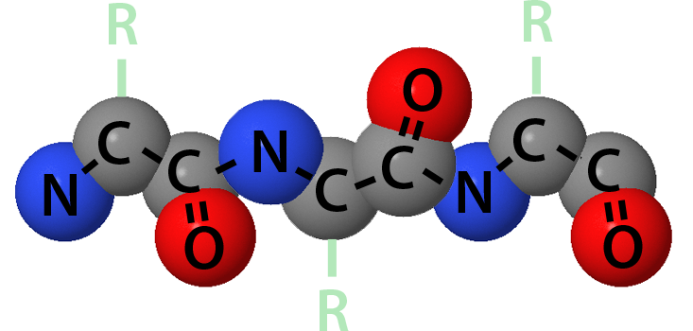
Conclusions
Proteins are made of amino acids that link together into long chains.
N-C-C - N-C-C - N-C-C...
Protein chains fold into 3D shapes comprised of the secondary structures alpha helices and beta sheets
Secondary structures are supported by hydrogen bonds, which provide rigidity to the protein.
Notes:
Teacher: Summary slide with objectives​​
Student: Make a final sketch in your notebook for future reference

