Slide 1

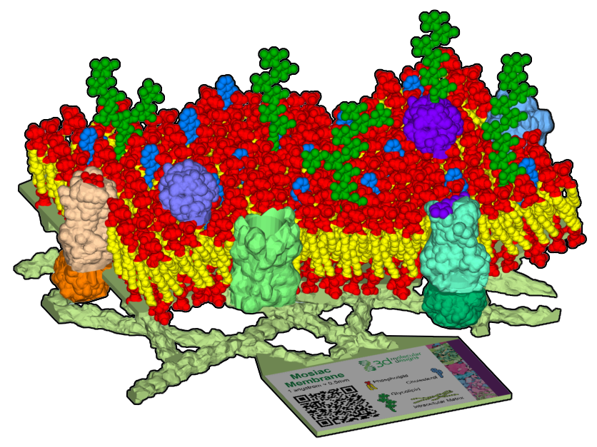
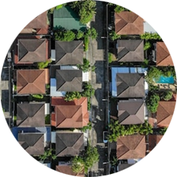

Cellular Membranes
A Neighborhood of Cells
“The body is a community made up of its innumerable cells or inhabitants."
– Thomas Edison

Slide 2

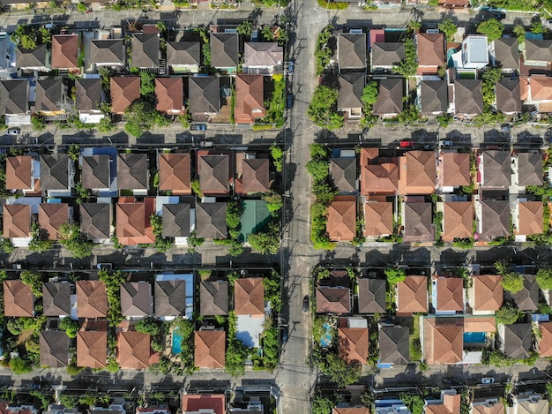


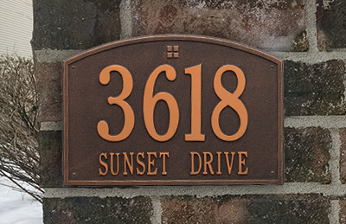
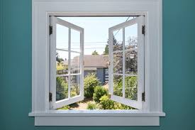
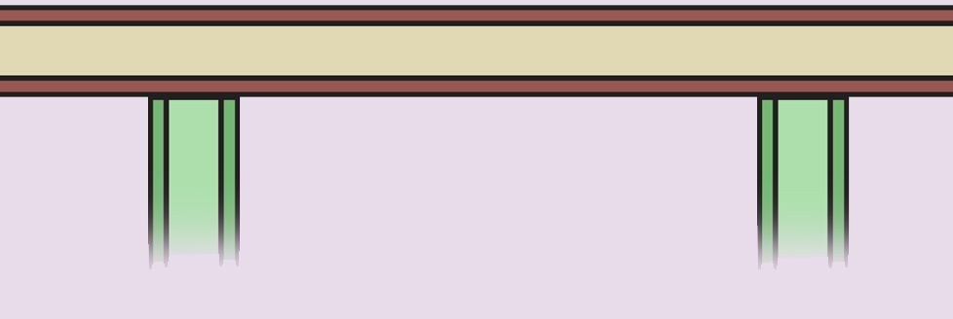
Teacher Guide – Summary
Activity Summary
Cellular membranes define what is inside and outside of a cell. They were among the first biological structures to evolve and play a crucial role in almost every cellular processes.
In many ways, cellular membranes are like the exterior walls of a house. In this activity, students will populate a physical model of the cellular membrane, using the house analogy to explore key structure and function features, including:
Note that this analogy is like all symbols or metaphors in that, at some level, it breaks down or is not accurate. This is not inherently a bad thing, as shortcomings or differences in the analogy can also be used to stimulate rich discussion and learning.
Cellular membranes are like house walls that define inside/outside
Cholesterol molecules are like screws/nails that increase rigidity
The intracellular matrix is like interior walls that provide support
Glycolipids are like address numbers that help with identification
Proteins are like windows and doors that regulate entrance

Slide 3
Teacher Guide - Overview
Activity Objectives
  Membrane structure and function
  Estimated Class Time:
45 minutes
Required Model:
Mosaic Membrane Mighty Model
Required Media:
Optional: device with a camera and web access
Optional Materials:
Phospholipid & Membrane Transport Kit ©
Grade, Class
9-12 Biology or Chemistry
Topics
Phospholipid bilayer
Cellular transport
Prerequisite Knowledge
Hydrophilic and hydrophobic

Slide 4






Teacher Guide - Using This Slide Deck
Student and Teacher Slide Deck Pages
  Slides that are meant for student viewing will feature a green top
  banner. Slides that are meant only for teacher viewing will feature a
  purple top banner and will appear hidden when in "slide show" mode.
Prompting Icons
  Each student slide will include a prompting icon in the top right corner of the slide. These icons on each slide cue your students to the type of activity they will be doing.
Turn and talk discussion
Write in your notebook
Quiet thinking time
Digital modeling
Physical modeling
Teacher Moves and Student Moves
Class slides provide notes (teacher notes below the slide) with specific information to assist you in facilitating the activity using effective modeling and education practices.

Slide 5
Teacher Guide - Standards
Next Generation Science Standards
SEPs | CCCs | DCIs
Asking Questions and Defining Problems | Structure and Function Systems and System Models | MS-LS1-2
Developing and Using Models | Cause and Effect | HS-LS1.A
 | Scale, Proportion, and Quantity | HS-LS1-2

Slide 6

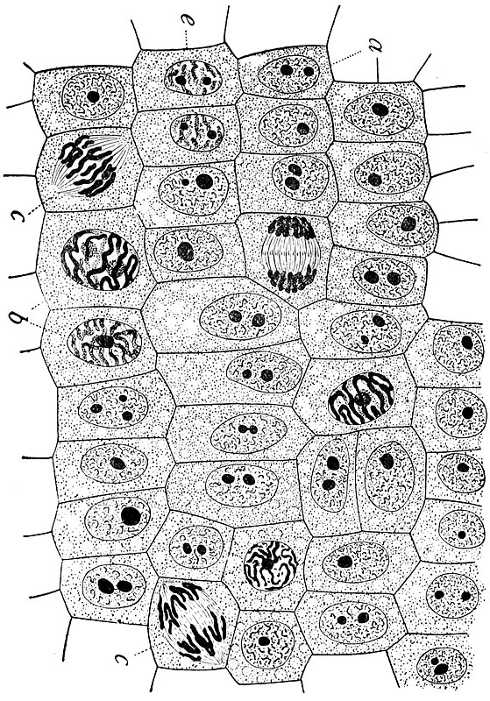
If cells were like houses…
Which part would their membranes be?
Notes:
Teacher: Give students an appropriate amount of time to think, discuss with a partner or small group, and write a response to the prompts.
Student: Compare and contrast. Discuss your ideas with a partner or small group. Write a response to the prompts in your notebook.

Slide 7
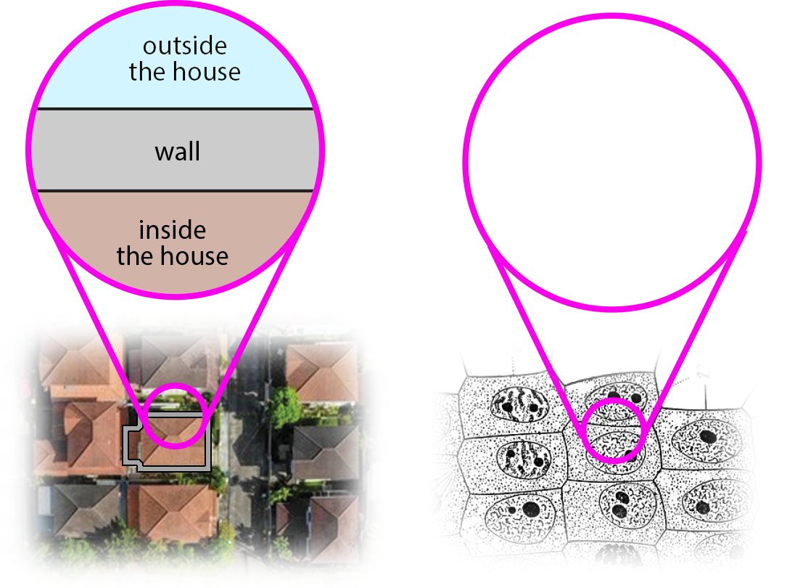
House Walls
For example, the houses in a neighborhood have exterior walls that separate the outside of each house from the inside.
Do cells have a similar structural feature?
?
Notes:
Teacher: Give students an appropriate amount of time to think and discuss with a partner or small group. Allow students to identify what they already know / background knowledge.
Student: Compare and contrast -
Misconception alert! - Be sure to point out that the wall of the house IS NOT a cell wall, but a cell membrane! In our example, a cell wall would be comparable to a fence around the yards-

Slide 8

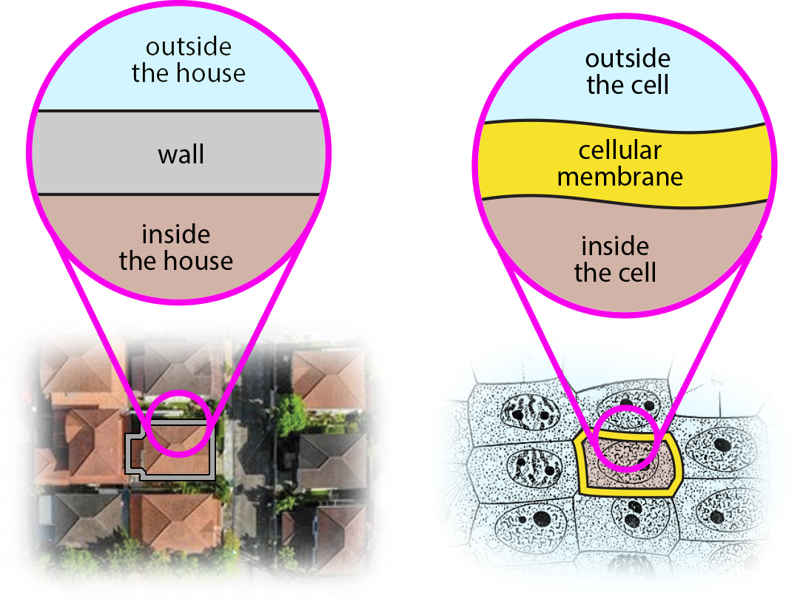
Cellular Membrane
Cells do!
Every cell is surrounded by a cellular membrane, which separates the inside of the cell from the outside.
Notes:
Teacher: Facilitate discussion
Student: Contribute to class discussion
Misconception alert! - Be sure to point out that the wall of the house IS NOT a cell wall, but a cell membrane! In our example, a cell wall would be comparable to a fence around the yards-

Slide 9

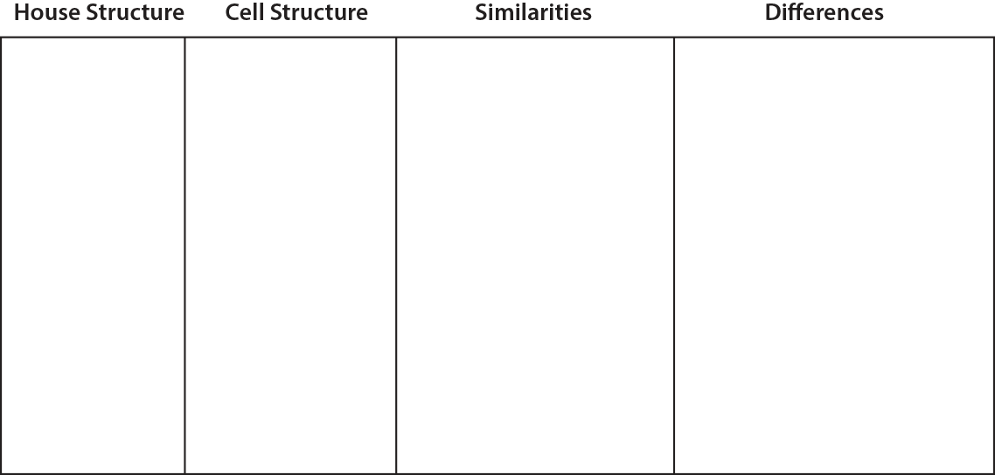
Create Your Comparison Table
Create a table in your notebook like the one to the right.
We will use this table throughout the activity to record similarities between cells and houses . . . as well as some differences.
Notes:
Teacher: Give students time to copy the table into their notebook. Alternatively, Print this slide off for students.
Student: Follow the onscreen prompt or tape the table into your notebook if it was provided as a handout.

Slide 10
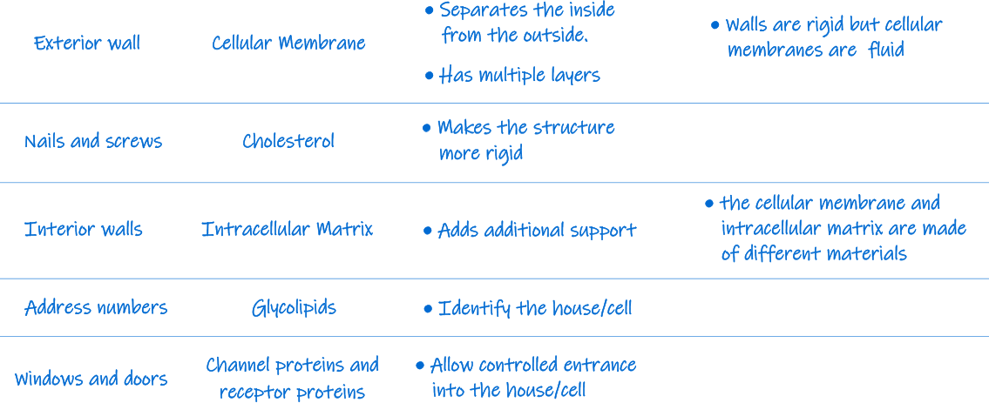

Make & Record Your Observations
What similarities and differences can you observe?
In your notebook, record the similarities between cells.
Notes:
Teacher: Give students time to begin filling in their table and brainstorming other ideas for similarities.
Student: Fill in the table with the information provided.

Slide 11
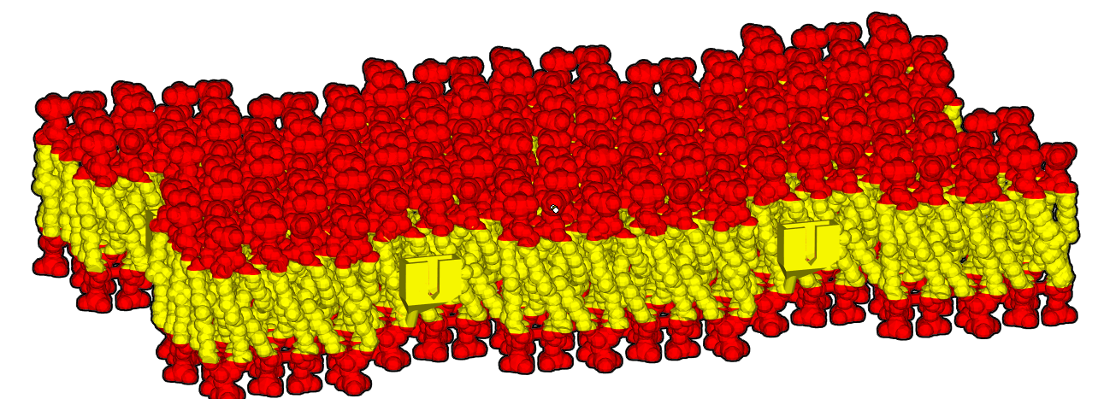
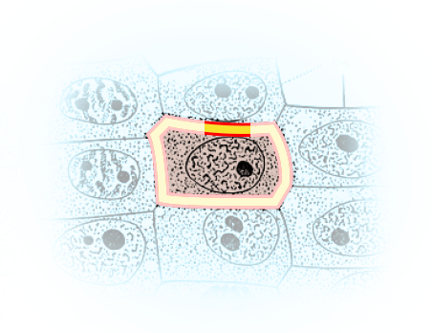

Where in the cell are we?
Now let's use a model to explore cellular membranes.
This model represents only a small cross-section of the cellular membrane that surrounds each cell.
Notes:
Teacher: Give students time to examine the model
Student: Play!

Slide 12
Play with your model!
Before we further explore cellular membranes, let’s play our model.
What do you see?
What does it do?
Are membranes red and yellow?
Notes:
Teacher: Give students time to examine the model
Student: Play!

Slide 13
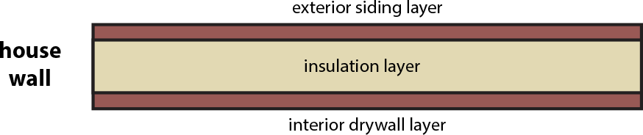
Exterior Walls of a House…
In a house, the exterior walls have multiple layers.
There is a core layer of insulation, surrounded on both sides by layers that interact with air both inside and outside of the house.
Do you see anything similar in your membrane model?
Notes:
Teacher: Give students time to think and respond to the writing prompt
Student: Write a response in your notebook

Slide 14
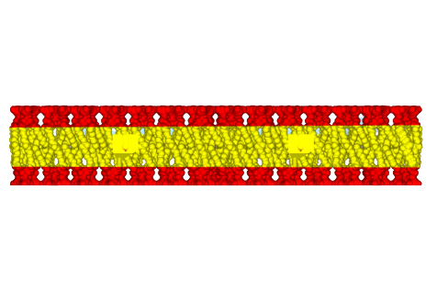
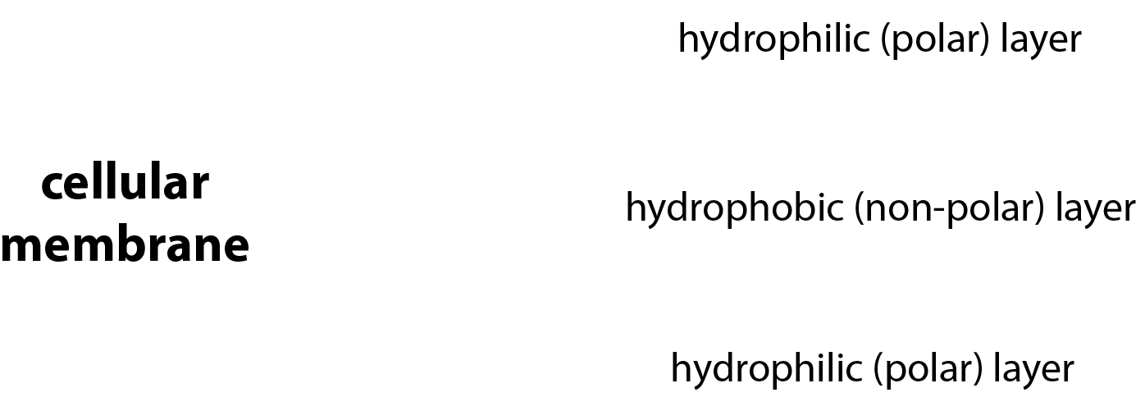
Compare the Exterior Surfaces
Cellular membranes have layers too!
There is a hydrophobic (non-polar) region, which limits water and other molecules from crossing the membrane.
It is surrounded on both sides by hydrophilic (polar) regions, which interact with water and other molecules both inside and outside of the cell.
Notes:
Teacher: Confirm student observations through discussion
Student: Confirm or revise your written response

Slide 15
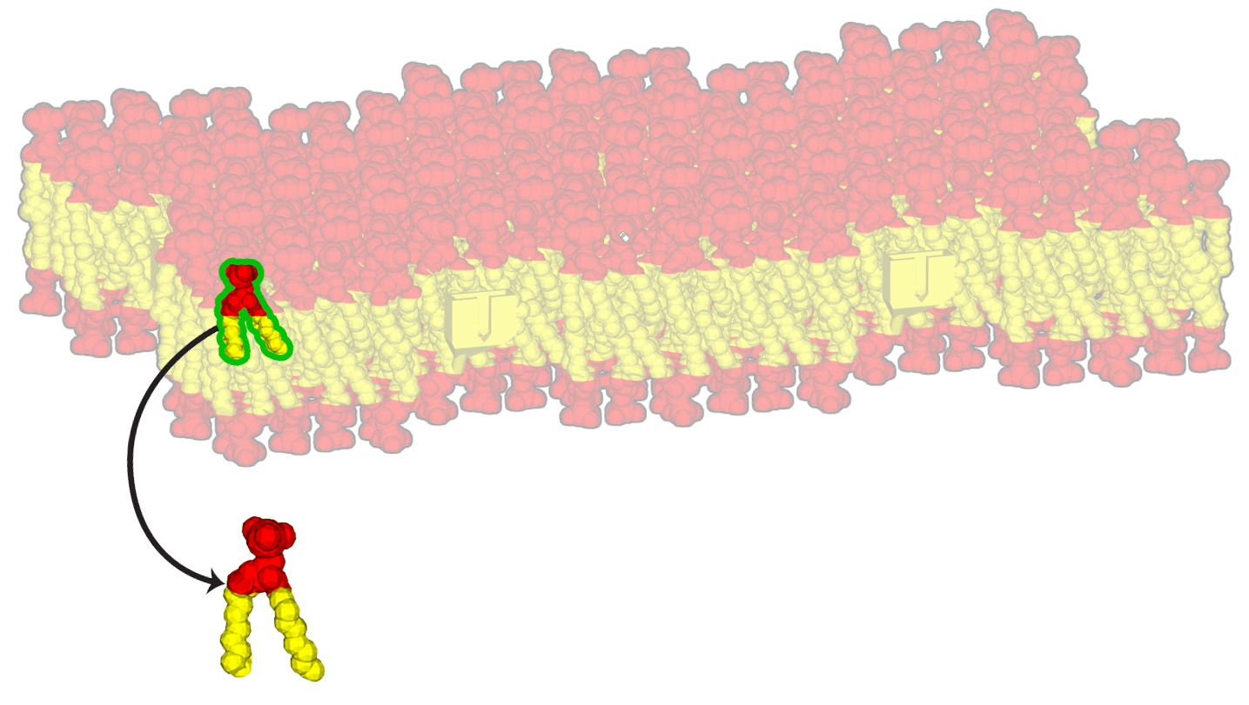
Observe
These layers are the result of phospholipids, the individual units that make up a cellular membrane.
Can you see the individual phospholipids in your model?
Hint: They are sometimes hard to individually recognize, as each phospholipid is closely packed up against the other phospholipids around it. Find the individual phospholipids included with your membrane model.
Notes:
Teacher: Allow students to explore the model
Student: Closely examine the model and identify a phospholipid.

Slide 16
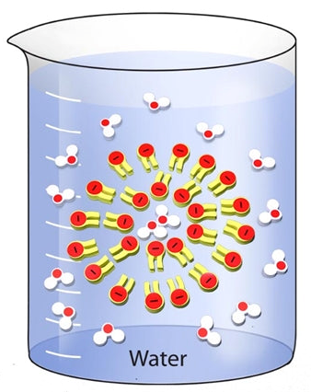
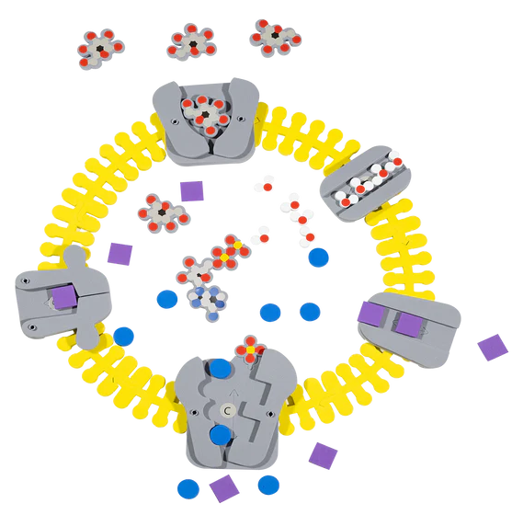
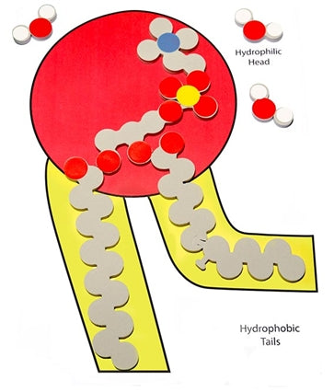
Extension – Phospholipid & Membrane Transport Kit
Membranes and cell processes become memorable as students build and revise their models.
Students uncover the structure and function of phospholipids, how cell membranes form, and how water and ions move in and out of cells via transport proteins. Students can model different conditions and then predict which way water will move, making vocabulary like hypertonic, hypotonic, and isotonic more memorable.
50 individual phospholipid molecule models demonstrate hydrophobic and hydrophilic concepts to create monolayers, micelles, and bilayers
Water molecule models show polarity and how water interacts with cell membranes
The bilayer membrane model creates a cell structure that is flexible yet sturdy
Active and passive transport is made easy with 5 different proteins, ion models, and ATP

Slide 17
Model a Two-layer Membrane
Can you see the individual phospholipids in your model?
With the individual phospholipids, model a membrane with two layers and draw it in your notebook.
Notes:
Teacher: Allow students to explore the model
Student: Closely examine the model and identify a phospholipid.

Slide 18
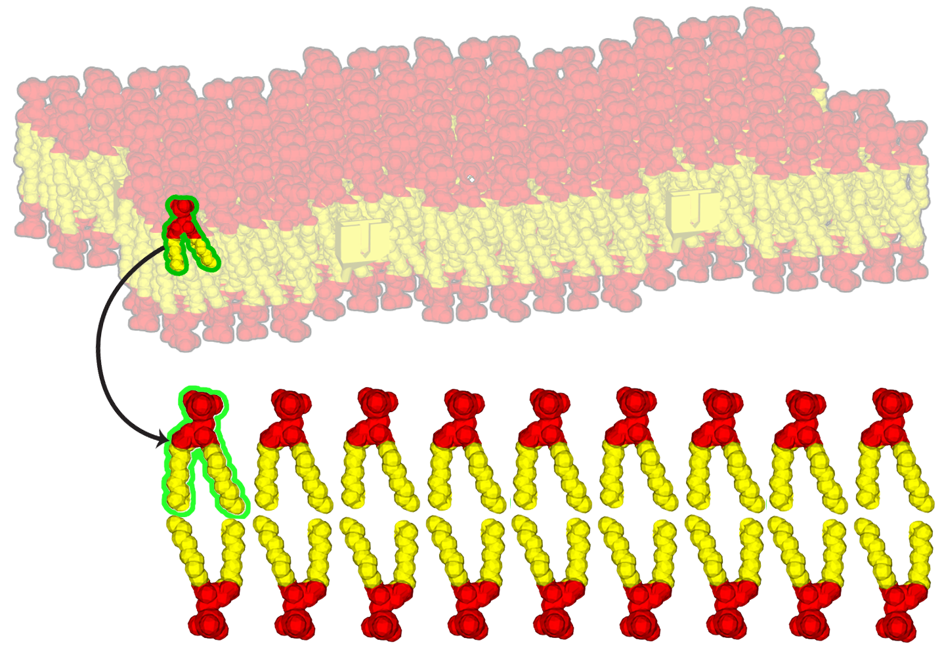
Compare your Models
Each phospholipid has two yellow-colored hydrophobic (non-polar) tails and one red-colored hydrophilic (polar) head.
The phospholipids form two layers, with their hydrophobic tails always facing the hydrophobic core of the membrane.
In the membrane model, the phospholipids are connected.
In real membranes, the phospholipids stay separate!
Notes:
Teacher: Review hydrophilic and hydrophobic if necessary. This is also called a phospholipid bilayer.
Misconception Alert! There are no covalent bonds between the hydrophobic tales.
Student: Sketch the bilayers and label the properties of a phospholipid.

Slide 19
Make & Record Your Observations
What similarities and differences can you observe?
In your notebook, record the similarities between cells.
Notes:
Teacher: Give students time to begin filling in their table and brainstorming other ideas for similarities.
Student: Fill in the table with the information provided.

Slide 20
Record your Observations
Let’s add this to our table.
Notes:
Teacher: Give students time to begin filling in their table and brainstorming other ideas for similarities.
Student: Fill in the table with the information provided.

Slide 21
Compare
So far, we have only discussed similarities between house walls and cellular membranes.
Have you noticed any differences?
Notes:
Teacher: Give students time to think about differences and discuss them with a partner or small group
Student: Think about differences and share as directed

Slide 22
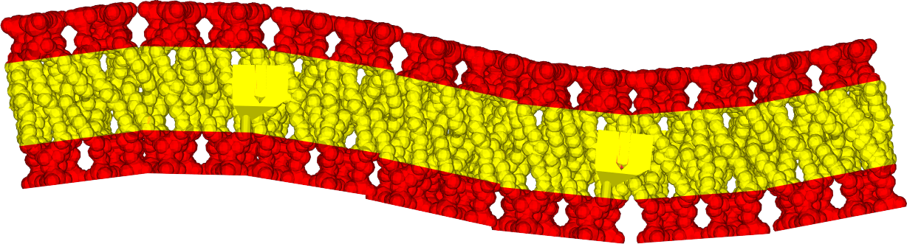
What Makes Cell Membranes Fluid?
One key difference is that cellular membranes are not rigid, but fluid, allowing them to bend and change shape.
Pick up and feel your model! Does it feel somewhat fluid?
What allows cellular membranes to be fluid?
Notes:
Teacher: Give students an appropriate amount of time to think and write to the prompt in their notebook.
Student: Write to the prompt.

Slide 23
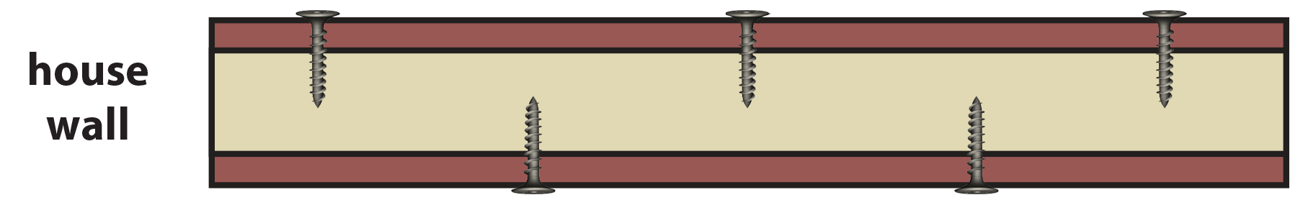
Contrast
Nails and screws bind the individual parts of a house wall together.
But the phospholipids that make up a cellular membrane are not rigidly bound together.
Rather, they can move fluidly relative to each other.
Notes:
Teacher: Note- The lipid tales have hydrophobic interactions, but there are no covalent bonds between the phospholipids on the outside and inside of the membrane.
Student: Add to your notes in your notebook

Slide 24
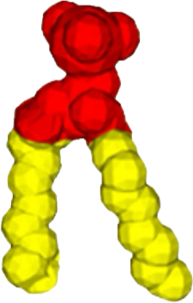

Phospholipid Structure
In a real membrane, phospholipids can rotate in place or drift along through the bilayer. In our Mosaic Membrane Mighty Model, the phospholipids are anchored in place to keep the structure together.
Notes:
Teacher: Give students an appropriate amount of time to think and write to the prompt in their notebook.
Student: Write to the prompt.

Slide 25
Fluid Membrane Structure
Membranes are described as fluid because of the movements of phospholipids.
Can you think of some advantages or disadvantages of phospholipid movements?
Notes:
Teacher: Give students an appropriate amount of time to think and write to the prompt in their notebook.
Student: Write to the prompt.

Slide 26
Record your Observations
Let’s add this to our table.
Notes:
Teacher: Give students time to begin filling in their table and brainstorming other ideas for similarities.
Student: Fill in the table with the information provided.

Slide 27
Record your Observations
Let’s add this to our table.
Notes:
Teacher: Give students time to begin filling in their table and brainstorming other ideas for similarities.
Student: Fill in the table with the information provided.

Slide 28
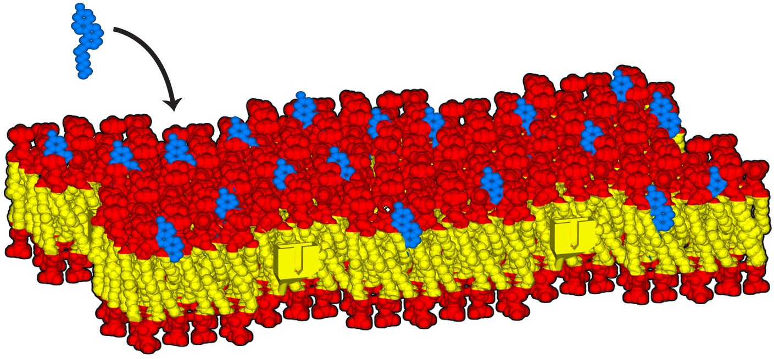
When a Membrane Becomes Less Fluid
Despite being considered fluid, cells can regulate how flexible the cellular membrane is.
Insert all the blue pieces into your membrane and pick up your membrane.
Do you notice any difference in the flexibility or rigidity of the membrane?
Why might cells want to regulate membrane fluidity?
Notes:
Teacher: Allow students to add blue cholesterol pieces to the model and make new observations. Facilitate a discussion or have students write responses to the prompts in their notebooks.
Student: PLAY! Add the blue cholesterol pieces and make new observations. Contribute to classroom discussion or write to the prompts in your notebook.

Slide 29
Comparing Cholesterol to Wall Screws
The blue pieces represent cholesterol molecules.
Cholesterol is mostly hydrophobic (non-polar) It embeds itself in the core of the membrane.
Remember how screws make the walls of a house more rigid?
Cholesterol increases the rigidity of the cellular membrane.
Notes:
Teacher: Allow students to add blue cholesterol pieces to the model and make new observations. Students should notice that the addition of cholesterol “firms” the membrane and reduces fluidity.
Student: PLAY! Add the blue cholesterol pieces and make new observations. Contribute to classroom discussion or write to the prompts in your notebook.

Slide 30
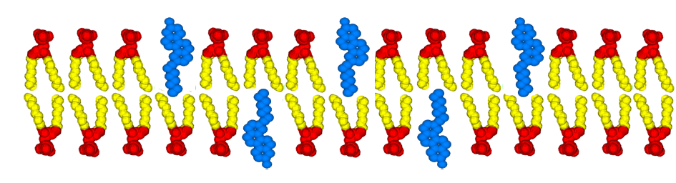
Discuss
Cholesterol molecules can exist in the top or bottom layer of phospholipids that make up cellular membranes.
One limitation of this physical model is that the cholesterol molecules only sit in the top layer.
Notes:
Teacher: All models are wrong. Some models are useful. Discuss the limitations of the model.
Student: Correct mental model if necessary

Slide 31
Record your Observations
Let’s add this to our table.
Notes:
Teacher: Give students time to begin filling in their table and brainstorming other ideas for similarities.
Student: Fill in the table with the information provided.

Slide 32
Record your Observations
Let’s add this to our table.
Notes:
Teacher: Give students time to begin filling in their table and brainstorming other ideas for similarities.
Student: Fill in the table with the information provided.

Slide 33
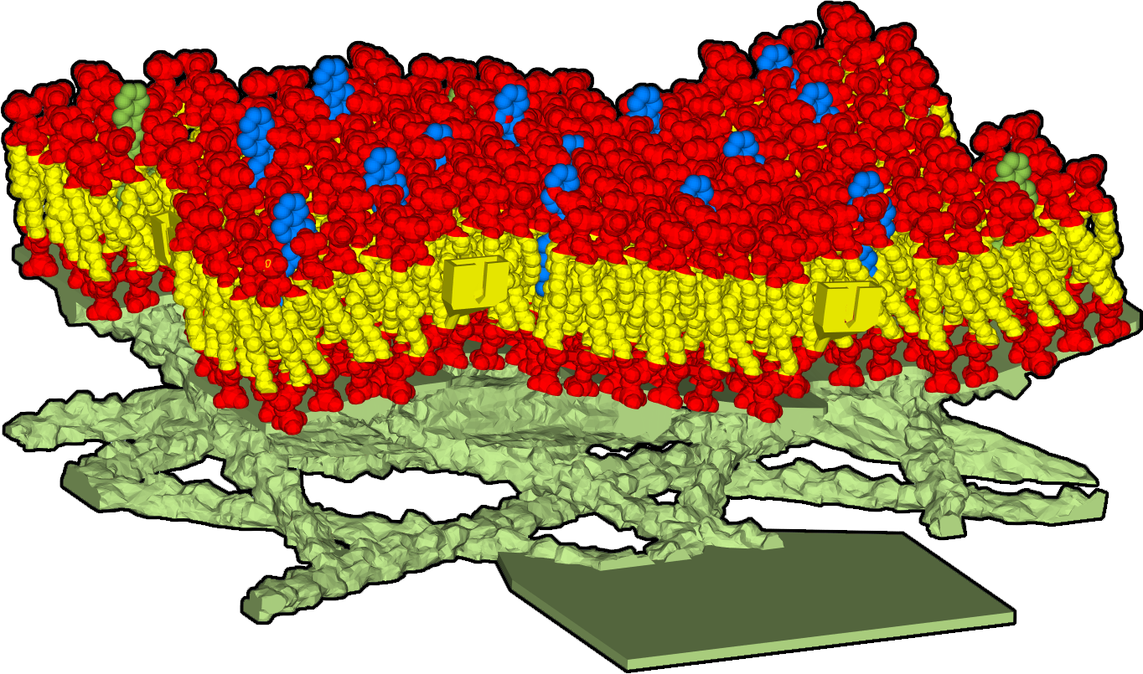

Supporting Structure Adds Stability
Move your cellular membrane model onto the green display base.
What does this display base do to the flexibility of your membrane model?
Notes:
Teacher: Give students time to explore the model and respond to the prompt
Student: Follow the onscreen prompts

Slide 34
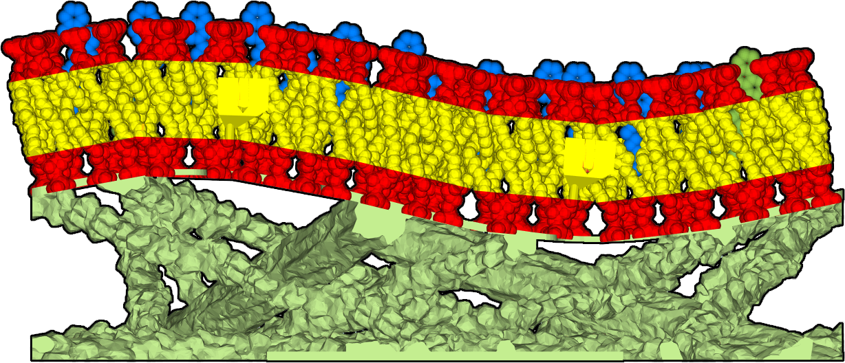
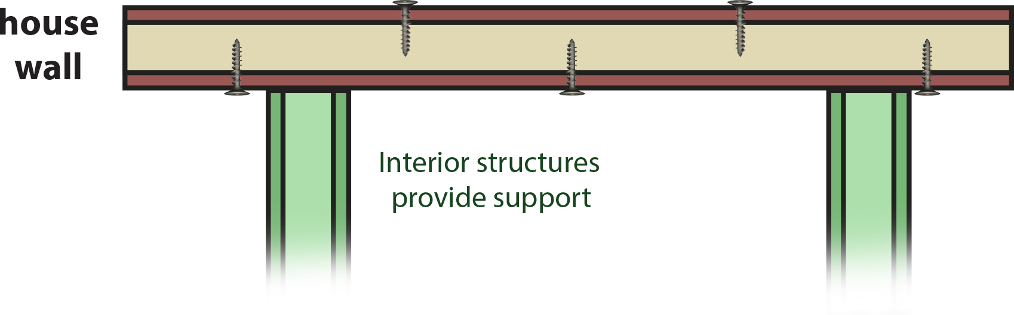
It’s More than a Base!
In a house, the exterior walls are further stabilized by interior walls and structures.
The green display base represents the intracellular matrix, a network of actin filaments and microtubules that further stabilize the cell membrane.
Unlike the interior and exterior walls of a house, the intracellular matrix is not made of the same material as the cellular membrane.
The intracellular matrix is made primarily of proteins.
Notes:
Teacher: Discuss new information with students
Student: Add to discussion and write additional details in your notebook

Slide 35
Record your Observations
Let’s add this to our table.
Notes:
Teacher: Give students time to begin filling in their table and brainstorming other ideas for similarities.
Student: Fill in the table with the information provided.

Slide 36
Record your Observations
Let’s add this to our table.
Notes:
Teacher: Give students time to begin filling in their table and brainstorming other ideas for similarities.
Student: Fill in the table with the information provided.

Slide 37
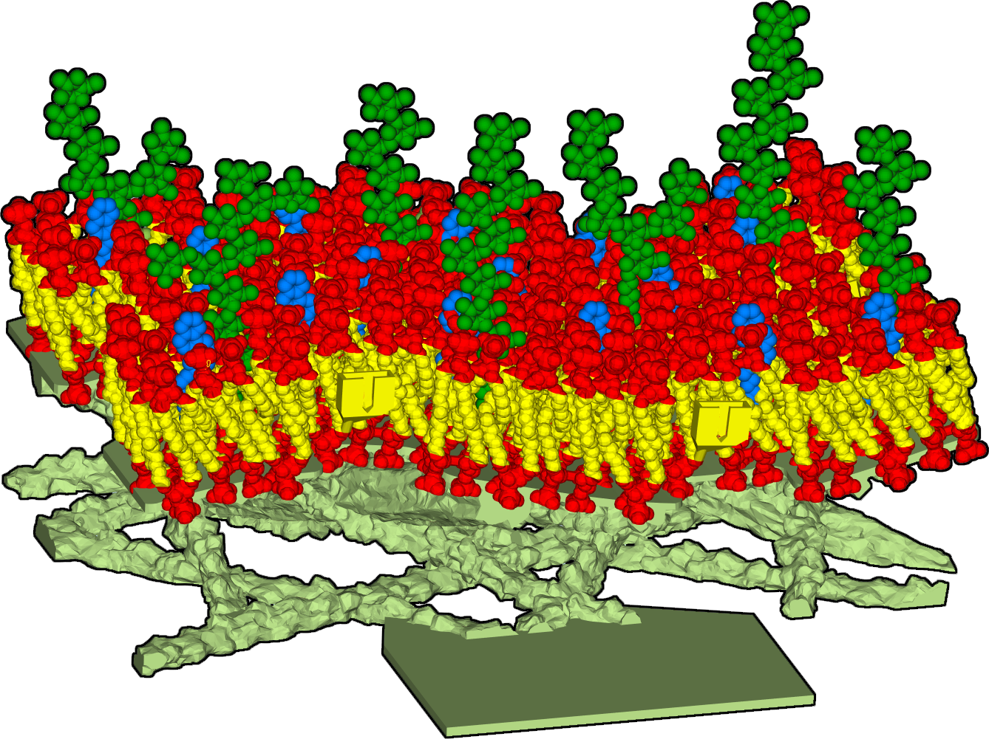
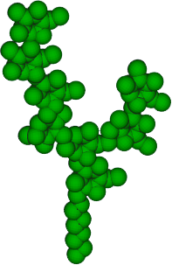
Explore
Insert all the green pieces into your membrane.
Are they all the same shape and size?
What might their purpose be?
Notes:
Teacher: Allow students to add green glycolipid pieces to the model and make new observations. Facilitate a discussion or have students write responses to the prompts in their notebooks.
Student: PLAY! Add the green glycolipid pieces and make new observations. Contribute to classroom discussion or write to the prompts in your notebook.

Slide 38
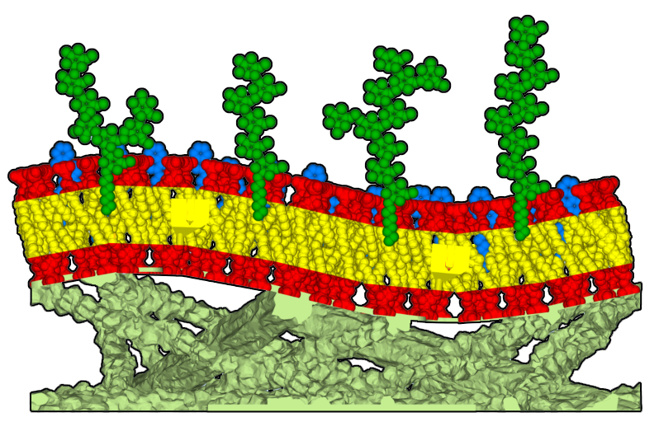

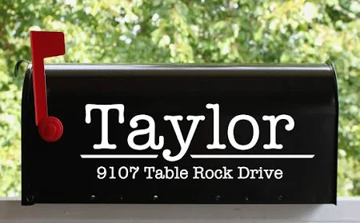
Compare
Buildings display address numbers and signs on their outside walls, so they can be properly identified by neighbors.
The green pieces represent glycolipids, long strings of sugar molecules tethered to the cellular membrane by a single hydrophobic (non-polar) tail.
Different glycolipid shapes communicate different information about the cell, such as:
- what type of cell it is
- its state of development
- health an immune responses
Notes:
Teacher: Facilitate discussion
Student: Write additional details in your notebook

Slide 39
Record your Observations
Let’s add this to our table.
Notes:
Teacher: Give students time to begin filling in their table and brainstorming other ideas for similarities.
Student: Fill in the table with the information provided.

Slide 40
Record your Observations
Let’s add this to our table.
Notes:
Teacher: Give students time to begin filling in their table and brainstorming other ideas for similarities.
Student: Fill in the table with the information provided.

Slide 41
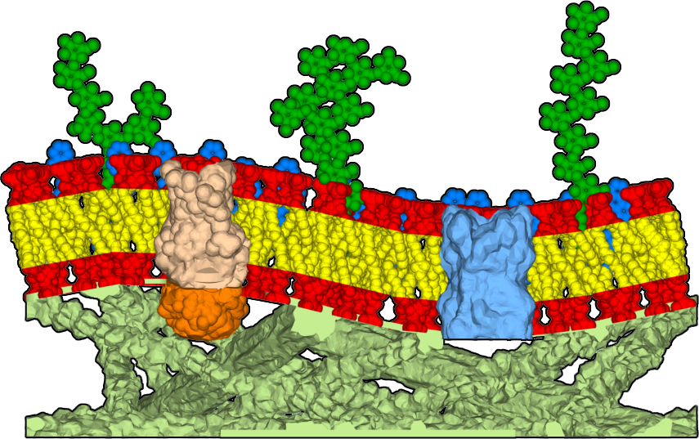
What there’s more?
Cell membranes facilitate many of your body’s functions as other structures embed themselves in the bilayer.
Add four larger pieces to your membrane by inserting the tab on the back of each piece into the corresponding slot on the membrane model.
Are they all the same shape and size?
What might their purposes be?
Notes:
Teacher: Allow students to add more to their model and speculate what these might do with a partner or small group. Students could write predictions in their notebook or contribute to a classroom discussion.
Student: Add additional pieces to your model.

Slide 42
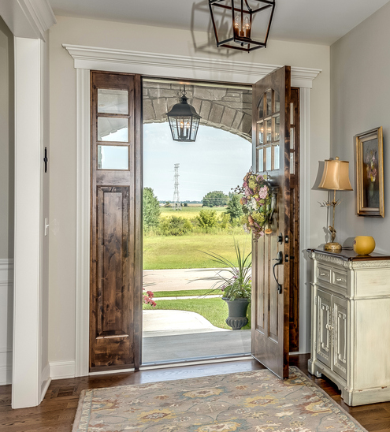
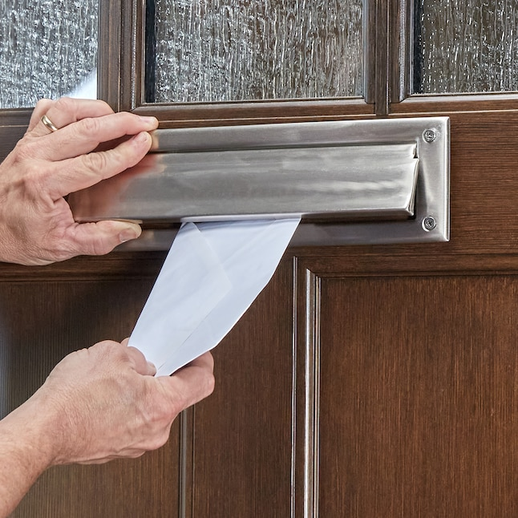
Compare
The main reason a house has walls is to keep things from getting in.
But sometimes, you want things to enter your house, like mail through a door slot, guests through a front door, or breeze through a window.
The purple pieces represent proteins, a complex type of molecule that can span a cell membrane.
Notes:
Teacher: Facilitate discussion
Student: Contribute to the discussion and revise your responses

Slide 43
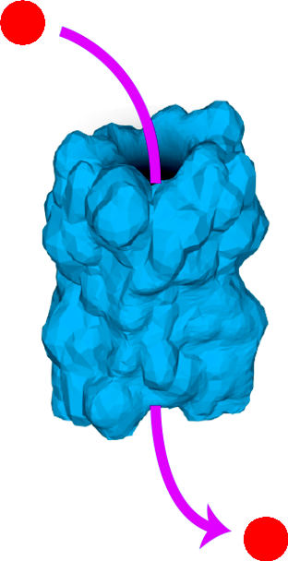
Channel Proteins
Channel Proteins have pores, which allow specific types of molecules to cross the cell membrane and enter the cell.
Cells often use this flow of ions across the membrane to send signals or trigger cell processes.
In some cases, these channel proteins can even be opened or closed, depending on other conditions inside the cell.
Notes:
Teacher: Facilitate discussion. Ask students to list channel proteins. Add to the list, as needed. Ask why ions or other molecules would be need by cells as students discuss the functions of specific channels.
Student: Contribute to the discussion and revise your responses

Slide 44
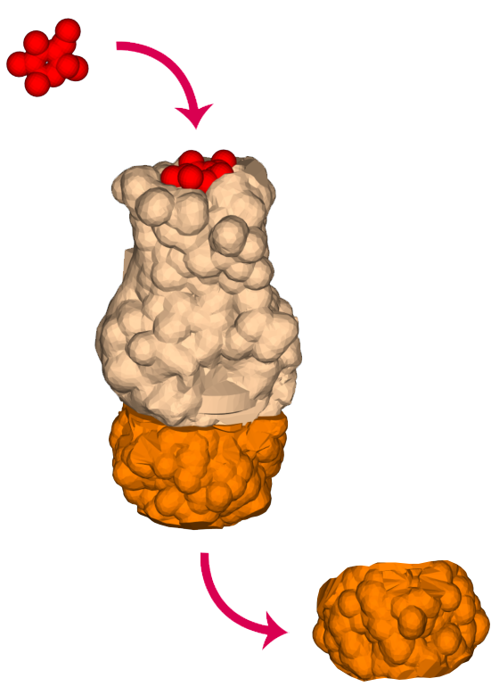
Receptor proteins
Receptor Proteins allow molecules to bind outside of the cell and transduce a signal to the inside of the cell.
Cells often use receptor proteins to receive signals from other systems in your body that regulate cell processes.
In some cases, a single type of receptor protein can trigger multiple different responses inside the cell.
Notes:
Teacher: Facilitate discussion
Student: Contribute to the discussion and revise your responses

Slide 45
Record your Observations
Let’s add this to our table.
Notes:
Teacher: Give students time to begin filling in their table and brainstorming other ideas for similarities.
Student: Fill in the table with the information provided.

Slide 46
Record your Observations
Let’s add this to our table.
Notes:
Teacher: Give students time to begin filling in their table and brainstorming other ideas for similarities.
Student: Fill in the table with the information provided.

Slide 47
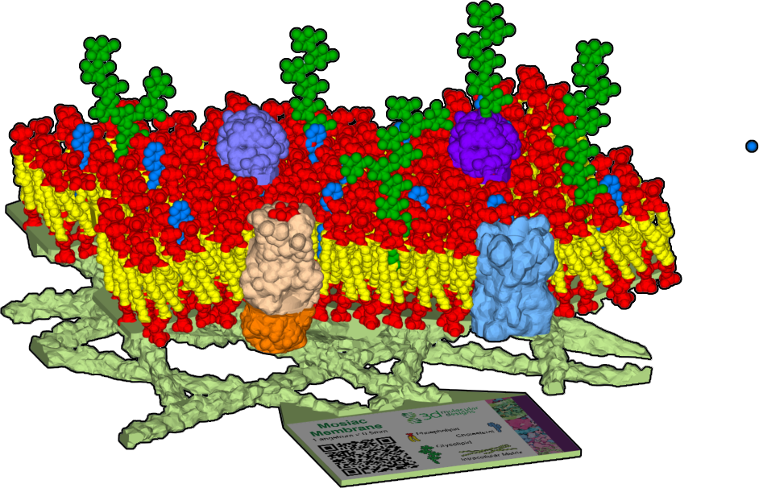
Model, Observe, Explore & Record
Add the two small purple pieces to your membrane by setting them on top of the phospholipids.
Predict what their purpose might be?
How are they similar or different from channel proteins or receptor proteins?
Record your predictions and observations in your notebook.
Notes:
Teacher: Allow students to add more to their model and speculate what these might do with a partner or small group. Students could write predictions in their notebook or contribute to a classroom discussion.
Student: Add additional pieces to your model.

Slide 48
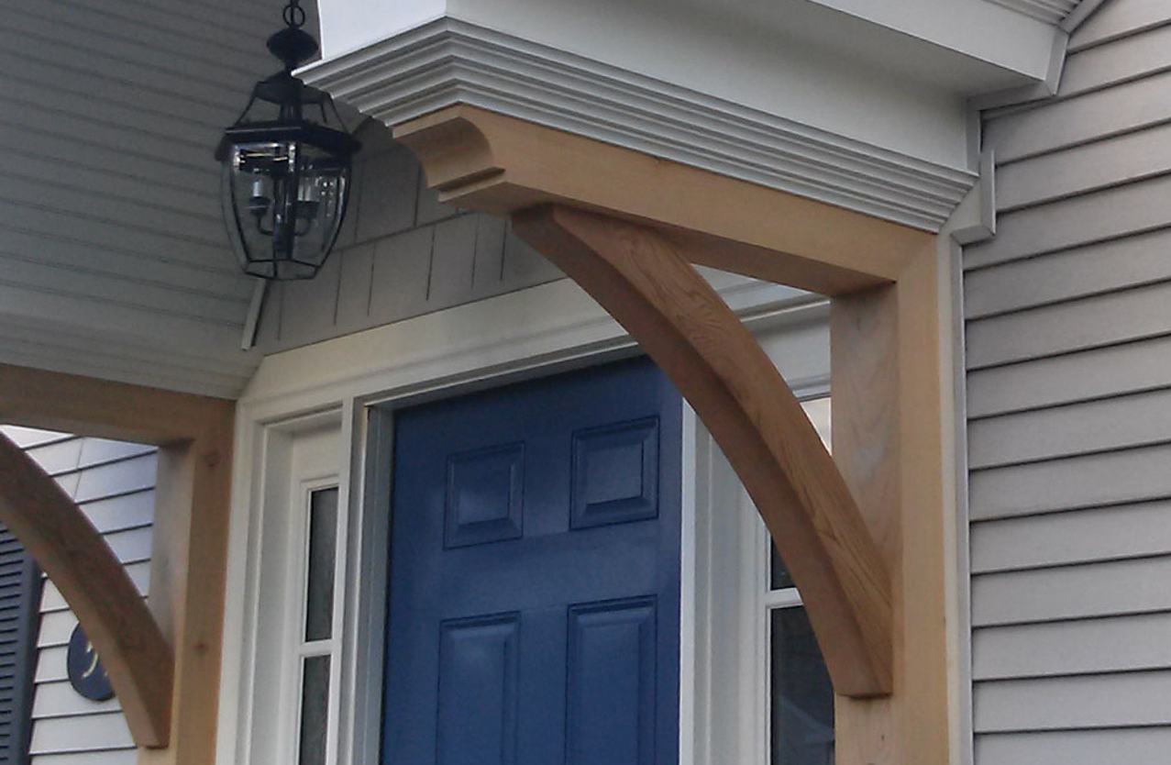

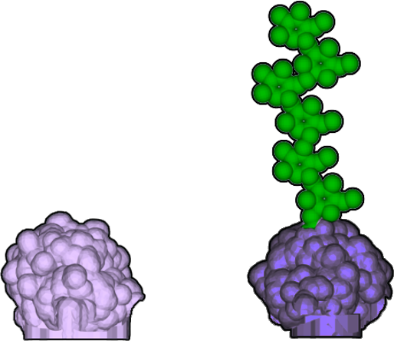
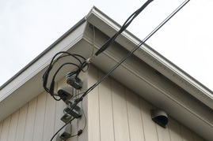
Peripheral Proteins
Most houses have additional fixtures on the outside, such as brackets to add support, signs to help with identification, or hardware to bind the house to external structures.
Peripheral proteins perform similar tasks, such as maintaining cell shape, helping with cell identification, and binding to molecules.
Some, called glycoproteins, even have sugar strands, like glycolipids, which help with cell identification and cell-to-cell signaling.
Notes:
Teacher: Facilitate discussion
Student: Contribute to the discussion and revise your responses

Slide 49
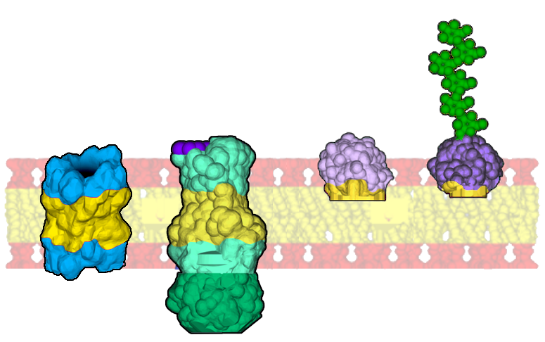
Compare
Channel and receptor proteins span the full membrane. They usually have a hydrophobic (non-polar) middle, which allows them to sit comfortably in the membrane’s hydrophobic (non-polar) core.
In contrast, peripheral proteins do not span the membrane. They may have some hydrophobic regions, but they do not fully submerge into the core of the membrane.
Notes:
Teacher: Facilitate discussion
Student: Contribute to the discussion and revise your responses

Slide 50
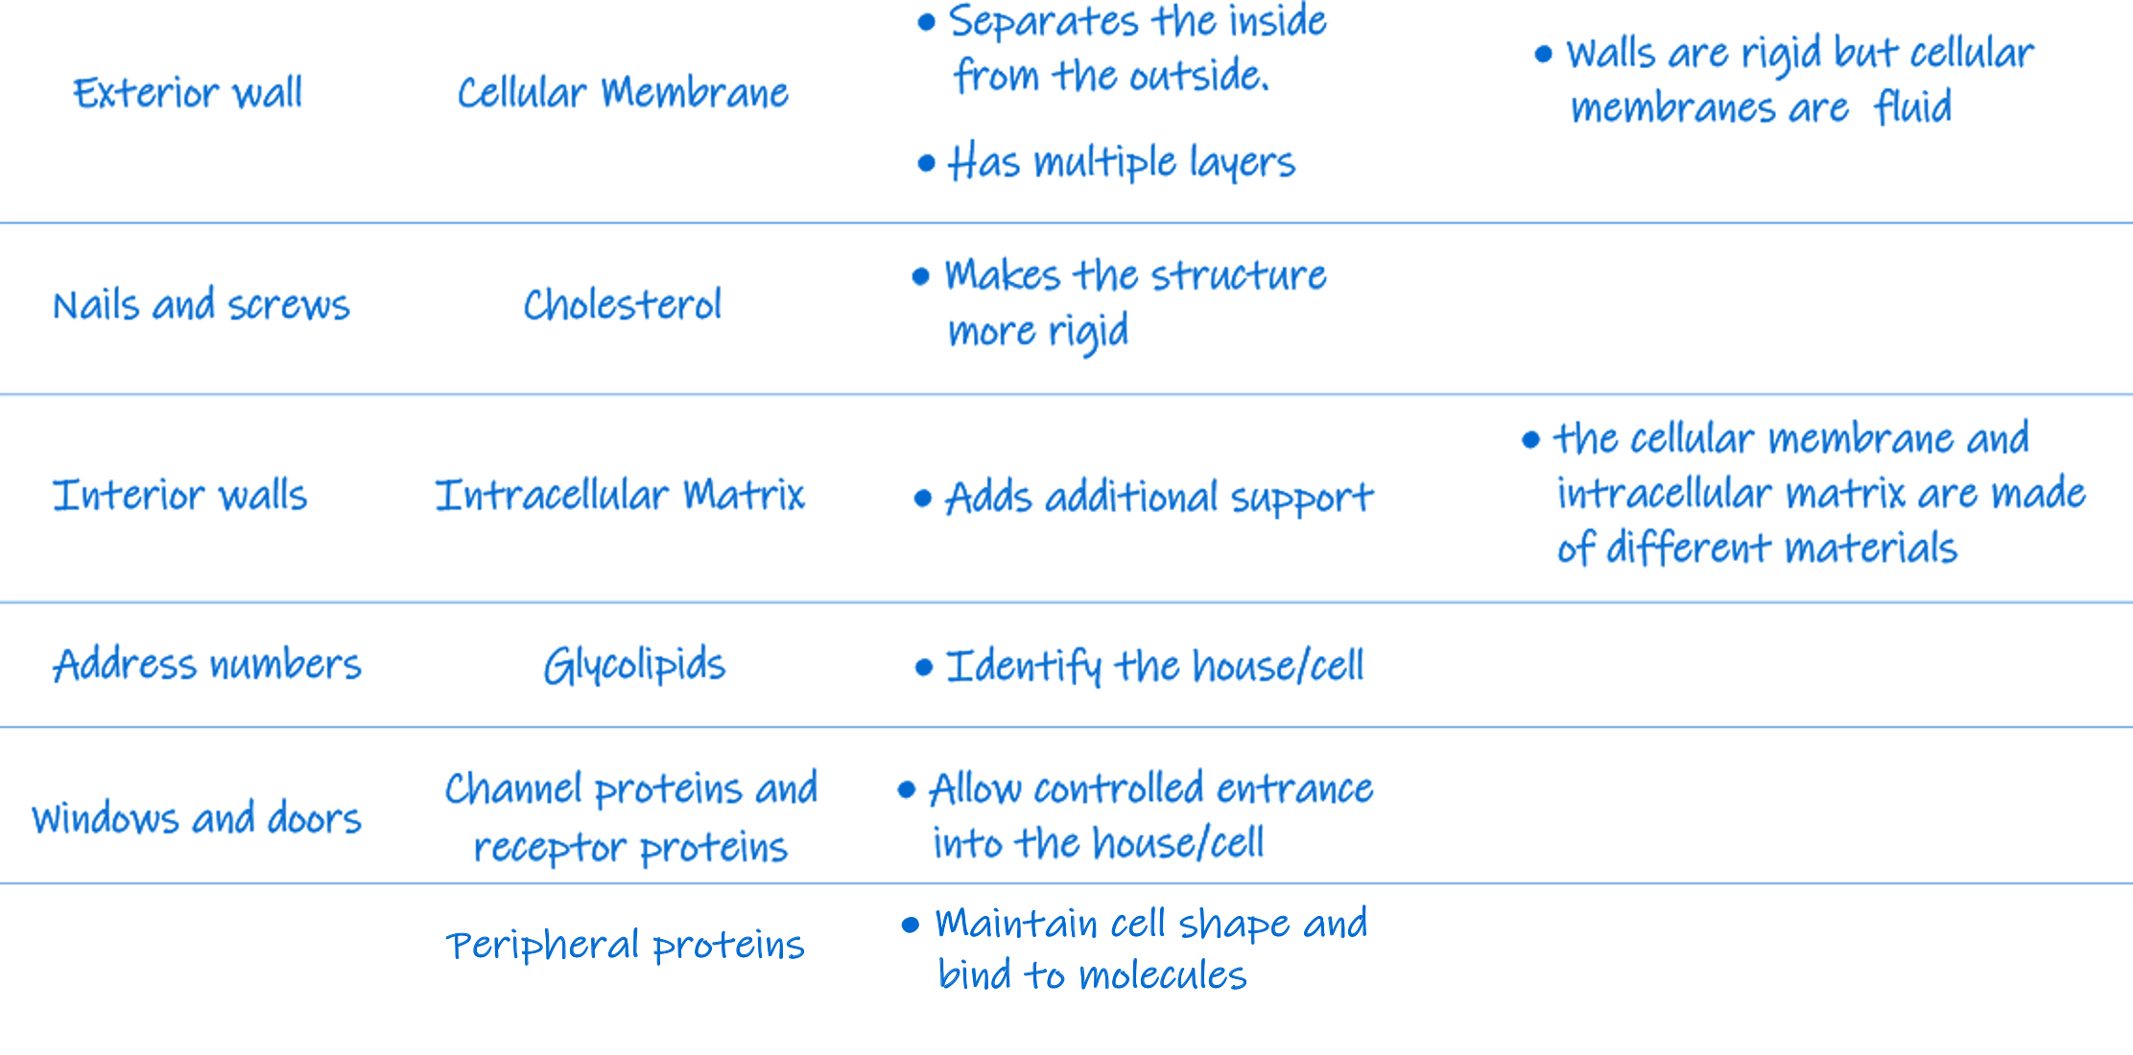
Record your Observations
Let’s add this to our table.
Notes:
Teacher: Give students time to begin filling in their table and brainstorming other ideas for similarities.
Student: Fill in the table with the information provided.

Slide 51

Record your Observations
Let’s add this to our table.
Notes:
Teacher: Give students time to begin filling in their table and brainstorming other ideas for similarities.
Student: Fill in the table with the information provided.

Slide 52
Summarize your Observations
Write a couple-sentence summary of membrane structure and function.
Notes:
Teacher: Give students time to begin filling in their table and brainstorming other ideas for similarities.
Student: Fill in the table with the information provided.

Slide 53
Summary
Cellular membranes are similar to the exterior of a house. The structures embedded in the membrane are important for the cell to perform its functions, including passage of polar molecules, identification, and signaling. In some instances, they trigger responses in other cells and systems within your body. These interacting systems keep your body functioning normally.
Notes:
Teacher: Give students time to begin filling in their table and brainstorming other ideas for similarities.
Student: Fill in the table with the information provided.

Slide 54

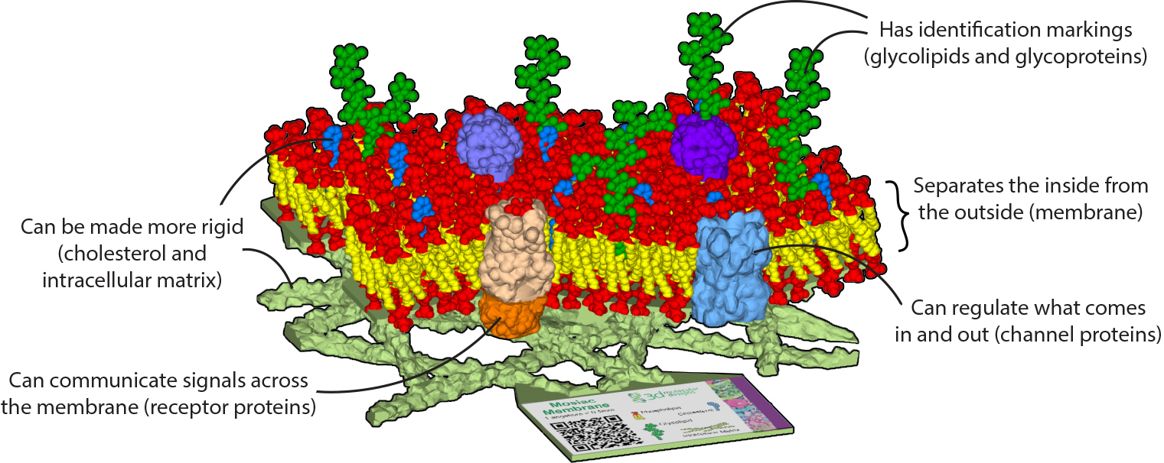
Notes:
Teacher: Facilitate discussion of the conclusions, including the interacting cells and systems. Have students write conclusions in their notebooks, noting the interacting systems aspect.
Student: Make a final sketch in your notebook for future reference

