Slide 1

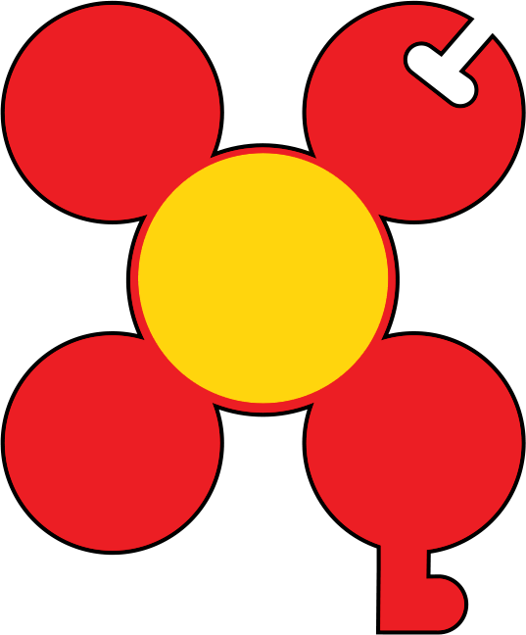
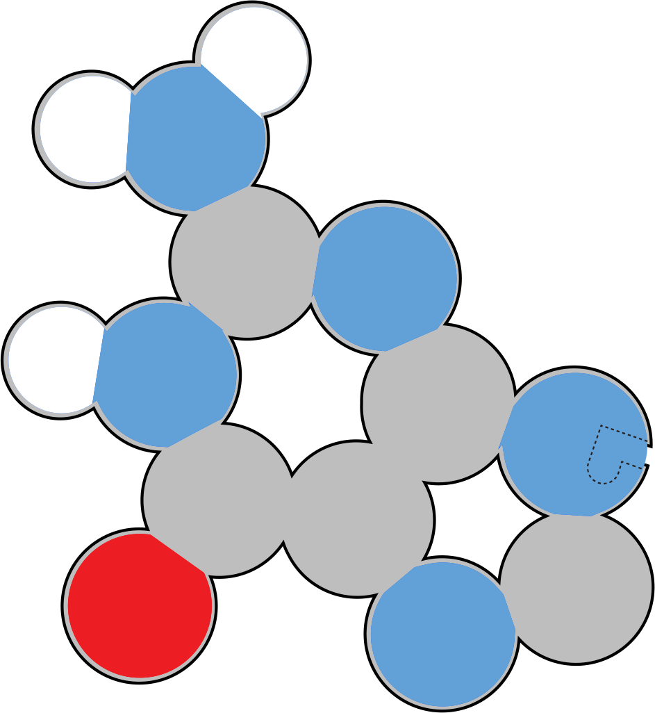

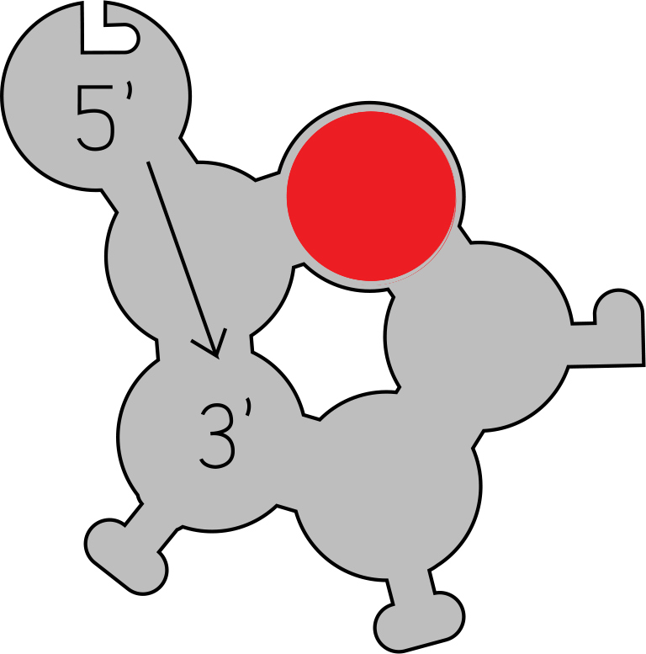
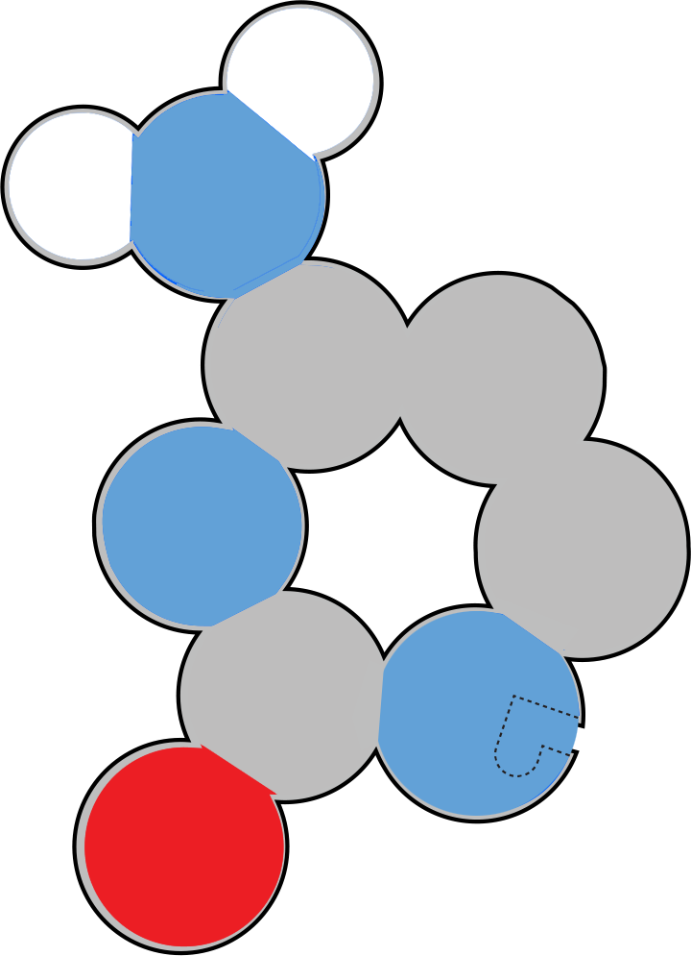
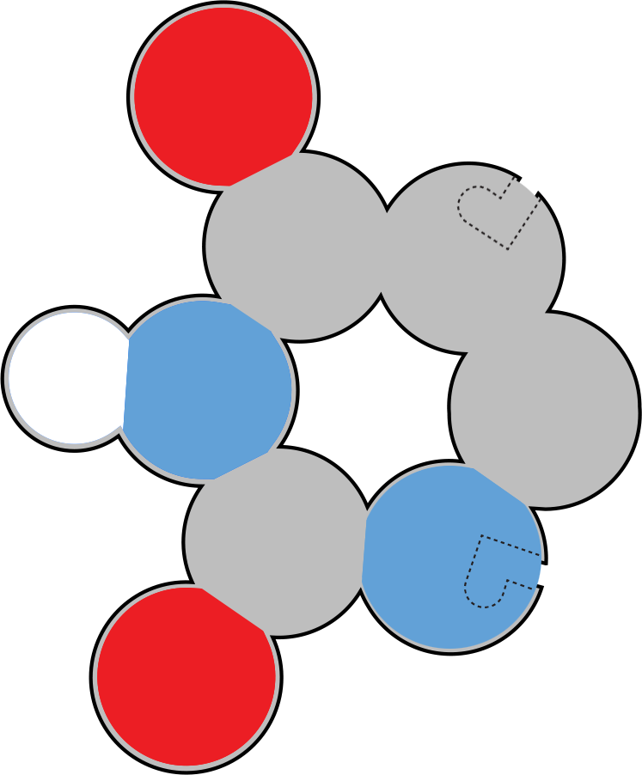
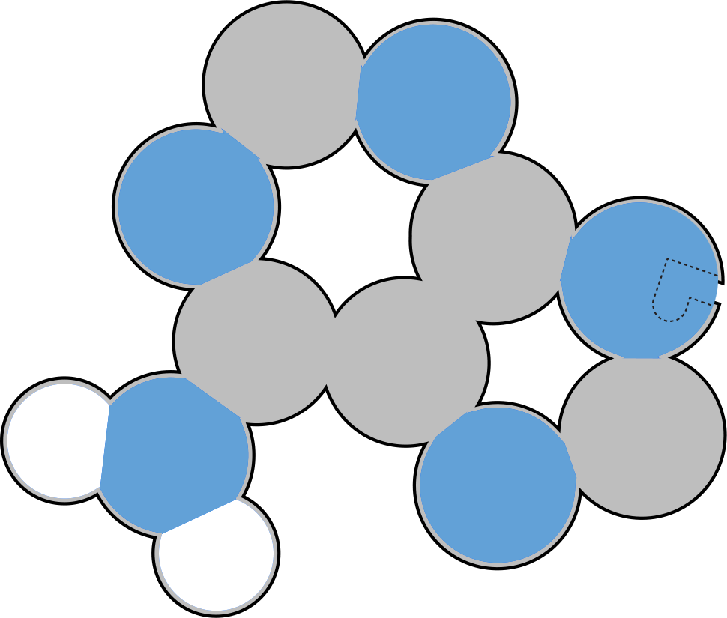
Molecules of Life:
DNA
Molecules of Life Kit
“Biology is the most powerful technology ever created. DNA is software, proteins are hardware, cells are factories."
- Arvind Gupta

Slide 2
Molecules of Life Overview
The Molecules of Life Modeling Kit© includes components for amino acids, nucleotides, carbohydrates, and phospholipids. A dedicated slide deck for each structure can be used to guide your students’ modeling with each of the molecules. We encourage you to edit the slides as appropriate for your students and curriculum.
In addition to the primary function of each molecule, there are five overarching concepts in each slide deck.
The molecules are monomers that combine together to form polymers.
The amino acids, nucleotides, and carbohydrates combine into polymers through a dehydration synthesis process, which is catalyzed by enzymes, forming a covalent bond between each monomer. Phospholipids combine through hydrophobic and hydrophilic interactions. Covalent bonds do not join phospholipids as they combine to form bilayers.*
The monomers and polymers or macromolecules shown on the slides are all at the same scale for your students to see and compare the relative sizes of the structures.
There are repeating patterns within structures, such as the DNA backbone, and sometimes nature utilizes functional groups in multiple structures, such as the phosphate group within the DNA backbone, and also in the head component of phospholipids.
There is an essential relationship between structure and function, for the structure to perform its function within an organism.
*We suggest you save the phospholipid slide deck for last to emphasize that phospholipids do not form covalent bonds with each other when forming bilayer membranes. Dehydration synthesis occurs as an enzyme joins the functional groups of the phospholipid together.

Slide 3
Teacher Guide - Summary
Double-stranded DNA plays a critical role in a cell by storing the instructions needed to create every protein in your body. Double-stranded DNA is composed of monomeric small molecules called nucleotides. Each nucleotide is composed of a phosphate group, a deoxyribose sugar and a nitrogenous base.
Nucleotides have an identical backbone, composed of a phosphate group and a deoxyribose sugar. But each has a unique nitrogenous base, giving each a unique name and single-letter abbreviation: 1)Adenine Nucleotide (A), 2)Thymine Nucleotide (T), 3) Guanine Nucleotide (G), and 4) Cytosine Nucleotide (C).
An enzyme called DNA polymerase will catalyze the covalent bond (a phosphodiester bond) between the two nucleotide monomers.
DNA strands are usually thousands, even millions, of nucleotides long! DNA sequences encode the sequence of amino acids that make up proteins. Nucleotides form base pairs, stabilized by hydrogen bonds between the nitrogenous bases. There are very specific rules for base pairing:
  adenine (A) pairs with thymine (T) with two hydrogen bonds
  guanine (G) pairs with cytosine (C) with three hydrogen bonds
Each strand also has directionality, often referred to as 5' to 3' directionality because of the carbon atom numbering in the deoxyribose sugars in the DNA backbones. The two strands are anti-parallel
Protein synthesis involves making a temporary single-stranded copy of the double-stranded DNA. This transcribed copy is called messenger RNA. All four RNA nucleotides have an additional oxygen atom at the 2’ carbon of on the ribose sugar of the RNA backbone. One of the four RNA nucleotides, uracil, is different than thymine in that it is missing the methyl group at the 5’ carbon of thymine.

Slide 4
Teacher Guide - Overview
Activity Objectives​​
Your students will:
Use molecular monomer models to build a polymer, specifically assembling nucleotide monomers into double-stranded DNA.
Explore the components and assembly of nucleotide monomers (including phosphate group, deoxyribose sugar, and nitrogenous base).
Understand base pairing rules and the chemical bonds involved in nucleotide polymerization (such as phosphodiester bonds and hydrogen bonds).
Model the directionality and anti-parallel nature of double-stranded DNA.
Compare and contrast DNA and RNA nucleotides, including differences in sugar structure and nitrogenous bases.
Utilize hands-on modeling to observe, sketch, and label molecular structures, promoting understanding of structure–function relationships in biology.
Record observations ("I notice") and questions ("I wonder") in lab notebooks to develop critical thinking and inquiry skills.
Estimated Class Time Needed
30 minutes
Materials Needed
Molecules of Life Modeling Kit©
Related Materials
Dynamic DNA Kit©
DNA Starter Kit©
Flow of Genetic Information Kit©
Technology Needed
None
Grade, Class
Middle School Life Science
High School Biology, Honors, AP Biology
Topics
Monomers to Polymers
Macromolecules
Dehydration Synthesis
DNA and RNA Structure
Double-stranded DNA
Antiparallel and directionality

Slide 5
Teacher Guide - Using This Slide Deck

Slide 6
Teacher Guide - Standards
Next Generation Science Standards
Science and​ Engineering Practices​ | Cross Cutting​ Concepts​ | Disciplinary​ Core Ideas​
Developing and Using Models​ ​ | Scale, Proportion and Quantity | MS & HS-LS1
Constructing Explanations and Designing​ Solutions | Structure and Function​ | MS & HS-LS1.A
Obtaining, Evaluating and Communicating Information/ Engaging in Argument from Evidence | Cause and Effect/Stability and Change | MS & HS-LS2

Slide 7
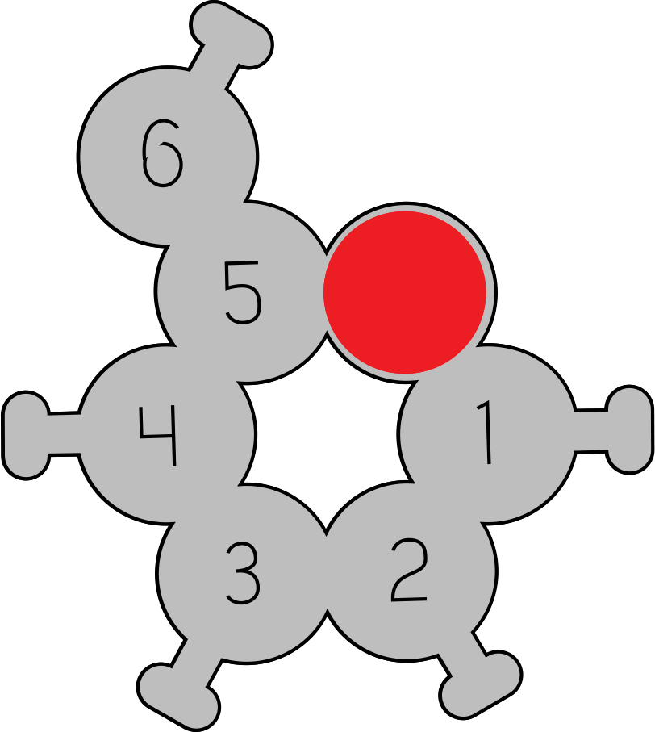

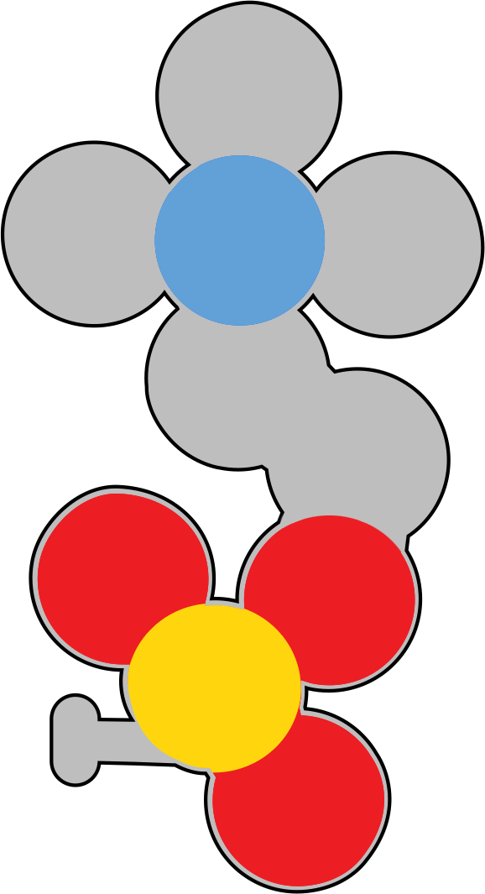
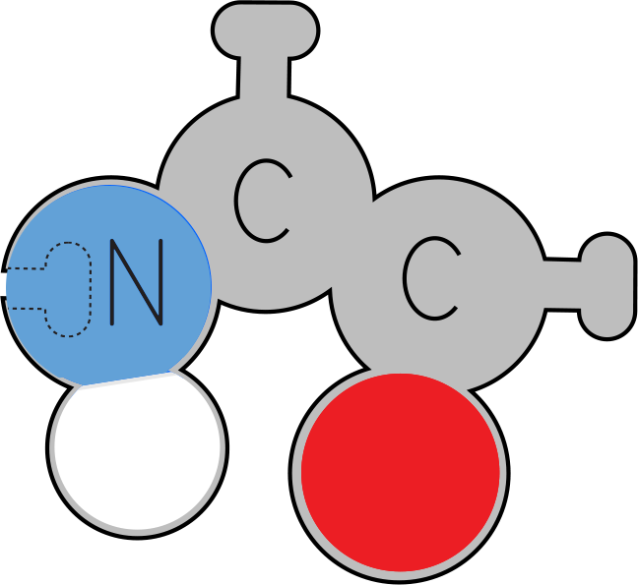
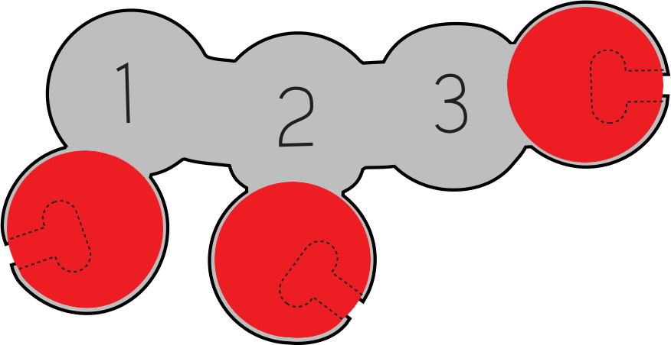



Small Molecules
Observe these small molecules.
How are they similar?
How are they different?
Notes:
Teacher: Distribute one of each of the monomers to each student group. Give students time to examine the molecules.
Student: Follow the onscreen prompt.

Slide 8
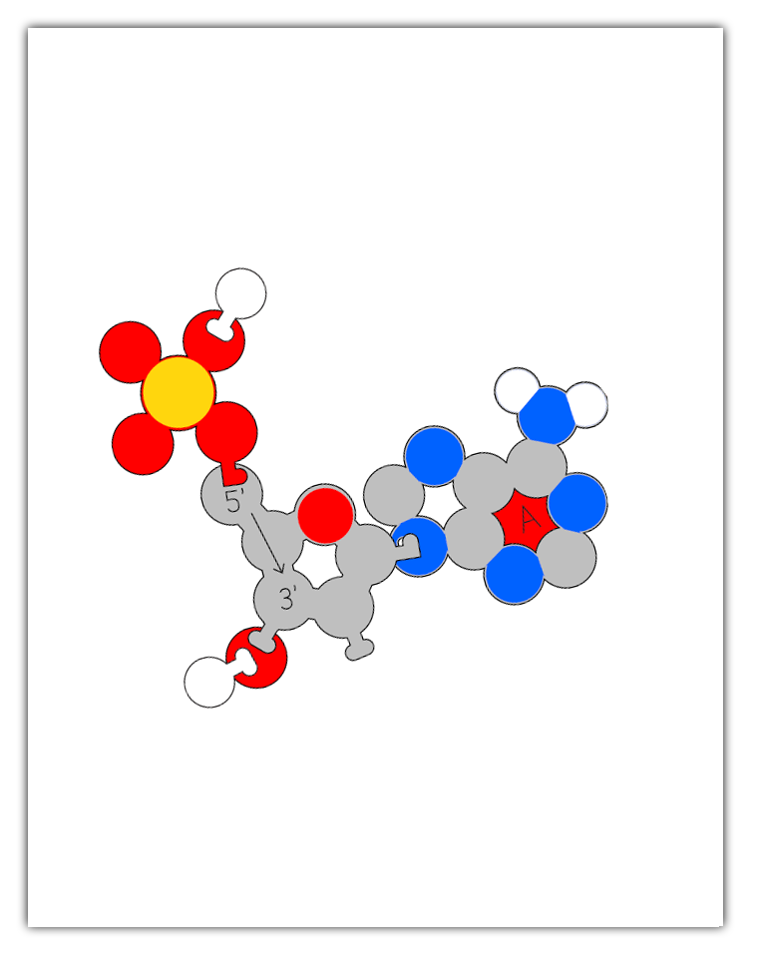
Teacher Guide - Monomer Assembly
The Molecules of Life kit involves students using molecular monomer models to build a polymer. For example, nucleotide monomers assemble into double-stranded DNA.
Instead of giving each group of students the whole kit and having them assemble parts as needed, we recommend staging the different monomers and only distributing the parts as needed.
For this polymer assembly to work properly, the initial monomer must be assembled properly. Some students may have success assembling the monomer models simply by using the illustrations on the subsequent slides.
However, if you or your students are struggling with proper monomer assembly, a PDF with printable assembly guides is freely available in the Digital Modeling Hub. These guides are sized to match the scale of the physical models (when printed with no scaling on 8.5" x 11" paper). The foam physical models can be set directly on the printed monomer graphics to help aid in proper assembly.

Slide 9

Small Molecules
Record at least 10 things you notice and at least 3 questions you wonder about in your lab notebook.
I Notice I wonder
Notes:
Teacher: Give students time to write in their notebook.
Student: Draw a t in the middle of your notebook page. Label the left side, I notice, and the right side I wonder. Write one list of things you noticed about the molecules and one list about the things you wonder.

Slide 10





Small Molecules
Carbohydrate
Phospholipid
With your lab group, identify the characteristics that two or more of these molecules have in common.
Amino Acid
Atom Color Key
Carbon
Nitrogen
Oxygen
Phosphorus
Hydrogen
DNA
Nucleotide
Notes:
Teacher: Monitor and facilitate discussion, as needed.
Optional: You may want to point out that any specific atom is the same size, whether in an amino acid or phospholipid, for example. Conversely, not all atoms are the same size. In this 2D Molecules of Life Modeling Kit, all the atoms are about the same size. For differentiation, you could assign more advanced students to research the relative sizes of the atoms shown here and how size is determined. This may also be a good time to discuss how all models are wrong, but some are useful.
Student: Discuss with your group.

Slide 11
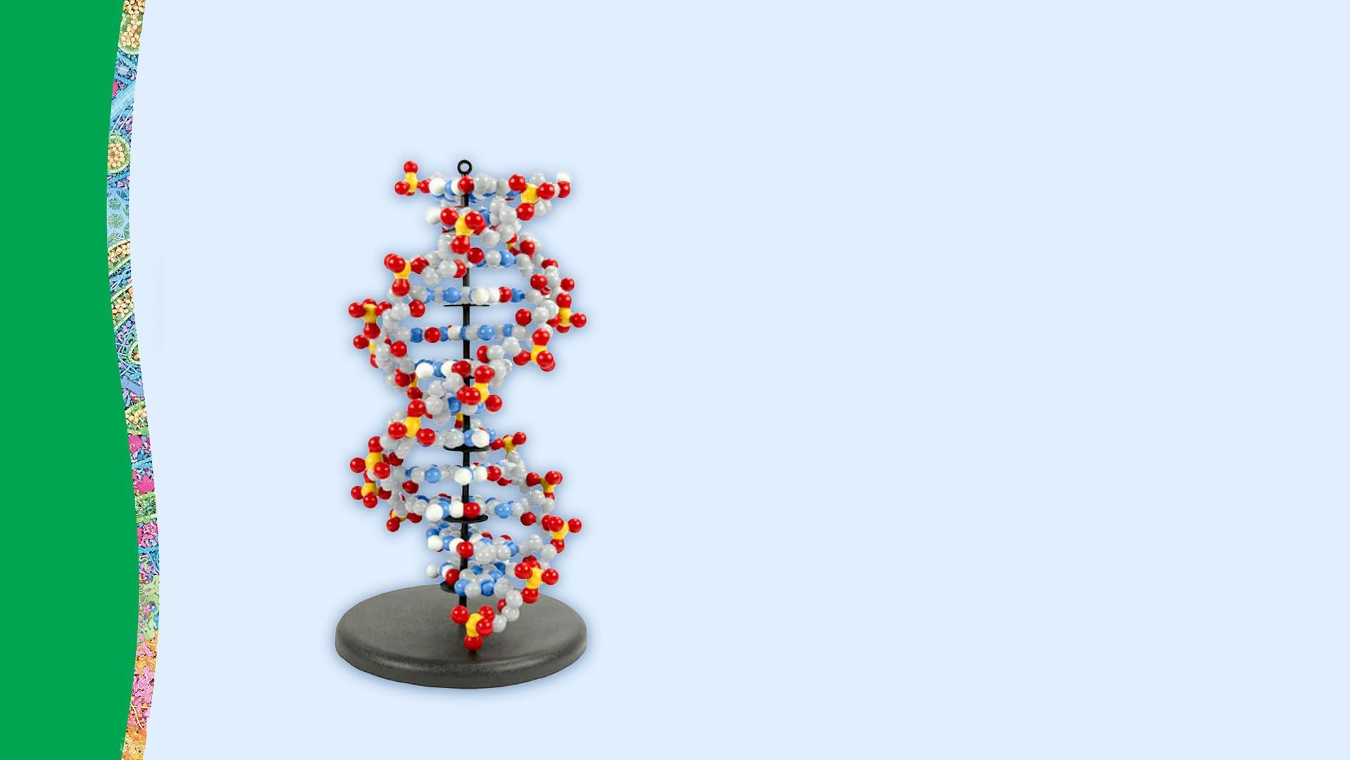
Nucleotides and Double-stranded DNA
Double-stranded DNA plays a critical role in a cell by storing the instructions needed to create every protein in your body.
Double-stranded DNA is composed of monomeric small molecules called of nucleotides.

Slide 12
Nucleotide Components
Closely observe your models of the functional groups of a nucleotide.
What do these structures have in common?
How are they different?
Record your observations and questions in your lab notebook.
I Notice I wonder
Notes:
Teacher: Give students time to write in their notebook.
Student: Draw a t in the middle of your notebook page. Label the left side, I notice, and the right side I wonder. Write one list of things you noticed about the molecules and one list about the things you wonder.

Slide 13
Nucleotide Monomers
Nitrogenous
Base
Nucleotide monomers are the building blocks of double-stranded DNA.
Each nucleotide is composed of a phosphate group, a deoxyribose sugar and a nitrogenous base.
Using the pieces shown to the right, create a model of a single nucleotide.
Phosphate
Group
Deoxyribose
Sugar
Notes:
Teacher: Give students time to explore and work with their models.​​
Student: Follow the onscreen prompts to build a model.

Slide 14

Nucleotide Monomers
Your assembled nucleotide should look like the image to the right.
With the remaining pieces shown below, create three more nucleotides.
Nucleotide
3x
3x
Notes:
Teacher: Distribute the rest of the nucleotide functional groups. Give students time to explore and work with their models.​​
Student: Follow the onscreen prompts to build a model.

Slide 15
Nucleotide Monomers
What do these four nucleotide structures have in common?
How are they different?
Record your observations and questions in your lab notebook.
I Notice I wonder
Notes:
Teacher: Give students time to write in their notebook.
Student: Draw a t in the middle of your notebook page. Label the left side, I notice, and the right side I wonder. Write one list of things you noticed about the molecules and one list about the things you wonder.

Slide 16
Nucleotide Monomers
All four nucleotides have an identical backbone, composed of a phosphate group and a deoxyribose sugar.
But each has a unique nitrogenous base, giving each a unique name and single-letter abbreviation:
Adenine Nucleotide (A)
Thymine Nucleotide (T)
Guanine Nucleotide (G)
Cytosine Nucleotide (C)
C
G
T
A
Notes:
Teacher: Explain the concepts on the slide as needed.
Students: Engage with the concepts as instructed.

Slide 17



Nucleotide Monomers
Use the colored A, T, G and C inserts to label your four nucleotides models.
Why might our cells need four different types of nucleotides?
How might individual nucleotides
join together?
Notes:
Teacher: Give students time to think and discuss with a partner or small group​​
Student: Think about questions and share as directed

Slide 18
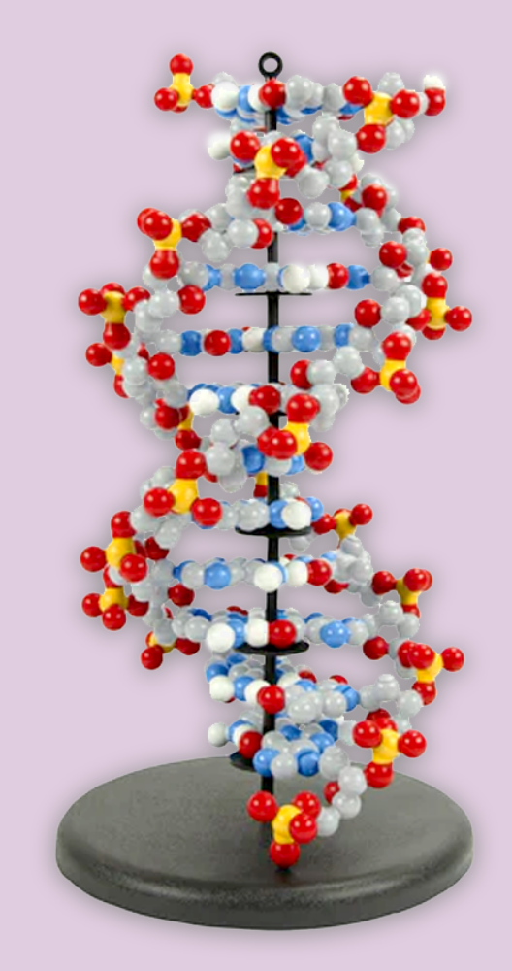
Dynamic DNA Kit
The Dynamic DNA kit provides a more in-depth exploration of nucleotide structure and double-stranded DNA.
Sturdy, colorful pieces and magnets make it easy for students to snap, bend, twist, and interact as they build DNA. Thanks to our patented design innovations, the structure of this molecule is revealed to students through their own investigation.
Students will:
Construct individual nucleotides with nitrogenous bases, sugars, and phosphate groups.
Feel the hydrogen bonding of the A-T and G-C base pairs
Twist and unwind the double helix to set the stage for replication and transcription
Convert thymine to uracil
Additional pieces allow them to make ATP, consider epigenetics and gene expression, and much more.
Notes:
Each bullet point is a hyper-link

Slide 19
Nucleotides Form DNA Polymers
Like many biomolecules, nucleotide monomers can be linked together to form polymers.
Using your models of the adenine (A) and guanine (G) nucleotides, create a polymer linking their backbones.
What is the result of this linking?
Notes:
Teacher: Give students time to explore and create their own models.​​
Student: Follow the onscreen prompts to build a model.

Slide 20
Nucleotides Form DNA Polymers
Single-stranded DNA
An enzyme called DNA polymerase will catalyze the covalent bond between the two nucleotide monomers, often called a phosphodiester bond, through a dehydration synthesis reaction.
A segment of single-stranded DNA and a water molecule are the end products in this reaction.
Water
Molecule
Notes:
Teacher: Explain the concepts on the slide as needed.
Students: Engage with the concepts as instructed.

Slide 21
Nucleotides Form DNA Polymers
DNA strands are usually thousands, even millions of nucleotides long!
The order of the nucleotides in a DNA strand is often written as simple letters, called DNA sequence.
G A C T T A A G A C C
DNA sequences store the code for building proteins, the molecular machines needed for life.

Slide 22
Nucleotides Form DNA Polymers
Single-stranded DNA
Create a sketch of this short DNA segment in your lab notebook.
With your lab group, draft a definition of a nucleotide.
Record your definition in your lab notebook. Leave room to modify & refine.
Water
Molecule
Notes:
Teacher: Explain the concept on the slide as needed.
Student: Sketch your model and draft a definition.

Slide 23
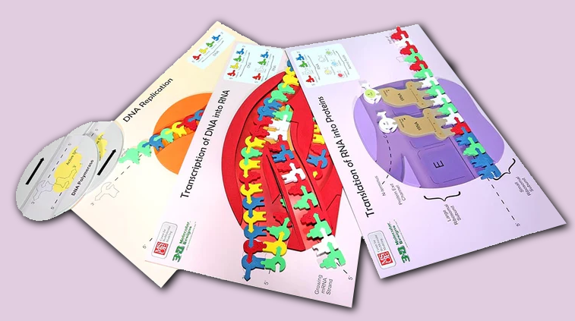
Flow of Genetic Information Kit
The Flow of Genetic Information kit provides a more in-depth exploration of replication, transcription and translation, and the important role DNA plays in protein synthesis.
Students will:
Identify essential enzymes like helicase and polymerase
Model replication of the leading and lagging strands of DNA
Explore transcription as they copy one strand of DNA into mRNA using an RNA polymerase
Engage in translation/protein synthesis as they decode the mRNA into protein on the ribosome placemat
Reenact the different results of the Meselson and Stahl experiment
Notes:
Each bullet point is a hyper-link

Slide 24
Nucleotides Form Double-stranded DNA
In addition to backbone linkages, nucleotide monomers can interact with each other in a second way.
Using your four nucleotide models, explore how the nitrogenous bases might interact.
Record your ideas in your lab notebook.
Notes:
Teacher: Explain the concept on the slide as needed.
Student: Test different connections with your models and then record your best idea in your lab notebook.

Slide 25
Nucleotides Form Double-stranded DNA
Nucleotides form base pairs, stabilized
by hydrogen bonds between the ends of the nitrogenous bases.
There are very specific rules for base pairing:
adenine (A) pairs with thymine (T)
guanine (G) pairs with cytosine (C)
Notes:
Teacher: Explain the concepts on the slide as needed.
Students: Engage with the concepts as instructed.

Slide 26
Nucleotides Form Double-stranded DNA
How many hydrogen bonds form between an A-T base pair?
How many between a G-C base pair?
Notes:
Teacher: Give students time to think and discuss with a partner or small group​​
Student: Think about questions and share as directed

Slide 27
Nucleotides Form Double-stranded DNA
Base pairing allows two segments of single-stranded DNA to form one segment of double-stranded DNA.
A-T base pairs contain 2 hydrogen bonds
G-C base pairs contain 3 hydrogen bonds
DNA
strand 1
Backbone
Hydrogen-bonded
nitrogenous bases
DNA
strand 2
Backbone
Notes:
Teacher: Explain the concepts on the slide as needed.
Students: Engage with the concepts as instructed.

Slide 28
Nucleotides Form Double-stranded DNA
Create a sketch of the 4 nucleotides and label the connections.
Notes:
Teacher: Give students time to sketch and label the model in their lab notebooks.
Student: Sketch and label the model in your lab notebook.

Slide 29
Nucleotides Form Double-stranded DNA
Compare the two strands.
How are they the same or different?
What patterns do you see?
Notes:
Teacher: Give students time to think and discuss with a partner or small group​​
Student: Think about questions and share as directed

Slide 30
Nucleotides Form Double-stranded DNA
Each strand also has directionality, often referred to as 5' to 3' directionality because of the carbon atom numbering in the deoxyribose sugars in the strand backbones.
The two strands are considered anti-parallel, because the directionality of the two strands go in the opposite direction.
3'
5'
5'
3'

Slide 31
Nucleotides Form Double-stranded DNA
Create a sketch of double-stranded DNA. Add notes about directionality and define antiparallel.
Notes:
Teacher: Give students time to sketch and label the model in their lab notebooks.
Student: Sketch and label the model in your lab notebook.

Slide 32



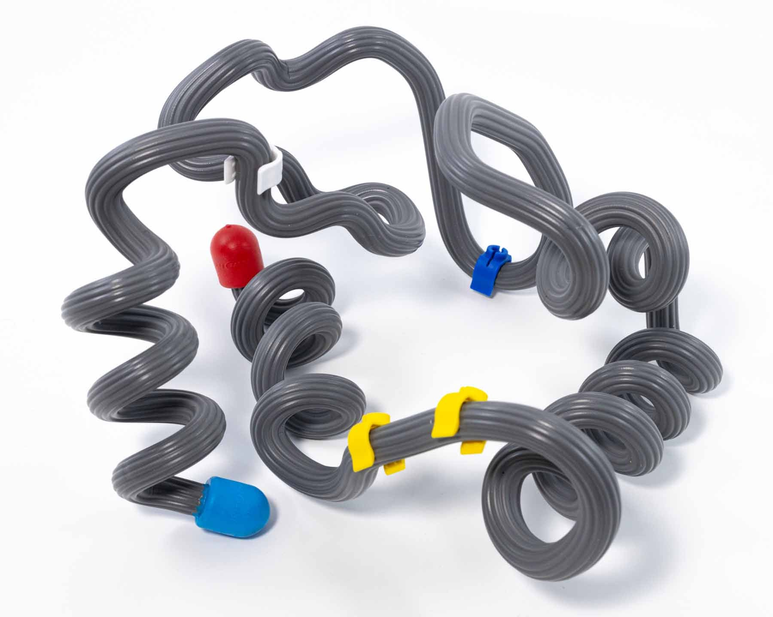
RNA Nucleotides
Double-stranded
DNA
Double-stranded DNA stores the instructions for building proteins.
Protein synthesis involves making a temporary single-stranded copy of the double-stranded DNA.
This transcribed copy is called RNA.
Single-stranded
RNA
Folded
Protein Structure
Notes:
Teacher: Explain the concepts on the slide as needed.
Students: Engage with the concepts as instructed.

Slide 33
RNA Nucleotides
Compare these RNA nucleotides with the DNA nucleotides in front of you.
How are RNA nucleotides the same as a DNA nucleotides? How are they different?
Why would RNA be different than DNA? What purpose does it serve?
Notes:
Teacher: Give students time to think and discuss with a partner or small group​​
Student: Think about questions and share as directed

Slide 34
RNA Nucleotides
All four RNA nucleotides have an additional oxygen atom on the ribose sugar of the backbone.
One of the four RNA nucleotides, uracil, has a carbon atom on the nitrogenous base removed.
DNA is stable under alkaline conditions, while RNA is not stable. DNA is for long-term storage while RNA is for short term protein synthesis.
Notes:
Teacher: Explain the concepts on the slide as needed.
Students: Engage with the concepts as instructed.

Slide 35
RNA Nucleotides
Create a sketch of RNA nucleotides in your lab notebook.
Label the differences between DNA & RNA.
Notes:
Teacher: Give students time to sketch and label the model in their lab notebooks.
Student: Sketch and label the model in your lab notebook.

Slide 36
Structure –Function Relationship
An important concept in biology is that structure is critical to function, enabling a structure to do its job within an organism.
In your notebook, write how you think the structure of nucleotides enables DNA to contain the code for all the proteins our bodies need.
Notes:
Teacher: Give students an appropriate amount of time to think and write to the prompt in their notebook. ​​
Student: Write to the prompt.

Slide 37
Conclusions
Nitrogenous
Base
Phosphate
Group
Deoxyribose
Sugar
Nucleotide monomers have a phosphate group, deoxyribose sugar, and one of four nitrogenous bases (A, T, G and C).
Nucleotide monomers join together to form a DNA strand, which can base pair with a complimentary DNA strand.
RNA nucleotides have an additional oxygen and use Uracil instead of Thymine

