Slide 1
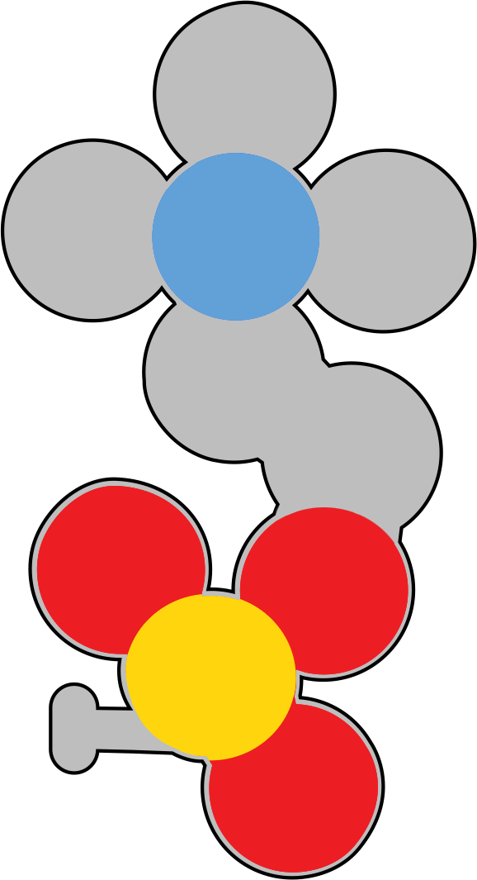
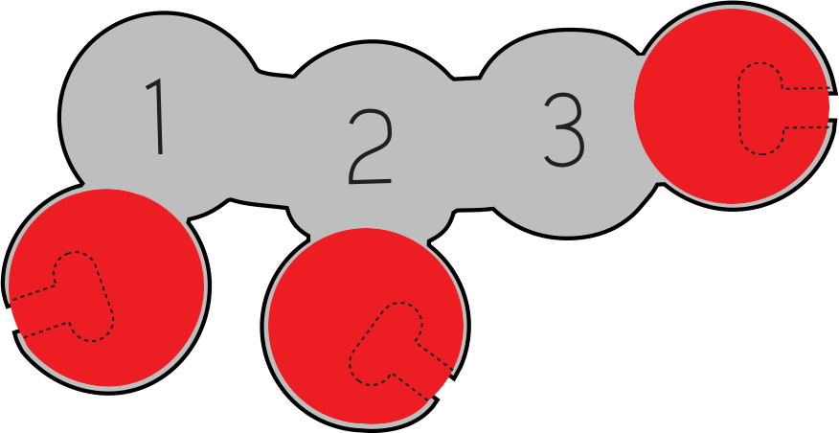


Molecules of Life: Phospholipids
Molecules of Life Modeling Kit
Phospholipids are true molecules of life—these dynamic structures not only build barriers, but also create the stage upon which cellular existence unfolds, making life possible.

Slide 2
Molecules of Life Overview
The Molecules of Life Modeling Kit© includes components for amino acids, nucleotides, carbohydrates, and phospholipids. A dedicated slide deck for each structure can be used to guide your students’ modeling with each of the molecules. We encourage you to edit the slides as appropriate for your students and curriculum.
In addition to the primary function of each molecule, there are five overarching concepts in each slide deck.
The molecules are monomers that combine to form polymers.
The amino acids, nucleotides, and carbohydrates combine into polymers through a dehydration synthesis process, which is catalyzed by enzymes, forming a covalent bond between each monomer. Phospholipids combine through hydrophobic and hydrophilic interactions. Covalent bonds do not join phospholipids as they combine to form bilayers.*
The monomers and polymers or macromolecules shown on the slides are all at the same scale for your students to see and compare the relative sizes of the structures.
There are repeating patterns within structures, such as the DNA backbone, and sometimes nature utilizes functional groups in multiple structures, such as the phosphate group within the DNA backbone, and also in the head component of phospholipids.
There is an essential relationship between structure and function, for the structure to perform its function within an organism.
*We suggest you save the phospholipid slide deck for last to emphasize that phospholipids do not form covalent bonds with each other when forming bilayer membranes. Dehydration synthesis occurs as an enzyme joins the functional groups of the phospholipid together.

Slide 3
Teacher Guide – Phospholipid Summary
Phospholipids are the major structural component of membranes. Each monomeric phospholipid consists of a 3-carbon glycerol molecule connected to two fatty acid tails and the phosphate-containing “head group”. Each phospholipid is amphipathic –the hydrocarbon tails of the fatty acids are hydrophobic while the phosphate head groups are hydrophilic.
Unlike the other three Molecules of Life (amino acids, carbohydrates and nucleotides), individual phospholipids are not joined by covalent bonds to form a larger, polymeric macromolecule, i.e., a membrane. Instead, the amphipathic nature of phospholipids causes them to spontaneously assemble into a lipid bilayer – or membrane – as a result of the hydrophobic interactions between the hydrocarbon tails of the fatty acids. Hydrophobic interactions between the hydrocarbon tails of the fatty acids loosely stabilize the membrane, allowing channel proteins and other structures to embed in the membrane.
Lipid Bilayers are referred to as fluid-mosaic membranes. Our Mosaic Membrane Mighty Model© can give students a sense of the fluidity of the membrane. With the model’s proteins and other structures, students will have a better understanding of the flexible, fluid nature of membranes.
Even though monomeric phospholipids are not joined together to make a covalently bonded macromolecule, a dehydration synthesis reaction is involved in creating each monomeric phospholipid from its component parts. Your students can easily model this condensation reaction as they create a phospholipid. They will generate a water molecule each time they add a fatty acid or a phosphate head group to glycerol.
Curriculum Connections: In biology, it is essential to distinguish between a simple chemical reaction and an enzyme-catalyzed reaction. All the dehydration synthesis reactions that can be modeled with the Molecules of Life kit are performed by enzymes – biological catalysts that speed up chemical reactions. For example, glucose molecules are joined to form cellulose by an enzyme known as cellulose synthase. Nucleotides are joined together to make DNA by the enzyme DNA polymerase.

Slide 4
Teacher Guide – Overview
Activity Objectives​
Your Students will:
Model the amphipathic structure of phospholipids.
Demonstrate dehydration​ synthesis as they join the glycerol to the phosphate headgroup, and the fatty acid tails (made of hydrocarbons).
Predict how phospholipids form bilayer membranes without forming covalent bonds.
Discover that some components of the other molecules of life are similar to those in phospholipids.
Describe how the structure of phospholipids enables them to form lipid bilayers that separate the inside of the cell from its exterior environment.
Estimated Class Time Needed
30 minutes
Materials Needed
Molecules of Life Modeling Kit©
Related Materials
Phospholipid & Membrane Transport Kit©
Mosaic Membrane Mighty Model©
Phospholipid Modeling Set
Cell Modeling Kit© (To be released in September 2025)
Technology Needed
None
Grade, Class
Middle School Life Science
High School Biology, Honors, AP Biology
Topics
Macromolecules
Monomers to Polymers
Dehydration Synthesis
Repeating patterns
Relative Scale
Amphipathic Molecules

Slide 5
Teacher Guide - Using This Slide Deck

Slide 6
Teacher Guide - Standards
Next Generation Science Standards
Science and​ Engineering Practices​ | Cross Cutting​ Concepts​ | Disciplinary​ Core Ideas​
Developing and Using Models​ ​ | Scale, Proportion and Quantity | MS & HS-LS1
Constructing Explanations and Designing​ Solutions | Structure and Function​ | MS & HS-LS1.A
Obtaining, Evaluating and Communicating Information/ Engaging in Argument from Evidence | Cause and Effect/Stability and Change | MS & HS-LS1

Slide 7



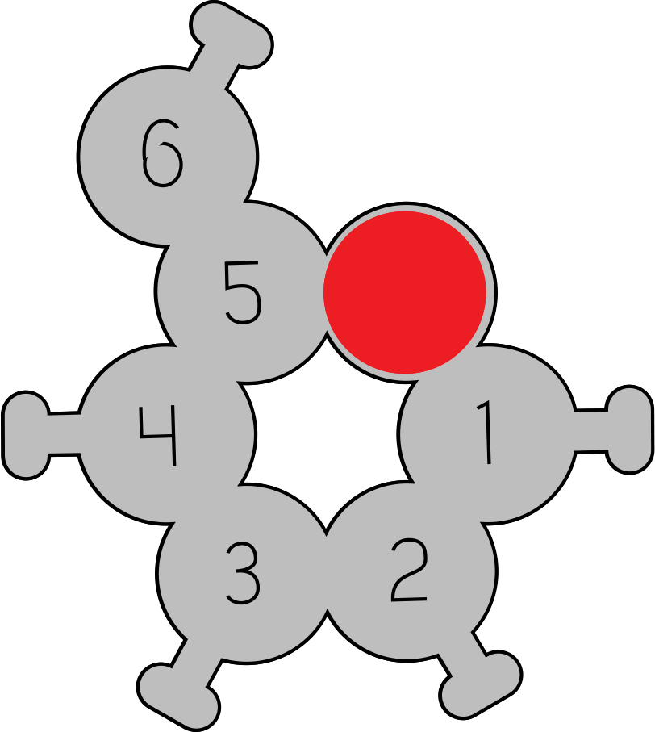
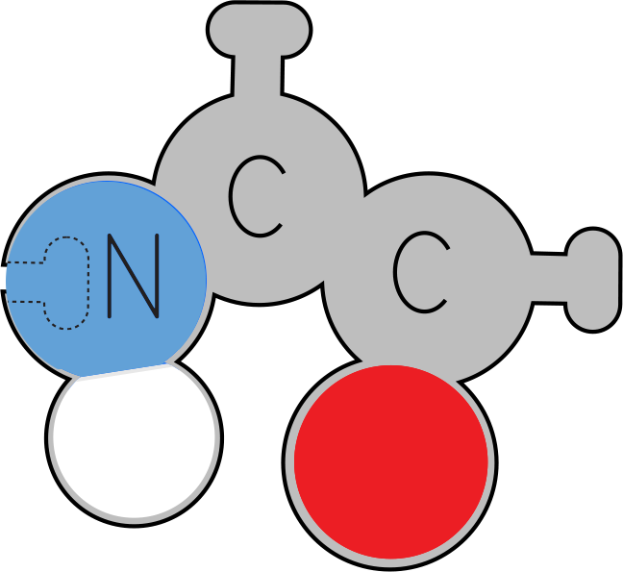
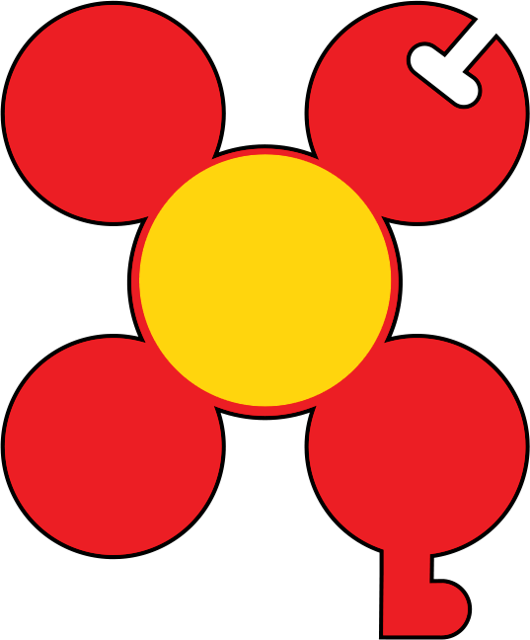
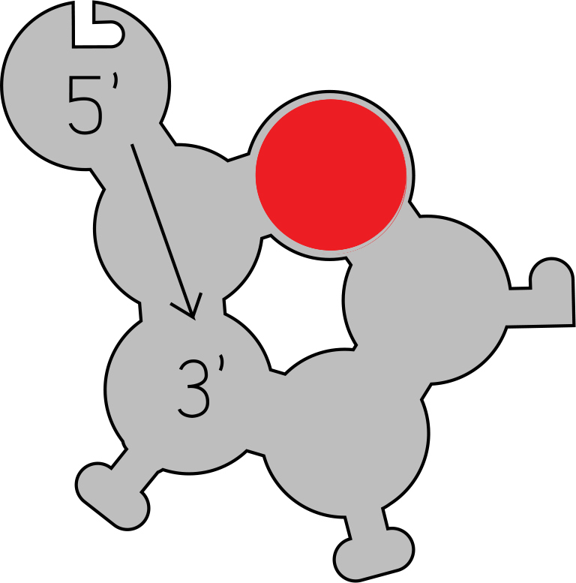
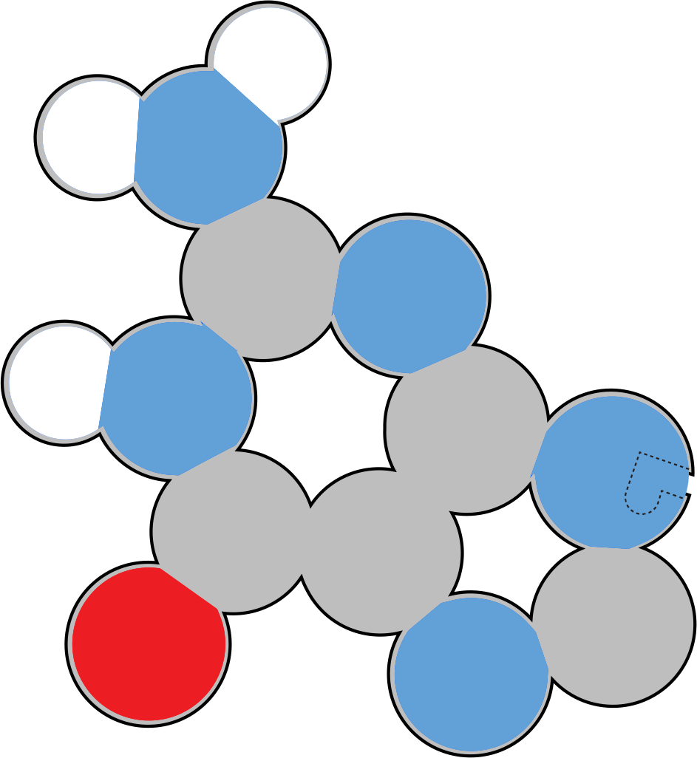

Small Molecules
Observe these small molecules.
How are they similar?
How are they different?
Notes:
Teacher: Distribute one of each of the monomers to each student group. Give students time to examine the molecules.
Student: Follow the onscreen prompt.

Slide 8
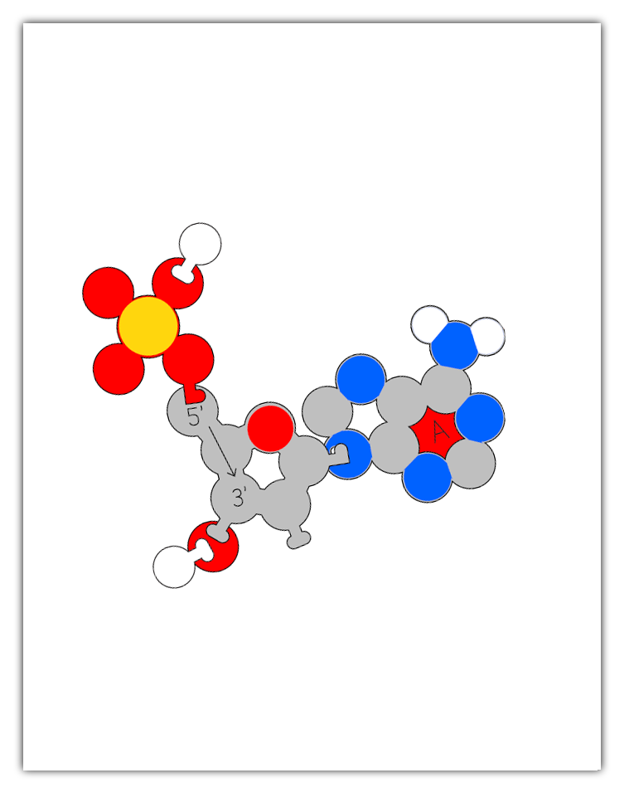
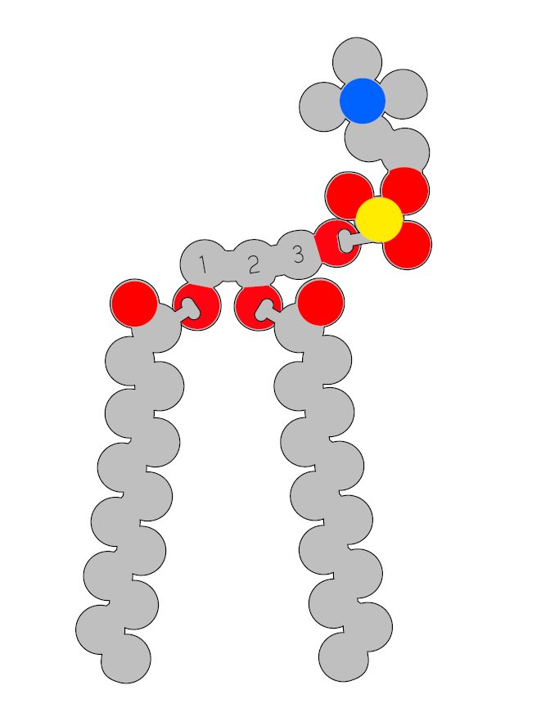
Teacher Guide - Monomer Assembly
The Molecules of Life kit involves students using molecular monomer models to build a polymer. For example, phospholipid monomers assemble into membranes.
Instead of giving each group of students the whole kit and having them assemble parts as needed, we recommend staging the different monomers and only distributing the parts as needed.
For this polymer assembly to work properly, the initial monomer must be assembled properly. Some students may have success assembling the monomer models simply by using the illustrations on the subsequent slides.
However, if you or your students are struggling with proper monomer assembly, a PDF with printable assembly guides is freely available in the Digital Modeling Hub. These guides are sized to match the scale of the physical models (when printed with no scaling on 8.5" x 11" paper). The foam physical models can be set directly on the printed monomer graphics to help aid in proper assembly.

Slide 9

Small Molecules
Record at least 10 things you notice and at least 3 questions you wonder about in your lab notebook. Have the things you noticed and wondered changed as you explored each molecule?
I Notice I wonder
Notes:
Teacher: Give students time to write in their notebook.
Student: Draw a t in the middle of your notebook page. Label the left side, I notice, and the right side I wonder. Write one list of things you noticed about the molecules and one list about the things you wonder.

Slide 10





Small Molecules
Carbohydrate
Phospholipid
With your lab group, identify the characteristics that two or more of these molecules have in common.
Amino Acid
Atom Color Key
Carbon
Nitrogen
Oxygen
Phosphorus
Hydrogen
DNA
Nucleotide
Notes:
Teacher: Monitor and facilitate discussion, as needed.
Optional: You may want to point out that any specific atom is the same size, whether in an amino acid or phospholipid, for example. Conversely, not all atoms are the same size. In this 2D Molecules of Life Modeling Kit, all the atoms are about the same size. For differentiation, you could assign more advanced students to research the relative sizes of the atoms shown here and how size is determined. This may also be a good time to discuss how all models are wrong, but some are useful.
Student: Discuss with your group.

Slide 11
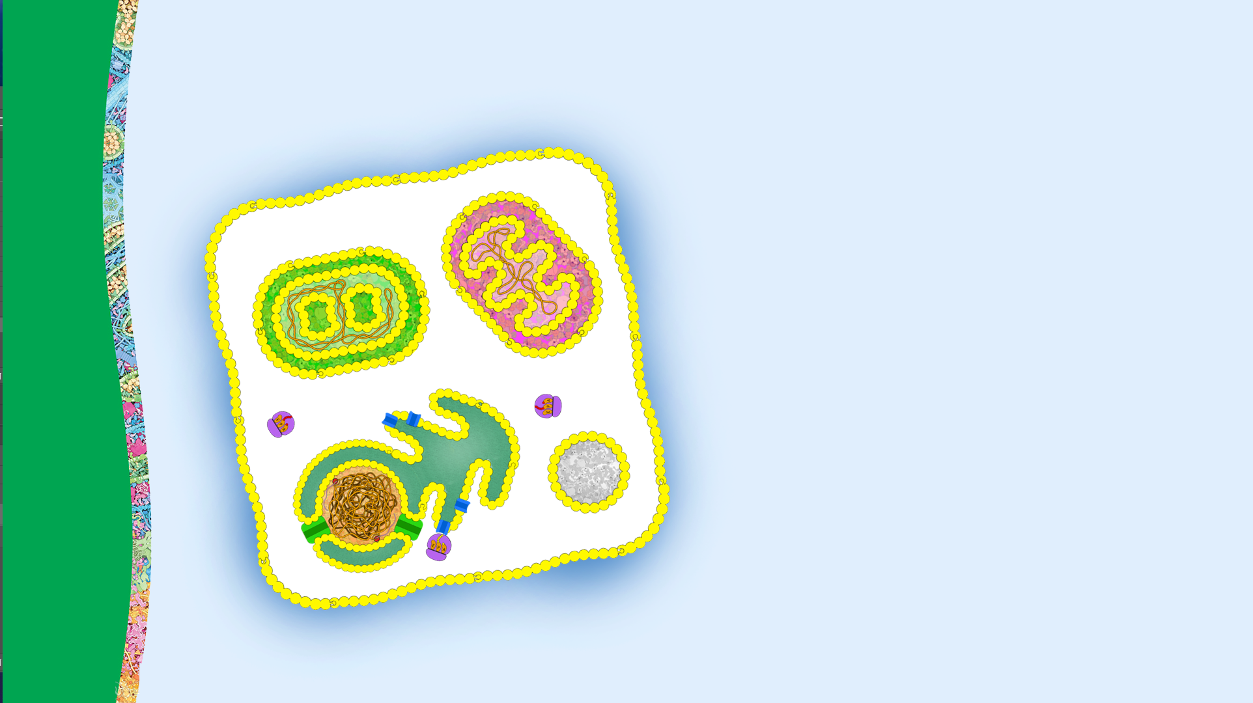
Membranes and Phospholipids
Membranes play a critical role in a cell by separating the inside of a cell from the external environment outside the cell. Another important role of membranes is facilitating intercellular communication.
Membranes are composed of phospholipids, a small molecule.

Slide 12
Phospholipids
Create a T-chart on your table or in your lab notebook. Label one side hydrophobic and the other hydrophilic.
Closely observe the parts that make up a phospholipid shown to the right.
Place each piece on your chart in the appropriate column based on its chemical properties.
Hydrophobic Hydrophilic
Notes:
Teacher: Give students the components of a phospholipid model and let them explore and work with their models.​​
Student: Follow the onscreen prompts to build a model.

Slide 13
Phospholipids
Some of the parts that make up a phospholipid have regions that are hydrophobic and other regions that are hydrophilic. These molecules are described as being amphipathic.
Revise the placement of the phospholipid parts on your chart if needed.
Notes:
Teacher: Explain the concepts on the slide as needed.
Students: Engage with the concepts as instructed.

Slide 14
Phospholipids
Hydrophobic Hydrophilic
Most of the parts of a phospholipid are hydrophilic.
Only the hydrocarbon tails are hydrophobic.
Notes:
Teacher: Explain the concepts on the slide as needed.
Students: Engage with the concepts as instructed.

Slide 15
Phospholipids
Hydrophobic Hydrophilic
Sketch these parts in your notebook and identify the following parts:
  Glycerol
  Phosphate Head Group
  Fatty Acids
Glycerol
Fatty Acid
Phosphate Head
Group
Fatty Acid
Notes:
Teacher: Explain the concepts on the slide as needed.
Students: Engage with the concepts as instructed.

Slide 16
Phospholipids
Hydrophobic Hydrophilic
What patterns, or functional groups, do you see in these parts that are similar to other small molecules?
What are these functional groups called?
Glycerol
Fatty Acid
Phosphate Head
Group
Fatty Acid
Notes:
Teacher: Give students time to think and discuss with a partner or small group​​
Student: Think about questions and share as directed

Slide 17


Phospholipids
Phosphate Head Group
Hydroxyl groups contain an oxygen and a hydrogen (OH).
Carboxyl groups (-COOH) contain two oxygen atoms bonded to a carbon atom. One oxygen is double-bonded to the carbon.
Glycerol
Fatty
Acids
Note these definitions in your lab notebook and label functional groups in your sketches.
Notes:
Teacher: Explain the concept on the slide as needed
Student: Add notes to your lab notebook

Slide 18
Phospholipids
Phosphate Head Group
Hydroxyl groups contain an oxygen and a hydrogen (OH).
Carboxyl groups (-COOH) contain two oxygen atoms bonded to a carbon atom. One oxygen is double-bonded to the carbon.
Glycerol
Hydroxyl
group
Hydroxyl
groups
Fatty
Acids
Carboxyl
groups
Notes:
Teacher: Explain the concepts on the slide as needed.
Students: Engage with the concepts as instructed.

Slide 19
Phospholipids
In your cells, enzymes catalyze these parts to build a phospholipid.
Model this enzymatic action with your parts.
Notes:
Teacher: Give students time to explore and create their own models.​​
Student: Follow the onscreen prompts to build a model.

Slide 20
Phospholipids
Your two fatty acid tails covalently bond to carbons 1 & 2. The phosphate head group covalently bonds to carbon 3.
Sketch a phospholipid in your lab notebook.
Describe the reaction and end products. Include all the vocabulary you learned in the activity.
Notes:
Teacher: Give students time to sketch and label the model in their lab notebooks.
Student: Sketch and label the model in your lab notebook.

Slide 21
Phospholipids
An enzyme will catalyze the covalent bonding of the fatty acids to the carbons 1 & 2 of the glycerol through dehydration synthesis.
The phosphate head group is also covalently bonded to carbon 3 of the glycerol through dehydration synthesis.
Three water molecules and one phospholipid are the end products.
Notes:
Teacher: Explain the concepts on the slide as needed.
Students: Engage with the concepts as instructed.

Slide 22
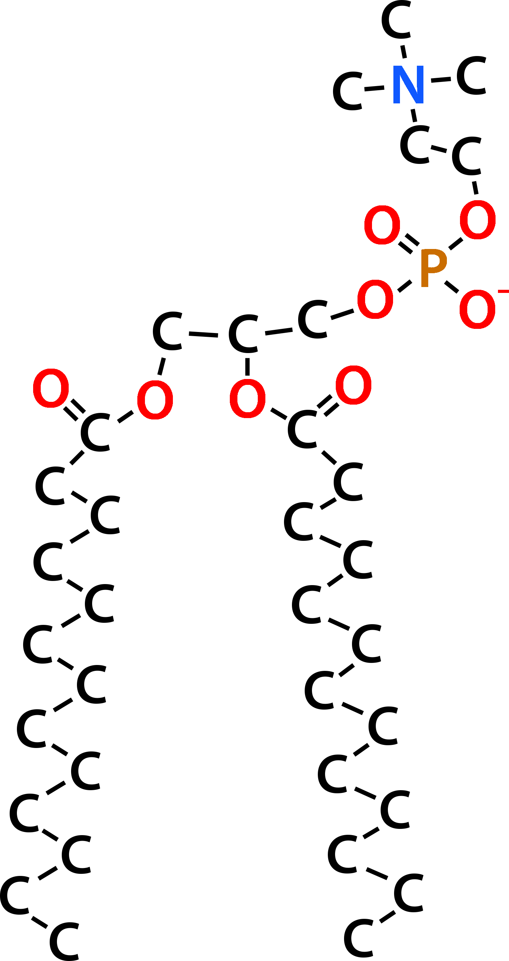
Phospholipids
Compare this chemical drawing of a phospholipid to your model.
What information does the chemical drawing communicate that your physical model does not?
What information does your physical model communicate that the chemical drawing does not?
Notes:
Teacher: Give students time to think and discuss with a partner or small group​​
Student: Think about questions and share as directed

Slide 23
Phospholipids Form Membranes
Phospholipids are the monomers that make up a membrane.
How could these phospholipids form a polymer?
Where/are there covalent bonds between the monomers?
Predict how this could happen and support your prediction with evidence.
Notes:
Teacher: Allow students to explore the models.
Student: Create a model and record information in your lab notebook.

Slide 24
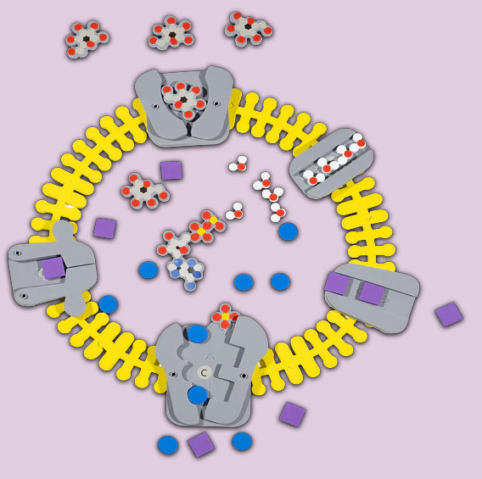
Phospholipid and Membrane Transport Kit
The Phospholipid and Membrane Transport kit provides a more in-depth exploration of phospholipids and membranes.
Students uncover the structure and function of phospholipids, how cell membranes form, and how water and ions move in and out of cells via transport proteins. Students can model different conditions and then predict which way water will move, making vocabulary like hypertonic, hypotonic, and isotonic more memorable.
The kit includes:
50 individual phospholipid molecule models demonstrate hydrophobic and hydrophilic concepts to create monolayers, micelles, and bilayers
Water molecule models show polarity and how water interacts with cell membranes
Bilayer membrane model creates a cell structure that is flexible yet sturdy
Active and passive transport is made easy with 5 different proteins, ion models, and ATP
Notes:
Each bullet point is a hyper-link

Slide 25
Phospholipids Form
Bilayer Membranes
Phospholipids in a membrane are not covalently bonded.
The amphipathic (hydrophobic and hydrophilic) properties of the phospholipid are the stabilizing force in membranes.
Hydrophilic
Region
Hydrophobic
Region
Hydrophilic
Region

Slide 26
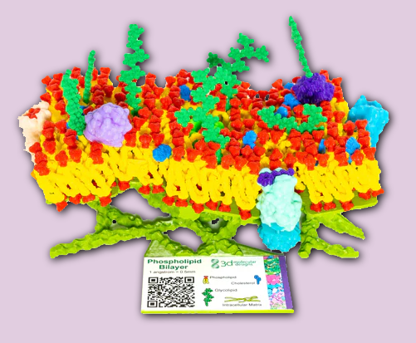
Mosaic Membrane Mighty Model
With the Mosaic Membrane Mighty Model©, your students will feel a lipid bilayer's flexible, fluid nature as they learn about membranes and their important role in separating the inside of a cell from the extracellular environment outside of the cell.
This hands-on model includes:
channel proteins that move nutrients and ions across the membrane
receptor proteins that bind extracellular ligands and trigger signal transduction cascades inside the cell
peripheral proteins and glycoproteins on the outside surface of the membrane that serve as markers for cell-cell-recognition and aid in cell-cell communication
glycolipids and cholesterol that aid in cell identification and affect membrane fluidity.
A base that represents the intracellular matrix of the cell – composed of actin filaments and microtubules.
Notes:
Each bullet point is a hyper-link

Slide 27
Triglycerides
Triglycerides do not contain a phosphate head group. Instead, they contain a third fatty acid tail.
Build a model of a triglyceride from your component pieces.
Notes:
Teacher: Distribute the models to each group. Give students time to think about the prompts.
Students: Create a model based on the prompt.

Slide 28
Triglycerides
Triglycerides store energy efficiently in their fatty acid tails and can release a large amount of energy when metabolized.
Sketch this structure in your notebook and write a definition.
Notes:
Teacher: Explain the concept on the slide as needed.
Student: Sketch your model and draft a definition.

Slide 29
Structure –Function Relationship
An important concept in biology is that structure is critical to function, enabling a structure to do its job within an organism.
In your notebook, write how you think the structure of phospholipids enables them to form membranes that separate the inside of the cell from the external environment outside the cell.
Notes:
Teacher: Give students an appropriate amount of time to think and write to the prompt in their notebook. ​​
Student: Write to the prompt.

Slide 30
Conclusions
Phosphate Head Group
Glycerol
Fatty
Acid
Fatty
Acid
Phospholipids are made up of a glycerol, two fatty acids and a phosphate head group.
Multiple phospholipids form membranes and are stabilized by hydrophobic and hydrophilic forces.
Triglycerides are another form of lipid, used to store energy.

