Slide 1


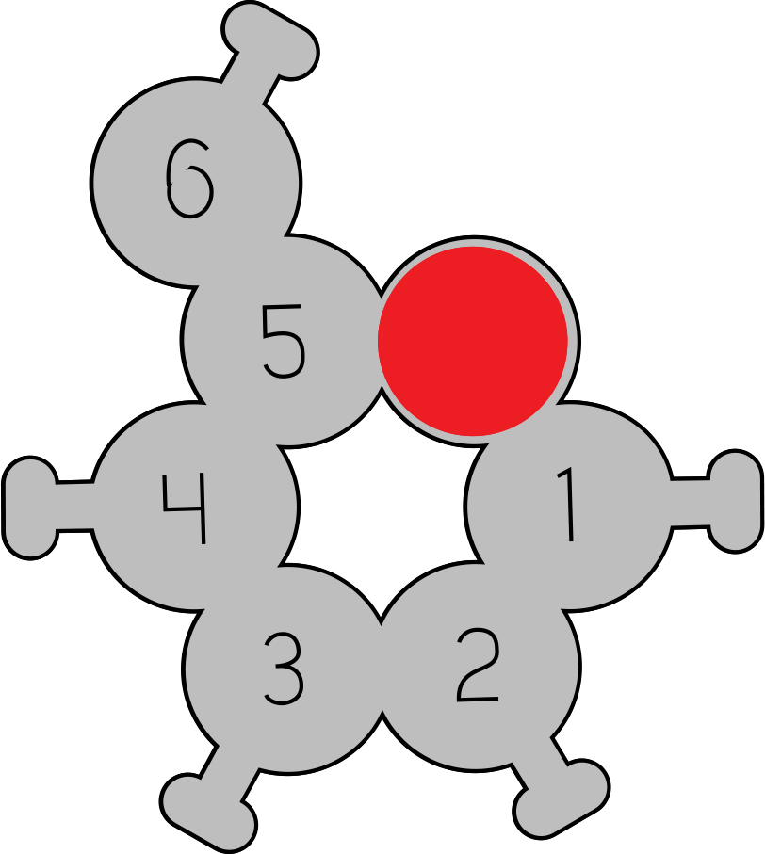
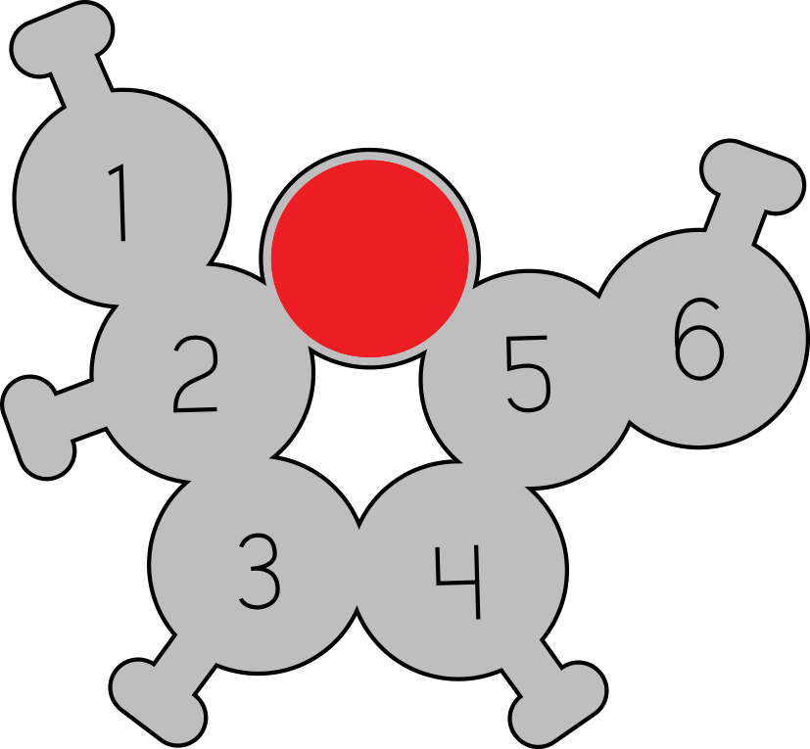
Molecules of Life:
Carbohydrates
Molecules of Life Modeling Kit
“Biological energy comes from the sun
and is stored in sugar"
- John E. Walker

Slide 2
Molecules of Life Overview
The Molecules of Life Modeling Kit© includes components for amino acids, nucleotides, carbohydrates, and phospholipids. A dedicated slide deck for each structure can be used to guide your students’ modeling with each of the molecules. We encourage you to edit the slides as appropriate for your students and curriculum.
In addition to the primary function of each molecule, there are five overarching concepts in each slide deck.
The molecules are monomers that combine to form polymers or macromolecules.
The amino acids, nucleotides, and carbohydrates combine into polymers through a dehydration synthesis process, which is catalyzed by enzymes, forming a covalent bond between each monomer. Phospholipids combine through hydrophobic and hydrophilic interactions. Covalent bonds do not join phospholipids as they combine to form bilayers.*
The monomers and polymers or macromolecules shown on the slides are all at the same scale for your students to see and compare the relative sizes of the structures.
There are repeating patterns within structures, such as the DNA backbone, and sometimes nature utilizes functional groups in multiple structures, such as the phosphate group within the DNA backbone, and also in the head component of phospholipids.
There is an essential relationship between structure and function, for the structure to perform its function within an organism.
*We suggest you save the phospholipid slide deck for last to emphasize that phospholipids do not form covalent bonds with each other when forming bilayer membranes. Dehydration synthesis occurs as an enzyme joins the functional groups of the phospholipid together.

Slide 3
Teacher Guide – Carbohydrates Summary
Carbohydrates play a critical role in a cell by storing chemical energy and contributing to cell signaling. Fructose and glucose are two common carbohydrate monomers that form complex carbohydrate polymers.
Carbohydrate monomers are composed of carbon, hydrogen, and oxygen atoms, typically with a 1:1 ratio of carbon and oxygen atoms. They form ring structures in aqueous environments, with a single oxygen atom incorporated into the ring and exocyclic carbons that are bonded to the ring structure, but are outside of the ring.
An enzyme will catalyze the covalent bond between the two carbohydrate monomers, often called a glycosidic bond. Sucrose is formed when glucose and fructose form a 1-2 linkage. A water molecule is an end product in this dehydration synthesis reaction.
Amylose, a form of starch, is a complex carbohydrate made from glucose monomers linked together with a 1-4 linkage. They form a curved structure of amylose, with the exocyclic number 6 carbons all on the same inner side of the curve. Complex carbohydrates like amylose are used to store energy in your body.
Water molecules are used to break the glycosidic bonds of amylose. This is known as hydrolysis, where a water molecule is split into hydrogen and a hydroxyl group. These fragments attach to the glucose molecules.
Different complex carbohydrates have different shapes. Some carbohydrates, like amylose, are linear and form long strands. Other carbohydrates, like glycogen, are branching and form diverging strands. Glycogen, a complex carbohydrate used by cells as an energy reserve, has both 1-4 linkages and 1-6 linkages.
Because enzymes can only break down carbohydrates from the ends of a strand, glycogen can be broken down more quickly than amylose.

Slide 4
Teacher Guide - Overview
Activity Objectives​​
Your Students will:​
Compare and contrast glucose and fructose structures
Discover the monomers form rings, have a 1:1 ratio of oxygens to carbons, and include exocyclic carbons
Model dehydration synthesis, in which an enzyme catalyzes a covalent bond between glucose and fructose, forming sucrose and a water molecule
Model hydrolysis, in which an enzyme utilizes water molecules to break the covalent bonds in amylose, forming glucose monomers
Explore differences in amylose’s and glycogen’s structures by linking the 1-4 carbons of glucose when modeling amylose, and also linking the 1-6 carbons of glucose when modeling glycogen
Learn that branching complex carbohydrates break down faster than linear ones, since enzymes can only break down the molecules from the ends of strands.
Estimated Class Time Needed
30 minutes
Materials Needed
Molecules of Life Modeling Kit©
Technology Needed
None
Grade, Class
Middle School Life Science
High School Biology, Honors, AP Biology
Topics
Monomers to Polymers
Macromolecules
Dehydration Synthesis

Slide 5
Teacher Guide - Using This Slide Deck

Slide 6
Teacher Guide - Standards
Next Generation Science Standards
Science and​ Engineering Practices​ | Cross Cutting​ Concepts​ | Disciplinary​ Core Ideas​
Developing and Using Models​ ​ | Scale, Proportion and Quantity | MS & HS-LS1
Constructing Explanations and Designing​ Solutions | Structure and Function​ | MS & HS-LS1.A
Obtaining, Evaluating and Communicating Information/ Engaging in Argument from Evidence | Cause and Effect/Stability and Change | MS & HS-LS2

Slide 7
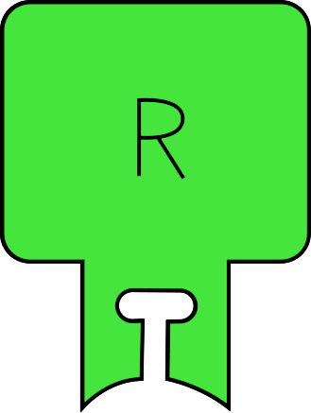
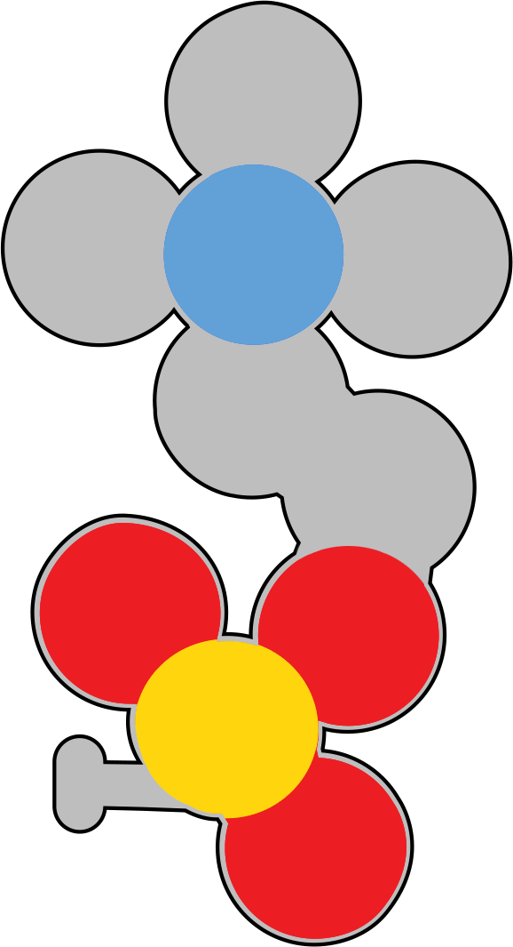
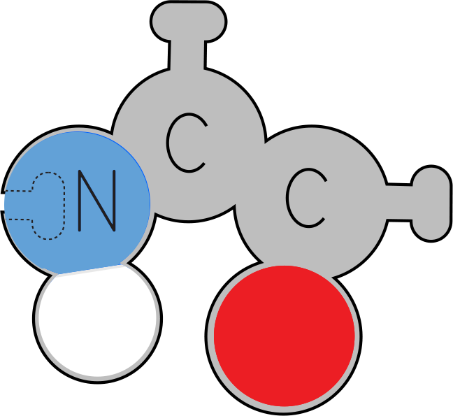
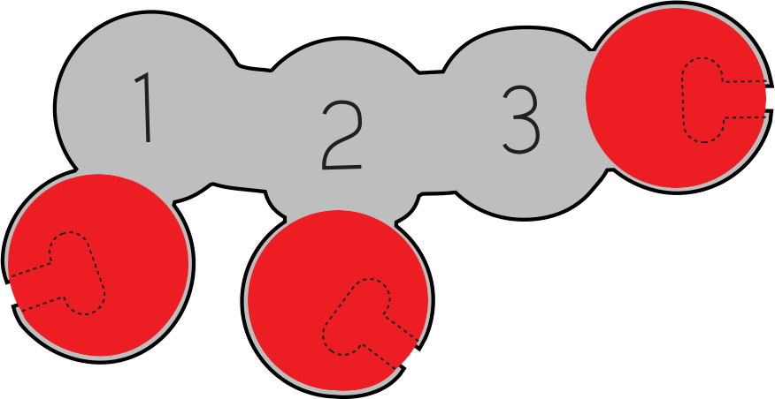

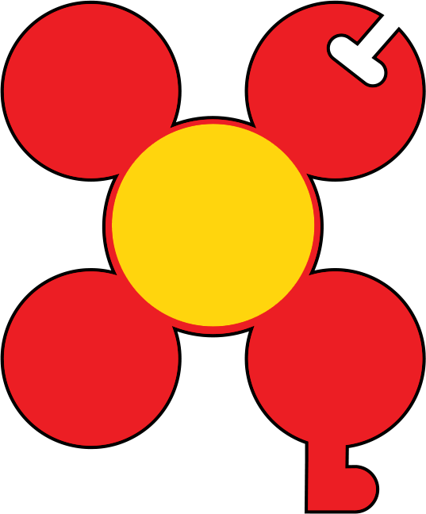

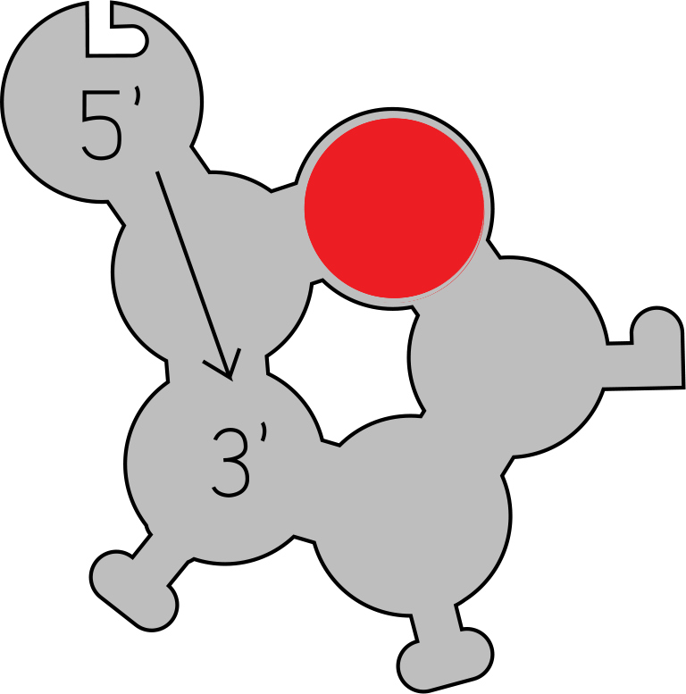
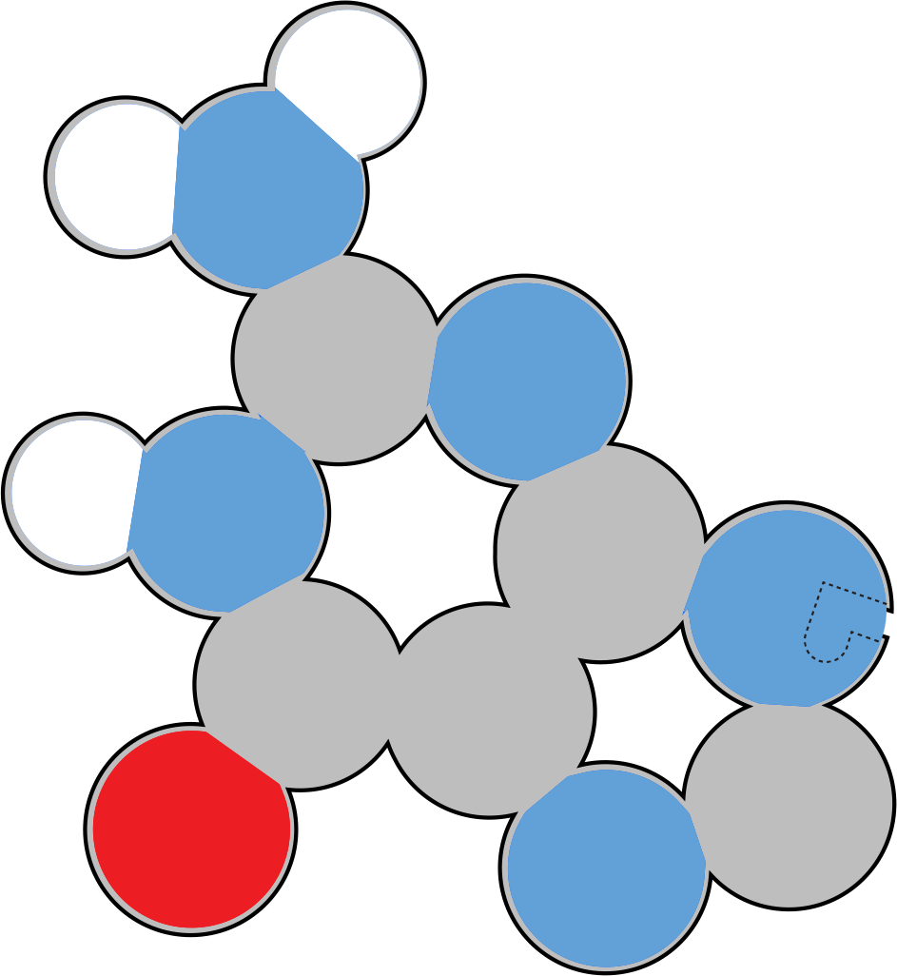

Small Molecules
Observe these small molecules.
How are they similar?
How are they different?
Notes:
Teacher: Distribute one of each of the monomers to each student group. Give students time to examine the molecules.
Student: Follow the onscreen prompt.

Slide 8
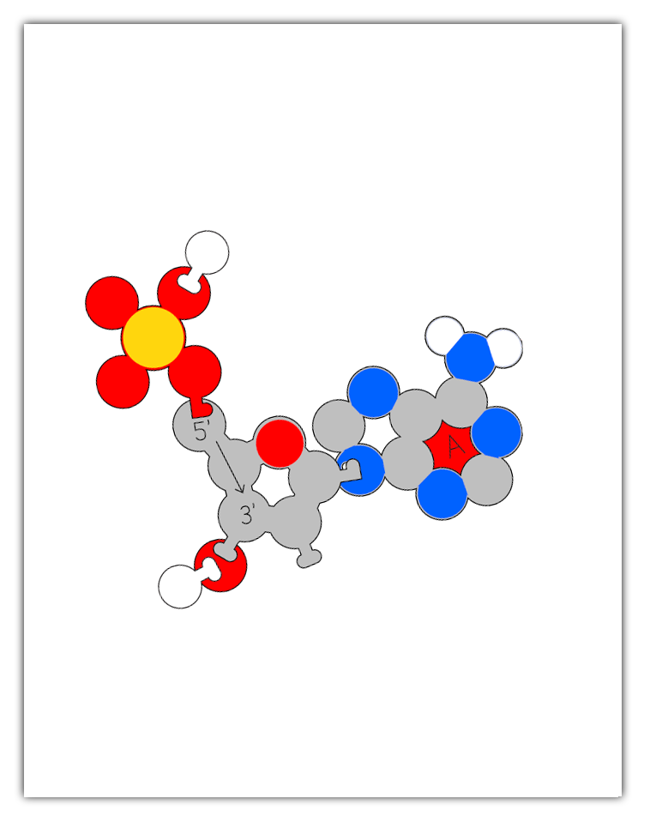
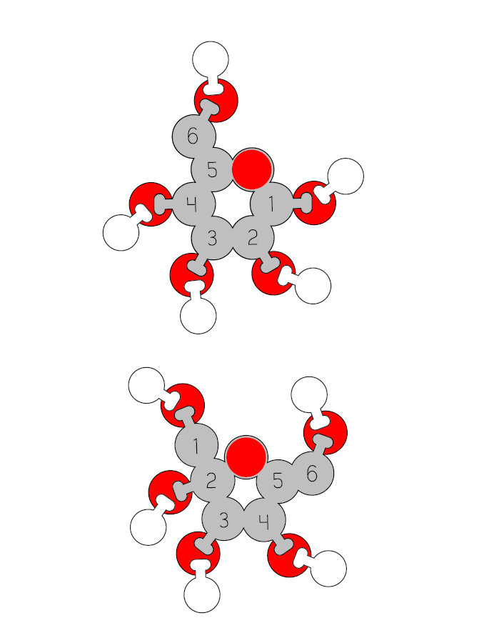
Teacher Guide - Monomer Assembly
The Molecules of Life kit involves students using molecular monomer models to build a polymer. For example, carbohydrate monomers assemble into complex carbohydrates.
Instead of giving each group of students the whole kit and having them assemble parts as needed, we recommend staging the different monomers and only distributing the parts as needed.
For this polymer activity to work properly, the initial monomer must be assembled properly. Some students may have success assembling the monomer models simply by using the illustrations on the subsequent slides.
However, if you or your students are struggling with proper monomer assembly, a PDF with printable assembly guides is freely available in the Digital Modeling Hub. These guides are sized to match the scale of the physical models (when printed with no scaling on 8.5" x 11" paper). The foam physical models can be set directly on the printed monomer graphics to help aid in proper assembly.

Slide 9

Small Molecules
Record at least 10 things you notice and at least 3 questions you wonder about in your lab notebook.
I Notice I wonder
Notes:
Teacher: Give students time to write in their notebook.
Student: Draw a t in the middle of your notebook page. Label the left side, I notice, and the right side I wonder. Write one list of things you noticed about the molecules and one list about the things you wonder.

Slide 10





Small Molecules
Carbohydrate
Phospholipid
With your lab group, identify the characteristics that two or more of these molecules have in common.
Amino Acid
Atom Color Key
Carbon
Nitrogen
Oxygen
Phosphorus
Hydrogen
DNA
Nucleotide
Notes:
Teacher: Monitor and facilitate discussion, as needed.
Optional: You may want to point out that any specific atom is the same size, whether in an amino acid or phospholipid, for example. Conversely, not all atoms are the same size. In this 2D Molecules of Life Modeling Kit, all the atoms are about the same size. For differentiation, you could assign more advanced students to research the relative sizes of the atoms shown here and how size is determined. This may also be a good time to discuss how all models are wrong, but some are useful.
Student: Discuss with your group.

Slide 11
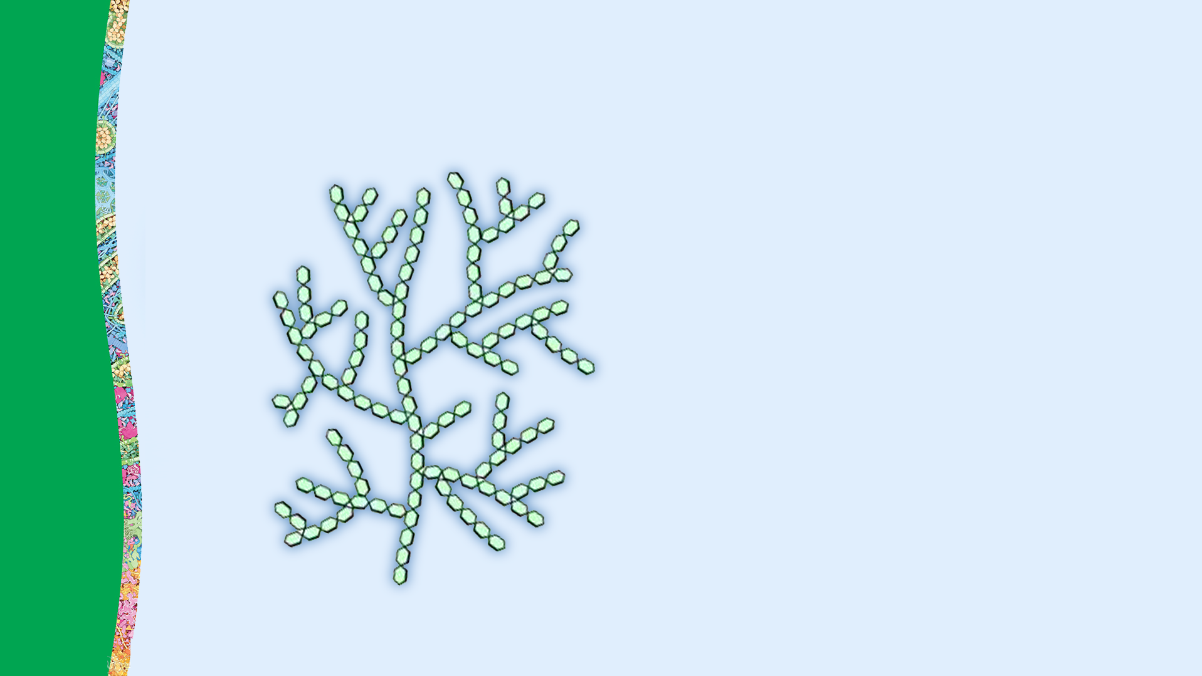
Carbohydrate Monomers and Polymers
Carbohydrates play a critical role in a cell by storing chemical energy and contributing to cell signaling.
Carbohydrate polymers are composed of carbohydrate monomers, small molecules.
Notes:
Teacher: Explain the concepts on the slide as needed
Student: Engage with the concepts as directed

Slide 12
Carbohydrate Monomers
Closely observe your models of the two common carbohydrate monomers, glucose and fructose.
What do these structures have in common?
How are they different?
Record your observations and questions in your lab notebook.
Fructose
I Notice I wonder
Glucose
Notes:
Teacher: Distribute a fructose model to each group. Give students time to think about the prompts.
Students: Compare and contrast the models.

Slide 13
Carbohydrate Monomers
What is the ratio of carbon to oxygen atoms in each structure?
How many carbons are in each ring?
How many carbons are outside of each ring?
Fructose
Glucose
Notes:
Teacher: Give students time to think and discuss with a partner or small group​​
Student: Think about questions and share as directed

Slide 14
Carbohydrate Monomers
Create a sketch of each structure in your lab notebook and label the parts.
With your lab group, draft a definition of a carbohydrate monomer based on your observations today.
Record your definition in your lab notebook. Leave room to modify & refine.
Fructose
Glucose
Notes:
Teacher: Explain the concept on the slide as needed.
Student: Sketch your model and draft a definition.

Slide 15
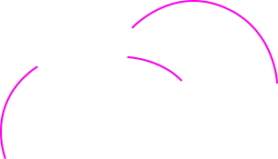

Carbohydrate Monomers
Carbohydrate monomers are:
Composed of carbon, hydrogen, and oxygen atoms, typically with a 1:1 ratio of carbon and oxygen atoms.
Form ring structures in aqueous environments, with a single oxygen atom incorporated into the ring.
Include Exocyclic carbons that are bonded to the ring structure, but are outside of the ring.
Exocyclic
Carbons
Fructose
Glucose
Notes:
Teacher: Explain the concepts on the slide as needed.
Students: Engage with the concepts as instructed.

Slide 16
Carbohydrate Monomers
Carbohydrate monomers are:
Composed of carbon, hydrogen, and oxygen atoms, typically with a 1:1 ratio of carbon and oxygen atoms.
Form ring structures in aqueous environments, with a single oxygen atom incorporated into the ring.
Include Exocyclic carbons that are bonded to the ring structure, but are outside of the ring.
Revise and add to your definition of a carbohydrate in your lab notebook.
Exocyclic
Carbons
Fructose
Glucose
Notes:
Teacher: Explain the concept on the slide as needed
Student: Edit, or elaborate on your sketch and definitions as needed

Slide 17
Carbohydrate Monomers Form Polymers
Like many biomolecules, carbohydrate monomers can be linked together to form polymers.
Using your models, create a carbohydrate polymer that links the 1 carbon of glucose to the 2 carbon of fructose.
This is often referred to as a 1-2 linkage.
Fructose
Glucose
Notes:
Teacher: Give students time to explore and create their own models.​​
Student: Follow the onscreen prompts to build a model.

Slide 18
Carbohydrate Monomers Form Polymers
Sucrose
This forms a carbohydrate polymer called sucrose, more commonly known as table sugar!
What else was produced when creating a sucrose molecule?
Notes:
Teacher: Give students time to think and discuss with a partner or small group​​
Student: Think about questions and share as directed

Slide 19
Carbohydrate Monomers Form Polymers
Sucrose
An enzyme will catalyze the covalent bond between the two carbohydrate monomers, often called a glycosidic bond.
One sucrose and one water molecule are the end products in a reaction often called dehydration synthesis.
Glucose + Fructose → Sucrose & Water
Water
Molecule
Notes:
Teacher: Explain the concepts on the slide as needed.
Students: Engage with the concepts as instructed.

Slide 20
Carbohydrate Monomers Form Polymers
Create a sketch of sucrose in your lab notebook. Label the glycosidic bond.
Add notes about how sucrose is made.
Sucrose
Glucose + Fructose → Sucrose & Water
Water
Molecule
Notes:
Teacher: Give students time to sketch and label the model in their lab notebooks.
Student: Sketch and label the model in your lab notebook.

Slide 21
Forming Complex Carbohydrates
Complex Carbohydrates form when many monomers are linked.
Amylose, a form of starch, is a complex carbohydrate made from glucose monomers linked together with a 1-4 linkage.
Using your four glucose models, build a four-monomer amylose molecule.
4x Glucose
Notes:
Teacher: Distribute the rest of the glucose models to each group. Give students time to explore and create their own models.​​
Student: Follow the onscreen prompts to build a model.

Slide 22
Complex Carbohydrate: Amylose
Observe this model of amylose and compare it to the glucose and fructose models.
What do you notice about this structure?
How could a cell make this polysaccharide?
What else is created when you made amylose?
Amylose
Fructose
Glucose
Notes:
Teacher: Give students time to think and discuss with a partner or small group​​
Student: Think about questions and share as directed

Slide 23
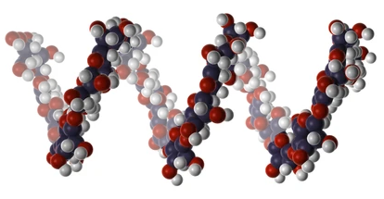

Amylose’s Exocyclic Carbons Curve Inward
Note the curved structure of amylose, with the exocyclic number 6 carbons all on the same inner side of the curve.
In 3D, this curve results in a helical structure like the illustration shown below.
Exocyclic
Carbons
Amylose
Notes:
Teacher: Explain the concepts on the slide as needed
Student: Engage with the concepts as directed

Slide 24
Complex Carbohydrates Store Energy
Complex carbohydrates like amylose are used to store energy in your body.
In your lab notebook, describe the process of building a complex carbohydrate like amylose.
Include vocabulary words you learned in this lesson.
Water Molecules
Amylose
Notes:
Teacher: Give students time to sketch and label the model in their lab notebooks.
Student: Sketch and label the model in your lab notebook.

Slide 25
Complex Carbohydrates: Amylose
How would your body digest amylose into glucose to use it for energy?
What will happen to the water molecules around your amylose models?
Use your model to demonstrate your prediction of this process. Justify your prediction in your lab notebook.
Water Molecules
Amylose
Notes:
Teacher: Give students time to explore the model and respond to the prompt​​
Student: Follow the onscreen prompts

Slide 26
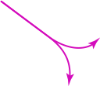
Breaking Amylose’s Bonds is Hydrolysis
Water molecules are used to break the glycosidic bonds of amylose. This is known as hydrolysis, where a water molecule is split into hydrogen and a hydroxyl group. These fragments attach to the glucose molecules.
Add this definition to your lab notebook.
Notes:
Teacher: Explain the concepts on the slide as needed.
Student: Add this information in your lab notebook.

Slide 27
Complex Carbohydrates: Glycogen
Different linkages between monomers will produce different complex carbohydrates.
For example, amylose was formed through 1-4 linkages of glucose monomers. But glycogen, a complex carbohydrate used by cells as an energy reserve, has both 1-4 linkages and 1-6 linkages.
Using your four glucose models, build a four-monomer glycogen molecule.
Notes:
Teacher: Give students time to explore and create their own models.​​
Student: Follow the onscreen prompts to build a model.

Slide 28
Different Linkages Form Glycogen
How is the structure of glycogen different than the structure of amylose?
How might this impact how a cell builds or breaks apart glycogen?
Glycogen
Notes:
Teacher: Give students time to think and discuss with a partner or small group​​
Student: Think about questions and share as directed

Slide 29

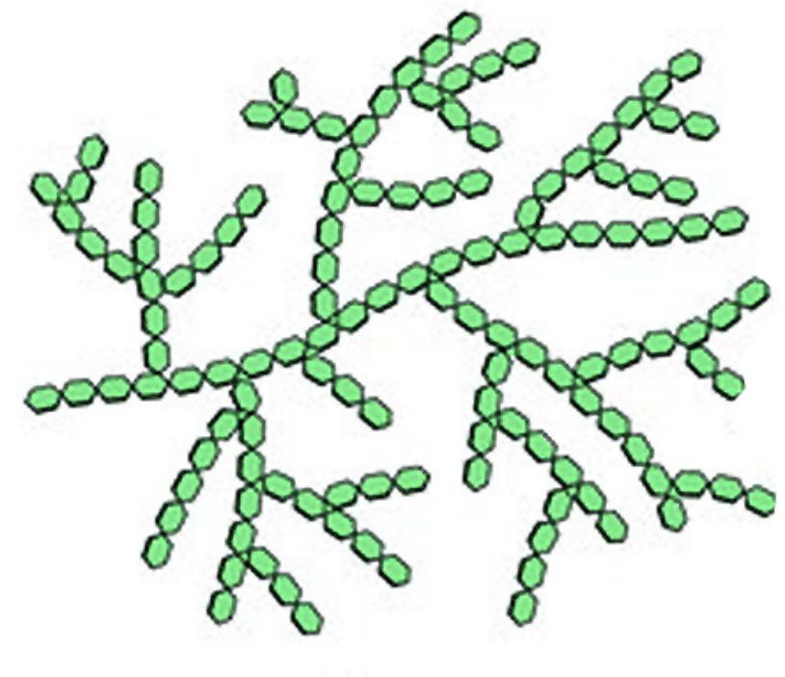
Glycogen Is a Branching Carbohydrate
Amylose
Some carbohydrates, like amylose, are linear and form long strands.
Other carbohydrates, like glycogen, are branching and form diverging strands.
Because enzymes can only break down carbohydrates from the ends of a strand, glycogen can be broken down more quickly than amylose.
Glycogen
Notes:
Teacher: Give students time to think and discuss with a partner or small group​​
Student: Think about questions and share as directed

Slide 30
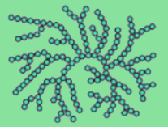
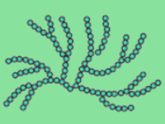

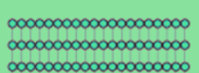
Carbohydrate Diversity
There are an almost limitless variety of complex carbohydrates, each formed by bonding different carbohydrate monomers with different linkages.
Use your glucose models to determine how the structures shown to the left might form.
Notes:
Teacher: Allow students to explore the model ​​
Student: Closely examine the images and model different ways these could be formed.

Slide 31
Carbohydrate Diversity
Select one of these complex carbohydrates and research it online.
Identify the following in your lab notebook:
  Monomers involved
  Linkages
  Pattern
  Function
Glycogen
Amylopectin
Amylose
Cellulose
Notes:
Teacher: Allow students to explore the model ​​and research the structures in a text or online.
Student: Research a structure, create a model and record information in your lab notebook.

Slide 32
Structure –Function Relationship
An important concept in biology is that structure is critical to function, enabling a structure to do its job within an organism.
In your notebook, write how you think the structures of glucose and fructose enable them to form so many different complex carbohydrates.
Fructose
Glucose
Notes:
Teacher: Give students an appropriate amount of time to think and write to the prompt in their notebook. ​​
Student: Write to the prompt.

Slide 33
Structure –Function Relationship
An important concept in biology is that structure is critical to function, enabling a structure to do its job within an organism.
In your notebook, write how you think the structures of glucose and fructose enable them to form so many different complex carbohydrates.
Fructose
Glucose
Notes:
Teacher: Give students an appropriate amount of time to think and write to the prompt in their notebook. ​​
Student: Write to the prompt.

Slide 34
Conclusions
Carbohydrate monomers like glucose are made of carbon, oxygen and hydrogen, and have a ring structure.
Carbohydrate monomers join together to form complex carbohydrates with specific linkages.
Different complex carbohydrates have different shapes.

