Slide 1

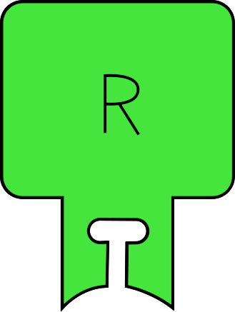
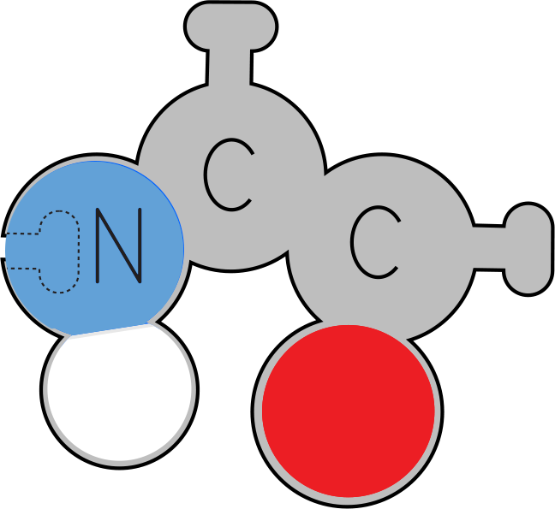

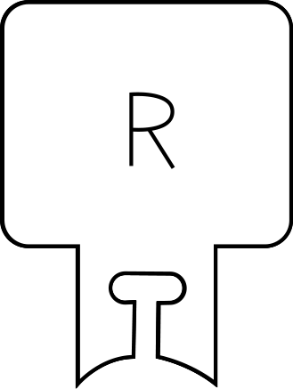



Molecules of Life:
Amino Acids
Molecules of Life Modeling Kit
“Proteins are the bricks and mortar of life; and amino acids – their building blocks – are nature’s most creative toolkit.”
- Inspired by the work of Sir Frederick Sanger

Slide 2
Molecules of Life Overview
The Molecules of Life Modeling Kit© includes components for amino acids, nucleotides, carbohydrates, and phospholipids. A dedicated slide deck for each structure can be used to guide your students’ modeling with each of the molecules. We encourage you to edit the slides as appropriate for your students and curriculum.
In addition to the primary function of each molecule, there are five overarching concepts in each slide deck.
The molecules are monomers that combine together to form polymers.
The amino acids, nucleotides, and carbohydrates combine into polymers through a dehydration synthesis process, which is catalyzed by enzymes, forming a covalent bond between each monomer. Phospholipids combine through hydrophobic and hydrophilic interactions. Covalent bonds do not join phospholipids as they combine to form bilayers.*
The monomers and polymers or macromolecules shown on the slides are all at the same scale for your students to see and compare the relative sizes of the structures.
There are repeating patterns within structures, such as the DNA backbone, and sometimes nature utilizes functional groups in multiple structures, such as the phosphate group within the DNA backbone, and also in the head component of phospholipids.
There is an essential relationship between structure and function, for the structure to perform its function within an organism.
*We suggest you save the phospholipid slide deck for last to emphasize that phospholipids do not form covalent bonds with each other when forming bilayer membranes. Dehydration synthesis occurs as an enzyme joins the functional groups of the phospholipid together.

Slide 3
Teacher Guide – Amino Acids Summary
Amino Acids are the major structural components of proteins. They are sometimes referred to as the Building Blocks of Proteins. Each of the 20 amino acids has an identical backbone, consisting of an amino group, an alpha carbon, and a carboxyl group. Individual amino acids in a protein are joined together by covalent peptide bonds. The formation of a peptide bond is catalyzed by a peptidyl transferase activity present in ribosomes.
The formation of a peptide bond can be modeled as an example of dehydration synthesis, in which a hydroxyl group (oxygen and hydrogen) from the carboxylic acid group of one amino acid, and a hydrogen from the amino group of an adjacent amino acid form a water molecule.
Following its synthesis by a ribosome, the linear sequence of amino acids spontaneously folds up into a complex 3D shape following basic principles of chemistry.
Each of the 20 R-groups, or side chains is unique. Based on the atoms in each side chain, the amino acid can be grouped into five categories:
Hydrophobic
Hydrophilic
Positive
Negative
Cysteines (with sulfur to form disulfide bonds)
Proteins, also known as molecular machines, perform critical roles in cells. They act as structural supports, enzymes, hormones, and regulators of cellular processes.

Slide 4
Teacher Guide - Overview
Objectives
Students will compare and contrast the amino acid, nucleotide, carbohydrate, and phospholipid models
Students will identify what is the same in all amino acids and what is different
Students will learn the structure of amino acids, including the
N-C-C backbone, side chains, and properties of side chains
Students will model dehydration synthesis, as they join amino acids into a polypeptide
Students will learn that polypeptides fold into 3-dimensional structures, called proteins
Students will be introduced to the concept that proteins perform critical roles in our bodies
Estimated Class Time Needed
30 minutes
Materials Needed
Molecules of Life Modeling Kit©
Related Materials
Amino Acid Starter Kit©
Amino Acid Building Block Models©
Technology Needed
None
Grade, Class
Middle School Life Science
High School Biology, Honors, AP Biology
Topics
Macromolecules
Monomers to Polymers
Dehydration Synthesis
Repeating patterns
Relative Scale

Slide 5
Teacher Guide - Using This Slide Deck

Slide 6
NGSS
Next Generation Science Standards
Science and​ Engineering Practices​ | Cross Cutting​ Concepts​ | Disciplinary​ Core Ideas​
Developing and Using Models​ ​ | Scale, Proportion and Quantity | MS & HS-LS1
Constructing Explanations and Designing​ Solutions | Structure and Function​ | MS & HS-LS1.A
Obtaining, Evaluating and Communicating Information/ Engaging in Argument from Evidence | Cause and Effect/Stability and Change | MS & HS-LS2

Slide 7
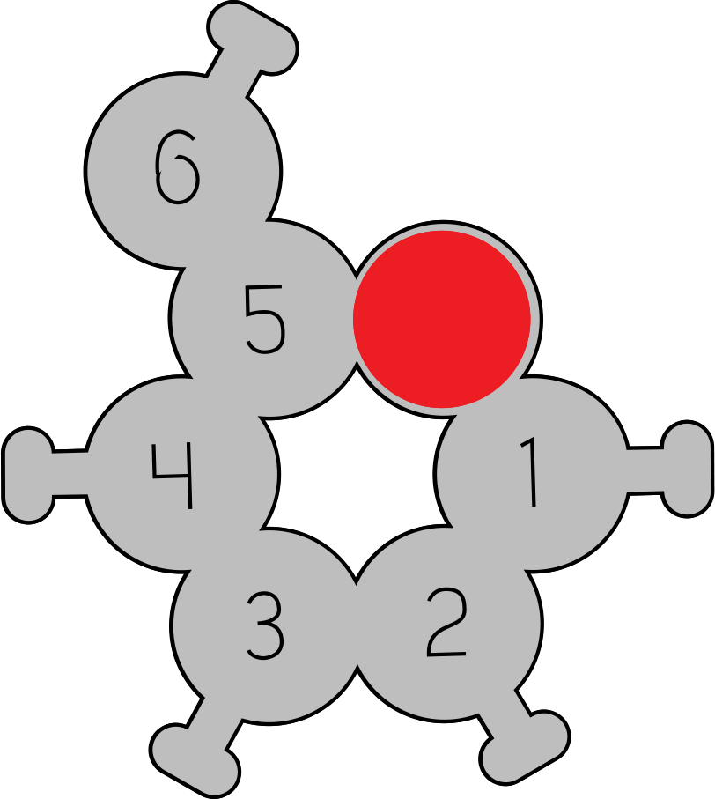
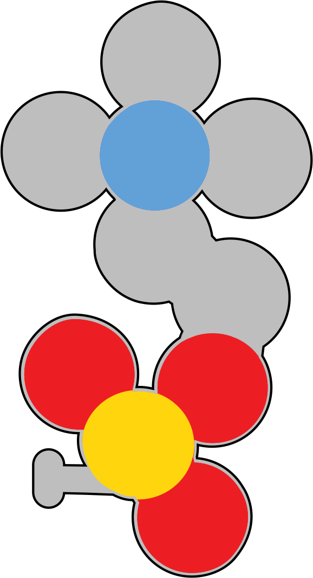
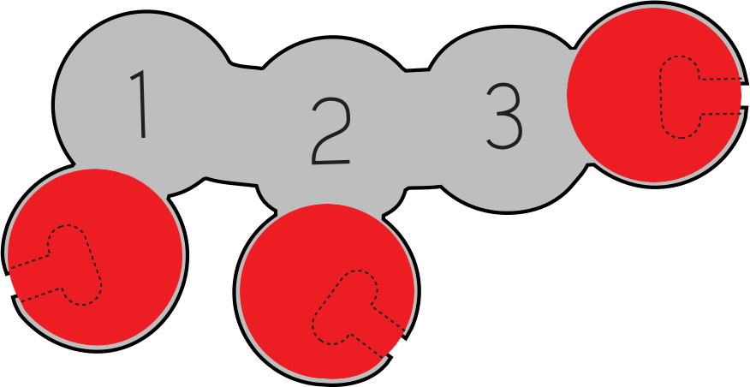

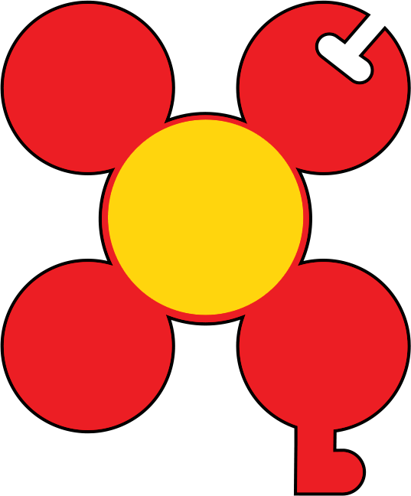

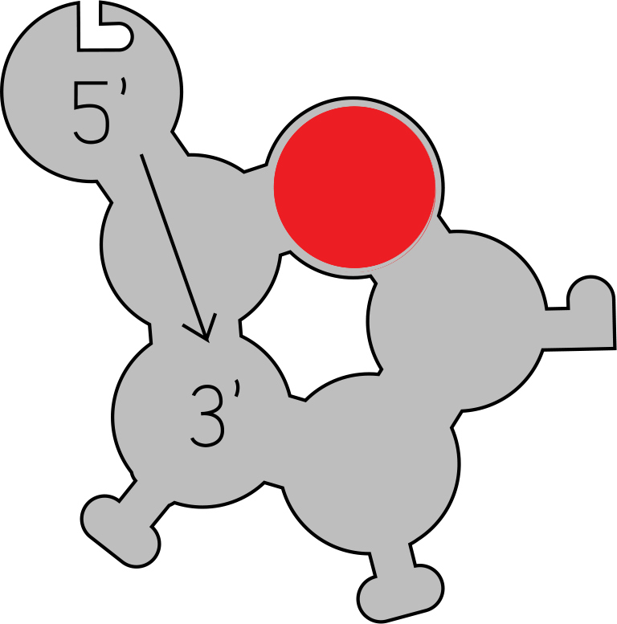
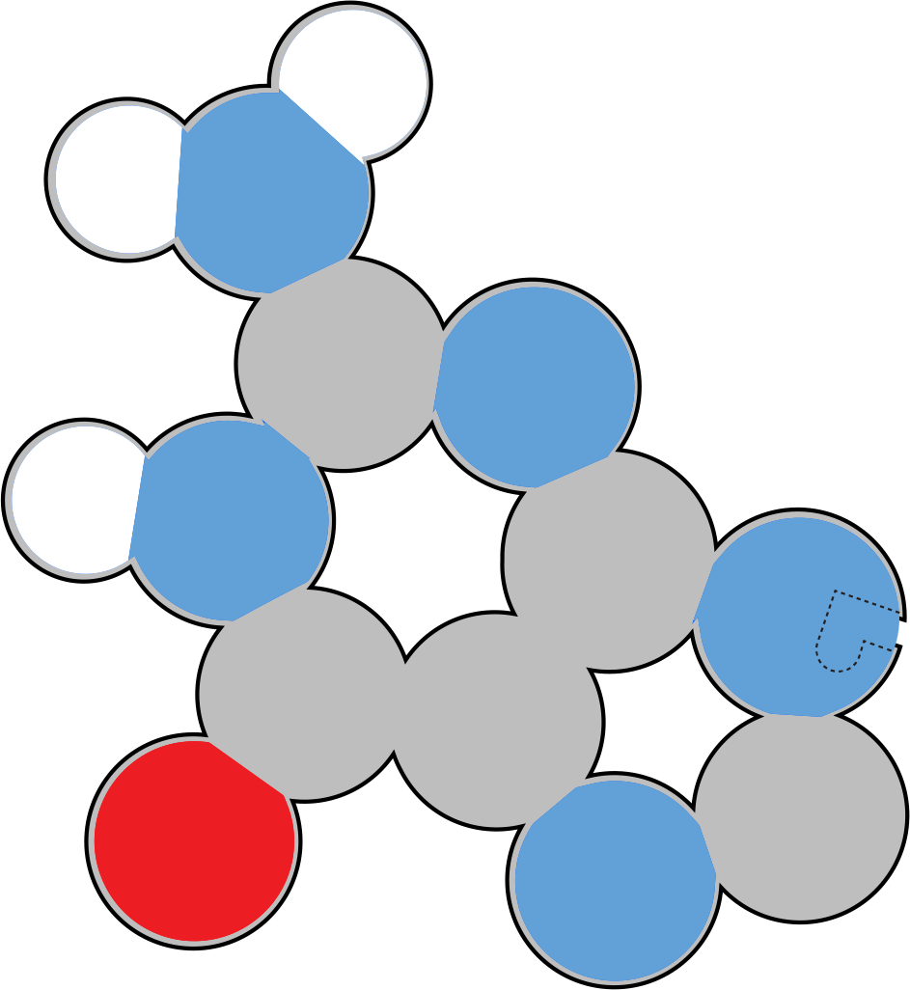

Small Molecules
Observe these small molecules.
How are they similar?
How are they different?
Notes:
Teacher: Distribute one of each of the monomers to each student group. Give students time to examine the molecules.
Student: Follow the onscreen prompt.

Slide 8
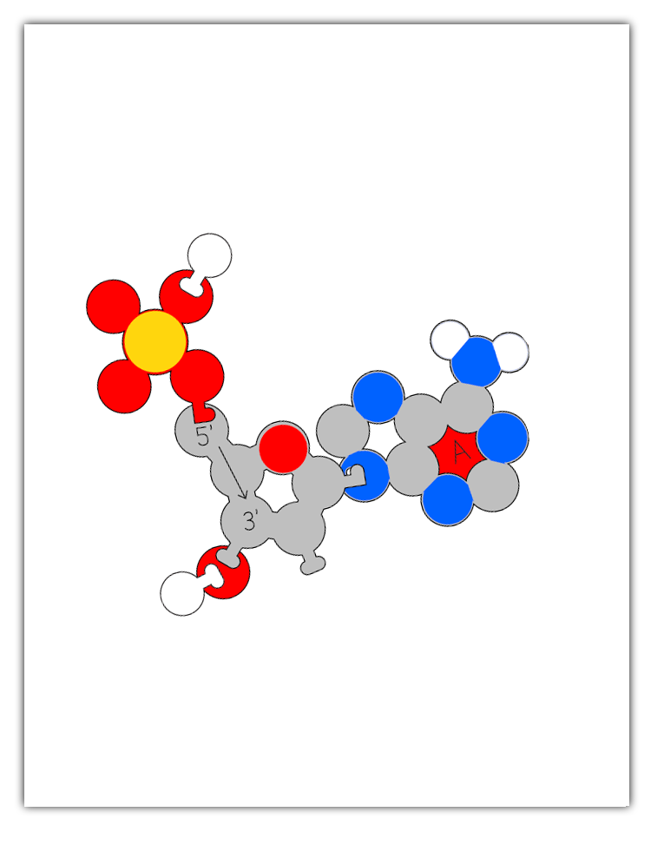
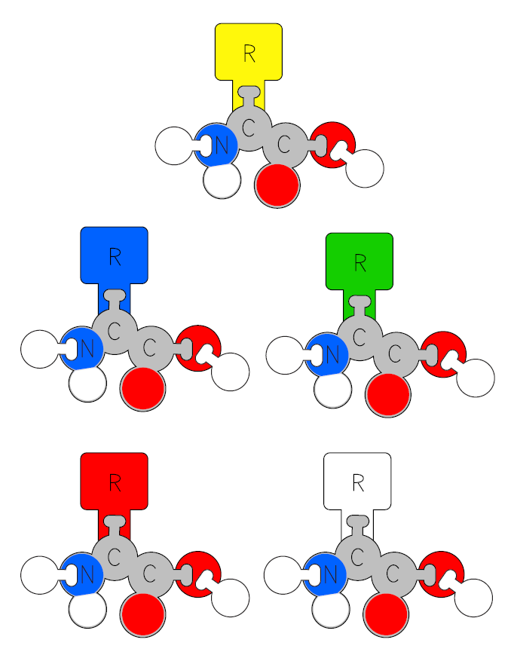
Teacher Guide - Monomer & Polymer Assembly
The Molecules of Life kit involves students using molecular monomer models to build a polymer. Amino acids, for example, assemble into protein chains.
Instead of giving each group of students the whole kit and having them assemble parts as needed, we recommend staging the different monomers and only distributing the parts as needed.
For this activity to work properly, the initial monomer must be assembled properly. Some students may have success assembling the monomer models simply by using the illustrations on the subsequent slides.
However, if you or your students are struggling with proper monomer assembly, a PDF with printable assembly guides is freely available on the Digital Modeling Hub. These guides are sized to match the physical models (when printed with no scaling on 8.5" x 11" paper). The foam physical models can be set directly on the printed monomer graphics to help aid in proper assembly.

Slide 9

Small Molecules
Record at least 10 things you notice and at least 3 questions you wonder about in your lab notebook.
I Notice I wonder
Notes:
Teacher: Give students time to write in their notebook.
Student: Draw a t in the middle of your notebook page. Label the left side, I notice, and the right side I wonder. Write one list of things you noticed about the molecules and one list about the things you wonder.

Slide 10





Small Molecules
Carbohydrate
Phospholipid
With your lab group, identify the characteristics that two or more of these molecules have in common.
Amino Acid
Atom Color Key
Carbon
Nitrogen
Oxygen
Phosphorus
Hydrogen
DNA
Nucleotide
Notes:
Teacher: Monitor and facilitate discussion, as needed.
Optional: You may want to point out that any specific atom is the same size, whether in an amino acid or phospholipid, for example. Conversely, not all atoms are the same size. In this 2D Molecules of Life Modeling Kit, all the atoms are about the same size. For differentiation, you could assign more advanced students to research the relative sizes of the atoms shown here and how size is determined. This may also be a good time to discuss how all models are wrong, but some are useful.
Student: Discuss with your group.

Slide 11
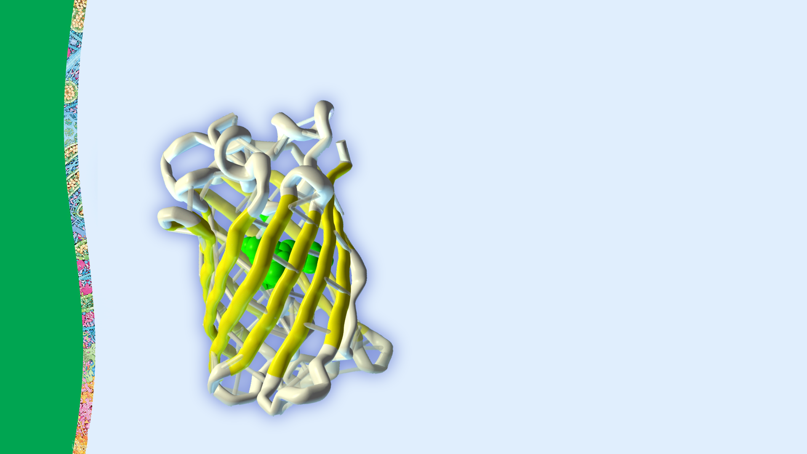
Amino Acids Assemble into Proteins
Proteins play a variety of critical roles in our cells, acting as structural supports, biochemical catalysts, hormones, enzymes, and regulators of cell processes. Our bodies couldn’t function without proteins.
Amino acids assemble into proteins.
Notes:
Teacher: Explain the concepts on the slide as needed
Student: Engage with the concepts as directed

Slide 12
Amino Acid Structure –
Similarities & Differences
Look at the five amino acids shown to the left.
What is the same on each amino acid?
What is different?
What could the R-groups represent?
Notes:
Teacher: Distribute the rest of the amino acids. Give students time to think about the prompts.
Students: Compare and contrast the models.

Slide 13
Amino Acid Parts
Each amino acid is composed of the following parts:
Amino Group
Alpha Carbon
Carboxyl Group
R-Group, or Side Chain
The backbone region of each type of amino acid is identical, but the side chains are unique.
R-Group
or side chain
Backbone
Amino
Group
Carboxyl Group
Alpha
Carbon
Notes:
Teacher: Explain the concepts on the slide as needed.
Students: Engage with the concepts as instructed.

Slide 14
Sketch Amino Acids
Sketch an amino acid in your lab notebook and label its parts.
R-Group
or side chain
Backbone
Amino
Group
Carboxyl Group
Alpha
Carbon
Notes:
Teacher: Give students time to sketch and label the model in their lab notebooks.
Student: Sketch and label the model in your lab notebook.

Slide 15
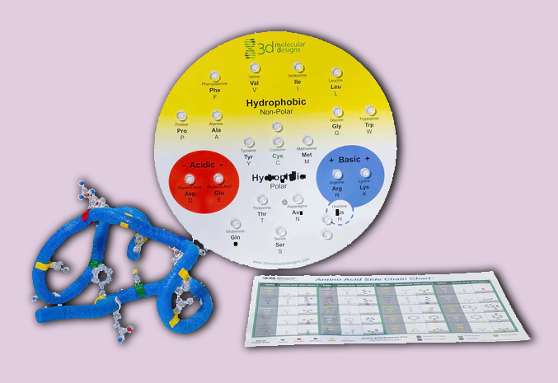
Amino Acid Starter Kit
The Amino Acid Starter kit provides a more in-depth exploration of amino acids and protein structures.
Working collaboratively, students explore the chemical properties of the 20 amino acids and how amino acid sequence ultimately determines protein structure.
Students will:
Examine patterns within and between side chains of amino acids
Use indicators like the colored clip at the base of each side chain indicating chemical properties and embedded colored sphere showing atomic structure
Group the side chains into one of 5 categories: hydrophobic (nonpolar), hydrophilic (polar), negatively charged, positively charged, and cysteines, which sometimes form disulfide bonds
Explore 3D protein structure by constructing and folding a 15-amino acid protein.

Slide 16
Amino Acids Form Polypeptides
Amino acids are the monomers that make up a protein.
Individual amino acids join together to form long protein strands called polypeptides.
Create a model of a polypeptide by connecting these amino acids.
Notes:
Teacher: Give students time to explore and create their own models.​​
Student: Follow the onscreen prompts to build a model.

Slide 17
Amino Acids Form Polypeptides
Your model might look like the image to the left.
What will happen with the oxygen and hydrogen atoms?
What is the process called?
What patterns can you identify?
Notes:
Teacher: Give students time to think and discuss with a partner or small group​​
Student: Think about questions and share as directed

Slide 18
Dehydration Synthesis Occurs when Amino Acids Form Polypeptides
The bond formed between amino acids is called a peptide bond.
As each peptide bond is formed, a hydroxyl group (oxygen and hydrogen) from the carboxylic acid group and a hydrogen from the amino group form a water molecule.
This process is called dehydration synthesis.
Peptide
Bond
Water Molecules
18
Notes:
Teacher: Explain the concepts on the slide as needed.
Students: Engage with the concepts as instructed.

Slide 19
Amino Acids Form Polypeptides
Sketch a short polypeptide in your lab notebook. Label individual amino acids and water molecules.
Add notes about peptide bonds and dehydration synthesis.
Peptide
Bond
Water Molecules
19
Notes:
Teacher: Give students time to sketch and label the model in their lab notebooks.
Student: Sketch and label the model in your lab notebook.

Slide 20
Backbone of the Polypeptide
Study this polypeptide again.
Proteins and polypeptides are described as having a backbone.
What repeating unit could be described as the backbone of this polypeptide?
Notes:
Teacher: Give students time to explore the model and ponder the question
Student: Explore the model and think about how to answer the question

Slide 21
Backbones of Polypeptides
R-Groups
or side chains
The backbone of a protein has a repeating N–C–C pattern.
The sidechains, or R-groups, branch off of this backbone.
Add this information to your lab notebook.
Backbone
21
Notes:
Teacher: Give students time to explore the model and respond to the prompt​​
Student: Follow the onscreen prompts

Slide 22
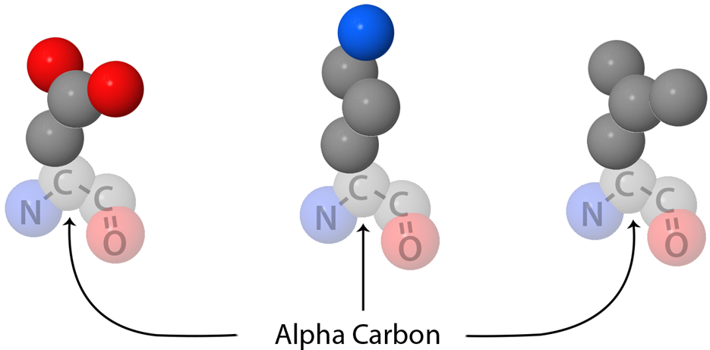
Amino Acid R-Groups
In this model, R-groups are represented by schematic shapes.
But R-groups actually come in a variety of shapes, sizes, and compositions of atoms.
But all R-groups attach to the same alpha carbon in the backbone of each amino acid.
Notes:
Teacher: Discuss new information with students​​
Student: Consider how this new information fits in with your observations, or address questions you may have.

Slide 23
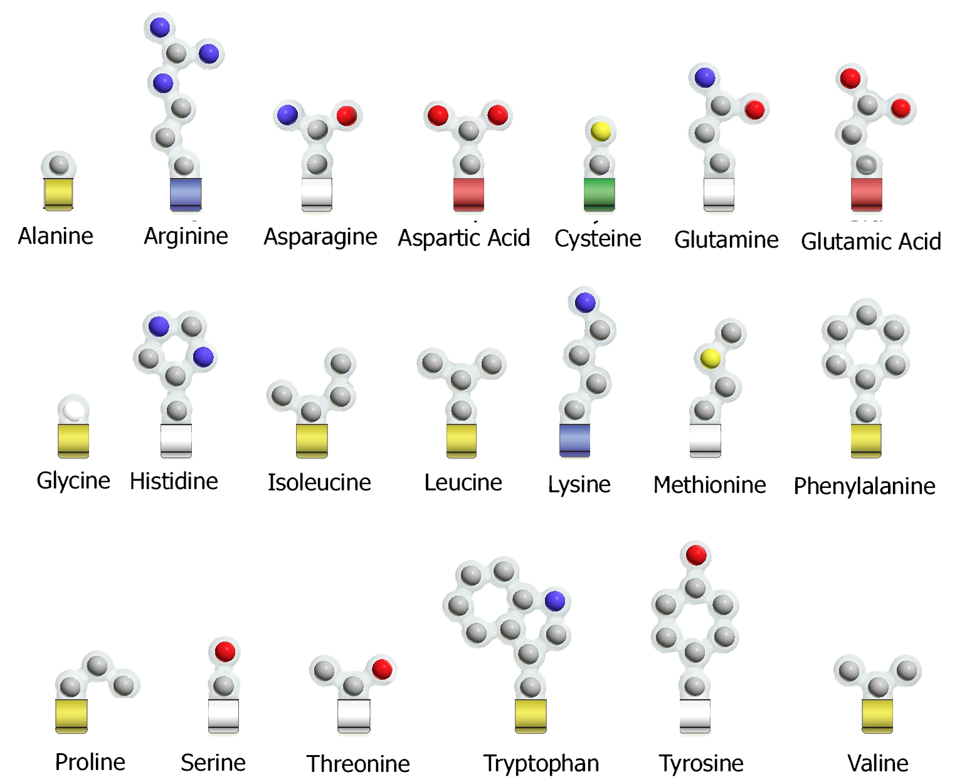





Amino Acid R-Groups
There are 20 different amino acid sidechains, or R-Groups. Based on their properties, they can be grouped into five categories.
Hydrophilic
Hydrophobic
Cysteine
Positive
Negative
Notes:
Teacher: Explain the concepts on the slide as needed
Student: Engage with the concepts as directed

Slide 24
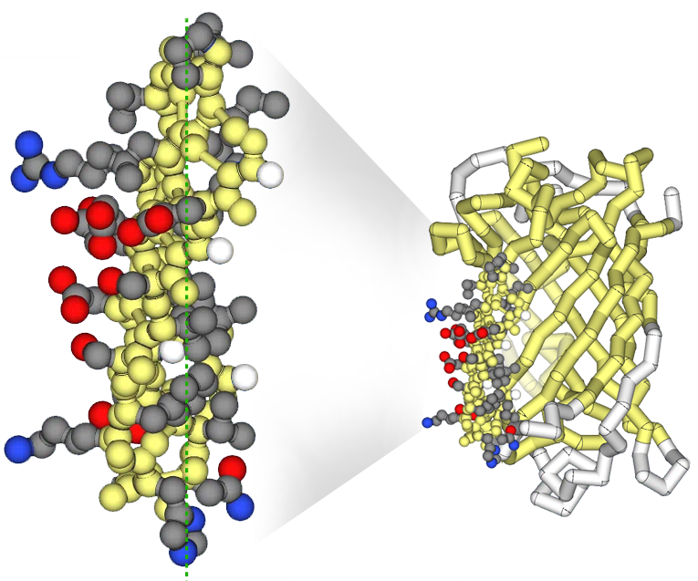
Protein Structure
Protein polypeptides do not stay as long linear strands. Rather, they fold into
3-dimensional shapes or structures.
The backbone is often depicted without side chains – a small section of the protein to the right is displayed with all the side chains.
Notes:
Teacher: Explain the concepts on the slide as needed
Student: Engage with the concepts as directed

Slide 25
Structure –Function Relationship
An important concept in biology is that structure is critical to function, enabling a structure to do its job within an organism.
In your notebook, write how you think the structures amino acids enable them to form so many different complex proteins.
Notes:
Teacher: Give students an appropriate amount of time to think and write to the prompt in their notebook. ​​
Student: Write to the prompt.

Slide 26
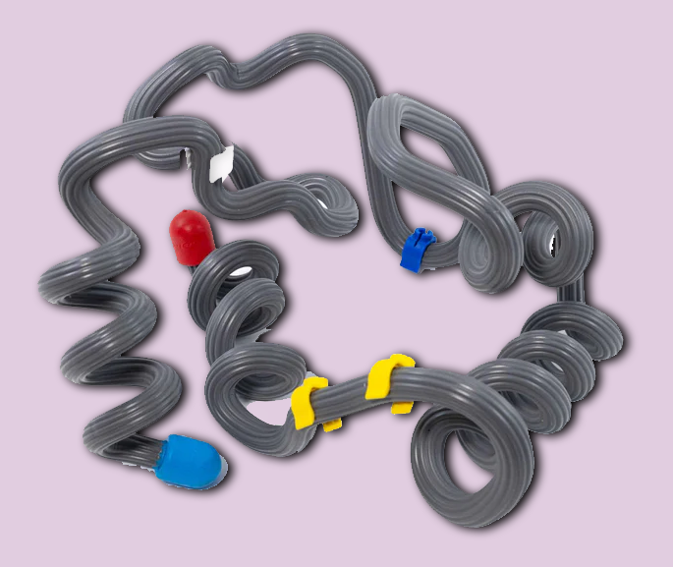
Protein Structure Modeling Kit
The Protein Structure Modeling kit provides a more in-depth exploration of protein folding and an actual protein structure.
With sturdy, flexible materials, your students will:
Review protein primary structure, identify key amino acid sidechains and mark secondary structures
Create alpha helices and its beta sheets and fold these secondary structures into a final tertiary structure shape
Explore how the protein’s structure facilitates its function and learn more about its role in an organism
Explore other proteins with computer visualizations from our Protein Exploratorium© or JUDE©, available through 3DMD’s Digital Modeling Hub©.
Notes:
Each bullet point is a hyper-link

Slide 27
Conclusions
R-Group
Alpha
Carbon
Carboxyl Group
Amino
Group
Amino acids are made up of an amino group, an alpha carbon, a carboxylic acid group and an R-group.
Amino acids are joined together to form protein polypeptides, which fold into 3-dimensional shapes.

