Slide 1

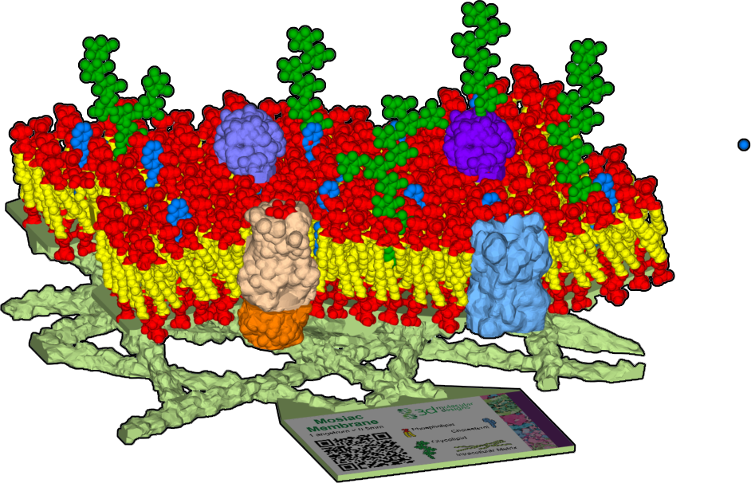

Cellular Membranes
Modeling Biological Membranes
“Life needs a membrane to contain itself so it can replicate and mutate."
– Frans Lanting

Slide 2

Teacher Guide - Overview
Activity Objectives
  Students will engineer model membranes using a provided set of structures.
  Student-constructed models highlight the flexibility and dynamic organization of the outer layer of all cells.
  Students compare membrane protein models to identify the different functions that membranes perform.
  Estimated Class Time:
45 minutes
Required Models:
The Mosaic Membrane Model
Optional Materials:
Phospholipid & Membrane Transport Kit©
Tour of a Cell Panorama ©
Grade, Class
9-12 Biology or Chemistry
Topics
Lipids are made of phospholipids that form continuous, sheet-like bilayers in water.
Hydrophobic carbon tails form a barrier between the cell interior and exterior.
Hydrophilic heads face water on either side of the membrane.
Integral and peripheral proteins insert into the bilayer forming a mosaic of structures and functions.
Phospholipid and proteins embedded within bilayers move and self-heal.
Prerequisite Knowledge
Cells are the basic unit of life
Am amphipathic, hydrophobic and hydrophilic molecules

Slide 3
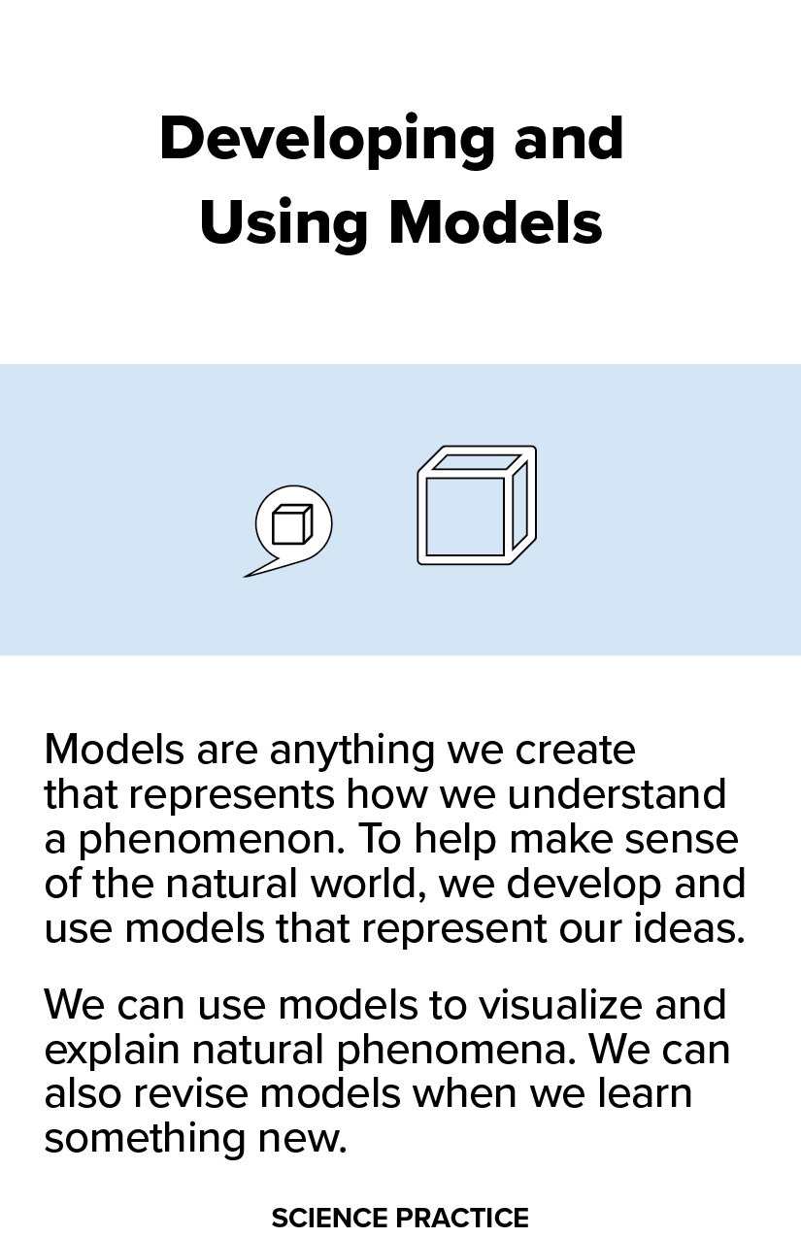
Teacher Guide – Modeling Biological Membranes
In this activity, you can invite your students to engage with a tactile membrane model that will help them understand the basic properties, structures and functions of a biological membrane in cells. They will design their own membrane and explore how changing the membrane components will alter the functions supported by their membrane. They will evaluate the limitations of the model and apply their knowledge to make claims about real cell types and membrane proteins functions.
This activity presumes an understanding of amphipathic, hydrophobic and hydrophilic molecules but this can be introduced as background if desired, using the small phospholipid pieces. Each phospholipid has two hydrophobic (non-polar) tails and one hydrophilic (polar) head. The phospholipids form two layers, with their hydrophobic tails always facing the membrane’s hydrophobic core.
What is a scientific model? These are tools used to communicate ideas or hypotheses, to make predictions, or to explore relationships.
“Models can be valuable in predicting a system’s behaviors or in diagnosing problems or failures in its functioning, regardless of what type of system is being examined.”
National Research Council. 2012. A Framework for K-12 Science Education: Practices, Crosscutting Concepts, and Core Ideas. Washington, DC: The National Academies Press. https://doi.org/10.17226/13165.
https://www.biointeractive.org/classroom-resources/using-three-dimensional-learning-cards-science-classroom

Slide 4
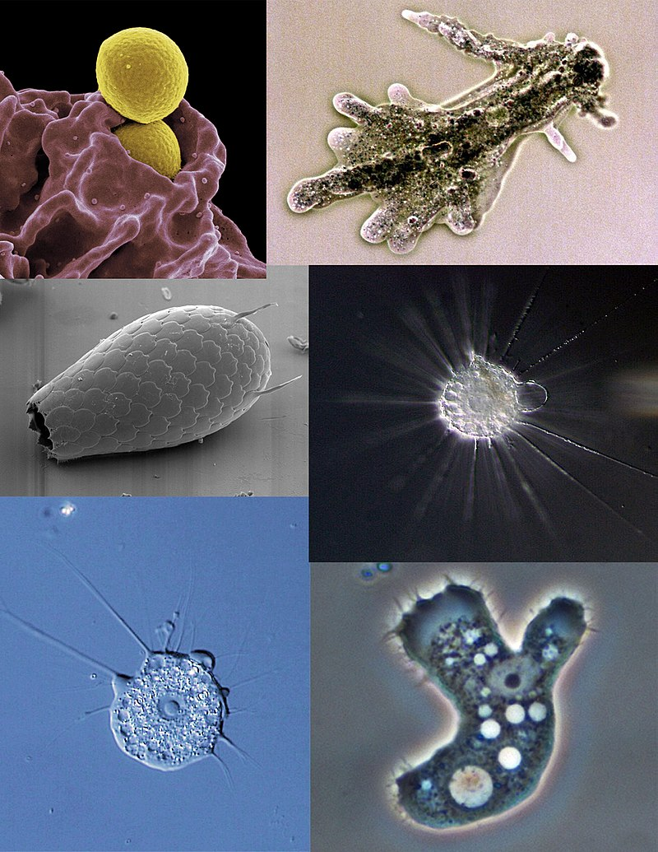
Teacher Guide – Part 1 Introducing Cells
A cell is the basic unit of life. All cells share certain common features because being alive has certain predictable characteristics and needs. A whole human is made up of around 200 different types of cells – that vary in their shapes, sizes and functions. Circuits of nerves send signals across the body. Within a single organ, your cells have specific functions. Some cells in your pancreas secrete digestive enzymes at just the right time, others respond to changes in blood sugar by processing incoming messages and sending signals to adjust in real time.
What is the weirdest cell known? Perhaps it is the giant amoeba (Amoeba proteus). This organism spends its whole life as a single cell that can grow large enough to be seen without a microscope (around a millimeter – the smallest metric division on a ruler). It doesn’t really have a shape because it is a shapeshifter. It can send extensions in all directions at the same time, or in a single direction, as it crawls across surfaces toward prey or away from danger. How does this giant cell sense and respond to its environment? The answer lies in the stretchy covering that surrounds its liquidy interior.

Slide 5






Teacher Guide - Using This Slide Deck
Student and Teacher Slide Deck Pages
  Slides that are meant for student viewing will feature a green top
  banner. Slides that are meant only for teacher viewing will feature a
  purple top banner and will appear hidden when in "slide show" mode.
Prompting Icons
  Each student slide will include a prompting icon in the top right corner of the slide. These icons on each slide cue your students to the type of activity they will be doing.
Turn and talk discussion
Write in your notebook
Quiet thinking time
Digital modeling
Physical modeling
Teacher Moves and Student Moves
Class slides provide notes (teacher notes below the slide) with specific information to assist you in facilitating the activity using effective modeling and education practices.

Slide 6
Teacher Guide – NGSS Standards
Science and Engineering Practices | Cross Cutting Concepts | Disciplinary Core Ideas
Developing and Using Models Develop and use a model based on evidence to illustrate the relationships between systems or between components of a system. (HS-LS1-2) | Structure and Function Investigating or designing new systems or structures requires a detailed examination of the properties of different materials, the structures of different components, and connections of components to reveal its function and/or solve a problem. (HS-LS1-1) | LS1.A: Structure and Function Systems of specialized cells within organisms help them perform the essential functions of life. (HS-LS1-1) HS-LS1-2: Develop and use a model to illustrate the hierarchical organization of interacting systems that provide specific functions within multicellular organisms.

Slide 7


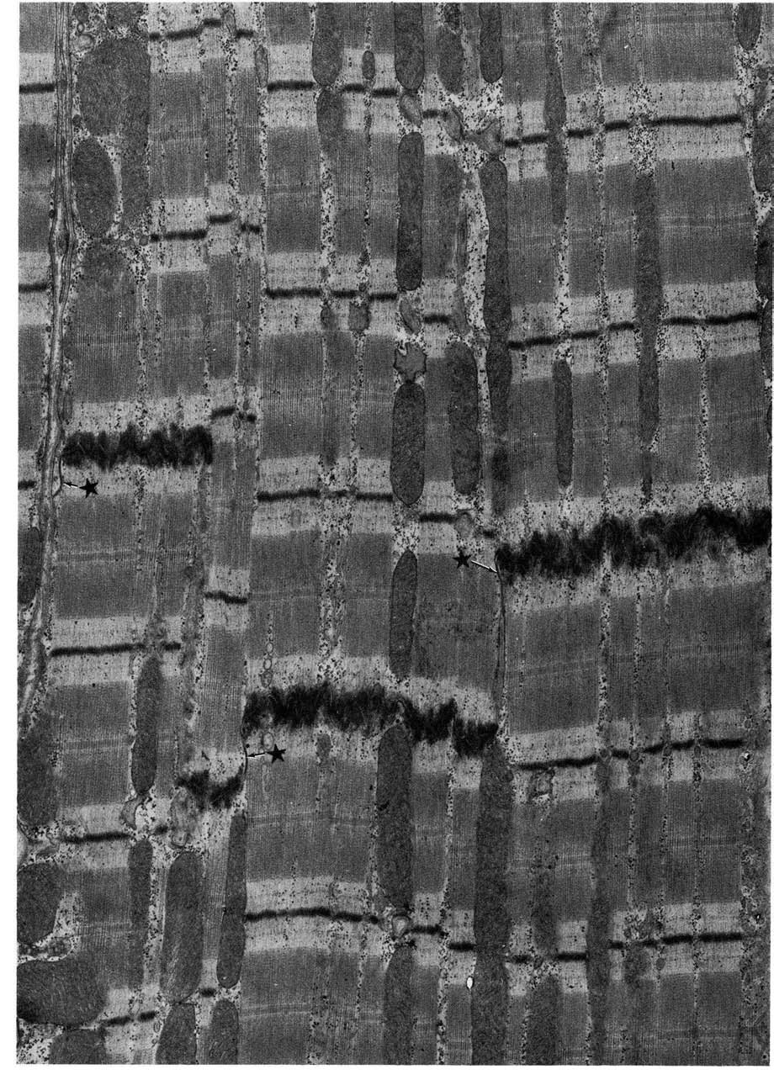
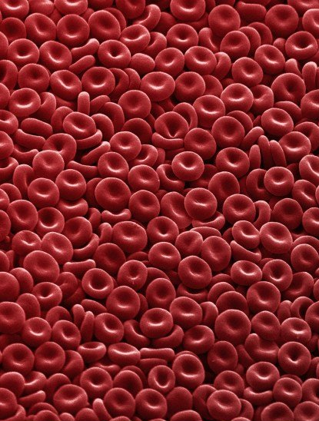
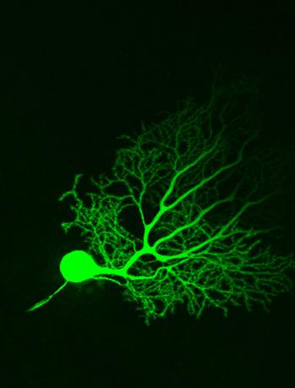
Types of Cells
List as many different types of cells as possible
All images from www.cellimagelibrary.org
Notes:
Teacher: Give students an appropriate amount of time to think, discuss with a partner or small group, and write a response to the prompts.​​ Record a list on the board.
Student: Compare and contrast. Discuss your ideas with a partner or small group. Write a response to the prompts in your notebook.

Slide 8
Cell Structures
What structures do all these cells have in common?
All images from www.cellimagelibrary.org
Notes:
Teacher: Facilitate discussion until they identify cell membranes.
Students: Contribute to class discussion.

Slide 9

Cell Functions
Select 4 cell types and record their function in your notebook.
Leave room for more columns.
Do you think that the cell membrane in each of these cells functions the same way?
Cell Type | Function
Notes:
Teacher: Give students time to copy the table into their notebook. Alternatively, Print this slide off for students.​​
Student: Follow the onscreen prompt or tape the table into your notebook if it was provided as a handout.

Slide 10
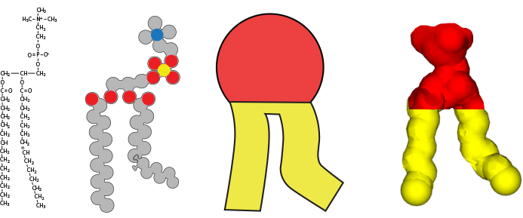
Phospholipids
Examine these different representations of a phospholipid molecule.
What do the different colors represent?
Why do we need different models of phospholipids?
Notes:
Teacher: Facilitate discussion: (models from left to right)
Chemical Drawing
Schematic Spacefill – Gray carbon, red oxygen, blue nitrogen, yellow phosphorous
Schematic – Red Polar, yellow non-polar
Spacefill - Red Polar, yellow non-polar
Student: Contribute to class discussion

Slide 11
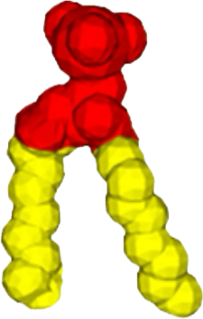
Membranes are Made of Phospholipids
The hydrophilic (polar) head regions of the phospholipid point toward water.
The hydrophobic (non-polar) tails point away from water to form the bilayer.
Hydrophilic
Hydrophobic
Hydrophilic
Notes:
Teacher: Facilitate discussion​​
Student: Contribute to class discussion

Slide 12
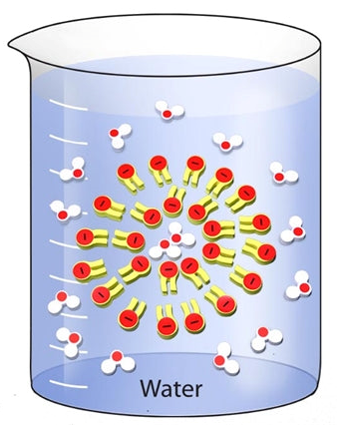
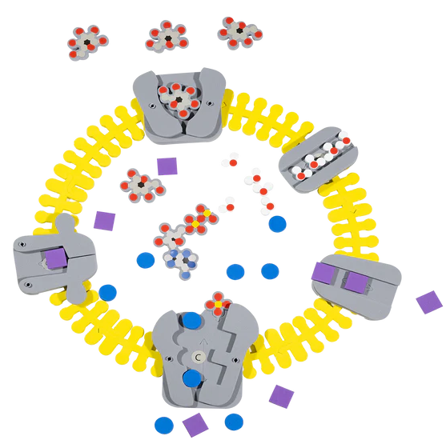
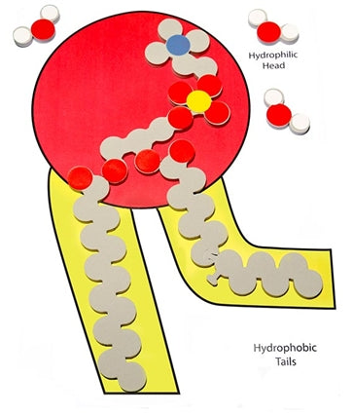
Extension – Phospholipid & Membrane Transport Kit
Membranes and cell processes become memorable as students build and revise their models.
Students uncover the structure and function of phospholipids, how cell membranes form, and how water and ions move in and out of cells via transport proteins. Students can model different conditions and then predict which way water will move, making vocabulary like hypertonic, hypotonic, and isotonic more memorable.
50 individual phospholipid molecule models demonstrate hydrophobic and hydrophilic concepts to create monolayers, micelles, and bilayers
Water molecule models show polarity and how water interacts with cell membranes
The bilayer membrane model creates a cell structure that is flexible yet sturdy
Active and passive transport is made easy with 5 different proteins, ion models, and ATP

Slide 13
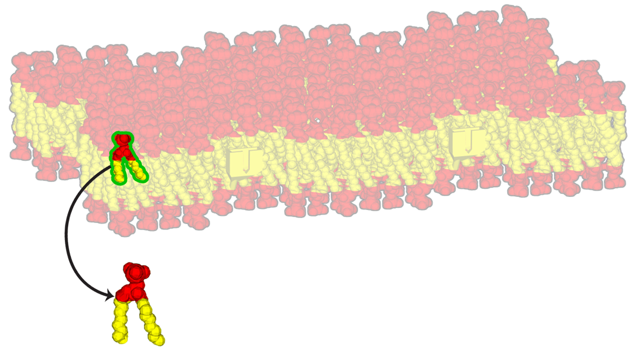
Explore
Explore this model of a cellular membrane and the phospholipid models.
How do they compare?
Notes:
Teacher: Allow students to explore the model ​​
Student: Closely examine the model and write down what you notice

Slide 14

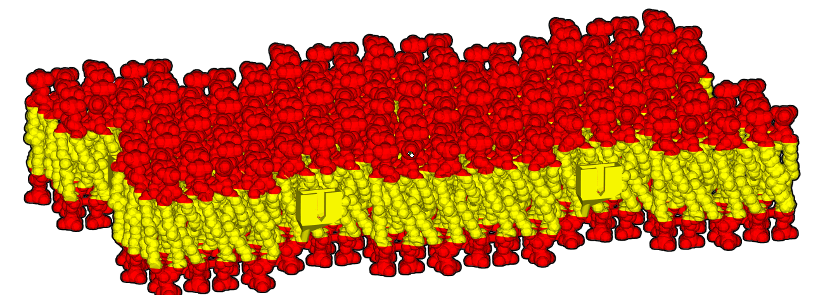
Notice | Wonder
Create a Notice | Wonder Chart and record your observations and questions about this model and membranes.
I Notice I wonder
Notes:
Teacher: Give students time to copy the table into their notebook. Alternatively, Print this slide off for students.​​
Student: Follow the onscreen prompt or tape the table into your notebook if it was provided as a handout.

Slide 15
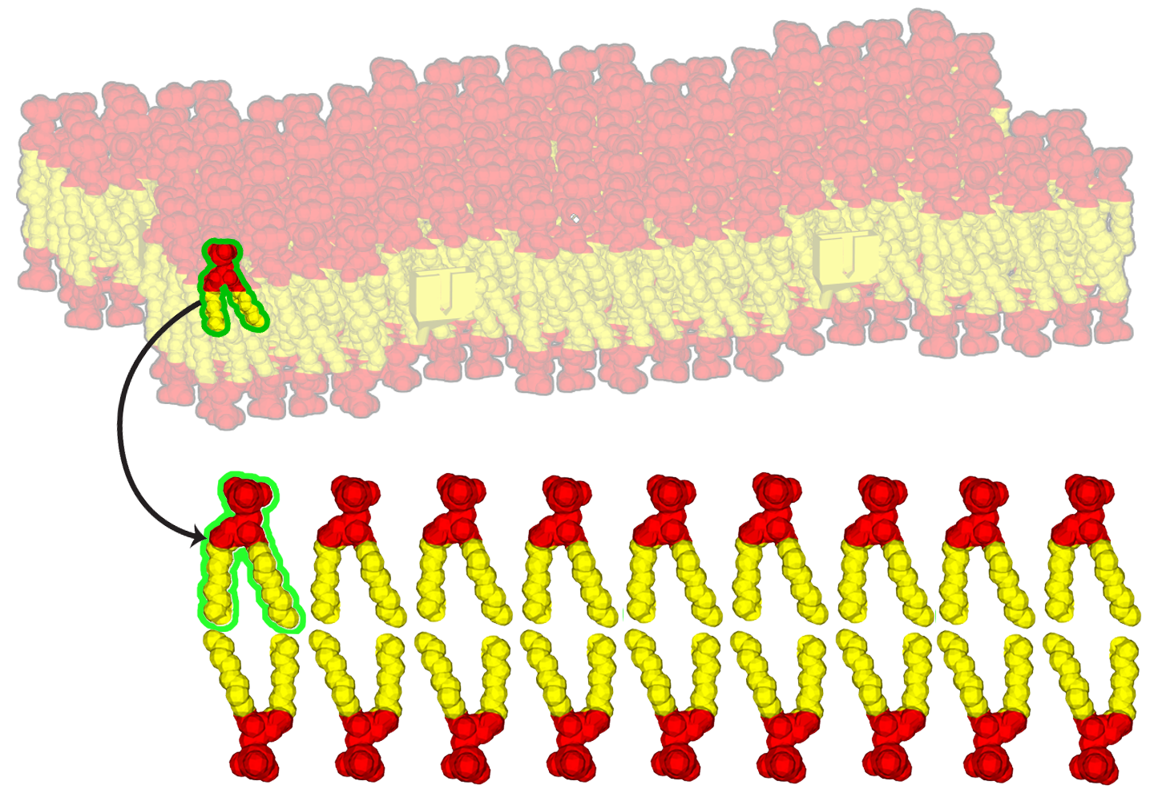
Membrane Integrity
Membrane integrity – the ability to stay together and form a surface – results from the way phospholipids come together, heads facing out and tails facing in.
This results in a highly flexible structure, allowing cells like the amoeba to shape-shift and engulf prey.
Why might this structure be called a bilayer?
Notes:
Teacher: Facilitate discussion​​
Student: Contribute to class discussion

Slide 16
Model Scale
Sketch a side view of this model in your notebook.
Use a ruler to measure the width of your model and record this information in your notebook.
Sketch
Notes:
Teacher: Measure the width of the membrane: _________ (3.5 cm). That’s 35 mm, 35,000 μm or 35,000,000 nanometers in width. This membrane is magnified 10 million times! Calculate the magnification of this model. You can approach this as a challenge question or show them how (see teacher support slide).
Teacher: Give students time to think and respond to the prompt​​
Student: Write a response in your notebook
Student:

Slide 17
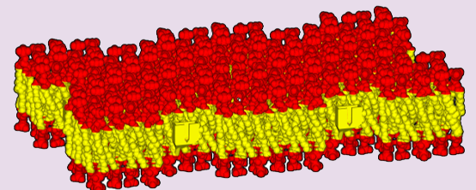
Calculating the scale of this model
The actual thickness of a cell membrane is 10nm. The measured thickness of physical model = 4.5 cm (or 45 mm). This is 45,000 μM or 45,000,000 nm
Divide the thickness of the model by the actual thickness of membranes:
45,000,000 nm / 10 nm = 4.5 milion-fold magnification!
20 cm
10 cm
3.5 cm

Slide 18
What is the scale of this model?
If the actual thickness of a cell membrane is 10 nanometers, how many times larger than real life is your model?
Record your answer in your notebook.
10 nm
Notes:
Teacher: Measure the width of the membrane: _________ (3.5 cm). That’s 35 mm, 35,000 μm or 35,000,000 nanometers in width. Divide by the ACTUAL thickness of a membrane (10 nm) and you get 3.5 million times magnified. At this scale, the amoeba with this membrane (which can read up to 300 μm in diameter) would be 1,050,000,000 nm in diameter (but we would never use nanometers to describe something so big!). To really see an amoeba you need to use a microscope (though larger ones might appear as specks in a jar of pond water held against the light).
Student: Write a response in your notebook

Slide 19

Membrane Movement
In a real membrane, phospholipids can rotate in place or drift along through the bilayer. In our mighty model, the phospholipids are anchored in place to keep the structure together so that you can lift it!
Notes:
Teacher: Facilitate discussion​​
Student: Contribute to class discussion

Slide 20
Fluid Membranes
Membranes are described as fluid because of the movements of phospholipids.
Can you think of some advantages or disadvantages of phospholipid movements?
Notes:
Teacher: This structure might feel risky for cells (but all cells use the same basic organization!). That said, at high temperatures…
Student: Contribute to class discussion

Slide 21
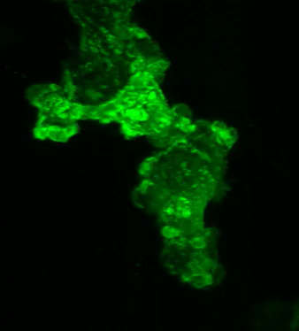
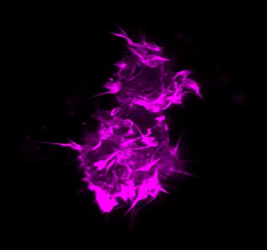
Flexible Membranes
https://www.cellimagelibrary.org/images/54602
https://www.cellimagelibrary.org/images/54604
Notes:
Teacher: Observe the the videos of cells and describe what you see. Record your descriptions in your notebook..
This activity helps with orienting students to the differences between observations and making inferences about function/behaviors.
Student: Contribute to class discussion

Slide 22
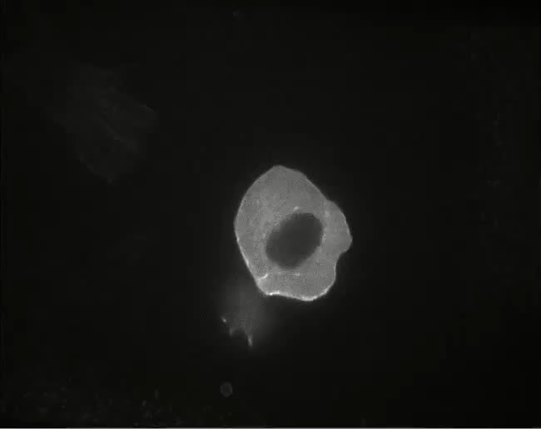
Cells Crawl!
During development, cells move to their final destination, like this cell from a fish embryo.
https://www.cellimagelibrary.org/images/7792
Notes:
Teacher: This cell is moving within a developing embryo. What do you notice about the way the cell moves? (the white appearing edge contains actin filaments, proteins that tell the cell which direction to move in).
Student: Describes and contributes to class discussion (example: it seems to be moving in the direction of the white-appearing edge).

Slide 23
Cell Movement
Amoeba proteus are giant single-celled organisms that move by sending out cytoplasm-filled, membrane extensions called pseudopods, or false feet).
This type of crawling motion across surfaces is common in large, complex cells including slime molds, cancer cells and even cells of our immune system.
Why would a cell need to move?
SmallRex, CC BY-SA 4.0 <https://creativecommons.org/licenses/by-sa/4.0>, via Wikimedia Commons
Notes:
Teacher: Amoeboid movement is common in lots of cells (like slime molds, cancer cells and even cells of our immune systems.
Students: Typical student responses are cells searching for food or moving away from threats.

Slide 24
Cell Membrane Functions
Membranes are flexible and fluid.
Add this to a column in your chart and make notes about if/how this applies to each of your identified cell types.
Cell Type | Function
Notes:
Teacher: Give students time to copy the table into their notebook. Alternatively, Print this slide off for students.​​
Student: Follow the onscreen prompt or tape the table into your notebook if it was provided as a handout.

Slide 25
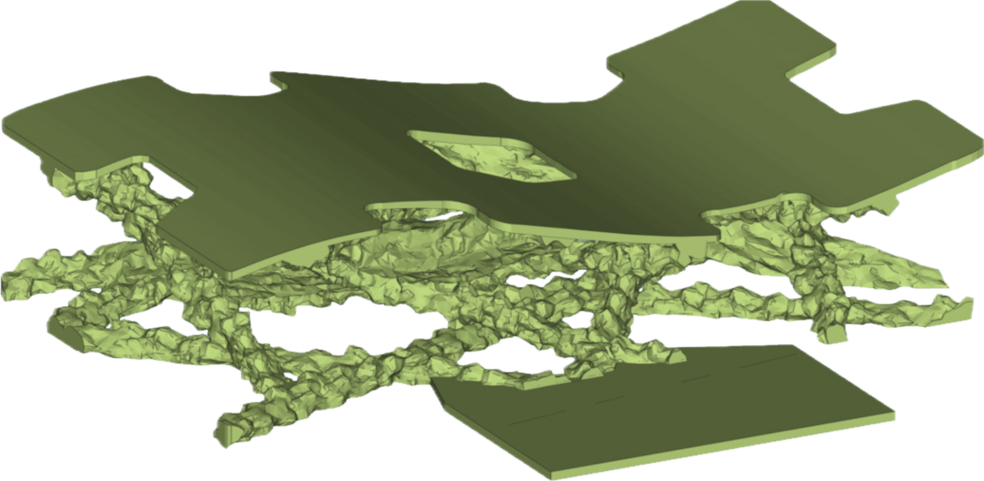
Cytoskeleton
Lay your membrane on the green base. The base represents the cytoplasmic face of the membrane. Inside the cell, proteins of the cytoskeleton make up an intracellular matrix that supports the membrane and gives the cell its shape.
How would you describe the green structure?
What properties do you think this meshwork of proteins gives the cell?
Notes:
Teacher: Link to one of David’s Landscapes….showing elements of the intracellular matrix
Student: Contribute to class discussion

Slide 26
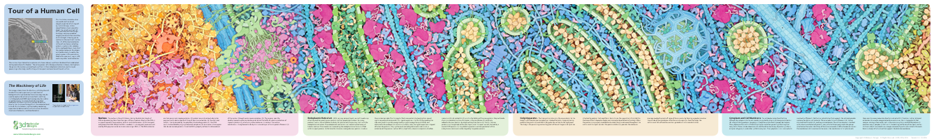
Extension: Tour of the Human Cell Panorama
Contrary to most cell models students see, cells are busy, crowded, and fascinating places! Invite students to journey from the nucleus to the outer cell membrane with this beautiful watercolor poster by scientist, and artist David Goodsell, PhD example of the immunology of your flu shot. Printed by 3D Molecular Designs. The Panorama© and Grand Panorama© capture students’ imaginations as they:
  Identify how DNA is wrapped around histones forming nucleosomes
  Explore RNA polymerase unwrapping the DNA and making mRNA
  Examine mRNA moving through nuclear pore complexes to ribosomes, the site or protein production
  Discover antibody proteins delivered into the endoplasmic reticulum
  Observe vesicles carrying these proteins through the Golgi
  Notice the kinesin motor proteins pulling the antibodies to the cell membrane to be released
Captivating shapes and colors tell the story of cell organelles working as a system to prepare antibodies as an immune response. Dr. Goodsell creates cellular landscapes that accurately illustrate the size, shape, and distribution of proteins in the cells. These unique images connect the molecular world, inferred by X-ray crystallography and NMR spectroscopy, with the cellular world, observed by light and electron microscopy.

Slide 27
Cell Membrane Functions
Cell membranes are supported by a cytoskeleton.
Add this to a column in your chart and make notes about if/how this applies to each of your identified cell types.
Cell Type | Function
Notes:
Teacher: Give students time to copy the table into their notebook. Alternatively, Print this slide off for students.​​
Student: Follow the onscreen prompt or tape the table into your notebook if it was provided as a handout.

Slide 28
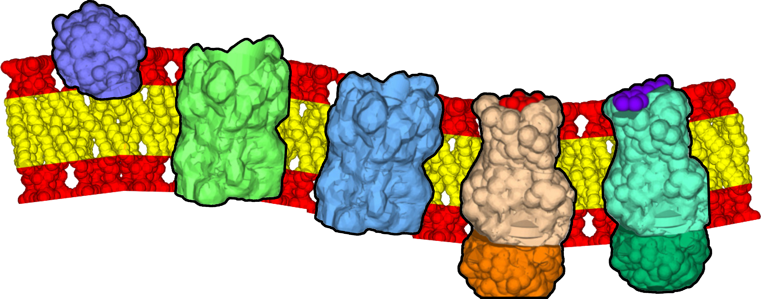
Cell Membranes are More than Phospholipid Bilayers
Proteins can embed peripherally (on a membrane edge) or integrally (embedded within the hydrophobic tails). Integral membrane proteins contain hydrophobic regions to hold them in place.
Peripheral protein
Transmembrane proteins
Notes:
Teacher: Facilitate discussion​​. What do you think holds peripheral membrane proteins in place?
Student: Contribute to class discussion

Slide 29
Membrane Proteins
Receptors bind incoming signals from outside the cell and communicate responses on the inside.
Channels allow charged or polar molecules to pass through the bilayer.
Channels
Receptors
Outside
Inside
Notes:
Teacher: Facilitate discussion​​
Student: Contribute to class discussion

Slide 30
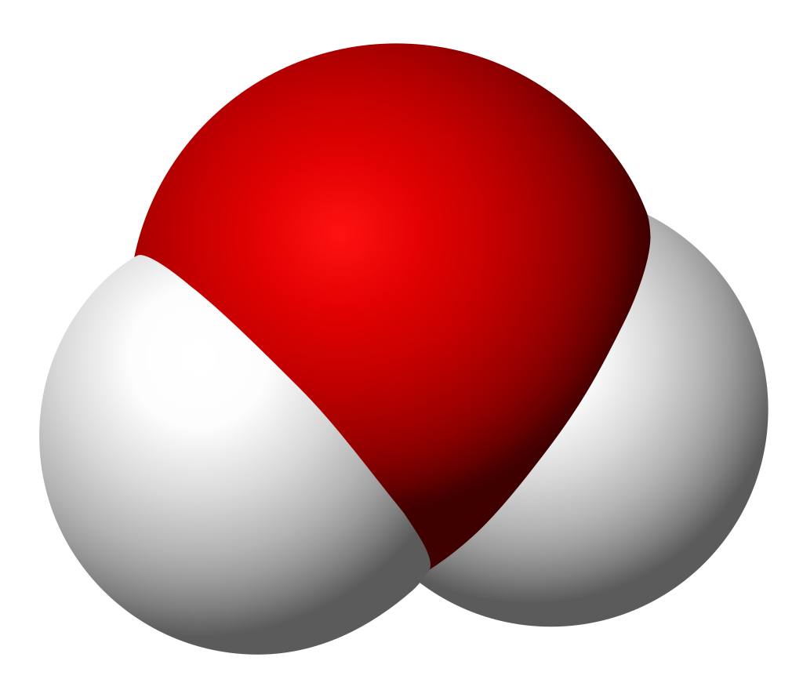
Channel Proteins
Small molecules like oxygen and carbon dioxide are small enough to pass directly through the membrane.
Charged molecules like potassium ions (purple) or small polar molecules like water need a passageway to get through the bilayer.
Why do you think it is too difficult for water and potassium ions to pass directly through the bilayer?
+
+
Outside
+
+
Inside
+
Notes:
Teacher:
Student:

Slide 31
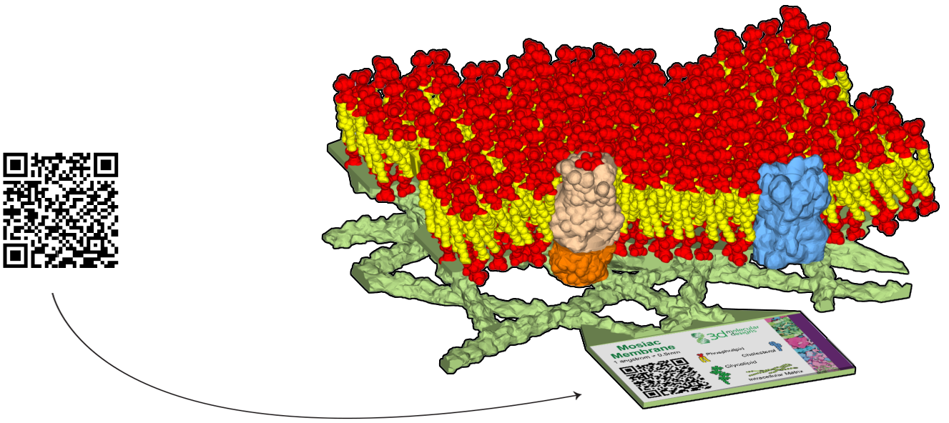
Activate your Membrane
Scan the QR code and activate the augmented reality features of the membrane model.
Notes:
Teacher: Have one partner hold the phone and scan the QR code and one person record your observations and questions.​​
Student: Write your observations in your notebook

Slide 32

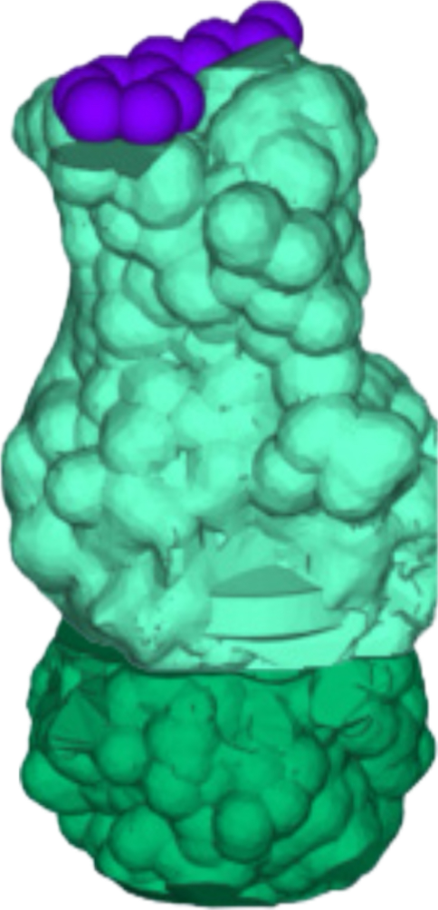
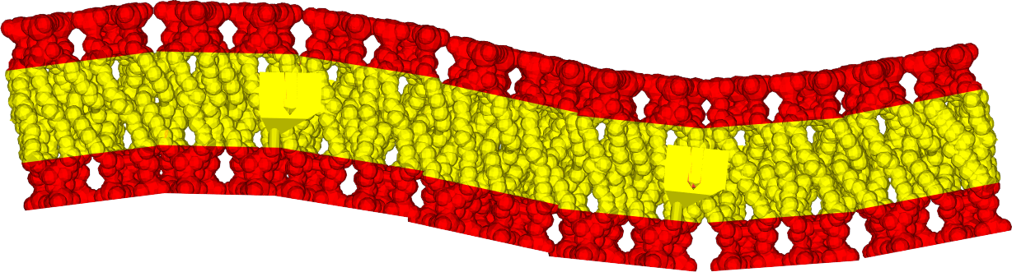
Receptor Proteins
Receptor proteins allow molecules to bind outside of the cell and transduce a signal inside of the cell.
Untwist the intracellular portion of the protein to model the signal transduction.
Cells often use receptor proteins to receive signals from other parts of the body that regulate cell processes.
In some cases, a single type of receptor protein can trigger different types of responses inside the cell.
Outside
Inside
Notes:
Teacher: Facilitate discussion​​
Student: Contribute to class discussion

Slide 33
Cell Membrane Functions
Channel proteins allow polar molecules to cross the membrane.
Receptor proteins transduce messages across the cell membrane
Add these to two columns in your chart and make notes about if/how this applies to each of your identified cell types.
Cell Type | Function
Notes:
Teacher: Give students time to copy the table into their notebook. Alternatively, Print this slide off for students.​​
Student: Follow the onscreen prompt or tape the table into your notebook if it was provided as a handout.

Slide 34
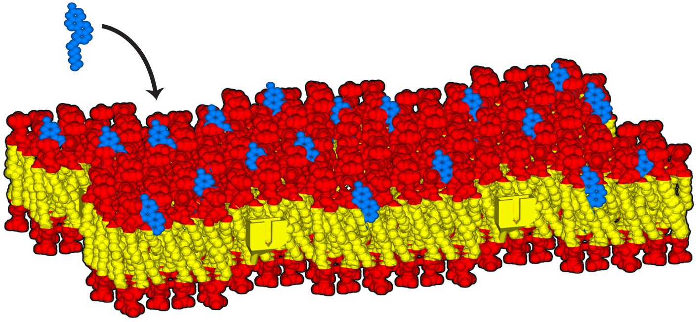
Cholesterol
Despite being considered fluid, cells regulate the flexibility of their membrane.
The blue pieces are cholesterol molecules. In the model, they fit only on the outside layer, but in real membranes, they can be on both halves of the bilayer.
Do you notice any difference in the flexibility or rigidity of the membrane with the cholesterol added in?
Why might cells want to regulate membrane fluidity?
Notes:
Teacher: Facilitate discussion​​
Student: Contribute to class discussion

Slide 35
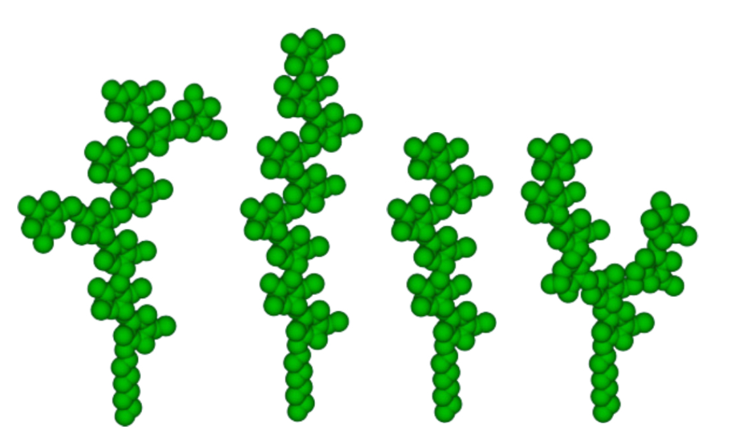
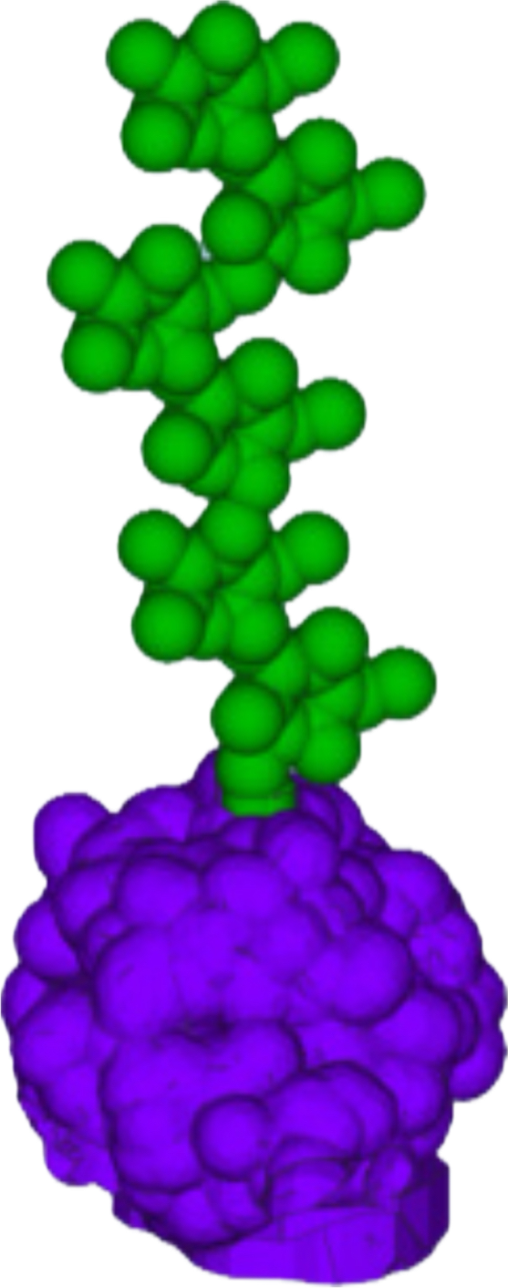
Glycolipids & Glycoproteins
The green pieces represent glycolipids, long strings of sugar molecules tethered to the cellular membrane by a single hydrophobic (non-polar) tail.
Glycoproteins are sugar molecules attached to the membrane through a peripheral protein (shown in purple). These proteins can make cells “sticky”- to other cells or to surfaces.
Different glycolipid shapes communicate different information about the cell, such as:
- what type of cell it is
- its state of development
- health an immune responses
Notes:
Teacher: Facilitate discussion​​
Student: Contribute to class discussion

Slide 36
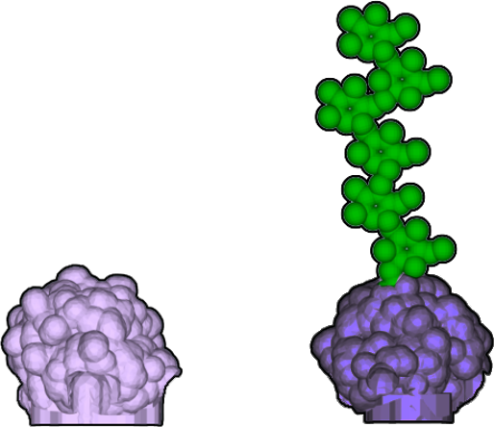
Peripheral Proteins
Peripheral proteins are located on the surface of the cellular membrane, where they perform various tasks, such as maintaining cell shape and binding to molecules.
Some, called glycoproteins, even have sugar strands, like glycolipids, which help with cell identification or recognition and cell-to-cell signaling.
Notes:
Teacher: Facilitate discussion​​
Student: Contribute to class discussion

Slide 37
Cell Membrane Functions
Cholesterol regulates membrane flexibility.
Glycolipids communicate information about the cell.
Peripheral proteins aid in shape, binding, and communication.
Add these to columns in your chart and make notes about if/how this applies to each of your identified cell types.
Cell Type | Function
Notes:
Teacher: Give students time to copy the table into their notebook. Alternatively, Print this slide off for students.​​
Student: Follow the onscreen prompt or tape the table into your notebook if it was provided as a handout.

Slide 38
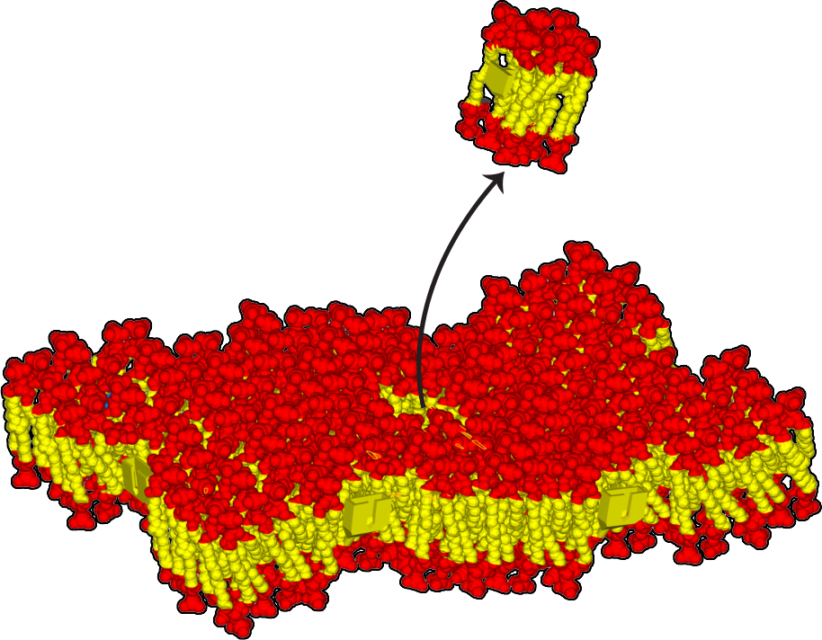
Self-Healing Membranes
Notice that there is a hole in the middle of your membrane model.
Remove the inserted piece.
How do you think a membrane could heal itself?
Notes:
Teacher: Facilitate discussion​​
Student: Contribute to class discussion

Slide 39
Design a Biological Membrane
Design your own biological membrane by adding structures of your choice from the parts provided.
As you add parts to the membrane, remember that each structure supports a specific function.
Notes:
Teacher: Give students time to examine the model​​. Note there are different places you might insert proteins in the model.
Student: Play!

Slide 40
Your Membrane
What kind of cell did you model?
In your notebook, identify a type of cell your model could represent. List the features you added to your model that support the cell function.
Notes:
Teacher: Give students time to think and respond to the writing prompt​​
Student: Write a response in your notebook

Slide 41
Membrane Gallery
Share and Compare
Carefully bring your model to a different partner group and compare the structures.
Discuss the following:
Did you use the same parts in your models?
Were the same pieces used but put in a different place? If so, do you think this would affect how your membrane functions?
Notes:
Teacher: Students compare their models and point out similarities and differences. Extending the membrane increases the surface for exchange. Materials might move more quickly into the cell because there are more channels (or it could be more responsive if it has more receptors.)
Student: Write a response in your notebook

Slide 42
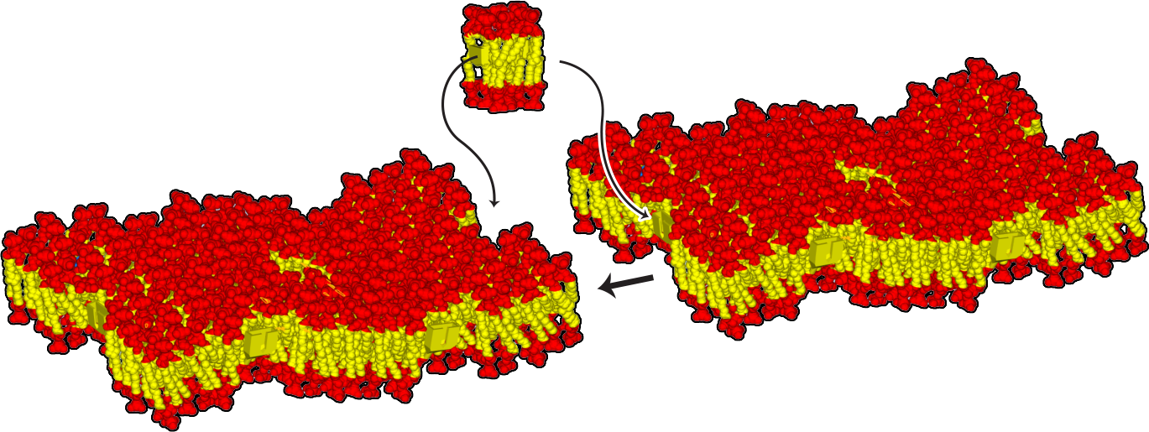
Membrane Gallery
Connect your models together.
How does this change or not change the way the membrane functions?
Notes:
Teacher: Students compare their models and point out similarities and differences. Extending the membrane increases the surface for exchange. Materials might move more quickly into the cell because there are more channels (or it could be more responsive if it has more receptors.)
Student: Discuss with your group or write a response in your notebook

Slide 43
What I think …
In your lab notebook, brainstorm the following:
How could a membrane hold its shape in water?
How does a membrane hold everything inside a cell?
Why does a membrane need to be flexible?
My ideas
Notes:
Teacher: Give students time to think and respond to the writing prompt​​
Student: Write a response in your notebook

Slide 44
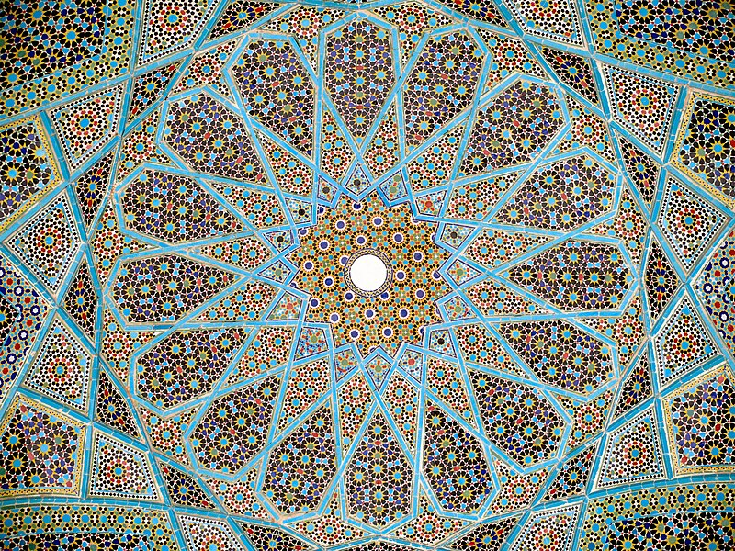
Mosaic Membrane Model
A mosaic is an artwork made of many small pieces of tiles which combine to make a larger image.
Explain whether or not you think that “mosaic” is an effective description of the model you just built.
Can you think of another way to describe your structure?
Notes:
Teacher: Facilitate discussion​​
Student: Contribute to class discussion

Slide 45
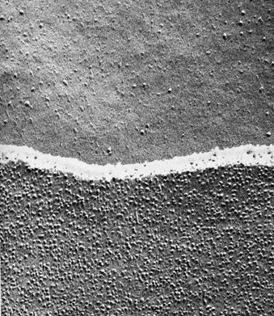
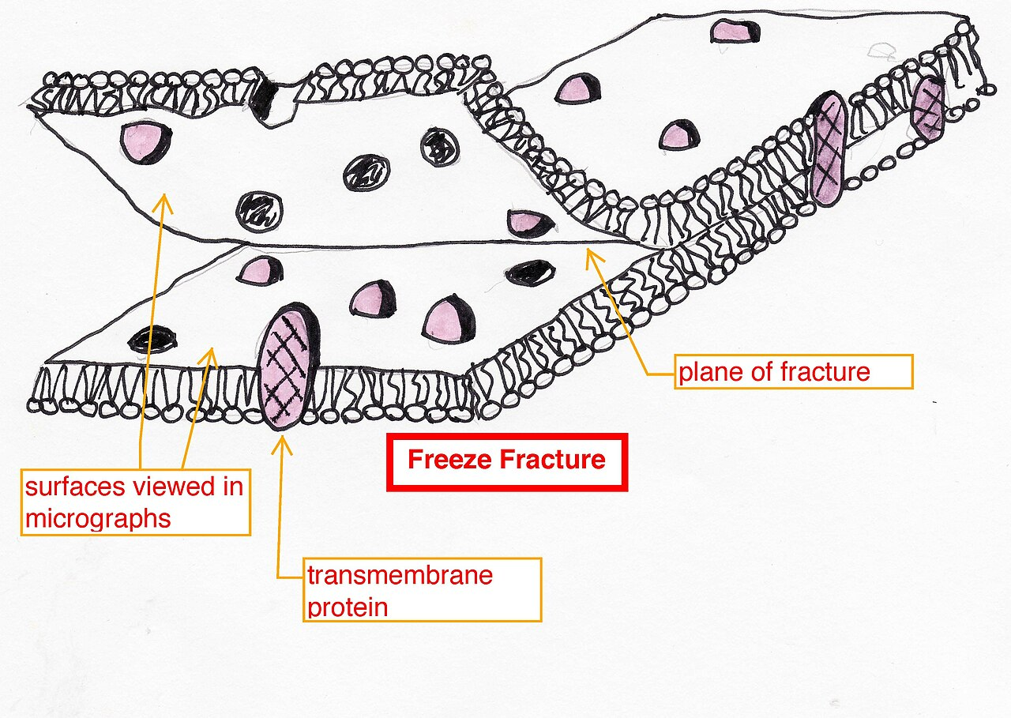
How did scientists learn about membrane organization?
This electron micrograph (to the right) shows a lipid bilayer that has been peeled apart. The bottom half of the screen shows the bottom half of the bilayer.
What can you learn from these images?
https://www.cellimagelibrary.org/images/10900
Notes:
Teacher: By freezing cells and fracturing them with a diamond knife that broke the bilayers apart, it became clear that protein was not organized on one uniform layer across the membranes. Instead, proteins were inserted in the bilayer individually. When the two bilayers were separated, the location of induvial proteins was revealed. Think of the depressions like the imprint you leave behind on your pillow. The proteins allow specific molecules through (water passes through aquaporin and potassium uses a potassium specific channel. What would the scientists have seen if the proteins were uniformly spread? Why do you think this model is referred to as a mosaic?
Student: Describe how the image might look different if the protein was spread uniformly on both sides of the bilayer. The fact that the inner and outer leaflet look different was a big clue!

Slide 46
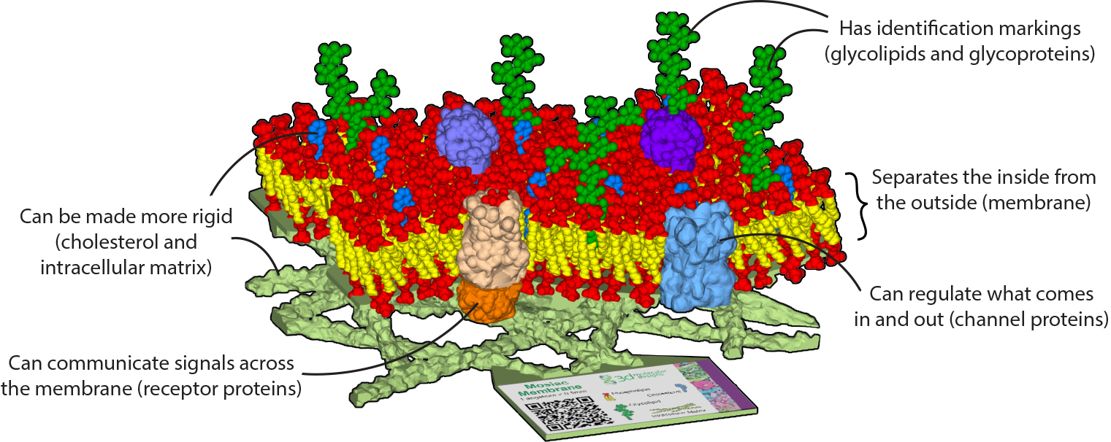
Mosaic Membrane Model
Notes:
Teacher: Allow students to explore the model ​​
Student: Closely examine the model and play

Slide 47
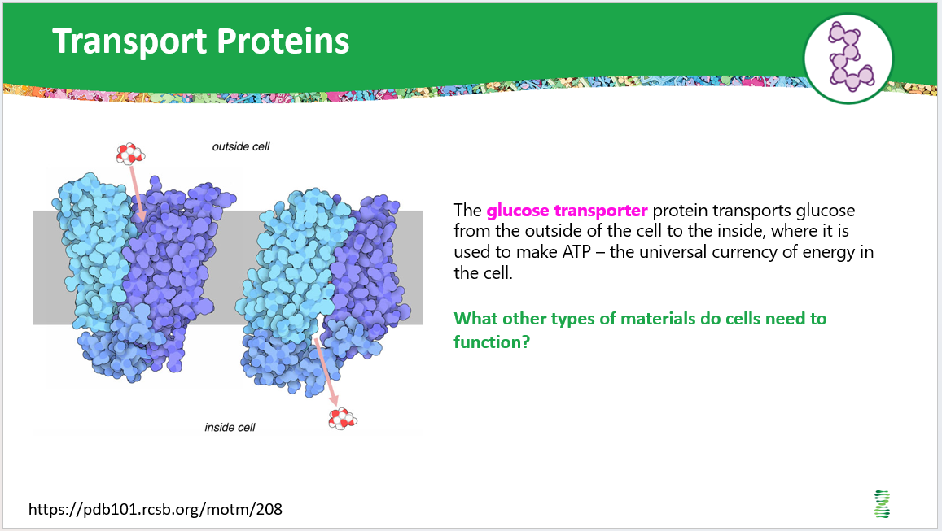
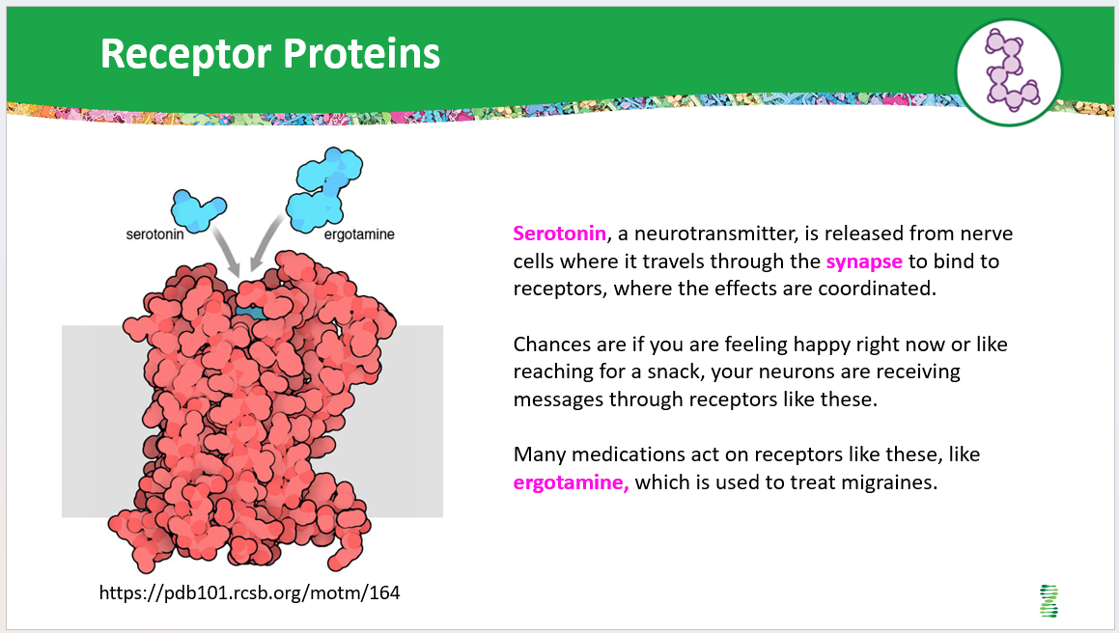
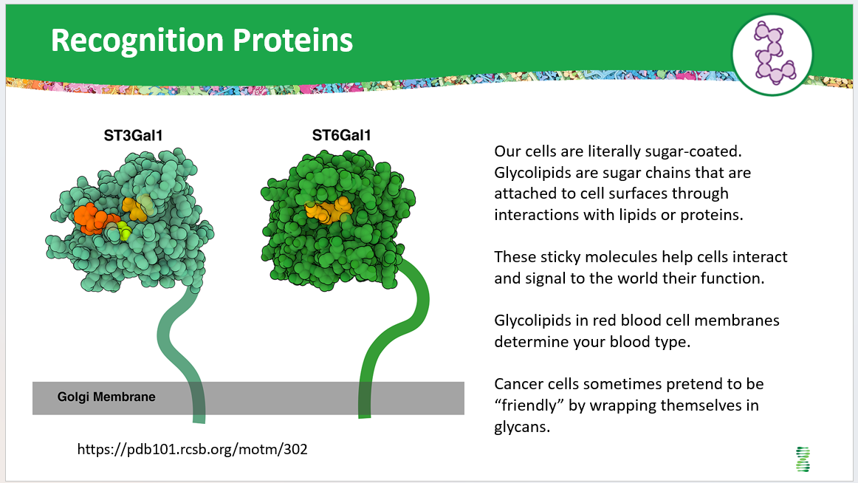
Teacher Guide – Extensions
Students can extend their knowledge by exploring a gallery of specific membrane proteins and their associated functions, to give context to their model. Several examples are shown but there are many more in the protein data bank (pdb.org).
You can assign each student group one slide and then have them share it in a whole-group discussion. They could discuss which structures in their model might represent each specific membrane protein in the gallery (or whether they might need a new structure to represent the membrane protein they explored).

Slide 48
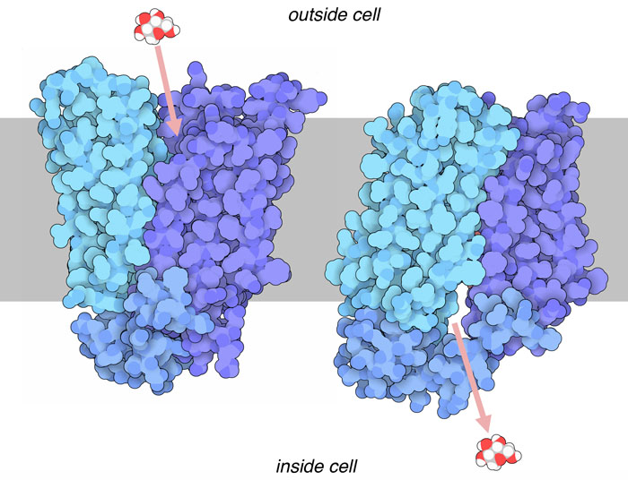
Transport Proteins
The glucose transporter protein transports glucose from the outside of the cell to the inside, where it is used to make ATP – the universal currency of energy in the cell.
What other types of materials do cells need to function?
https://pdb101.rcsb.org/motm/208
Notes:
Teacher: Facilitate discussion​​
Student: Contribute to class discussion

Slide 49
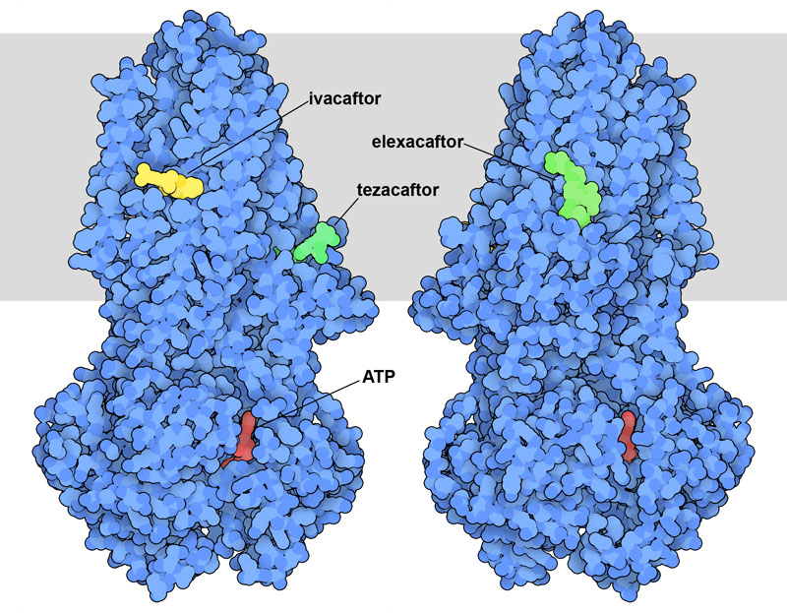
Transport Proteins
The cystic fibrosis transmembrane conductance channel (CFTR) regulates the movement of ions across the membranes of cells lining the respiratory tract. The membrane is represented in gray.
What other types of materials do cells need to function?
https://pdb101.rcsb.org/motm/293
Notes:
Teacher: Facilitate discussion​​
Student: Contribute to class discussion

Slide 50
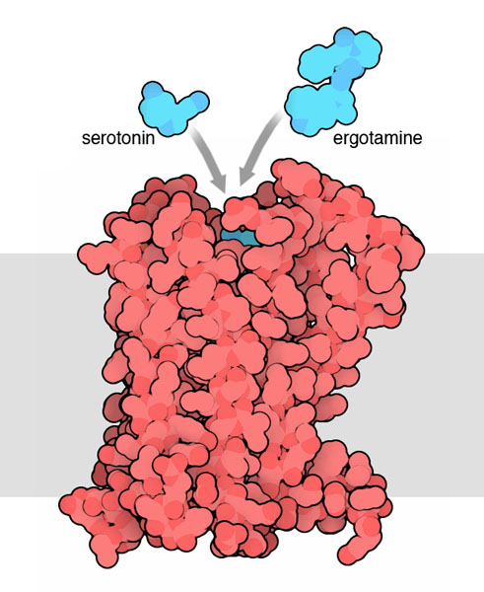
Receptor Proteins
Serotonin, a neurotransmitter, is released from nerve cells where it travels through the synapse to bind to receptors, where the effects are coordinated.
Chances are if you are feeling happy right now or like reaching for a snack, your neurons are receiving messages through receptors like these.
Many medications act on receptors like these, like ergotamine, which is used to treat migraines.
https://pdb101.rcsb.org/motm/164
Notes:
Teacher: Facilitate discussion​​
Student: Contribute to class discussion

Slide 51
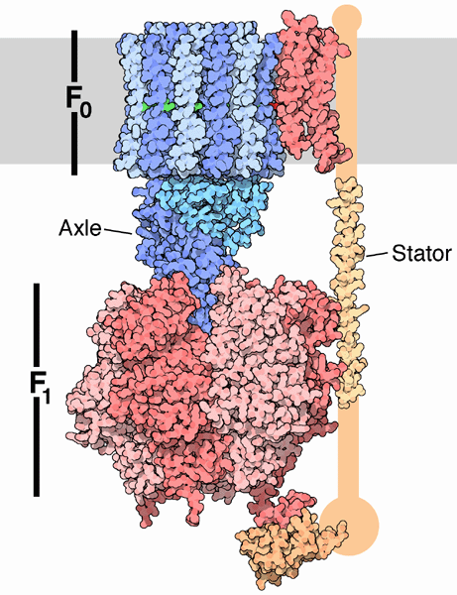
Embedded Proteins
This famous enzyme, ATP synthase, synthesizes ATP - the universal currency of energy inside the cell.
The rotors embedded in the membranes (in gray) give this organelle the nickname, powerhouse.
https://pdb101.rcsb.org/motm/72
Notes:
Teacher: Facilitate discussion​​
Student: Contribute to class discussion

Slide 52
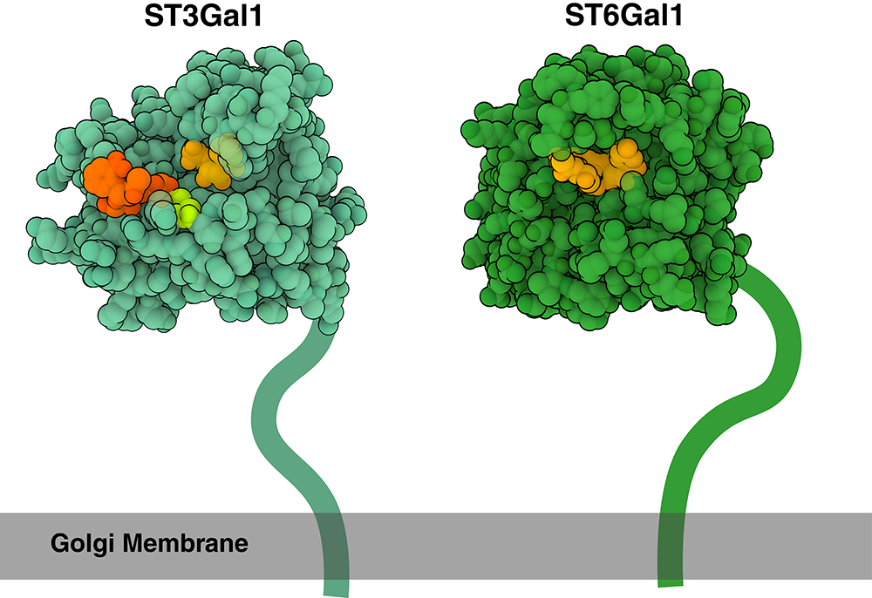
Recognition Proteins
Our cells are literally sugar-coated. Glycolipids are sugar chains that are attached to cell surfaces through interactions with lipids or proteins.
These sticky molecules help cells interact and signal to the world their function.
Glycolipids in red blood cell membranes determine your blood type.
Cancer cells sometimes pretend to be “friendly" by wrapping themselves in glycans.
https://pdb101.rcsb.org/motm/302
Notes:
Teacher: Facilitate discussion​​
Student: Contribute to class discussion

Slide 53
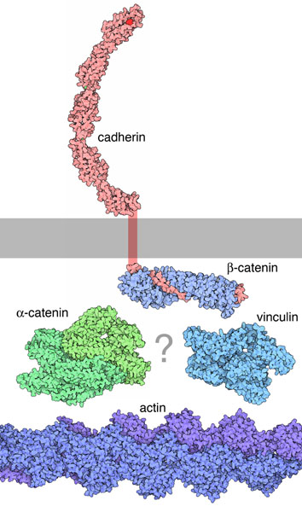
Connector Proteins
Cells connect in networks to form tissues through membrane proteins like cadherin. Connector proteins reach through the membrane (in gray) and grab onto the cytoskeleton inside of the cell.
Can you find the cytoskeleton on your physical model?
https://pdb101.rcsb.org/learn/structural-biology-highlights/alpha-catenin-connections
Notes:
Teacher: Facilitate discussion​​
Student: Contribute to class discussion

Slide 54
Teacher Guide – applications
Application: Have students generate a claim about how/why the cell types shown might perform their functions, given what they have learned about cell membranes. This is a great option for a CER activity.
You could have students develop their own model diagrams to explore ideas related to the three questions below (or others that they may have come up with in their “I wonder” charts).
How could a membrane hold its shape in water?
How does a membrane hold everything inside a cell?
Why does a membrane need to be flexible?

Slide 55
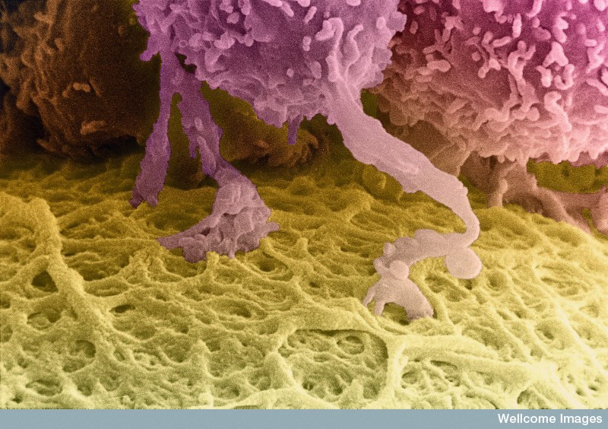
Why is it necessary for membranes to be fluid?
A colorized scanning electron micrograph of a human egg, which is the huge cell colored yellow at the bottom of this image. The follicle cells that surround it (top) send out long projections that penetrate through the tough outer coating (the zona pellucida) into the egg cell itself giving it the nourishment it needs to develop to maturity. Even when the egg is released from the ovary at ovulation it remains surrounded by a cloud of follicle cells that only gradually fall away as the egg progresses along the Fallopian tube.
Write your ideas in your notebook.
https://www.cellimagelibrary.org/images/38957
Notes:
Teacher: Discuss your ideas with a partner. Explain what you learned from your discussion in your notebook.
Student: Write a response in your notebook

Slide 56
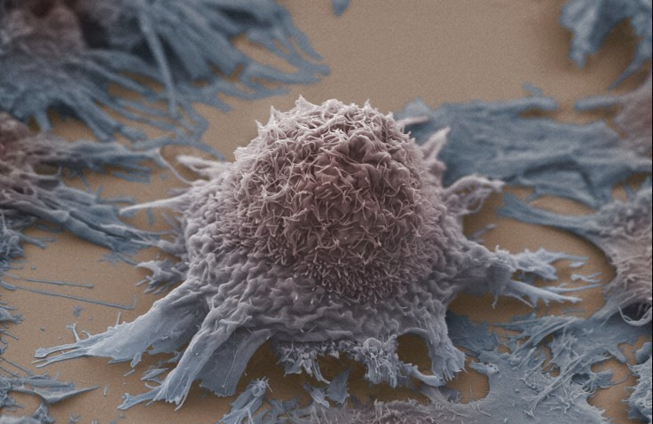
Reflection
How might a lung cancer cell interact with a surface in this way?
Use your knowledge of membrane structure and properties to brainstorm ideas.
Write your ideas in your notebook.
https://www.cellimagelibrary.org/images/39049
Notes:
Teacher: Give students time to think and respond to the writing prompt​​
Student: Write a response in your notebook

Slide 57
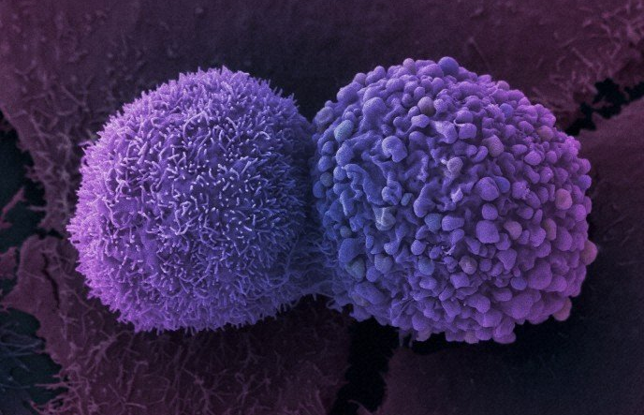
Reflection
How might a lung cancer cell interact with another cell in this way?
In what ways might these two cells differ?
Use your knowledge of membrane structure and properties to brainstorm ideas.
Write your ideas in your notebook.
https://www.cellimagelibrary.org/images/39021
Notes:
Teacher: Give students time to think and respond to the writing prompt​​
Student: Write a response in your notebook

