Slide 1




Acetylcholinesterase Active Site - Part 3
Diversity and Survival
“Uniformity is not nature's way. Diversity is nature's way.”
– Vandana Shiva

Slide 2

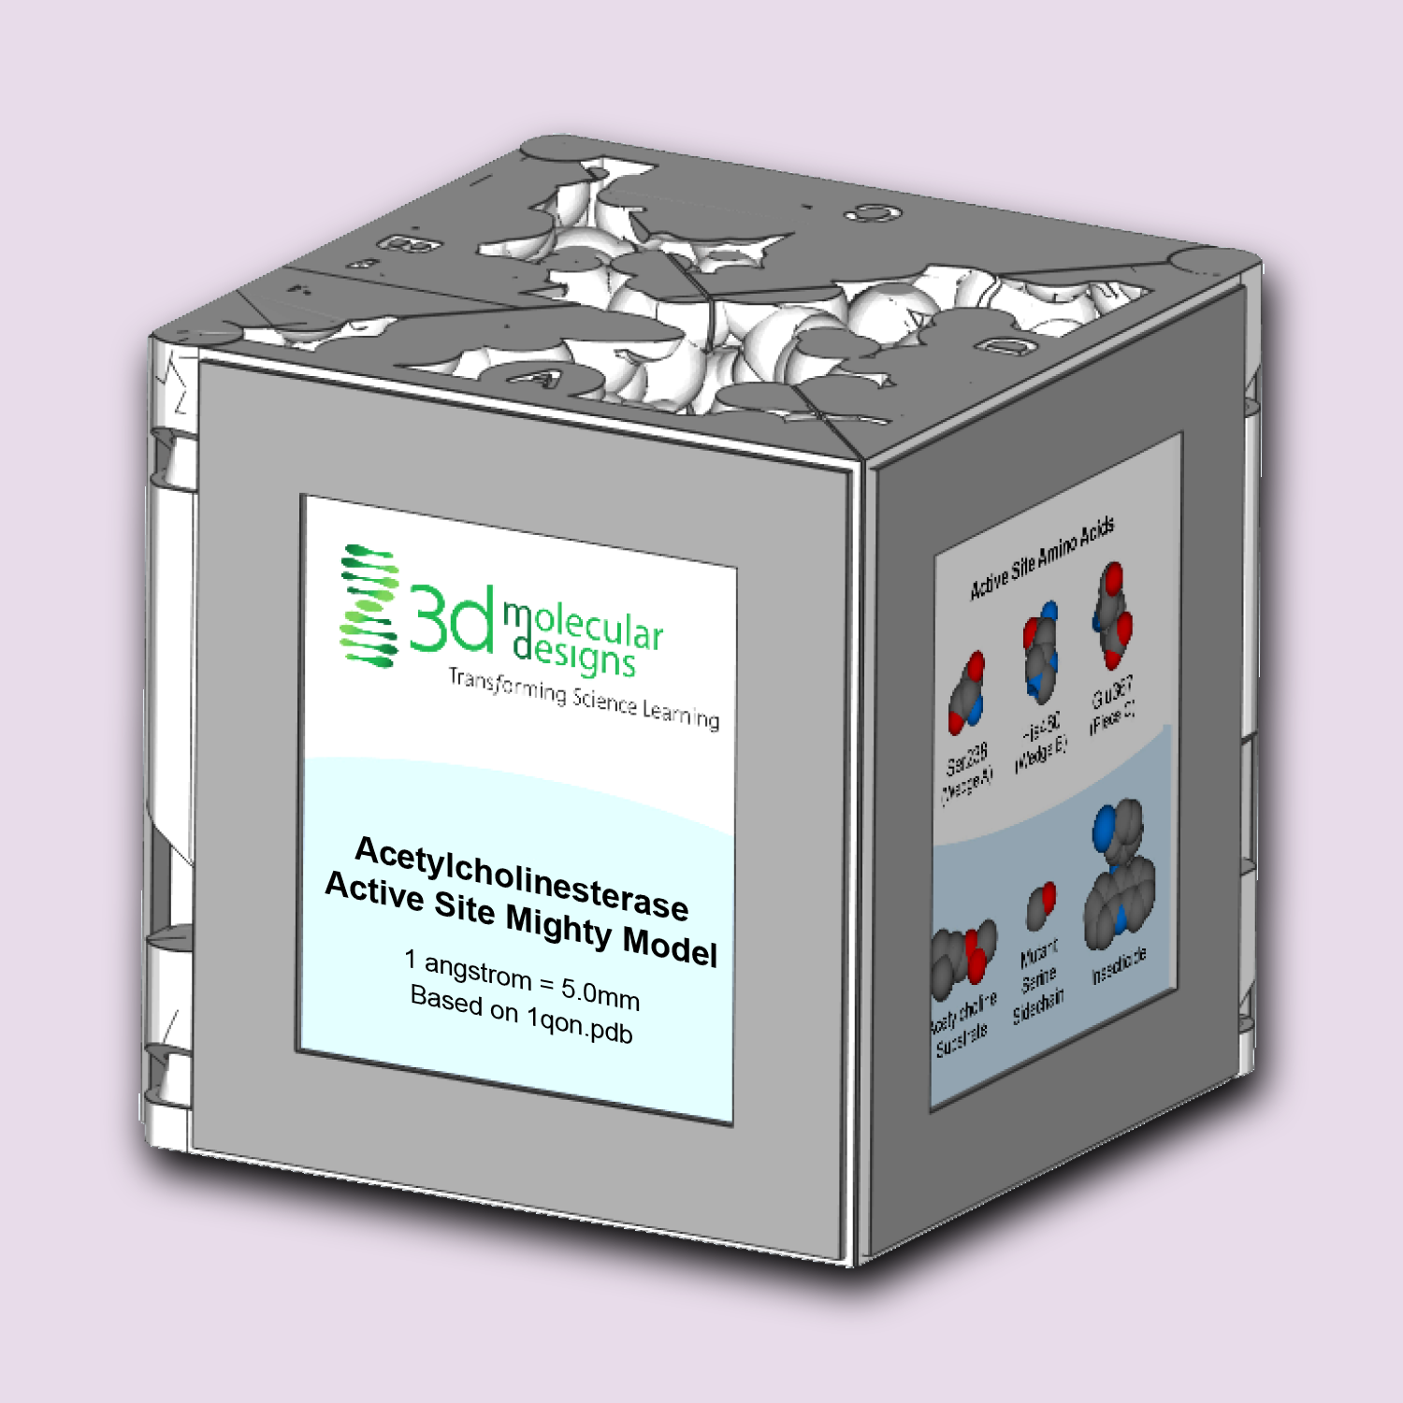
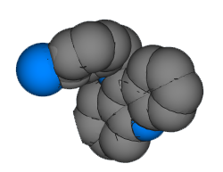
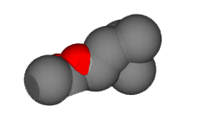
Teacher Guide – Summary
Activity Summary
Acetylcholinesterase (ACHE) is an incredibly fast enzyme responsible for breaking down the neurotransmitter acetylcholine (ACH). When a signal traveling down a neuron meets a muscle cell, ACH is released by the neuron and sensed by the muscle cell, triggering contraction. The ACH is then "recycled" (broken apart) by the ACHE enzyme, clearing the space between the cells (the synapse) in preparation for the next signal.
Because of its key role in muscle function and its long history of being a well-validated pesticide target, the ACHE enzyme can be used to cover a variety of concepts, including:
Activity 1: The Speed
of Thought
Neurotransmission and Enzyme Activity
Activity 2:
Inhibiting Movement
Competitive Inhibitors and Enzyme Activity
Activity 3:
Diversity and Survival
Mutations, Genetic Diversity and Survival

Slide 3
Teacher Guide - Overview
Activity Objectives
  Natural selection – adaptations based on environmental pressure from a molecular perspective.
  Estimated Class Time:
15 minutes
Required Models:
Achetylecholine Active Site Mighty Model
Required Media:
None
Recommended Materials:
Weill, M., Lutfalla, G., Mogensen, K., Chandre, F., Berthomieu, A., Berticat, C., Pasteur, N., Philips, A., Fort, P., & Raymond, M. (2003). Insecticide resistance in mosquito vectors. Nature, 423(6936), 136–137. https://doi.org/10.1038/423136b
Grade, Class
9-12 Biology or Chemistry
Topics
Natural selection and environmental pressure
Mutation – variation - adaptation
Prerequisite Knowledge
Enzyme activity
ACHE cube lessons I (The Speed of Thought) and lesson II (Inhibiting Movement)

Slide 4






Teacher Guide - Using This Slide Deck
Student and Teacher Slide Deck Pages
  Slides that are meant for student viewing will feature a green top
  banner. Slides that are meant only for teacher viewing will feature a
  purple top banner and will appear hidden when in "slide show" mode.
Prompting Icons
  Each student slide will include a prompting icon in the top right corner of the slide. These icons on each slide cue your students to the type of activity they will be doing.
Turn and talk discussion
Write in your notebook
Quiet thinking time
Digital modeling
Physical modeling
Teacher Moves and Student Moves
Class slides provide notes (teacher notes below the slide) with specific information to assist you in facilitating the activity using effective modeling and education practices.

Slide 5
Teacher Guide - Standards
Next Generation Science Standards
Science and Engineering Practices | Cross Cutting Concepts | Disciplinary Core Ideas
Scientific Investigations Use a Variety of Methods | Structure and function | HS-LS1-1
Developing and Using Models | System and System Models | HS-LS4-3
Constructing Explanations and Designing | Cause and Effect | HS-LS4-4

Slide 6

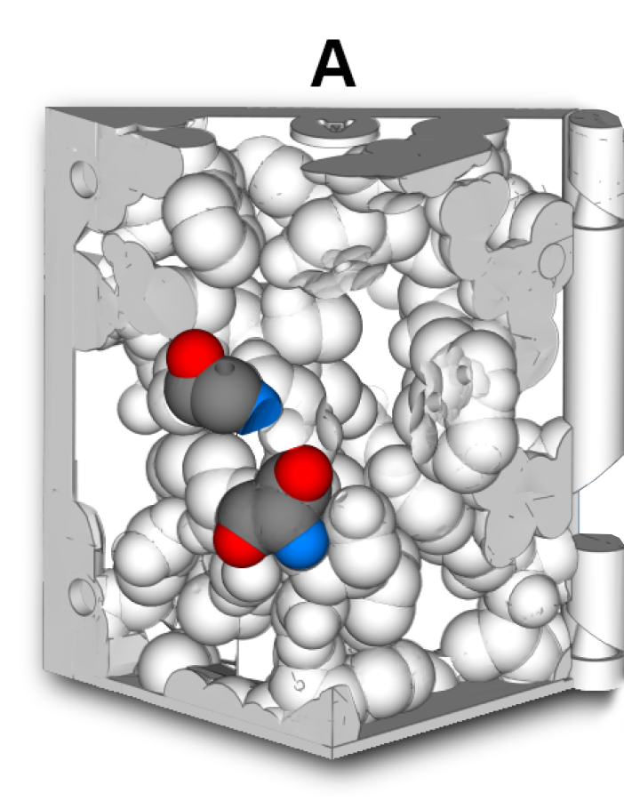
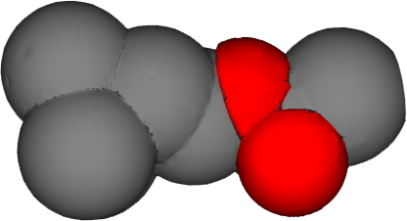
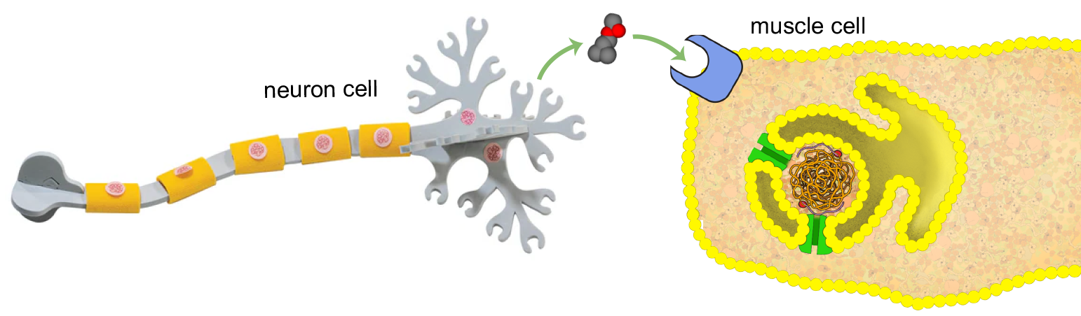
Review of the ACHE Enzyme
Mosquitoes spread Malaria, one of the world's deadliest diseases.
Insecticides can be used to inhibit mosquito acetylcholinesterase (ACHE) enzymes, preventing the breakdown of the neurotransmitter acetylcholine (ACH).
This kills the mosquito, lowering the mosquito population, and in turn, lowering malaria transmission.
Notes:
Teacher: A review of the Inhibiting movement lesson (ACHE Active Site Pt. II).
Student: Review the lesson

Slide 7

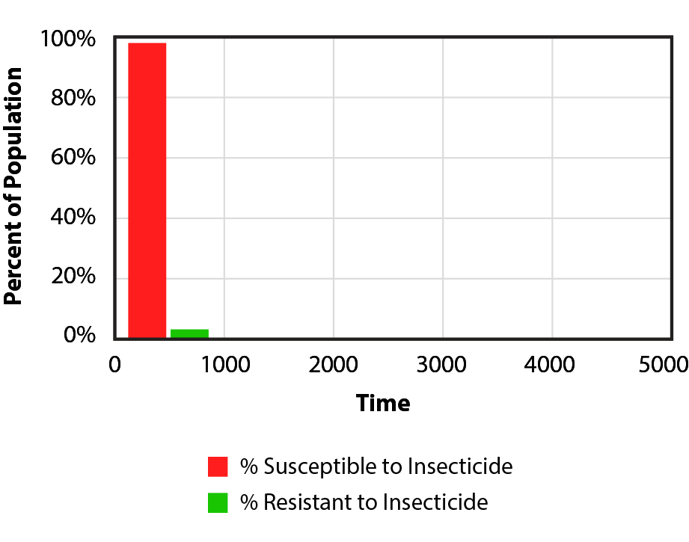
The Impact of Insecticides
Explore the graph to the right and discuss it with your lab partners.
What do you notice?
What do you wonder?
Notes:
Teacher: Give students time to interpret the data in the graph. Think-pair-share or alternative strategies can be used to facilitate a discussion.
Student: Analyze the data and write to the prompts in your notebook.

Slide 8
The Impact of Insecticides
This graph represents a mosquito population that has been exposed to the insecticide.
The percentage of the population that was susceptible to the insecticide (died) is shown in red and the percent that is resistant to the insecticide (survived) is shown in green.
Notes:
Teacher: Facilitate discussion.
Student: Contribute to classroom discussion

Slide 9
The Impact of Insecticides
A successful insecticide will kill the vast majority of a mosquito population.
But it doesn't appear to kill 100% of them. A small percentage survives.
In your lab notebook, predict:
What will happen with continued use of this insecticide?
Notes:
Teacher: Give students an appropriate amount of time to think, sketch, and make a prediction
Student: Sketch or write your prediction in your notebook

Slide 10
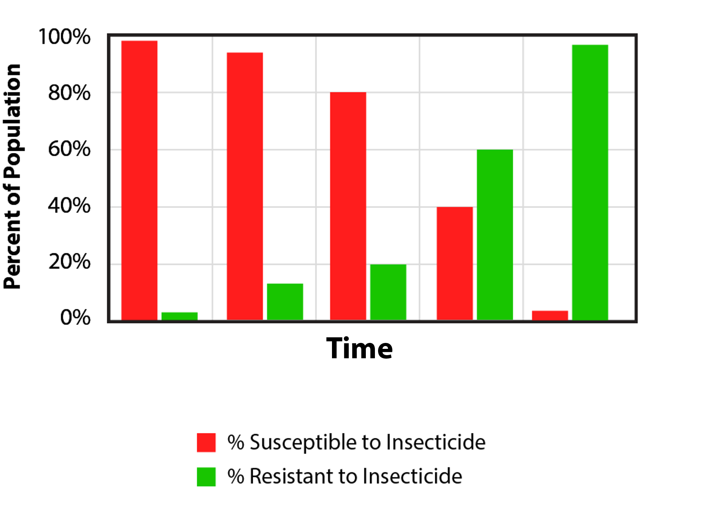
Resistance Over Time
When the impact of the insecticide is tracked over multiple generations, an alarming trend emerges.
What are the different ways that a mosquito could be resistant to an insecticide?
What data do you need to determine what is happening?
Notes:
Teacher: Facilitate discussion.
Student: Contribute to classroom discussion. Respond to the writing prompts in your notebook.

Slide 11
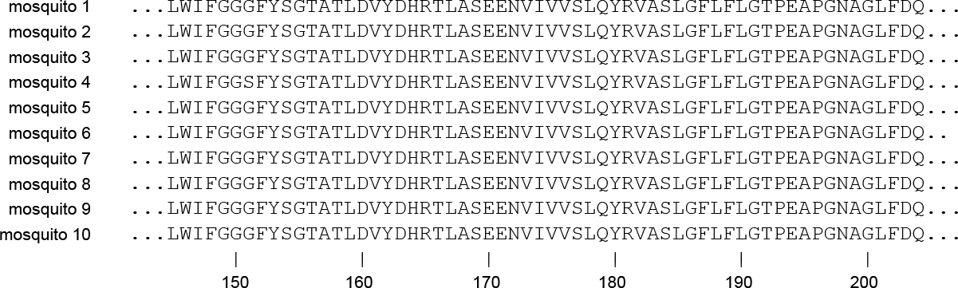
Amino Acid Sequence of the ACHE Enzyme
But when comparing the sequence of amino acids that make up the ACHE enzyme in a sample of ten mosquitoes from the population, something interesting was noticed.
Study the amino acid sequences below. Do you notice anything?
Notes:
Teacher: Give students an appropriate amount of time to analyze the data – This is an amino acid sequence for ACHE.
NOTE: It may be easier for students to analyze the data if this slide is printed off for them in advance.
Student: Look for a difference in the sequences of the Amino Acids

Slide 12
Amino Acid Sequence of the ACHE Enzyme
The vast majority of the mosquitoes sampled had a glycine amino acid in position 151. . .
. . .But, a small percentage had a serine amino acid in position 151, not a glycine amino acid!
Notes:
Teacher: Position 151 in the amino acid sequence –
Ask students if they can identify a possible mutation for this change in AA sequence by examining a codon chart-
Multiple potential responses, including a single base mutation (GGC -> AGC codon) or SNP (Single Nucleotide Polymorphism)
NOTE: The Amino acid sequence is used to avoid confusion. Many silent mutations exist in these mosquitos, but this single amino acid difference at location 151 gives a high resistance to the insecticide
Student: Confirm the difference found in analysis
Extension – determine the mutation

Slide 13
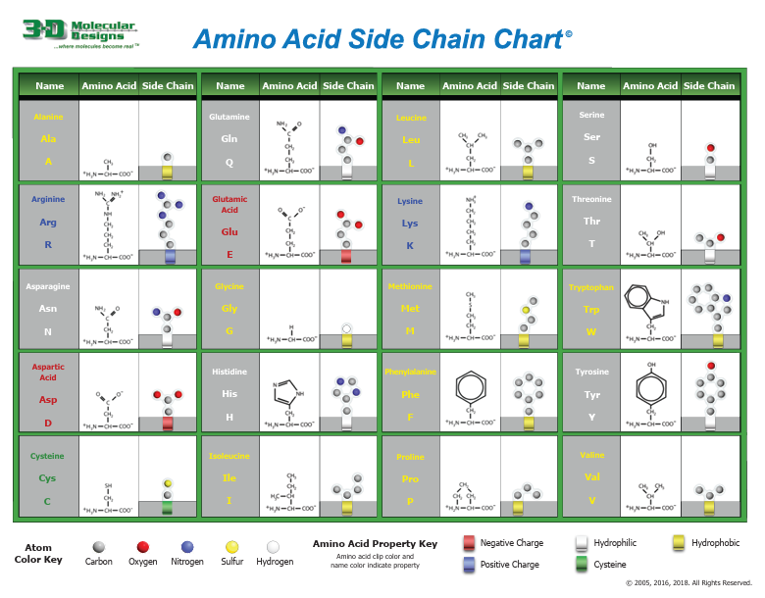
Amino Acid Side Chains
In your lab notebook:
Compare and contrast Glycine and Serine amino acid side chains.
Does this change your prediction about mosquito resistance? If so, update your prediction.
Notes:
Teacher: Teacher: Give students an appropriate amount of time to look at the difference between Serine and Glycine and revise their prediction.
Student: Look at Serine and glycine. Revise your prediction in your notebook.

Slide 14
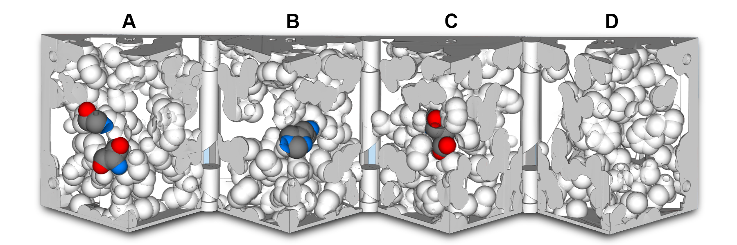
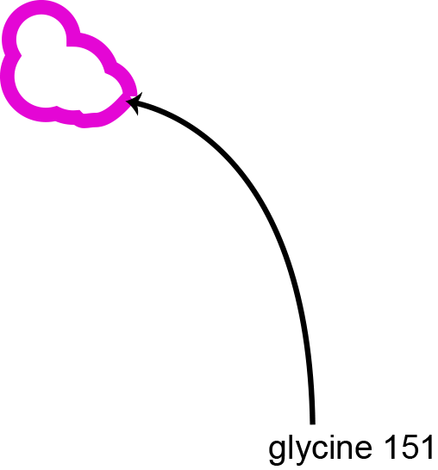
Glycine 151 of the ACHE Enzyme
Explore the ACHE enzyme box one last time to determine the impact.
There is one part of the model colored by atom type that we have not yet discussed, representing amino acid glycine 151 of the ACHE enzyme. Open the box and locate this amino acid.
Notes:
Teacher: Assist students in finding Gly151
Student: Follow the onscreen prompts to locate GLY 151

Slide 15
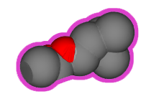
Glycine 151 of the ACHE Enzyme
Glycine 151 is close to where both the ACH neurotransmitter and the insecticide competitive inhibitor bind to the ACHE enzyme. . . but not so close that it inhibits the binding of either molecule.
Notes:
Teacher: Assist students in docking ACH substrate to SER 238. Note the proximity of GLY 151 to the active site.
Student: Follow the onscreen prompts to dock ACH into the active site.

Slide 16


The Serine 151 Mutation
We can represent this difference in our physical model of the ACHE enzyme by adding the serine sidechain piece to glycine 151 on wedge A of the model.
This models the change, or mutation, of the amino acid 151 from the wildtype of glycine to the serine that exists in some mosquitos.
The ACHE enzyme now represents a small percentage of the mosquito population with this mutation.
Notes:
Teacher: Assist students as they add the carbonyl (CO) group onto GLY 151 to mutate it into SER 151.
Student: Add the carbonyl (CO) group onto GLY 151 to mutate it into SER 151.

Slide 17

The Serine 151 Mutation - ACH Binding
Let's test the binding of both of our substrates in the ACHE enzyme of mosquitoes with the serine 151 mutation:
  ACH Neurotransmitter
  Insecticide Competitive Inhibitor
Remember to completely close the box to confirm if the molecule fits.
What is the result of this mutation?
Notes:
Teacher: Assist students as they get the two substrates to interact with the ACHE cube.
Student: PLAY! Try to get both substrates (ACH and the insecticide) to interact with the enzyme. Write a response to the prompt based upon your observations in your notebook.

Slide 18
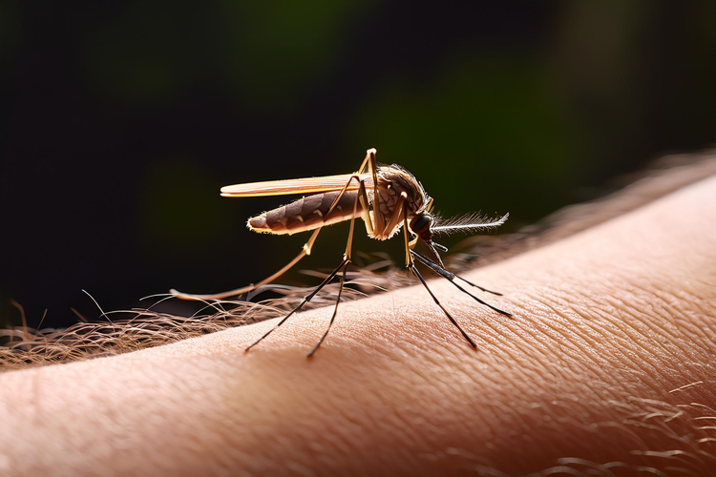
The Impact of the Serine 151 Mutation
In mosquitoes with the serine 151 mutation. . .
The ACH neurotransmitter properly fits and will be broken down by the ACHE enzyme.
The insecticide competitive inhibitor does not fit, clashing with the serine sidechain.
Update your lab notebook with this correct information.
Explain how this impacts the mosquito population over time.
Notes:
Teacher: Facilitate discussion with your students – did their observations align with this confirmation slide?
Student: Contribute to classroom discussion. Revise your model in your notebook.

Slide 19
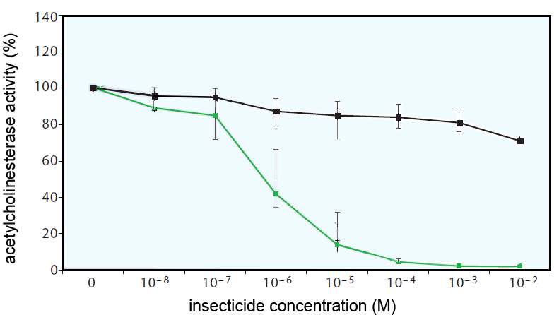
The Impact of the Serine 151 Mutation
The graph to the right shows ACHE enzyme activity (Y-axis) in mosquitoes exposed to different concentrations of the insecticide (X-axis).
What does this graph represent?
Notes:
Teacher: Give students an appropriate amount of time to look at the data and write responses to the prompt
Student: Write responses to the two prompts in your notebook.

Slide 20
The Impact of the Serine 151 Mutation
Mosquitoes with glycine 151 are killed by the insecticide competitive inhibitor and are removed from the population.
Mosquitoes with the serine 151 mutation survive the insecticide competitive inhibitor and can reproduce.
Notes:
Teacher: Discuss how this mutation at position 151 gave the mutants a beneficial variation due to the presence of an environmental pressure (the insecticide). This graph demonstrates natural selection in action at a molecular level!
Student: Contribute to discussion. Revise your response if necessary.

Slide 21
Resistance Over Time
Over time, the mosquitoes with glycine 151 are removed from the population while the insecticide resistant mosquitoes with the serine 151 mutation make up a larger portion of the mosquito population.
This is an example of how genetic diversity in a population can help the species survive emerging threats.
Review and update your explanations of the impact of insecticide application over time and the Serine 151 mutation.
Notes:
Teacher: Facilitate discussion
Student: Look at the data. Write a response to the prompt.

Slide 22

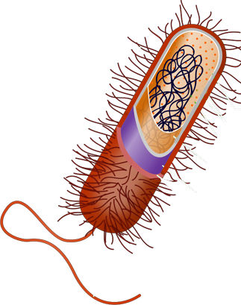
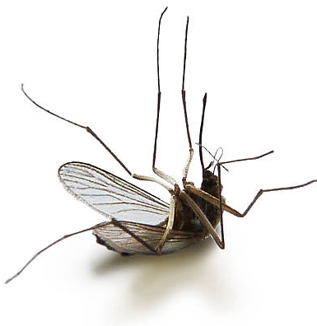
The Impact of Genetic Diversity on Survival
This example of genetic diversity also demonstrates why one "cure" rarely works forever.
Like antibiotics, vaccines, and other medicine, new insecticides are constantly being researched.
Notes:
Teacher: Facilitate discussion
Student: Contribute to discussion

Slide 23


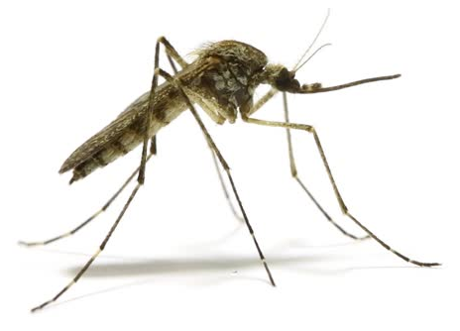

Conclusions
A naturally occurring serine 151 mutation in the ACHE enzyme was found in a small percent of the mosquito population.
The ACHE enzymes of mosquitos with this mutation were able to properly break down ACH neurotransmitters, but did not bind to the insecticide.
This insecticide resistance allowed them to survive and reproduce, making up a larger percent of the mosquito population over time.
Notes:
Teacher: Summary slide- the big take aways from this lesson.
Student: Review / revise your thoughts in your notebook

Slide 24
Emerging Antibiotic Resistance
The Acetylcholinesterase Active Site Mighty Model can be used to tell a story about how insects can evolve to become resistant to an insecticide. Just as importantly, this story can be used to introduce students to another health concern— the emerging resistance of microbes to antibiotics.
The public has come to expect that when we experience an infection, a visit to the doctor will result in a prescription for an antibiotic that will soon control the infection. But we will soon come to understand that many of the very effective antibiotics that we have used in the past are no longer effective. Just as the introduction of the insecticide into the environment resulted in a selective advantage for the rare mosquito that had a mutation in the gene encoding the protein target of the insecticide – the widespread use of an antibiotic will select for a mutant microbe that is no longer sensitive to the antibiotic. This emerging antibiotic resistance will be a serious problem that today’s students will have to address in their adult lives.

