Slide 1

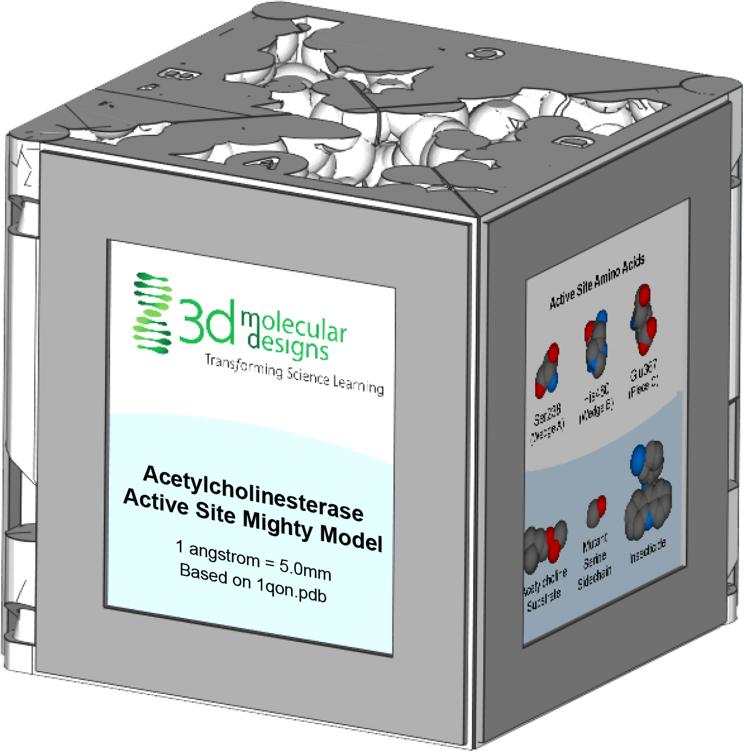
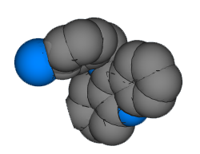

Acetylcholinesterase Active Site - Part 2
Inhibiting Movement
“Every mosquito bite avoided brings us closer to a malaria-free world.”
– Goodbye Malaria Foundation

Slide 2

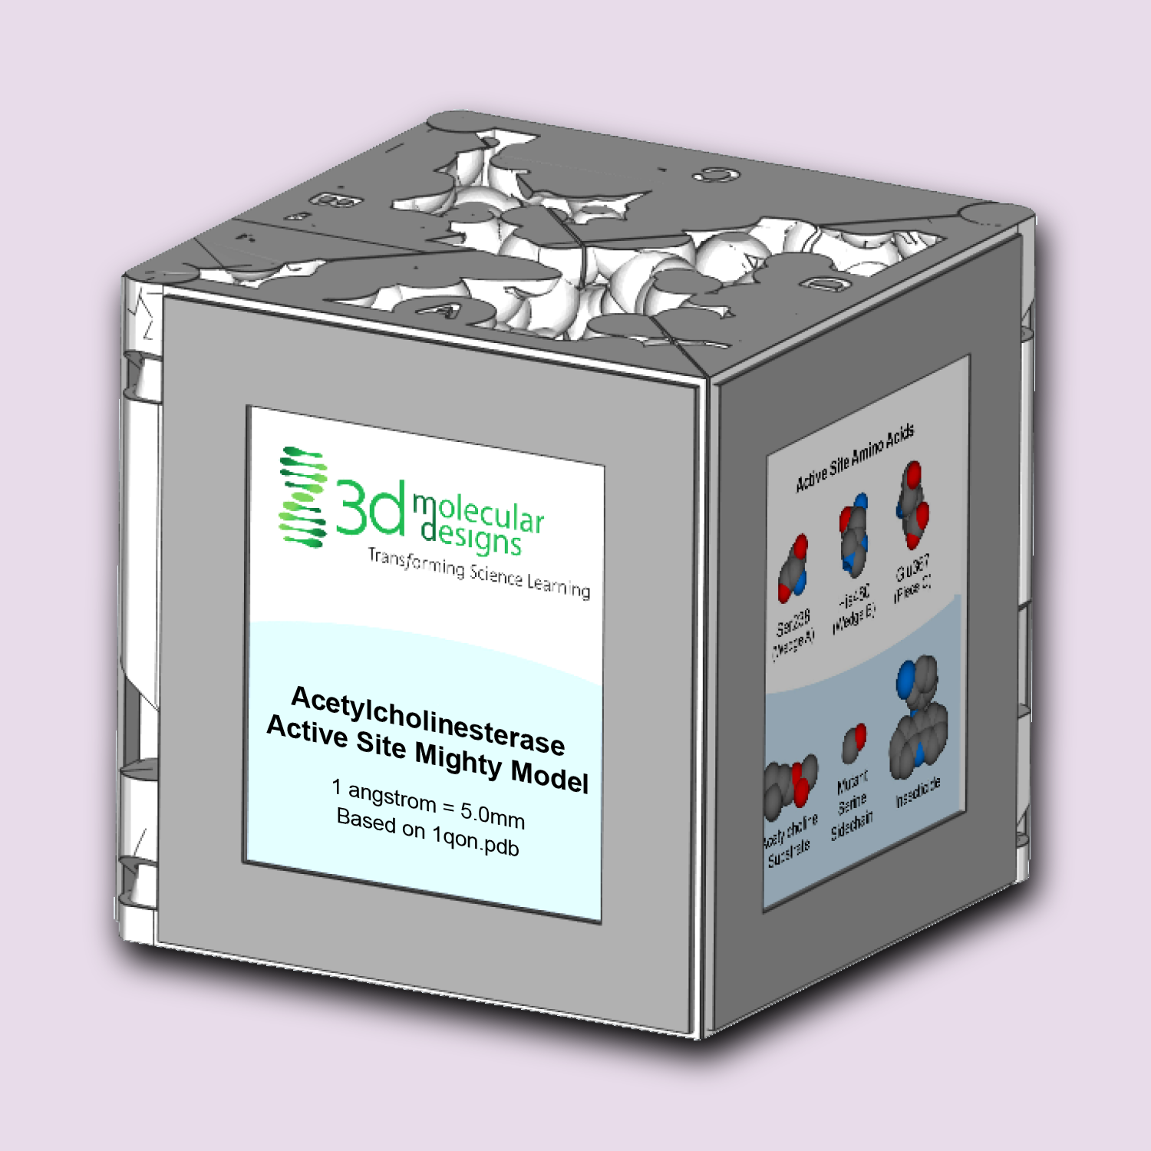
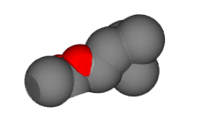

Teacher Guide – Summary
Activity Summary
Acetylcholinesterase (ACHE) is an incredibly fast enzyme responsible for breaking down the neurotransmitter acetylcholine (ACH). When a signal traveling down a neuron meets a muscle cell, ACH is released by the neuron and sensed by the muscle cell, triggering contraction. The ACH is then "recycled" (broken apart) by the ACHE enzyme, clearing the space between the cells (the synapse) in preparation for the next signal.
Because of its key role in muscle function and its long history of being a well-validated pesticide target, the ACHE enzyme can be used to cover a variety of concepts, including:
Activity 1: The Speed
of Thought
Neurotransmission and Enzyme Activity
Activity 2:
Inhibiting Movement
Competitive Inhibitors and Enzyme Activity
Activity 3:
Diversity and Survival
Mutations, Genetic Diversity and Survival
© 2023 3D Molecular Designs. All Rights Reserved.

Slide 3
Teacher Guide - Overview
Activity Objectives
  Discover how small molecules can inhibit enzyme activity
  Estimated Class Time:
15 minutes
Required Models:
Acetylcholinesterase Active Site Mighty Model
Required Media:
None
Other Materials Recommended:
Enzyme in Action Kit©
Neron Modeling Kit©
Synapse Construction Kit©
Grade, Class
9-12 Biology or Chemistry; College/University
Topics
Small molecule inhibitors
Mosquitos, malaria, and humans
Prerequisite Knowledge
ACHE Active Site Part I – The Speed of Thought should have been covered prior to this

Slide 4






Teacher Guide - Using This Slide Deck
Student and Teacher Slide Deck Pages
  Slides that are meant for student viewing will feature a green top
  banner. Slides that are meant only for teacher viewing will feature a
  purple top banner and will appear hidden when in "slide show" mode.
Prompting Icons
  Each student slide will include a prompting icon in the top right corner of the slide. These icons on each slide cue your students to the type of activity they will be doing.
Turn and talk discussion
Write in your notebook
Quiet thinking time
Digital modeling
Physical modeling
Teacher Moves and Student Moves
Class slides provide notes (teacher notes below the slide) with specific information to assist you in facilitating the activity using effective modeling and education practices.

Slide 5
Teacher Guide - Standards
Next Generation Science Standards
Science and Engineering Practices | Cross Cutting Concepts | Disciplinary Core Ideas
Scientific Investigations Use a Variety of Methods | Structure and Function | HS-LS1-1
Developing and Using Models | System and System Models | HS-LS1-3
Constructing Explanations and Designing | Cause and Effect | HS- LS1-6

Slide 6






Deadliest Animals to Humans
Mosquitos are annoying, right?
How do human deaths from mosquitos compare to deaths from other animals or insects?
Discuss with your lab partners.
Notes:
Teacher: Facilitate discussion.
Alternatively, assign student groups to research animal related deaths and share in a classroom discussion.
Student: Contribute to group or classroom discussion.

Slide 7
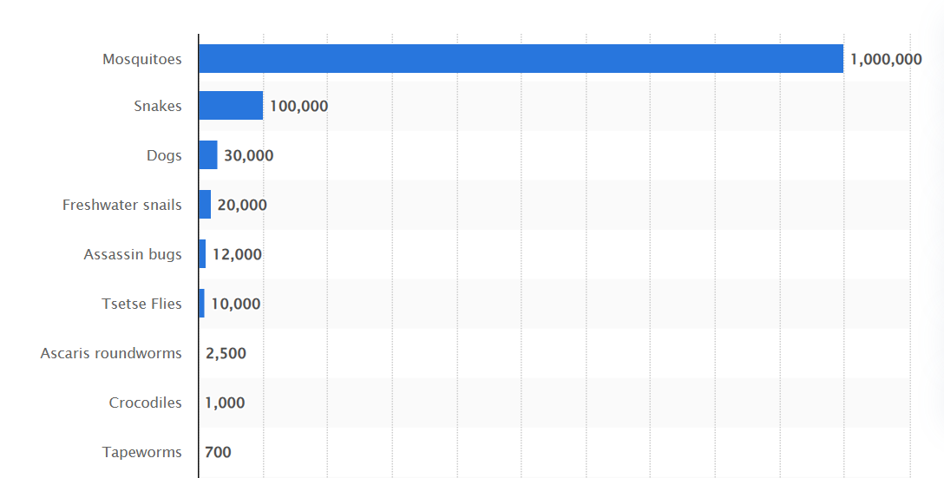
Deadliest Animals to Humans
Deadliest animals by annual number of human deaths
Take a moment to study this data table.
What do you notice?
What do you wonder?
Mosquitoes
Snakes
Dogs
Freshwater Snails
Assassin Bugs
Tsetse Flies
Roundworms
Crocodiles
Tapeworms
https://www.statista.com/statistics/448169/deadliest-creatures-in-the-world-by-number-of-human-deaths/
Notes:
Teacher: Give students an appropriate amount of time to examine the data and write responses to the prompts.
Student: Using your Notice / Wonder Chaart in your notebook, write responses to the two prompts.

Slide 8
Deadliest Animals to Humans
Deadliest animals by annual number of human deaths
Mosquitoes aren't just annoying. . .
They are deadly!
Each year mosquitoes kill more humans than every other animal combined.
How is that possible?
Mosquitoes
Snakes
Dogs
Freshwater Snails
Assassin Bugs
Tsetse Flies
Roundworms
Crocodiles
Tapeworms
https://www.statista.com/statistics/448169/deadliest-creatures-in-the-world-by-number-of-human-deaths/
Notes:
Teacher: Facilitate discussion.
Student: Contribute to class discussion.

Slide 9
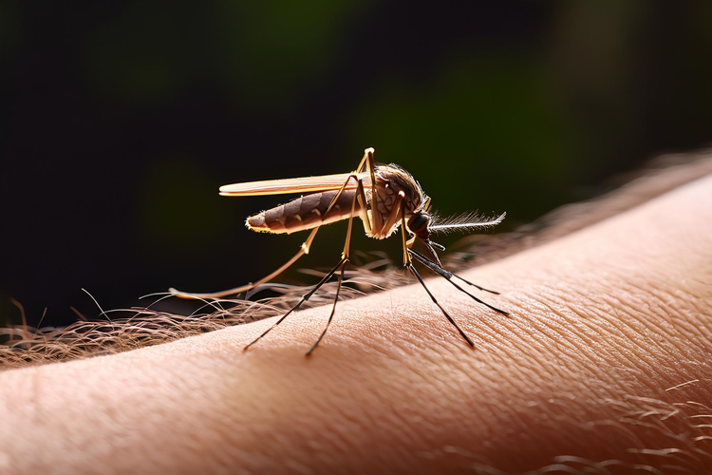
Malaria Transmission
Mosquitos carry a parasite called Plasmodium, which causes malaria, one of the top killing diseases globally.
Plasmodium has a very complicated life cycle that requires both mosquitos and humans. It is easily transferred between species.
Notes:
Teacher: While the protist that causes malaria (plasmodium) is the focus, they can also carry a host of viruses!
Examples include Yellow fever, Zika, Dengue, Chikungunya, and West Nile.
According to the World Health Organization, an estimated 207 million cases and 500,000 children under the age of five died of malaria in 2012. (https://www.who.int/publications/i/item/9789241564694)
Extension – have students investigate malaria life cycles.
Student: Jot down thoughts in your notebook.

Slide 10
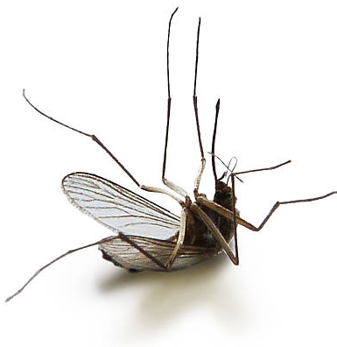
Lowering Mosquito Populations
Many doctors believe reducing mosquito populations could help reduce malaria infections.
But how can millions of mosquitoes be killed in a safe and controlled way?
One solution could involve the acetylcholinesterase (ACHE) enzyme we learned about earlier. . .
In your notebook, brainstorm and propose ways the ACHE enzyme could be involved in killing mosquitoes.
Notes:
Teacher: Give students appropriate amounts of time to think and respond in their notebooks.
Student: Think about ways ACHE could be involved in killing mosquitoes and write them in your lab notebook.

Slide 11
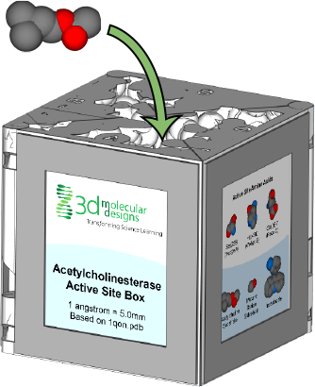
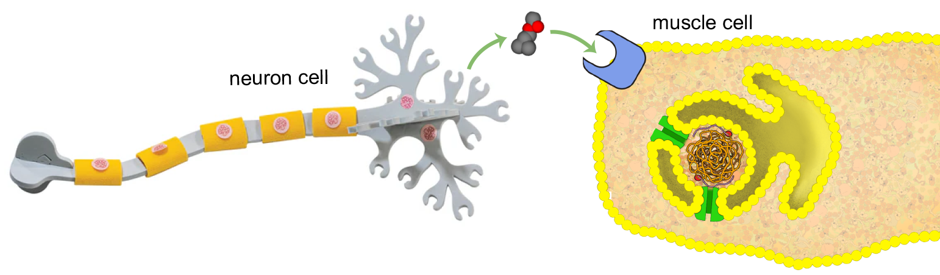
Review of Neurotransmission
When a brain signal is sent down a neuron, it triggers the release of the neurotransmitter acetylcholine (ACH). ACH then binds to receptors on muscle cells, triggering contraction.
After the signal is sent, ACH must be "recycled" by the enzyme acetylcholinesterase (ACHE). The ACH neurotransmitter enters the ACHE enzyme and is broken apart by three key amino acids.
Notes:
Teacher: Review ACHE key points from ACHE Active Site Part I – The Speed of Thought.
Student: Contribute previous knowledge and observations to classroom discussion.

Slide 12
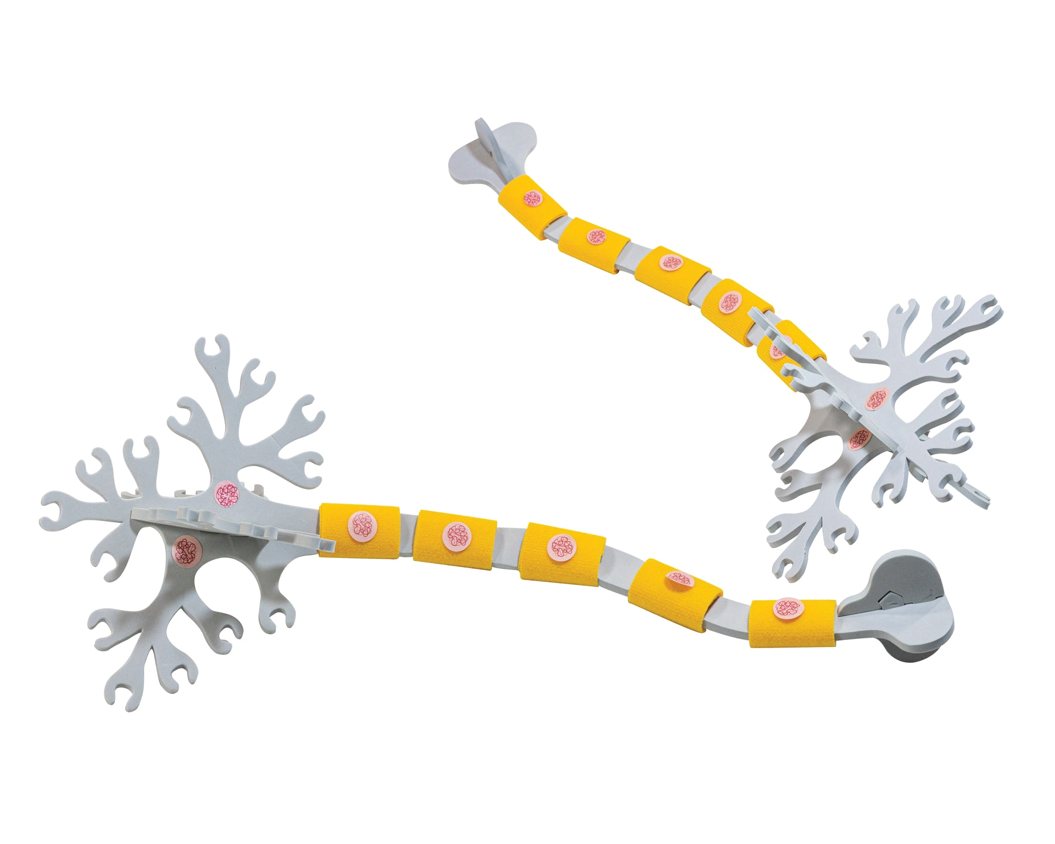
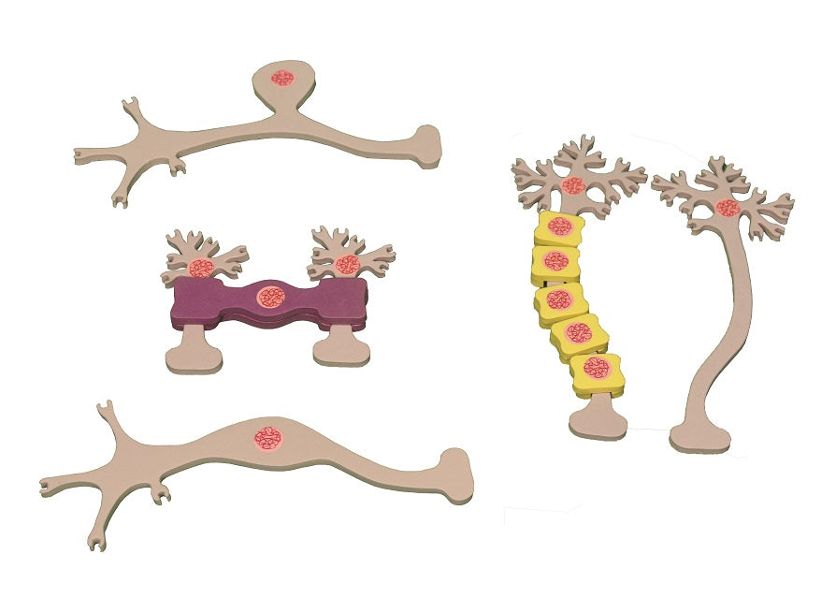
Extension: Neuron Modeling Kit ©
Building neurons invites your students to consider how the chemical and electrical signals in their brains are transported. Constructing neurons with various-sized models lets students:
Distinguish between multipolar, bipolar, and unipolar neurons and interneurons
Add myelin sheath pieces to explore two types of neuroglia in our nervous systems
Examine the overall effect on neuronal firing at excitatory and inhibitory synapses
These elegantly designed models allow students to create a network of neurons and develop questions about structure and function. A perfect complement to any study of cell communication or neuroscience concepts.
Notes:
Classroom extension – As needed, review neuron communication. Then using 3D Molecular Design’s Neuron Modeling Kit© ask your students to model ways to disrupt ACH from triggering an action.

Slide 13
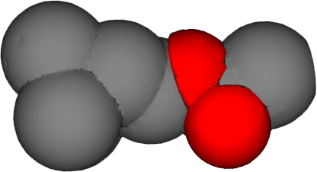
Exploring Physical Models
Let’s take another look at an insecticide, which is another small molecule from a family of molecules that repel or harm insects.
In your lab notebook, compare and contrast these models.
How is the insecticide similar to ACH?
How is it different?
Insecticide
Acetylcholine
Notes:
Teacher: Give students an appropriate amount of time to examine the models and write in their notebooks.
Student: In your noterbook, respond to the questions in green.

Slide 14
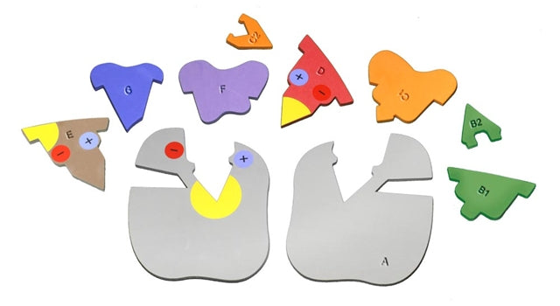
Substrates & Enzymes
Think back to when you learned about substrates and enzymes.
What are the ways that enzymes and substrates interact?
How can small molecule substrates help or hinder an enzyme?
Notes:
Teacher: Review with your students what they learned when modeling enzyme and substrate interactions with 3DMD’s Enzyme in Action Kit©, or have your students model with the kit now to explore concepts. Be sure students understand the basics of competitive inhibition before continuing.
Student: Using your prior experiences and knowledge, contribute to classroom discussion and respond to the questions in green in your notebook.

Slide 15
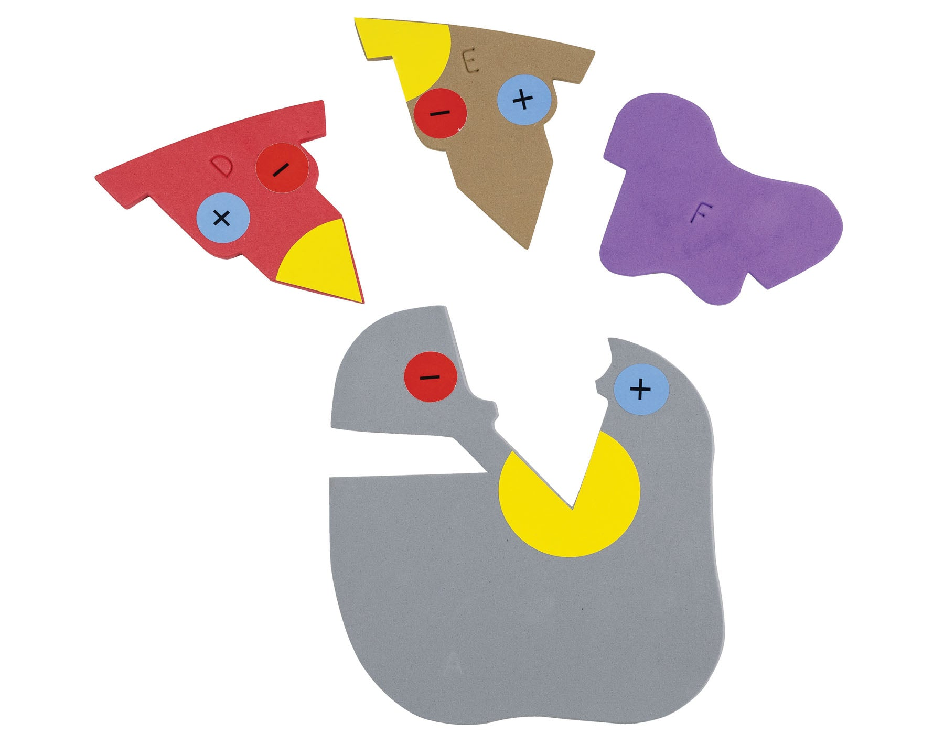
Extension: Enzyme in Action Kit ©
Models give words meaning. These colorful foam pieces with intuitive shapes let your students experience enzymes in action before they know the vocabulary. Collaboration and discourse naturally occur between learners as they figure out what it means for a protein to be a catalyst. The easy-to-use pieces allow small groups of students to:
Explore how enzymes interact with substrates
Investigate the active site of an enzyme and its specificity
Simulate competitive and allosteric inhibition
Contrast the lock-and-key and induced fit theories using evidence
Examine how an enzyme may affect activation energy
Excellent at revealing student thinking, this kit can complement traditional classroom catalase or amylase labs.

Slide 16
Insecticide Prediction
Based on what you remember of the ACHE Enzyme, make a prediction of how this insecticide would or would not interfere with the breakdown of ACH.
Record your prediction with sketches and or writing, in your lab notebook.
Notes:
Teacher: Give students an appropriate amount of time to think, sketch, and make a prediction.
Student: Sketch or write your prediction in your notebook.

Slide 17
Insecticide Exploration
Open your model to explore how the insecticide interacts with ACHE.
Where does the insecticide bind?
How does that impact the ACH neurotransmitter?
Notes:
Teacher: Give students time to play and explore the model pieces to discover how the insecticide acts as a competitive inhibitor. Support students as necessary.
Student: PLAY! Try to discover how the insecticide inhibits ACHE.

Slide 18
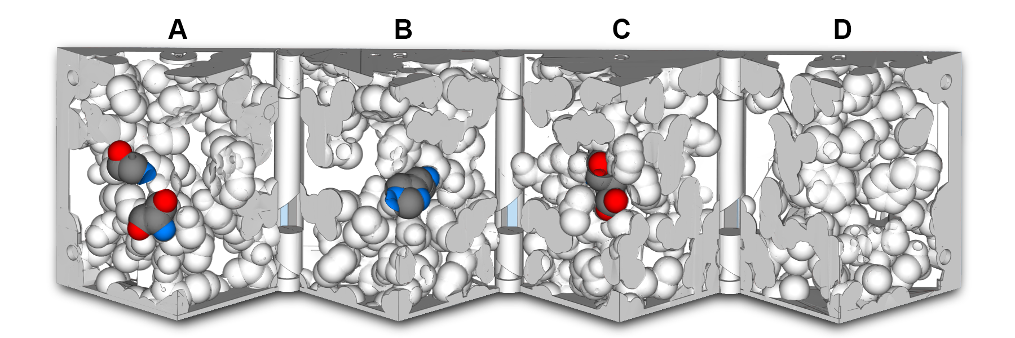
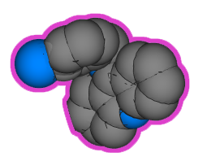
Binding to the ACHE Enzyme
The insecticide binds to a similar region of the ACHE enzyme as the ACH neurotransmitter (on Wedge A).
Confirm placement by closing the model to examine the fit.
Notes:
Teacher: Assist students with modeling as needed.
Student: Revise your prediction in your notebook.

Slide 19
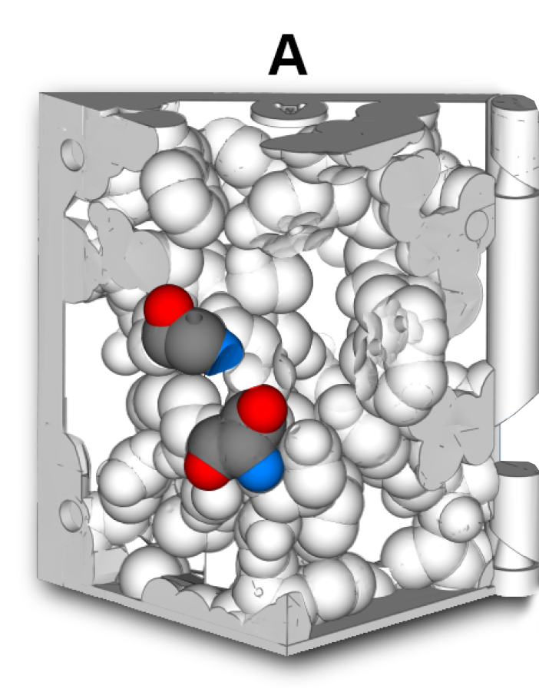

Binding to the ACHE Enzyme
Now bring the ACH neurotransmitter back.
With the insecticide bound, does the ACH neurotransmitter molecule still correctly bind?
Can you close the model with both molecules present?
Notes:
Teacher: Give your students time to play with the model. Prompts if needed: Can you close the active site box model with both molecules present? Why or why not?
Student: Write to the prompt in your notebook.

Slide 20
Binding to the ACHE Enzyme
In your lab notebook:
Explain the consequence of the insecticide binding to ACHE.
Notes:
Teacher: Give your students time to play with the model. Prompt, if needed: Can you close the active site box model with both molecules present? Why or why not?
Student: PLAY!

Slide 21
Competitive Inhibition of the ACHE Enzyme
When the insecticide is present, the ACH neurotransmitter does not have room to fit! A molecule that competes for the same space in an enzyme as the natural substrate is called a competitive inhibitor.
Discuss the impact this would have on the ACHE enzyme's ability to break down ACH.
Notes:
Teacher: Facilitate discussion.
Student: Think of potential outcomes and contribute to discussion.

Slide 22
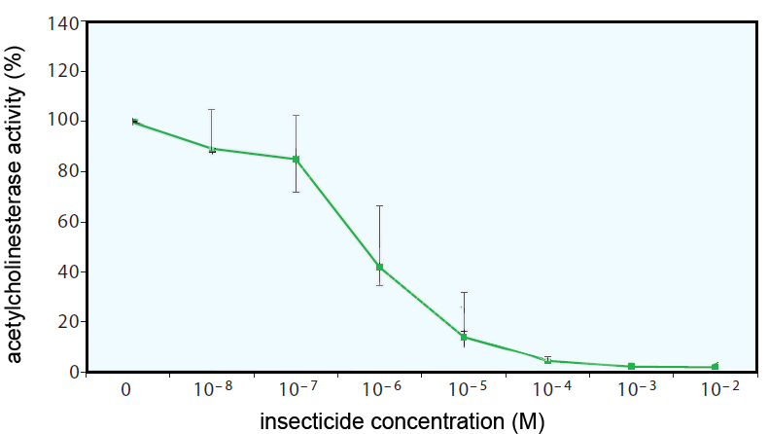
Competitive Inhibition of the ACHE Enzyme
The graph to the right shows ACHE enzyme activity (Y-axis) in mosquitoes exposed to different concentrations of the insecticide (X-axis).
Does this data confirm your prediction?
What impact would this have on the mosquito population?
Notes:
Teacher: Give students time to interpret the data in the graph. Use think-pair-share or alternative strategies to encourage discussion.
Student: Analyze the data and write to the prompts in your notebook.

Slide 23
Competitive Inhibition of the ACHE Enzyme
Review your notes and predictions in your lab notebook.
Update your lab notebook to correctly document this process.
Notes:
Teacher: Give students time to revise their mental and notebook models.
Student: Revise your model / sketches / notes as necessary in your notebook.

Slide 24
Competitive Inhibition of the ACHE Enzyme
The insecticide competes with the ACH neurotransmitter for room in the ACHE enzyme. ACH is not properly broken apart, preventing future brain signals from reaching muscle cells.
The result is paralysis, respiratory failures, seizures and eventually mosquito death, lowering the mosquito population and reducing the spread of malaria.
Notes:
Teacher: Content slide -
Student: Add to your thoughts in your journal

Slide 25

Summary
The insecticide competes for space in the ACHE enzyme, inhibiting the binding of ACH.
This prevents the ACHE enzyme from properly breaking apart ACH.
ACH is not properly cleared away and future brain signals are not received by muscle cells, causing mosquito death.
Notes:
Teacher: Facilitate summary discussion, then show slide.
Student: First in class discussion, then in your notebook, summarize the key points of this modeling activity. Review the summary slide and revise your notebook summary as needed.

