Slide 1

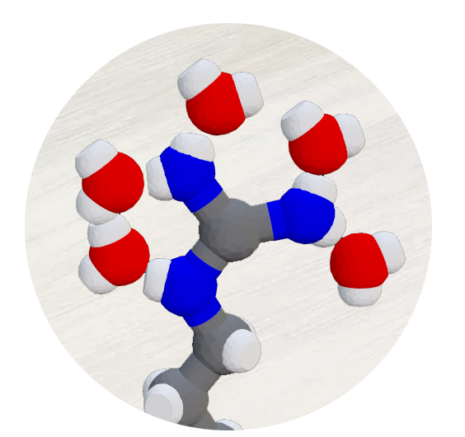
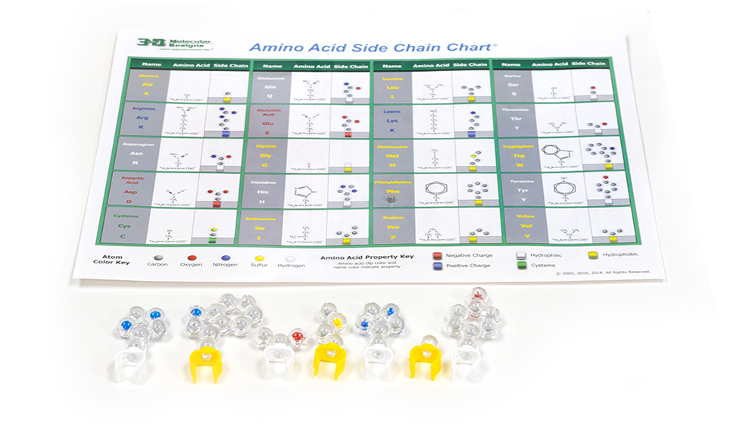

Side Chain Explorer
“One amino acid does not a protein make.”
– Preston Cloud Jr.
Activity ID: AASK-AR1
Required Models: AASK Side Chain Chart
Required Media: 3DMD AR EDU App

Slide 2

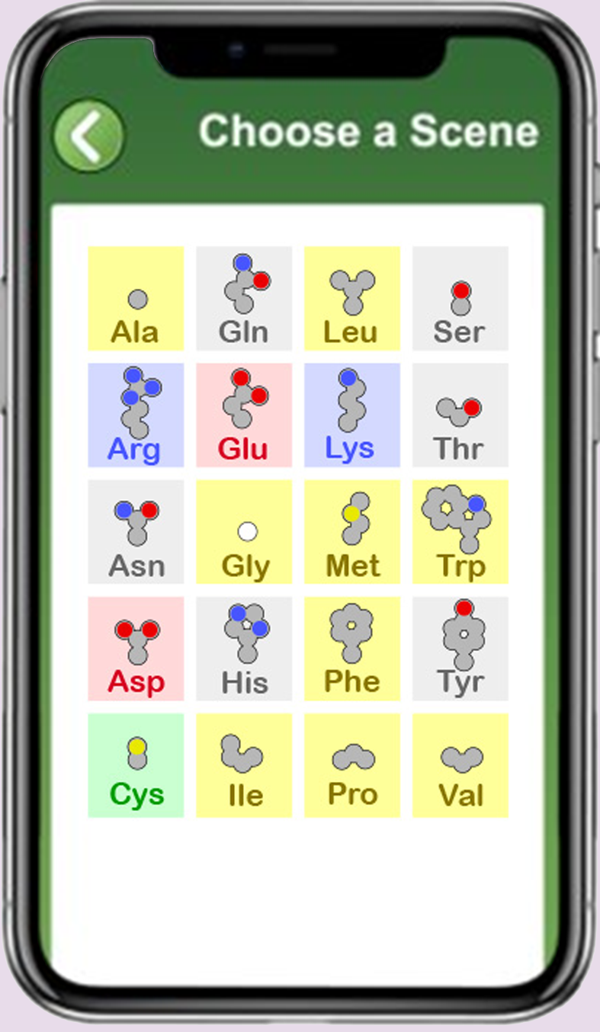
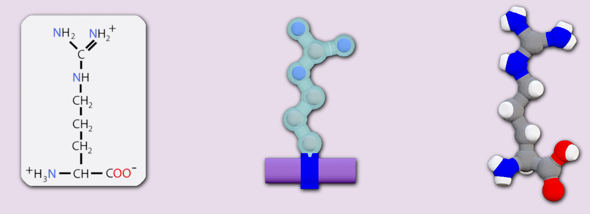
Teacher Guide – Summary
Activity Summary
This AR activity explores the structure of amino acids and how interactions with water and other amino acids drive protein folding. Students will label parts, learn amino acid properties, look for patterns, and discover the rules of protein folding. This activity will not explore the effects of environment, like pH or temperature on protein structure.
This activity requires the 3DMD AR EDU application, available for download from the Google Play and Apple App stores. Each of the twenty amino acids will be shown in three formats: a chemical structure, a side chain clipped to a mini-toober, and a ball-and-stick rendering. Below the amino acid arginine is shown as an example.
Chemical
structure
Sidechain clipped to a mini-toober
Ball-and-stick
rendering

Slide 3
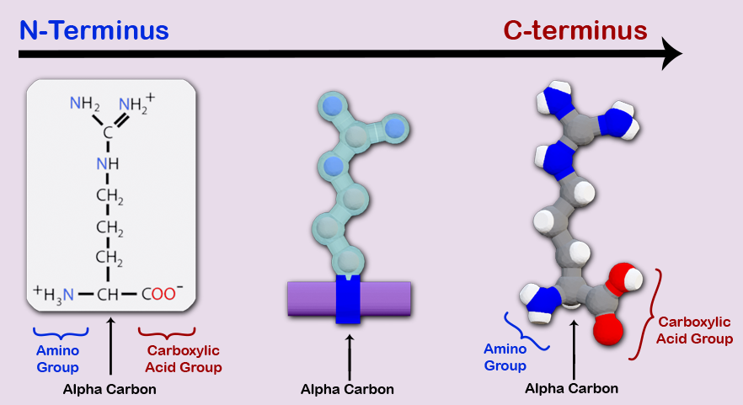
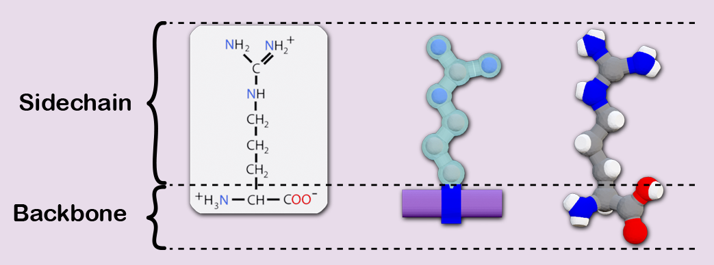
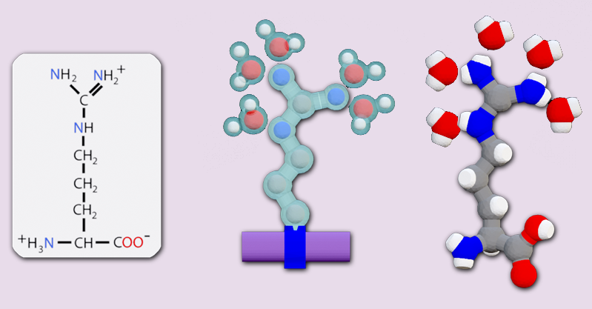
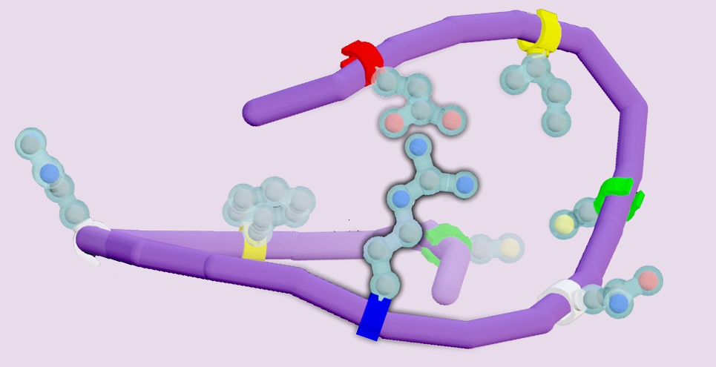
Teacher Guide – Summary (continued)
Activity Summary (continued)
Four overlays can be applied to each amino acid. Below the amino acid arginine is shown as an example.
Overlay 1
Highlights the side chain and backbone of the amino acid.
Overlay 2
Highlights the backbone groups and directionality of the amino acid.
Overlay 3
Highlights the way water interacts with the amino acid.
Overlay 4
Highlights the way other amino acids interact with the amino acid.

Slide 4
Teacher Guide - Overview
Activity Objectives
  Discover how amino acids interact with each other.
  Evaluate the structure of amino acid and classify them by their chemical properties.
  Determine the rules for protein folding based on the interactions of amino acids within the primary sequence.
  Estimated Class Time:
60 minutes
Required Models:
Amino Acid Side Chain Chart©
Required Media:
3DMD AR EDU App + subscription
Other Materials Needed:
None
Grade, Class
9-12 Biology or Chemistry
Topics
Amino acid properties
Protein folding – tertiary structure
Prerequisite Knowledge
Polarity
Properties of water

Slide 5
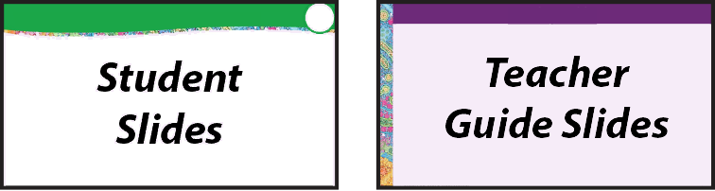




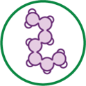
Teacher Guide - Using This Slide Deck
Student and Teacher Slide Deck Pages
  Slides that are meant for student viewing will feature a green top
  banner. Slides that are meant only for teacher viewing will feature a
  purple top banner and will appear hidden when in "slide show" mode.
Prompting Icons
  Each student slide will include a prompting icon in the top right corner of the slide. These icons on each slide cue your students to the type of activity they will be doing.
Turn and talk discussion
Write in your notebook
Quiet thinking time
Digital modeling
Physical modeling
Teacher Moves and Student Moves
Class slides provide notes (teacher notes below the slide) with specific information to assist you in facilitating the activity using effective modeling and education practices.

Slide 6
Teacher Guide - Standards
Next Generation Science Standards
Science and Engineering Practices | Cross Cutting Concepts | Disciplinary Core Ideas
Asking Questions and Defining Problems | Patterns | HS-LS1-1
Developing and Using Models | Structure and Function
Constructing Explanations and Designing

Slide 7
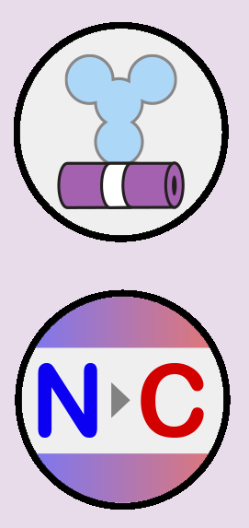
Teacher Guide – Overlay 1 and 2
Overlay 1 and 2: Amino Acid Representations
Students will scan the Amino Acid Side Chain Chart from the Amino Acid Starter Kit© to explore the overall structure of amino acids. Each amino acid will be shown with three representations: a chemical structure, a sidechain clipped to a mini-toober, and a ball-and-stick rendering.
Students will explore amino acid side chain and backbone atoms and compare how each type of amino acid is similar and different. The backbone atoms of all amino acids are the same and the side chain atoms of each type of amino acid are unique.
Overlay 1 Button
Chemical
structure
Overlay 2 Button

Slide 8


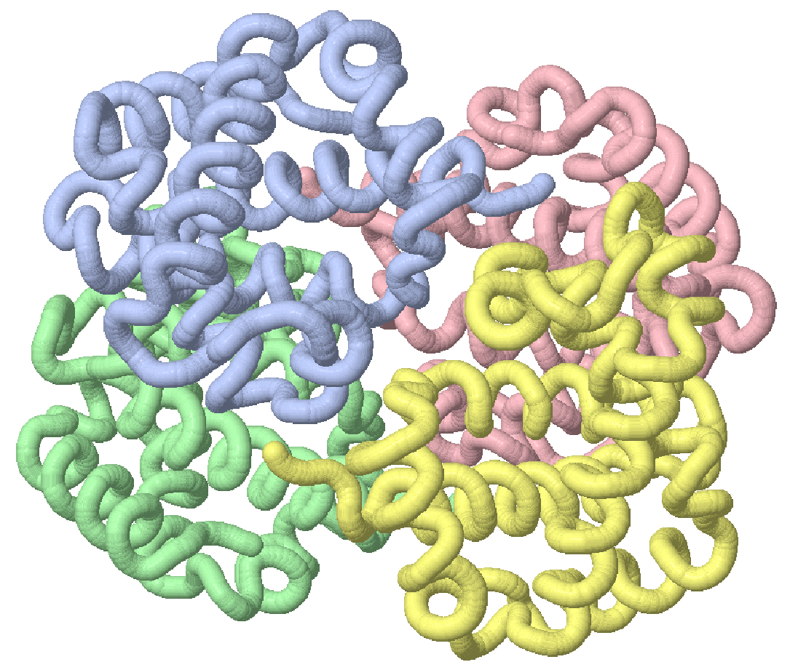
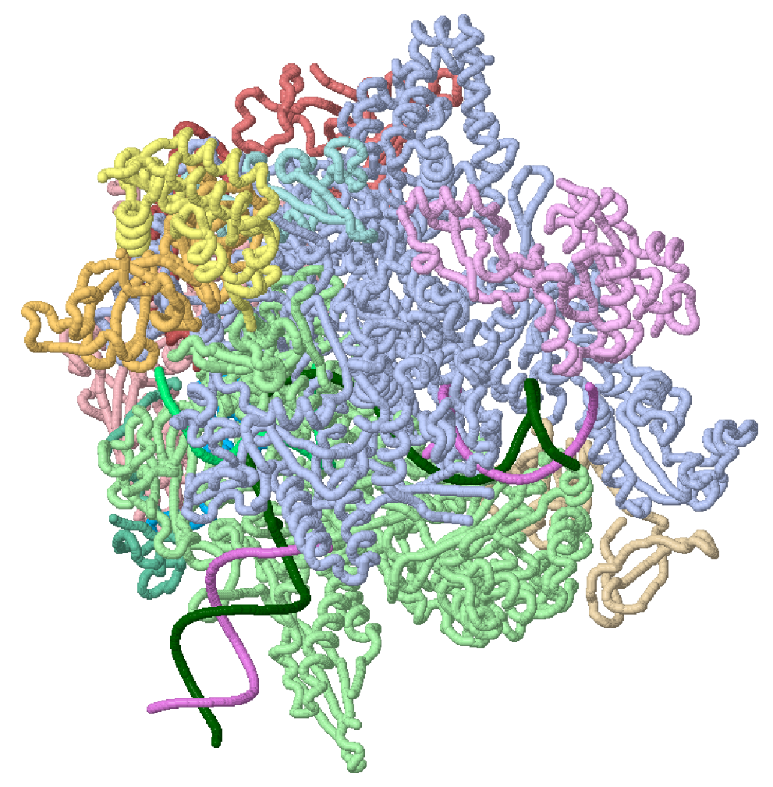
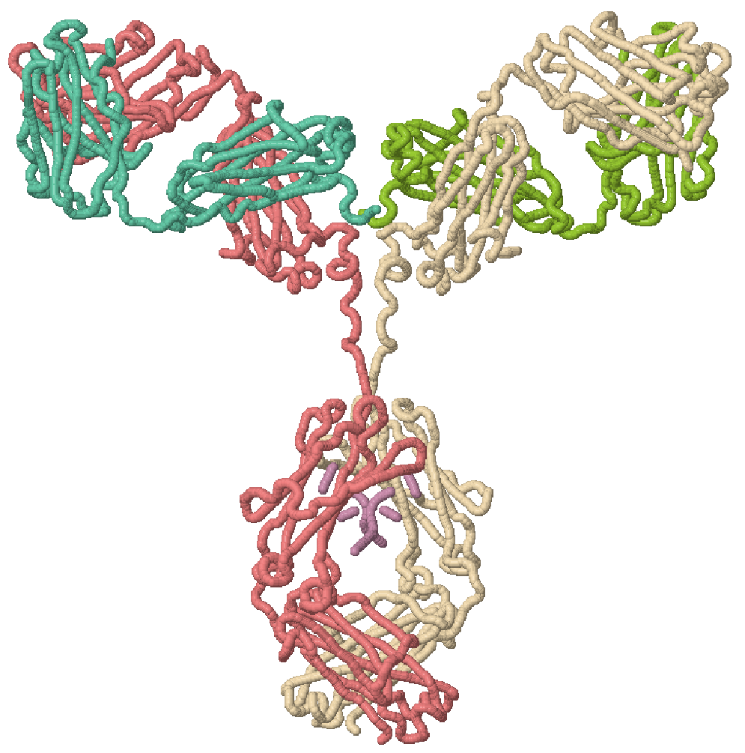
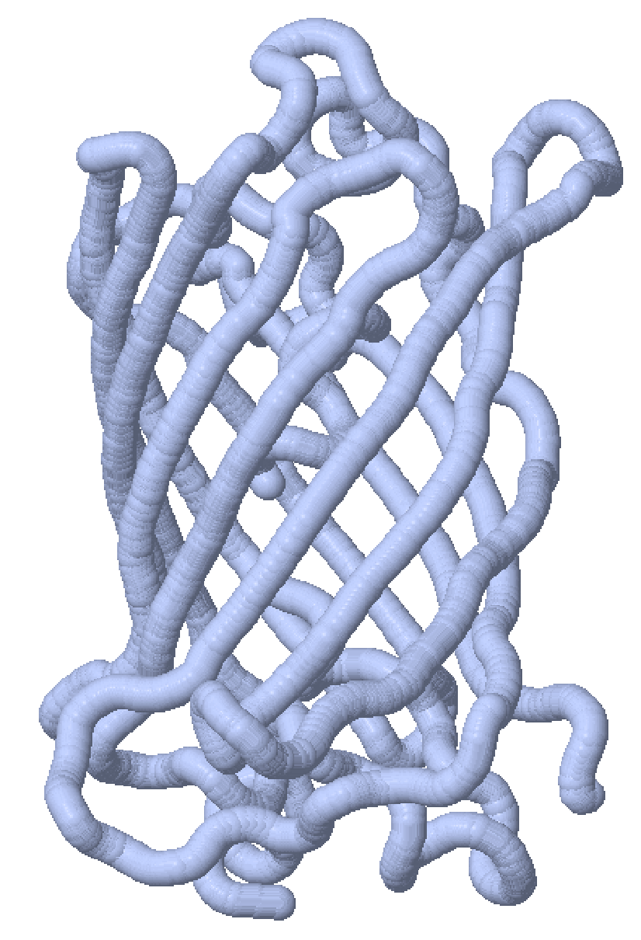
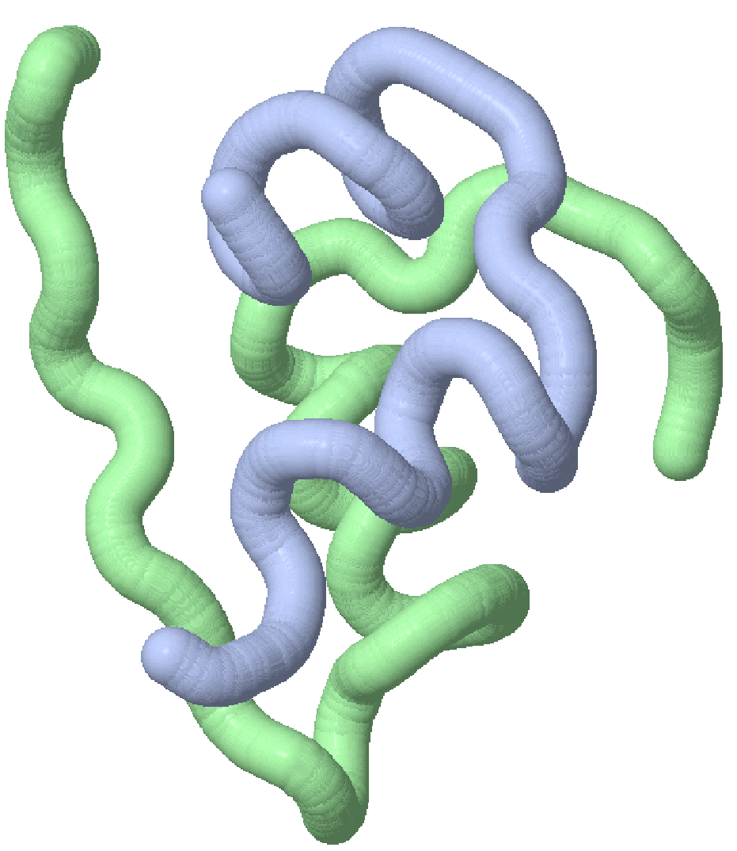
Proteins are Important to Life
Proteins are important to life.
They help us move, speed up chemical reactions, provide structure and shape, respond to stimuli, and transport molecules from one place to another.
How do the various proteins
shown to the right differ?
What do you notice?​
What do you wonder?
Notes:
Teacher: Facilitate a discussion with students by asking them: What is a protein? Expand on why proteins are so important in living systems. Organisms are nothing more than a well-organized series of chemical reactions that are regulated by tiny machines we call proteins. Note: Most students will answer with the information they learned in Nutrition class—protein is steak, eggs, burgers, chicken, etc.
Student: Brainstorm a list about what they already know about protein.

Slide 9

Proteins Come in a Variety of Shapes and Sizes
Proteins come in a wide variety of complex shapes and sizes.
To understand protein structures and how they function, we first need to study what they are made of:
Amino Acids
Antibody
Protein
RNA Polymerase
Protein
Green
Fluorescent
Protein
Insulin
Protein
Hemoglobin
Protein
Notes:
Teacher: Facilitate a discussion to determine what students already know about proteins. Explain to students that proteins are made of subunits called amino acids.
Student: Share what is on their list and add other classmates' responses to their list.

Slide 10


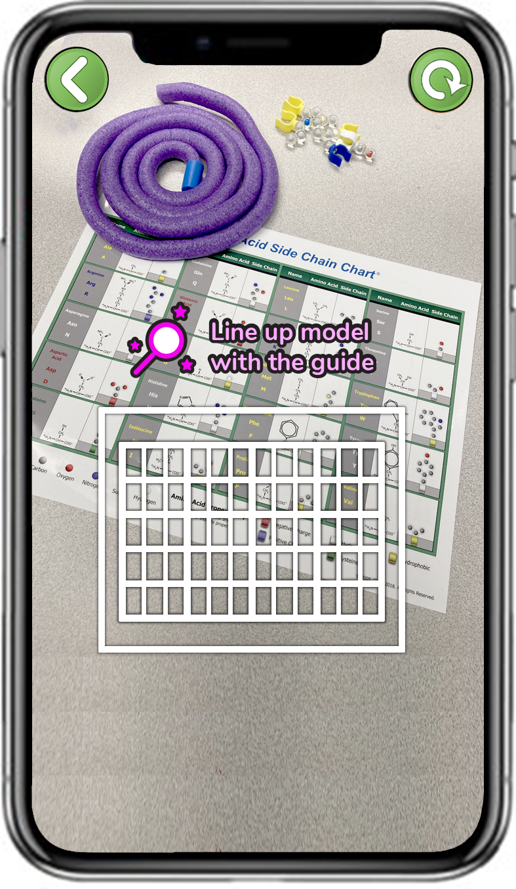
Explore Side Chains with the 3DMD AR EDU App
Select Met from the scene menu
Scan the Amino Acid Side Chain Chart©
There are twenty types of amino acids that can be part of a protein.
Let's start by looking at just one.
Select the Methionine amino acid, abbreviated Met.
Notes:
Teacher: Move around the room and provide tech support.
Student: Open the app and select the appropriate activity and scene.

Slide 11
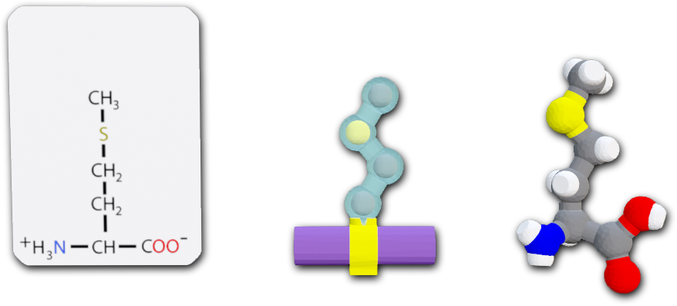
Multiple Representations of Amino Acids
How many representations of the methionine amino acid do you see?
Why might we want more than one representation of a single amino acid?
Notes:
Teacher: Guide them in noticing the similarities and differences between the three models. Discuss the N-terminus and C-terminus and what that means to the polypeptide sequence.
Student: Sketch and label Met in their favorite representation.

Slide 12
Each Representation Highlights Different Features
Each representation highlights different features of the amino acid.
Comparing and contrasting multiple representations can help us recognize features of their structure.
Chemical Structure
Shows every
atom and how
they connect.
Mini-toober
Shows how amino acids are represented in the physical modeling kit.
Ball-and-Stick
Shows the 3D shape of the amino acid.
Notes:
Teacher: Ask students to share what they determined.
Student: Explain why using several different representations of methionine is important. What are the benefits of each model?

Slide 13
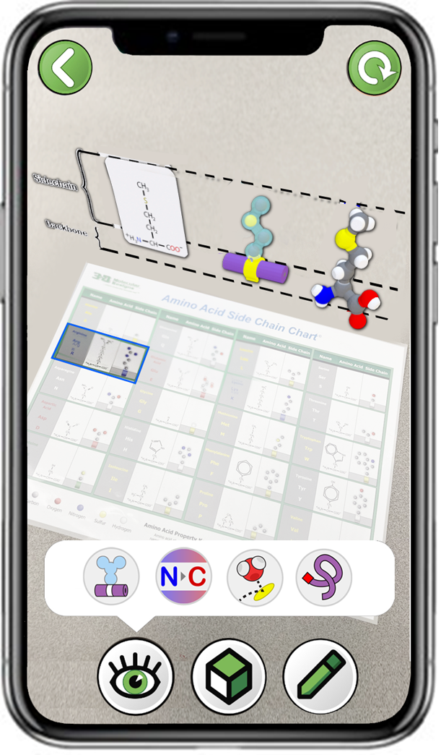
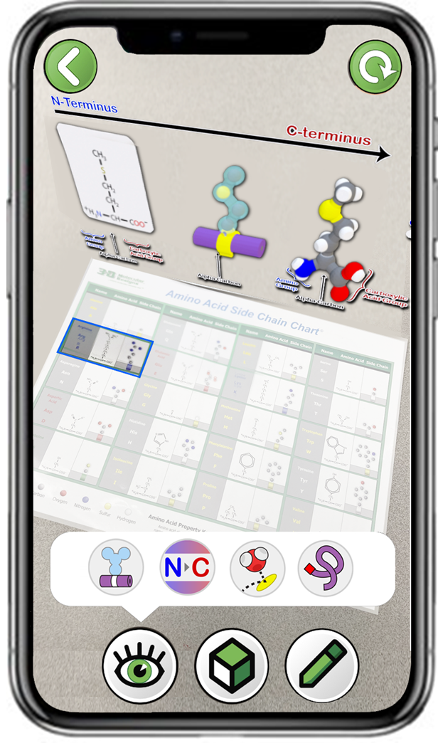
Explore Side Chains with the 3DMD AR EDU App
Next, explore the two bottom left buttons.
What atoms make up the side chain of Methionine?
What atoms make up the backbone of Methionine?
What else do you notice?
Notes:
Teacher: Move around the room and provide tech support.
Student: Open the app and select the appropriate activity and scene.

Slide 14
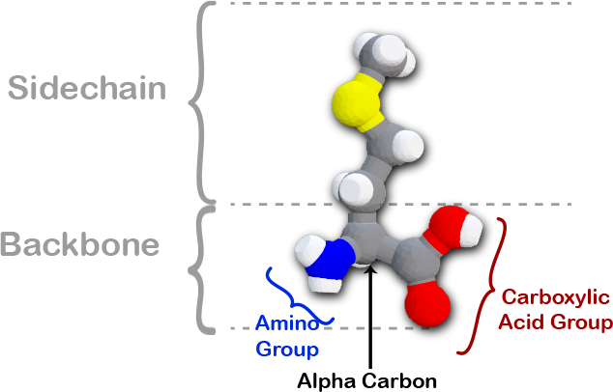
Methionine Has a Backbone and a Side Chain
A methionine amino acid is comprised of two main regions, the side chain and the backbone.
The backbone is further divided into three regions, the amino group, the alpha carbon, and the carboxylic acid group.
The backbone gives the amino acid directionality.
Notes:
Teacher: Move around the room and provide tech support. Walk students through the first amino acid. Help students identify the amine group, carboxyl group, side chain, and alpha carbon.
Student: Continue to label their sketch of met in their notebook.

Slide 15
Explore Side chains with the 3DMD AR EDU App
Select any two amino acids
Scan the Amino Acid Side Chain Chart©
Let's explore more amino acids.
Select at least two more amino acids from the scene menu.
Do they all have a side chain?
Do they all have a backbone?
How are they similar and how are they different?
Notes:
Teacher: Move around the room and provide tech support.
Student: Open the app and select the appropriate activity and scene. As they complete the activity, consider the prompts on the screen.

Slide 16

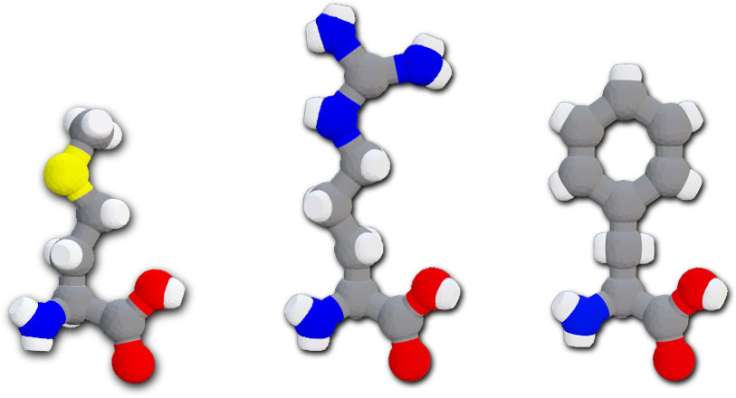
Backbones are Identical and Sidechains are Unique
Every amino acid has a side chain and a backbone.
The backbone of every type of amino acid is identical.
The side chain of each different type of amino acid is unique.
Pick your favorite amino acid and draw it in your notebook or take a screenshot in the app using the pencil. Label the parts in your drawing.
Notes:
Teacher: Point out to students where the backbone ends and the side chain begins.
Student: Follow the prompts on the screen.

Slide 17

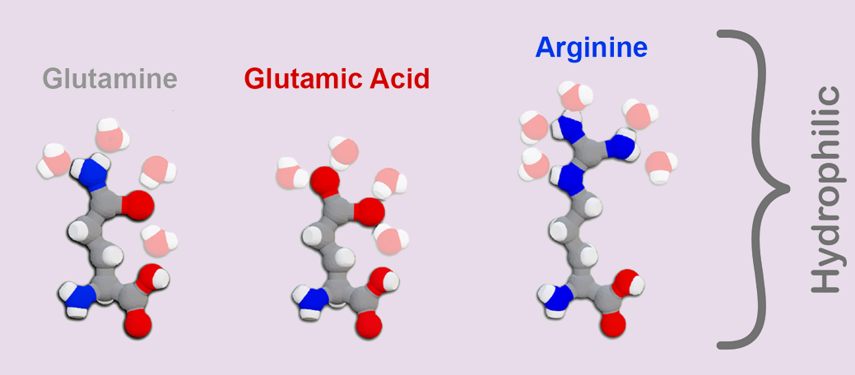
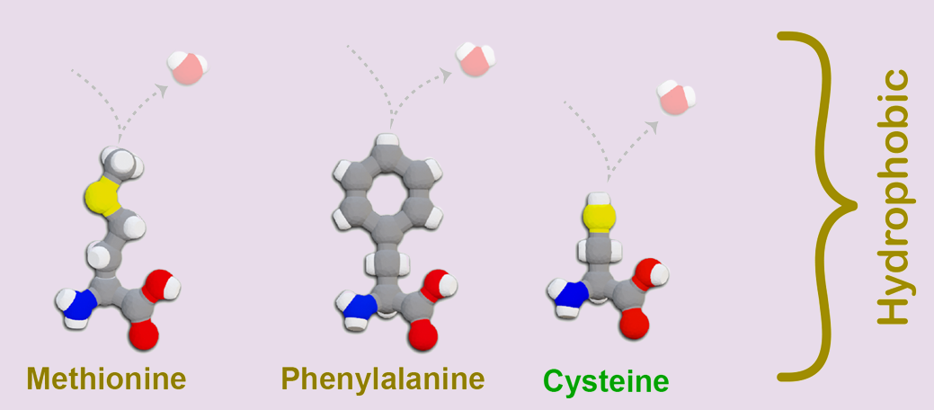
Teacher Guide – Overlay 3
Overlay 3: Water Interactions
Students will use the third overlay button to see how individual amino acids interact with water molecules.
Students will need to look at a minimum of five amino acids, one from each group: Acidic, Basic, Cysteine, Hydrophilic, and Hydrophobic.
Students will create a table to document how water interacts with each group of amino acids.
Overlay 3 Button

Slide 18
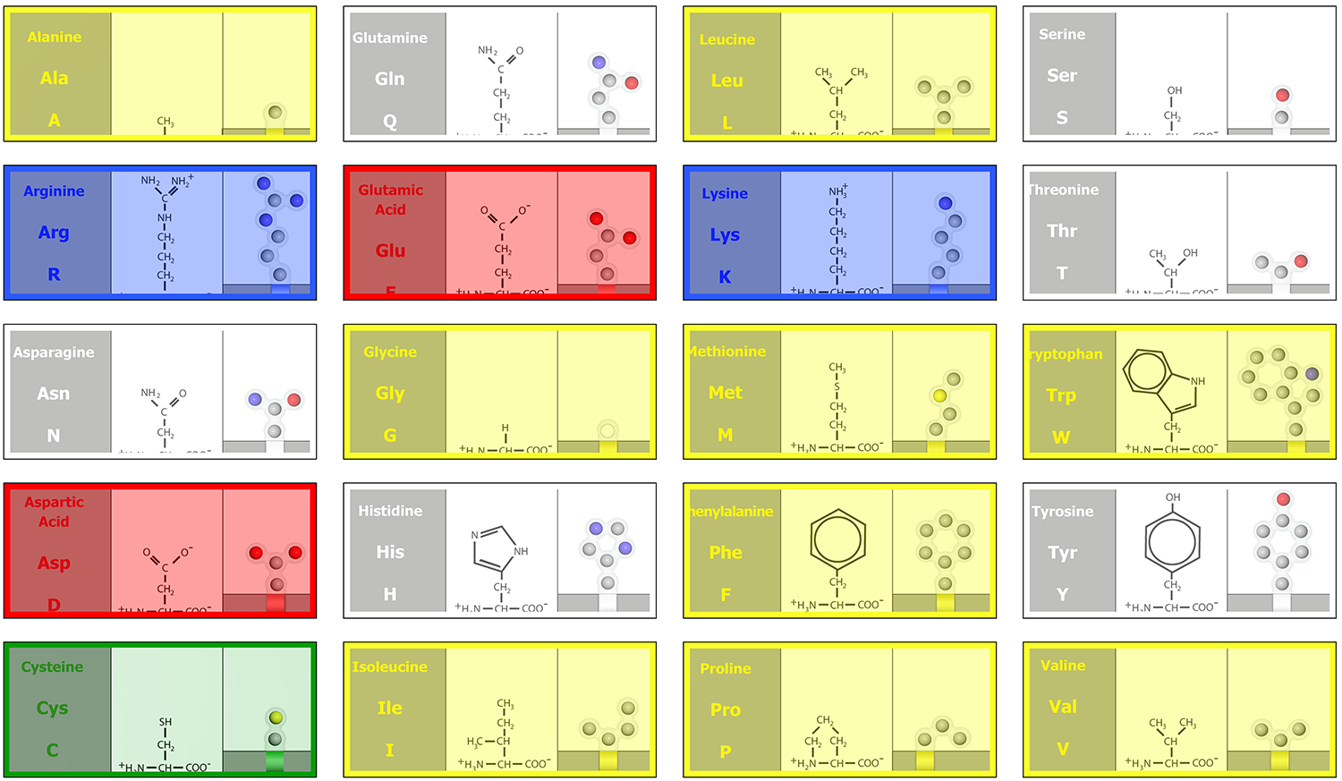
Exploring Side Chain Properties
The twenty amino acids are often sorted into five groups based on their side chain shape and chemical properties.
Acidic
Basic
Hydrophobic
Hydrophilic
Cysteine
Notes:
Teacher: Assign your student groups four additional amino acids: hydrophobic, hydrophilic, basic, and acidic. An example might include hydrophobic (Phe), hydrophilic (Gln), basic (Arg), acidic (Glu), and cysteine (Cys).
Student: Sketch and annotate their five assigned amino acids in their notebook

Slide 19
Record Your Observations on Side Chain Atoms
 | Atoms in the Side Chains | Interactions with Water | Interactions with Amino Acids
Acidic
Basic
Hydrophobic
Hydrophilic
Cysteine
Create a table in your notebook like the one shown to the right.
Explore at least one amino acid from each group.
In the first column, record what atoms generally make up the side chains in each group.
Notes:
Teacher: Give your students time to create the table in their lab notebook or make a copy of this slide and give it to them.
Student: Create the following table in their lab notebook. Complete it as they finish the AR activity.

Slide 20
Atoms that Make Up Each Side Chain
 | Atoms in the Side Chains | Interactions with Water | Interactions with Amino Acids
Acidic | Oxygen and Carbon
Basic | Nitrogen and Carbon
Hydrophobic | Mostly Carbon
Hydrophilic | Oxygen, Nitrogen and Carbon
Cysteine | Sulfur and Carbon
Acidic have oxygen
Basic have nitrogen
Hydrophobic have mostly carbon
Hydrophilic have oxygen and nitrogen.
Cysteine has sulfur
Notes:
Teacher: Have your students share the trends that they found when looking at the different classification of side chains.
Student: Share out their findings.

Slide 21
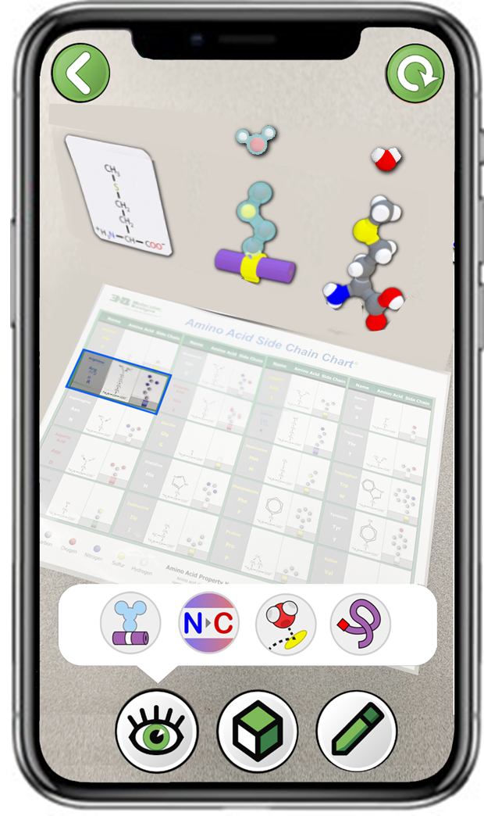
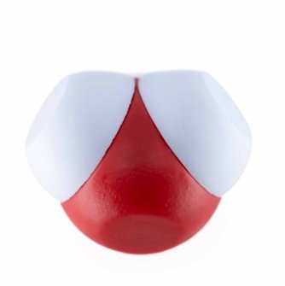
Explore Water Interactions with the 3DMD AR EDU App
The atoms in a side chain determine how it interacts with other molecules, such as water, which makes up most of our cells.
Using the app, explore at least one amino acid from each of the five groups. Select the third button to show water molecules.
Are the water molecules attracted to the side chain? Are they repelled?
How are the water molecules oriented?
Notes:
Teacher: Ask students to explore how water interacts with the different classifications of side chains. Remind students about polarity. Remember, if you see the atoms SNO-H, it's polar.
Student: Before viewing the AR, predict how the water molecules will interact with the side chain. Using the green prompts as a guide, explore how water interacts with the different side chains.

Slide 22
Record Your Observations of Water Interactions
 | Atoms in the Sidechains | Interactions with Water | Interactions with Amino Acids
Acidic | Oxygen and Carbon
Basic | Nitrogen and Carbon
Hydrophobic | Mostly Carbon
Hydrophilic | Oxygen, Nitrogen and Carbon
Cysteine | Sulfur and Carbon
In the second column, record how water molecules interact with the side chains in each group.
Notes:
Teacher: Move around the room and assist students as they observe the water interactions. Facilitate a discussion and have students share what they discovered.
Student: Record their findings in their data table. Confirm or revise models and sketches in their notebook. Be prepared to share with the class.

Slide 23
Water Interactions with Each Sidechain
 | Atoms in the Sidechains | Interactions with Water | Interactions with Amino Acids
Acidic | Oxygen and Carbon | Attract Water (hydrogen)
Basic | Nitrogen and Carbon | Attract Water (oxygen)
Hydrophobic | Mostly Carbon | Repels Water
Hydrophilic | Oxygen, Nitrogen and Carbon | Attract All Atoms in Water
Cysteine | Sulfur and Carbon | Repels Water
Acidic attract the hydrogen in water.
Basic attract the oxygen in water.
Hydrophobic repel water.
Hydrophilic attract all atoms in water.
Cysteine repels water
Notes:
Teacher: Summarize what students determined after viewing the activity.
Student: Revise the information in their notebook as needed.

Slide 24
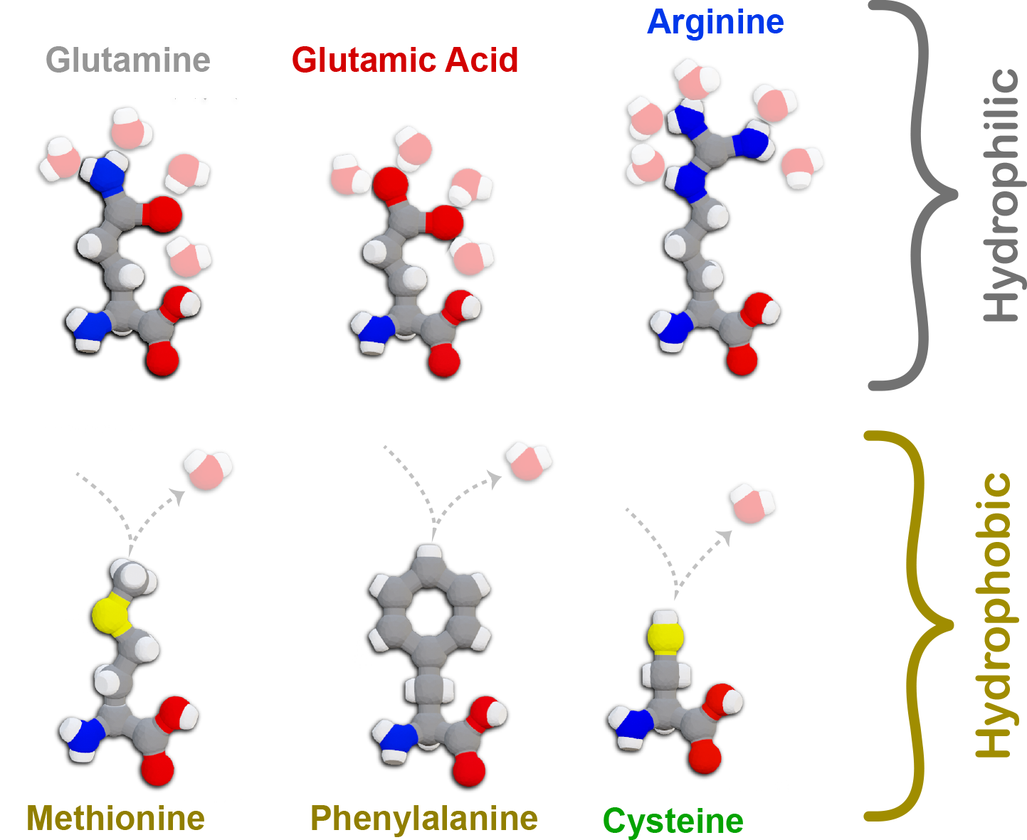
Hydrophobic and Hydrophilic Sidechains
Water is attracted to hydrophilic side chains, including acidic and basic side chains.
Water is repelled by hydrophobic side chains, including the cysteine side chain.
Notes:
Teacher: Summarize the differences between hydrophilic and hydrophobic amino acids.
Student: Confirm or revise models and sketches in their notebook.

Slide 25

Teacher Guide – Overlay 4
Overlay 4: Amino Acid Interactions and the Four Rules of Protein Folding
Experienced teachers would now normally share the 4 rules of protein folding. This overlay has been designed for students to discover these rules independently. Clicking on an amino acid from the side chain chart will place it in the center of an 8 amino acid long mini-toober.
The surrounding amino acids will fold around the selected amino acid, showing how other amino acids might interact with it. Students can determine these rules by watching the protein fold and unfold.
At the conclusion of this activity, students should be ready to fold their own 15 amino acid long protein using the Amino Acid Start Kit© mini-toober.
Overlay 4 Button

Slide 26
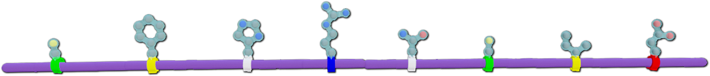
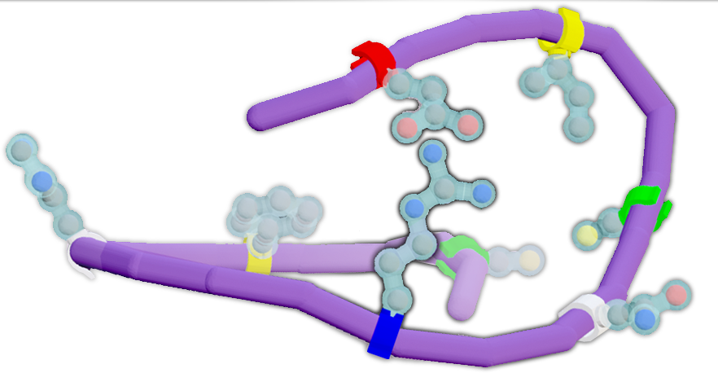
Proteins Form Chains that Fold
Amino acids link together to form protein chains, which then fold into 3-dimensional shapes.
The side chains in a protein chain determine how the protein folds.
Notes:
Teacher: Give some background explaining that polypeptide (primary structure) will rotate into a protein (tertiary structure). Explain to students that this next activity will help them determine how side chains interact with each other to form a 3-d shape.
Student: Think about how amino acids interact with each other while completing the next activity.

Slide 27
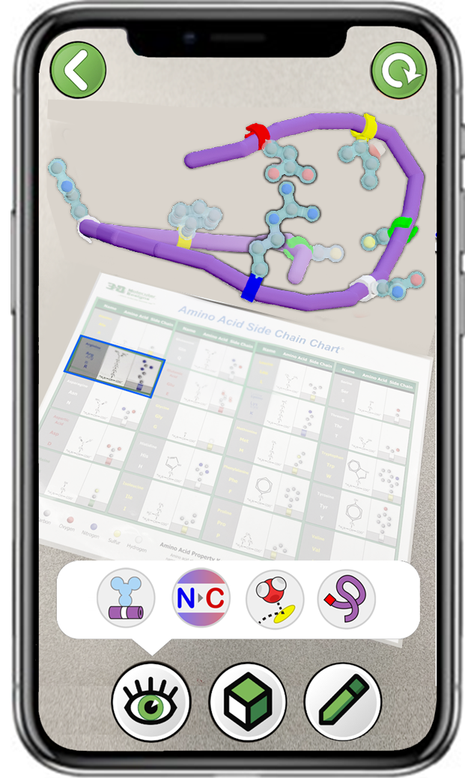
Explore Protein Folding with the 3DMD AR EDU App
The atoms in a side chain also determine how it interacts with other amino acid side chains.
Using the app, explore at least one amino acid from each of the five groups. Select the fourth button to show a chain of amino acids fold.
How do side chains in each group
interact with other side chains?
Do they attract?
Do they repel?
Notes:
Teacher: As students investigate the overlays support their technology needs. Remind them that they are trying to identify the four rules of protein folding so they will need to view the animations carefully. Typically proteins fold, but do not immediately unfold. Remind your students of this fact.
Student: As they watch the animations, consider the green prompts on the screen.

Slide 28
Record Your Observations of Amino Acid Interactions
 | Atoms in the Side Chains | Interactions with Water | Interactions with Amino Acids
Acidic | Oxygen and Carbon | Attract Water (hydrogen)
Basic | Nitrogen and Carbon | Attract Water (oxygen)
Hydrophobic | Mostly Carbon | Repel Water
Hydrophilic | Oxygen, Nitrogen and Carbon | Attract All Atoms in Water
Cysteine | Sulfur and Carbon | Repels Water
In the third column, record how other amino acid side chains interact with the side chains in each group.
Notes:
Teacher: Walk around the room and assist with technology. Help individual student groups notice the different amino acid interactions if they are struggling. Facilitate a discussion where students share their findings.
Student: Investigate how amino acids interact for each category and determine how they interact. Record findings in the data table. Students should be prepared to share their findings with the class.

Slide 29
Amino Acid Interactions with Each Side Chain
 | Atoms in the Side Chains | Interactions with Water | Interactions with Amino Acids
Acidic | Oxygen and Carbon | Attract Water (hydrogen) | Attract Basic
Basic | Nitrogen and Carbon | Attract Water (oxygen) | Attract Acidic
Hydrophobic | Mostly Carbon | Repels Water | Hide in the Center
Hydrophilic | Oxygen, Nitrogen and Carbon | Attract All Atoms in Water | Face the Outside
Cysteine | Sulfur and Carbon | Repels Water | Attract to Cysteine
Notes:
Teacher: Help students create a class consensus model. Facilitate discussion to determine the four rules of protein folding.
Student: Revise the table in their notebook to match the class consensus model.

Slide 30
Amino Acid Interactions with Each Side Chain
 | Atoms in the Side Chains | Interactions with Water | Interactions with Amino Acids
Acidic | Oxygen and Carbon | Attract Water (hydrogen) | Attract Basic
Basic | Nitrogen and Carbon | Attract Water (oxygen) | Attract Acidic
Hydrophobic | Mostly Carbon | Repels Water | Hide in the Center
Hydrophilic | Oxygen, Nitrogen and Carbon | Attract All Atoms in Water | Face the Outside
Cysteine | Sulfur and Carbon | Repels Water | Attract to Cysteine
Acidic attract to basic
(salt bridge).
Basic attract to acidic
(salt bridge).
Hydrophobic cluster in the center to hide from water.
Hydrophilic face the outside to interact with water.
Cysteine attract to cysteine (disulfide bond).
Notes:
Teacher: Give students time to write the four rules of protein folding in their notebook. Stress that these interactions all occur simultaneously!
Student: Revise the table in their notebook to match the class consensus model.

Slide 31
The Four Rules of Protein Folding
Your observations can be summarized into four rules of protein folding:
Hydrophobic Amino Acids will cluster near the center of the protein to hide from water and interact with each other.
Hydrophilic Amino Acids will interact with other hydrophilic amino acids and the surrounding water in the cell.
Acidic (-) Amino Acids and Basic (+) Amino Acids will be attracted to each other and form a salt bridge (hydrogen bond).
Cysteines will interact with another cysteine to form a disulfide bond (covalent bond).
Notes:
Teacher: Review the four rules of protein folding. Stress that these interactions all occur simultaneously!
Student: Jot their thoughts and ideas in their notebook.

Slide 32
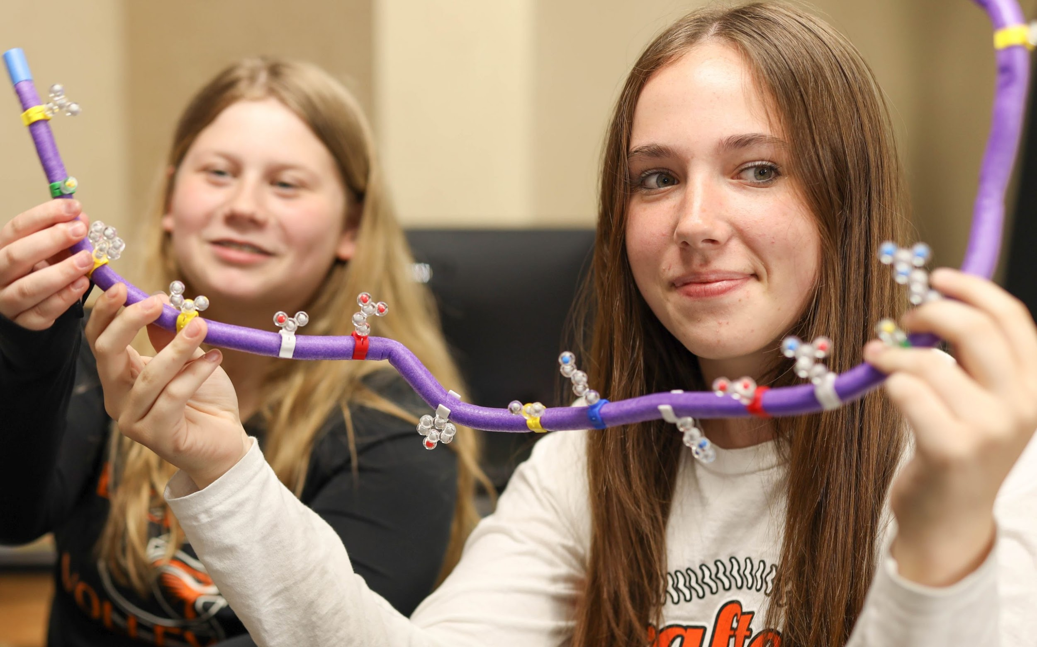
Amino Acid Sequence Impacts Protein Folding
Discuss these observations with the rest of the class.
How might the sequence of amino acid side chains in a protein impact how it folds?
Would two different sequences fold into the same shape?
Notes:
Teacher: Allow students to talk about the prompts with their partner. Facilitate a class discussion and have students share their thoughts.
Student: Discuss the green prompts with their partners. Be prepared to share their ideas with the class.

Slide 33
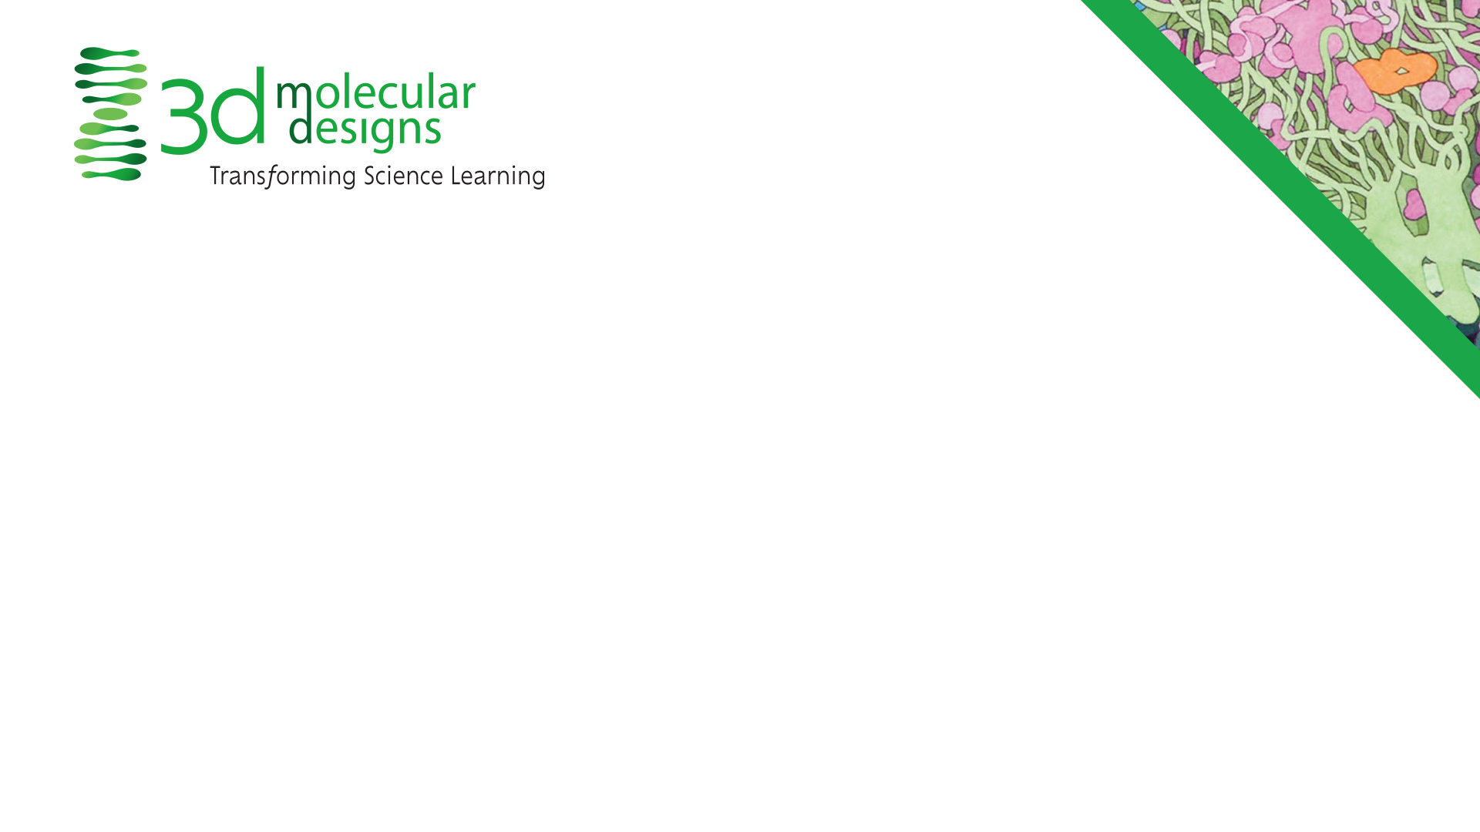
Conclusions
Acidic
Basic
Hydrophobic
Hydrophilic
Cysteine
All amino acids have identical backbones but unique side chains.
Amino acids fit into five groups based on their side chain shape and chemical properties.
Side chain interactions with water and other amino acids dictates how a protein folds into a 3-dimensional shape.
Notes:
Teacher: Summary slide with learning objectives of this lesson.
Student: Jot their thoughts and ideas in their notebook.

