Slide 1
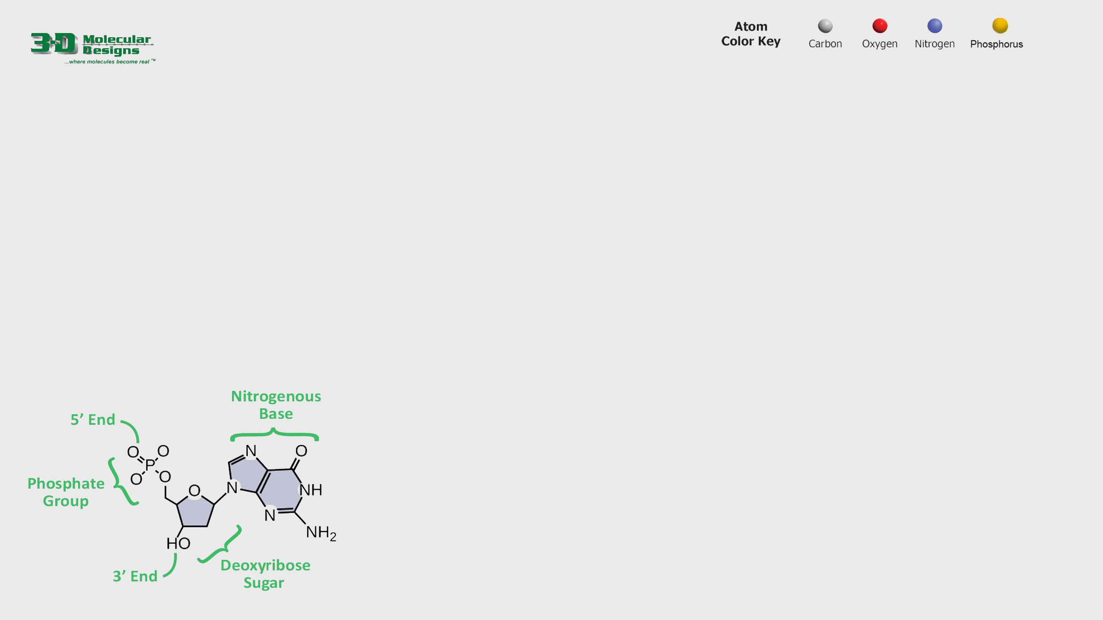

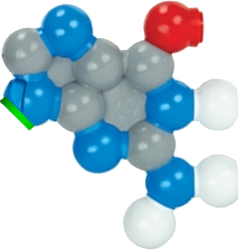
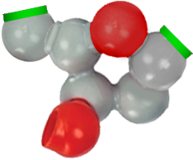
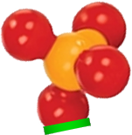




Building a DNA Nucleotide
Double stranded DNA is made up of individual DNA units called nucleotides. Each nucleotide contains a phosphate group and a deoxyribose sugar that make up the backbone, and a nitrogenous base.
1. Study the chemical structure below.
2. Drag and connect the nucleotide components on the right to build your own single DNA nucleotide.
3. Label the parts of the nucleotide.
4. Answer the question below and move to the next slide.
How many different nucleotides are there in DNA and what are they named?

Slide 2
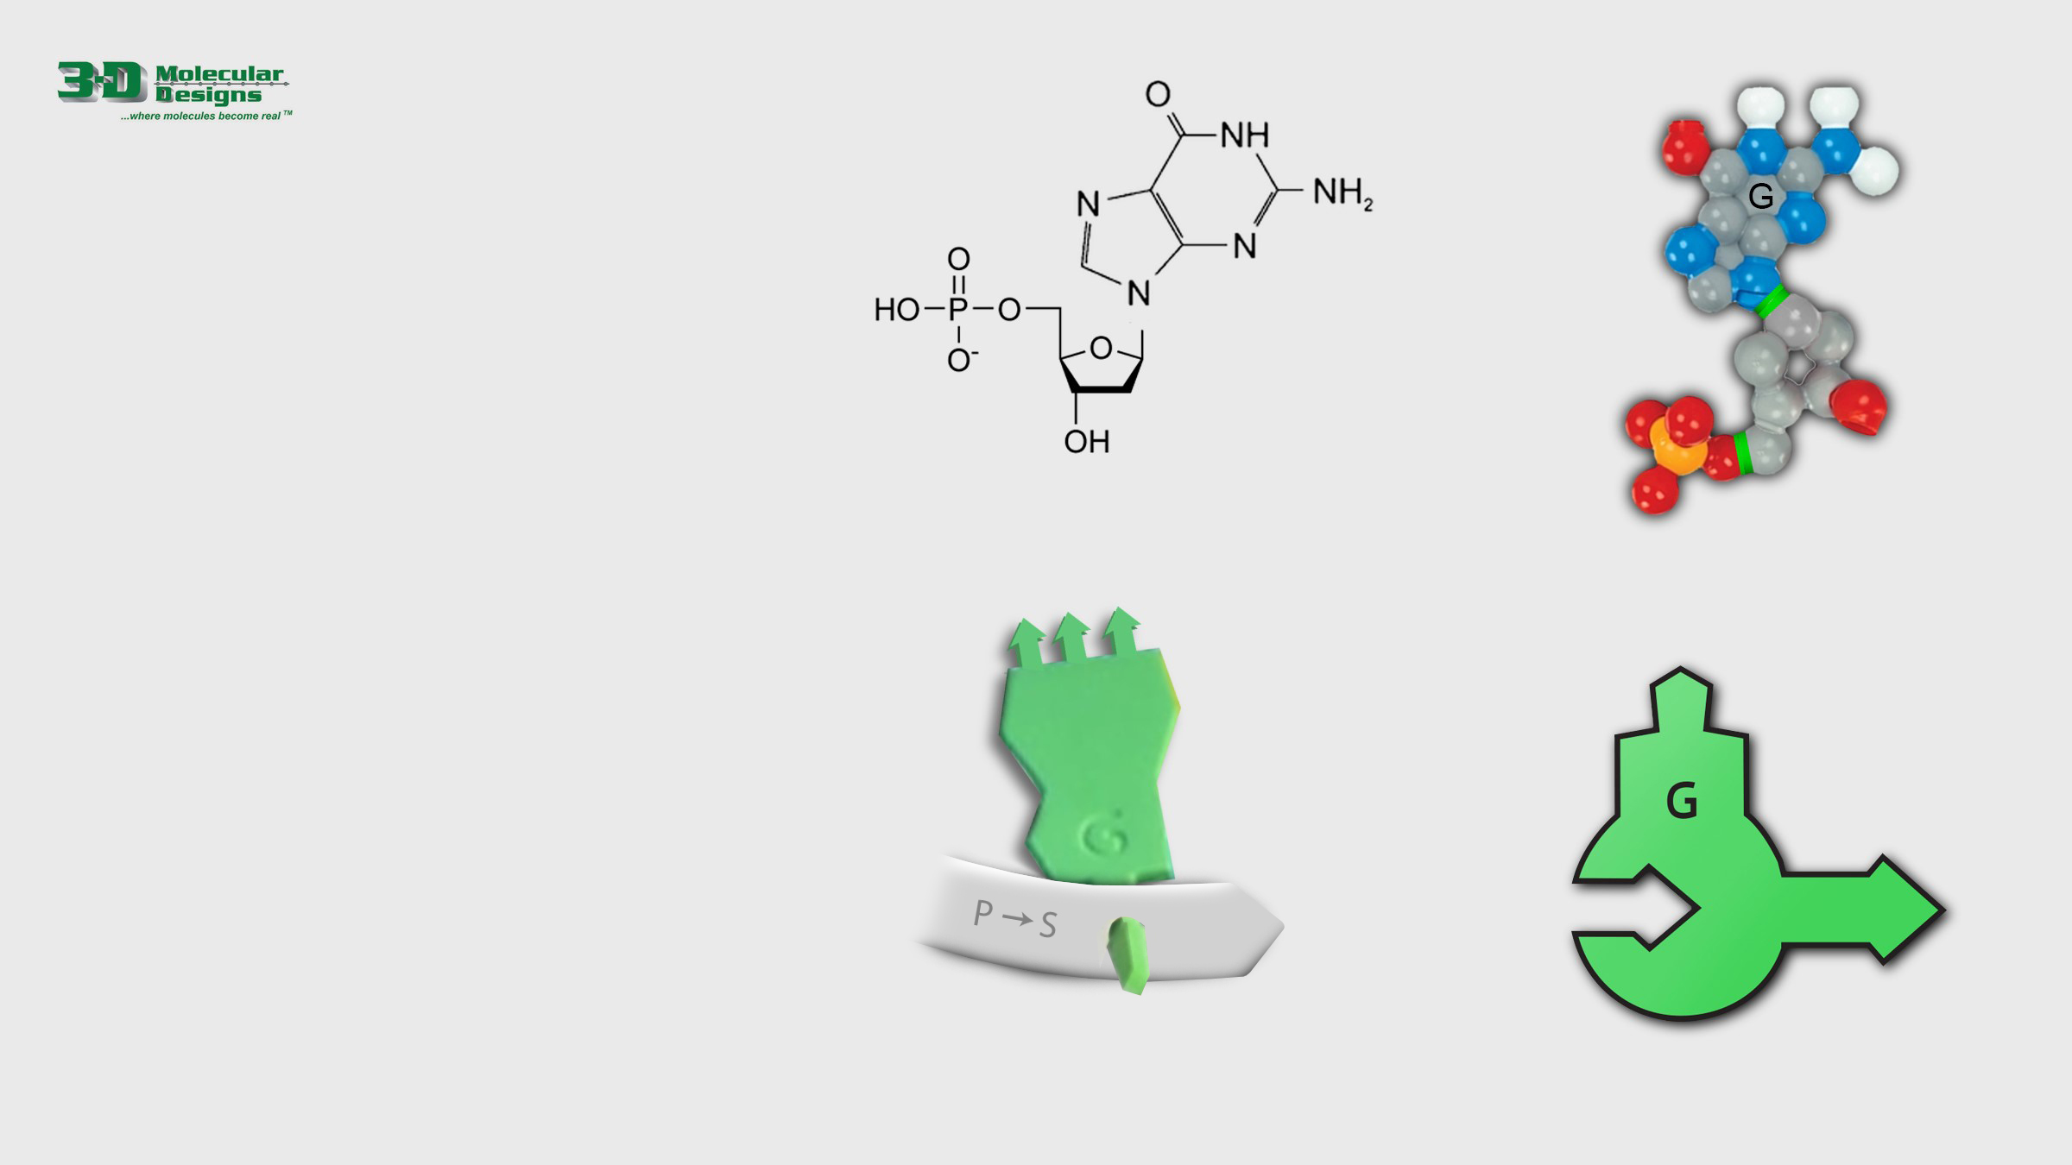




Many Representations of DNA
There are a variety of ways to represent DNA nucleotides. Despite being very different, the four illustrations shown to the right all show the DNA backbone, the nitrogenous base and the 5’ to 3’ directionality ends of the backbone.
1. Grab and position the labels below to name the parts of each nucleotide illustration on the right.
2. Answer the question below and then move to the next slide.
Of the 4 different representations of a nucleotide shown here, which do you think is the most useful? Why?

Slide 3
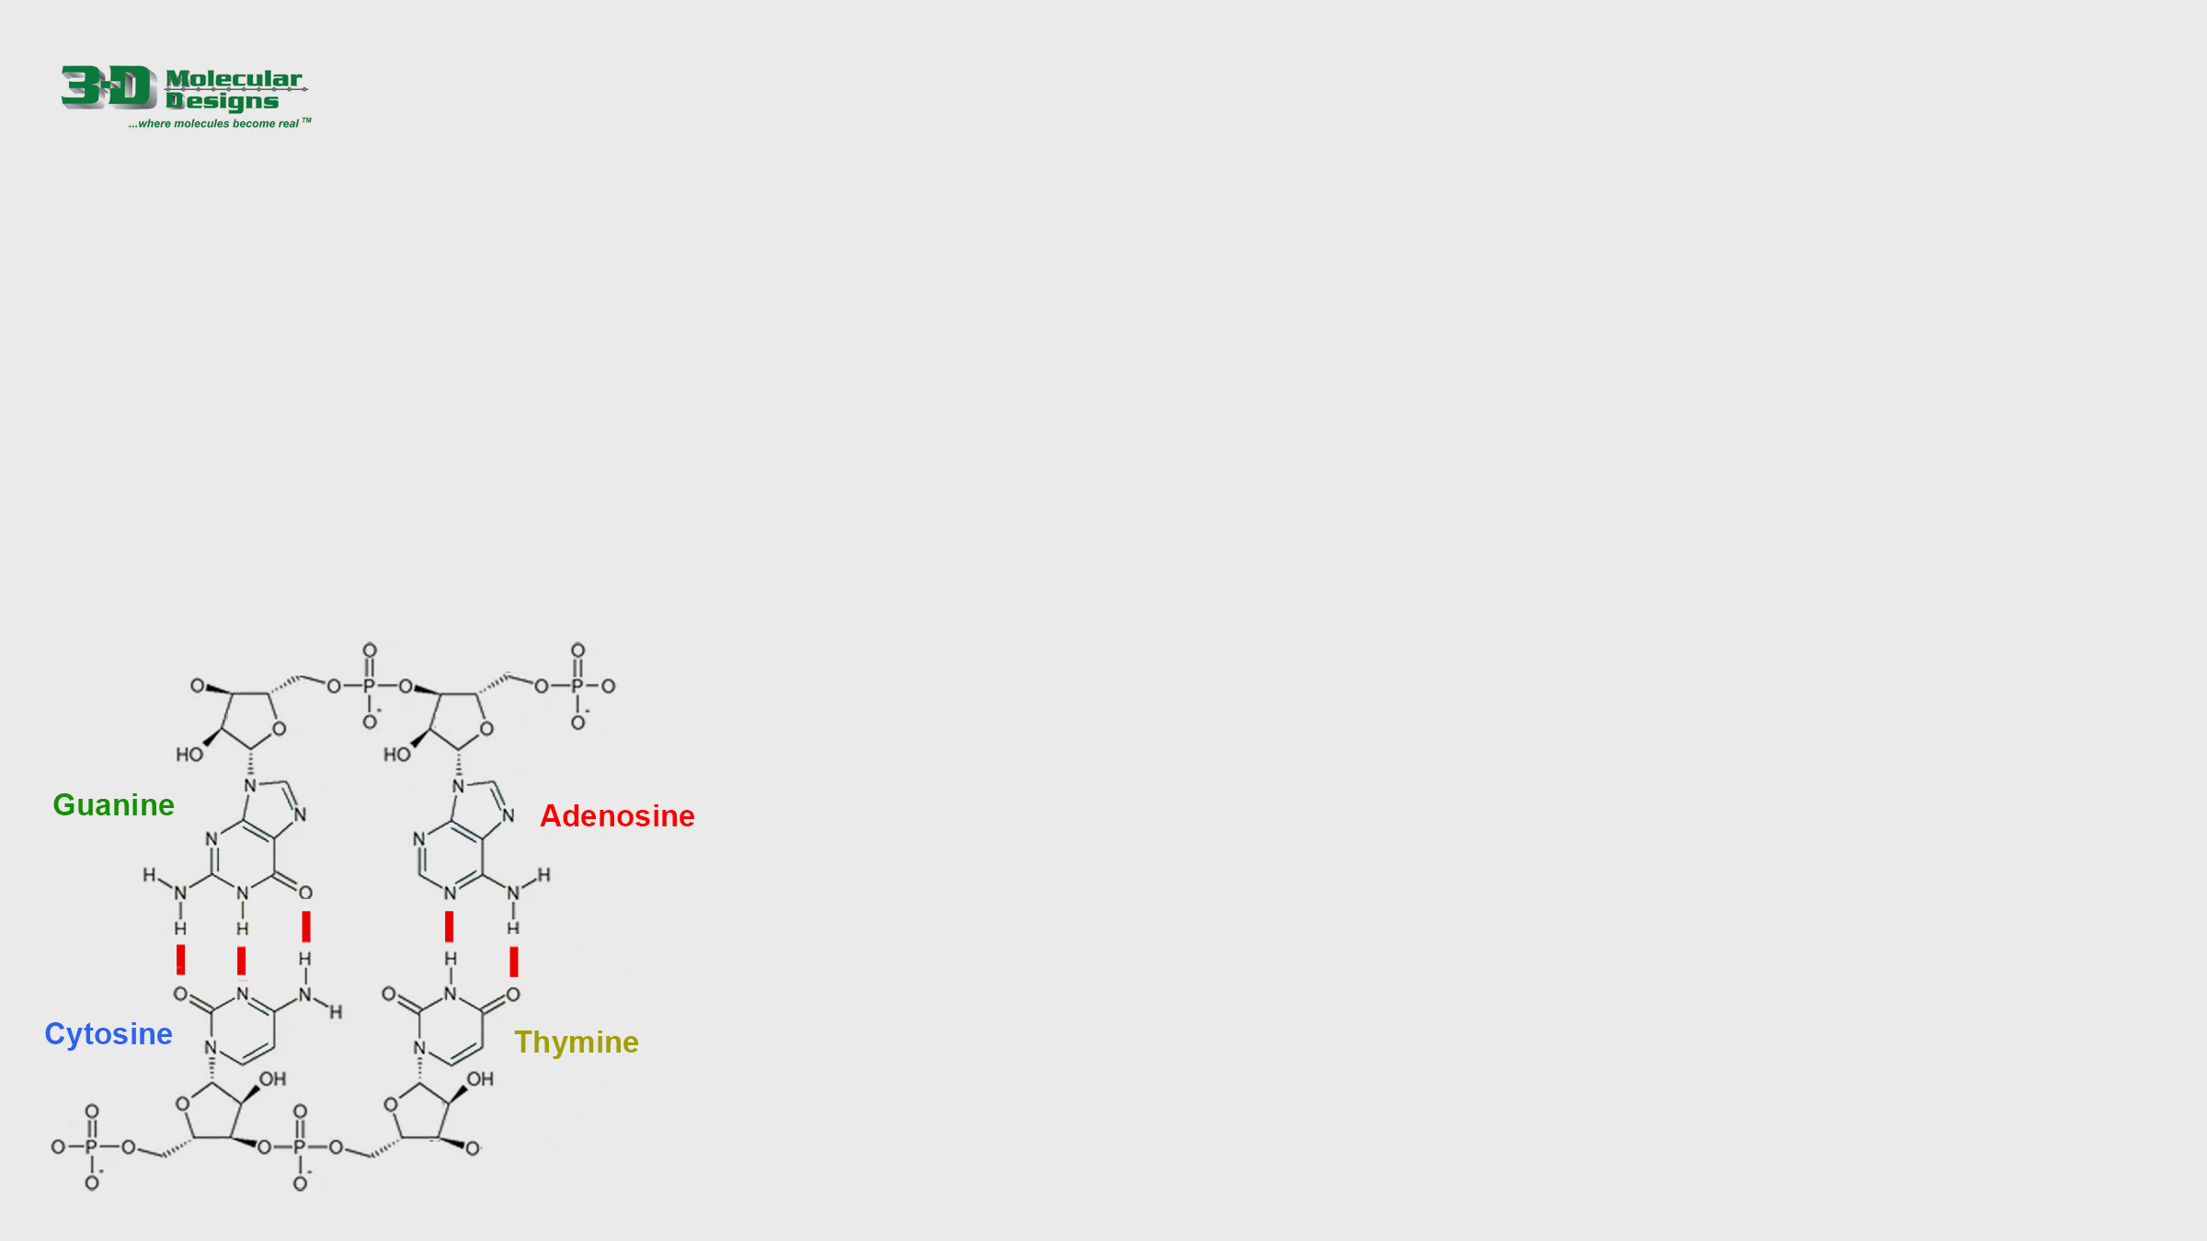
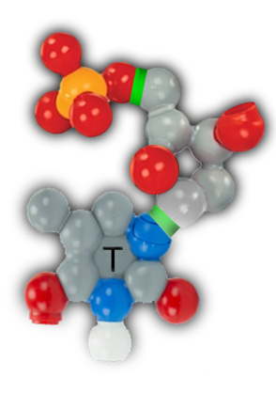
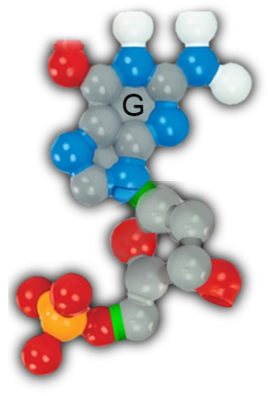


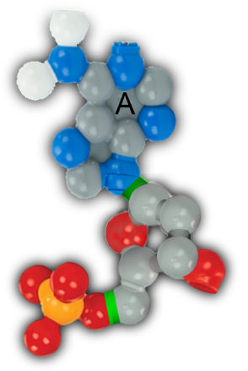
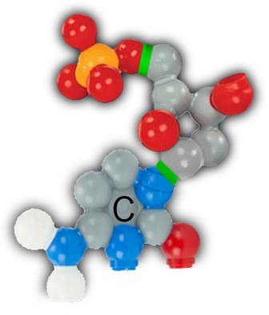


Nucleotides Form Base Pairs
There are four types of nucleotides, each with a different nitrogenous base: guanine (G), cytosine (C), adenosine (A) and thymine (T). They join to form base pairs.
1. Study the chemical structure below.
2. Drag and connect the nucleotides on the right to build base pairs.
3. Answer the question below and move to the next slide.
How does the size of an A-T base pair compare with the size of a G-C base pair?

Slide 4

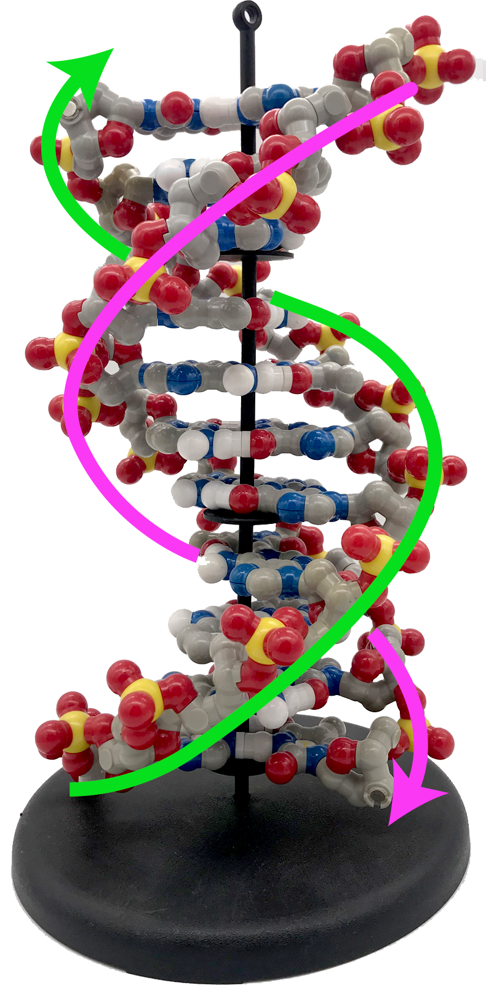
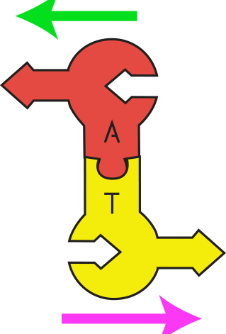
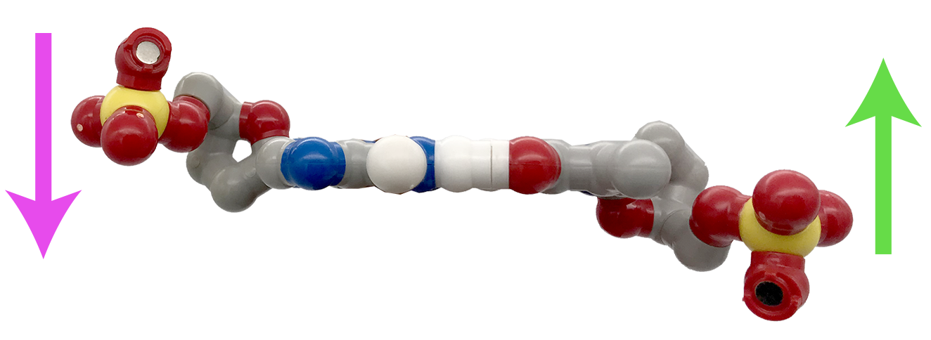
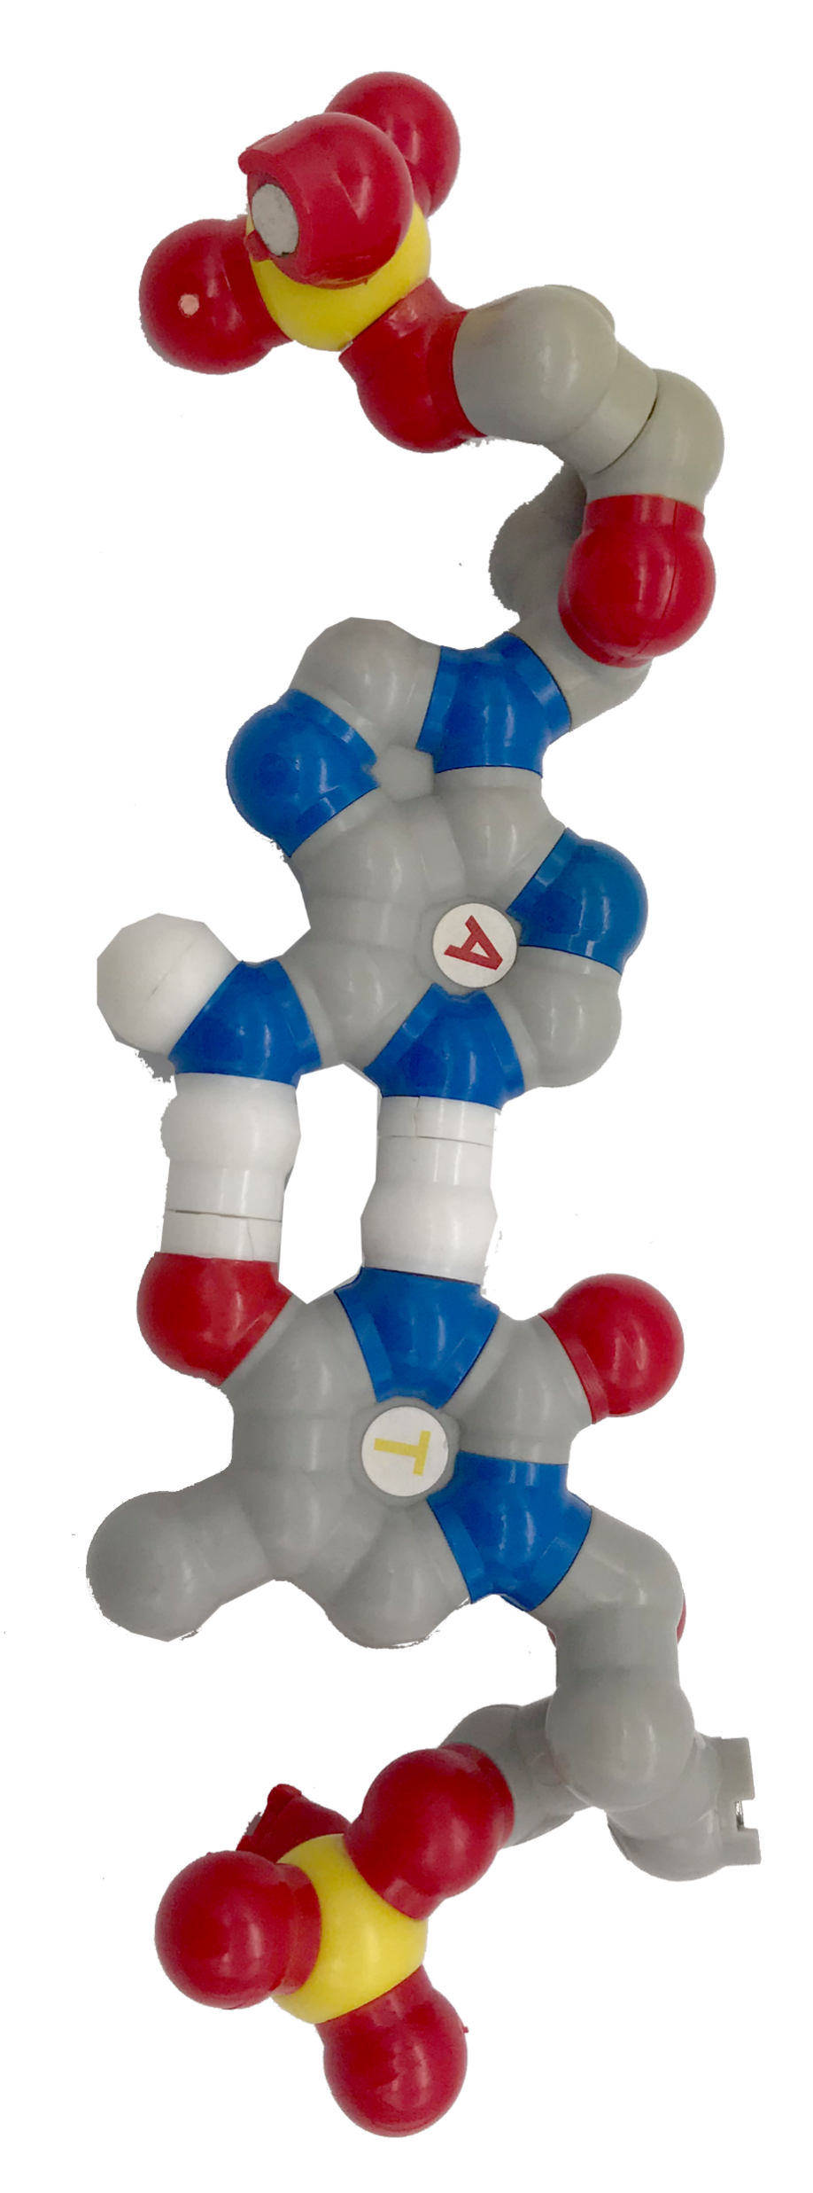
A Note on DNA Directionality
The two strands of nucleotides that make up a DNA double helix are often referred to as anti-parallel, meaning that they go in opposite directions. This can be seen in schematic representations of DNA basepairs, such as the graphic to the right.
However, it is a bit harder to see this directionality when looking at atom-based representations of DNA basepairs, such as the graphic to the right. At first glance, the backbone regions appear to be going in the same direction!
This is because real DNA exists in 3-dimensions, and so it is difficult to capture all of its attributes in a single 2-dimensional image. The direction of the strands can be more easily seen by viewing a DNA base pair from the side, rather than from the top.

Slide 5
Thought Questions
How large (in base pairs) is the human genome?
Why is it useful to know the sequence of nucleotides that make up the human genome?

