Slide 1

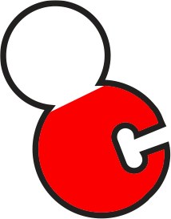

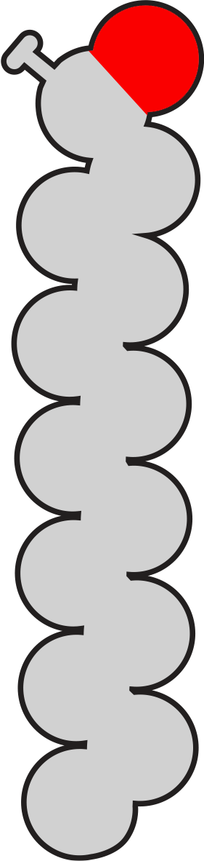
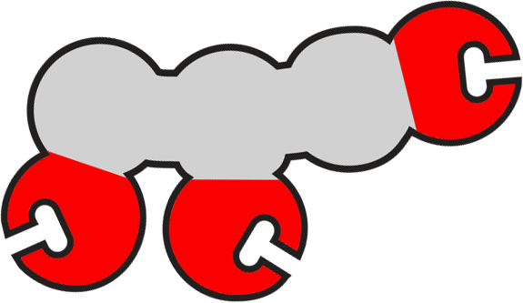
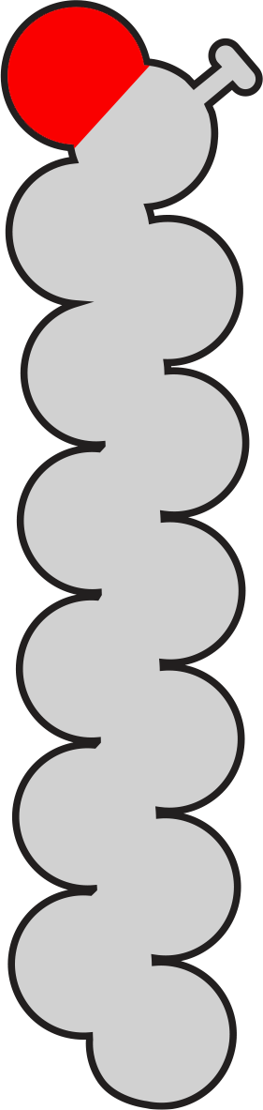
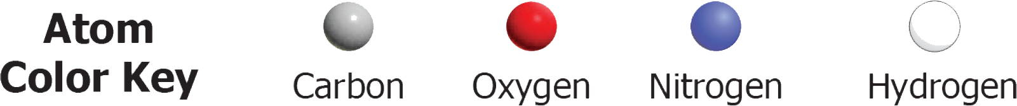
Glycerol Group
Building a Triglyceride
Triglycerides are neutral fats. They are composed of a central glycerol group (C₃O₃H₃) that can attach to three fatty acids tails (long strands of carbon and hydrogen). Attaching a fatty acid tail to a glycerol group produces a water molecule and is called a dehydration synthesis reaction.
1. Create a triglyceride with three fatty acid tails by moving and connecting the pieces on the right.
2. Answer the question below and move to the next slide.
Fatty Acid
Tails
How many water molecules did you generate while making the triglyceride?
3

Slide 2
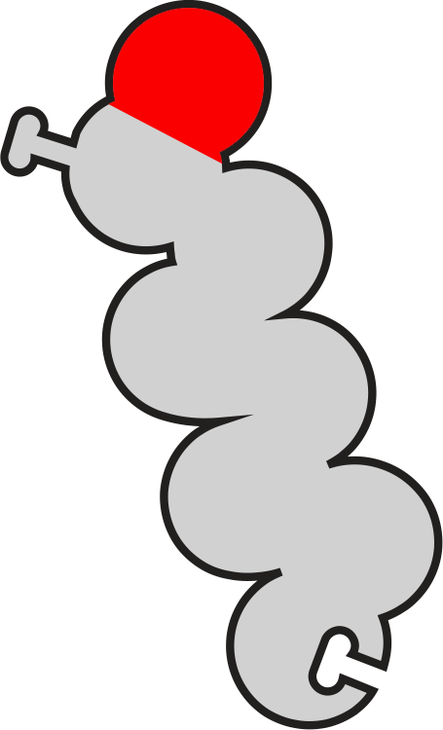
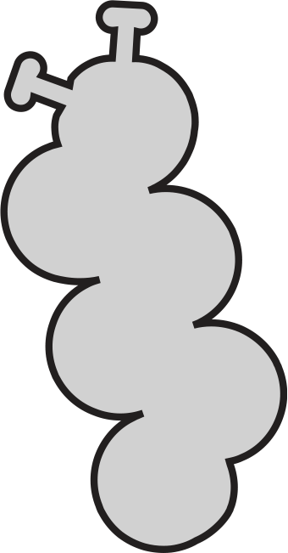
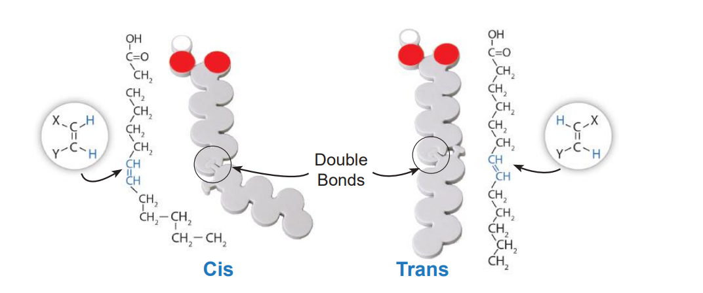
Glycerol
Group
Saturated and Unsaturated
Not all fatty acid tails are the same. If they are saturated with hydrogen atoms, every carbon atom will have two hydrogen atoms attached. If they are unsaturated, some carbon atoms will have only one hydrogen atom attached to them.
Unsaturated tails can be either “cis” or “trans” depending on the location of the missing hydrogen atom(s). (See diagram below.)
1. Arrange the parts on the right to create a triglyceride with three fatty acid tails: one fully saturated, one cis unsaturated and one trans unsaturated.
2. Answer the question below and move to the next slide.
Which do you think contains more unsaturated triglycerides: a liquid oil or hard butter? Why?
An oil, because the kinked fatty acid doesn't allow for the close packing of triglycerides found in solid fats.
Fatty Acid Tail Components

Slide 3
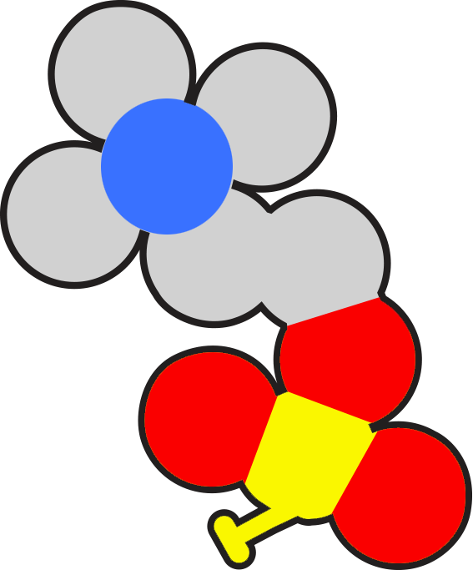
Glycerol
Group
Building a Phospholipid
Phospholipids are another key type of fat. They are the main component of the membranes that surrounds cells and organelles.
Like triglycerides, phospholipids are composed of a head and a central glycerol group. Instead of three fatty acid tails, however, there are only two.
1. Arrange the pieces on the right to create a phospholipid with one head and two fatty acid tails. 2. Answer the question below and then move to the next slide.
What is the difference between a phospholipid and a triglyceride?
Phospholipids have two fatty acid tails and triglycerides have two fatty acid tails.
Phospholipid
Head
Fatty Acid
Tails

Slide 4
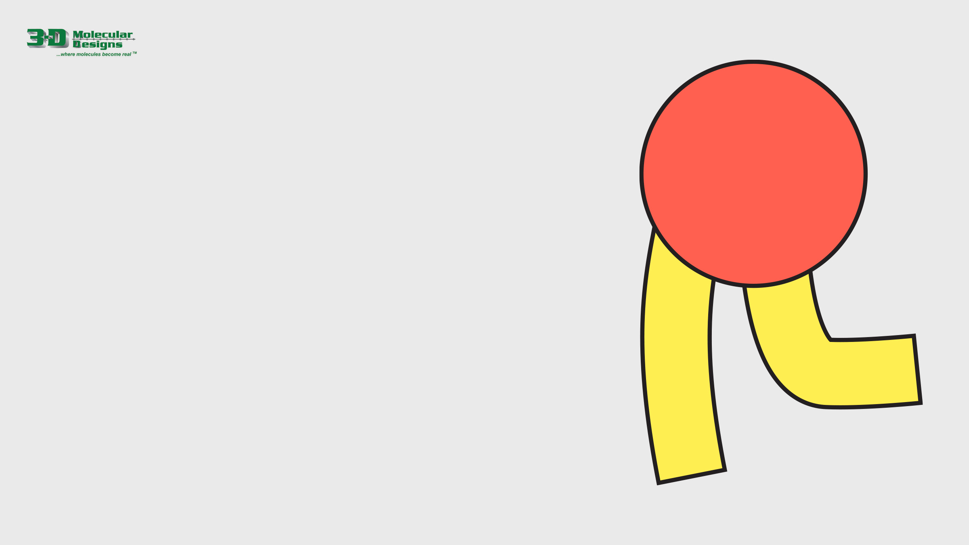
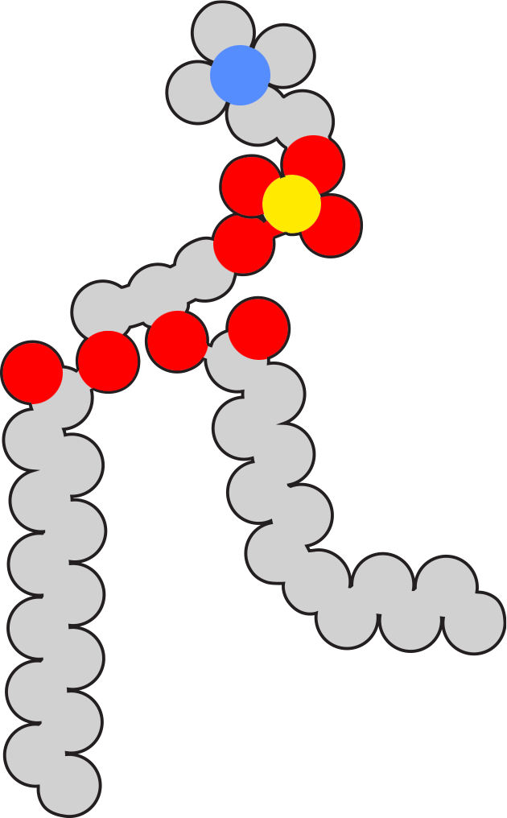
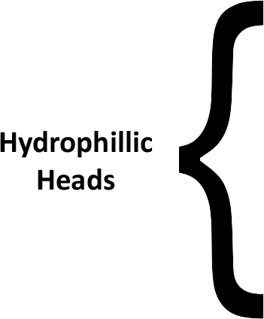
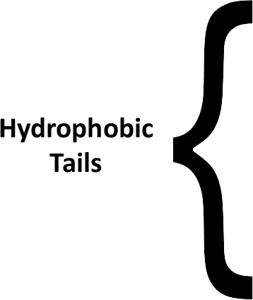
Hydrophobic and Hydrophilic
The two main regions of a phospholipid are shown on the far right. The hydrophilic head is red and the hydrophobic tails are yellow.
1. Move the phospholipid on the right and the two labels below onto the red and yellow image.
2. Answer the question and move to the next slide.
Why are the tails of the phospholipid hydrophobic?
The tails are mainly carbon atoms and can't bond with water molecules. They tend to clump together.

Slide 5
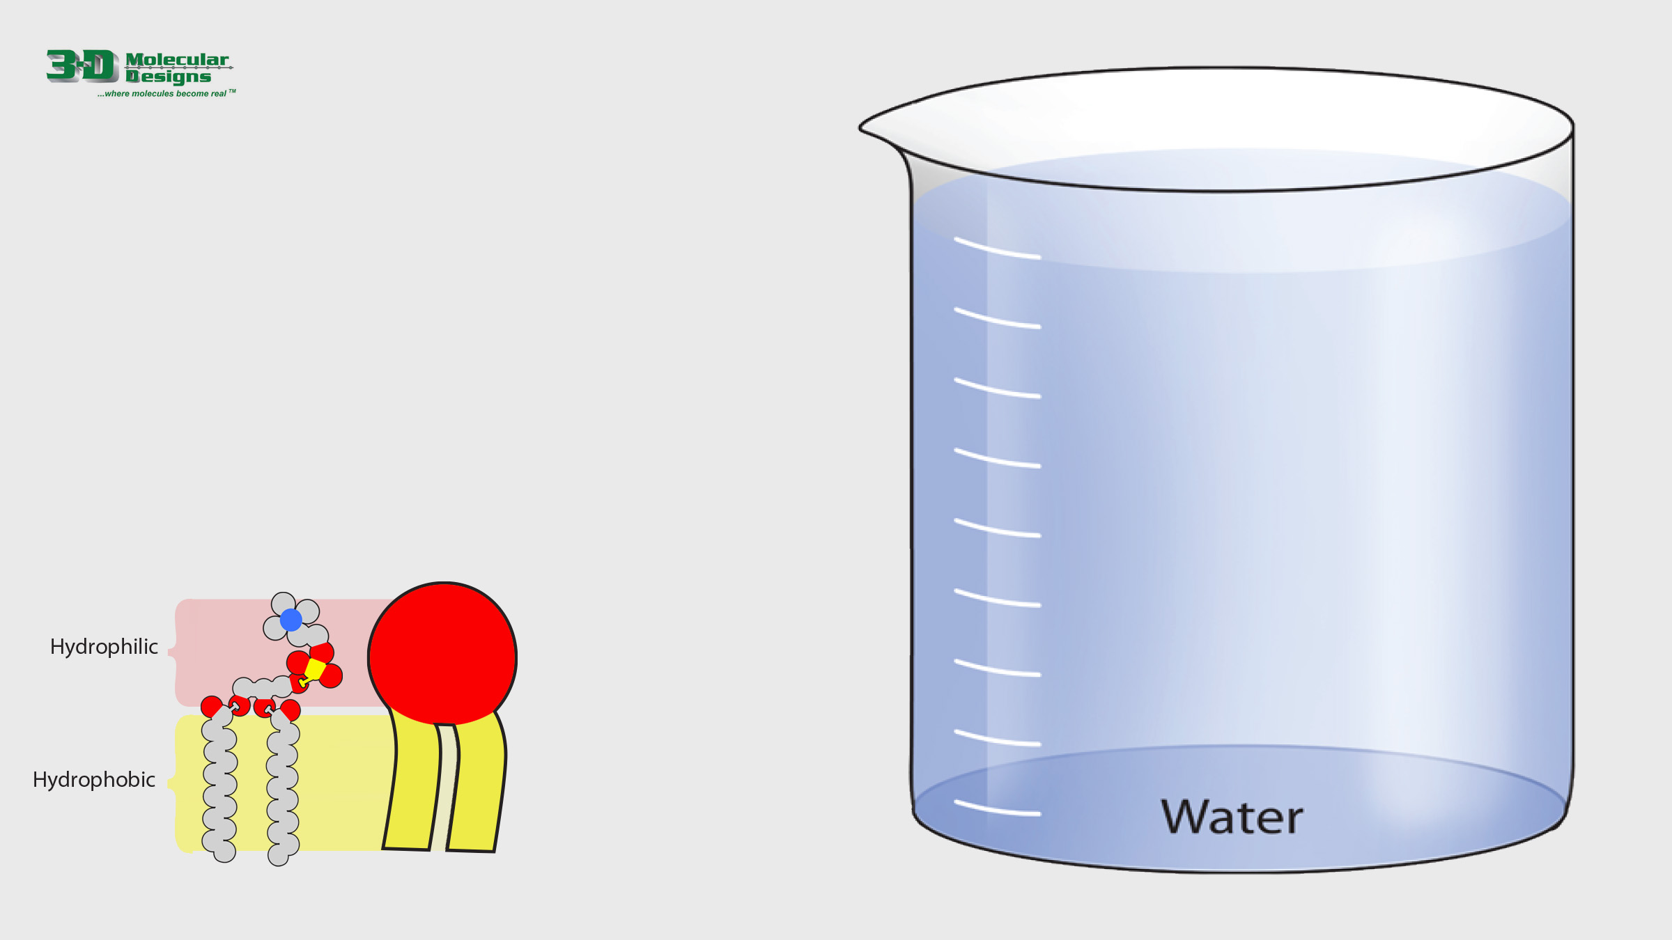
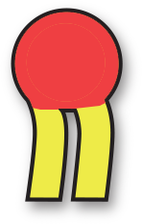
From Phospholipids to Membranes
Every phospholipid has a hydrophilic (water-loving) head, and two hydrophobic (water-fearing) fatty acid tails. (See figure below.)
When many phospholipids are placed in water, they assemble into a phospholipid bilayer, often called a membrane.
1. Drag the small phospholipid pieces on the right to construct a membrane in the beaker of water.
2. Move to the next slide.

Slide 6
Thought Questions
How many covalent bonds stabilize a membrane by joining one phospholipid to another?
Zero. The membrane is stabilized by hydrophobic interactions between the fatty acid tails of adjacent phospholipids.
Phospholipids come from your diet and your own cells. What do you think catalyzes the synthesis of phospholipids in your cells?
Proteins/enzymes
Phospholipids are called amphipathic. What do you think amphipathic means?
The molecule has both hydrophobic and hydrophilic properties.

