Slide 1
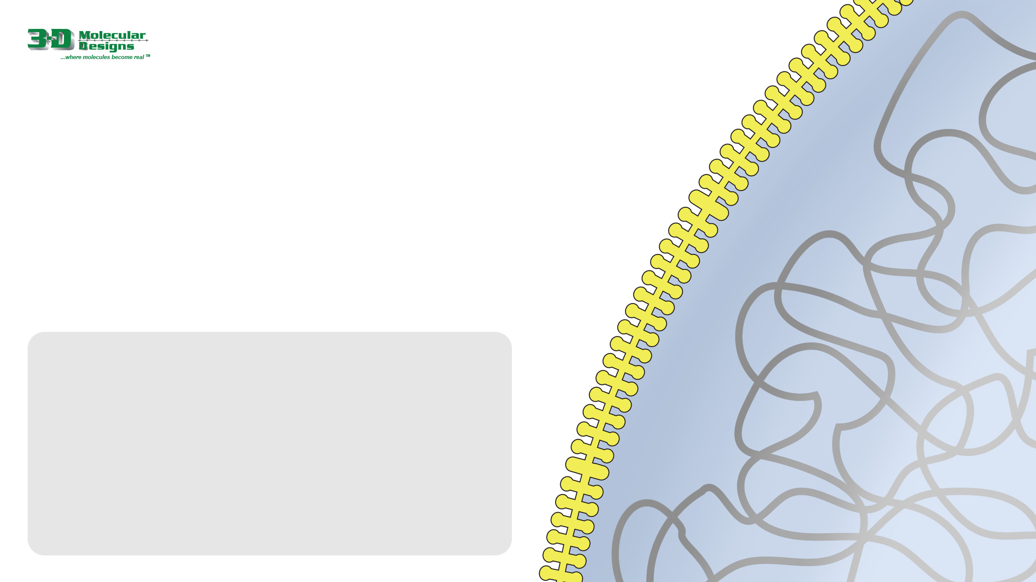



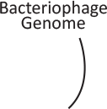

Bacteria and Bacteriophages
Bacteria are in a constant war with bacteriophages (viruses that only infect bacteria). Some species of bacteria have evolved a way to “remember” bacteriophages they have encountered in the past so that they can more quickly destroy them in the future.
They do this by saving a small segment of the bacteriophage’s DNA in their own genome. To demonstrate how this happens, start by:
1. Docking the purple bacteriophage (below) on to the bacteria’s cell membrane to the right
2. Adding the labels (below) to the graphic on the right
Once docked onto the host cell membrane, what do you think the bacteriophage will do next?

Slide 2
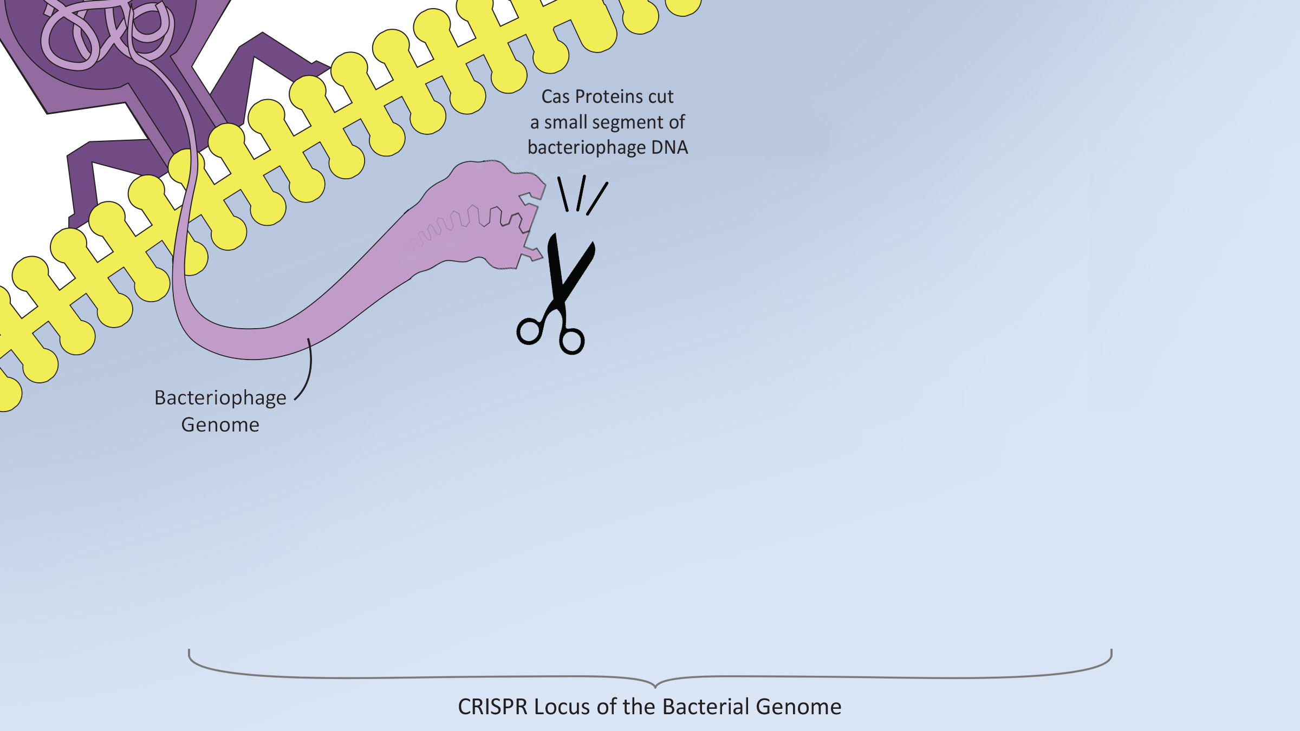
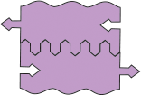

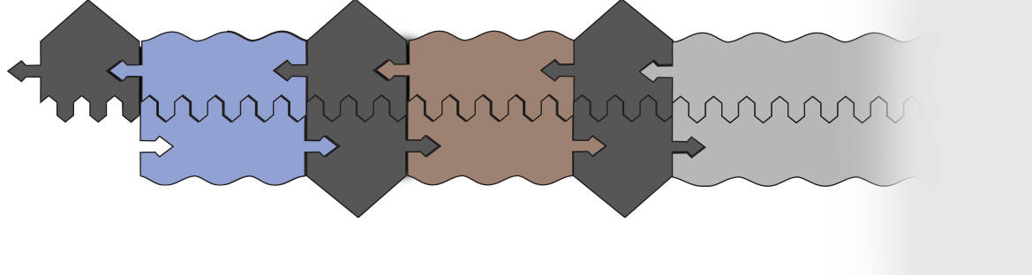

Inserting the Bacteriophage DNA
Once docked, the bacteriophage will dump its genome into the bacteria. Using a family of defensive proteins called Cas, the bacteria will cut a small segment of the bacteriophage’s DNA and insert it into its own genome at a specific spot called the CRISPR Locus. To demonstrate this insertion:
1. Opening a gap in the CRISPR Locus below
2. Insert the cut section of the bacteriophage’s DNA
3. Fill in the complementary sections of the black repeat using the pieces to the right.
Once the bacteria has acquired a piece of the bacteriophage genome, how does it use it?

Slide 3
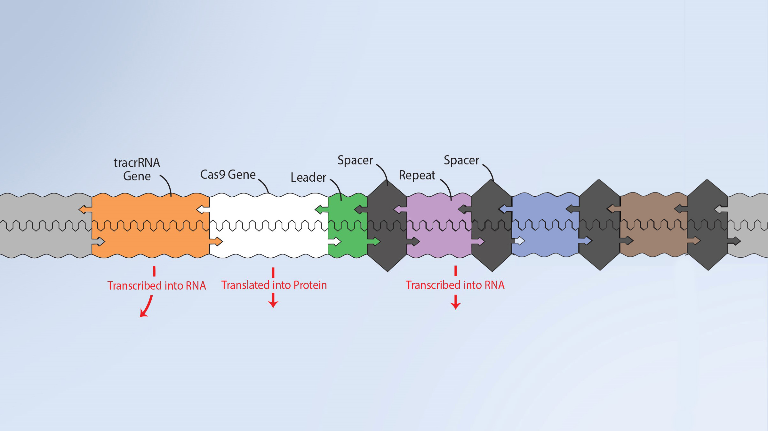



Building a Cas9 Protein
The bacteria’s genome now includes a small section of the bacteriophage’s DNA in the CRISPR Locus. But how does that help fight future infections?
The answer lies in a specific bacterial protein called Cas9, which can hold an RNA copy of the acquired
bacteriophage DNA and use it to surveil invading virus genomes. If it finds a match, the Cas9 protein will cut the invading DNA, thereby preventing it from doing further damage.
Assemble a Cas9 protein using the transcribed RNA and translated protein pieces shown below.
Do you think the Cas9 protein you assembled below will attack every types of bacteriophage?

Slide 4
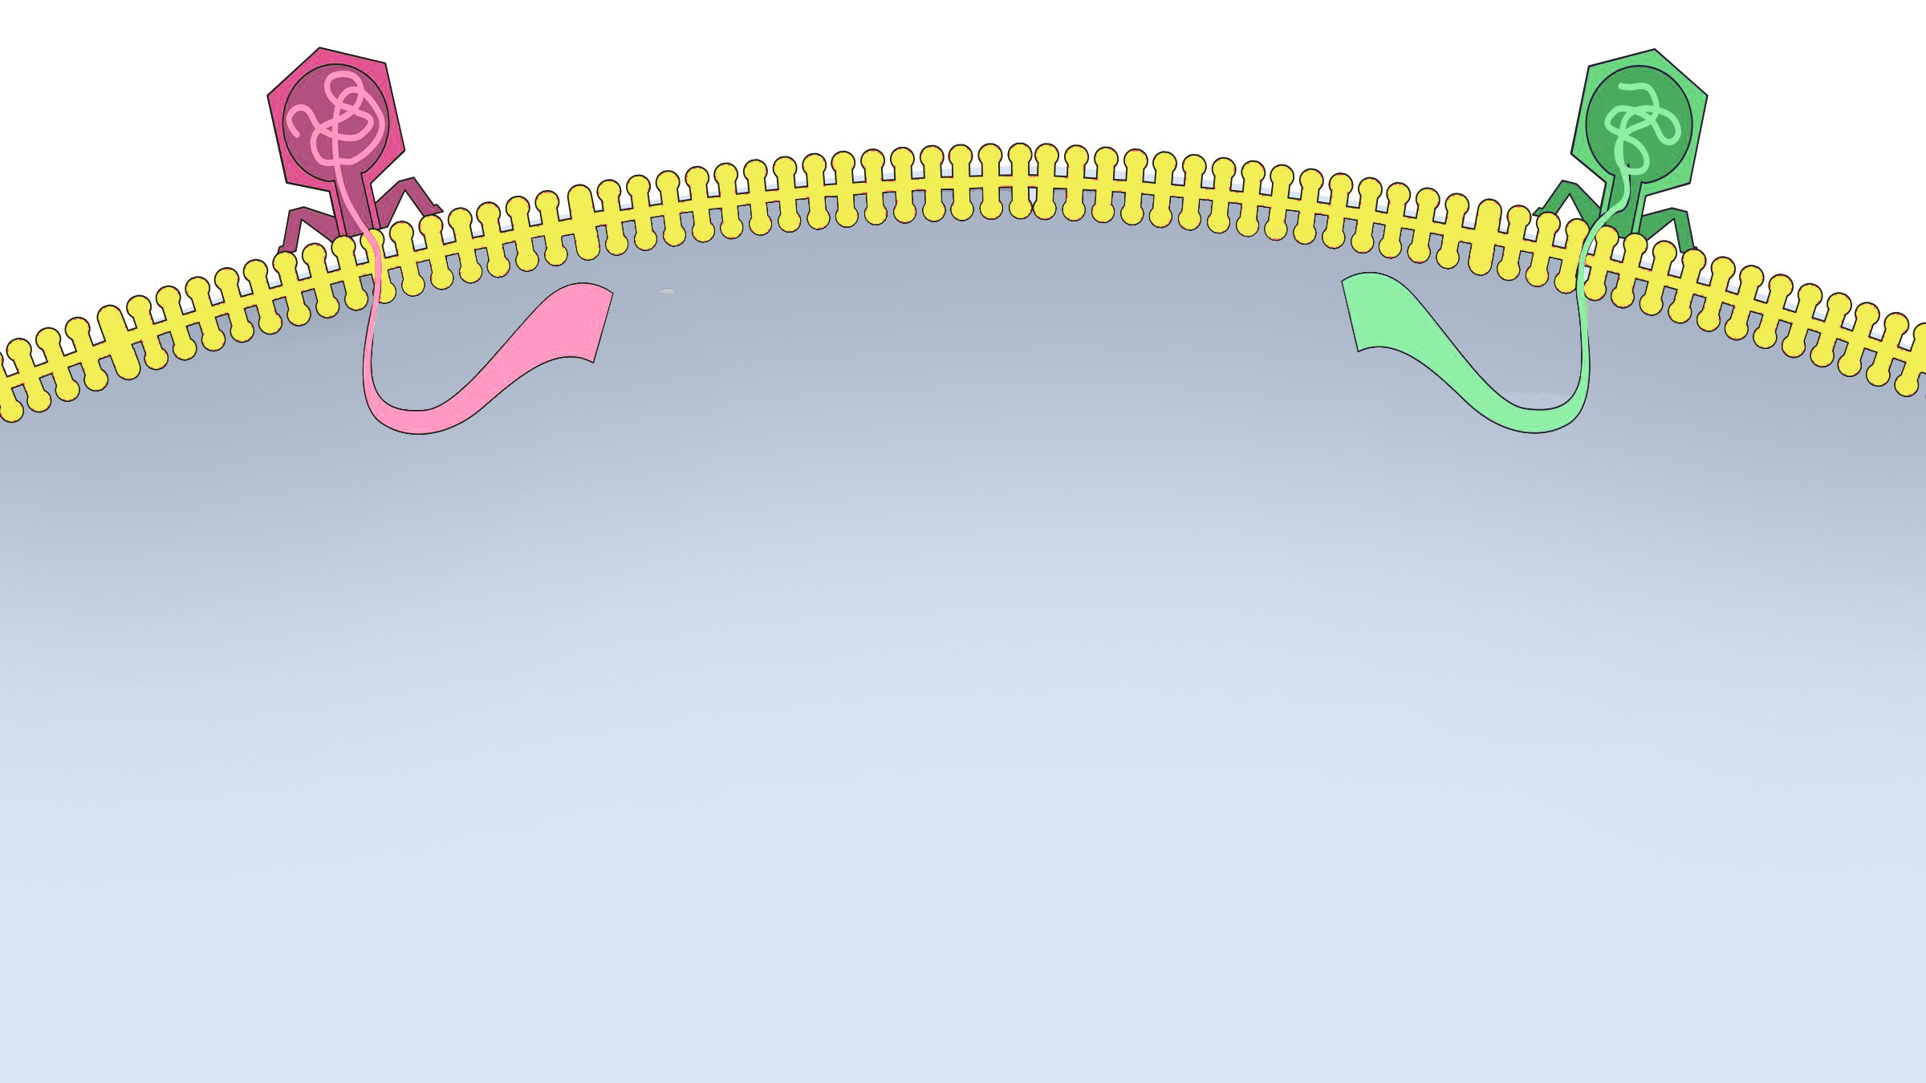
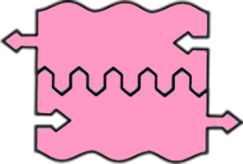
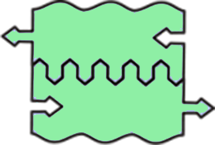
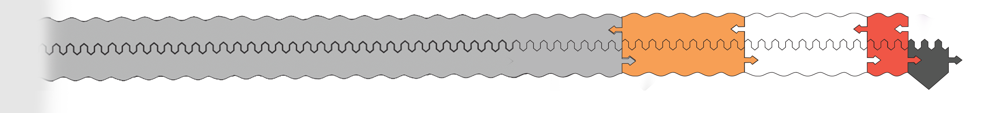
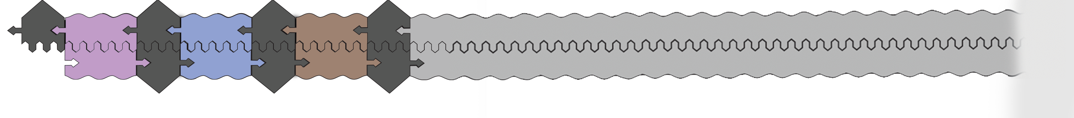



An Army of Cas9 Proteins
At this point, our bacteria has inserted a segment of bacteriophage DNA into it’s genome and built a Cas9 protein ready to identify and cut the genome of any matching bacteriophage it may encounter in the future.
That is a good start. . . but there is more than one type of bacteriophage. So our bacteria must continually repeat this process, adding more and more segments of bacteriophage DNA to its CRISPR Locus, and creating more and more Cas9 proteins equipped with different RNAs to target different bacteriophage genomes.
Demonstrate this process two more times using the pieces above and to the right.
How many types of bacteriophages could this bacteria potentially defend against?

Slide 5
Activity Questions:
Add questions as needed. . .

