Slide 1
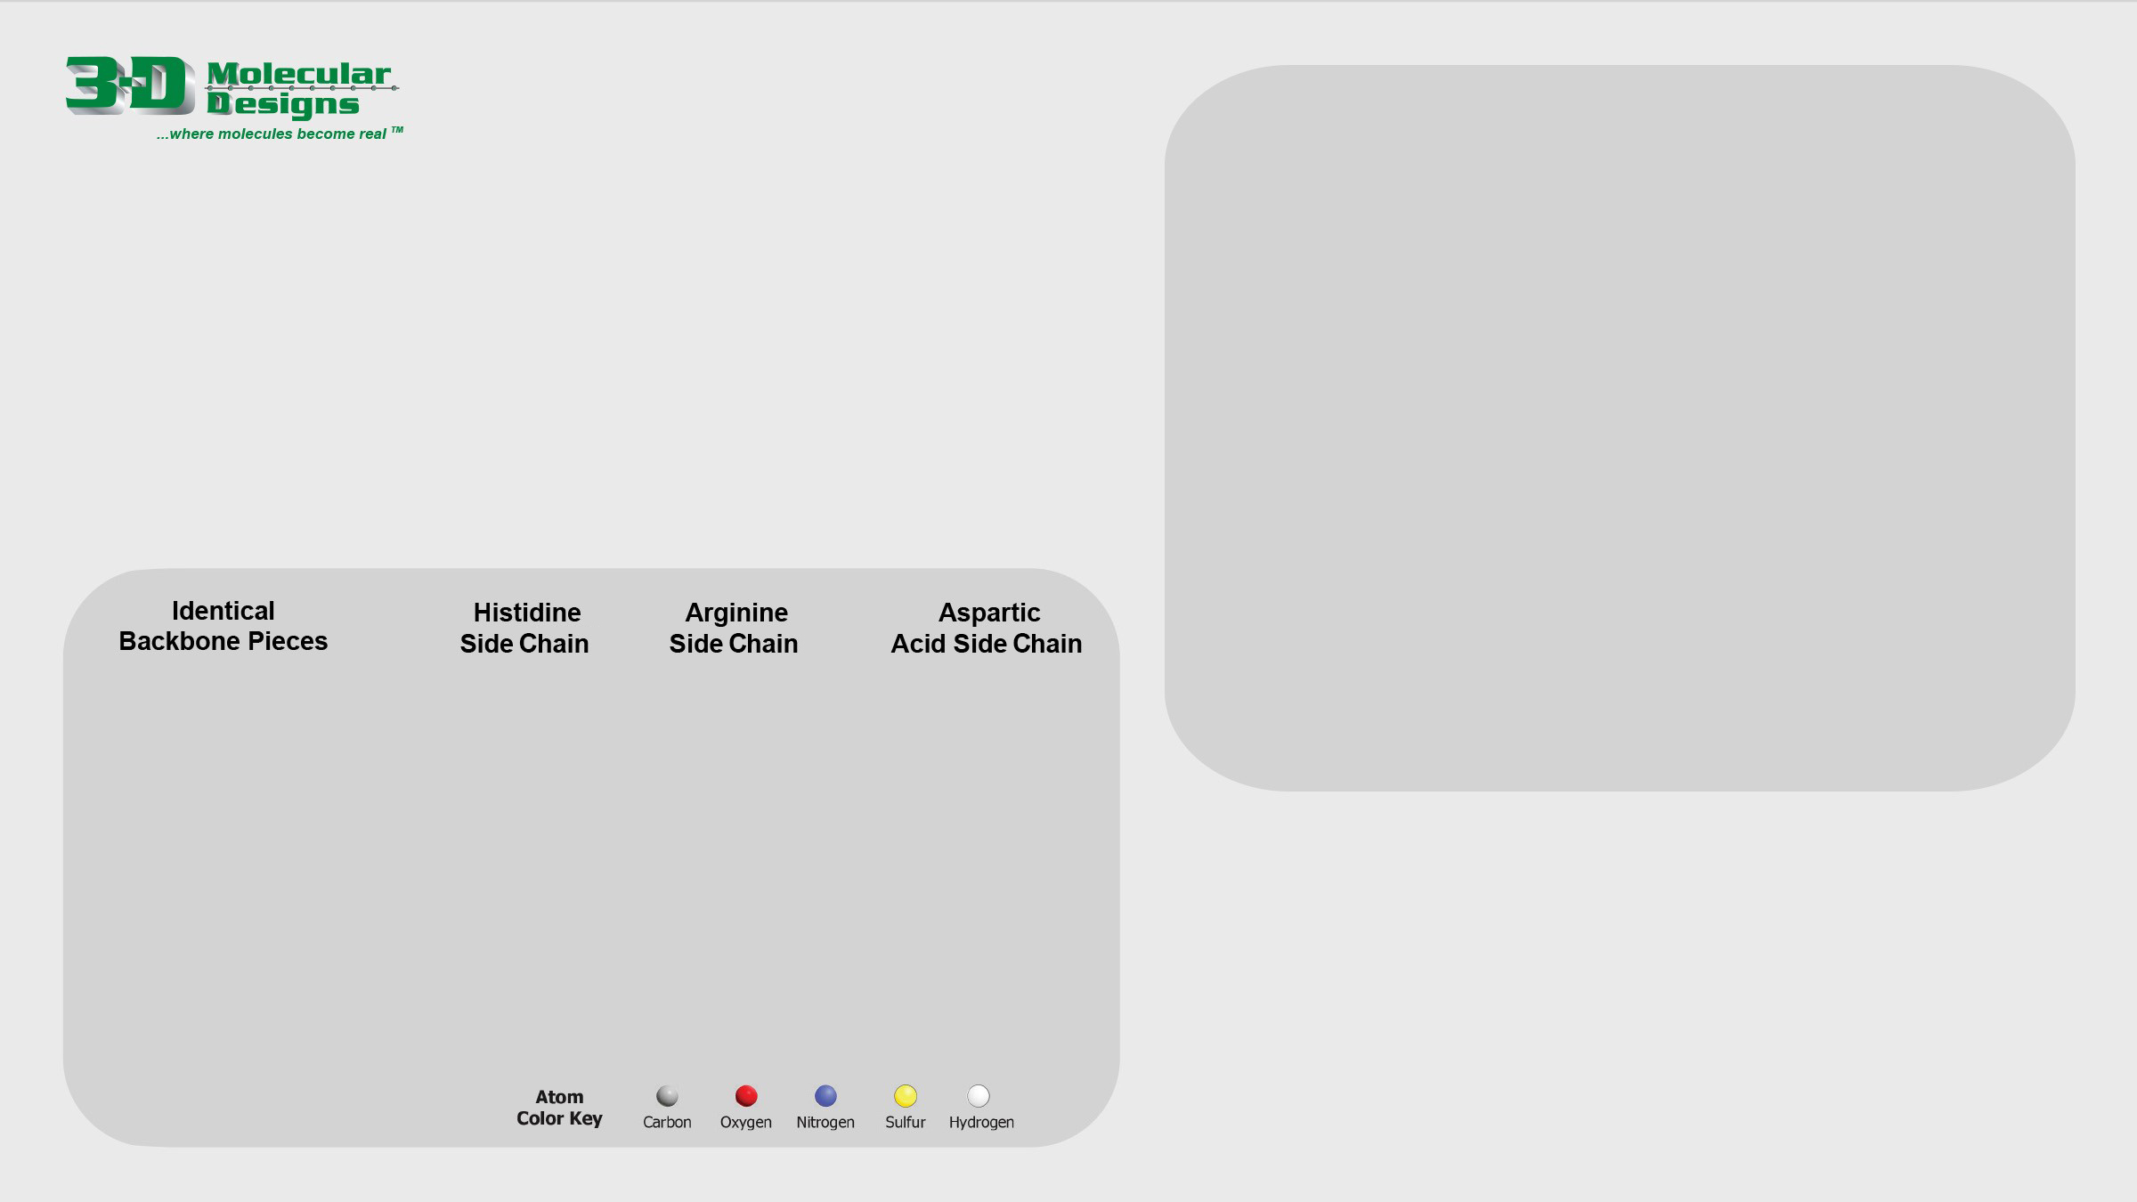
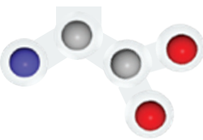
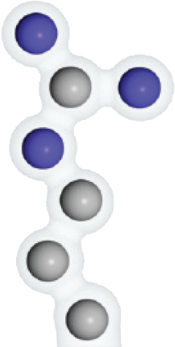
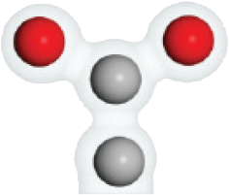
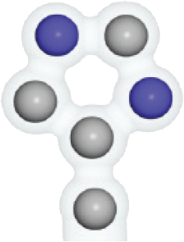
Amino Acid Side Chains
There are 20 different types of amino acids. Each one has identical backbone
atoms (see aminoAcids1) but a unique set of side chain atoms. It's the side chains that make the 20 amino acids different from each other.
1. Use the three identical backbone pieces and three unique side chain pieces below to construct three amino acids in the space to the right.
2. Answer the question below and move to the next slide.
Describe the two parts of every amino acid.

Slide 2
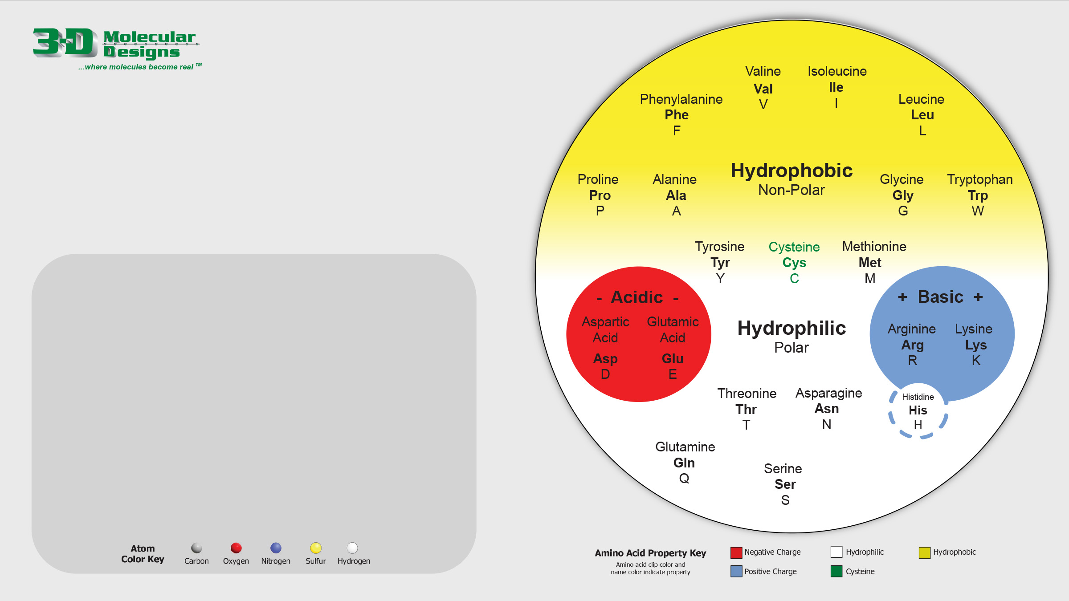
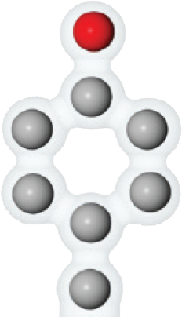
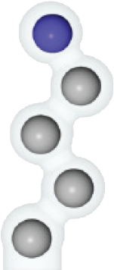
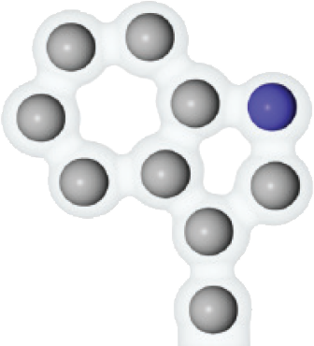
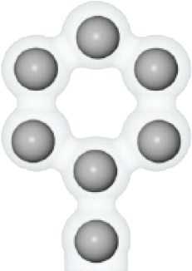
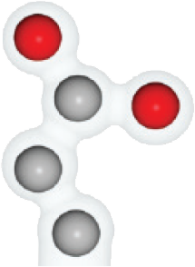
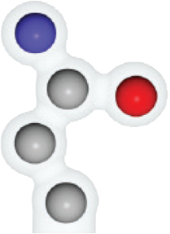
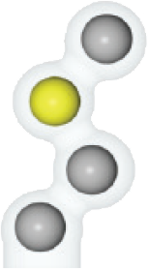
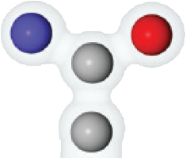
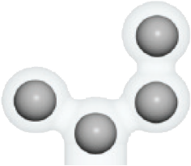
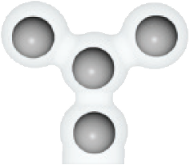


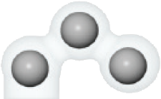
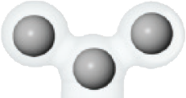
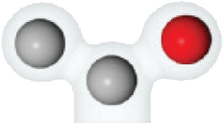


Amino Acid Side Chains
Now let's look at all 20 different amino acid side chains.
1. Consider the Amino Acid Side Chain Chart on the next slide.
2. Use that chart as you drag each side chain below into the correct spot on the circular chart to the right.
3. Move to the next slide.

Slide 3
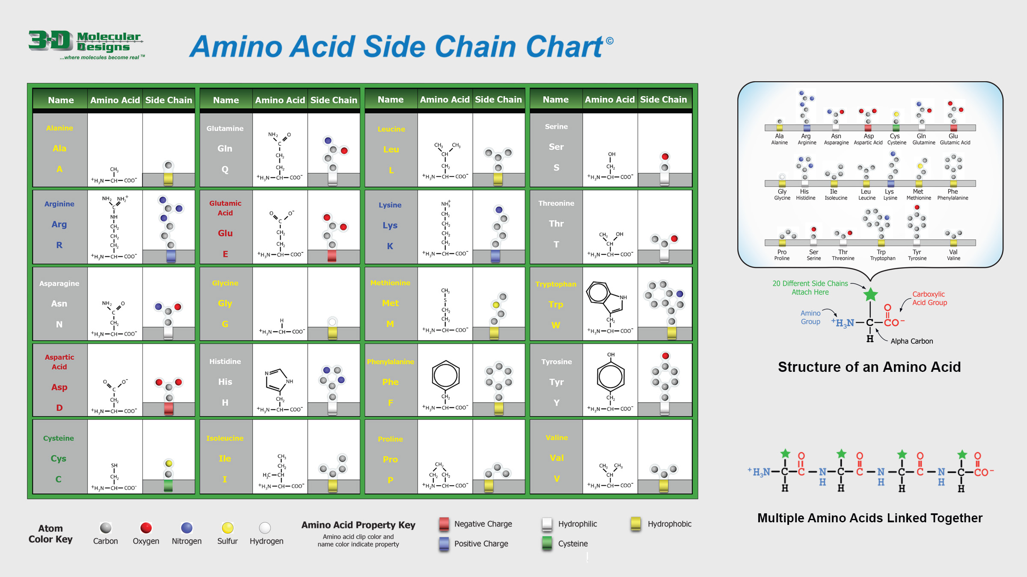

Slide 4
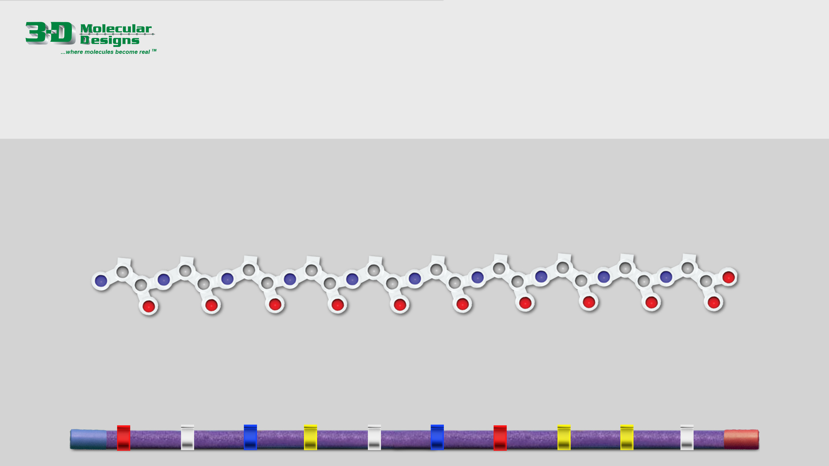
Joining Amino Acids
Amino acids link together to form long protein chains. The order of side chains in a protein chain determines what 3-dimensional shape it folds into. To make it easier to focus on the order of the side chains, we often simplify the backbone, showing a single strand instead of the individual atoms.
1. Place the side chains below on the simplified backbone at the bottom of the slide.
2. Move to the next slide and answer the activity questions.

Slide 5

Activity Questions:
Remember: A protein is simply a linear sequence of amino acids… that spontaneously folds up into a complex 3D shape… following basic principles of chemistry and physics.
Write the sequence of amino acids that you joined together to make a protein on slide 4.
Remembering that proteins are made in cells that are 70% water – and water is polar – describe how you might imagine that a protein spontaneously folds up into a complex 3D shape.

