Slide 1
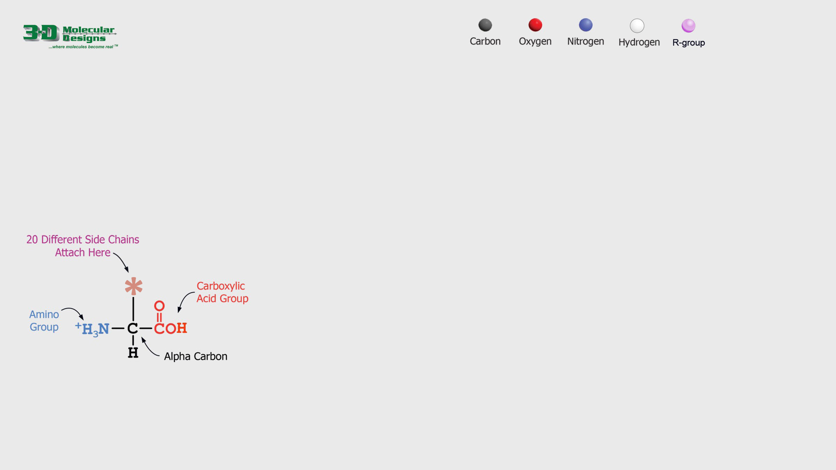
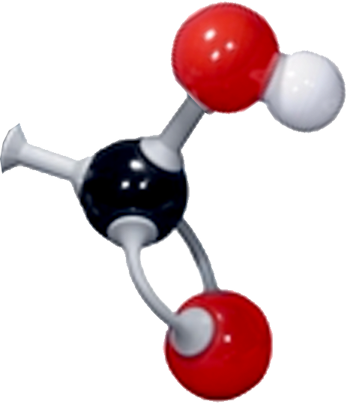

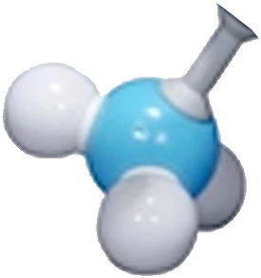
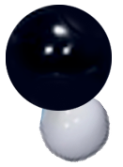
Building an Amino Acid
Amino acids are small molecules that link together to form long protein chains.
1. Study the chemical structure below.
2. Drag and connect the amino acid components on the right to build your own single amino acid.
3. Answer the question below and move to the next slide.
In your own words describe and name the molecule you just modeled.

Slide 2
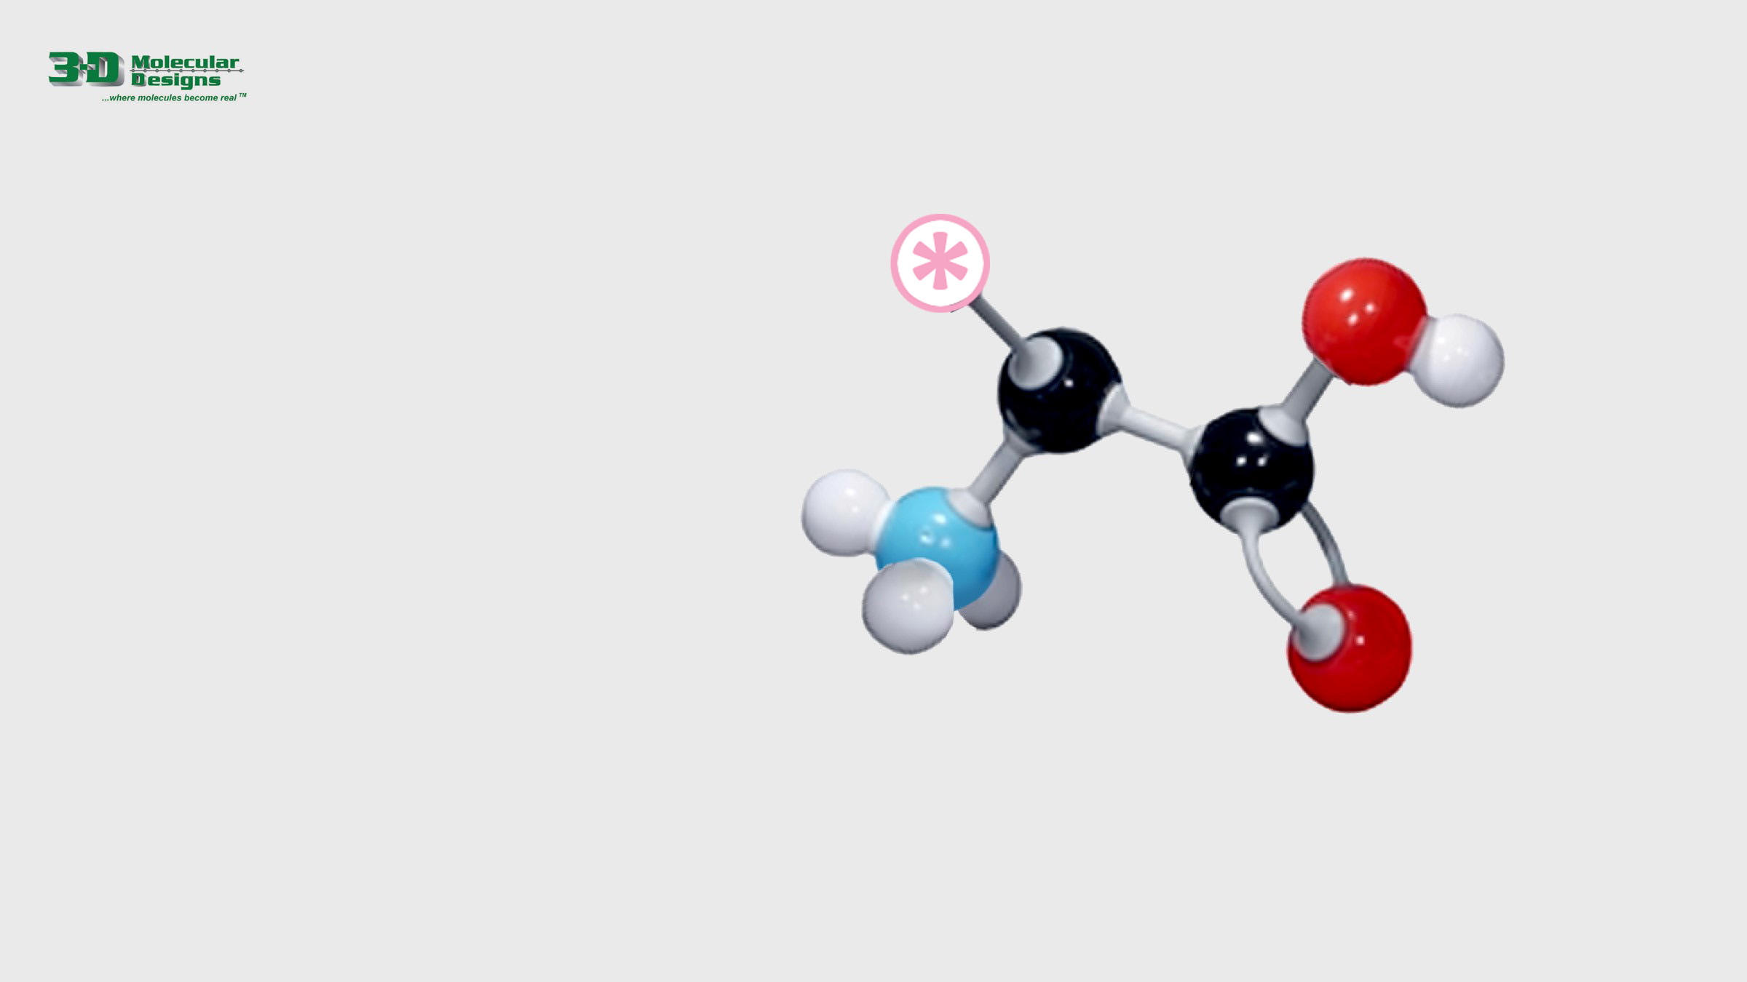
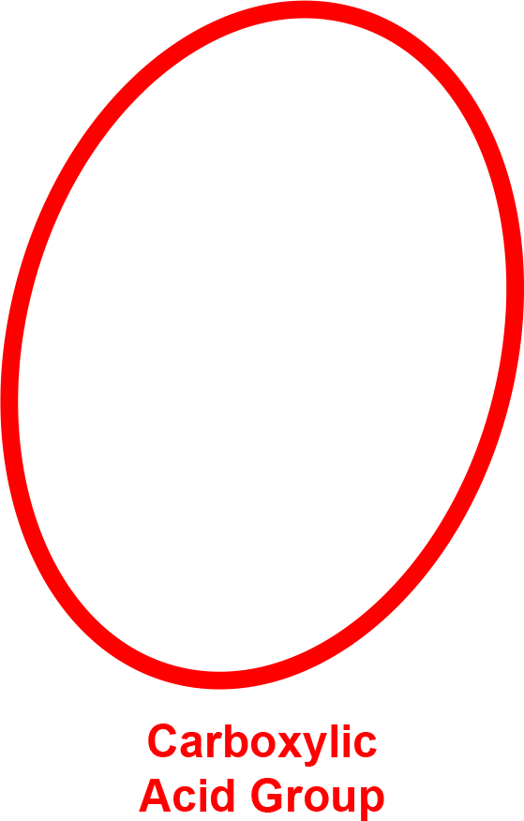
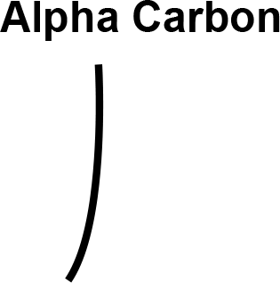

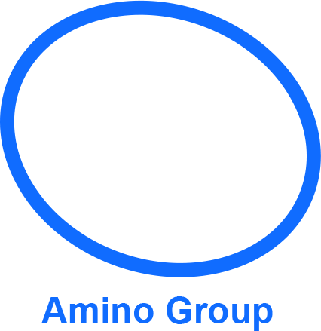
Label Your Amino Acid
Now that you have constructed an amino acid, let’s add some labels.
1. Use the elements below to name the parts of the amino acid on the right.
2. Answer the question below and move to the next slide.
There are 20 different amino acids that make up proteins. What makes one amino acid different from the other 19?

Slide 3

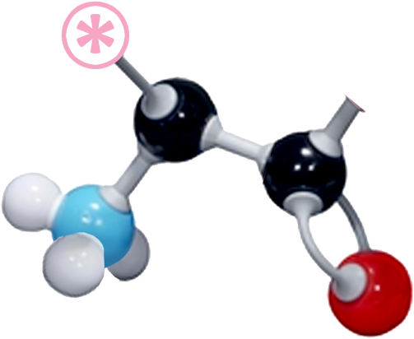
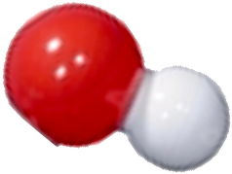
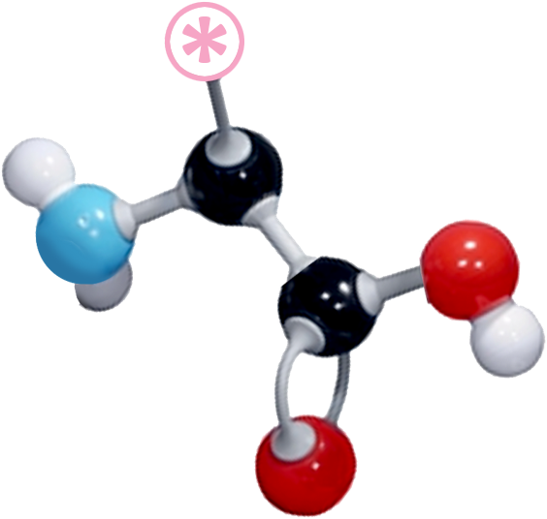

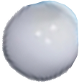
Joining Amino Acids
Amino acids link together to build long protein chains.
1. Click on the white box below to play an animation of two amino acids joining, resulting in a peptide bond and a single water molecule.
2. Drag the pieces to the right to demonstrate this process.
3. Answer the question below and then move to the next slide.
Describe the process in which two amino acids are joined to create a dipeptide.

Slide 4
Thought Questions
What macromolecular machine catalyzes the formation of a peptide bond?
How many amino acids do you think might make up an average-sized protein?

