Slide 1
Cytoskeleton

Slide 2
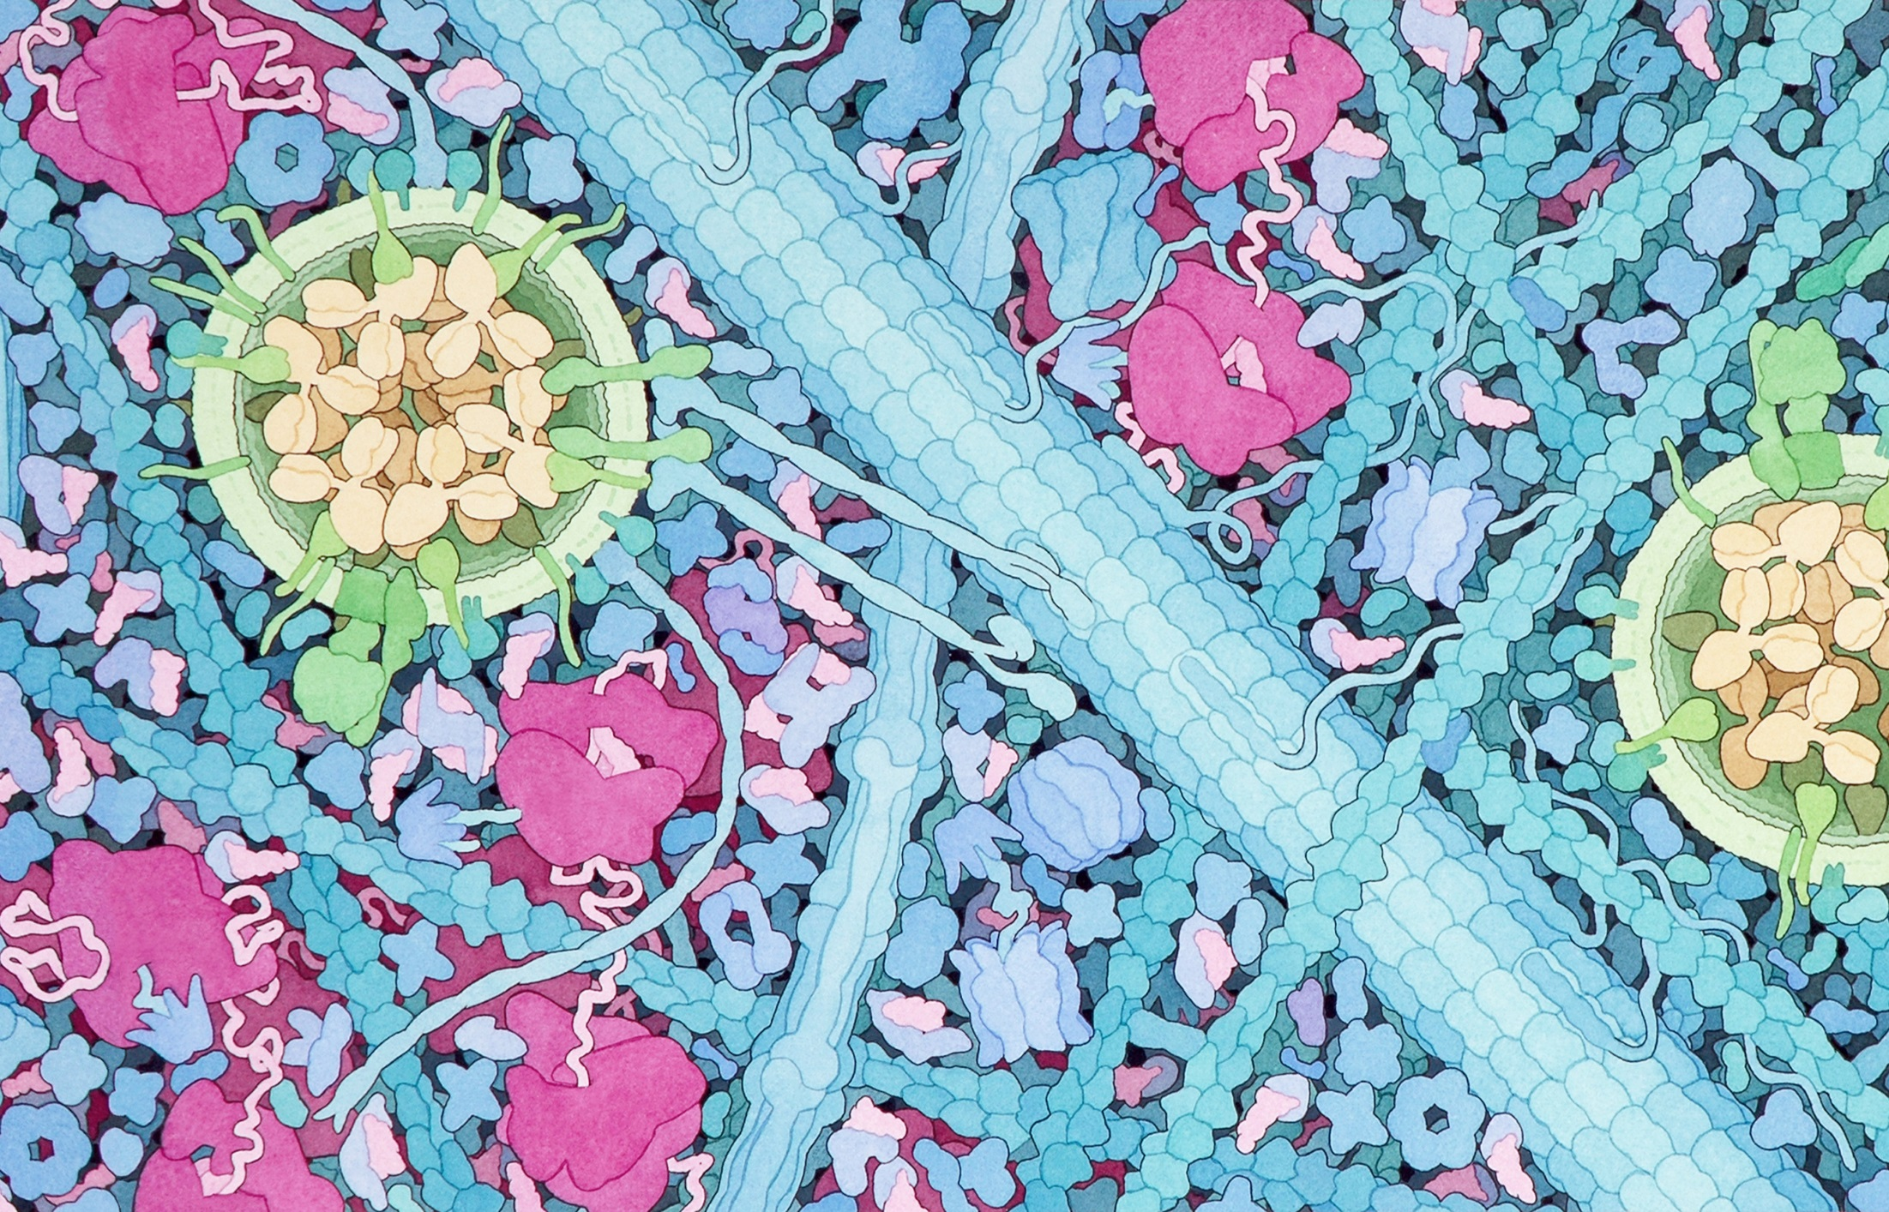

Slide 3
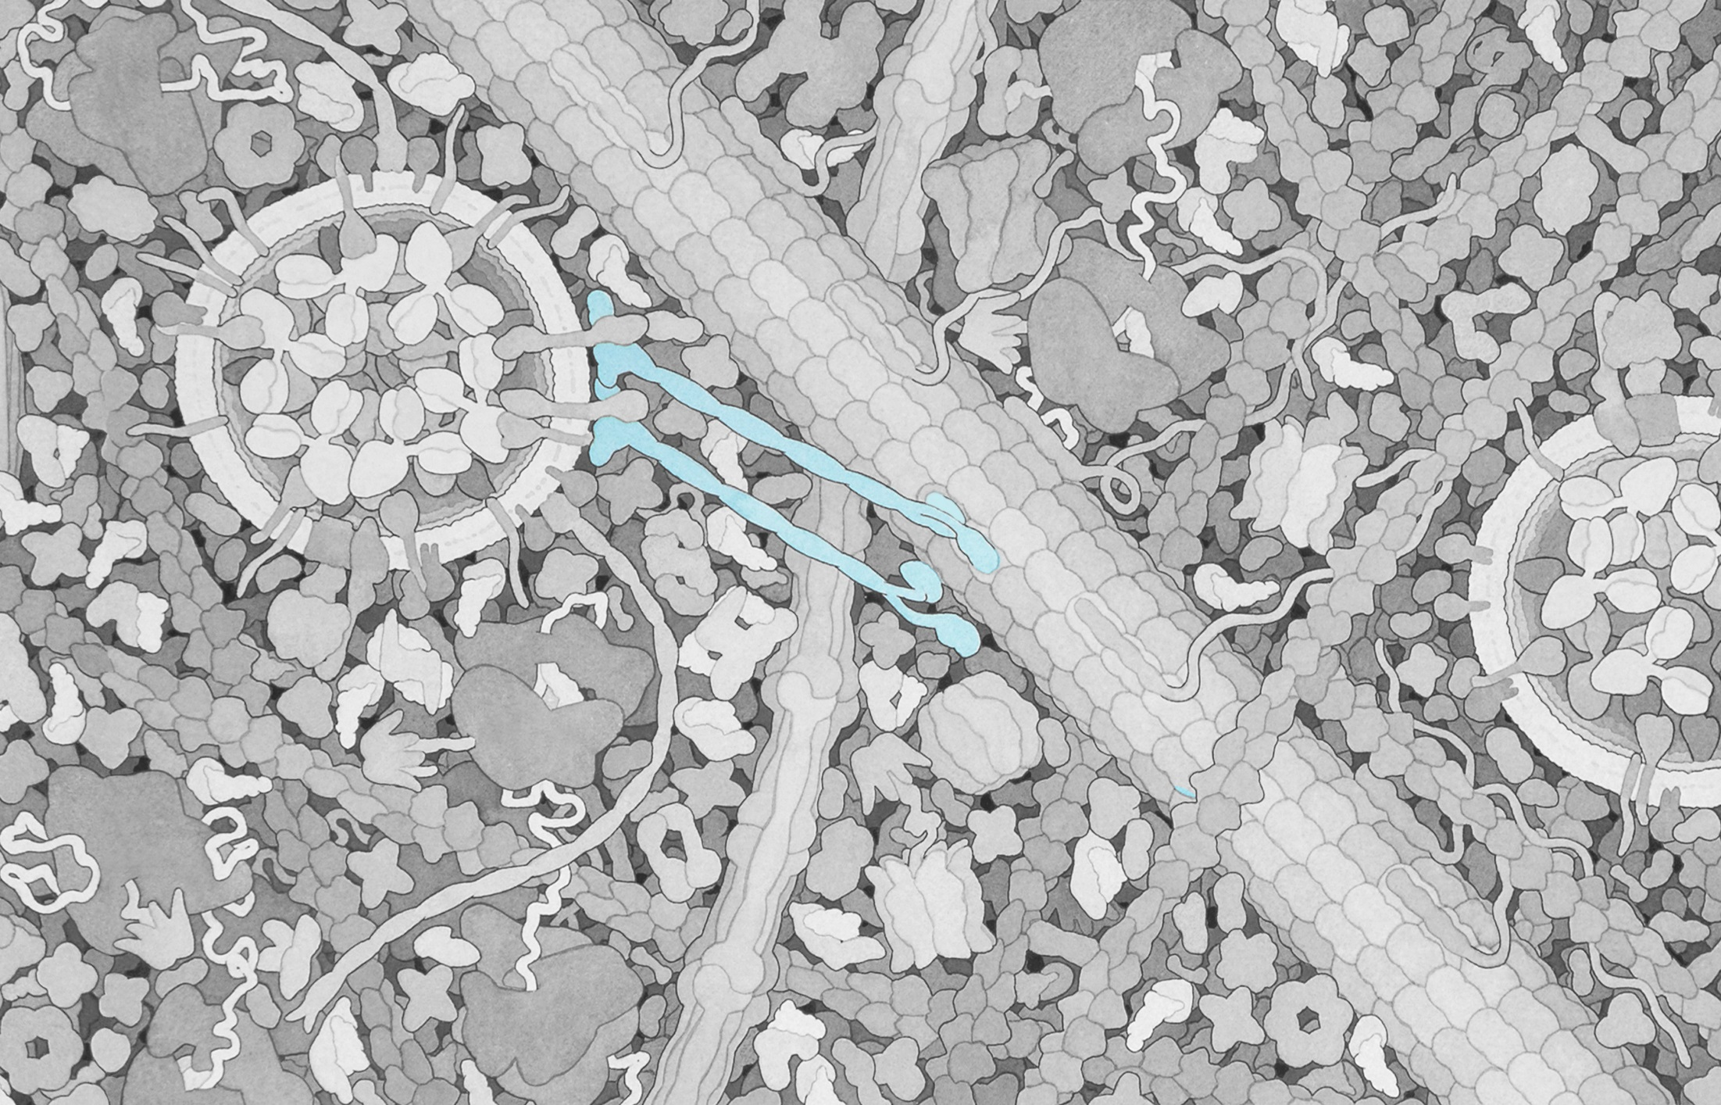

Slide 4
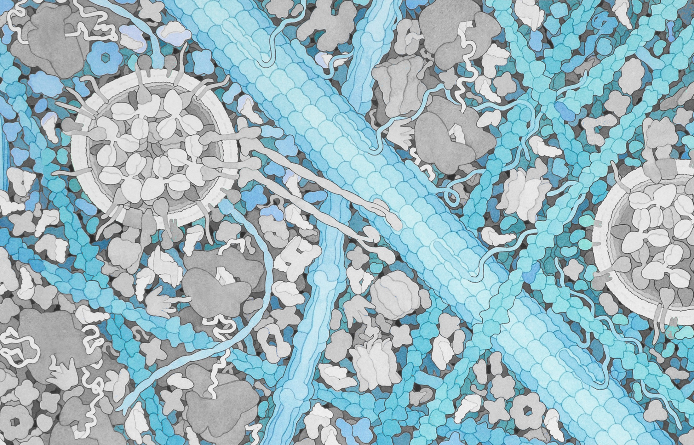

Slide 6
Plasma Membrane

Slide 7
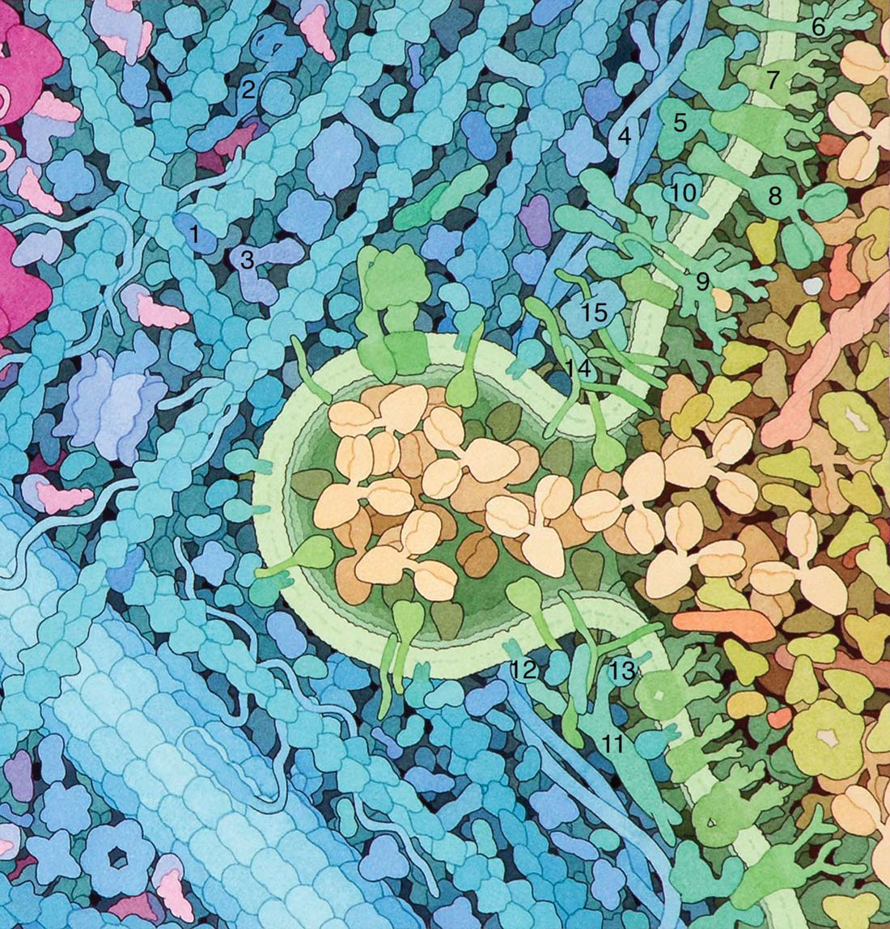

Slide 8
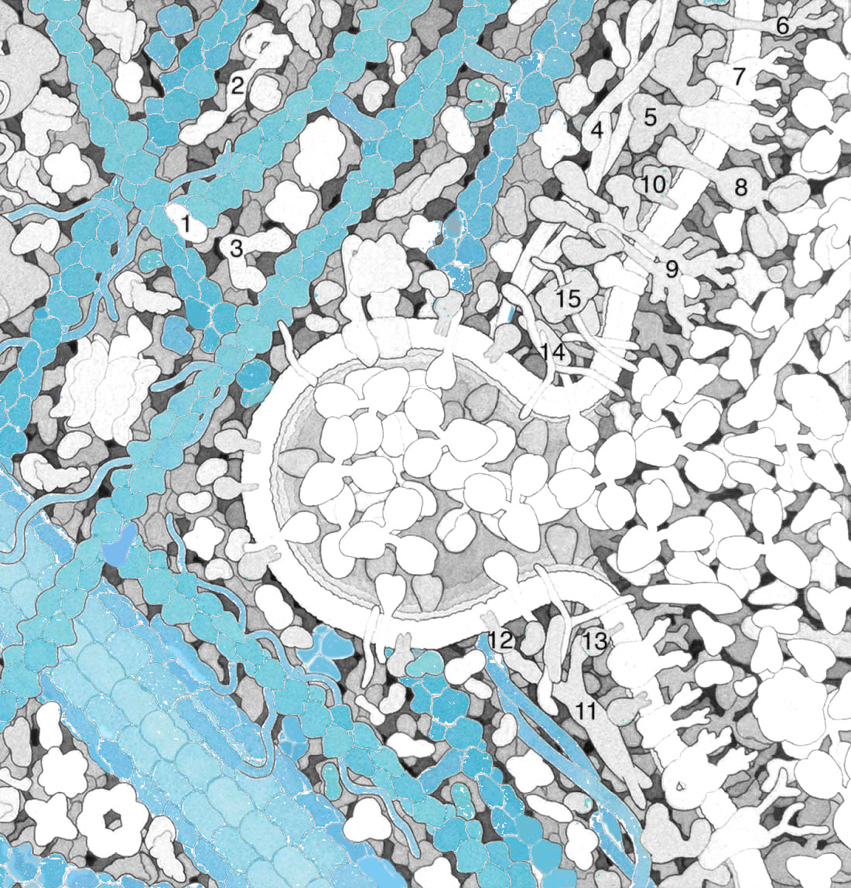

Slide 9
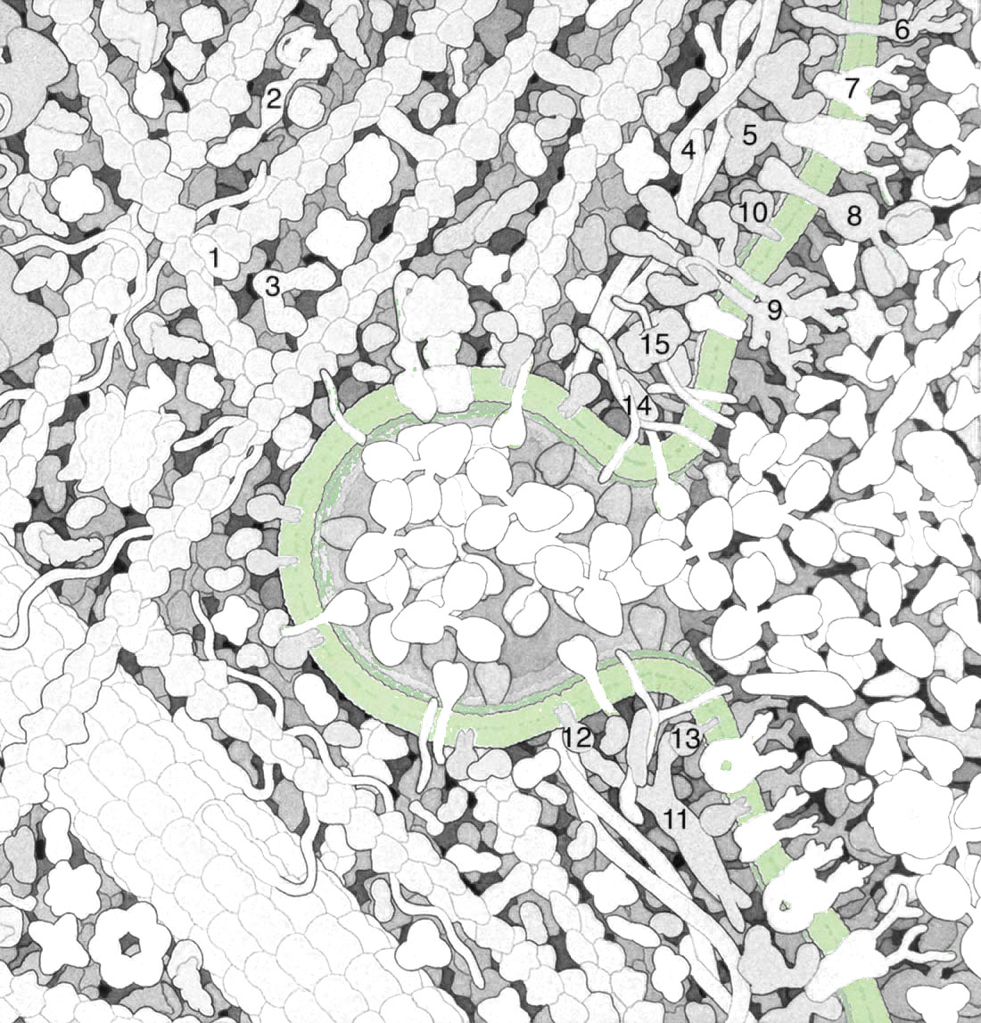

Slide 10
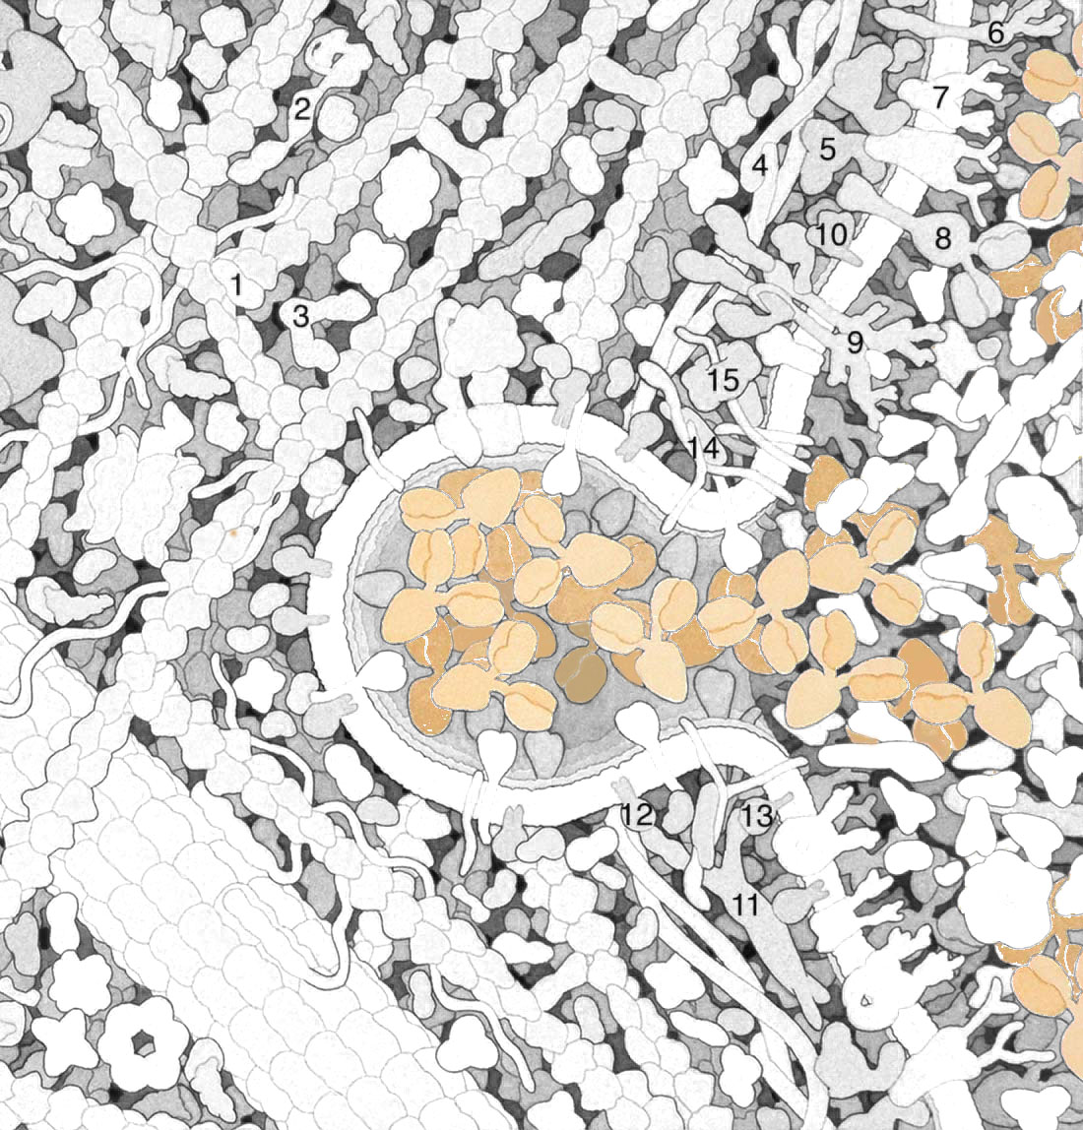

Slide 11
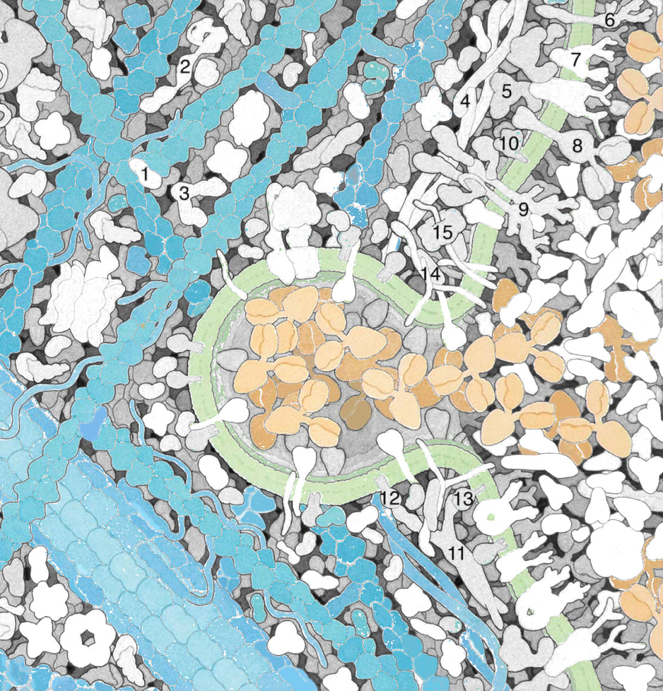

Slide 12


Slide 13
Mitochondrion

Slide 14
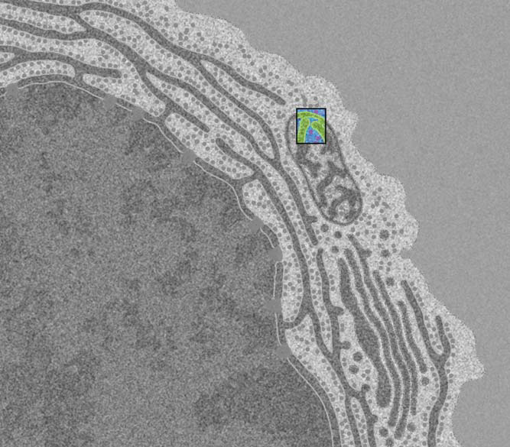

Slide 15
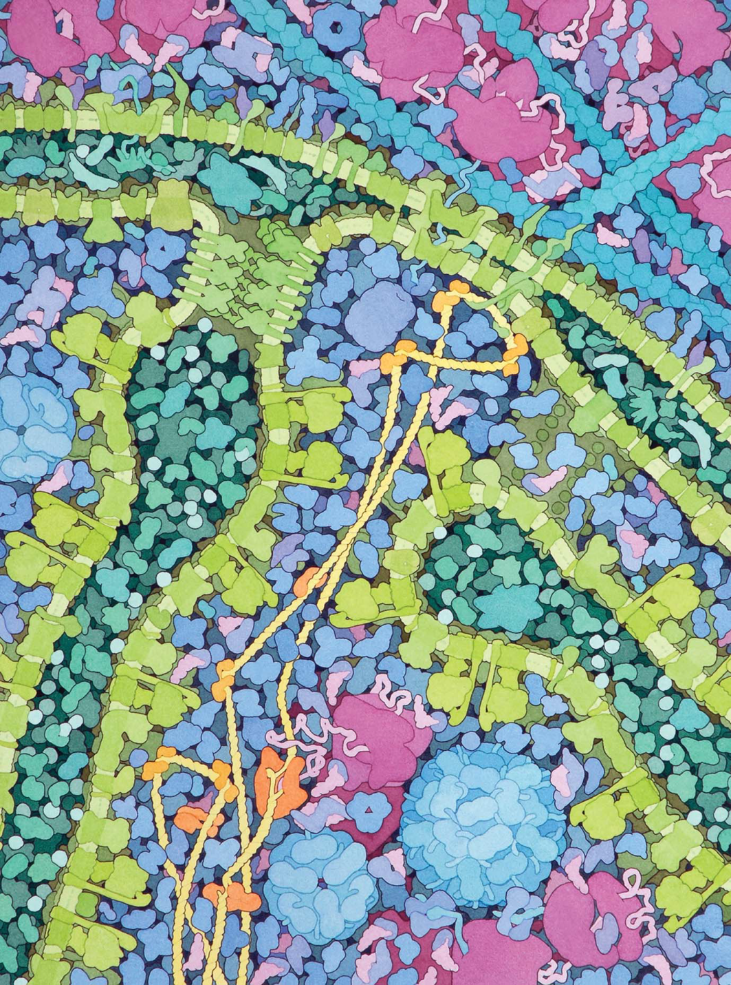

Slide 16
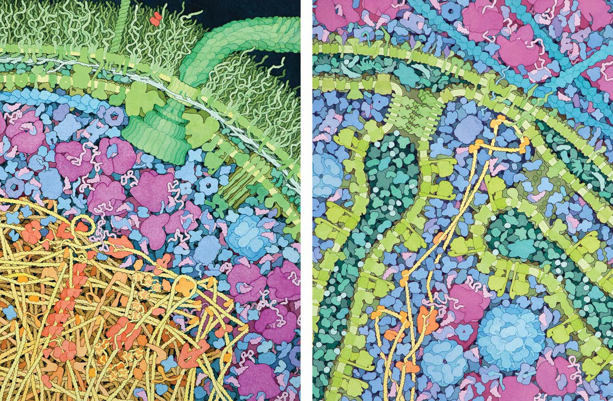

Slide 17
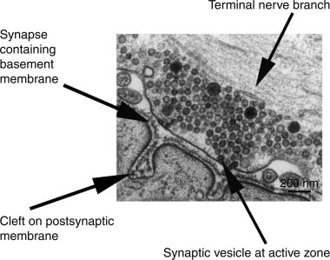

Slide 18
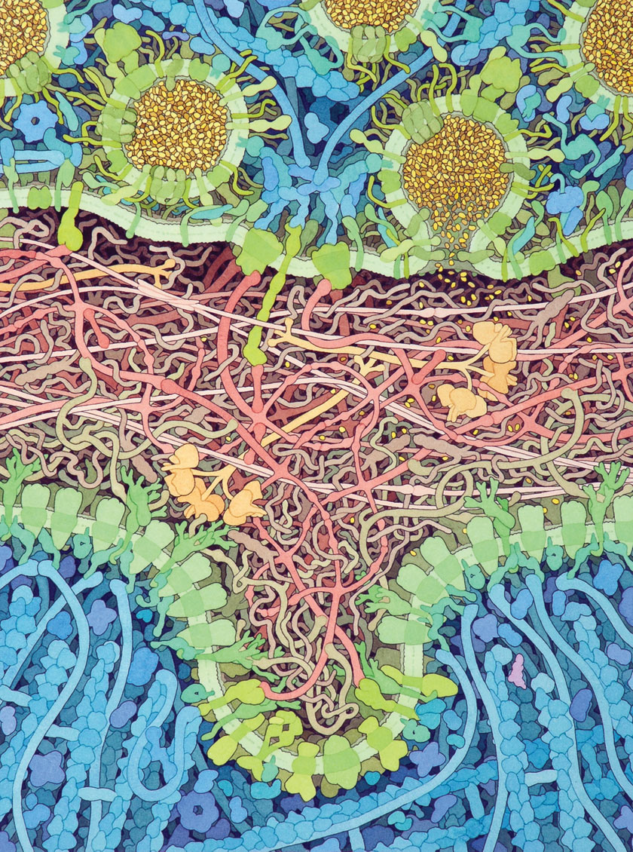

Slide 19
Using Landscapes in the Classroom
Where are we in the cell?
Endomembrane system
Flow of genetic information
Compare/contrast prokaryotic/eukaryotic cells
  RNA polymerase
  Membranes
  Ribosomes (where is Waldo?)
  ATP synthase

