Slide 1
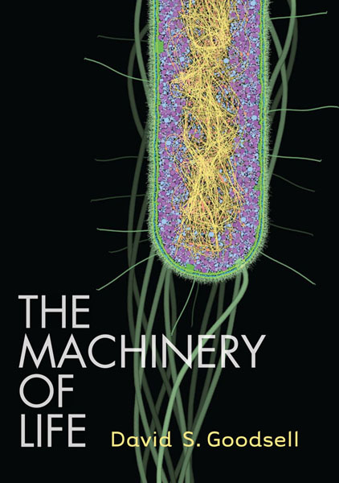
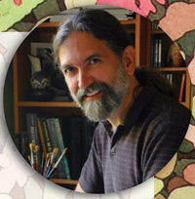
David Goodsell
Scripps Research institute
Scientist…, Author,… and Artist of all things small.

Slide 2
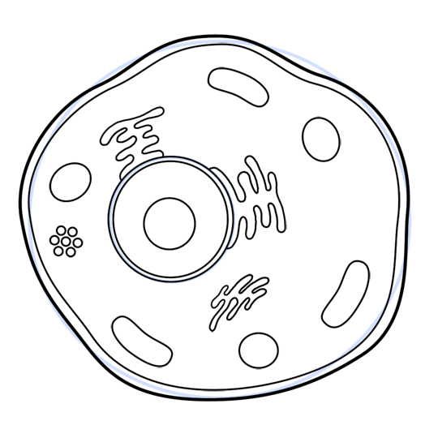
And finally... finish it off with lots of little details …..

Slide 3
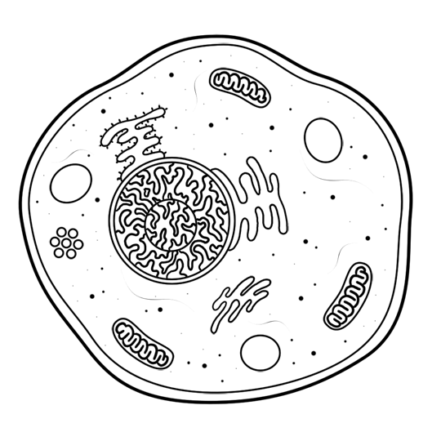
thus completing the cytoplasm

Slide 4
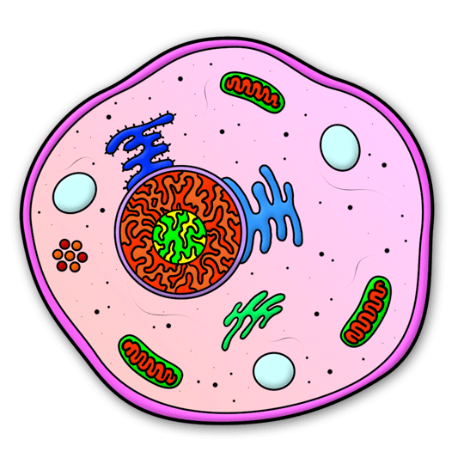
And you're done!

Slide 5
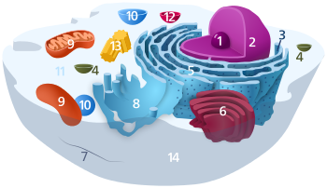
Nucleolus
Nucleus
Ribosome
Vesicle
Rough Endoplasmic reticulum
Golgi Apparatus
Cytoskeleton
Smooth E.R.
Mitochondria
Vacuole
Cytosol
Lysosome
http://en.wikipedia.org/wiki/File:Animal_Cell.svg

Slide 6
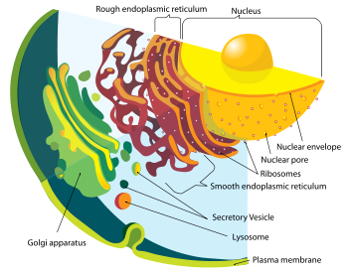
http://en.wikipedia.org/wiki/Animal_cell

Slide 7
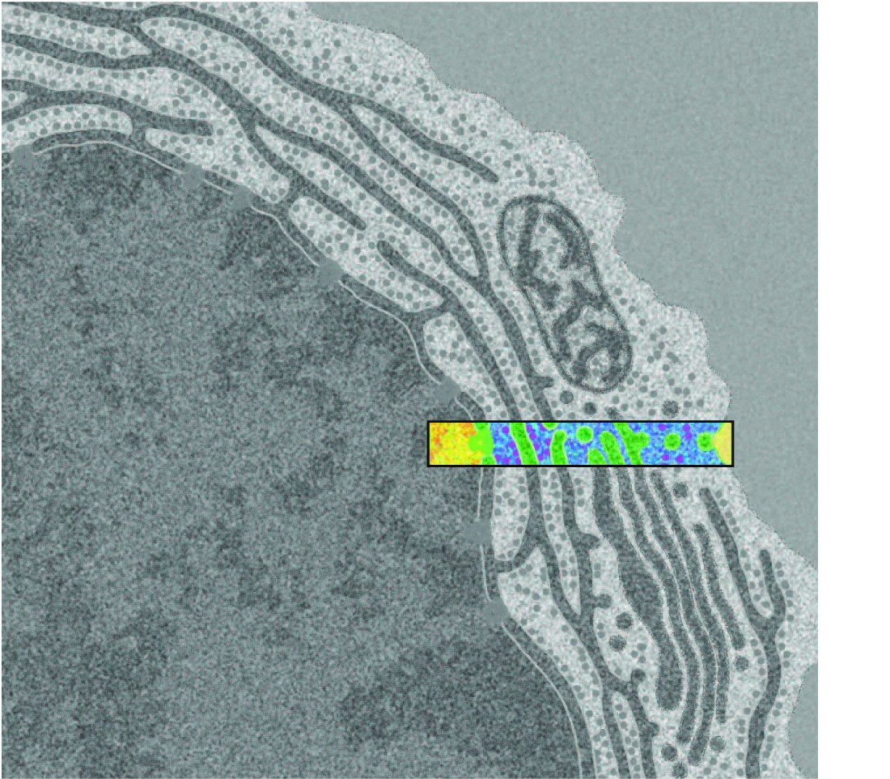
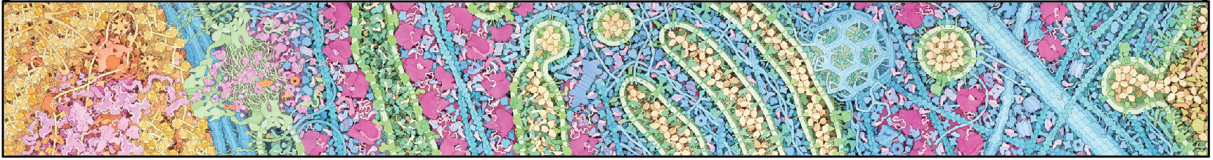
An electron micrograph of an antibody-producing B-cell
Your recent flu shot,….in action.

Slide 8
BAMBED … Biochemistry and Molecular Biology Education
Article
Miniseries: Illustrating the Machinery of Life
Eukaryotic Cell Panorama
Received for publication, October 7, 2010, and in revised form, December 13, 2010
David S. Goodsell‡
From the Department of Molecular Biology, The Scripps Research Institute, La Jolla, CA 92102
Diverse biological data may be used to create illustrations of molecules in their cellular context. This report describes the scientific results that support an illustration of a eukaryotic cell, enlarged by one million times to show the distribution and arrangement of macromolecules. The panoramic cross section includes eight panels that extend from the nucleus to the cell surface, showing the process of protein synthesis and export. Results from biochemistry, electron microscopy, NMR spectroscopy and x-ray crystallography were used to create the image.

Slide 9
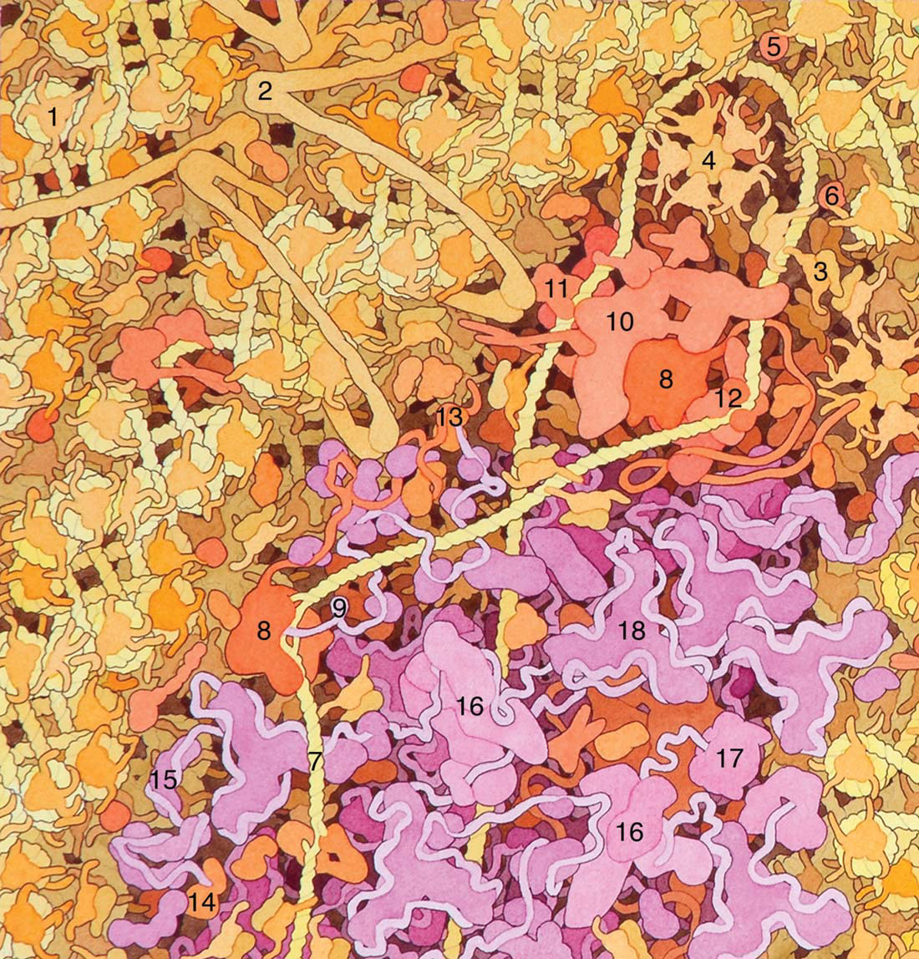

Slide 10
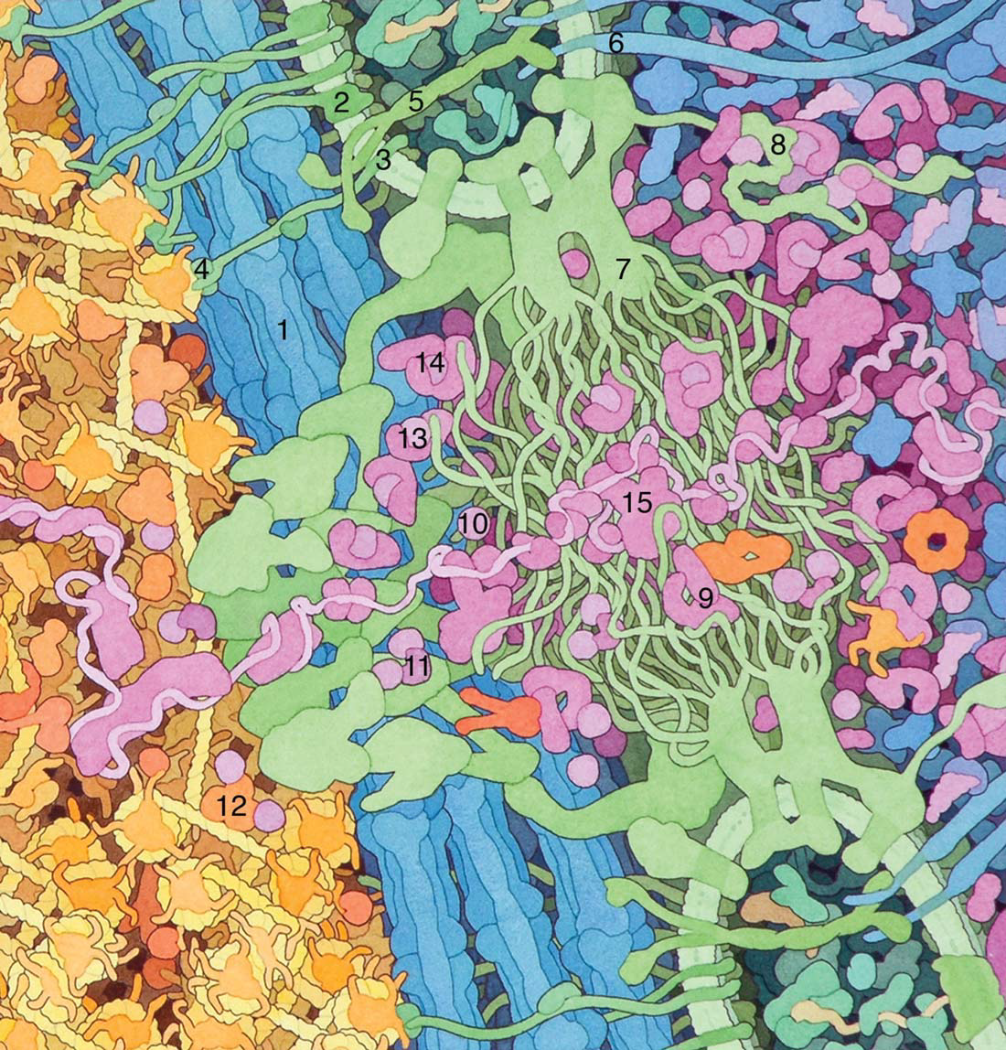

Slide 11
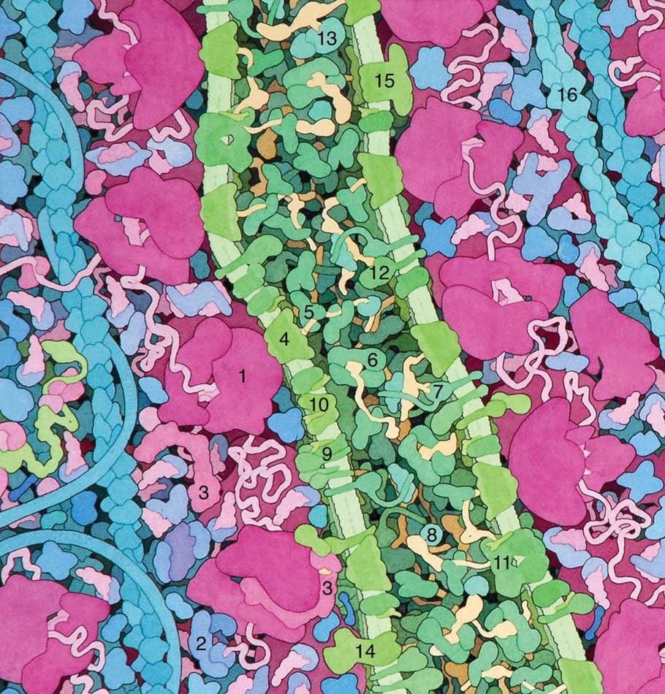

Slide 12
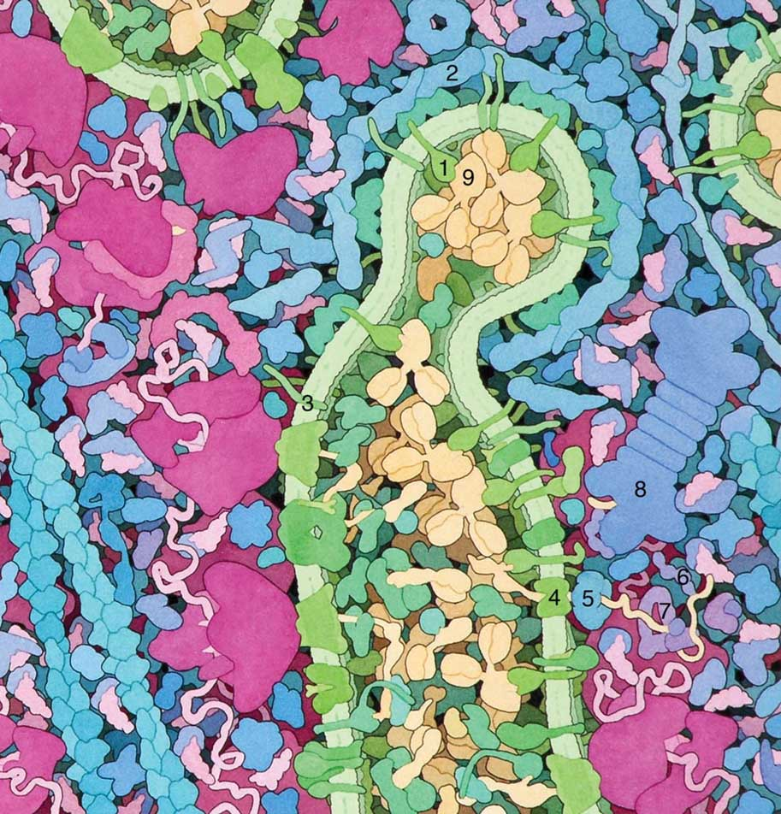

Slide 13
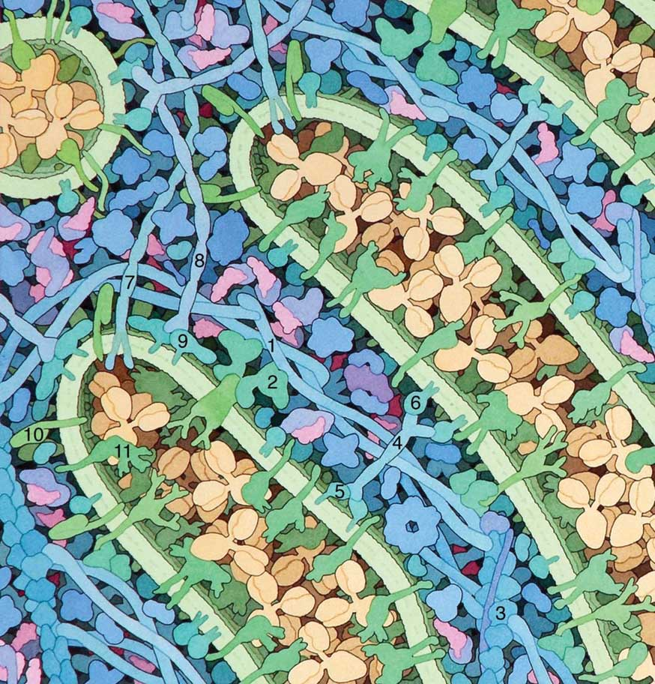

Slide 14
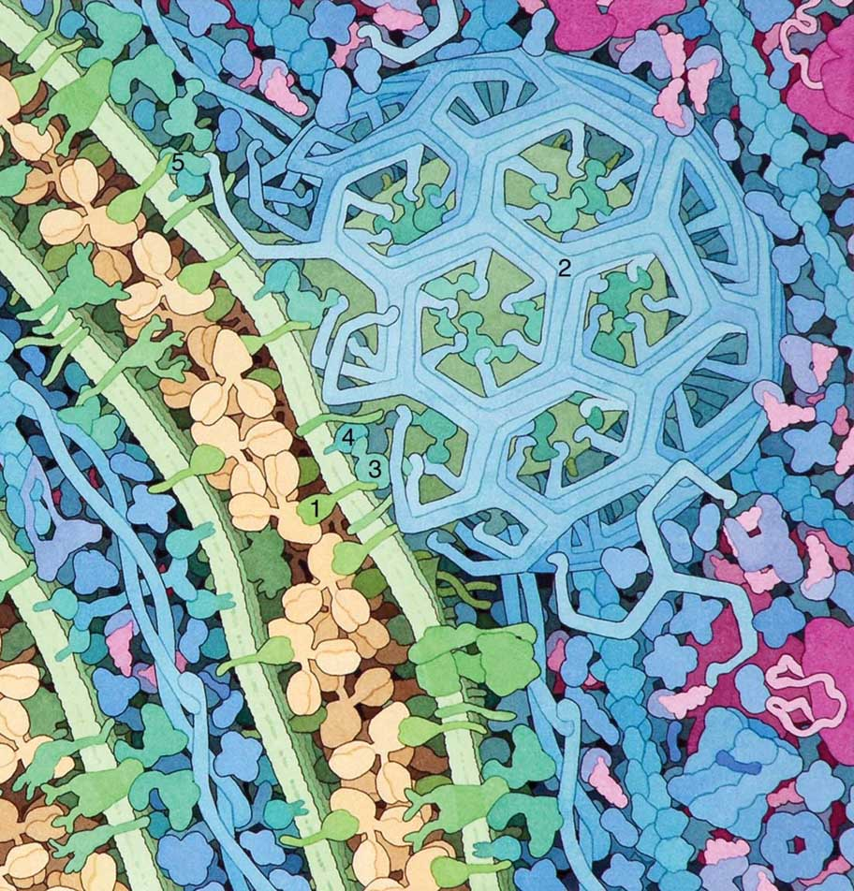

Slide 15
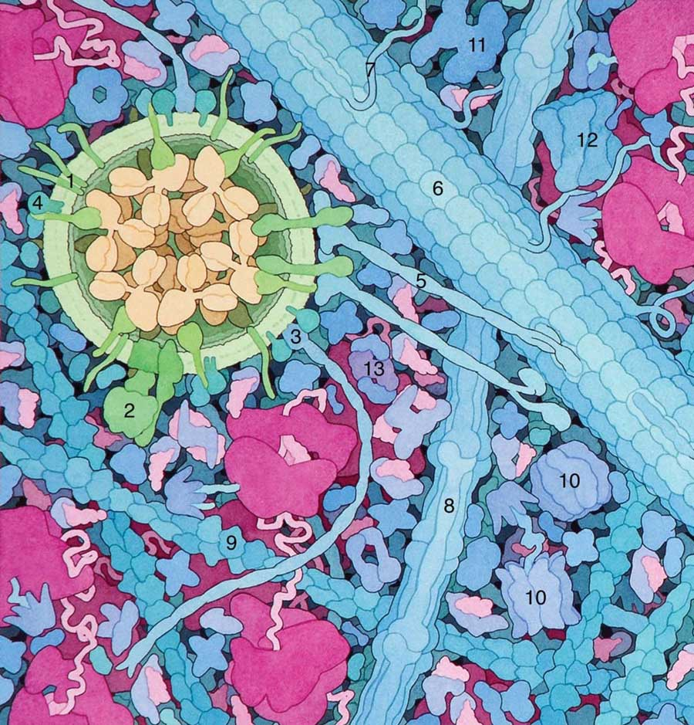

Slide 16
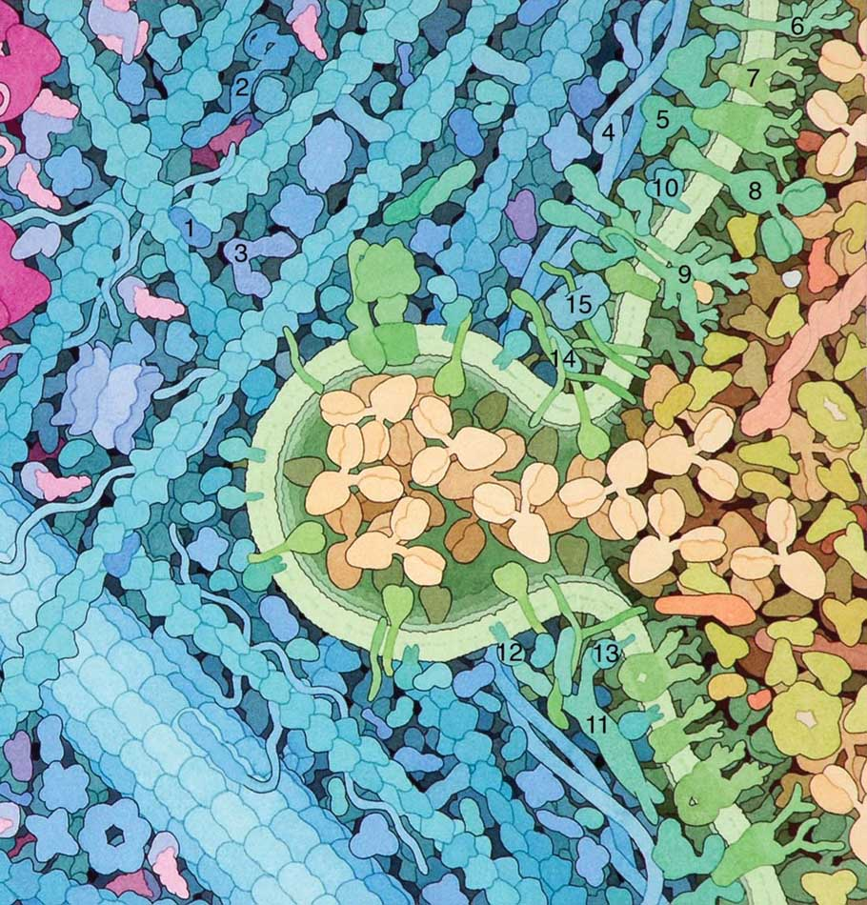

Slide 17
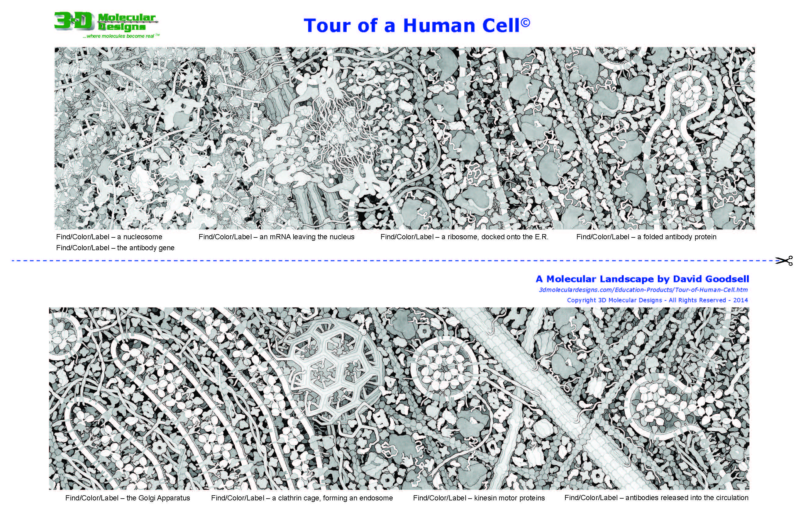

Slide 18
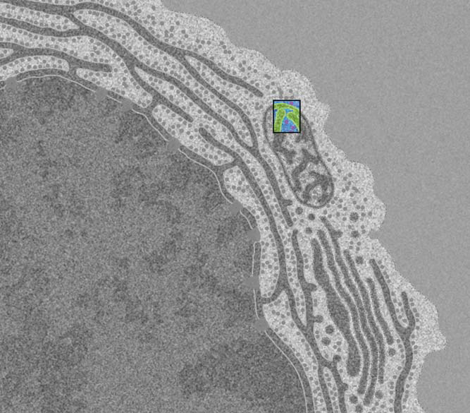

Slide 19
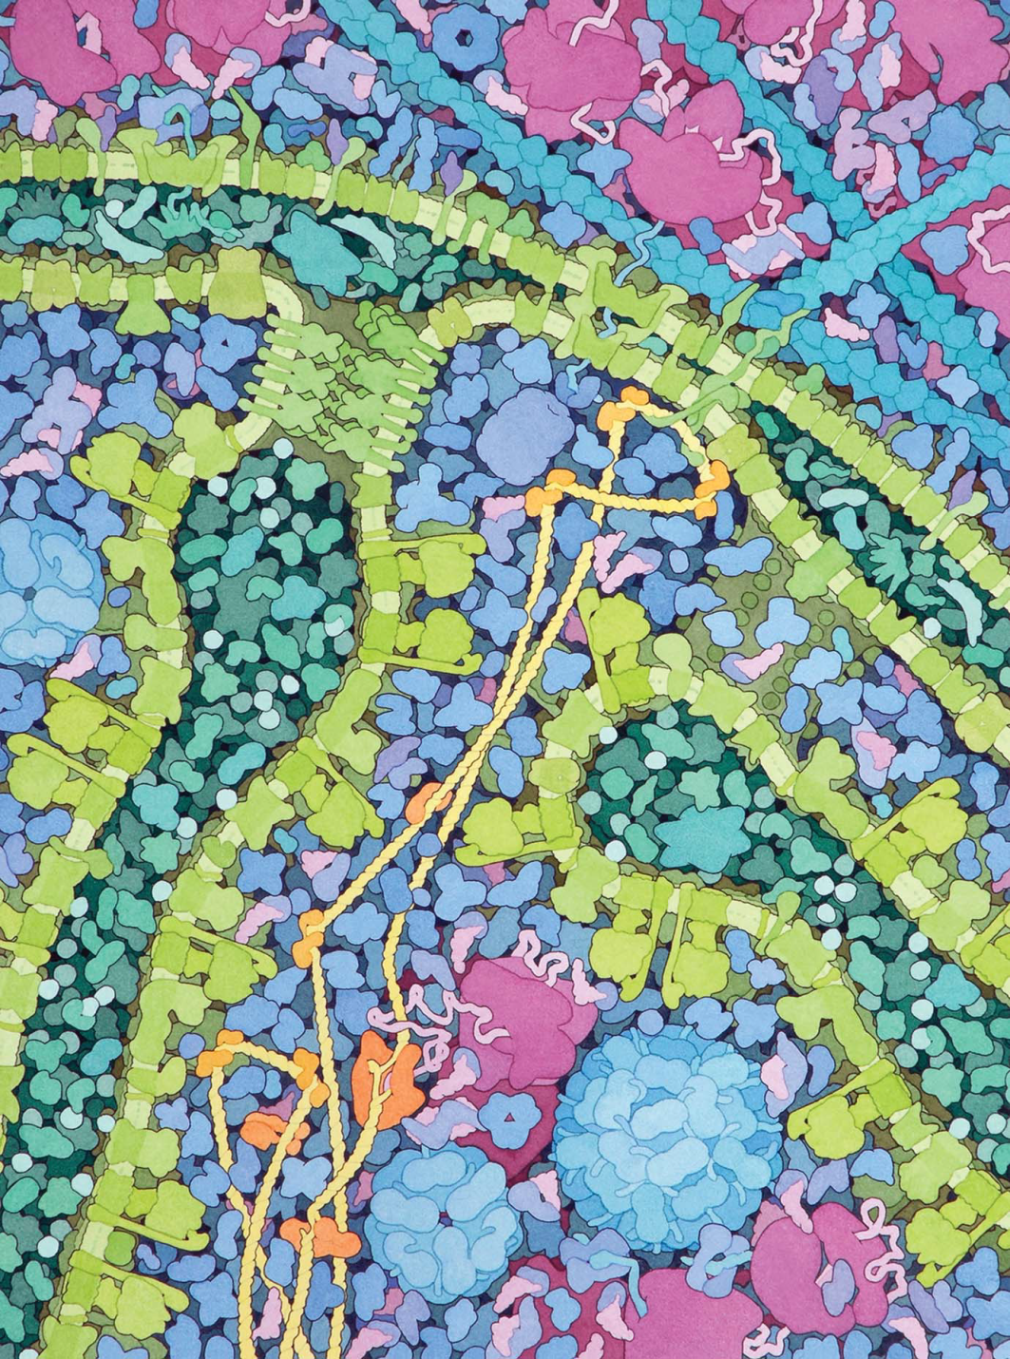

Slide 20
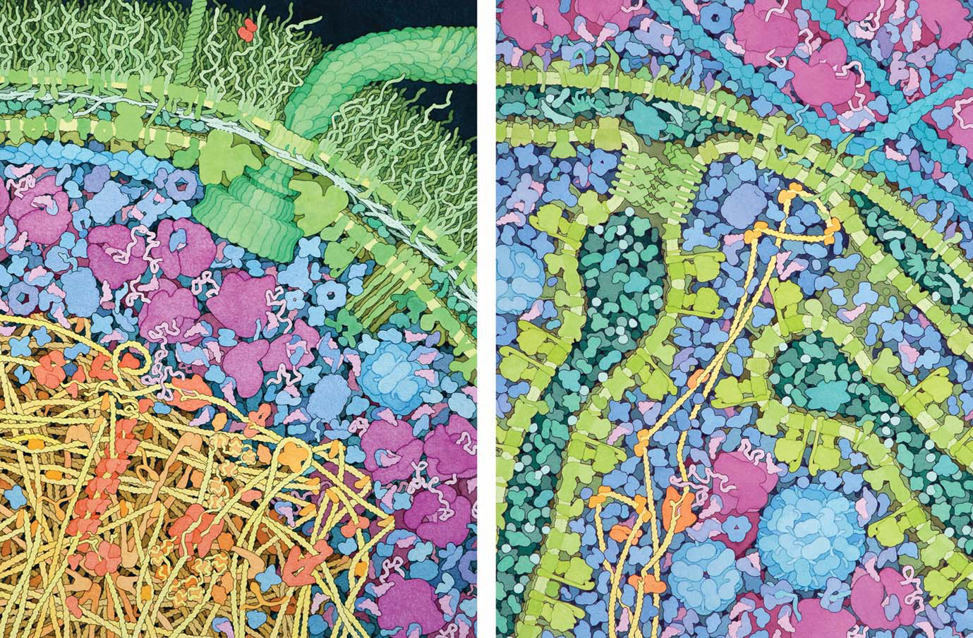
E. coli
Mitochondrion

